Slide 1
Multi-level modeling
Kelsey Holt, ScD
Assistant Professor
Department of Family and Community Medicine
Kelsey.Holt@ucsf.edu
Epi 223
May 6, 2019

Slide 2
Multi-level structures: strict hierarchy
Image credit: SV Subramanian
Notes:
Data structures that involve "nesting' are viewed as multilevel.

Slide 3
Implications
Technical reasons
  Individuals recruited from the same clinic will be more alike than a random sample
  Incorrect estimates of precision; increased risk of finding relationships and differences where none exist
    Robust standard errors also account for clustering but don’t allow for addressing substantive questions
Substantive reasons
  Are patients in a clinic influenced by structural/policy factors at that clinic?
  Is the variance in patient outcomes more attributable to differences at the individual or clinic level?

Slide 4
Multilevel analysis
Simultaneous examination of group- and individual-level effects
Both between group and within group variability

Slide 5
Multilevel models appropriate when…
Observations are correlated/clustered;
Causal processes are thought to operate at multiple levels; and/or
Intrinsic interest in modeling heterogeneity in the population (versus just controlling for higher level processes)

Slide 6
Motivations
Understand when variation at a cluster level (e.g., school, clinic, neighborhood) is due to composition versus context
Model the association between cluster-level variables (i.e., attributes of schools, clinics, neighborhoods) and individual outcomes
Model the interaction between cluster-level attributes and individual-level attributes in relation to individual-level outcomes

Slide 7
Composition versus context
Let’s say smoking rates are twice as high in San Francisco compared to Atlanta…
Compositional effect: the difference people make to places
  Say being young doubles the probability of smoking and San Francisco has twice the young people
Contextual effect: the difference places make to people
  Probability of smoking doubles when you move to San Francisco
Multi-level models parse the variance in the outcome by level

Slide 8
In terms of equations…

Slide 9
Levels versus variables
A level is a unit of analysis
  Clinics=population of units from which we have taken a random sample
A variable is an attribute of a level
  Gender is an attribute of individuals
  Size is an attribute of clinics
  Gender≠sample of all possible gender categories
Notes:
Groups or contexts are not treated as unrelated but are conceived as coming from a larger population of groups about which inferences want to be made.

Slide 10
Single Level Models
Observed
Fixed
Random
Slide credit: Chuck Huber

Slide 11
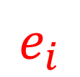

Single Level Models
$$y_{i}$$
$$e_{i}$$
$$y_{i}=μ+e_{i}$$
Slide credit: Chuck Huber

Slide 12
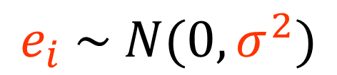
$$y_{i}=μ+e_{i}$$
$$e_{i} \sim N(0,σ^{2})$$
Slide credit: Chuck Huber

Slide 13
Levels can become variables
When a group (e.g., clinic, state) is in the fixed part of a regression equation, as a variable:
  Generalization to population of schools is not possible
When group is treated as a level in the random part of a regression equation
  Generalization possible to population of schools, in addition to identifying specific school effects
Notes:
Groups or contexts are not treated as unrelated but are conceived as coming from a larger population of groups about which inferences want to be made.

Slide 14
Two Level Models
Patient observations within physician practice will vary about each physician’s mean.
Slide credit: Chuck Huber

Slide 15
Two Level Models
Physicians’ means will vary about the grand mean.
Slide credit: Chuck Huber

Slide 16
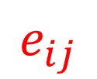

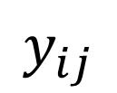
physician
mean
$$y_{ij}$$
$$u_{i.}$$
$$e_{ij}$$
$$y_{ij}=μ+u_{i.}+e_{ij}$$
Slide credit: Chuck Huber

Slide 17
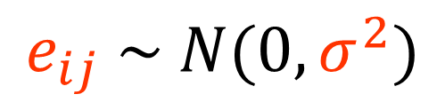
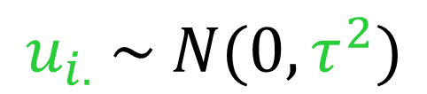
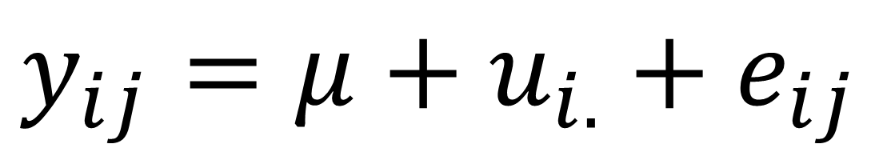
Two Level Models
$$y_{ij}=μ+u_{i.}+e_{ij}$$
Observed
Fixed
Random
$$u_{i.} \sim N(0,τ^{2})$$
$$e_{ij} \sim N(0,σ^{2})$$
Slide credit: Chuck Huber
Notes:
Fixed part of equation can have variables at both individual and clinic levels!

Slide 18
Fixed versus random effects
Do female patients report better experience with providers than male patients?
  Fixed part of model
Do patients in clinics with QI processes report better experiences?
  Fixed part of model
  If multi-level model, can draw inferences about the population of clinics
Do females in clinics without QI processes report worse experiences?
  Cross-level interaction
  Fixed part of model
How much of the variability in patient experience scores is due to differences between clinics versus differences between individuals?
  Random part of model
Is clinic X different from other clinics in the sample in its effect on patient experience scores?
  Fixed part of model
Are females more or less variable than males in their reported experience with providers?
  Random part of model
Is the gender gap in patient experience different across clinics?
  Random part of model
Notes:
Any questions about the variability are in random part of model – regardless of whether it’s individual or clinic level question

Slide 19
Other data structures…

Slide 20
Multi-level structures: cross-classification
Image credit: SV Subramanian
Notes:
Neighborhoods and workplaces not nested but crossed – individuals occupy more than one set of contexts
Question – what is the relative contribution of neighborhoods versus workplaces?
Just some examples – can also have multiple membership structure, for example

Slide 21
Multi-level structures: repeated measures (longitudinal studies)

Slide 22
Longitudinal Models
Repeated observations within patients will
vary about each patient’s mean.
Slide credit: Chuck Huber

Slide 23
Longitudinal Models
Patients’ means will vary about the grand mean.
Slide credit: Chuck Huber

Slide 24



Longitudinal Models
patient
mean
$$y_{it}$$
$$u_{i.}$$
$$e_{it}$$
$$y_{it}=μ+u_{i.}+e_{it}$$
Slide credit: Chuck Huber

Slide 25
