Slide 1


Pivot:
Finding Funding & Collaborating Opportunities for International Postdocs
Min-Lin Fang, MLS
Research and Education Librarian
Min-lin.fang@ucsf.edu

Slide 2
Learning Objectives
By the end of the training, participants will be able to:
Finding funding opportunities
  Search by text or sponsor or keywords
  Save, organize and share funding opportunities
  Set email alerts
Find potential collaborators both inside and outside of UCSF
Find information on calls for papers with deadlines about forthcoming conferences and special issues of scholarly journals.

Slide 3
Pivot: one of the most comprehensive funding databases
  Is a multi-disciplinary searchable funding opportunities database
  Represents over 40,000 federal, private and international funding opportunities
  Matches faculty with funding opportunities
  Helps identify potential collaborators
  Edited daily by group of editors

Slide 4
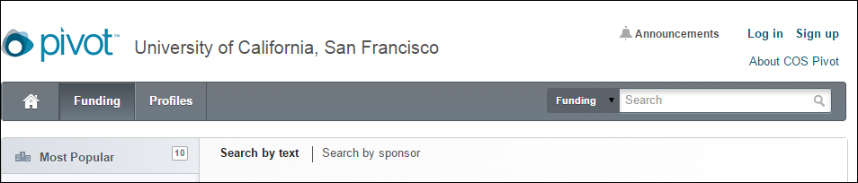
Setting Up an Account
Need account in order to:
    Save search results
    Manage your home page (dashboard)
    Receive funding alerts
      Must register with UCSF email address
    Click on “Sign up,” on the top right corner to set up an account

Slide 5
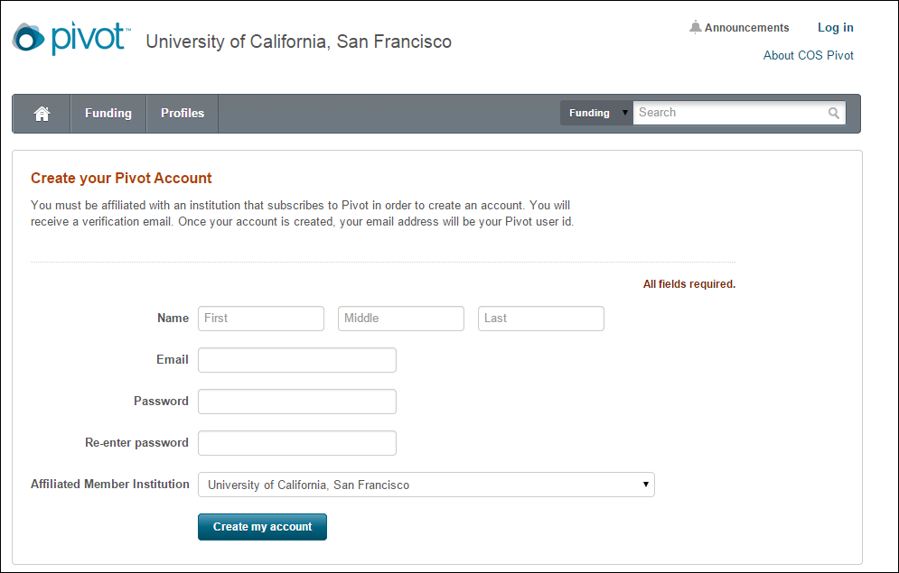

Slide 6
Setting Up an Account
Once you have registered an account you will receive confirmation email
Once you confirm, you may “claim” your profile
Claiming your profile allows you to:
  Receive recommended opportunities from the Pivot Advisor
  Edit your profile

Slide 7
Three Types of Searches
Text search
Sponsor Search
  US federal
  Private
  Non-US federal
Advanced Search

Slide 8
TEXT SEARCH
Most basic search
Also called a Quick Search
Is the default search mechanism on main search page
Searches all fields (title, abstract, sponsor)
Default connector is “and” (sleep disorders will search for sleep and disorders
Use quotation for exact phrase searching: “sleep disorders”

Slide 9
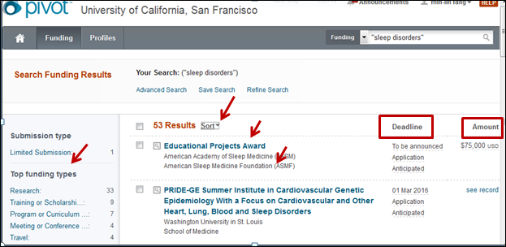
RESULTS PAGE
  Grant title
  Sponsor
  Deadline
  Amount
Search results are always sorted by relevance, with the most relevant at the top
Refine search results: Left side of page will provide a faceted breakout of results

Slide 10
RESULTS PAGE
Clicking on magnifying glass icon to the left of the title will provide the following information:
  Abstract
  Eligibility
Clicking on title will link you to the full opportunity record, including:
  URL
  Sponsor
  Eligibility information
  Any information you requested in the search field will appear in red

Slide 11
SPONSOR SEARCH
Search by:
  All sponsors (listed alphabetically)
  US federal sponsors
  Non-US federal sponsors
Funding opportunities by sponsor
  Hyper-linked=active
  Grayed-out=not currently active but Pivot either knows or has reason to know the opportunity will be repeated or upcoming

Slide 12
ADVANCED SEARCH
Radio dial
      Keep defaults as “all fields” (vs. “any of the fields) for most specific search
      Connects rows (as opposed to fields) with “and” instead of “or” (which is what will appear if click on “any” radio dial)
Drop-down box to left of search fields indicates what is included in the search:’
  Abstract
  Title
  Sponsor
  Sponsor ID

Slide 13
Advanced Search
NOTE: Use quotations for exact phrase search
IMPORTANT: categories in “Find Opportunities Matching” are the same as in portion of screen labeled “exclude Opportunities Matching,” found toward the bottom of the page. DO NOT CONFUSE THE TWO!
Use broader terms to run a search.

Slide 14
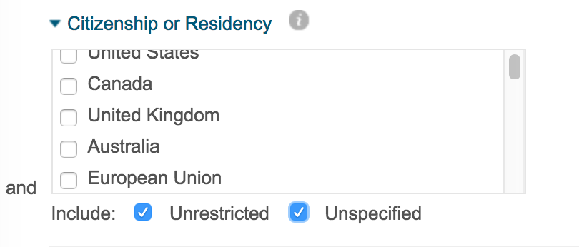
Useful Tips for
International Postdocs –
ADVANCED SEARCH

Slide 15
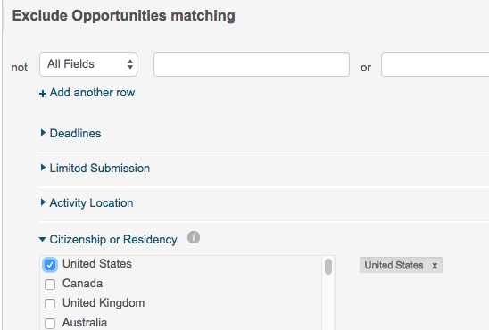
Useful Tips for
International Postdocs –
Do NOT Do IT!!!

Slide 16
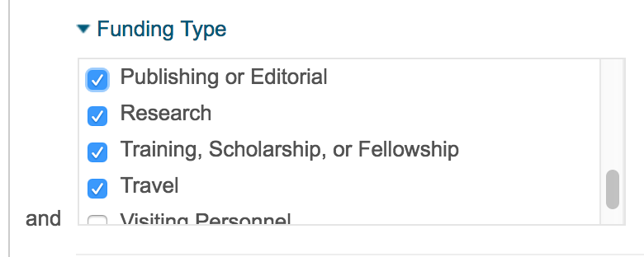
Useful Tips for Postdocs – Advanced Search

Slide 17
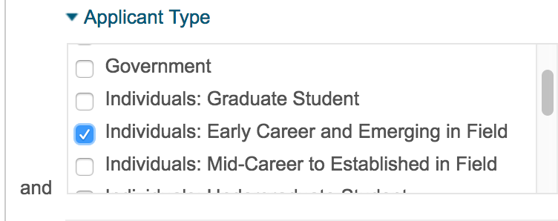
Useful Tips for Postdocs, Junior faculty – Advanced Search

Slide 18
RESULTS PAGE
Will always show query at top of page
Classifies results (see faceted breakout on left)
  Top Funding Types
  Top Sponsor Types
  Top Requirements
  Top Keywords
Allows you to:
  Save search
  Refine search

Slide 19
SAVING & ORGANIZING SEARCH RESULTS
Can save search queries (save search) or particular opportunity (track record)
To save search query:
  Click on “Save Search” at top of results page
  Will ask you to name category
  Will ask if would like to receive email alerts (This is your funding alerts!!)
  “Save search” will appear on your Home page
  At any time, can run, edit or share that search
  Can save an unlimited number of search queries

Slide 20
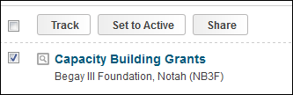
SAVING & ORGANIZING SEARCH RESULTS
To track record:
  Track from either the results page of from inside a record
From the Results page:
  Click on empty box two over from the left
  opportunity title
  The following will appear immediately above title
  of first results:

Slide 21
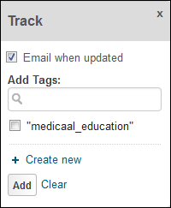
SAVING & ORGANIZING SEARCH RESULTS
Choose which option would like:
Tack, Set to Active, Share or Export
The following will appear:
  Tracked opportunities are
  those that you want to follow but may not be
  pressing
  Active opportunities are those that want to follow but may have more urgency (e.g., upcoming deadline)

Slide 22
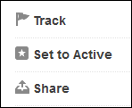
SAVING & ORGANIZING SEARCH RESULTS
From within a record:
  Will see options on top right of page
  Click on whichever option you want
Note: When naming a tracked or active record, there may not be any dead space in between characters; you must use underscores, periods, etc., between words
All results will appear on your Home page

Slide 23
SHARING SEARCH RESULTS
Can do so from either the results page or within the record
Follow same steps as for tracking a record, beginning with clicking on box two to the left of the opportunity title and will see:
Click on Share and follow steps delineated

Slide 24
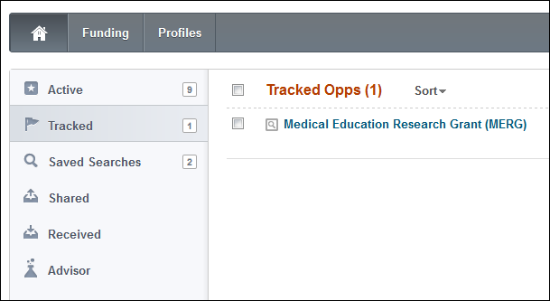
SHARING SEARCH RESULTS
To view opportunities shared
  Click on Home tab on top left of screen
  Will see column on left-hand side containing a faceted breakout of :
    Active
    Tracked
    Saved Searches
    Shared
    Shared Received
    Advisor

Slide 25


FUNDING ALERTS
To set up Pivot Funding Alerts:
    Must have Pivot user account
    Will see the following at the top of Results page
    Click on Save Search and follow steps delineated
    Query will be stored on your Home page
    Can save an unlimited number of searches
    Note: remember, you are saving your query, not your results!

Slide 26
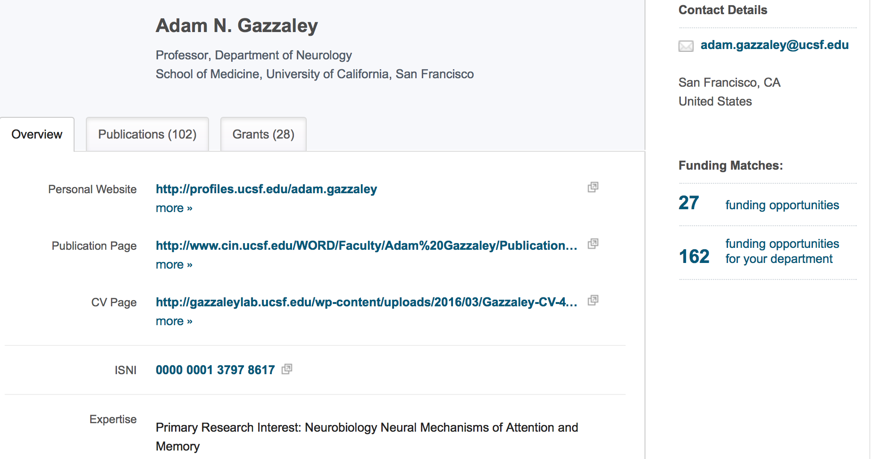
PROFILES
Recommend creating your profile
Link to funding opportunities uniquely matched to your scholar profile

Slide 27
PROFILES:
Finding Collaborators
Click on Profiles tab
  Can search by:
  Text
  Faculty name
  Advanced search
Follow same rules as with Advanced Search
Will see faceted breakout column on left of results page

Slide 28
Paper Invited
Find information on calls for papers with deadlines about forthcoming conferences and special issues of scholarly journals.

Slide 29
QUICK GUIDES & SUPPORT
Online tutorials by ProQuest
Monthly PIVOT class
Grants Subject Guide
Min-Lin Fang, MLS
Research and Education Librarian
Min-lin.fang@ucsf.edu (by appointment)

Slide 30
Questions?
Thank you!

