Slide 1
Week 6: External Validity and Robust Impact
Epi 239

Slide 2
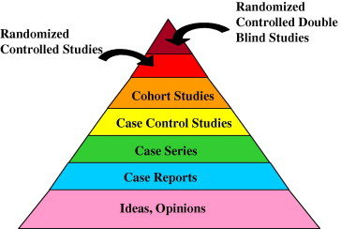

Slide 3
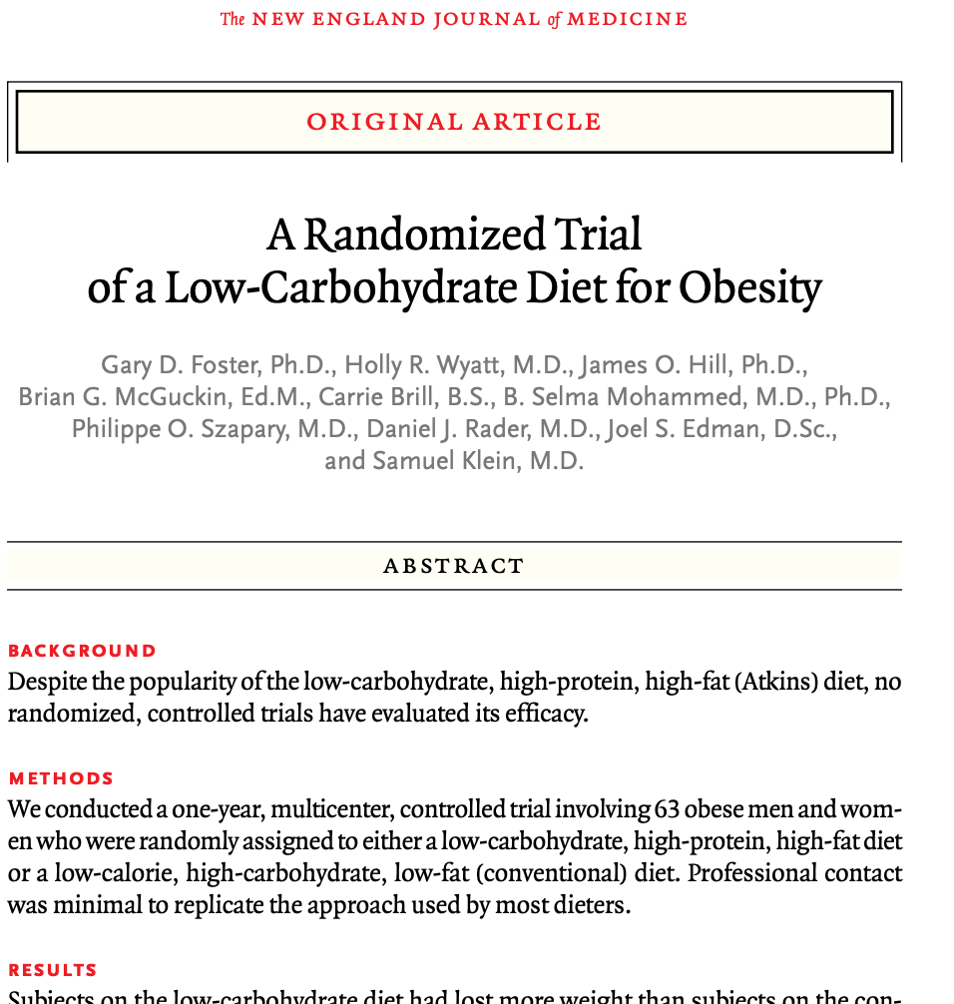

?

Slide 4
Treatment effects
Treatment
Outcome

Slide 5
Treatment effects in different contexts or settings
Context
Treatment
Outcome

Slide 6
Levels of context
Treatment as designed
Context (implementation factors)
Context (organizational factors)
Use (fidelity or adaptation)
Facilitation model
Context (population characteristics)
Process outcomes
Health outcomes

Slide 7

Interventions that work across settings and people
Knowledge that of whether things work in different settings and people

Slide 8
Two problems
Robustness of interventions
External validity

Slide 9
Strategies for robust impact? Multicomponent interventions for implementation science

Slide 10
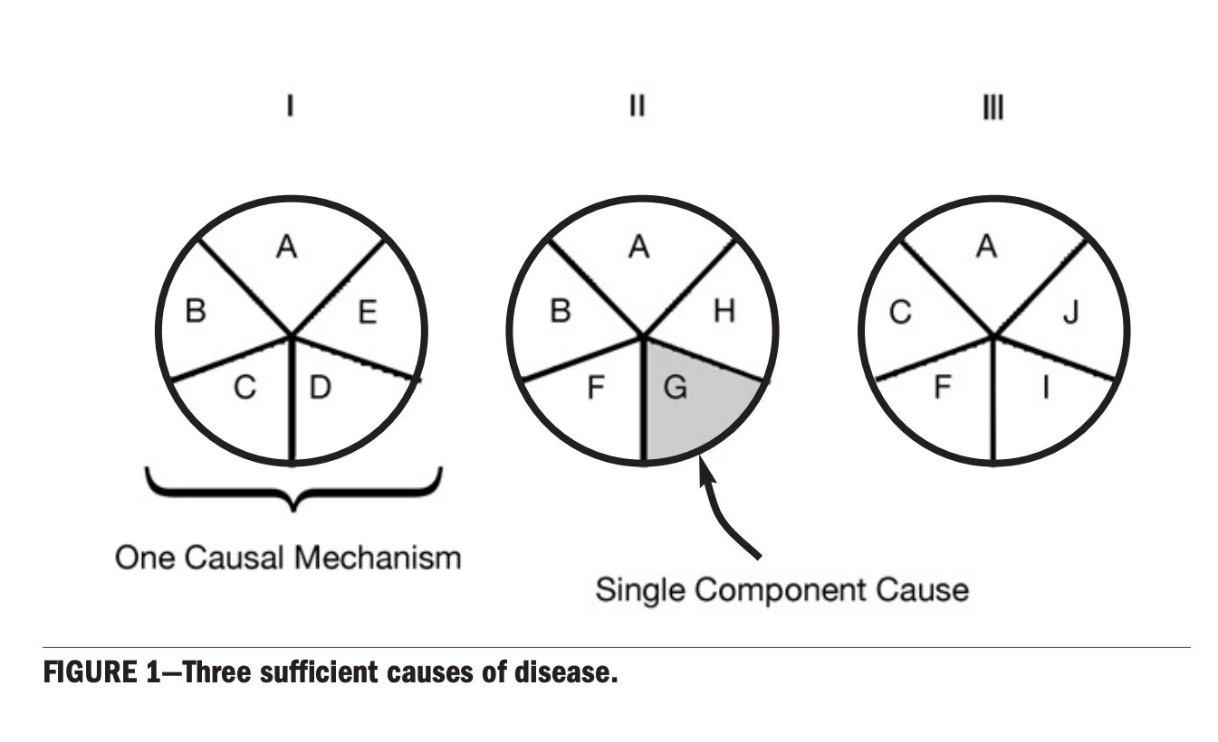

Slide 11
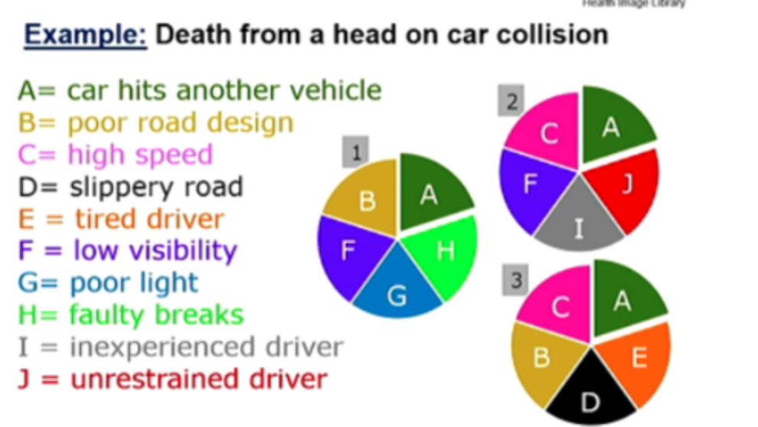

Slide 12
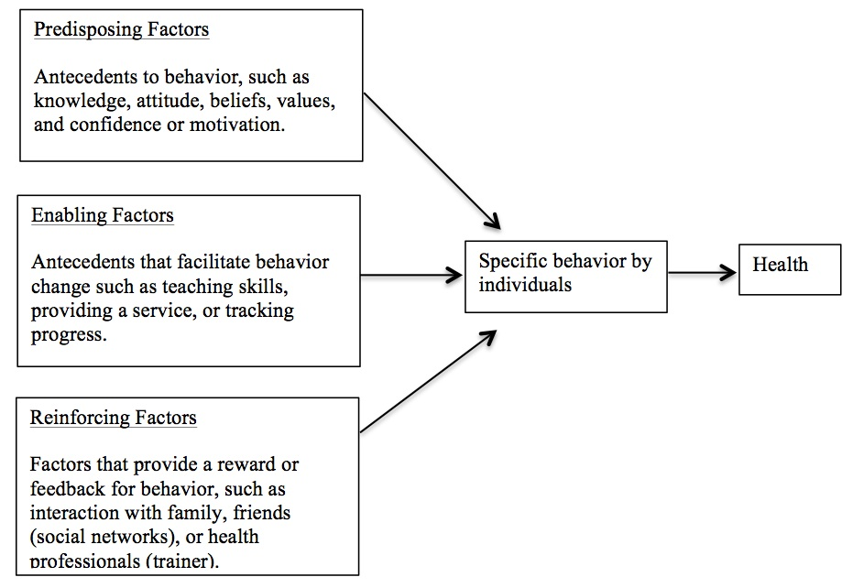

Slide 13

Predisposing
Enabling
Reinforcing

Slide 14
Multicomponent interventions or strategies
Intervention or strategy
Distribution of Necessary
Components of a Sufficient Cause
Population 1
0.4
RR=.4/.2=2
Effect heterogeneity
0.2
RR=.2/.2=1
Population 2
Notes:
Using rothman’s causal pies
If there are numerous barriers, one approach might just to give everything you can think of – sms, counseling, food, transport voucher, peer health worker.. Etc., but that is not generalizable
Another way is to try apply social theory or contextual knowledge to identify a minimum set of interventions that provide a ‘sufficient’ cause in diverse settings –
So let’s say there are 4 conditions you need for making the next on ART clinic visit: Social support, means to get to clinic, internal motivation (counseling), and positive last experience at clinic
You want high p 111 that is resistant to variability in underling components of a sufficient cause

Slide 15
Multicomponent interventions or strategies
Intervention or strategy
Distribution of Necessary
Components of a Sufficient Cause
Population 1
0.8
RR=.8/.2=4
Effect homogeneity
0.8
RR=.8/.2=4
Population 2
Rothman 1976, 2015
Notes:
Using rothman’s causal pies
If there are numerous barriers, one approach might just to give everything you can think of – sms, counseling, food, transport voucher, peer health worker.. Etc., but that is not generalizable
Another way is to try apply social theory or contextual knowledge to identify a minimum set of interventions that provide a ‘sufficient’ cause in diverse settings –
So let’s say there are 4 conditions you need for making the next on ART clinic visit: Social support, means to get to clinic, internal motivation (counseling), and positive last experience at clinic
You want high p 111 that is resistant to variability in underling components of a sufficient cause

Slide 16
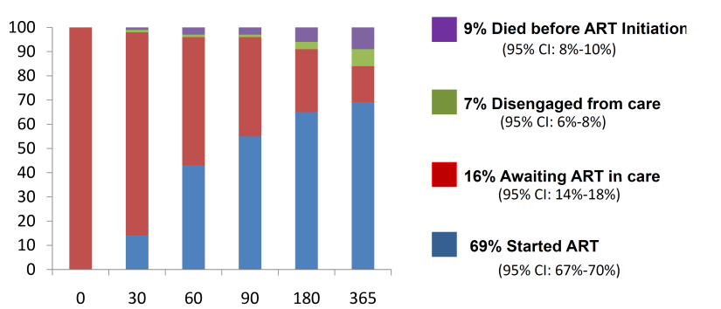
Delays in ART Initiation among ART Eligible Patients
East Africa IeDEA Consortium
Days since ART eligibility

Slide 17
Reasons…
Structural
  Overnight processing of CD4 testing
    Failure to return for second visit
Organizational
  One size fits all counseling
    “treatment supporter” and three pre-ART adherence visit requirements
Providers
  Slow diffusion of new clinical research findings
    Unaware of new data suggesting timing matters (Zolopa 2009, Havlir 2011)
    “ART is not an emergency”

Slide 19
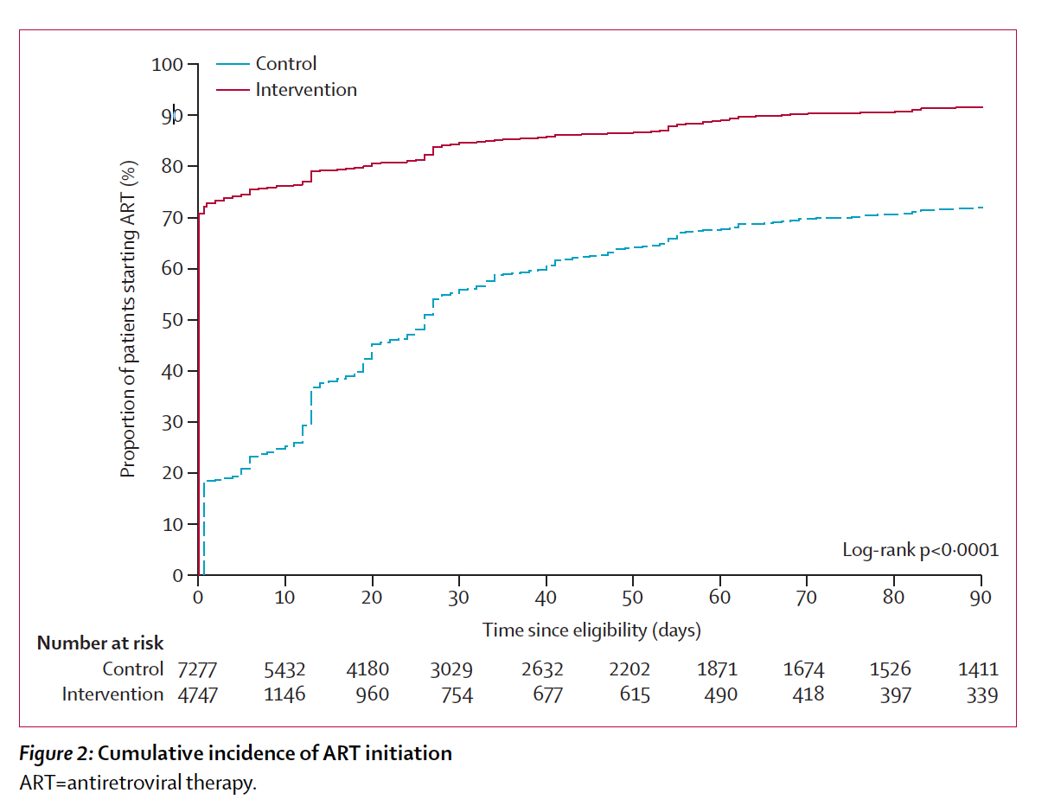

Slide 20
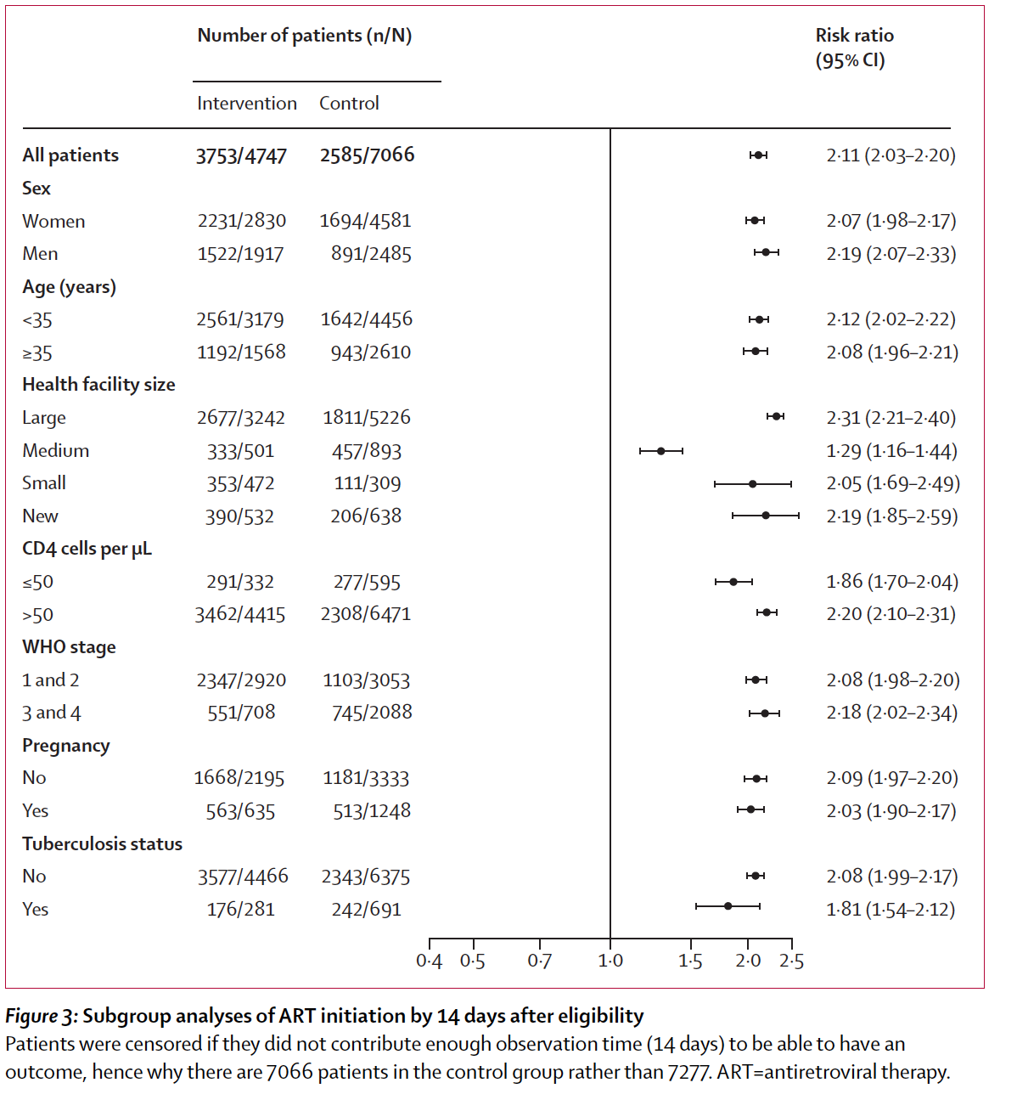

Slide 21
Other strategies for robust impact? Adaptive strategies

Slide 22
Heterogeneity: Diverse Patient-Reported Reasons for Disengagement
Notes:
No one size fits all
Any intervention for everyone will be inefficient since different people need different things
Any one intervention will also be sub-optimally effective, since any one person only has

Slide 23
Structural
Psychosocial
Clinical
Patients not in care (N=78)
Patients in care elsewhere (N=112)

Slide 24
“Multi-hit” Explanatory Framework for Engagement in Care
Grieving and emotional distress (prioritization)
Insufficient personal resources (access)
Failure to find transportation back (access)
Worker burn out / staffing shortage (monitoring)
Quarrel with staff / communication (shared commitment)
Ware, Wyatt, Geng PLoS Medicine 2013
Notes:
Five things needed for engagement – loss of any means loss of engagement – recognition, prioritization, access, appropriate monitoring and care and shared commitment -

Slide 25
Informing an Intervention Strategy for Retention in HIV Care: No Silver Bullet
Not all patients need a retention intervention (fewer than thought): most patients are retained in care within today’s standard of care.
For patients who do lapse in retention, different patients face different types of barriers (e.g., structural, psychosocial, clinic-based)
Each episode of disengagement for a particular patient results from multiple barriers and the “rate limiting” barrier is not obvious
Notes:
Example:
For someone with psychological barriers such as stigma, a transport voucher might miss the point.
Alternatively, for someone with no transportation – counseling and peer support will not change the outcome.

Slide 26
Implications
…
  “Multi-hit” theory explains why existing interventions have small effects (counseling, navigation, SMS, vouchers, outreach) since each only addresses some barriers
  Blanket application of any one intervention is likely inefficient: may squander resources on patients who do not need help
Blanket application of any one intervention is likely not optimally effective: may only help some patients in need
  No single intervention is optimally effective and efficient: There is no silver bullet

Slide 27
Adaptive Strategies to Target Public Health Interventions
  An adaptive, sequential strategy uses multiple interventions (each of which may have small effects) over time to maximize effectiveness in the population
  “Adaptive” because the intervention(s) a patients receives depend prior response
    Start with less effective but less toxic / less expensive intervention and then escalate (switch, augment) among those not responding well
Minimizes expenditures / toxicities for whom the initial intervention is sufficient (optimizing efficiency)
Intensifies support for those who need additional or alternative help (optimizing effectiveness)

Slide 28
Sequential Multiple Assignment Randomized Trial
to Enhance Retention in Care in Kenya

Slide 29
Strategies for Impact in Diverse Settings: Adaptivity
Multicomponent
Adaptive
Population 1
0.8
0.8
Population 2
0.8
0.8
Notes:
Adaptivity – a different strategy than PPKS
Two hypothetical populations with different distribution of underlying INUS causes of retention (but same probability at baseline which is 0.2)
Again, PPKS achieves high probability of success in both cases
An adaptive approach, in contrast would seek to give, the “missing pieces” selectively
Compared to PPKS – in this heuristic – you get same effectiveness in two settings but it “cost” less because you gave fewer “pieces” (6 vs. 9)
Adapation take numerous forms
Assess at baseline and target treatment to barrier (you must know how to measure determinants)
Adapt over time: see who responds and who does not and give more to those who do not – in a slightly different version is to switch
MP: the latter can be refined- ie augment as needed using both response and other characterstics (mix of the two)

Slide 30
Part II: External Validity
Proposition: Findings are not generalizable, but mechanisms might be

Slide 31
Intervention Mechanism: Transportability
Hypothesizing and measurement of mechanism enables inference about results in one setting in another
Illustration from clinical medicine
  Protease inhibitors have anti p. falciparum effect
  Protease inhibitors alter kinetic of anti-malarial drugs
Mechanism informs generalizability
  Direct anti-plasmodium effect → effect is transportable
  Boosting coartem → not transportable to low prevalence settings
Achan NEJM 2012;367:2110-8.
Notes:
In this 2012 NEJM paper the investigators sought to test the effect of PI vs. NNRTI in the treatment of HIV infected children in Uganda on malaria.
Use of PI’s was motivated by the observation that PI’s have a direct effect on p falciparum. At the same time PI’s influence the . The investigators stored samples every 12 weeks
176 children between 2 and 5 were randomized
In the intervention condition, malaria incidence went from 2.3 to 1.3 episodes per person year with a incidence rate ratio of 0.59 – p value that is 0.04
When they examined the “mechanism” of the effect, the found no evidence of a direct anti-malarial effect, but rather a marked change in the levels of coartem after an initial episdoe, and indeed overall the effect of PI was seen only in on recurrent episdoes
MP: do you really mean effect is not transportable….? I guess you are using transportable to be dierectly transportable (ie the same effect size in a new place)? And you are talking about an effect measure like relative risk of recurrent malaria. But then niether would be directly transportable? Probably being slow…
My take would have been that they imply different transport formulas

Slide 32
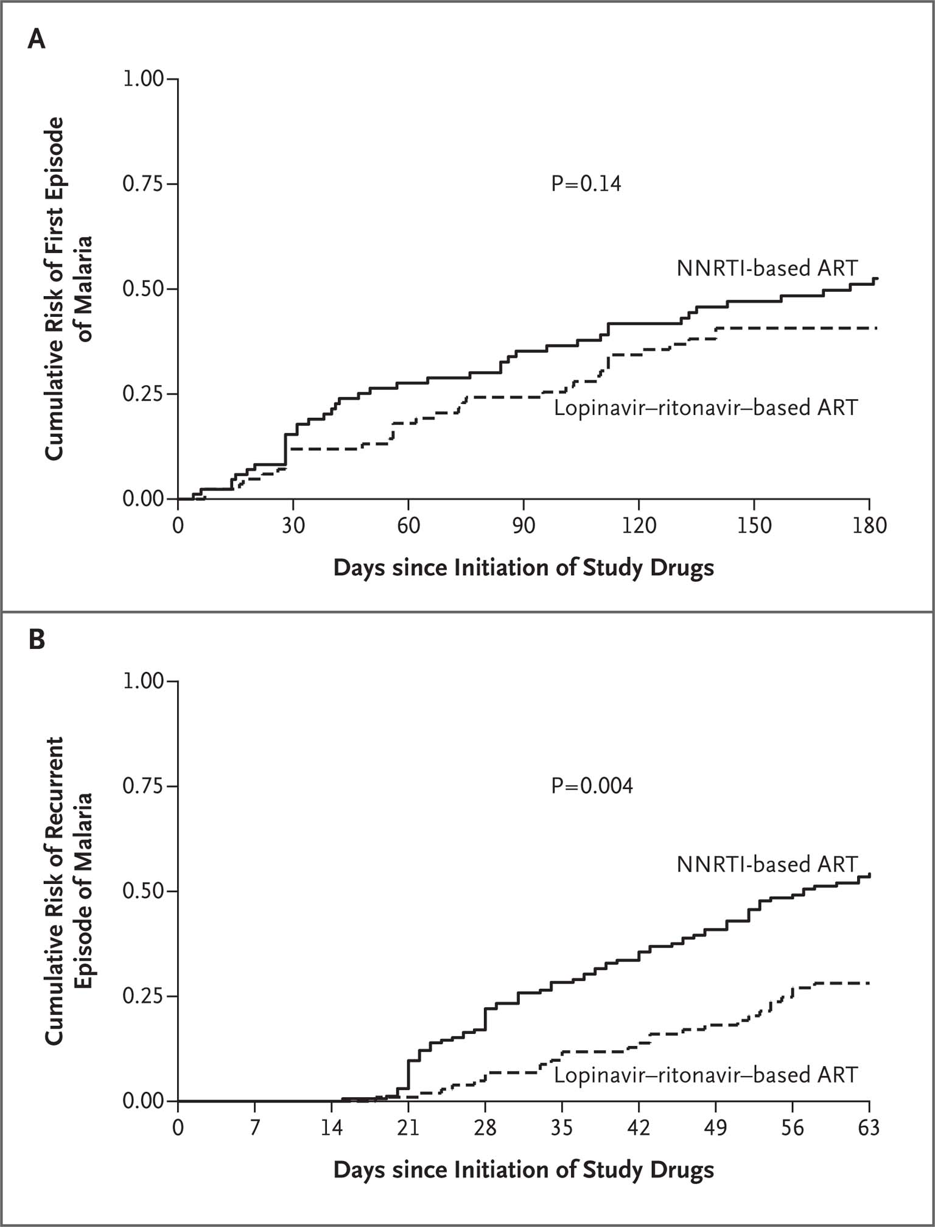
First episode of malaria
Recurrent malaria

Slide 33

Notes:
Can’t reproduce
Grimwood (JIAS 2012) examined the effect of “patient advocates” on pediatric HIV treatment outcomes
In South Africa, studied retention of children on ART
3563 total, 323 had a patient advocate
Results: reduced attrition and mortality AHR) 0.57 (95% CI: 0.35 to 0.94) and 0.39 (95% CI: 0.15 to 1.04),
Strong description of the actor (the “patient advocates”) including selection process, education, training length and topics, renumeration
The action is also well described – including caseload, assessments performed, counseling and concrete care activities performed
But nothing on temoporality, dose, frequency, duration
No description of interventoin
Selection bias (geography, maternal characteristics)
Nothing about frequency of contact – can vary from something very intensive to something very attenuated…
Can’t combine
Network meta-analyses for indirect comparisons across common SOC –
Couples counseling increases uptake of pMTCT (Becker 2009)
Act through patient knowledge, beliefs and attitudes or through facilitated disclosure?
If you measure the extent to which the effect is mediated by disclosure, you can infer more accurately about the effect of the interventino in settings with different levels of disclosure, different drivers of disclosure and in environments where disclosure may be effect modified by something else

Slide 35
Levels of context
Treatment as designed
Context (implementation factors)
Context (organizational factors)
Use (fidelity or adaptation)
Facilitation model
Context (population characteristics)
Process outcomes
Health outcomes

Slide 36
Conclusions
What works is actually two questions
Robust impact is the property of the intervention
Generalizability or external validity is the design

