Slide 1
Using Meta-Analyses for Decision-Making
“... the outlook for thrombolysis in unstable angina has dimmed considerably. The ballgame is in late innings and the home team is losing badly. Soon the meta-analysts will arrive, like sportscasters, to announce the final score.”
David Waters and Jules Lam, Circulation 86: 1642-1644, 1992

Slide 2
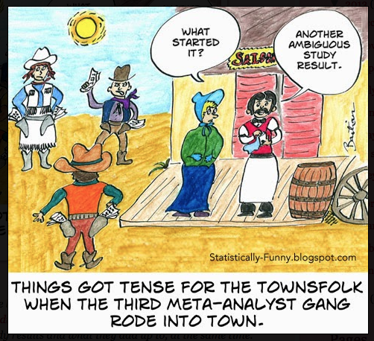

Slide 3


Do you want Apples & Oranges or Fruit Salad?
OR

Slide 4
Advanced Techniques for Meta-Analysis
A few follow-ups & Stata shortcuts
Single arm Meta-Analysis of Rates
Meta-Regression
Survival Analysis
Diagnostic Tests & ROC curves
Indirect/Network Meta-Analyses

Slide 5
Background – How much do you know?
Analysis of Variance vs. Meta-analysis
ANOVA is used with individual patient data to understand differences between trials or subgroups within a trial. Meta-analysis is used to find the overall effect, synthesizing similar outcomes either on a study (publication) basis or using individual data.

Slide 6
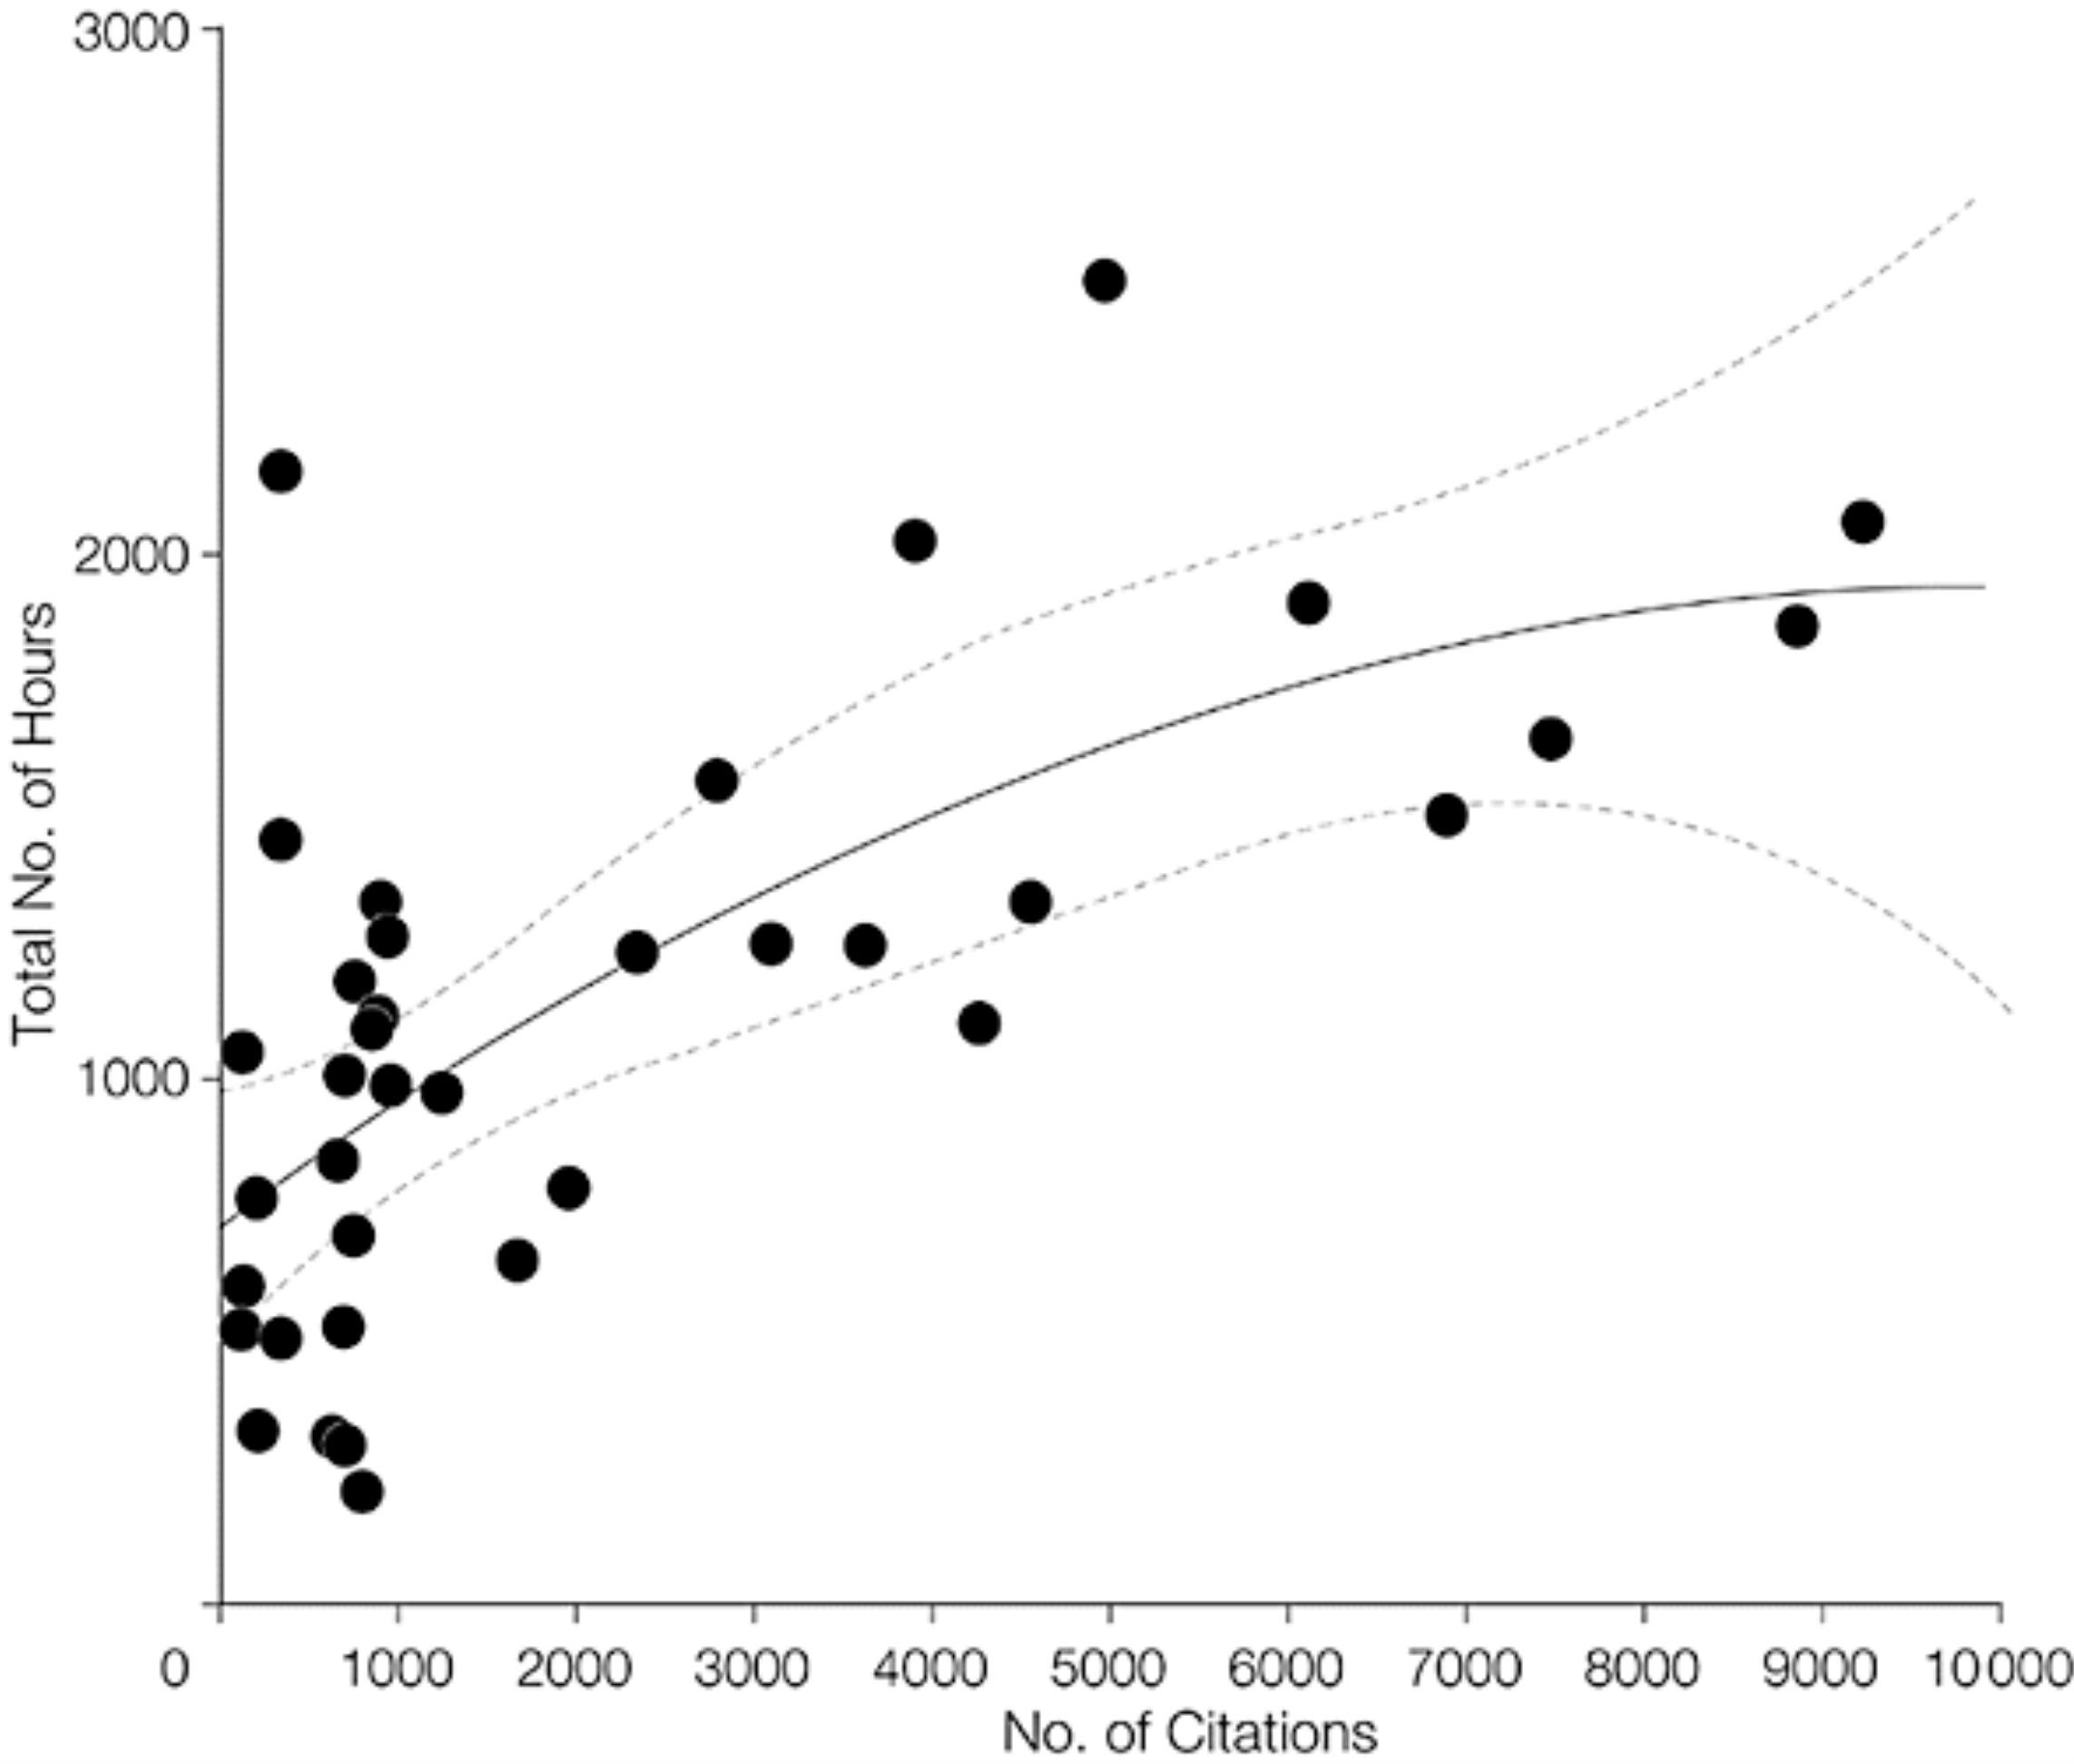
Background – How much do you know?
How long does a meta-analysis take?
Mean total number of hours = 1139 Median = 1110, Range =216 to 2518
Allen & Olkin, JAMA. 1999;282(7):634-635. doi:10-1001/pubs.JAMA-ISSN-0098-7484-282-7-jbk0818

Slide 7
Background – How much do you know?
Why do we perform a meta-analysis?
All our trials are too small
We’re applying for a new indication
We want to make a marketing claim or rebut a marketing claim from a competitor
We want to show superiority of our treatment
Concisely communicate findings/great background for grants
Identifies areas for future study

Slide 8
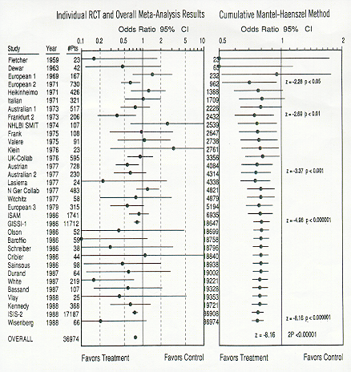
Background:The Meta-Analysis that started EBM
Lau, Chalmers et al. NEJM 1992; 327:250
Streptokinase was finally approved by the FDA in 1988

Slide 9
Background: Different kinds of meta-analytic models
Fixed-effects model
Random-effects model
Fixed-effects meta-analysis assumes that the intervention has a single true effect.
Random-effects meta-analysis assumes that the effect of the intervention varies across studies.

Slide 10
Bayesian Models
Conceptual Model: Evidence (or likelihood)
= What the data say
Inference or Bayesian analysis:
What the data say + What you know (Prior information)
= What you believe (Posterior information)
Action or Decision analysis:
What you believe + Consequences (utility, cost)
= What you DO

Slide 11
Background: Heterogeneity is your friend!
  Clinical diversity
  Methodological diversity
  Statistical heterogeneity
    I² Statistics or Cochran’s Q
    Bias testing or adjustment
    Study sponsorship adjustment
    Meta-regression
    Individual or grouped Jackknife
    Subgroup analyses
    Funnel plots
    NNT
    Fail safe number

Slide 12
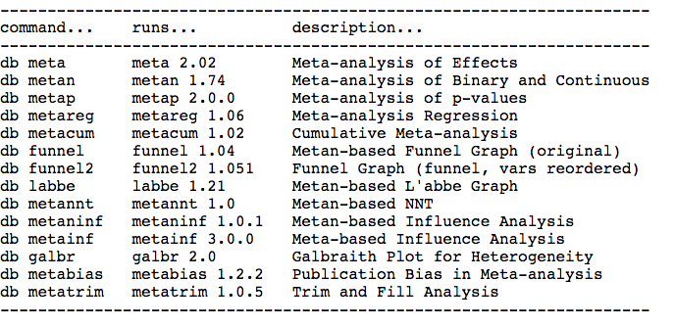
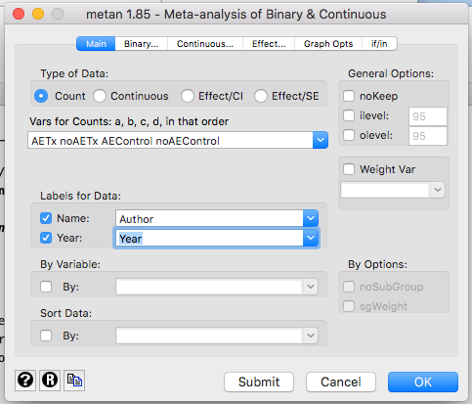
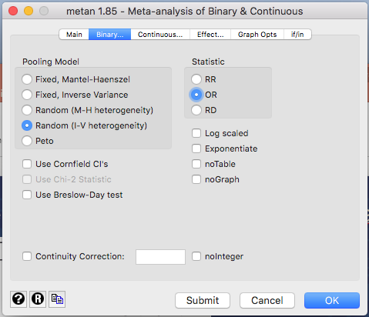
Using the dialog box in STATA: install metadialog
db metan
Download
streptokinase data.dta

Slide 13
Using the dialog box in STATA: install metadialog
metan AETx noAETx AEControl noAEControl, label(namevar=Author, yearvar=Year) randomi or

Slide 14
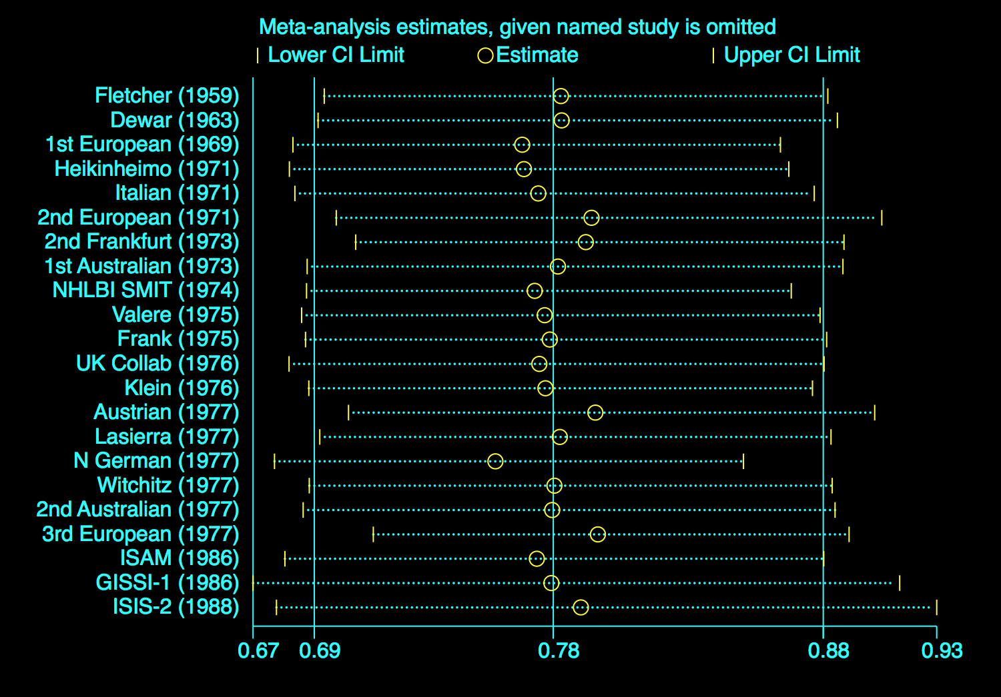
Using the dialog box in STATA: jackknife – influence of individual studies
db metaninf
metaninf AETx noAETx AEControl noAEControl, label(namevar=Author, yearvar=Year) randomi or

Slide 15
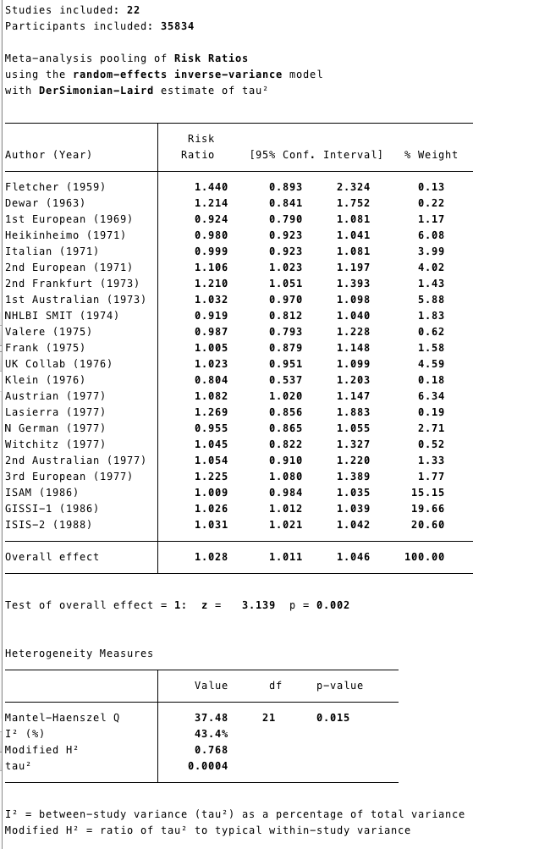
A new Meta-Analysis command: admetan
Using the streptokinase data:
admetan noAETx AETx noAEControl AEControl, random label(namevar=Author, yearvar=Year)

Slide 16
A new Meta-Analysis command: confunnel
Using the streptokinase data:
gen logOR = .
replace logOR = log(OR)
confunnel logOR _selogOR

Slide 17
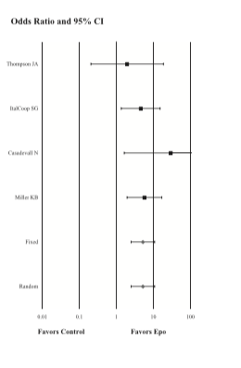
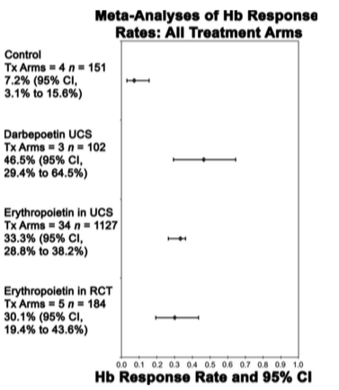
Meta Analysis of Rates
Efficacy and Safety of Erythropoiesis-Stimulating Proteins in Myelodysplastic Syndrome: A Systematic Review and Meta-Analysis Susan D. Ross, I. Elaine Allen, Corey A. Probst, Brian Sercus, Sheila M. Crean and Gayatri Ranganathan Oncologist 2007;12;1264-1273

Slide 18
SINGLE ARM META-ANALYSIS in STATA: Diagnostic performance of two-phase and four-dimensional computed tomography for parathyroid localization; a systematic review and meta-analysis*
35 arms from 30 studies from 2000-2016
Only outcomes from one type of contrast per study
Sample of the data
*Use of PET tracers for parathyroid localization: a systematic review and meta-analysis
Wouter P. Kluijfhout et al, Arch Surgery 2016

Slide 19
SINGLE ARM META-ANALYSIS: STATA Metaprop command:
. metaprop TP SensDenom, random cimethod(exact) label(namevar=Author, yearvar=Year)
Considerable heterogeneity – will subgroups help?

Slide 20
. metaprop TP SensDenom, random cimethod(exact) by(Phase) label(namevar=Author, yearvar=Year)
Separating by contrast phase does not help so the next step was a cumulative meta-analysis

Slide 21
Cumulative Meta-Analysis: STATA
. metacum TP SensDenom, random label(namevar=Author, yearvar=Year)
db metacum
If we had more information, we could have looked at a meta-regression

Slide 22
Meta-Regression
Subgroup analyses
Examining the control rate
Identification of important covariates
Control for baseline differences
Control for bias or sponsorship
Control for heterogeneity
STATA command does not work for single-arm analyses but you could perform a regression with the effect size as the outcome.

Slide 23
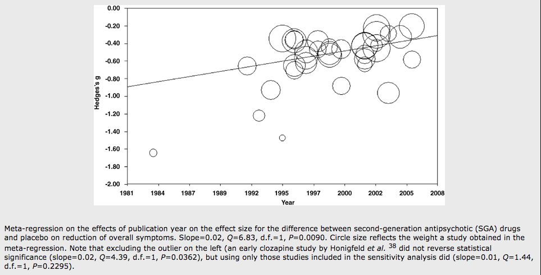
Meta-Regression
Only appropriate in meta-analyses of 10 or more studies
The outcome is the effect estimate
Predictors are characteristics of study design
How effective are second-generation antipsychotic drugs? A meta-analysis of placebo-controlled trials S Leucht, D Arbter, R R Engel, W Kissling & J M Davis, Molelar Psychiatry , 2008

Slide 24
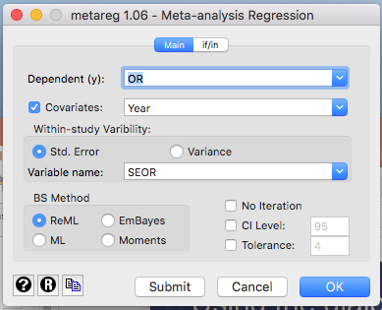
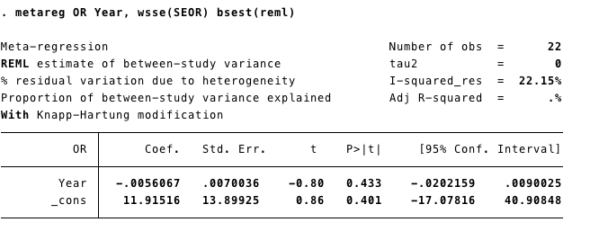
Using the dialog box in STATA: install metadialog
db metareg

Slide 25
. metareg OR Year, wsse(SEOR) bsest(reml) level(95) graph

Slide 26
Meta-Regression STATA example
Meta-analysis comparing CABG to PCI*
23 studies
Slight benefit to CABG
I² ⁼ 86%
Ashok Krishnaswami, MD; Anne C H Goh, MD; Alan S Go, MD; Robert J Lundstrom, MD; Jonathan Zaroff, MD; James J Jang, MD; Elaine Allen, PhD, Journal of Cardiology, 2016

Slide 27
STATA: metareg _ES yrpublished, wsse(_selogES) graph
Meta-Regression
Notice that you have new variables after your meta-analysis:
_SS _ES _selogES _LCI _UCI _WT
25 .75 1.154701 .0780151 7.210147 .0681302
1.06 .2371708 .6701138 1.697887 1.475598
^{Meta-regression}
REML estimate of between-study variance
% residual variation due to heterogeneity
Proportion of between-study variance explained With Knapp-Hartung modification
^{Number of obs = 22}
^{tau2 = .01639}
^{I-squared_res = 78.80%}
^{Adj R-squared = 25.32%}
_ES Coef. Std. Err. t P>t [95% Conf. Interval]
yrpublished -.0015316 .0071283 -0.21 0.832 -.0164008 .0133377
_cons 4.02446 14.30124 0.28 0.781 -25.80741 33.85633

Slide 28
PUBLICATION YEAR – heterogeneity still 80%

Slide 29
STATA: metareg _ES hypertension, wsse(_selogES) graph
HYPERTENSION – reduces heterogeneity to 50% but…

Slide 30
Survival Analyses
Reconstruct actuarial life tables
- impute interim timepoints
Reconstruct log rank statistics
- need p-values
Deconstruct survival curves
- using a ruler, ‘graph mapping software’
Combine into meta-analysis of median survival time

Slide 31
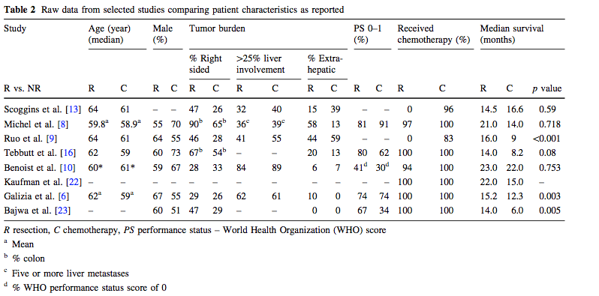
Survival Analyses
Meta-Analysis of Survival of Patients with Stage IV Colorectal Cancer Managed with Surgical Resection Versus Chemotherapy Alone P. Stillwell • P. G. Buettner • Y-H. Ho World J Surg (2010) 34:797–807

Slide 32
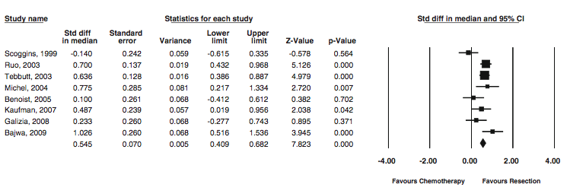
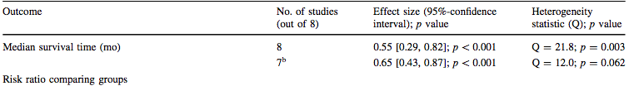
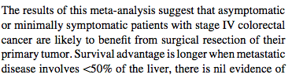
Survival Analyses
Sensitivity Analysis of Heterogeneity

Slide 33
Diagnostic Studies
Objective may be diagnosis, imaging modalities,
evaluation vs. a gold standard
Studies may use different thresholds
- compute 2 x 2 tables for each study
Compare areas under the ROC curve using logit models

Slide 34

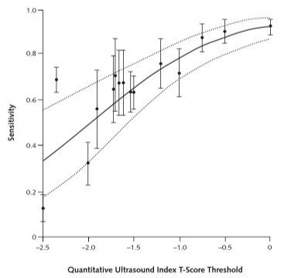
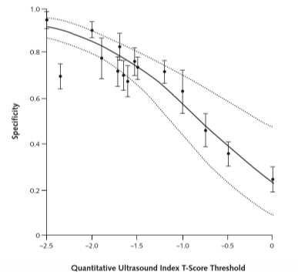
Diagnostic Studies
Meta-Analysis: Accuracy of Quantitative Ultrasound for Identifying Patients with Osteoporosis Smita Nayak, MD; Ingram Olkin, PhD; Hau Liu, MD, MPH, MBA; Michael Grabe, PhD; Michael K. Gould, MD, MS; I. Elaine Allen, PhD; Douglas K. Owens, MD, MS; and Dena M. Bravata, MD, MS 6 June 2006 Annals of Internal Medicine Volume 144 • Number 11

Slide 35
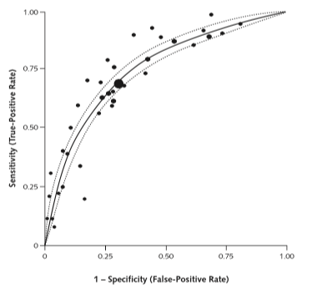
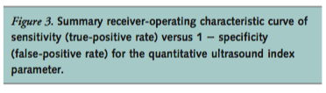
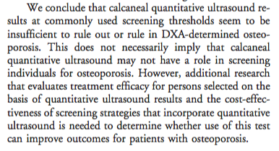
Diagnostic Studies

Slide 36
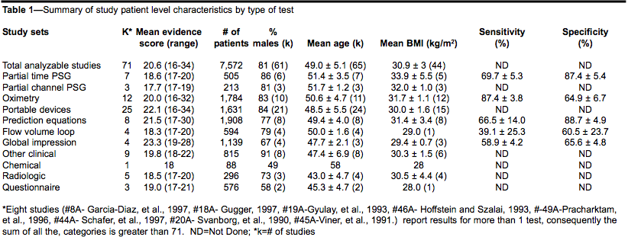
STATA example: Diagnostic Studies
Systematic Review and Meta-analysis of the Literature Regarding the Diagnosis of Sleep Apnea Susan D. Ross MD, FRCPC, Iris A. Sheinhait MA, Katherine J. Harrison BA,Marion Kvasz MD, MPH, Janet E. Connelly BS, Steven A. Shea PhD, and I. Elaine Allen PhD SLEEP, Vol. 23, No. 4, 2000

Slide 37
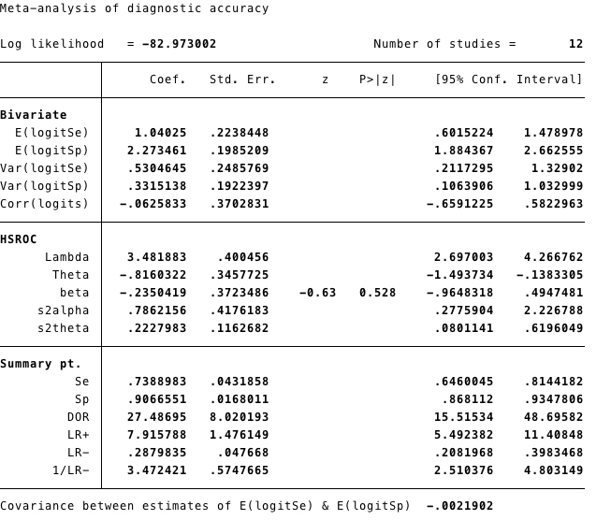
STATA: metandi TP FP FN TN

Slide 38
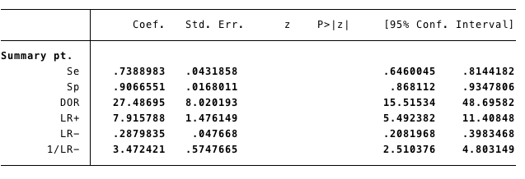
metandi TP FP FN TN, nobivariate nohsroc plot
Easy to use
Results can be used in other models
Can get prediction plots

Slide 39
Diagnostic Studies – Stata midas command
Install midas
. midas tp fp fn tn, fagan(.2)
midas tp fp fn tn, modchk(all)

Slide 40
Diagnostic studies with multiple cutpoints
Suppose you want to model and examine the difference between each studies ROC curve and then meta-analyze them?
STATA does not have a procedure but R has a package to do this
Data from Kevin Selby, MD (Fellow, TICR grad, ULausanne)

Slide 41
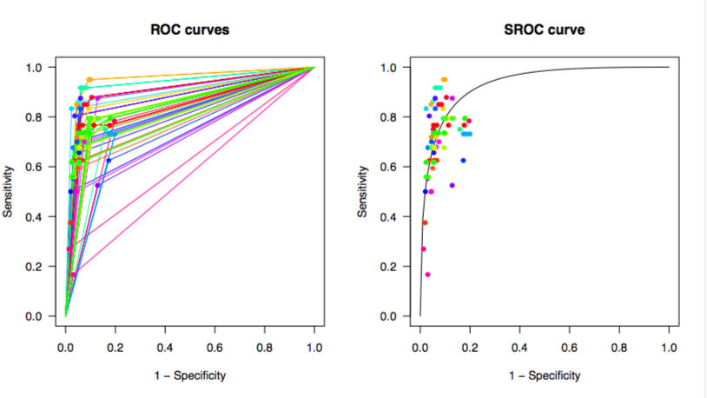
Multiple cutpoints: R Studio – use devtools and diagmeta*
*Steinhauser et al. BMC Medical Research Methodology (2016) 16:97

Slide 42
Evaluating Indirect Effects
Evidence includes studies of two treatments:
  comparing one to the other
  comparing each to a placebo
  comparing each to a third comparator
  or any combination of these

Slide 43
Testing Treatment Differences in Placebo Controlled Studies
Evaluating Indirect Effects
Outcomes at 30 Days Composite (Death or MI)
Study Drug # of Patients # Studies Odds Ratio 95% CI
Drug A 9,606 5 0.45 (0.37, 0.55)
Drug E 5,834 4 0.82 (0.69, 0.98)
Drug T 3,634 3 0.73 (0.57, 0.92)

Slide 44
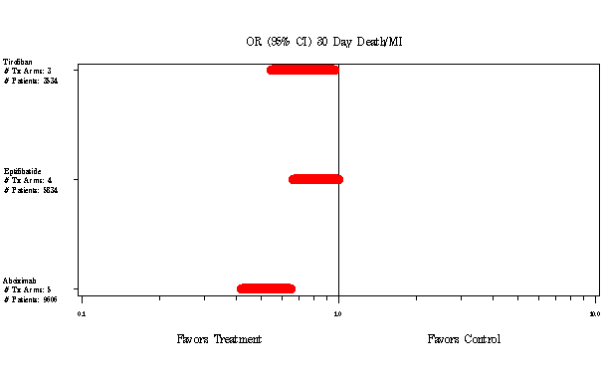
Evaluating Indirect Effects
Testing Treatment Differences in Placebo Controlled Studies
One-way ANOVA comparing treatments:
Drug A vs. Drug E p < 0.001
Drug A vs. Drug T p < 0.01
Drug E vs. Drug T p > 0.05

Slide 45
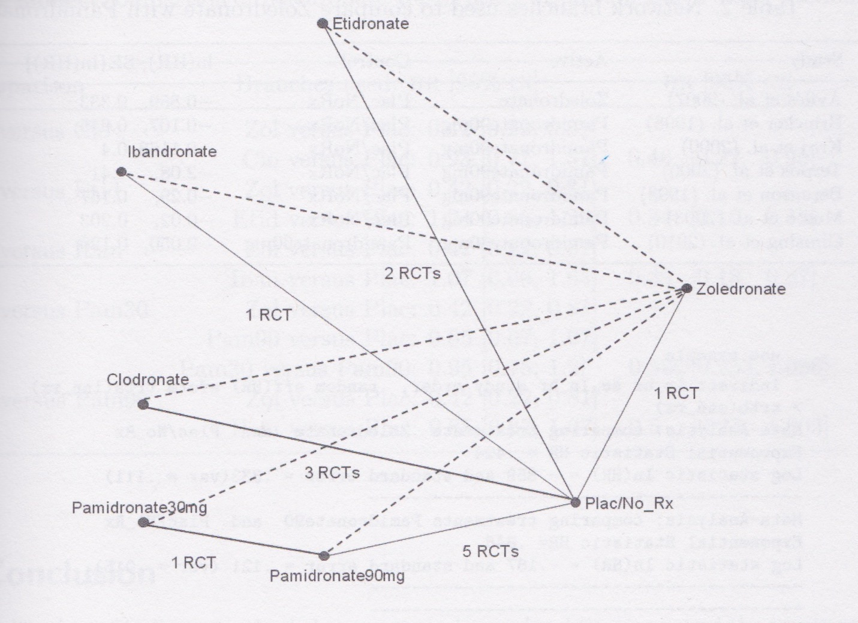
Beyond ANOVA: Evaluating Indirect Effects
And Network Analyses

Slide 46
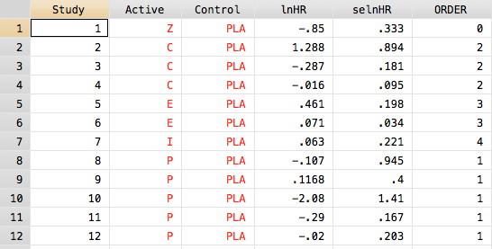
Evaluating Indirect Effects in Stata
Raw data
STATA: indirect lnHR selnHR Study ORDER, random eff(HR) eform trta(Active) trtb(Control)

Slide 47
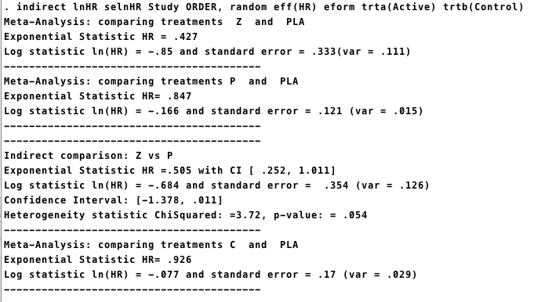
Evaluating Indirect Effects

Slide 48
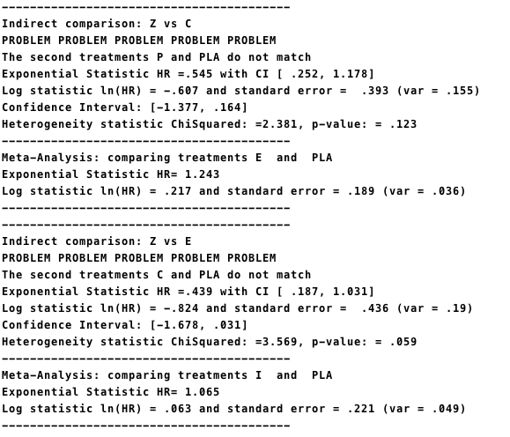
Evaluating Indirect Effects
Why no I vs. Z?

Slide 49
Special Issues in Meta-Analysis
Meta-Analysis of transition probabilities
Pharmocoeconomic Meta-Analysis
Meta-Analysis of zero events

Slide 50
Markov Chain Meta-Analyses
Where is it being applied?
Policy analyses in mental health
-modeling transition probabilities within a mental health system
-probability of transition to outpatient or readmission
Genome analyses
-modeling likelihood of gene pairings

Slide 51
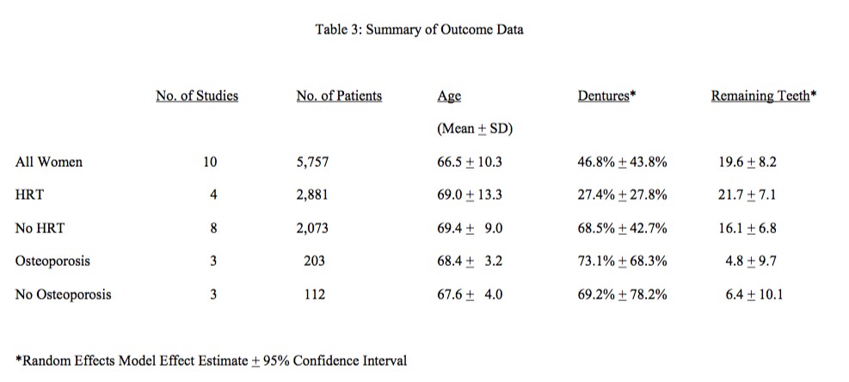
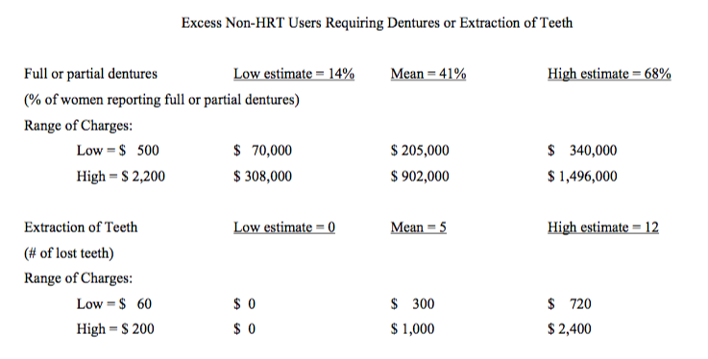
Pharmacoeconomic Meta-Analysis
Effect of postmenopausal hormone replacement therapy on dental outcomes: systematic review of the literature and pharmacoeconomic analysis.
Allen IE, Monroe M, Connelly J, Cintron R, Ross SD. Managed Care Interface, 2000
Overall, the annualized excess cost associated with these two dental outcomes in non-HRT users is estimated to be between $ 14,000 and $ 300,000 with a mean of $ 100,000 per thousand untreated postmenopausal women per year.

Slide 52
What to do with zero events?
Bracco v. Amersham (X-Ray Contrast Media)
Dueling Marketing Claims each based on a meta-analysis
Re-analysis of both meta-analyses by each company
Most fun: Teaching the judge (she was an English major) about statistics, odds ratios, meta-analyses, and Bayes
STATA has two fixes here
  Easy – adds 0.5 to each outcome using cc(.5)
  Hard – imputes the missing data

Slide 53
What to do with zero events?
Renal Safety of Iodixanol(IOCM) v. Iopamidol (LOCM) on the incidence of Contrast Induced Nephropathy
Fixed effects models
Per protocol analysis
Omits 6 studies with zero outcomes

Slide 54
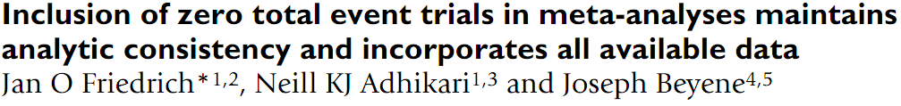
What to do with zero events?
Reanalysis using all the studies, intent-to-treat population, and random-effects models

Slide 55
Look Fred, This seems to be the
same thing…SUMMARIZED

Slide 56
Using Meta-Analysis as a Primary Evidence Tool*
Aredia – Zometa Deutsch v. Novartis Pharm. (E.D.N.Y. 2011)
Avandia In re Avandia Marketing (E.D. Pa. 2011)
Baycol In re Baycol Prods. (D. Minn. 2007)
Benzodiazepine Vinitski v. Adler, (PhilaCt. Common Pleas 2004)
Celebrex – Bextra In re Bextra & Celebrex Marketing (2007)
E5 (anti-endotoxin monoclonal antibody for sepsis) (1996)
Fenfluramine, Phentermine In re Diet Drugs Prod. (E.D.Pa. 2000)
Fosamax In re Fosamax Prods. Liab. Litig., (S.D.N.Y. 2009)
Gadolinium In re Gadolinium-Based Contrast Agents (N.D. Ohio 2010 and 2014)
Hydroxycut In Bechler v. MuscleTech (2003 & 2006)
Neurontin In re Neurontin Marketing, Sales Practices (D. Mass. 2009)
Paxil (SSRI) In Tucker v. Smithkline Beecham Corp (S.D.Ind. 2010)
Procrit In Amgen v. OrthoBiotech (2009)
Prozac (SSRI) In Rimberg v. Eli Lilly & Co. (2009)
(RIAA) In A&M Records, Inc. v. Napster, Inc., 239 F.3d 1004 (2001, 2007)
Seroquel In re Seroquel Products Liab. (M.D. Fla. 2009)
Thimerosal – Vaccine Salmond v. Sec’y Dep’t of HHS, (Fed.Cl. 1999)
Trasylol In re Trasylol Prods. Liab. Litig.,(S.D. Fla. 2010)
Ultra Dawn In Proctor & Gamble class action suit (2002 and 2010)
Vioxx Merck & Co v. Ernst, (Tex. Ct. App. 2009) (Tex. 2011)
X-Ray Contrast Media Bracco v. Amersham (D.N.J. 2009, 2012)
Zoloft (SSRI) Miller v. Pfizer, Inc.,(10th Cir. 2004)
Zymar Senju Pharmaceutical Co. Ltd. v. Apotex Inc. (D.Del. 2011)
Zyprexa In re Zyprexa Products Liab. (E.D.N.Y. 2007)
*Cases I worked on

Slide 57
Does Ultra Dawn Live Up to Its Name?
Consumer Reports that Ultra Dawn may not be a ‘significant’ improvement over regular Dawn
  CR policy is that it does not release its experimental results or design or the tests it performs
  What does ‘significant’ mean?
Law firm in California files a class action suit to reimburse users of Ultra Dawn for the difference in price
Proctor & Gamble law firm hires MetaWorks to reproduce P&G’s analysis and also produce a meta-analysis of all the (internal) trials comparing Ultra Dawn to regular Dawn
Exhaustive internal protocol of analyses but only select pertinent information given to Ingram Olkin from Stanford, who will testify for P&G

Slide 58
Overall Summary Provided to Ingram & to P&G
All the experiments carried out by Procter & Gamble comparing Ultra Dawn to Standard Dawn were reviewed. The test procedures and statistical methodologies used to establish the superiority of Ultra Dawn vs. Standard Dawn were statistically rigorous. Over 300 experiments were done.
All the statistical analyses were replicated with increase in fat dissolved as the primary outcome.
Meta-analyses performed of the experiments conducted by Procter & Gamble comparing Ultra Dawn with Standard Dawn.
Meta-analysis showed the superiority of Ultra Dawn vs. Standard Dawn.
Effect Size 95% Confidence Interval Significance Level
0.85& [0.65 to 1.06] p < 0.001
What type of meta-analysis model is appropriate? What was the outcome of the lawsuit?
*Ultra Dawn **Regular Dawn &in favor of Ultra Dawn

Slide 59
Safety of Ephedrine Weight Loss Supplements
Class action suits after deaths linked to ephedrine and FDA issuing new regulations for the supplement
Objective: Quantify selected efficacy and safety outcomes of Hydroxycut™ when used as indicated as a dietary supplement, with or without caloric restriction and exercise, in overweight healthy adults
  Efficacy in Weight Loss
  Safety in no excessive increase in BP or pulse
Hydroxycut was marketed by MuscleTech, a Canadian company, for several years, and was tested for selected efficacy and safety outcomes in 6 randomized controlled trials (RCTs) sponsored by MuscleTech since 1999
What meta-analysis model is appropriate here?

Slide 60
Modest Weight Loss Overall - (at 8 weeks or LOCF)
Per Protocol analysis

Slide 61
Safety Analyses
 | k | n | Baseline |  | 8 Weeks |  | Effect size for MD (95%CI) |  | MD (95% CI)*
 |  |  | Control | Intervention | Control | Intervention
Average SBP (mmHg)
LOCF | 6 | 150 | 122.1 | 122.1 | 120.2 | 121.8 | 0.90 (-.35, 2.15) p = 0.156 |  | -1.95 (-5.05, 1.14)
Completers | 6 | 124 | 122.7 | 122.5 | 119.2 | 122.5 | -0.15 (-1.66, 1.36) p = 0.845 |  | -3.07 (-6.71, 0.57)
Average DBP (mmHg)
LOCF | 6 | 150 | 78.5 | 77.8 | 75.6 | 75.7 | 0.75 (-1.01, 2.25) p = 0.400 |  | -0.53 (-3.65, 2.58)
Completers | 6 | 124 | 74.9 | 76.8 | 74.9 | 76.7 | 1.46 (-0.26, 3.18) p = 0.097 |  | -1.28 (-4.97, 1.06)
Average Pulse (bpm)
LOCF | 5 | 132 | 77.6 | 76.5 | 74.1 | 76.0 | 0.11 (-1.32, 1.55) p=0.880 |  | -2.21 (-5.76, 1.34)
Completers | 5 | 107 | 77.3 | 77 | 73.7 | 76.0 | 0.46 (-0.14, 1.06) p=0.129 |  | -3.13 (-6.97, 1.34)
k = number of studies
n = total number of subjects in group
SBP = systolic blood pressure
DBP = diastolic blood pressure
mmHg = millimeters of mercury
bpm = beats per minute
LOCF = last observation carried forward (includes all subjects who started for whom any follow-up data were available)
Completers = only subjects completing at least 8 weeks on study
MD = mean difference
CI = confidence interval
* Mean difference of test change - control change (kg)
FDA & Trial Outcomes?

Slide 62
Clinical Trial Feasibility: Asthma
Question: Will a planned multicenter phase 4 trial ($10 million estimate) succeed in proving that drug P is better than drug Z?
EBMI tool: Meta-analysis of all sponsor’s trials of drug P vs. SBA drug Z.

Slide 63
Drug P or Z Vs. Placebo: All Outcomes
#Study/
Outcome Treatment Arms #Pts
FEV 1 Z₁ 3 1042
FEV 1 P₁ 4 805
AM PEFR Z 3 1042
AM PEFR P₁ 4 805
PM PEFR Z₁ 3 1042
PM PEFR P₁ 4 2805
β agonist Z 3 1042
β agonist P₁ 4 805
Odds Ratio and 95% C.I.
-6
-4
-2
0
2
4
6
Favors Placebo
Favors Treatment
Random Effects Model
Notes:
7

Slide 64
Sample Size:
Estimated Clinical Trial Sample Size
Outcome A B Required Sample Size
per Group**
FEV1
Overall 0.069 0.068 27,000
Recommended Dose* 0.066 0.077 7,000
Morning PEFR
Overall 0.054 0.062 1,700
Recommended Dose* 0.053 0.055 10,500
Evening PEFR
Overall 0.051 0.039 3,700
Recommended Dose* 0.051 0.036 2,500
Beta-Agonist Use
Overall 0.299 0.245 2,000
Recommended Dose* 0.321 0.250 2,300
** α = 0.05, 1-β = 0.80
Company’s decision?
Notes:
11

Slide 65
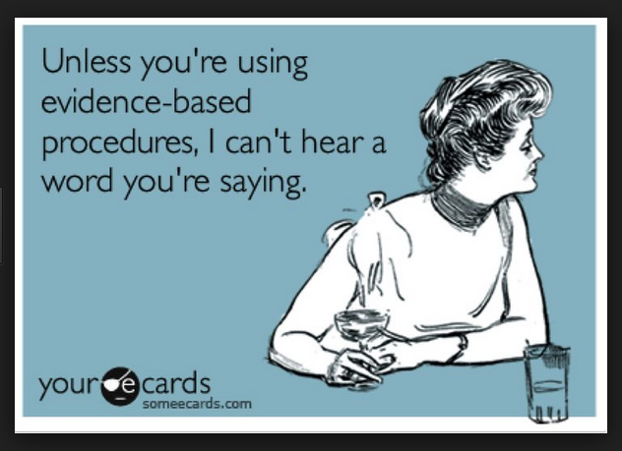
When working on meta-analyses in the future, you can certainly find me if you have questions. For more detailed help you can get a free hour or 2 of CTSI consulting with me for your project,
Isabel.allen@ucsf.edu 2nd Floor Mission Hall
https://www.youtube.com/watch?v=QUW0Q8tXVUc

