Slide 1
From Evidence to Policy and Practice
Spring 2019
Epi 239
Elvin Geng

Slide 2
Overview
Implementation science is mean to change practice
How does evidence influence policy and practice?
The “benevolent despot” model
But how do things really work?
Usual approaches: not bad, but naïve?
Case study in reality – the lifecycle of evidence
What’s a scientist to do?

Slide 3
Implementation science and it’s discontents
Make clinical evidence, influence policy
What’s the problem?
OK, we need ways of implementing evidence based interventions…
So, make evidence on implementation strategies
But people aren’t using my research results

Slide 4
Guidance on how to make implementation science usable…
Engage stakeholders
Ask relevant questions (through engaging stakeholders)
Community engagement
Work closely with implementers
Co-produce science

Slide 5
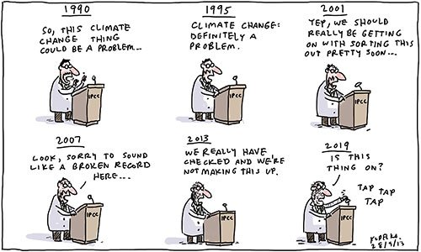
Jon Kudelka.

Slide 6
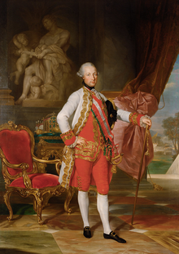

Slide 7


Slide 8
Research’s role in policy
Policy making process
Multiple actors
Not all motivations and values are in the open
Contested
Role of research in that process
Warning
Guidance
Reconceptualization
Mobilization of support
Unintended consequences
Weiss

Slide 9
The role of research: examples from the HIV response

Slide 10
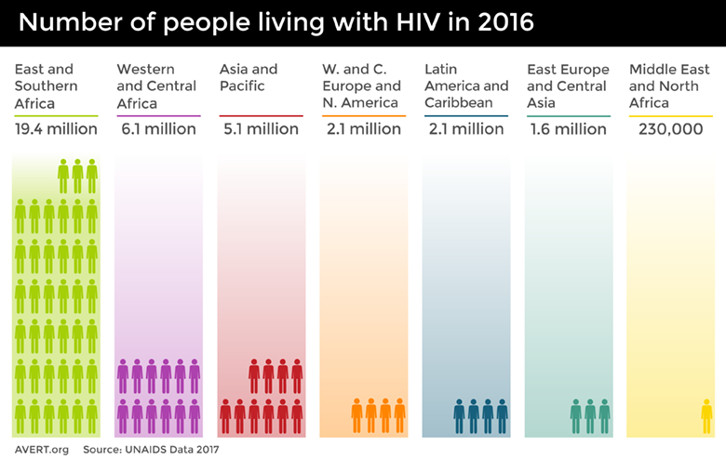

Slide 11


Slide 12
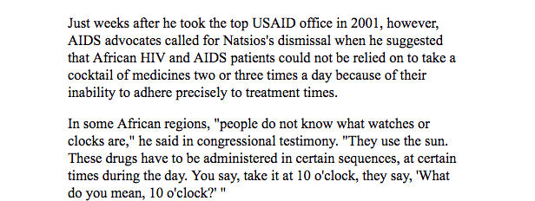

Slide 13
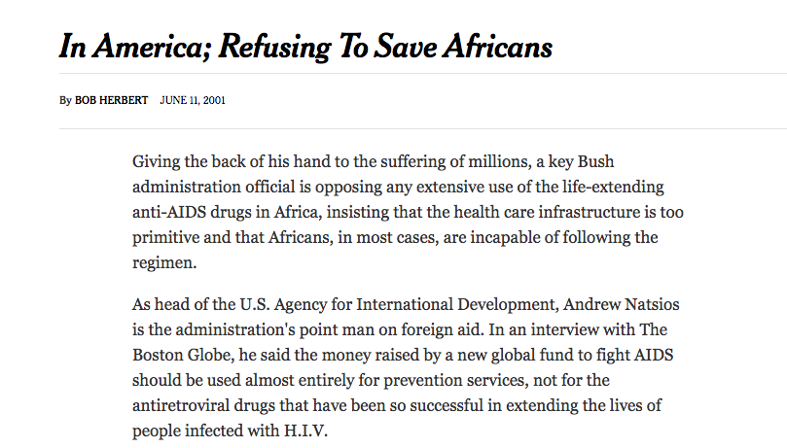

Slide 14


Slide 15


Slide 16


Slide 17
“Combination antiretroviral therapy, remarkably efficacious when used as prescribed, may stand as the most complicated and demanding regimen for a condition requiring continuous open-ended treatment [2].”
“It is estimated that adherence levels of >95% are required to achieve durable suppression of HIV load [3].”

Slide 18
The accompagnateurs are the structural backbone of the HIV Equity Initiative. Although we used the term DOT to describe what they do, it was clear from the outset that far more complex social processes were occurring.
The accompagnateurs are respected in their home communities and serve as the essential link between the villages and the clinic. When a patient from the catchment area is given the diagnosis of advanced HIV disease requiring HAART, an accompagnateur is either selected from the current staff or hired from the community at the patient's request.
The majority of these village-based health workers are peasant farmers or market women. Accompagnateurs receive training on the importance of confidentiality and emotional support for the patients. In addition, they are educated about the clinical presentation and management of HIV infection and tuberculosis, including proper use of medications, management of side effects, and prevention of HIV infection.
During daily visits, accompagnateurs are asked to directly observe the ingestion of at least 1 dose of HAART and are permitted to leave the second treatment dose with the patient at that time. In most cases, however, accompagnateurs visit their patients more than once a day, to observe the ingestion of the second dose.

Slide 19


Slide 20
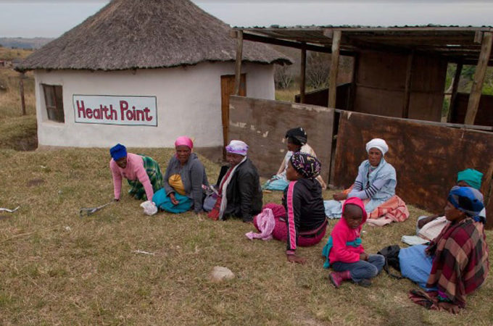
Credit: http://www.aljazeera.com/mritems/Images/2013/11/28/2013112855453306580_20.jpg

Slide 21
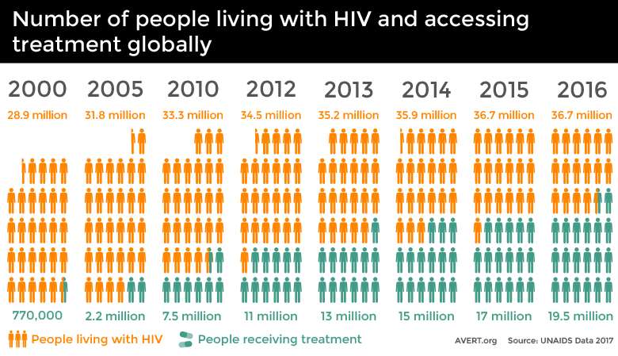

Slide 22
Guidance and mobilization

Slide 23
Unintended Consequences?

Slide 24
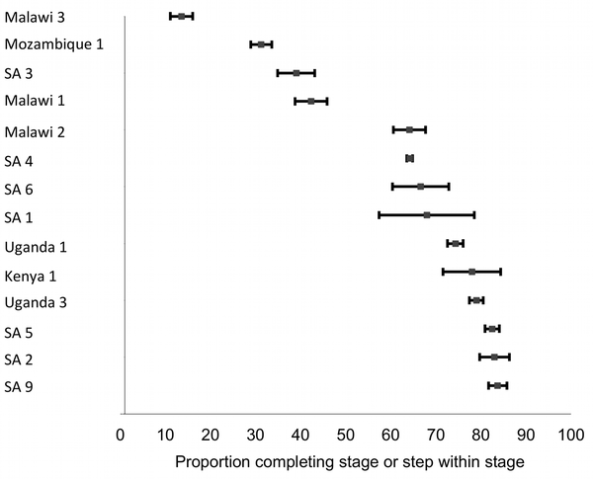
ART Initiation among Eligible Patients
Fox PLoS Medicine 2011

Slide 25
Conclusions
Research produces findings
Findings are used (or not) in a complex policy making environment
Lots of actors, different agendas
Evidence is best through of as enlightening the policy environment

