Slide 1


Using Qualitative and Mixed Methods to Understand Complexity in Implementation Research
Sara Ackerman, MPH, PhD
Associate Professor
Department of Social & Behavioral Sciences

Slide 2
Overview
  Qualitative and mixed methods
  Complexity: opening the black box of context
  Toward methodological pluralism

Slide 3
Implementation research
Goal is to study efforts to change
  Individual behaviors
  How groups work
  Organizations and systems
Involves complex
(often unpredictable) interactions between
    Intervention
    Context
    People

Slide 4
Implementation researchers use qualitative methods to understand…
Context
  Social, institutional, economic, regulatory forces
  Informal & formal rules/norms, values, power dynamics
Local knowledge/evidence
  Research participants’ and other stakeholders’ understanding of problem
  Knowledge and practices of “experts” and “lay” people
Change mechanisms
  Uptake variation, non-adoption, abandonment, unexpected uses
  Non-linear pathways between intervention and outcome

Slide 5

Qualitative approaches
Individual interviews
Group interviews
(e.g. focus groups, community meetings)
Ethnographic/participant observation
Stakeholder engagement
Asset/social network mapping
Video/audio recording
Photography
Review documents, artifacts, visual data
First try at participant observation
Jonaton Zinger, licensed under CC BY 2.0.
Notes:
‘First try at participant observation’ by Jonaton Zinger is licensed under CC BY 2.0. Sourced from Flickr and reproduced under a Creative Commons Attribution-NonCommercial-NoDerivs 2.0 Generic (CC BY-NC-ND 2.0) license. http://www.flickr.com/photos/cachifotos/467557839/

Slide 6
Mixed methods
Use of both qualitative and quantitative modes of inquiry in one study,
e.g. surveys and in-depth interviews
One type of data may be used to…
- explain
- support
- refute
or
- add complexity and meaning to another
Notes:
However, not exactly a nice, neat dichotomy

Slide 7
Trick questions
Do the strengths/weaknesses of qual and quant approaches offset each other?
Are qual and quant mutually exclusive categories?
Do qual and quant approaches offer different understandings of phenomena?
Notes:
Strength/weakness are not inherent attributes of research approaches
ALL data are aspects of experiences or phenomena transformed into words, numbers, visual forms
This means they can be transformed into other forms
QUANT research does not escape qualitizing/QUAL research does not escape quantitizing
Not necessarily; depends on methodology and interpretation
What’s the difference between method and methodology?

Slide 8
Type of knowledge produced depends on worldview/paradigm
Worldview
Assumptions about reality and how it can be known
E.g. (post)positivism, constructivism
Methodology
Theoretical assumptions/principles that guide research Qs and choice of methods
E.g. experimental, ethnography
Methods
Tools used to collect and analyze data
E.g. measurement, survey, observation, interview
Notes:
Choice of methods always led (implicitly or explicitly) by paradigm/methodology
any study which is predicated on summarising its results into a series of numbers is, by any definition, highly subjective, with personal judgements made about what is valuable and worthy of measure, how measurement should be undertaken, and what should and should not be reported – and even, what the numbers mean, and how they are interpreted by different shareholder groups. Nevertheless, this type of work still claims objectivity in terms of measurement and outcome.
Positivism – belief in objective, value-free knowledge, deductive logic
Constructivism – meaning/what we know and how we know it is socially constructed; reality created through interactions with each other and context and our interpretation of those interactions

Slide 9


Slide 10
How should we study complex interventions?
Complexity: “dynamic and constantly emerging set of processes and objects that not only interact with each other, but come to be defined by those interactions.”
- Cohn, 2013

Slide 11
 | Clinical research | Greenhalgh’s proposal for studying complexity
Knowledge sought | Certainty, predictability; linear cause and effect; barriers/facilitators | Uncertainty, unpredictability, generative/emergent causality
Questions asked | Does the intervention work? What is the effect size? Is it acceptable/ feasible/appropriate? | - What works for whom in what circumstances? - What happened here and what can we learn from it?
Methodology | Experimental; remove or control for contextual influences to the extent possible | Methodological flexibility
Notes:
Methodological flexibility is not the same as mixed methods

Slide 12

Case Study

Slide 13
Improving efficiency in overcrowded acute care settings
  more people use emergency departments for non-life threatening medical problems
  75% of urban EDs at or above capacity
  increasing wait times, especially for most acute conditions

Slide 14
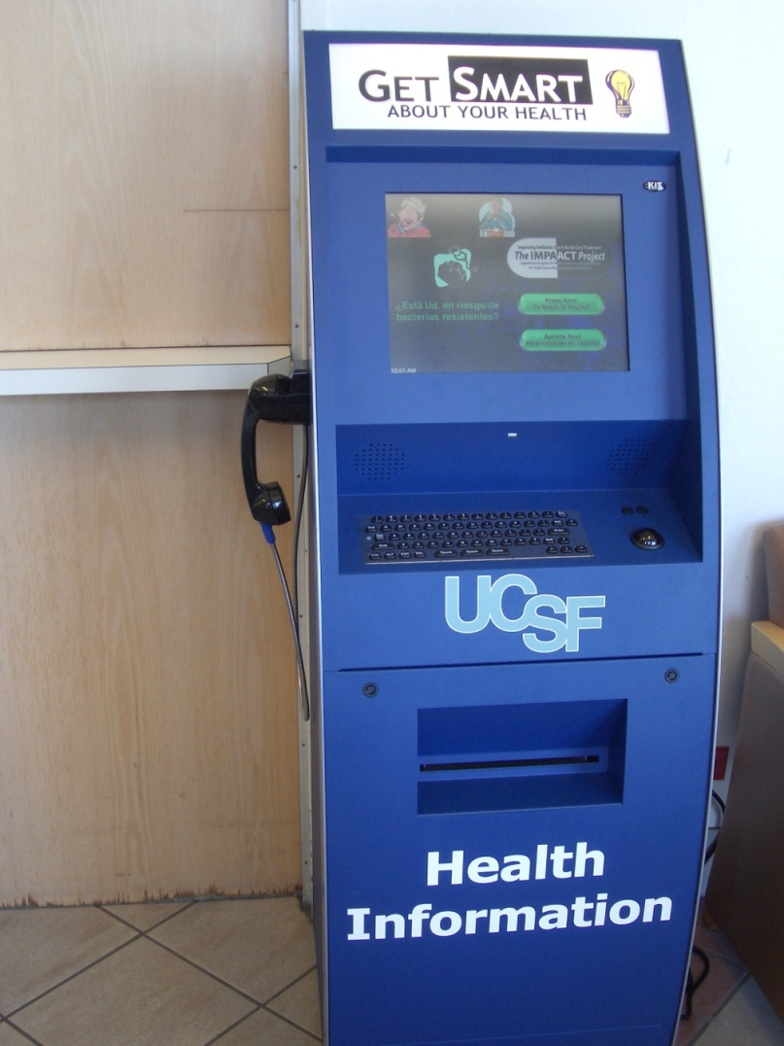
The UTI diagnostic kiosk: phase 1
  UCSF Urgent Care Clinic
  Women aged 18-64 with history of UTI
  Touchscreen and audio in Spanish and English
  40-50% eligibility for kiosk-assisted care
  Rapid & accurate dx/treatment of UTIs
  High patient & clinician satisfaction

Slide 15
Validation study
Compare clinician dx with algorithm’s dx
Patient satisfaction survey

Slide 16
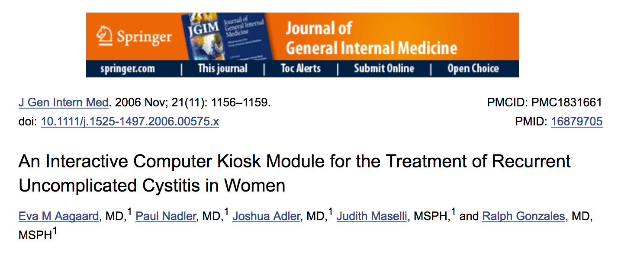

Slide 17
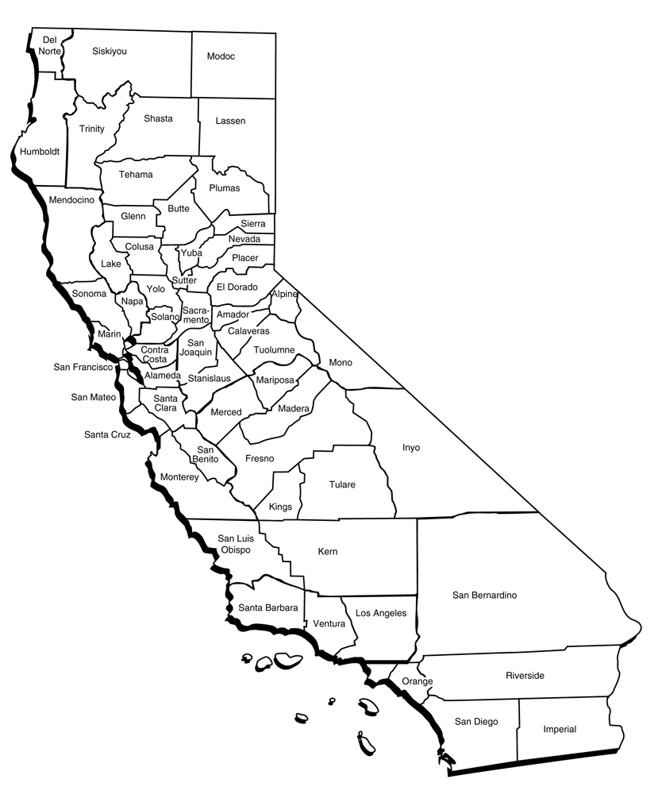
Phase 2: Implementation at 4 hospital EDs
  RCT design w/implementation strategies
    Enlist champions
    Training
  Kiosks placed in waiting rooms
  and check-in areas
  Triage staff instructed to refer all women
  w/suspected UTIs to kiosk (goal: 70%)

Slide 18

Notes:
17% eligible and randomized (n=624)
Same satisfaction as non-kiosk patients
1 hour less in ED
Accurate, efficient, safe

Slide 19
Implementation challenges
  Variable referral rates
      Solution: Reminders, incentives
  Lower-than-expected eligibility for kiosk-assisted care
      Solution: expand eligibility criteria
  By close of 3-year study, kiosks abandoned at all but 1 site

Slide 20
Evaluation
Methodology
Ethnographic approach informed by sociotechnical theory
Methods
Focus on interactions between technology, (intended) users, setting
20 hours observation
Review study findings and archives
35 interviews with ED staff, site research staff, research/design team
Notes:
Sociotechnical – technologies and their users are co-constituted, e.g. technologies actively shape and are shaped by work practices, social relations, institutions
Most interviews were in situ

Slide 21
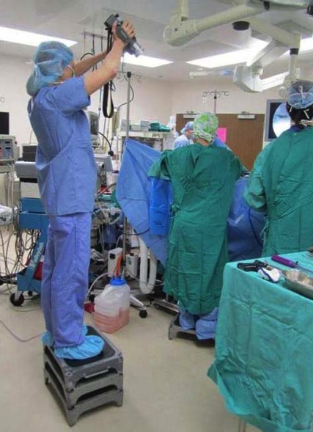
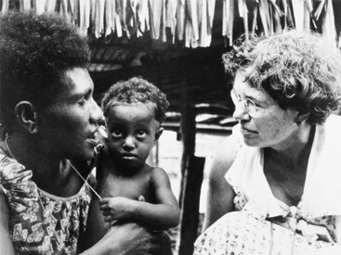
Ethnography
  Study of social groups where people live/work
  Focus on meaning-making, rules/norms, processes
  Immersive
  Often involves qual and quant methods
photo credit: http://hilobrow.com/2011/12/16/margaret-mead/
photo credit: http://www.farmpd.com/Farm-Blog/?Tag=user%20research

Slide 22
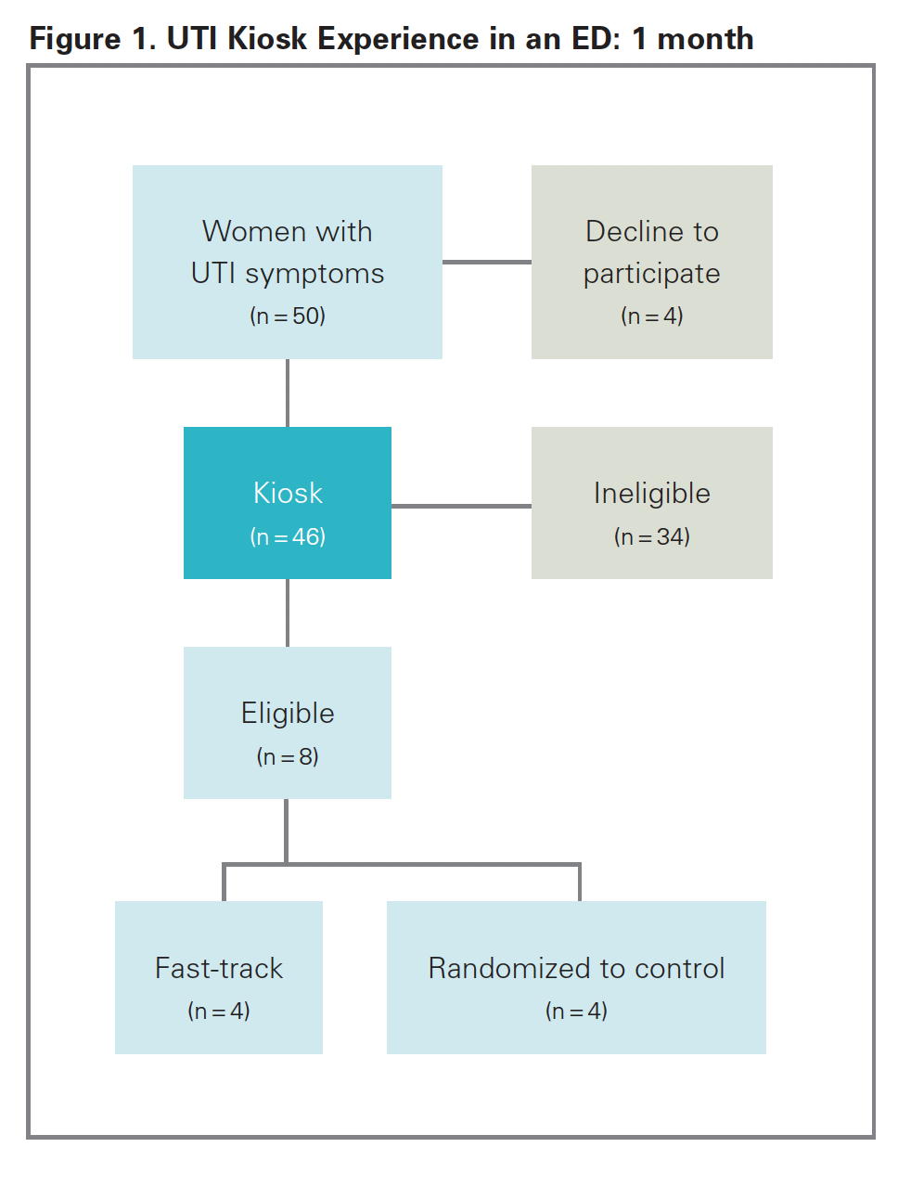

Slide 23
What we learned
  Assumptions built into device/intervention
  Simple procedure:
  - Kiosk became detour in complex, time-sensitive work routine
  - Kiosk threatened patient care ethos and institutional autonomy at one site
  Characteristics of patient population:
  % of patients w/uncomplicated UTIs in ED vs. acute care settings
  Privacy: Clinical device in public space
  Clinic hierarchy: Triage nurses are powerful actors in ED
  Study design vs. implementation
  - RCT undermined acceptability, effectiveness, reach

Slide 24
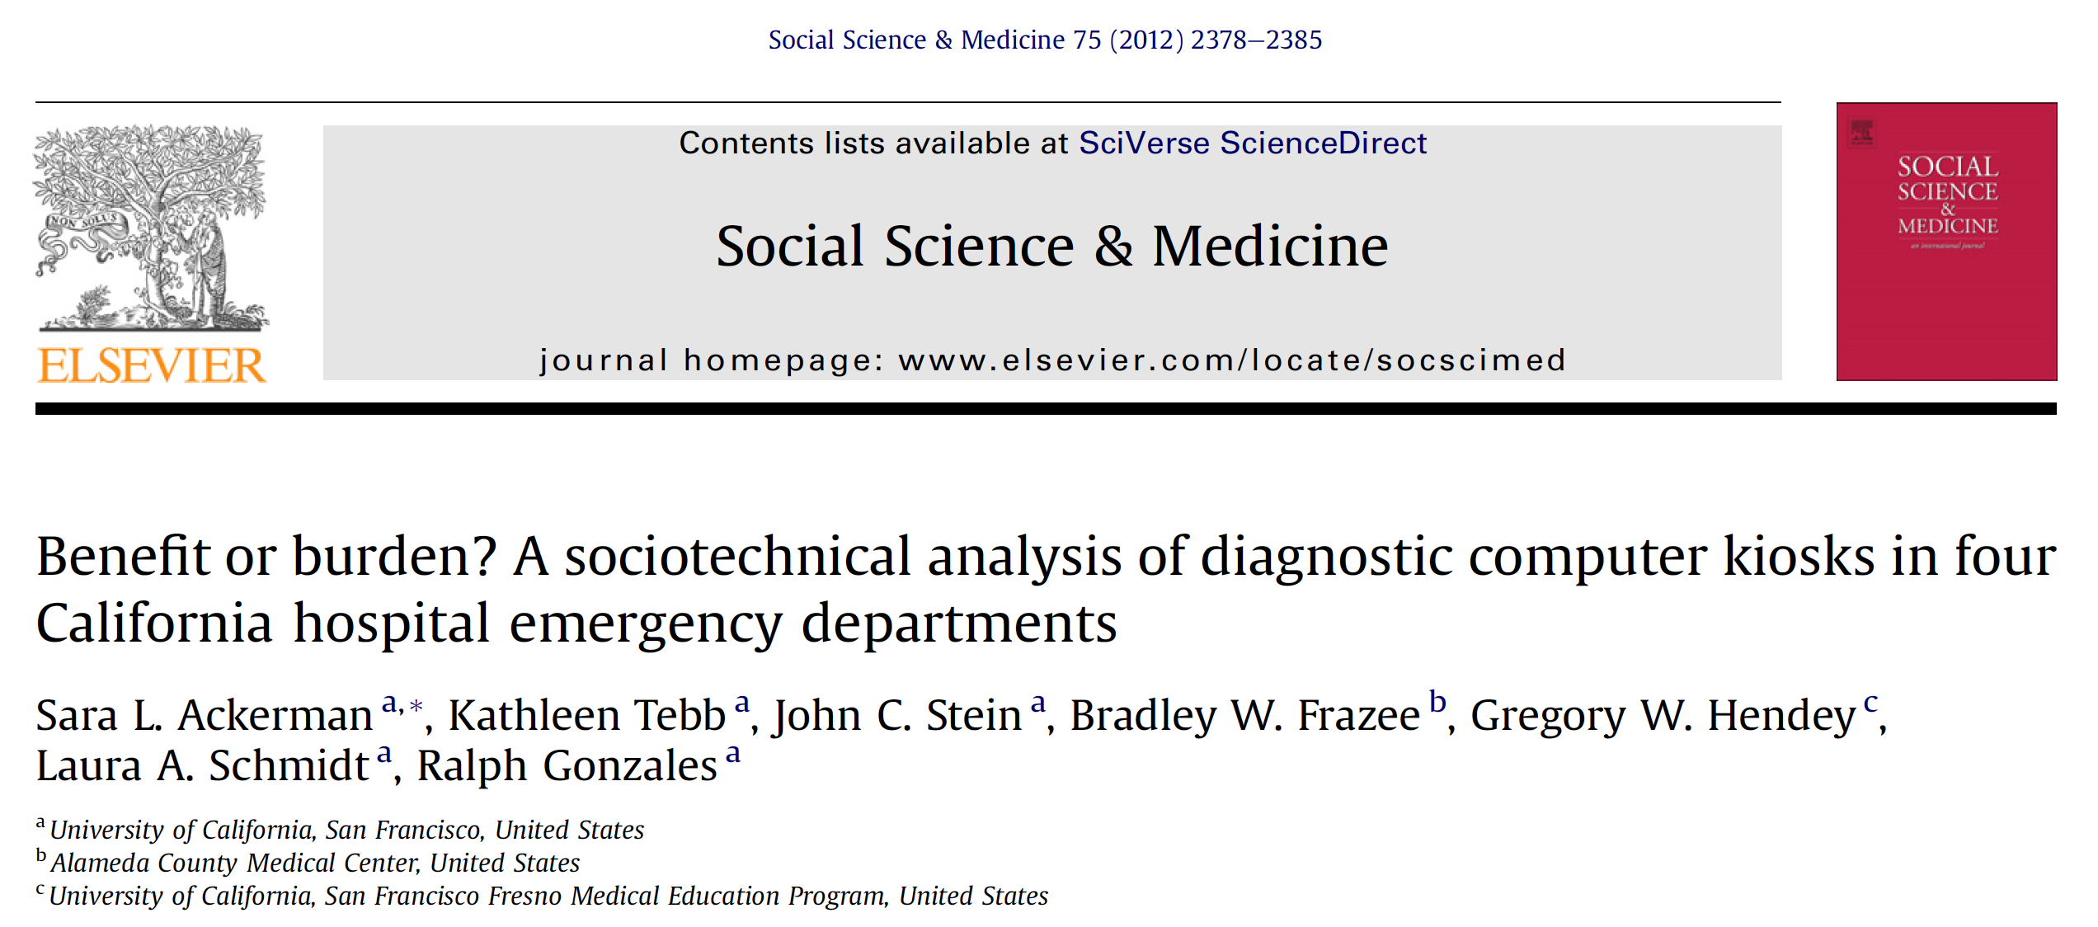

Slide 25
Methodological approach enabled insights into complex, dynamic unfolding of intervention
  Gap between how things are supposed to work and how they actually work
  Social and political dimensions of technology adoption
  Assumptions built into technologies
  Local knowledge and work routines
  Meaningful differences between apparently similar settings
  Mechanisms of change in real world settings

Slide 26
7 years later: how would we study the kiosk now?
Gap analysis
Needs assessment
Identify appropriate intervention
Adapt intervention design and implementation strategies to context
Identify and resolve implementation challenges
Assess effectiveness
Sustainability
Formative research
Process and impact evaluation

Slide 27
Mixed methods vs. methodological pluralism
Simply adding qual methods isn’t enough
Consider which methodologies and design strategies make the most sense for understanding and facilitating implementation
Creatively combining methodologies can lead to…
More relevant, acceptable and effective interventions
Deeper understanding of mechanisms of change through which program outcomes are achieved

Slide 28
The world moves quickly; baselines shift; technologies crash; actions are (variously) constrained; and certainty is elusive. The gap between the evidence-based ideal and the political and material realities of the here and now may be wide. Decisions must be made on the basis of incomplete or contested data. People use their creativity and generate adaptive solutions that make sense locally. The articulations, workarounds and muddling-through that keep the show on the road are not footnotes in the story, but its central plot. They should be carefully studied and represented
in all their richness.
  - Trish Greenhalgh 2018

Slide 29
Thank you!

