Slide 1
Machine Learning in R
Lecture 1 – Introduction
John Kornak – Epidemiology and Biostatistics
john.kornak@ucsf.edu

Slide 2
Logistics
Lectures every Thursday, 1.00-2.30 (Mission Hall Room 1407: 4/4, 4/11, 4/18, 5/16, 5/23, 5/30 and 6/6; Genentech North 114: 4/25, 5/2, 5/9)
Labs every Thursday in same room as lecture, 2.45-3.45
Structured discussion sessions: 4/11, 4/25, 5/9, and 5/23, 3.45-4.45
Lectures are to be recorded and posted online
Grades based on 5 hw assignments (70%) + data analysis project (30%, due 5/30/19)
Check materials online at CLE (and Biostat 216 discussion forum)

Slide 3
Data Analysis Project
You will need to perform a data analysis project as part of the course (30% contribution to grade)
You will be provided with datasets and suggestions as to how to proceed
However, if you are particularly confident you have the option to work with your own dataset

Slide 4
R, RStudio, and R packages
You need to have R installed on your laptop: www.cran.org -current version is R 3.5.3.
I also recommend that you install RStudio and run R from within Rstudio: www.rstudio.com/products/RStudio/
We will be installing multiple machine learning packages for R and we will do that as we go along. This is easy to do with the install.packages(“package_name”) command in R
Try to install a package, e.g. the lme4 package with install.packages("lme4") to make sure that you don’t have any problems

Slide 5
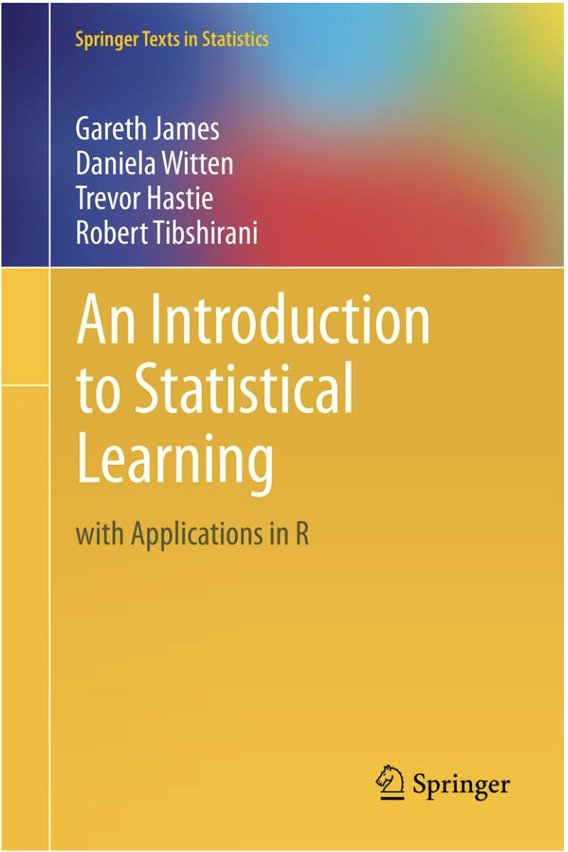
Texts
Parts of this course borrow from An Introduction to Statistical Learning, and associated lectures. James et al., available for free at: https://www-bcf.usc.edu/~gareth/ISL/
Also useful is the more technical Elements of Statistical Learning: http://web.stanford.edu/~hastie/ElemStatLearn/ (again, available free)
There is a myriad of Machine Learning in R books (of varying quality), many of which are available free via UCSF electronic library.

Slide 6
TICR Professional Conduct Statement – clarifications for this class
I will maintain the highest standards of academic honesty
I will not use answer keys from prior years
Problem Sets and Projects: I am permitted to consult with other classmates, but I will write final answers in my own words away from other classmates

Slide 7
Course objectives
Generate intuition and mechanistic understanding for a set of important machine learning methods
Gain insight as to which methods are most appropriate in which situations
Learn best practices in machine learning
Discover potential pitfalls to avoid in machine learning
Enable practical implementation of machine learning methods covered in R

Slide 8
Topics covered in this course
What is machine learning: supervised vs. unsupervised learning
Model choice, evaluation and comparison
Supervised machine learning methods
  Support vector machines
  Classification and regression trees / random forests
  Boosting and gradient boosting
  Penalized regression
Unsupervised machine learning methods
  Clustering algorithms
  Dimension reduction algorithms
Applications in biomedical problems
rtemis meta-package

Slide 9
In this lecture:
What is Machine Learning?
Supervised vs. Unsupervised learning
Introduction to prediction techniques for supervised learning with continuous outcomes:
  Local estimation and nearest neighbors
  Loss functions and mean square error
  The training-test paradigm
  The curse of dimensionality
  Linear regression modeling (including polynomials)
  Some trade-offs

Slide 10
Machine Learning Definitions
No well accepted definition
Machine learning is a subfield of computer science that evolved from the study of pattern recognition and computational learning theory in artificial intelligence.
In 1959, Arthur Samuel defined machine learning as a “Field of study that gives computers the ability to learn without being explicitly programmed”
Tom Mitchell in 1998 defined Machine Learning via “A computer program is said to learn from experience E with respect to some task T and some performance measure P, if its performance on T, as measured by P, improves with experience E.”
Machine learning is a type of artificial intelligence (AI) that provides computers with the ability to learn without being explicitly programmed. Machine learning focuses on the development of computer programs that can teach themselves to grow and change when exposed to new data.
Focus on prediction or identifying patterns in data.
Machine learning problems broadly split into Supervised and Unsupervised learning problems
Note that the term “Statistical Learning” is used in ISLR – difficult to define a clear difference

Slide 11
Machine learning problems in biomedicine
Predict disease-free survival times of patients breast cancer surgery based on diagnostic measures, demographic variables and genetic information
Determine whether there are distinct subgroups of patients with anxiety and depression that may have different patterns of progression
Automatically label patients as different types of dementia based on neuropsychological testing scores

Slide 12
Supervised vs. Unsupervised Learning
Supervised Learning
Have data where you know outcome in order to train the model
Train the model to predict future outcomes from sets of predictors
Unsupervised Learning
No specified outcomes
Separate data points into groups with “similar” properties (clustering)
Or reduce data to fewer variables in some way that still captures important structure of the data
Prediction: Regression (continuous outcomes) and classification (categorical outcomes)
Clustering and dimension reduction

Slide 13
Supervised vs. unsupervised
Machine Learning
Supervised
Regression (continuous outcome)
Classification (categorical outcome)
Unsupervised
Clustering
(grouping observations)
Data Reduction (transforming variables)
Survival outcome
Outcome observed
No outcome

Slide 14
Machine learning problems in biomedicine
Predict disease-free survival times of patients breast cancer surgery based on diagnostic measures, demographic variables and genetic information
Determine whether there are distinct subgroups of patients with anxiety and depression that may have different patterns of progression
Automatically label patients as different types of dementia based on neuropsychological testing scores

Slide 15
Machine learning problems in biomedicine
Predict disease-free survival times of patients breast cancer surgery based on diagnostic measures, demographic variables and genetic information (supervised)
Determine whether there are distinct subgroups of patients with anxiety and depression that may have different patterns of progression (unsupervised)
Automatically label patients as different types of dementia based on neuropsychological testing scores (supervised and unsupervised)

Slide 16
Supervised Regression -- Predictive Models
You have seen linear, logistic and Cox proportional hazards models in previous courses that fit this framework depending on outcome type – continuous outcome (linear), binary outcome (logistic), survival (Cox proportional hazards)
Predictors
Model
Outcome

Slide 17
General supervised learning
Predictors
In supervised machine learning we generalize the model part to “model, algorithm, or procedure”
Model, algorithm, or procedure
Outcome

Slide 18
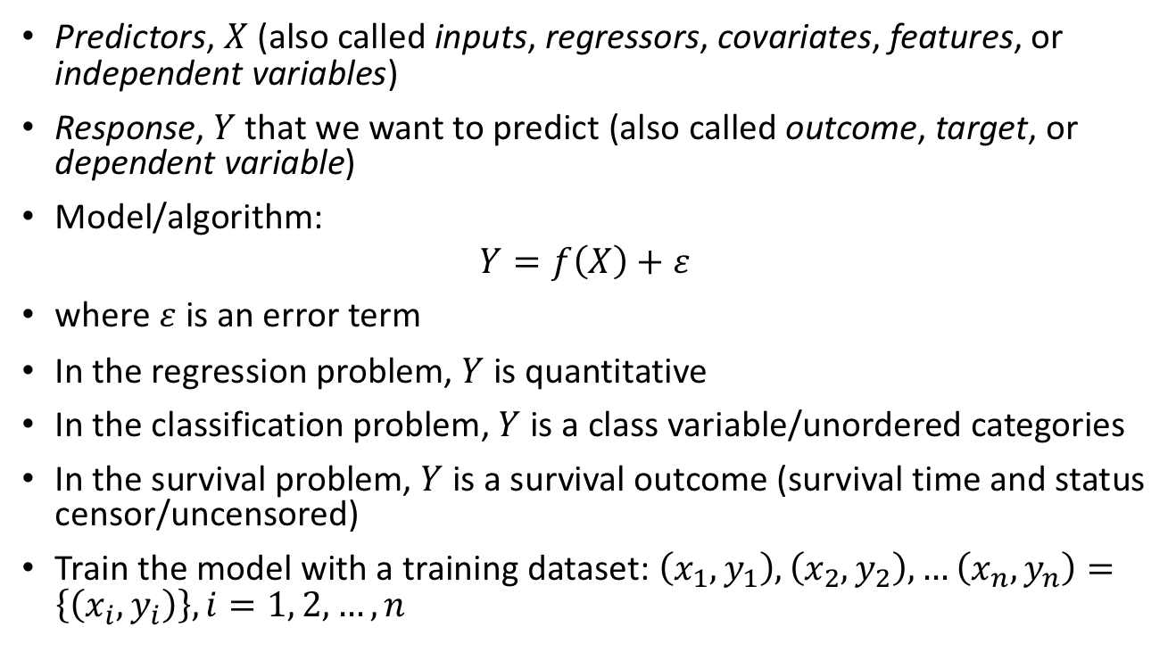
Supervised prediction
Predictors, $X$ (also called inputs, regressors, covariates, features, or independent variables)
Response, $Y$ that we want to predict (also called outcome, target, or dependent variable)
Model/algorithm:
$$Y=f\left(X\right)+ε$$
where $ε$ is an error term
In the regression problem, $Y$ is quantitative
In the classification problem, $Y$ is a class variable/unordered categories
In the survival problem, $Y$ is a survival outcome (survival time and status censor/uncensored)
Train the model with a training dataset: $\left(x_{1},y_{1}\right),\left(x_{2},y_{2}\right), …\left(x_{n},y_{n}\right)=\left\{\left(x_{i},y_{i}\right)\right\}, i=1, 2,…,n$

Slide 19
Supervised prediction objectives
Build a model/algorithm that can:
Predict unknown future responses/outcomes
Determine which predictors/inputs affect the outcome, and how
Inform as to the quality of predictions and inferences

Slide 20
Unsupervised learning
No responses, just a set of variables/predictors/features measured on a set of samples
Objective can be:
  Clustering: find groups for which predictors follow a more similar pattern (correlated) than between groups
  Dimension reduction: find ways to reduce the information in a large set of predictors to something more manageable – ideally, such that you get new features that are interpretable

Slide 21
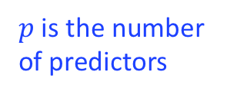
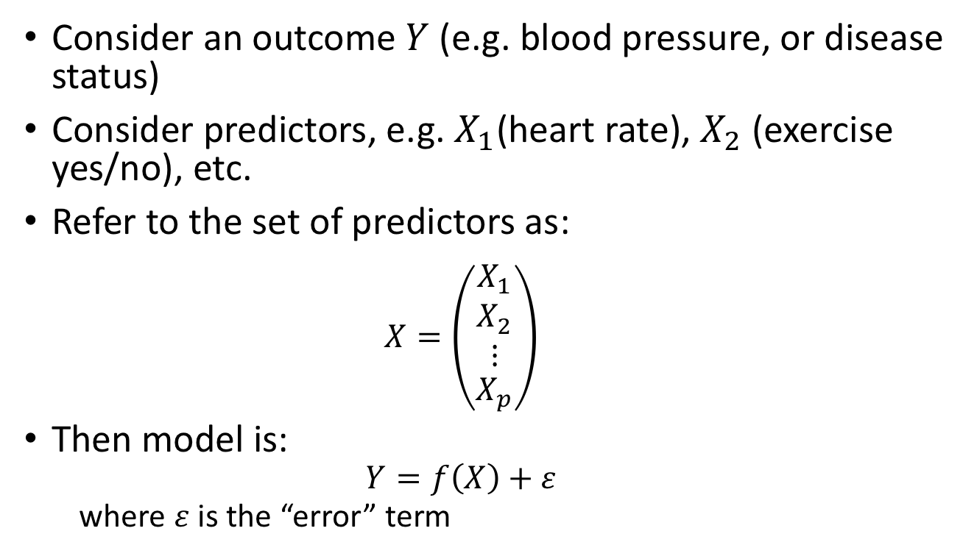
Back to supervised learning: notation
Consider an outcome $Y$ (e.g. blood pressure, or disease status)
Consider predictors, e.g. $X_{1}$(heart rate), $X_{2}$ (exercise yes/no), etc.
Refer to the set of predictors as:
  $$X=\left(\begin{aligned}\begin{matrix}X_{1} \\ X_{2} \\ ⋮\end{matrix} \\ X_{p}\end{aligned}\right)$$
Then model is:
  $$Y=f\left(X\right)+ε$$
  where $ε$ is the “error” term
$p$ is the number of predictors

Slide 22
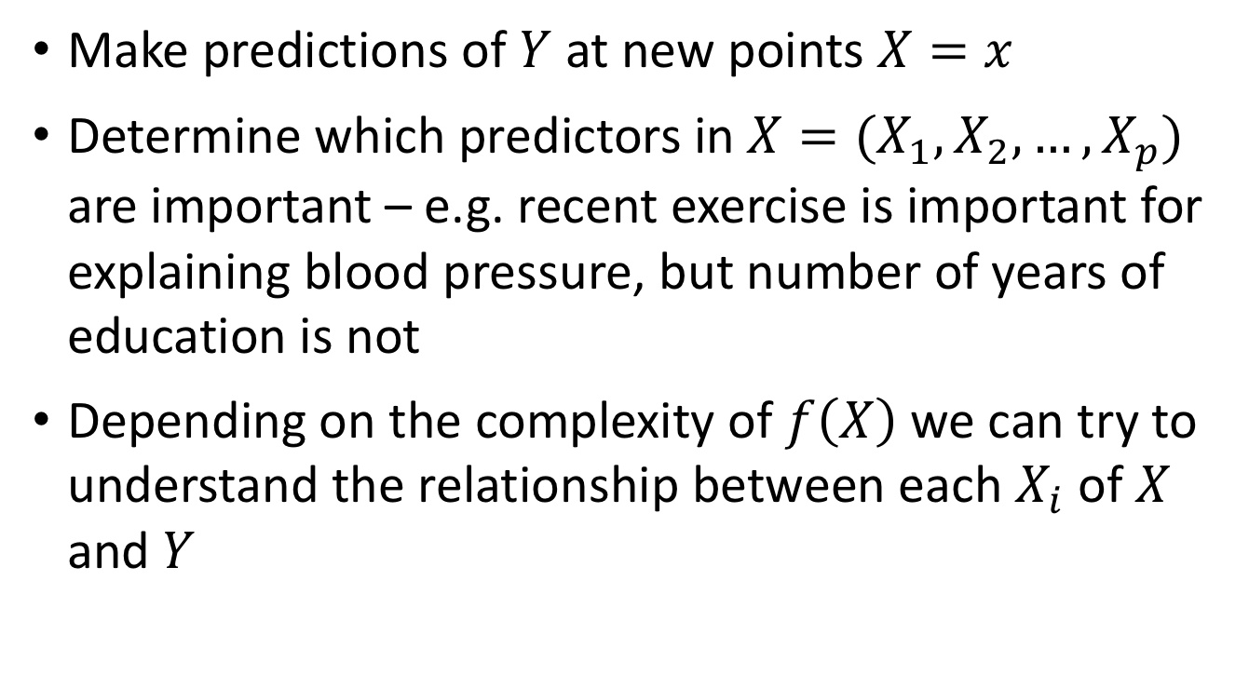

What do we do with $f(X)$?
Make predictions of $Y$ at new points $X=x$
Determine which predictors in $X=(X_{1},X_{2},…,X_{p})$ are important – e.g. recent exercise is important for explaining blood pressure, but number of years of education is not
Depending on the complexity of $f\left(X\right)$ we can try to understand the relationship between each $X_{i}$ of $X$ and $Y$

Slide 23
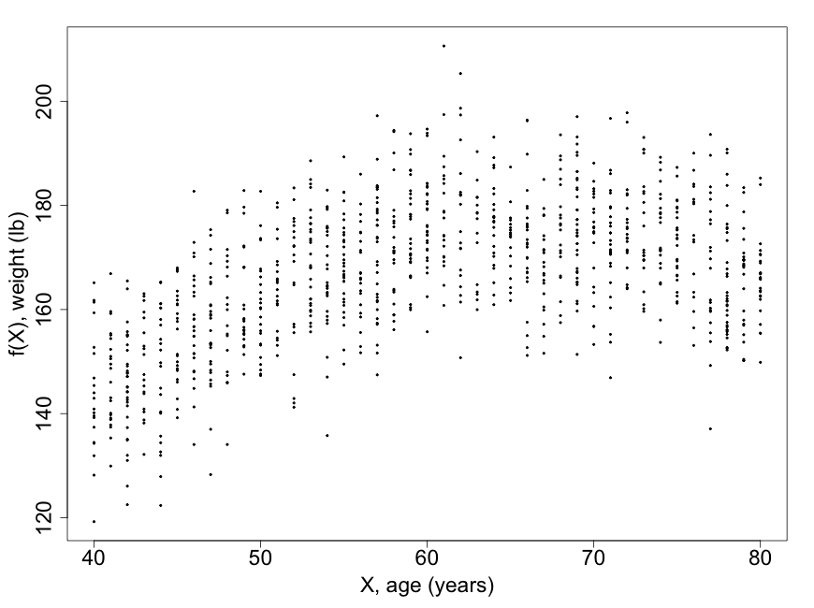

What makes a good estimate of $f\left(X\right)?$
Consider supervised learning with a continuous outcome and a single predictor
Training data

Slide 24
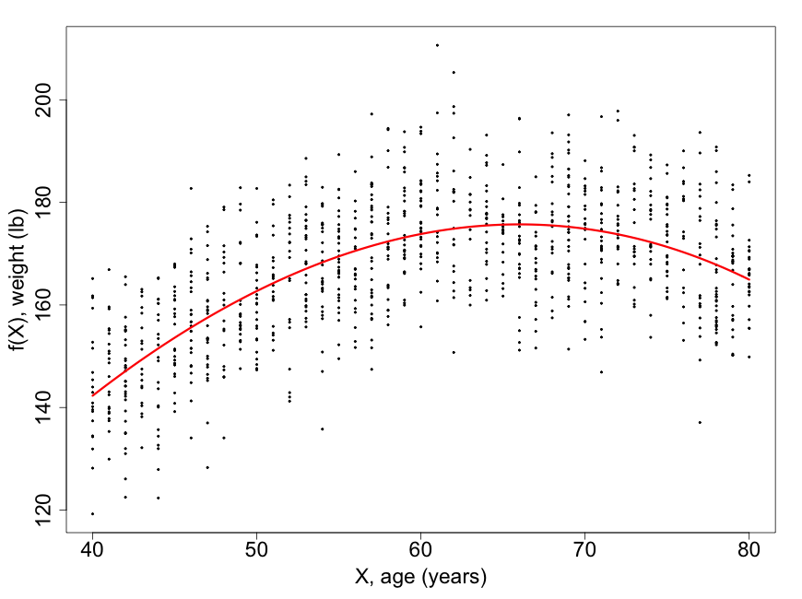
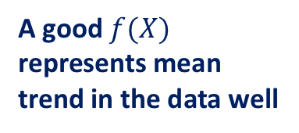
What makes a good estimate of $f\left(X\right)?$
Consider supervised learning with a continuous outcome and a single predictor
A good $f(X)$ represents mean trend in the data well
Training data

Slide 25
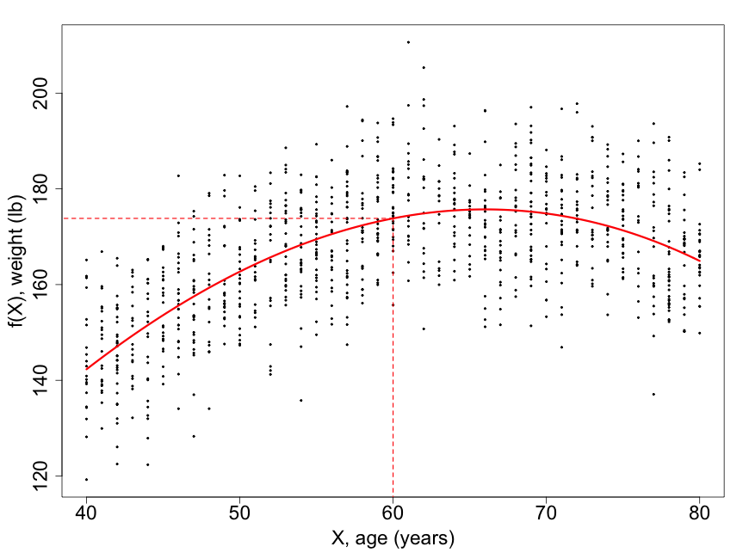
What makes a good estimate of $f\left(X\right)?$
Consider supervised learning with a continuous outcome and a single predictor
A good $f(X)$ represents mean trend in the data well
173.8 lb
Training data
Does a good job (intuitively) of making a prediction

Slide 26
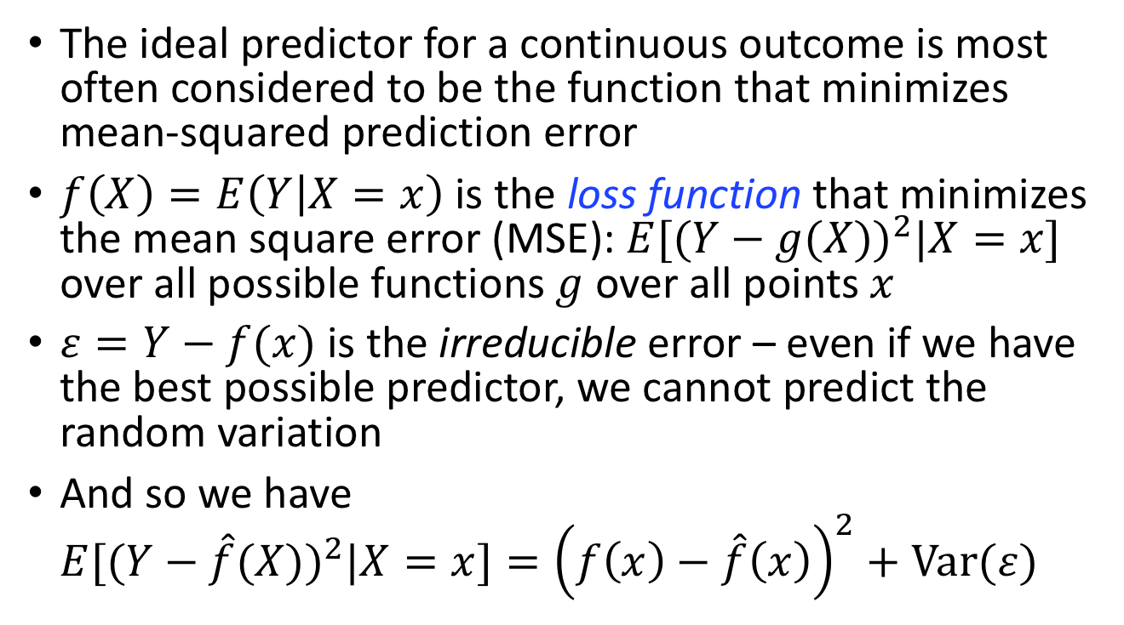
What makes a good estimate of $f\left(X\right)?$
The ideal predictor for a continuous outcome is most often considered to be the function that minimizes mean-squared prediction error
$f\left(X\right)=E\left(Y | X=x\right)$ is the loss function that minimizes the mean square error (MSE): $E[(Y−{g(X))}^{2}|X=x]$ over all possible functions $g$ over all points $x$
$ε=Y−f(x)$ is the irreducible error – even if we have the best possible predictor, we cannot predict the random variation
And so we have $E[(Y−{\hat{f}(X))}^{2}|X=x]={\left(f\left(x\right)−\hat{f}\left(x\right)\right)}^{2}+Var(ε)$
^ = estimate
Reducible
Irreducible
Represents mean trend in the data well

Slide 27
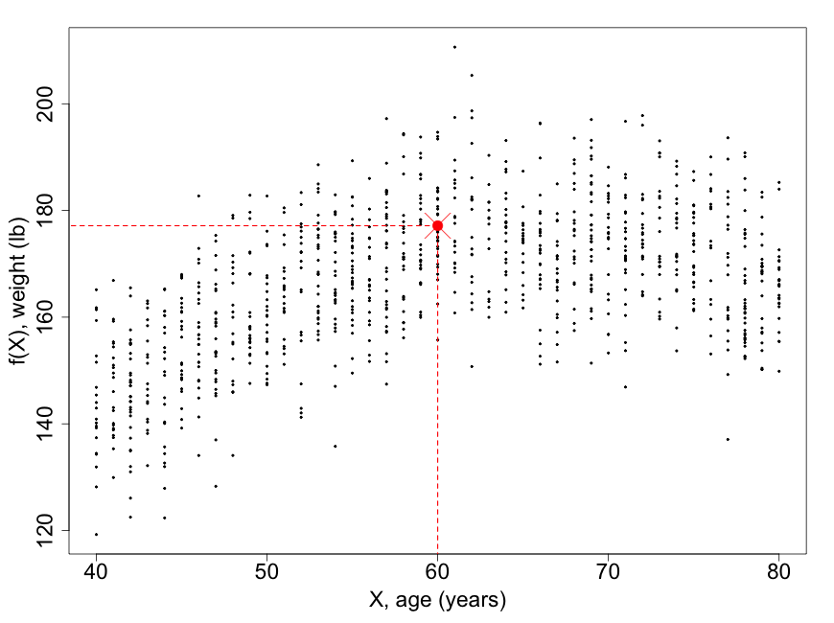


What can we choose for $\hat{f}\left(X\right)?$
We could choose $\hat{f}\left(X\right)=E\left(Y | X=x\right)$ calculated at each age, e.g. estimate $\hat{f}(60)$ as the mean weight of age 60 individuals
Training data

Slide 28
What can we choose for $\hat{f}\left(X\right)?$
We could choose $\hat{f}\left(X\right)=E\left(Y | X=x\right)$ calculated at each age, e.g. estimate $\hat{f}(60)$ as the mean weight of age 60 individuals
177.1 lb
Training data

Slide 29
What can we choose for $\hat{f}\left(X\right)?$
We could choose $\hat{f}\left(X\right)=E\left(Y | X=x\right)$ calculated at each age, e.g. estimate $\hat{f}(60)$ as the mean weight of age 60 individuals
177.1 lb
173.8 lb
Training data

Slide 30
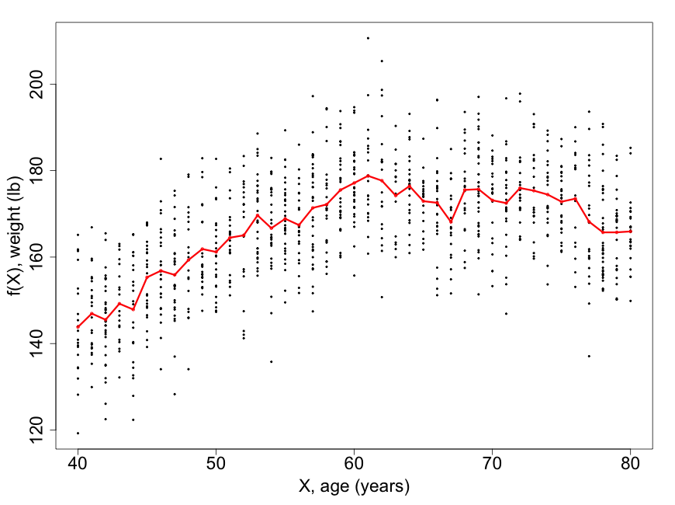

Local expectation
So try $\hat{f}\left(X\right)=E\left(Y | X=x\right)$ at all ages…
Training data

Slide 31
What can we choose for $\hat{f}\left(X\right)?$
Tracks true curve pretty well, but “noisy”
177.1 lb
173.8 lb
Training data

Slide 32
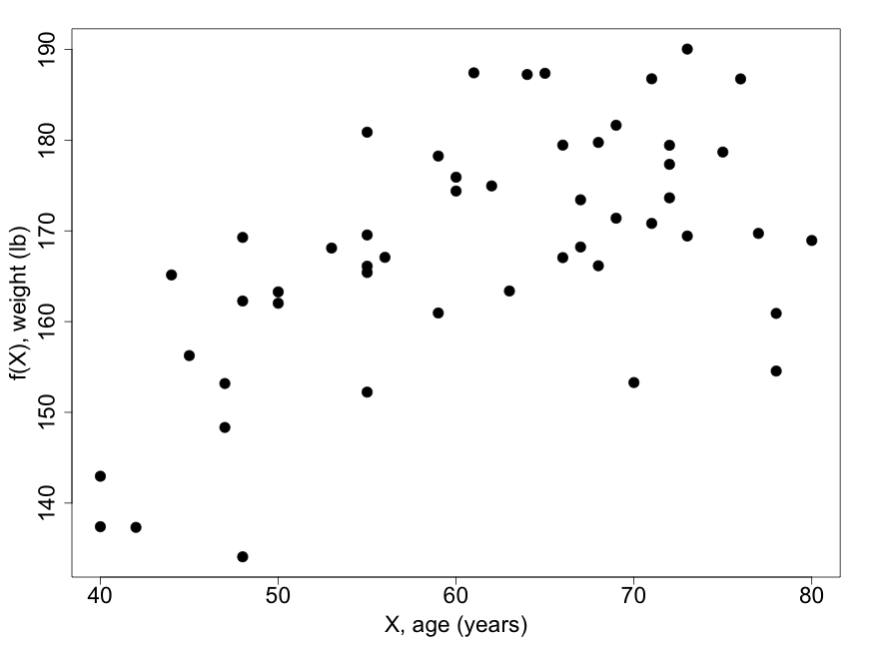
Local expectation
And what if we have less data?
Training data

Slide 33
Local expectation
But what if we have less data?
Training data
Few points = noisy estimate

Slide 34
Local expectation
But what if we have less data?
No points = no estimate
Training data
Few points = noisy estimate

Slide 35
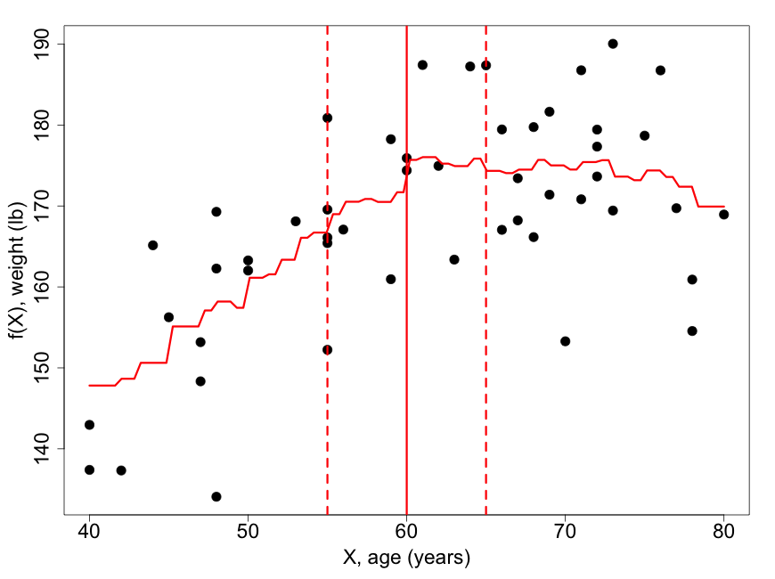

Kernel estimation/smoothing
We can “average” over a neighborhood of $X$,…
ksmooth(x, y, kernel = "box”, bandwidth = 10)
Training data
Bandwidth

Slide 36
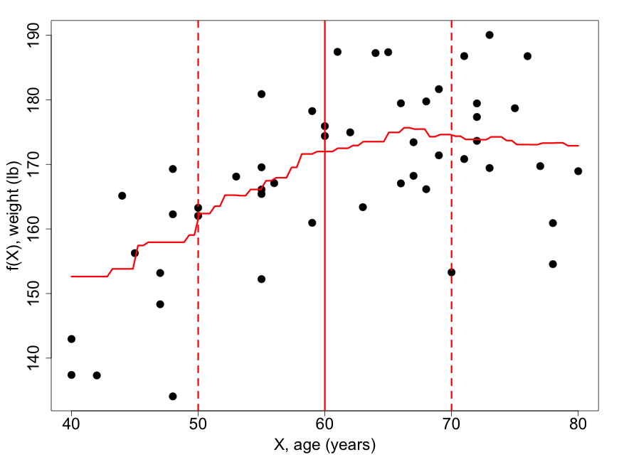

Kernel estimation
We can average over a neighborhood of $X$,…
Ksmooth(x, y, kernel = "box”, bandwidth = 20)
Training data
Bandwidth

Slide 37
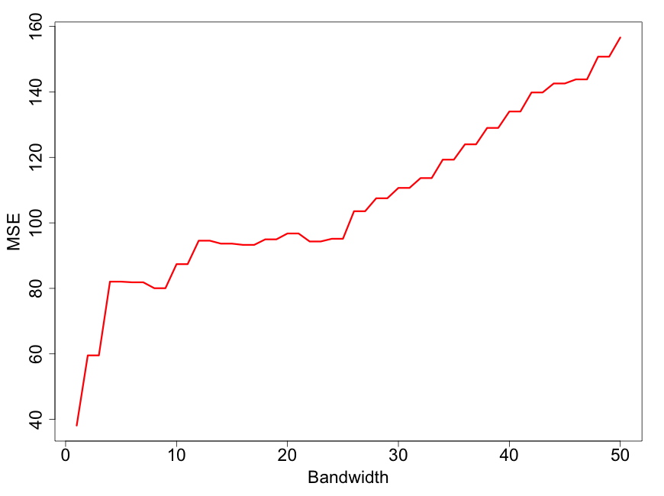

How to choose the bandwidth?
We can try different values of the bandwidth and figure out which value gives us the smallest MSE: $E[(Y−{g(X))}^{2}|X=x]$

Slide 38
How to choose the bandwidth?
We can try different values of the bandwidth and figure out which value gives us the smallest MSE: $E[(Y−{g(X))}^{2}|X=x]$
Overfitting?

Slide 39
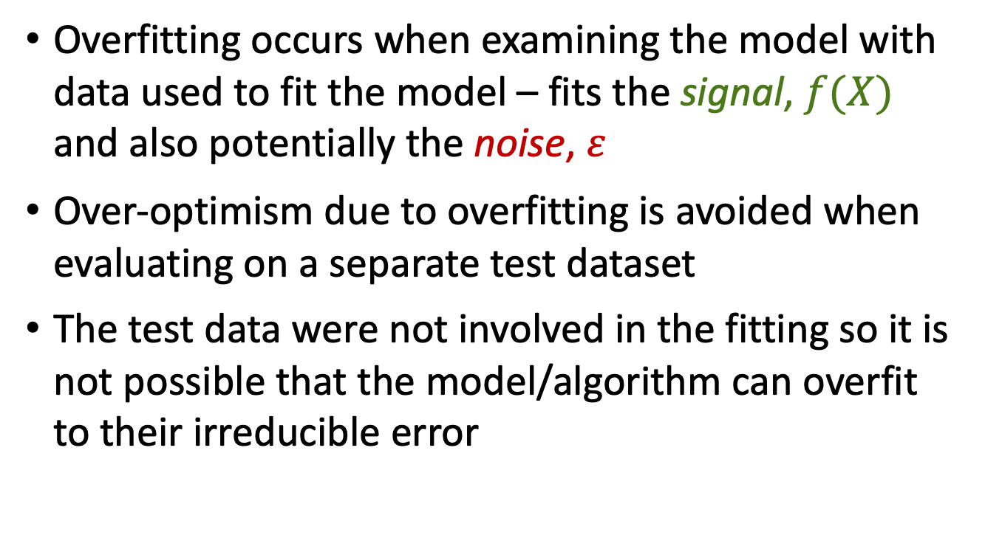
Evaluate on independent test set
Overfitting occurs when examining the model with data used to fit the model – fits the signal, $f(X)$ and also potentially the noise, $ε$
Over-optimism due to overfitting is avoided when evaluating on a separate test dataset
The test data were not involved in the fitting so it is not possible that the model/algorithm can overfit to their irreducible error

Slide 40
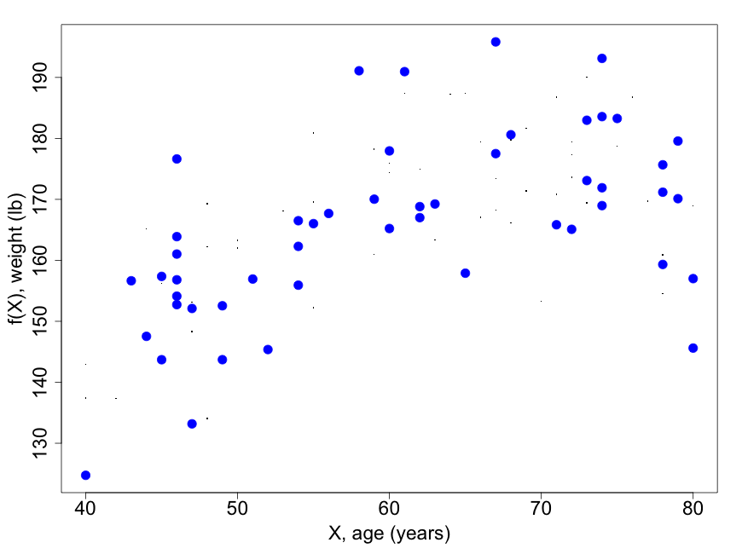
Evaluate on independent test set
Test dataset independently generated from the same model as the training data (similar to if I went out and collected more data of the same type)

Slide 41
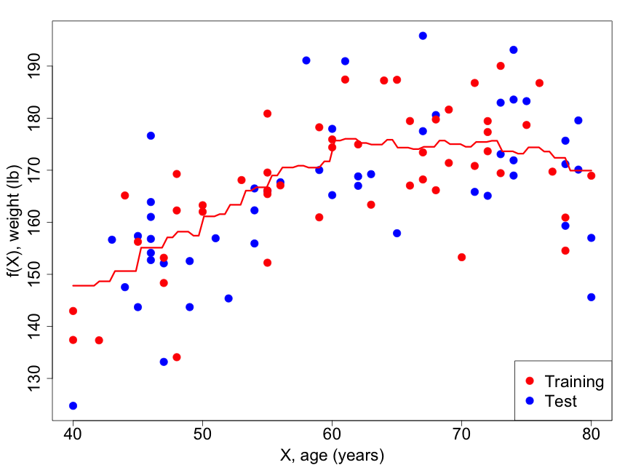
Evaluate on independent test set
Test dataset independently generated from the same model as the training data (similar to if I went out and collected more data of the same type)
Take kernel fit to training data and evaluate on test data (w.r.t. MSE)

Slide 42
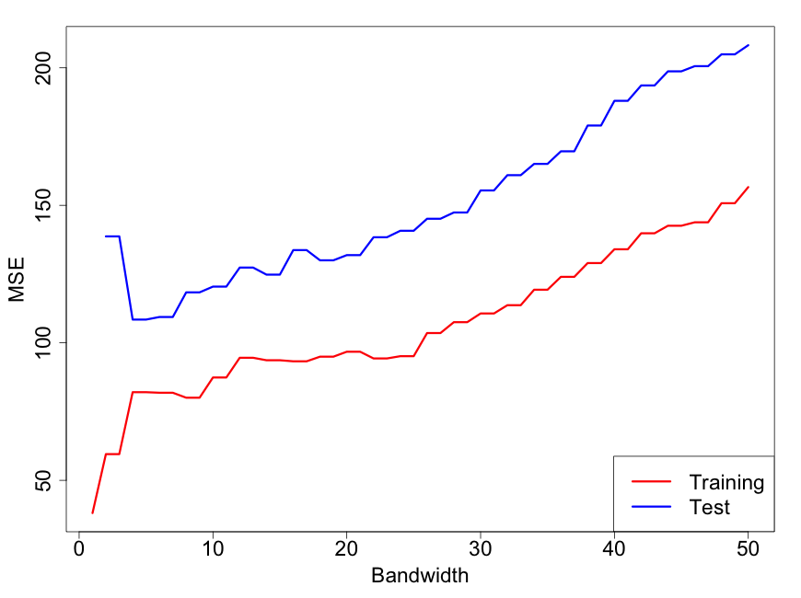

How to choose the bandwidth?
We can try different values of the bandwidth and figure out which value gives us the smallest MSE on the test set: $E[(Y−{g(X))}^{2}|X=x]$

Slide 43
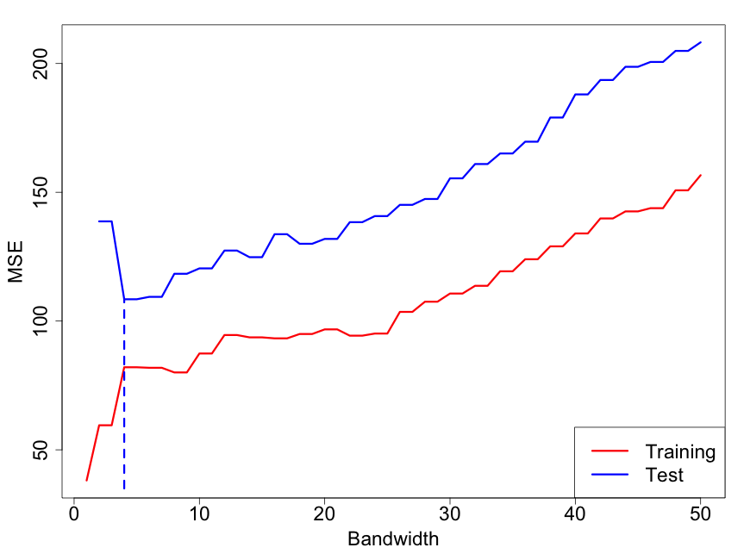
How to choose the bandwidth?
We can try different values of the bandwidth and figure out which value gives us the smallest MSE on the test set: $E[(Y−{g(X))}^{2}|X=x]$
MSE at minimum = 108.5
Bandwidth for minimum MSE = 4

Slide 44
How to choose the bandwidth?
We can try different values of the bandwidth and figure out which value gives us the smallest MSE on the test set: $E[(Y−{g(X))}^{2}|X=x]$
MSE at minimum = 108.5
This is an example of independent testing
Bandwidth for minimum MSE = 4

Slide 45
How to choose the bandwidth?
We can try different values of the bandwidth and figure out which value gives us the smallest MSE on the test set: $E[(Y−{g(X))}^{2}|X=x]$
MSE at minimum = 108.5
Finding the minimum of a loss function such as MSE is a common computational problem in machine learning
This is an example of independent testing
Bandwidth for minimum MSE = 4

Slide 46
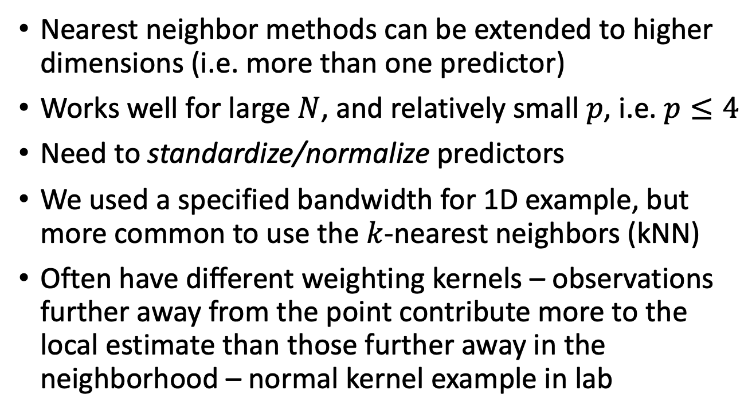
What if we want to do smoothing with 2 or more predictors?
Nearest neighbor methods can be extended to higher dimensions (i.e. more than one predictor)
Works well for large $N$, and relatively small $p$, i.e. $p≤4$
Need to standardize/normalize predictors
We used a specified bandwidth for 1D example, but more common to use the $k$-nearest neighbors (kNN)
Often have different weighting kernels – observations further away from the point contribute more to the local estimate than those further away in the neighborhood – normal kernel example in lab

Slide 47
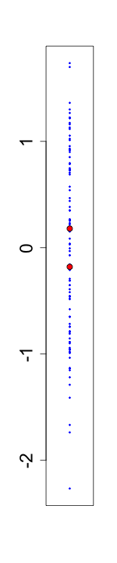
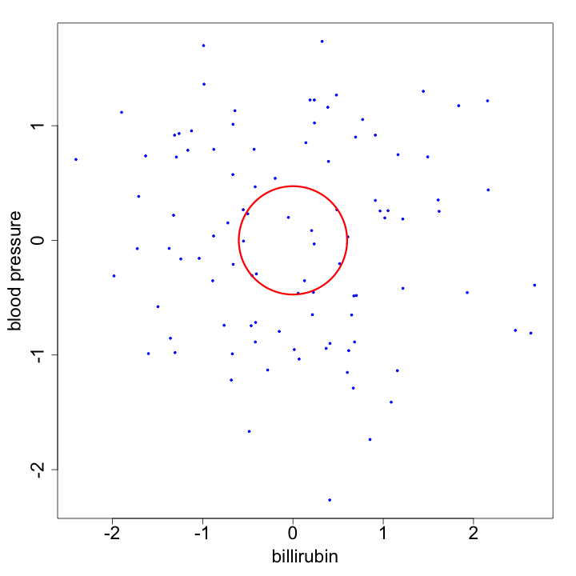
Curse of dimensionality
100 data points
Standardized on each axis
Compare size of kernel needed to capture 10 points in each of 1D and 2D cases

Slide 48
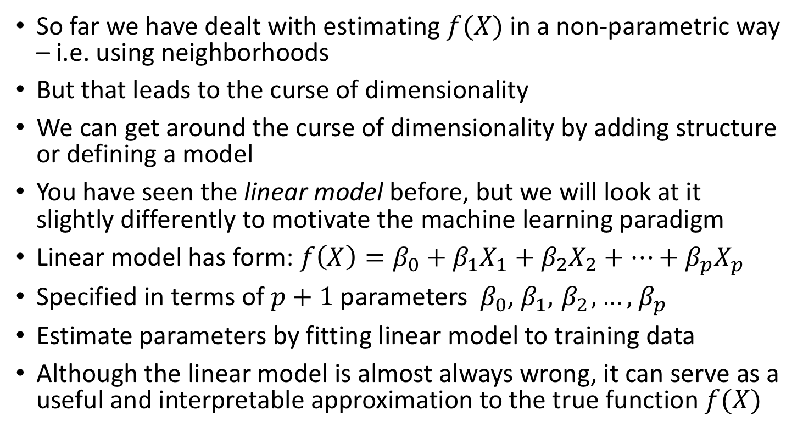
Linear model
So far we have dealt with estimating $f(X)$ in a non-parametric way – i.e. using neighborhoods
But that leads to the curse of dimensionality
We can get around the curse of dimensionality by adding structure or defining a model
You have seen the linear model before, but we will look at it slightly differently to motivate the machine learning paradigm
Linear model has form: $f\left(X\right)=β_{0}+β_{1}X_{1}+β_{2}X_{2}+…+β_{p}X_{p}$
Specified in terms of $p+1$ parameters ${{ β}_{0}\text{,} β}_{1},{ β}_{2},…,{ β}_{p}$
Estimate parameters by fitting linear model to training data
Although the linear model is almost always wrong, it can serve as a useful and interpretable approximation to the true function $f(X)$

Slide 49
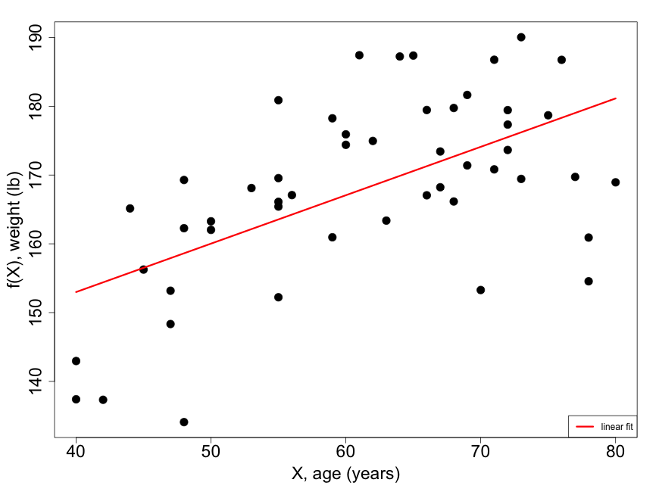
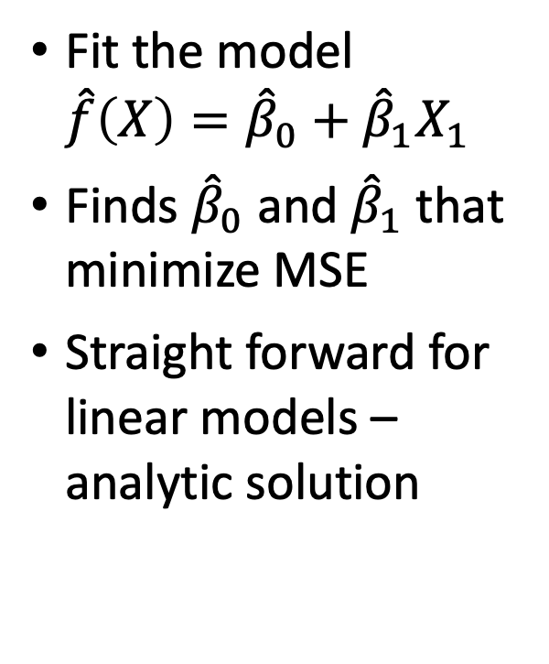
Linear model – linear
Fit the model $\hat{f}\left(X\right)={\hat{β}}_{0}+{\hat{β}}_{1}X_{1}$
Finds ${\hat{β}}_{0}$ and ${\hat{β}}_{1}$ that minimize MSE
Straight forward for linear models – analytic solution

Slide 50
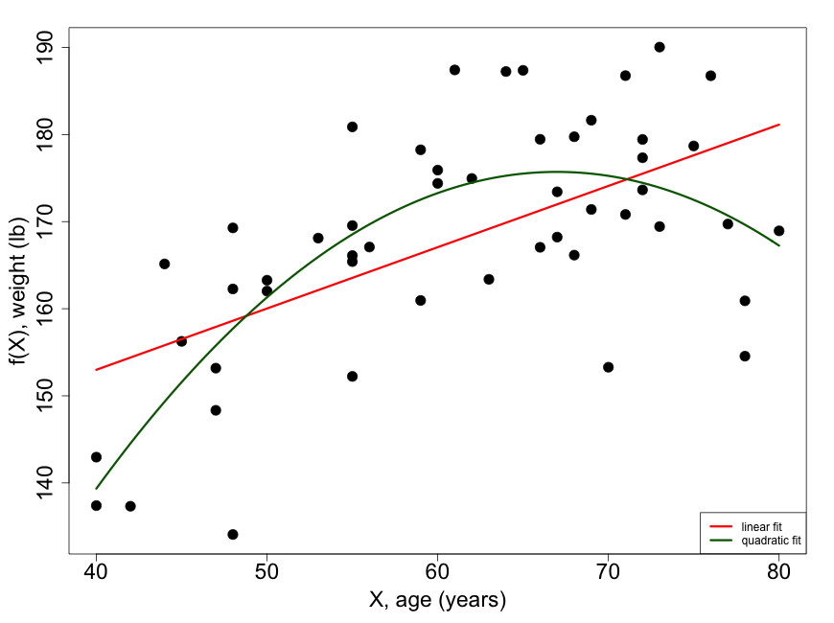

Linear model – quadratic
$\hat{f}\left(X\right)={\hat{β}}_{0}+{\hat{β}}_{1}X_{1}+{\hat{β}}_{2}X_{2}$

Slide 51
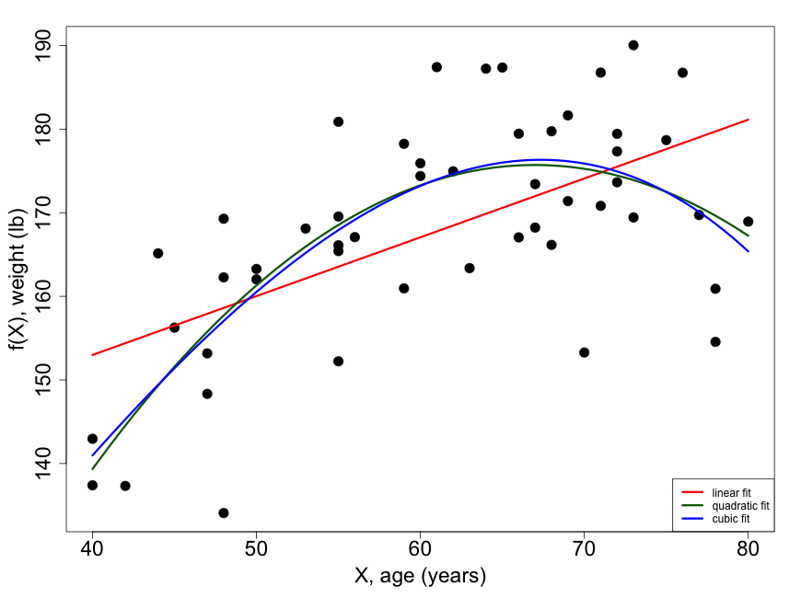

Linear model – cubic
$\hat{f}\left(X\right)={\hat{β}}_{0}+{\hat{β}}_{1}X_{1}+{\hat{β}}_{2}X_{2}+{\hat{β}}_{3}X_{3}$

Slide 52
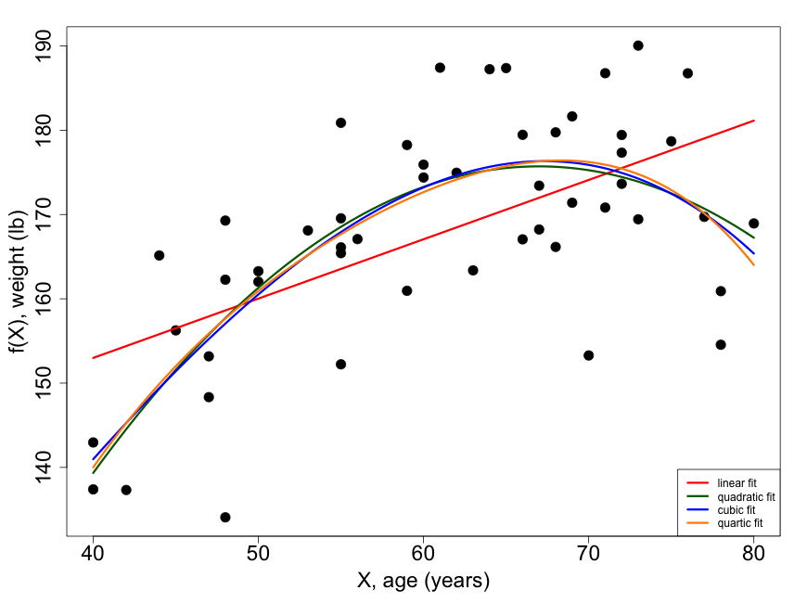

Linear model – quartic
$\hat{f}\left(X\right)={\hat{β}}_{0}+{\hat{β}}_{1}X_{1}+{\hat{β}}_{2}X_{2}+{\hat{β}}_{3}X_{3}+{\hat{β}}_{4}X_{4}$

Slide 53
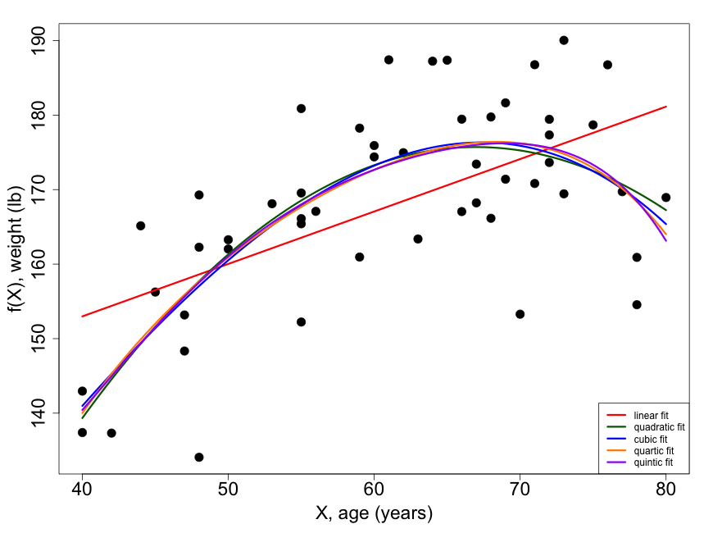

Linear model – quintic
$\hat{f}\left(X\right)={\hat{β}}_{0}+{\hat{β}}_{1}X_{1}+{\hat{β}}_{2}X_{2}+{\hat{β}}_{3}X_{3}+{\hat{β}}_{4}X_{4}+{\hat{β}}_{5}X_{5}$

Slide 54
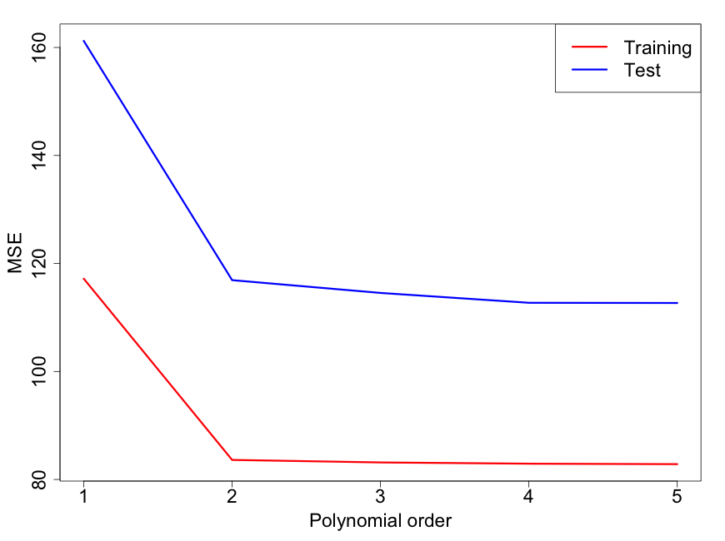
Which order polynomial to pick?

Slide 55
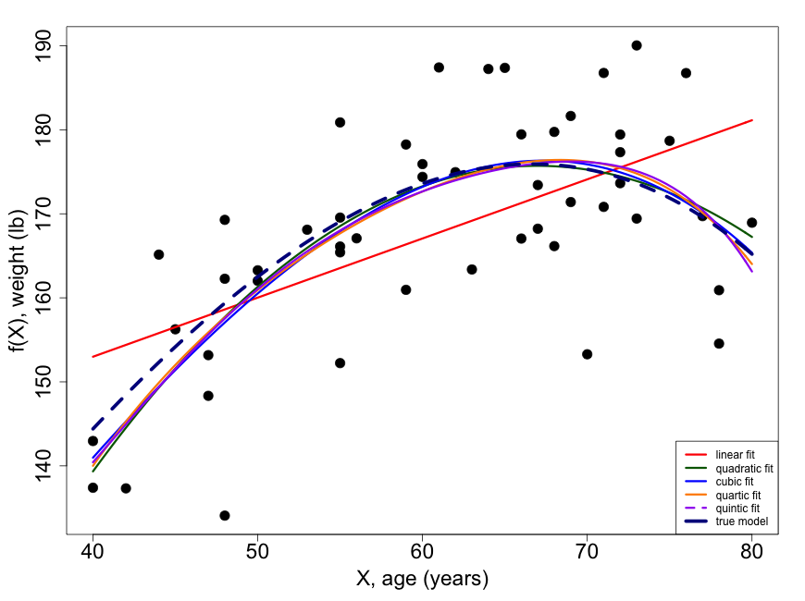
The truth was cubic
Trade off between complexity and fit in the test data
Would like a simple model
Would like good fit to test data
For this data quadratic looked good enough

Slide 56
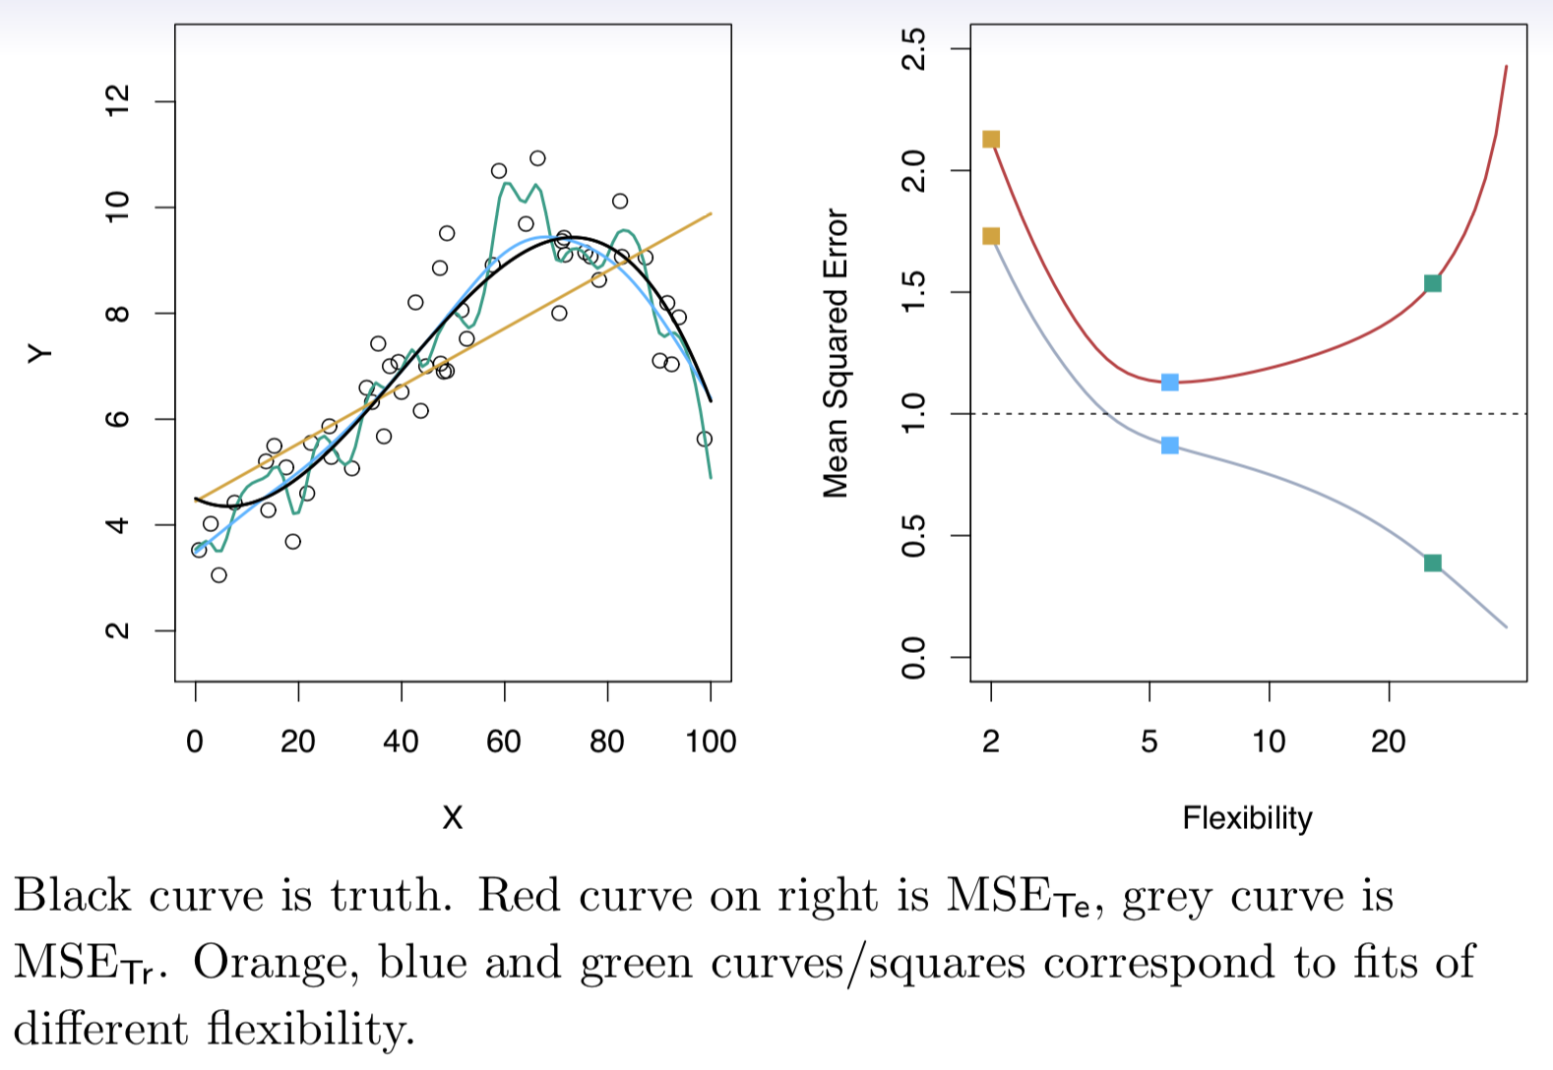
Another example (from ISLR)

Slide 57
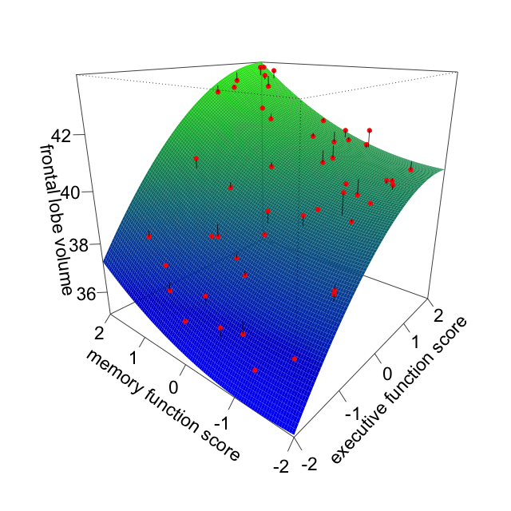
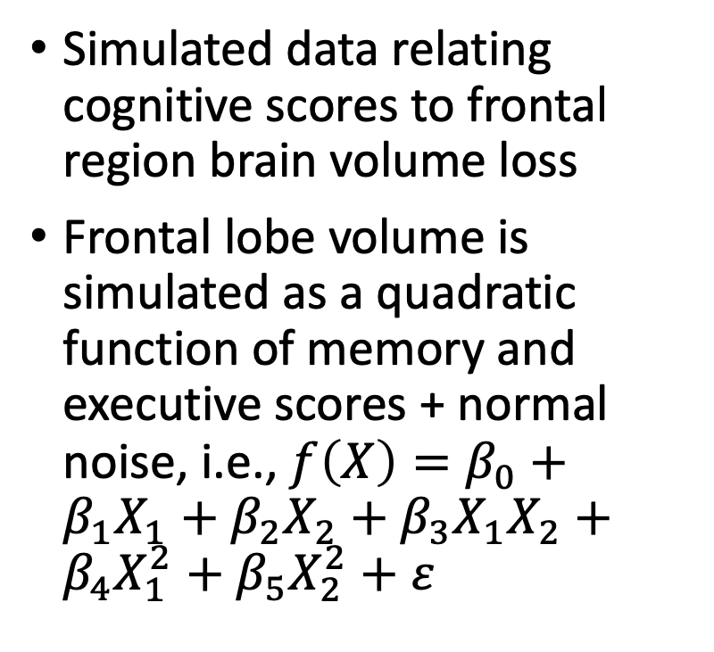
Linear models with 2 or more predictors
Simulated data relating cognitive scores to frontal region brain volume loss
Frontal lobe volume is simulated as a quadratic function of memory and executive scores + normal noise, i.e., $f\left(X\right)=β_{0}+β_{1}X_{1}+β_{2}X_{2}+β_{3}X_{1}X_{2}+β_{4}X_{1}^{2}+β_{5}X_{2}^{2}+ε$

Slide 58
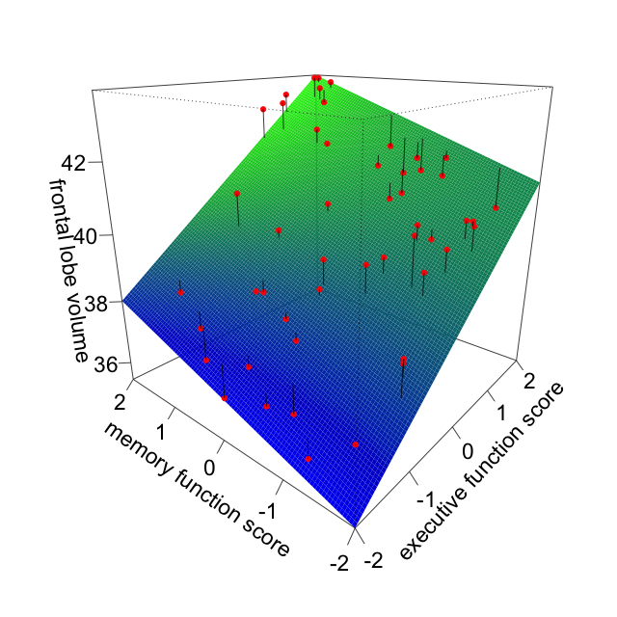
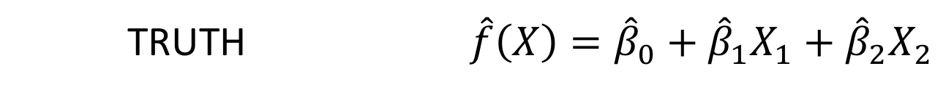
Linear terms only
TRUTH $\hat{f}\left(X\right)={\hat{β}}_{0}+{\hat{β}}_{1}X_{1}+{\hat{β}}_{2}X_{2}$

Slide 59
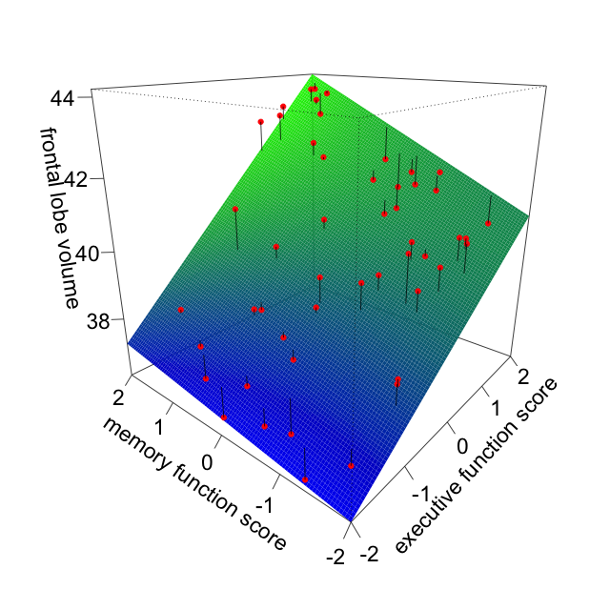
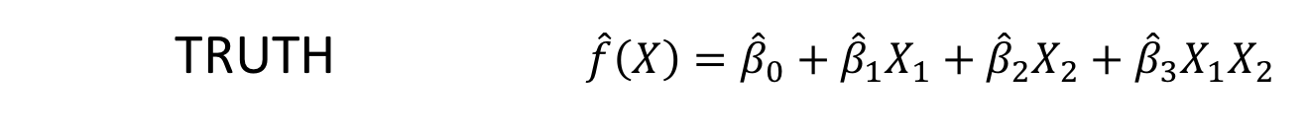
Adding an interaction
TRUTH $\hat{f}\left(X\right)={\hat{β}}_{0}+{\hat{β}}_{1}X_{1}+{\hat{β}}_{2}X_{2}+{\hat{β}}_{3}X_{1}X_{2}$

Slide 60


And finally quadratic terms
TRUTH $\hat{f}\left(X\right)={\hat{β}}_{0}+{\hat{β}}_{1}X_{1}+{\hat{β}}_{2}X_{2}+{\hat{β}}_{3}X_{1}X_{2}+{\hat{β}}_{4}X_{1}^{2}+{\hat{β}}_{5}X_{2}^{2}$

Slide 61
Trade-offs
Prediction accuracy vs. interpretability
  Linear models easy to interpret; nearest-neighbors not so much
Good fit vs. under or over-fitting
  How do we find the fit which is “just right”
Parsimony vs. black box
  Usually prefer a simpler model involving fewer variables over a black-box predictor involving them all

Slide 62
Trade-offs
High
Subset selection:
Lasso
Recursive partitioning (trees)
Standard regression (linear, logistic, survival)
Interpretability
Bagging, Boosting, Random forests
Kernel smoothing
Support vector machines
Low
Low
High
Flexibility

Slide 63
What we covered in this lecture:
What is Machine Learning?
Supervised vs. Unsupervised learning
Lead into prediction techniques for supervised learning with continuous outcomes:
  Local estimation and nearest neighbors
  Loss functions and mean square error
  The training-test paradigm
  The curse of dimensionality
  Linear regression modeling (including polynomials)
  Trade-offs
  Assessing model accuracy

Slide 64
Next lecture
Classification
Loss functions for binary data
Matrix algebra and calculus
Minimizing loss functions

Slide 65
Extra materials
Linear algebra tutorials – Andrew Ng, Stanford Machine Learning Course on YouTube or Coursera Lecture 3.1 to 3.6 https://www.youtube.com/playlist?list=PLLssT5z_DsK-h9vYZkQkYNWcItqhlRJLN
And read pages 9-11 of ISLR

