Slide 1
Definitions
True Positive (TP) – observation is positive and was predicted as positive
True Negative (TN) – observation is negative and was predicted as negative
False Positive (FP) – observation is negative and was predicted as positive
False Negative (FN) – observation is positive and was predicted as negative
Classification accuracy – proportion of observations classified correctly = (#TP + #TN)/N

Slide 2
Evaluation
Possible evaluation measures:
  Classification Accuracy – or conversely, the classification error rate = 1 – classification accuracy
  Differential penalties – different errors may have different costs
  Area Under Receiver-Operating Characteristic (ROC) Curve (AUC)
How reliable are the predicted results ?

Slide 3
Classifier error rate
Natural performance measure for classification problems: error rate (or success rate)
  Success: instance’s class is predicted correctly
  Error: instance’s class is predicted incorrectly
  Error rate: proportion of errors made over the whole set of instances
  Success rate: proportion of errors made over the whole set of instances = 1 – Error rate

Slide 4
Cost-Benefit
Cost-benefit is similar to classification error, except that we might want to count some errors to be worse than others
Consider a disease where treatment involves taking a simple cheap and benign medicine to cure it (e.g. taking vitamin C), but if the disease is unchecked, the consequences are severe.
In that case, I would want to put much more weight on missing positives than missing negatives; i.e. consequences of false negatives are much worse than false positives.
For example, we might make the penalty (cost) for a false negative be 10 or 100 times that of a false positive

Slide 5
Sensitivity and Specificity
Test\Truth | Disease Free | Diseased | Total
Negative | TN | FN | FN+TN
Positive | FP | TP | TP+FP
Total | FP+TN | TP+FN | N

Slide 6
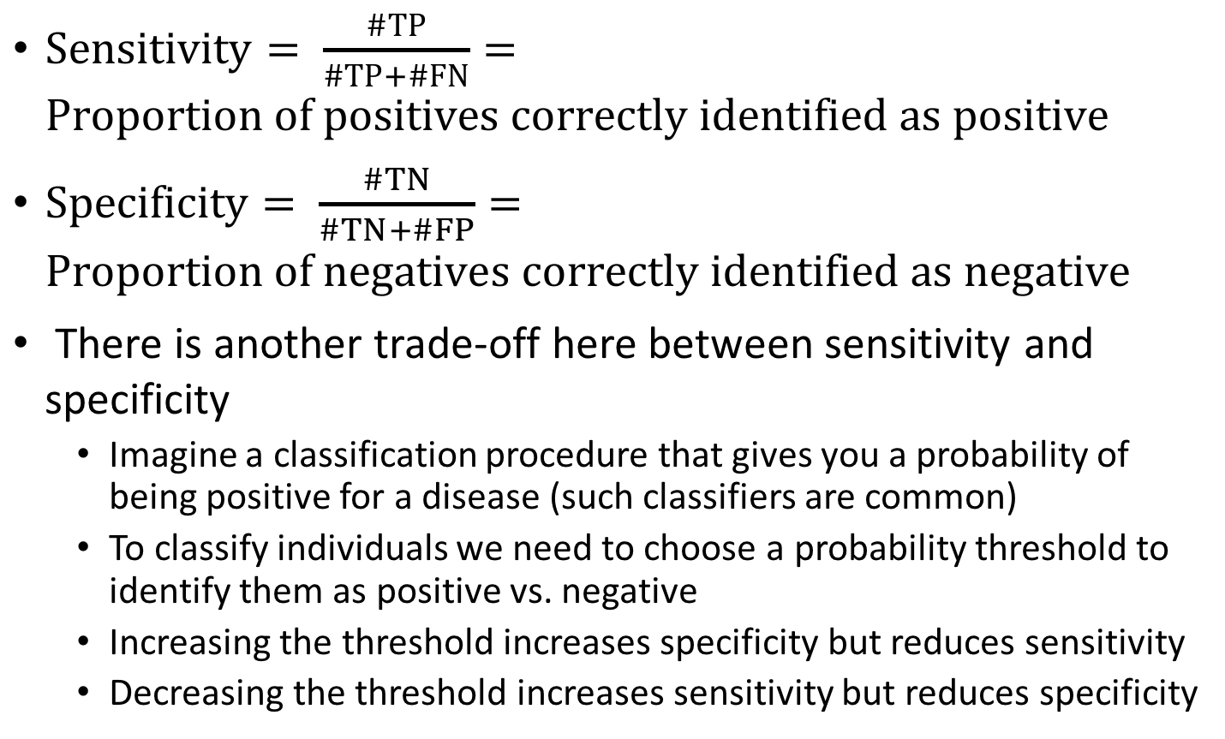
Sensitivity and Specificity
$Sensitivity= \frac{\#TP}{\#TP+\#FN}=Proportion of positives correctly identified as positive$
$Specificity= \frac{\#TN}{\#TN+\#FP}=Proportion of negatives correctly identified as negative$
There is another trade-off here between sensitivity and specificity
  Imagine a classification procedure that gives you a probability of being positive for a disease (such classifiers are common)
  To classify individuals we need to choose a probability threshold to identify them as positive vs. negative
  Increasing the threshold increases specificity but reduces sensitivity
  Decreasing the threshold increases sensitivity but reduces specificity

Slide 7
Receiver operating characteristic (ROC) curve
Sensitivity
1 - Specificity

Slide 8
Choosing threshold based on ROC
Many possible thresholds, each corresponding to one point on curve
Choosing a single one depends on context
Some studies say (for example) give me best specificity for a sensitivity of at least 0.8 (blue x)
General alternative – maximal perpendicular from diagonal (red x)
We will not be concerned with choosing thresholds, rather, we will use ROC to generate a metric
x
x
Sensitivity
1 - Specificity

Slide 9
Area under the (ROC) curve (AUC)
AUC gives a measure of how well the predictor does across all possible thresholds
Ideal AUC is 1
AUC for random predictor = 0.5
Objective is to find classifier that maximizes AUC
Sensitivity
1 - Specificity

Slide 10
Error rate vs. AUC
When should we choose error rate and when AUC?
Error rate (and cost-benefit) work well when your dataset is representative of the larger population (metric incorporates prevalence – e.g. proportion of people in population that have disease)
AUC works better when your dataset is not representative of larger population, e.g. in “case-control” studies (metric is independent of prevalence)

