Slide 1
Machine Learning in R
Lecture 3 – Linear Algebra, Optimization and Validation
John Kornak – Epidemiology and Biostatistics
john.kornak@ucsf.edu

Slide 2
Projects
How many people interested in performing their project on their own data?

Slide 3
In this lecture:
Matrix algebra
Validation and Cross-validation methods

Slide 4
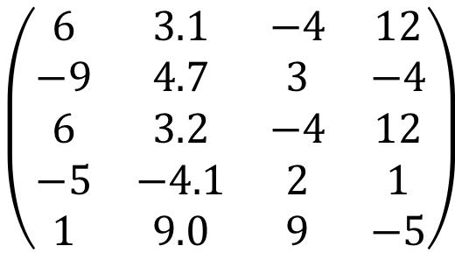
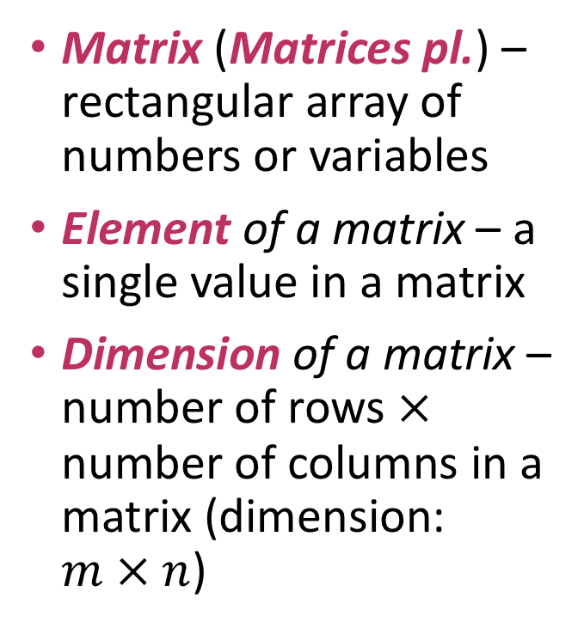
Matrix algebra / Linear algebra
Matrix (Matrices pl.) – rectangular array of numbers or variables
Element of a matrix – a single value in a matrix
Dimension of a matrix – number of rows $×$ number of columns in a matrix (dimension: $m × n$)
$$\left(\begin{matrix}6 & 3.1 & −4 & 12 \\ −9 & 4.7 & 3 & −4 \\ 6 & 3.2 & −4 & 12 \\ −5 & −4.1 & 2 & 1 \\ 1 & 9.0 & 9 & −5\end{matrix}\right)$$
Note that some prefer to use square rather than curved parentheses to represent a matrix – it’s up to you.

Slide 5

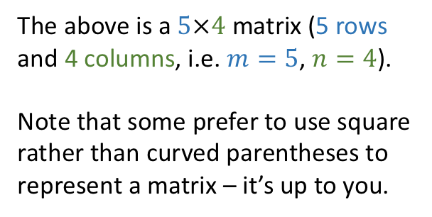
Matrix algebra
Matrix (Matrices pl.) – rectangular array of numbers or variables
Element of a matrix – a single value in a matrix
Dimension of a matrix – number of rows $×$ number of columns in a matrix (dimension: $m×n$)
4 columns
$$\left(\begin{matrix}6 & 3.1 & −4 & 12 \\ −9 & 4.7 & 3 & −4 \\ 6 & 3.2 & −4 & 12 \\ −5 & −4.1 & 2 & 1 \\ 1 & 9.0 & 9 & −5\end{matrix}\right)$$
5 rows
The above is a $5×4$ matrix (5 rows and 4 columns, i.e. $m=5$, $n=4$).
Note that some prefer to use square rather than curved parentheses to represent a matrix – it’s up to you.

Slide 6
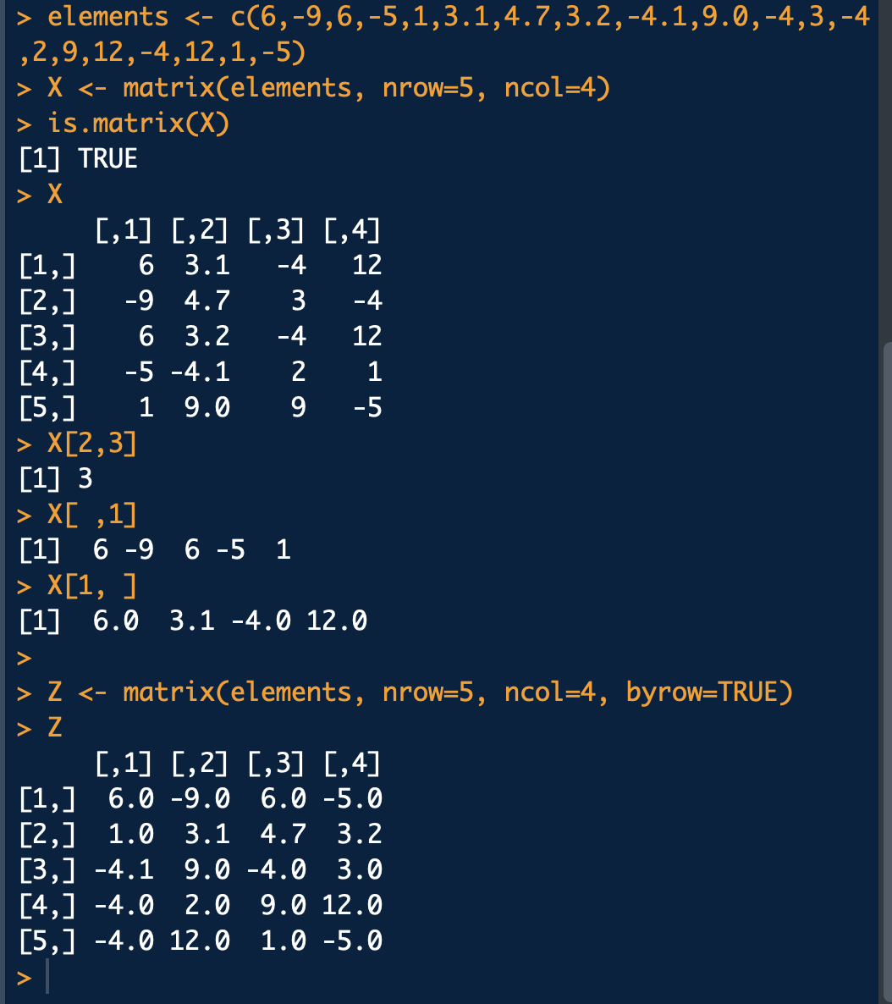


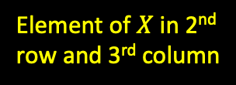
Matrices in R
4 columns
$$\left(\begin{matrix}6 & 3.1 & −4 & 12 \\ −9 & 4.7 & 3 & −4 \\ 6 & 3.2 & −4 & 12 \\ −5 & −4.1 & 2 & 1 \\ 1 & 9.0 & 9 & −5\end{matrix}\right)$$
5 rows
Element of $X$ in 2nd row and 3rd column
1st column of $X$
The above is a $5×4$ matrix (5 rows and 4 columns, i.e. $m=5$, $n=4$).
Note that some prefer to use square rather than curved parentheses to represent a matrix – it’s up to you.
1st row of $X$

Slide 7
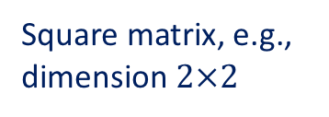
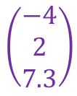
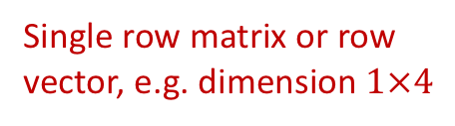

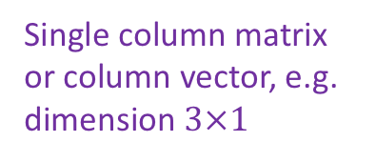


Matrices
Matrices are typically indexed by upper case letters, e.g. $A, B, X, Y$
We can perform arithmetic on Matrices
Matrices of important dimensions:
$$\left(\begin{matrix}−4 \\ 2 \\ 7.3\end{matrix}\right)$$
$$\left(\begin{matrix}6 & 2 & −2 & −1\end{matrix}\right)$$
$$\left(\begin{matrix}4 & 2 \\ 4 & 3\end{matrix}\right)$$
Single row matrix or row vector, e.g. dimension $1×4$
Square matrix, e.g., dimension $2×2$
Single column matrix or column vector, e.g. dimension $3×1$

Slide 8

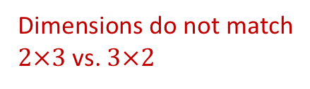
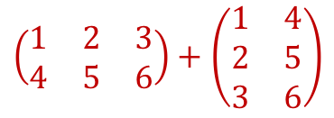
Adding and subtracting matrices
To add or subtract matrices they need to be of the same dimension. Then you just add or subtract element-by-element:
or,
But not
$$\left(\begin{matrix}4 & 2 \\ 4 & 3\end{matrix}\right)+\left(\begin{matrix}7 & 3 \\ −2 & −6\end{matrix}\right)=\left(\begin{matrix}11 & 5 \\ 2 & −3\end{matrix}\right)$$
$$\left(\begin{matrix}8.3 & 4.4 & 9.2 \\ 7.6 & 4.8 & 9.1\end{matrix}\right)−\left(\begin{matrix}6.2 & 7.1 & 9.4 \\ 6.8 & 6.7 & 9.1\end{matrix}\right)=\left(\begin{matrix}2.1 & −2.7 & −0.2 \\ 0.8 & −1.9 & 0.0\end{matrix}\right)$$
$$\left(\begin{matrix}1 & 2 & 3 \\ 4 & 5 & 6\end{matrix}\right)+\left(\begin{matrix}1 & 4 \\ 2 & 5 \\ 3 & 6\end{matrix}\right)$$
Dimensions do not match
$2×3$ vs. $3×2$

Slide 9
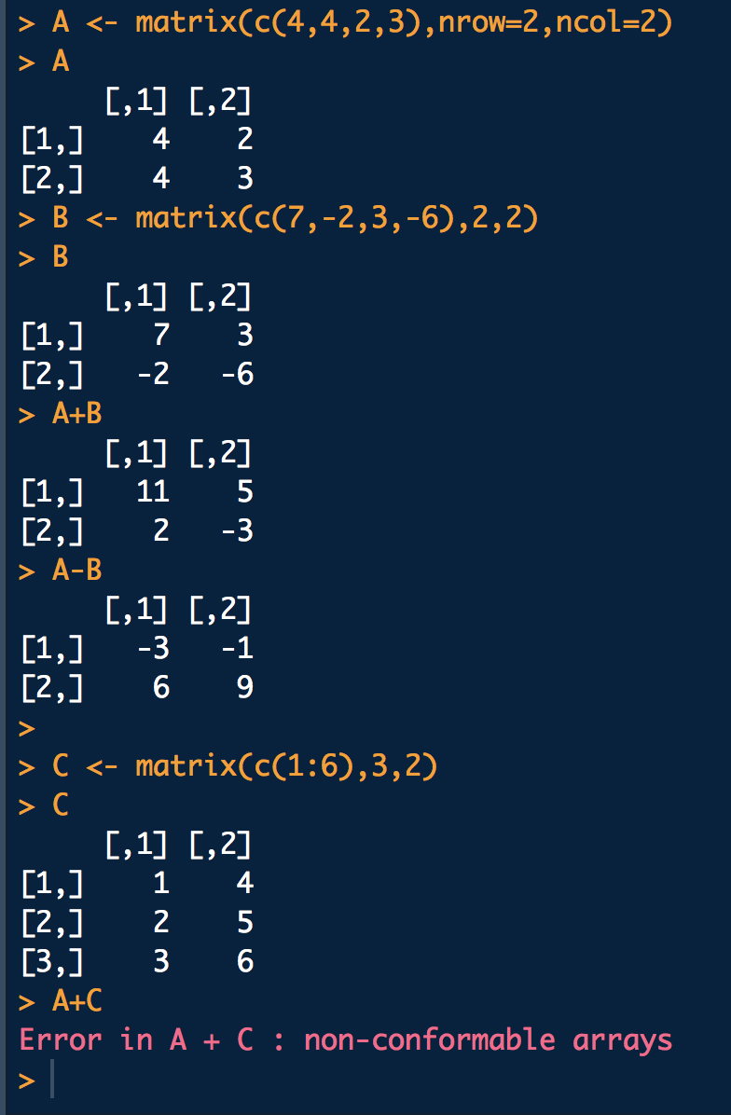
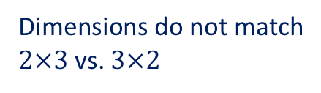
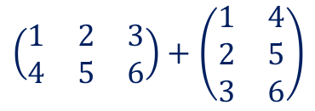
Adding and subtracting matrices
To add or subtract matrices they need to be of the same dimension. Then you just add or subtract element-by-element:
or,
But not
$$\left(\begin{matrix}4 & 2 \\ 4 & 3\end{matrix}\right)+\left(\begin{matrix}7 & 3 \\ −2 & −6\end{matrix}\right)=\left(\begin{matrix}11 & 5 \\ 2 & −3\end{matrix}\right)$$
$$\left(\begin{matrix}8.3 & 4.4 & 9.2 \\ 7.6 & 4.8 & 9.1\end{matrix}\right)−\left(\begin{matrix}6.2 & 7.1 & 9.4 \\ 6.8 & 6.7 & 9.1\end{matrix}\right)=\left(\begin{matrix}2.1 & −2.7 & −0.2 \\ 0.8 & −1.9 & 0.0\end{matrix}\right)$$
$$\left(\begin{matrix}1 & 2 & 3 \\ 4 & 5 & 6\end{matrix}\right)+\left(\begin{matrix}1 & 4 \\ 2 & 5 \\ 3 & 6\end{matrix}\right)$$
Dimensions do not match
$2×3$ vs. $3×2$

Slide 10
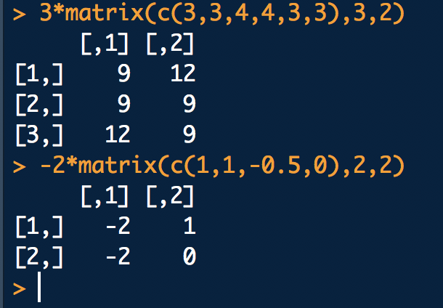
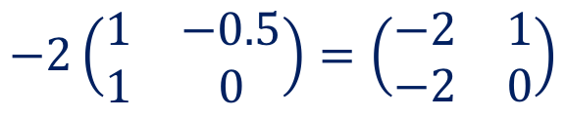
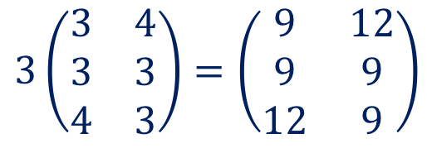
Matrix multiplication by a scalar
A scalar is a single value
When a matrix is multiplied by a scalar each element in the matrix is multiplied by the scalar e.g.
or,
$$3\left(\begin{matrix}3 & 4 \\ 3 & 3 \\ 4 & 3\end{matrix}\right)=\left(\begin{matrix}9 & 12 \\ 9 & 9 \\ 12 & 9\end{matrix}\right)$$
$$−2\left(\begin{matrix}1 & −0.5 \\ 1 & 0\end{matrix}\right)=\left(\begin{matrix}−2 & 1 \\ −2 & 0\end{matrix}\right)$$

Slide 11
Matrix multiplication by a scalar
A scalar is a single value
When a matrix is multiplied by a scalar each element in the matrix is multiplied by the scalar e.g.
or,
$$3\left(\begin{matrix}3 & 4 \\ 3 & 3 \\ 4 & 3\end{matrix}\right)=\left(\begin{matrix}9 & 12 \\ 9 & 9 \\ 12 & 9\end{matrix}\right)$$
$$−2\left(\begin{matrix}1 & −0.5 \\ 1 & 0\end{matrix}\right)=\left(\begin{matrix}−2 & 1 \\ −2 & 0\end{matrix}\right)$$
What about multiplication of 2 matrices?

Slide 12
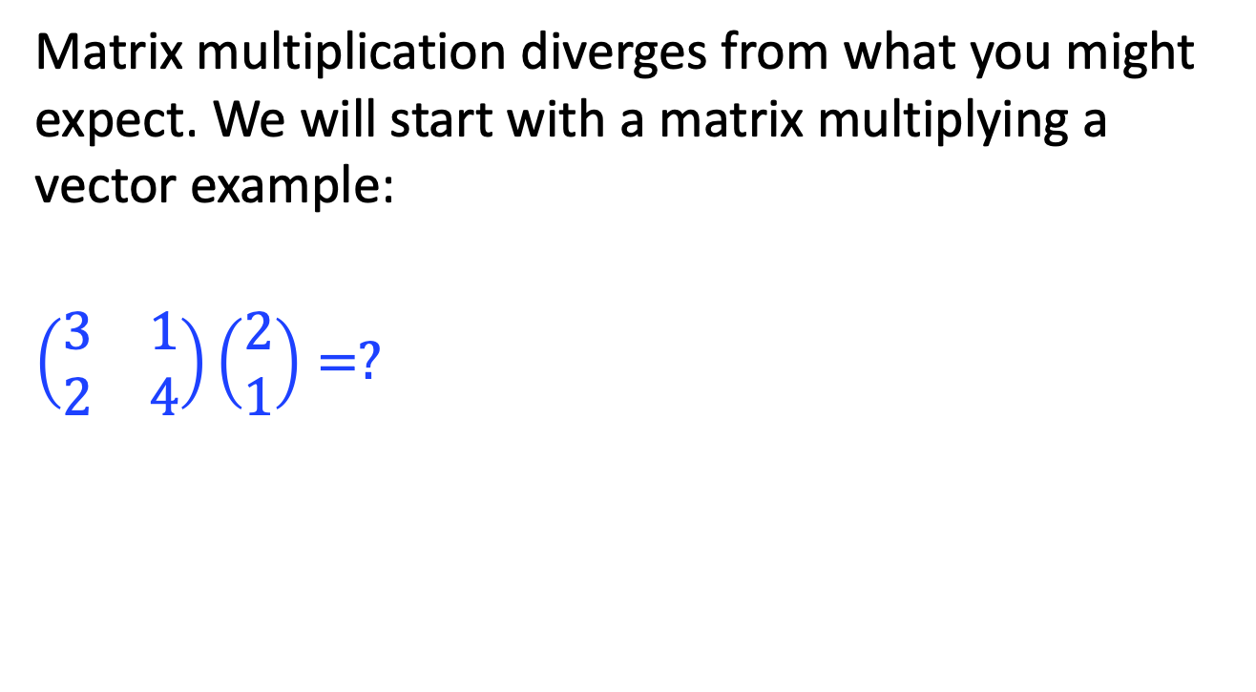
Multiply a column vector by a matrix
Matrix multiplication diverges from what you might expect. We will start with a matrix multiplying a vector example:
$$\left(\begin{matrix}3 & 1 \\ 2 & 4\end{matrix}\right)\left(\begin{matrix}2 \\ 1\end{matrix}\right)=?$$

Slide 13
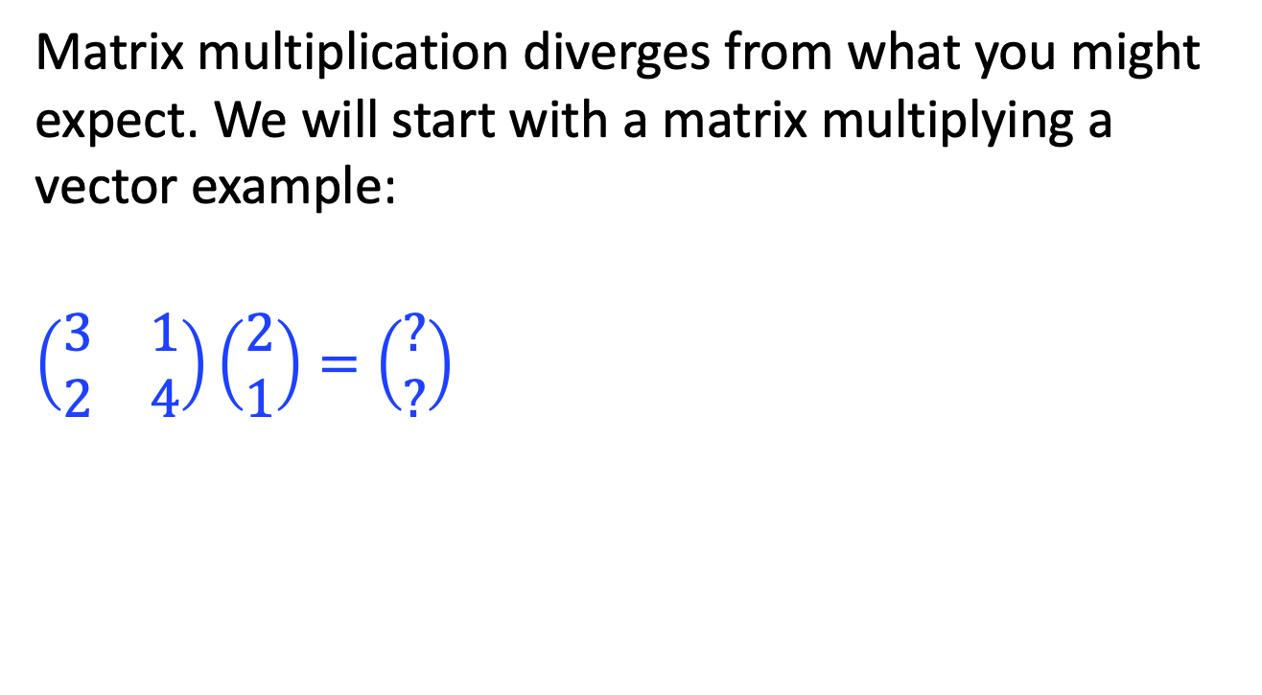
Multiply a column vector by a matrix
Matrix multiplication diverges from what you might expect. We will start with a matrix multiplying a vector example:
$$\left(\begin{matrix}3 & 1 \\ 2 & 4\end{matrix}\right)\left(\begin{matrix}2 \\ 1\end{matrix}\right)=\left(\begin{matrix}? \\ ?\end{matrix}\right)$$

Slide 14
Multiply a column vector by a matrix
Matrix multiplication diverges from what you might expect. We will start with a matrix multiplying a vector example:
$$\left(\begin{matrix}3 & 1 \\ 2 & 4\end{matrix}\right)\left(\begin{matrix}2 \\ 1\end{matrix}\right)=\left(\begin{matrix}? \\ ?\end{matrix}\right)$$

Slide 15
Multiply a column vector by a matrix
Matrix multiplication diverges from what you might expect. We will start with a matrix multiplying a vector example:
$$\left(\begin{matrix}3 & 1 \\ 2 & 4\end{matrix}\right)\left(\begin{matrix}2 \\ 1\end{matrix}\right)=\left(\begin{matrix}? \\ ?\end{matrix}\right)$$

Slide 16
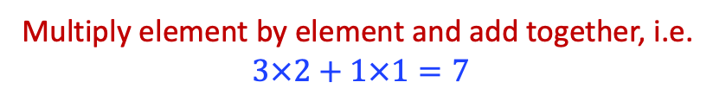
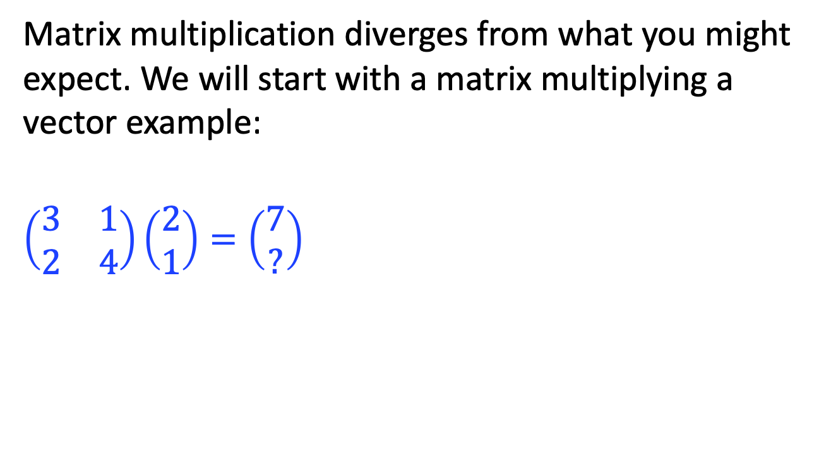
Multiply a column vector by a matrix
Matrix multiplication diverges from what you might expect. We will start with a matrix multiplying a vector example:
$$\left(\begin{matrix}3 & 1 \\ 2 & 4\end{matrix}\right)\left(\begin{matrix}2 \\ 1\end{matrix}\right)=\left(\begin{matrix}7 \\ ?\end{matrix}\right)$$
Multiply element by element and add together, i.e.
$$3×2+1×1=7$$

Slide 17
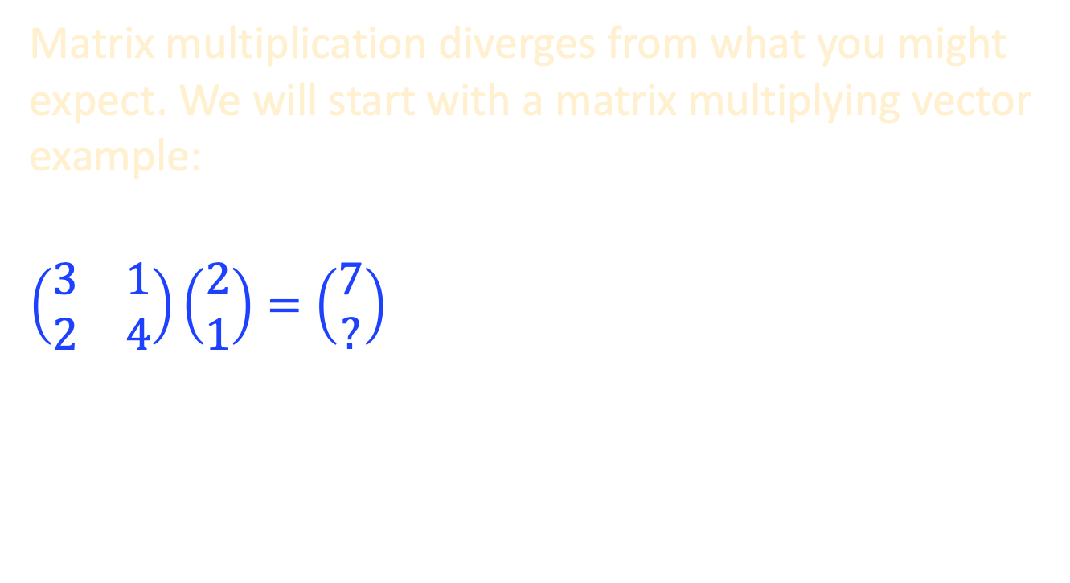

Multiply a column vector by a matrix
Matrix multiplication diverges from what you might expect. We will start with a matrix multiplying vector example:
$$\left(\begin{matrix}3 & 1 \\ 2 & 4\end{matrix}\right)\left(\begin{matrix}2 \\ 1\end{matrix}\right)=\left(\begin{matrix}7 \\ ?\end{matrix}\right)$$
$×$ and $+$
Multiply element by element and add together, i.e.
$$3×2+1×1=7$$

Slide 18
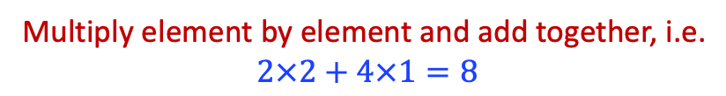
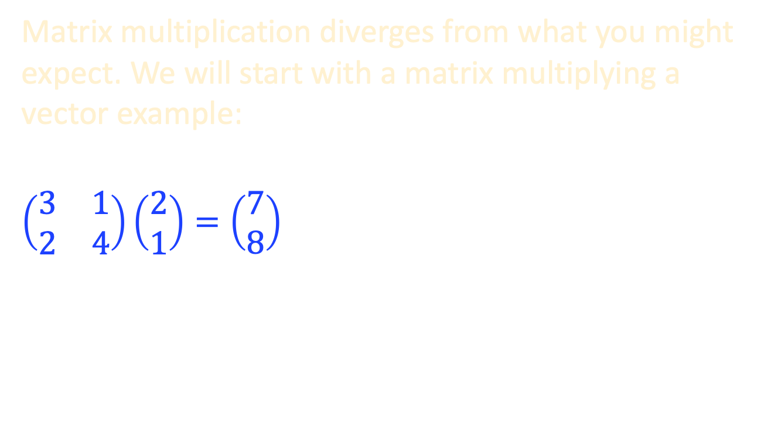

Multiply a column vector by a matrix
Matrix multiplication diverges from what you might expect. We will start with a matrix multiplying a vector example:
$$\left(\begin{matrix}3 & 1 \\ 2 & 4\end{matrix}\right)\left(\begin{matrix}2 \\ 1\end{matrix}\right)=\left(\begin{matrix}7 \\ 8\end{matrix}\right)$$
$×$ and $+$
Multiply element by element and add together, i.e.
$$2×2+4×1=8$$

Slide 19
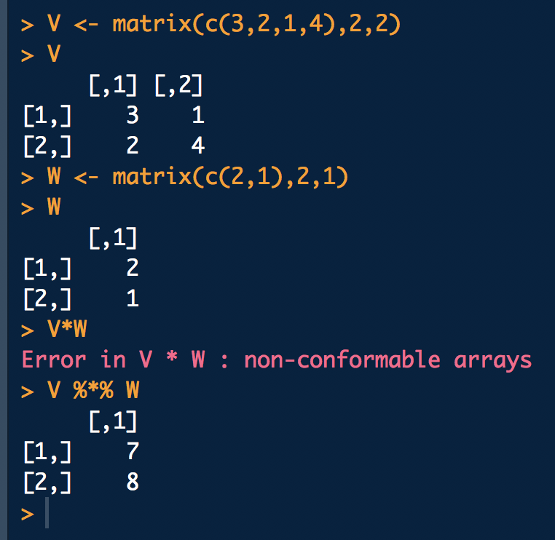
Multiply a column vector by a matrix
Matrix multiplication diverges from what you might expect. We will start with a matrix multiplying a vector example:
$$\left(\begin{matrix}3 & 1 \\ 2 & 4\end{matrix}\right)\left(\begin{matrix}2 \\ 1\end{matrix}\right)=\left(\begin{matrix}7 \\ 8\end{matrix}\right)$$
$×$ and $+$

Slide 20
Multiply a column vector by a matrix
Matrix multiplication diverges from what you might expect. We will start with a matrix multiplying a vector example:
$$\left(\begin{matrix}3 & 1 \\ 2 & 4\end{matrix}\right)\left(\begin{matrix}2 \\ 1\end{matrix}\right)=\left(\begin{matrix}7 \\ 8\end{matrix}\right)$$
$×$ and $+$

Slide 21
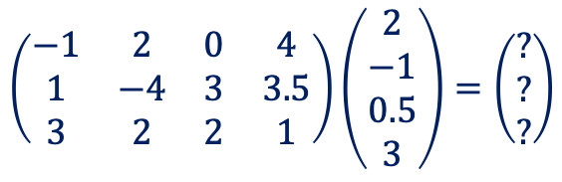
Multiply a column vector by a matrix – 2nd example
$$\left(\begin{matrix}−1 & 2 & 0 & 4 \\ 1 & −4 & 3 & 3.5 \\ 3 & 2 & 2 & 1\end{matrix}\right)\left(\begin{matrix}2 \\ −1 \\ 0.5 \\ 3\end{matrix}\right)=\left(\begin{matrix}? \\ ? \\ ?\end{matrix}\right)$$

Slide 22
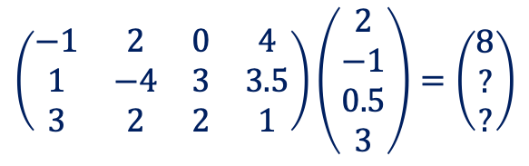
Multiply a column vector by a matrix – 2nd example
$$\left(\begin{matrix}−1 & 2 & 0 & 4 \\ 1 & −4 & 3 & 3.5 \\ 3 & 2 & 2 & 1\end{matrix}\right)\left(\begin{matrix}2 \\ −1 \\ 0.5 \\ 3\end{matrix}\right)=\left(\begin{matrix}8 \\ ? \\ ?\end{matrix}\right)$$
$$−1×2+2×\left(−1\right)+0×0.5+4×3=8$$

Slide 23
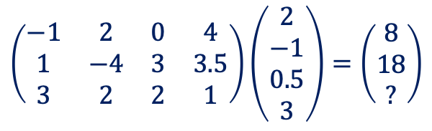
Multiply a column vector by a matrix – 2nd example
$$\left(\begin{matrix}−1 & 2 & 0 & 4 \\ 1 & −4 & 3 & 3.5 \\ 3 & 2 & 2 & 1\end{matrix}\right)\left(\begin{matrix}2 \\ −1 \\ 0.5 \\ 3\end{matrix}\right)=\left(\begin{matrix}8 \\ 18 \\ ?\end{matrix}\right)$$
$$−1×2+2×\left(−1\right)+0×0.5+4×3=8$$
$$1×2+\left(−4\right)×\left(−1\right)+3×0.5+3.5×3=18$$

Slide 24
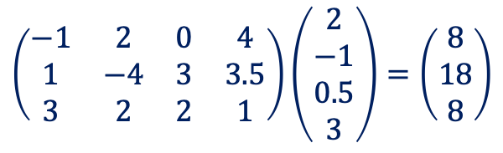
Multiply a column vector by a matrix – 2nd example
$$\left(\begin{matrix}−1 & 2 & 0 & 4 \\ 1 & −4 & 3 & 3.5 \\ 3 & 2 & 2 & 1\end{matrix}\right)\left(\begin{matrix}2 \\ −1 \\ 0.5 \\ 3\end{matrix}\right)=\left(\begin{matrix}8 \\ 18 \\ 8\end{matrix}\right)$$
$$−1×2+2×\left(−1\right)+0×0.5+4×3=8$$
$$1×2+\left(−4\right)×\left(−1\right)+3×0.5+3.5×3=18$$
$$3×2+2×\left(−1\right)+2×0.5+1×3=8$$

Slide 25
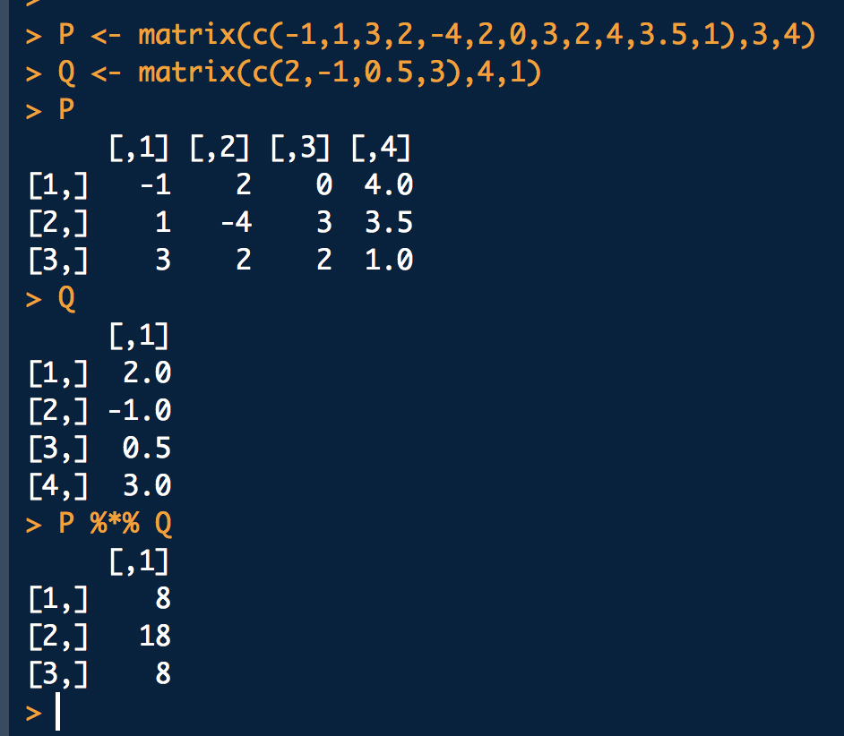
Multiply a column vector by a matrix
$$\left(\begin{matrix}−1 & 2 & 0 & 4 \\ 1 & −4 & 3 & 3.5 \\ 3 & 2 & 2 & 1\end{matrix}\right)\left(\begin{matrix}2 \\ −1 \\ 0.5 \\ 3\end{matrix}\right)=\left(\begin{matrix}8 \\ 18 \\ 8\end{matrix}\right)$$
$$−1×2+2×\left(−1\right)+0×0.5+4×3=8$$
$$1×2+\left(−4\right)×\left(−1\right)+3×0.5+3.5×3=18$$
$$3×2+2×\left(−1\right)+2×0.5+1×3=8$$

Slide 26
Multiply a column vector by a matrix
$$\left(\begin{matrix}−1 & 2 & 0 & 4 \\ 1 & −4 & 3 & 3.5 \\ 3 & 2 & 2 & 1\end{matrix}\right)\left(\begin{matrix}2 \\ −1 \\ 0.5 \\ 3\end{matrix}\right)=\left(\begin{matrix}8 \\ 18 \\ 8\end{matrix}\right)$$
$$−1×2+2×\left(−1\right)+0×0.5+4×3=12$$
$$1×2+\left(−4\right)×\left(−1\right)+3×0.5+3.5×3=18$$
$$3×2+2×\left(−1\right)+2×0.5+1×3=8$$
So why is all this useful?

Slide 27
Multiply a column vector by a matrix
$$\left(\begin{matrix}−1 & 2 & 0 & 4 \\ 1 & −4 & 3 & 3.5 \\ 3 & 2 & 2 & 1\end{matrix}\right)\left(\begin{matrix}2 \\ −1 \\ 0.5 \\ 3\end{matrix}\right)=\left(\begin{matrix}8 \\ 18 \\ 8\end{matrix}\right)$$
$$−1×2+2×\left(−1\right)+0×0.5+4×3=12$$
$$1×2+\left(−4\right)×\left(−1\right)+3×0.5+3.5×3=18$$
$$3×2+2×\left(−1\right)+2×0.5+1×3=8$$
So why is all this useful?
Because it allows simplification for computation and notation

Slide 28

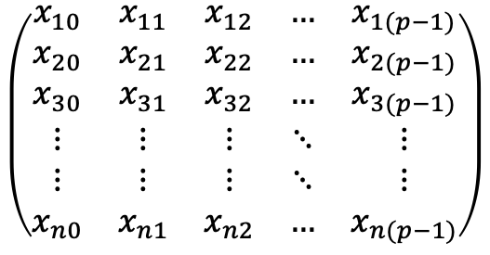

Consider a data matrix
$p$ columns
$$\left(\begin{matrix}x_{10} & x_{11} & x_{12} & … & x_{1(p−1)} \\ x_{20} & x_{21} & x_{22} & … & x_{2(p−1)} \\ x_{30} & x_{31} & x_{32} & … & x_{3(p−1)} \\ ⋮ & ⋮ & ⋮ & ⋱ & ⋮ \\ ⋮ & ⋮ & ⋮ & ⋱ & ⋮ \\ x_{n0} & x_{n1} & x_{n2} & … & x_{n(p−1)}\end{matrix}\right)$$
$n$ rows
where $x_{ij}$ is the value of the $j$^{th} variable for the $i$^{th} observation (subject)

Slide 29

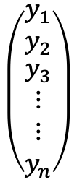
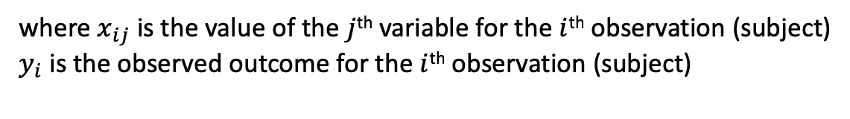
a response column vector matrix
$p$ columns
$$\left(\begin{matrix}x_{10} & x_{11} & x_{12} & … & x_{1(p−1)} \\ x_{20} & x_{21} & x_{22} & … & x_{2(p−1)} \\ x_{30} & x_{31} & x_{32} & … & x_{3(p−1)} \\ ⋮ & ⋮ & ⋮ & ⋱ & ⋮ \\ ⋮ & ⋮ & ⋮ & ⋱ & ⋮ \\ x_{n0} & x_{n1} & x_{n2} & … & x_{n(p−1)}\end{matrix}\right)$$
$$\left(\begin{matrix}y_{1} \\ y_{2} \\ \begin{matrix}y_{3} \\ ⋮ \\ ⋮ \\ y_{n}\end{matrix}\end{matrix}\right)$$
$n$ rows
$n$ obs.
where $x_{ij}$ is the value of the $j$^{th} variable for the $i$^{th} observation (subject)
$y_{i}$ is the observed outcome for the $i$^{th} observation (subject)

Slide 30
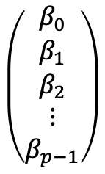

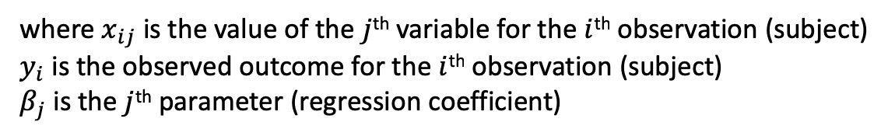

a vector of parameters
$p$ columns
$$\left(\begin{matrix}β_{0} \\ β_{1} \\ \begin{matrix}β_{2} \\ ⋮ \\ β_{p−1}\end{matrix}\end{matrix}\right)$$
$$\left(\begin{matrix}x_{10} & x_{11} & x_{12} & … & x_{1(p−1)} \\ x_{20} & x_{21} & x_{22} & … & x_{2(p−1)} \\ x_{30} & x_{31} & x_{32} & … & x_{3(p−1)} \\ ⋮ & ⋮ & ⋮ & ⋱ & ⋮ \\ ⋮ & ⋮ & ⋮ & ⋱ & ⋮ \\ x_{n0} & x_{n1} & x_{n2} & … & x_{n(p−1)}\end{matrix}\right)$$
$$\left(\begin{matrix}y_{1} \\ y_{2} \\ \begin{matrix}y_{3} \\ ⋮ \\ ⋮ \\ y_{n}\end{matrix}\end{matrix}\right)$$
$p$ parameters
$n$ rows
$n$ observations
where $x_{ij}$ is the value of the $j$^{th} variable for the $i$^{th} observation (subject)
$y_{i}$ is the observed outcome for the $i$^{th} observation (subject)
$β_{j}$ is the $j$^{th} parameter (regression coefficient)

Slide 31

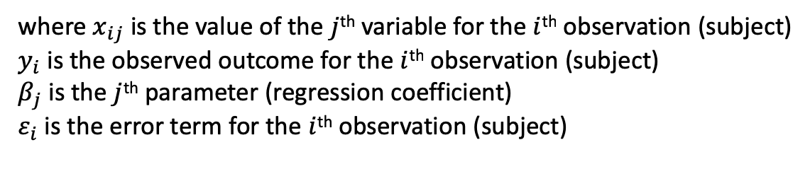
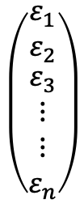
a vector of parameters
$p$ columns
$$\left(\begin{matrix}β_{0} \\ β_{1} \\ \begin{matrix}β_{2} \\ ⋮ \\ β_{p−1}\end{matrix}\end{matrix}\right)$$
$$\left(\begin{matrix}x_{10} & x_{11} & x_{12} & … & x_{1(p−1)} \\ x_{20} & x_{21} & x_{22} & … & x_{2(p−1)} \\ x_{30} & x_{31} & x_{32} & … & x_{3(p−1)} \\ ⋮ & ⋮ & ⋮ & ⋱ & ⋮ \\ ⋮ & ⋮ & ⋮ & ⋱ & ⋮ \\ x_{n0} & x_{n1} & x_{n2} & … & x_{n(p−1)}\end{matrix}\right)$$
$$\left(\begin{matrix}y_{1} \\ y_{2} \\ \begin{matrix}y_{3} \\ ⋮ \\ ⋮ \\ y_{n}\end{matrix}\end{matrix}\right)$$
$p$ parameters
$n$ rows
$n$ observations
$$\left(\begin{matrix}ε_{1} \\ ε_{2} \\ \begin{matrix}ε_{3} \\ ⋮ \\ ⋮ \\ ε_{n}\end{matrix}\end{matrix}\right)$$
$n$ error variables
where $x_{ij}$ is the value of the $j$^{th} variable for the $i$^{th} observation (subject)
$y_{i}$ is the observed outcome for the $i$^{th} observation (subject)
$β_{j}$ is the $j$^{th} parameter (regression coefficient)
$ε_{i}$ is the error term for the $i$^{th} observation (subject)

Slide 32
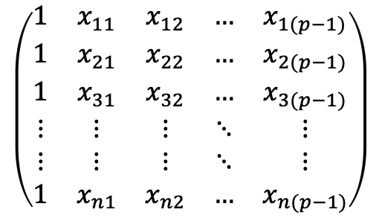

Now set $x_{i0}=1$ for all $i$
$p$ columns
$$\left(\begin{matrix}β_{0} \\ β_{1} \\ \begin{matrix}β_{2} \\ ⋮ \\ β_{p−1}\end{matrix}\end{matrix}\right)$$
$$\left(\begin{matrix}1 & x_{11} & x_{12} & … & x_{1(p−1)} \\ 1 & x_{21} & x_{22} & … & x_{2(p−1)} \\ 1 & x_{31} & x_{32} & … & x_{3(p−1)} \\ ⋮ & ⋮ & ⋮ & ⋱ & ⋮ \\ ⋮ & ⋮ & ⋮ & ⋱ & ⋮ \\ 1 & x_{n1} & x_{n2} & … & x_{n(p−1)}\end{matrix}\right)$$
$$\left(\begin{matrix}y_{1} \\ y_{2} \\ \begin{matrix}y_{3} \\ ⋮ \\ ⋮ \\ y_{n}\end{matrix}\end{matrix}\right)$$
$p$ parameters
$n$ rows
$n$ observations
$$\left(\begin{matrix}ε_{1} \\ ε_{2} \\ \begin{matrix}ε_{3} \\ ⋮ \\ ⋮ \\ ε_{n}\end{matrix}\end{matrix}\right)$$
$n$ error variables
where $x_{ij}$ is the value of the $j$^{th} variable for the $i$^{th} observation (subject)
$y_{i}$ is the observed outcome for the $i$^{th} observation (subject)
$β_{j}$ is the $j$^{th} parameter (regression coefficient)
$ε_{i}$ is the error term for the $i$^{th} observation (subject)

Slide 33
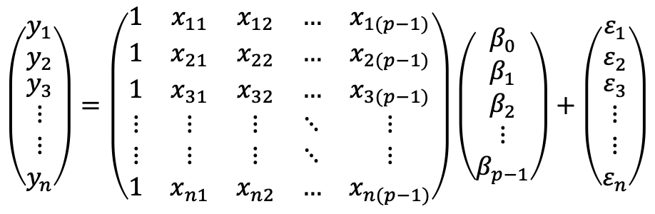
And write
$$\left(\begin{matrix}y_{1} \\ y_{2} \\ \begin{matrix}y_{3} \\ ⋮ \\ ⋮ \\ y_{n}\end{matrix}\end{matrix}\right)=\left(\begin{matrix}1 & x_{11} & x_{12} & … & x_{1(p−1)} \\ 1 & x_{21} & x_{22} & … & x_{2(p−1)} \\ 1 & x_{31} & x_{32} & … & x_{3(p−1)} \\ ⋮ & ⋮ & ⋮ & ⋱ & ⋮ \\ ⋮ & ⋮ & ⋮ & ⋱ & ⋮ \\ 1 & x_{n1} & x_{n2} & … & x_{n(p−1)}\end{matrix}\right)\left(\begin{matrix}β_{0} \\ β_{1} \\ \begin{matrix}β_{2} \\ ⋮ \\ β_{p−1}\end{matrix}\end{matrix}\right)+\left(\begin{matrix}ε_{1} \\ ε_{2} \\ \begin{matrix}ε_{3} \\ ⋮ \\ ⋮ \\ ε_{n}\end{matrix}\end{matrix}\right)$$
where $x_{ij}$ is the value of the $j$^{th} variable for the $i$^{th} observation (subject)
$y_{i}$ is the observed outcome for the $i$^{th} observation (subject)
$β_{j}$ is the $j$^{th} parameter (regression coefficient)
$ε_{i}$ is the error term for the $i$^{th} observation (subject)

Slide 34
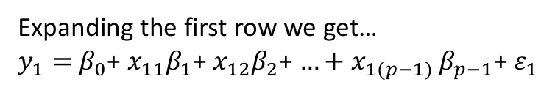
And write
$$\left(\begin{matrix}y_{1} \\ y_{2} \\ \begin{matrix}y_{3} \\ ⋮ \\ ⋮ \\ y_{n}\end{matrix}\end{matrix}\right)=\left(\begin{matrix}1 & x_{11} & x_{12} & … & x_{1(p−1)} \\ 1 & x_{21} & x_{22} & … & x_{2(p−1)} \\ 1 & x_{31} & x_{32} & … & x_{3(p−1)} \\ ⋮ & ⋮ & ⋮ & ⋱ & ⋮ \\ ⋮ & ⋮ & ⋮ & ⋱ & ⋮ \\ 1 & x_{n1} & x_{n2} & … & x_{n(p−1)}\end{matrix}\right)\left(\begin{matrix}β_{0} \\ β_{1} \\ \begin{matrix}β_{2} \\ ⋮ \\ β_{p−1}\end{matrix}\end{matrix}\right)+\left(\begin{matrix}ε_{1} \\ ε_{2} \\ \begin{matrix}ε_{3} \\ ⋮ \\ ⋮ \\ ε_{n}\end{matrix}\end{matrix}\right)$$
Expanding the first row we get…
$y_{1}=$ $β_{0}$+ $x_{11}β_{1}$+ $x_{12}β_{2}$+ ${…+x}_{1(p−1)}β_{p−1}$+ $ε_{1}$

Slide 35
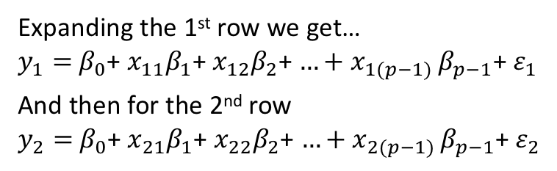
And write
$$\left(\begin{matrix}y_{1} \\ y_{2} \\ \begin{matrix}y_{3} \\ ⋮ \\ ⋮ \\ y_{n}\end{matrix}\end{matrix}\right)=\left(\begin{matrix}1 & x_{11} & x_{12} & … & x_{1(p−1)} \\ 1 & x_{21} & x_{22} & … & x_{2(p−1)} \\ 1 & x_{31} & x_{32} & … & x_{3(p−1)} \\ ⋮ & ⋮ & ⋮ & ⋱ & ⋮ \\ ⋮ & ⋮ & ⋮ & ⋱ & ⋮ \\ 1 & x_{n1} & x_{n2} & … & x_{n(p−1)}\end{matrix}\right)\left(\begin{matrix}β_{0} \\ β_{1} \\ \begin{matrix}β_{2} \\ ⋮ \\ β_{p−1}\end{matrix}\end{matrix}\right)+\left(\begin{matrix}ε_{1} \\ ε_{2} \\ \begin{matrix}ε_{3} \\ ⋮ \\ ⋮ \\ ε_{n}\end{matrix}\end{matrix}\right)$$
Expanding the 1st row we get…
$y_{1}=$ $β_{0}$+ $x_{11}β_{1}$+ $x_{12}β_{2}$+ ${…+x}_{1(p−1)}β_{p−1}$+ $ε_{1}$
And then for the 2nd row
$y_{2}=$ $β_{0}$+ $x_{21}β_{1}$+ $x_{22}β_{2}$+ ${…+x}_{2(p−1)}β_{p−1}$+ $ε_{2}$

Slide 36
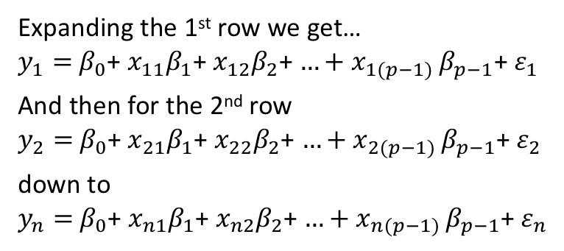
And write
$$\left(\begin{matrix}y_{1} \\ y_{2} \\ \begin{matrix}y_{3} \\ ⋮ \\ ⋮ \\ y_{n}\end{matrix}\end{matrix}\right)=\left(\begin{matrix}1 & x_{11} & x_{12} & … & x_{1(p−1)} \\ 1 & x_{21} & x_{22} & … & x_{2(p−1)} \\ 1 & x_{31} & x_{32} & … & x_{3(p−1)} \\ ⋮ & ⋮ & ⋮ & ⋱ & ⋮ \\ ⋮ & ⋮ & ⋮ & ⋱ & ⋮ \\ 1 & x_{n1} & x_{n2} & … & x_{n(p−1)}\end{matrix}\right)\left(\begin{matrix}β_{0} \\ β_{1} \\ \begin{matrix}β_{2} \\ ⋮ \\ β_{p−1}\end{matrix}\end{matrix}\right)+\left(\begin{matrix}ε_{1} \\ ε_{2} \\ \begin{matrix}ε_{3} \\ ⋮ \\ ⋮ \\ ε_{n}\end{matrix}\end{matrix}\right)$$
Expanding the 1st row we get…
$y_{1}=$ $β_{0}$+ $x_{11}β_{1}$+ $x_{12}β_{2}$+ ${…+x}_{1(p−1)}β_{p−1}$+ $ε_{1}$
And then for the 2nd row
$y_{2}=$ $β_{0}$+ $x_{21}β_{1}$+ $x_{22}β_{2}$+ ${…+x}_{2(p−1)}β_{p−1}$+ $ε_{2}$
down to
$y_{n}=$ $β_{0}$+ $x_{n1}β_{1}$+ $x_{n2}β_{2}$+ ${…+x}_{n(p−1)}β_{p−1}$+ $ε_{n}$

Slide 37
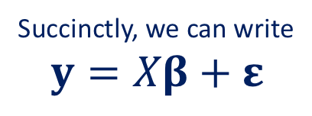
And write..
$$\left(\begin{matrix}y_{1} \\ y_{2} \\ \begin{matrix}y_{3} \\ ⋮ \\ ⋮ \\ y_{n}\end{matrix}\end{matrix}\right)=\left(\begin{matrix}1 & x_{11} & x_{12} & … & x_{1(p−1)} \\ 1 & x_{21} & x_{22} & … & x_{2(p−1)} \\ 1 & x_{31} & x_{32} & … & x_{3(p−1)} \\ ⋮ & ⋮ & ⋮ & ⋱ & ⋮ \\ ⋮ & ⋮ & ⋮ & ⋱ & ⋮ \\ 1 & x_{n1} & x_{n2} & … & x_{n(p−1)}\end{matrix}\right)\left(\begin{matrix}β_{0} \\ β_{1} \\ \begin{matrix}β_{2} \\ ⋮ \\ β_{p−1}\end{matrix}\end{matrix}\right)+\left(\begin{matrix}ε_{1} \\ ε_{2} \\ \begin{matrix}ε_{3} \\ ⋮ \\ ⋮ \\ ε_{n}\end{matrix}\end{matrix}\right)$$
Succinctly, we can write
$$y=Xβ+ε$$
Expanding the 1st row we get…
$y_{1}=$ $β_{0}$+ $x_{11}β_{1}$+ $x_{12}β_{2}$+ ${…+x}_{1(p−1)}β_{p−1}$+ $ε_{1}$
And then for the 2nd row
$y_{2}=$ $β_{0}$+ $x_{21}β_{1}$+ $x_{22}β_{2}$+ ${…+x}_{2(p−1)}β_{p−1}$+ $ε_{2}$
down to
$y_{n}=$ $β_{0}$+ $x_{n1}β_{1}$+ $x_{n2}β_{2}$+ ${…+x}_{n(p−1)}β_{p−1}$+ $ε_{n}$
The linear model

Slide 38

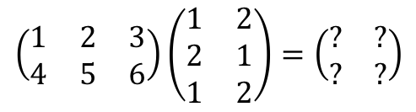


Matrix multiplication
$$\left(\begin{matrix}1 & 2 & 3 \\ 4 & 5 & 6\end{matrix}\right)\left(\begin{matrix}1 & 2 \\ 2 & 1 \\ 1 & 2\end{matrix}\right)=\left(\begin{matrix}? & ? \\ ? & ?\end{matrix}\right)$$
$$2×3$$
$$3×2$$
$$2×2$$

Slide 39
Matrix multiplication
$$\left(\begin{matrix}1 & 2 & 3 \\ 4 & 5 & 6\end{matrix}\right)\left(\begin{matrix}1 & 2 \\ 2 & 1 \\ 1 & 2\end{matrix}\right)=\left(\begin{matrix}? & ? \\ ? & ?\end{matrix}\right)$$
$$2×3$$
$$3×2$$
$$2×2$$
Number of columns of first matrix must match number of rows of second matrix

Slide 40
Matrix multiplication
$$\left(\begin{matrix}1 & 2 & 3 \\ 4 & 5 & 6\end{matrix}\right)\left(\begin{matrix}1 & 2 \\ 2 & 1 \\ 1 & 2\end{matrix}\right)=\left(\begin{matrix}? & ? \\ ? & ?\end{matrix}\right)$$
$$2×3$$
$$3×2$$
$$2×2$$
Getting the dimensions of the matrix answer

Slide 41

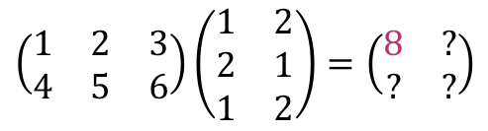
Matrix multiplication
$$\left(\begin{matrix}1 & 2 & 3 \\ 4 & 5 & 6\end{matrix}\right)\left(\begin{matrix}1 & 2 \\ 2 & 1 \\ 1 & 2\end{matrix}\right)=\left(\begin{matrix}8 & ? \\ ? & ?\end{matrix}\right)$$
Element $\left(1,1\right)=1×1+2×2+3×1=8$

Slide 42
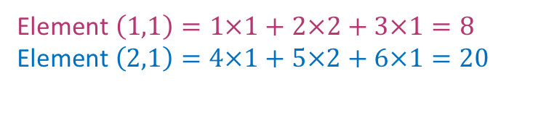
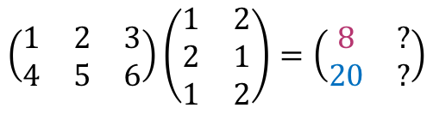
Matrix multiplication
$$\left(\begin{matrix}1 & 2 & 3 \\ 4 & 5 & 6\end{matrix}\right)\left(\begin{matrix}1 & 2 \\ 2 & 1 \\ 1 & 2\end{matrix}\right)=\left(\begin{matrix}8 & ? \\ 20 & ?\end{matrix}\right)$$
Element $\left(1,1\right)=1×1+2×2+3×1=8$
$$\text{Element} \left(2,1\right)=4×1+5×2+6×1=20$$

Slide 43
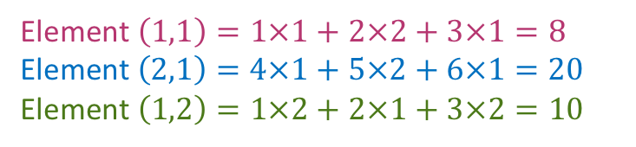
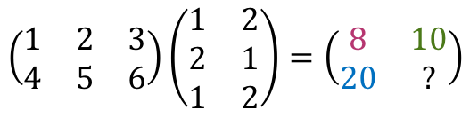
Matrix multiplication
$$\left(\begin{matrix}1 & 2 & 3 \\ 4 & 5 & 6\end{matrix}\right)\left(\begin{matrix}1 & 2 \\ 2 & 1 \\ 1 & 2\end{matrix}\right)=\left(\begin{matrix}8 & 10 \\ 20 & ?\end{matrix}\right)$$
Element $\left(1,1\right)=1×1+2×2+3×1=8$
$$\text{Element} \left(2,1\right)=4×1+5×2+6×1=20$$
Element $\left(1,2\right)=1×2+2×1+3×2=10$

Slide 44


Matrix multiplication
$$\left(\begin{matrix}1 & 2 & 3 \\ 4 & 5 & 6\end{matrix}\right)\left(\begin{matrix}1 & 2 \\ 2 & 1 \\ 1 & 2\end{matrix}\right)=\left(\begin{matrix}8 & 10 \\ 20 & 25\end{matrix}\right)$$
Element $\left(1,1\right)=1×1+2×2+3×1=8$
$$\text{Element} \left(2,1\right)=4×1+5×2+6×1=20$$
Element $\left(1,2\right)=1×2+2×1+3×2=10$
$$\text{Element} \left(2,2\right)=4×2+5×1+6×2=25$$

Slide 45



Matrix multiplication
$$\left(\begin{matrix}1 & 2 & 3 \\ 4 & 5 & 6\end{matrix}\right)\left(\begin{matrix}1 & 2 \\ 2 & 1 \\ 1 & 2\end{matrix}\right)=\left(\begin{matrix}8 & 10 \\ 20 & 25\end{matrix}\right)$$
Element $\left(1,1\right)=1×1+2×2+3×1=8$
$$\text{Element} \left(2,1\right)=4×1+5×2+6×1=20$$
Element $\left(1,2\right)=1×2+2×1+3×2=10$
$$\text{Element} \left(2,2\right)=4×2+5×1+6×2=25$$

Slide 46


Element-by-element multiplication
$$\left(\begin{matrix}2 & 6 \\ 3 & 5 \\ 4 & 4\end{matrix}\right)∗\left(\begin{matrix}2 & 6 \\ 4 & 7 \\ 2 & 3\end{matrix}\right)=\left(\begin{matrix}4 & 36 \\ 12 & 35 \\ 8 & 12\end{matrix}\right)$$

Slide 47

Matrix transpose
To get a matrix transpose you reflect the matrix elements along the main diagonal:
$${\left(\begin{matrix}1 & 2 & 3 \\ 4 & 5 & 6 \\ 7 & 8 & 9\end{matrix}\right)}^{T}=\left(\begin{matrix}1 & 4 & 7 \\ 2 & 5 & 8 \\ 3 & 6 & 9\end{matrix}\right)$$

Slide 48
Matrix transpose
To get a matrix transpose you reflect the matrix elements along the main diagonal:
$${\left(\begin{matrix}1 & 2 & 3 \\ 4 & 5 & 6 \\ 7 & 8 & 9\end{matrix}\right)}^{T}=\left(\begin{matrix}1 & 4 & 7 \\ 2 & 5 & 8 \\ 3 & 6 & 9\end{matrix}\right)$$

Slide 49

Matrix transpose
To get a matrix transpose you reflect the matrix elements along the main diagonal:
$${\left(\begin{matrix}1 & 2 & 3 \\ 4 & 5 & 6 \\ 7 & 8 & 9\end{matrix}\right)}^{T}=\left(\begin{matrix}1 & 4 & 7 \\ 2 & 5 & 8 \\ 3 & 6 & 9\end{matrix}\right)$$

Slide 50

Matrix transpose
To get a matrix transpose you reflect the matrix elements along the main diagonal:
$${\left(\begin{matrix}1 & 2 & 3 \\ 4 & 5 & 6 \\ 7 & 8 & 9\end{matrix}\right)}^{T}=\left(\begin{matrix}1 & 4 & 7 \\ 2 & 5 & 8 \\ 3 & 6 & 9\end{matrix}\right)$$
You can also transpose non-square matrices
$${\left(\begin{matrix}1 & 3 & 5 \\ 2 & 4 & 6\end{matrix}\right)}^{T}=\left(\begin{matrix}1 & 2 \\ 3 & 4 \\ 5 & 6\end{matrix}\right)$$

Slide 51



Matrix transpose
To get a matrix transpose you reflect the matrix elements along the main diagonal:
$${\left(\begin{matrix}1 & 2 & 3 \\ 4 & 5 & 6 \\ 7 & 8 & 9\end{matrix}\right)}^{T}=\left(\begin{matrix}1 & 4 & 7 \\ 2 & 5 & 8 \\ 3 & 6 & 9\end{matrix}\right)$$
And note that if $A^{T}=B$, then $B^{T}=A$
$${\left(\begin{matrix}1 & 3 & 5 \\ 2 & 4 & 6\end{matrix}\right)}^{T}=\left(\begin{matrix}1 & 2 \\ 3 & 4 \\ 5 & 6\end{matrix}\right)$$
$${\left(\begin{matrix}1 & 2 \\ 3 & 4 \\ 5 & 6\end{matrix}\right)}^{T}=\left(\begin{matrix}1 & 3 & 5 \\ 2 & 4 & 6\end{matrix}\right)$$

Slide 52

Identity matrix
The identity matrix is a square matrix with ones on the diagonal and zeros everywhere else. Whenever, you multiply with the identity matrix you get the same answer (like multiplying scalars by one)
$$\left(\begin{matrix}1 & 0 \\ 0 & 1\end{matrix}\right)\left(\begin{matrix}6 & 7 \\ 12 & 2\end{matrix}\right)=\left(\begin{matrix}6 & 7 \\ 12 & 2\end{matrix}\right)$$

Slide 53


Identity matrix
The identity matrix is a square matrix with ones on the diagonal and zeros everywhere else. Whenever, you multiply with the identity matrix you get the same answer (like multiplying scalars by one)
$$\left(\begin{matrix}1 & 0 \\ 0 & 1\end{matrix}\right)\left(\begin{matrix}6 & 7 \\ 12 & 2\end{matrix}\right)=\left(\begin{matrix}6 & 7 \\ 12 & 2\end{matrix}\right)$$
Identity matrix denoted by $I$, e.g. $I_{2}$, and $I_{3}$
$$\left(\begin{matrix}1 & 2 & 3 \\ 4 & 5 & 6\end{matrix}\right)\left(\begin{matrix}1 & 0 & 0 \\ 0 & 1 & 0 \\ 0 & 0 & 1\end{matrix}\right)=\left(\begin{matrix}1 & 2 & 3 \\ 4 & 5 & 6\end{matrix}\right)$$
Works whether you pre- or post-multiply

Slide 54


Identity matrix
The identity matrix is a square matrix with ones on the diagonal and zeros everywhere else. Whenever, you multiply with the identity matrix you get the same answer (like multiplying scalars by one)
$$\left(\begin{matrix}1 & 0 \\ 0 & 1\end{matrix}\right)\left(\begin{matrix}6 & 7 \\ 12 & 2\end{matrix}\right)=\left(\begin{matrix}6 & 7 \\ 12 & 2\end{matrix}\right)$$
Identity matrix denoted by $I$, e.g. $I_{2}$, and $I_{3}$
$$I_{2}$$
$$\left(\begin{matrix}1 & 2 & 3 \\ 4 & 5 & 6\end{matrix}\right)\left(\begin{matrix}1 & 0 & 0 \\ 0 & 1 & 0 \\ 0 & 0 & 1\end{matrix}\right)=\left(\begin{matrix}1 & 2 & 3 \\ 4 & 5 & 6\end{matrix}\right)$$
$$I_{3}$$
Works whether you pre- or post-multiply

Slide 55


Inverse matrix
For a matrix $A$ it’s inverse $A^{−1}$ is such that
$$AA^{−1}=I=A^{−1}A$$
E.g. ${\left(\begin{matrix}4 & 7 \\ 2 & 6\end{matrix}\right)}^{−1}=\left(\begin{matrix}0.6 & −0.7 \\ −0.2 & 0.4\end{matrix}\right)$
Not all matrices have an inverse (most don’t) – they have to be square and nonsingular
Calculating an inverse is quite involved but R can do it for you with the solve command

Slide 56
Validation and Cross-validation

Slide 57
Training Error versus Test error
Recall the distinction between the test error and the training error:
The test error is the average error that results from using a machine learning method to predict the response on a new observation, i.e., one that was not used in training the method.
In contrast, the training error is the average error of the machine learning method to predict the observations that were used in training.
But the training error rate can be quite different from the test error rate, and in particular the training error can dramatically underestimate the the test error of interest.

Slide 58

Training- versus Test-Set Performance

Slide 59
More on prediction-error estimates
Best solution: a large designated independent test set. Often not available.
Some methods make a mathematical adjustment to the training error rate in order to estimate the test error rate. These include AIC and BIC.
Here we instead consider a class of methods that estimate the test error by removing a subset of the training observations from the fitting process, and then applying the fitted machine learning method to those held out observations (the validation set [sometimes called hold-out set], which is now effectively a test set)

Slide 60
Validation approach
Here we randomly divide the available set of samples into two parts: a training set and a validation set.
The model is fit on the training set, and the fitted model is used to predict the responses for the observations in the validation set.
The resulting validation set error provides an estimate of the test error. This is typically assessed using MSE in the case of a quantitative response and misclassification rate in the case of a qualitative (discrete) response.

Slide 61

The Validation process
…
…
Training Set
Validation Set
…
n 44 2
4 35 …
… 17
A random split is made into two halves: left part is training set, right part is validation set (it is also common to split 60:40)

Slide 62

Example
Want to compare linear vs higher-order polynomial terms in a linear regression
We randomly split the 392 observations into two sets, a training set containing 196 of the data points, and a validation set containing the remaining 196 observations.
Left panel shows single split; right panel shows multiple splits

Slide 63

Drawbacks of validation set approach
The validation estimate of the test error can be highly variable, depending on precisely which observations are included in the training set and which observations are included in the test set.
In the validation approach, only a subset of the observations — those that are included in the training set rather than in the validation set — are used to fit the model.
This suggests that the validation set error may tend to overestimate the test error for the model fit on the entire data set. (The model has been fit with a sample size of $n/2$ rather than $n$, which will clearly provide a less reliable fit.)

Slide 64

Alternative: K-fold cross-validation
Widely used approach for estimating test error.
Estimates can be used to select best model, and to give an idea of the test error of the final chosen model.
Idea is to randomly divide the data into $K$ equal-sized parts. We leave out part $k$, fit the model to the other $K−1$ parts (combined), and then obtain predictions for the left-out $k$^{th} part.
This is done in turn for each part $k=1,2,…K$, and then the results are combined.

Slide 65
K-fold Cross-validation in detail
Divide data into $K$ roughly equal-sized parts ($K=5$here)
Validation
Train
Train
Train
Train

Slide 66
K-fold Cross-validation in detail
Divide data into $K$ roughly equal-sized parts ($K=5$here)
Validation
Train
Train
Train
Train
Now fit the model on the four training parts combined
Calculate the prediction error on the validation set.

Slide 67
K-fold Cross-validation in detail
Divide data into $K$ roughly equal-sized parts ($K=5$here)
Validation
Train
Train
Train
Train
Now fit the model on the four training parts combined
Calculate the prediction error on the validation set.
Now switch the validation set and refit to the 4 remaining train sets and calculate prediction error on new validation set.
Train
Validation
Train
Train
Train

Slide 68
K-fold Cross-validation in detail
Divide data into $K$ roughly equal-sized parts ($K=5$here)
Validation
Train
Train
Train
Train
Now fit the model on the four training parts combined
Calculate the prediction error on the validation set.
Now switch the validation set and refit to the 4 remaining train sets and calculate prediction error on new validation set.
Train
Validation
Train
Train
Train
Repeat this process until every partition has been the validation set and average the prediction error over all 5 validation sets.

Slide 69



The details
Let the $K$ parts be $C1,C2,…CK,$where $Ck$ denotes the indices of the observations in part $k$. There are $nk$ observations in part $k$: if $N$ is a multiple of $K$, then $nk=n/K$.
Compute
where and ${\hat{y}}_{i}$ is the fit for observation $i$, obtained from the data with part $k$ removed.
Setting $K=n$yields $n$-fold or leave-one-out cross-validation (LOOCV).
MSE for continuous outcome

Slide 70


A nice special case!
With least-squares linear or polynomial regression, an amazing shortcut makes the cost of LOOCV the same as that of a single model fit! The following formula holds:
where ${\hat{y}}_{i}$ is the $i$^{th} fitted value from the original least squares fit, and $hi$ is the leverage (diagonal of the “hat” matrix; see ISLR book for details.) This is like the ordinary MSE, except the $i$^{th} residual is divided by $1−hi$.

Slide 71


Limitations of LOOCV
LOOCV sometimes useful, but typically doesn’t shake up the data enough. The estimates from each fold are highly correlated and hence their average can have high variance.
A better choice is $K=5$ or $10$.

Slide 72

Other issues with Cross-validation
Since each training set is only $(K−1)/K$as big as the original training set, the estimates of prediction error will typically be biased upward. Why?
This bias is minimized when $K=n$(LOOCV), but this estimate has high variance.
$K=5$or $10$ provides a good compromise for this bias-variance tradeoff.

Slide 73




Cross-Validation for Classification Problems
We divide the data into $K$ roughly equal-sized parts $C1,C2,…CK$. $Ck$ denotes the indices of the observations in part $k$. There are $nk$ observations in part $k$: if $n$ is a multiple of $K$, then $nk=n/K$.
Compute
The estimated standard deviation of $CVK$ is
This is a useful estimate, but strictly speaking, not quite valid. Why not?
where

Slide 74
Cross-validation: right and wrong
Consider a simple classifier applied to some two-class data:
Starting with 5000 predictors and 50 samples, find the predictors having the largest correlation with the class labels
We then apply a classifier such as logistic regression, using only these 100 predictors
How do we estimate the test set performance of this classifier?
Can we apply cross-validation in step 2, forgetting about step 1?

Slide 75
NO!
This would ignore the fact that in Step 1, the procedure has already seen the labels of the training data, and made use of them. This is a form of training and must be included in the validation process.
It is easy to simulate realistic data with the class labels independent of the outcome, so that true test error =50%, but the CV error estimate that ignores Step 1 is zero!
Try to do this yourself
This error has been made in many high profile genomics papers

Slide 76
The Wrong and Right Way
Wrong: Apply cross-validation in step 2
Right: Apply cross-validation to steps 1 and 2.

Slide 77

Wrong way
Use all data to subset predictors

Slide 78

Right way

Slide 79
Right way
This means you will get different subsets of predictors for predicting each fold

Slide 80
Summary
Matrix algebra
Training-test validation
Cross-validation

Slide 81
Next Lecture
Support vector machines
And maybe a few other bits and pieces

