Slide 1
Boosting Algorithms
Gilmer Valdes, PhD DABR
Assistant Professor, Department of Radiation Oncology
University of California, San Francisco.

Slide 2
Outline
The origin of Boosting
Adaboost
Adaboost as a exponential loss minimizer
Gradient Boosting
Practical considerations.

Slide 3
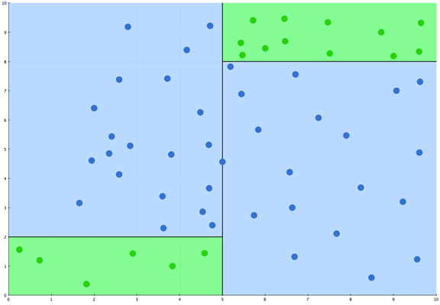
Recap
Decision Trees
X1
X2

Slide 4
Advantages and Disadvantages of Decision Trees
Advantages
Disadvantages
Consistent estimators
Fast
Natural way to handle missing data
Independent of monotonic transformations of the input variables.
Interpretable
Each rule is obtained with exponentially less data.
Rules are memory-less.
They are unstable procedures.
Do not model linear data very well.

Slide 5
The origin of Boosting
Hypothesis: Does the existence of a weak algorithm that outputs a hypothesis that is
just slightly better than random implies that there is a strong algorithm which outputs
a hypothesis of arbitrary accuracy? (1988)
http://www.cis.upenn.edu/~mkearns/papers/boostnote.pdf

Slide 6
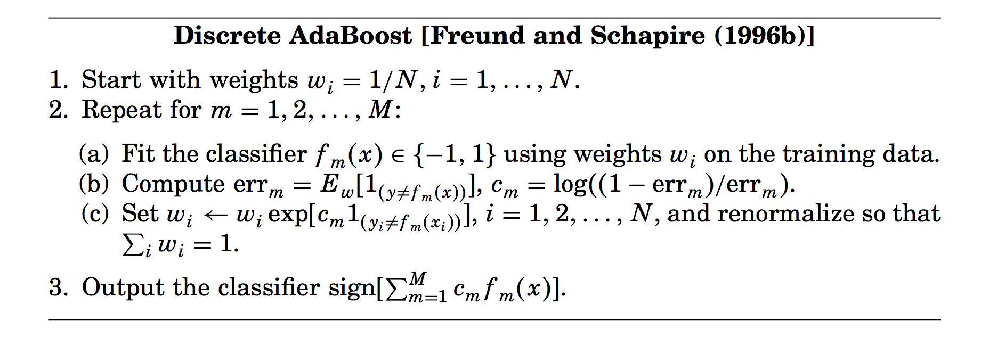
Adaboost
“Experiments with a new boosting algorithm.” Yoav Freund and Robert E. Schapire (1996)
http://web.eecs.utk.edu/~leparker/Courses/CS425-528-fall12/Handouts/AdaBoost.M1.pdf
https://alliance.seas.upenn.edu/~cis520/dynamic/2018/wiki/index.php?n=Lectures.Boosting

Slide 7

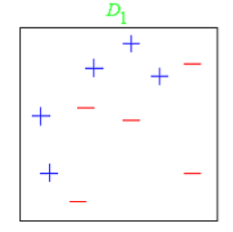
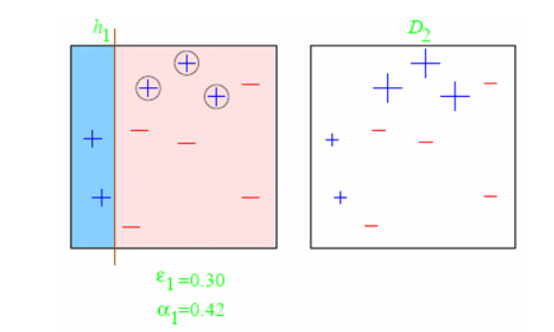
Boosting Decision Stumps
h₁(x) =
First round:
https://alliance.seas.upenn.edu/~cis520/wiki/
Notes:
Is boosting interpretable according to our definiion

Slide 8
Adaboost
“Experiments with a new boosting algorithm.” Yoav Freund and Robert E. Schapire (1996)
http://web.eecs.utk.edu/~leparker/Courses/CS425-528-fall12/Handouts/AdaBoost.M1.pdf
https://alliance.seas.upenn.edu/~cis520/dynamic/2018/wiki/index.php?n=Lectures.Boosting

Slide 9
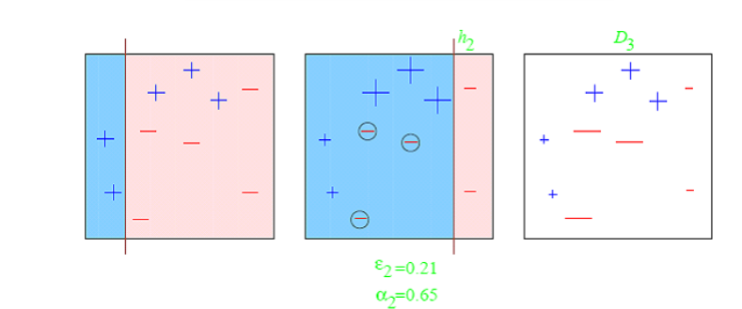
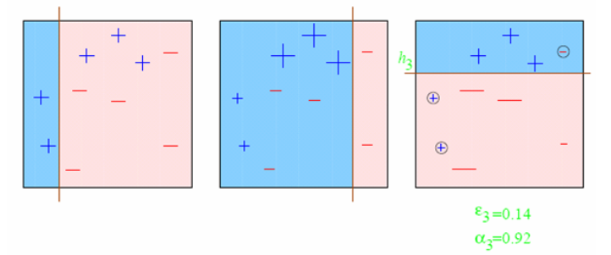
Boosting Decision Stumps
Second round:
Third round:
https://alliance.seas.upenn.edu/~cis520/wiki/

Slide 10
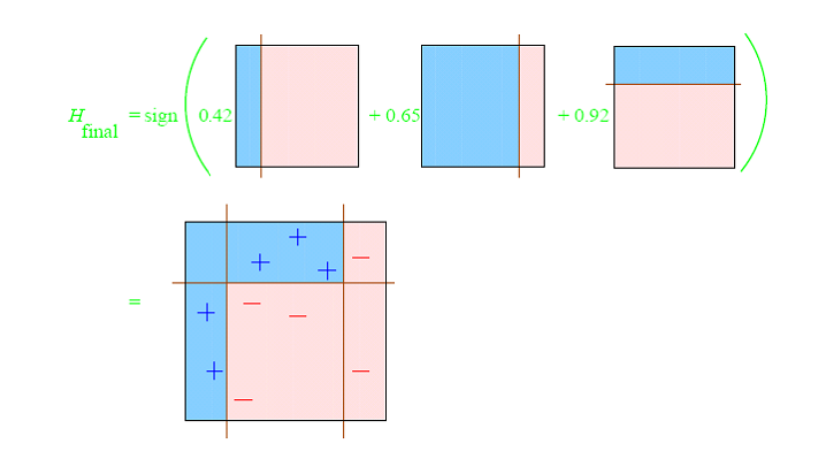
Boosting Decision Stumps
The final classifier:
https://alliance.seas.upenn.edu/~cis520/wiki/

Slide 11
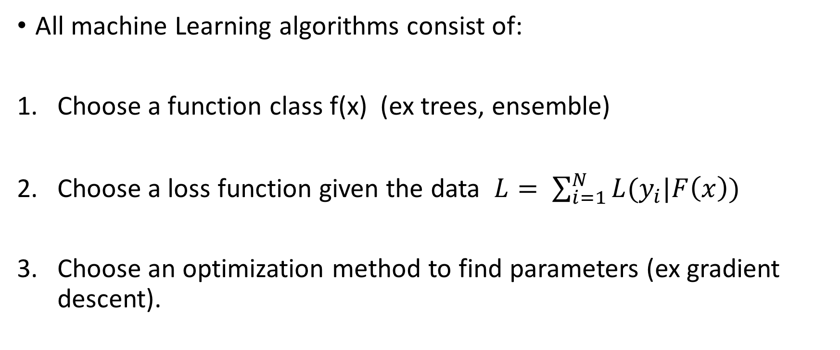
Why boosting works?
All machine Learning algorithms consist of:
Choose a function class f(x) (ex trees, ensemble)
Choose a loss function given the data $L= \sum_{i=1}^{N}{L(y_{i}|F\left(x\right))}$
Choose an optimization method to find parameters (ex gradient descent).

Slide 12
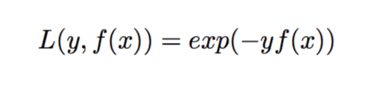
Why boosting works?
Minimizes exponential loss
Using Forward Stagewise Additive Modeling
“Additive Logistic Regression: Statistical View of Boosting” (2000). Friedman et al
https://projecteuclid.org/download/pdf_1/euclid.aos/1016218223

Slide 13

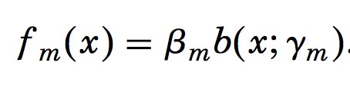
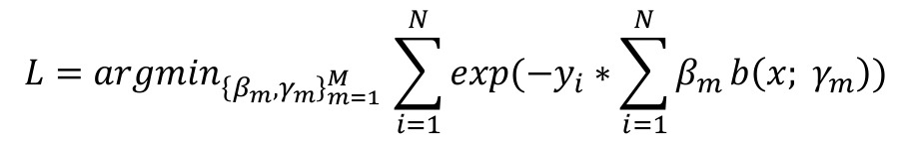
Why boosting works?
1. Type of function: Additive modeling is just the fact that the solution to adaboost is a weighted sum of “basis” functions
2. Loss function: Average over the training data.
$$L={argmin}_{{\left\{β_{m},γ_{m}\right\}}_{m=1}^{M} }\sum_{i=1}^{N}{exp({−y}_{i}∗\sum_{i=1}^{N}{β_{m}}b\left(x; γ_{m}\right))}$$

Slide 14
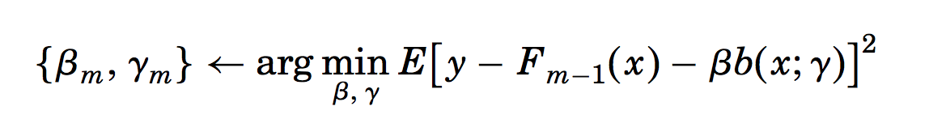
Why boosting works?
3. Stage forward fitting
It is a greedy optimization algorithm in which each function is added one at a time.
Previously added terms are not modified.

Slide 15
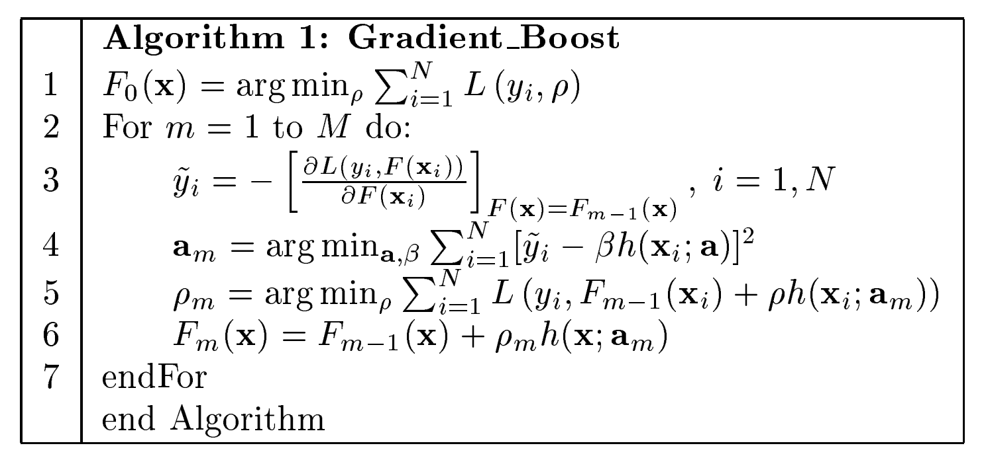
Gradient Boosting

Slide 16
Gradient Boosting vs Adaboost
Similar
Computing trees in a sequential way
Final model is a sum of weighted trees
Different
Trees in Adaboost are fitted on the same data but changing weights
Trees in boosting are fitted by modifying the target variable

Slide 17
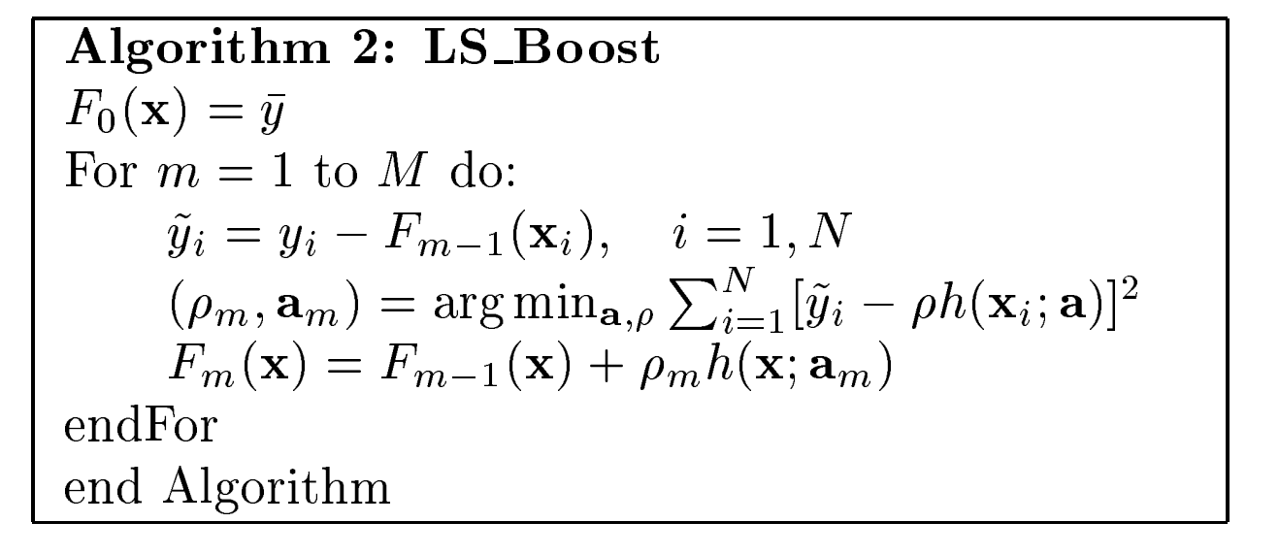

Gradient Boosting: Regression with Least Squared Loss
$$L=\sum_{i=1}^{N}{{\left(y_{i}−F(x_{i})\right)}^{2}}$$

Slide 18
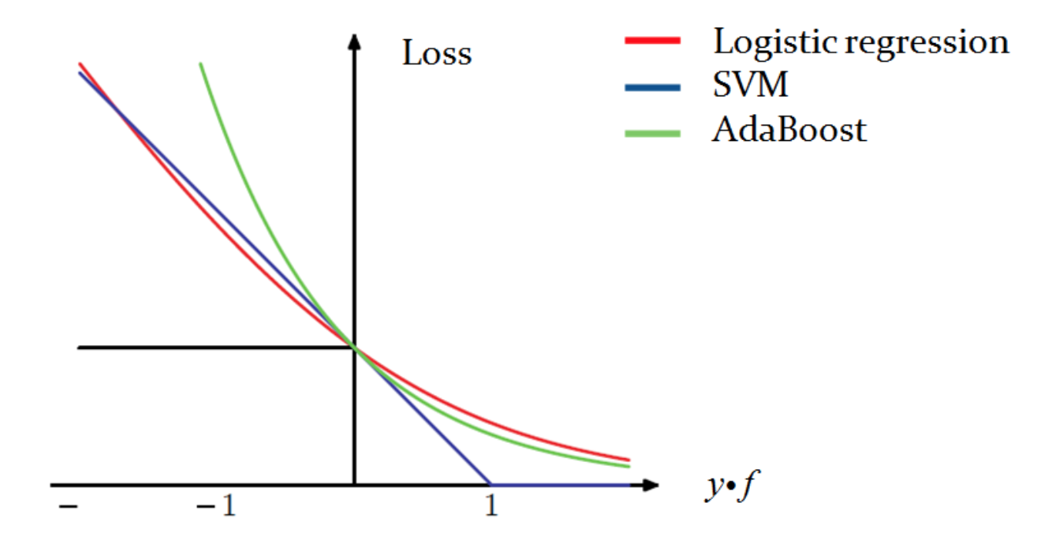
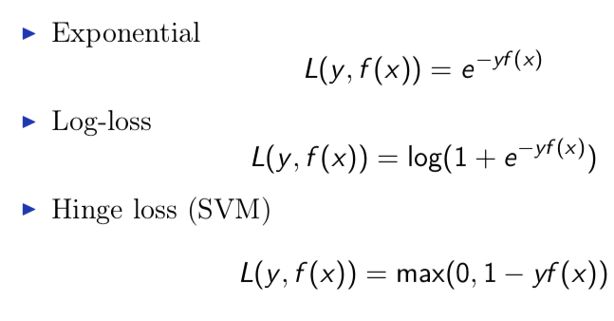
Least Squared Loss is a bad loss for classification

Slide 19
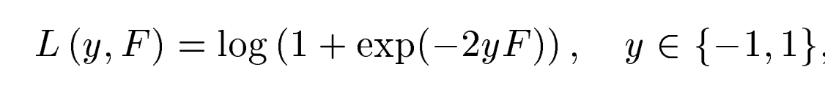
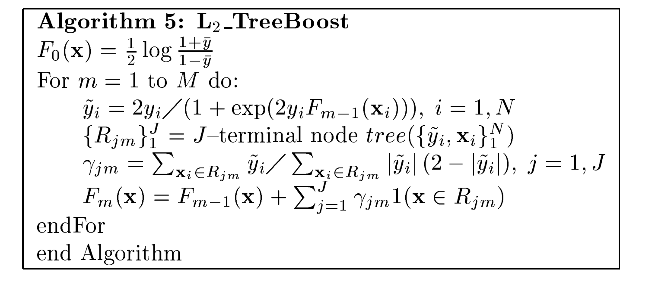
Gradient Boosting for Classification

Slide 20

Regularization in Gradient Boosting
Learning rate (also called shrinkage)
If decrease learning rate need to increase the number of three (M)
  First fix a learning rate (say 0.1).
  Then find the optimal M.
  Then you can divide learning rate by 2 and set M = 2M.
Very important parameter in gradient boosting

Slide 21
Regularization in Gradient Boosting
eta: shrinkage | 0.1
num_rounds: number of trees
max_depth : maximum depth of tree | 7
sub_sample: subsample ratio of the training instance | 0.5
colsample_bytree: fraction of columns to sample
http://xgboost.readthedocs.io/en/latest/parameter.html

Slide 22
Gradient Boosting vs Random Forests
Gradient Boosting generally perform better than a random forest.
Gradient Boosting have a few hyper-parameters to tune.
Random forest is almost tuning-free:
    You may want to control how big a tree can grow
      max_depth or min sample per leaf
    max_features

Slide 23
Gradient Boosting vs Neural Nets
Random Forest and Gradient Boosting models work well on tabular data.
  Each column of a tabular data has high information content on its own
  Demographic features, such as the age and gender of a person
Neural Nets useful when applied to “raw” sensory data
  Speech, Images, NLP
  Individual feature contains very little information
  Some success on training embeddings for categorical features on tabular data

Slide 24
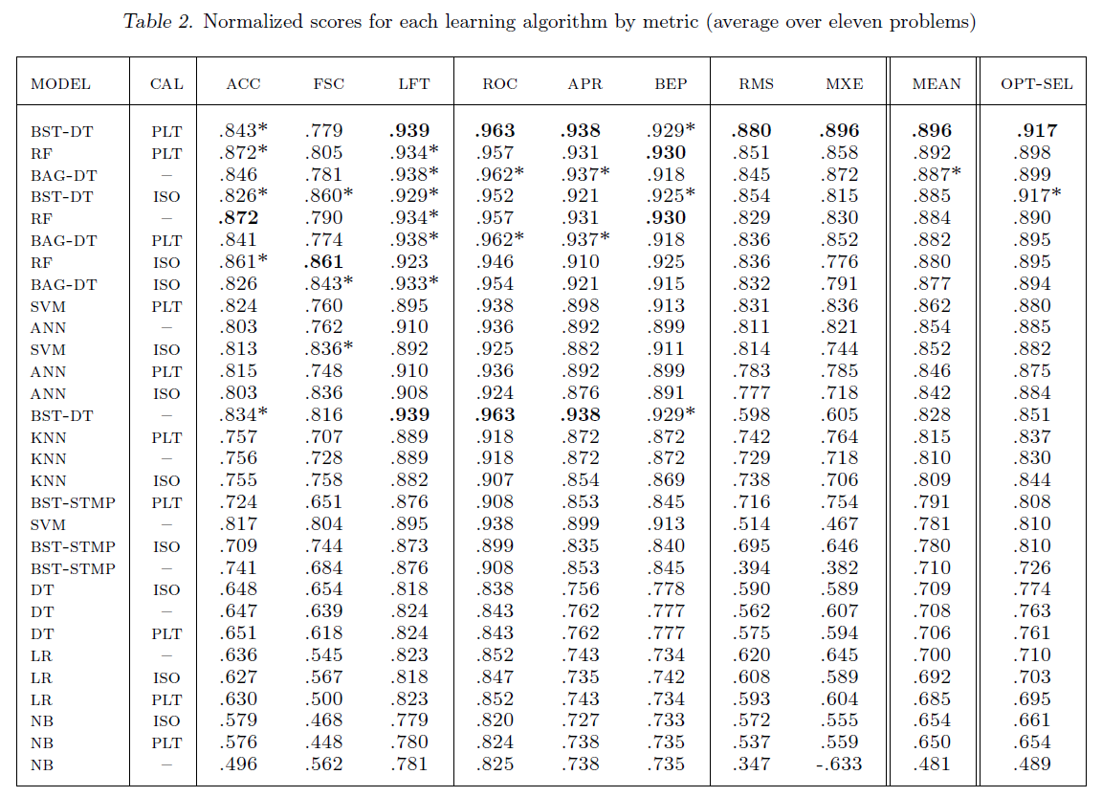
Empirical Comparison of Algorithms
“An Empirical Comparison of Supervised Learning Algorithms.” Rich Caruana, Alexandru Niculescu-Mizil.
Cornell University. https://www.cs.cornell.edu/~caruana/ctp/ct.papers/caruana.icml06.pdf

Slide 25
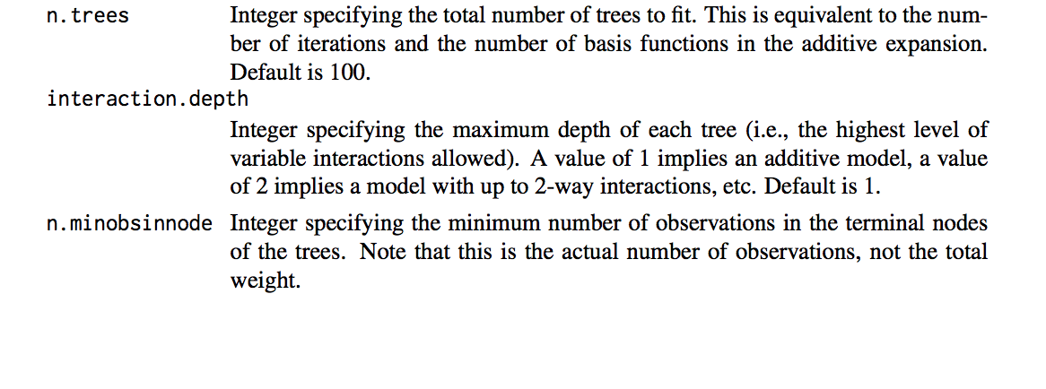
Gradient Boosting in R
https://cran.r-project.org/web/packages/gbm/gbm.pdf
Package GBM: hyper-parameters

Slide 26
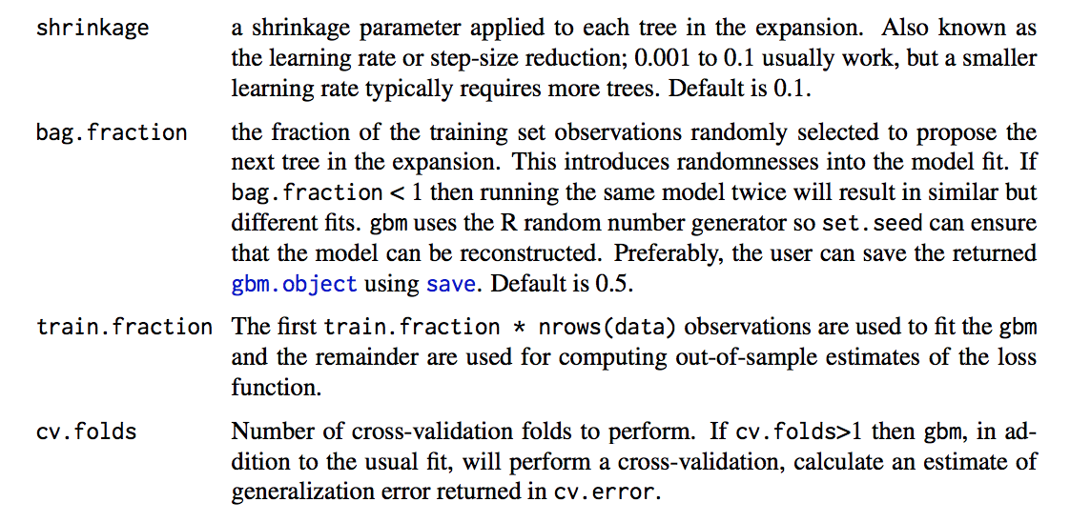
Gradient Boosting in R
https://cran.r-project.org/web/packages/gbm/gbm.pdf
Package GBM: hyper-parameters

Slide 27
Questions?
Email: gilmer.valdes@ucsf.edu

