Slide 1
Machine Learning in R
Cross-Validation and Nested Cross-Validation
John Kornak – Epidemiology and Biostatistics
john.kornak@ucsf.edu

Slide 2
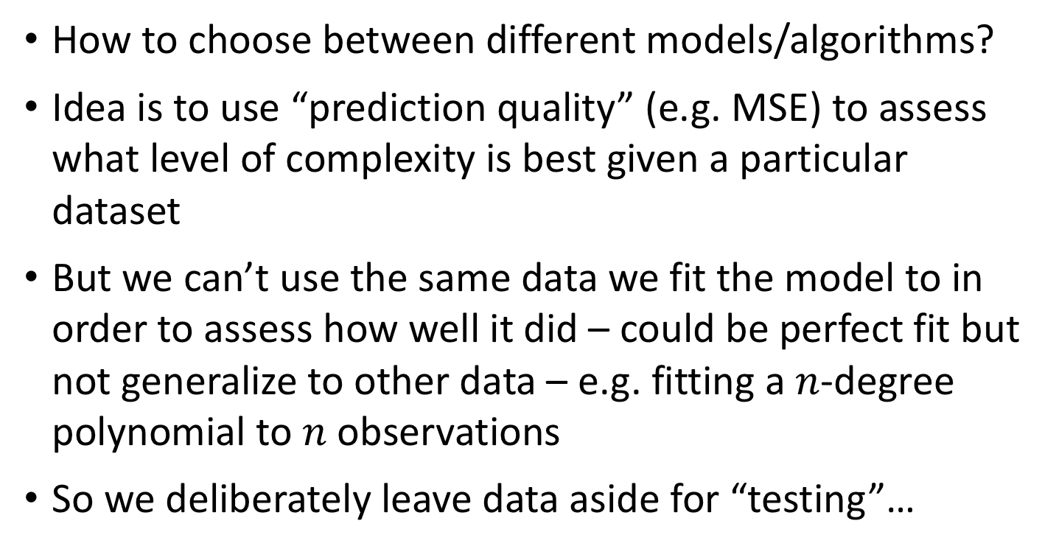
Estimating and evaluating “best” models without overfitting
How to choose between different models/algorithms?
Idea is to use “prediction quality” (e.g. MSE) to assess what level of complexity is best given a particular dataset
But we can’t use the same data we fit the model to in order to assess how well it did – could be perfect fit but not generalize to other data – e.g. fitting a $n$-degree polynomial to $n$ observations
So we deliberately leave data aside for “testing”…

Slide 3
Training/test
Randomly split data into training and test sets (often ~2/3 for train, 1/3 for test)
E.g., fit a linear regression model using the training set and evaluate it using Mean Squared Error (MSE) on the test set

Slide 4
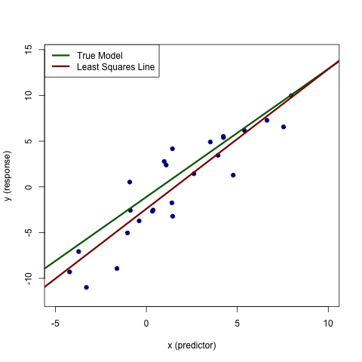
Training/test
Fit model to training data
Evaluate on test data
E.g. Linear regression
Red line is overfitting to this specific dataset

Slide 5
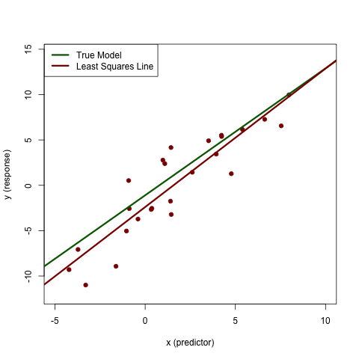
Training/test
Fit model to training data
Evaluate on test data
E.g. Linear regression
Red line is overfitting to the training dataset

Slide 6
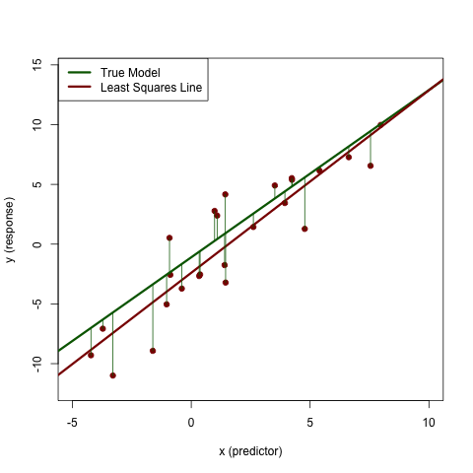
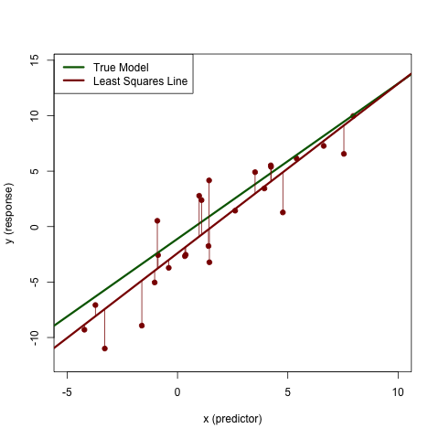
Training/test
Fit model to training data
Evaluate on test data
E.g. Linear regression
True noise Var is 9.0.
MSE to true line is 8.25
Train MSE is 6.62
(underestimated – i.e. overfitted)
Red line is overfitting to the training dataset

Slide 7
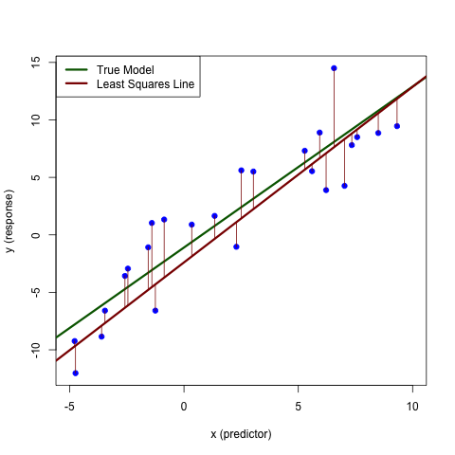
Training/test
Fit model to training data
Evaluate on test data
E.g. Linear regression
Train MSE is 6.62
(underestimated – i.e. overfitted)
Test MSE is 9.52
(not underestimated i.e. not overfitted)
Red line not overfitting to the test dataset

Slide 8
Training/test
Results Known
+
Training set
+
-
-
Data
+
-
+
+
Testing set

Slide 9
Training/test
Results Known
+
Training set
+
-
-
Data
+
-
+
+
Model Builder
Testing set

Slide 10
Training/test
Results Known
+
Training set
+
-
-
Data
+
-
+
+
Model Builder
Evaluate
Predictions
+
-
+
-
Y
N
Testing set

Slide 11
Training/test
Results Known
+
Training set
+
-
-
Data
+
-
+
+
Model Builder
Evaluate
Predictions
+
-
+
-
Y
N
Testing set

Slide 12
Training/test
Results Known
+
Training set
+
-
-
Data
+
-
+
+
Model Builder
Evaluate
Predictions
+
-
+
-
Y
N
Testing set
This is great if you have a lot of data to be able to reserve a testing set, but what if you don’t?

Slide 13
Cross-validation for training/test
Cross-validation
  First step: data is split into k subsets of equal size
  Second step: each subset is used in turn for validation and the remainder for training
This is called k-fold cross-validation (10-fold is common choice, also 5-fold for smaller datasets approx. <200 and even N-fold for very small datasets, called leave-one-out)
Often the subsets are stratified before the cross-validation is performed – e.g. same proportion of each diagnostic class in each fold
The error estimates are averaged across folds to yield an overall error estimate

Slide 14
E.g. 5-fold cross-validation
Break up data into 5 groups of the same size
Hold aside one group for testing and use the rest to build model
Repeat
When every group has had a turn at being the test set then you can estimate the accuracy (MSE or classification) based on the combined Test data (i.e. the 5 test-sets)

Slide 15
Cross-validation for training/test
Notice that at no time is the classification accuracy based on data that was used to fit or choose the model – so there is no over-fitting
And all of the data gets used in the process unlike training/test
As a final step you can then rebuild the classifier using all the data for predicting future observations – this model will (on average) be better than any of the individual models in the cross-validation because it uses more data

Slide 16
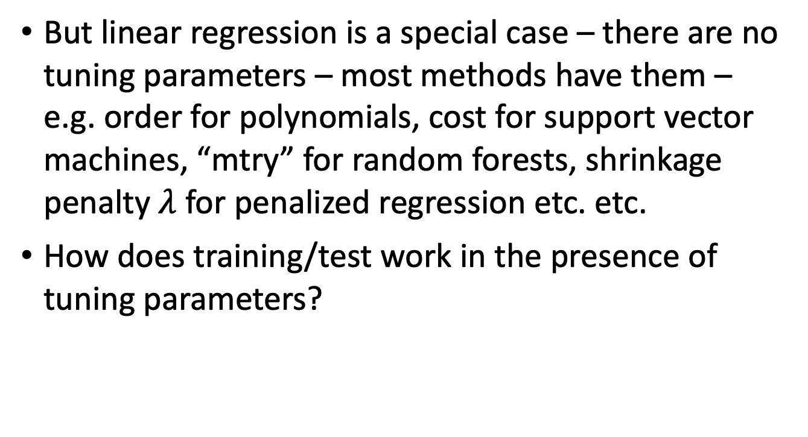
The issue of tuning parameters
But linear regression is a special case – there are no tuning parameters – most methods have them – e.g. order for polynomials, cost for support vector machines, “mtry” for random forests, shrinkage penalty $λ$ for penalized regression etc. etc.
How does training/test work in the presence of tuning parameters?

Slide 17
Polynomial example
Assume we have training set and test set as before (i.e. generated as linear model with noise)
But we don’t know that and we want to find the optimal polynomial fit
We want to reserve the test data to independently evaluate fit
So we work on finding the best polynomial in the training data based on MSE to evaluate in the test set

Slide 18
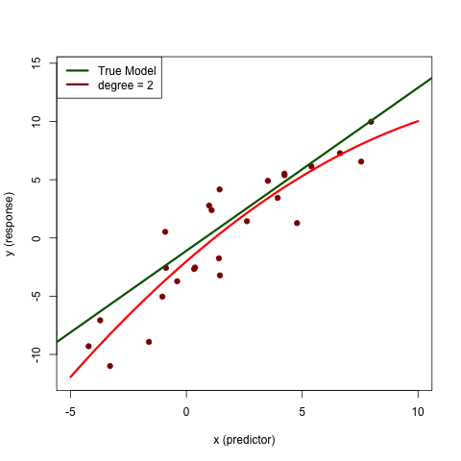
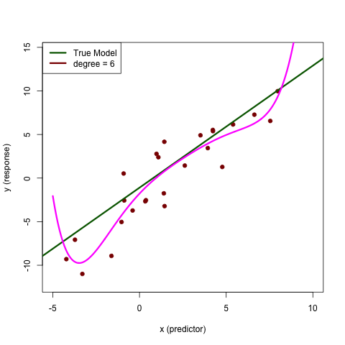
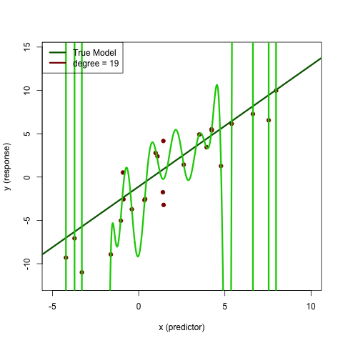
Polynomial fits to training data
Varying the degree of the fitted polynomial (the degree is the tuning parameter)
Train MSE = 4.98
Train MSE = 4.58
Train MSE = 1.48

Slide 19
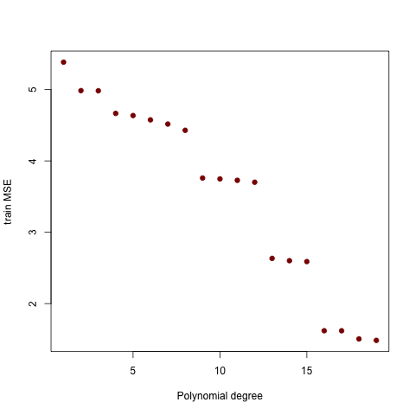
Training MSE
Choose polynomial degree 19?

Slide 20
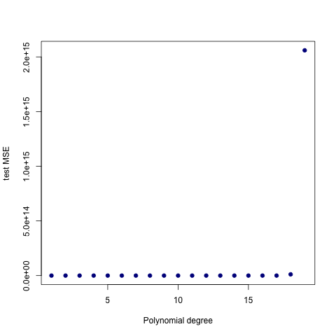
Training MSE – and – test MSE
Choose polynomial degree 19?
Degree 19 does really bad in test set – overfitting in training
Can we then try again? NO!

Slide 21
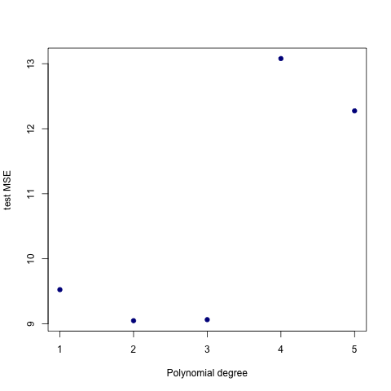
Training MSE – and – test MSE
Test error would pick degree 2
But we can’t use the test error based on degree 2 because we used the test data to select the model: model could be overfitted with respect to degree (or whatever parameter your optimization method uses)
Choose polynomial degree 19?
Degree 19 does really bad in test set – overfitting in training
Can we then try again? NO!

Slide 22
Solution train/validate/test
Full dataset

Slide 23
Solution train/validate/test
Split in 3

Slide 24
Solution train/validate/test
Split in 3
Training set
Validation set
Test set

Slide 25
Solution train/validate/test
Split in 3
Training set
Validation set
Test set
Fit all models here with all values of tuning parameters

Slide 26
Solution train/validate/test
Split in 3
Training set
Validation set
Test set
Fit all models here with all values of tuning parameters
Choose the best model here among the different values of tuning parameters

Slide 27
Solution train/validate/test
Split in 3
Training set
Validation set
Test set
Fit all models here with all values of tuning parameters
Choose the best model here among the different values of tuning parameters
Evaluate how well your chosen model performed here

Slide 28
Train/validate/test
Do this green box for multiple values of the procedures parameter(s), e.g. d = 3, 4, 5, 6 for polynomial degree
Results Known
+
Model
Builder
+
Training set
-
Data
-
+
Evaluate
-
Model Builder
+
Predictions
+
+
-
+
-
Y
N

Slide 29
Train/validate/test
Do this green box for multiple values of the procedures parameter(s), e.g. d = 3, 4, 5, 6 for polynomial degree
Results Known
+
Model
Builder
+
Training set
-
Data
-
+
Evaluate
-
Model Builder
+
Predictions
+
+
-
+
-
Y
N
Each model based on training set has potentially been over-fitted… so utilize a validation set to determine best fitting model

Slide 30
Train/validate/test
Do this green box for multiple values of the procedures parameter(s), e.g. d = 3, 4, 5, 6 for polynomial degree
Results Known
+
Model
Builder
+
Training set
-
Data
-
+
Evaluate
-
Model Builder
Choose best parameter value based on validation set results – evaluate model for each parameter value and choose the best
+
Predictions
+
+
-
+
-
Y
N
Validation set

Slide 31
Train/validate/test
Do this green box for multiple values of the procedures parameter(s), e.g. d = 3, 4, 5, 6 for polynomial degree
Results Known
+
Model
Builder
+
Training set
-
Data
-
+
Evaluate
-
Model Builder
Choose best parameter value based on validation set results – evaluate model for each parameter value and choose the best
+
Predictions
+
+
-
+
-
Y
N
Validation set
Because we are choosing from many models we have again potentially over-fitted and the classification accuracy may be optimistic -- so utilize a test set to determine accuracy of best fitting model

Slide 32
Train/validate/test
Do this green box for multiple values of the procedures parameter(s), e.g. d = 3, 4, 5, 6 for polynomial degree
Results Known
+
Model
Builder
+
Training set
-
Data
-
+
Evaluate
-
Model Builder
Choose best parameter value based on validation set results – evaluate model for each parameter value and choose the best
+
Predictions
+
+
-
+
-
Y
N
Validation set
+
-
+
-
Final Test Set
Final Model with optimized parameter(s) from validation set
Final Evaluation

Slide 33
Train/validate/test
But this is expensive in terms of data
We need to reserve a good part of the data for each of validation and testing
Can we use cross-validation again to help us not be so wasteful?
Yes, but we have to be careful…

Slide 34
Incorporating cross-validation
Split in 3
Training set
Validation set
Test set
Fit all models here with all values of tuning parameters
Choose the best model here among the different values of tuning parameters
Evaluate how well your chosen model performed here

Slide 35
Incorporating cross-validation
Training set
Validation set
Test set
Fit all models here with all values of tuning parameters
Choose the best model here among the different values of tuning parameters
Evaluate how well your chosen model performed here
Step 1: break down the problem. Let’s combine the training and validation into a single set that we will cross-validate over to get parameter estimates…

Slide 36
Incorporating cross-validation
Training set
Validation set
Test set
Perform k-fold cross-validation in here
Test set
Gives k estimates of parameters – take the average and refit to the combined training/validation set – note that this would not pick d = 19 for the polynomial -- why not?

Slide 37
Incorporating cross-validation
Perform k-fold cross-validation in here
Test set
Gives k estimates of parameters – take the average (or most common) and refit to the combined training/validation set – note that this would not pick d = 19 for the polynomial -- why not?
This approach is commonly used in medical research where the Test Set ideally comprises of a completely independent dataset – perhaps from another institution

Slide 38
Incorporating cross-validation
Perform k-fold cross-validation in here
Test set
Gives k estimates of parameters – take the average and refit to the combined training/validation set – note that this would not pick d = 19 for the polynomial -- why not?
This approach is commonly used in medical research where the Test Set ideally comprises of a completely independent dataset – perhaps from another institution
But what about if we really have a single data set that is not particularly big. Can we avoid reserving the test dataset for a single use? The answer is yes, but it takes some computer muscle. We need to perform an outer cross-validation around an inner cross-validation – nested cross-validation

Slide 39
Nested cross-validation
Full data
Split in k-folds

Slide 40
Nested cross-validation
Full data
Split in k-folds
Set the first test-fold

Slide 41
Nested cross-validation
Full data
Split in k-folds
Set the first test-fold
Use the k-1 training folds to fit the model and parameters

Slide 42
Nested cross-validation
Full data
Split in k-folds
Set the first test-fold
Use the k-1 training folds to fit the model and parameters with m-fold cross-validation

Slide 43
Nested cross-validation
Full data
Split in k-folds
Set the first test-fold
Use the k-1 training folds to fit the model and parameters with m-fold cross-validation

Slide 44
Nested cross-validation
Full data
Split in k-folds
Set the first test-fold
Use the k-1 training folds to fit the model and parameters with m-fold cross-validation

Slide 45
Nested cross-validation
Full data
Split in k-folds
Set the first test-fold
Use the k-1 training folds to fit the model and parameters with m-fold cross-validation
Gives cross-validated model with optimized
parameter value

Slide 46
Nested cross-validation
Full data
Split in k-folds
Set the first test-fold
Use the k-1 training folds to fit the model and parameters with m-fold cross-validation
Gives cross-validated model with optimized
parameter value
Evaluate model on reserved fold

Slide 47
Nested cross-validation
Full data
Split in k-folds
Set the first test-fold
Use the k-1 training folds to fit the model and parameters with m-fold cross-validation
Gives estimated cross-validated model
Repeat through all k-folds such that within each of the k-folds, m-fold cross-validation is performed on the remaining k-1 training folds
Evaluate model accuracy on reserved fold

Slide 48
Nested cross-validation
Full data
Split in k-folds
Set the first test-fold
Use the k-1 training folds to fit the model and parameters with m-fold cross-validation
Gives estimated cross-validated model
Repeat through all k-folds such that within each of the k-folds, m-fold cross-validation is performed on the remaining k-1 training folds
Evaluate model accuracy on reserved fold

Slide 49
Summary
Bountiful data
Limited data
No tuning
parameters
Training/test
Cross-validation
Has tuning
parameters
Cross-validation with reserved test data
Training/validation/test
Nested cross-validation

