Slide 1
Machine Learning in R
Lecture 8 – Unsupervised Learning: Clustering and Data Reduction Algorithms
John Kornak – Epidemiology and Biostatistics
john.kornak@ucsf.edu

Slide 2
In this lecture:
Unsupervised Learning
  Cluster analysis
    K-means clustering
    Hierarchical clustering
  Dimension reduction
    Principal components analysis

Slide 3
Supervised vs. unsupervised
Machine Learning
Supervised
Regression (continuous outcome)
Classification (categorical outcome)
Unsupervised
Clustering
(grouping observations)
Data Reduction (transforming variables)
Survival outcome
Outcome observed
No outcome

Slide 4
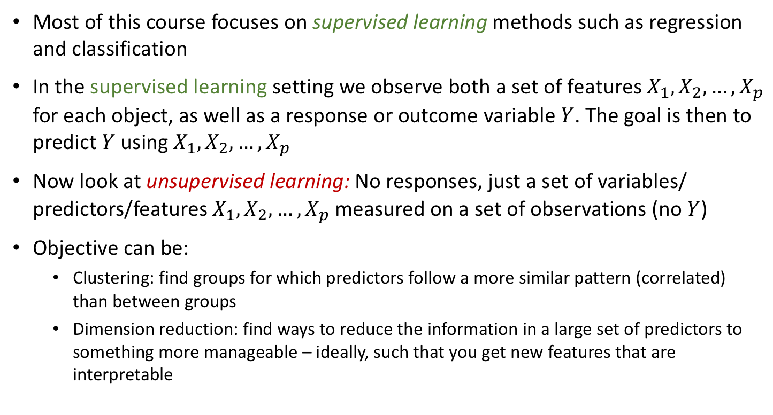
Unsupervised learning
Most of this course focuses on supervised learning methods such as regression and classification
In the supervised learning setting we observe both a set of features $X_{1},X_{2},…,X_{p}$ for each object, as well as a response or outcome variable $Y$. The goal is then to predict $Y$ using $X_{1},X_{2},…,X_{p}$
Now look at unsupervised learning: No responses, just a set of variables/ predictors/features $X_{1},X_{2},…,X_{p}$ measured on a set of observations (no $Y$)
Objective can be:
  Clustering: find groups for which predictors follow a more similar pattern (correlated) than between groups
  Dimension reduction: find ways to reduce the information in a large set of predictors to something more manageable – ideally, such that you get new features that are interpretable

Slide 5
Unsupervised learning
The goal is to discover “interesting” things about the measurements: is there an informative way to visualize the data? Can we discover subgroups among the variables or among the observations?
We will look at 2 approaches:
  clustering, a broad class of methods for discovering unknown subgroups in data
  principal components analysis, a tool used for data visualization or data pre-processing before supervised techniques are applied

Slide 6
The Challenge of Unsupervised Learning
Unsupervised learning is more subjective than supervised learning, as there is no simple goal for the analysis, such as prediction of a response
A common scenario in biomedical research where we need unsupervised learning is in finding subgroups of a disease population:
  subgroups of breast cancer patients grouped by their gene expression measurements
  subgroups of dementia types based on neuropsychological or brain tissue changes

Slide 7
An advantage of unsupervised methods
It is often easier to obtain unlabeled data — from a lab instrument or a computer — than labeled data, which can require human intervention
For example, it can be easy to collect a massive dataset of medical images, but much harder to get a diagnosis or score for each of them, which would require human intervention

Slide 8
Clustering
Clustering refers to a very broad set of techniques for finding subgroups, or clusters, in a data set
We want to find a partition of the data into distinct groups so that the observations within each group are more similar to each other than observations in differing groups
To make this concrete, we must define what it means for two or more observations to be similar or different
This should be a domain-specific consideration that is made based on knowledge of the data being studied

Slide 9
Clustering to find different subgroups among different types of dementia
We have imaging data on different types of dementia
Within a particular type of dementia (e.g. Alzheimer’s disease) can we find distinct subgroups that correspond to distinct patterns of the disease
The task of finding such subgroups is to perform cluster analysis within Alzheimer’s patients

Slide 10
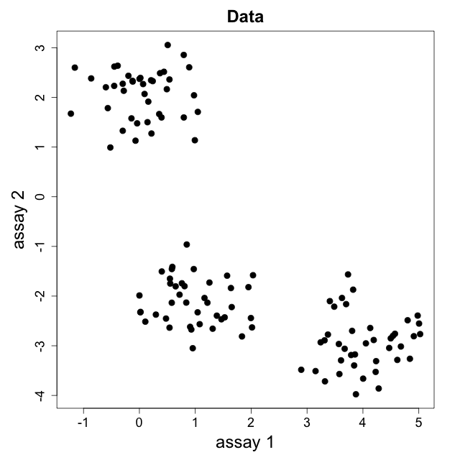
Clustering example
How many clusters?
How do we come up with a rule to assign each point to an appropriate cluster?

Slide 11
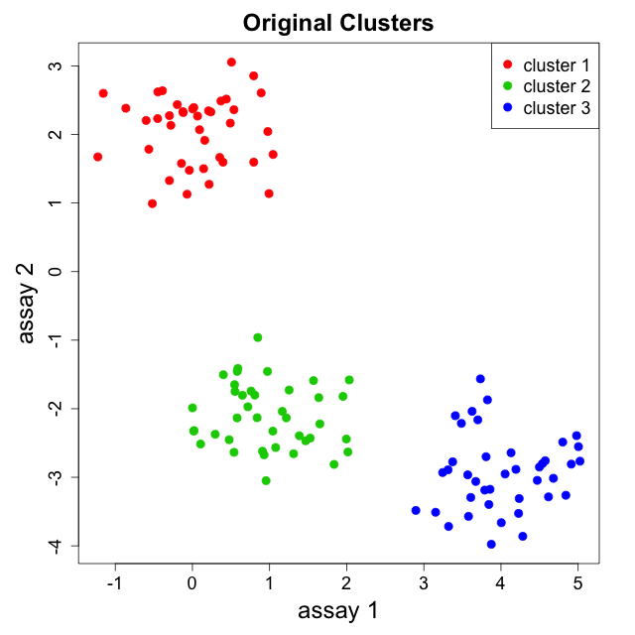
You guessed it…
How many clusters?
How do we come up with a rule to assign each point to an appropriate cluster?

Slide 12
Properties of good cluster separation (or segmentation)
How many clusters?
How do we come up with a rule to assign each point to an appropriate cluster?
Roughly speaking: maximize distance (dissimilarity) between clusters while minimizing area (variance) within clusters (maximize similarity) within clusters

Slide 13
Similarity and dissimilarity
Need to define similarity (or dissimilarity) and we need to be able to measure it
Want to maximize similarity (or minimize dissimilarity) within clusters and minimize similarity (maximize dissimilarity) between clusters

Slide 14

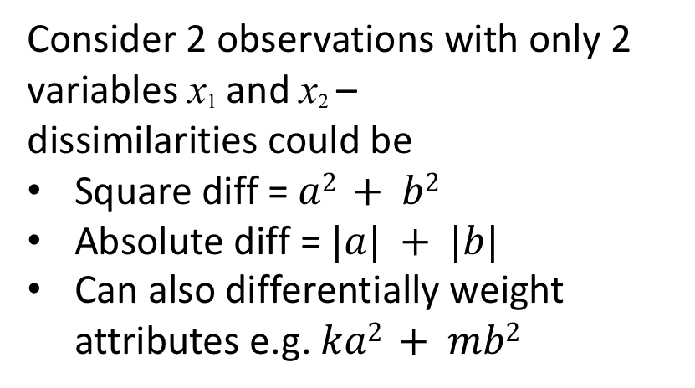

Measures of similarity/dissimilarity
Most common choice for dissimilarity between 2 instances is the squared difference summed over all attributes (higher values = more dissimilar)
x₂
Consider 2 observations with only 2 variables x₁ and x₂ –
dissimilarities could be
Square diff = $a2 + b2$
Absolute diff = $|a| + |b|$
Can also differentially weight attributes e.g. $ka2 + mb2$
$$a$$
$$b$$
x₁
Extension to 3D would be e.g. $a2 + b2 + c2$, and so on for higher dimensions

Slide 15
Measures of similarity/dissimilarity
Generally need to “standardize variables”
Ordinal variables are treated the same as continuous variables
Nominal variable differences between groups need to be explicitly given. A common choice is difference 1 if the groups are the same and 0 if they are different. (This then needs to be standardized if any non-categorical variables are also considered.)
Remember, we want to maximize similarity (or minimize dissimilarity) within clusters and minimize similarity (maximize dissimilarity) between clusters

Slide 16
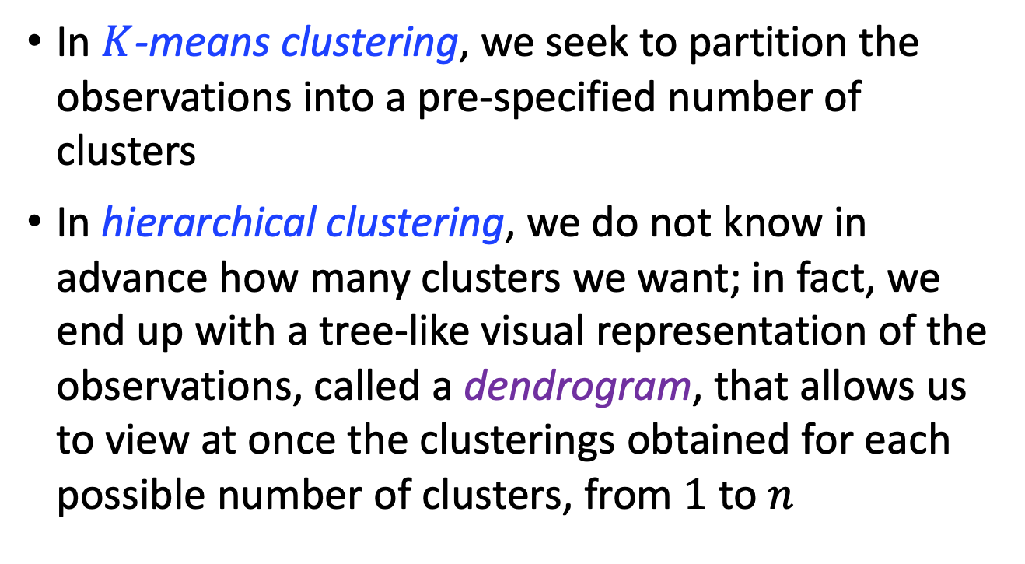
Two clustering methods
In $K$-means clustering, we seek to partition the observations into a pre-specified number of clusters
In hierarchical clustering, we do not know in advance how many clusters we want; in fact, we end up with a tree-like visual representation of the observations, called a dendrogram, that allows us to view at once the clusterings obtained for each possible number of clusters, from $1$ to $n$

Slide 17
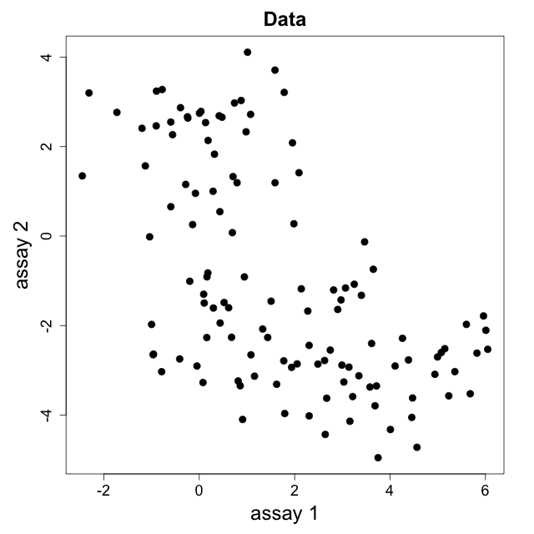
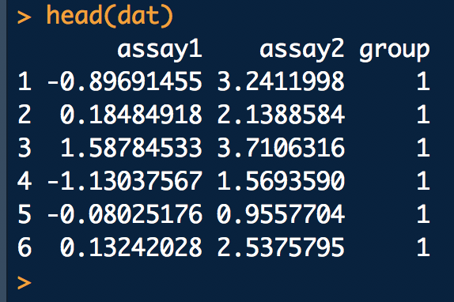
K-means example

Slide 18
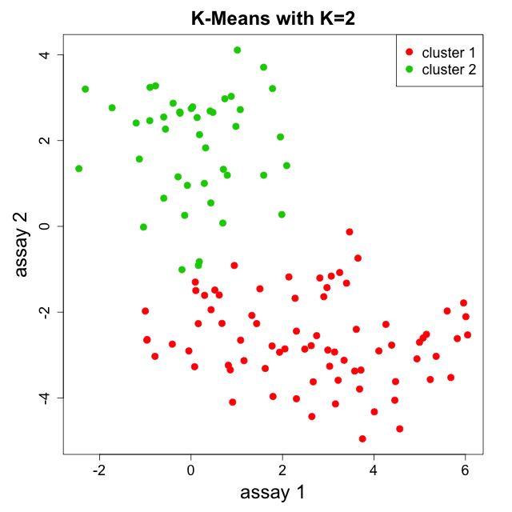
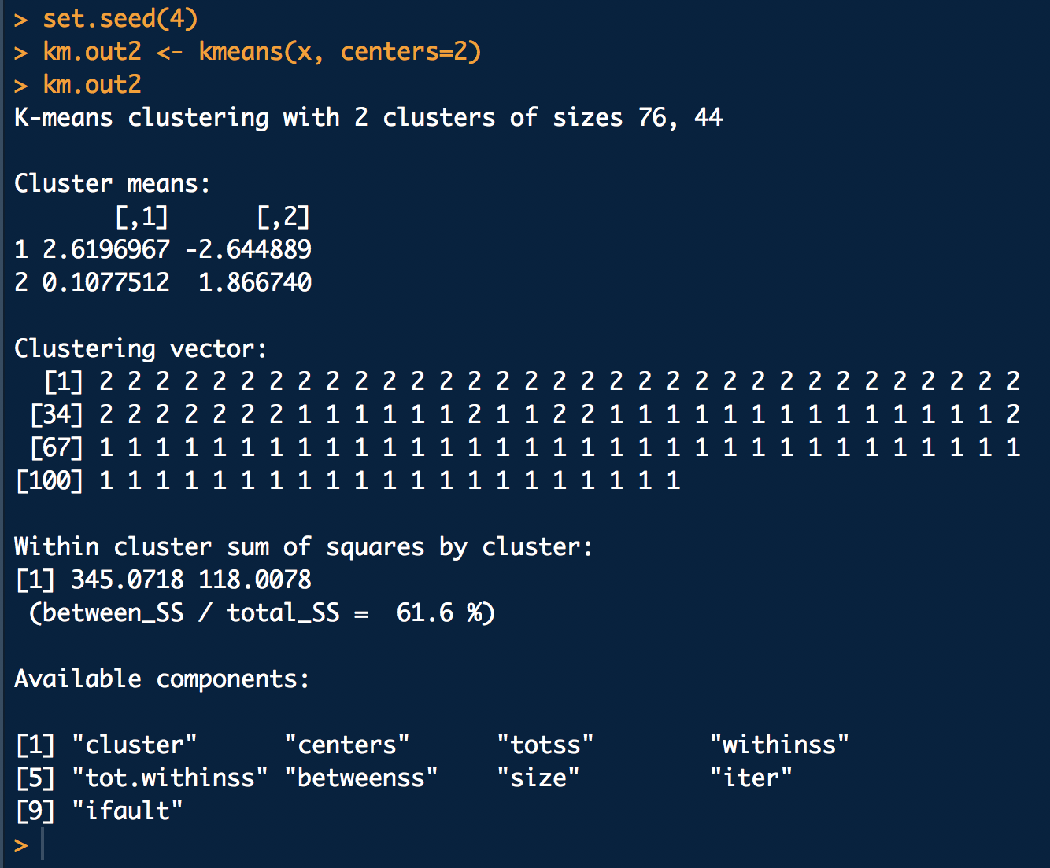
K-means example

Slide 19
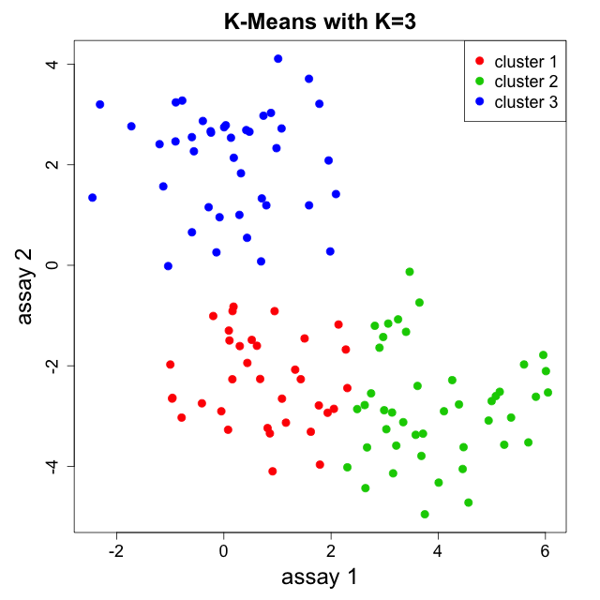
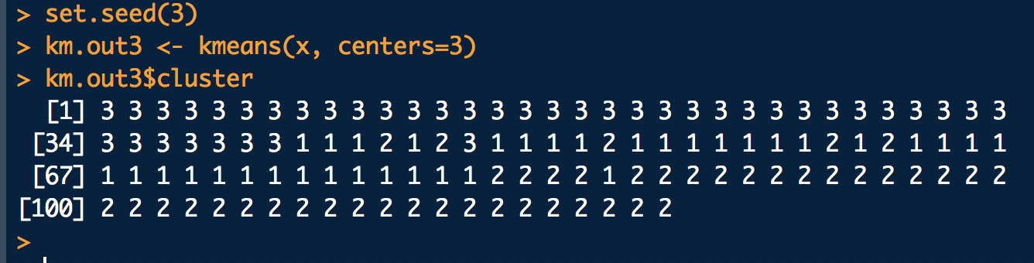
K-means example

Slide 20
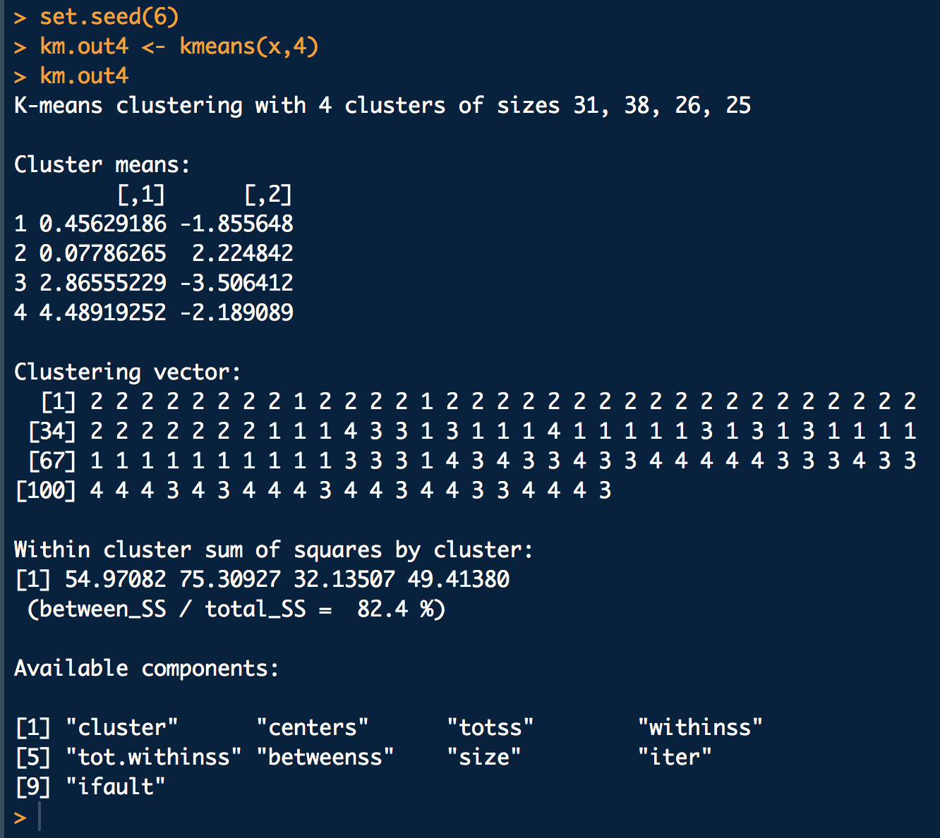
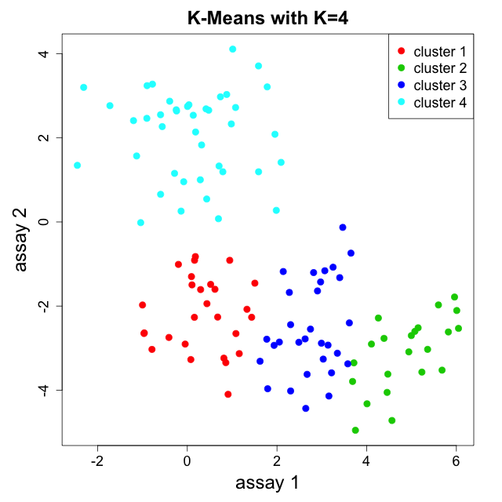
K-means example

Slide 21
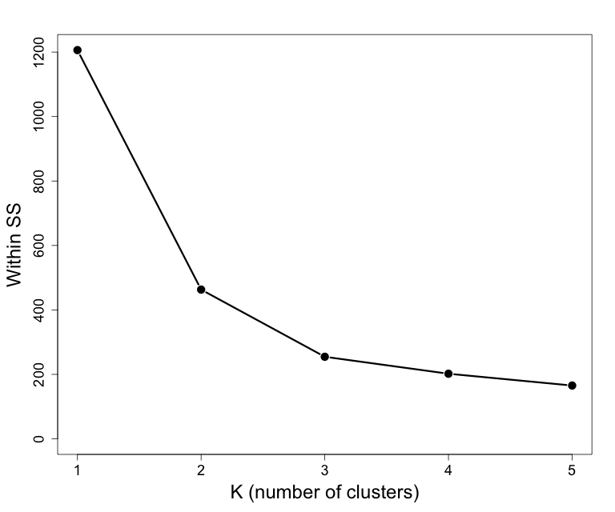
Elbow method
Where does the Within SS stop changing much?
Other methods exist (notably “silhouette method” which tries to quantify quality of clusters) but still somewhat ad hoc

Slide 22
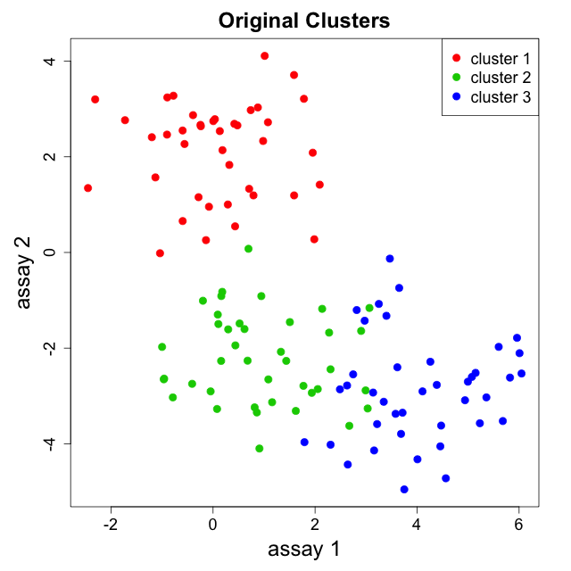
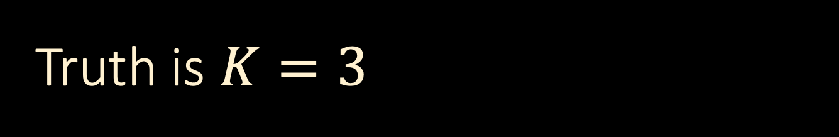
Truth is $K=3$

Slide 23
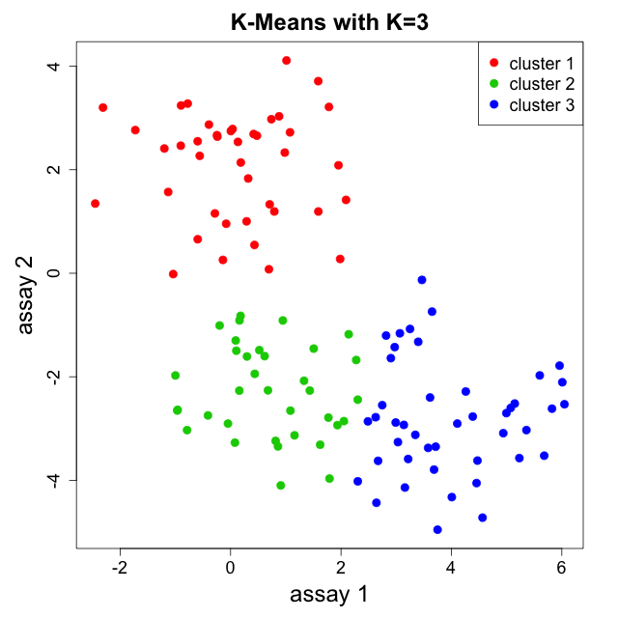
Truth is $K=3$
Labels are arbitrary so can permute at will

Slide 24
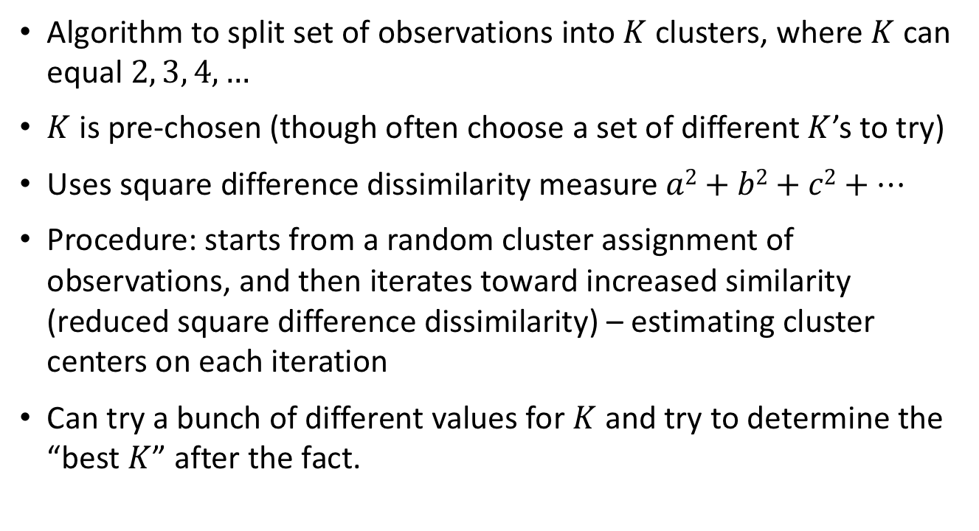
K-means clustering overview
Algorithm to split set of observations into $K$ clusters, where $K$ can equal $2, 3, 4, …$
$K$ is pre-chosen (though often choose a set of different $K$’s to try)
Uses square difference dissimilarity measure $a2+b2+c2+…$
Procedure: starts from a random cluster assignment of observations, and then iterates toward increased similarity (reduced square difference dissimilarity) – estimating cluster centers on each iteration
Can try a bunch of different values for $K$ and try to determine the “best $K$” after the fact.

Slide 25
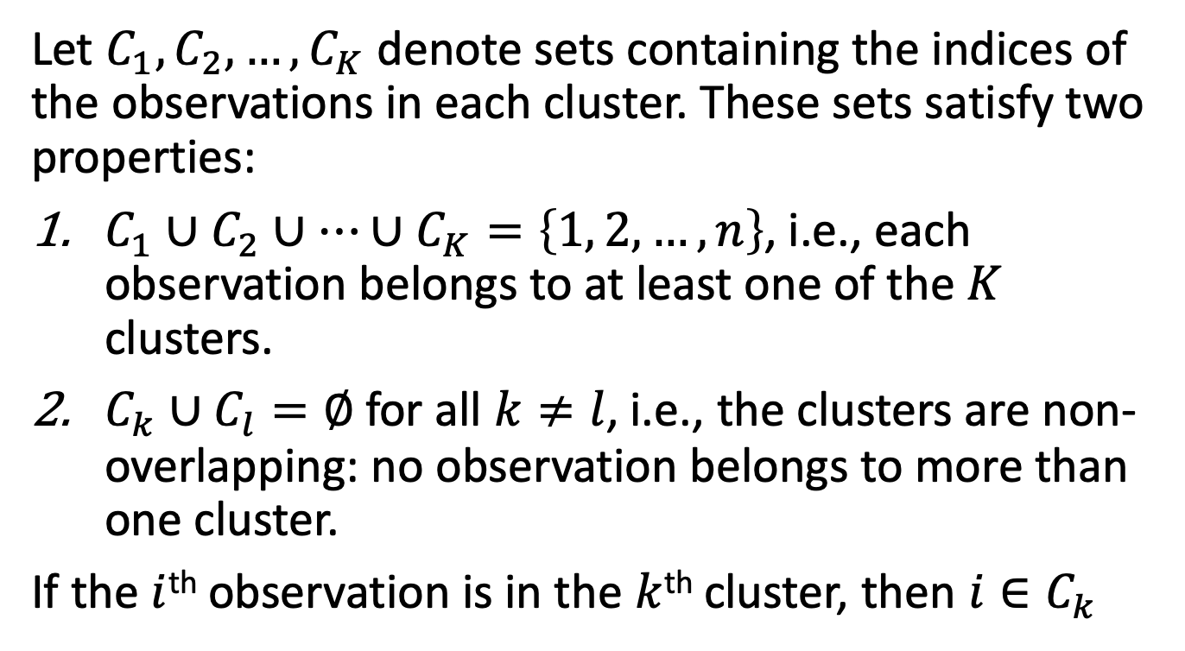

Details of $K$-means clustering
Let $C_{1},C_{2},…,C_{K}$ denote sets containing the indices of the observations in each cluster. These sets satisfy two properties:
$C_{1}∪C_{2}∪…∪C_{K}=\left\{1, 2,…,n\right\}$, i.e., each observation belongs to at least one of the $K$ clusters.
$C_{k}∪C_{l}=∅$for all $k≠l$, i.e., the clusters are non-overlapping: no observation belongs to more than one cluster.
If the $i$^{th} observation is in the $k$^{th} cluster, then $i∈C_{k}$

Slide 26
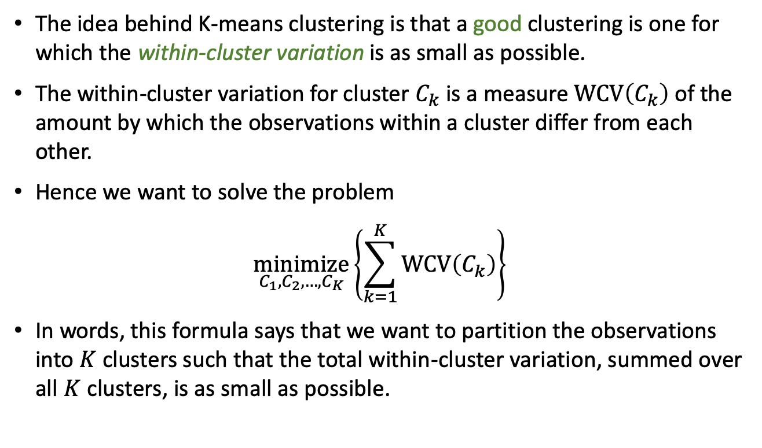
Details continued
The idea behind K-means clustering is that a good clustering is one for which the within-cluster variation is as small as possible.
The within-cluster variation for cluster $C_{k}$ is a measure $WCV\left(C_{k}\right)$ of the amount by which the observations within a cluster differ from each other.
Hence we want to solve the problem
$$\underset{C_{1},C_{2},…,C_{K}}{minimize}\left\{\sum_{k=1}^{K}{WCV\left(C_{k}\right)}\right\}$$
In words, this formula says that we want to partition the observations into $K$ clusters such that the total within-cluster variation, summed over all $K$ clusters, is as small as possible.

Slide 27
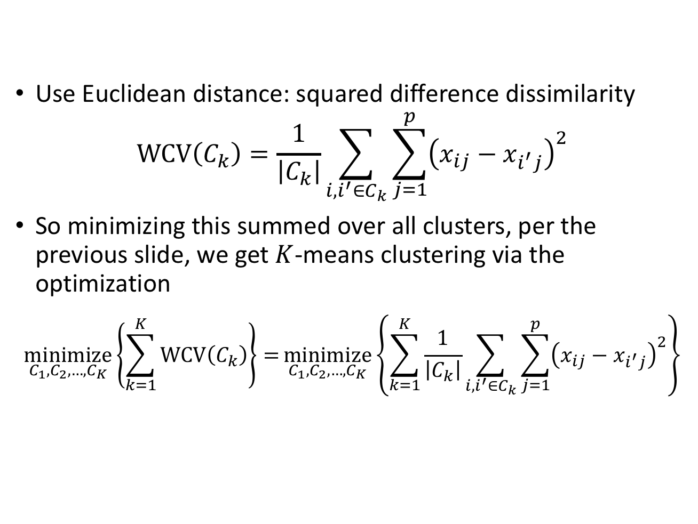
Defining within-cluster variation
Use Euclidean distance: squared difference dissimilarity
$$WCV\left(C_{k}\right)=\frac{1}{\left|C_{k}\right|}\sum_{i,i^{′}∈C_{k}}{\sum_{j=1}^{p}{{\left(x_{ij}−x_{i^{′}j}\right)}^{2}}}$$
So minimizing this summed over all clusters, per the previous slide, we get $K$-means clustering via the optimization
$$\underset{C_{1},C_{2},…,C_{K}}{minimize}\left\{\sum_{k=1}^{K}{WCV\left(C_{k}\right)}\right\}=\underset{C_{1},C_{2},…,C_{K}}{minimize}\left\{\sum_{k=1}^{K}{\frac{1}{\left|C_{k}\right|}\sum_{i,i^{′}∈C_{k}}{\sum_{j=1}^{p}{{\left(x_{ij}−x_{i^{′}j}\right)}^{2}}}}\right\}$$

Slide 28

K-means algorithm
Algorithm proceeds as follows:
  Randomly assign a cluster number (between $1$ and $K$) to each of the observations/instances in the dataset. These are the initial cluster assignments

Slide 29
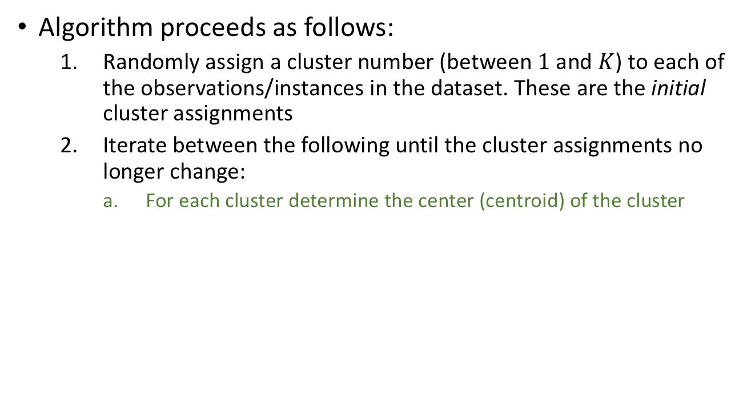
K-means algorithm
Algorithm proceeds as follows:
  Randomly assign a cluster number (between $1$ and $K$) to each of the observations/instances in the dataset. These are the initial cluster assignments
  Iterate between the following until the cluster assignments no longer change:
    For each cluster determine the center (centroid) of the cluster

Slide 30
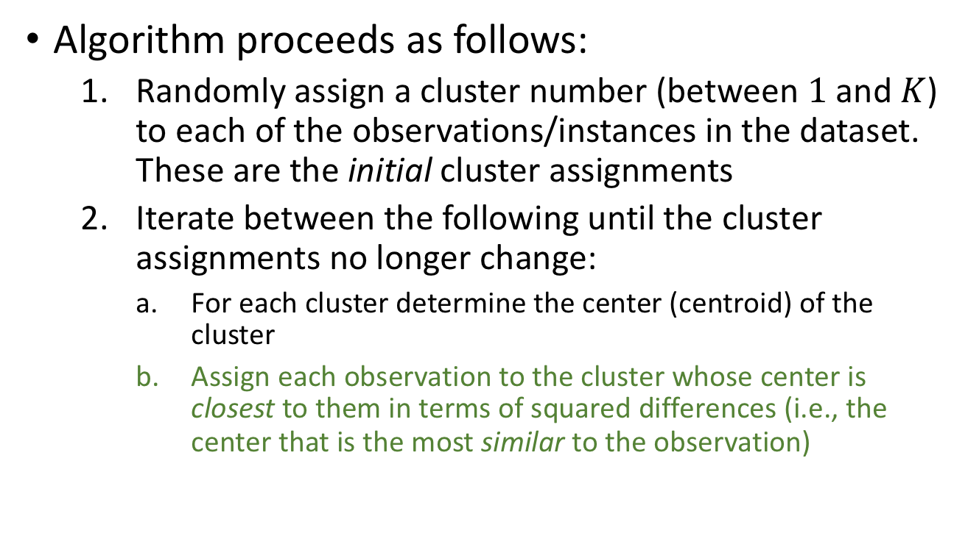
K-means algorithm
Algorithm proceeds as follows:
  Randomly assign a cluster number (between $1$ and $K$) to each of the observations/instances in the dataset. These are the initial cluster assignments
  Iterate between the following until the cluster assignments no longer change:
    For each cluster determine the center (centroid) of the cluster
    Assign each observation to the cluster whose center is closest to them in terms of squared differences (i.e., the center that is the most similar to the observation)

Slide 31
Illustration
Assign each observation to the cluster whose center is closest to them in terms of squared differences (i.e., the center that is the most similar to the observation)

Slide 32
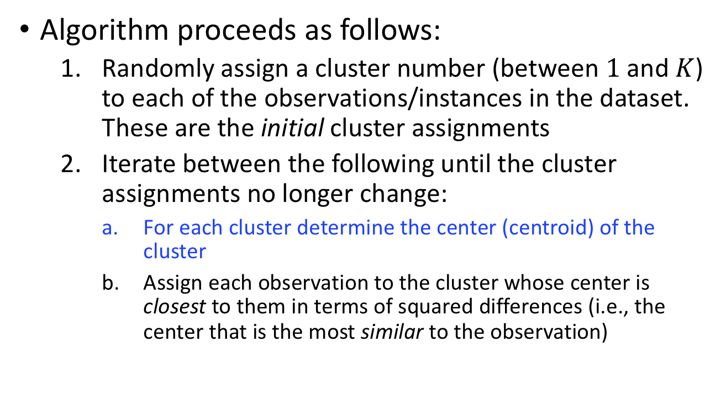
K-means algorithm
Algorithm proceeds as follows:
  Randomly assign a cluster number (between $1$ and $K$) to each of the observations/instances in the dataset. These are the initial cluster assignments
  Iterate between the following until the cluster assignments no longer change:
    For each cluster determine the center (centroid) of the cluster
    Assign each observation to the cluster whose center is closest to them in terms of squared differences (i.e., the center that is the most similar to the observation)

Slide 33
Illustration
    Second time: For each cluster determine the center (centroid) of the cluster

Slide 34
Illustration

Slide 35
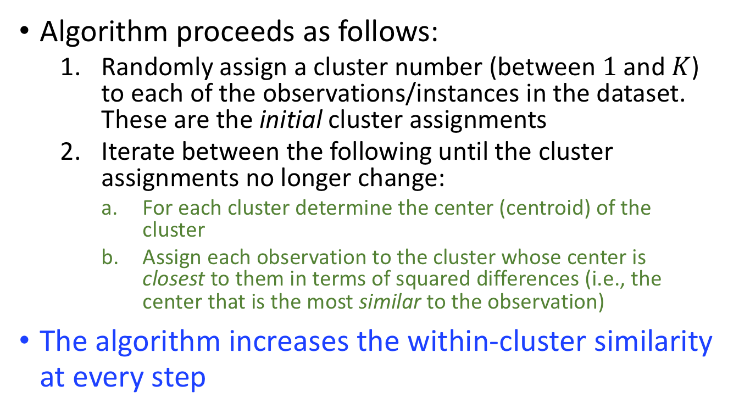
K-means algorithm
Algorithm proceeds as follows:
  Randomly assign a cluster number (between $1$ and $K$) to each of the observations/instances in the dataset. These are the initial cluster assignments
  Iterate between the following until the cluster assignments no longer change:
    For each cluster determine the center (centroid) of the cluster
    Assign each observation to the cluster whose center is closest to them in terms of squared differences (i.e., the center that is the most similar to the observation)
The algorithm increases the within-cluster similarity at every step

Slide 36
K-means algorithm
  The center of a cluster is simply the point associated with the mean of each of the attributes for the observations assigned to that cluster – e.g. in the Age direction the center would be located at the mean Age for all subjects in the cluster.
  Note that for different initial random assignments of observations to clusters, K-means may lead to different final clustering (it is a local not global minimizer of dissimilarity)
Local minimum
global minimum
Upshot - may not converge to best answer

Slide 37

Different starting values
This problem of finding only a local minimum can be somewhat mitigated by using multiple starting random configurations and taking the best one
This is easy in R:

Slide 38
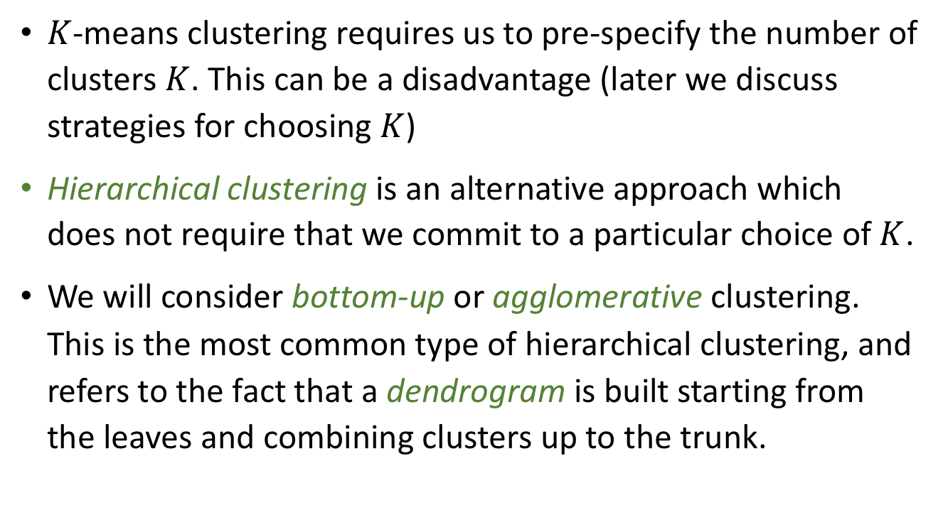
Hierarchical clustering
$K$-means clustering requires us to pre-specify the number of clusters $K$. This can be a disadvantage (later we discuss strategies for choosing $K$)
Hierarchical clustering is an alternative approach which does not require that we commit to a particular choice of $K$.
We will consider bottom-up or agglomerative clustering. This is the most common type of hierarchical clustering, and refers to the fact that a dendrogram is built starting from the leaves and combining clusters up to the trunk.

Slide 39
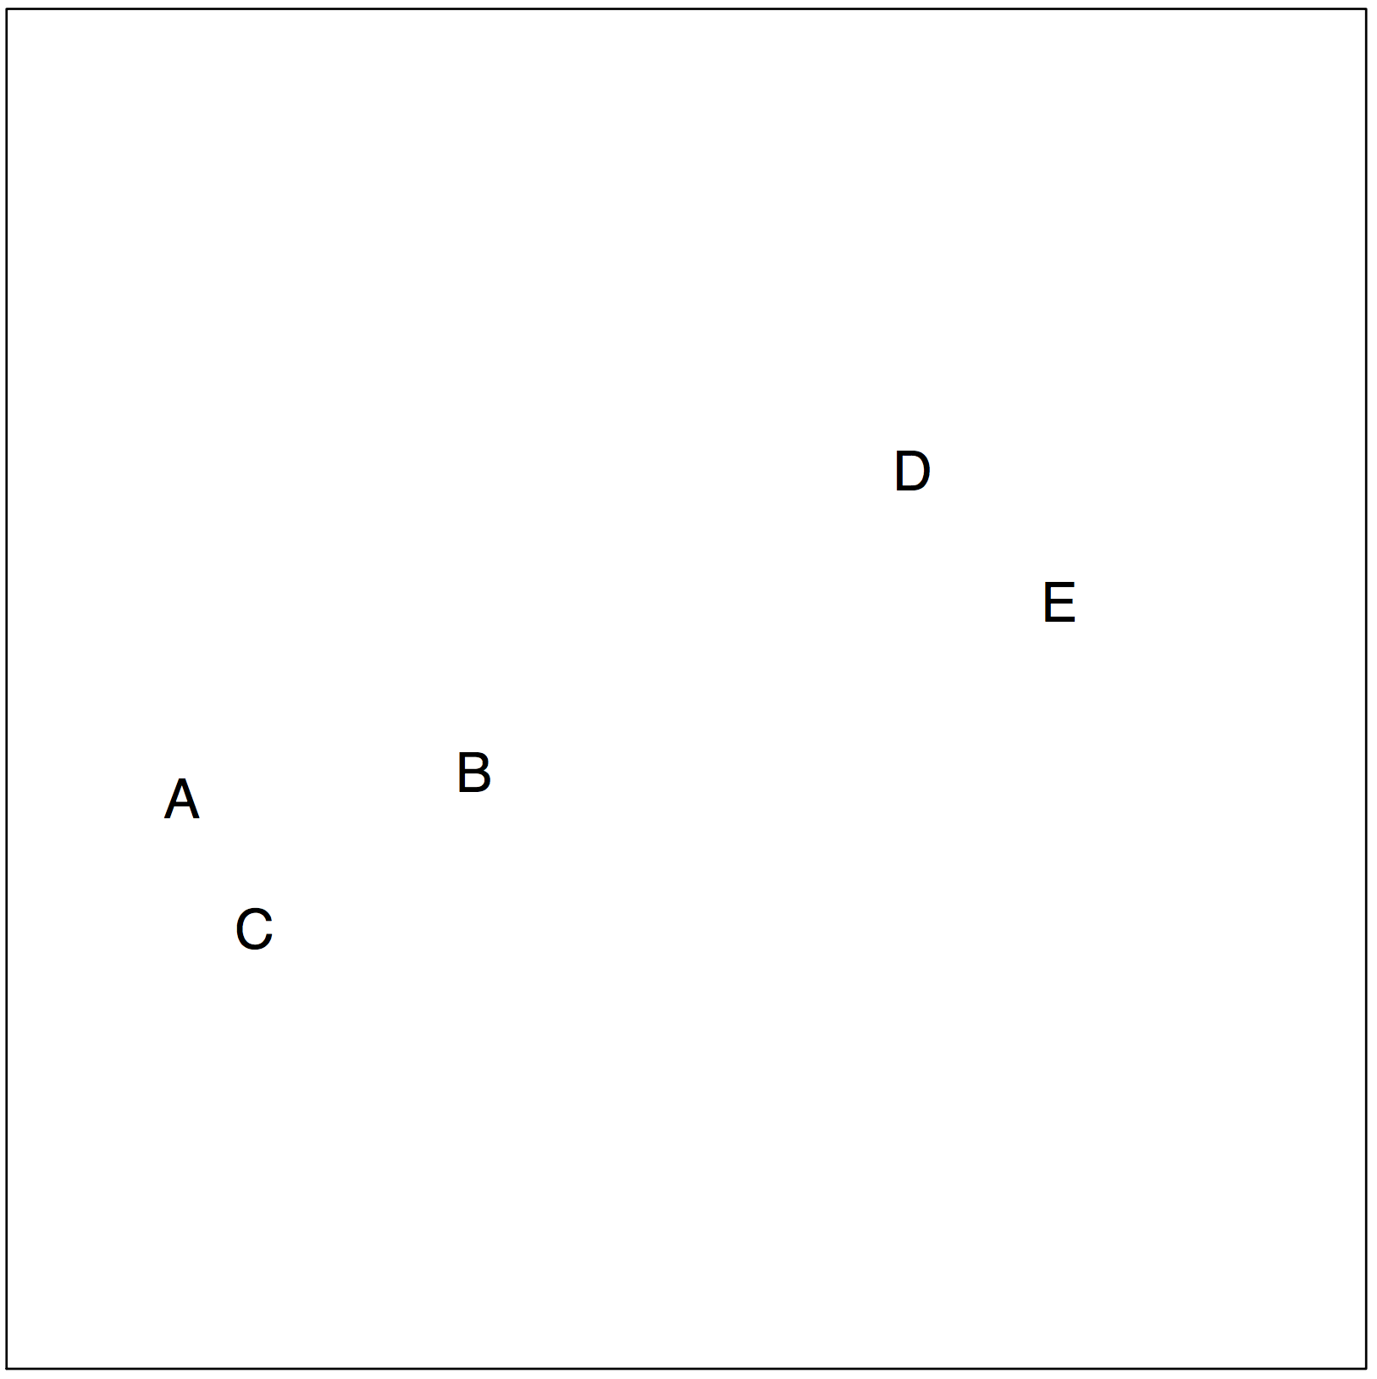
Hierarchical clustering – bottom up

Slide 40
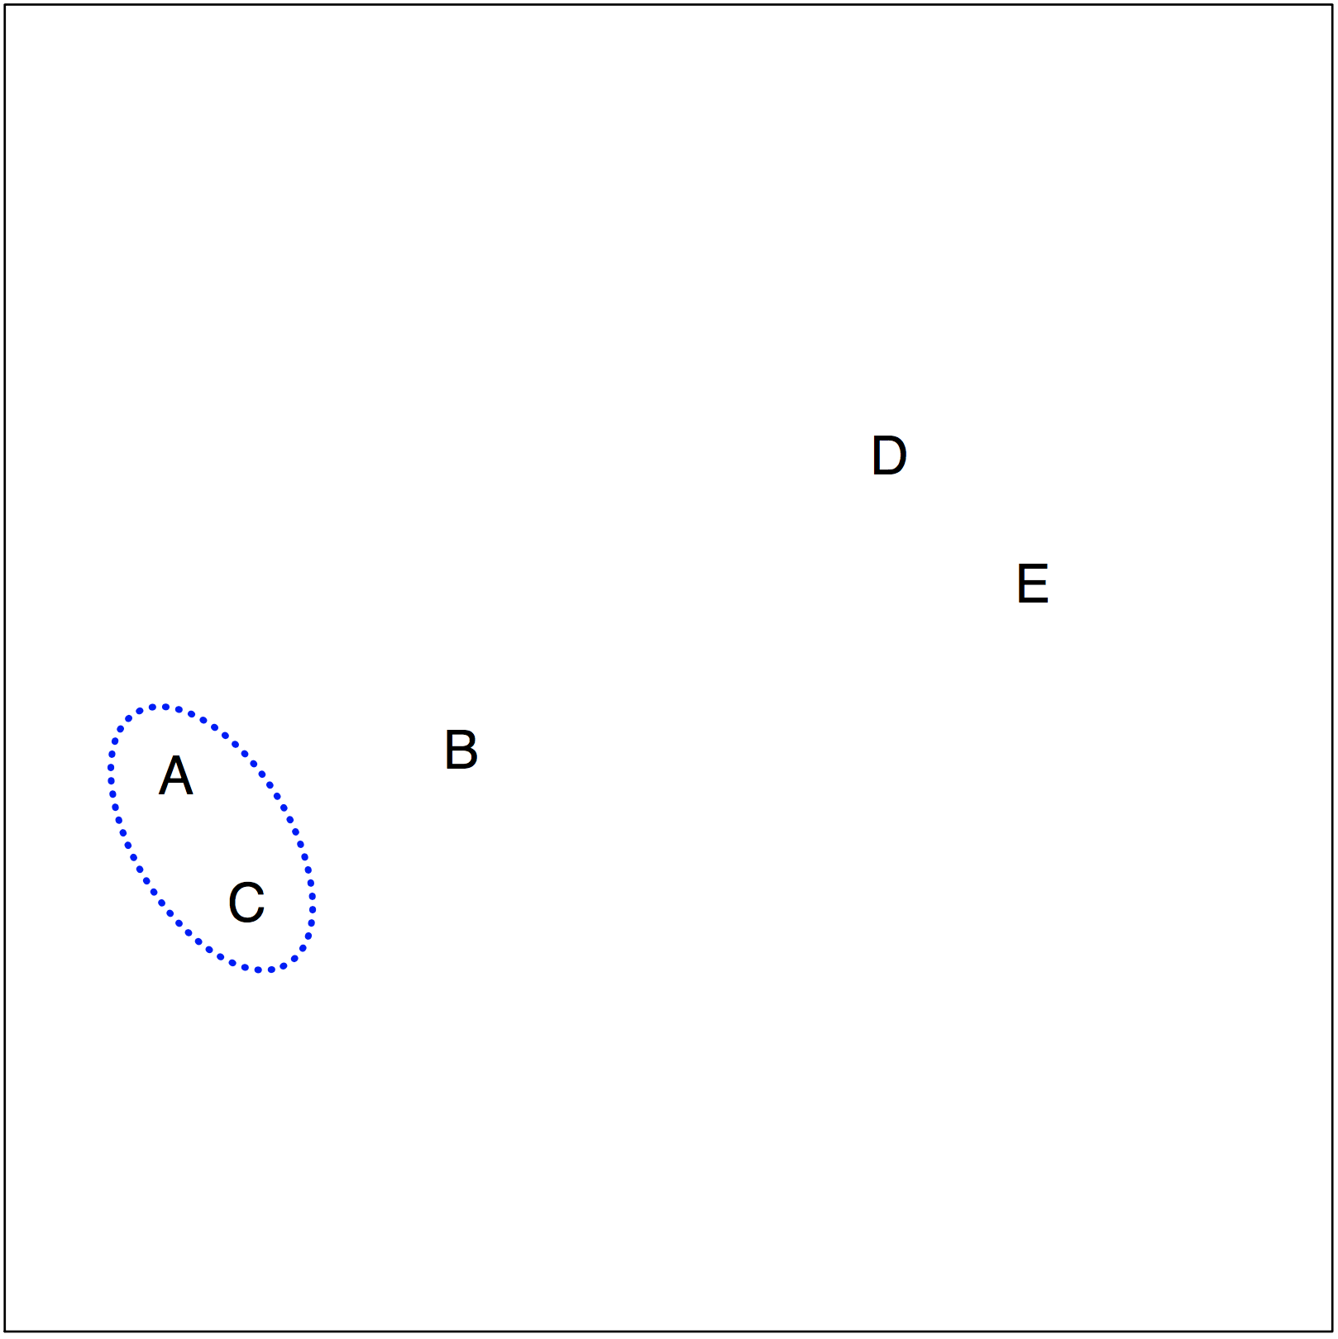
Hierarchical clustering – bottom up

Slide 41
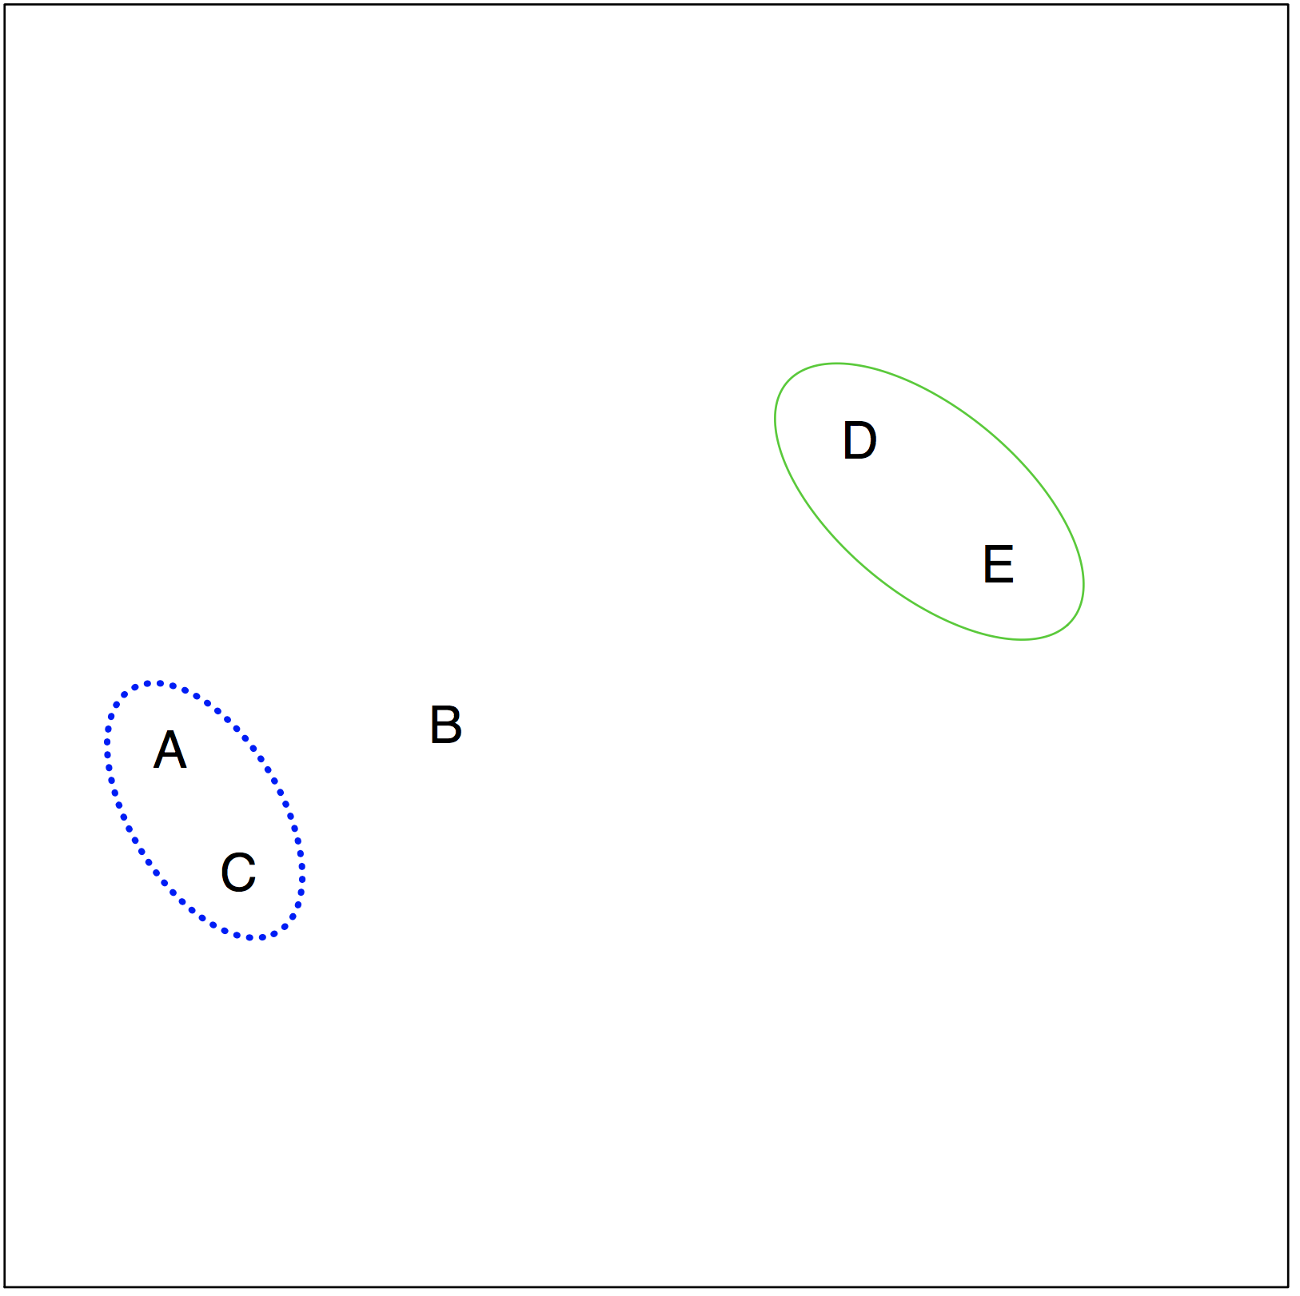
Hierarchical clustering – bottom up

Slide 42
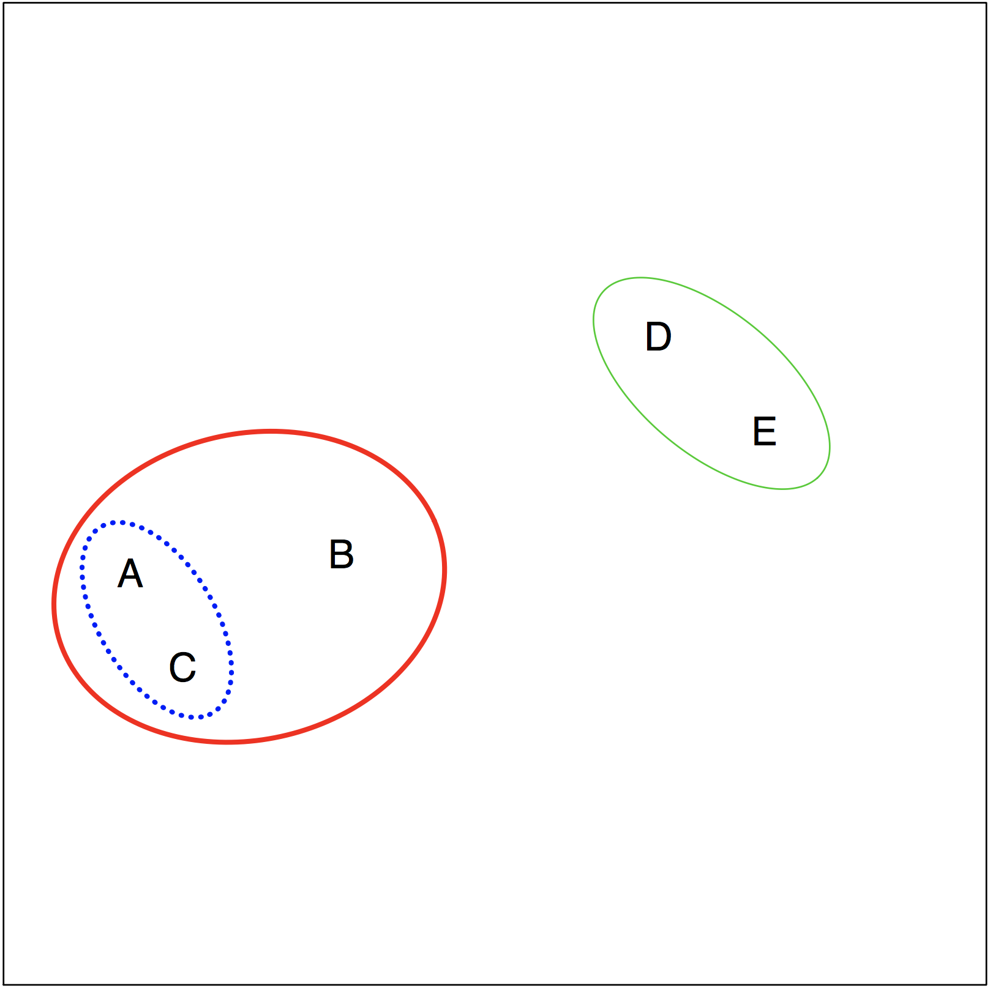
Hierarchical clustering – bottom up

Slide 43
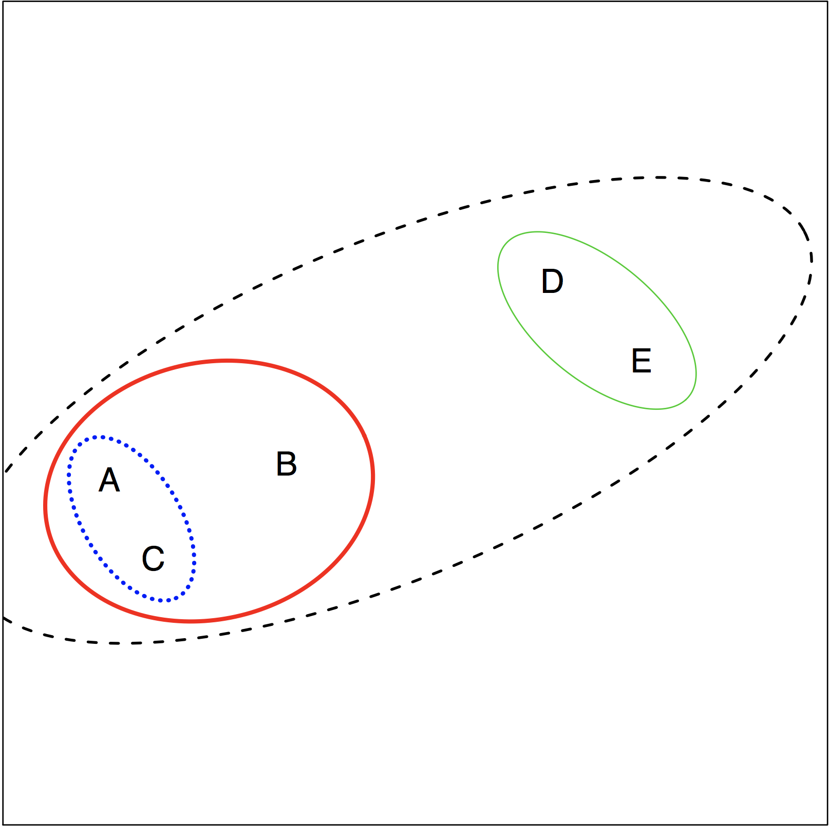
Hierarchical clustering – bottom up

Slide 44
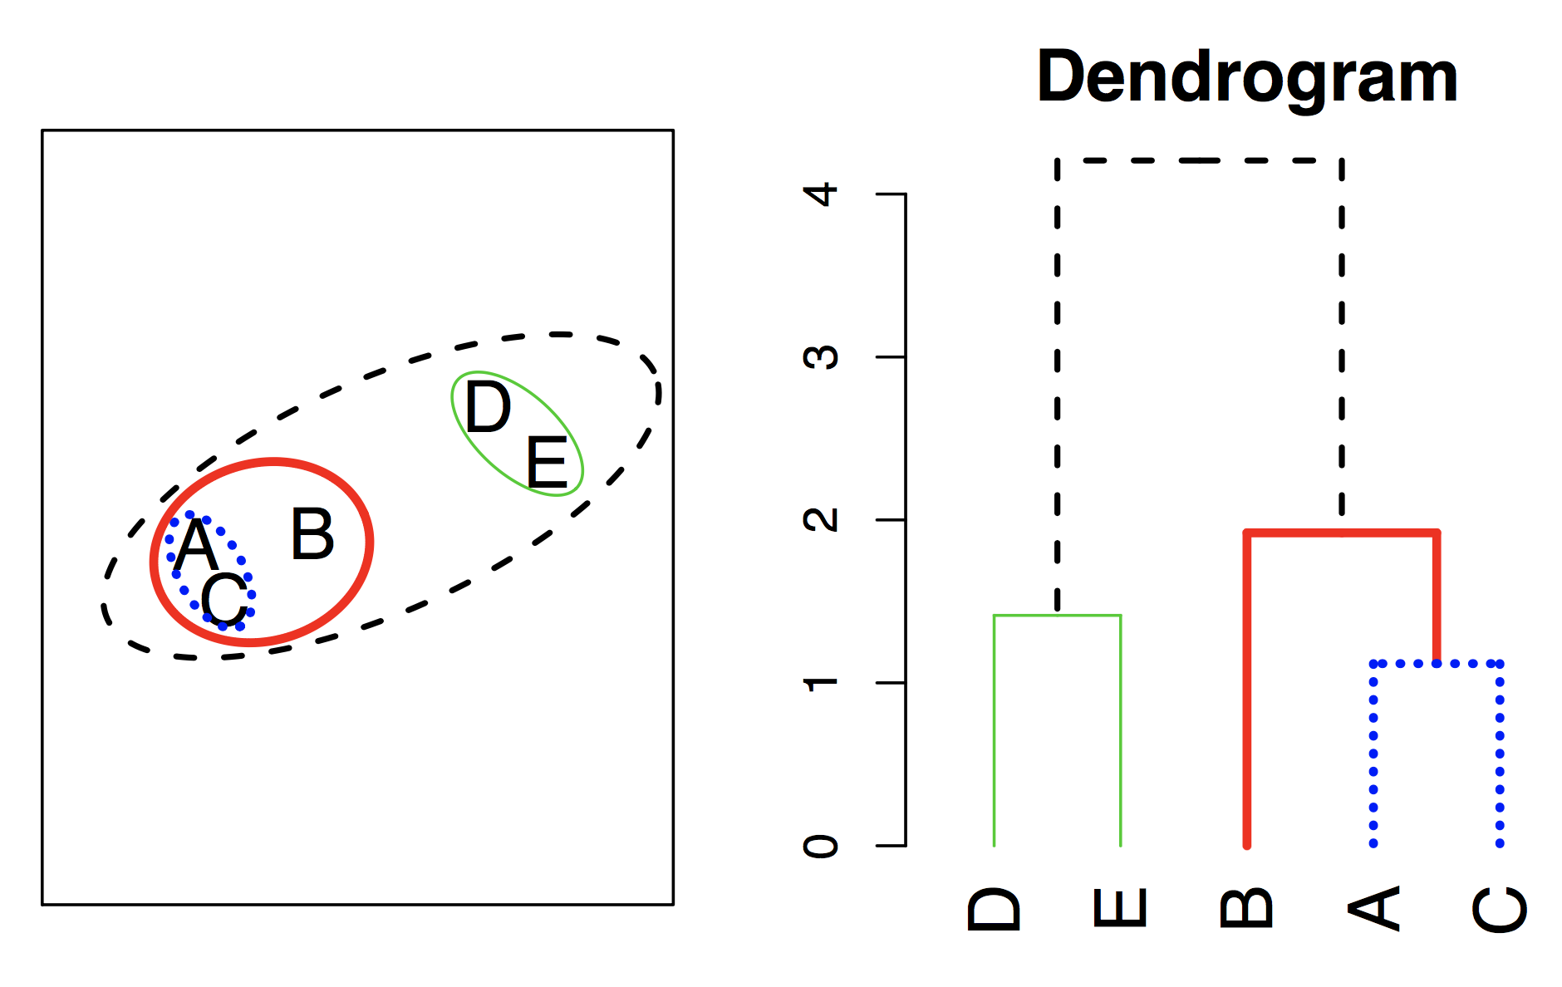
Hierarchical Clustering Algorithm
The approach in words:
Start with each point in its own cluster
Identify the closest two clusters and merge them
Repeat.
Ends when all points are in a single cluster.

Slide 45
Simulated example
45 observations generated in 2D space
3 distinct classes (separate colors)
Treat class labels as unknown and try to cluster the observations in order to discover the classes from the data.

Slide 46
Application of hierarchical clustering
Left: Dendogram from hierarchical clustering (complete linkage and Euclidean distance)
Center: cut at 9 = 2 clusters
Right: cut at 5 = 3 clusters

Slide 47
Types of linkage – complete
Complete – largest dissimilarity between 2 points

Slide 48
Types of linkage – single
Single – smallest dissimilarity between 2 points

Slide 49
Types of linkage – average
Average – average dissimilarity between 2 points

Slide 50
Types of linkage – single
Centroid – dissimilarity between 2 centroids

Slide 51
Choice of dissimilarity measure
So far have used Euclidean distance.
An alternative is correlation-based distance which considers two observations to be similar if their features are highly correlated.
This is an unusual use of correlation, which is normally computed between variables; here it is computed between the observation profiles for each pair of observations.

Slide 52
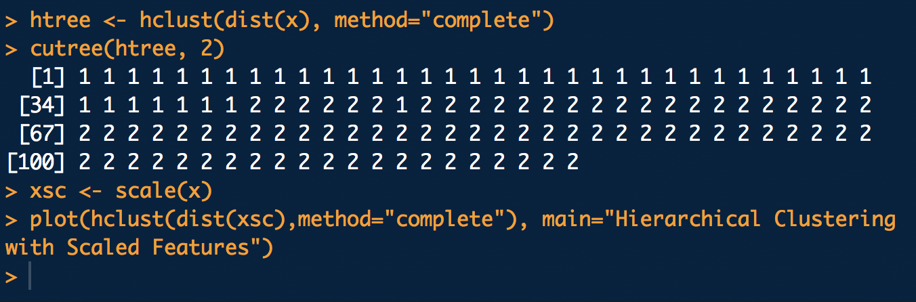
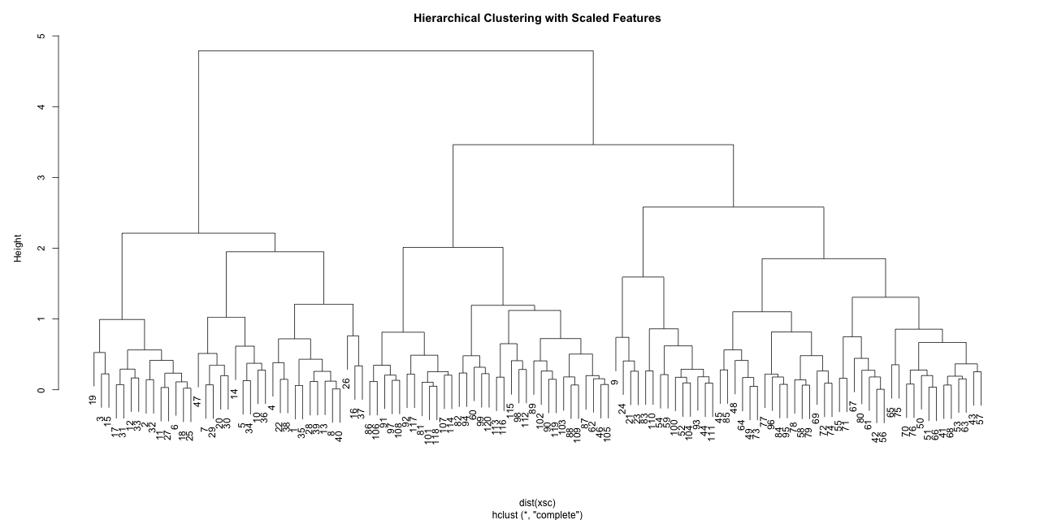
Hierarchical clustering in R

Slide 53
Principal components analysis
PCA produces a low-dimensional representation of a dataset. It finds a sequence of linear combinations of the variables that have maximal variance, and are mutually uncorrelated.
Apart from producing derived variables for use in supervised learning problems, PCA also serves as a tool for data visualization.

Slide 54
Clustering vs. PCA
Clustering looks for homogeneous subgroups among the observations
PCA looks for a low-dimensional representation of the observations that explains a good fraction of the variance

Slide 55
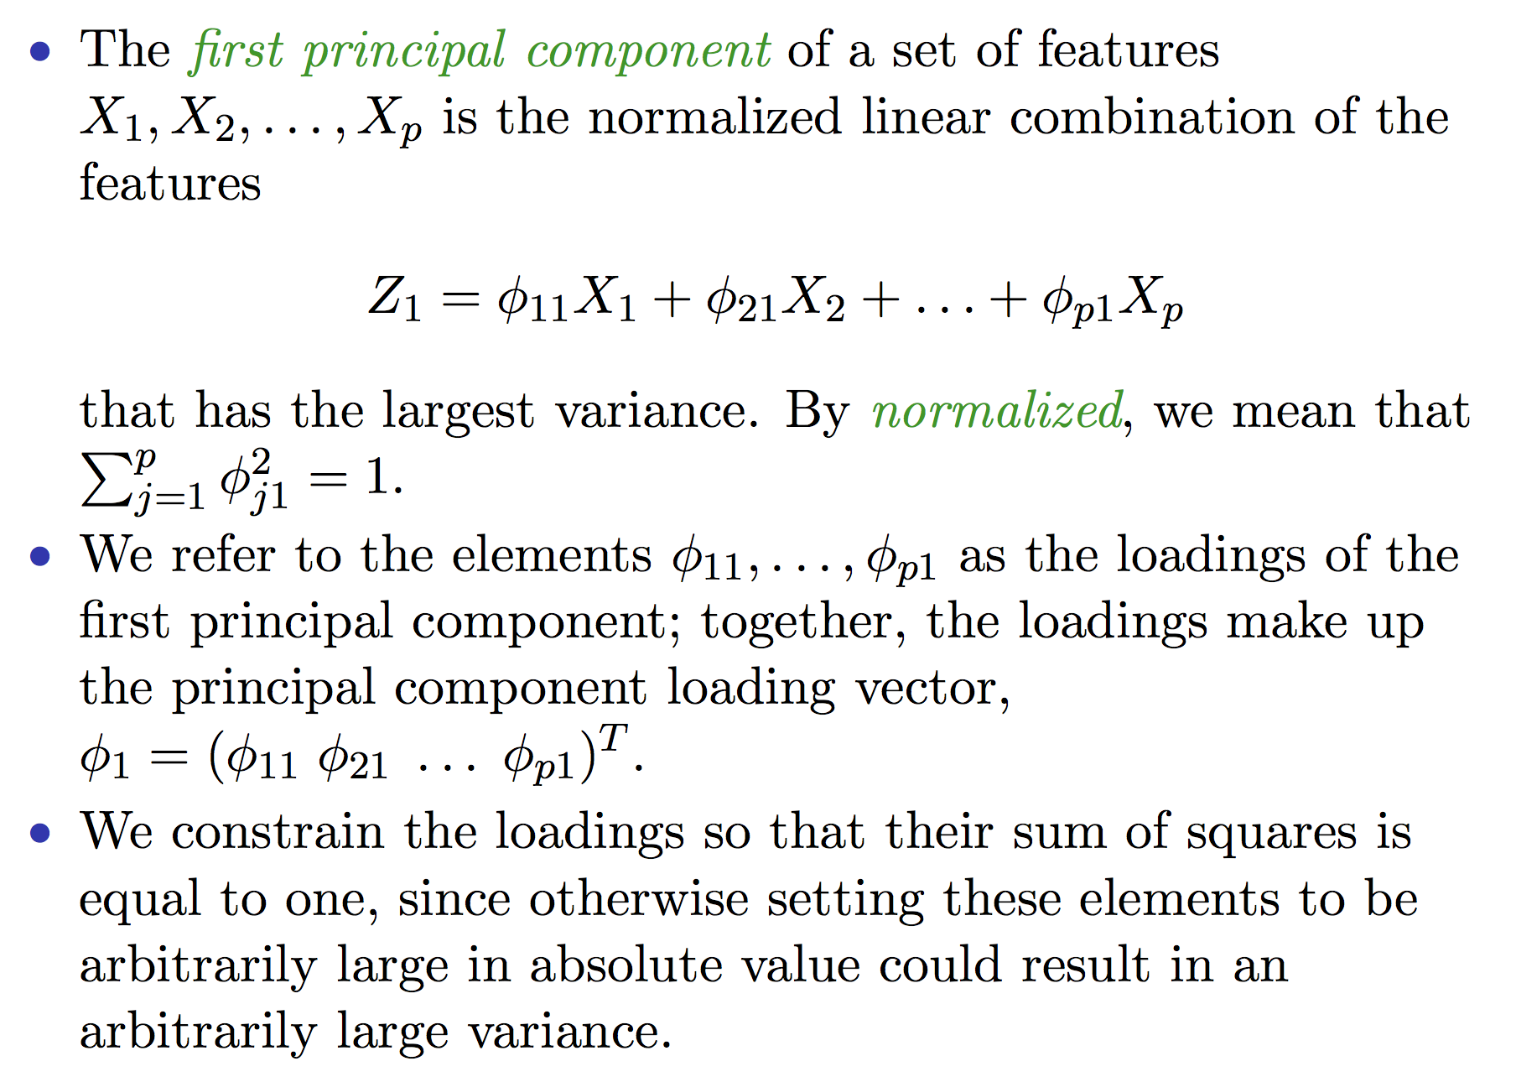
PCA details

Slide 56
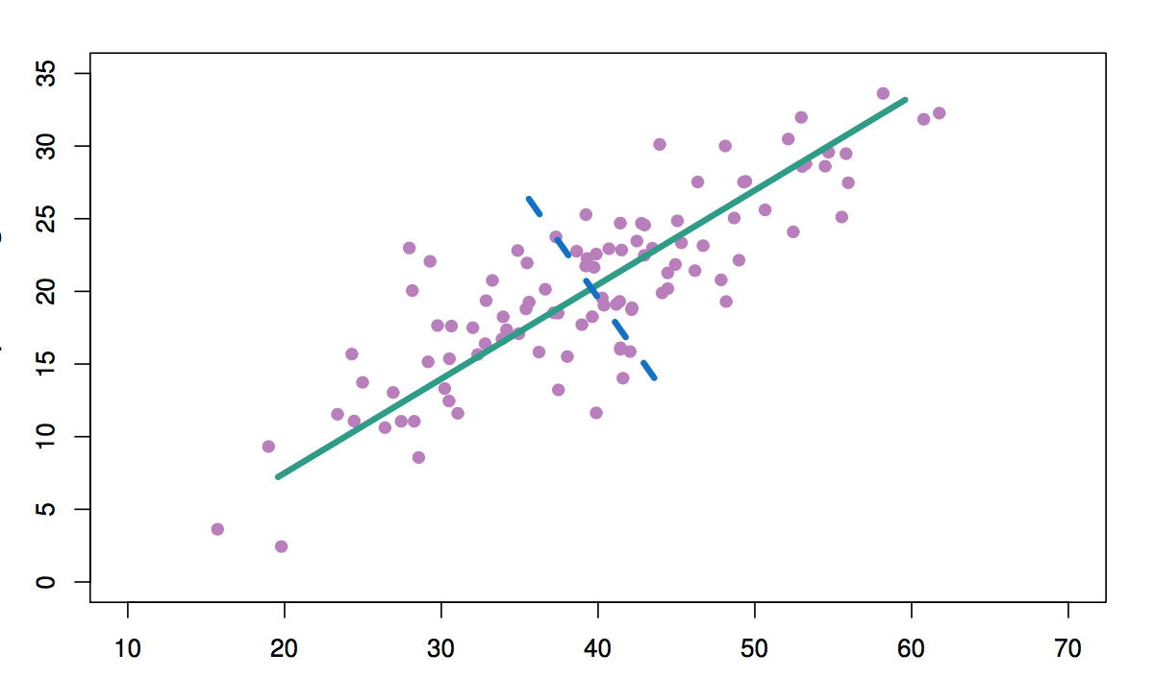
PCA illustration
1st PC
2nd PC
Predictor 2
Predictor 1

Slide 57
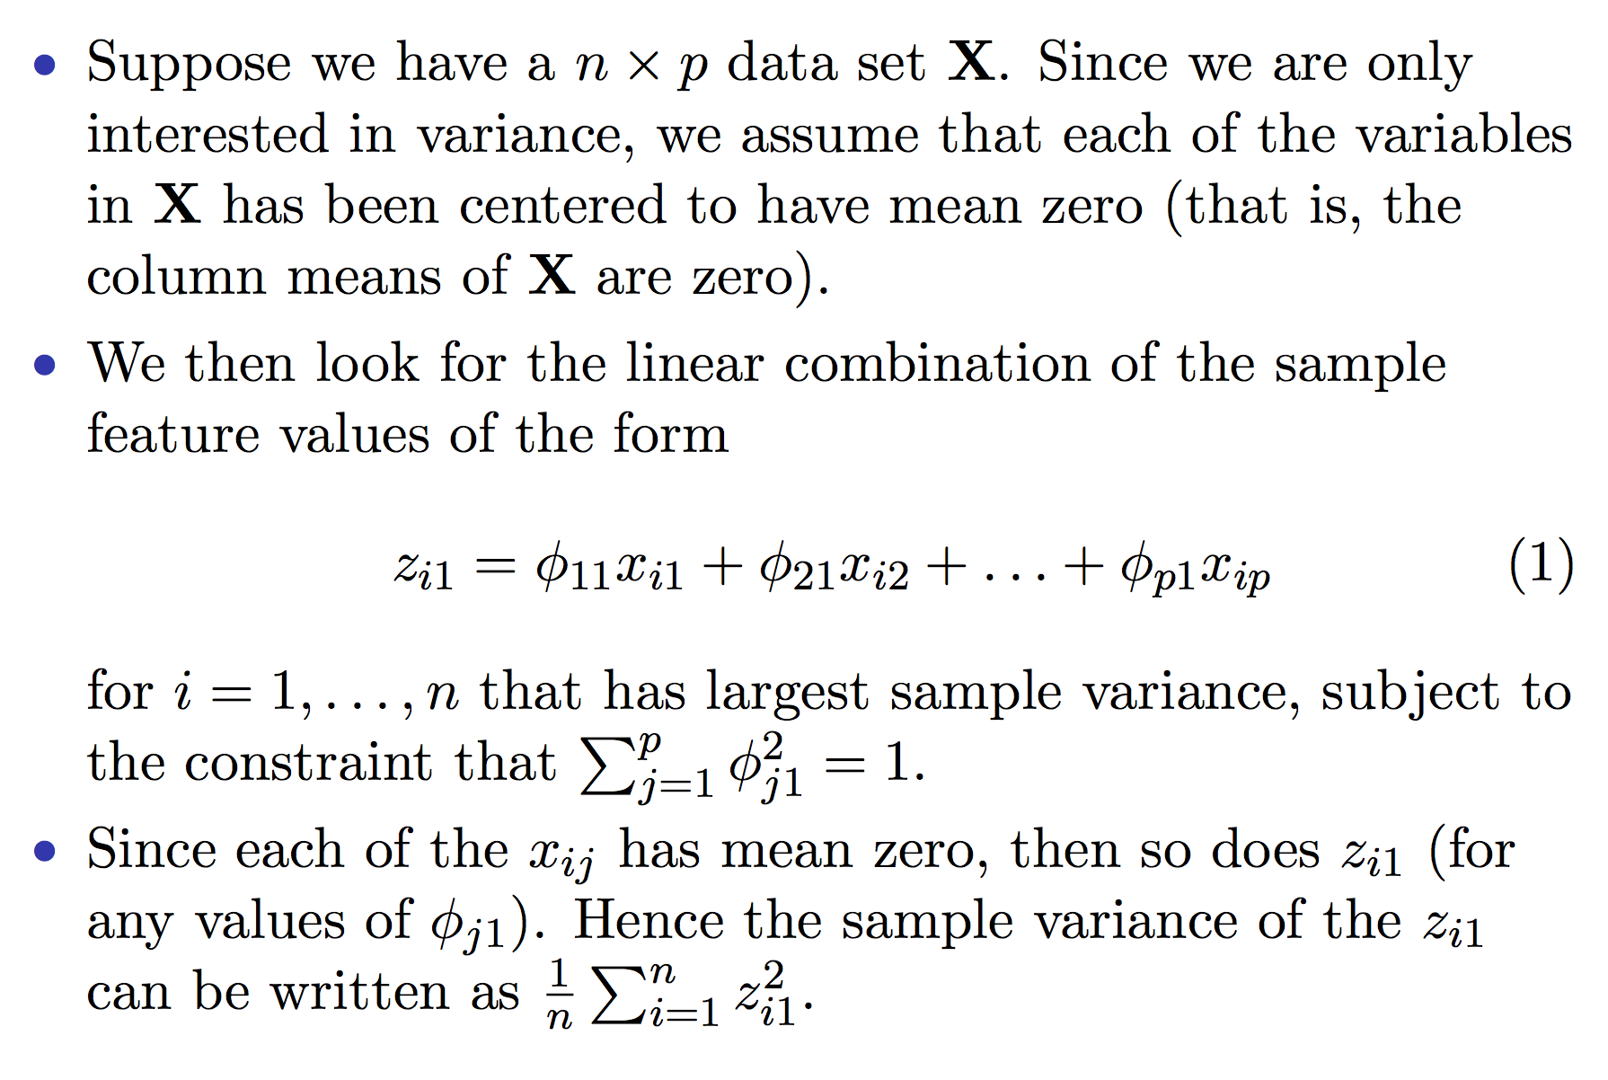
Computation of PCA

Slide 58
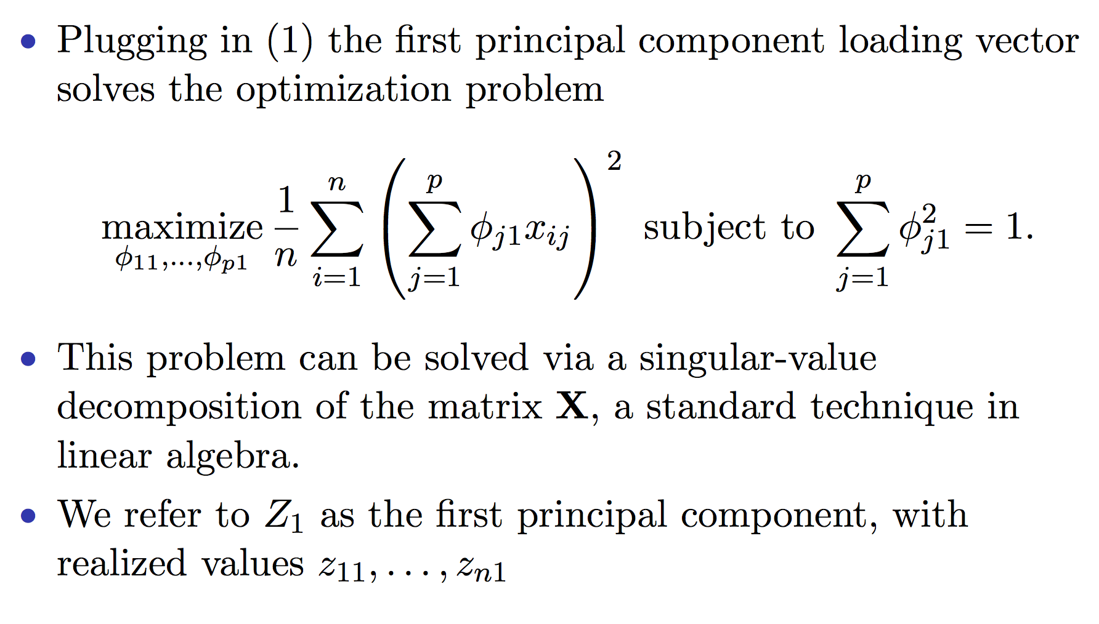
Computation of PCA continued

Slide 59
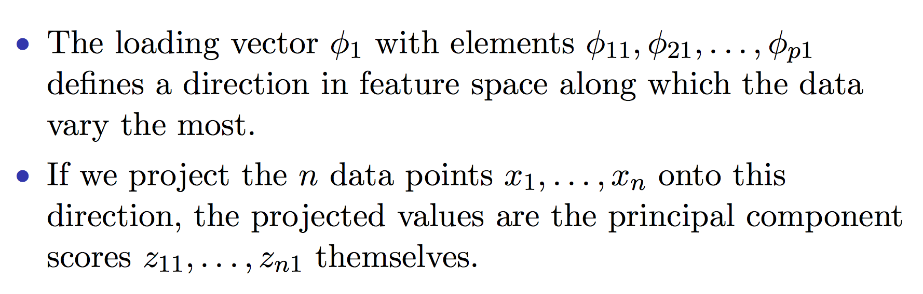
Geometry of PCA

Slide 60
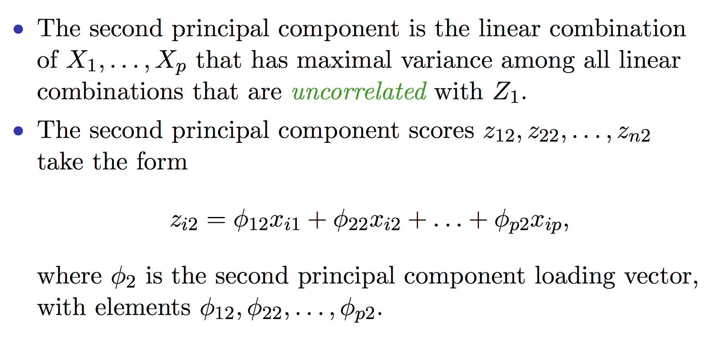
Additional PC’s

Slide 61
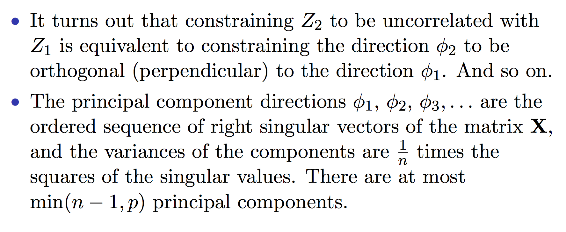
Additional PC’s continued

Slide 62
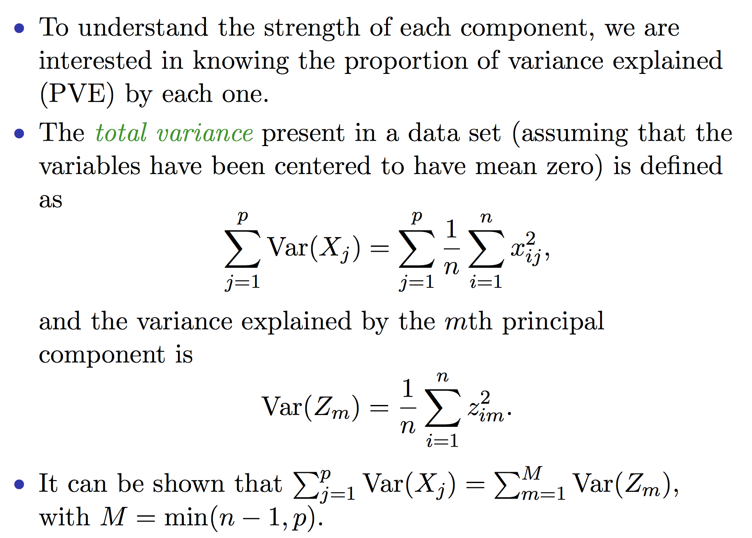
Proportion variance explained

Slide 63
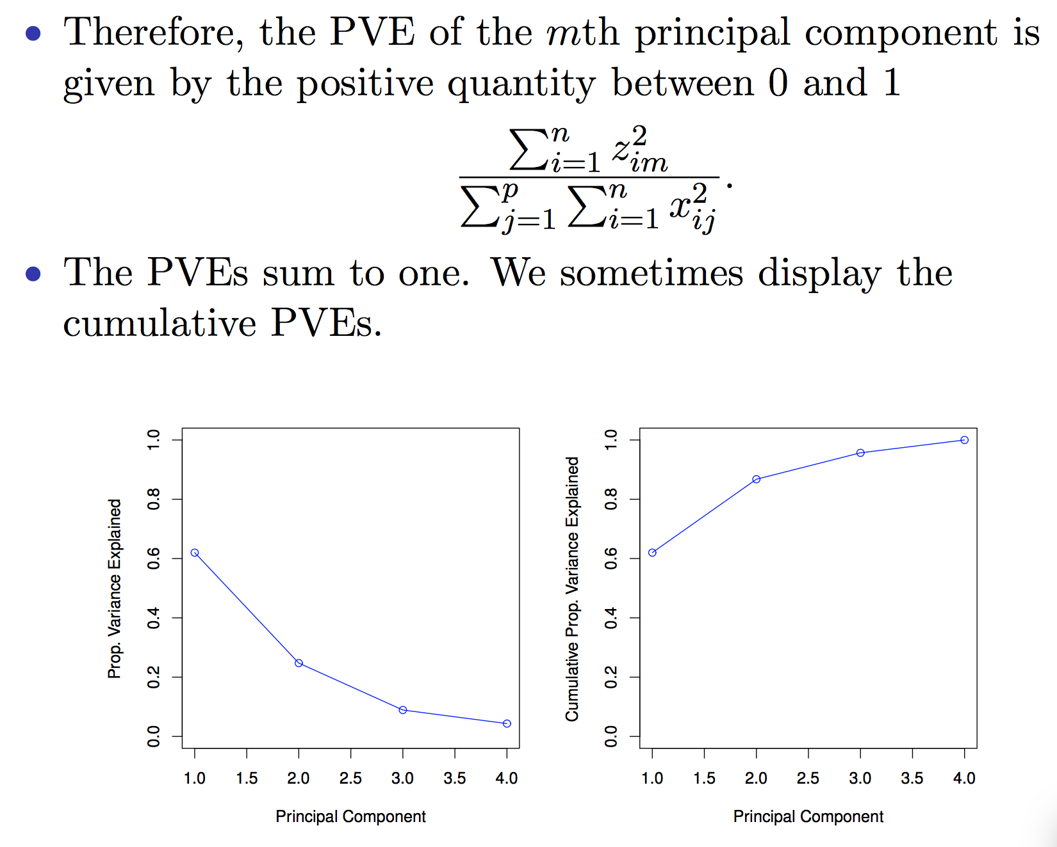
Prop var explained continued

Slide 64
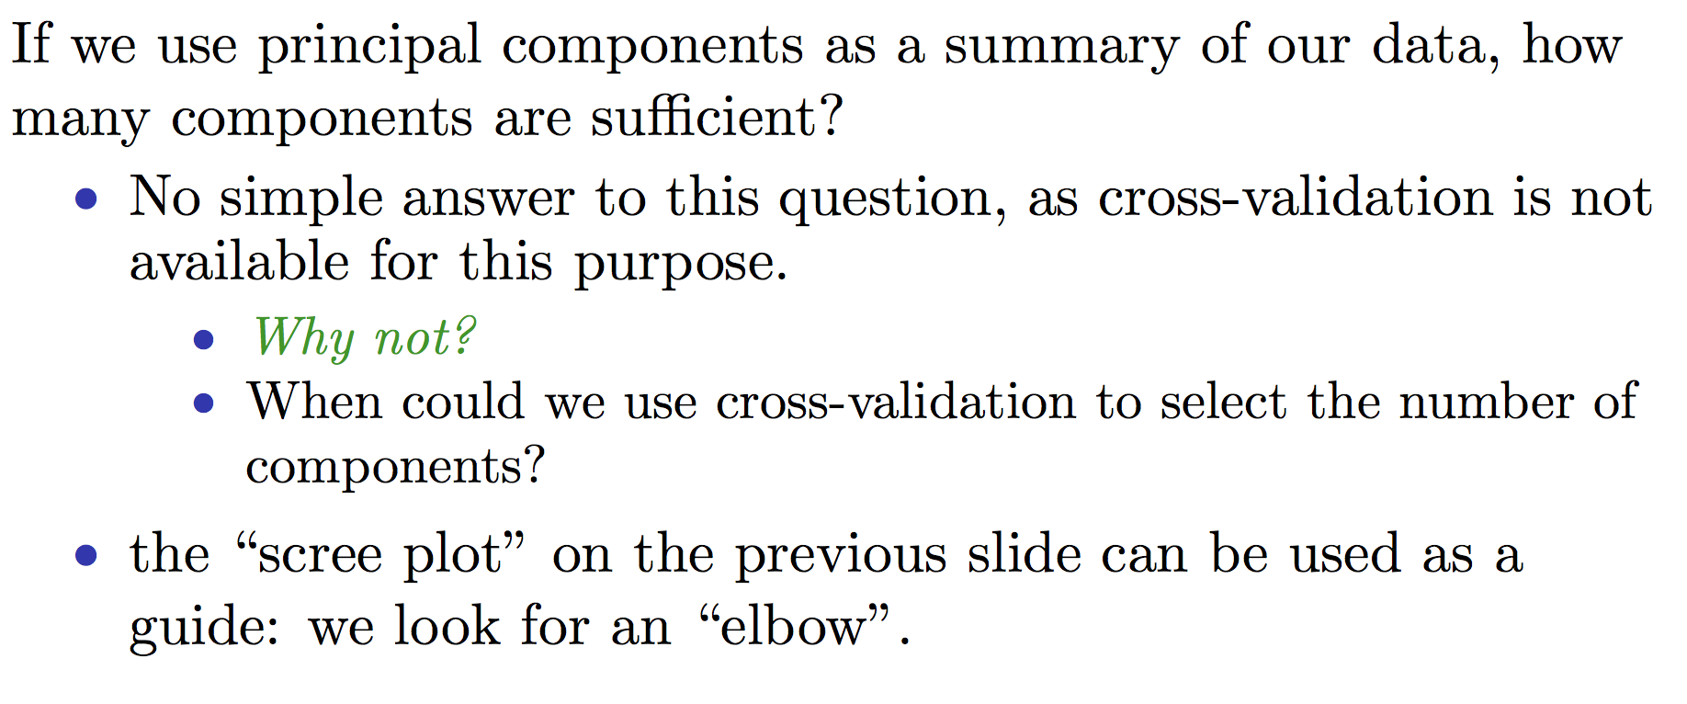
How many PC’s?

Slide 65
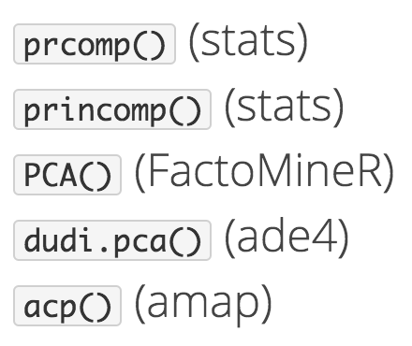
PCA in R
We will work through in lab
prcomp command
But many others also exist

Slide 66
Summary
We looked at unsupervised methods
Clustering: K-means and hierarchical
Dimension reduction: principal components analysis
Some of the figures in this presentation are taken from "An Introduction to Statistical Learning, with applications in R" (Springer, 2013) with permission from the authors: G. James, D. Witten, T. Hastie and R. Tibshirani

Slide 67
Next Lecture
Applications lecture: clustering and classification of high-dimensional data in a genomic context – Dr. Adam Olshen

