Slide 1
Machine Learning in R
Lecture 9 - Clustering and classification of high-dimensional data in a genomic context
Adam Olshen – Epidemiology and Biostatistics and Helen Diller Family Comprehensive Cancer Center
adam.olshen@ucsf.edu

Slide 2
Goal of lecture
To give an understanding of how genomic data is analyzed in order
  to evaluate a genomic analysis in a manuscript
  to get started on one’s own analysis
To give real data examples of some techniques already seen in this class such as unsupervised learning and cross-validation
To teach some new, simple analysis techniques

Slide 3
Genomic analyses are special because:
p (variables) >> n (samples), with p in the tens of thousands or more and n in the tens
Design is often suboptimal for financial reasons, lack of available material, or other reasons
There are often systematic biases in the data due to “batch” effects
Scientific validation is possible through lab work, model systems or other means

Slide 4
Genomic analyses are special because:
Interpretability of analysis is usually required
Pure black box solutions are discouraged
An attempt is often made to discover the biology behind the results

Slide 5
Outline
Study design, batch adjustment and normalization
Visualization/unsupervised learning
Issues related to classification and a couple simple classification methods
Biological interpretation and gene theme analysis

Slide 6
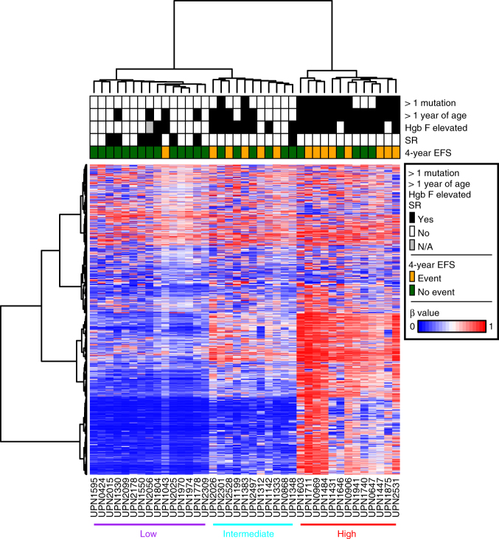
Genomics data is often displayed via heatmaps

Slide 7
Breast cancer blood biomarkers: A true story
Goal: Develop a diagnostic for breast cancer from blood samples
Blood samples were collected from hundreds of breast cancer cases and hundreds of controls
Samples were analyzed in batches of 24
Early results showed consistent gene expression differences between cases and controls!

Slide 8
An optimally poor design
The analyst (me) asked to see which samples were run in which batches
Early batches were all controls and later batches were all cases!
This is problematic for two reasons:
  Cannot separate batch and case/control effects
  Cannot determine if shift over time
I suggested running future batches mixing cases and controls and differences disappeared

Slide 9
An optimally poor design (the lesson)
One should not apply machine learning without understanding the data generation mechanism
Common sense reasoning can be used to evaluate the quality of an experiment
  Have the correct samples been collected?
  Are there enough samples to have power to detect differences?
Search for batch effects in data and correct for them if possible

Slide 10
Normalization
Normalization is the process of making comparable data from different samples
Sample preparation or measuring devices may lead to shifts in data, outliers or other changes
Normalization is very specific to technology, but a couple types are:
  Light – adjust data to make average values the same
  Severe – adjust data to make whole distributions the same

Slide 11
Batch effects
Batch effects are systematic biases in data that can result from collection or processing of samples occurring in groups
They can be corrected using regression methods like ComBat (Johnson et al.) and SVA (Leek)
They are often identified using principal components

Slide 12
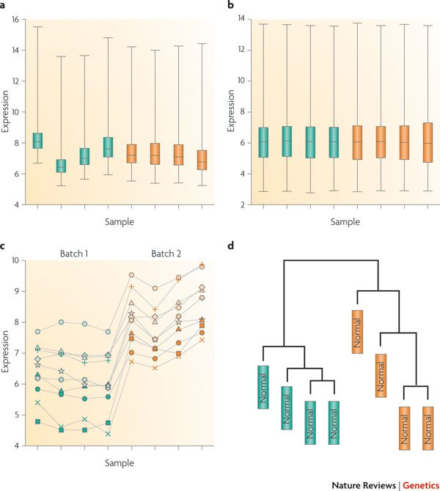
Normalization does not prevent batch effects
8 samples are shown in Figure (a)
They are normalized in Figure (b)
Figure (c) shows 10 genes vulnerable to batch effects
The samples cluster by batch in Figure (d)
Taken from Leek et al. Nature Reviews Genetics volume 11, pages 733–739 (2010)

Slide 13
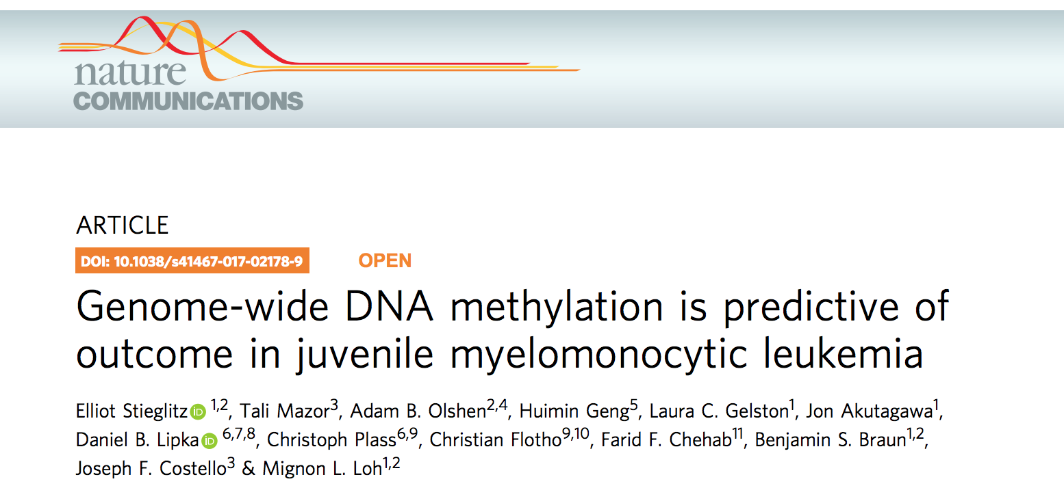
Example data

Slide 14
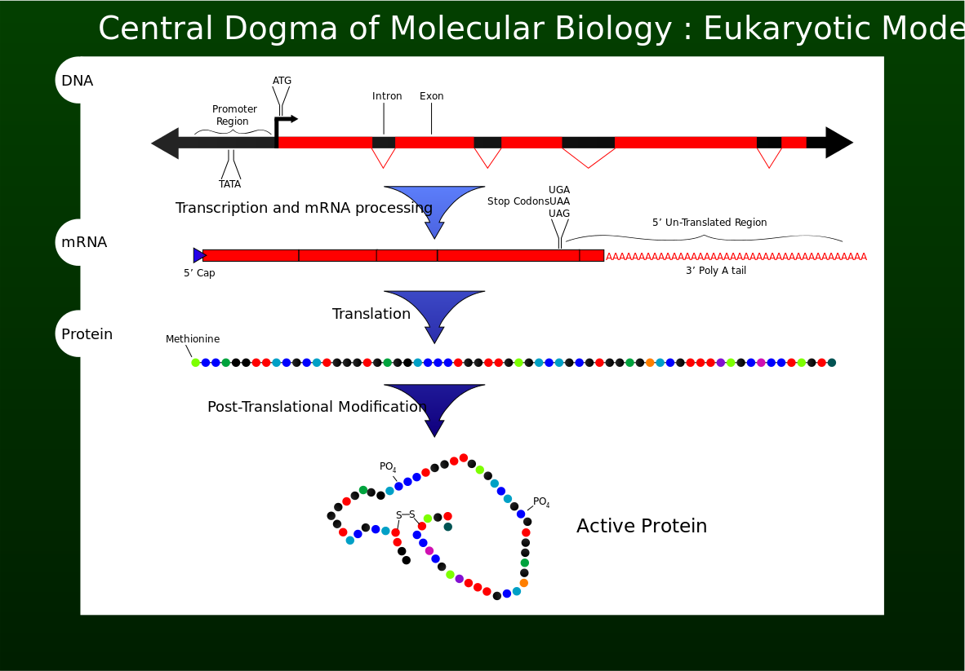
Central dogma of molecular biology
Figure taken from wikipedia: Original work by Mike Jones

Slide 15
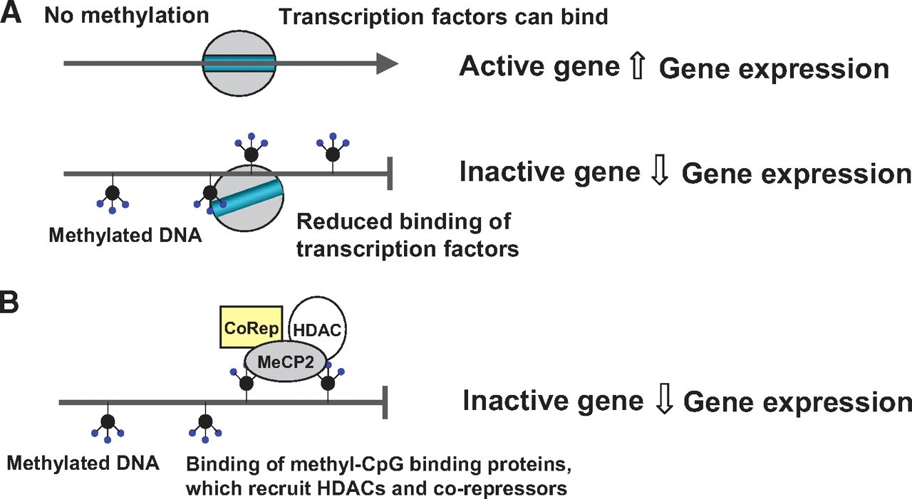
Methylation blocks gene expression
Figure taken from wikipedia: Original work by Mike Jones

Slide 16
Example data
Juvenile myelomonocytic leukemia (JMML) is a rare and serious form of childhood leukemia
Outcomes in JMML vary from spontaneous resolution to rapid relapse after hematopoietic stem cell transplantation
The authors believe that DNA methylation patterns would help predict disease outcome
The data are genome-wide DNA methylation
  39 patient training set (from UCSF)
  40 patient test set (from Germany)

Slide 17
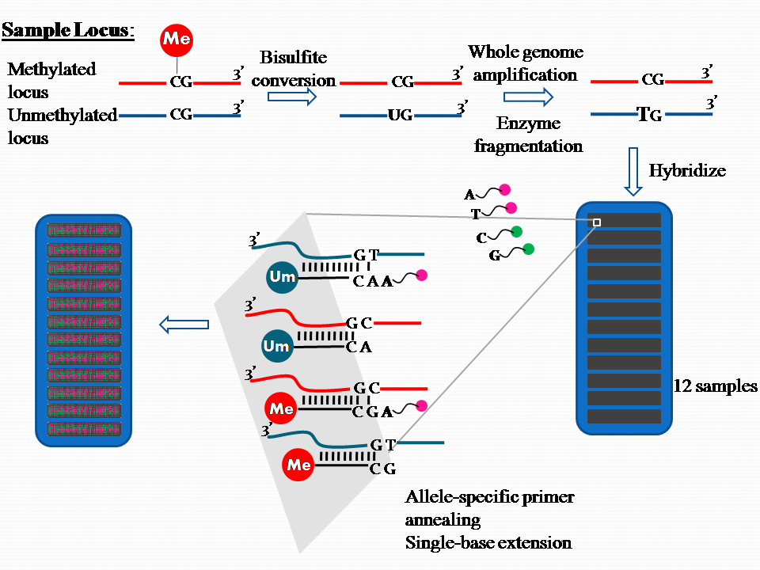
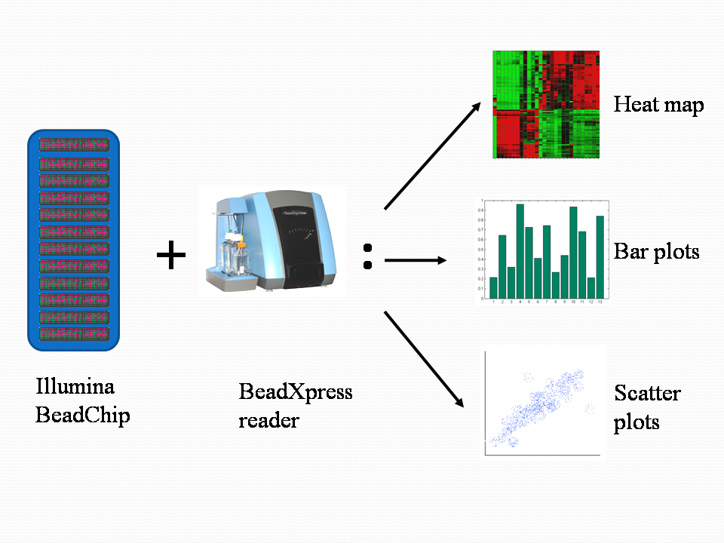
Methylation measured using microarrays
JMML samples taken at diagnosis
Step 1
Step 2

Slide 18
Markers, genes and variables
I will refer to the methylation measurements as markers
Later in the talks I will refer to measurements as genes
I may also use the word variables to refer to either

Slide 19
Visualization
After normalization and adjusting for batch effects my next step is to look at the data
A common method for data visualization is agglomerative hierarchical clustering

Slide 20
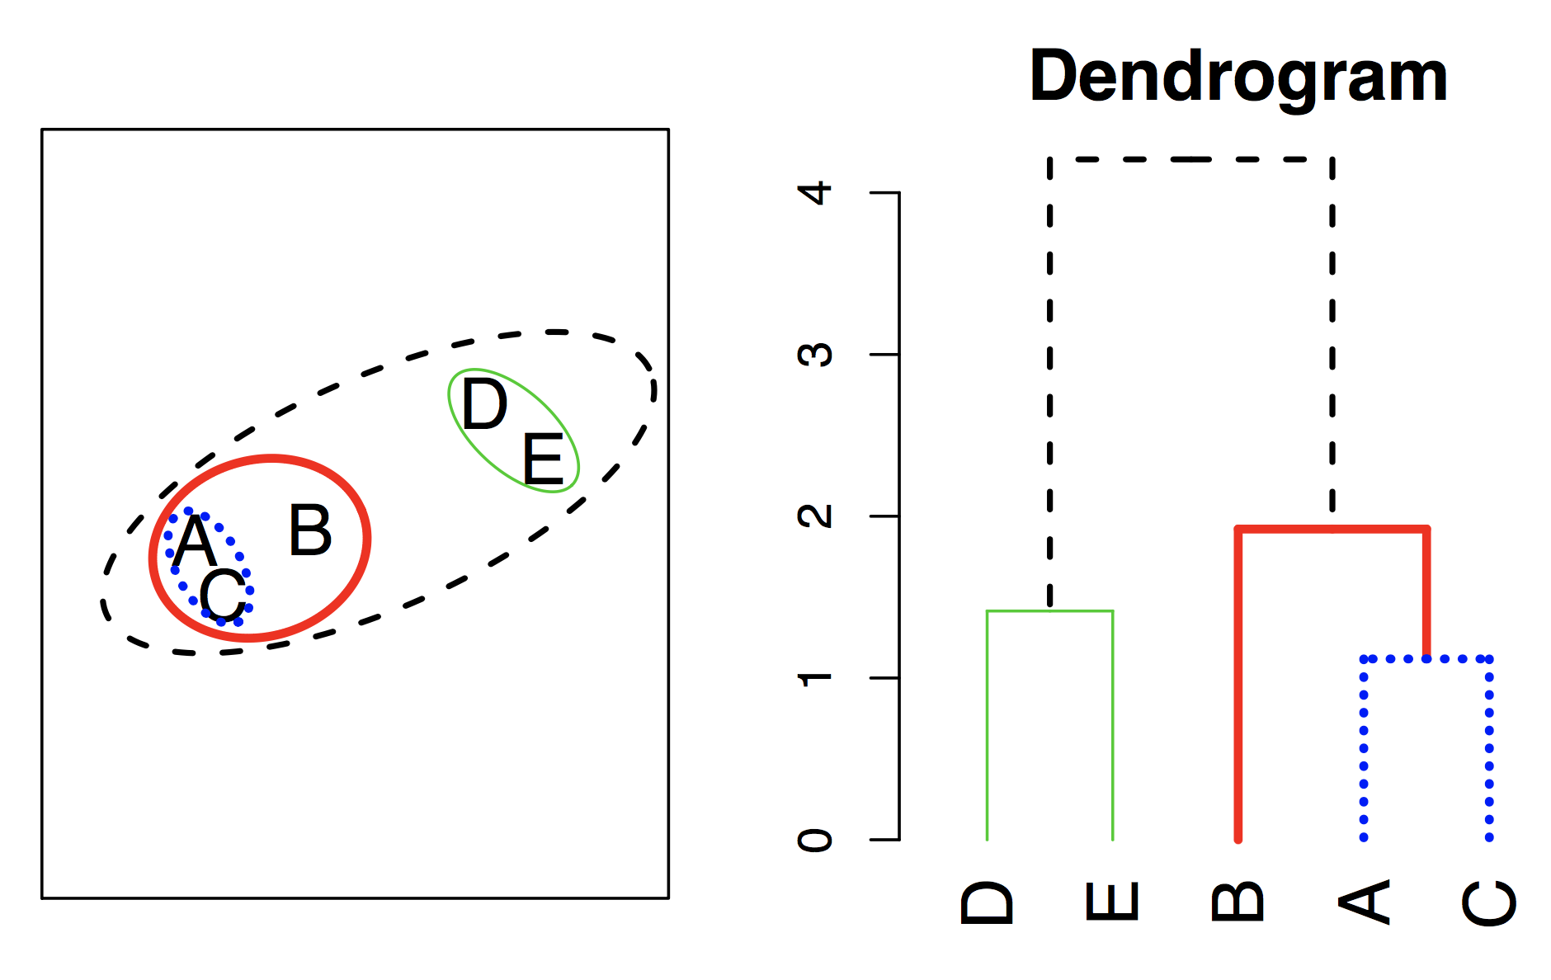
Hierarchical Clustering Algorithm
Start with each point/object in its own cluster
Identify the closest two clusters and merge them
Repeat
Ends when all points are in a single cluster
Decide how many clusters there are

Slide 21
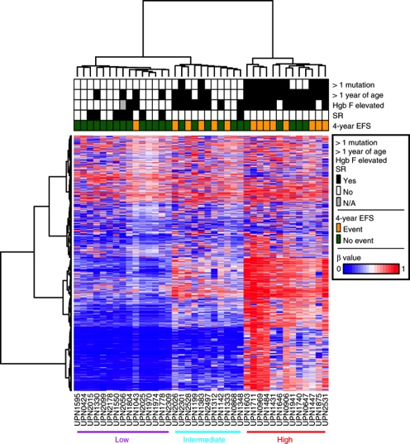
Dendogram of methylation training in both directions with heatmap has massive amounts of information
39 samples, 1500 markers
Lower methylation more blue, higher methylation more red
Samples naturally split into low, intermediate and high methylation groups
Sample groups appear related to survival and other factors
Markers split into four or so groups

Slide 22
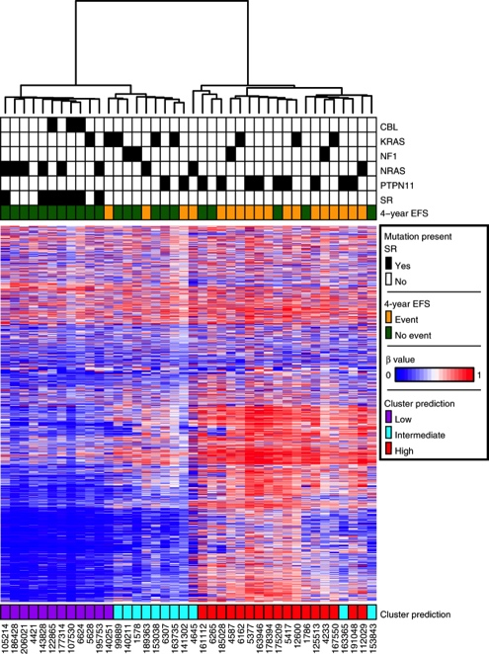
Clustering of methylation test
40 samples, same 1500 markers
Samples again cluster into low, intermediate and high clusters
Prediction based on nearest training set centroid
Relationship to survival repeated
Such luck is not often the case!

Slide 23
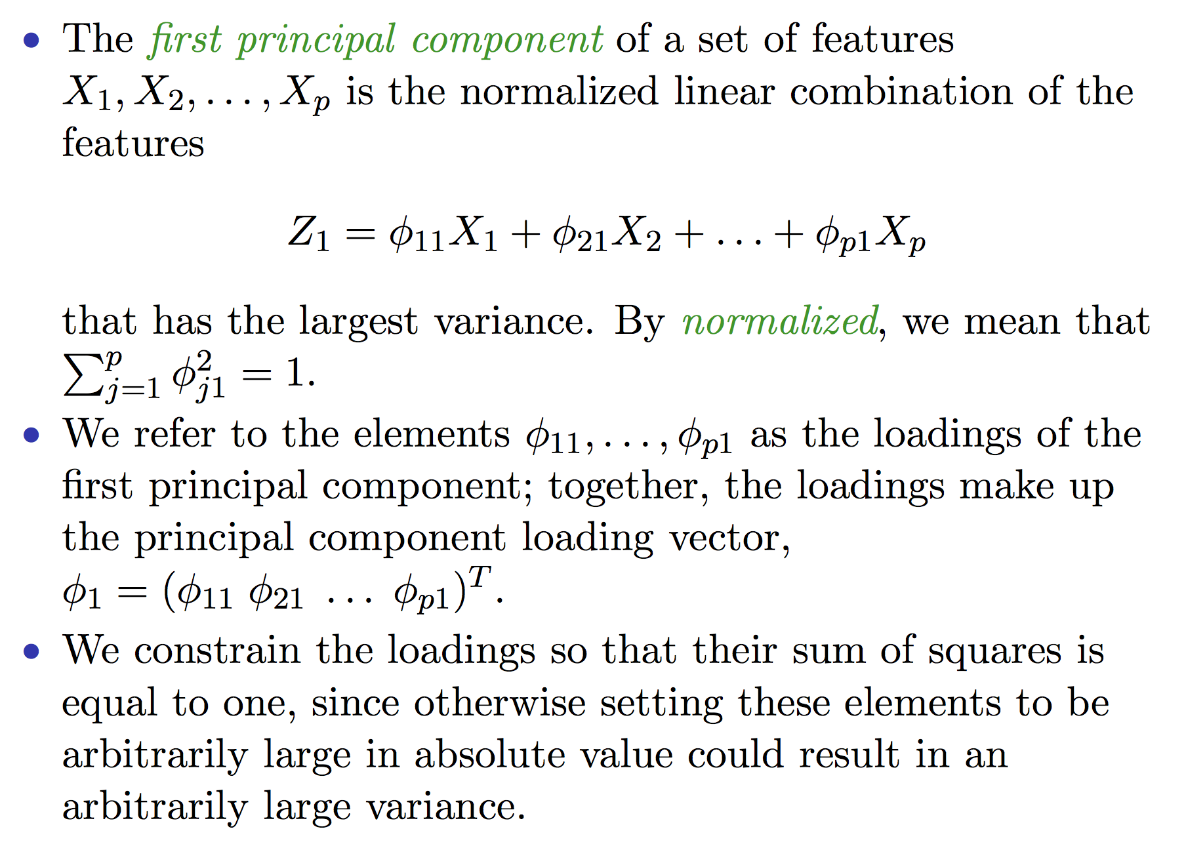
PCA details

Slide 24
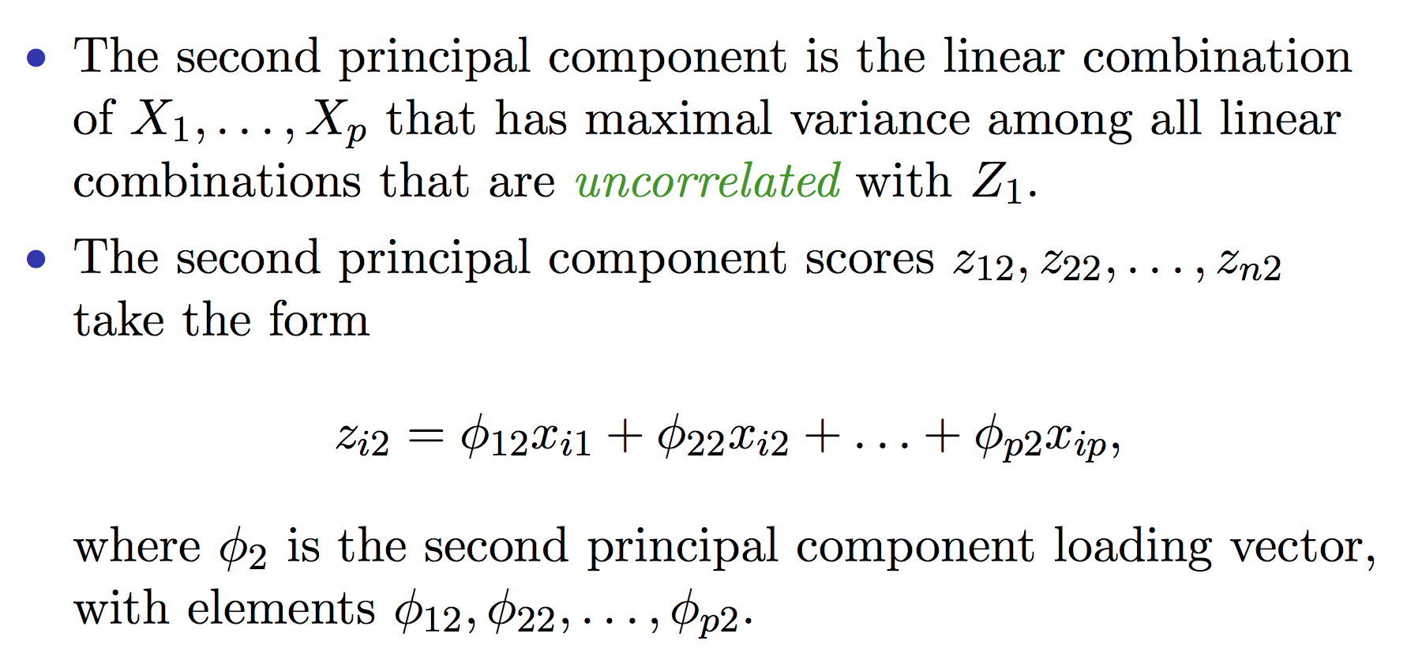
Additional PC’s

Slide 25
PCA of methylation training data leads to similar groupings to AHC
for low methylation
+ for intermediate methylation
for high methylation

Slide 26
Clustering vs. PCA
Clustering optimizes for homogeneous subgroups among the observations
PCA optimizes for a low-dimensional representation of the observations that explains a good fraction of the variance
PCA solutions can appear like clusters
PCA useful for finding batch effects

Slide 27
Predictive Modeling/Classification
Suppose one wants to predict some categorical feature
  Long or short survivors
  Responds to therapy or not
  Cluster membership
Many methods exits for such predictions
  Tree-based such as CART/Random Forests
  Support vector machines
  “Deep learning”

Slide 28
Predictive Modeling/Classification
I will focus on a few simple methods because:
  Small sample sizes lead to inability to distinguish
  Noisy data makes different methods give similar answers
  Interpretability is often a key consideration

Slide 29
p (markers) >>n (samples), why n small?
There are many reasons why n is usually small:
  The cost of the assay is hundreds or thousands of dollars each
  For a respective study there are few tissues in a tissue bank
  For a perspective study few samples can be accrued per month
  There is a mistaken belief among investigators that because p is large n can be small

Slide 30
Model building for n small
Ideally models are built on a training set and evaluated on a test/validation set
In genomics models are often evaluated using cross-validation
In the JMML methylation example the data being taken from two sites led to a natural grouping of training and test despite small size

Slide 31
Training/test
Results Known
+
Training set
+
-
-
Data
+
-
+
+
Testing set

Slide 32
Training/test
Results Known
+
Training set
+
-
-
Data
+
-
+
+
Model Builder
Testing set

Slide 33
Training/test
Results Known
+
Training set
+
-
-
Data
+
-
+
+
Model Builder
Evaluate
Predictions
+
-
+
-
Y
N
Testing set

Slide 34
Training/test
Results Known
+
Training set
+
-
-
Data
+
-
+
+
Model Builder
Evaluate
Predictions
+
-
+
-
Y
N
Testing set

Slide 35
Training/test
Results Known
+
Training set
+
-
-
Data
+
-
+
+
Model Builder
Evaluate
Predictions
+
-
+
-
Y
N
Test set
This is great if you have a lot of data to be able to reserve a testing set, but what if you don’t?

Slide 36
Cross-validation for training/test
Cross-validation
  First step: data is split into k subsets of equal size
  Second step: each subset is used in turn for validation and the remainder for training
This is called k-fold cross-validation (10-fold is common choice, also 5-fold for smaller datasets approx. <200 and even N-fold for very small datasets, called leave-one-out or loocv)
Often the subsets are stratified before the cross-validation is performed – e.g. same proportion of each diagnostic class in each fold
The error estimates are averaged across folds to yield an overall error estimate

Slide 37
E.g. 5-fold cross-validation
Break up data into 5 groups of the same size
Hold aside one group for testing and use the rest to build model
Repeat
When every group has had a turn at being the test set then you can estimate the accuracy (MSE or classification) based on the combined Test data (i.e. the 5 test-sets)

Slide 38
p>>n, what happens with p large?
p is large because there are 20k genes, millions of CpG sites, and human DNA spans 3 billion bases
Standard methods such as linear discriminant analysis and logistic regression are literally not possible for p>n
Even for methods that are possible we prefer a reduction in noisy probes to improve performance

Slide 39
How do we handle large p?
Shrinkage such as the lasso method
Dimensionality reduction such as PCA
Selecting the best subset by a statistical measure

Slide 40
Selecting the best subset of markers by a statistical measure
Suppose the problem is to distinguishing long and short survivors in methylation data
Algorithm:
  Choose best subset with t-test, Wilcoxon test, or other measure
  Use tree, SVM, or other classifier with subset
Long (n=25) Short (n=14)

Slide 41
There are the 255 best markers by the Wilcoxon rank sum test
Suppose the problem is to distinguish long and short survivors in methylation data
Algorithm:
  Choose the best subset with t-test, Wilcoxon test, or other measure
  Use tree, SVM, or other classifier with subset
Long (n=25) Short (n=14)

Slide 42
The k-nearest-neighbor rule for classification works well in many contexts
Compute the distance between the unknown sample and all samples in the training set
Identify the k nearest neighbors via distance
Classify the unknown sample based on the majority class of the k nearest neighbors
k should be odd and at least 3

Slide 43
The k-nearest-neighbor rule
Compute the distance between the unknown sample and all samples in the training set
Identify the k nearest neighbors via distance
Classify the unknown sample based on the majority class of the k nearest neighbors
k should be odd and at least 3

Slide 44
The k-nearest-neighbor rule
Compute the distance between the unknown sample and all samples in the training set
Identify the k nearest neighbors via distance
Classify the unknown sample based on the majority class of the k nearest neighbors
k should be odd and at least 3

Slide 45
The k-nearest-neighbor rule
Compute the distance between the unknown sample and all samples in the training set
Identify the k nearest neighbors via distance
Classify the unknown sample based on the majority class of the k nearest neighbors
k should be odd and at least 3

Slide 46
The k-nearest-neighbor rule on methylation test data
Using k=7
16 out of 18 short survivors accurately called
14 out of 22 long survivors accurately called

Slide 47
Errors in prediction as k varies
The success of the classifier varies substantially with k
Choosing the best k could lead to a biased success estimate
Two choices to deal with this issue:
  Choose k by cross-validation of training set and live with results
  Choose many values of k and have predictions vote and classify by the majority vote

Slide 48
Developing a scoring system
The k-nearest-neighbor method and other methods assign new samples to a class
Suppose one wants to estimate to what degree a sample belongs to a class
Some idea of degree could be estimated by varying k and calculating proportion a sample is classified correctly
Alternatively, a score could be developed to represent degree directly

Slide 49
Scores depend on weighted top markers
An algorithm:
Choose the top S markers by the p-values of an appropriate test. Call these marker values for the ith sample M_{i1},…,M_{is}
Weight these markers using t-statistics, principal components, or another weighting scheme. Call these weights W₁,…,W_{s} and use for all samples
Call the score for a sample S_{i}^{initial}=W₁M_{i1}+..+W_{s}M_{is}
S_{i}^{final}₌ 100 x (S_{i}^{initial} - min(S_{i}^{initial}))/(max(S_{i}^{initial})-min(S_{i}^{initial})), with min and max across samples to put on 0 to 100 scale.

Slide 50
Scoring methylation test data
Scoring method has been added to KNN predictions
The lighter the box the more likely to have an event (orange)
Note the knn and scoring methods are not the same so the predictions may vary

Slide 51
ROC Curve based on scores
True positive rate = sensitivity is proportion of samples with events predicted to have events
False positive rate = 1- specificity is proportion of samples without events predicted to have events
ROC curve traces the tradeoff between these two quantities
Area under the ROC curve (AUC) is a measure of the quality of the rule, with 0.5 random and 1 best

Slide 52
Summary of JMML methylation research
The three methylation subtypes also found by investigators in Germany and Japan
Each site has been developing assays simpler than microarrays to classify new patients into subtypes
The hope is to have a subtype classifier in the clinic in the new few years to help guide treatment

Slide 53
Downstream analysis
For the rest of the lecture we leave what I think of as machine learning and discuss biological interpretation
The two methods discussed involve statistical analysis of machine learning results

Slide 54
Biological analysis of results
Start with a list of markers that are in a cluster or have found to be differentially expressed
If the marker list is related to a biological process it could mean that process is important to the findings
For example if a group of related genes has higher expression in cancer patients with poorer outcomes the corresponding biological process may be part of the cause of the poorer outcome

Slide 55
Over-representation analysis
Over-representation analysis identifies biological processes that are over-represented in a gene list
Suppose we have this setup:
  n11 be genes in a gene list and in a biological process list
  n12 be genes in a gene list and not in a biological process list
  n21 be genes not in a gene list and in a biological process list
  n22 be genes not in a gene list and not in a biological process list
Biological process
+ -
Gene list
+
-
n11 | n12
n21 | n22
2 by 2 table assessed by Fisher exact test
Is n11 big given other counts?

Slide 56
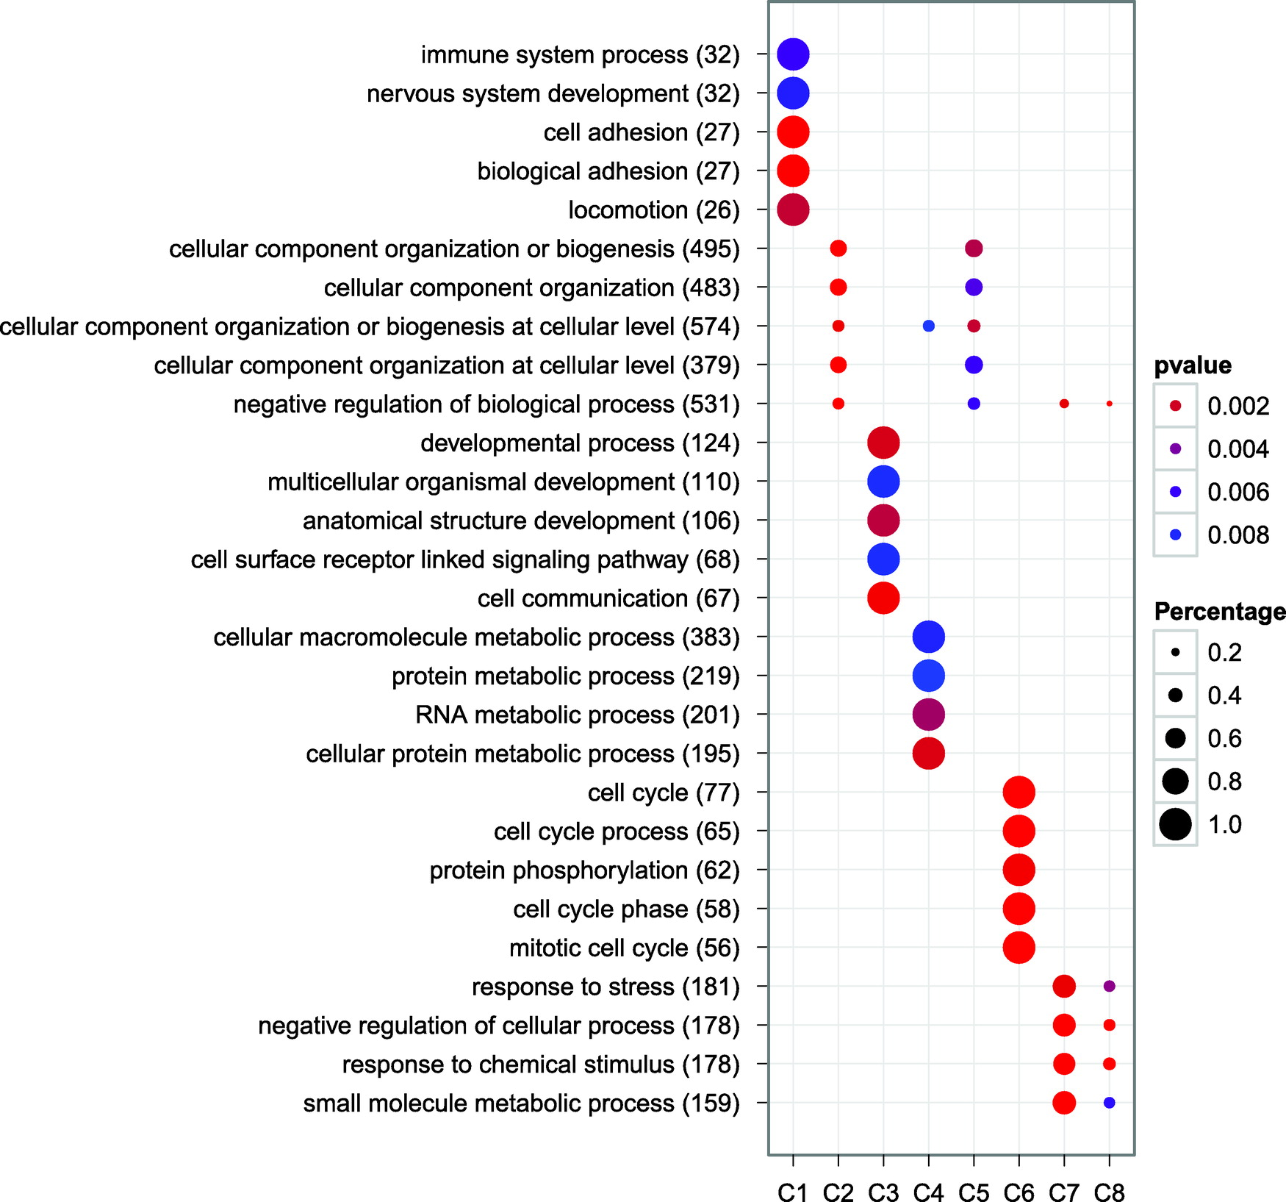
Over-representation analysis
Cluster on x-axis
Biological process on the y-axis
Only significant processes plotted
Taken from clusterprofiler manuscript (Yu et al. OMICS: A Journal of Integrative Biology, 16(5), 284-287.)

Slide 57
Gene set enrichment analysis
Gene set enrichment analysis (GSEA) is another common method for assessing a list of differentially expressed genes
Here one orders genes by p-value or other method
Then one can assess whether genes from a biological process are earlier in the ordering than expected

Slide 58
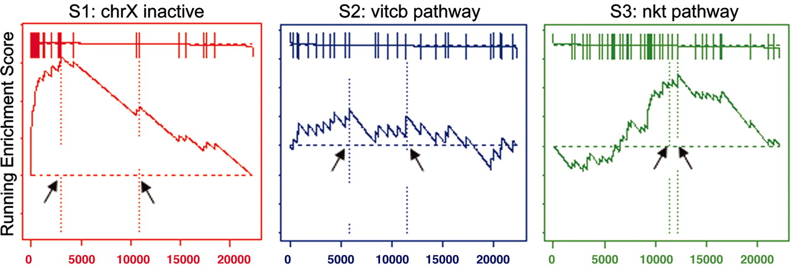
Gene set enrichment analysis
(Subramanian et al. PNAS October 25, 2005 102 (43) 15545-15550)
GSEA analysis of three pathways
Running enrichment score compares ranks of genes to expected ranks
Arrows correspond to maximum deviation from expected ranks
Analysis based on a weighted Kolmogorov-Smirnov test

Slide 59
Concluding remarks
I introduced pre-processing steps including normalization and batch effect adjustment
Through an extended data example we saw
  Unsupervised methods like AHC and PCA
  Simple supervised methods like KNN and scoring
We saw how to biologically evaluate machine learning results
You should be more prepared to evaluate genomic manuscripts and maybe approach your own analyses

Slide 60
R libraries and functions
For clustering heatmap.2() from gplots package
For principal components prcomp() from core package
For k-nearest-neighbor knn() from class package
For biological interpretation clusterProfiler package

