Slide 1
Pain and Symptom Management
Charity Hale, Pharm.D.
Pain Management Pharmacist
October 30, 2017

Slide 2
Cancer Related Bone Pain
When a tumor grows inside a bone it can cause skeletal related events (SRE) including
  Pathological fractures
  Intractable severe pain
  Spinal cord and nerve compression
Therapies to manage metastatic bone pain
  NSAIDs
  Corticosteroids
  Bisphosphonates
  RANK Ligand Inhibitor (denosumab)
  Opioids
  Radiation therapy
  Chemotherapy

Slide 3
NSAIDs

Slide 4
NSAID Classes
Over 40% of patients consume more than the recommended dose of OTC NSAIDs and APAP
NSAID
Non Selective (ns)
COX 2 Selective

Slide 5
NSAIDs
What are the three main body systems to pay attention to before starting or continuing an NSAID
    GI System
    CV System
    Renal System

Slide 6
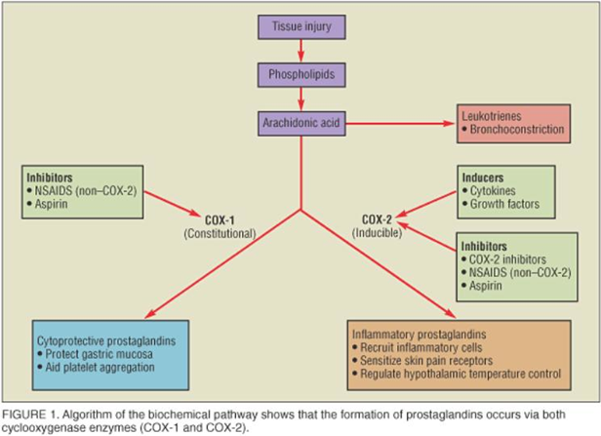
Formation of Prostaglandins

Slide 7
NSAIDs and the GI Tract
All NSAIDs inhibit the formation of prostaglandins that protect the GI mucosa
  However the risk is lower with COX-2 selective NSAIDs (celecoxib)
There are pathological differences between the upper and lower GI tract
  Upper GI tract has acidic secretions that can play a role in GI mucosal damage
    For this reason, PPIs can be used to protect the upper GI system however PPIs do not protect the GI system past the duodenum

Slide 8
Non Selective NSAID Agents and Pearls
    Motrin / Advil (ibuprofen)
      OTC: 200 mg
      RX: 600 mg and 800 mg
    Naproxen
      BID dosing
      Relatively lower cardiac risks
    Indocin (indomethacin)
      Lipophilic / higher risk for CNS side effects (avoid with concurrent psych conditions)
      Higher GI toxicity risk
    Feldene (piroxicam)
      Higher risk for GI toxicity
      Higher risk for severe skin rashes including SJS and TENS
    Toradol / Sprix NS (ketorolac)
      5 days total (IV + PO)
      SE include acute renal and hepatic failure
    Clinoril (sulindac)
      May be preferred in reduced renal function if NSAID is required

Slide 9
COX 2 Selective NSAIDs and Pearls
  Celebrex (celecoxib)
    Lower risk for GI complications
    No effects on platelets
    CI with sulfonamide allergies
  Of note, Mobic (meloxicam), Lodine (etodolac), and Relafen (nabumetone) have more COX-2 selectivity than other ns-NSAIDs but are not as selective as celecoxib

Slide 10
Incidence
More than 30 million people use NSAIDs every day
Over 40% of patients consume more than the recommended dose of OTC NSAIDs and APAP
30-50% of chronic NSAID users have endoscopic lesions
  Including hemorrhages, erosions, and ulcerations
  Generally, these lesions have no clinical significance and are not symptomatic
    It appears over time, the GI mucosa adapts to the presence of NSAIDs and lesions often reduce or even disappear with chronic NSAID use

Slide 11
Incidence
Up to 40% of NSAID users do have symptoms
  Most frequent is GERD/heartburn and dyspeptic symptoms (including belching, epigastric discomfort, bloating, early satiety, and postprandial nausea)
  1-2% of NSAID users (300,000-600,000 people) develop serious GI complications such as bleeding, perforation and obstruction
    Risk for GI complications appears to be the highest in the first month of therapy and remains elevated for up to 2 months after NSAID discontinuation

Slide 12
GI Risk Factors
Risk factors for NSAID induced GI complications
  Age > 65 years old
  Alcohol
  Hx of peptic ulcer
  Use of 2 or more NSAIDs
  Concomitant therapy with antiplatelet agents, anticoagulants, corticosteroids, and SSRI
  Severe illness
  H. pylori (H.pylori and NSAID use have a synergistic effect on the risk of developing GI complications)

Slide 13
GI Risk Factors
GI damage is dose dependent and not all NSAIDs are created equal
Slow release formulations and drugs with a longer half life appears more toxic to the GI system
  RR of GI complications < 2: ibuprofen and celecoxib
  RR of GI complications 2 to 4: meloxicam, sulindac, diclofenac and ketoprofen
  RR of GI complications 4 to 5: naproxen and indomethacin
  RR of GI complications > 5: piroxicam and ketorolac

Slide 14
CV Risk of NSAIDs
NSAIDs increase the risk of serious and potentially fatal adverse cardiovascular thrombotic events including heart attack and stroke (BBW)
CV events related to ns-NSAIDs versus COX-2 Selective agents appear to be comparable. However, naproxen potentially has lower CV risks
About 20-25% of patients are taking both low dose ASA for secondary prevention + another NSAID (especially in the older population)
The benefits of low dose ASA for secondary prevention clearly outweighs the risks of discontinuing ASA
When patients are on low dose ASA for secondary prevention plus ns-NSAID (including naproxen), the ns-NSAID impairs the anti-platelet activities of ASA
  Celecoxib does not have this interaction with ASA

Slide 15
GI Risks + Low Dose ASA
From a GI standpoint, when low dose ASA is given with any NSAID the risk for GI complications increases
  The risk of upper GI bleeds increases around 50% with ns-NSAIDs
Studies comparing Celecoxib + ASA vs ns-NSAID + PPI+ASA found lower GI complications in the Celecoxib + ASA arm

Slide 16
Steroids

Slide 17
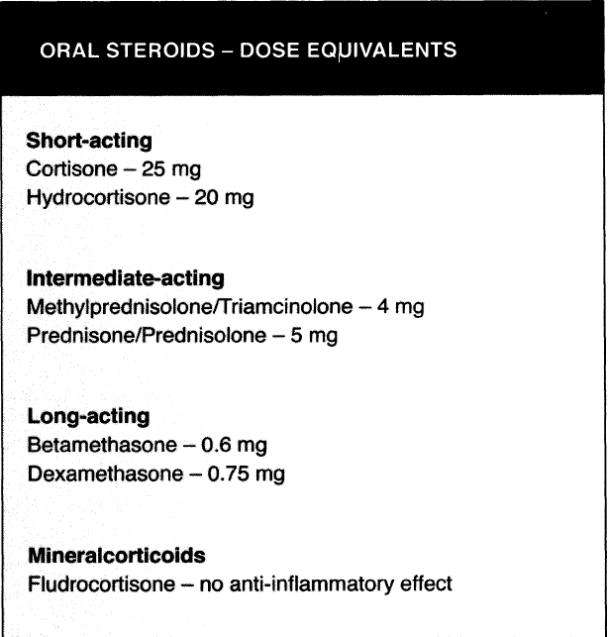
Oral Steroids

Slide 18
Steroids: MOA
Treat inflammatory pain
  Inhibits prostaglandin synthesis reducing inflammation, vascular permeability and tissue edema
  Inhibits the expression of collagenase (the key enzyme involved in tissue degeneration during inflammatory mechanisms)
Treat neuropathic pain
  Bones contain many nerves therefore patients with metastatic bone disease may have a neuropathic pain
  Shrinks tumors which reduces peritumoral edema
  Decreases pain secondary to spinal cord compression

Slide 19
Steroids: SE
Most frequent SE
Weight gain
  Increased appetite or weight gain
  Water and sodium retention / potassium loss
    Dexamethasone causes less fluid retention than other agents due to its minimal mineralocorticoid effect
Myopathy (eg muscle weakness)
Insomnia
  May dose earlier in the day
Glucocorticoids are lipophilic and can cross the BBB
  Psychiatric SE (delirium, depression, anxiety, and psychosis)
Osteoporosis with long term use
Infection
Increased blood glucose

Slide 20
Steroids: SE
Life threatening SE
GI bleeds
  The combination of CS and NSAIDs increases the risk of GI bleed by 15 fold!
  PPI or H2RA provide GI protection
    Eg pantoprazole 40 mg PO or IV once daily for GI protection while on NSAID or steroid

Slide 21
Bisphosphonates

Slide 22
Process of Normal Bone Homeostasis
Normal bone turnover involves equilibrium of a complex interaction between bone breakdown and bone turnover
  OsteoClasts “Chew bone up” / decompose bone matrix allowing mononuclear cells to prepare bone surface for osteoblasts
  OsteoBlasts “Build bone” / lay down new bone matrix
Metastases dysregulate the normal bone turnover process
Bisphosphonates work by accumulating in bone and inhibiting osteoclast activity

Slide 23
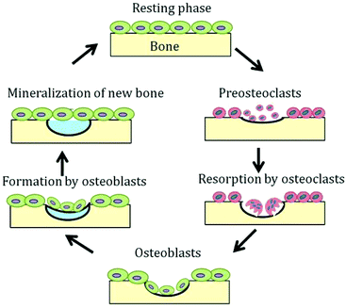
Normal Bone Homeostasis: Simple Depiction

Slide 24
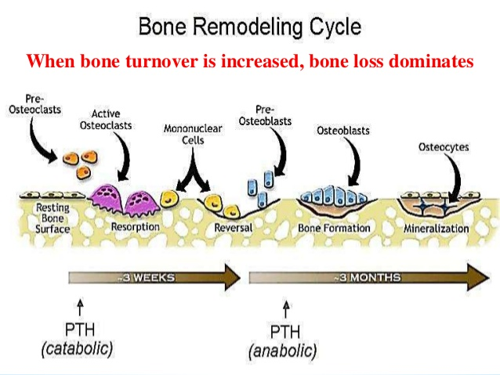
Normal Bone Homeostasis: Detailed Depiction

Slide 25
Bisphosphonates: Agents
Zoledronic acid
Pamidronate
Ibandronate

Slide 26
Bisphosphonates: SE / Monitoring
GI upset (nausea, vomiting, dyspepsia or heartburn)
Esophagitis (may increase esophageal cancer risk long term)
  To decrease risk, sit upright or stand at least 30 minutes (60 minutes with ibandronate) after taking drug
Joint / back pain
Renal toxicity
  Renal dose adjustments
Zoledronic acid
  Transient post dose syndrome occurs in 25-40% of patients on days 2-3 post injections: flu like symptoms such as achiness, runny nose, and HA. Taking NSAIDs prior and after injection can decrease symptoms

Slide 27
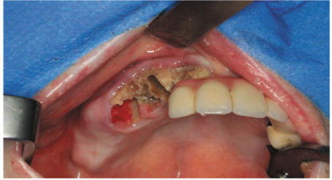
Bisphosphonates: SE / Monitoring
Jaw osteonecrosis (rare with long term use)
  Presents as painful oral ulcerations that expose underlying bone
  Risk is increased with IV bisphosphonates, oral infections, and dental extractions
  Dental examination should be performed before beginning therapy or in patients who have been given bisphosphonates within the last three months

Slide 28
Bisphosphonates: FDA Warning
Due to the risk of atypical femur fracture, esophageal cancer and osteonecrosis of the jaw, bisphosphonates should be stopped after 3-5 years

Slide 29
Benefits of Bisphosphonates
Benefits of bisphosphonates in patients with bone cancer
  Prevent or delayed onset of initial and recurring SRE (skeletal related events)
  Decreased pain levels
  Decreased analgesics
  Delays worsening of performance status

Slide 30
Intrathecal Pump

Slide 31
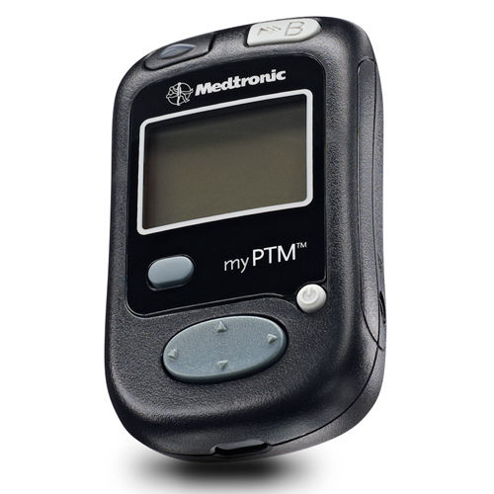
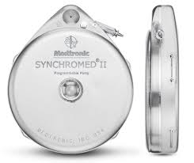
Intrathecal Pump
Used in patients with refractory pain
The intrathecal pump AKA a “pain pump” is a round metal device about the size of a hockey puck (20 mL or 40 mL) and it’s surgically implanted beneath the skin (typically the abdomen)
A catheter delivers medication into the intrathecal space
Have an option for continuous infusion and/or patient controlled bolus doses

Slide 32
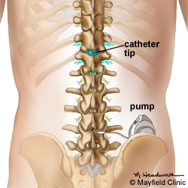
Intrathecal Pump
The fluid filled space around the spinal cord is called the subarachnoid or intrathecal space
CSF flows through this area bathing and protecting the brain and spinal cord
Significantly smaller intrathecal doses are needed compared to systemic (oral or IV) doses
Goal of pump is to achieve better symptom control and to reduce side effects by reducing systemic exposure to medications

Slide 33
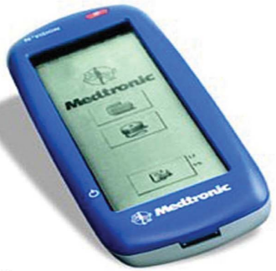
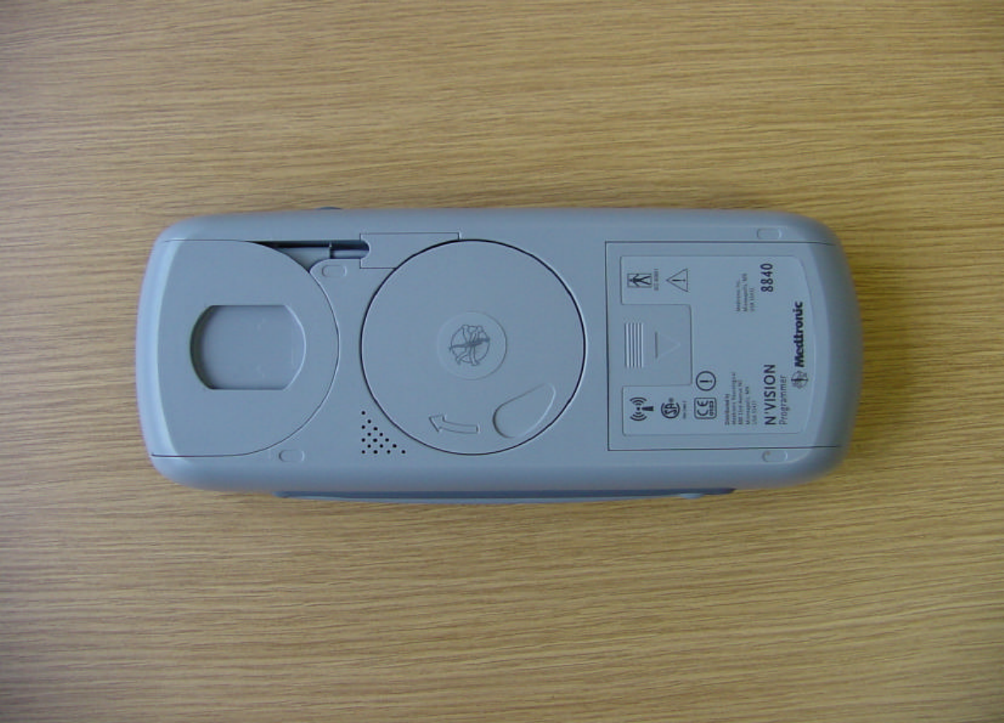
Intrathecal Pump
“Interrogate” the pump and retrieved information from the pumps memory
  Physician who implanted the pump
  Drug / concentration
  Rate (continuous or bolus)
  Next refill date
    Pump will alarm when the reservoir is low and the pump needs to be refilled

Slide 34
Patient Case

Slide 35
Patient Case
57 y/o female patient with pancreatic cancer with bone metastasis. SCr = 1.6 (baseline 0.9). BMI = 32. PLTs are WNL. BUN:SCr ratio is less than 20.
Patient appears: somewhat uncomfortable, awake (RASS =0), alert and answers questions appropriately
Location and description of pain:
  Pelvis and right hip: burning, shooting, throbbing and sharp
  Back: charley horses
  Left upper quadrant: cramping and pressure
Numerical Rating Scale:
  Patient reports pain score of 8 at rest and 10 with movement
    Where 0 is no pain and 10 is the worst pain imaginable
Diet: eating 60% of regular diet. Patient reports increased abdominal cramping/pain due to eating however she reports an increase in appetite

Slide 36
Patient Case
Last bowel movement: 2 days ago and denies feeling constipated (1 bowel movement every other day at baseline) per patient
Symptoms: complains of newly occurring heartburn, hiccups, and dysphagia but denies drowsiness, dizziness, n/v, and itching
Function:
  Patient reports she is unable to ambulate secondary to pain
  Patient reports sleeping poorly due to pain and from waking up hungry and eating snacks
Patient’s functional goals:
  To ambulate to bathroom
  To shower independently
  To sleep throughout the night
  These goals are written on the whiteboard in the patient's room to encourage discussion of functional goals

Slide 37
Patient Case
Analgesic Regimen Prior to Admission:
Intrathecal Pump:
  Drugs and Concentrations:
  1) Hydromorphone 30 mg/mL
  2) Baclofen 500 mcg/mL
  Infusion Rates:
1) Hydromorphone 5.207 mg/day
2) Baclofen 86.78 mcg/day
  Reservoir Volume: 18.9 mL
  Low Reservoir Alarm Volume: 2 mL
  Pump refill date: 12/1/17

Slide 38
Patient Case
Current (Inpatient) Analgesic Regimen:
  Dexamethasone 6 mg po TID (on fourth day of therapy)
  Ketorolac 15 mg IV q 6 hours around the clock
  Intrathecal pump (settings were not altered since hospital admission)
Work through the following questions with your group
Drug resources may be used but please share with the class which ones are used

Slide 39
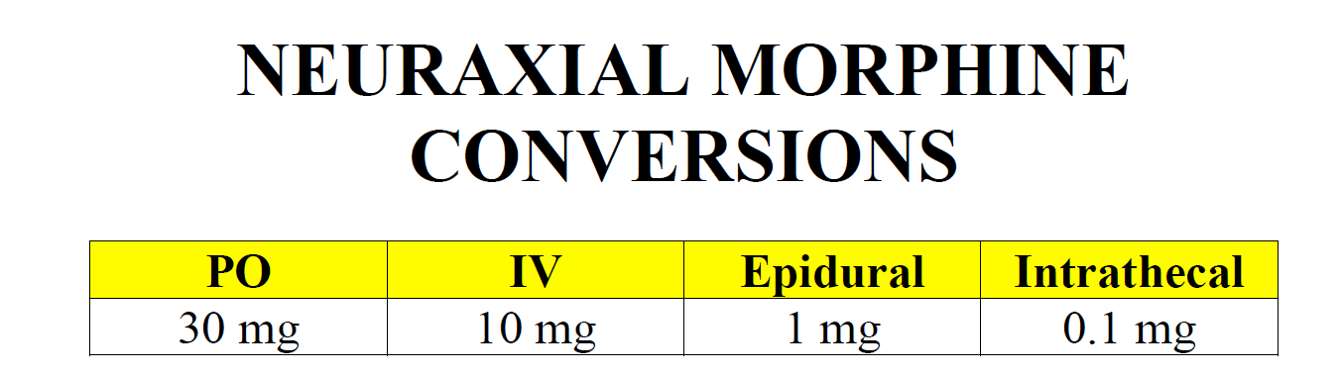
Intrathecal Pump

Slide 40
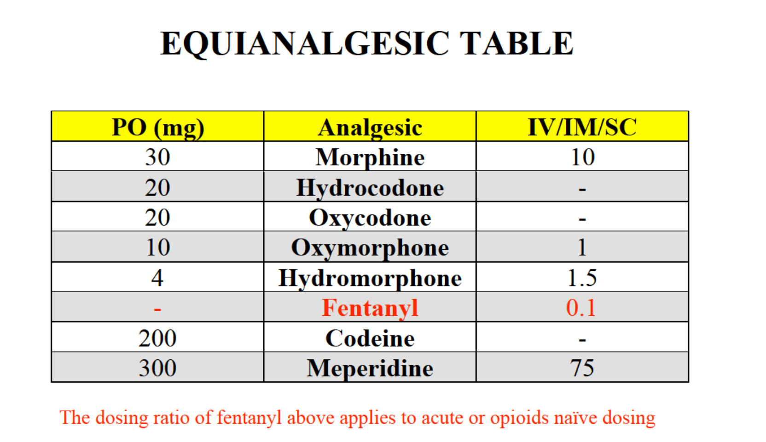
Intrathecal Pump

Slide 41
Patient Case: Q1
Q1: What is a benefit and limitation of ketorolac compared to other ns-NSAIDs?
  Benefit: IV option
  Limitation: use is limited to 5 days secondary to increased risk of GI complications

Slide 42
Patient Case: Q2
Q2: What are some potential strategies to help your patient meet her functional goal of sleeping through the night?
  Giving the steroid earlier in the day
  Lower dose of steroid
  Better pain management

Slide 43
Patient Case: Q3
Q3: How would you counsel a patient using steroids?
  Timing of the dose (avoid taking past 17:00 to minimize insomnia)
  For diabetic patients, monitor for elevated blood glucose levels
  Side effects
  Indication
  Compliance

Slide 44
Patient Case: Q4
Q4: What medication is likely causing heartburn, hiccups, and dysphagia? How can this medication be altered to decrease these side effects?
  Most likely the steroids
  Decreased dexamethasone dose to 6 mg po am
  Begin pantoprazole 40 mg po once daily for GI protection while on steroids

Slide 45
Patient Case: Q5
Please list the possible mechanisms of pain this patient is experiencing and list therapy suggestions for each (including drugs, doses, pertinent monitoring parameters, and patient counseling).
Spasmodic pain:
  Begin diazepam 5 mg po q 6 hours prn muscle spasms
Visceral Pain:
  Levsin 0.125-0.25 mg SL QID for visceral cramping

Slide 46
Patient Case: Q5
Please list the possible mechanisms of pain this patient is experiencing and list therapy suggestions for each (including drugs, doses, pertinent monitoring parameters, and patient counseling).
Neuropathic Pain:
  Begin gabapentin 300 mg po TID for neuropathic pain
    Monitor for dizziness and sedation / out of bed with assistance only
    Titrate dose accordingly based on patient’s response and tolerability
    May dose gabapentin q 6 hours due to saturable absorption
  SNRI
    Duloxetine 60 mg po once daily for neuropathic pain
    Venlafaxine XR 75 mg po once daily for neuropathic pain
      Monitor for headaches and hypertension

Slide 47
Patient Case: Q5
Please list the possible mechanisms of pain this patient is experiencing and list therapy suggestions for each (including drugs, doses, pertinent monitoring parameters, and patient counseling).
Visceral, Inflammatory, and Neuropathic Pain:
  Dexamethasone 6 mg po qam
    Decreasing dose may help with side effects
    Dosing in the morning may minimize insomnia
  Duration of therapy depends on goals of care:
    End of life patient: may leave on indefinitely
    Not end of life: steroid burst several days
  Discontinue ketorolac
    Concomitant NSAID and steroid therapy increases the risk of GI bleed
    May be the cause for the increasing SCr trend (monitor renal function with NSAIDs)

Slide 48
Patient Case: Q5
Please list the possible mechanisms of pain this patient is experiencing and list therapy suggestions for each (including drugs, doses, pertinent monitoring parameters, and patient counseling).
Bone Pain:
  Anti-inflammatory medications
  Neuropathic agents
  Bisphosphonates
    Zometa 4 mg IV once q 3-4 weeks
  RANK Ligand Inhibitor (denosumab)
  Radiation therapy or chemotherapy

Slide 49
Patient Case: Q5
Please list the possible mechanisms of pain this patient is experiencing and list therapy suggestions for each (including drugs, doses, pertinent monitoring parameters, and patient counseling).
Additional considerations:
  Acetaminophen 1000 mg po q 6 hours (may mask fever / opioid sparing)
  Topical agents for localized pain:
    LidoDerm patches: apply up to 3 patches transdermally to the most affected area. May leave on up to 12 hours per 24 hours, then remove.
TENS unit
Nerve Blocks

Slide 50
Patient Case: Q6
Q6: How many OME are provided via the intrathecal pump?
  Intrathecal hydromorphone X 100 = IV hydromorphone
    5.207 X 100 = 521 mg IV hydromorphone
  IV hydromorphone X 20 = OME
    521 mg X 20 = 10,420 mg OME

Slide 51
Questions / Comments?

