Slide 1
Today
Review of binomial and normal distribution
Sampling
Central limit theorem
Confidence intervals for means
Normal approximation to the binomial distribution
Confidence intervals for proportions

Slide 2
Recap of binomial distribution
The binomial distribution describes the probability of x successes in n independent trials, each with probability p of success
The distribution will be symmetric when p=0.5, skewed right when p<0.5, and skewed left if p>0.5
The possible number of “successes” will be 0 to n, because there are n “trials”
Often “successes” are number of people with a disease, “number of trials” is the number of people in the sample
Notes:
Where trials = number of coin flips, for example and successes could be the number of heads counted in those coin flips. For a diagnostic test this could be the number of subjects with a disease tested and the successes could be the number of positive tests.

Slide 4
Binomial distribution
P(X=x)
X represents the random variable X that follows a binomial distribution
x represents what you actually get (number of successes) when you draw your sample
In statistics, the mean of a theoretical probability distribution is also called the “Expected value”.
The expected value or mean of the binomial distribution is n*p
For the binomial distribution, if you know the underlying p in the population, then you know that if you take your sample over and over, then the mean number of successes will be n*p

Slide 5
Example 1: Binomial
P(X=x) = P(exactly x successes occurring)
e.g. n=20, p=.05, x=2 P(X=2)?
** using comb(n,x)*p^x*(1-p)^(n-x)
di comb(20,2)*.05^2*.95^18
.1886768
** using binomialp(n,k,p) (order matters!!!)
di binomialp(20,2,.05)
.1886768
Notes:
Do not mistake binomialp() with binomial()… It represents a different entity.
binomial(n,k,p)
Description: the probability of observing (k) or fewer successes
in (n) trials when the probability of a success on
one trial is p; 0 if k < 0; 1 if k > n
binomialp(n,k,p)
Description: the probability of observing exactly (k) successes in
(n) trials when the probability of a success on one
trial is p

Slide 6
Example 2: Binomial
P(X≥x) = P(of x or more successes occurring)
e.g. n=20, p=.05, x=2
P(X≥ 2) =1 - ( P(X=0) + P(X=1) )
** using binomialp(n,k,p)
di 1 - binomialp(20,0,.05) - binomialp(20,1,.05) .26416048
*** using binomialtail(n,k,p)
di binomialtail(20,2,.05)
.26416048

Slide 7
Example 3: Binomial
P(X>x) = P(More than x successes occurring)
e.g. n=20, p=.05, x=2
P(X>2) = P(X ≥ 3) = 1 - ( P(X=0) + P(X=1) + P(X=2) )
** using binomialp(n,k,p)
di 1- binomialp(20,0,.05) - binomialp(20,1,.05) - binomialp(20,2,.05)
.07548367
*** di binomialtail(n,k+1,p)
di binomialtail(20,3,.05)
.07548367
Whether you are looking at P(X≥x) vs P(X>x) matters for discrete distributions!!!

Slide 8
Recap from the normal distribution
We do not calculate P(X=x) or P(Z=z)
  Probability of individual values are 0
We do calculate P(X>x) or P(X<x) or the probability of a range of values (e.g. -1.96, 1.96)
It does not make a difference if we use the notation P(X>x) or P(X≥x) because we just said P(X=x)=0
Notes:
If a distribution is continuous, there is no probability at a single point of the distribution, only for an interval

Slide 9
Normal distribution
Z~N(0,1) is a normal distribution with mean 0 and standard deviation 1
P(Z > a big z) is small, e.g. P(Z>3)
di 1-normal(3)
.0013499
P(Z < a big z) is close to 1
di normal(3)
.9986501
But if z is negative, it is the converse
P(Z>-3)
di 1-normal(-3)
.9986501
P(Z<-3)
di normal(-3)
.0013499

Slide 10
Normal distribution
Remember:
Using di normal() in Stata
for P(Z>z) use di 1-normal(z)
for P(Z<z) use di normal(z)

Slide 11
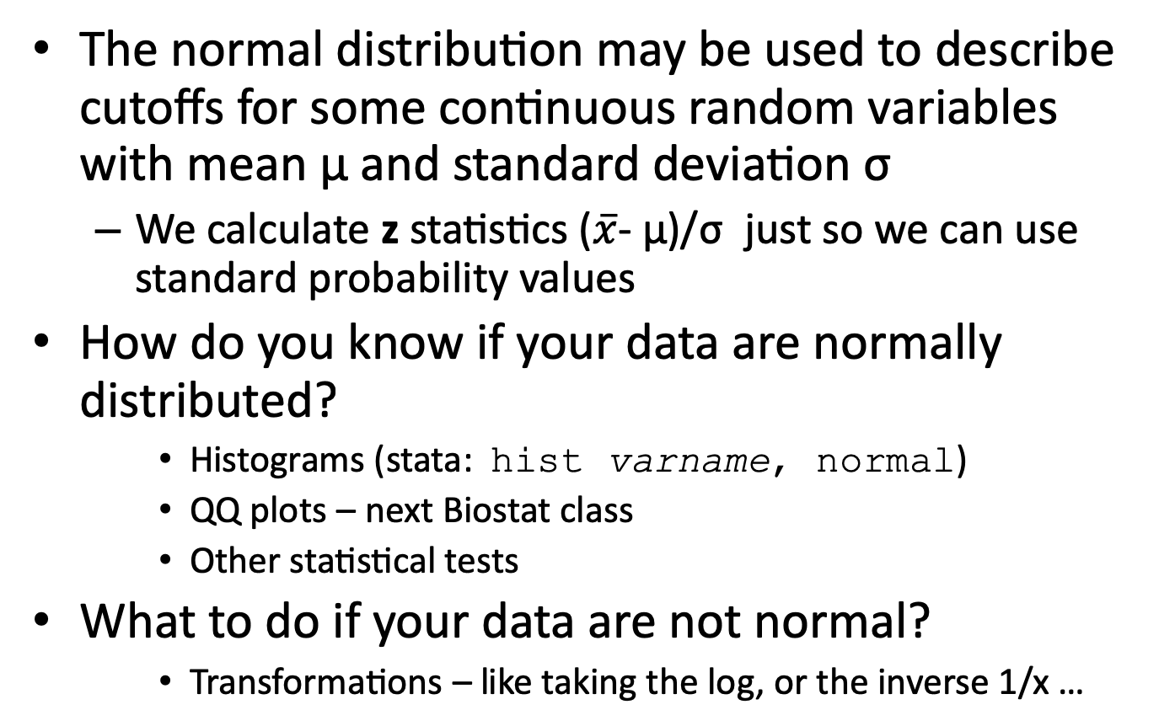
Recap from the normal distribution
The normal distribution may be used to describe cutoffs for some continuous random variables with mean µ and standard deviation σ
  We calculate z statistics ($\overline{x}$- µ)/σ just so we can use standard probability values
How do you know if your data are normally distributed?
    Histograms (stata: hist varname, normal)
    QQ plots – next Biostat class
    Other statistical tests
What to do if your data are not normal?
    Transformations – like taking the log, or the inverse 1/x …

Slide 12
A bit more about the theory behind means and variances
The mean of a random variable X is the long run average of the X’s and another name is the “Expected value of X”.
The variance of a random variable describes the long run spread of the possible values around the mean.
Both are calculated based on the theoretical distribution function P(X=x) or f(x).

Slide 13
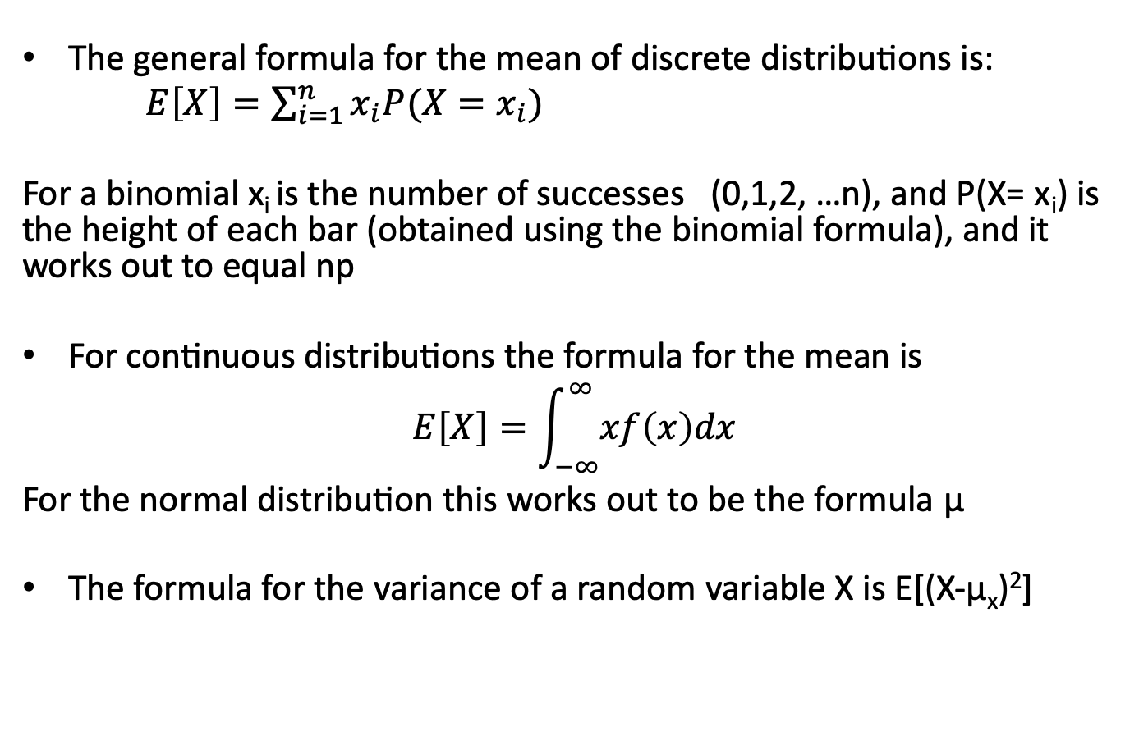
The formulae (just fyi)
The general formula for the mean of discrete distributions is:
$E\left[X\right]=\sum_{i=1}^{n}{x_{i}P(X=x_{i})}$
For a binomial x_{i} is the number of successes (0,1,2, …n), and P(X= x_{i}) is the height of each bar (obtained using the binomial formula), and it works out to equal np
For continuous distributions the formula for the mean is
$$E\left[X\right]=\int_{−∞}^{∞}{xf\left(x\right)dx}$$
For the normal distribution this works out to be the formula μ
The formula for the variance of a random variable X is E[(X-μ_{x})²]

Slide 14
Sample means and variances
The formulae presented in the last lecture are used for calculating sample means and variances using sample data.
They are estimates of the mean and variance of the underlying population distribution from which the sample was chosen.

Slide 15
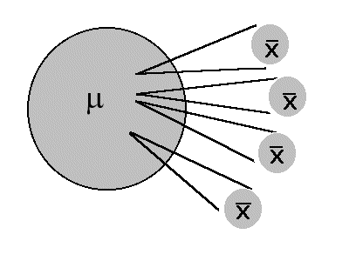
Sampling
When we cannot measure the entire population we take a sample
We estimate the population characteristics, i.e. the mean and variance of our data, using the sample mean and variance
We use statistical inference to draw conclusions about the how the estimates from the sample relate to the population values
Timothy Shortell http://www.shortell.org/book/chap10.html

Slide 16
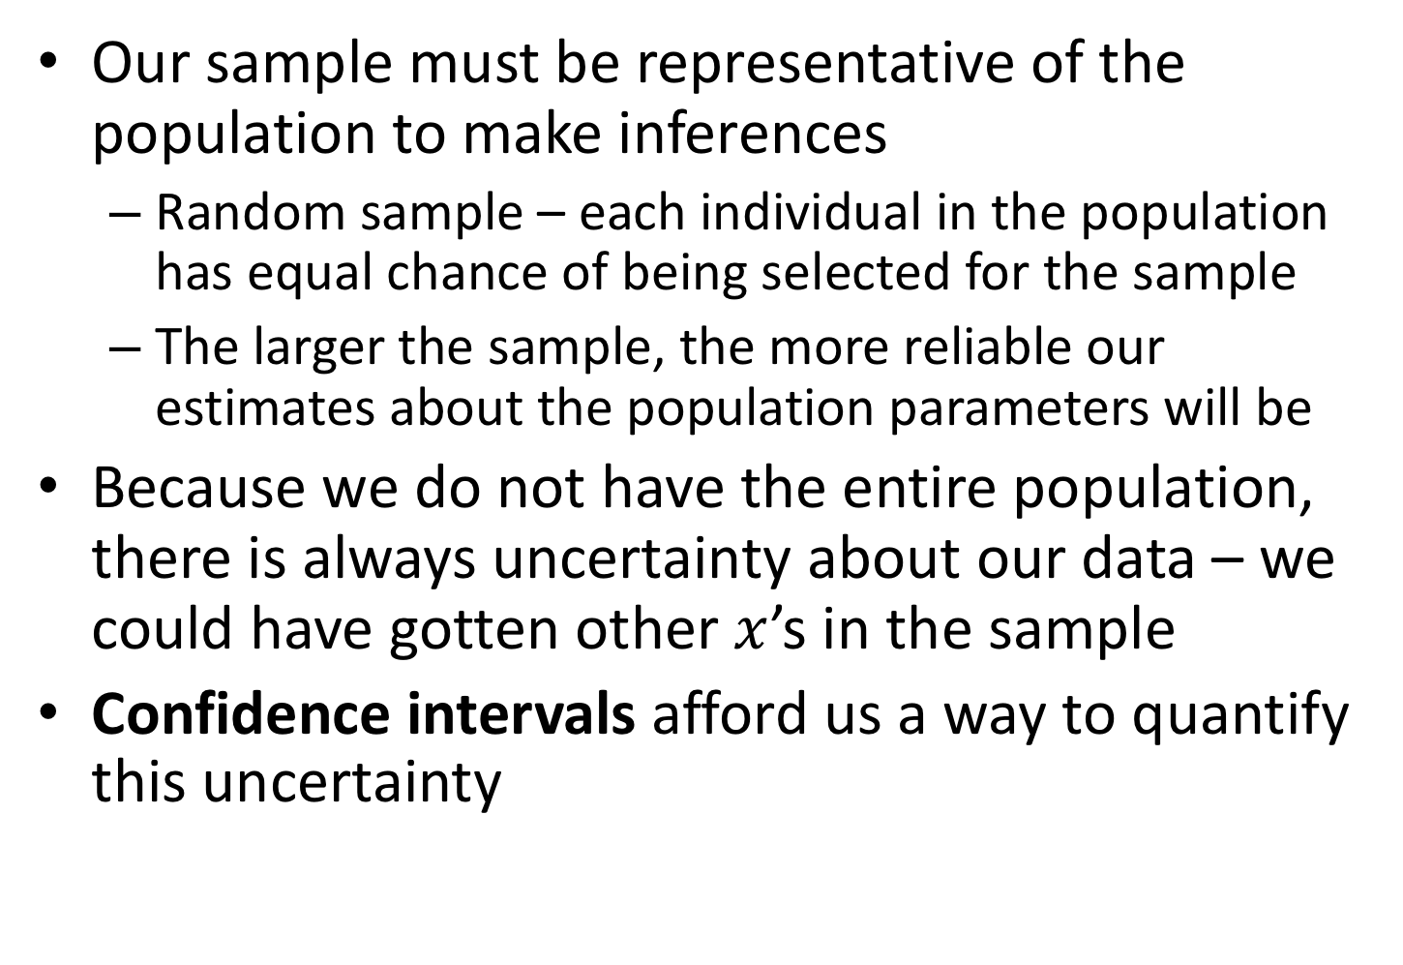
Sampling
Our sample must be representative of the population to make inferences
  Random sample – each individual in the population has equal chance of being selected for the sample
  The larger the sample, the more reliable our estimates about the population parameters will be
Because we do not have the entire population, there is always uncertainty about our data – we could have gotten other $x$’s in the sample
Confidence intervals afford us a way to quantify this uncertainty

Slide 17
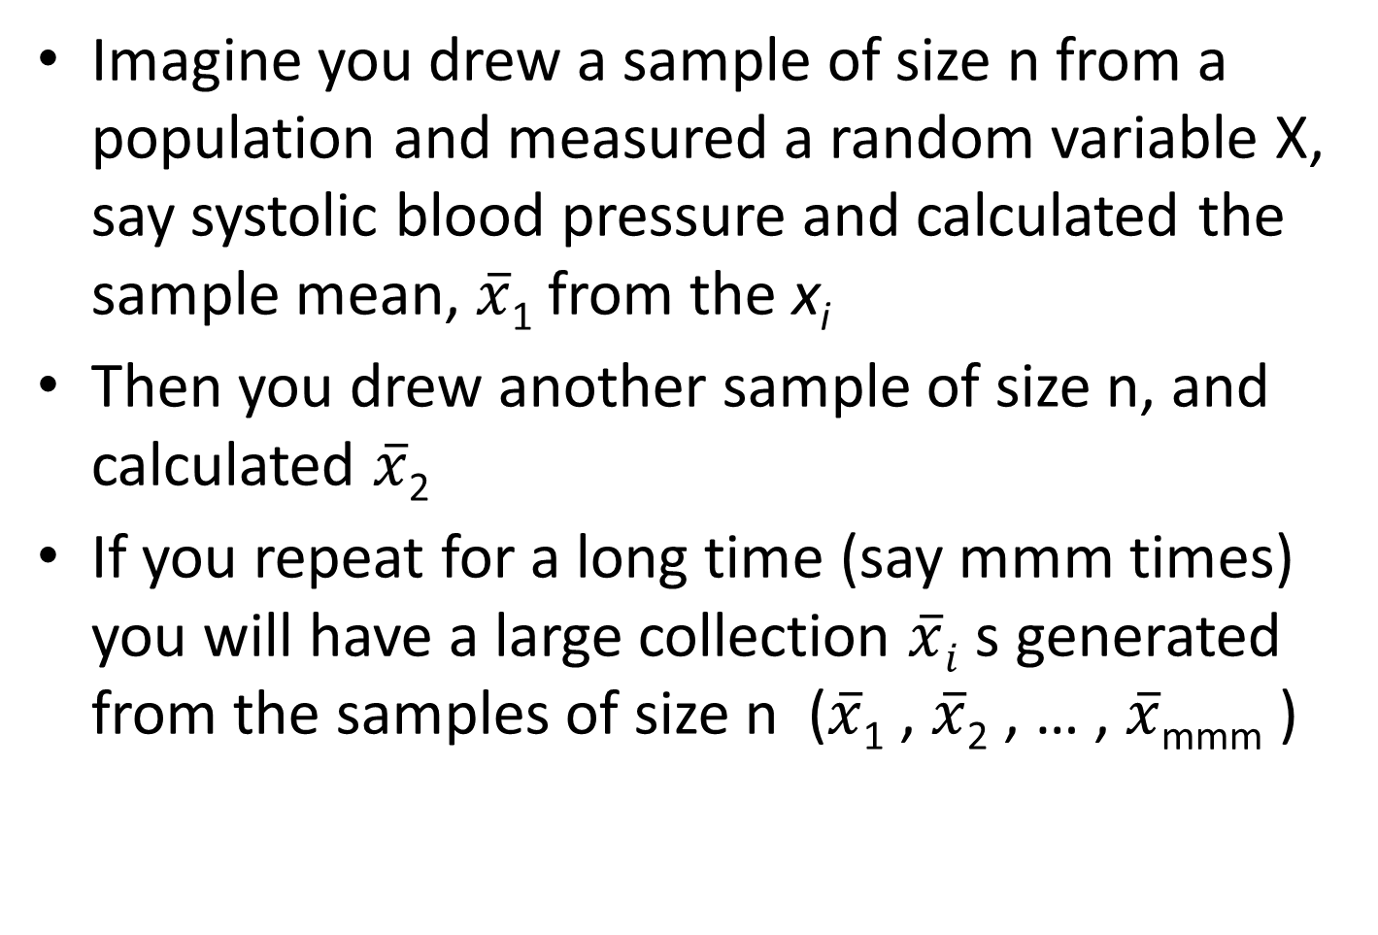
Sampling distributions: Example

Slide 18
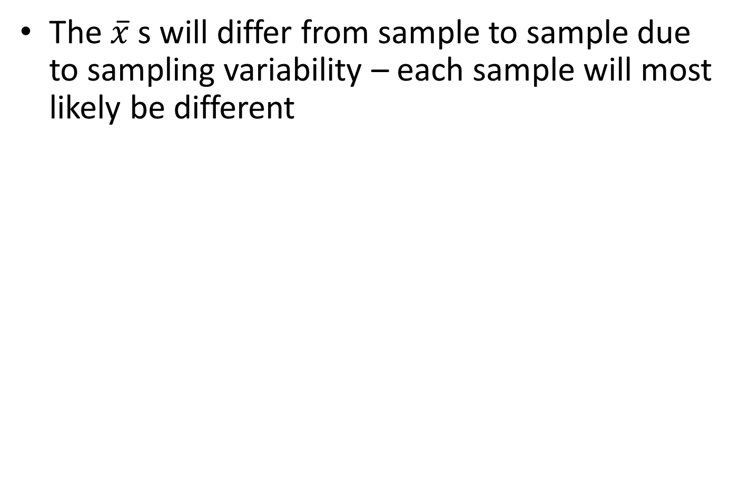
Sampling distributions: Example
Timothy Shortell http://www.shortell.org/book/chap10.html

Slide 19
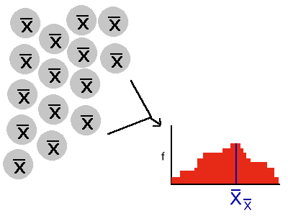

Sampling distributions: Example
Treat all the $\overline{x }$s as a sample and calculate their mean and sample variance, make a histogram to look at their distribution
Timothy Shortell http://www.shortell.org/book/chap10.html

Slide 20

Sampling distributions: Example
The collection of all the $\overline{x}$ s that can be obtained can be thought of as a random variable$\overline{X }$that follows some distribution
The distribution of all the possible $\overline{x}$ s is called the sampling distribution
Timothy Shortell http://www.shortell.org/book/chap10.html

Slide 21
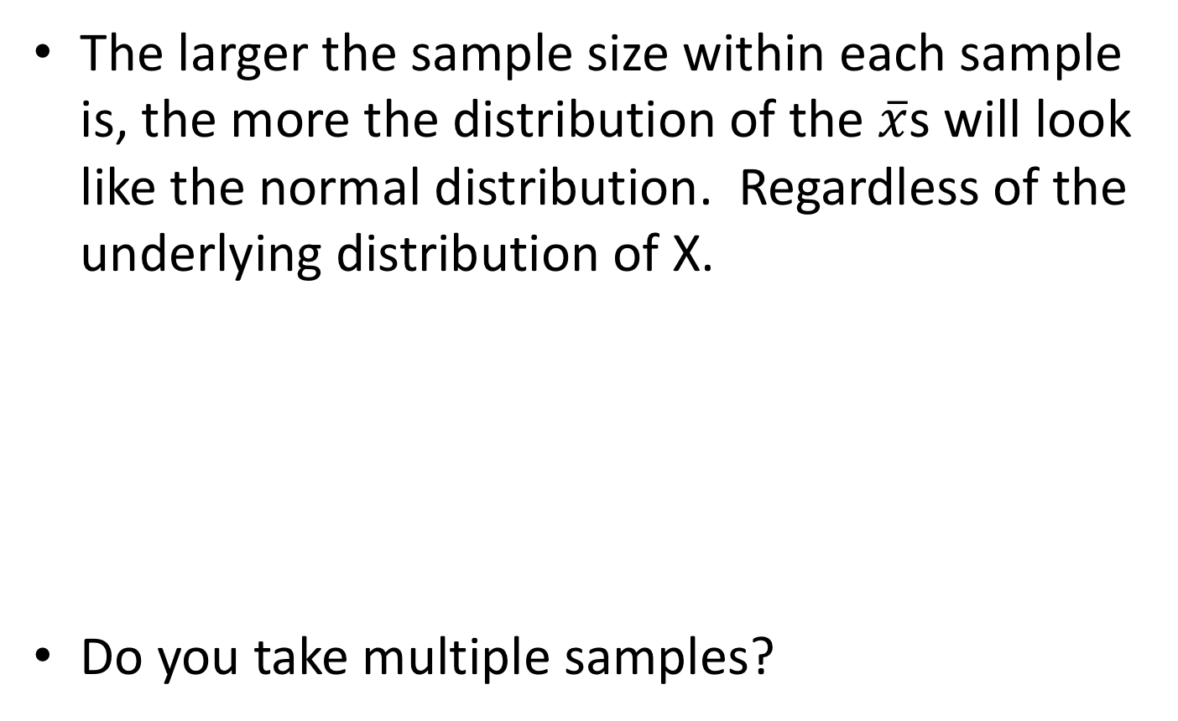
Sampling distributions: Example
The larger the sample size within each sample is, the more the distribution of the $\overline{x}$s will look like the normal distribution. Regardless of the underlying distribution of X.
Do you take multiple samples?
Timothy Shortell http://www.shortell.org/book/chap10.html

Slide 22
Central limit theorem
If you have a random variable that comes from a distribution with mean=µ and standard deviation=σ, the following is true for the sampling distribution (i.e. the distribution of all possible sample means) from samples of size n
  If n is large enough, the shape of the sampling distribution will be approximately normal
  The mean of the sampling distribution is µ
  The standard deviation of the sampling distribution is σ/√n
Notes:
Note that the Central Limit Theorem is about the distribution of the sample mean, not the distribution of the sample, which may be totally non-normal.

Slide 23
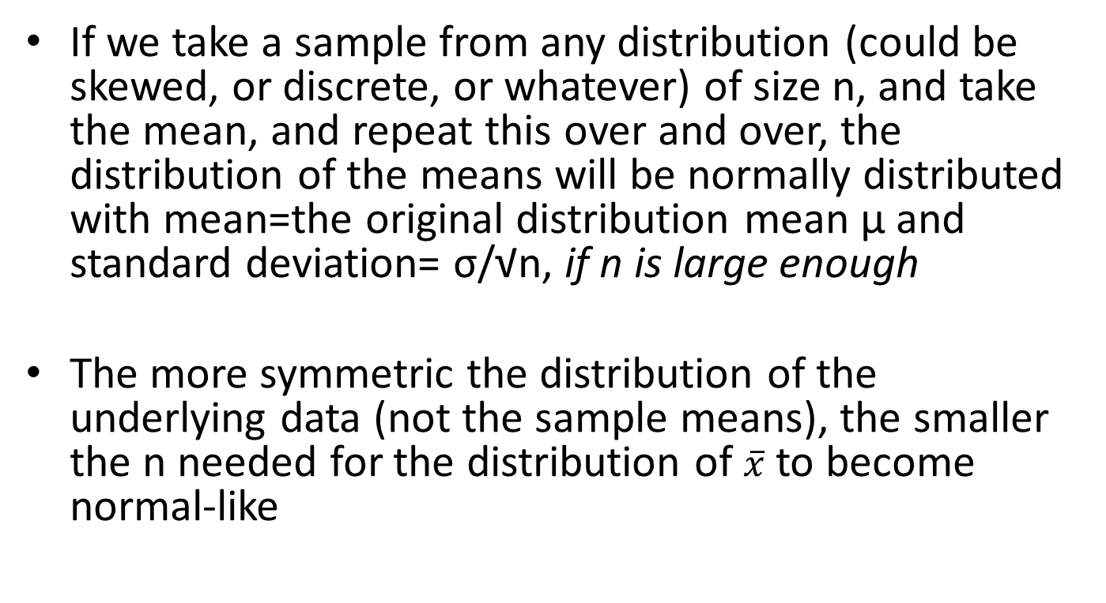
Central limit theorem

Slide 24
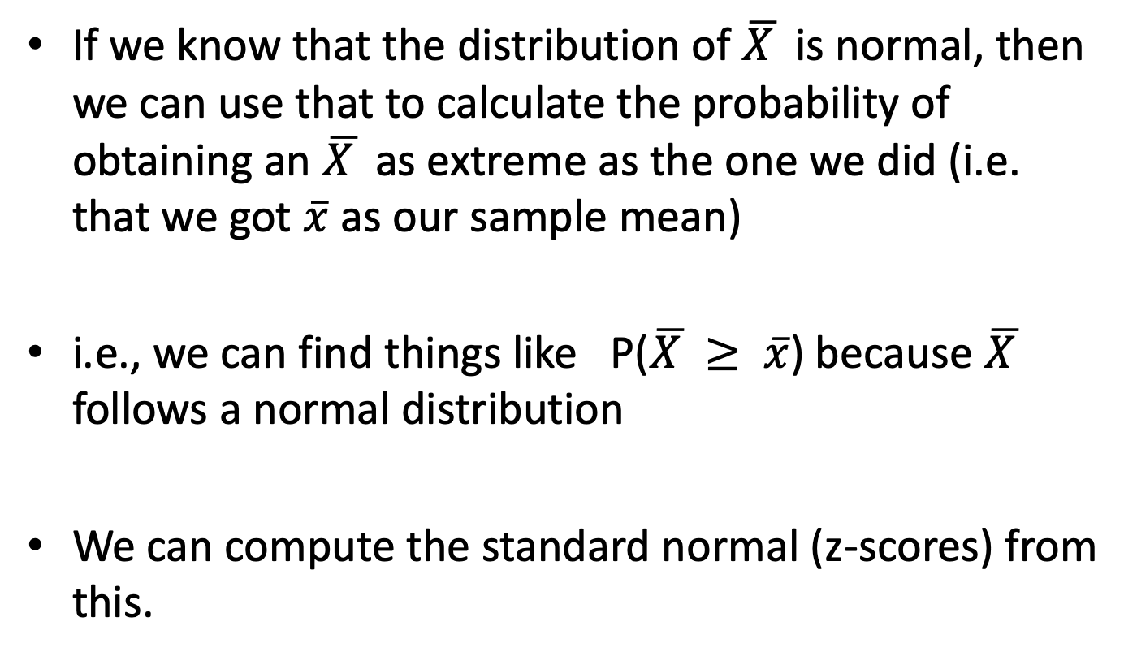
CLT: Why do we care?
If we know that the distribution of $\overline{X }$ is normal, then we can use that to calculate the probability of obtaining an $\overline{X }$ as extreme as the one we did (i.e. that we got $\overline{x}$as our sample mean)
i.e., we can find things like P($\overline{X }≥ \overline{x}$) because $\overline{X }$ follows a normal distribution
We can compute the standard normal (z-scores) from this.

Slide 25
Sampling distributions
Does this make sense?
  It makes sense that the distribution of means would cluster around the population mean
  It makes sense that the variability in the means is smaller than in the raw data because the extreme values are already averaged out (remember σ/√n)
  The part about the distribution being normal if n is large enough? Mathematical proof … But we can demonstrate it for several examples

Slide 26
Sampling distributions
Distribution of the Sample Mean
σ is the standard deviation of the original distribution
σ/√n is called the standard error, or more precisely, the standard error of the mean, and it is the standard deviation of the distribution of the sample mean.

Slide 27
Distributions of the means of Uniformly distributed random variables

Slide 28
Uniform Distribution Example
Taking samples from the following Uniform distribution
Uniform(1, 100) with different sample sizes
http://www.ltcconline.net/greenl/java/Statistics/clt/cltsimulation.html
http://195.134.76.37/applets/AppletCentralLimit/Appl_CentralLimit2.html

Slide 29
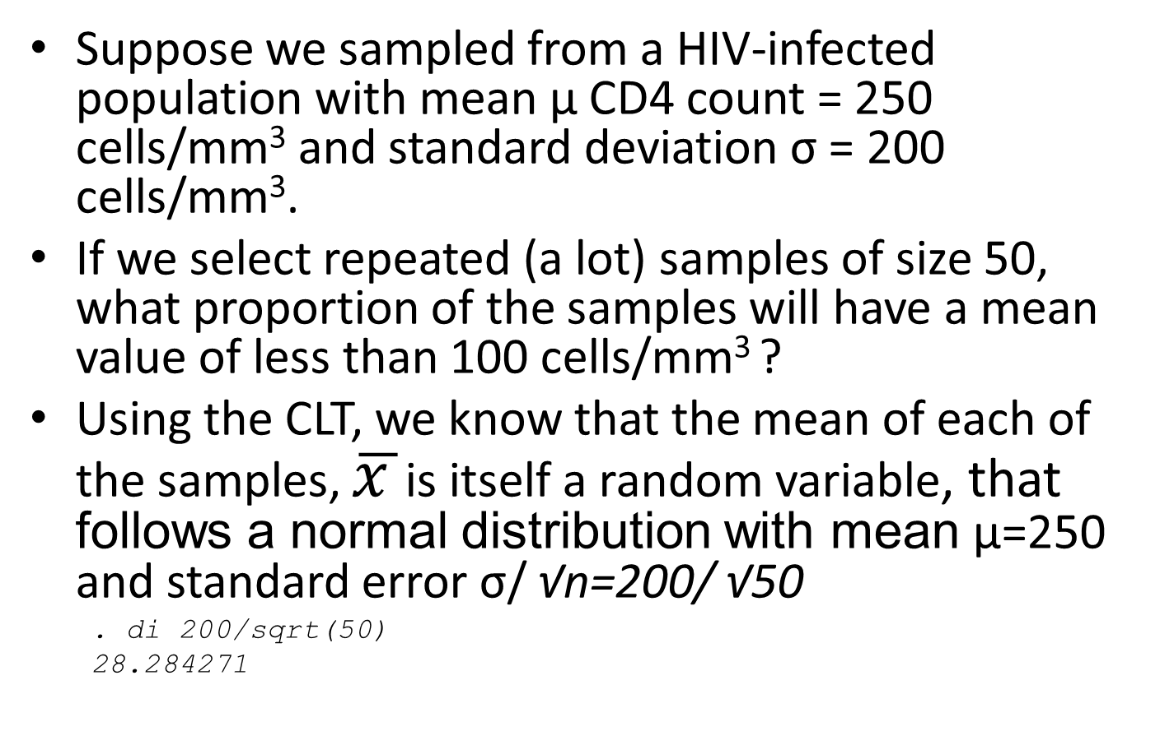
Using the Central Limit Theorem

Slide 30
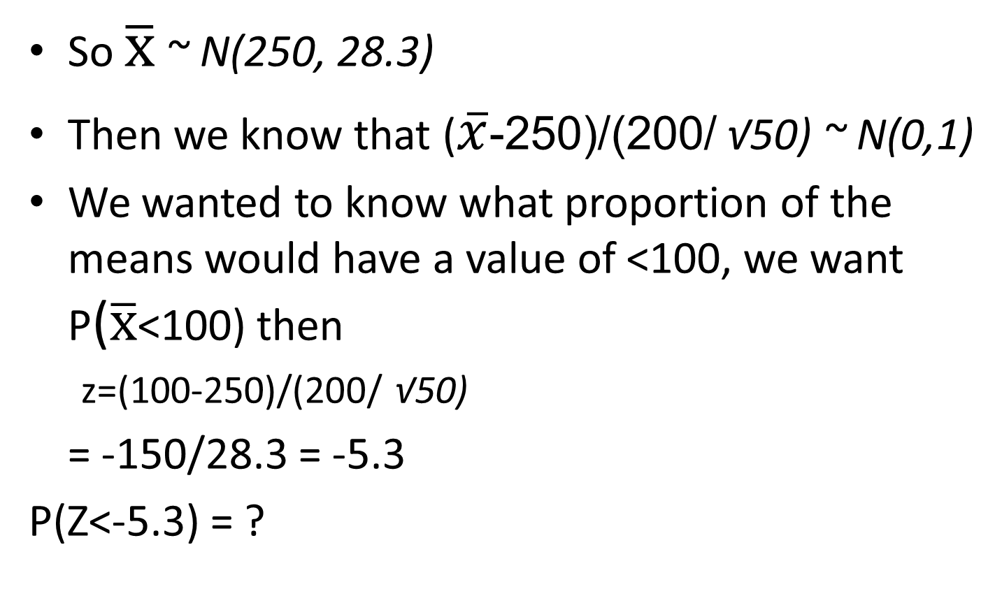
Using the Central Limit Theorem
Notes:
200/sqrt(50) = 28.3 and we are now transforming this to a standard normal distribution

Slide 31
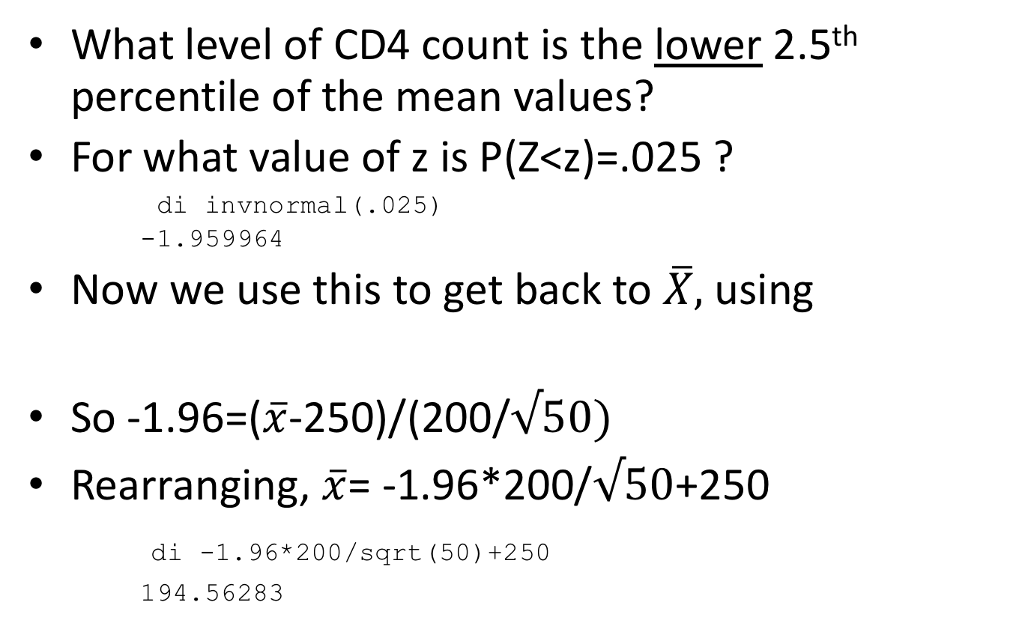
Using the Central Limit Theorem
What level of CD4 count is the lower 2.5th percentile of the mean values?
For what value of z is P(Z<z)=.025 ?
di invnormal(.025)
-1.959964
Now we use this to get back to $\overline{X},$using
So -1.96=($\overline{x}$-250)/(200/$√50)$
Rearranging, $\overline{x}$= -1.96*200/$√50$+250
di -1.96*200/sqrt(50)+250
194.56283
Notes:
Using the Standard Normal to find the z-value corresponding to our x value

Slide 32
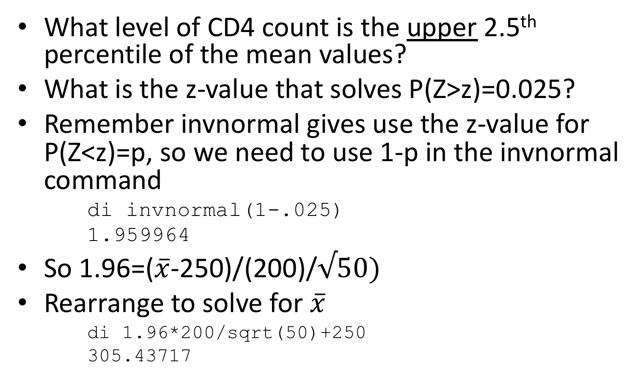
Using the Central Limit Theorem
What level of CD4 count is the upper 2.5th percentile of the mean values?
What is the z-value that solves P(Z>z)=0.025?
Remember invnormal gives use the z-value for P(Z<z)=p, so we need to use 1-p in the invnormal command
di invnormal(1-.025)
1.959964
So 1.96=($\overline{x}$-250)/(200)/$√50)$
Rearrange to solve for $\overline{x}$
di 1.96*200/sqrt(50)+250
305.43717
Notes:
Now we are using the standard normal distribution to tell us what values of x are above the 2.5% tail of the Normal distribution

Slide 33
Using the Central Limit Theorem
Now we have the lower and upper 2.5% percentiles of the distribution of the sample means.
The interior area contains 95% of the sample means.
95% of the means from samples of size 50 that come from the underlying distribution ~N(250,200) will lie within this interval (194.6, 305.4)

Slide 34
Using the Central Limit Theorem
If we selected just one sample of size 50 (what you usually do) and the sample mean was outside these limits (e.g. 315), it possibly came from a different underlying population, or that a rare (<5% probability) event had occurred.
  Because we had said that 95% of the time the sample mean will be in the range of 195-305
  We could say this because the central limit theorem told us that the distribution of the sample means is approximately a normal distribution with mean 250 and standard deviation 200/ √50

Slide 35
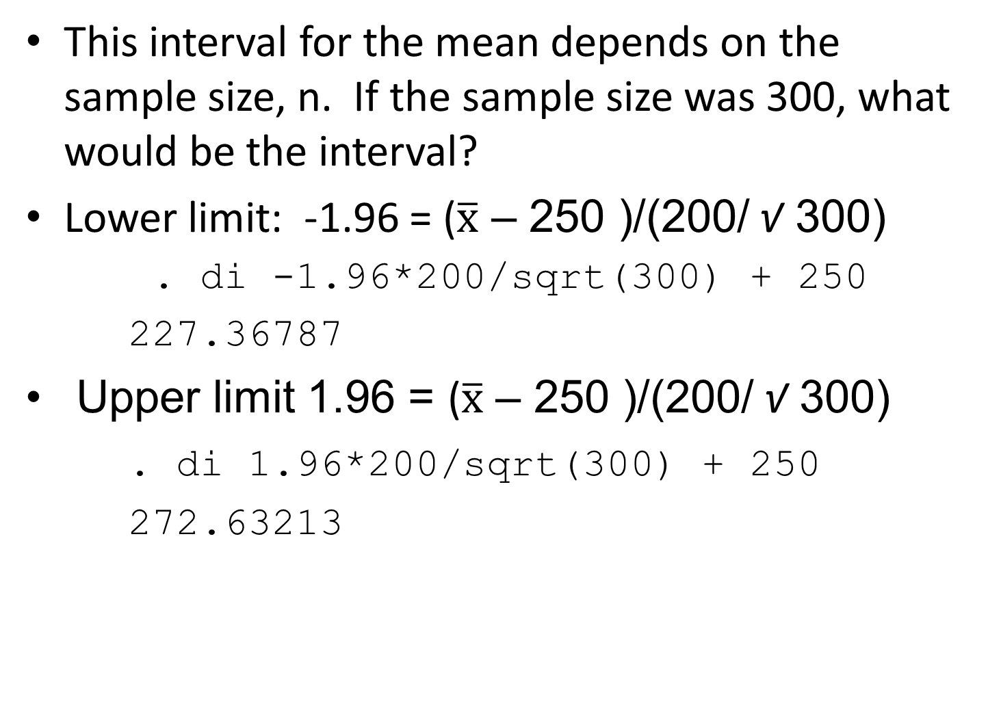

Slide 36
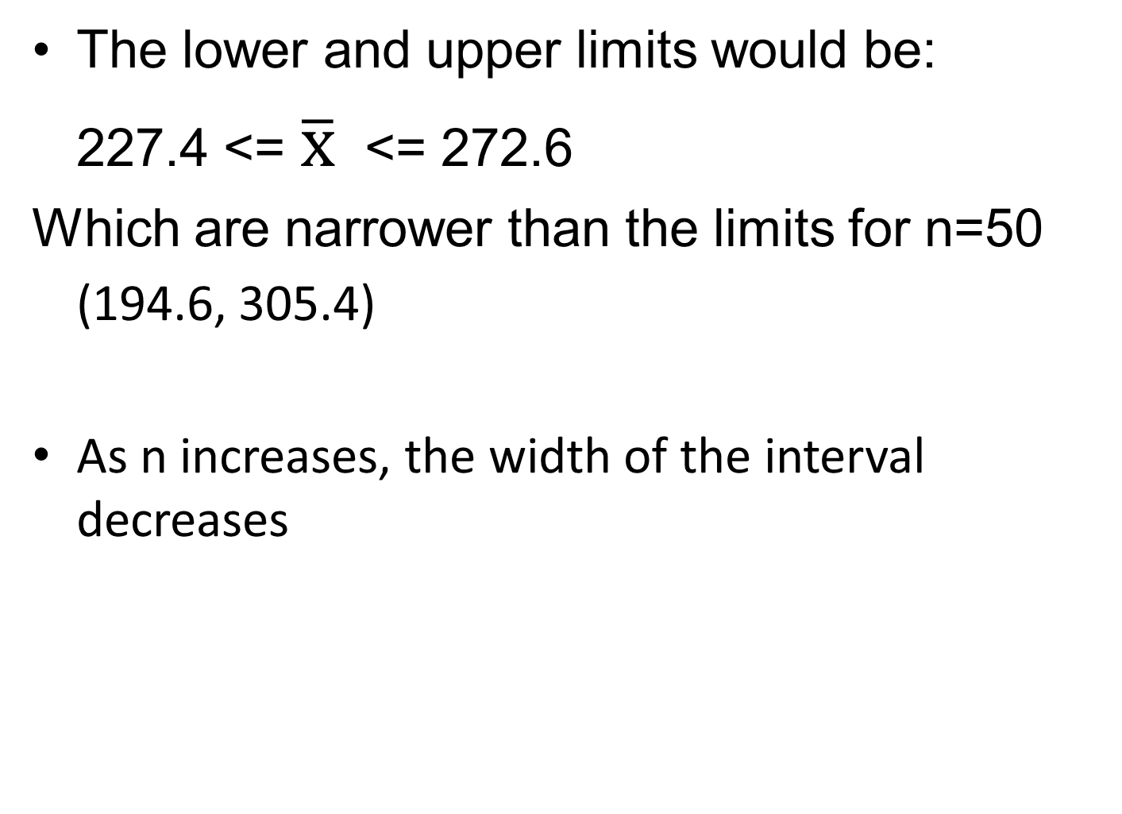

Slide 37
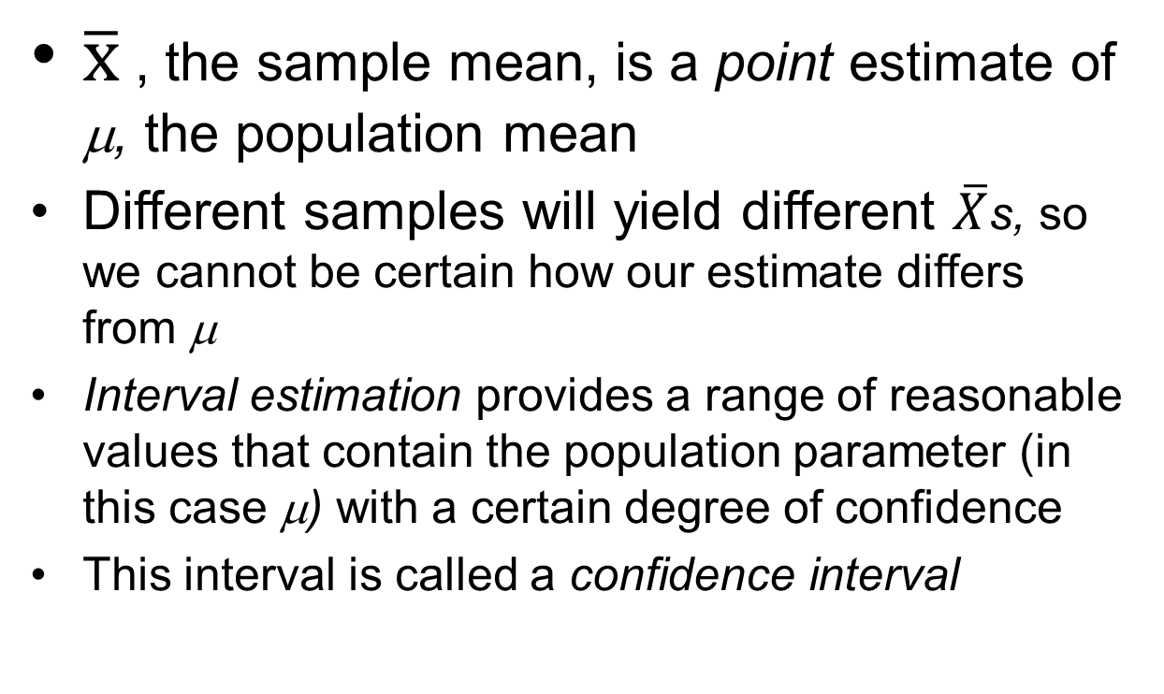
Confidence intervals for means

Slide 38
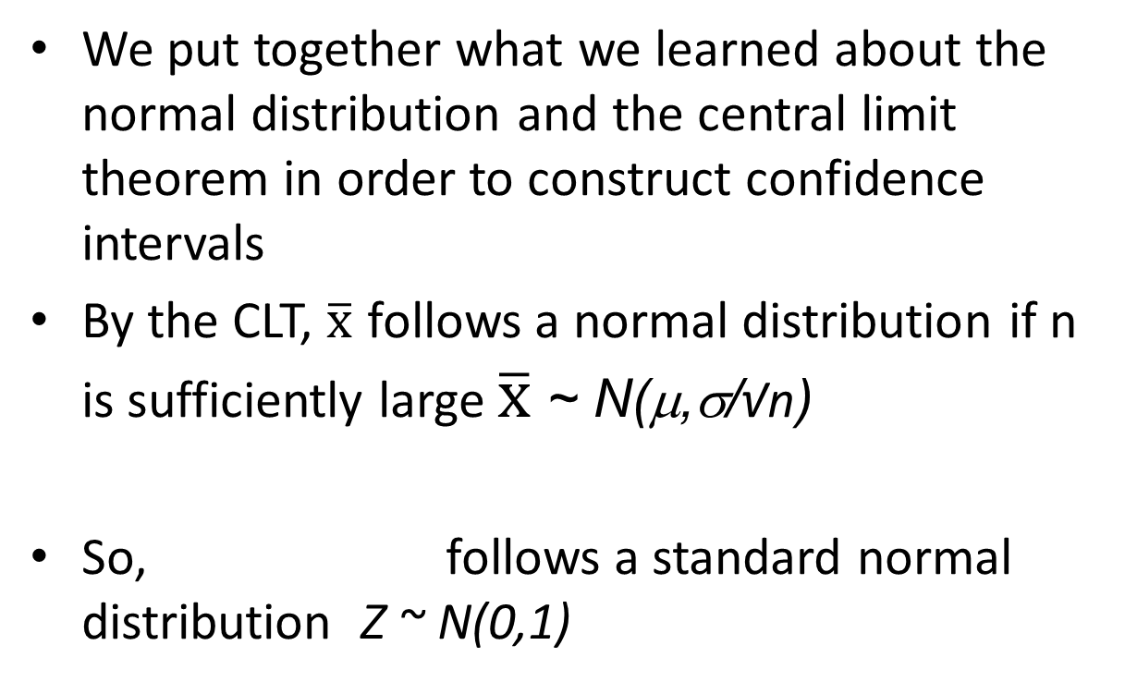
Confidence intervals for means

Slide 39
Confidence intervals for means
We use what we know from the CLT to calculate confidence intervals for means in general
We know from examining the standard normal distribution that P(-1.96 ≤ Z ≤ 1.96) = 0.95
95%
2.5%
2.5%

Slide 40

Confidence intervals for means
P(-1.96 ≤ Z ≤ 1.96) = 0.95
We also know by the CLT that $\overline{X}$ ~ N(µ, σ /√n) so
Substituting the formula for Z into the above we get
Rearranging and multiplying by -1 within the parentheses we get:
Notes:
Remember that the standard deviation of x bar is sigma / square root (n) . It is not sigma, which was the standard deviation of X.

Slide 41
Confidence intervals for means
Thus the lower 95% confidence limit for µ is
And the upper 95% confidence limit for µ is
We say we are 95% confident that the interval we calculate using the above formulae includes µ (the true mean of the distribution)

Slide 42
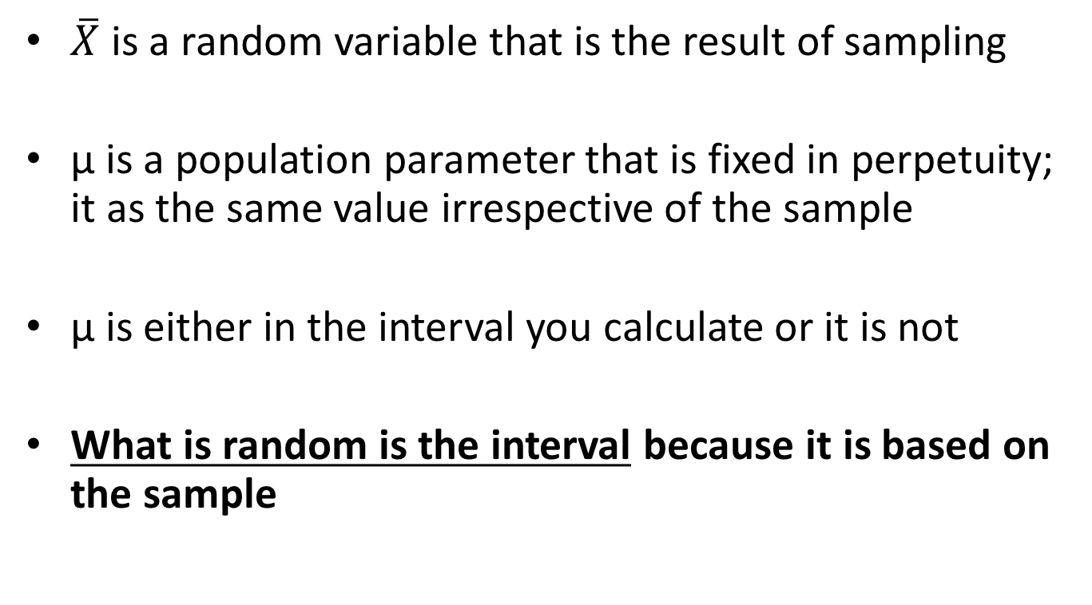
Confidence intervals for means
$\overline{X}$ is a random variable that is the result of sampling
μ is a population parameter that is fixed in perpetuity; it as the same value irrespective of the sample
μ is either in the interval you calculate or it is not
What is random is the interval because it is based on the sample

Slide 43
Confidence intervals for means
So we say that the probability that the interval contains the true population mean is 95%
If we were to select 100 random samples from the population and calculate confidence intervals for each, approximately 95 of them would include the true population mean µ (and 5 would not)

Slide 44
Confidence intervals for means
90% confidence interval
  Replace 1.96 in the formula with 1.64
99% confidence interval
  Replace 1.96 in the interval with 2.58
  Generic formula:
  Where 100%*(1-⍺) is the % of the confidence interval
  E.g. for a 95% confidence interval, ⍺ =0.05, and we use z_{0.025} =1.96

Slide 45
Confidence intervals for means
How to get a tighter interval?
  Decrease the confidence level
Confidence level | ⍺ | Z _{⍺/2}
99% | .01 | 2.58
95% | .05 | 1.96
90% | .10 | 1.64
80% | .20 | 1.28

Slide 46
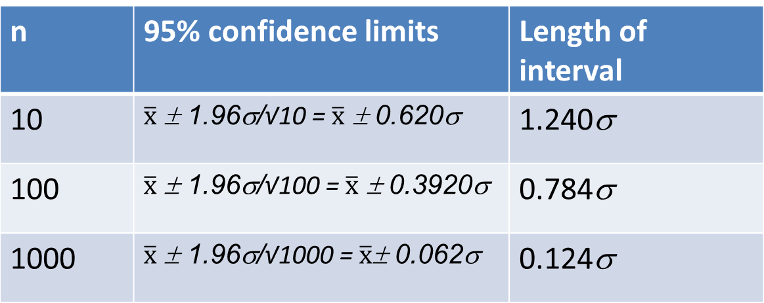
Confidence intervals for means
How to get a tighter interval?
  Increase n
n | 95% confidence limits | Length of interval
10 |  | 1.240σ
100 |  | 0.784σ
1000 |  | 0.124σ

Slide 47
Confidence intervals for means
What to do when σ is not known? (In practice, always)
By the Central Limit Theorem, follows a normal distribution, if n is sufficiently large
Can we substitute s, the sample standard deviation
for σ ?
s is not a reliable estimate of σ if n is small

Slide 48
Confidence intervals for means
If X is normally distributed, and a sample of size n is chosen, then follows a Student’s t distribution
with n-1 degrees of freedom
Who was Student?
This is denoted t_{n-1}
Notes:
The t-distrubution is very robust, so if n is large, say >30, and the distribution isn’t too far from normal, it’ll work.
See http://people.virginia.edu/~rwm3n/pdf/When%20do%20you%20use%20the%20t%20distribution.pdf for a discussion of this.
Student was Will Gosset, a statistician for Guinness Brewery

Slide 49
Student’s t distribution
The mean of the t distribution is 0 and the standard deviation is 1
The t distribution is symmetric and bell-shaped, but has heavier tails than the standard normal – extreme values are more likely to occur
For small n, the tails are fatter
For large n, the t distribution approaches (i.e. becomes indistinguishable from) the standard normal distribution

Slide 50
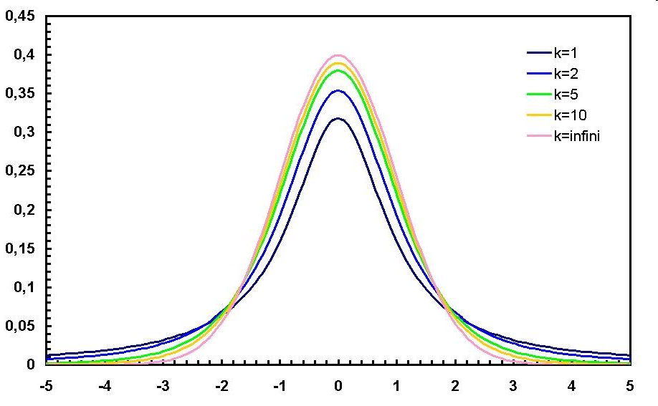
The t-distribution

Slide 51
Student’s t-distribution
There are separate curves for each degree of freedom (df)
  Most basic stat books still include tables of the t-distribution
Better to use Stata:
P(T≥t) is calculated using ttail *****
**** note that normal() gives P(Z<z)!!!
The code is ttail(df,t)
E.g., P(T>1.96) n=20
  display ttail(19,1.96)
  .03241449
  USE n-1 for the df
  What are degrees of freedom?
Notes:
What are degrees of freedom? https://en.wikipedia.org/wiki/Degrees_of_freedom_(statistics)

Slide 52
Student’s t-distribution
To find the value for which P(T>t)=p use invttail(df,p) in Stata
For example, for what t is P(T>t)=.025 for a sample of size 20?
The answer for this t cutoff value is denoted t_{19,.05}
  display invttail(19,.025)
  2.0930241

Slide 53
95% confidence intervals for means when σ is not known
Student’s t-distribution
So using the t-distribution, the formula for a for a 95% confidence interval for a mean is:
Where df =n-1

Slide 54
Confidence intervals for means
n | t_{n-1,0.025}
2 | 12.706
3 | 4.303
5 | 2.776
10 | 2.262
50 | 2.010
100 | 1.984
200 | 1.972
300 | 1.968
500 | 1.965
1000 | 1.962
1500 | 1.962
Remember that when n is large, the t distribution approaches the normal distribution
  E.g. z_{0.025} = 1.960
  While t_{n-1,0.025} = →

Slide 55
Confidence intervals for means: Example
CD4 cell count among HIV positives diagnosed at Mulago Hospital
  N=999
  Sample mean = 329.2
  Sample SD = 266.1
  t cutoff?
      . di invttail(998,.025)
      1.9623438
  95% CI
    = ( 329.2 – 1.962*266.1/√999, 329.2 + 1.962*266.1/√999)
    = (312.7-345.7)

Slide 56
Confidence intervals for means in Stata
. . summ cd4count
Variable | Obs Mean Std. Dev. Min Max
-------------+--------------------------------------------------------
cd4count | 999 329.2332 266.1177 1 1932
. mean cd4count
Mean estimation Number of obs = 999
--------------------------------------------------------------
| Mean Std. Err. [95% Conf. Interval]
-------------+------------------------------------------------
cd4count | 329.2332 8.419592 312.7111 345.7554
--------------------------------------------------------------
. ci mean cd4count
Variable | Obs Mean Std. Err. [95% Conf. Interval]
-------------+---------------------------------------------------------------
cd4count | 999 329.2332 8.419592 312.7111 345.7554
Notes:
Note that summ does not give you confidence intervals for the mean.
Mean does, and print out the standard error of the mean. The ci mean command does the same.

Slide 57
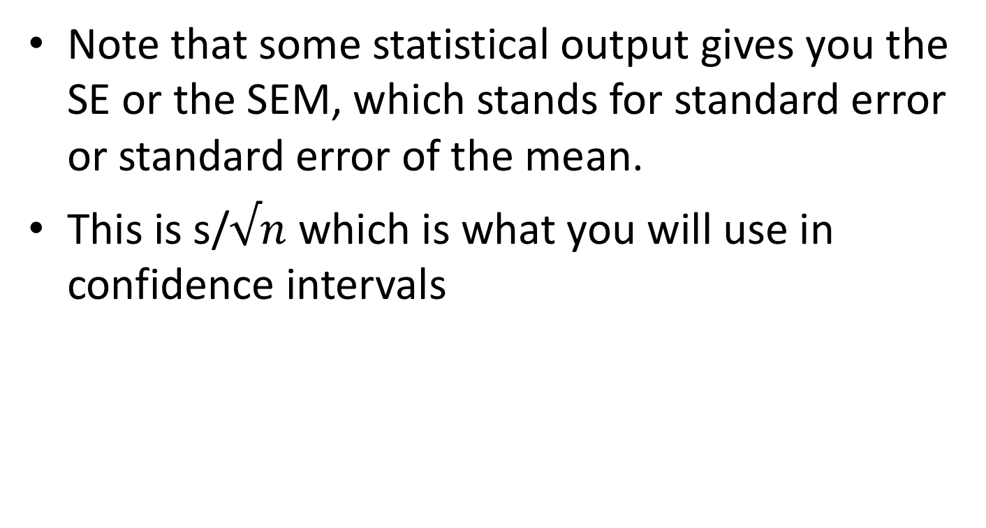
Confidence intervals for means in Stata
Note that some statistical output gives you the SE or the SEM, which stands for standard error or standard error of the mean.
This is s/$√n$ which is what you will use in confidence intervals

Slide 58
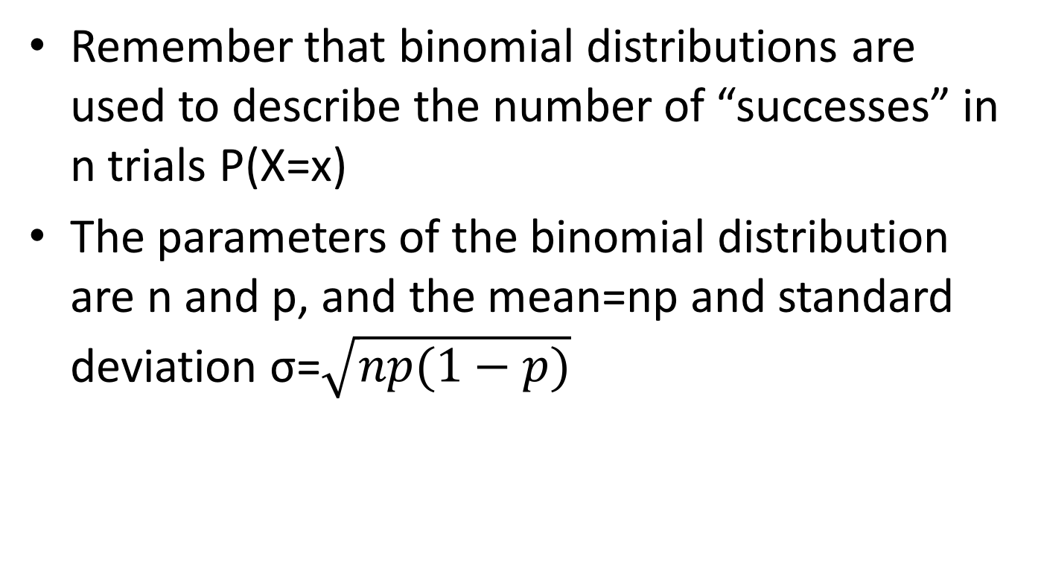
Normal approximation to the Binomial distribution
Remember that binomial distributions are used to describe the number of “successes” in n trials P(X=x)
The parameters of the binomial distribution are n and p, and the mean=np and standard deviation σ=$\sqrt{np(1−p)}$
Notes:
Why do we want to do this? Knowing that for large n we can approximate the Normal distribution from the Binomial distribution makes our analyses easier and easier to compare among other analyses.

Slide 59
Normal approximation to the Binomial distribution
As n, the number of “trials”, increases, the binomial distribution more closely resembles the normal distribution
Note that the binomial distribution approaches normality at smaller sample sizes when p is closer to 0.5

Slide 60
Normal approximation to the Binomial distribution

Slide 61
Normal approximation to the Binomial distribution
Notes:
The difference here is that p=0.35, which is closer to .5 than the p=.05 on the previous slide

Slide 62
Normal approximation to the Binomial distribution
Therefore you could use the normal distribution to look up the probability of observing X or more (or less) successes
  You would use n*p as the mean
  You would use np(1-p) as the variance
  You would use sqrt[np(1-p)] as the standard deviation

Slide 63
Normal approximation to the Binomial distribution
What is the probability of 30 or more successes in a sample of size 50 where p=0.45?
Using the binomial distribution for P(X>=30; n=50, p=.45)
    . di binomialtail(50,30,.45)
    .02353582

Slide 64
Normal approximation to the Binomial distribution
Using the normal approximation
  Mean=n*p= 50*.45=22.5
  SD= sqrt(np(1-p)) = sqrt(50*.45*.55) = 3.518
  Then Z=(30-22.5)/3.518 = 2.132, and we find P(Z>2.132)
    . di 1-normal(2.132)
    .01650342
Notes:
Continuity correction – subtract .5 from X if you are trying to find P(X>x); add .5 to X if you are trying to find P(X<x). The reasoning behind this is somehow it makes up for the fact that we are using a continuous distribution to approximate a discrete distribution. Don’t worry too much about this…

Slide 65
Binomial distribution, now n=100
Normal approximation to the Binomial distribution
Using the binomial distribution for P(X>=60; n=100, p=.45)
    . di binomialtail(100,60,.45)
    .00182018
Notes:
The approximation works better when n is larger

Slide 66
Normal approximation to the Binomial distribution, now n=100
Using the Normal approximation
  Mean=100*.45=45
  SD= sqrt(100*.45*.55) = 4.975
  Then Z=(60-45)/4.975 = 3.015, and we find P(Z>3.015)
    . di 1-normal(3.015)
    .0012849
Notes:
The approximation works better when n is larger

Slide 67
Sampling distribution of a proportion
Previous slides were about estimating X, the number of successes
We often are more interested in the proportion p of successes, rather than the number of successes x
The true population proportion p is estimated by
x = the number of successes or events
n=the number of trials or people or observations

Slide 68
Sampling distribution of a proportion
If we take repeated samples of size n from a variable that follows the Bernoulli distribution (i.e. the outcome is 0 or 1), and calculate p̂=x/n for each of the samples (x=total count of successes), if n is large enough, then p̂ will follow a normal distribution (by the central limit theorem)
  The mean of this distribution is p
  The standard deviation is which is also called the standard error

Slide 69
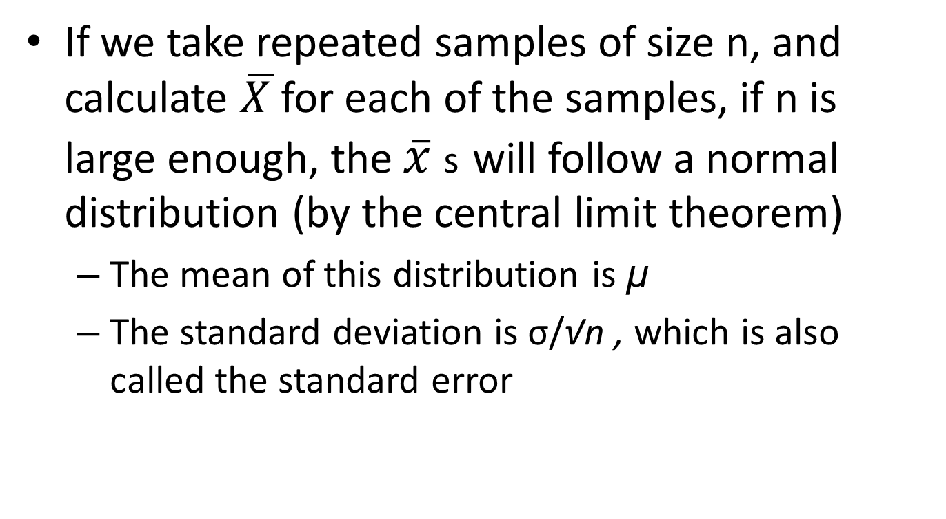
Reminder: Sampling distribution of a mean

Slide 70
Sampling distribution of proportions
So if p̂ follows a normal distribution with mean p and standard deviation
Then ~ N(0,1)
This holds true by the CLT
Considered valid when the expected number of successes np is ≥5 and the expected number of failures n(1-p) is ≥5

Slide 71
Sampling distribution of proportions
So now we can use the normal distribution to calculate probabilities of observing certain proportions in a sample
E.g. What proportion of samples of size 50 from a population with p=.10 will have a p̂ of .20 or higher?
What is P(p̂ ≥ 0.20)?
  Mean=0.10
  SE = √(.10*.90 )/√50 = 0.0424
  P(Z ≥ ((.20-.10)/.0424)) = P(Z ≥ 2.36)
  . display 1-normal(2.36)
  .00913747

Slide 72
Confidence intervals for proportions
~ N(0,1)
  So
Rearranging, we get
Lower 95% confidence limit:
Upper 95% confidence limit:

Slide 73
Confidence intervals for proportions
However we don’t know p (if we did we wouldn’t be calculating these intervals). So we substitute p̂ into the formula for the SEM.
Lower 95% confidence limit:
Upper 95% confidence limit:
With repeated sampling, 95% of such intervals would include the true population parameter p

Slide 74
Confidence intervals for proportions
Proportion of Biostat 200-2016 students who are parents
  x with kids = 8 of 55 who answered the survey
  Proportion with any children = 8/55 = .146
  Standard error estimate = sqrt [ .146*(1-.146)/55 ] = 0.048
  95% CI : (.146 – 1.96*.048, .146+ 1.96*.048) = (.052, .240)
Notes:
Here we use the normal distribution rather than the t distribution…

Slide 75
Confidence intervals for proportions in Stata
CI using the normal approximation
ci means children_any
Variable | Obs Mean Std. Err. [95% Conf. Interval]
-------------+---------------------------------------------------------------
children_any | 55 .1454545 .0479771 .0492662 .2416429
CI proportion
ci proportion children_any
-- Binomial Exact --
Variable | Obs Proportion Std. Err. [95% Conf. Interval]
-------------+---------------------------------------------------------------
children_any | 55 .1454545 .047539 .0649514 .2666323
Notes:
Note that ci means does NOT get you the normal approximation formula – it assumes you are using the t-distribution, so you get a wider interval.

Slide 76
Key points
It is not practical or feasible to study an entire population, so we take a sample
We need to make inference (i.e. decisions) from our sample to the population
We use the properties of repeated samples to do so
For any random variable X with mean µ and standard deviation σ, if the sample n is large enough, the distribution of the sample mean is normally distributed with mean µ and standard deviation σ/ √n
We use this to calculate intervals with known probability of containing the population mean or proportion

Slide 77
Next Time
Review Confidence Intervals and sampling distributions
Hypothesis testing
Types of error

