Slide 1
Studies of Diagnostic Test Accuracy
Tom Newman
October 10, 2019
Open a browser window to PollEv.com/ebmdoc

Slide 2
Overview
Announcements
Common biases of studies of diagnostic test accuracy
Meta-analyses of diagnostic tests
Checklist & systematic approach
Examples:
  Pain with percussion, hopping or cough for appendicitis
  Clinical diagnosis of pertussis
Notes:
Put on board:
Outline of talk
Table with names of biases and effects on sens and spec to be filled in during class?

Slide 3
Reminders/Announcements
OK to work together on the on HW, but write answers in your own words and list collaborators
EBD-1 has many more problems and answers you can use to help learn the material. (On 2-hour reserve at MB library.)
Homework/exam problem due by 11/14/19, 23:59 (preferably sooner) via CLE website. Instructions posted at the top of the syllabus.
See course website for article by Kohn, Carpenter and Newman (a bit more rigorous than EBD-2)

Slide 4
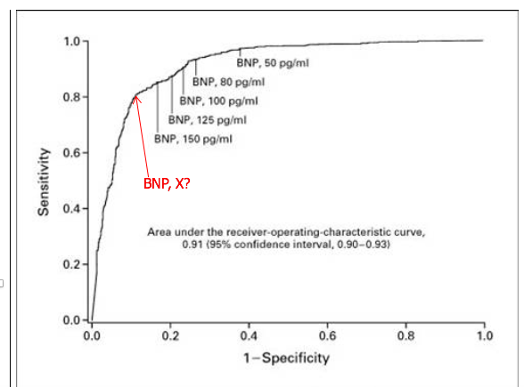
Bias #1 Example
Study of BNP to diagnose congestive heart failure (CHF, Chapter 3, Box 3.2)

Slide 5
Bias #1 Example
Gold standard: determination of CHF by two cardiologists blinded to BNP (only)
“The best clinical predictor of congestive heart failure was an increased heart size on chest roentgenogram [x-ray] (accuracy, 81 percent)”
Would sensitivity and specificity of chest x-rays to diagnose CHF from this study be biased?
Answers A to D “Yes, and direction is…”
  A. Sens ↓, Spec ↓ B. Sens↓, Spec ↑
  C. Sens ↑, Spec ↓ D. Sens↑, Spec ↑
  E. No bias or can’t predict
*Maisel AS, Krishnaswamy P, Nowak RM, McCord J, Hollander JE, Duc P, et al. Rapid measurement of B-type natriuretic peptide in the emergency diagnosis of heart failure. N Engl J Med 2002;347(3):161-7.

Slide 6

Notes:
Would sensitivity and specificity of chest x-rays to diagnose CHF from this study probably be biased?
https://www.polleverywhere.com/multiple_choice_polls/pET0AhkUSEasDSB

Slide 7
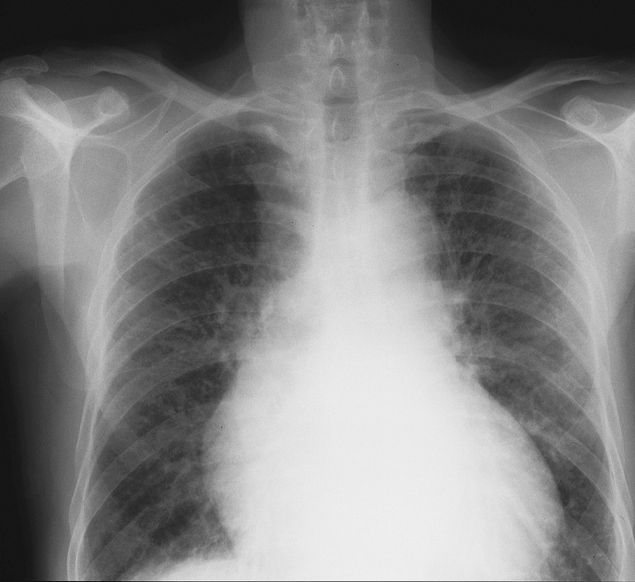
Bias #1: Incorporation bias
Cardiologists not blinded to chest x-ray
Probably used (incorporated) chest x-ray to make final diagnosis
Incorporation bias for assessment of chest x-ray (not BNP)
Biases both sensitivity and specificity upward
©2000 by British Medical Journal Publishing Group

Slide 8
Incorporation bias: Other examples
Amylase and lipase (pancreatic enzymes) levels to diagnose pancreatitis: gold standard was a consensus conference definition that included these enzymes. (See EBD-2)
Physician’s final diagnosis as the gold standard: incorporation bias for any test that contributed to the final diagnosis
  Negative Chest Radiography and Risk of Pneumonia. Pediatrics, September 2018.
  Gold standard was whether (unblinded) MD diagnosed pneumonia

Slide 9
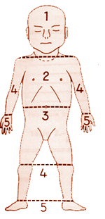
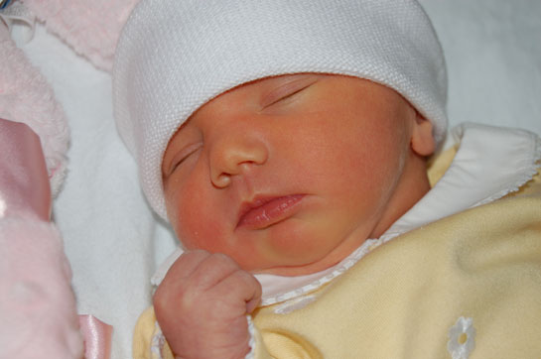
Bias #2 Example: Visual assessment of jaundice in newborns
Study subjects: newborns who are getting a serum bilirubin measurement
Test: Clinicians estimate of the level of jaundice at time of blood draw
Gold standard: Serum bilirubin level
*Moyer et al., Arch Pediatr Adol Med 2000; 154:391; Kramer LI. Advancement of dermal icterus in the jaundiced newborn. Am J Dis Child 1969;118:454–8

Slide 10
Visual Assessment of jaundice in newborns:* Results
Sensitivity of jaundice below the nipple line for serum bilirubin ≥ 12 mg/dL = 97%
Specificity = 19%
What is the problem?
Editor’s Note: The take-home message for me is that no jaundice below the nipple line equals no bilirubin test, unless there’s some other indication.
--Catherine D. DeAngelis, MD
*Moyer et al., Arch Pediatr Adol Med 2000; 154:391

Slide 11
Bias #2: Partial Verification Bias* -1
Inclusion criterion for study: gold standard test was done
  in this case, blood test for bilirubin
Subjects with positive index tests are more likely to get the gold standard and to be included in the study
  Clinicians less likely to order a blood test for bilirubin if there is little or no jaundice
How does this affect sensitivity and specificity?
  A. Sens ↓, Spec ↓ B. Sens↓, Spec ↑
  C. Sens ↑, Spec ↓ D. Sens↑, Spec ↑
  E. Can’t tell
*AKA verification bias, work-up bias, referral bias, or ascertainment Bias

Slide 12
Notes:
How would including only those in whom the gold standard blood test was done affect sensitivity and specificity of visual assessment of jaundice?
https://www.polleverywhere.com/multiple_choice_polls/PLYTqsqBpasxr62

Slide 13
Bias #2: Partial Verification Bias
 | Bilirubin >12 | Bilirubin <12
Jaundice below nipple | 67 | 141
No jaundice below nipple | 2 ↓ | 34 ↓
Subjects with negative tests results under-represented
Sensitivity too high (missing false-negatives)
Specificity too low (missing true negatives)

Slide 14
Visual Assessment of jaundice*: Results
Recall “Gold Standard” was bilirubin ≥ 12 mg/dL
Specificity = 19%
This low specificity was a clue! What does it mean?
NIH: 19% of newborns with bilirubin <12 mg/dL are not jaundiced below the nipple line
81% of babies with bilirubin <12 mg/dL are jaundiced below the nipple line
  But at most ~70% of babies ever get ANY jaundice at all!
*Moyer et al., Archives Pediatr Adol Med 2000; 154:391

Slide 15
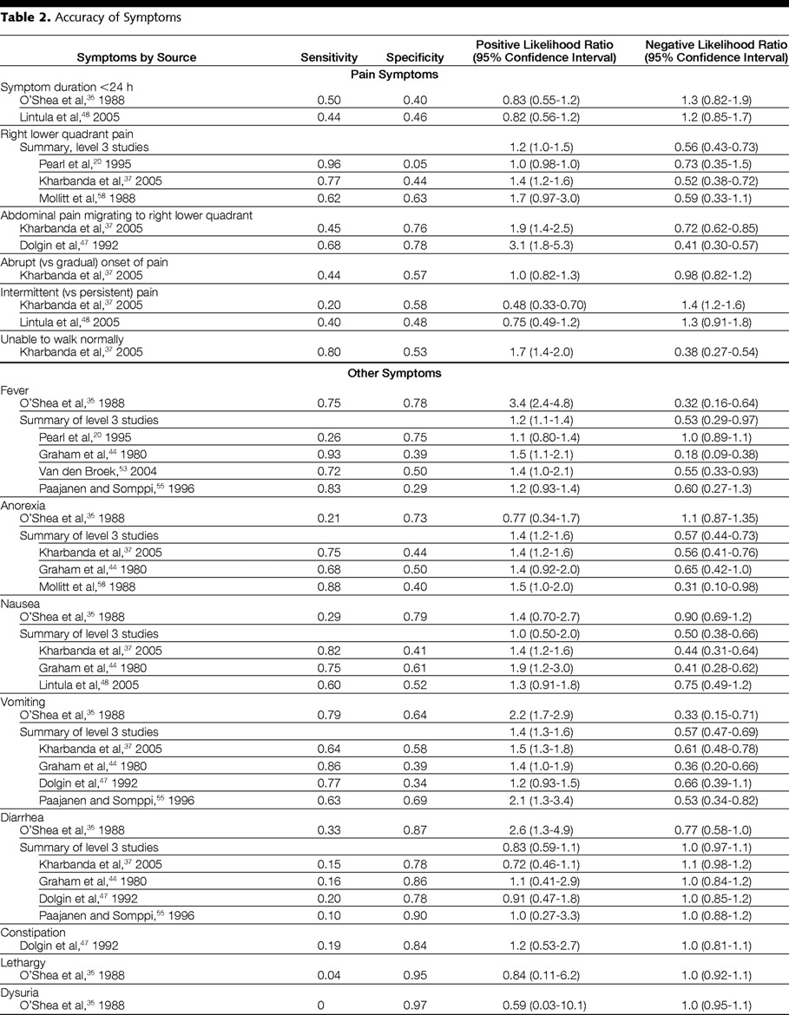
Does This Child Have Appendicitis?
JAMA. 2007;298:438-451.
Copyright restrictions may apply.
Right Lower Quadrant (RLQ) Pain: Sensitivity = 96% Specificity = 5% Likelihood Ratio =1.0
RLQ pain was present in 96% of those with appendicitis and 95% of those without appendicitis.
Study subjects all had appendectomy!

Slide 16
How does partial verification bias affect predictive value?*
 | TSB >12 | TSB < 12
Jaundice below nipple | 67 TP | 141 FP
No jaundice below nipple | 2 ↓ FN | 34 ↓ TN
Recall Problem 2.5, BRCA Referral Screening Tool (RST), with oversampling of positives
If samples of those with positive and negative tests are representative, then we can estimate PPV and NPV but not sensitivity or specificity
*Not in EBD-1

Slide 17
“Case-control” sampling
 |  | Disease status
 |  | Has disease | No disease | Total
Test Result | Positive | A | B | A + B
 | Negative | C | D | C + D
 | Total | A + C | B + D | A + B + C + D
 |  | Disease status
 |  | Has disease | No disease | Total
Test Result | Positive | TP | FP | TP+FP
 | Negative | FN | TN | TN+FN
 | Total | TP+FN | FP+TN | TP+FP+FN+TN
PPV=TP/(TP+FP)
NPV=TN/(FN+TN)
Subjects with and without disease are sampled separately
Proportion with disease is determined by investigator
Sensitivity and specificity OK if samples are representative

Slide 18
Test Result-based sampling
T+ and T- are sampled separately
Proportion with T+ is determined by investigator
PPV and NPV OK if samples representative
 |  | Disease status
 |  | Has disease | No disease | Total
Test Result | Positive | A | B | A + B
 | Negative | C | D | C + D
 | Total | A + C | B + D | A + B + C + D
 |  | Disease status
 |  | Has disease | No disease | Total
Test Result | Positive | TP | FP | TP+FP
 | Negative | FN | TN | TN+FN
 | Total | TP+FN | FP+TN | TP+FP+FN+TN
Sensitivity=TP/(TP+FN)
Specifcity=TN/(TN+FP)

Slide 19
What if samples of T+ and T− are not representative?
 | TSB >12 | TSB < 12
Jaundice below nipple | 67 TP | 141 FP
No jaundice below nipple | 2 FN | 34 TN
↑
↑↑
If other factors associated with disease (besides T+) lead to the gold standard, TP and FN (especially FN) will be falsely high relative to FP and TP
Example: yesterday’s bilirubin level or a +Coombs test
  PPV may be falsely high
  NPV 34/36 = 94% may be falsely low

Slide 20
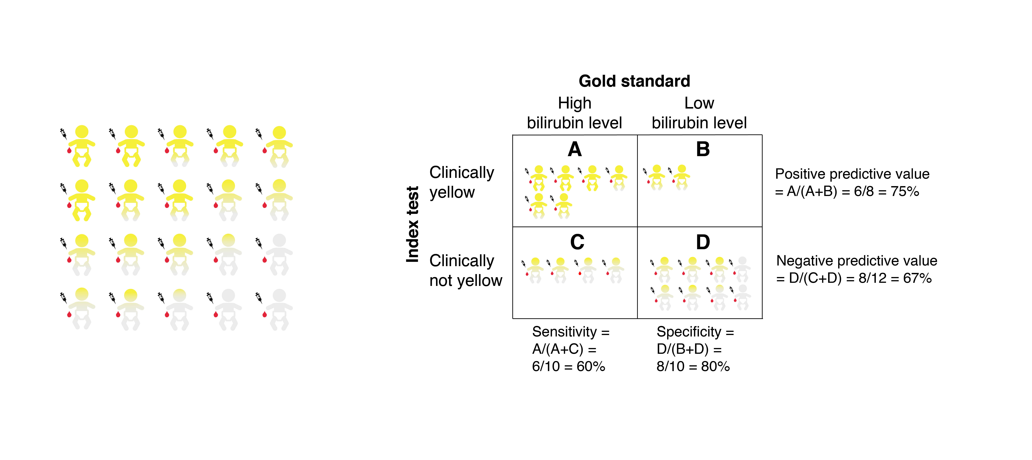
Martina’s Illustration: Unbiased
Everyone gets a blood test

Slide 21
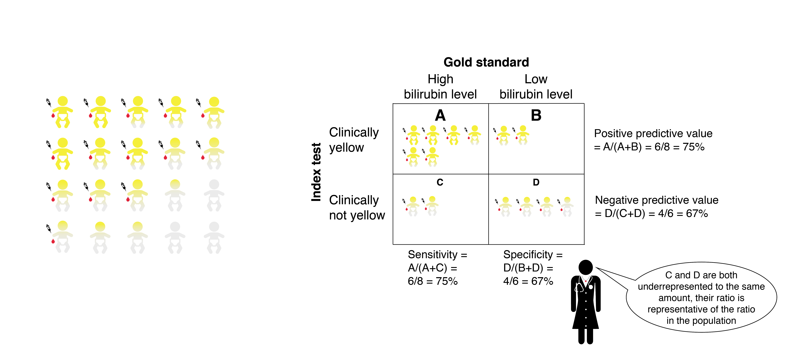
Random sample of Test − : Biased sensitivity and specificity
More blood tests if jaundiced

Slide 22
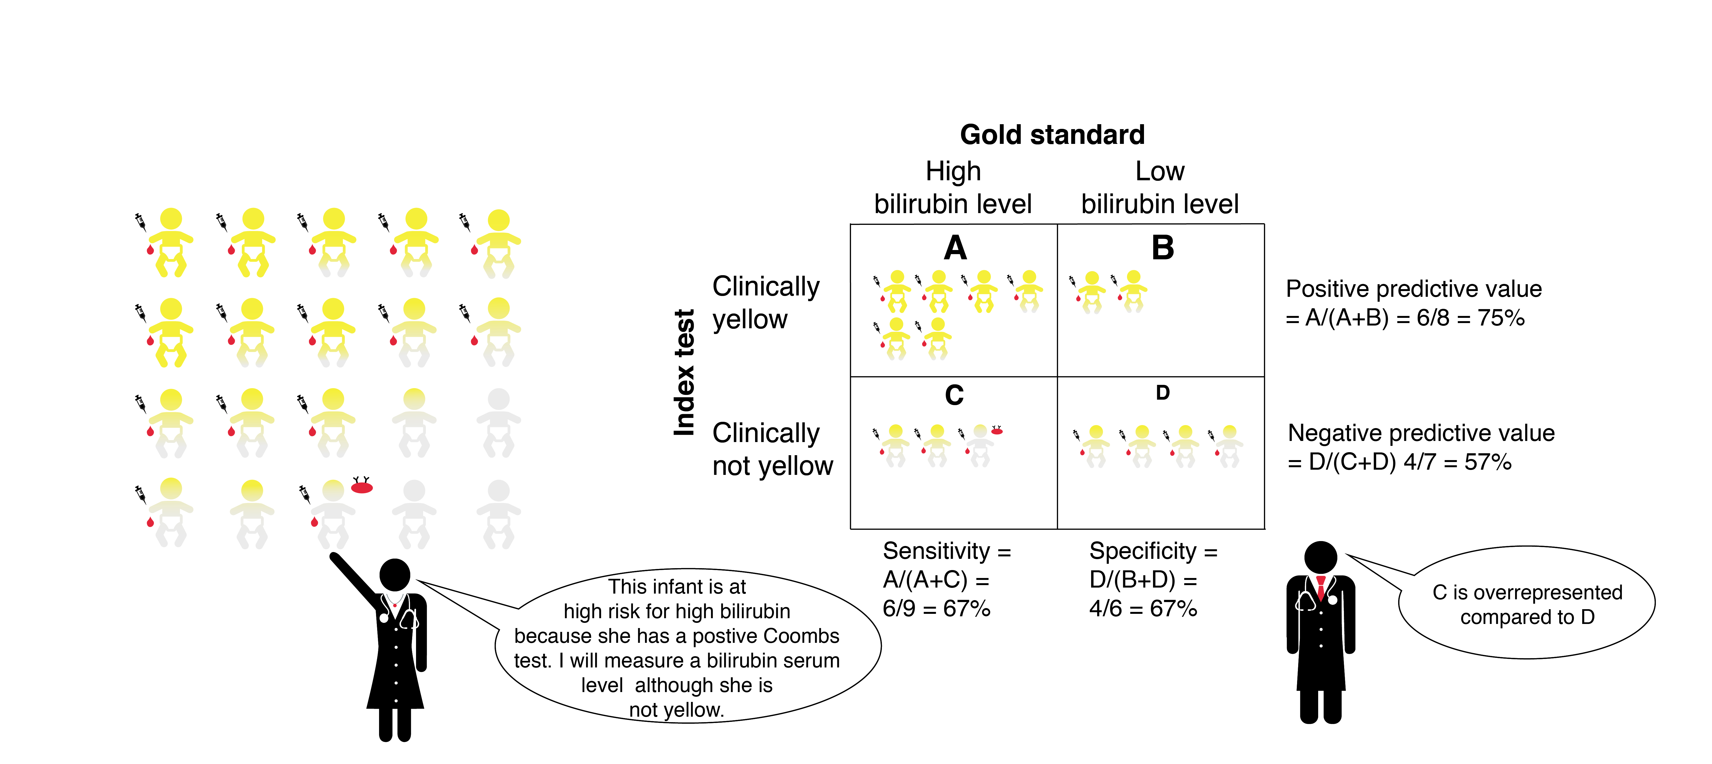
Biased sample of Test − : Biased sensitivity, specificity and NPV

Slide 23
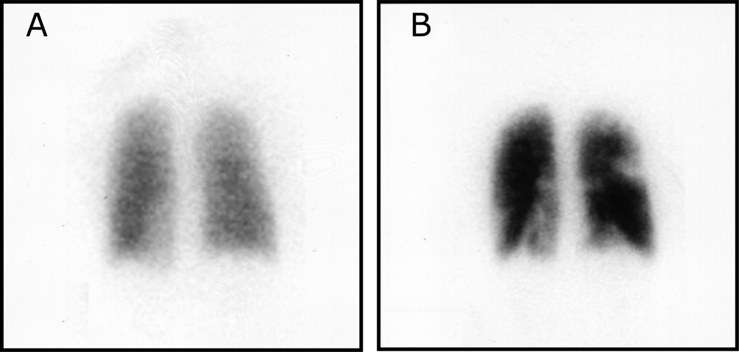
Bias #3
Example: PIOPED study of accuracy of ventilation/perfusion (V/Q) scan to diagnose pulmonary embolism (PE, blood clot in the lungs)*
Study Population: All patients presenting to the emergency department who received a V/Q scan
Index Test: V/Q Scan
Disease: Pulmonary embolism (PE)
Gold Standards:
  1. Pulmonary arteriogram if one was done (more likely with more abnormal V/Q scan)
  2. Clinical follow-up in other patients (more likely with normal VQ scan)
JAMA 1990;263(20):2753-9.
Images: By Westgate EJ, FitzGerald GA - Pulmonary Embolism in a Woman Taking Oral Contraceptives and Valdecoxib. PLoS Medicine Vol. 2, No. 7, e197. doi:10.1371/journal.pmed.0020197, CC BY 2.5, https://commons.wikimedia.org/w/index.php?curid=5594243

Slide 24
Differential Verification Bias
Also called Double Gold Standard bias
  Mainly by us
Two different “gold standards”
  One gold standard (usually an immediate, more invasive test, e.g., angiogram, surgery) is more likely to be applied in patients with positive index test
  Other gold standard (usually less invasive, e.g., clinical follow-up) is more likely to be applied in patients with a negative index test.

Slide 25
Differential Verification Bias
There are some patients in whom the two “gold standards” do not give the same answer
  Spontaneously resolving disease (positive on immediate invasive test, but negative with follow-up)
  Newly occurring or newly detectable disease (negative on immediate invasive test but positive with follow-up)

Slide 26
Effect of Differential Verification Bias 1: Spontaneously resolving disease
If the test result determines which gold standard will be used, test and gold standard will always agree
Example: Joe has a small pulmonary embolus (PE) that will resolve spontaneously.
  If his VQ scan is positive, he will get an angiogram that shows the PE (true positive)
  If his VQ scan is negative, he will get clinical follow-up. His PE will resolve and we will think he never had one (true negative)
VQ scan on Joe can’t be wrong!
Both sensitivity and specificity increase

Slide 27
Effect of differential verification Bias 2: Newly occurring or newly detectable disease
If the test result determines which gold standard will be used, they will always disagree
Example: Jane has a nasty breast cancer but it is currently undetectable by “gold standard” biopsy
  If her mammogram is positive, she will get biopsies that will not find the tumor (mammogram will look falsely positive)
  If her mammogram is negative, she will clinical follow-up, during which she will return with breast cancer (mammogram will look falsely negative)
In Jane, mammogram can’t be right!
Both sensitivity and specificity decrease

Slide 28
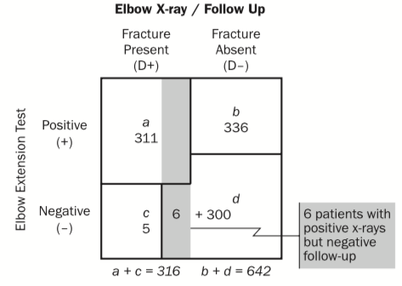
Differential Verification Bias: spontaneously resolving elbow fracture
Kohn et al. Acad Emerg Med 2013. On course website.

Slide 29
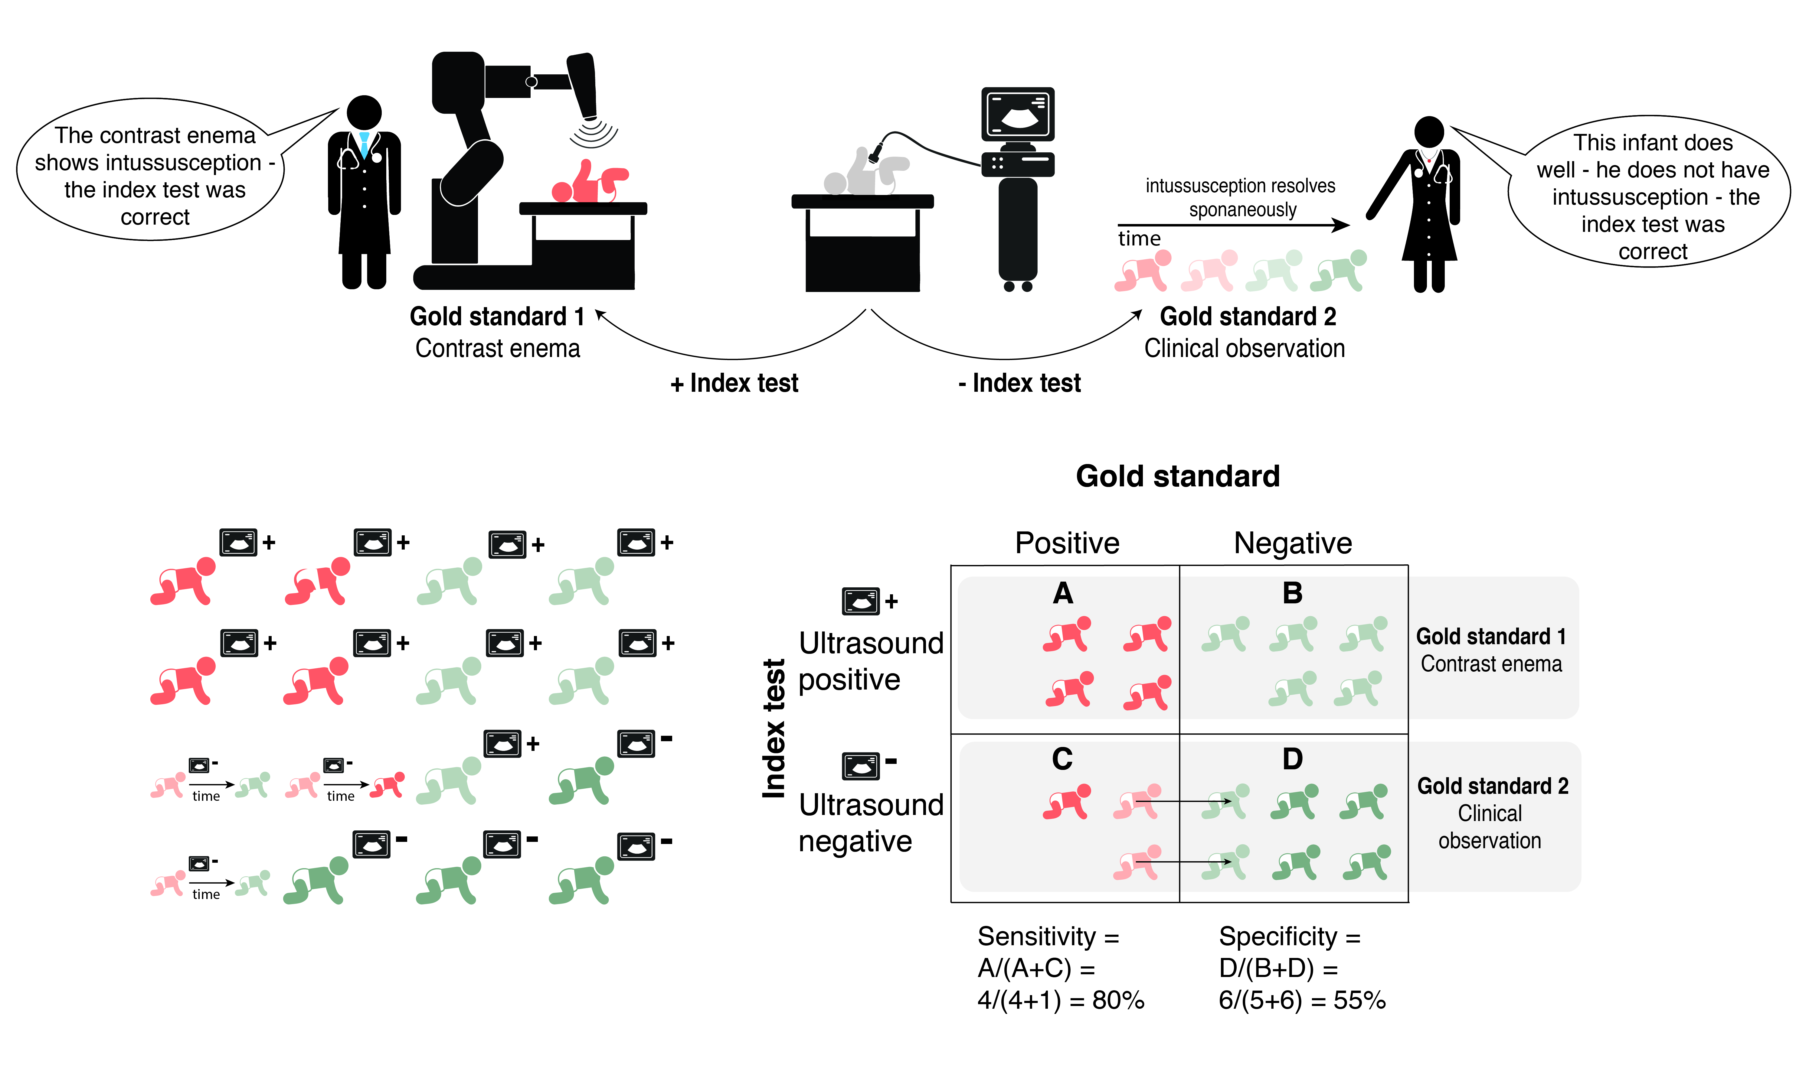
Differential Verification Bias
Spontaneously resolving intussusception

Slide 30
Bias #4: Imperfect Gold Standard Bias
Also called “copper standard bias”
  Mostly by us
If the gold standard sometimes gives the wrong answer, a better test will always look inferior to it!
  The subjects the new test got right that the “copper standard” got wrong will be counted as errors
  But sensitivity and specificity might still be too high if the new test mostly makes the same mistakes as the copper standard

Slide 31
Direction of Imperfect Gold Standard Bias
If errors on the index test and copper standard are independent, both sensitivity and specificity of the index test will be falsely low
If errors on the index test and copper standard are correlated and the index test is no better than the copper standard, sensitivity and/or specificity will be falsely high
If errors are correlated and the index test is better than the copper standard, can’t tell

Slide 32
Example of Imperfect Gold Standard Bias
Treatment decisions in Hepatitis C patients may be partly based presence of fibrosis (scarring) on liver biopsy
Liver biopsy is used as a gold standard in studies of markers of fibrosis
But liver biopsy is an imperfect gold standard
  Sampling error (different parts of the liver give different results ~10% of the time)
  Observer error (pathologists disagree on whether biopsies show fibrosis ~15% of the time)
Mehta, S. H., B. Lau, N. H. Afdhal and D. L. Thomas (2009). Exceeding the limits of liver histology markers. J Hepatol 50(1): 36-41. Thanks to Sili Liu (MAS 2017).
Notes:
Sili distributed the Mehta article for Masters Seminar Jan 2017. Her seminar was about a phone alternative to Bayley scores.

Slide 33
Example of Imperfect Gold Standard Bias-2
Assuming errors are independent, if a near perfect marker existed (AUROC 0.99)…
  If the sensitivity and specificity of liver biopsy (compared with truth) were 80%, the observed AUROC for the near perfect marker would be 0.76
  If the sensitivity and specificity of liver biopsy (compared with truth) were 90%, the observed AUROC for the near perfect marker would be 0.90
Observed AUROC for many markers compared with biopsy have been 0.76 to 0.88!
Mehta, S. H., B. Lau, N. H. Afdhal and D. L. Thomas (2009). Exceeding the limits of liver histology markers. J Hepatol 50(1): 36-41.
Notes:
Sili distributed the Mehta article for Masters Seminar Jan 2017. Her seminar was about a phone alternative to Bayley scores.

Slide 34
STRETCH BREAK!

Slide 35
Bias # 5: Spectrum of Disease, Nondisease and Test Results
Disease is often easier to diagnose if severe ("sickest of the sick")
“Nondisease” is often easier to diagnose if patient is well than if the patient has other diseases ("wellest of the well")
Test results will be more reproducible if ambiguous results excluded

Slide 36
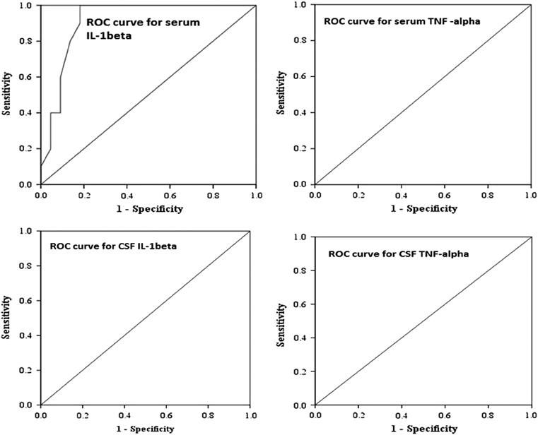
Elevated plasma and cerebrospinal fluid… [markers] and combined outcome of death or abnormal neuroimaging in preterm neonates with early-onset clinical sepsis.
AUROC = 1.0
AUROC = 1.0
AUROC = 1.0
Basu et al. J Perinatol. 2015 Oct;35(10):855-61.

Slide 37
Spectrum bias
STUDY DESIGN: “Thirty-two preterm (⩽34 weeks) neonates with early onset clinical sepsis and 32 gestational age-matched, healthy neonates served as cases and controls, respectively.”
All cases and no controls had a history of chorioamnionitis (maternal fever + prolonged rupture of membranes) and clinical illness
Spectrum bias
  Cases: Sickest of the sick for predicting infection, but representative for predicting death or abnormal imaging
  Controls: wellest of the well – not even risk factors for illness
Basu et al. J Perinatol. 2015 Oct;35(10):855-61.

Slide 38
Spectrum bias
What would be the predicted effect of the spectrum bias on prediction of death or abnormal imaging in this study?
  Both Sensitivity and Specificity falsely high
  Sensitivity falsely high, specificity OK
  Sensitivity OK, Specificity falsely high
  Cannot be predicted
J Perinatol. 2015 Oct;35(10):855-61.
Notes:
What would be the predicted effect of the spectrum bias in this case?
Both Sensitivity and Specificity falsely high
Sensitivity falsely high, specificity OK
Sensitivity OK, Specificity falsely high
Cannot be predicted

Slide 39

Notes:
What would be the predicted effect of the spectrum bias in this case?
https://www.polleverywhere.com/multiple_choice_polls/neffAGRHNFordjb

Slide 40
Partial verification bias as one cause of spectrum bias
In the jaundice example, the spectrum of those with serum bilirubin <12 mg/dL was toward the “sickest of the well,” so specificity falsely low. (They may have had bilirubin levels of 10 or 11 mg/dL, which is why they got the blood test.)
In the appendicitis example, the spectrum of those with no appendicitis was toward the “sickest of the well” (harder to diagnose, ↓specificity) because those with RLQ pain were over-represented
(On exams, say “partial verification bias,” the more specific term, if it applies.)

Slide 41
Meta-analyses of Diagnostic Tests
Systematic and reproducible approach to finding studies
Summary of results of each study
Investigation into heterogeneity
Summary estimate of results, if appropriate
Unlike other meta-analyses (e.g., or risk factors or treatments), results aren’t summarized with a single number (e.g., RR), but with two related numbers (sensitivity and specificity)
These can be plotted on an ROC plane

Slide 42
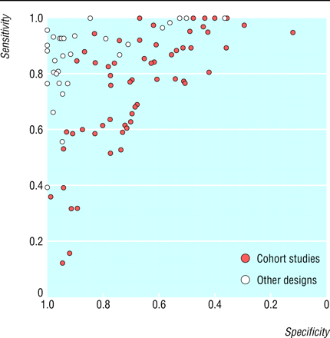
MRI for the diagnosis of MS
Whiting et al. BMJ 2006;332:875-84
Notes:
Note funny labeling on ROC curve

Slide 43
Meta-analyses of Diagnostic Tests
Studies plotted on an ROC plane can be summarized statistically with a summary ROC curve (sROC)
Studies will (more or less) follow a single ROC curve if the heterogeneity is due to different thresholds for calling the test positive
Even dichotomous tests can have underlying thresholds

Slide 44
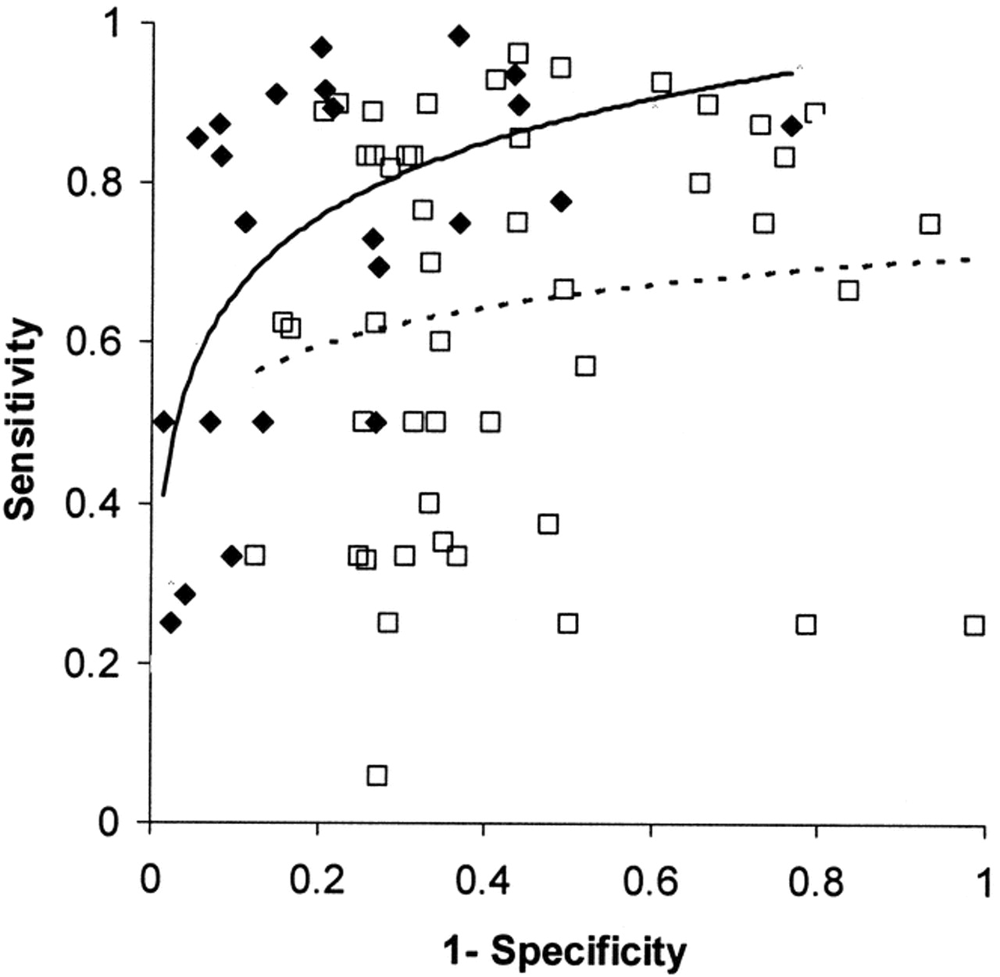
SROC
Figure 1. Graph showing the summary receiver operating characteristic curve (SROC) for the 25 stress echocardiography studies (closed diamond) or the 50 stress nuclear scintigraphy studies (open squares).
Predicting post-op MI or death in elective noncardiac surgery patients
Beattie W S et al. Anesth Analg 2006;102:8-16
©2006 by Lippincott Williams & Wilkins
Notes:
Figure 1. The solid line represents the SROC for echocardiography (r = 0.60). The dotted line represents the thallium imaging SROC (r = 0.13 n.s.). These are studies to predict post operative MI or death in patients scheduled for elective noncardiac surgery
MAKE THE POINT that something is terribly wrong here − there are several squares below the 45 degree line.

Slide 45
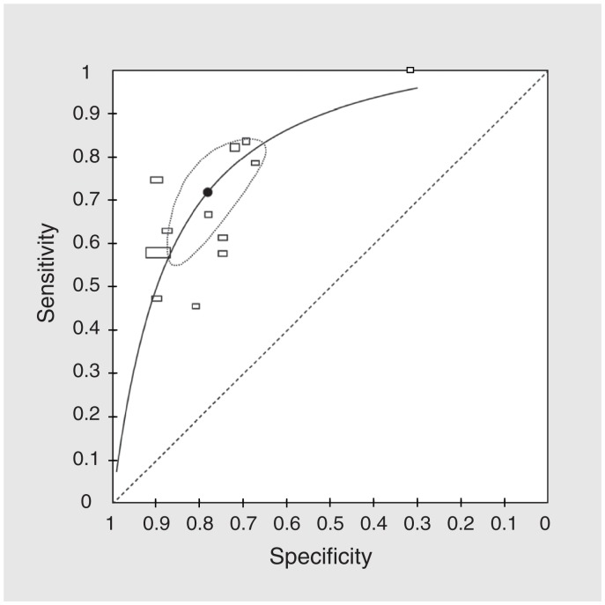
sROC Curve for the “surprise question” for predicting mortality in 6-12 months
Test is clinicians ask themselves, "Would I be surprised if this patient died in the next 12 months?"
A “No” answer is a positive result
Some clinicians are harder to surprise
Downar, J., R. Goldman, R. Pinto, M. Englesakis and N. K. Adhikari (2017). "The "surprise question" for predicting death in seriously ill patients: a systematic review and meta-analysis." CMAJ 189(13): E484-E493.

Slide 46
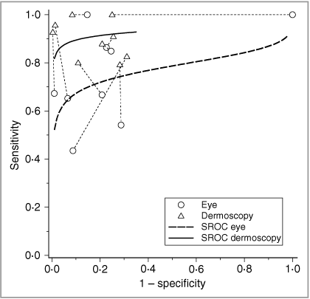
Dermoscopy vs Naked Eye for Diagnosis of Malignant Melanoma
Dermoscopy performed unequivocally better in 7 of the 9 studies.
Find a study for which this was not the case.
Br J Dermatol. 2008 Sep;159(3):669-76

Slide 47

Notes:
Click on the "o" for a labeled study for which this was NOT the case.
https://www.polleverywhere.com/clickable_images/NahUUHtd9FyuCAJ

Slide 48
Studies of Diagnostic Test Accuracy: Checklist
Was there an independent, blind comparison with a reference (“gold”) standard of diagnosis?
Was the diagnostic test evaluated in an appropriate spectrum of patients (like those in whom we would use it in practice)?
Was the reference standard applied regardless of the diagnostic test result?
Was the test (or cluster of tests) validated in a second, independent group of patients?
From Sackett et al., Evidence-based Medicine,2nd ed. (NY: Churchill Livingstone), 2000. p 68

Slide 49
Systematic Approach
Authors and funding source
Research question
Study design
Study subjects
Predictor variable
Outcome variable
Results & Analysis
Conclusions

Slide 50
A clinical decision rule to identify children at low risk for appendicitis -1 (EBD-1 Problem 5.6)*
Study design: prospective "cohort" study
Subjects
  Of 4140 children 3-18 years old presenting to Boston Children’s Hospital ED with abdominal pain
  767 (19%) received surgical consultation for possible appendicitis
    113 Excluded (chronic diseases, recent imaging)
    53 missed
  Leaving 601 in the study (425 in derivation set)
*Kharbanda et al. Pediatrics 2005; 116(3): 709-16

Slide 51
A clinical decision rule to identify children at low risk for appendicitis -2
Predictor variables
  Standardized assessment by pediatric ED attending
  Focus on “Pain with percussion, hopping or cough” (complete data in N=381)
Outcome variable:
  Pathologic diagnosis of appendicitis (or not) for those who received surgery (37%)
  Follow-up telephone call to family or pediatrician 2-4 weeks after the ED visit for those who did not receive surgery (63%)
Kharbanda et al. Pediatrics 116(3): 709-16

Slide 52
A clinical decision rule to identify children at low risk for appendicitis -3
Results: Pain with percussion, hopping or cough
78% sensitivity and 83% NPV seem low to me. Are they valid for me in deciding whom to image?
 | Appendicitis | No Appendicitis | Total
Yes | 106 | 94 | 200 | PPV = 53%
No | 30 | 151 | 181 | NPV = 83%
Total | 136 | 245 | 381
 | Sens = 78% | Spec = 62%
 | Prevalence | = 136/381=36%
Kharbanda et al. Pediatrics 116(3): 709-16

Slide 53
Diagnostic Test Study Checklist
Was there an independent, blind comparison with a reference (“gold”) standard of diagnosis?
  Findings may have determined what gold standard was done, but probably did not affect its interpretation
Was the diagnostic test evaluated in an appropriate spectrum of patients (like those in whom we would use it in practice)?
  Higher prevalence of appendicitis than 6M
Was the reference standard applied regardless of the diagnostic test result?
  No; differential verification bias
Was the test (or cluster of tests) validated in a second, independent group of patients?
  Yes
From Sackett et al., Evidence-based Medicine,2nd ed. (NY: Churchill Livingstone), 2000. p 68

Slide 54
In what direction would these biases affect results?
Sample not representative (population referred to pedi surgery; prior prob higher than kids I see)
  PPV too high, NPV too low
Partial verification bias
  Sensitivity too high, specificity too low
Differential verification bias
  Falsely increase all measures of test accuracy
Spectrum bias
  Sensitivity OK, specificity probably low
Bottom line: can't blame low sensitivity on bias, but NPV probably higher in the lower prevalence population I see

Slide 55
Does this coughing patient have pertussis?*
RQ (for us): what are LR for coughing fits, whoop, and post-tussive vomiting in adults with persistent cough?
Design (for one study we reviewed**): Prospective cross-sectional study
Subjects: 217 adults ≥18 years with cough 7-21 days, no fever or other clear cause for cough enrolled by 80 French GPs.
  In a subsample from 58 GPs, of 710 patients who met inclusion criteria only 99 (14%) enrolled
* Cornia et al. JAMA 2010;304(8):890-896
**Gilberg S et al. J Inf Dis 2002;186:415-8

Slide 56
Does this coughing patient have pertussis?
Predictor variables: “GPs interviewed patients using a standardized questionnaire.”
Outcome variable: Laboratory evidence of pertussis based on any of:
  Culture (N=1)
  PCR (N=36)
  ≥ 2-fold change in anti-pertussis toxin IgG (N=40)
  Total N = 70/217 with evidence of pertussis (32%)
*Gilberg S et al. J Inf Dis 2002;186:415-8

Slide 57
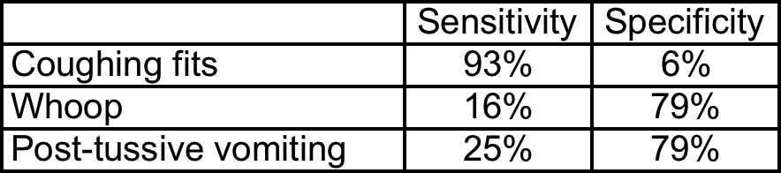
Results
89% in both groups (with and without "laboratory evidence of pertussis") met CDC criteria for pertussis*
*Gilberg S et al. J Inf Dis 2002;186:415-8

Slide 58
Issues
Verification bias: only 14% of eligible subjects included
  Subjects with more pertussis symptoms probably more likely to be included
Questionable “gold standard”
Notes:
Selection bias should operate like verification bias in the chapter – patients with clinical signs suggestive of pertussis are clearly over-represented. This biases sensitivity up and specificity down. This clearly was operating for paroxysms, probably less for the other symptoms
The poor gold standard would bias sensitivity down if it has a lot of false positives, and specificity down if it has a lot of false negatives.

Slide 59
What is wrong with this picture?
Outcome variable: Evidence of pertussis based on any of:
  Culture (N=1)
  PCR (N=36)
  ≥ 2-fold change in anti-pertussis toxin IgG (N=40)
  Total N = 70/217 with evidence of pertussis (32%)
Protocol apparently included serologic tests and PCR on all, but culture only if it could be plated in < 4 hours
Not much overlap!

Slide 60
Issues
Correlation between serologic and PCR pertussis tests (derived from Table 1 of Gilberg et al.*)
. tab PT PCR [fw=pop]
PT_IGG_cha | PCR
nge | POS NEG | Total
-----------+----------------------+----------
POS | 6 30 | 36
NEG | 34 53 | 87
-----------+----------------------+----------
Total | 40 83 | 123
*Gilberg S et al. J Inf Dis 2002;186:415-8
Notes:
Selection bias should operate like verification bias in the chapter – patients with clinical signs suggestive of pertussis are clearly over-represented. This biases sensitivity up and specificity down. This clearly was operating for paroxysms, probably less for the other symptoms
The poor gold standard would bias sensitivity down if it has a lot of false positives, and specificity down if it has a lot of false negatives.

Slide 61
Issues
. kap PT PCR [fw=pop]
Expected
Agreement Agreement Kappa Std. Err. Z Prob>Z
-----------------------------------------------------------------
47.97% 57.25% -0.2171 0.0899 -2.41 0.9921
Nice illustration of difficulty doing a systematic review!
Important take-home message: you can’t judge study quality only by looking at the methods! You need to look at results, too!
Notes:
Selection bias should operate like verification bias in the chapter – patients with clinical signs suggestive of pertussis are clearly over-represented. This biases sensitivity up and specificity down. This clearly was operating for paroxysms, probably less for the other symptoms
The poor gold standard would bias sensitivity down if it has a lot of false positives, and specificity down if it has a lot of false negatives.

Slide 62
Questions?

