Slide 1
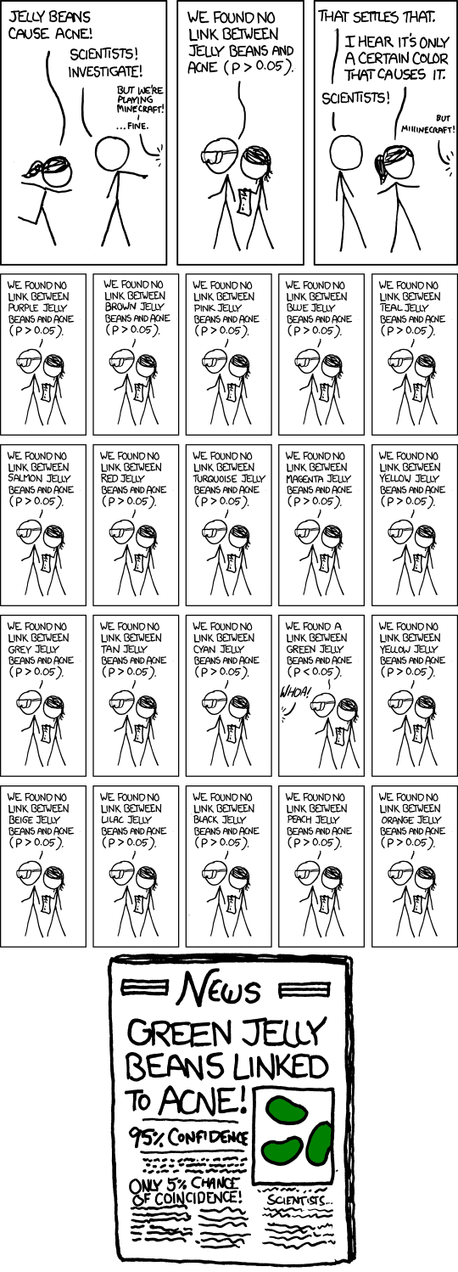
ANOVA = multiple comparisons in my data, can’t use the t-test

Slide 2
t-tests, one-way ANOVA
Admissions to the Psychiatric ward of
a hospital by type of moon and whether it was Friday the 13th.
Are there more admissions during a
Full moon? On Friday the 13th?

Slide 3
Univariate Summary Statistics

Slide 4
Bivariate Summary Statistics

Slide 5
ANOVA Statistics
Independent groups
t-test p = 0.026
One-way Analysis of Variance p = 0.0009
Post-hoc comparisons:
Post-hoc tests show that: During a Full Moon is significantly higher than Before or After a Full moon.

Slide 6
ANOVA Statistics – two-way ANOVA

Slide 7

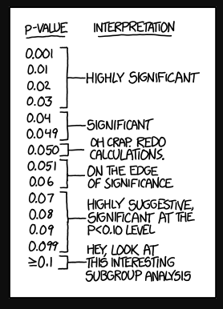
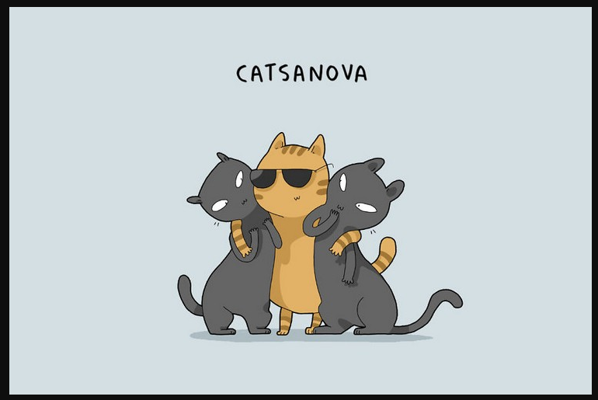
http://biostatisticsryangoslingreturns.tumblr.com/

