Slide 1
Pocket Full of Resources
Rebekah Kaplan, CNM
Thanks to: Missi Willmarth-Stec, DNP, APRN, CNM for APP inspiration and her slides

Slide 2
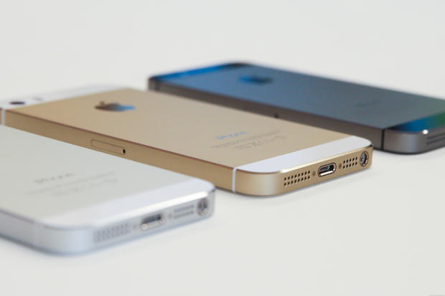
OBJECTIVES
Resources for clinical
AP’s for day to day SNM-hood
Peripheral Brain
  Your key to success
  Options

Slide 3


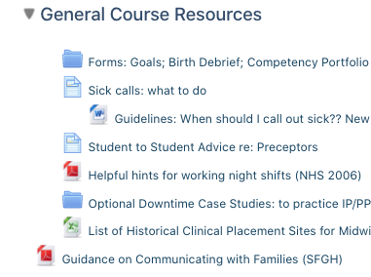
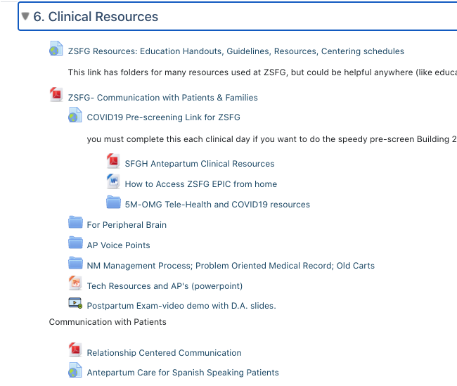
Resources for Clinical
ZSFG AP & IP Guidelines
Your Clinical CLE sites: Ambulatory and Inpatient

Slide 4

THE LIBRARY
Tour
HELP
Textbooks
  Williams
  Gabbe
Cochrane Database
Video Library
Up-To Date
Notes:
Cochrane: Evidence based meta analyses for OB topics
Video’s – health assessment Bates.

Slide 5

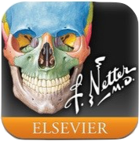
Anatomy-Health Assessment
My Human
Netter's anatomy
Atlas of Human Anatomy
Bates Videos
Notes:
Nettter in our library
My Human-Free nice female reproductive system.

Slide 6
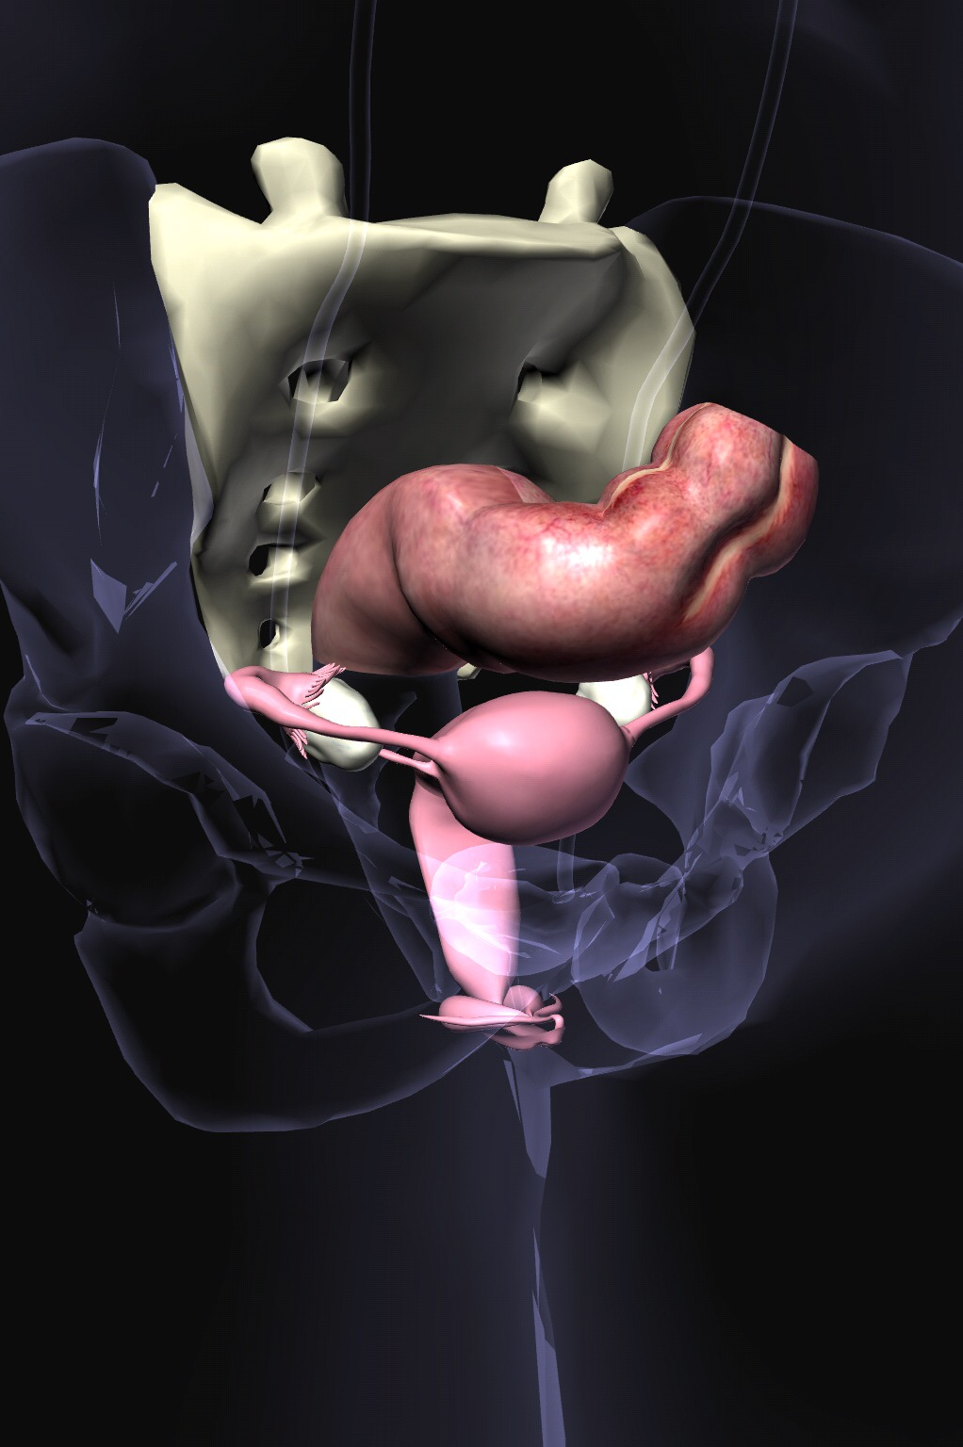
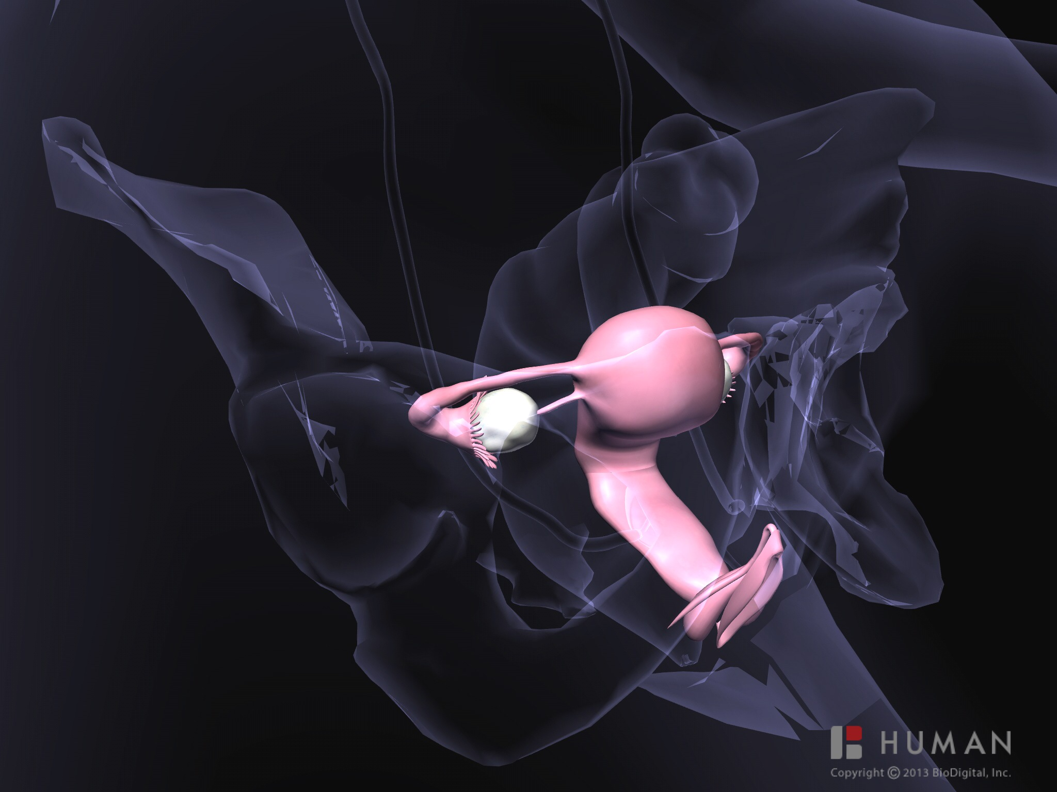


Slide 7
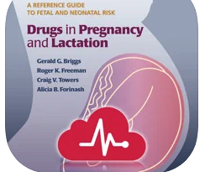
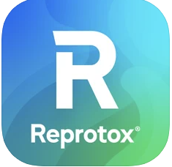
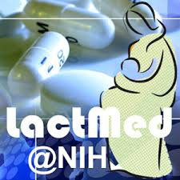

pharmacology
Drugs in Lactation and Pregnancy
Lact-Med@NIH
MPR
Epocrates
Reprotox
Notes:
Monthly prescribing reference- gives you FDA updates can look up by disease processes (free)
Drugs in preg and …..Briggs, Freeman and Yaffe $79.99 A must own - This is a core drug reference in the field of maternal health and a worthwhile contribution to the discipline. "Download the FREE app and view selected topics (Approximately 10% of the content is viewable in the free app and tapping on the locked topic will launch the in-app purchase screen).
Epocrates Plus Annual$174.99Epocrates Plus$16.99Epocrates Plus Monthly$16.99more
Especially handy for dosages and thing like swimmers ear etc that you don’t see all the time.

Slide 9

guidelines
CDC
ASCCP
Evidence
Up-To-Date
Your clinical site (ZSFG/Planned Parenthood…)
Notes:
CDC contraception AP & STI/Vaginitis AP and immunizations AP
ASCCP-$10 with pap guidelines-screening, mmnt, when to colpo, put in age, HPV status etc…up-to-date
Evidence Central:
Evidence-Based Medicine Guidelines
Evidence-Based Medicine Guidelines (EBMG) features nearly 1,000 clinical guidelines including diagnosis and treatment and more than 3,000 evidence summaries that support each recommendation. EBMG includes an image library of over 1,000 images of dermatologic presentations, electrocardiograms, and conditions of the eye, as well as an extensive video collection. EBMG is updated quarterly.
Cochrane Abstracts
Cochrane Abstracts are summaries of the most up-to-date reviews of research findings for hundreds of therapeutic interventions. Each review details all of the evidence surrounding a type of medical treatment, providing clinicians with new information that can influence healthcare decisions. Cochrane Abstracts are updated monthly.
EE+ POEMs
EE+ POEMs (Patient-Oriented Evidence that Matters from Essential Evidence Plus) delivers new evidence that is especially relevant to patient care. Each new POEM is reviewed for accuracy and graded for relevancy before being released, supporting application of the best research findings to your clinical practice. View new POEMs daily as they are delivered or search the archive by date or title.
MEDLINE Journals
MEDLINE Journals delivers citations and abstracts from your choice of trusted medical journals to your mobile device. Link directly to the fully-integrated Unbound

Slide 11
toolkit
OB Wheel
BMI Calculator
EFM Guide
Bishop Score
ICD-9/ICD-10
Notes:
The perfect wheel-$1.99
EFM goes over tracings (cat 1,II,III has some pix)

Slide 12
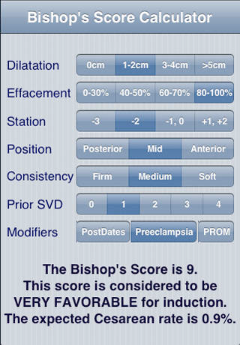

Slide 13
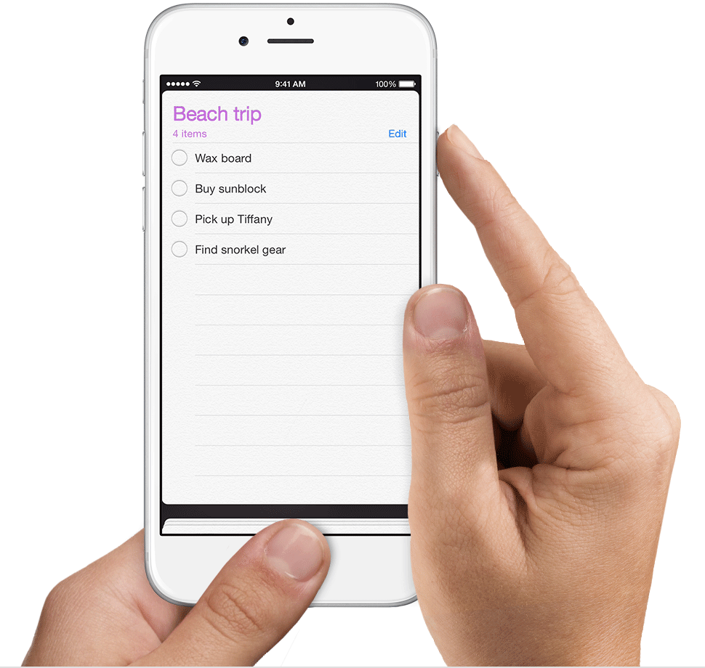



YOUR PERIFERAL BRAIN
Paper
Evernote
One-Note
Google Docs

