Slide 1
Biostat 200
Linear and Logistic Models

Slide 2
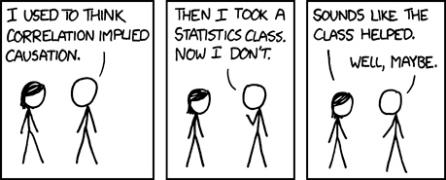
Correlation is not Causation

Slide 3
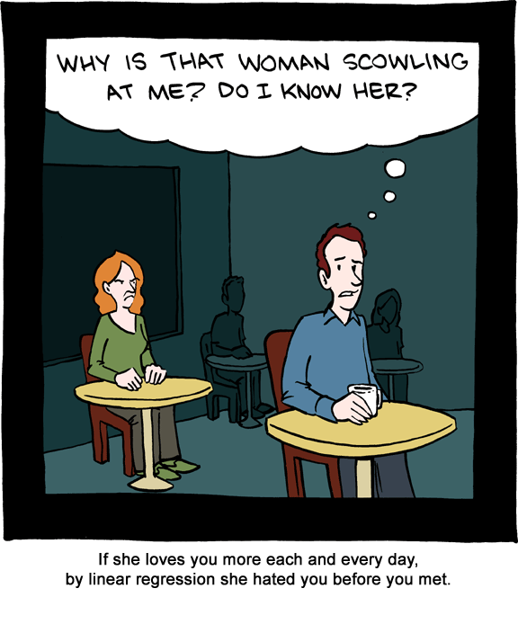

Slide 4
Review: Inference for predicted values
We might want to estimate the mean value of y at a particular value of x
What is the mean FEV for children who are 10 years old? ŷ = .432 + .222*x = .432 + .222*10 = 2.643 liters
We can construct a 95% confidence interval for the estimated mean
  ( ŷ - t_{n-2,.025}se(ŷ) , ŷ + t_{n-2,.025}se(ŷ) ), where

Slide 5
Use Stata for your prediction
Stata will calculate the fitted regression values and the standard errors
  regress fev age
  predict fev_pred, xb -> predicted mean values (ŷ)
  predict fev_predse, stdp -> se of ŷ values
You don’t have to calculate these to get a plot with the 95% CI:
twoway (lfitci fev age)
New variable names that I made up
Stands for linear fit for the line, CI for the confidence interval

Slide 6
. list fev age fev_pred fev_predse
+-----------------------------------+
| fev age fev_pred fev_pr~e |
|-----------------------------------|
1. | 1.708 9 2.430017 .0232702 |
2. | 1.724 8 2.207976 .0265199 |
3. | 1.72 7 1.985935 .0312756 |
4. | 1.558 9 2.430017 .0232702 |
5. | 1.895 9 2.430017 .0232702 |
|-----------------------------------|
6. | 2.336 8 2.207976 .0265199 |
7. | 1.919 6 1.763894 .0369605 |
8. | 1.415 6 1.763894 .0369605 |
9. | 1.987 8 2.207976 .0265199 |
10. | 1.942 9 2.430017 .0232702 |
|-----------------------------------|
11. | 1.602 6 1.763894 .0369605 |
12. | 1.735 8 2.207976 .0265199 |
13. | 2.193 8 2.207976 .0265199 |
14. | 2.118 8 2.207976 .0265199 |
15. | 2.258 8 2.207976 .0265199 |
336. | 3.147 13 3.318181 .0320131 |
337. | 2.52 10 2.652058 .0221981 |
338. | 2.292 10 2.652058 .0221981 |

Slide 7
Remember that the Cis get wider as you get farther from x̅ ;
but here n is large so the CI is still very narrow
twoway (scatter fev age) (lfitci fev age, ciplot(rline) blcolor(black)), legend(off) title(95% CI for the predicted means for each age )

Slide 8
Prediction intervals
The intervals we just made were for means of y at particular values of x
What if we want to predict the FEV value for an individual child at age 10?
The prediction is the same – plug into the regression equation: ỹ =.432 + .222*10 = 2.643 liters
But the standard error of ỹ is not the same as the standard error of ŷ

Slide 9
Prediction intervals
This differs from the se(ŷ) only by the extra variance of y in the formula but it makes a big difference
There is much more uncertainty in predicting a future value versus predicting a mean
Stata will calculate these using
predict fev_predse_ind, stdf
Where the f is for forecast

Slide 10
. list fev age fev_pred fev_predse fev_pred_ind
+----------------------------------------------+
| fev age fev_pred fev~edse fev~ndse |
|----------------------------------------------|
1. | 1.708 9 2.430017 .0232702 .5680039 |
2. | 1.724 8 2.207976 .0265199 .5681463 |
3. | 1.72 7 1.985935 .0312756 .5683882 |
4. | 1.558 9 2.430017 .0232702 .5680039 |
5. | 1.895 9 2.430017 .0232702 .5680039 |
|----------------------------------------------|
6. | 2.336 8 2.207976 .0265199 .5681463 |
7. | 1.919 6 1.763894 .0369605 .5687293 |
8. | 1.415 6 1.763894 .0369605 .5687293 |
9. | 1.987 8 2.207976 .0265199 .5681463 |
10. | 1.942 9 2.430017 .0232702 .5680039 |
|----------------------------------------------|
11. | 1.602 6 1.763894 .0369605 .5687293 |
12. | 1.735 8 2.207976 .0265199 .5681463 |
13. | 2.193 8 2.207976 .0265199 .5681463 |
14. | 2.118 8 2.207976 .0265199 .5681463 |
15. | 2.258 8 2.207976 .0265199 .5681463 |
336. | 3.147 13 3.318181 .0320131 .5684292 |
337. | 2.52 10 2.652058 .0221981 .567961 |
338. | 2.292 10 2.652058 .0221981 .567961 |

Slide 11
Note the width of the confidence intervals for the means at each x versus the width of the prediction intervals
twoway (scatter fev age) (lfitci fev age, ciplot(rline) blcolor(black) ) (lfitci fev age, stdf ciplot(rline) blcolor(red) ), legend(off) title(95% prediction interval and CI )
Notes:
The stdf option in the lfitci tells stata that you are predicting an individual value

Slide 12
Model fit -- Residuals
Residuals are the difference between the observed y values and the regression line for each value of x: y_{i}-ŷ_{i}
If all the points lie along a straight line, the residuals are all 0
If there is a lot of variability at each level of x, the residuals are large
The sum of the squared residuals is what was minimized in the least squares method of fitting the line

Slide 14
Residuals
We examine the residuals using scatter plots
We plot the fitted values ŷ_{i} on the x-axis and the residuals y_{i}-ŷ_{i} on the y-axis
We use the fitted values because they have the effect of the independent variable removed
To calculate the residuals and the fitted values Stata:
  regress fev age
  rvfplot
RVF = residuals versus fitted

Slide 15
rvfplot, title(Fitted values versus residuals for regression of FEV on age)

Slide 16
Residuals
This plot shows that as the fitted value of FEV increases, the spread of the residuals increase – this suggests heteroscedasticity
We would get a similar plot if we plotted age on the x-axis
rvpplot age, name(res_v_age)
RVP=residuals versus predictor
We had a hint of this when looking at the box plots of FEV by age groups in the previous lecture

Slide 18
graph box fev, over(age) title(FEV by age)
Note that heteroscedasticity does not bias the estimates of the parameters, but it does reduce the precision of the estimates (and therefore reduces power)

Slide 19
Transformations
One way to deal with this is to transform either x or y or both
A common transformation is the log transformation
Log transformations bring large values closer to the rest of the data
There are methods to correct the standard errors for heteroscedasticity other than transformations

Slide 20
Log transformations
Value | Ln | Log₁₀
0 | -∞ | -∞
0.001 | -6.91 | -3.00
0.05 | -3.00 | -1.30
1 | 0.00 | 0.00
5 | 1.61 | 0.70
10 | 2.30 | 1.00
50 | 3.91 | 1.70
103 | 4.63 | 2.01
Be careful of log(0) or ln(0)
Be sure you know which log base your computer program is using
  In Stata log() will give you ln()
  If you want log10 use log10()

Slide 21
Transformations
Transform FEV to ln(FEV)
. gen fev_ln=log(fev)
. summ fev fev_ln
Variable | Obs Mean Std. Dev. Min Max
-------------+--------------------------------------------------------
fev | 654 2.63678 .8670591 .791 5.793
fev_ln | 654 .915437 .3332652 -.2344573 1.75665
Examine the histograms
Run the regression of ln(FEV) on age and examine the residuals
regress fev_ln age
rvfplot, title(Fitted values versus residuals for regression of lnFEV on age)

Slide 22
Regressions: fev & fev_ln

Slide 25
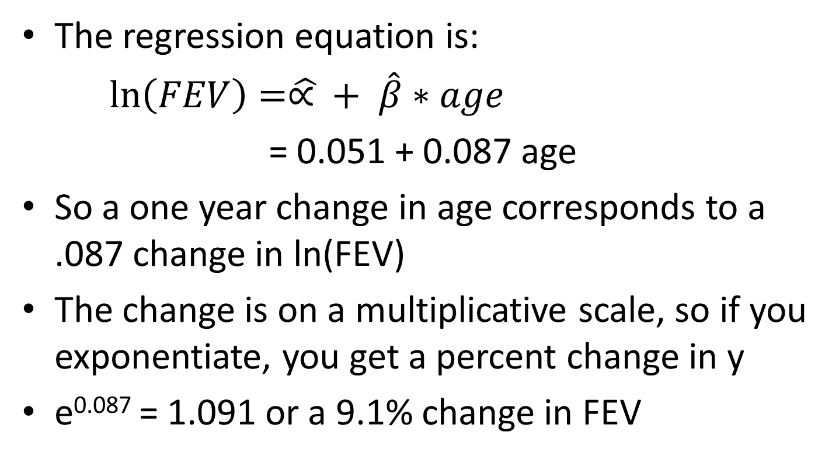
Interpretation of regression coefficients for transformed y value

Slide 26
For example…
Ln(FEV) = 0.051 + 0.087 age
Ln(FEV_{age21}) = 0.051 + 0.087*21
Ln(FEV_{age20}) = 0.051 + 0.087*20
Ln(FEV_{age21})-ln(FEV_{age20}) = 0.087
Remember ln(a)-ln(b) = ln(a/b)
Ln(FEV_{age21} /FEV_{age20})= 0.087
FEV_{age21}/FEV_{age20} = e^{0.087} = 1.09

Slide 27
Now using height as the independent variable
Make a scatter plot of FEV by height and FEV_ln by height
Run a regression of FEV on height and FEV_ln on height
What does this tell you?

Slide 29
Categorical independent variables
We previously noted that the independent variable (the X variable) does not need to be normally distributed
In fact, this variable can be categorical

Slide 30
Categorical independent variables
Coding: Dichotomous variables in regression models
  1 to represent the level of interest
  0 to represent the comparison or reference group.
  These 0-1 variables are called indicator or dummy variables.
The regression model is the same
The interpretation is slightly different
  β̂ is the change in y that corresponds to being in the group of interest vs. the reference category

Slide 31
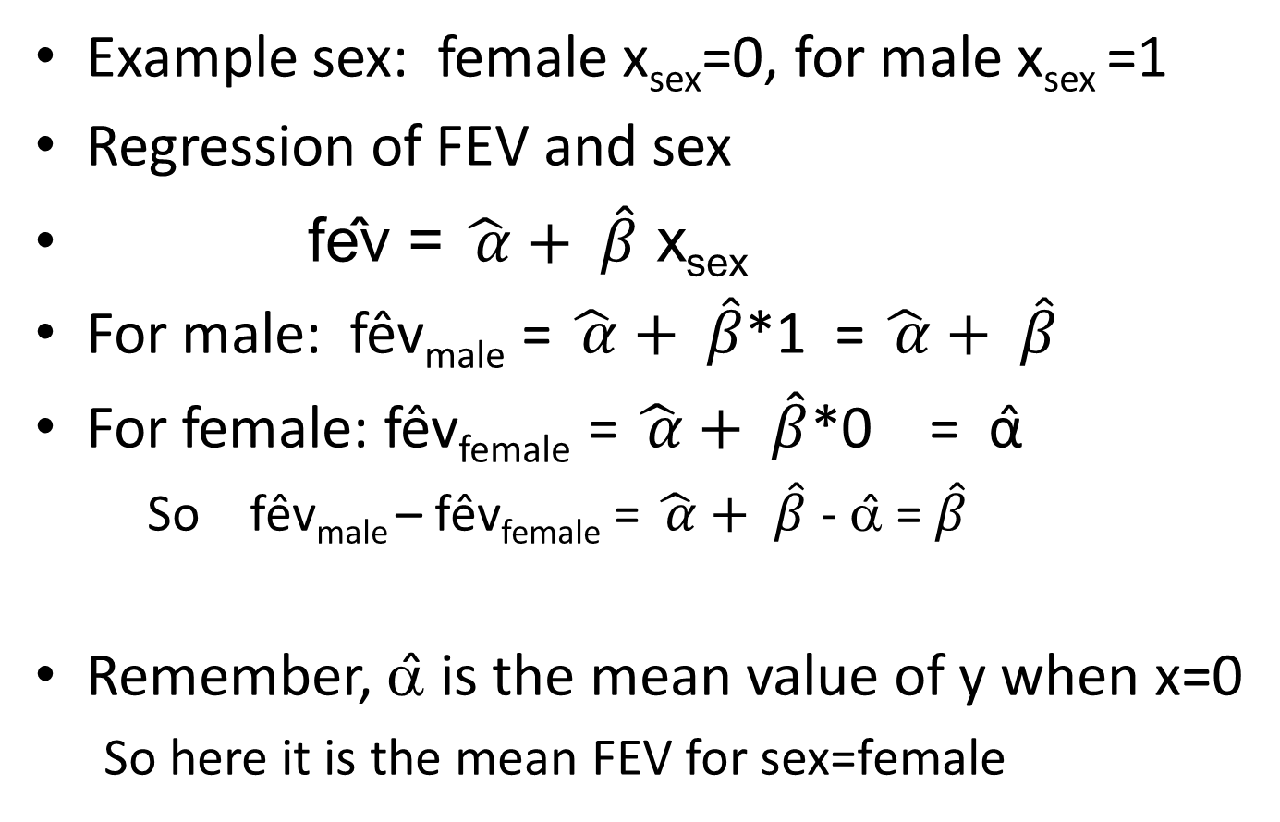
Categorical independent variables

Slide 32
What is the estimate for beta? How is it interpreted?
What is the estimate for alpha? How is it interpreted?
What hypothesis is tested where it says P>|t|?
How much of the variance in FEV is explained by sex?
What does the rvfplot look like?

Slide 34
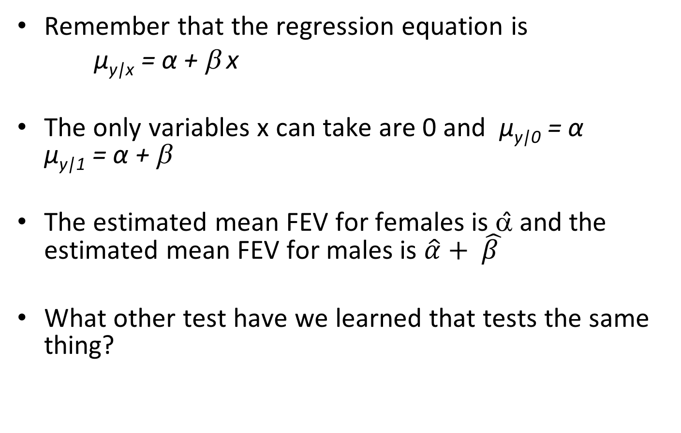
Categorical independent variable
Remember that the regression equation is
μ_{y|x} = α + β x
The only variables x can take are 0 and μ_{y|0} = α μ_{y|1} = α + β
The estimated mean FEV for females is α̂ and the estimated mean FEV for males is $\hat{α}+ \hat{β }$
What other test have we learned that tests the same thing?

Slide 36
Categorical independent variables
e.g. Race group = White, Asian/PI, Other
If Race=White is set as reference category, dummy variables look like:
 | x_{Asian/PI} | x_{Other}
White | 0 | 0
Asian/PI | 1 | 0
Other | 0 | 1

Slide 37
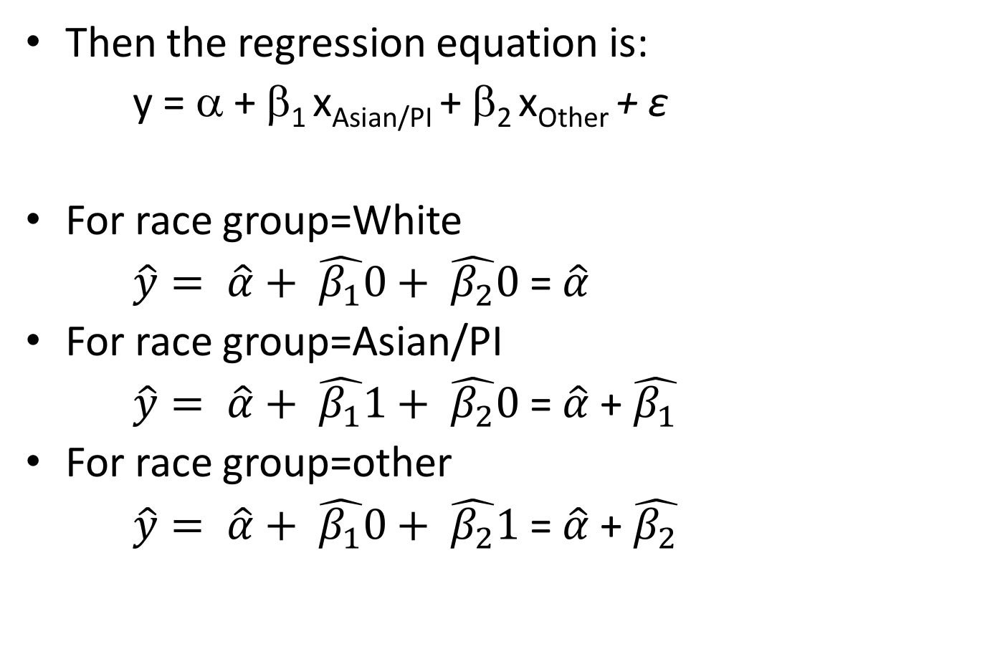
Categorical independent variables
Then the regression equation is:
y = α + β₁ x_{Asian/PI} + β₂ x_{Other} + ε
For race group=White
$\hat{y}= \hat{α}+ \hat{β_{1}}0+ \hat{β_{2}}0$ = $\hat{α}$
For race group=Asian/PI
$\hat{y}= \hat{α}+ \hat{β_{1}}1+ \hat{β_{2}}0$ = $\hat{α}$ + $\hat{β_{1}}$
For race group=other
$\hat{y}= \hat{α}+ \hat{β_{1}}0+ \hat{β_{2}}1$= $\hat{α}$ + $\hat{β_{2}}$

Slide 38
Stata indicator variables
You actually don’t have to make the dummy variables yourself
All you have to do is tell Stata that a variable is categorical using i. before a variable name
The regression of FEV regressed on age group
regress fev i.agecat

Slide 39
Multiple regression
Additional explanatory variables might increase our understanding of a dependent variable
We can posit the population equation
μ_{y|x1,x2,...,xq} = α + β₁x₁ + β₂x₂ + ... + β_{q}x_{q}
α is the mean of y when all the explanatory variables are 0
β_{i} is the change in the mean value of y the corresponds to a 1 unit change in x_{i} when all the other explanatory variables are held constant

Slide 40
Multiple regression
y = α + β₁x₁ + β₂x₂ + ... + β_{q}x_{q} + ε
Assumptions
  x₁,x₂,...,x_{q} are measured without error
  The distribution of y is normal with mean μ_{y|x1,x2,...,xq} and standard deviation σ_{y|x1,x2,...,xq}
  The population regression model holds
  For any set of values of the explanatory variables, x₁,x₂,...,x_{q} , σ_{y|x1,x2,...,xq} is constant – homoscedasticity
  The y outcomes are independent

Slide 41

Multiple regression – Least Squares
We estimate the regression line
$\hat{y}= \hat{α}+ \hat{β_{1}}$ $x_{1}+ \hat{β_{2}}$ $x_{2}+ …\hat{β_{q}} x_{q}$
using the method of least squares to minimize

Slide 42
Multiple regression
For one explanatory variable – the regression model represents a straight line through a cloud of points -- in 2 dimensions
With 2 explanatory variables, the model is a plane in 3 dimensional space (one for each variable)
etc.
In Stata we just add explanatory variables to the regress statement
regress fev age ht

Slide 43
. regress fev age ht
Source | SS df MS Number of obs = 654
-------------+------------------------------ F( 2, 651) = 1067.96
Model | 376.244941 2 188.122471 Prob > F = 0.0000
Residual | 114.674892 651 .176151908 R-squared = 0.7664
-------------+------------------------------ Adj R-squared = 0.7657
Total | 490.919833 653 .751791475 Root MSE = .4197
------------------------------------------------------------------------------
fev | Coef. Std. Err. t P>|t| [95% Conf. Interval]
-------------+----------------------------------------------------------------
age | .0542807 .0091061 5.96 0.000 .0363998 .0721616
ht | .1097118 .0047162 23.26 0.000 .100451 .1189726
_cons | -4.610466 .2242706 -20.56 0.000 -5.050847 -4.170085
------------------------------------------------------------------------------
Now the F-test has 2 degrees of freedom in the numerator because there are 2 explanatory variables
R² will always increase as you add more variables into the model
The Adj R-squared accounts for the addition of variables and is comparable across models with different numbers of parameters

Slide 44
Examine the residuals…

Slide 45
Logistic regression
For linear regression
  The predicted values can be from -∞ to +∞
  Y values are assumed to follow a normal distribution
For many situations we want to model a dichotomous outcome, such as disease/no disease and cannot use linear regression
We want to model p, the probability of disease

Slide 46
Logistic regression
p=P(Y=1) i.e. P(outcome=disease)
A model of the form p= α + βx would be able to take on negative values or values more than 1
p=e^{α + βx} is an improvement because it cannot be negative, but it still could be greater than 1

Slide 47
Logistic regression
How about the function?
When α + βx =0, p=1/(1+1) = 0.5
When x=big negative number, p nears 0/(1+0) = 0
When x=big positive number, p nears (big number)/(1+big number) = 1
The function models the probability slowly increasing over the values of X, until there is a steep rise, and another leveling off

Slide 48
Logistic regression
The logistic function
Now check this out:
So odds of disease/success are
And therefore ln(p/(1-p)) = ln(e^{α+βx}) = α + bx

Slide 49
Logistic regression
So instead of assuming that the relationship between p and X is linear (as in linear regression), we are assuming that the relationship between ln(p/(1-p)) and X is linear.
ln(p/(1-p)) is called the logit function
Logit(p) = ln(p/(1-p))
In generalized linear models, some function of the outcome variable is assumed to be linear
  e.g. f(y) = α + βx or f(p) = α + β x
  e.g. logit(p)= α + β x

Slide 50
Logistic regression
Assumptions
  Y_{i} follows a bernoulli distribution (0,1)
  The mean of Y at every X, P(Y=1|x) is given by the logistic function
  The values of the outcomes are independent
Estimation
  The parameters are estimated via a procedure called maximum likelihood
  There is not a closed form solution of the maximization (i.e. we cannot write down a solution) – it is an iterative procedure

Slide 51
Interpretation of coefficients
One dichotomous explanatory variable
For x=0 logit(p₀) = ln(p₀/(1-p₀))
= ln(P(Y=1|X=0)/(1- P(Y=1|X=0)))
= ln(odds of the outcome when x=0)
= α + β*x = α + β*0 = α
For x=1 logit(p₁) = ln(p₁/(1-p₁))
= ln(P(Y=1|X=1)/(1- P(Y=1|X=1)))
= odds of the outcome when x=1
= α + β*1 = α + β

Slide 52
Difference between treatment arms in PEth outcome (>50 ng/ml)*
logistic peth_audit_50 i.studyarm_n
Logistic regression Number of obs = 324
LR chi2(1) = 1.14
Prob > chi2 = 0.2858
Log likelihood = -223.91123 Pseudo R2 = 0.0025
-------------------------------------------------------------------------------
peth_audit_50 | Odds Ratio Std. Err. z P>|z| [95% Conf. Interval]
--------------+----------------------------------------------------------------
1.studyarm_n | .7869577 .1768227 -1.07 0.286 .5066332 1.222388
_cons | 1.05618 .1562084 0.37 0.712 .7903976 1.411335
-------------------------------------------------------------------------------
*BREATH cohort and comparisons_v3.dta

Slide 53
Difference between treatment arms in PEth outcome (>50 ng/ml)
logistic depvar indepvar
logistic peth_audit_50 i.studyarm_n
Logistic regression Number of obs = 324
LR chi2(1) = 1.14
Prob > chi2 = 0.2858
Log likelihood = -223.91123 Pseudo R2 = 0.0025
-------------------------------------------------------------------------------
peth_audit_50 | Odds Ratio Std. Err. z P>|z| [95% Conf. Interval]
--------------+----------------------------------------------------------------
1.studyarm_n | .7869577 .1768227 -1.07 0.286 .5066332 1.222388
_cons | 1.05618 .1562084 0.37 0.712 .7903976 1.411335
-------------------------------------------------------------------------------
=e^{β}
Test of whether the model fit differs from the model with only α and no covariates
This is used in comparing nested models of the same data set
The Pseudo R² is an attempt to be analogous with linear regression but it is not

Slide 54
Stata logistic notes
logistic depvar indepvars
  gives you odds ratios
logistic depvar indepvars, coef
  gives you coefficients (alphas and betas)
logit depvar indepvars
  gives you coefficients
logit depvar indepvars, or
  gives you odds ratios

Slide 55
logit peth_50 i.studyarm_n
Iteration 0: log likelihood = -198.01065
Iteration 1: log likelihood = -197.99359
Iteration 2: log likelihood = -197.99359
Logistic regression Number of obs = 287
LR chi2(1) = 0.03
Prob > chi2 = 0.8534
Log likelihood = -197.99359 Pseudo R2 = 0.0001
------------------------------------------------------------------------------
peth_50 | Coef. Std. Err. z P>|z| [95% Conf. Interval]
-------------+----------------------------------------------------------------
1.studyarm_n | -.0453478 .2455377 -0.18 0.853 -.5265928 .4358972
_cons | -.1438942 .1490438 -0.97 0.334 -.4360146 .1482262
------------------------------------------------------------------------------
Notes:
Using logit to get beta rather than OR.

Slide 56
Odds ratio of PEth>=50 for comparison vs. standard group
tabodds peth_audit_50 studyarm_n, or
---------------------------------------------------------------------------
studyarm_n | Odds Ratio chi2 P>chi2 [95% Conf. Interval]
-------------+-------------------------------------------------------------
0 | 1.000000 . . . .
1 | 0.786958 1.13 0.2867 0.505895 1.224172
---------------------------------------------------------------------------
Test of homogeneity (equal odds): chi2(1) = 1.13
Pr>chi2 = 0.2867
Score test for trend of odds: chi2(1) = 1.13
Pr>chi2 = 0.2867
For one independent variable that is categorical, the odds ratio estimate is the same for logistic regression as for tabular methods.

Slide 57
What is the odds ratio?
The odds ratio represents the change in the odds of membership in the “target” category (e.g., the category coded as 1.0), given a 1-unit increase in the predictor variable.
Odds ratio is the increase (or decrease if negative) in odds of being in one outcome category when the value of the predictor variable increases by one unit.
The odds ratio is calculated by the formula: e^{g} (where e = 2.718, and g = the b coefficient from the logistic regression output).

Slide 58
What is the odds ratio?
For example:
  An odds ratio of 1.5 indicates that that outcome of “1” is 1.5 times as likely (or 50% more likely) with a 1-unit increase in the predictor. The odds increase by 50%.
  An odds ratio of 0.80 indicates that an outcome of “1” is 0.8 times as likely (or 20% less likely [1 – 0.8 = 0.2] with a 1-unit increase in the predictor; the odds are decreased by 20%.

Slide 59
How do you compute the probability of being in the “target” group, for a specific individual?
Multiply each predictor value by its “b” coefficient, and add them to the constant. That sum is called “g.”
Use “g” in the following formula:
e^{g} / 1 + e^{g}

Slide 60
Continuous explanatory variable
.
. . logistic peth_audit_50 age_b
Logistic regression Number of obs = 324
LR chi2(1) = 5.32
Prob > chi2 = 0.0210
Log likelihood = -221.81862 Pseudo R2 = 0.0119
-------------------------------------------------------------------------------
peth_audit_50 | Odds Ratio Std. Err. z P>|z| [95% Conf. Interval]
--------------+----------------------------------------------------------------
age_b | 1.029989 .0133876 2.27 0.023 1.004081 1.056565
_cons | .3782632 .1590054 -2.31 0.021 .1659534 .8621885
-------------------------------------------------------------------------------
Interpretation of the coefficients: The odds ratio is for a one unit change in the predictor
For this example 1.03 is the odds ratio for a one-year difference in age

Slide 61
Continuous explanatory variable
When the explanatory variable is a continuous variable, there is no equivalent tabular method without dividing the variable into groups (e.g. age groups)
You need to use logistic regression when you want to model the relationship between a dichotomous outcome and a continuous explanatory variable

Slide 62
Continuous explanatory variable
To find the OR for a 10-year change in age
.
. logistic peth_audit_50 age_b, coef
Logistic regression Number of obs = 324
LR chi2(1) = 5.32
Prob > chi2 = 0.0210
Log likelihood = -221.81862 Pseudo R2 = 0.0119
-------------------------------------------------------------------------------
peth_audit_50 | Coef. Std. Err. z P>|z| [95% Conf. Interval]
--------------+----------------------------------------------------------------
age_b | .0295481 .0129978 2.27 0.023 .0040729 .0550234
_cons | -.972165 .4203565 -2.31 0.021 -1.796049 -.1482814
-------------------------------------------------------------------------------
OR for a 10-year change in age = exp(10*0.029) = 1.34
.
Notes:
We are looking at age because in our preliminary tables, we found that the age in the minimally assessed arm was somewhat younger than in the standard assessment arm.

Slide 63
Continuous explanatory variable
To find the OR for a 10-year change in age
.
. lincom age_b*10
( 1) 10*[peth_audit_50]age_b = 0
------------------------------------------------------------------------------
peth_audi~50 | Odds Ratio Std. Err. z P>|z| [95% Conf. Interval]
-------------+----------------------------------------------------------------
(1) | 1.343773 .1746612 2.27 0.023 1.04157 1.733658
------------------------------------------------------------------------------
.

Slide 64
Continuous explanatory variable
Another way to find the OR for a 10-year change in age
gen age_10 = age_b/10
. logistic peth_audit_50 age_10
Logistic regression Number of obs = 324
LR chi2(1) = 5.32
Prob > chi2 = 0.0210
Log likelihood = -221.81862 Pseudo R2 = 0.0119
-------------------------------------------------------------------------------
peth_audit_50 | Odds Ratio Std. Err. z P>|z| [95% Conf. Interval]
--------------+----------------------------------------------------------------
age_10 | 1.343773 .1746612 2.27 0.023 1.04157 1.733658
_cons | .3782632 .1590054 -2.31 0.021 .1659534 .8621885
-------------------------------------------------------------------------------

Slide 65
Checking logit-linearity
. tab agecat
agecat | Freq. Percent Cum.
------------+-----------------------------------
15 | 80 24.69 24.69
25 | 136 41.98 66.67
35 | 80 24.69 91.36
45 | 28 8.64 100.00
------------+-----------------------------------
Total | 324 100.00
logistic peth_audit_50 i.agecat
Logistic regression Number of obs = 324
LR chi2(3) = 8.22
Prob > chi2 = 0.0416
Log likelihood = -220.3693 Pseudo R2 = 0.0183
-------------------------------------------------------------------------------
peth_audit_50 | Odds Ratio Std. Err. z P>|z| [95% Conf. Interval]
--------------+----------------------------------------------------------------
agecat |
25 | 1.525822 .4390615 1.47 0.142 .8680944 2.681887
35 | 2.254902 .728875 2.52 0.012 1.196699 4.248838
45 | 2.575758 1.16071 2.10 0.036 1.06495 6.229893
|
_cons | .6 .1385641 -2.21 0.027 .3815704 .9434694
-------------------------------------------------------------------------------
Notes:
Age categories are 15-24, 25-34, 35-44, >=45. If the odds ratios are going up (or down) somewhat monotonically we are somewhat reassured.

Slide 66
Logistic regression with >1 explanatory variable
In multiple logistic regression, the probability of success depends on more than one explanatory variable
Therefore
ln(p/(1-p)) = α + β₁ x₁ + β₂ x₂+ ... + β_{k} x_{k}

Slide 67
Interpretation of the coefficients
Example: 2 independent variables, X₁ a numerical variable, X₂ a dichotomous exposure variable
logit(p) = log(p/(1-p)) = α+ β₁x₁ + β₂x₂
When x₂=1 (exposed), holding x₁ constant,
  logit(p₁) = α+ β₁x₁ + β₂
When x₂=0 (not exposed), holding x₁ constant,
  logit(p₀) = α+ β₁x₁

Slide 68
. logistic peth_audit_50 age_10 i.studyarm_n
Logistic regression Number of obs = 324
LR chi2(2) = 6.00
Prob > chi2 = 0.0498
Log likelihood = -221.48068 Pseudo R2 = 0.0134
-------------------------------------------------------------------------------
peth_audit_50 | Odds Ratio Std. Err. z P>|z| [95% Conf. Interval]
--------------+----------------------------------------------------------------
age_10 | 1.328877 .1737573 2.17 0.030 1.028457 1.717053
1.studyarm_n | .8295213 .1886524 -0.82 0.411 .5311835 1.29542
_cons | .4248297 .188248 -1.93 0.053 .1782524 1.012498
-------------------------------------------------------------------------------
0.83 is the odds ratio for PEth>=50 for being in the minimally assessed vs. standard study arm when you hold age constant

Slide 69
To sum up…
OLS
Response variable = Y
Link function between the response variable and what is being modeled =1
Eq. Y=a+bX
Distr. = Normal
Var. = Constant
Logistic
Response variable = Y
Link function between the response variable and what is being modeled= logit
Ln(π/1-π)=a+bX
Distr. = Binomial
Var = Not Constant

Slide 70
To sum up…
OLS
Y=a+bX
Interpretation of b
Omnibus test =F
Testing of b = t
Goodness of fit=R²
Logistic
Ln(π/1-π)=a+bX
Interpretation of b
Omnibus test =-2LL
Testing of b = Wald
Goodness of fit= -2LL, pseudo-R²

Slide 71
To sum up… assumptions
OLS
Linearity
Additivity
Normal distribution
Errors terms are independent
Logistic
Non-Linearity … however assumes a linear relationship between the logit of the dependent and the independent variables.
Additivity
Non-normal distribution
Errors terms are independent

Slide 72
To sum up… assumptions
OLS
OLS relies on the central limit theorem which states that ‘as we increase the sample size of the statistics that make up the sampling distribution,.., the form of the distribution becomes increasingly symmetrical and bell-shaped
Logistic
‘Maximum likelihood estimation (MLE) relies on large-sample asymptotic normality which means that reliability of estimates decline when there are few cases for each observed combination of X variables.’

Slide 73
Next week – more multiple regression and multivariate logistic regression
Review of methods this term
Good website for Stata statistical methods:
  http://www.ats.ucla.edu/stat/stata/webbooks/

