Slide 1
Propensity Scores for Control of Confounding
Dave Glidden
Biostatistics 210

Slide 2
The steps
Predictor Selection
Build model for exposure calculate the prob. of exposure for each person
Assess overlap/positivity
Compare exposure by level of propensity quintiles, splines, matching

Slide 3
Propensity Fit: Example
Splines for age, age of donor year
Interactions of these with presence of previous transplant
logistic txtype prevtx prevtx##c.yearsp* prevtx##c.agesp* prevtx##c.agedonsp* i.hla
predict prop
xtile group=prop, nq(5)

Slide 4
Spline
. mkspline prop_sp = prop, cubic nknots(7)
. logistic death txtype prop_sp*
Logistic regression Number of obs = 7347
LR chi2(7) = 23.23
Prob > chi2 = 0.0016
Log likelihood = -1398.3454 Pseudo R2 = 0.0082
------------------------------------------------------------------------------
death | Odds Ratio Std. Err. z P>|z| [95% Conf. Interval]
-------------+----------------------------------------------------------------
txtype | 1.399637 .2433085 1.93 0.053 .9955092 1.967821
prop_sp1 | 144.3345 1024.966 0.70 0.484 .0001302 1.60e+08
prop_sp2 | 9.0e-203 5.8e-200 -0.73 0.467 0 .
prop_sp3 | . . 0.72 0.470 0 .
prop_sp4 | 2.6e-213 1.8e-210 -0.71 0.478 0 .
prop_sp5 | 4.36994 197.448 0.03 0.974 1.52e-38 1.26e+39
prop_sp6 | 1.03e+67 1.47e+69 1.08 0.281 1.79e-55 5.9e+188
_cons | .0241336 .0161688 -5.56 0.000 .0064914 .0897228
------------------------------------------------------------------------------

Slide 5
Quintile
. logistic death i.txtype i.group
Logistic regression Number of obs = 7347
LR chi2(5) = 23.85
Prob > chi2 = 0.0002
Log likelihood = -1398.0372 Pseudo R2 = 0.0085
------------------------------------------------------------------------------
death | Odds Ratio Std. Err. z P>|z| [95% Conf. Interval]
-------------+----------------------------------------------------------------
1.txtype | 1.460813 .2433996 2.27 0.023 1.053823 2.024982
|
group |
2 | 1.301893 .2544977 1.35 0.177 .8875235 1.909723
3 | 1.274882 .2676887 1.16 0.247 .8447766 1.923968
4 | 1.07496 .2522625 0.31 0.758 .6786397 1.702727
5 | 1.480443 .3480316 1.67 0.095 .9338694 2.346915
|
_cons | .0327919 .0048379 -23.16 0.000 .0245576 .0437872
------------------------------------------------------------------------------

Slide 6
Causal Effects
p0 = Probability of death if everyone got living
p1 = Probability of death “ “ got cadaveric
Can be estimated by “margins” based on a particular model
p1 - p0 = ACE
p1/p0 = Causal RR
p1 (1-p0)/(1-p1) p0 Causal OR

Slide 7
Marginal Effects
Margined Over Quintile
. margins txtype
------------------------------------------------------------------------------
| Delta-method
| Margin Std. Err. z P>|z| [95% Conf. Interval]
-------------+----------------------------------------------------------------
txtype |
0 | .0386335 .0041469 9.32 0.000 .0305057 .0467613
1 | .0554319 .0046479 11.93 0.000 .0463223 .0645416
------------------------------------------------------------------------------
. margins, dydx(txtype)
------------------------------------------------------------------------------
| Delta-method
| dy/dx Std. Err. z P>|z| [95% Conf. Interval]
-------------+----------------------------------------------------------------
1.txtype | .0167985 .0072948 2.30 0.021 .0025008 .0310961
------------------------------------------------------------------------------

Slide 8
Code for ACE Risk Difference
logistic death i.txtype i.group fits propensity model
margins txtype calculate predicted
margins dxdy(txtype) calculate different

Slide 9
Code for Causal RR
logistic death i.txtype i.group could be any model for the data
margins txtype, post post saves some key results
nlcom (RR: _b[1.txtype] / _b[0.txtype]) SE can a little off
nlcom (logRR: log(_b[1.txtype]) - log(_b[0.txtype])) then exponentiate -- always better SE/CI

Slide 10
Causal RR -- Quintile Fit
logistic death i.txtype i.group
margins txtype, post
nlcom (risk_ratio: _b[1.txtype]/_b[0.txtype] )
------------------------------------------------------------------------------
| Coef. Std. Err. z P>|z| [95% Conf. Interval]
-------------+----------------------------------------------------------------
risk_ratio | 1.434816 .228147 6.29 0.000 .9876558 1.881976
------------------------------------------------------------------------------
logistic death i.txtype i.group
margins txtype, post
. nlcom (logRR: log(_b[1.txtype]) - log(_b[0.txtype]))
logRR: log(_b[1.txtype]) - log(_b[0.txtype])
------------------------------------------------------------------------------
| Coef. Std. Err. z P>|z| [95% Conf. Interval]
-------------+----------------------------------------------------------------
logRR | .3610364 .1590079 2.27 0.023 .0493867 .6726861
------------------------------------------------------------------------------
marginal RR = 1.43 (1.05, 1.96)

Slide 11
Usual Regression
Basic Model
. logistic death txtype prevtx year age age_don i.hla
Logistic regression Number of obs = 7347
LR chi2(11) = 109.57
Prob > chi2 = 0.0000
Log likelihood = -1355.1776 Pseudo R2 = 0.0389
------------------------------------------------------------------------------
death | Odds Ratio Std. Err. z P>|z| [95% Conf. Interval]
-------------+----------------------------------------------------------------
txtype | 1.352607 .2104378 1.94 0.052 .9971076 1.834852
prevtx | 1.025545 .148438 0.17 0.862 .7722383 1.361941
year | .8667789 .0149232 -8.30 0.000 .8380179 .8965269
age | .9693932 .0102048 -2.95 0.003 .9495972 .989602
age_don | .9976164 .0042928 -0.55 0.579 .9892381 1.006066
|
hlamat |
1 | 1.118378 .2534091 0.49 0.621 .7173287 1.74365
2 | .9684949 .2219639 -0.14 0.889 .6180381 1.517677
3 | .8122357 .1911163 -0.88 0.377 .51215 1.288151
4 | .8067894 .2186669 -0.79 0.428 .4743032 1.372348
5 | .9442997 .3425764 -0.16 0.874 .4637757 1.922701
6 | .89599 .3324897 -0.30 0.767 .4329461 1.854268

Slide 12
Usual Regression
Spine/Interaction Model
logistic death txtype prevtx prevtx##c.yearsp* prevtx##c.agesp* prevtx##c.agedonsp* i.hla
Logistic regression Number of obs = 7347
LR chi2(32) = 162.11
Prob > chi2 = 0.0000
Log likelihood = -1328.9077 Pseudo R2 = 0.0575
------------------------------------------------------------------------------------
death | Odds Ratio Std. Err. z P>|z| [95% Conf. Interval]
-------------------+----------------------------------------------------------------
txtype | 1.472337 .2414501 2.36 0.018 1.067623 2.030471
prevtx | 6.5e+189 3.3e+192 0.86 0.389 1.8e-242 .
yearsp1 | .975281 .1156388 -0.21 0.833 .7730419 1.230429
yearsp2 | 1.058858 .8618707 0.07 0.944 .2147788 5.220161
yearsp3 | .2970671 1.00785 -0.36 0.721 .0003846 229.4555
yearsp4 | 3.538337 15.02097 0.30 0.766 .0008615 14531.97
|
prevtx#c.yearsp1 |
1 | .8033063 .2045974 -0.86 0.390 .4876241 1.323358
|
prevtx#c.yearsp2 |
1 | 3.321273 6.292198 0.63 0.526 .0810385 136.1187
|
and more!

Slide 13
20 Strata
xtile group3=prop, nq(20)
logit death txtype, i.group3
logistic death txtype i.group3
Logistic regression Number of obs = 7347
LR chi2(20) = 50.29
Prob > chi2 = 0.0002
Log likelihood = -1384.8183 Pseudo R2 = 0.0178
------------------------------------------------------------------------------
death | Odds Ratio Std. Err. z P>|z| [95% Conf. Interval]
-------------+----------------------------------------------------------------
txtype | 1.427705 .2478669 2.05 0.040 1.01592 2.0064
|
group3 |
2 | .326775 .1705254 -2.14 0.032 .1175046 .9087467
3 | .7250355 .292959 -0.80 0.426 .3284139 1.600653
4 | 1.137948 .4122547 0.36 0.721 .5594356 2.314701
5 | 1.500861 .5153622 1.18 0.237 .765697 2.941874
6 | .8503287 .3286302 -0.42 0.675 .3986753 1.813654
ETC

Slide 14
Models
Model | Risk Diff | Marginal OR | Cond. OR
Prop: Quint | 0.017 | 1.46 | 1.46
Prop: Spline | 0.015 | 1.40 | 1.40
Reg: Simple | 0.014 | 1.35 | 1.35
Reg: Spline+Int | 0.017 | 1.47 | 1.46

Slide 15
Regression | Propensity Score
assess confounding | assess confounding
draw DAG | draw DAG
assess predictor size | assess predictor size
select confounders | select confounders
model for outcome | model exposure
check overlap | check overlap
 | check for interaction
 | compare outcome exposure adjusted for propensity

Slide 16
Major Differences
Propensity scores (PS) only useful for binary exposure
Model size can be very different PS great for rare outcome/common exposure
PS involves less modeling of the outcome
More choices for controlling for propensity
PS involves many ad-hoc choices

Slide 17
Final Recommendations
Useful for binary variable or possibly ordinal variable
Switches modeling to exposure rather than outcome
  Advantage if exposure is common, outcome is rare
Makes overlap transparent
Analysis for like “randomized trial” less modeling of the outcome
Often similar results

Slide 18
Propensity Scores, cont
Dave Glidden

Slide 19
Distinct Objectives
for a regression model
Developing a Model for Prediction/Stratification
Adjusted Effect of Single Variable
Identifying Multiple Predictors of Outcome
Adjustment to Improve Efficiency in RCT

Slide 20
Example: Prediction
Cohort: 11,701 community-dwelling elders
Predictors: age, co-morbidities, functional status
42 candidate predictors
Follow-up: mortality over 4 years 1,361 deaths
Who is at the highest risk of death?
Lee, SJ et al. JAMA. 2006;295:801-808.

Slide 21
Study Context
Objective: inform patients/risk stratification
Predictors obtained from patient report
Wanted index “as simple as possible”
Combine functional measure + co-morbidities
Doesn’t state if high or low risk more important: important for grouping

Slide 22
Statistical Objective
Develop a regression model
Discriminates between high and low risk how to quantify discriminatory ability?
Pure prediction is not enough want some parsimony/interpretation external validity
Implications for predictor selection all 42 significantly associated with death

Slide 23
Getting Best Model
Need a measure of model predictiveness
Sift through large # models
Handle optimism/overfitting “how many predictors can the data handle?”
Consider what will validate externally

Slide 24
Finding Our Model
  Look at every possible model and choose the best one in terms of prediction
1. Infeasible in many cases
2. Susceptible to “overfitting”
3. Places no value on simplicity or plausibility

Slide 25
Measures of Prediction
Log-likelihood measure how close model is to the data how max. likelihood methods to select model analogous to a sum of squares in linear model
Binary data: C-statistic area under ROC curve “proportion of person with event has higher risk than someone without event”
A good model optimizes these

Slide 26
Best Subsets
Consider all possible models
Each variable may be in or out 2 possibilities
Repeated for each predictor total number of predictors p
2 x ........ x 2 (p times) = 2^{p}
Increases very fast 2⁴² = 4.4 trillion models trillion seconds > 31,000 years cut predictors in half: 2.1 million models

Slide 27
Backward Selection
Start all variables in the model
Fit model
Drop term with highest p-value
Repeat 2 and 3 until all p-value less than some threshold (e.g., p < 0.05)
what is the right threshold? Avoid overfitting

Slide 28
Stepwise Model Selection
Reduces the model selection immensely
42 predictors => 42 possible models 43 predictors => 43 possible models
Gives a logical sequence for fitting probably don’t need to fit all 42 fit until some criterion is reached
But will not select the best model

Slide 29
Overfitting
Overfitting is a broad term that refers to entering too many terms into the model -- for the amount of available data.
This produces unstable, variable estimates. The extreme ones tend to be both spurious and also tend to get the most focus.
Hence, results are frequently unreplicable.

Slide 30
Testimation Bias
The combination of testing a hypothesis and
then estimating a quantity, resulting in estimation of an effect which is stronger than is true. One example the process of estimating regression coefficients only among significant predictors.

Slide 31
Example
Take 5% sample of Lee data
Fit all variables to data subset
0.05 criterion with backward selection
Would results be reliable?

Slide 32
Model Replication
mortality model
 | Odds Ratio
Variable | test data | full data
hrsdm | 2.9 | 1.8
bmicat | 3.3 | 2.2
hrsmemory | 45.7 | 2.7
hrsarth | 7 | 1.3
hrscad | 4.2 | 1.4
hrslung | 4.8 | 2.3
meals | 5.4 | 2.7
walkjog | 9.5 | 3.8
yellow: test result lies outside CI for full data

Slide 33
Poor Validation
Odds Ratios consistently overestimated consistent overestimation -> bias
Many estimates outside CI
More extreme OR -> more overestimated
Artifact of model selection procedure retained only if p < 0.05

Slide 34
Cross-Validation
Correcting for model-based optimism
Split data into a series of random subsets usually 10 of them
one-at-time, leave subset out
Build model on 90% use other 10% for validation

Slide 35
Stata Code
gen u = uniform() makes random # and puts in “u”
xtile cat=u, nq(10) creates “cat” 10 groups based on “u”
logistic dead predictors if cat!=k xtile cat1=u if dead==1, nq(10)
predict prediction if cat==k save prediction for kth group

Slide 36
How it works
Uses data to build and validate model
90% builds model, 10% validates it
Every observation gets used in 1 test set
Provides an internal validation

Slide 37
Model Fit and Complexity
Log-likelihood (LL) measures closeness of data to model
-2*Log-likelihood: like a sum of squares smaller means more variation explained
Always goes down with more predictors
LR test: must go down by 3.84 for 1 predictor to be significant

Slide 38
Aikake Info. Criterion
Turns out -2*log-likelihood is biased
Assessed on same data use to minimize
Unbiased version:
-2*log-likelihood - 2*K
K is # parameters in model
Call the Aikake Info. Criterion (AIC)
p-value criterion p < 0.16

Slide 39
Bayesian Info. Criteria
A more stringent version
-2*LL - K*log(n)
n is number of predictors
bigger penalty for adding predictor increases with sample size

Slide 40
BIC Table
N | Chi2 > | p-value
20 | 3 | 0.083
100 | 4.6 | 0.032
200 | 5.3 | 0.021
500 | 6.2 | 0.013
2000 | 7.6 | 0.006

Slide 41
Information Criteria
Choose model with lowest AIC/BIC
Very big difference
AIC will allow some non-sig predictors
BIC will exclude some non-sig predictors BIC can lead to underfitting

Slide 42
Building Prediction Models
Balance utility, prior knowledge
Predictors powerful, portable, interpretable, accessible
Mitigate overfitting: BIC, cross-validation, Construct simple score
Context dependent cutpoints

Slide 43
Prediction w/ Logistic Regression
Predictor
x1, ......, xp
Score
Linear Pred.
x1β1+ ...... + xpβp
Predicted Probability
exp(β0+x1β1+ ...... + xpβp)
1+exp(β0+x1β1+ ...... + xpβp)

Slide 44
17 df predictor model
coefficients
. xi: logistic dead i.agecat male hrsdm hrsca hrslung hrschf bmi smoke bath money walkjog push, coef
i.agecat _Iagecat_0-6 (naturally coded; _Iagecat_0 omitted)
Logistic regression Number of obs = 11652
LR chi2(17) = 2080.12
Prob > chi2 = 0.0000
Log likelihood = -3132.1774 Pseudo R2 = 0.2493
------------------------------------------------------------------------------
dead | Coef. Std. Err. z P>|z| [95% Conf. Interval]
-------------+----------------------------------------------------------------
_Iagecat_1 | .6345948 .1454731 4.36 0.000 .3494727 .9197169
_Iagecat_2 | 1.039148 .1413782 7.35 0.000 .7620513 1.316244
_Iagecat_3 | 1.314136 .1370846 9.59 0.000 1.045455 1.582817
_Iagecat_4 | 1.689447 .1371779 12.32 0.000 1.420583 1.958311
_Iagecat_5 | 2.11972 .1429917 14.82 0.000 1.839461 2.399979
_Iagecat_6 | 2.789075 .1451113 19.22 0.000 2.504662 3.073487
male | .712165 .0704824 10.10 0.000 .5740221 .8503079
hrsdm | .5781861 .0848568 6.81 0.000 .4118699 .7445023
hrsca | .7208027 .0851805 8.46 0.000 .553852 .8877534
hrslung | .8225759 .1244037 6.61 0.000 .5787491 1.066403
hrschf | .851144 .145293 5.86 0.000 .5663751 1.135913
bmicat | .5017212 .0698006 7.19 0.000 .3649147 .6385278
smoke | .7204122 .0927079 7.77 0.000 .5387081 .9021163
bath | .6721684 .1055242 6.37 0.000 .4653448 .8789919
money | .643781 .0961402 6.70 0.000 .4553498 .8322122
walkjog | .7358055 .0786537 9.36 0.000 .5816471 .8899639
push | .4231833 .0791656 5.35 0.000 .2680215 .578345
_cons | -4.903092 .1321857 -37.09 0.000 -5.162171 -4.644013
------------------------------------------------------------------------------

Slide 45
Creating a Score
Mimics the linear predictor (lp) if model is right, lp summarizes risk
Simple score requires categorical predictor
Recode them so 1=high risk, 0 = low
Score is sum of points for each predictor
Score for jth predictor: round( βj/min(β))

Slide 46
Calculating Points
Push: HR = 1.53
coef = 0.42
(smallest coef)
points = +1
0.42/0.42
Walk/Jog HR = 2.1
coef = 0.736
points = +2
0.736/0.42 ≈ 2

Slide 47
Variable | Lee Points
Age 60-64 | +1
Age 65-69 | +2
Age 70-74 | +3
Age 75-79 | +4
Age 80-84 | +5
Age > 85 | +7
Male | +2
Diabetes | +1
Cancer | +2
Lung Disease | +2
Heart Failure | +2
BMI < 25 | +1
Smoking | +2
Bathing | +2
Money | +2
Walking | +2
Pushing | +1

Slide 48
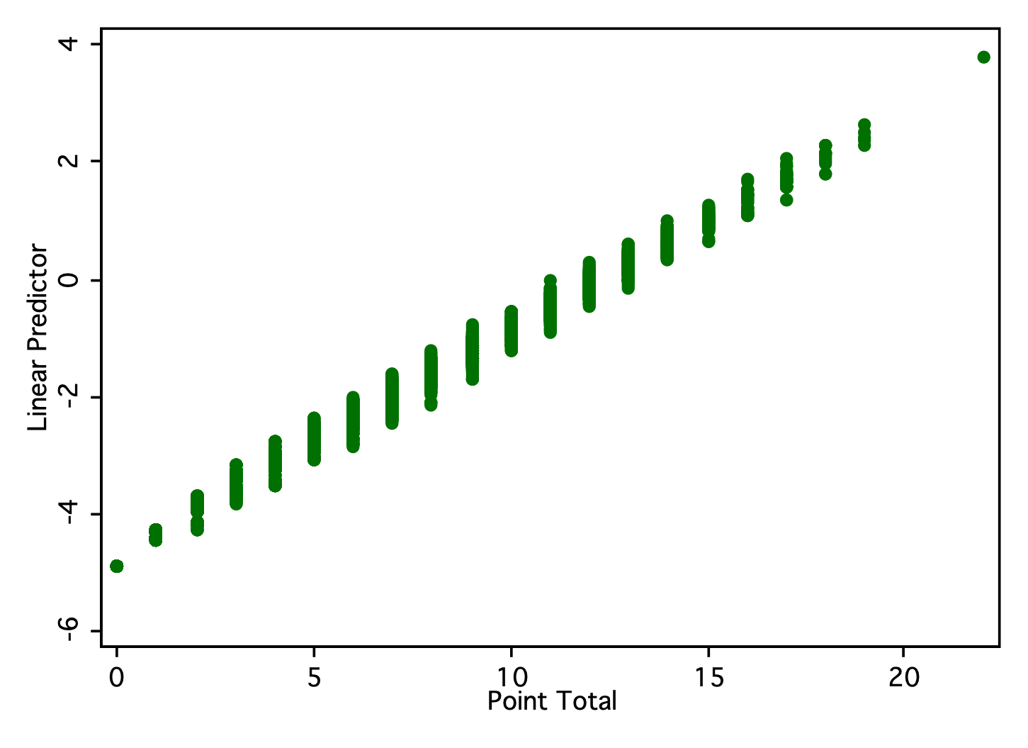
Points v. Linear Predictor

Slide 49
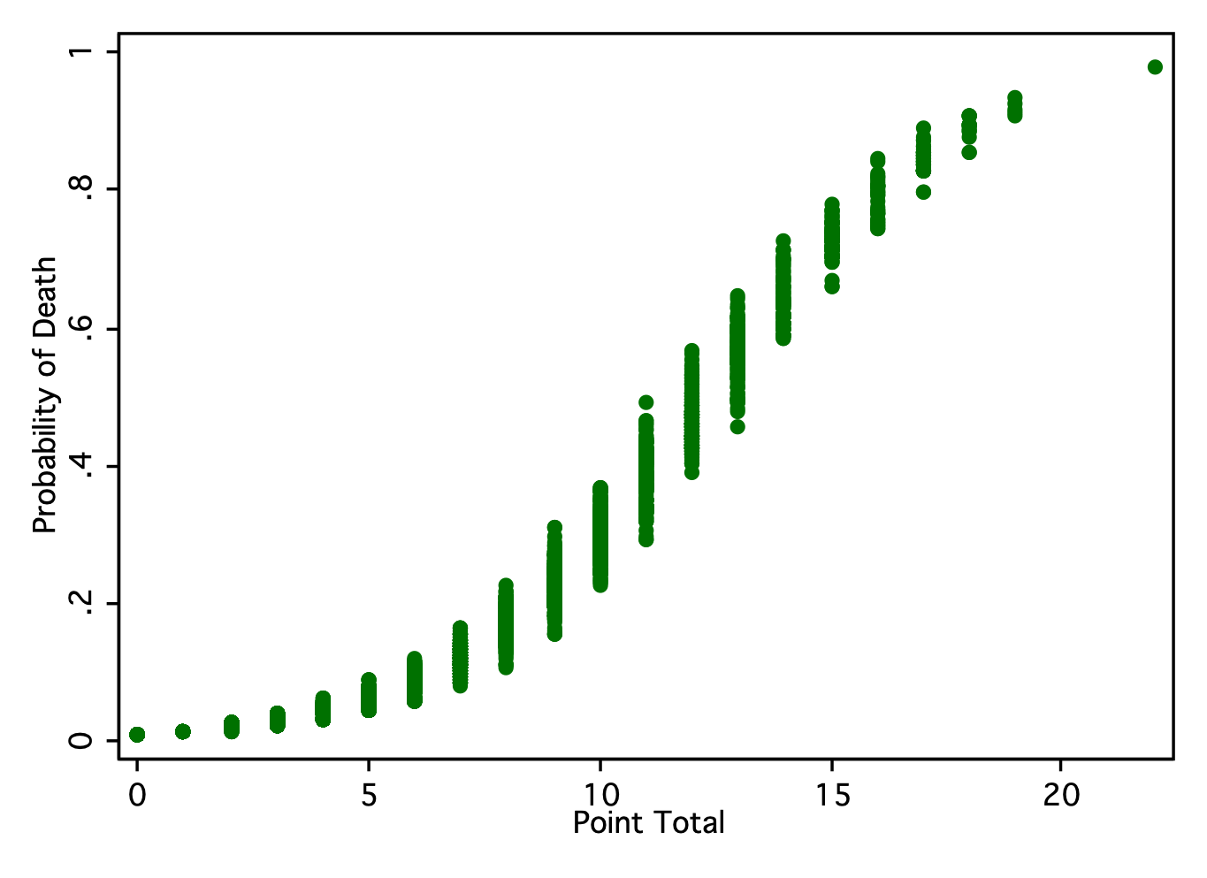
Probability of Death

