Slide 1

Please take an i>clicker

Slide 2
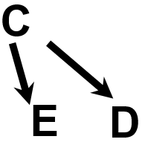



DAGs to Broaden Our Understanding
Any statistical (numerical) association in your data between E and D might be due to:
1. Confounding
2. Selection Bias
3. Measurement Bias
C
E Meas. error
AKA collider-stratification bias
E_{obs}
D_{obs}
E
D
e.g., independent differential misclassification of exposure
E_{true}
D_{true}
4. Reverse Causality
5. Chance
6. True Causation
Notes:
As a review, we have now seen how DAGs can broaden our understanding about the interpretation of data. Just by knowing a few simple rules about how to draw and read DAGs, we can prove to ourselves how any statistical (numerical) association in our data can represent one of 6 different inferences. Any statistical (numerical) association in our data between two variables (say, exposure and outcome) might be due to confounding, conditioning on a collider (i.e., selection bias or collider-stratification bias), measurement bias (differential misclassification or dependent error), reverse causality, chance, or truth (causal effect). Of course, DAGs don’t formally encode chance, they just encode so-called “structural” issues (i.e., bias). Hence, DAGs do not help us with chance. We have, in any case, depicted chance as number 5, by showing no true causal relationship between exposure and outcome (no edge between exposure and outcome and no other connection between E and D).
One nuanced addition to this list is when assessing the direct effect of exposure on disease, failure to fully control for the indirect effects (either through ignorance or measurement problems) can result in a spurious direct causal effect when one truly does not exist. While this is, in part, subsumed under measurement bias (which is meant to include all variables including mediators of indirect path), failure to ignore an indirect effect is a separate problem not captured in the 6 items in this list.

Slide 3
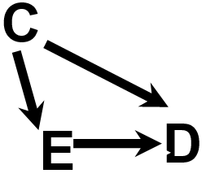
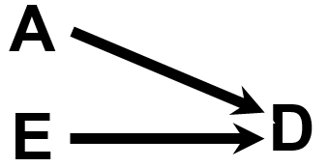
DAGs to Broaden Our Understanding
A lack of statistical (numerical) association in your data between E and D might be due to:
1. Confounding
2. Selection Bias
3. Measurement Bias
C
E Meas. error
E_{obs}
D_{obs}
E
D
E_{true}
D_{true}
4. Effect-measure Modification Bias
5. Chance
6. True Lack of Causation
Notes:
Similarly, any time we fail to show evidence for statistical (numerical) association in our data between two variables (say, exposure and outcome), DAGs help us to remember the possible explanations. A lack of statistical association between exposure and outcome might be due to unmanaged confounding (“negative confounding”), conditioning on a collider (i.e., selection bias), measurement bias (in this example both differential and non-differential misclassification, bias from failure to account for effect-measure modification (qualitative interaction that cancels out in the adjusted estimate; effect-measure modification can entirely obscure a true effect or cause misspecification of an effect), chance (type II error), or true lack of a causal effect. (Note: This list does not include various issues in statistical model building which can also result in obscuring true associations. Such issues are called model misspecification bias.)
Note: DAGs don’t formally encode chance; they just encode so-called “structural” issues (i.e., bias). We have, in any case, depicted chance as number 5, by showing a true causal relationship between exposure and outcome, but one we do not see in our data because of type II error.

Slide 4
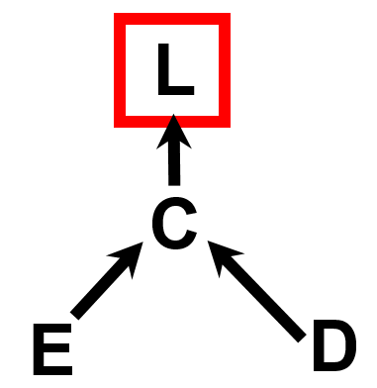
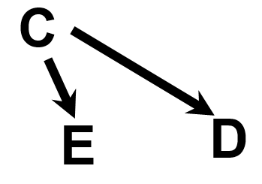
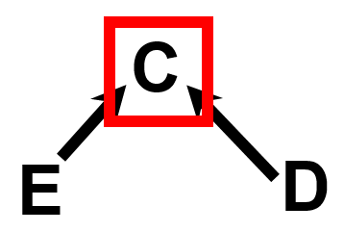
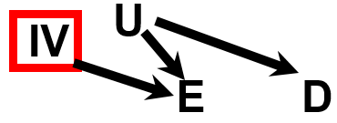
Just a Few Patterns to Recognize: Allows for Compact Notation
Two Basics
Three Nuances
1. Confounding
Conditioning on descendant of a collider
- also results in collider-stratification bias (induces spurious relationship between E & D)
Y
4. Conditioning on descendant of outcome
Selection Bias
aka “collider-stratification” bias
E
D
- alters relationship between E & D
5. Conditioning on instrumental variable
- in the presence of residual confounding by U, results in bias amplification (see Addt’l Slides)
Notes:
Reading and working with DAGs comes down to understanding two basic patterns and three more nuanced patterns. The first basic pattern is confounding. By now, hopefully everyone has this iconic pattern firmly emblazoned in their minds. Confounding occurs when exposure is causally influenced by factor — a common cause — which also causally influences outcome. The graphic itself may not obviously depict confounding to you. It does for some people, who see the influence, C, on both E and D, but it does not for everyone. If the graphic does not obviously depict confounding to you, it likely will soon enough if you begin to use it frequently.
The second basic pattern is selection bias. It is also known as collider-stratification bias because it occurs when we evaluate the relationship between two factors (E and D) at fixed levels of another factor (C), called a common effect, which is caused by both of the factors. Selection bias induces a spurious relationship between E and D. Note: this is not the only way selection bias occurs; it can also occur under the non-null without colliders.
Again, these two efficient and unambiguous compact notation configurations are not necessarily intuitive to the naked eye. I have shown these to laypersons many times only to be met with quizzical looks. In other words, they need some amount of explanation before one understands them. If you use them for a while, however, their appearance will become second nature to you as representing the basic constructs of confounding and selection bias. Once they do become second nature to you, they become a very efficient way to organize your thinking and communication to others.
Slightly less intuitive are these three more nuanced patterns. The first is conditioning upon a descendant (L) of a collider (C). It also results in collider-stratification bias; it induces a spurious relationship between the colliding parents E and D. The second more nuanced pattern (item #4) is also a form of selection bias (collider-stratification bias). It occurs when we condition upon a descendant of an outcome variable under non-null conditions. It will also induce a spurious relationship between E and D and add it to the non-null association. A trick to remember this is that we know that there are other causal influences on D. We know this because every condition, D, is multifactorial. We just do not usually need to show all of the causes of D on a DAG. For example, think of a factor, A, that has an edge coming into D. This means that Y is actually a descendant of a collider (D). When we condition upon Y, we are conditioning upon a descendant of a collider. Descending upon a descendent of a collider, as pattern #3 shows, results in collider-stratification bias.
The third nuanced pattern (item #5) occurs when we condition on an instrumental variable. As a review, an instrumental variable is a cause of exposure but it is related to nothing else on the DAG. When we condition on an instrumental variable in a situation in which there is residual confounding of the exposure-disease relationship, this will result in amplification of the residual confounding. In other words, the association becomes farther away from 1.0. This phenomenon is known as “bias amplification”, and it is explained in more detail in the Additional Material Slides from the last session.
These three nuanced DAG are worth remembering because they are reasons to avoid indiscriminate adjustment out of the spirit of “controlling for everything”.

Slide 5
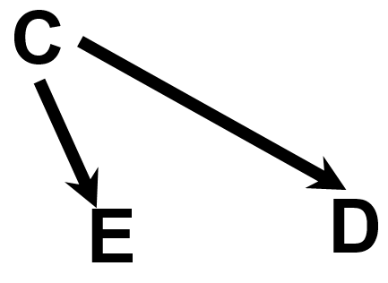
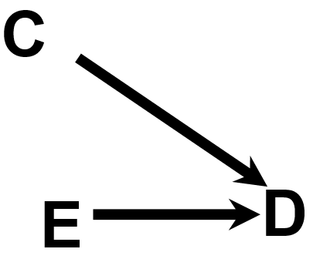
Confounding and Interaction: DAGs
DAGs pristinely demonstrate confounding
DAGs are sensitive at pointing out where interaction is but not specific
– There is interaction between E and C on the occurrence of D on at least one scale (additive, multiplicative), if not both
Notes:
Some course participants were wondering about how confounding and interaction are depicted and differ on DAGs.
DAGs are unequivocal about demonstrating confounding. We have thoroughly discussed the iconic structure of confounding. On the other hand, DAGs are sensitive at pointing out where interaction might occur but not specific. Whenever two factors are causally related to another factor, there will be interaction on at least one scale (additive or multiplicative) if not both. In other words, DAGs never miss pointing out the potential for interaction, but they are not specific about pointing whether additive, multiplicative, or both scales exhibit interaction.
Note: Although the DAG on the right indicates the presence of interaction on at least one scale, we may fail to see statistical significance for interaction on either scale. At least one scale will truly have it in truth, but we may fail to see it in our data because of being underpowered statistically.

Slide 6
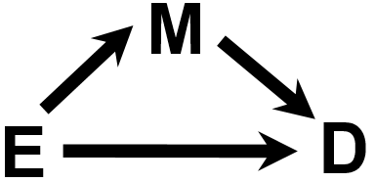
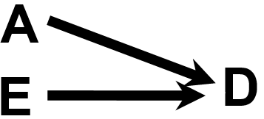
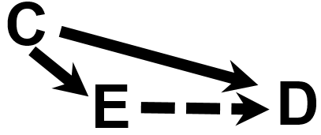
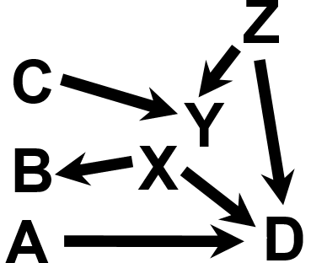
What Kinds of Questions Does Clinical Research/Epidemiology Answer? “Big 6”
Description
  How frequent/common are risk factors/exposures/conditions/diseases?
D
Mediation
  Understanding the mechanisms of causation. How does E cause D?
Causation (“Causal inference”)
  The science of establishing causal relationships among biological, behavioral, environmental (etc.) factors within humans. Does E cause (or prevent) D?
  Will intervening upon E change occurrence of D?
Interaction
  When and for whom does E cause/predict D?
B
Prediction
  Do A, B, and C predict concurrent presence/future occurrence of D?
  e.g., diagnosis or prognosis
Attribution
  What fraction or how many cases of disease D can be eliminated if causal exposure E is eliminated/reduced?
A
D
E
Notes:
Who remembers the Big 6? We have mentioned 5 of them: description, causation, attribution, mediation, and interaction. We also can now draw DAGs that depict each. DAGs are very efficient compact notation that remind us what we need to do to address these different objectives. (Notice how the edge goes away in the DAG to depict attribution).
We have not and will not formally say much about prediction in this course although we talked about sensitivity and specificity (which are important metrics of prediction) as well as measures of association. Measures of association that are not causal do depict prediction. We typically do not use DAGs to describe prediction objectives, but we can use DAGs to show the variety of ways that one variable can predict another, either through a true causal relationship or a variety of non-causal relationship (e.g., via confounding or via collider-stratification).
As review, one way to think about clinical research and epidemiology is to think about the different kinds of questions that clinical researchers and epidemiologists answer. We call these the Big 6. Most of what clinical research and epidemiology answer can be placed into one of these 6 categories or objectives, and each is highly relevant. A big use of this list is for students to be able to encounter any given research question or problem and instantly classify the work into one or more of these categories/objectives. Then, once the category/objective is recognized, this should invoke a mental checklist of what is needed methodologically to fulfill the objective. For example, if description is the objective, is the parameter of interest prevalence, incidence, or something else? If incidence, is the parameter risk or rate and have all of pitfalls with risks and rates been addressed? This type of pattern recognition will instantly help students and experienced researchers alike to focus on key threats to validity in any of type of research.

Slide 7
Confounding and Interaction: Part III
Methods to reduce confounding
  during study design:
    Randomization
    Restriction
    Matching
    Instrumental variables
  during study analysis:
    Stratification
    ------ INTERLUDE ON INTERACTION--------
      Forming “adjusted” summary estimates
      Concept of weighted average
      Woolf’s Method
      Mantel-Haenszel Method
Handling more than one confounder
  Minimal sufficient adjustment set (MSAS)
Managing uncertainty in your DAGs
  Role of an analysis plan
Limitations of stratification to manage confounding
  Motivation for multivariable regression approaches
Limitations of conventional “conditioning” approaches
  Motivation for “non-conditioning” techniques
If time:
  Residual confounding; importance of overlap; quantitative bias analysis (in Additional Material Slides)
Notes:
Let us now move on to new material, and here is our roadmap for today. Two sessions ago, we motivated and defined confounding. Last session, we discussed strategies to reduce confounding in the design phase and analysis phase, and, on our way to discussing management of confounding in the analysis phase via stratification, we came across the concept of statistical interaction. As a reminder, we also refer to statistical interaction as effect-measure modification, and we spent much of last week distinguishing it from confounding. One other reminder is that statistical interaction is just one of the four different concepts of interaction (public health, mechanistic, and biologic being the others).
After this journey/interlude into interaction, we will now return to management of confounding during the analysis phase (by “analysis phase” we mean the analysis of the collected data), and we will spend the majority of today talking about stratification. We will talk about how to form adjusted summary estimates through the process of forming a weighted average. In particular, we will describe two specific methods, Woolf’s Method and the Mantel-Haenszel Method.
We will then talk about strategies of how to handle more than one confounding path. Specifically, we will describe the concept of the minimal sufficient adjustment set, abbreviated as MSAS. As we discuss MSASs, we will confront the inevitable limitation of DAGs, which is that we are sometimes uncertain about whether or not they are correct. This refers to whether or not we have put in all of the relevant relationships (edges) and whether the relationships we have listed are correct. This will get us into the topic of an analysis plan and why having one is important.
As we end the topic of confounding, we will discuss the limitations of stratification and how this is a motivation for other techniques one can use in the analysis phase, such as multivariable mathematical regression. Lastly, we will discuss how all of the conventional conditioning approaches, including both stratification and regression, have limitations, which have motivated the development of newer non-conditioning techniques, which are sometimes called “causal” approaches. They are called “causal” approaches because it is their goal to derive causal estimates, but, of course, seeking to derive casual estimates is nothing new. One suspects in time that these techniques which we call “causal” today will be replaced by even newer techniques which themselves will be called “causal” thus supplanting the old causal techniques as being cutting edge. In other words, there are a variety of techniques that can produce estimates of causal relationships, not just the newest techniques.
If we have time, we will discuss three important topics: residual confounding, the importance of overlap in the distributions of confounders in exposed and unexposed, and quantitative bias analysis. If we do not have time, then we will ask you to read about these on your own in the Additional Material Slides.

Slide 8
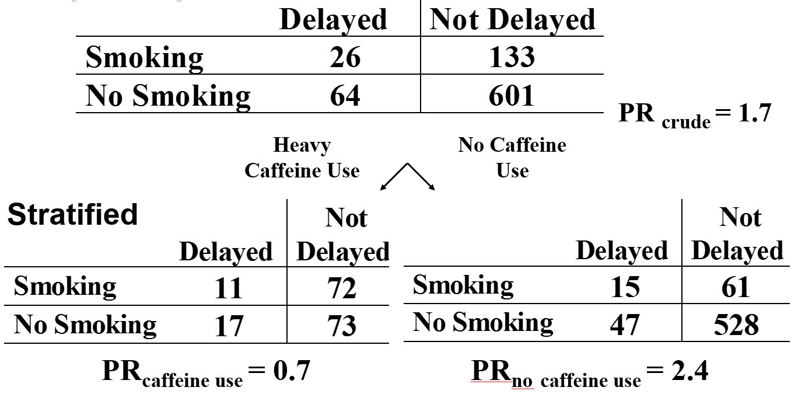
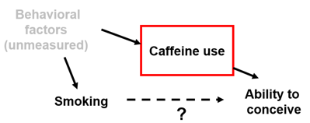
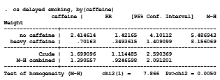
Effect-Measure Modification
Crude
Report or ignore interaction?
Report interaction. Managing confounding by summarizing the 2 stratum-specific estimates into 1 number is not appropriate/hides an important inference.
Instead, show stratum-specific estimates.
Remember: reporting two stratum-specific estimates IS managing confounding by caffeine
Notes:
Remember this example from our last session of a study of the effects of smoking and caffeine use on the occurrence of delayed pregnancies among women hoping to conceive. The principal exposure of interest is smoking. We needed to get rid of a confounding pathway which is mediated by caffeine use.
We therefore stratified by caffeine use, and, remember, that we saw qualitative statistical interaction, which is, by definition, both on the multiplicative (i.e., the prevalence ratio) and additive (i.e., the prevalence difference) scales. Qualitative statistical interaction on one scale always implies qualitative interaction on the other scale. When we performed a test of homogeneity in Stata for the multiplicative scale, we saw the following. The test statistic is 7.8 and it follows a chi square distribution with 1 degree of freedom. This corresponds to a p value of 0.005. The null hypothesis is that the two stratum-specific estimates are the same. The interpretation of the p value is that finding this test statistic or larger would occur 5 times out of 1000 by chance alone if there was indeed no true difference between stratum. Here, we reject the null in favor of the alternative hypothesis. On the additive scale, the p value for the test of interaction was 0.018.
We decided that this is too rich of a story to sweep under the carpet, and hence it would not be appropriate to try to summarize these two effects, 2.4 and 0.7, into one overall number. It would be wrong to lump this story together into one number. Instead, we should report the two stratum-specific estimates separately. In the presence of effect-measure modification of this magnitude and this level of statistical significance, effect-measure modification trumps any further consideration of summarizing the stratum-specific estimates into one number. Stop here. End of story; do not try to form one single summary adjusted measure of association. Note, however, any confounding that might be present has been managed if we decide to report two stratum-specific estimates in that the two stratum-specific estimates are unconfounded with respect to caffeine use. The point is that with interaction present, one should not go on to summarize stratum-specific estimates into one number.

Slide 9
Presenting Interaction
 | No Smoking |  | Smoking
 | Probability of delayed conception | Prevalence ratio (95% CI) | Probability of delayed conception | Prevalence ratio (95% CI) | Prevalence ratio (95% CI) comparing smoking to non-smoking within strata of caffeine use
No caffeine use | 0.082 | 1.0 (reference) | 0.20 | 2.4 (1.4 to 4.1) p = 0.001 | 2.4 (1.4 to 4.1) p = 0.001
Heavy caffeine use | 0.19 | 2.3 (1.4 to 3.8) p = 0.001 | 0.13 | 1.6 (0.88 to 3.0) p = 0.13 | 0.70 (0.35 to 1.4) p = 0.31
Measure of effect modification on additive scale = -0.17; p = 0.018
Measure of effect modification on multiplicative scale = 0.29; p = 0.005
Notes:
This table is an example of how we should display the final findings when we desire to report interaction of dichotomous exposures. Remember the goal is to present enough information such that readers can evaluate both scales (additive and multiplicative) even if you, as author, are interested in just one of the two. The p values for tests of interaction on both the additive and multiplicative scale are shown in the footnotes.

Slide 10
Report vs. Ignore Effect-Measure Modification? Some Guidelines
Is an art form: requires consideration of substantive, statistical and practical considerations
P value threshold for reporting might be higher than other contexts, but p value interpretation is no different
Notes:
Here are the rough guidelines that we presented at the end of our last lecture when we concluded that whether to report or ignore interaction requires substantive, statistical, and practical considerations. There are no absolute rules to use for all analyses, although as we will see later, it is important to set forth your criteria for reporting in your analysis plan.
Let us say we are looking at the association between a given exposure and a given disease, and we are contending with a third variable that has two levels: present and absent. We are evaluating the effect of this third variable because we depicted it as a cause of the outcome in our DAG or something that is related to a cause of the outcome. In these two columns you see the stratum-specific measures of association; in this example, we are using risk ratios, such that we are concerned about statistical interaction on the multiplicative scale. In the 3rd column from the left is the p value for the test of homogeneity (or heterogeneity), and in the rightward column is our suggestion or recommendation in terms of whether to report or ignore interaction.
If the two strata give results of 2.3 and 2.6 and a p-value for the test of heterogeneity of 0.45, what should we do with it? We should ignore this difference and not report the presence of interaction. What if the p value is 0.001? This is an example of where we should still ignore it because this difference really is small from a substantive perspective — not substantively meaningful. What if we got 2.0 in one stratum and 20 in another and a p value of 0.001. This is worth reporting. However, if we saw a difference of 2 and 20 and a p value of 0.1, we still might want to report or show this interaction rather than ignoring it. As the p value gets higher, we would be less and less interested in reporting and more and more interested in just lumping the stratum together. How about a difference between 3 and 4.5? This is not that big a difference in clinical or biological terms. Hence, we would probably ignore it if the p value was 0.3 and be on the fence about it even if the p value was very small. Finally, how about in the presence of what appears to be qualitative interaction. We would have a lower threshold to report it, perhaps even up to a p value of 0.15. Again, the p value interpretation does not have any different meaning here than in other contexts, and we are not saying that a p of 0.15 is “statistically significant”. We are just stating that it is reasonable to report stratum-specific differences of large magnitude, even if the p value is up to 0.10 or 0.15. Such a report still requires dedicated confirmation in other future studies, hopefully with adequate statistical power.

Slide 11
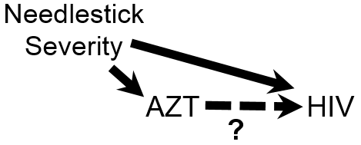
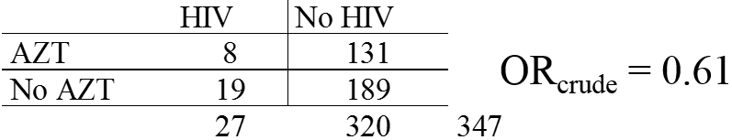
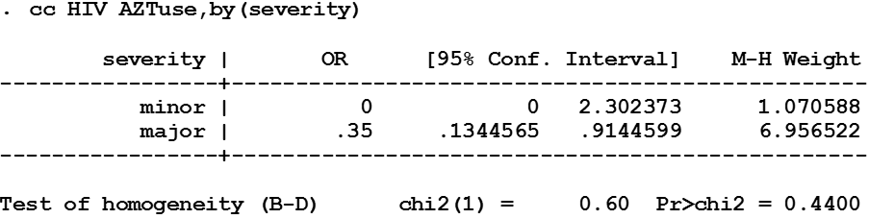
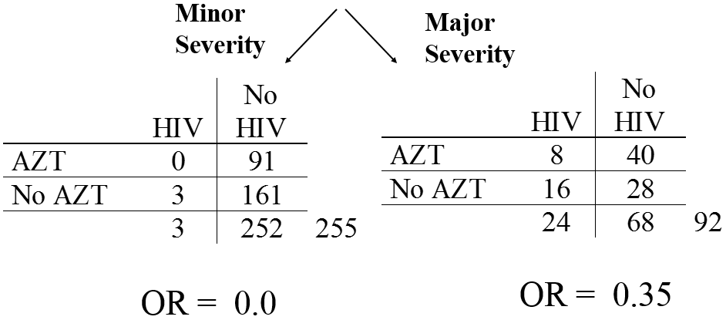
Does AZT use after needlesticks prevent HIV?
Crude
Stratified
Report or ignore interaction?
Report Interaction - A
Need more information - C
Ignore Interaction - B
Notes:
Let us recall another example from two sessions ago. This was a case-control study among health care workers looking at the effectiveness of AZT in preventing HIV acquisition after a needlestick from an HIV-infected patient. The context is that needlesticks among health care workers from patients with HIV disease are unfortunately all too common. The question is whether taking the drug called AZT immediately after a needlestick can prevent the healthcare worker from becoming infected with HIV. Attempts to address this question with a randomized experiment did not work because few doctors or nurses wanted to be randomized to the placebo group. Therefore, this had to be sorted out observationally, and luckily there were at least some doctors and nurses who did not elect to use AZT such that we have some variability in exposure to work with.
Thus, the exposure in question is the use of AZT and the outcome is the acquisition of HIV infection. Cases were health care workers who had acquired HIV after a needlestick and controls were health care workers who did not acquire HIV after a needlestick. In the crude analysis, the OR was 0.61, which, by the way, was not statistically significant, i.e., no strong evidence of a benefit from AZT. However, remember that the authors were aware of confounding by severity of exposure and hence they measured and stratified by the severity of the needlestick. When they did this, the stratum-specific estimates are now much greater in magnitude (farther away from 1). Not only are they much farther away from 1.0, but the stratum-specific estimates look different from each other. Hence, the first thing to decide is whether to report of ignore interaction.

Slide 12
Does AZT use after needlesticks prevent HIV?
Crude
Stratified
Report or ignore interaction?
Need more information - C
Report Interaction - A
Ignore Interaction - B
Notes:
There is a big substantive difference in magnitude between the two strata (0 and 0.35), but note how few cases there are in the minor needlestick severity group. Accordingly, when we look at a statistical test of heterogeneity, we see a p value of 0.44 showing that chance could have easily caused this difference or greater between strata even when there is truly no interaction. So, the authors did not decide to declare that there was any important interaction. We agree with this decision not to report interaction. Also, remember, although it is more interesting, it is also a bit more complicated to report interaction. Hence, you would not want to report if it is unwarranted.

Slide 13
If No Interaction, What Next?
Crude
Stratified
How would you summarize these two strata estimates into one number?
Notes:
Back to our example, we have decided not to report interaction by showing two estimates. This means that we are assuming that the two strata are both estimating the same thing. How do we estimate the quantity that both strata are estimating? In other words, how do we now complete the analysis and get a single unconfounded estimate of the effect of AZT on HIV acquisition?

Slide 14
Assuming Interaction is Not Present, Form a Summary of the Unconfounded Stratum-Specific Estimates
Construct a weighted average of the strata
  Assign weights to the individual strata
  Summary Adjusted Estimate = Weighted average of the stratum-specific estimates
  a simple mean is a weighted average where the weights are equal to 1
  which weights to use depends on type of effect estimate desired (OR, RR, RD, etc.), characteristics of the data, and goal of research
  examples of weighted average methods
    Woolf’s method
    Mantel-Haenszel method (most common)
Notes:
Assuming interaction is not present, the process of forming a summary adjusted estimate is based on the concept of forming a weighted average.
To do this, we will form a weighted average of the individual stratum-specific estimates. In other words, we will assign weights to the various strata and then take an average of the strata using these weights. Mathematically, it looks like this (see formula). We take the measure of association in each stratum and multiply by the weight and then add all of this up. Then, we divide by the total sum of the weights. A simple mean is an example of a weighted average where all the weights are 1. For example, the average of 2, 4, 6, and 8 equals 1(2) + 1(4) + 1(6) + 1(8) divided by (4*1) which equals 5. This concept of a “weighted average” is used in a variety of contexts and likely familiar to most readers.
Which weighting scheme we should use in our goal of forming a single summary adjusted measure of association depends upon a lot of factors, like the measure of association you are calculating, the nature of the data, and the purpose of the analysis. These weighting methods have been developed by statisticians in the past 70 years. Two methods that we will discuss today are called Woolf’s method and the method of Mantel and Haenszel. The method of Mantel and Haenszel has over the years become the method of choice in most stratification contexts.

Slide 15
Forming a Summary Adjusted Estimate for Stratified Data
Crude
Stratified
How would you weight these strata? (the w_{i})
By degree of balance among cases/ controls - C
By inverse of the stratum-specific variance - E
By stratum sample size - A
By number of cases - B
Evenly (weight of 1) - D
Notes:
Back to our example, we know that the weighted average is going to be somewhere between 0.0 and 0.35, but where exactly is it going to be? In other words, how are we going to weight these two strata? How do we get the w_{i}’s? Would you weight them by sample size of each stratum, number of cases in each stratum, degree of balance among cases and controls (remember when we talked about matching how we focused on the degree of balance between cases and controls)? Or, would you just weight them evenly, meaning they all get a weight of 1, or perhaps by the inverse of their variance?

Slide 16
Forming a Summary Adjusted Estimate for Stratified Data
Crude
Stratified
How would you weight these strata? (the w_{i})
By degree of balance among cases/ controls - C
By inverse of the stratum-specific variance - E
By stratum sample size - A
By number of cases - B
Evenly (weight of 1) - D
Notes:
It is interesting to see everyone’s initial intuition on this. Indeed, an argument could be made for either total sample size or inverse of variance. Total sample size has appeal but do you really want to give this much weight to a stratum with just 3 cases? Probably not. Instead, we will focus on what has gained the most theoretical support by weighting according to the precision of the estimate, i.e., how confident we are in our estimate from the perspective of sampling error. This makes sense. After all, we decided to ignore interaction on the basis of the precision of the stratum-specific estimates. To do this, we will use the so-called variance or precision estimators, which weight by the inverse of the stratum-specific variance.
Note: In this course, we will not derive the proof for the superiority of this weighting technique, but it involves consideration of both bias and precision.

Slide 17
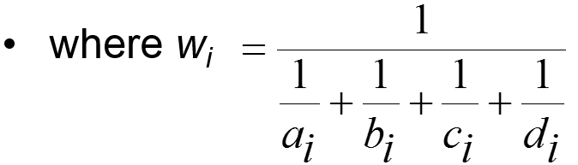

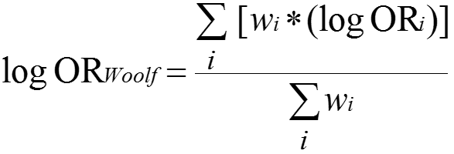

Summary Estimators: Woolf’s Method
One of the first summary adjusted estimators
AKA “Directly pooled” or “precision” estimator
Woolf’s estimate for adjusted odds ratio (OR_{Woolf})
Each of i number of strata has this form
  w_{i} is the inverse of the variance of the stratum-specific log(odds ratio)
  Makes sense: smaller variance gets greater weight
Notes:
For an intuitive understanding for the reason for choosing inverse of the variance, remember that in all of our studies we are just taking a sample of the population, and we know there is always the threat of sampling error. The potential for sampling error is best depicted in the variance of the measure of association for each stratum. Hence, one intuitive approach is to weight each stratum according to its sampling error — give the most weight to those strata that have the smallest variance. In fact, this is the basis of the one of the first techniques developed called Woolf’s method. We will show Woolf’s method for a summary adjusted estimator for the odds ratio. In this method, when we estimate an adjusted odds ratio, we initially work with log of the odds ratio, and the formula follows the general formula we showed before for a weighted average. The weighted average of the different strata is the weighted average of the log odds ratios from each of the strata. In other words, this is the sum of the products of each stratum-specific log odds ratio times its weight, all divided by the sum of the weights. After you have taken the weighted average on the log scale, at the end you exponentiate this to get back to the native scale.
The weight is not the variance of the log odds ratio, but it is the inverse of the variance. Thus, what you see in the denominator of the weight is the variance of the log odds ratios. This makes sense because the bigger the variance, the inverse of the variance is smaller and thus a smaller weight. The smaller the variance, i.e., the more confident that you have nailed down the estimate, the inverse is larger — i.e., more weight.
Original reference: Woolf B. On estimating the relation between blood group disease. Annals of Human Genetics 19: 251–253, 1955. The summary adjusted measure of association described in this paper is believed to be the first described for an odds ratio. In this paper, Woolf also pointed the fallacy of comparing exposure proportion between cases and controls in that the comparison of proportions will be very dependent upon the overall prevalence of the exposure, as best seen in the controls. In other words, for two scenarios in which the odds ratio is the same but prevalence of exposure in controls is different, the comparison of exposure proportions will be different.

Slide 18
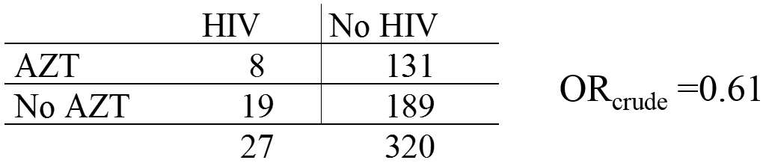
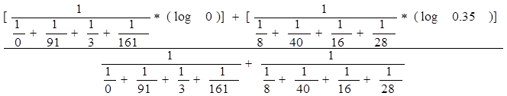
Calculating a Summary Effect Using the Woolf Estimator
e.g., AZT use, severity of needlestick, and HIV
Crude
Stratified
OR_{crude} =0.61
Problems: cannot take log of 0; cannot divide by zero
Notes:
When we work through the calculations, assign each stratum a weight based on the inverse of its variance and take a weighted average, we uncover a problem with Woolf’s method. It cannot handle cells that have zeros in them because a) you cannot take a log of zero; and b) you cannot divide by zero.

Slide 19
Summary Adjusted Estimator:
Woolf’s Method
Conceptually straightforward
Best when:
  number of strata is small
Cannot be calculated when any cell in any stratum is zero because log(0) is undefined
  “1/2” cell corrections have been suggested but are slightly biased
Formulae for Woolf’s summary estimates for other measures (e.g., risk ratio, RD) available in texts and software documentation
Rarely used in practice today but most clearly illustrates most intuitive weighting scheme
Notes:
The main advantage of Woolf’s method is that it is conceptually very straightforward. It is best used when the number of strata are small and the sample size within each stratum is large, but it formally does not work when there are zeros in cells. You can substitute 0.5 in these cells to get answers as a work-around, but this is an imperfect solution.
You can also find formulae for the Woolf’s approach for other measures of association, like a risk ratio, risk difference in various textbooks and software documentation, but we will not use these in our course. In practice, Woolf’s method is rarely implemented these days, but we describe it first because it most clearly illustrates variance weighting.

Slide 20
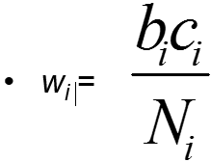
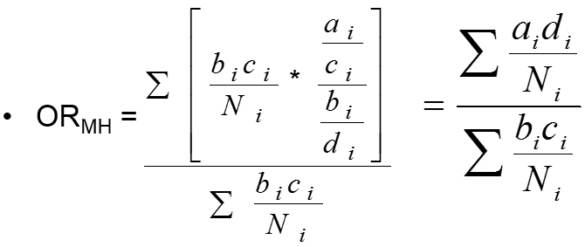
Summary Adjusted Estimators:
Mantel-Haenszel
To avoid the “0” problem . . .
Mantel-Haenszel estimate for odds ratio
  w_{i} is inverse of the variance of the stratum-specific odds ratio under the null hypothesis (OR_{i} = 1)
Notes:
Given this problem with cells of zero, a second method, the Mantel-Haenszel method, is more widely used. Its formula is shown here for an odds ratio. Here, we are not working on the log odds scale; instead, we are working with the native odds scale. The weight for each stratum is bc/N which happens to be the inverse of the variance of each stratum under the conditions when the OR=1. This is one of those things you are going to have to accept without proof in this course because we do not have time to derive the proof. In other words, the weight is again related to the variance, but a special form of the variance, that is, when there is no association. Now, you might wonder why we are using a variance associated with an odds ratio of no effect if indeed there is an effect in the stratum. It turns out that despite this apparent illogic, this weight works quite well compared to what is considered the gold standard approach of using a technique called maximum likelihood estimation to find the adjusted measure. Maximum likelihood estimation (MLE) is used in some of the techniques in multivariable regression you will learn about in the Winter and Spring Biostatistics courses, but MLE does require a computer to calculate and is not entirely transparent to the observer. Because Mantel-Haenszel estimation works about as well as maximum likelihood estimation in many situations, it has become a stalwart technique for stratification. Recall that we introduced MLE in the Grosso et al. article about self-controlled case series.
Note: another intuitive approach to understanding the MH formula is to note that ad/n is a pretty good approximation of the numerator ad in an odds ratio and bc/N is a pretty good approximation of the denominator of the odds ratio.
Original reference: Mantel N and Haenszel W. Statistical aspects of the analysis of data from retrospective studies of disease. Journal of the National Cancer Institute 22: 719–748, 1959.

Slide 21
Summary Adjusted Estimator:
Mantel-Haenszel
Advantages:
More resistant to the effects of large numbers of strata with few observations
Resistant to cells with a value of “0”
Computationally easy
Bottomline:
  The “workhorse” estimator for stratification
  Most commonly available technique in commercial software (typically the default)
Notes:
The Mantel-Haenszel technique, although not quite as straightforward conceptually as the Woolf technique, which directly uses the actual stratum-specific variances, has many advantages. It is more resistant to large numbers of strata and can handle cells with zeros. It also is computationally very easy, although this is not an issue in these days of computers. For all these reasons, it is the most common approach to forming adjusted summary estimates in the context of stratification. It is the workhorse. It is the technique most commonly available in commercial software, and it is typically the default estimator in various stratification commands (such as in Stata).
Note: need to point out that the M-H technique is only relatively resistant to strata with few observations. If you start to get a lot of strata with just 1 observation (or just exposed persons and no unexposed), it can be seen how this will waste that observation because there will be nothing to which compare this observation.

Slide 22
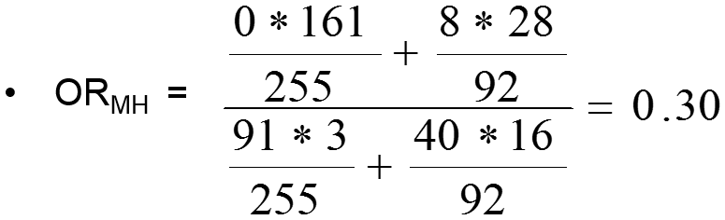
Calculating a Summary Adjusted Effect:
Mantel-Haenszel Estimator
Crude
OR_{crude} = 0.61
Stratified
Notes:
Let us work through our AZT and healthcare worker example and obtain an adjusted summary estimate for the association between AZT use and HIV acquisition, using the Mantel-Haenszel technique, after adjusting for severity of needlestick.
What do we end up with? The summary adjusted estimate is 0.3. Note that it is much closer to the point estimate in the major severity stratum than to the other stratum. This is despite the minor severity stratum having a larger sample size. The answer is unconfounded but whether or not this particular weighted average is desirable for all research purposes is an advanced topic and has to do with the limitations of the interpretation of conditional measures of association.
Recall that this is an example of negative confounding. The crude estimate was 0.6 and not statistically significant. After adjustment for severity of needlestick, the OR is now an impressive small 0.3. There is a 70% reduction in odds of HIV seroconversion associated with using AZT. Without this adjustment, the interpretation of the crude estimate would have been that there is no strong evidence to use AZT after a needlestick. This would have been very unfortunate for many health care workers. Proper management for confounding shed light on a useful intervention.

Slide 23
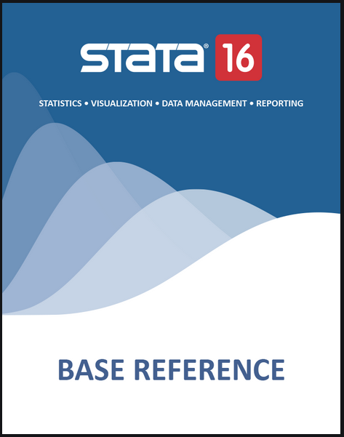
Calculating a Summary Effect in Stata
To stratify by a third variable:
  cs var_{case} var_{exposed}, by(var_{third variable})
  cc var_{case} var_{exposed}, by(var_{third variable})
Default summary estimator is Mantel-Haenszel
  “ , pool” will also produce Woolf’s method
To stratify by several variables:
  mhodds var_{case} var_{exposed} vars_{adjust}, by(var_list_{stratify})
  Problem Set this week
epitab command
- Tables for epidemiologists
A good place to learn epidemiology
Notes:
How do we do this in Stata? You know the commands already. It is found in the ‘epitab’ command, which is short hand for “Tables for Epidemiologists”, which also happens to be a very cogent text to learn about epidemiologic methods. Remember, for a cross-sectional or cohort study, to get the crude measure of association, the command is “cs” followed by the outcome variable, followed by the exposure variable. For a case-control study, it is “cc” followed by outcome variable followed by exposure variable.
To stratify by a third variable, you add a comma and a “by(name of third variable)” option. The default summary estimator is Mantel-Haenszel, but if you add a “, pool” you will also get the summary estimate using the Woolf method.
If you want to stratify by more than one variable, then use the mhodds command. You will get a chance to do this in the Problem Set this week. The mhodds variable also allows you to evaluate stratum-specific measures of association across one variable while after adjusting for another (i.e., Stata will go ahead and form the adjusted estimate for one list of variables but then stratify and show you the stratum-specific estimates for another variable).

Slide 24
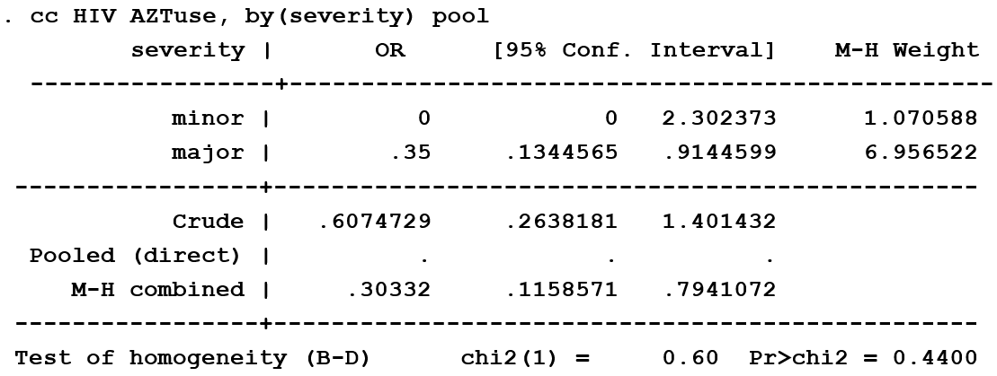
Calculating a Summary Effect
Using the Mantel-Haenszel Estimator
e.g., AZT use, severity of needlestick, and HIV
Crude
Stratified
OR_{crude} = 0.61
Notes:
Let us see what Stata does with our problem of AZT use, severity of needlestick, and HIV acquisition.
On the bottom is the Stata command, “cc outcome predictor, by(third variable)” , for which we added the “pool” option.
Its shows the crude estimate of 0.6.
Here are the stratum-specific estimates: 0 and 0.35.
Here are the Mantel-Haenszel weights.
Here is the Woolf estimate, that Stata calls Pooled or Direct: Note it is undefined (Stata just puts a dot for undefined) because Stata had the same problem we had when dividing by zero. Stata cannot produce a Woolf’s method estimate.
Finally, here is the Mantel-Haenszel adjusted measure: 0.30 just like we got by hand on the prior slide.

Slide 25
After the Point Estimate: What is Left to Do?
Confidence Interval Estimation and Hypothesis
Testing for the Mantel-Haenszel Estimator
e.g., AZT use, severity of needlestick, and HIV
. cc HIV AZTuse,by(severity) pool
severity | OR [95% Conf. Interval] M-H Weight
-----------------+-------------------------------------------------
minor | 0 0 2.302373 1.070588
major | .35 .1344565 .9144599 6.956522
-----------------+-------------------------------------------------
Crude | .6074729 .2638181 1.401432
Pooled (direct) | . . .
M-H combined | .30332 .1158571 .7941072
-----------------+-------------------------------------------------
Test of homogeneity (B-D) chi2(1) = 0.60 Pr>chi2 = 0.4400
Test that combined OR = 1:
Mantel-Haenszel chi2(1) = 6.06
Pr>chi2 = 0.0138
?
Notes:
Now that we have derived the Mantel-Haenszel summary estimate (i.e., the adjusted point estimate), what is left to do? Now we know that the adjusted summary estimate is our best single answer (the “point estimate”) but what about the precision of this estimate? In addition to calculating the M-H summary point estimate (shown here), Stata also calculates the 95% confidence interval (shown here in red). The MH-adjusted odds ratio confidence interval is 0.12 to 0.79; it does not cross 1. There is also a null hypothesis being tested in addition to the display of the MH-adjusted OR and its 95% confidence interval. The null hypothesis is that the adjusted OR is equal to 1. This is what Stata means by “Test that combined OR = 1”. This follows a chi-square distribution of 1, regardless of the number of strata. This is known as the Mantel-Haenszel chi square statistic, and here it is 6.06 with the corresponding p value of 0.0138

Slide 26
After Confounding is Managed: Confidence Interval Estimation and Hypothesis Testing for the Mantel-Haenszel Estimator
. cc HIV AZTuse,by(severity) pool
severity | OR [95% Conf. Interval] M-H Weight
-----------------+-------------------------------------------------
minor | 0 0 2.302373 1.070588
major | .35 .1344565 .9144599 6.956522
-----------------+-------------------------------------------------
Crude | .6074729 .2638181 1.401432
M-H combined | .30332 .1158571 .7941072
-----------------+-------------------------------------------------
Test of homogeneity (B-D) chi2(1) = 0.60 Pr>chi2 = 0.4400
Test that combined OR = 1:
Mantel-Haenszel chi2(1) = 6.06
Pr>chi2 = 0.0138
What does the p value = 0.0138 mean?
If there truly is no association between AZT and HIV acquisition after adjustment for severity of exposure, there is a 1.38% probability of obtaining an OR of 0.30 or more extreme by chance alone. - C
1.38% probability that the difference between crude and adjusted OR is due to chance - B
1.38% probability that the adjusted OR = 0.30 is due to chance - A
Some better answer - D
Notes:
What does the p value mean? Is it A, B, C or D?

Slide 27
After Confounding is Managed: Confidence Interval Estimation and Hypothesis Testing for the Mantel-Haenszel Estimator
. cc HIV AZTuse,by(severity) pool
severity | OR [95% Conf. Interval] M-H Weight
-----------------+-------------------------------------------------
minor | 0 0 2.302373 1.070588
major | .35 .1344565 .9144599 6.956522
-----------------+-------------------------------------------------
Crude | .6074729 .2638181 1.401432
M-H combined | .30332 .1158571 .7941072
-----------------+-------------------------------------------------
Test of homogeneity (B-D) chi2(1) = 0.60 Pr>chi2 = 0.4400
Test that combined OR = 1:
Mantel-Haenszel chi2(1) = 6.06
Pr>chi2 = 0.0138
What does the p value = 0.0138 mean?
If there truly is no association between AZT and HIV acquisition after adjustment for severity of exposure, there is a 1.38% probability of obtaining an OR of 0.30 or more extreme by chance alone. - C
1.38% probability that the difference between crude and adjusted OR is due to chance - B
1.38% probability that the adjusted OR = 0.30 is due to chance - A
Some better answer - D
Pause for Reflection
Notes:
The answer is C. Like all other contexts, the p value is a conditional probability. Here it is conditioned upon the null hypothesis, which is that after adjustment for severity of exposure, there is no association between AZT use and HIV acquisition. Remember, also, that the probability referred to is of observing the effect seen in the study or a larger effect.
It is worth pausing here to note how far we have come in the course, from study design, measurement, measure of disease occurrence, and, now, measure of disease association with attention to statistical interaction, and, finally to adjustment for confounding (and also attention to selection bias and measurement bias). We have now discussed each of these topics. This covers the one of the most fundamental aspects of clinical research, figuring out how we relate one construct (e.g., an exposure) to another (e.g., a disease state) for the purpose of causal inference. Although things can and do get more complex when we have to contend with multiple “covariates”, what we have just discussed nonetheless represents the foundation for much of human subjects research-related design and analysis.
As we address in the next slide, although we undertook this analysis for the purpose of causal inference, the answer, which is conditional measure of association, does not have a pristine causal interpretation.

Slide 28
“Conditional” vs “Marginal” Measures of Association
Analyses which use conditioning techniques (e.g., stratification, conventional mathematical regression) to adjust for confounding natively produce:
  “conditional” measures of association
  e.g., OR_{Woolf} & RR_{MH}
  Not strictly interpretable at the group level
    i.e., not necessarily = average effect of study population when exposed as compared to when unexposed
    Hence, do not strictly have a “causal interpretation” although often close
    Unless strictly no statistical interaction and collapsible measure of association
Analyses which use techniques other than conditioning (e.g., randomization or inverse probability weighting) to manage confounding natively produce:
  “marginal” measures of association
  Are interpreted at level of the entire study/target population
    Average effect of study population when exposed as compared to when unexposed (a “causal interpretation”)
Conditional approaches, however, can be mathematically manipulated to produce marginal measures of association
Distinguishing between “conditional” and “marginal” is growing in the literature
More in EPI II & BIOSTAT 215 courses
Notes:
Now that we have taken these adjusted measures of association to their completion, we should spend a moment discussing a bit more on what to call them and what they mean.
Analyses which use the conditioning techniques we have been discussing to adjust for confounding (e.g., stratification) as well as techniques we will not discuss in the course (e.g., conventional mathematical regression, such as logistic regression) natively produce what are known as “conditional” measures of association. The terminology is fortunate (conditioning – conditional). The adjusted measures of association by the method of Woolf or Mantel-Haenszel that we just discussed are examples of conditional measures of association. The approach to get these measures can be used to estimate “subject-specific” risk associated with having exposure versus not having exposure. By subject-specific, we mean the risk associated with having exposure for a given person with some specific values of all of the other measured causes of the outcome under study. Because of interaction, we typically know that there will not be just one measure of association that applies to everyone. The measure of association will differ according to values of the effect modifiers. This is especially the case for additive measures of association for which interaction is more common than for multiplicative scale measures of association. It is these conditional measures of association which allow us to identify groups of persons with the most favorable numbers needed to treat, for example.
These conditional measures of association, however, are typically not technically interpretable at the group or population level. That is, they typically do not represent the average effect of the exposure when applied to the study population compared to when the study population is unexposed. This average effect is called the “marginal” effect in epidemiologic and statistical jargon. The only way that a conditional measure of association could be equal to the marginal measure of association is if a) there was strictly no interaction in one’s data and b) the measure of association was collapsible (which means using a risk ratio or risk difference, or a prevalence ratio or difference). We say “strictly no interaction” to mean that all of the stratum-specific estimates must be identical. This is because if various stratum-specific estimates are not identical but no show no evidence of substantive or statistical interaction, they will need to be averaged using some weighted average scheme. The schemes used in the Mantel-Haenszel approach and most regression models are not weighting to sample size but instead use another approach. Thus, the weighted average in those approached do not yield a true group-level average. Regarding collapsibility, recall from earlier in the course how the odds ratio (and rate ratio) are non-collapsible. Thus, even without interaction, non-collapsible measures of association in different strata, when collapsed (which in the face of no interaction will simply be the value of each identical measure of association) will produce measures of association that can be very different than marginal measures of association. Non-collapsibility is only manifest when at least one stratum has a high frequency of outcome; if outcome is uncommon in all strata, then it will be negligible. Because these conditional measures of association do not represent the average effect of the exposure when applied to the population as compared to when the population is unexposed, they are said not to have a “causal interpretation”.
In contrast, analyses which use techniques other than conditioning to manage confounding natively produce what are called “marginal” measures of association. Randomization is the prototype for this. Remember, with randomization the groups being compared (exposed and unexposed) are balanced from the beginning in terms of confounding. They depict the difference between having everyone in the entire study population exposed to everyone in the entire population unexposed. “Everyone” is another term for the “margins” in a 2 x 2 table (recall how we defined the margins of all exposed persons and all unexposed persons?). This is one way to remember what a “marginal” measure of association means because the term “marginal” is not exactly intuitive. As such, because we are comparing everyone in the exposed group to everyone in the unexposed group, and they exposed are technically exchangeable with the unexposed (at least we are hoping they are), these measures of association CAN be interpreted as the group or population level. Specifically, they can be interpreted as the average effect of the exposure when it is applied to the study population as compared to when it is not. They are said to have a “causal interpretation”.
There are other approaches to manage confounding which yield what are known as “marginal” measures of association. These approaches include the so-called marginal structural models (MSM), most prominently inverse probability weighting, which is among the most popular techniques and “potential outcomes estimation”. We will not be discussing these in our course. These measures of association can also be interpreted at the group level as the average effect of the exposure when applied to the group as compared to when the exposure is not applied to the group. This is sometimes called the “average causal effect” or “ACE”; these are synonymous with marginal measures of association.
These marginal approaches are not the only way to derive marginal measures of association. Conditional approaches can now be mathematically manipulated to derive marginal measures of association. The “margins” command in Stata, for example, now does this.
In summary, for any given study population, there is just one marginal measure of association (of a given type) for the contrast in which everyone is exposed versus everyone is unexposed. For example, there is just one marginal odds ratio, risk ratio or rate difference. In contrast, there may be many conditional measures of association, one for every different type of person, depending upon the extent of interaction between causes.
The distinction between conditional and marginal measures is poorly understood by most researchers and readers of the literature. In practice, this ignorance is not causing too much trouble because multiplicative measures of association are so commonly used, multiplicative interaction is uncommon, and overt non-collapsibility is also uncommon (because it only manifests with common outcomes). Thus, with multiplicative measures of association, it is often the case that the conditional measure of association is very close to the marginal.
In any case, the distinction is gaining popularity in the literature, and, thus, it is becoming important to be familiar with the terms. We cover this distinction in more depth in our advanced courses.

Slide 29
Confounding and Interaction: Part III
Methods to reduce confounding
  during study design:
    Randomization
    Restriction
    Matching
    Instrumental variables
  during study analysis:
    Stratification
    ------ INTERLUDE ON INTERACTION--------
      Forming “adjusted” summary estimates
      Concept of weighted average
      Woolf’s Method
      Mantel-Haenszel Method
Handling more than one confounder
  Minimal sufficient adjustment set (MSAS)
Managing uncertainty in your DAGs
  Role of an analysis plan
Limitations of stratification to manage confounding
  Motivation for multivariable regression approaches
Limitations of conventional “conditioning” approaches
  Motivation for “non-conditioning” techniques
If time:
  Residual confounding; importance of overlap; quantitative bias analysis (in Additional Material Slides)
Notes:
Thus far, we have talked about how to handle one confounding variable and one confounding path. What if there is more than one confounding path we need to manage to get rid of confounding?

Slide 30
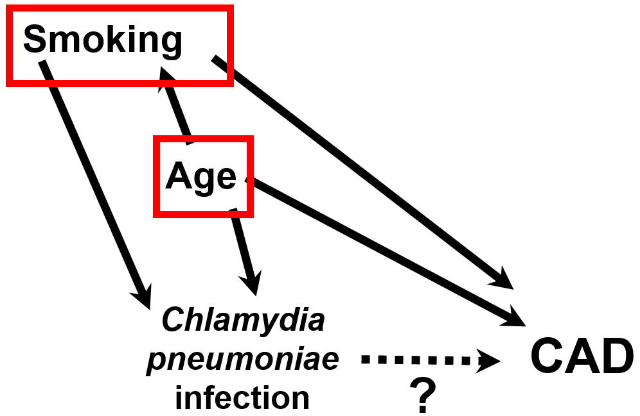
More than One Confounding Path
RQ: Does Chlamydia pneumoniae infection cause coronary artery disease (CAD)?
What will we need to do to estimate the causal effect of Chlamydia pneumoniae infection on CAD?
Notes:
How about if we have more than one confounding path to contend with? Here, the research question, which this DAG depicts, is whether Chlamydia pneumoniae infection causes coronary artery disease. When we draw the DAG for this system it becomes apparent to us that there are at least two confounding paths to contend with, stemming from the common causes age and smoking, if we hope to manage all of the confounding and estimate a causal effect of Chlamydia pneumoniae infection on the occurrence of coronary artery disease. Our goal is to adjust for smoking and age and therefore block the backdoor paths, but how should we do this?
(Note: there may be more than two common causes operative here, and we would need to include them all to be able to call this a “causal DAG”. We just show two now for illustrative purposes.)

Slide 31
Stratifying by Multiple Confounders
Confounders: Age and Smoking
Because the confounders are occurring together in nature, we seek to control for them simultaneously
To control for multiple confounders simultaneously, must construct mutually exclusive and exhaustive strata that are jointly homogenous for the multiple confounders.
  Here, 2 strata (smoking) by 3 strata (age) = 6 strata.
Notes:
Again, we have two factors we need to contend with to eliminate confounding. How should we do this?
Because the confounders operate together in nature and exert their “other influences” at the same time, we naturally want to deal with them simultaneously. To do this, we can use stratification, and we can use it in a way in which we evaluate the association between exposure and outcome in strata that are jointly homogeneous for the confounders, age and smoking. In other words, we can stratify by the confounding factors together by forming mutually exclusive and exhaustive strata from the two factors. There are a variety of ways that we could specify age and smoking, but let us assume, for this example, that we break up smoking into smokers and non-smokers. Then, for age, let us assume we break up age into those less than 40, between 40 and 60, and greater than 60.
To do this, we form six mutually exclusive and exhaustive strata (in which we could put each participant only once) by crossing smoking by age. We form strata of the following: < 40 year old smokers, < 40 year old non-smokers, 40-60 year old smokers, 40-60 year old non-smokers, > 60 year old smokers, and > 60 year old non-smokers.

Slide 32
Because Confounders Operate Together in Nature, Joint Stratification is Needed
Crude
Stratified
<40 non-smokers
40-60 non-smokers
>60 non-smokers
<40 smokers
40-60 smokers
>60 smokers
Next step: Assess for “three way” interaction
-- If present, describe 6 stratum-specific estimates
-- If absent, evaluate for “two-way” interaction (‘mhodds’ in Stata); eventually, 1 or more M-H estimates
Practice in Problem Set this week
Notes:
This is what the joint stratification looks like. (Joint simply means taking both confounders into account simultaneously.) We have six strata.
The next steps would be to assess for interaction by the joint effect of these two factors and decide whether to report interaction. When we stratify by two factors, the presence of interaction is termed “three-way” interaction (because there are a total of 3 exposures involved). If yes (interaction is present), we would stop by reporting the six stratum-specific estimates. Three-way interaction is typically very difficult to prove with statistical significance because most studies are not adequately powered to see statistical significance of anything other than very large interaction.
If there is no convincing evidence for three-way interaction, we would go on to look for interaction between Chlamydia infection and either of the two factors individually, while adjusting for the other factor; we call this interaction (between two factors) “two-way” interaction. For example, we could control for age and look for interaction between Chlamydia infection and smoking status. This would be done by forming an adjusted measure of association in the non-smokers that is a Mantel-Haenszel weighted average of the age strata (averaging across the top row of strata) and then doing the same for the smokers (averaging across the bottom row of strata); in other words, you would have two age-adjusted smoking-specific measures of association. These two measures of interaction would then be examined for interaction. The reverse (controlling for smoking and looking for interaction between age and Chlamydia infection) should also be done; this would involve evaluating the differences between 3 smoking-adjusted age-specific measures of association. Depending upon what you find, you might 3 stratum-specific estimates (if there was interaction between Chlamydia and age) or 2 stratum-specific estimates (if there was interaction between Chlamydia and smoking). If there was no evidence for two-way interaction, then you would calculate a single Mantel-Haenszel adjusted summary estimator across all six strata. This latter set of analyses can be done with the mhodds command in Stata. You will practice in the Problem Set this week with two additional variables above and beyond exposure and disease.

Slide 33
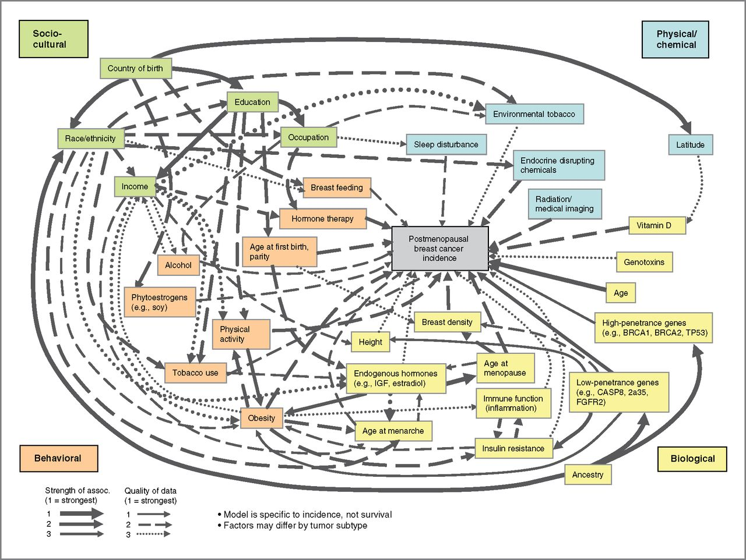
Multi-Level Model of Breast Cancer Incidence
How do we handle this complexity?
Do we adjust for everything?
What if we wanted to study the causal effect of physical activity on breast cancer?
Hiatt et al. Cancer Epidemiol Biomarkers Prev 2014
Notes:
In real life, the complexity is often much more than two confounders. For example, here is a causal diagram for the occurrence of breast cancer in post-menopausal women. How can you handle this much complexity? Should we just adjust for everything?

Slide 34
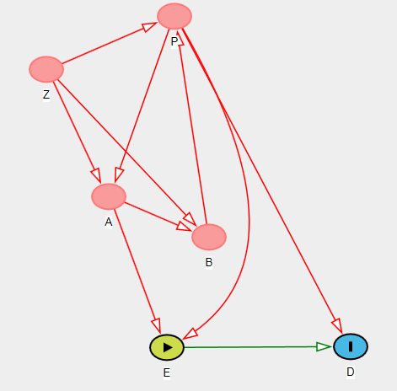
Simplifying the Complexity
Sometimes evaluating the causal association between an exposure (E) and outcome (D) is simpler than it appears
Which variable(s) do we need to control for ?
P only
?
Notes:
Sometimes, there is a simpler solution to this complexity than is initially apparent on the DAG. Here is a somewhat complicated looking DAG (or at least more complicated than many of the DAGs we have drawn so far). Which variable(s) do we need to control for to determine the causal effect of E on D? The answer is P only.

Slide 35
Minimal Sufficient Adjustment Sets (MSAS)
Sometimes evaluating causal association between exposure (E) & outcome (D) simpler than appears
DAGs allow us to identify the minimal set of variables, which if controlled for, will allow for estimation of causal effect of E on D
i.e., An MSAS is the minimal set of factors you need to control for that will:
  - keep direct causal paths between E and D open (+/- the indirect paths depending upon your interest)
  and
  - close all non-causal paths between E & D
For any DAG, there may be several minimal sufficient adjustment sets (MSAS’s) that allow us to evaluate causal effect of E on D.
Notes:
Sometimes, there is a simpler solution to this complexity than is initially apparent on the DAG. DAGs allow us to identify a minimal set of variables, which, if controlled for, will allow for estimation of the causal effect of some exposure on some outcome. This set of variables is called a minimal sufficient adjustment set or MSAS. This is defined as the minimal set of variables, which, if controlled for, will keep all direct causal paths open (and indirect causal paths if desired) between E and D, close all the non-causal paths between E and D, and thus allow for estimation of the total (or direct, if desired) causal effect of E on D.
In other words, an MSAS is a minimal set of factors you need to control for that will keep all causal paths open and close all non-causal paths in the context of evaluating the causal relationship between E and D.
Remember, the general statistical term for one means of “controlling for” is condition. To condition means to hold constant or fixed. The techniques we have described thus far (restriction, matching (followed by stratification), and stratification alone) are all called conditioning techniques. Multivariable regression is also a conditioning technique. Later today, we will mention some non-conditioning techniques, but for now we are focused on conditioning techniques. When we speak of conditioning on a set of variables, it does not mean that we have to use the same technique on each variable. For some variables, we might use restriction and for others we might use stratification.
When we adjust for the MSAS and if the DAG is correct, we should achieve what is called “conditional independence” and E and D. That is, we expect there to be independence (no relationship) between E and D after conditioning for what we needed to control confounding. If we still do see an association in our data, then this is suggestive of a causal direct effect.
Importantly, for any DAG, there may be several MSASs.
(Advanced note: adjusting for any one of the MSAS’s will equally manage confounding and allow you to estimate the causal effect of E on D only if there are no other unmeasured confounding pathways. If there are additional unmeasured and unmanaged confounding pathways (“residual confounding”), then there are some choices to be made in terms of which MSAS is best to control for. This topic is known as “bias amplification” and it is at the frontier of methodologic research (Pearl J. Invited Commentary: Understanding Bias Amplification. AJE 174(11):1223–1227, 2011.))

Slide 36
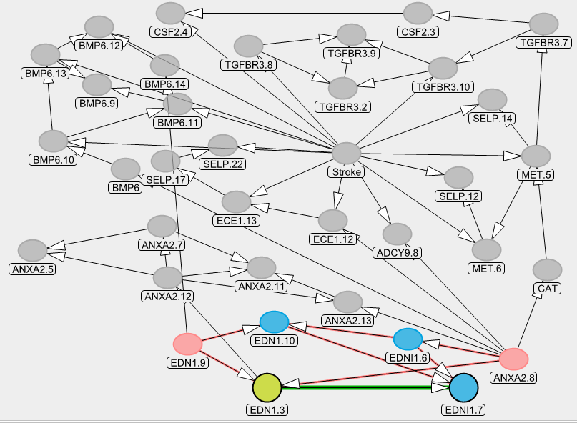
DAGitty.net now makes it simple to find the MSAS’s
Real life DAGs make it very difficult for the human eye to manually determine the MSAS’s
  Although there are manual ways (see Shrier & Platt), humans wear out trying & make mistakes
  Has, in part, led to DAGs being underused
Notes:
Here is a real life DAG. It is complicated. Although there are some formal manual approaches (see optional reading Shrier and Platt BMC Med Res Methodology 2008), it is hard for the human eye to manually determine the MSAS’s. Up until now, this was one of the biggest limitation of DAGs. People got worn out trying to solve them, and this has, in part, led to DAGs being underused. Humans also make mistakes when they try to identify all MSASs.
Thankfully, in the past few years, software has been developed — free software — to determine the MSAS’s. DAGitty.net is one such software.

Slide 37
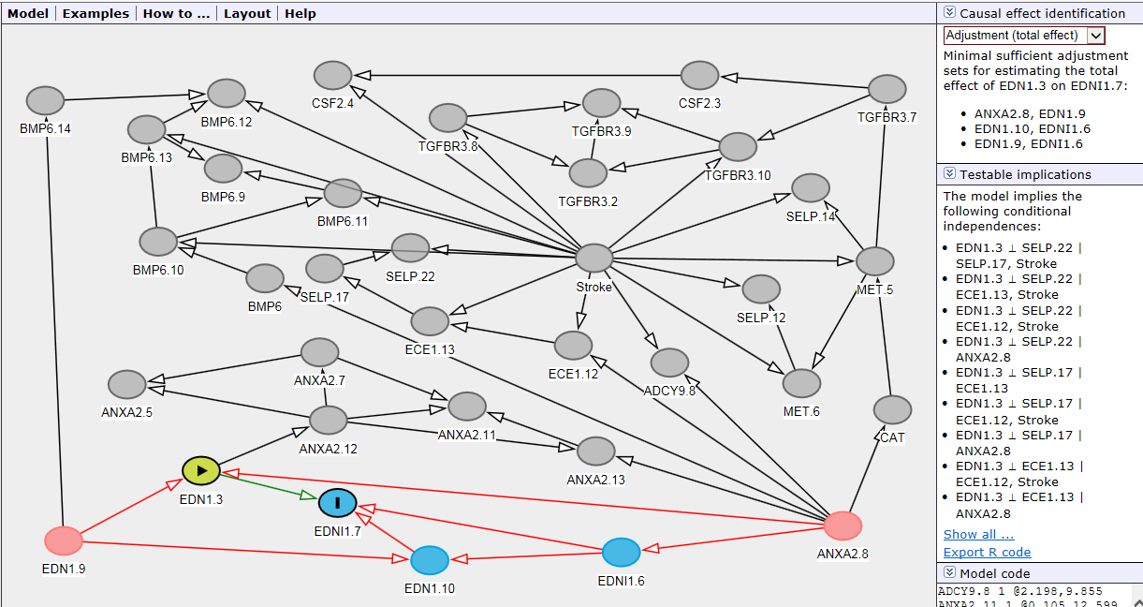
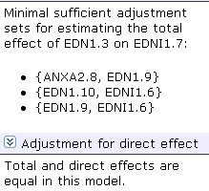
This is the major innovation of this software
Notes:
Specifically, most of you have already noted that in the upper right hand corner of the DAGitty.net screen, the program provides the minimal sufficient adjustment sets for unbiased estimation of the total causal effect of E on D and the direct causal effect (if there are indirect paths noted). Recall earlier how we distinguished total effect from direct effect.
In this example, this seemingly very complicated DAG boils down to 3 MSAS’s, listed here. In fact, DAGitty.net figures this all out on the fly. Adjusting for any one of the contents of these 3 sets will close the non-causal paths and is all you need to estimate, measurement error and sampling error aside, the causal effect of exposure on outcome. Those of you who are interested in the background for this can look at the Shrier and Platt article (BMC Med Res Methodology 2008), which explains the so-called moral graph approach upon which DAGitty.net works through its algorithms.
The drop-down menu in the upper right hand corner allows you to list the MSAS’s to estimate the direct effect of E on D apart from any of the other shown indirect causal paths. In this DAG, there is only one causal path in question so the program tells us that the total and direct effects are equal in this model.
Identifying the MSAS’s is the major technical innovation of this software. Heretofore, many DAGs were just too tedious to solve. DAGitty.net makes it trivial to solve them in terms of finding the MSASs (or telling you that no MSAS exists). Of course, it is also true that the ease by which Dagitty.net allows one to draw and edit the DAGs is also very convenient.

Slide 38
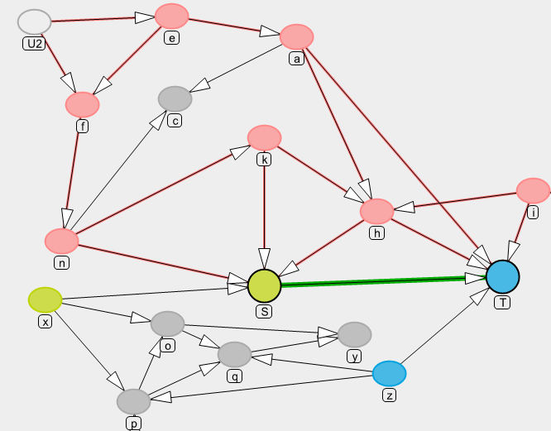
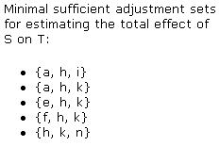
What are the MSAS’s for causal effect of S on T?
Which MSAS to choose?
Notes:
Here is another complicated DAG. We just put letters in the nodes for simplicity. Who has this solved in terms of the MSASs? Too late. DAGitty.net has you beat. It has come up with 5 different MSAS’s.
Controlling for the factors in any of the MSAS’s will close the biasing paths (the red will go away) and decrease the count of biasing paths to zero.
Which one would you choose?

Slide 39
Why might we decide to adjust for one MSAS over another?
Not all variables are created equal
  i.e., not all variables are equally easy to control for
Some variables:
  Have lots of missing data in your study
  Are poorly measured
    Either reproducibility or validity
  Difficult to quantity
    e.g., injection drug use, or hypertension
  Difficult to specify shape of relationship with outcome
    e.g., continuous variables (may lead to model misspecification bias)
  Expensive to measure
  Involve ethical issues if measured
    e.g., illegal behavior (drug use; commercial sex)
Advice
  Choose MSAS which has variables that are most feasible, reproducible, accurate, and manageable
  DAGitty cannot make this decision
Notes:
It turns out that often there is more than one MSAS to choose from. If this is the case, why might we decide to adjust for one MSAS over another? The answer is that when it comes to measurement and adjustment, not all variables are created equal. In other words, not all variables are equally easy or wise to control for.
Some variables may have lots of missing data in a particular study. Attempting to adjust for variables with lots of missing data creates a number of problems, which are beyond the scope of this course, but suffice it to say that variables with missing data are typically inferior to variables with complete data. Some variables are poorly measured, a concept we talked a lot about several weeks ago. By this, I mean problems with either reproducibility or validity. Remember a few weeks how we discussed how a poorly measured confounding variable does not allow us to fully adjust for that variable.
A related concept are variables that are difficult to quantify, such as injection drug use or hypertension. Earlier we talked about the problems quantifying infection drug use, for example. How do you really fully control for history of hypertension? It is hard to know, but you likely would have to know the daily blood pressure over a person’s lifetime and control for some area under the curve. Nearly impossible.
Even if you had accurate measurement of a confounder, actually adjusting for it — in a technical sense — can be a challenge. Although we will not be discussing this in our course, finding the correct functional “specification” of a variable in terms of how it relates to the outcome, particularly continuous variables, can be a challenge. This refers to finding the best mathematical relationship between the variable and the outcome in question. This issue gets into modeling aspects like whether adding quadratic or cubic terms is useful or whether a spline may be better. To the extent you do not fully capture this relationship, you are left with at least some “model misspecification bias”.
Finally, there are issues of feasibility. Some variables are more expensive than others to measure. Biological variables, in particular, are expensive, and some are more expensive than others. Then, there are issues of ethics. Measuring illegal behavior such as drug use or commercial sex brings with it several ethical issues.
In the face of these issues, the advice becomes clear: choose the MSAS which contains variables that are, collectively, the most feasible, reproducible, accurate, and technically manageable. This is a human decision and nothing that a computer can do for you.

Slide 40
Need h in all scenarios
If k is a problem to measure, go for {a, h, i}
Notes:
Back to our DAG, DAGitty.net tells us that we are going to need variable h in our adjustment set no matter what. So, we know that we will really have to focus on measuring h well. Let us say that variable k is difficult to measure, for whatever reason. If this is true, then we will plan to measure a and i in addition to h for our MSAS.

Slide 41
Confounding and Interaction: Part III
Methods to reduce confounding
  during study design:
    Randomization
    Restriction
    Matching
    Instrumental variables
  during study analysis:
    Stratification
    ------ INTERLUDE ON INTERACTION--------
      Forming “adjusted” summary estimates
      Concept of weighted average
      Woolf’s Method
      Mantel-Haenszel Method
Handling more than one confounder
  Minimal sufficient adjustment set (MSAS)
Managing uncertainty in your DAGs
  Role of an analysis plan
Limitations of stratification to manage confounding
  Motivation for multivariable regression approaches
Limitations of conventional “conditioning” approaches
  Motivation for “non-conditioning” techniques
If time:
  Residual confounding; importance of overlap; quantitative bias analysis (in Additional Material Slides)
Notes:
Let us regroup for a moment and switch to the next topic, uncertainty in your DAGs.

Slide 42
The Ideal Process
You are confident about the DAG: it is correct
Find all the MSASs
Choose the most practical MSAS
Adjust for the chosen MSAS
  Via restriction, matching, stratification, or regression
Report the final adjusted measure of association (or stratum-specific estimates, if interaction present)
The Often More Realistic Situation
You are NOT confident about the DAG
B
?
A
?
D
E
?
Why not just take the most conservative route and adjust for everything that is conceivable?
Notes:
In the ideal situation, we are confident about our DAG. This means that the DAG, as written, is correct. If we are confident and the DAG is correct, the rest of the process is that we simply find all of the MSAS’s and choose the “best” (i.e., most practical) MSAS using the tips we just discussed. We perform the adjustment for the variables in the MSAS by restriction, matching, stratification, or regression or some combination of them. We then go ahead and report the final adjusted measure of association or the stratum-specific estimates if statistical interaction is present.
That is the ideal, but often the more realistic situation is that you are NOT fully confident about the DAG. For example, you might be sure that A causes D, but you are and the literature are not so sure that A causes E. Or, perhaps you know that B causes E, but you are not so sure that B causes D. What should you do? Perhaps you figure you should take the conservative route and adjust for all confounding that is conceivable? Is there any downside to this?

Slide 43
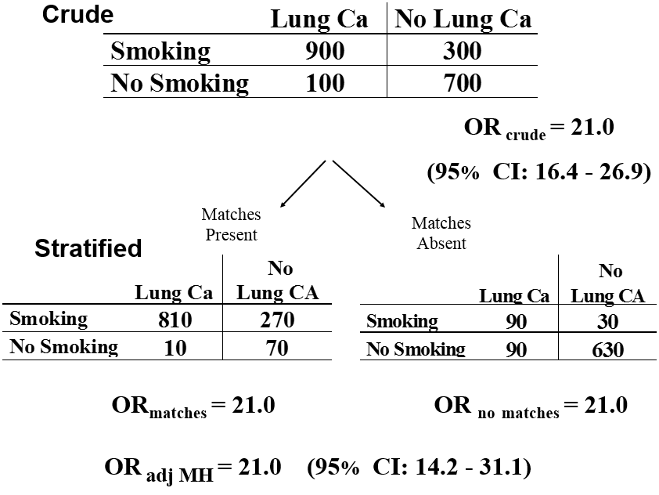
What adverse effect occurred when we adjusted for matches?
Which will you report as your final answer?
Need more information - C
Adjusted (95% CI) - B
Crude (95% CI) - A
Notes:
To address this, let us go back to our original motivating example of smoking, carrying matches, and lung cancer. Here, in the crude 2 x 2 table, we are looking at the effect of smoking on lung cancer. The crude association shows a strong effect; the odds ratio is 21. What if we now stratified on carrying matches? The two stratum-specific measures of association are both 21. What would we report as the final answer, the crude and its associated 95% CI or the adjusted estimate and its 95% CI?

Slide 44
What adverse effect occurred when we adjusted for matches?
We have suffered a precision penalty by adjustment
Which will you report as your final answer?
Need more information - C
Adjusted (95% CI) - B
Crude (95% CI) - A
Notes:
The answer is that we suffered a penalty in terms of statistical precision when we stratified. We should choose the crude. Look at the width of the crude and adjusted odds ratios. As you can see, the 95% confidence interval for the crude estimate is 16.4 to 26.9 compared to 14.2 to 31.1 for the adjusted. The confidence interval widened when we adjusted for matches. We have suffered a precision penalty.

Slide 45
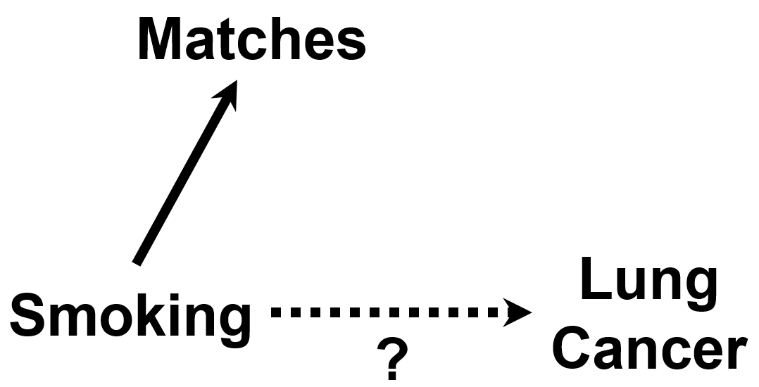
DAGs make that choice obvious
No indication from the DAG that Matches should be controlled for
Don’t adjust for things you don’t need to (because it can sometimes cause you trouble in terms of bias and imprecision)
Notes:
Of course, you might say that you would have never adjusted for matches in the first place because it would have never been indicated by your DAG. If you did say this, you would be right. There is no evidence that matches cause lung cancer such that we should have never stratified on it.
Hence, this example illustrates why you do not want to adjust for factors that you do not need to, factors that are not indicated by your DAG. This is because they can sometimes decrease precision (and they may also worsen bias).
Another problem with adjusting for matches is that if there are factors that are common causes of matches use and lung cancer, then we have adjusted for a collider and have induced bias. This is collider-stratification bias. Recall how this happened with the folate, stillbirths, and congenital birth defects example.

Slide 46
Effect of Adjustment on Precision (Variance)
Adjustment (e.g., stratification) is not always “all good”
Adjustment can increase or decrease standard errors (and CI’s) depending upon:
  Nature of outcome (interval scale vs. binary)
  Method of adjustment (stratification vs. regression vs other)
  Strength of association between “potential” confounding factor and exposure/disease
    “potential” because as last slide illustrates, the uninitiated may decide to adjust for non-confounders
Not always straightforward to predict effect on precision
Good news:
  adjustment for strong confounders removes bias and often improves precision
  adjustment for strong determinants of outcome often improves precision
Bad news:
  adjustment for non-confounders, weak determinants of outcome, or less-than-strong confounders often (not always) worsens precision
Notes:
This is one of the first adverse manifestation of stratification (or adjustment) that we have observed (aside from the collider-stratification bias). Heretofore, stratification was seemingly always beneficial. Stratification was useful to assess for effect-measure modification and also useful to get rid of the bias from confounding. Now, we see that adjustment can be accompanied by a decrease in precision, and a decrease in precision from stratification is indeed a shortcoming for many analyses with limited sample size. In summary, we can say that a decrease in precision is never a good thing, but, in practice, if you are working with a very large sample size then a decline in precision will have no practical importance.
Whether or not adjustment will decrease precision is a complicated story because adjustment can increase or decrease standard errors (and hence confidence intervals) depending upon a number of factors including:
the nature of the outcome: binary vs. interval scale. In this class, we have only been talking about binary outcomes, but some of the effects of adjustment are different in the case of interval scale. In general, adjustment for factors which are strong determinants of the outcome will increase precision when outcomes are on the interval scale;
the method used for adjustment, in other words, Woolf vs. Mantel-Haenszel (stratification-based) vs. a maximum likelihood estimation-based regression technique, for example, logistic regression; and
finally, the strength of association between the “potential” confounding factor and the exposure and disease, respectively. We note that this “potential” because as the last slide illustrates, the uninitiated may ill-advisedly decide to adjust for a factor that is not a confounder.
This is complex and nothing most researchers can easily predict or commit to memory. However, the good news is that adjustment for strong confounders removes bias and typically often improves precision as well. This is a win-win situation. It is also the case that adjustment for strong determinants of outcome, even if they are not confounders, will also often (but not always) improve precision.
The bad news is that adjustment for non-confounders, weak determinants of outcomes, or less-than-strong confounders can often (but not always) worsen precision. This is yet another reason we need to be careful about indiscriminate adjustment (“adjustment for everything”).

Slide 47
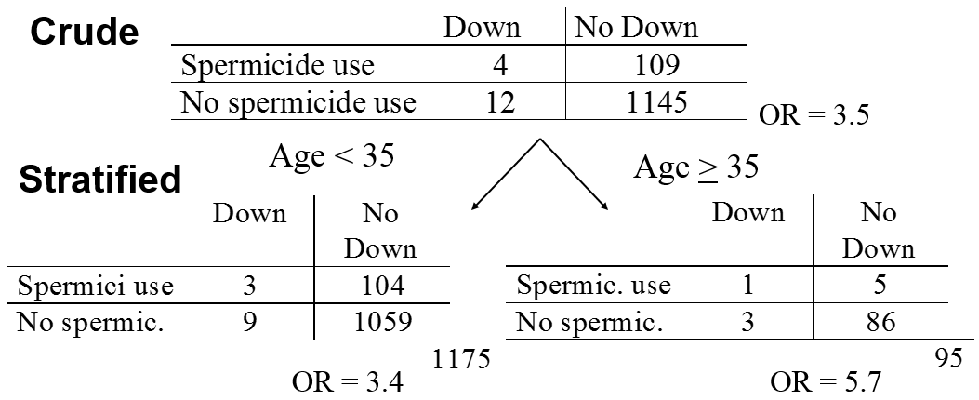
Spermicides, Maternal Age & Down Syndrome
We already decided not to report interaction, but which estimate should you report as “final”?
Crude (95% CI) - A
Adjusted (95% CI) - B
Need more information - C
Notes:
Let us look at another example. Remember our earlier question looking at the effect of spermicide use and the development of Down Syndrome in a case-control study? Let us assume that our interest is in the multiplicative scale. Remember after we stratified by maternal age, we saw these two stratum-specific estimates of the odds ratio: 3.4 and 5.7, which are substantively different. We were suspicious because of the small numbers in some of the cells that the stratum-specific estimates differed only because of sampling error. When we go ahead and performed a test of homogeneity on the multiplicative scale, we find it is 0.71 and so we are willing to pass on interaction (i.e., not report it), and now we need to finish our work.
Here, the crude estimate is 3.5. The adjusted OR by Woolf method is 3.82 and adjusted OR by M-H is 3.78; both are essentially 3.8. What should we report as our final answer, the crude (95% CI) or the adjusted (95% CI) estimate? Or, do we need more information?

Slide 48
Spermicides, Maternal Age & Down Syndrome
All 3 answers are defensible.
Adjusted point estimate is different than crude
Adjusted CI is also wider
We already decided not to report interaction, but which estimate should you report as “final”?
Crude (95% CI) - A
Adjusted (95% CI) - B
Need more information - C
Notes:
All 3 answers are defensible. Notice that adjustment does change the point estimate a bit from 3.5 to 3.8. Those of you who chose B are probably happy about that because you believe it changed because you have accounted for confounding. However, again, adjustment results in loss of precision. Those of you who chose A are probably very conscious about this. You did not choose to control for age because you did not think it was a confounder and because you were concerned about worsening precision if you controlled for it. Or, if this substantive field is unfamiliar to you, then you might have rightfully said that you needed more external information about age.

Slide 49
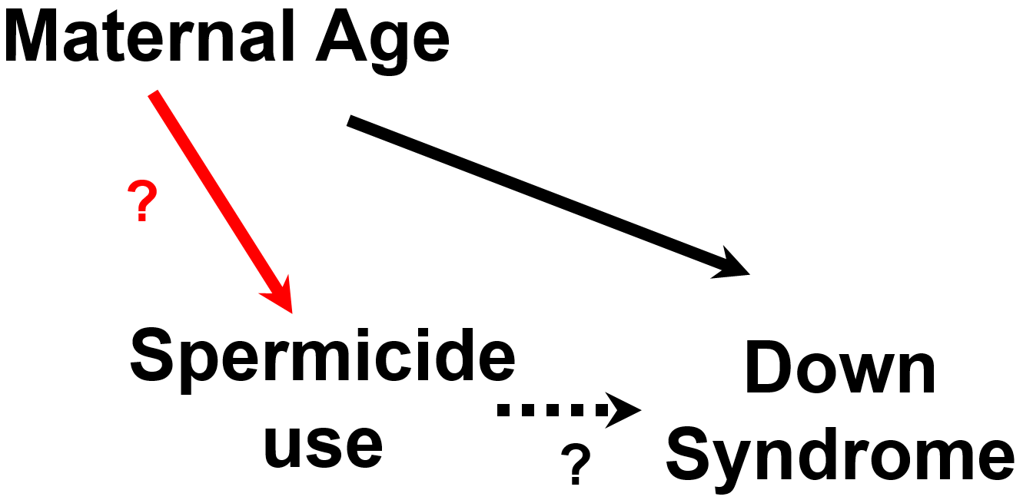
It all comes down to the red edge
If the red edge exists in your view, you will want to control for maternal age.
If the red edge does not exist in your view, you do not have to control (but you could to perhaps improve precision)
What if you don’t know if the red edge exists? (i.e., existing literature is inconclusive)
Notes:
I am sure that many of you have already quickly drawn your DAG for this system. Most people realize that maternal age is a causal determinant of Down Syndrome, but for most observers it all comes down to this edge, in red. If you believe the red edge exists, you will control for age and accept whatever final adjusted answer you get. If you do not believe it exists, then you do not have to adjust for age. However, what if you simply do not know the answer, i.e., the available literature is inconclusive or at least it is inconclusive in your population?

Slide 50
If there are uncertain edges:
Whether to accept “adjusted” summary estimate instead of the crude?
No one correct answer
  “Bias-variance tradeoff” (tension / inverse relationship between bias control and variance)
One scientifically rigorous approach is to:
  Create DAG with all “potential” confounding paths
  Prior to adjustment, classify the potential confounders as either being:
    “A” List: Those factors for which you will accept the adjusted result no matter how small or large the difference from the crude. You must manage confounding paths.
      Factors strongly believed to be confounders
    “B” List: Those factors for which you will accept the adjusted result only if it meaningfully differs from the crude (with some pre-specified difference, e.g., at least 5 to 10%).
      Factors you are less sure about
      Termed: “Change-in-estimate” approach
Always putting all factors on A list may seem “conservative”, but not necessarily the right thing to do in light of penalty of statistical imprecision
Bias control paramount
Need for tradeoffs:
trade a bit of bias to protect variance
Notes:
It turns out that there is not one correct answer, and that the methodologic literature is inconsistent about what to do. The inconsistency in the literature is, in part, a manifestation of what is called the “bias-variance tradeoff”, something that you will see again in the next 3 quarters in our Biostatistics course sequence. The tension is between trying to get the most valid answer (least biased), or at least not a very biased answer, but without having to suffer too much in decreasing precision. This tension comes up all of the time in study design and data analysis. The tension is just how close is close enough when looking for an unbiased answer and how much increased variance are you willing to endure to get a nearly unbiased answer?
In our view, one scientifically rigorous approach to this is to first create a DAG with all of the “potential” confounding paths. In other words, include all variables which you strongly believe to be common causes of E and D as well as those you are unsure about. Include all of the “inconclusive” or “uncertain” edges we spoke of earlier. Prior to adjustment, create two lists: On one list, the “A” list, would be those factors for which you will accept the adjusted result no matter how small (or large) the difference from the crude. You will accept the adjusted results because these are factors you believe strongly to be confounders based on your subject matter knowledge (i.e., review of the scientific knowledge). They are either common causes themselves or any factor on a confounding pathway which, if blocked, can close that confounding pathway. An example might be age when looking at the association between hypertension and coronary artery disease. Age is definitely a confounder in the hypertension and coronary artery disease relationship (in most adult populations) and must be controlled for.
On another list, the “B” list, would be those factors which you are not sure about regarding their role in confounding. They might be confounders but you honestly do not know because you are not sure about one or both of the causal relationships between the originating common cause in question (or mediating variable) and exposure and/or the common cause and outcome (or anything mediating the relationship). Note that this “B” list factor does not have to be the common cause per se but can be any factor on the confounding pathway that if adjusted for could block the pathway. For example, you might be sure that this confounding path has a solid causal relationship with outcome but not sure it is associated with exposure. For these factors, the advice is that you accept the adjusted result only if it meaningfully differs from the crude (with some pre-specified difference, e.g., at least 5 to 10%). For these factors, if they are not causing a large bias (i.e., the adjusted is no more than, say, 5 or 10% from crude) you would be willing to accept a bit of bias to protect against the loss of precision if you had adjusted (trade a bit of bias to protect against loss of precision). This approach in deciding whether to control for a variable or not is called the “change-in-estimate” or “change-in-coefficient” approach.
These kind of bias-variance tradeoff decisions are actually being made all of the time in statistical analyses. They come up when we need to decide whether certain types of statistical models are acceptable for our data, models which we know may not be 100% accurate (i.e., could be slightly biased) but do offer the promise of more precise estimates.
For some analyses, you may have no factors on the B list. For other analyses, you would have some factors on B list. Putting all factors on the A list may seem conservative, but it is not necessarily the right thing to do in that there may be a penalty to take in statistical imprecision when you adjust for these variables.
Note: Worse precision may not be the only problem that occurs when one adjusts for a factor. If one adjusts for a factor causally related to exposure and if there is residual confounding by another pathway, the bias caused by that residual pathway will be amplified. This is especially problematic when one adjusts for an instrument for which there is no confounding path to be closed, but instead only bias amplification to be had. Bias amplification is explained in further detail in the Additional Material Slides. This type of situation is not a bias-variance tradeoff, but is instead, in the case of an instrument, an instance of pure worsening of bias. For near-instruments (variables associated with exposure but only weakly with outcome), there is a tradeoff, the trading of some known bias control vs some unknown degree of bias amplification.
Advanced Note: The phenomenon of non-collapsibility (which we earlier in the course demonstrated with odds ratios) presents some complications for a change-in-estimate approach when using non-collapsible measures of associations (e.g., odds ratios and rate ratios).

Slide 51
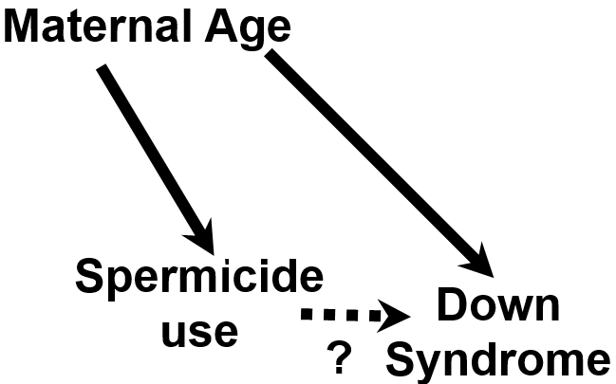
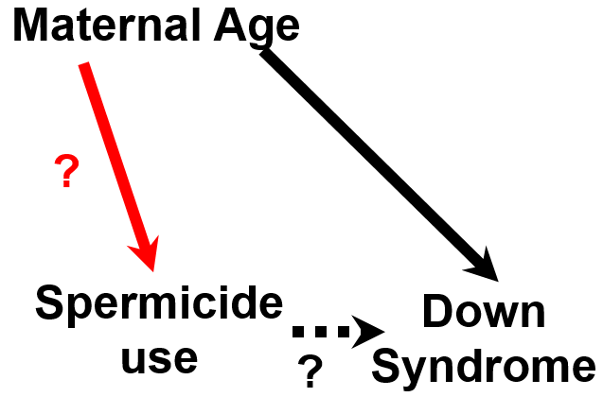
Adjusting for Maternal Age?
Age is on “B” List
Accept/report age-adjusted result only if exceeds pre-specified change-in- estimate threshold (e.g., 5%) c/w crude (here, it is ~8%)
i.e., you will allow your data to help you decide
Age is on “A” List
Adjust for Age;
Accept OR_{MH} = 3.8 as final estimate
Whether age is on “A” or “B” list (& your threshold) should be pre-specified in your analysis plan
Notes:
So, back to the spermicide use, maternal age, and Down syndrome problem. If we drew the DAG on the left, and we were very sure that maternal age was a common cause of exposure and outcome, this means that we will place maternal age on our A list. This means that we will need to adjust for age and accept the adjusted estimate no matter what it is. In this case, we would accept OR_{MH} = 3.8 as the final estimate.
On the other hand, you might be unsure after your review of the literature if age is truly related to spermicide use and hence unsure if age is truly is a confounder in your DAG. In this case, you will place age on your “B” list. In this case, you should adjust for age in your final estimate only if doing so exceeds your pre-specified change-in-estimate (e.g., 5%) when comparing crude to adjusted estimates. In other words, you will adjust for age only if makes some difference in the result. Another way of thinking about this is that you will use your own data (the data that you have collected) to help you decide if the inconclusive edge truly exists or not.
Which of these to choose is up to you, based upon your conclusion about the edge from age to spermicide use. This decision, whether age is on your “A” or “B” list, should be pre-specified in your analysis plan. You cannot, for example, adjust for age, see that it changes the crude by 6% but also moves it from a p value of 0.03 to 0.15 and decide that you don’t like it based on what you found. You need a pre-specified principled approach.
Advanced Note: the change-in-estimate approach is not without some problems. First, if you are using a non-collapsible measure of association such as an odds ratio, and the frequency of the outcome is not rare, then change in the measure of association from crude to adjusted may be because of non-collapsibility (and not confounding). Second, a change may be the result of bias amplification and not confounding.

Slide 52
Choosing the crude or adjusted estimate?
Assume no multiplicative statistical interaction
Pre-specified analysis plan: Factors on B list have 10% change-in-estimate rule in place
Notes:
Let us go through a few numerical examples. First, let us assume there is no strong evidence in any of these examples for multiplicative statistical interaction and that our interest is in the multiplicative scale. Also, let us say that our pre-specified rule in our analysis plan is that any factors that we place on the “B” list must have a 10% change-in-estimate compared to the crude result in order for us to accept the adjusted estimate. In other words, we will adjust for the factor only if the adjusted differs from the crude by equal to or greater than 10%. Let us go through these examples.

Slide 53
“Change in Estimate” Approach
– A Historical Perspective
Historically, confounding often defined by whether the adjusted estimate differed from the crude
  “if there is a change after adjustment, there has to be confounding present”
i.e., in the past, one’s available data defined confounding
  “data-based definition of confounding”
Today, theoretical philosophy is very different
  We primarily don’t use data from the current study to define presence or absence confounding or what to control for
    We put more weight into the collective body of prior evidence/literature than our single study
    e.g., if we adjust for something and it changes the estimate, we don’t accept this as confounding unless there was some a priori belief (e.g., gum chewing in melanoma)
  Exception: if the prior literature is uncertain about a part of a DAG (B list), reasonable to use data from current study to inform decision to adjust
    This is how we use “change in estimate” approach today
However, not all investigators practice this, leading to much non-uniformity
Notes:
There has been a change over the past decade in the theoretical understanding of how to define and manage confounding. For many years, confounding was often defined by the data at hand in the current study. If adjustment for a factor changed the estimate, confounding was deemed to be present.
Today, the philosophy is quite different. We do not primarily use the data from the current study to decide what to control for. Instead, we put more weight into the collective body of prior evidence, which we encode in our DAG. The exception is that sometimes we are unsure about one or more edges and one or more confounding paths. In these situations, it is reasonable to use the data at hand to inform the decision — to break the tie. This is how we selectively use the “change in estimate” approach today.
Unfortunately, this new understanding of confounding is not known by most researchers, who are instead practicing the older techniques. This leads to a lot of confusion in the literature and explains some fraction of the diversity of inferences for any given research question.

Slide 54
No Role for Statistical Testing for Confounding
Testing for statistically significant differences between crude & adjusted measures is inappropriate
e.g., examining an association for which there is a factor (from literature) which is a known confounder (e.g., age in association between hypertension & CAD)
  if the study has a small sample size, even large differences between crude and adjusted measures may not be statistically different
    yet, we know confounding by age is present
    therefore, the difference between crude & adjusted measures cannot be ignored as merely chance.
    bias must be prevented and hence adjusted estimate should be used/reported
    we must live with whatever effects we see after adjustment for a factor for which there is a strong a priori belief about confounding
e.g., If study has large sample size, even small differences between crude & adjusted will be statistically significant
  Will you accept all these adjustments — which could begin to add up to a large difference — to be necessary even if no a priori evidence of confounding?
Notes:
Many of you are perhaps saying why do we not just apply a statistical test to see if the difference between the crude and adjusted estimate is significant? After all, we used a statistical test when helping to decide whether statistical interaction is present. If there is anything we want you to leave you with today is that statistical testing for confounding is a bad idea. Luckily, even if you wanted to perform such a statistical test, they are actually not readily available in software packages.
Why is statistical testing for confounding inappropriate? Let us say you are working with a variable that you know is a confounder from every bit of prior literature, like age in the evaluation of the relationship between hypertension and coronary artery disease. What if you happened to have a small sample size in your study? In a small study, even large differences between the crude and adjusted measures of association might not be statistically significant. What are you going to do? Throw out age and just go with crude estimate of the relationship between hypertension and CAD? Of course, you would not do this because you know that confounding is present! You cannot ignore differences between crude and adjusted measures just because they are not statistically significant. In other words, when protecting against bias with a known confounder, you have to do whatever you can regardless of statistical significance. If we believe that a factor is a confounder, then we have to live with (i.e., accept) what we see as differences between crude and adjusted regardless of the statistics.
Similarly, with a large sample size, even small differences between crude and adjusted estimates will be statistically significant. These small differences could add up to be a substantial difference once you start adding up the effects from many variables. Yet, if you have no substantive conviction that a factor is a confounder (e.g., gum chewing and melanoma), why would you adjust for it?

Slide 55
The Ideal Process
The Often More Realistic Situation
You are confident about the DAG
Find all the MSASs
Choose the most practical MSAS
Adjust for the chosen MSAS
  Via restriction, matching, stratification, or regression
Report the final adjusted measure of association
You are NOT confident about the DAG
Why not just take the most conservative route and adjust for everything that is conceivable?
Problems with this approach of “indiscriminate adjustment” – a summary:
  1. Precision (increase variance)
  2. Bias -- if inadvertent adjustment on a collider or descendant of a collider or descendent of outcome
  — e.g., folate, birth defects, and stillbirths
  3. Bias amplification – if adjustment on an instrument or near-instrument (See Additional Material Slides)
  Non-collapsibility
    — ORs, rate ratios in face of high frequency outcomes
Notes:
Let us pause for a moment to review where we are. In the ideal situation, we are confident about our DAG, and it is correct. If so, we simply find all of the MSAS’s and choose the best, or most practical MSAS and then adjust for it. We do this by restriction, matching (followed by stratification), stratification, or regression or some combination of them. We then go ahead and report the final adjusted measure of association. (Note: we will also need to pay attention to statistical interaction along the way.)
That is the ideal, but here is the often more realistic situation: It is often the case that you are NOT fully confident about the DAG. Earlier, we asked, why not just take the most conservative route and adjust for everything that is conceivable to adjust for? We just illustrated one problem with this approach, which is that it can increase variance.
There are, however, other problems with indiscriminate adjustment. Here is a summary of problems we have already mentioned in the course. The second issue is that adjustment for “everything” may result in inadvertent adjustment on a collider (or a descendant of a collider, or a descendant of the outcome) with resultant bias. Remember our initial example of collider bias with folate intake (exposure), birth defects (outcome), and stillbirths (collider)? For an explanation of the problems with adjustment on a descendent of a collider or of the outcome, see the initial slides which describe the nuances of DAGs.
The third problem is what can happen when you inadvertently adjust on a factor associated with exposure but nothing else. Such a factor is known as an instrumental variable or instrument. If you followed the rules of DAGs, you would not think to do this, but if you did not follow these rules you might just adjust for such a factor. If you did adjust for an instrument (or even a near instrument, which is a factor strongly associated with exposure but weakly with outcome) and there still happens to be residual confounding by one or more other open confounding pathways, the resultant measure of association will have its bias amplified. Bias amplification is further described in the Additional Material Slides.
The final reason is the phenomenon we called non-collapsibility earlier in the course. This is when adjustment for a factor which is not a confounder can result in a summary adjusted estimator being different than the crude. Recall how we discussed this with odds ratios, rate ratios, and high incidence/prevalence (“high" frequency) outcomes. Adjusting for “everything” is going to uncover the manifestations of non-collapsibility, and non-collapsibility is not a good thing if you are interested in average group effects.

Slide 56
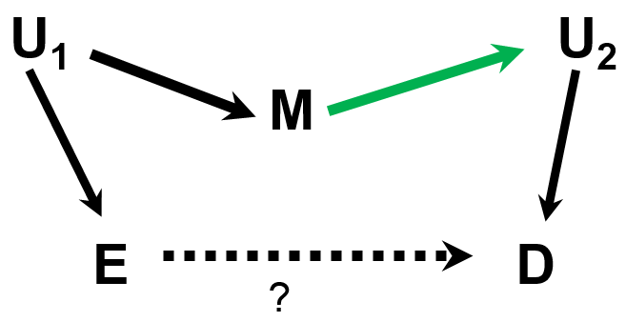
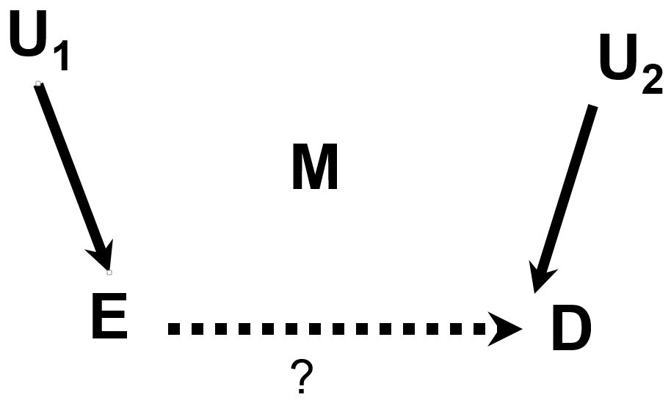
In Addition to Presence, Direction of an Edge Can Make a Difference
Controlling for M gives a desirable result
Controlling for M induces collider bias
Solution: If crude & adjusted estimates differ by > 5% to 10%, report both analyses and discuss the influence of this unknown direction. If differ <5%, then does not matter; report crude
  Pre-specify % in your analysis plan
Notes:
In addition to wondering about the presence of an edge, the direction of an edge can also make a big difference when you are considering adjustment. Let us say that you were uncertain about the direction of the relationship between M and U2. In one DAG, we might draw it like we see in the left figure. However, in another DAG (on the right), we might draw the DAG in the opposite direction. It may be hard to know which is correct.
Unfortunately, the consequences of controlling for M are very dependent upon the direction of the edge. In the left DAG, controlling for M gives a desirable result; it closes a confounding path. In the right DAG, you have just the opposite. Here, controlling for M induces collider bias.
This issue is not whether the edge exists, as it was in our A list vs B list scenario, but rather it is an issue of the direction of the edge. This situation can also be handled with a similar strategy as before, i.e., if the decision makes a difference in the analysis (changes the measure of association by more than 5% to 10%), then we need to worry about it, report both answers, and tell your readers how the direction of the edge is influential and that we need to perform more research to understand the direction if we hope to get the right answer for the causal effect of E on D. If it does not make much a differences (less than 5 to 10%), then we can ignore it and report one answer. It typically will not matter which you present because typically adjusted and crude will have the same qualitative statistical significance. The problem is if the two approaches vary in their statistical significance (i.e., straddling p values of 0.05). This will be rare. Here, we believe the principled approach is to choose the crude because there is no evidence that M is causally related to D in your data and hence we have no justification to control for M. (No evidence for confounding and no evidence a strong determinant of outcome.)
We can envision a day when software can analyze one’s base DAG (best guess at a DAG) and evaluate an accompanying dataset and produce the universe of DAG structures (given the nodes of the base DAG) that produce a measure of association that are within + or – 5% of the base DAG. This will help researchers know how robust their inferences are to mistakes (called “misspecifications” in statistical jargon) in the DAG. As described in later slides, an application in the “R” software package is coming close to this.
Note: Some will ask why we did not promote reporting both results in the prior example of when we adjusted in the presence of an uncertain edge and observed a difference between crude and adjusted of more than 5%/10%. The reason is that with some reasonable prior probability of an edge and data that supported this edge, we feel there is no choice but to accept the adjusted in order to decrease bias. Furthermore, we have no evidence that the adjusted estimate itself could be biased (although it could be, in some instances, via bias amplification). That is, if the goal is to reduce bias, one must accept the adjusted estimate; it appears far more likely to be correct than the unadjusted. In contrast, in the scenario on this slide, in attempting to reduce bias in the left DAG, we might be introducing bias. We thus conclude that it is important to report both results if the two estimates are substantively different (> 5 to 10%).

Slide 57
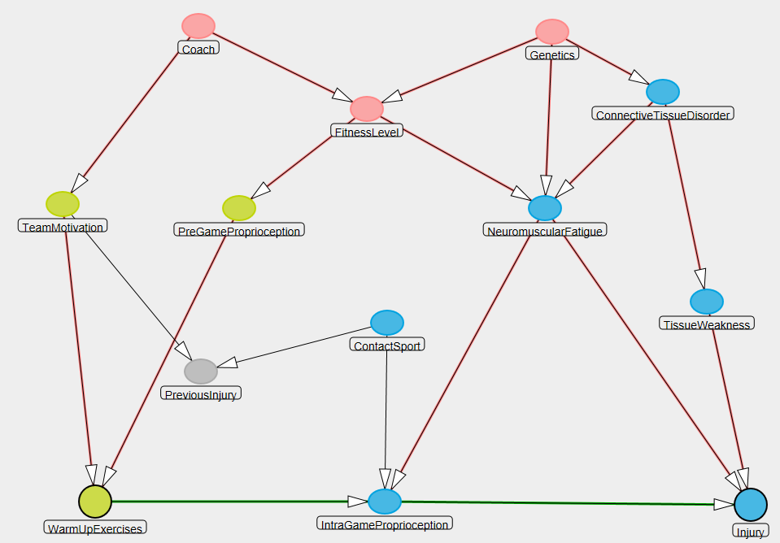
What About Multiple Areas of Uncertainty?
?
No one best/accepted approach
  Frontier of methodologic research
  See Extra Slides for our advice and algorithms
  More in BIOSTAT 208 and 209
?
?
Notes:
This advice is simple enough in the presence of just one non-causal path, but what happens when you have multiple areas of uncertainty in a complex DAG?
Unfortunately, there is no one single best or accepted approach. How to best handle this is on the frontier of methodologic research. Please see the Additional Material Slides for an example of an algorithm that we endorse.

Slide 58
An Analysis Plan
Selecting variables to control for (“final model”) is one of the least standardized research processes
Available methods often arbitrary and can give different answers for the “final estimate”
  Invites fishing for desired answers
Solution: Analysis Plan
Written before the data are analyzed
Content
  Detailed description of the techniques to be used to analyze data, step by step
  Forms the basis of “Statistical Analysis” section in manuscripts
  Parameters/rules/logic to guide key decisions:
    which variables will be assessed for interaction and for adjustment?
    what p value and magnitude/scale of heterogeneity will be used to guide reporting of interaction?
    what is a meaningful change-in-estimate threshold between two estimates (e.g., 5% or 10%) to determine variable selection and model reporting?
Utility: A plan helps to keep the analysis:
  Focused
  Transparent
  Reproducible (“reproducible research”)
  Honest (avoids p value shopping)
Not legitimate to try various analyses until you find a statistically significant result
Notes:
The goal of the prior discussion was to figure out which variables to control for in order to estimate the causal effect of some exposure on some outcome. If the adjustment technique used is mathematical regression, the process is sometime called finding the “final model”. It turns out that this process is one of the least standardized in all of clinical and epidemiologic research.
There are many different approaches that researchers use (i.e., many to choose from), but unfortunately many are arbitrary in their justification and can lead to different answers. Hence, it is possible to try many different approaches until you get the result you want to see. This is a big problem in observational research. There is no one industry standard approach about how to handle multiple areas of uncertainty in one’s DAG, and, hence, there is too much of an invitation to shape one’s final results by picking and choosing the approach that gives you a desired answer. Indeed, many researchers know nothing about DAGs, and they are choosing what variables to control for based on data-based definitions of confounding or some other outdated philosophy.
The only solution to this, in our view, is an analysis plan that is written before the data are analyzed. The content of the plan is a description of the various techniques you will use to analyze the data, step by step. This plan will form the basis of the Statistical Analysis section in your manuscript. It contains all of the parameters and logic you will use to guide your decisions about interaction and confounding. For example, it will state which p value thresholds you will use to decide whether to report interaction or not. It will also state the logic you will use to deal with uncertainty in your DAG. For example, it will list the change-in-estimate threshold (e.g., 5% to 10%) you will use to handle the bias-variance tradeoff of determining what to control for (when you have B list variables or when the direction of an edge is unknown). An analysis plan will describe your A list variables and B list variables.
There are many advantages to having such a plan. For one, it helps keep you focused in your own work and avoids your wasting a lot of time making things up as you go. A well written plan provides transparency to your work and is useful in that it is reproducible by others. As we mentioned earlier in the course, the world (and particularly funders) is beginning to demand reproducible research. Finally, as I mentioned above, a plan helps keep you honest by avoiding p value shopping, by which we mean trying a number of different approaches until you get the answer you like. To be clear, it is not legitimate to try various analyses until you find a statistically significant result that favors the hypothesis that you are promoting.
Note: Having an analysis plan does not mean one should not or cannot explore one’s data. It just means that when you are ready to answer a specific research question, particularly one related to causation-driven research, there should be focused plan written prospectively.

Slide 59
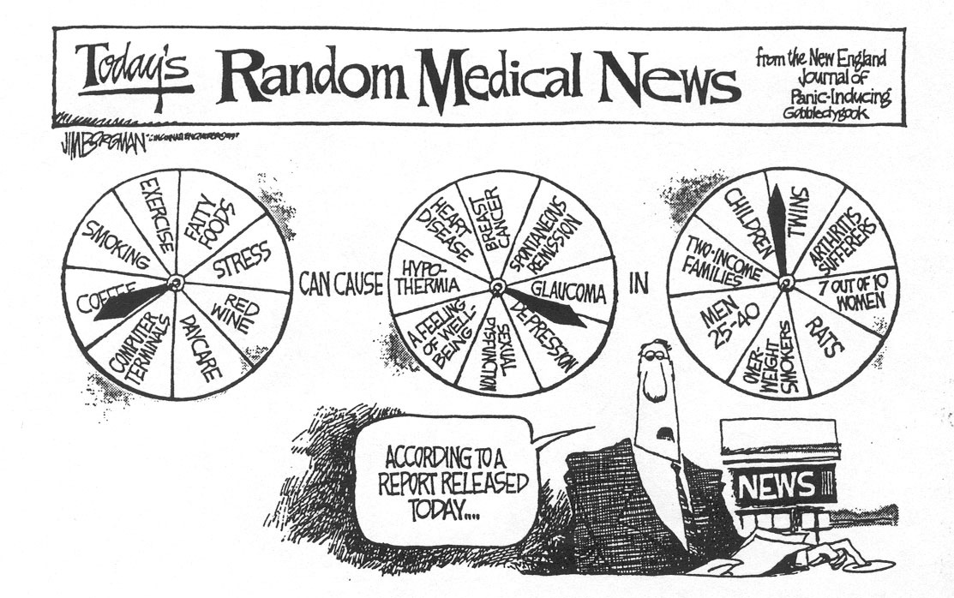
Transparency of Analytic Plans
Poor Quality of Reporting Confounding Bias in Observational Studies: A Systematic Review. Groenwold et al. Ann Epid 2008
Review of 174 observational studies, 2004 - 2007
Lack of transparency contributes to…
Notes:
How well do scientists perform with reporting a transparent analytic plan? There was an interesting study that looked at this. These authors looked at 174 consecutive observational studies in selected journals for a variety of characteristics related to the reporting and conduct of analyses related to confounding. They looked at a variety of things, but two stood out. The first was the percentage of articles where the authors reported why they were choosing the factors they did when controlling for confounding. Only 10% did so. The other was the percentage of articles where the authors reported the reasons for the factors they ultimately included in the final analysis. Only about 50% of articles did this. It is hard to know what authors are doing, or if it is correct, if they do not tell you. This lack of transparency likely contributes to the cartoon we showed earlier.

Slide 60
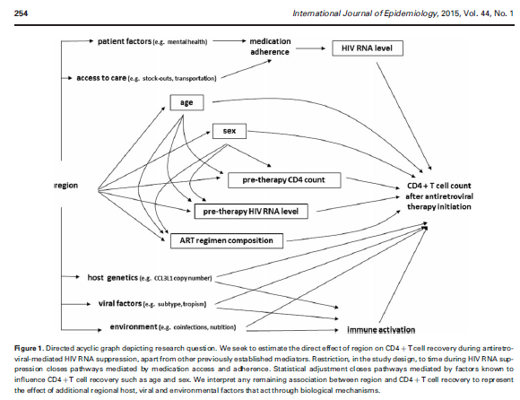
DAGs as a Means of Transparency and Communication
Precise way for scientists to talk to each other regarding:
  What is the research question (RQ)?
  What do we need to know about the surrounding system to answer the RQ?
  What do we need to control for to answer the RQ?
Use a DAG as Figure 1 in grants and papers
Notes:
You can go a long way towards transparency if you use a DAG as Figure 1 in your manuscripts and grants.
Shown here is one of the more elaborate Figure 1 DAGs I have worked on (Geng et al. IJE 2015). It is also a good idea to provide some narrative in the figure caption (and will not typically cost against the word count).
Even scientists who do not know the formal rules on reading DAGs can very easily follow these DAGs (and the accompanying narrative) and instantly understand what you are trying to do in your grant or your paper. This is one of the best examples of how a picture is worth a thousand words.

Slide 61
Stratification to Manage Confounding
Advantages
  Straightforward to implement and comprehend
  Transparent; some reviewers phobic of regression
  Easy way to evaluate for presence of interaction
Limitations
  Requires continuous variables to be discretized
    loses information; possibly results in “residual confounding”
    discretizing often brings less precision
  Deteriorates with multiple confounders
    e.g., suppose 4 confounders with 3 levels
        3x3x3x3 = 81 strata needed
        unless huge sample, many cells have “0”’s and strata have undefined effect measures, which wastes data (“sparse data problem”)
Conventional solution to these limitations: Conditioning via regression
  Mathematical modeling (aka, multivariable regression)
    e.g.,
      linear regression
      logistic regression
      log-binominal regression
      Poisson regression
      proportional hazards regression
See BIOSTAT 208 & 209
Notes:
Let us end our discussion of stratification by summarizing its advantages and limitations. The primary advantage is that it is a very straightforward and easy to comprehend approach. Some reviewers are phobic of regression models (because they appear to be a black box) and, hence, stratification, if you can do it, is very easily understood; everything is very easy to see in stratification — it is entirely transparent. You can see the strata directly. Stratification is also a very easy way to evaluate for the presence of interaction; you can immediately see any stratum-specific differences across strata. In contrast, multivariable regression makes interaction harder to identify in terms of the magnitude of the differences.
There are, however, limitations.
The first limitation is what do we do if we have continuous variables as our exposure or confounders, something like age, for example? To use stratification, we have to break these continuous variables into categories in order to get them into our contingency tables. This unfortunately is not the richest use of continuous data. This can also result in residual confounding if our categories are not narrow enough.
Second, probably the biggest limitation of stratification, that we have already touched upon, is that it deteriorates with multiple potential confounders. Suppose there are 4 confounders present each with 3 levels. If you wanted to manage and eliminate the presence of joint confounding by these 4 confounders you would have to form 81 strata, and, unless you had an enormous sample size, many of these strata would have unusable data (no ability to make comparisons between exposed vs unexposed, or between cases vs controls), which effectively results in throwing away data and less precise estimates.
The conventional solution to all of these limitations lies in the use of mathematical regression models, also known as multivariable regression. These regression models are also a form of conditioning. Listed are few examples of regression. You will learn the detailed aspects of how to do these in the Biostatistics courses starting in January.

Slide 62
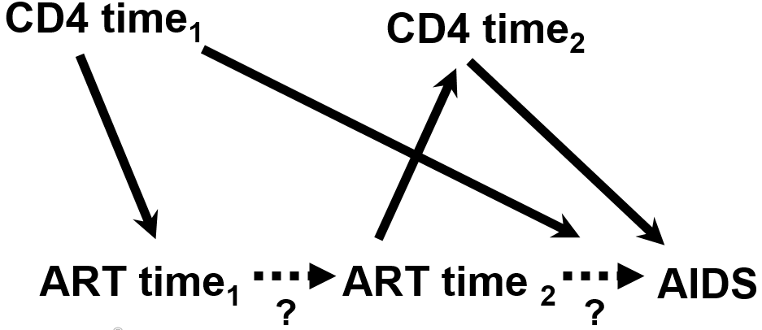
Limitation of Conventional Regression (as well as Stratification)
Scenario: Time-varying exposures in the presence of time-varying confounders which are also mediators of relevant causal paths
  e.g., Cohort study of effect of antiretroviral therapy (ART) on AIDS incidence
CD4 here = time-dependent confounder/mediator
At any given observation time:
there are some patients for whom you wish to control for CD4 (to manage confounding); and
some patients for whom you do NOT wish to control for CD4 (because it is a mediator of one of the relevant direct causal paths)
See Additional Slides for another scenario
Notes:
It turns out that even regression methods themselves are not infallible. Therefore, before we end our discussion of confounding, it is useful to describe some scenarios where none of the conditioning methods we have discussed for observational data, be it stratification or regression, will give you an unbiased answer.
One scenario is when you are studying time-varying exposures (for example, treatment) in the face of a factor we refer to as a time-dependent confounder/mediator. As an example, let us say we are performing a cohort study of the effect of antiretroviral therapy, ART, on the incidence of AIDS among HIV-infected patients. Because the exposure, here ART, varies with time in this cohort, we depict it with two nodes, one for time 1 and another for time 2. In reality, you could have an infinite number of nodes for each period in time. At time 1, the CD4 count of a patient will affect whether he/she is administered ART. The CD4 count also affects whether or not he/she will develop clinical AIDS. Yet, we also know that ART affects/causes CD4 count at time 2 which influences the occurrence of AIDS.
Therefore, at given time, we simultaneously desire to, in some patients, control for CD4 count to block this backdoor pathway, the one where CD4 is confounding, but in other patients we also want to leave it alone because it is a mediator of one of the relevant indirect causal paths we are studying. Let us assume we are studying the total effect of ART on AIDS. In this scenario, we are in trouble if we control for CD4 count (we will block one of the indirect paths) and in trouble if we don’t (we will not control for confounding effect). If stratification or regression are the only tools we have for this, we cannot both control and not control simultaneously in a group of participants; you need to do one or the other (control or not control). We are stuck, and thus we need another technique.
The Additional Material Slides show an another scenario in which conventional conditioning techniques lead to bias.

Slide 63
Time-varying exposures in presence of time-varying confounders which are also mediators of relevant indirect causal paths
“Weighted” refers to inverse probability weighting (a type of marginal structural model)
Cole et al, AJE 2003
Notes:
What happens if you have such a dilemma? These are data from a large cohort of HIV-infected women, known as the Women’s Interagency HIV Study (WIHS). The research question is whether highly active antiretroviral therapy has an effect on the occurrence of AIDS or death. In the first 3 lines in the table, we see the unadjusted or crude analysis. Women who were not treated with highly active antiretroviral therapy, abbreviated as HAART in this paper, formed the reference category. The comparator group was women who received no HAART. Compared to this reference category, women who received HAART had 0.98 times the hazard of developing AIDS or death. As you know, a hazard ratio is a form of a rate ratio. This means essentially no effect of HAART. This unadjusted effect is likely prone to negative confounding, that is, the sickest patients got treated and they had highest incidence of AIDS.
In the fourth line, the adjusted analysis is presented, where CD4 count and a variety of other factors (detailed in the footnote) are controlled for in a conventional multivariable regression model. Here, the hazard ratio has changed, 0.81, compared to crude, but its confidence interval still crosses 1. We expected this change because we expected negative confounding. The interpretation would still have to be that there is no strong evidence of an effect of HAART on the occurrence (prevention) of death or AIDS.
It was only when the investigators performed a technique called inverse probability weighting (a form of what is called marginal structural modeling) did they arrive at an estimate of the hazard ratio of 0.54, which was statistically significant. We happen to know that this estimate is the correct one because well-performed randomized clinical trials have shown that HAART drastically reduces AIDS and mortality to a similar extent as the HR of 0.54.
We do not have time in this course to describe how these marginal structural models work other than to say they re-weight the study populations for the confounders instead of directly performing conditioning. The reweighting is similar to what two arms of randomized trial look like; the arms have the same distribution of different confounding variables.

Slide 64
Conditioning vs Non-Conditioning Approaches to Manage Confounding
Conditioning approaches:
  e.g., Restriction, matching (with subsequent stratification), stratification, mathematical regression
  Compare exposed to unexposed at fixed levels of the confounders
In contrast, non-conditioning approaches:
  Several different techniques:
    G-estimation
    Structural nested models
    Marginal structural models (e.g., inverse probability weighting -- Currently most popular)
    (& others, e.g., nested new user cohort analysis)
  Theme: balance exposed and unexposed groups for the confounder
    then compare exposed to unexposed to achieve “marginal” measure of association
    This is what randomization does, but non-conditioning techniques for observational analysis are much more complicated!
Goal for you
    Recognize when these techniques are needed by spotting relevant scenarios
See BIOSTAT 215
Notes:
Again, what we have talked about thus far are called conditioning techniques to manage confounding. Restriction, matching (with subsequent stratification), stratification, and mathematical regression are examples of conditioning. What they do is to compare exposed to unexposed persons at a fixed level of confounding variables.
In contrast, non-conditioning approaches (whose names are listed here) do something other than fixing the confounder at a set level to manage confounding. They first balance exposed and unexposed groups for the presence of confounders. If you think back, you will recall that this is what randomization did. By randomly distributing people to exposure groups, the exposure groups were balanced. Randomization is pretty simple to do in experimental designs, but performing these non-conditioning techniques on observational data is more complicated.
At this point in time, the implementation of these non-conditioning approaches are largely in the hands of expert analysts. The data manipulation is extensive and sophisticated. They typically should not be done by non-experts unless they have a lot of help. As they techniques become easier to implement, it is easier to see how they might become the standard approach in many observational study analyses. It is therefore important to be aware of these techniques. Note: one problem with some of these approaches is that they are sometimes less precise than conditioning approaches.
Although we will not discuss how to implement these other techniques, what is important for all clinical researchers and epidemiologists is to recognize when these non-conditioning techniques need to be used. The data will not be screaming out for these approaches, and most researchers are unaware of these situations. The goal for you is to be able to spot the scenarios where conventional conditioning techniques do not work, and we have described two big ones (one in the prior slides regarding time-dependent confounding/mediators and in the Additional Material Slides).
Note: Yet another family of non-conditioning techniques to manage confounding can be found in the discipline of econometrics. These are techniques such as “regression discontinuity” and “difference-in-differences”. We have an entire course in econometric approaches to causal inference.

Slide 65
Summary
Stratification useful to: evaluate interaction, control for confounding, block indirect causal paths & (sometimes) increase precision
Adjusted summary estimators are formed via weighted averaging of stratum-specific estimates
  Mantel-Haenszel technique most common
  Constitute a “conditional” measure of association (contrast with marginal measures of association)
While adjustment can reduce bias, it can worsen precision (& amplify (IV’s) or create bias (colliders))
DAGs (plus software, if needed) tell us the MSAS’s
  Investigators must choose the best MSAS based on a variety of considerations
Yet, we are not always certain about our DAGs
Use a principled and transparent analysis plan to guide your work and navigate bias-variance tradeoff
Stratification falls apart with multiple confounders
  Regression is the typical conventional solution
DAGs help us recognize when conventional conditioning methods (stratification/regression) fail
  And hence non-conditioning technique needed
Notes:
Here is a summary of our discussion today.
We have shown how stratification is useful to evaluate for the presence of interaction, control for confounding, block indirect causal paths & (sometimes) increase precision.
When performing stratification, adjusted summary estimates are formed (when they are appropriate to form) via the process of a weighted average of the stratum-specific estimates. The Mantel-Haenszel technique is the most commonly used. Stratification produces what is called a “conditional” measure of association.
We learned that stratification is not always beneficial. It can worsen precision, create bias where it is not heretofore present (collider bias), and amplify unmeasured confounding bias (adjustment on an instrument).
Solving DAGs refers to determining what one needs to do to estimate (or “identify”) the causal effect of exposure on disease. This typically means to contend with one or more confounding pathways. To solve complex DAGs, we need to identify the MSASs and choose to manage the MSAS which is most practical.
The dirty little secret, however, about DAGs is that you might be uncertain about them. If this is the case, an analysis plan is the principled approach to guide our work. Sometimes there is not just one final model or one final measure of association. If so, show readers how the exposure-disease association differs across different assumptions in a DAG.
We talked about the limitations of stratification and how these were a motivation for conventional mathematical regression, which are, in essence, a very sophisticated form of conditioning. However, all conditioning approaches also have limitations. Time-dependent confounding/mediation is the biggest such limitation of conditioning approaches to confounding management. When conditioning techniques fail, for example, in the face of time-dependent confounders/mediators, there are a family of non-conditioning techniques. Inverse probability weighting is currently the most popular, although this may change in the future. It is most important that applied researchers understand and recognize when these more advanced techniques are needed.

Slide 66
Next Tuesday (Next Week)
8:45 to 10:15: Journal Club
  Meet in Room 1400. We are all together.
1:30 to 3:00 pm: Last Small Group Section
  Web-based course evaluation
  Bring laptop
Distribute Final Exam (on website)
  Exam due following week by 4 pm Tuesday (Dec. 17)
  Upload your completed file on the CLE website (the syllabus site)
    Use a .pdf to preserve all of your formatting
    List your name in the file name
  Contact Agnes (agnes.ng@ucsf.edu) if problems
Notes:
This is the schedule for next week. We have a Journal Club, a Small Group Section, and we will distribute the final exam. We take a lot of time to carefully grade the exams. They may not be returned until January.

Slide 67
Additional Material Slides

Slide 68
Terminology to use when describing adjusted relationships
e.g. AZT use, severity of needlestick, and HIV
. cc HIV AZTuse, by(severity) pool
severity | OR [95% Conf. Interval] M-H Weight
-----------------+-------------------------------------------------
minor | 0 0 2.302373 1.070588
major | .35 .1344565 .9144599 6.956522
-----------------+-------------------------------------------------
Crude | .6074729 .2638181 1.401432
Pooled (direct) | . . .
M-H combined | .30332 .1158571 .7941072
-----------------+-------------------------------------------------
Test of homogeneity (B-D) chi2(1) = 0.60 Pr>chi2 = 0.4400
Test that combined OR = 1:
Mantel-Haenszel chi2(1) = 6.06
Pr>chi2 = 0.0138
“Use of AZT is associated with decreased odds of HIV acquisition, independent of needlestick severity”
“Use of AZT is associated with decreased odds of HIV acquisition, adjusted for needlestick severity”
“Use of AZT is associated with decreased odds of HIV acquisition, controlling for needlestick severity”
“Use of AZT is associated with decreased odds of HIV acquisition, conditioned on needlestick severity”
Notes:
This is the terminology to use when describing, in general, an adjusted relationship. There are several acceptable sentences.

Slide 69
“Independent of”
“Use of AZT is associated with decreased odds of HIV acquisition, independent of needlestick severity”
“independent of” simply refers to adjustment/control for specific factors
  Does not refer to whether or not adjusted estimate is different from crude
  Just means that something has been done to contend with confounding by the factor in question (e.g., via stratification)
  Does not necessarily mean the association is causal
Notes:
Let us look at this term “independent” a bit more because in the past some students have been confused by it. “Independent of” simply refers to something having been done to contend with confounding. This something could have been restriction, matching, an instrumental variable, stratification, regression, or some other form of adjustment. It does not refer to whether or not the adjusted estimate differs from the crude. It just means that some form of adjustment has been performed (for example, via stratification).
“Independent of” also does mean that that the association is necessarily causal. There still are other explanations, other than causal, for a numeric association.

Slide 70
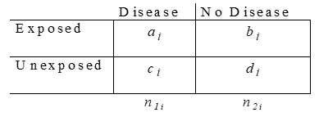

Mantel-Haenszel Confidence Interval and Hypothesis Testing
Notes:
Consider again the AZT use, needlestick severity, and HIV acquisition example. It is worth pointing that Stata is working hard for you behind the scenes in the Mantel-Haenszel-adjusted confidence interval formation and hypothesis testing. Whereas the point estimate for the adjusted measure of association point estimate is easy to calculate, the standard error, shown here, is not. But luckily Stata calculates all of this for you. And, remember, the standard formula for a 95% confidence interval is the point estimate plus or minus 1.96 times the standard error.
For the hypothesis test of adjusted measure of association equal to one, the bottom equation is the formula for the chi-square statistic which has 1 degree of freedom. E subscript i refers to the expected value of the “a” cell (upper left hand cell) in each of the k strata. There is no need for remember these formulae, but you do need to know how to interpret them.

Slide 71

Some Mantel-Haenszel Techniques
Mantel-Haenszel estimators
Mantel-Haenszel chi-square statistic
Mantel’s test for trend (dose-response)
Notes:
It is also worth pointing that in addition to the Mantel-Haenszel estimators we are discussing, you’ll see other techniques named after Mantel and/or Haenszel, and it is worth keeping it straight which is which. We actually described the M-H chi-square statistic in the last slide, and there is also something known as the Mantel test for trend, for which there’s a nice discussion in the Appendix of the S & N textbook.
This undated photograph of the two was taken by a former UCSF faculty member, Dr. Nicholas Petrakis.

Slide 72
How about this conclusion?
“Use of AZT is causally related to reduced HIV acquisition.”
Formally, our analyses produce statistical associations, which could result from:
  Causal relationship (Truth)
  Or bias due to:
  Selection bias
  Measurement bias
  Confounding bias
  Or
  Reverse causality (but not here since we know AZT use came first)
  Or
  Chance
Data from a single observational study rarely suffices as argument for causality
Data themselves do not establish causality
  - Instead, scientists infer it, by consensus, by excluding the other 5 explanations (“causal inference”)
Notes:
How about this conclusion? Use of AZT is causally related to reduced HIV acquisition (or as short hand: AZT prevents HIV acquisition). Can we say this? Probably not, at least not with just the information at hand and without more discussion. This is because formally our analyses can only produce statistical associations, which could have resulted from one of 6 possibilities shown. We have discussed this many times in the course now.
We can never formally prove causality. The best we can do is to make arguments why the other 5 explanations (selection bias, measurement bias, confounding, reverse causality, or chance) are not present. We are not going to take any time in this course to discuss the various other criteria or guidelines for establishing causation because they are becoming outdated. The most famous are the guidelines set forth by Austin Bradford Hill in the early 1960’s. These were prominent in the case made for cigarettes as a cause of lung cancer in the early 1960’s. We will not take the time to discuss these other criteria because you have now learned the more important aspects of the process, which is to exclude the 3 main threats to validity, reverse causation, and chance. This is a process that is only done by consensus among methodologically astute and substantively grounded scientists. This process is known as causal inference. This is what we mean when we say that data themselves do not establish causality. Instead, scientists do in a process of consensus, by excluding the 5 other explanations.
Because of the uncertainties involved in causal inference using observational data, it is rare that a single observational suffices as a sole argument for causality. It is not impossible, but it is uncommon.

Slide 73

Bias Amplification
Whenever there is residual confounding of exposure (E) and disease (D), any adjustment for other factors that are associated with E will amplify the magnitude of the residual confounding
  The stronger the association between the controlled for factor(s) and E, the greater the “bias amplification”
  Heuristic: Decreasing variability in E that is caused by sources other than the residual confounding pathway will inflate the contribution of the confounding pathway to the (biased) estimate of the effect of E on D
We naturally accept this downside when we adjust for known strong confounders
In the presence of residual confounding, adjustment for a factor associated only with exposure (“instrumental variable” –IV) has no upside; it only results in “bias amplification” (also worsens precision)
Also a problem with “near-IV’s”, factors associated with E but only very weakly with D
Advice: Never adjust for IV’s. If you fear residual confounding, be cautious about adjustment for near-IV’s
Notes:
One of the more recent findings in the causal inference movement has been the description of what is called “bias amplification” and “bias amplifiers”.
Consider our usual observational scenario in which we are interested in the causal effect of some exposure (E) on some outcome (D). We know from the sufficient-component cause model (Rothman 1976) that exposures themselves are the result of many causes. DAGs also remind us of this. Thus, when we list E on a DAG, it means that there is variability in the construct and that all of the causes of E contribute to the variability.
Bias amplification refers to what can happen anytime there is residual confounding of the E – D relationship, i.e., some unmeasured and unaccounted for confounding pathway, as shown on the DAG. If there is residual confounding, then any adjustment that is performed on factors that are causal of E, other than the unmeasured confounder, will decrease the variability in E. The only variability that is left in E that is available for us to evaluate the association between E and D is the variability that is caused by the unmeasured confounder and any other causes of E. If we take away variability in E that is caused by causal factors of E other than the unmeasured confounder, then this means that we are increasing the relative contribution of the unmeasured confounder to the variability of E and thus increasing the role of the unmeasured confounder pathway to the overall effect of E on D. Increasing the role of the unmeasured confounder pathway means that its bias is accentuated in comparison to what it would be without the adjustment for causal factors of E. This heuristic understanding is the basis of the bias amplification that occurs when we adjust for factors related to E in the face of residual confounding. Bias amplification means that the bias due to the residual confounding is larger than it would have been if we had not adjusted for the factor.
You might say that we always facing this risk when we adjust for known and measured confounders of the E – D relationship, and this is true, but if there is no residual confounding, as we hope is the case, then there can be no bias amplification. Even if there is residual confounding, we will naturally accept this bias amplification when we adjust for a strong confounder because of all of the benefits of adjusting for a strong confounder.
Where bias amplification really comes into play is when we decide to adjust for factors that are solely associated with E but not with D. As we learned a few sessions ago, such a factor is called an instrumental variable, or “IV”. In the presence of residual confounding, adjustment for an IV has no upside, no advantages. Adjusting for an IV in the presence of residual confounding will cause amplification of the residual confounding. And, the stronger the association between the IV and E, the greater the bias amplification. Adjusting for IV’s can also worsen precision.
Bias amplification was only relatively recently described (Bhattacharya J and Vogt W, 2007; and Wooldridge, 2009) and popularized in the epidemiologic literature by Pearl (2010). More nuanced approaches involving the effects of multiple adjustment are also available (Myers 2011 and Pearl 2011).
Thus, the simple advice is to never adjust for IV’s and is yet another reason to avoid indiscriminant adjustment. This is despite the older advice, by some in a less enlightened era, that all “pretreatment” covariates (factors that occur prior to exposure) should be controlled for.
While it is easy to follow the advice to avoid adjusting for IVs, the harder and more common situation is knowing what to do with factors that are related to E and are either weakly related to D (these are known as “near instrumental variables”, which are depicted in the DAG with a light edge from the instrumental variable to D) or you are not sure if they are related to D. Should you adjust for them to remove a confounding path or do you do more harm (via bias amplification) than good? If you can be sure that there is no residual confounding, then there is no threat of bias amplification. However, if you cannot be sure there is residual confounding (which is usually the case), then the only honest approach is to perform analyses both with and without adjustment for the factors and see how much the E — D inference changes. If the E — D inference changes considerably, this indicates that more research is needed to sort out the problem.
Colliders and bias amplifiers are two examples of recent methodologic discoveries that have entirely changed the way we perform observational research and management of confounding. We suspect other discoveries will continue to occur. In short, anything short of randomization is fraught with potential problems. It does not mean the problems cannot overcome; it just means that we have to be cautious before drawing conclusions about causality.
Bhattacharya J and Vogt W. Do Instrumental Variables Belong in Propensity Scores? (NBER Technical Working Paper no. 343). Cambridge, MA: National Bureau of Economic Research; 2007.
Wooldridge J. Should instrumental variables be used as matching variables? East Lansing, MI: Michigan State University; (https://www.msu.edu/~ec/faculty/wooldridge/current%20research/treat1r6.pdf). 2009.
Pearl J. On a class of bias-amplifying variables that endanger effect estimates. In: Proceedings of the Twenty-Sixth Conference on Uncertainty in Artificial Intelligence (UAI 2010). Corvallis, OR: Association for Uncertainty in Artificial Intelligence; 2010:425–432. (http://ftp.cs.ucla.edu/pub/stat_ser/r356.pdf). 2010.
Myers JA, Rassen JA, Gagne JJ, et al. Effects of adjusting for instrumental variables on bias and precision of effect estimates. Am J Epidemiol. 174(11):1213–1222, 2011.
Pearl J. Invited commentary: understanding bias amplification. Am J Epidemiol. 174(11):1213–1222, 2011.

Slide 74
How to handle multiple areas of uncertainty in complex DAGs?
No one best approach
  Frontier of methodologic research
Our advice features transparency & reproducibility
Draw the different possible DAGs & find the MSAS’s
Common MSAS’s present across the DAGs
No common MSAS’s across the DAGs
Determine adjusted estimate that includes all of the uncertain relationships (all of the B list variables). Consider this “maximally adjusted”.
Adjust for the common MSAS
Does any uncertainty involve colliders?
One by one, recalculate adjusted estimate without one of the B list variables. Drop the B list variable if its exclusion results in an estimate no more than some threshold (e.g., 5% to 10%) away from maximally adjusted estimate. Stop when no more B list variables can be dropped.
Yes
No
Done
Next slide
Notes:
Earlier we posed a question about how to handle multiple areas of uncertainty in complex DAGs. The answer is that there is no one best approach that is universally agreed upon, and this is an active area of methodologic research. In this sense, epidemiology and biostatistics are relatively young scientific fields.
Our advice features transparency, scientific honesty, and a goal of reproducibility. It starts by drawing the different possible DAGs based on the various uncertainties you believe are present in the presence, absence, or direction of edges and then finding the MSASs for each of the different DAGs. If there are common MSASs across the DAGs, then you are in good shape. If this is the case, this means there are identical actionable approaches for each of the different DAGs. If so, then adjust for that common MSAS (or, if there are many common MSAS, then choose the most feasible given the prior advice). Accept for answer that adjustment brings. This produces the “final” estimate.
If there are not common MSASs across the DAGs, then we have to ask if any of the uncertainty involves colliders? If yes, see the next slide. If no, then determine the adjusted estimate that includes all of the uncertain relationships, in other words, all of the “B” list variables. Consider this the maximally adjusted estimate. Then, one by one, recalculate the adjusted estimate without one of the B list variables, but keep all of the A list variables fixed. Drop the B list variables, using a change-in-estimate approach, if excluding the variable does not change the estimate by more than some threshold (of say, 5% to 10%). Stop the process when no more B list variables can be dropped.

Slide 75
How to handle multiple areas of uncertainty in complex DAGs?
Draw the different possible DAGs & find the MSAS’s
If necessary, reduce # of DAGs to some reasonable #
Common MSAS’s present across the DAGs
No common MSAS’s across the DAGs
Determine adjusted estimate for the different DAGs
Estimates from different DAGs are all close (within 5% or 10%)
Estimates NOT close (> 5% or 10%)
Adjust for the common MSAS
Does any uncertainty involve colliders?
Report adjusted estimates for the different DAGs
Done
Done
No
Yes
Prior slide
Discuss which uncertain relationships are most influential & highlight them for future research
Additional approaches in BIOSTAT 208 and 209
Notes:
Continuing the algorithm, if the uncertainty does involve colliders, then we need to determine how many different DAGs are there after considering the different directions that key edges may have. If the number of DAG permutations is unmanageable, then you as the investigator will need to make some decisions to get this down to a reasonable number. This might mean fixing the direction of some of the edges for which you have uncertainty. After this is done, determine the adjusted estimate for each of the different DAGs. If they are close, say within 5% to 10%, then you are done. If they are not close (e.g., they differ by more than some threshold of 5% or 10%), then you should report the different results and discuss which of the uncertain peripheral relationships are most influential. These uncertain peripheral relationships should be highlighted for future research.
This is just one approach, and you will learn of others in our BIOSTAT 208 and 208 courses. Software is also beginning to be developed to look across several DAGs. One application is in the R software program, and it allows the user to import in a DAG created in DAGitty.net (Textor et al. International Journal of Epidemiology 2016). The application (also called dagitty in R) has several functions including a) evaluating whether a given DAG is compatible with a given dataset (“DAG-dataset consistency”) and determining what other DAG structures are similar in their testable statistical implications to a given base DAG (finding “equivalent” DAGs). The overall goal of this R application is get some evidence that one’s DAG is “correct” (i.e., all of the nodes and edges are properly placed and directed). At this time, the application is best at providing some evidence that a given DAG is incorrect; it cannot prove that a given DAG is correct. As stated before, this is the underlying challenge in causation-based work — knowing if one’s DAG is correct.

Slide 76
Remember the Research Purpose When Performing Adjustment
We have focused on adjustment to remove confounding for causal hypothesis testing of a single exposure variable
However, there are other reason objectives that require multivariable regression analysis
  Evaluating multiple exposure variables for causation
  Mediation analysis
  Prediction of outcome by a set of variables (even if non-causal variables)
The first (evaluating multiple exposures) requires the same principles as testing single exposure; there is no shortcut when evaluating multiple ones
These latter two (prediction and mediation) require different approaches to decide what variables to adjust for and different metrics to assess
Notes:
One must remember the research purpose/objective anytime one performs adjustment via multivariable mathematical regression equations. In other words, why are you conducting the work in the first place? We have focused thus far on adjustment for causal hypothesis testing of a single (primary) exposure variable. Yet, there are other purposes that require multivariable adjustment. Three other main categories are, one, evaluating multiple exposure variables for causation; two, for mediation analysis; and, three, for prediction of outcome by a set of variables even if non-causal.
The first (evaluating multiple exposures) requires the same principles as testing single exposure; there is no shortcut when evaluating multiple ones. That is, every individual exposure needs to be treated in isolation as the primary exposure and the researcher needs to draw causal DAGs in relation to each individual exposure to identify its causal effect. This is a lot of work, but there is no substitute. Sometimes, researchers embark on an endeavor to identify a set of “risk factors” for a given outcome and do so by finding all factors that are independently associated with outcome in multivariable regression. This is, in fact, a very common objective. It is, however, a dubious task in that one does not know, with such a process, if these “independent” risk factors are causal or just predictive. The practice may be reasonable in the earliest stages of investigation of a condition, but we predict that it will fall by the wayside as research methods evolve and researchers become more sophisticated. In fact, we hope and suspect that the non-specific term “risk factor” disappears. Others agree (see Schooling CM and Jones HE. Clarifying questions about “risk factors”: predictors versus explanation. Emerg Themes Epidemiol 15:10, 2018.)
The latter two purposes (prediction and mediation) require different approaches to decide which variables to adjust for. In the realm of prediction, we are no longer interested in the effect of individual exposures but instead want to know the predictive accuracy (on some outcome) of a group of variables. This requires different strategies and metrics to asses. A DAG can be helpful to think about which variables to include in a predictive model, but variables do not have to be causal to be included. Regarding mediation, there are several considerations to keep in mind which are much more sophisticated than simply estimating the total effect in a typical causation question. These include indirect and direct effects, controlled and natural effects, mediator-outcome confounding, and the importance of interaction. The details of performing adjustment for purposes of prediction and mediation are beyond the scope of this course but will be covered in our Biostatistics course sequence, including BIOSTAT 215 and our courses on predictive analytics.

Slide 77


Importance of Overlap of the Confounder
From Last Week
2. Matching also provides a way to ensure overlap between comparator groups (e.g., cases/controls) in the distribution of confounders other than complex nominal variables
e.g., Case-control study of prostate cancer -- confounding by age
  Cases will have many old individuals
  Random sampling of controls, especially in smaller studies, apt not to contain oldest individuals
  - Matching age distribution of controls to age distribution of cases ensures complete overlap in age between cases and controls
Notes:
Recall this slide from the discussion of matching from last week. Recall how we discussed how matching ensures overlap between the comparison groups in the distribution of confounders. We spoke of how this applies to both categorical variables and interval scale categorical variables. We considered a case-control study of prostate cancer, where there is concern for confounding by age. Certainly, the case group will contain many older individuals. If one just randomly sampled a control group from the general population, it is likely, especially in a small study, not to contain men as old as some of the cases, and it may contain many younger men. This is shown here in the two distributions of age in cases and controls. In a situation like this, there is no way to adjust for age in the analysis phase without some strong assumptions (or restricting to the overlap range). Both stratification and regression techniques need there to be overlap in the distribution of the confounder between comparator groups. Without overlap, there are no controls to use to compare against these older cases. Matching provides a solution for this because it ensures that the distribution of age in the controls will completely overlap the age distribution in the cases. Then, in the analysis phase, you can adjust for age completely and without the need for strong assumptions.
Matching will guarantee overlap but matching is not required to achieve overlap. Sometimes overlap will be present with just random sampling of study population or comparator groups. Or, even if there is not overlap for one confounders, a multivariable collection of confounders will achieve overlap. This is what can occur with the use of propensity scores, a topic that we will not discuss in this course. The main point is that overlap needs to be assessed prior to performing adjustment. It can most easily be addressed in the setting of multiple confounders by plotting the distribution of propensity scores across exposure categories.

Slide 78
Importance of Overlap of Confounder Distribution Across Comparators
Overlap is guaranteed in restriction, and matching; overlap theoretically guaranteed in randomization
But not guaranteed in stratification or regression
In stratification, lack of overlap will result in unused strata and wasted data
In regression, certain assumptions are made about the non-overlap zones (based on behavior of the data in overlap zones)
  Typically without the investigator being aware
  Can lead to bias
Advice
  Look for presence of overlap of confounder distributions between comparator groups
  Propensity scores are easiest approach
    Lack of overlap also called:
      Positivity violation
      Experimental treatment allocation (ETA) violation
Notes:
In general, overlap is guaranteed in restriction and matching. It is also theoretically guaranteed in randomization (assuming that chance imbalance does not occur). It is not, however, guaranteed in stratification or regression. In stratification, lack of overlap will result in some strata where a comparison between exposed and unexposed (or case and control) cannot be made. This wastes data. In regression, certain assumptions are made about the non-overlap zones based on the behavior of the data in the overlap zones. If these assumptions are incorrect, the resulting inferences from the regression are biased. Unlike stratification where the investigator might typically see the non-overlap, the problem is more insidious in regression because the analyst can easily just push the buttons in Stata without even knowing there is non-overlap.
The advice for this issue is that one needs to look for the presence of overlap of confounder distribution between comparator groups. This takes extra effort. Creating propensity scores are the easiest approach. Any lack of overlap is given names such as “positivity violation” or “experimental treatment allocation violation”.

Slide 79
Residual Confounding
(i.e. confounding still present after adjustment)
Four Mechanisms
Categorization of confounder too broad
  e.g., Association between natural menopause and prevalent CHD
  Szklo and Nieto
Misclassification of confounders
  Can be differential or non-differential with respect to exposure and disease
  If independent non-differential, will lead to adjusted estimates somewhere in between crude and true adjusted
  If independent differential, can lead to a variety of not easily predictable directions of bias
Notes:
Let us review the four different mechanisms of residual confounding. Residual confounding means confounding is still present even after some attempt at adjustment.
To our count, there are 4 mechanisms for this.
The first is when the categorization of confounder is too broad. Let us look at a telling example from the S & N textbook in which age adjustment is performed. The results are very different as we move from too broad (just dichotomous) to a continuous variable specification of age. There are many other examples, such as when investigators dichotomize very complex and rich variables such as smoking and hypertension. This is a very common problem in the literature.
The second mechanism for residual confounding is when the measurement of the confounders is misclassified. Note that the misclassification can be differential or non-differential with respect to exposure and disease; it can also be dependent or independent. If the misclassification is all independent and non-differential, this will lead to adjusted estimates that rest somewhere between the crude and true adjusted estimate.
If the misclassification is independent differential, this can lead to a variety of difficult-to-predict directions of bias. This is also the case for dependent misclassification.

Slide 80

Residual Confounding
Mechanisms – cont’d
Variable used for adjustment is imperfect proxy/surrogate for true confounder
Unmeasured confounders
Unmeasured C
Age
D
E
?
Notes:
The third mechanism for residual confounding is when the variable used for adjustment is an imperfect proxy or surrogate for the true confounder. We actually encountered this system in our problem sets with the CRP, inflammation, and coronary artery disease example.
The fourth mechanism is simple, caused by when you have unmeasured confounders and unblocked backdoor paths. This is shown in the DAG with the construct “Unmeasured C”. The threat of unmeasured confounding can be levied against essentially any observational study design but the threat is more real in some systems than others. It stands to reason that systems that have been studied extensively for many years have less threat of unmeasured confounding than newer systems.

Slide 81

Reasons to Adjust: To Close an Indirect Path
Close a backdoor path generated by a non-collider which is a “common cause” (a confounder)
2. Close an indirect path which is a nuisance
  estimating “direct effect” of E, apart from its effect on X (e.g., poor diet)
Parental myopia
Nightlights
Child’s myopia
?
First 3 “residual” mechanisms noted in the two prior slides also pertain to this reason for adjustment -- results in “incomplete adjustment for indirect causal pathways”
Notes:
Everything we just said about the first 3 mechanisms for residual confounding (categorization too broad; misclassification; and use of proxy) also pertain to when adjustment to block indirect causal pathways is the objective. If this occurs, it results in what we call incomplete adjustment for indirect causal pathways.

Slide 82
Quantitative Analysis of Unmeasured Confounding
Can back calculate to determine how a confounder would need to act in order to spuriously cause any apparent measure of association; e.g., observed OR= 2.0
Prevalence of “high” level of unmeasured confounder
Association between unmeasured confounder and exposure (prevalence ratio)
A (low prevalence scenario) = 7
B (high prevalence scenario) = 3.4
Association between unmeasured confounder and disease (risk ratio)
Winkelstein et al., AJE 1984
Notes:
Remember when we were discussing measurement bias that we described ways how the investigator could go from the observed results to the truth if he/she knew something about the specifications of the measurement? This is known as a form of quantitative bias analysis. Another form of quantitative bias analysis can be done with unmeasured confounders. The idea is that the investigator can back calculate to determine what characteristics a confounder would have to have in order to spuriously cause any apparent measure of association. In other words, what would the association need to be between the unmeasured confounder and the exposure and between the unmeasured confounder and the outcome in order to cause the observed measure of association between exposure and outcome, assuming that there was truly no association between exposure and outcome. In the graph that is shown on the left, let us assume we have an observed odds ratio of 2.0 in our study sample. We are concerned that it has been caused by unmeasured confounding. The y axis shows magnitude of association between the unmeasured confounder and exposure, as described in a prevalence ratio. In the x axis, we show the magnitude of association between the unmeasured confounder and the outcome, as described with a risk ratio. In addition to the magnitude of association between the unmeasured confounder and exposure/disease, the other relevant parameter is the prevalence of the confounder, shown by these contour lines.
As an example, let us assume that the unmeasured confounder is dichotomous and it has a “high” level and a “low” level. Let us look at situations where the prevalence of the ‘high’ level of the unmeasured confounder is 0.1 (10%), in other words, uncommon. The curved line marked “A” depicts this scenario of uncommon prevalence of the confounder. It shows the combination of associations between the unmeasured confounder and the exposure and disease, respectively, in order for us to spuriously see an odds ratio of 2 between the exposure and disease. At the point where the line crosses the hatched diagonal line, the graph is telling us that there would need to be a prevalence ratio of 7 between the unmeasured confounder and the exposure and a risk ratio of 7 between the unmeasured confounder and outcome to cause positive confounding of an odds ratio of 2.0 Or, if the prevalence of the ‘high’ level of the unmeasured confounder was higher, say 52% (as depicted in the curve labeled “B”), then the associations would need to be 3.4 in the two arms. These two scenarios make sense to us: for a low prevalence confounder to be operative it would have to have very strong relationships with exposure and disease (measures of association ~7). A more common confounder would not need to have such strong relationships with exposure and disease.
With this in mind, investigators can then try to convince readers that it is unlikely that such unknown confounders and relationships exist. We can examine the two scenarios in this example. In the first, for a low prevalence confounder to be operative it would have to have very strong relationships with exposure and disease (measures of association ~7). As authors, we would try to argue that if such strong relationships (“7’s”) existed, we would surely know about them already. In the second scenario, that of a more common confounder (50% prevalence), one would not need to have such strong relationships with exposure and disease (3.4). In this scenario, we, as authors, would argue that we would surely know such a moderately strong confounder if it existed in 52% of the population. The logic of these arguments is compelling in certain systems (those that are well studied) more so than in others (new systems).
Perhaps the first example of this quantitative bias analysis for confounding, and perhaps also the most famous, came during the scientific discussions regarding the association between smoking and lung cancer. R.A. Fisher, who was a famous statistician and also a smoker, argued that some "underlying constitution" existed that both caused lung cancer and a propensity to smoke. He thought that this underlying constitution was an unmeasured confounder that was spuriously causing smoking to look like it was associated with lung cancer. However, other scientists (most notably Jerome Cornfield) countered this by saying that if such an underlying constitution existed, its strength of association with both smoking (exposure) and disease (outcome) would have to be very very large -- large enough to explain the odds ratio of 10 that was observed for smoking and lung cancer. The argument was that if such a strong factor existed the scientific community would surely know about it already and could measure it. If Fisher could do no better than simply saying an "underlying constitution" existed, this is not convincing enough. With an important public health decision on smoking needed to be made, the Cornfield-led scientists argued that without being to specify this notion of an underlying constitution it had to be rejected in favor of believing and acting upon the nominal association between smoking and lung cancer. This was a critical nail in the coffin for smoking.
One other aspect of this is that you could have multiple confounders of smaller magnitude that could in combination add up to these effects. Convincing readers that these smaller magnitude confounders are absent is more difficult.

Slide 83

Quantitative assessment of unmeasured confounders
  Kitahata et al. NEJM 2009
In this study, the exposure was deferral of anti-HIV therapy vs immediate use and the outcome was death.
Observed risk ratio was 1.94.
“The contour plot shows that a confounding factor with a relative risk for death of 4.0 and an odds ratio for deferral of therapy of 4.0 after adjustment for all included variables would reduce the estimated relative risk for deferred therapy to approximately 1.30.”
Notes:
Here is an another example that the Course Director was involved with in the NEJM where the research group showed a contour plot looking at various scenarios for unmeasured confounding and how much this might influence our findings. In this approach, we showed how adjustment for different combinations of would-be confounder/exposure and would-be confounder/outcome relationships would alter the observed relationship. In other words, if the confounder did exist and we controlled for it, how would our answer change.

Slide 84
Quantitative Bias Analysis
Our teaching of selection, measurement, and confounding bias has mainly been qualitative
Frontier of epidemiologic methods is quantitative bias analysis
  Selection bias: use estimates of selection probabilities to back-calculate to truth
  Measurement bias: use estimates of misclassification to back-calculate to truth
  Confounding:
    How would results change in presence of certain confounding factors of a given prevalence and strength of association with exposure and outcome?
    How strong would associations be between unmeasured confounders and exposure/outcome in order to result in the nominal association if one truly does not exist?
Software is just beginning to encode for this
  Stata “episens” user created ado file
Notes:
In this course, our discussion of selection bias, measurement bias, and confounding bias has mainly been qualitative. We have attempted to state the direction of the bias in the face of certain biases but not the magnitude. The one exception has been a few items on the problem sets where we gave you the opportunity to back calculate to the truth in the face of measurement bias ⎯ the cell phone problem and the regression dilution bias problem.
Qualitative bias analysis is the current approach that most researchers implicitly use, but we do want everyone to know that quantitative bias analysis is what is on the frontier of methodologic research and application. Specifically, for selection bias one can use estimates of the differential selection probabilities to back calculate to the truth. For measurement bias, one can use estimates of the measurement parameters (or ranges) and back-calculate to the truth. And for confounding bias, one can determine how much the results would change if we controlled for a confounder of a given prevalence and strength of association with exposure and disease. Or, one can state just how strong associations would need to be among would-be confounders and exposures/diseases in order to observe the nominal association between exposure and disease when one truly did not exist.
Within the next 10 years, these techniques will become more commonly used as the software to implement them improves. One such early software program is the user created ado file called “episens”, which we used in the Measurement Bias Problem Set.

Slide 85

Quantitative Bias Analysis in Stata: episens Command to Correct Unmeasured Confounding
Observed data
Association between confounder and exposure can be specified by either defining “dpexp” and “dpunexp” or by defining “dpunexp” and “dorce”; “drrcd” must be specified
. episensi 45 94 257 945, st(cc) dpunexp(c(.55)) dorce(c(2.5)) drrcd(c(5))
Pr(c=1|e=0): Constant(.55)
RR_cd : Constant(5)
OR_ce : Constant(2.5)
Observed Odds Ratio [95% Conf. Interval]= 1.76 [1.20, 2.58]
Deterministic sensitivity analysis for unmeasured confounding
External adjusted Odds Ratio = 1.40
Percent bias = 25%
$$\text{OR}= \frac{\frac{\text{a}}{\text{b}}}{\frac{\text{c}}{\text{d}}}$$
Example with immediate command, but also works with loaded dataset
Syntax:
episensi a b c d, st(cc) dpexp(c(.m)) dpunexp(c(.n)) dorce(c(o)) drrcd(c(p))
prevalence of higher level of confounder in exposed
prevalence of higher level of confounder in unexposed
association between confounder & exposure, expressed as odds ratio
association between confounder & outcome, expressed as ratio of probabilities
Back-calculation to expected true value, sampling error, selection bias, and measurement bias notwithstanding
Notes:
The episens command in Stata stands for sensitivity analyses for epidemiologic studies; it can be run with a dataset loaded into Stata or as an immediate command (“episensi”). It allows you to take observed data plus some external knowledge about some unmeasured confounding and then back-calculate to the expected true value, sampling error and other sources of bias (i.e., selection bias and measurement bias) notwithstanding.
The episens command will need to be manually installed into your local copy of Stata unless you have already done so. The command to install episens (and the immediate command episensi which is included) is:
ssc install episens, all replace
After episens is installed, Stata can either work with data via a dataset in memory or via the episensi immediate command in which the user provides Stata with the cell counts from an observed 2 x 2 table. When using episensi immediate command, one needs to be sure that the cells a, b, c, and d are what Stata expects to see. The 2 x 2 table shown in the slide depicts the positions of cells a, b, c, and d that Stata expects.
To run the immediate command, the syntax is:
episensi a b c d, st(cc) dpexp(c(.m)) dpunexp(c(.n)) dorce(c(o)) drrcd(c(p))
in which a b c d represent the numbers in cells a, b, c, and d from the observed data. After the comma, “st(cc)” refers to a case-control study; cross-sectional and cohort designs are also accepted. The expressions that follow represent where the user lists regarding what he/she speculates is the association between the unmeasured confounder and exposure and between the unmeasured confounder and the outcome. The presence and magnitude of associations come from some form of external information or informed speculation. For the association between the unmeasured confounder and the exposure, the user can either a) define the prevalence of the confounder (expressed as the prevalence of the higher level of the dichotomous confounder) in the exposed group (“dpexp”) and the prevalence of the confounder in the unexposed group (“dpunexp”); or b) define the prevalence of the confounder in the unexposed group and the odds ratio depicting the association between the confounder and exposure (“dorce”). For the association between the confounder and outcome, the user lists a ratio of probabilities (either a prevalence ratio or risk ratio) (“drrcd”).
An example is shown in which the user speculates that there is an unmeasured confounder of two levels (let’s say confounder equal to 1 and confounder to 0). The user then assumes that the prevalence of the confounder at level 1 is 55% among unexposed individuals (this is depicted in “dpunexp(c(.55))”) and that the odds ratio comparing exposed to unexposed persons for the presence of confounding level 1 is equal to 2.5 (depicted in “dorce(c(2.5))”). The user also assumes that the association between the confounder and the outcome variable is a risk ratio of 5 (depicted as “drrcd(c(5))”). In this particular example, the observed odds ratio, in the presence of unaccounted for confounding, is 1.76. After a correction is made for the degree of confounding that is specified in dpunexp, dorce, and drrcd, the adjusted odds ratio (which is more properly called a “corrected” odds ratio in this context) is 1.40.
When we list just one number each for the association between confounder and exposure and between confounder and outcome, as in this example, it is called a deterministic sensitivity analysis. More realistically, we do not know this number exactly and instead we can just realistically list a range. This is called a probabilistic sensitivity analysis. The episens command can also perform probabilistic sensitivity analyses. A full explanation of the command is found in Orsini et al. Stata Journal 2008, which is found in the Optional Reading.
As noted above, episens can also be applied directly to a dataset, in which the syntax is:
episens var_case var_exposure, st(cc) dpexp(c(.m)) dpunexp(c(.n)) dorce(c(o)) drrcd(c(p))
var_case is the variable for the outcome variable, and var_exposure is the variable for the exposure variable. st(cc) is used to tell Stata the design is case-control, st(cs) denotes cohort with equal follow-up or a cross-sectional study, and st(ir) denotes cohort study with person-time.
The episens command can also be used to quickly determine what parameters regarding the would-be confounder would have to be present for unmeasured confounding to entirely explain an observed association. For example, if one assumes a prevalence of the confounder in the unexposed (say, for example, 10%) and some measure of association between the confounder and the exposure (say, for example, an odds ratio of 10), then one just needs to alter the measure of association (by quick trial and error) between the confounder and the outcome until the adjusted measure of association is driven to zero. There are more sophisticated approaches, but this approach is quick and dirty.
The mathematical formulae for these calculations can be found in:
Greenland S. Basic methods for sensitivity analysis of biases. International Journal of Epidemiology 25: 1107–1116, 1996.

Slide 86

episens Command to Correct Unmeasured Confounding:
Probabilistic vs Deterministic Sensitivity Analysis
Syntax:
episensi a b c d, st(cc)
dpexp(distribution(<range>))
dpunexp(distribution(<range>))
dorce(distribution(<range>))
drrcd(distribution(<range>))
Observed data
prevalence of higher level of confounder in exposed
prevalence of higher level of confounder in unexposed
$$\text{OR}= \frac{\frac{\text{a}}{\text{b}}}{\frac{\text{c}}{\text{d}}}$$
association between confounder & exposure, expressed as odds ratio
Prior slide: 1 value given for prevalence of confounder and association between confounder and exposure & outcome
  - This is known as “deterministic” sensitivity analysis
Yet, what if uncertain about prevalence of confounder and magnitude of the associations
  - We prefer to evaluate a range of values; this is called a “probabilistic” sensitivity analysis
association between confounder & outcome, expressed as ratio of probabilities
In a probabilistic sensitivity analysis, the user:
  - Defines shape of the distribution of the prevalences and measures of association values he/she wishes to evaluate
    “distribution”: Stata has several options including uniform; trapezoidal; triangular; various permutations of normal
  - Defines absolute “range” of values of the prevalences and measures of association values he/she wishes to evaluate
Notes:
In the prior slide, one value was given for the presumed parameters regarding prevalence of the unmeasured confounder and the association between the unmeasured confounder and the exposure and between the unmeasured confounder and the outcome. When you believe you know the truth about these values (i.e., there is just one value), this is known as a deterministic sensitivity analysis.
What if it were the case, however, if you were not certain about one or more of these parameters? What if you wanted to evaluate a range of values? If this is the case, this is known as a “probabilistic” sensitivity analysis. The syntax for this, using the immediate command, in the context of a case-control study is:
episensi a b c d, st(cc) dpexp(distribution(<range>)) dpunexp(distribution(<range>)) dorce(distribution(<range>)) drrcd(distribution(<range>))
This is similar to the syntax for the deterministic analysis but instead now asks the user to define a distribution for a range of values the prevalence of the unmeasured confounder and its associations with exposure and outcome — not just one value. The user is asked to define the shape of the distribution in the syntax placeholder “distribution”. Stata allows for a variety of options including a uniform distribution, a triangular distribution, a trapezoidal (has a plateau), and other shapes (some of which are permutations on a normal distribution). The user is also asked to define the absolute range of values in the distribution as well as other parameters of the chosen distribution.

Slide 87
episens Command to Correct Unmeasured Confounding:
Probabilistic Sensitivity Analysis Example
Probabilistic sensitivity analysis
  Assume “triangular” distribution shape for confounder prevalences (others may be defensible)
  Assume “log-normal” distribution for measures of association (others may be defensible)
Example
. episensi 45 94 257 945, st(cc) reps(2000) dpunexp(tri(.45 .55 .65)) dorce(log-n(2.5 .125)) drrcd(log-n(5 .125))
Pr(c=1|e=0): Triangular(.45,.55,.65)
RR_cd : Log-Normal(5.00,0.13)
OR_ce : Log-Normal(2.50,0.13)
Probabilistic sensitivity analysis for unmeasured confounding
Percentiles Ratio
2.5 50 97.5 97.5/2.5
-------------------------------------
Conventional 1.20 1.76 2.58 2.14
Systematic error 0.92 1.04 1.17 1.27
Systematic and random error 0.69 1.02 1.53 2.22
Notes:
Here is an example of a probabilistic sensitivity analysis for unmeasured confounding. When performing a probabilistic sensitivity analysis, the user must define the distribution of values for the prevalences of the confounder and for the measures of association between the confounder and the exposure and outcome. In this example, let us assume a triangular distribution of values for confounder prevalences and a log-normal distribution for the measures of association.
A probabilistic sensitivity analysis involves drawing a value from the distribution of specified values, correcting the data according to the unmeasured confounding, and, finally, calculating the new corrected measure of association. The user can control how often this occur with the replications (reps) option. We have chosen 2000 here, but one could choose more if one’s computing speed is sufficient.
After performing 2000 pulls of values from the 3 defined distributions, we get 2000 different values for the odds ratio, and Stata displays the distribution of these in the output. The first line “conventional” is what got originally with the native uncorrected data. The second line “systematic error” is the distribution of corrected odds ratios from the 2000 different draws. The third line “systematic and random error” adds random error to the systematic error correction. This would be the best interval of estimates for the problem in that it incorporates both systematic and random error.
Note: these analyses can be made even more sophisticated by assigning more or less correlation between the exposure-specific confounder prevalences. This can be done with the corrprev(#) option.

Slide 88
E-Value (Evidence Value)
e.g., RQ: Is exclusive formula feeding, compared to breastfeeding, a cause of death by respiratory infection in infants
Original findings, after adjustment for a number of measured confounders:
  Risk ratio = 3.9 (95% CI: 1.8 to 8.7)
Concern: Smoking not controlled for. And, how about other unmeasured confounding?
E-value = RR + sqrt[RR x (RR – 1)].
  3.9 + sqrt(11.31) = 7.26
Repeat for lower bound of 95% CI (1.8)
  E-value = 1.8 + sqrt(1.44) = 3.0
Most easily calculated at website:
  https://www.evalue-calculator.com
Attempt to make quantitative bias analysis EASY
Coined by Harvard methodologists in 2017
The “bias analogy” to the P value
Identifies just how little unmeasured confounding must be present to negate your association
Formally: minimum strength of association that an unmeasured confounder would need to have with both the exposure and the outcome to fully explain away a specific exposure–outcome association, conditional on measured confounders
Large E-value: much unmeasured confounding would be needed to explain away effect
  Your inference is robust
Small E-value: little unmeasured confounding would be needed to explain away effect
  Your inference is weak
VanderWeele and Ding Ann Intern Med 2017
Notes:
As noted, the concept of quantitative bias analysis for confounding has been around many decades but its penetrance among applied researchers is very low. Software such as the episen command has also existed for some time but also is used uncommonly. One complaint is that the input required for these is often beyond the knowledge of the researchers. If the confounders are unknown, for example, how can researchers possibly know how strongly they are related to exposure and outcome, let alone understand the prevalence of these confounders across exposure categories.
To address this, methodologists at Harvard have set forth an overall strategy to make performing quantitative bias analysis very easy. The calculation is very simple. They have also intentionally attempted to capture the attention of the applied research audience by publishing their work in major medical journals (as opposed to methods-focused journals), given the estimation a catchy name, and developed a very easy to use web-based calculator. They call their metric the “E-value”, which stands for “Evidence value”. E-value rhymes with P-value, and it is their intention to make the E-value just as popular and requisite as the P-value. What the P-value is to sampling error, the E-value is to bias.
As we noted in earlier slides, one natural question concerning quantitative bias analysis for confounding is how strong would associations need to be between unmeasured confounders and exposure and between unmeasured confounders and outcome in order to spuriously result in one’s nominal association if the association truly does not exist? Stated another way, if you found an association in your analysis, what is the minimum degree of unmeasured confounding that is needed, which if controlled for, would drive your association down to nothing.
There are a variety of combinations of
a) strength of association between confounder and exposure;
b) strength of association between confounder and outcome; and
c) prevalence of confounder across the exposure categories that, collectively, could wipe out, if controlled for, a nominal association. The E-value simplifies this complexity by assuming that (a) and (b) are equal and by looking at whatever prevalence (c) is required for the minimal association in (a) and (b) to explain away the nominal association. E-value boils it down to one number, the association referred to in (a) and (b). Formally, this number is the minimum strength of association that an unmeasured confounder would need to have with both the treatment and the outcome to fully explain away a specific exposure–outcome association, conditional on measured confounders.
A large E-value means that there would need to be a lot of unmeasured confounding to explain away your observed effect. The larger the number, the more robust is the association. A small E-value means that little unmeasured confounding would be needed to explain away effect. This means that your inference is on weaker ground. There is no one number, however, that serves as any arbitrary cutoff. In this respect, the E-value is starting off on a better footing than the P-value, which early on get an arbitrary cut-off of 0.05.
As an example, we can look at that shown in the VanderWeele and Ding paper in their sentinel Annals of Internal Medicine paper in 2017, which first introduced E-value. The authors referred to an earlier research study which investigated whether exclusive formula feeding, compared to breastfeeding, is a cause of death by respiratory infection in infants. In the original findings, after adjustment for a number of measured confounders, the risk ratio was 3.9 (95% CI: 1.8 to 8.7). There were, however, concerns about residual confounding. In particular, smoking by the guardians was felt to be a confounder, but this was not measured or controlled for. And, how about other unmeasured confounding? The formula for the E-value is that the minimum strength of association needed to explain away the effect is RR + sqrt[RR x (RR – 1)], where RR is the observed risk ratio. In this example, it is 3.9 + sqrt(11.31) = 7.26. It is also good practice to calculate the E-value for the lower bound of the 95% confidence interval. That is, in the original study, the data were compatible with a risk ratio as small as 1.8 for the relationship between formula feeding and death by respiratory infection. If we calculate the E-value for a study with a finding of risk ratio equal to 1.8, it is 1.8 + sqrt(1.44) = 3.0. (sqrt = square root)
VanderWeele and Ding even give explicit language that researchers should feel free to use. We surmise that they do not care, and, in fact, they desire others to plagiarize them. The wording is:
“The observed risk ratio of 3.9 could be explained away by an unmeasured confounder that was associated with both the treatment and the outcome by a risk ratio of 7.2-fold each, above and beyond the measured confounders, but weaker confounding could not do so; the confidence interval could be moved to include the null by an unmeasured confounder that was associated with both the treatment and the outcome by a risk ratio of 3.0-fold each, above and beyond the measured confounders, but weaker confounding could not do so.”
Using this is apt to trip plagiarism detection systems, but you will easily be able to exonerate yourself.
E-values are most easily calculated at the authors’ website at: https://www.evalue-calculator.com. A variety of measures of association can be accommodated in addition to the risk ratio. For odds ratios, one should choose the Outcome type that is consistently estimated by the odds ratio (e.g., hazard ratio) and, in most contexts, choose the “…<15% …” option.
Other than “larger E-value means more of a robust inference” or “hope for a small E-value”, what else can one use to interpret an E-value? One argument is that one can look at the strength of the magnitude of association (with the outcome) of some of the known confounders that one has controlled for. If one’s E-value is larger than this, one would argue that it is unlikely (implausible) because science would have already known about it. Or, omit the known confounder with the strongest measure of association with outcome and then recalculate the E-value needed to get back to the original measure of association (this can be done on the website). If your initial E-value is larger than that E-value, one could argue your initial E-value is implausible.
To what extent the E-value penetrates the scientific literature will ultimately depend upon various journals’ policies We view it as a positive step forward to a day when even more sophisticated multi-dimensional quantitative bias analysis provides even fuller disclosure on the threats to validity.
We will not derive the formula for the E-value, but, as you can see, it is vitally dependent upon the nominal measure of association. This makes sense intuitively. The larger the measure of association, the stronger the associations need to be for the common cause with exposure and with outcome for confounding to explain the nominal association. This has been recognized since the 1950’s, and, indeed, explains the basis of Austin Bradford Hill including “strength of association” as part his guidelines for causation.
Hill AB. The environment and disease: association or causation? Proc R Soc Med. 1965;58:295-300, 1965 [PMID: 14283879]. We are not focusing on the famous Hill criteria as our guideposts for causal inference as they have been supplanted by more modern theory, but strength of association continues to be inportant today.
Reference to cite when using E-value:
VanderWeele TJ and Ding P. Sensitivity analysis in observational research: Introducing the E-value. Annals of Internal Medicine 167:268-274, 2017.
Proof for the derivation of the E-value:
Ding P and VanderWeele TJ. Sensitivity analysis without assumptions. Epidemiology 27:368-77, 2016

Slide 89
Methods to Manage Confounding
During study design:
  Conditioning techniques
    Restriction
    Matching -- with stratification
  Non-Conditioning techniques
    Randomization
    Matching – without stratification
    Instrumental variables
  (Econometric approaches)
    (Regression discontinuity)
    (others)
During study analysis:
  Conditioning techniques
    Stratification
    (Mathematical regression)
    (Propensity scores)
  Non-conditioning techniques
    (Inverse probability weighting)
    (G-estimation)
    (Structural nested models)
    (Nested new user cohort)
(not explained in this course)
Notes:
Here is a summary of all of the techniques we have mentioned to manage confounding. The techniques in the parentheses were not explained in this course.

Slide 90

Another Limitation of Conventional Regression
(as well as Stratification)
Scenario: Mediation Analysis
  e.g., Estimating effect of E on D apart from M
Our instinct is to condition on M to get direct effect of E on D apart from M
Yet, M is a collider.
Simultaneous desire to control for C to block non-causal collider bias; and NOT to control for C because it is part of the effect apart from M
Instead, a non-conditioning method needed
Notes:
Here is another scenario where the conditioning approaches of stratification or mathematical regression will fail to give unbiased answers. It is a scenario in which we wish to perform a mediation analysis. Let us say we want to determine the effect of E on D apart from its effects via the mediator M. An example would be where we are interested in the causal effect of smoking (E) on the occurrence of heart attack (D) apart from its effect on atherosclerosis (M). Perhaps smoking causes heart attack by some of type of vasospasm or altering of platelet function. Let us also say that blood pressure (C) is a cause of atherosclerosis and heart attack, and let us say that smoking causally influences blood pressure. When we go about this analysis and condition on M to block that indirect path mediated by M, we note that M is also a collider. Conditioning on a collider produces selection bias (also known as collider-stratification bias). While we might be tempted to control for C to undue this collider bias, we also recognize that C is part of another path to D that is apart from M. Conditioning on C will block that path and underestimate the effect of E on D apart from M.
So, there is a simultaneous desire to condition on C (to block the non-causal path) and not condition on C (to keep the causal path open). Again, as we saw for the situation of time-dependent confounding/mediation, some other technique, something other than the conditioning techniques we have discussed, is needed.
Hence, we have described two scenarios where both stratification and regression will not work and other “newer” methods are needed. The recognition that the older conventional techniques do not work in this situation is part of the genesis of the so-called “causal inference” era or “causal” methods.

Slide 91
Regression is ahead but don’t forget about the simple techniques …..
“Because of the increased ease and availability of computer software, the last few years have seen a flourishing of the use of multivariate analysis in the biomedical literature. These highly sophisticated mathematic models, however, rarely eliminate the need to examine carefully the raw data by means of scatter diagrams, simple n x k table, and stratified analyses.” Szklo and Nieto 2007
“The widespread availability and user-friendly nature of computer software make the method accessible to some data analysts who may not have had adequate instruction in its appropriate applications. When they are misapplied, multivariate techniques have the potential to contribute to incorrect model development, misleading results, and inappropriate interpretation of the effect of hypothesized confounders.”
Friis and Sellers, 2009
Notes:
Let us end with the following plea. Although we are building towards a crescendo which is calling for more sophisticated techniques for managing confounding, such as regression analysis and others, please do not forget about the simple techniques, like stratification, when exploring your data.
Here are a few diplomatic quotes echoing this. Less diplomatic quotes have also been offered.

