Slide 1
Biostatistics 226, Winter 2020
Course Overview
Jan 7 – Design of RCTs: How to avoid bias and achieve valid results
Jan 14 – Analyses: Baseline, Efficacy, and Safety
Jan 21 – Monitoring trials for efficacy, futility, and patient safety
Jan 28 – Cluster Randomized Trials
Feb 4 – Precision medicine I: SMART (Adaptive) Trials
Feb 11 – TBA
Textbook References
LM Friedman, CD Furberg, DL DeMets, DM Reboussin, CB Granger. Fundamental of Clinical Trials, 5th edition, 2015. e-copy: https://link-springer-com.ucsf.idm.oclc.org/book/10.1007/978-3-319-18539-2
Vittinghoff, Glidden, Shiboski, McCulloch, Regression Methods in Biostatistics. 2012.
e-copy: http://www.springer.com/us/book/9781461413523
Krause A, O'Connell M, editors. A Picture is Worth a Thousand Tables: graphics in life sciences. New York: Springer, 2012. https://link.springer.com/book/10.1007%2F978-1-4614-5329-1

Slide 2
Course website
Lectures for the course are posted online at :
https://courses.ucsf.edu/course/view.php?id=5474
Weekly HW assignments will be posted on the day of each class. We will briefly review assignments at the start of the following class.
HW1 – HW5: Due midnight on Saturday following each class; returned by end of Monday. Collectively they are worth 75% of grade.
HW 6 / Final exam: Due slightly later (Monday); worth 25% of grade.
Submit assignments by email to both
Michelle.Roh@ucsf.edu and Joan.Hilton@ucsf.edu
All students are asked to complete assignments and contribute to class discussion in order to fully engage in the course.

Slide 3
Regulatory phases for assessing investigational agents in humans
Development | Drugs, vaccines, biologics | Devices
Early | Phase I | Identifies a dose range, including P2RD and MTD, and DLTs
Middle | Phase II Phase IIa, ‘proof of concept’ Phase IIb, ‘definitive dose-finding’ studies’ | To show clinical efficacy or biological activity To find the optimum biologically active dose with minimal side-effects
Late | Phase III Phase IV | Pivotal Post-marketing surveillance
https://www.cancer.gov/about-cancer/treatment/clinical-trials/what-are-trials/phases
Notes:
Phase II clinical programs historically experience the lowest success rate of the four phases of development.
But that’s intended!! Goal is to weed out drugs found not to work as planned, or with toxic effects.
** Worse, treatment effects that appear large at phase 2 are often not reproduced in phase 3 trials (type-2 error). **
Some trials combine Phase I and Phase II, and test both efficacy and toxicity.
Some trials combine Phase II and Phase III, and test both mechanisms and clinical outcomes.

Slide 4
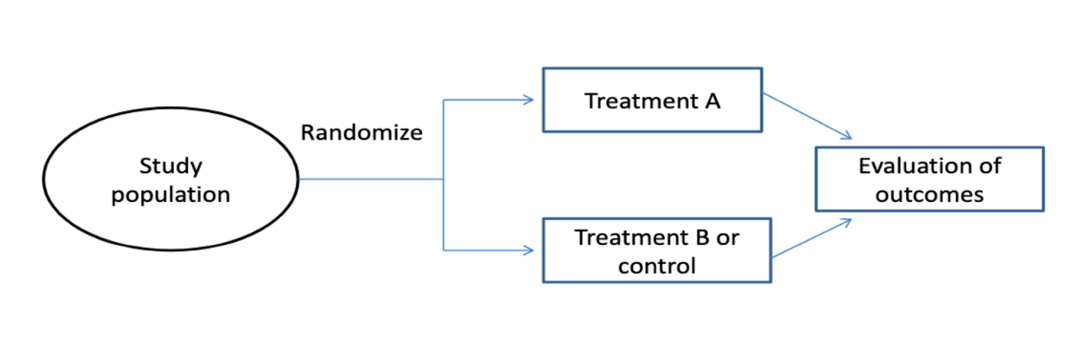
Forest View of Randomized Controlled Trials
Clinical Trials evaluate relationships between Intervention(s) and Clinical Outcomes
Prospective experiments: Allow investigator to control the intervention
  Intervention(s) studied, Eligibility, Allocation to participants, Outcome measures
  Measure outcomes (at baseline &) after receipt of the intervention:
  Design allows causal interpretation of intervention exposure on outcome(s)
Notes:
A trial schema is typically presented in the study protocol.
Can show treatment times.
Can show assessment times for primary outcome.
Participant experience is usually longitudinal: Screening period; Intervention period; Follow-up period.
→ But this could happen on one day (Phase I) or be spread over time (Phase II-IV).

Slide 5
I. RCT Goals and Pitfalls
Conventions and Context for Classical RCTs
For the purpose of this lecture, we will consider trials in which we have
two treatments (study “arms”): control (C) and experimental (E)
a single primary outcome of interest
each subject assigned a single treatment
Research Question: Is treatment E superior to treatment C?
Statistical Question: Is mean Y_{E} > mean Y_{C}?
Focus today on hypothesis testing rather than estimation.

Slide 6
Two types of measurement error, random and systematic
Bias = True value – Measured value
All experimental uncertainty is due to either random errors or systematic errors.
Random errors are statistical fluctuations (in either direction) in the measured data due to the precision limitations of the measurement device. Random errors usually result from the experimenter's inability to take the same measurement in exactly the same way to get exact the same number.
Systematic errors, by contrast, are reproducible inaccuracies that are consistently in the same direction. Systematic errors are often due to a problem which persists throughout the entire experiment.
Note that systematic and random errors refer to problems associated with making measurements. Mistakes made in the calculations or in reading the instrument are not considered in error analysis. It is assumed that the experimenters are careful and competent!

Slide 7
What is a Valid Trial?
Definition …
  A valid trial is a trial that establishes, up to a predetermined level of statistical certainty, whether an experimental treatment is superior (or non-inferior) to a control treatment.
Importantly, the sole source of uncertainty allowed by this definition is statistical, by which we mean non-systematic, random variation.
Therefore, the Goals of an investigator conducting a valid trial are to:
limit the impact of random variation, in particular by ensuring that the trial has sufficient sample size
eliminate (to the greatest extent possible) all other sources of uncertainty.
If any systematic sources of uncertainty remain, the validity of the trial is diminished, and whether the trial is salvageable will depend on a subjective assessment of the potential impact of the systematic error.
Notes:
Note that language used indirectly points out the need to PREVENT systematic errors, not CORRECT them at the end of the study.

Slide 8
How to minimize experimental error: some examples
Type | Example | How to minimize it
Random errors | You measure the weight of a baby three times using the same balance and get slightly different values: 7.46 lb, 7.42 lb, 7.44 lb | Take more data. Random errors can be evaluated through statistical analysis and can be reduced by averaging over a large number of observations.
Systematic errors | * In a multi-site trial, investigators at some sites interpret and apply the protocol differently than at other sites. * Over the course of a trial, the central lab modifies the procedure for evaluating the primary outcome. * In a cluster randomized trial, clinicians’ adherence to practice guidelines varies. | Systematic errors are difficult to detect and cannot be analyzed statistically, because all of the errors are in the same direction (either too high or too low). Spotting and correcting for systematic errors takes a lot of care. Q: How would you correct for inconsistently generated laboratory values? Q: How would you compensate for differential protocol & guideline adherence?
Notes:
Prevent via design strategies

Slide 9

Alternative statement of the goal of the trial:
to establish a treatment’s effectiveness to the satisfaction of a skeptic who is not prepared to believe the treatment is effective without convincing evidence.
This goal explicitly puts the burden on the
investigator/sponsor of the trial to conduct a trial
that will be convincing, not just to themselves,
but to the broader scientific community.
Study investigators & sponsors have an ethical obligation to
patients in the trial
future patients
the scientific community
to conduct a trial according to the highest possible scientific standards.
The skeptic
The skeptic

Slide 10
RCT Inference in Five Easy Steps
Enroll a group of subjects from the target population
Randomly assign individuals to either the experimental or control arm
Ascertain outcomes for each enrolled subject
Statistically compare the two treatments
… and the final step:
If, to the desired level of statistical certainty, on average the outcomes in the experimental treatment arm are superior to those in the control arm, then conclude that the experimental treatment is superior to the control treatment.
Step 5 requires a profound leap of logic! … because …
Statistical comparisons are simply computations involving observed data from which we draw conclusions about the distributions of the underlying data.
However, claims regarding the effectiveness of treatment are inherently about causal relationships in the physical universe.
→ Statistical analysis and causation are independent, unrelated concepts.
It is by the magic of randomization that we are able to make this leap.

Slide 11
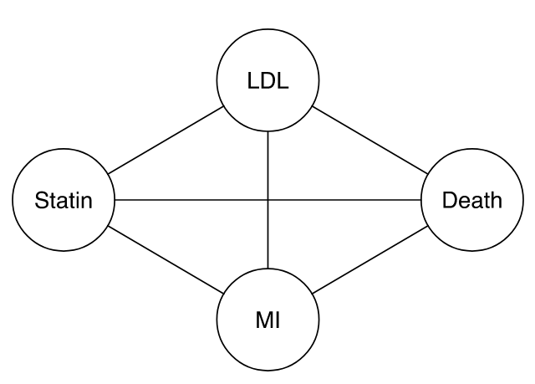
II. Statistics versus Causation
Consider this diagram.
For a given dataset, statistics can assess whether there are associations among these four features.
Statistics quantifies strengths of associations. Statistics can’t tell us anything about the direction of the causal pathways, or even that they’re causal at all!
Add arrows to represent causal pathways by which treatment with a statin might provide benefit.
Non-statistical evidence informs us of credibility of causality (eg, logic tells us that causes can only work forward in time; biology tells us …).

Slide 12
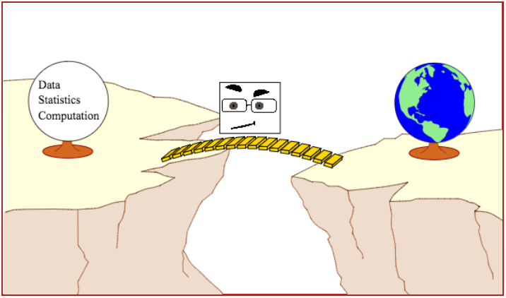
The Causal Bridge
Our skeptic is acting as the troll preventing anyone from crossing the chasm between statistical result and scientific interpretation unless their
study design and conduct,
combined with proper statistical analysis,
allow for meaningful inference about how the world works.

Slide 13
Statistics and Science
Statistical analyses fall into two broad categories …
Descriptive statistics, where there is no attempt to draw conclusions beyond the sample at hand.
  The mean value of variable X is 53.
  54% of our sample has Y = 2.
Statistical inference, where the goal is to gain generalizable knowledge about the distribution of Xs and Ys in the universe from which a sample has been drawn.
  The mean value of X in the population is 53 with 95% CI (42,64).
  The mean of X is larger when Y = 2 than when Y = 1.
Scientific inference also can fall into two primary categories …
Correlational or predictive inference, where the goal is to identify characteristics that vary together in the population.
  Older people have higher risk of mortality than younger people.
  People with high HDL (“good” cholesterol) are at lower risk for cardiovascular disease than those with low HDL.
Causal inference, where the goal is to infer that X causes Y.
  Statins reduce risk of cardiovascular disease relative to placebo.

Slide 14
Correspondingly,
A statistical hypothesis is a claim regarding a statistical parameter.
For example, given two groups A and B, if β is the difference between the mean response in group A and the mean response in group B, some statistical hypotheses are:
β = 0
β ≠ 0
β > 0
β < -10
A scientific hypotheses is a claim regarding the true state of nature.
For example, given two treatments, A and B and given a participant population, some scientific hypotheses are:
Treatments A and B are equally effective
Treatment A is less effective than treatment B
Treatment A is more effective than treatment B by 10 units
A valid trial aligns the statistical and scientific hypotheses.
We reject:
H₀: β = 0
if and only if we reject
H₀: treatments A and B are equally effective

Slide 15
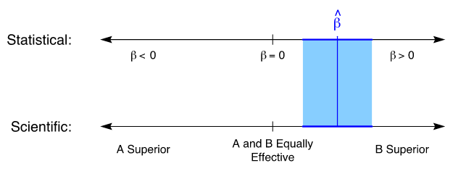
The scientific goal is to use data and statistics to assess a scientific hypothesis of interest. This requires a link between statistical and scientific hypotheses.
Suppose we construct a confidence interval for β, the “treatment effect.”
We would like for there to be a corresponding “confidence interval” for scientific hypotheses as well.
Randomization coupled with complete follow-up and
an intention-to-treat analysis is the only objective way in which
statistical and scientific hypotheses can be aligned.

Slide 16
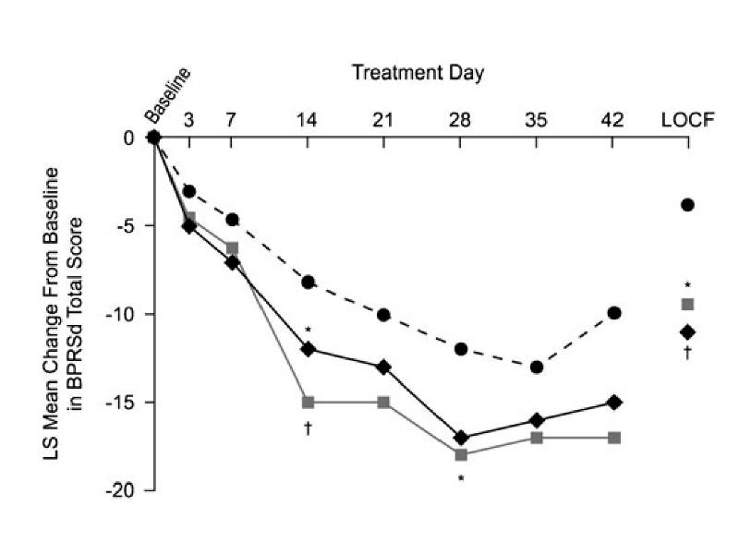
Example 1: 3-arm trial of change from baseline in Brief Psychiatric Rating Scale (BPRSd) score at 6 weeks. Ogasa et al. (Psychopharmacology, 2012)
Group # Randomized # (%) Complete
Placebo (0 mg/day) 50 15 (30.0%)
Lurasidone, 40 mg/day 50 16 (32.0%)
Lurasidone, 120 mg/day 49 20 (40.8%)
Complete case analysis: Neither active arm vs placebo had p<0.05 at 6 wks.
LOCF analysis: Both active arm vs placebo p<0.05 at 6 wks.
Notes:
Comments:
1) Primary outcome observed on less than half of randomized subjects. → Even if assigned treatment exposure stops, outcomes should be collected and analyzed in assigned arm. Is missingness nonrandomly assoc’d with treatment arm? Systematic bias? Confounding?
2) Primary analysis uses last-observation-carried-forward (LOCF) for subjects not completing study.
Because we don’t observe the 6-week outcome on all randomized subjects, our “skeptic” has no way to know whether the active treatments are really better than placebo or whether the observed differences are due to lack of adherence and follow-up.
3) The plotted trajectories are based on least squares means from an ANCOVA model, a hard-to-understand “black box”.

Slide 17
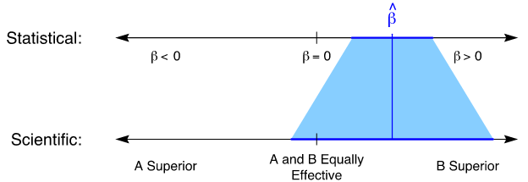
Example 1.a – Hope-Based Analysis
In this example, the extent of missingness compromises the result of the trial.
This analysis might be considered to be based on hope.
Authors make certain assumptions:
Last observations carried forward (LOCF) accurately reflect the 6-week outcomes
Observations are “missing at random,” so the statistical hypotheses tested using the ANCOVA model align with the scientific hypotheses of interest.
. . . We rely on hope that they’re correct.
Because a skeptic has no way to verify that these assumptions are correct, she might have good reason to conclude that this is a completely failed trial.

Slide 18
Example 1.b – Convincing Analysis
So, what evidence does a skeptic want to see?
A simple direct comparison of responses at 6 weeks
…including all randomized subjects
…analyzed according to their assigned treatment groups
…regardless of their adherence to their assigned treatments.
Without these features,
benefit of randomization is lost: Error could include systematic as well as random components. How / Why?
Skeptic must trust unverifiable assumption(s) made by the investigator and/or analyst.
Our scientific conclusions require two steps:
Statistical inference: “Are the two groups different?”
Scientific inference: “Is the difference due to an effect of treatment?”

Slide 19
III. Statistical Inference
Human populations are inherently heterogeneous with respect to prognosis.
Thus, arbitrarily chosen individuals have different baseline characteristics, different prognoses, and different outcomes.
  To characterize outcomes across a population, we might take a sample and calculate its mean and variability.
  Because of heterogeneity, the magnitude and variability of the sample mean depend on the kinds of subjects we sample.
Impacts of Eligibility Criteria compared with heterogeneous samples:
  Draw sample from a relatively homogeneous “healthy” subpopulation
    Outcomes (say, FEV₁%) are better on average and less dispersed than those of a sample from the full population.
    If we draw two samples from a subpopulation with a smaller average group difference, the observed difference in the sample will be smaller.
  Draw sample from a relatively homogeneous “sicker” subpopulation
    Outcomes (FEV₁%) are worse on average, but still less dispersed
    If we draw two samples from a subpopulation with a larger average group difference, the observed difference in the sample will be larger.
Notes:
Heterogeneity is good! We don’t want to be clones! Understanding heterogeneity reveals our world.

Slide 20
Hypothesis Testing
We want to compare mean outcomes of two arms, A and B.
  For a superiority trial, there are two hypotheses of interest:
  Null hypothesis, H₀: The arms are not different (e.g., the true average response is the same in both arms)
  Alternative hypothesis, H_{A}: The arms are different (e.g., the true average in one arm is larger than the average in the other)
  Before collecting any data, H₀ is assumed to be true and the statistical goal is to show that H₀ is false.
Typically, we set up the test to reject H₀ if the difference between the group means is large compared to their standard errors.
Statistics can only tell us if groups are or are not different.
The reason they are different is a causal question and can’t be identified statistically.
Failure to randomize can introduce confounding:
  If we draw arm A (placebo) participants from healthy subpopulation and arm B (treatment) participants from unhealthy subpopulation, baseline health status will be associated with both arm and outcome. → “Simpson’s Paradox”
Notes:
Refer back to Slide 17. Just as treatment assignments [start of f’up] can occur non-randomly, withdrawals [end of follow-up] can occur non-randomly. Both can introduce confounding.

Slide 21
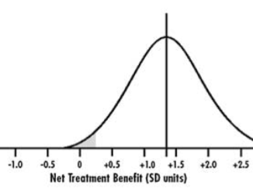
Randomization guarantees that, under H₀: No difference,
the distribution of outcomes is the same in both study arms.
This establishes the critical value corresponding with the type-1 error rate,
enabling us to test our study hypothesis and accept or reject H₀.

Slide 22
Is it important to Balance baseline covariates ?
Beliefs in the importance of baseline balance have led some to propose “balancing strategies” as supplements or alternatives to randomization.
Arguments in favor of balancing strategies seem to …
Assume that covariate balance, at least for “important” covariates, is desirable or necessary
Make unsubstantiated claims that covariate imbalance biases or invalidates statistical analysis
Make the specific claim that a trial demonstrating a treatment difference in the presence of a baseline covariate imbalance is not credible: the covariate imbalance, rather than the treatment itself, might have caused the observed treatment difference
The question of interest is:
In comparison to balancing strategies, does randomization cause biased or invalid statistical analysis?
Specifically, does randomization cause detection of spurious treatment differences that would not have been observed if only we had employed a balancing strategy?
→ This is a causal question, and we can evaluate it in our causal framework.

Slide 23
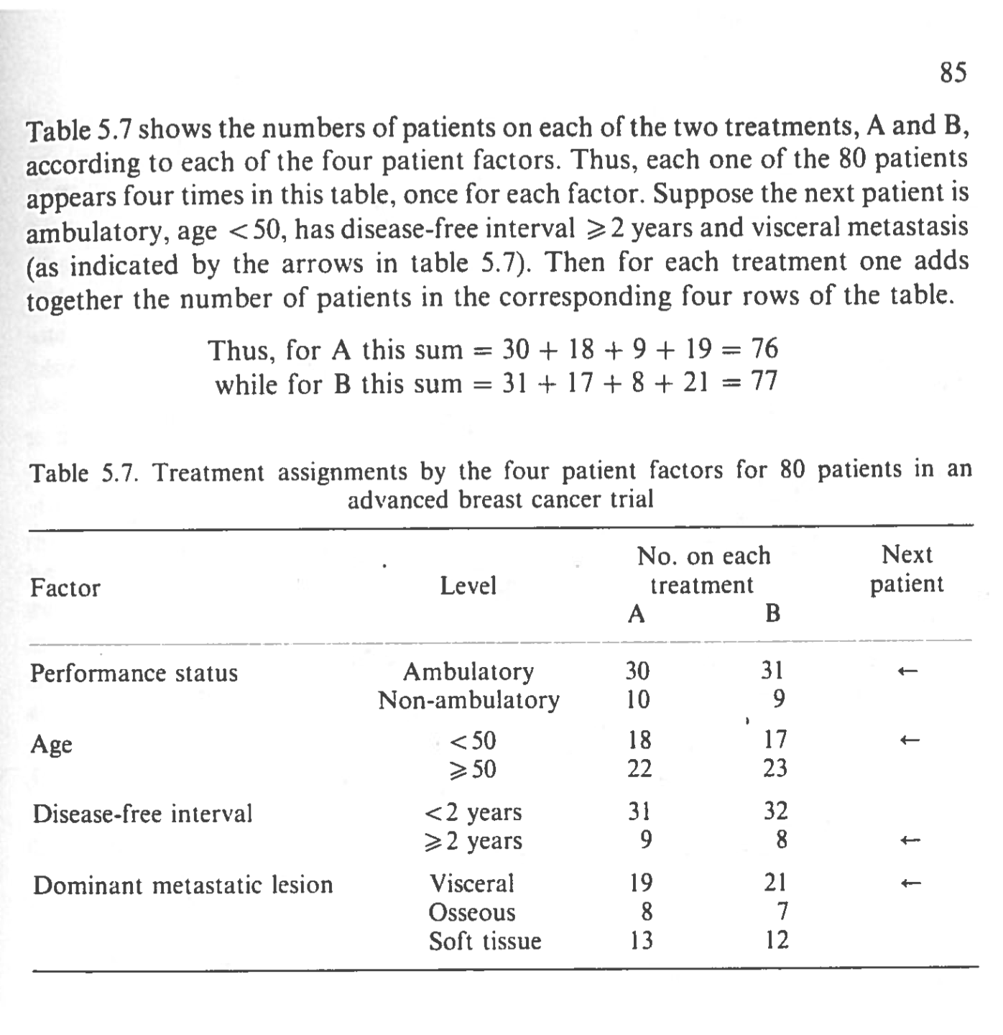
Minimization – a dynamic method of allocation to study arms that aims to achieve balance in baseline covariates without using randomization
Example from Pocock SJ. Clinical Trials – A Practical Approach, 1973, Wiley.

Slide 24
Compare Minimization with Randomization with respect to error rates
Study 100,000 simulated trials with H₀ true to determine spurious false positive (FP) rates.
  Overall, 8.5% (expected 5%)
  Randomization 4.7%; Minimization 3.8% → Difference = 0.8%
Study 100,000 simulated trials with H_{A} true and 90% power to determine spurious false negative (FN) rates.
  Overall, 0.79% (expected 10%)
  Randomization 0.35%; Minimization 0.44% → Difference = -0.09%
Inefficiently Improving Efficiency
Normally, we use statistical techniques (eg, adjust for covariates) to improve efficiency:
We want to increase power (i.e., decrease type 2 error)
while maintaining the same level of type 1 error (e.g., nominal α=0.05)
However, minimization uses baseline covariates inefficiently:
Power does increase
But type-1 error rate decreases → The statistical test becomes too conservative.
Notes:
Does not address unmeasured covariates . Also, in the course of balancing covariates, it may — literally — cause outcome imbalance!
Depends on sample size -- > covariate-adjusted randomization
Large trials: Modeling provides better implicit matching for multiple covariates
Small trials: Minimization ensures relevant covariate combinations are represented

Slide 25
IV. Scientific Inference
Intervention Exposure and Outcome Capture
We’ve established that randomization ensures the validity of the trial, in spite of any random covariate imbalances.
Some Unspoken Assumptions
We’ve made two key assumptions so far:
Full exposure to interventions → All subjects fully adhere to their treatment and realize the full causal effect on their outcomes.
No Missing Data → Outcomes are available on all subjects.
Missingness
Can make causal comparisons if either:
The data are missing at random.
The data are not missing at random and missingness isn’t influenced by treatment.
Cannot claim causal association if:
If neither assumption holds, as we’d expect in most real-world trials, then causal bridge is cut. (e.g., Scientifically nonsignificant difference may test as statistically significant. → Cannot claim difference is causal.)
Notes:
Slide 63 -- 71

Slide 26
Two possible outcomes for Paul following intervention/not on Jan 1, 2018:
Paul receives heart transplant and dies 5 days later.
Paul does not receive heart transplant and lives at least 5 days more.
→ Did the transplant cause the death? Yes, for Paul.
Two possible outcomes for Sue following intervention/not on Jan 1, 2018:
Sue receives heart transplant and lives at least 5 days more.
Sue does not receive heart transplant and lives at least 5 days more.
→ Did the transplant have a causal effect? No, for Sue.
Causation
In our context, we say that “X causes Y” if Y would have been different if X had been different.

Slide 27
Beth is a 45 year old female with a BMI of 29 and FEV₁% of 82 at baseline.
If she’s assigned to arm A, FEV₁% = 79 at 6 weeks; she will be “alive.”
If she’s assigned to arm B, FEV₁% = 93 at 6 weeks; she will be “alive.”
If we could observe both arms in Beth, her treatment effect would be
  B-A absolute difference = (93-82) – (79-82) = 14
  B-A percent change from baseline = 14/82 x 100% = 17%
→ The intervention has a causal effect on Beth’s 6-week change in FEV₁% but not on her survival status.
If we were omniscient, we would see all outcomes of every member of the heterogeneous population and could identify all causal effects of treatment for every individual.
The difficulty is that we only get to see the one outcome that actually happened. We can never know
  what would have happened if …
at least not for individual subjects.

Slide 28
Imagine a Sample of Twin Participants
Suppose in our population Every individual has a perfectly identical twin
→ Baseline features (observed + unobserved) are exactly the same
→ Hypothetical outcomes (“what would have happened if …”) match precisely.
Randomly assign Beth to E and her twin to C. The observed FEV₁% outcome difference between twins (93 − 79 = 14) is this pair of twins’ causal effect.
Randomize all twin pairs.
The average causal effect is the average difference in outcome between twins.
Note that: Mean of (Y_{E} – Y_{C}) equals Mean of (Y_{E}) – Mean of (Y_{C}).
Real Purpose of Randomization
Since a population of perfect twins doesn’t exits, we approximate it by applying RANDOMIZATION to a twin-less population.
Randomization provides approximate balance in baseline characteristics:
  Balance is neither necessary nor sufficient for the validity of our inference.
  Chance imbalances do not invalidate our conclusions; thus testing for balance is not needed or relevant.
This only works at the population level – Why? RCTs study populations, not individuals. In the classical RCT setting, thinking too much about individuals can lead one astray.
Notes:
Twins are randomized within blocks / strata.
Note that use of perfect twins controls for baseline covariates.
Since we sample a single population, covariates are the same in arms A and B as N increases.

Slide 29
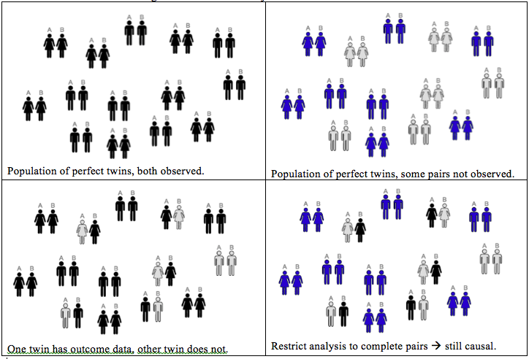
Imaginary Twins
Each individual has a “perfect twin:” All characteristics match except the intervention and the associated outcome.
Each pair generates a covariate-adjusted estimate of the treatment effect.
Mean over pairs yields trial estimate.
Notes:
Slide 65

Slide 30
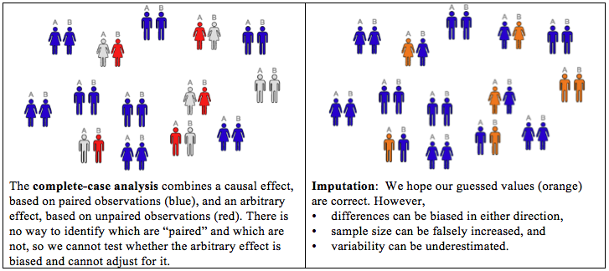
The Real World
We use randomization to approximate “perfect pairs”
In complete data, group-wise results do this well, because difference between means (mean of Y_{E} – mean of Y_{C}) equals mean of paired differences (mean of Y_{E} – Y_{C}).
In contrast to ideal world, in real world we have no way to identify paired individuals. If one “twin” has missing outcome data, we cannot exclude the whole pair in order to avoid confounding missingness with causation.
Notes:
Slide 65

Slide 31
V. Missing Outcomes
Virtually all trials have some missing data.
The assumption is frequently made that observations are missing at random.
If this assumption is correct, the only consequence of missing data is that we have a smaller sample size and, therefore, lower power and precision. Otherwise, the analysis of the available data will give the same results as if there were no missing data.
Sometimes, it’s acknowledged that observations are not missing at random, but it’s assumed that the missingness is not influenced by treatment.
If this assumption is correct, it can change the results of the analysis, but at least the analysis still has a causal interpretation.
The problem is that, by their very nature, missing data are unobserved and it is impossible to know whether they are actually missing at random.
With non-random, treatment-dependent missingness a straightforward statistical analysis remains sound; however, its relationship to the scientific hypotheses may yield FP or FN conclusions.
We cannot conclude there is a causal association between intervention and outcome.
Notes:
Slide 65

Slide 32
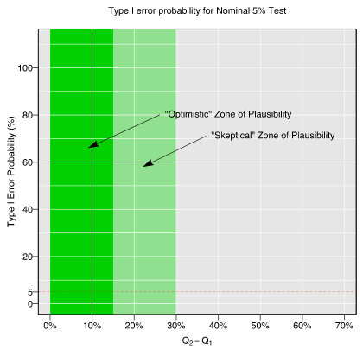
Effect of Missingness on Type 1 Error Rates
Assume for simplicity that the rates of missingness are the same in the two groups, and let’s consider two probabilities:
  Y_{A}=Pr(dead∣missing, group A)
  Y_{B}=Pr(dead∣missing, group B)
  If these two probabilities are equal, on average there is no net effect of missingness on the overall type 1 error rate.
Now consider the effect of a difference,
Y_{B}−Y_{A}, on type 1 error rate. Imagine there
are two zones: “optimistic” (smaller differences) and
“skeptical” (larger differences).
As Y_{B}−Y_{A} increases the type 1 error rates
can be seriously inflated, even within the
“optimistic” zone.
If missingness rates exceed 15%, nearly all
reasonably sized trials can be seriously
compromised.
Notes:
Slide 72 -- 78

Slide 33
Handling Missing Data
Common approaches when data are missing:
Complete-case analysis → Not a valid causal analysis
Imputation → Hope-based: Assumptions may be incorrect
  LOCF: No causal basis
  Single imputation: Worse than complete case
  Multiple imputation
Principal Stratification → No causal basis
Joint modeling of outcome and missing indicator → No causal basis
Inverse probability methods → No causal basis
Sensitivity Analysis (“Stress Test”)
We choose a primary analysis that is based on the best assumptions (maybe complete case, maybe multiple imputation)
We conduct a series of analyses that deviate from the best assumptions in a controlled way.
We consider our results robust if the conclusions are unchanged over a sufficiently wide range of plausible assumptions
Notes:
Slides: Missing data, 79 – 91; Sensitivity, 92 – 103

Slide 34
Importance of Complete Follow-Up
Missingness subverts randomization. The resulting naïve complete-case comparison is no longer causal.
This affects all types of data (e.g., safety, efficacy, adverse events, laboratory measures).
The magnitude and direction of the error (the difference of the obtained effect from the real causal effect) cannot be known.
The Panel on Handling Missing Data in Clinical Trials …
  “… encourages increased use of [modern statistical analysis tools]. However, all of these methods ultimately rely on untestable assumptions concerning the factors leading to the missing values and how they relate to the study outcomes …
  … There is no ‘foolproof’ way to analyze data subject to substantial amounts of missing data.” → “Substantial” amounts of missing data might be 10 or 15%.
All this applies to the importance of complete follow-up after withdrawal from treatment (i.e., despite lack of adherence).
Notes:
Slide 104

Slide 35
VI. Variable Intervention Exposure
Intervention Exposure: Incomplete Adherence
Like missing outcomes, non-adherence to assigned treatment occurs in virtually every clinical trial.
  Subjects are non-adherent if they are assigned a treatment but do not receive the intended dose.
Subjects may be non-adherent for lots of reasons:
They took one dose, didn’t like it or experienced a side effect, and stopped their study medication.
They took their assigned dose for part of the intended follow-up period, but their disease worsened and they stopped their study medication.
Study procedures became too onerous and they stopped their study medication.
→ Most of these reasons will probably result in adherence that depends on the assigned treatment.
Notes:
Slide 105

Slide 36
Intervention Exposure: Treatment-Dependent Adherence
Recall Beth. Her FEV₁% would be 79 is she received arm A (placebo), and 93 if arm B (active). Her FEV₁% causal effect is 93 – 79 = 14.
If Beth adheres to B but not to A: Since A is placebo, receipt doesn’t matter; we might still observe her causal effect of assignment of B versus A would be 93 − 79 = 14 → the same as the causal effect of receipt.
If Beth adheres to A but not to B: Beth might receive partial benefit from B … {79 if assigned treatment A; 93 83 if assigned treatment B} for a causal effect of assignment to B relative to assignment to A is 83 − 79 = 4.
  The causal effect of assignment to B versus A is, in general, different than the causal effect of receipt of B versus A, but it is still a real causal effect, and it is the object of an ITT analysis.
We would prefer to see the causal effect of receipt of B versus A but cannot.

Slide 37
Intervention Exposure: ITT analysis vs Per-protocol analysis
Critics of ITT say non-adherence subverts the purpose of the trial. Their objection is valid.
The goal of the trial is to “estimate the treatment effect” on the outcome in question.
Subjects who do not receive the treatment as intended do not benefit from it.
Therefore non-adherence prevents us from correctly “estimating the treatment effect.”
What’s the real problem?
By “estimate the treatment effect” we assume they mean the “full-adherence treatment effect.”
If the goal is to estimate the “full-adherence treatment effect,” then, unless we have achieved full adherence, we’ve done the wrong experiment!
Solutions:
The “correct” experiment strictly enforces full adherence. → In humans this isn’t possible but a well run trial comes close to achieving this. Adherence information is critical to trial interpretation.
We want to recover the “full-adherence treatment effect” from a trial with incomplete adherence. However, we cannot correctly guess full-adherence values from partial-adherence values.
Conduct a Per-protocol analysis: Only analyze subjects who are fully adherent (or nearly so). This subgroup analysis …
  … induces missing data (see Slide 16). We cannot determine if differences between groups are causally related to treatment or are induced by missing data.
  … does not recover the full-adherence treatment effect.
Change the question!

Slide 38
Intervention Exposure: The Right Question
What’s the “right” answer to the non-adherence problem?
The answer is to change the question!
Unless we have full adherence, our causal conclusions can’t be conclusions about the effect of full adherence to (receipt of) treatment.
We can, however, reach valid conclusions about the effect of assignment to treatment.
After all, in randomized trials in humans, we can randomly assign people to treatments, but we can’t force them to receive treatments.
The best basis for assessing the causal effect of treatment, and that which will satisfy skeptics, is inference based on randomization.
We’ve done a randomized experiment.
If we have complete data, we can draw valid causal conclusions from our trial if we perform (per Slide 10)
  A simple direct comparison of responses
  for all randomized subjects (no missing data!)
  analyzed according to their assigned treatment groups
  regardless of their adherence to their assigned treatments.
Notes:
Slide 110

Slide 39
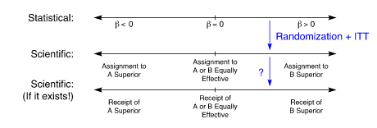
Intervention Exposure: Assignment versus Receipt
When we do not have full adherence, we actually have (at least) three sets of hypotheses:
statistical hypotheses
scientific hypotheses regarding the effect of assignment to treatment
  Randomization, complete data, and ITT analysis ensure alignment of hypotheses 1 & 2.
scientific hypotheses regarding the effect of receipt of treatment.
  Because we cannot observe full-adherence responses for some subjects, there is no objective way to ensure alignment of hypotheses 2 & 3; they can be “off” in either direction.
Notes:
Slide 112

Slide 40
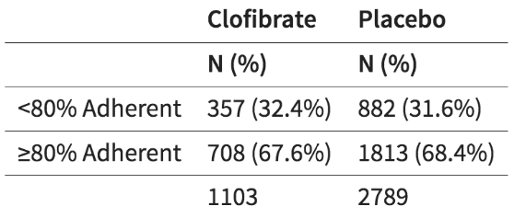
Intervention Exposure: Example 2 – Coronary Drug Project (CDP)
8341 patients enrolled between 1966 and 1969
Males, <3 months since MI
Exposures:
  5 active treatment groups (one was clofibrate) + placebo
  2:2:2:2:2:5 randomization (→ 1/3 randomized to placebo)
Primary Outcome: all-cause mortality
8.5 year total study length
Adherence rates are similar by arm, but we cannot assume (or check) non-adherence is independent of treatment.
Notes:
Slide 119

Slide 41
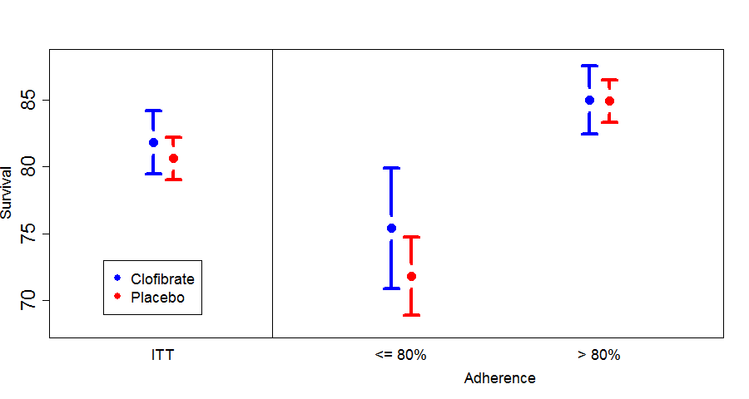
Intervention Exposure: Example 2
Regardless of arm, subjects who adhered to assigned treatment had better outcomes than those who failed to adhere.
Commonly, subjects who adhere are different than subjects who don’t.

Slide 42
Adherence Failure can break the link between Statistical Findings and Scientific Conclusions
Example 3.a: VOICE Trial (2015) http://www.nejm.org/doi/full/10.1056/NEJMoa1402269
    In a random sample, TFV was detected in 30%, 29%, and 25% of available plasma samples from participants randomly assigned to receive TDF, TDF-FTC, and TFV gel, respectively.
Example 3.b: Aspire Trial (2016) http://www.nejm.org/doi/full/10.1056/NEJMoa1506110
    In the dapivirine group, the drug was detected in 82% of plasma samples at levels of more than 95 pg per milliliter. In the subgroup of visits in which returned rings were available, 84% contained less than 23.5 mg of dapivirine, and dapivirine levels in plasma and in returned rings were correlated.

Slide 43
Intervention Exposure: Intention to Treat
  “[According to the Intention to Treat principle,] all subjects meeting admission criteria and subsequently randomized should be counted in their originally assigned treatment groups without regard to deviations from assigned treatment.” L. Fisher et al (1990)
The real reason we use ITT is this:
  ITT is the only analytical approach that relies solely on randomization to infer the effectiveness of treatment.
We do not use ITT because the ITT estimate is more realistic or more clinically relevant or more useful to calculate.
  We use ITT because it is the only assumption-free, causal analysis we can do with the experiments we can perform. It is the only analysis that can convince our skeptic.
Notes:
Slide 114

Slide 44
Intervention Exposure: Deviations from ITT
Strict ITT Principle
A catchy phrase commonly used to refer to the ITT principal is “analyze as you randomize.” This means:
A subject is later found to be ineligible → analyze him/her anyway
A subject doesn’t receive treatment → analyze anyway
A subject receives wrong treatment → analyze in assigned (not received) group
Let’s discuss each of these cases and whether we can ever deviate from the rules …
Case #1: Ineligible
When consider removing from the analysis, adhere to the spirit of ITT by reviewing every subject for a particular set of eligibility criteria in a systematic way:
Pre-specify (a) which criteria and (b) the review process
Conduct review in a blinded way (which is often harder than it sounds)
Notes:
Slide 122

Slide 45
Intervention Exposure:
Case #2: Received no treatment
A modified ITT analysis excludes those who never started treatment.
The decision to remove a case should be made blinded to the treatment assignment.
Case #3: Randomization errors
(Refers to application of the list (e.g., transcription errors), not the list itself.)
Different treatment arm than correct assignment:
  Analyze as assigned, making note of the error for potential reporting & sensitivity analysis.
  If the wrong item from the list was taken, retain that as originally specified.
A batch of wrong treatments. Regardless of arm ...
  Keep all, or
  Remove all who could have been in the bad batch, if blinding (esp of results) is secure.
Stratified design, with wrong stratum recorded, led to “wrong” treatment
  Randomization is still valid.
  Analysis should use corrected stratum and assigned arm
Notes:
Note: There are no compelling reasons to stratify randomization: negligible power gain, and nothing that could affect the causal bridge.

Slide 46
Summary
The purpose of randomization is:
* to establish a causal relationship between YES
an intervention and outcome
* to “estimate the treatment effect” NO
* to balance the baseline covariates NO
Randomization is the only available method we have to determine whether a treatment has a causal effect on an outcome.

Slide 47
Threats to Randomized Controlled Trials arising through Study Conduct
Intervention exposure: Randomization and intention-to-treat are tied together, and both are required for a valid causal inference.
  The only question that can be answered in a valid way, when participants are free to adhere or not, is the question of treatment assignment.
  Adherence information is critical to trial interpretation, but not to whether causal inference is possible.
Outcomes: Missing data. Can arise from incomplete follow-up, or be induced by excluding participants who are non-adherent (“per protocol”).
  Exclusions compromise the causal interpretation of the analysis of a trial. Analytic methods for dealing with missing data (including complete-case analysis) do not adequately restore the pure causal relationship.
  If the study design calls for outcome assessments beyond the intervention phase, these must continue even if exposure ends early.

Slide 48
To address the study goal:
Design the trial using randomized assignments.
Execute the trial with high fidelity to the study protocol, ensuring high levels of adherence and complete outcome ascertainment.
Analyze the trial applying the intention-to-treat principle, using straightforward methods of comparing study arms.

Slide 49
Conducting Valid Trials
The Critical (and Misunderstood) Roles of Randomization and Complete Follow-Up
Society for Clinical Trials, May 15, 2016, Montréal, Québec
Acknowledgement: Lecture 1 resource:
Presenters:
Thomas D. Cook, Department of Biostatistics and Medical Informatics, University of Wisconsin – Madison
Kevin A. Buhr, Department of Biostatistics and Medical Informatics, University of Wisconsin – Madison
T. Charles Casper, Departments of Pediatrics and Family and Preventive Medicine, University of Utah School of Medicine

