Slide 1

Welcome!
Epidemiology 207 - Epidemiologic Methods II
June M. Chan, ScD
Professor, Epidemiology & Biostatistics and Urology
Steven & Christine Burd-Safeway Distinguished Professor

Slide 2
Disclosures
Research:
  Individual: Collaborations with GenomeDx, federally funded grants
  Dept. of Urology collaborates with Genomic Health Inc., Genome Dx, and Myriad Genetics Lab
Husband: full-time employee for GRAIL

Slide 3
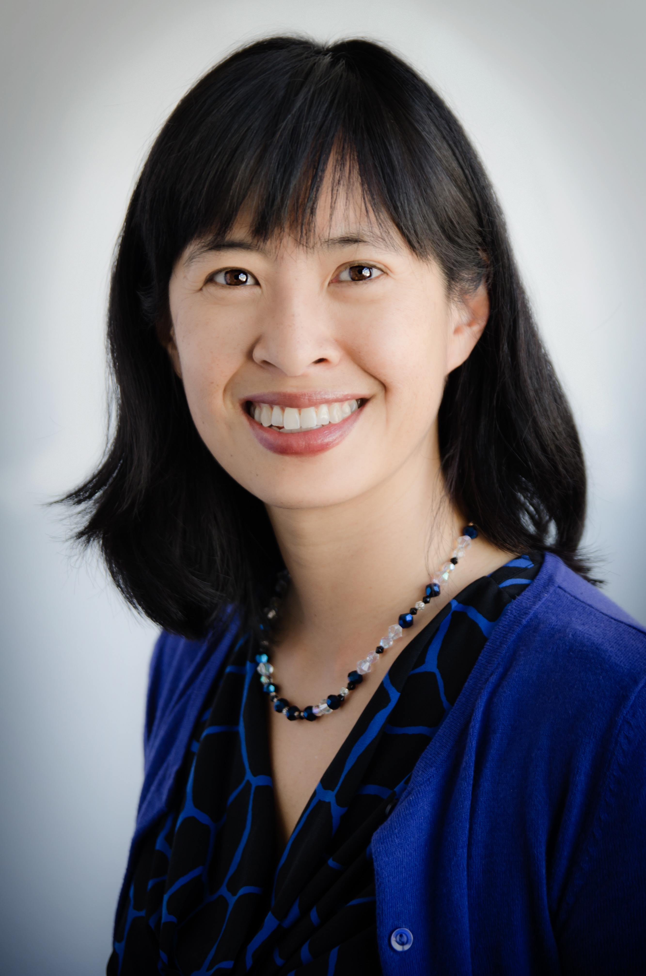
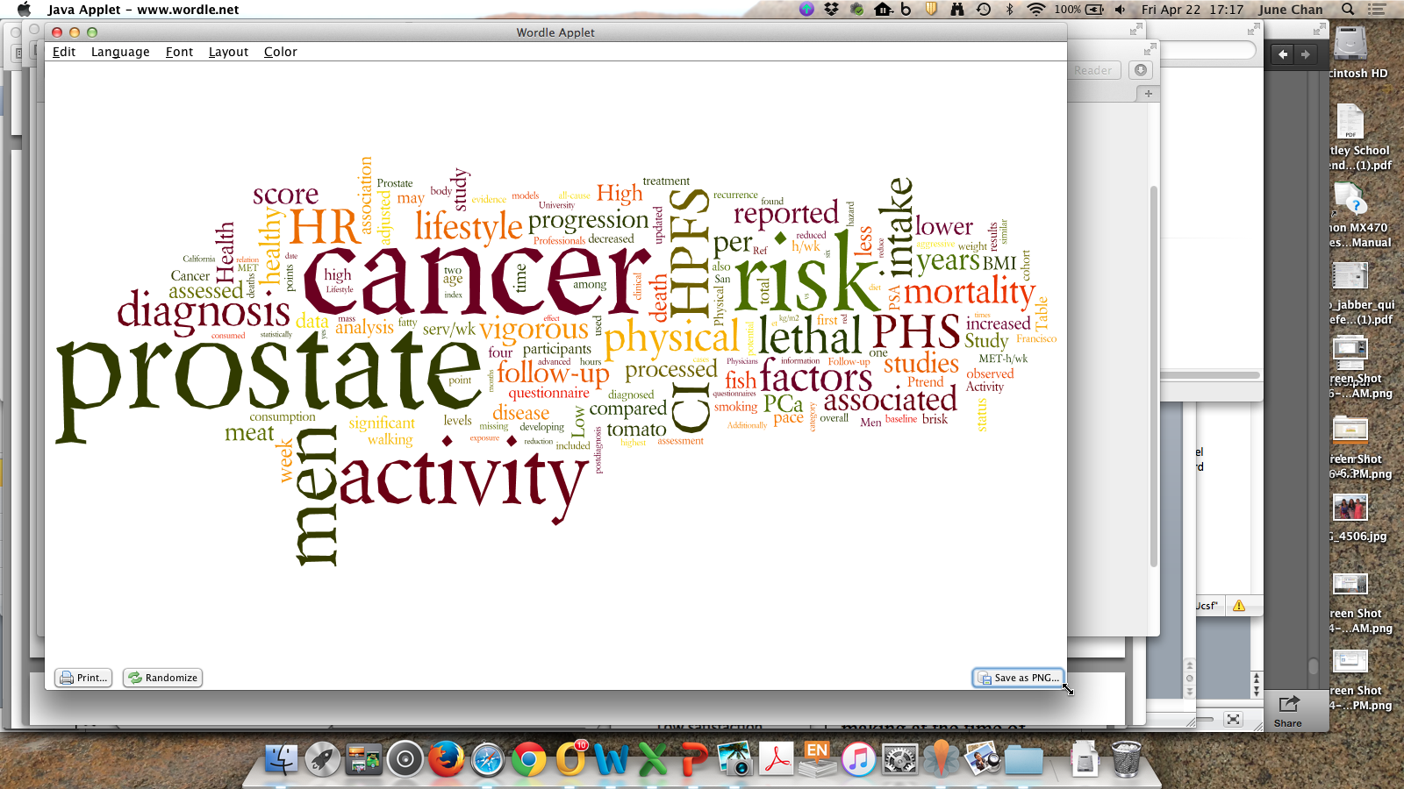
June M. Chan, ScD
Professor, Epidemiology & Biostatistics and Urology
Steven & Christine Burd-Safeway Distinguished Professor
Associate Chair, Clinical Research, Urology
Vice Chair, Education, Epidemiology & Biostatistics
Cancer Epidemiologist
Educator & Mentor
diet

Slide 4
Introduction to the Course
EPI 207, Epidemiologic Methods II

Slide 5
Outline
Course Learning Objectives
Schedule of Topics & Format
Resources
Assessment & Grades
Tips for learning in this course

Slide 6
Learning Objectives
Main objective – help you build skills in the design, conduct, analysis, and interpretation of epidemiologic & translational research.
Specific objectives:
  Understand common study designs used in epidemiologic research
  Identify sources of bias in observational epidemiology studies, including those arising from longitudinal studies with updated covariate and survival measurements
  Understand and practice applying methods to identify and address bias in observational epidemiologic studies, including causal inference methods and quantitative bias analysis
  Identify effect modification and interaction, understand how to interpret models with interaction terms, and be familiar with how to present these in results
  Gain experience interpreting data & critiquing results from epid studies

Slide 7
EPI 207 Schedule – 2020 Thursday, 1:00-3:00 pm
Day | Date | Time | Activity | Topic(s) | Instructor(s) | Due
Thurs | 9-Jan | 1-3pm | In-Person Lec | Intro / RCT/ Target Trial/Coh | Chan | Intro video lecture
Tues | 14-Jan | 8:30-9:30am | Office Hours | Intro / RCT/ Target Trial/Coh | TA's
Thurs | 16-Jan | 1-2pm | HW Review | HW #1 (RCTs/Target Trial/Coh) | TA's | HW #1
Thurs | 16-Jan | 2-3pm | In-Person Lec | Matching/Ca-Co/Case-only | Van Blarigan | Video lec
Tues | 21-Jan | 8:30-9:30am | Office Hours | Matching/Ca-Co/Case-only | TA’s
Thurs | 23-Jan | 1-2pm | HW Review | HW #2 (Matching/Ca-Co/Case-only) | TA's | HW #2
Thurs | 23-Jan | 2-3pm | In-Person Lec | Causal Inference | Graff | Video Lec
Tues | 28-Jan | 8:30-9:30am | Office Hours | Causal Inference | TA's
Thurs | 30-Jan | 1-2pm | HW Review | HW #3 (Causal Inference) | TA's/Graff | HW #3
 | 30-Jan | 2-3pm | In-Person Lec | Person Time & Bias | Chan | Video Lec
Tues | 4-Feb | 8:30-9:30am | Office Hours | Person Time & Bias | Chan
Thurs | 6-Feb | 1-3pm | In-Person Lec | DAG’s | Graff
Tues | 11-Feb | 9-10am | Office Hours | DAG’s/PT & Bias | TA's
Thurs | 13-Feb | 1-3pm | IHW Review | Person Time & Bias | TA’s | HW #4
Tues | 18-Feb | 8:30-9:30am | Office Hours | DAG’s/General | TA’s
Thurs | 20-Feb | 1-2pm | HW Review | HW #5 (DAGs) | TA's | HW #5
 | 20-Feb | 2-3pm | In-Person Lec | Interaction / Eff Mod | Chan/Rerolle | Video Lec
Tues | 25-Feb | 8:30-9:30am | Mini-Lab (STATA) | Interaction / Eff Mod | TA's
Thurs | 27-Feb | 1-3pm | HW Review | HW #6 (Interaction/Eff Mod) | TA's | HW #6
Tues | 3-Mar | 8:30-9:30am | Office Hours | General | TA's
Thurs | 5-Mar | 1-4pm | In-Person Workshop | Quantitative Bias Analysis (QBA) | ER Mayeda
Tues | 10-Mar | 9-10am | Office Hours | QBA | TA's
Thurs | 12-Mar | 1-2:30pm | HW Review | HW #7 (QBA) | TA's | HW #7
Thurs | 12-Mar | 2:30-3pm | In-Person Lec | Wrap up | Chan/TA's
Fri | 20-Mar | 8pm |  |  |  | Final Exam

Slide 8
Course Format
Lectures: 7 live lectures, 4 recorded lectures
  4 guest live lecturers
  Lec recordings and slides posted ~ 1 week prior to due date of assoc. HW
  Live Lecs ~ 1-2 hrs (recorded/posted after the session)
  Recorded Lecs ~ 30-60 min per topic
Small Groups (SG) to Review HW: 7 In-person sessions, 1 hour
Instructors
  Course Director: June M. Chan ScD june.chan@ucsf.edu
  Teaching Assistants: dan.Kelly@ucsf.edu, shelley.devost@ucsf.edu
  Curriculum Team: François Rerolle, Rebecca Graff
  Guest Lecturers: Graff, Van Blarigan, Mayeda

Slide 9
Study Resources
Lectures, Slides, & Notes
Assigned Readings
  Rothman/Greenland/Lash (3rd Edition, 2008) (RGL)
  Causal Inference: What if? (Hernan M, November 2019 edition)
  Selected articles and other chapters
Problem Sets, Small Groups, & Answer Keys
Software Resources that may be used
  Statistical software: STATA
  dagitty.net – free web-based software for DAGs
  MS Office Excel

Slide 10
Text Books
Rothman K, Greenland S, Lash T(2008), Modern Epidemiology (3rd edition). Philadelphia: Lippincott-Raven.
    UCSF users can access an electronic version of the book online at the UCSF library through OvidSP
Hernán M A, James M. Robins J A (2019), Causal Inference. Boca Raton: Chapman & Hall/CRC, forthcoming
    PDF of the book could be accessed here: http://www.hsph.harvard.edu/miguel-hernan/causal-inference-book/

Slide 11
Assessment & Grading Policies
  Overall Grade
    70% 7 Homework assignments (drop 1 lowest score)
    30% Take Home Final Exam
  Homework Assignments
    Late assignments NOT accepted (key posted after class on due date)
    Files posted on website ~1 week prior to due date
    Type responses (OK to handwrite some equations)
    Due at 1:00 pm day of HW review/small group (SG); CLE will not accept assignments after 1:00
    Any issues: e-mail teaching assistant before 1:00 pm on due date
  Attendance
    Lectures & Small Group: Not required, though highly recommended.

Slide 12
Professional Conduct Statement
I will maintain the highest standards of academic honesty
I will not use answer keys from prior years
Problem Sets: I am permitted to consult with other classmates, but I will write final answers in my own words away from other classmates
Final Examination: I will neither give nor receive aid in examinations
Notes:
RECORD
Regarding the weekly problem sets, this reminds me to clarify what we expect for professional conduct in this course. Following the overall tenets of the TICR Program Professional Conduct Statement, we ask that you maintain the highest standard of academic honesty and not use answer keys from prior years if you happen to come across them. It is fine and, in fact, we encourage you to work with other classmates on the problem sets, but please write the final answers in your own words. Finally, for the end of quarter final exam, please work on this entirely on your own without discussion with anyone else.

Slide 13
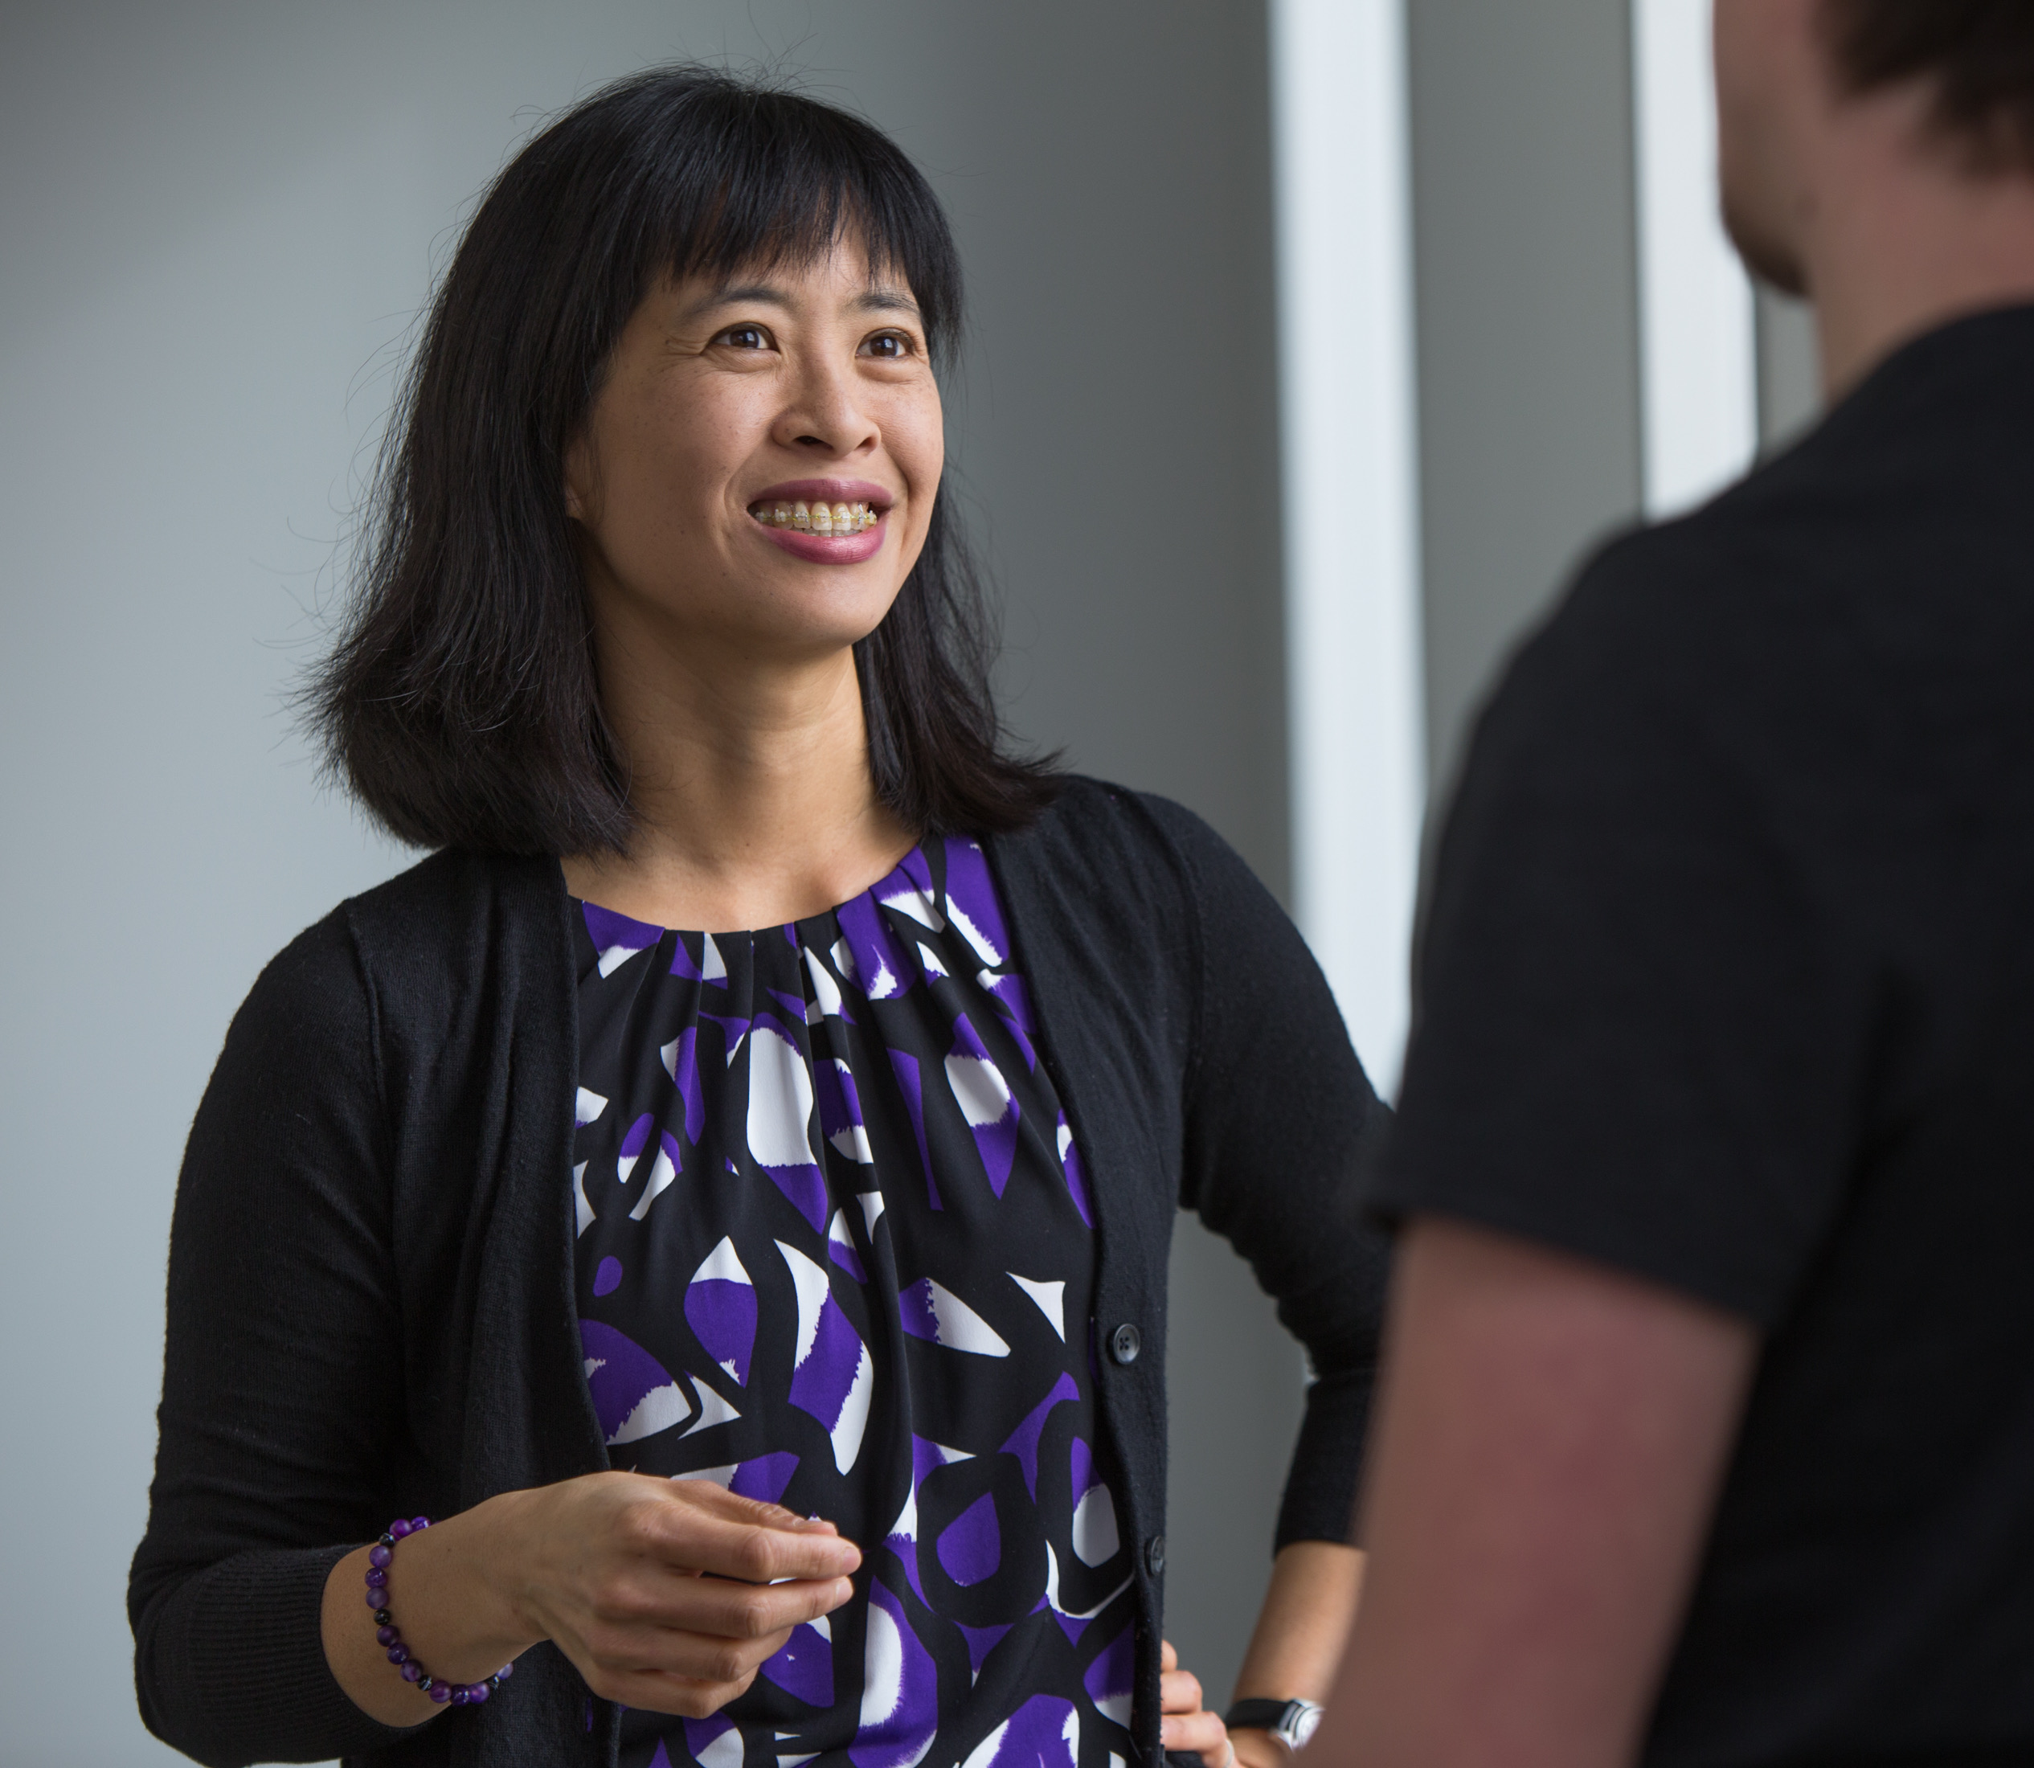
What is the best way to learn in this course?
Watch the lectures & review the slides, do assigned readings
Do the Problem Sets, engage in the small groups, review answer keys
Study with a partner or in a group
Ask questions, attend class & office hours for additional discussion

Slide 14
See you in class on January 9th!

