Slide 1

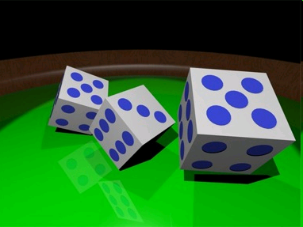
Welcome!!
Randomized Clinical Trials Course (EPI 205)

Slide 2
Welcome!!
Clinical Trials Course (EPI 205)
Objectives: detailed understanding of experimental design options well as methods of carrying out and interpreting randomized controlled trials
Nine Lectures
    Dennis Black (course director)
    Alison Huang
    Deborah Grady
Three section meetings (1/23, 2/20, 3/19)

Slide 3
Course Website
http://www.epibiostat.ucsf.edu/courses/schedule/clin_trials.html
Course information regularly updated
  Syllabus (aka Course Plan)
  Readings (4th edition of Hulley, et al)
  Note/Slide Files
  Lecture Recording
  Assignments Files
  Assignment Due Date
  Assignment Answer Files (posted after assignment is graded and returned to students)

Slide 4
Expectations – no late assignments
Dates in Syllabus
Four Protocol Assignments (email to section leader)
  5pm on Friday, January 10th (#1) – research question
  12pm on Tuesday, January 21 (Protocol assignment #1)
  12pm on Monday, February 17 (Protocol assignment #2)
  12pm on Monday, March 16 (Protocol assignment #3)
Five Lecture Exercise Assignments (email to TAs)
  5pm on Monday, January 13
  5pm on Tuesday, January 21
  5pm on Monday, February 10
  5pm on Monday, February 17
  5pm on Monday, March 9

Slide 5
Submission of Assignments
DO NOT submit assignments through CLE website
Submit assignments via email:
Homework assignments to TAs: UCSFClinicalTrials2020@gmail.com
Section assignments: submit to section leader

Slide 6

What’s coming up soon…
First Protocol Assignments (email to section leader)
  DUE THIS FRIDAY (AKA TOMORROW) !
  5pm on Friday, January 10th – research question
First Lecture Exercise Assignment (email to TA)
  DUE NEXT MONDAY
  5pm on MONDAY, January 13th (#1)

Slide 7
Discussion sections (meets 3 times)
Each student to develop own protocol for a clinical trial
A key part of course
In section
Discuss protocol and those of others
Each student to present once (3-5 per section)
Please attend all 3 sections….(important part of learning and of grade)
  If you cannot attend a section, let section leader know ahead of time
Notes:
7

Slide 8
Grading
Basis for grades
Lecture homework (25%)
Protocol development and protocol critiquing in sections (50%)
Final exam (25%) (posted to website 3/12, 10 am)

Slide 9
Course Content and Overlap
Some overlap with previous courses
eg. DCR and Biostat
2020: adjustments to maximize uniqueness of the material
Appreciate any feedback on duplication, content of course, etc. (dblack@psg.ucsf.edu)
PLEASE COMPLETE EVALUATION AT END OF THE COURSE!!!!!

Slide 10
Lectures to be videotaped
Lectures to be videotaped
Videos to be posted on Course website within 1-2 hours of lecture
Your LIVE attendance and participation at lectures is encouraged, strongly encouraged!
Remind all lecturers to repeat questions and reiterate discussion so it is captured on the recording
Notes:
10

Slide 11
TICR Professional Conduct Statement
Clarifications for this class
I will maintain the highest standards of academic honesty
I will neither give nor receive aid in examinations or assignments unless such cooperation is expressly permitted by the instructor
I will conduct research in an unbiased manner, reports results truthfully, and credit ideas developed and work done by others
I will not use answer keys from prior years
I will write answers in my own words, and, when collaboration is permitted, acknowledge collaborators when answers are jointly formulated
Notes:
11

Slide 12
Lecture 1:
Randomized Trials: Design, Subjects, and Randomization
Dennis Black, PhD
Dblack@psg.ucsf.edu

Slide 13
Lecture 1 Outline
Randomized trials: What? Why?
Randomization: the magic ingredient in RCTs
Selection of participants
Alternative Designs I

Slide 14
What is an RCT?
(Randomized Controlled Trial)
Centre for Evidence-based Medicine, Oxford
http://www.cebm.net/index.aspx?o=1116
An experiment in which subjects are randomly allocated into groups, usually called study and control groups, to receive or not to receive an experimental preventive or therapeutic procedure, maneuver, or intervention. The results are assessed by rigorous comparison of rates of disease, death, recovery, or other appropriate outcome in the study and control groups, respectively.
Centre for Evidence-based Medicine, Oxford
http://www.cebm.net/index.aspx?o=1116

Slide 15
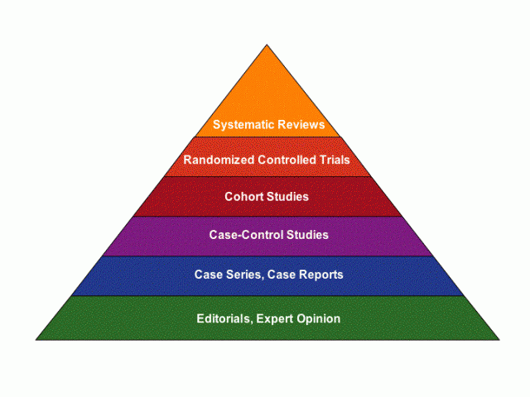
Randomized Trials: the Evidence in “Evidence-Based”

Slide 16
Reasons NOT to do RCTs
Can be expensive:
  Large phase III may cost $200-500M or more
Time Consuming: 2-5 years
Answer only 1 question
May not apply to most patients in practice
May not be practical
Generally challenging to get funded, esp NIH
Time consuming, organizationally complex
So, why bother?

Slide 17
Reasons for doing RCTs
Only design can prove causation
Eliminates confounding
Required by
  FDA (and others) for new drugs and some devices
  Payers (more and more)
Most influential to clinical practice

Slide 18
Alternatives to RCTs
(30 second Epi. Course)
RQ: Does Vitamin E prevent prostate cancer?
1. Case-control studies
  Vit E intake (past) in cases vs. non-cases
Cross-sectional studies (VE now and case/not)
3. Cohort studies (prospective)
  Vit E intake now ➔ prostate Ca future
Case-control and cohort studies are observational (not experimental)
  Need to control for confounding (DCR course and Epi course)
RCT’s are experimental

Slide 19
Anatomy of a Prospective Cohort Study
Population
Select participants
Baseline:
Assess predictors
and covariates
Analysis
Follow ppts. over time and assess outcome(s)

Slide 20

Overview of Randomized Trial Design
Population
Apply intervention
Measure
outcome(s)
Select participants
Rand
Compare
outcomes
Measure
outcome(s)
Apply control

Slide 21
Examples:
1. Vitamin E, C and Selenium on Prostate Cancer
2. Good ol’ HRT in Post-menopausal women

Slide 22
Vitamin E, C and Selenium on Prostate Cancer: Basis for Trials
Much observational data that anti-oxidents reduce Prostate Ca
Post-hoc analyses from 2 RCTs
Hope/belief: prostate cancer could be prevented by anti-oxidants
Many people were/are taking these anti-oxidants
No RCTs

Slide 23
Vit E, C and Selenium on Prostate Cancer
2 very large RCT’s published together
  SELECT study (Lippman, 2009) is largest cancer prevention trial ever performed (n=35,533)
  Also Gaziano study of prostate cancer
  (assigned for lecture 3)
Both: JAMA 2009

Slide 24
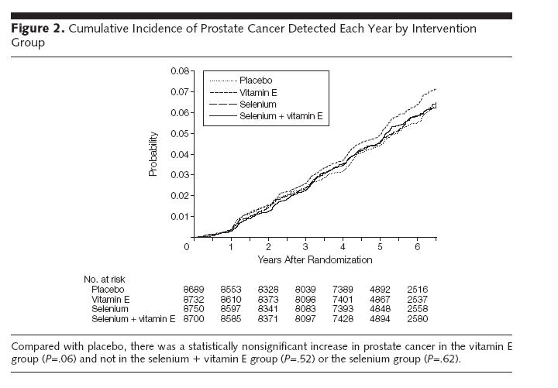
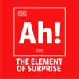
SELECT study (Lippman)
Results for Prostate Ca (Primary endpoint)
Non-significant increased risk for prostate cancer in vitamin E group compared to placebo
RR=1.13, 95% CI (0.99-1.3), p=.06

Slide 25
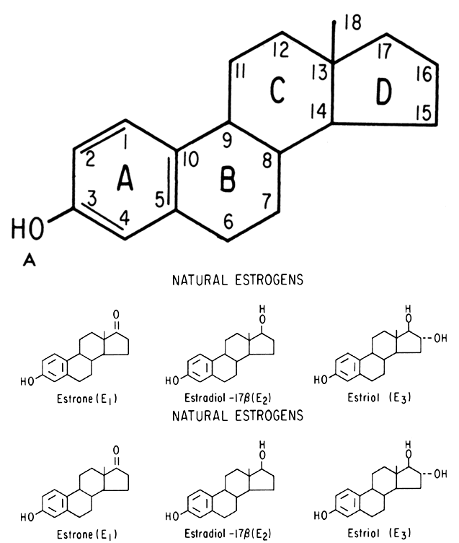


Once upon a time…..(Estrogen in the 1990’s)

Slide 26

Context: Should Post-menopausal Women Use Estrogen Replacement Therapy
Important therapeutic question
30 - 50 million women in US
Prempro (estrogen/progestin combo)
most prescribed drug in US in 1990’s
  Great for hot flashes and other PM symptoms
Potentially huge impact on public health
Complex: ERT effects multiple organs and diseases
  CHD, Cancers, Osteoporois, Cognition
  Look at CHD

Slide 27
1991: ERT and CHD in Nurses Health Cohort Study (NEJM, 9/12/91)
Prospective cohort study, n > 48,000, > 8 years
Risk of Major
Estrogen Use Coronary Disease* Relative Risk**
Never Used 1.4 1.0
Current user 0.6 0.56 (0.40-0.80)
Former user 1.3 0.83 (0.65-1.05)
* Events per 1000 women-years of follow-up
** Relative Risk (95% CI) compared to never users, adjusted for everything

Slide 28
ERT:
Results from Observational Studies ~ 1996
1996: 100’s of observational studies with consistent results…. But no randomized trials at that time
Disease Effect on Risk*
Coronary heart disease Decrease by 40 - 80%
Osteoporosis (hip fx) Decrease by 30 - 60%
Breast cancer Increase by 10 - 20%
Endometrial cancer Increase by 700%
Alzheimer’s Decrease by ?
Pulmonary embolism & Increase by 200 - 300%
deep vein thrombosis

Slide 29
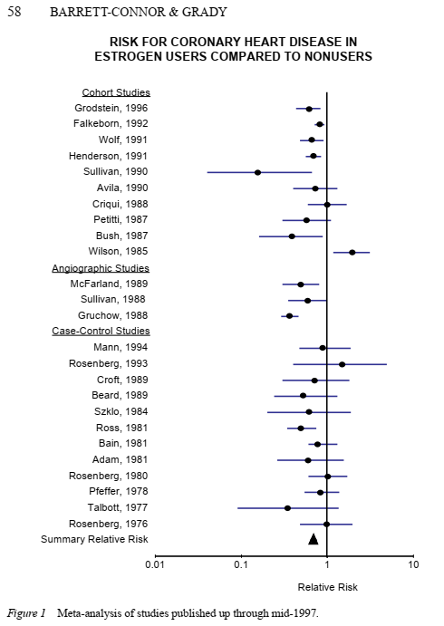
Meta-Analysis of Risk For CHD in Estrogen Users vs. Non-users
Summary RR= 0.7 (0.65-0.75)
30% reduction in risk
Barrett-Connor, Grady
Ann. Review Pub. Health, 1998

Slide 30
Meta-analysis of ERT, Published ~4/10/97
“Benefits (for CHD, osteoporosis) outweigh risks (breast cancer) and side effects…
All post-menopausal women should be taking ERT”*
* CNN, 4/10/97

Slide 31
1997: All ERT data were observational
Women chose to take ERT
Are ERT users different from non-users?
  Age
  Health status
  More exercise
  Health behaviors (see Dr.)
  SES
Try to adjust in analysis, but may not be possible
Is randomized trial ethically justified?

Slide 32
RCT to Rescue: Heart and Estrogen-Progestin Replacement Study (HERS)
1st major RCT of ERT (started 1992)
  2ndary prevention CHD
2763 women with CHD (mean age 67)
HRT (Prempro) vs. placebo (4-5 years)
UCSF (DG/DB/SC)
Funding by Wyeth-Ayerst (post-NIH refusal)
Our worry????
Study will be stopped by DSMB early due to strong reduction in CHD with HRT
Hulley et al Jama 1998

Slide 33
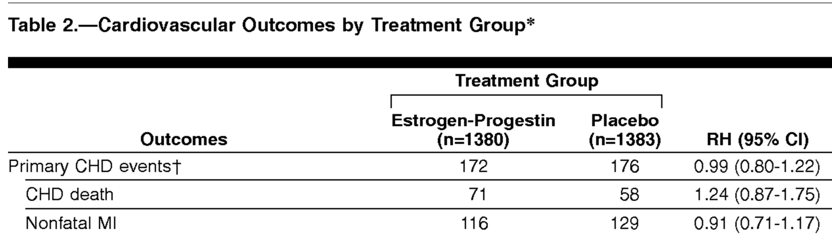
HERS: Incidence of CHD Events by Treatment
HR=xx,xxx, p=0.91

Slide 34
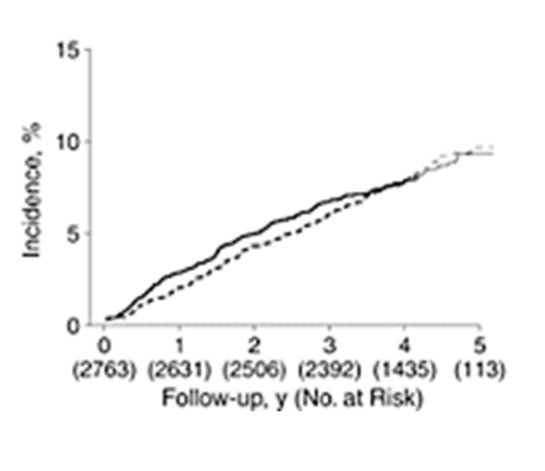
HERS: Incidence of Primary CHD Events by Treatment
HR=0.99 (0.80-1.22), p=0.91
HRT
Placebo
Hulley et al JAMA 1998

Slide 35
Women’s Health Initiative (WHI)
HRT study (7/10/02)
RCTs of HRT (2) in 37,000 women
  Estrogen with (1) and without (2) progesterone
Ages 50-79
Broad range of US women, 40 centers
  Without or with CHD
Planned 8.5 years
CHD was one key endpoint

Slide 36
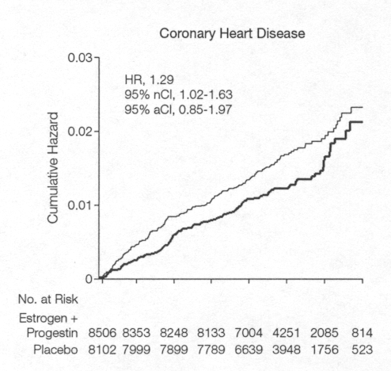

WHI E + P (stopped early 7/02):
CHD 29% increase with HRT
years 1 2 3 4 5 6

Slide 37
ERT Trials: Conclusions for RCTs
Observational studies can be/often wrong.
  Meta-analysis of observational studies can be wrong.
What went wrong with observational studies of vitamins and HRT?
Conclusion:
  Confounders (known + unknown) are almost impossible to fully identify and control for in non-randomized studies
RCT’s impact clinical care:
  HRT use dramatically declined

Slide 38

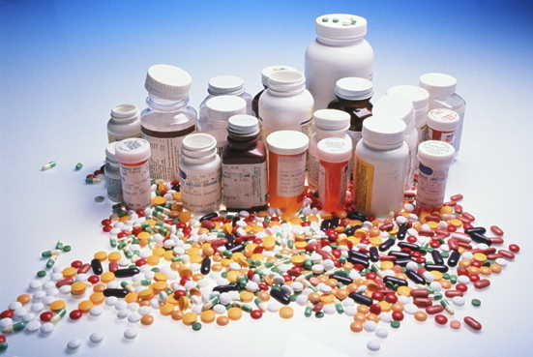
RCT’s..not just pills
Other types of interventions
Dietary
Surgical techniques
Behavioral Intervention

Slide 39
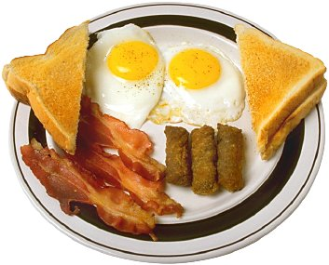

What did you eat this morning?
Vs.
Vs.
Want to make an evidence-based decision..

Slide 40
RCT of 4 Popular Weight Loss Programs (12 mos)
Vs.
Compare 4 diets
  1. Atkins (low carbohydrate)
  2. Weight Watchers (low calorie/portion size)
  3. Zone (high protein/low-glycemic load)
  4. Ornish (very low fat)
JAMA 1/5/05
JAMA 1/5/05

Slide 41
Diet study: Design
  N =160, 12 months
  Randomize to 1 of 4 diets
  Follow for 12 months
  Endpoints:
    Weight loss
    Heart disease risk factors (cholesterol, BP, triglycerides)
JAMA 1/5/05

Slide 42
Diet study: Results Summary
All diets: modest weight loss and help cardiac risk factors
Poor compliance for all diets, especially Atkins and Ornish
  Those who adhered well had better results
JAMA 1/5/05

Slide 43
RCT of Surgery Technique
RQ: What is optimal surgery technique for hernia repair?
RCT of Open Mesh vs. Laparoscopic??
Main result:
A UCSF prof got open mesh surgery in 2018

Slide 44
Examples of major positive breakthroughs from RCTs
Protease inhibitors and AIDS
Lipid lowering (statins) and heart disease
Bisphosphonates and fracture risk
Many examples of trials with huge impact on clinical practice and public health

Slide 45
Overview of Randomized Trial Design
Population
Apply intervention
Measure
outcome(s)
Select participants
Rand
Compare
outcomes
Measure
outcome(s)
Apply control
RANDOMIZATION!!

Slide 46
1. Randomization

Slide 47
Randomization
Key element of RCT’s
Assure equal distribution of confounders...
  Measured/known
  Unmeasured/unknown
Important to do well
  True random allocation
  Tamper-proof (no peeking, altering order of participants, etc)
Simple randomization
  Low tech
  High tech

Slide 48
Randomization
Want balance in “Table 1”
Lippman et. al

Slide 49
Randomization:
The Basics
Cannot assure equal numbers per group or balance

Slide 50
Randomized Permuted Blocks
Blocking: equal after each 4 (or n) assignments
  e.g., block size=4, treatments a and b (6 possible blocks):
  abab aabb abba baba bbaa baab
  Randomly choose blocks
  Assure relatively equal number of ppts. to each treatment
    Eg: abab abba abab baab
  Disadvantages of blocking (in unblinded trials)
  Size of block: 2 treatments--4 or 6
  Very commonly used

Slide 51
Balancing important covariates
If you are worried about a key variable being unbalanced across treatments by chance alone...
What to do?

Slide 52
Randomized Blocks to
Balance Prognostic Variables
Stratified permuted blocks
  Blocks within strata of prognostic variable
    e.g., Prostate cancer (PSA < 5 vs. PSA > 5)
  Use permuted blocks within stratum
  PSA < 5: aabb baba …
  PSA > 5: baab abab ….
  Limited number of risk factors
  Very common in multicenter RCTs to balance within clinical center
Fancier techniques for assuring balance
  Adaptive randomization

Slide 53

Implementation of randomization
Less challenging for blinded studies
  List of drug numbers
    a b a b b b a a
    1 2 3 4 5 6 7 8
    Clinic receives bottles labeled only by numbers--assign in order
  Sealed envelopes in fixed order at clinics
Unblinded studies: important to keep next assignment secret
  Problem with randomized blocks
#001
#002
#003

Slide 54
Randomization: Summary
Key element of RCTs
  Insure balance for all factors at baseline
Not really very complicated (usually)

Slide 55
2. Selection of Patients

Slide 56
Who to Study:
Trade-offs to think about for Inclusion/exclusion
Widest generalizability
High event rate (for adequate power)
Ease of recruitment
Population in whom intervention likely to be effective and safe
Likelihood of compliance with treatment and F/U

Slide 57
Who to Study (eg. CHD study of statin):
Principles for Inclusion/exclusion
Broad eligibility ------------------- Narrow elig.
eg. men or women >50 men > 70
Recruitment: easier difficult
Generalizability: wide narrow
Sample size: large small

Slide 58
Design-a-trial for a new statin:
Inclusion criteria options
Study new statin and CHD, 4 years. Inclusion options:
  Women > 50 years (WHI)
  Women > 60 years
  Women > 75 years
  Women with existing heart disease (HERS)
Generalizability?
Feasible sample size?
Population amenable to intervention?
Logistic difficulties (recruitment? cost? Adherence?)
?

Slide 59
Statin Trial: How many needed?
Statin trial options (CHD event rate)
  Women > 50 yrs (0.1%/y)
  Women > 60 yrs (0.5%/y)
  Women > 75 years (1%/y)
  Women with existing heart disease (4%/y)
What sample size needed to reduce risks by 40%?
?

Slide 60
Statin Trial Inclusion Options
Statin trial options (event rate) [n required]
  Women over age 50 years (0.1%/year) [55,000]
  Women over 60 years (0.5%/year) [45,000]
  Women over 75 years (1%/year) [34,000]
  Women with existing heart disease (4%/year) [3,000]

Slide 61
Digression: Study Protocol
Inclusion/exclusion are one part of a study protocol
Formal document for any RCT
Created during study design phase (prior to start of study)
Required by IRBs and FDA or EMEA
Needs to have key details included
  Often can be quite long

Slide 62
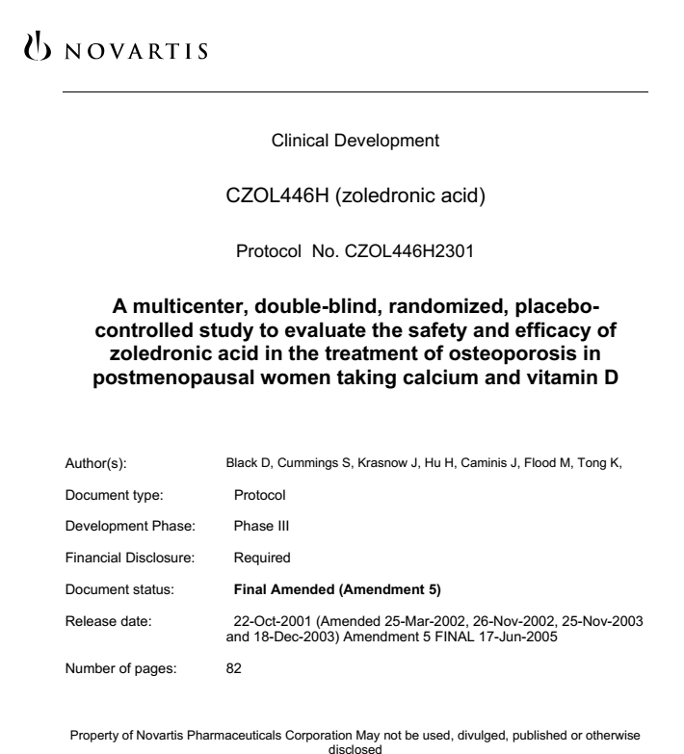
Study Protocol from Zoledronic Acid Trial*
General template for protocols:
https://www.spirit-statement.org/
* Black, et al NEJM 2007

Slide 63
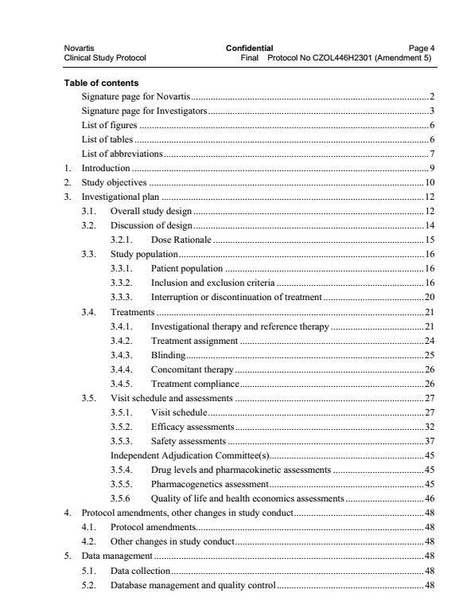
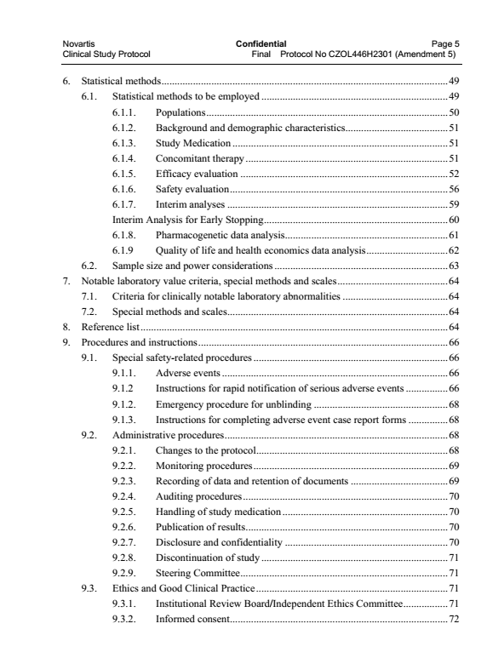
Study Protocol (Table of Contents)

Slide 64
Implementation of Inclusion/exclusion Criteria
Typically written as “inclusion/exclusion” section in protocol
The more explicit the better
Want investigators (esp. in multicenter RCTS) to be consistent
Eg. Want to exclude women with heart disease
  - “Women with heart disease” (not very specific) vs.
  - “Women with CABG surgery or documented MI by ecg (criteria) or enzymes (criteria)”

Slide 65
Example: Protocol
PTH and alendronate (PaTH) in combination for the treatment of osteoporosis
3.6.1 Inclusion Criteria
Women aged between 55 and 85 years of age.
Who are post-menopausal (have not had any menses in the last 5 years).
Have an evaluable bone mineral density scan (DXA) at the spine AND at the hip with a T-score < -2.5 either at the spine or the femoral neck or total hip
OR have a T-score < –2.0 with at least one of the following risk factors for fracture:
Age ≥ 65 years
History of post-menopausal fracture (non-vertebral or vertebral)
Maternal history of hip fracture.
Be willing and able to self-administer daily injections. ETC
* Black, et al NEJM 2003
Black, et al NEJM 2004

Slide 66
Example: Protocol
PTH and alendronate (PaTH) in combination for the treatment of osteoporosis
3.6.2 Exclusion Criteria
Have used estrogen (oral or patch) more than one month in the last 6 months or for more than 12 months in the last 2 years.
Have a history of more than 12 months of bisphosphonate use ever, or any use (> 4 weeks) within the past 12 months.
Have a history of rhPTH use ever.
Have any major life-threatening illnesses.
Have type 1 or uncontrolled type 2 diabetes mellitus (defined as hemoglobin A1C > 10.0), or currently using insulin.
Have Vitamin D level < 15 nanograms /ml.
Have any history of kidney disease (creatinine > 2.0 mg/dl).
Have renal insufficiency (creatinine clearance < 40 mg/min).
Have any history of kidney stones.
Have any history of hypercalcuria or currently have urine calcium/creatinine >300 mg.
Have any history of hypercalcemia.
Have any history of sarcoidosis.
Have any history of hyperparathyroidism.
Have any history of active or treated tuberculosis or other granulomatous disorders.
History of breast cancer, melanoma or hematologic malignancy which has required treatment within the last 10 years.
History of bone cancer or any other metabolic bone disease which has required treatment within the last 10 years.
History of any other non-skin cancer which has required treatment within the last 10 years.
Have a documented history of symptomatic esophageal reflux, achalasia or esophageal stricture.
Be currently taking > 7.5 mg systemic prednisone or equivalent per day.
Be currently using > 2 puffs, 4 times / day of inhaled steroids.
Be currently taking anticoagulants.
Be currently taking anticonvulsants( MORE)
Have used Calcitonin within the past 3 months.
Have used Raloxifene in the last 6 months or for more than 12 months in the last 2 years.
Have used Tamoxifen in the last 6 months or for more than 12 months in the last 2 years.
Have used fluoride for at least a month within the past 5 years.
Be currently taking > 1000 IU/day Vitamin D or Vitamin D analogues or metabolites.
Be currently taking thyroid hormone replacement AND have a TSH < 0.1mIU/L.
* Black, et al NEJM 2003

Slide 67
Inclusion, Exclusion: Summary
Many factors to balance in deciding who to include
Inclusion/exclusion criteria should be clear and explicit in study protocol
Generally not a clear cut or single correct decision
  Designers often don’t appreciate the complexity of issues…or implications of decisions

Slide 68
3. Alternative Designs for RCT’s

Slide 69
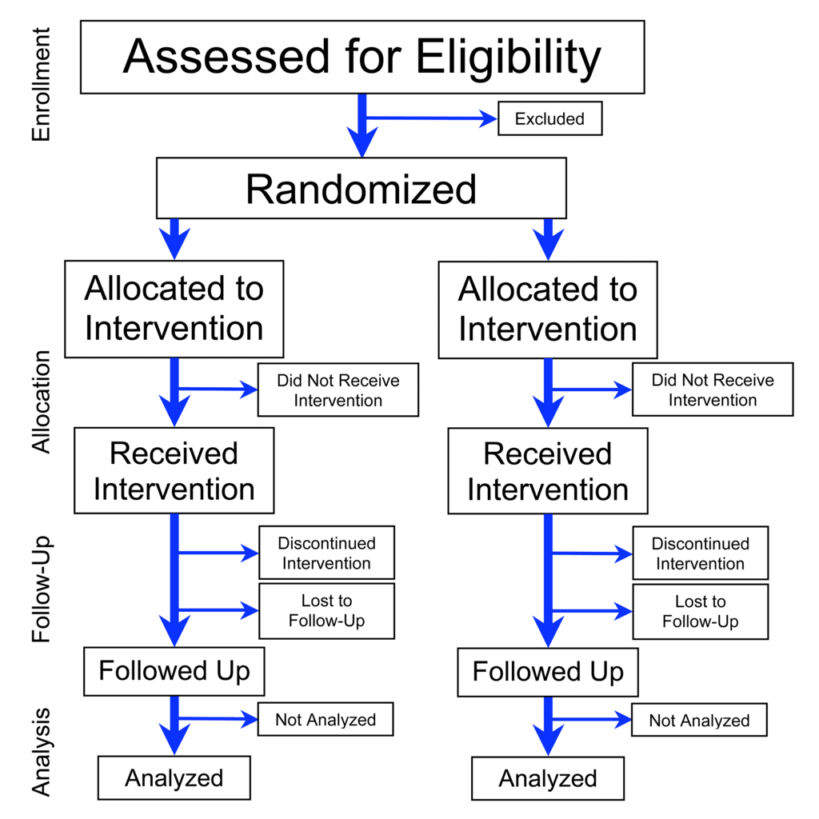
3. Alternative Designs for RCT’s
Parallel group design

Slide 70
Alternative designs for RCT’s 1:
Quick survey
Today (Introduce, more design types in later lectures)
Cross-over designs
Matched pair designs
Cluster randomization
Large, simple trials
Lecture 3: Factorial designs

Slide 71
Trial designs we won’t cover...
Phase I (and II) trials
Non-randomized
Adaptive Designs

Slide 72
Cross-over designs
Both treatments are administered sequentially to all subjects
Subject serves as own control, randomize the order
Compare treatment period vs. control period
  Increases power by reducing person-to-person variability

Slide 73
Cross-over designs
Diuretic (d) vs. beta blocker (bb) for blood pressure
  1/2 get d followed by bb
  1/2 get bb followed by d
Migraine prophylaxis
  Rx x 3 months followed by placebo
  Placebo x 3 months followed by Rx

Slide 74
Example of Crossover Design in Homework
Paroxetine for hot flashes in post-menopausal women
  Compare 10 mg to 20 mg of Paroxetine (SSRI, Anti-D)
Randomized to: | Week 1-4 | Week 5-8 | Week 9-12
Group 1 | 10 mg | Placebo | 20 mg
Group 2 | 20 mg | Placebo | 10 mg
Sterns, et al

Slide 75
Cross-over assumptions/limitations
Transient outcomes only
No order effects
  No carry-over effects
  Need quick response and quick resolution
“Wash out” period helpful
More commonly used in phase I/II

Slide 76

Matched Pair Randomization
One of each pair to each treatment
Each subject is their own control
Reduces risk of imbalanced randomization
Allows smaller sample size
Treatment A
Treatment B

Slide 77
Matched Pair Randomization
Example: Randomize each of two eyes within an individual (one to each treatment)
  Diabetic Retinopathy study
Example: Filter for carotid arteries in patients with atrial fibrillation
  Random side of intervention
Example: Quality Improvement in Stroke Prevention (QUISP) trial
  Randomize paired Kaiser facilities

Slide 78
Matched Pair Randomization: Issues
Efficient design in some situations
Not necessary when sample size makes balanced randomization likely
  Loss in efficiency
May not be feasible
Arguments about how to analyze the data
  Maintaining the match vs. breaking it

Slide 79
Cluster or grouped randomization
Randomize groups to treatments
Often useful especially for public health-type interventions
May be only way to study a question
  Intervention is at the group level
  Avoid cross-contamination between individuals

Slide 80
Cluster randomization
Examples of randomized clusters
  Cities to public health risk factor reduction (5 Cities Project, 1970’s)
  Medical practices to stop-smoking intervention (randomize med. prac.)

Slide 81
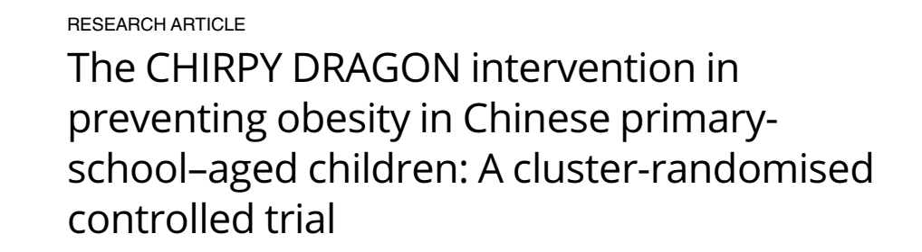
Cluster randomization example
PLOS, 11/26/19

Slide 82
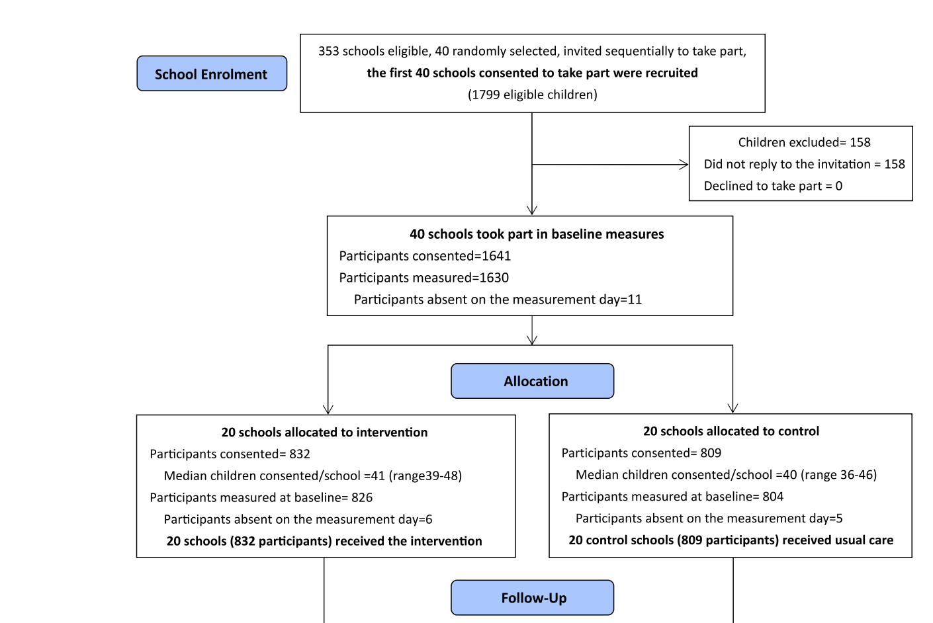
CHIRPY
DRAGON
Li, PLOS, 11/26/19

Slide 83
CHIRPY DRAGON
Goal: Develop programs to control obesity in children
Randomized 40 schools (total of 1461 6 YO) in Guangzhou to intervention vs control
Intervention to increase healthy eating and physical activity
Primary outcome: Change in BMI over 12 months.
Li, PLOS, 11/26/19

Slide 84
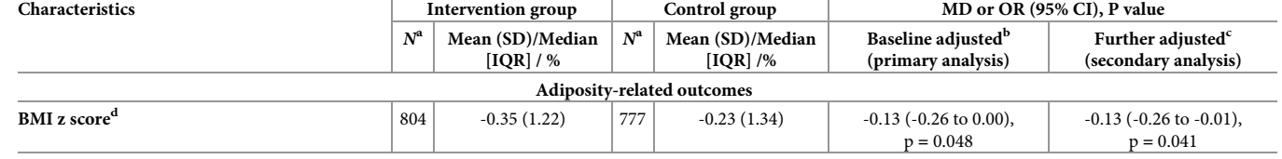
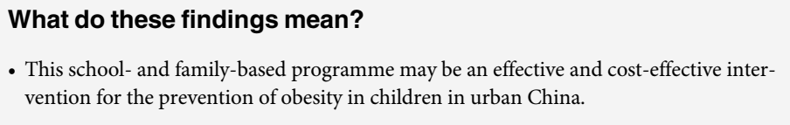
Change in BMI: Primary Analysis
Reduction in BMI =-.13 units, p=.041
  More significant in girls (p=.007)
Li, PLOS, 11/26/19

Slide 85
Cluster or grouped randomization:
Potential disadvantages
Sample size determination is complex: true n is between n clusters and n individuals (closer to clusters)
  Tendency to underestimate necessary sample size
  Example in homework 1
Analysis complex but do-able
  Must account for clustering
  Mixed models best
Very useful, efficient and underused design

Slide 86
Alternative RCT designs:
“Large-simple”
Large simple: less information on more people
  Balance loss of precision with sample size
  Can use internet/social media for recruitment/follow-up
  Low cost per patient
  Examples:
    COMMIT: 45,852 patients in China, adding clopidogrel to aspirin in acute MI
    VITAL : Internet-based study of Vitamin D and Cancer (2017)

Slide 87
Schedule for next weeks…
1/16: Dr. Grady: Blinding, Intervention and Controls
1/23: Discussion sections (please attend)
1/30: Dr. Black: Statistical issues, Factorial Designs, Analysis of Subgroups in RCTs
Don’t forget upcoming:
1st homework due Monday, 1/13, 5 pm
1st protocol assignment due Monday, 1/21, 12pm

