Slide 1
Study Design – RCT to Cohort
Epidemiology 207 - Epidemiology Methods II
June M. Chan, ScD
Professor & Vice Chair, Epidemiology & Biostatistics
Steven & Christine Burd-Safeway Distinguished Professor & Assoc. Chair, Clinical Research, Urology

Slide 2
DISCLOSURES
Individual: Research collaborations with GenomeDx
Urology Dept: Research collaborations with Genomic Health Inc., Genome Dx, & Mryriad Genetics
Husband: full time employee for GRAIL

Slide 3
Today’s Topics
Introductions
Expectations
Objectives Overview & Schedule
Study Design
  Strengths & Limitations of Randomized Clinical Trials
  Target Trial
  Observational Studies
    Cohort (continued on Jan 30)
    (Case-Control, Jan 16)
Supplemental Material

Slide 4
Objectives & Overview

Slide 5
Recap of Epi 203

Slide 6
Why 207? – Expanding on Study Design & Outcome Measures
Covered in EPI 203
  Study Design
    Ecologic studies
    Cross-sectional studies
    Cohort studies
      Fixed vs. dynamic
    Case-control studies
      Primary vs. secondary study base
      Sampling schema
  Disease occurrence
    Risk, rates, odds, hazard
Epi 207
  Study Design
    Experimental study designs
      A paradigm for causal inference
      Target Trial & Cohort
    Challenges of matching
    Case-only study designs
    Counterfactual framework & causal inference
  Outcome measure
    Time to event / Survival analysis

Slide 7
Why 207? – Expanding on Threats to Validity
Covered in EPI 203
  Threats to Validity
    Selection Bias
    Measurement Error
    Confounding
    Interaction
EPI 207
  Threats to Validity in settings with Person-time, Survival Analysis
    Selection Bias
    Immortal Person-time Bias
    Reverse Causation
  DAGs for depicting bias
  Quantitative Bias Analysis
  Interaction & Effect Modification & Causal Inference Framework

Slide 8
How does this build upon Epidemiologic Methods I?
Delve deeper into how to design rigorous, valid, observational epidemiologic studies
Provide a practical framework for integrating and applying concepts taught in Epid Methods I by thinking through the research process - from hypothesis development, to study design, analysis, and interpretation; & practical tips on implementation.
Gain further practice in interpretation of observational epidemiologic & translational research by reading and critiquing papers.

Slide 9
Expectations & Ground Rules

Slide 10
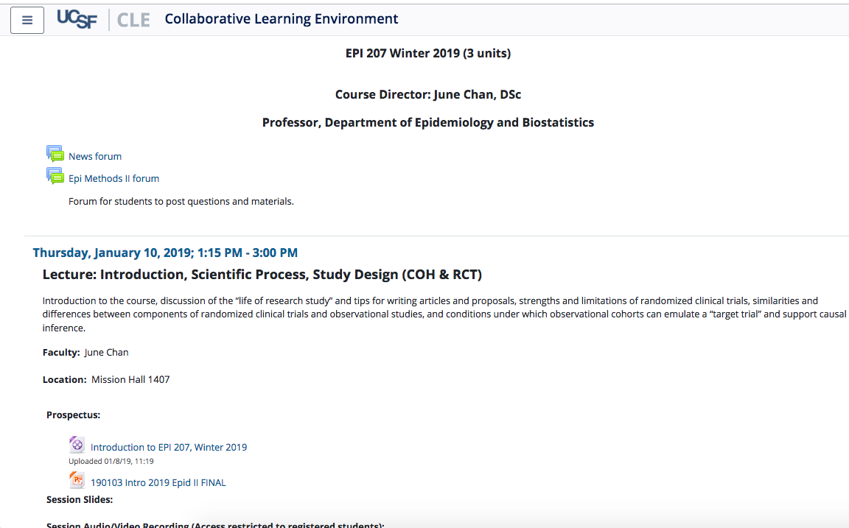
The Course
See Intro Video on CLE for more on logistics etc.

Slide 11
Notes:
Introduce TA’s, discussion sessions, format
Live Thursday sessions will be a mix of lecture and HW review. We’ve shortened HW review this year to allow more “live lec” per f/b from last year. Please use this time to ask questions.
We also have added standing OH/optional mini-lab sessions on Tuesday’s, mainly with TA’s
The more you ask questions, participate, and engage, the more we will all learn

Slide 12
The classroom is a safe space for learning… and making mistakes… so engage!
Notes:
Be respectful of each other
Don’t be afraid to ask question
Team work is important – how are we a “team” here?...
this is a classroom, not a competition
For all of us, when you come to this classroom, please consider this a “safe environment”, to learn, to listen to others, and be supportive, fine to disagree, learn to do it respectfully – teamwork is important

Slide 13
Expectations Summary
Team Learning & Professionalism
Safe Space
Assessments
  7 HW assignments (70% of grade)
    Due Thursday by 1:00 PM starting 1/16 through 3/12
    CLE will NOT accept late assignments
    Drop lowest score
  Take-home final assigned 3/12, due 3/20 (30% of grade)
Notes:
Code of Conduct

Slide 14

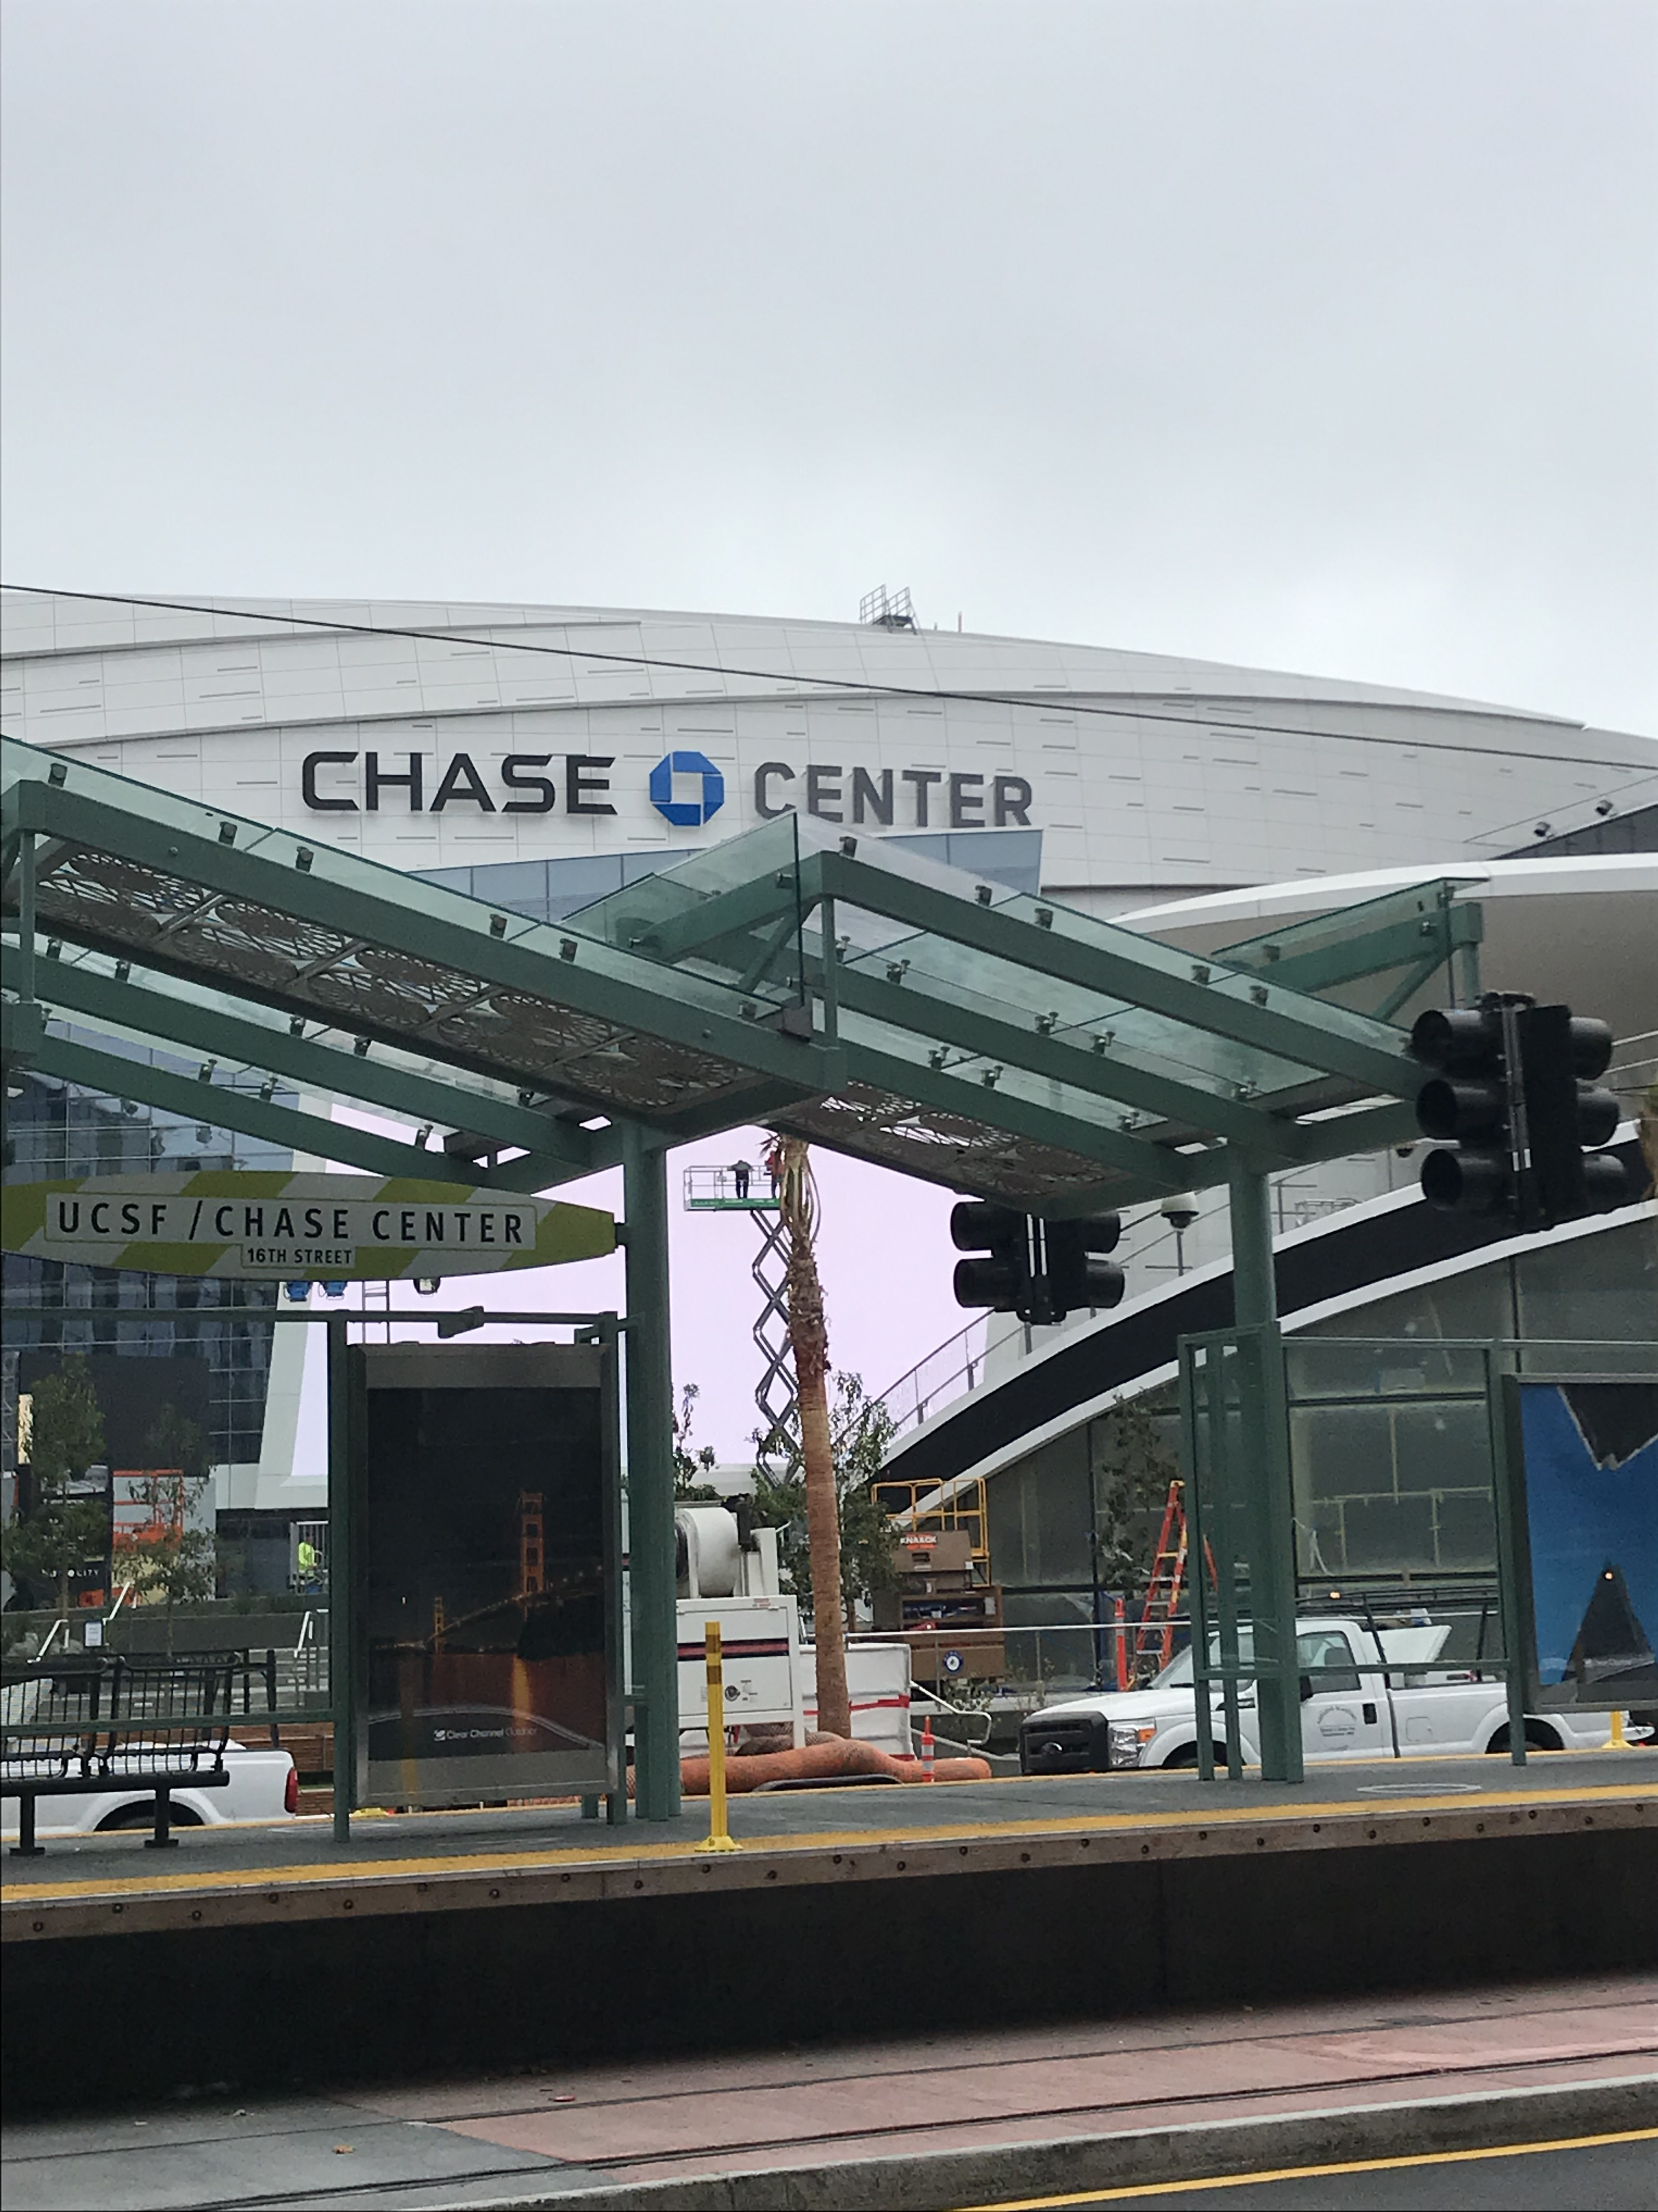
Notes:
Introduction
The Course – There have been a lot of revisions; it is a work in progress. Welcome constructive feedback.
Life long learning
I’m a learner too… I may make mistakes… goal is to learn from these mistakes
For you, want you to feel comfortable speaking up, engage in conversation, try out your ideas, answer and ask questions – this is the place to do it in your training!

Slide 15
Questions?

Slide 16
Study Design – RCT to COH
Notes:
~ min 33 (2018)

Slide 17
Recap from Epid Methods I – Study Design
Research Studies Based on Humans
Unit of observation
Group (e.g., geographic area)
Individual
Observational
Experimental
Experimental
Ecologic Studies
Randomized
Non-randomized
Observational
Randomized
Non-randomized
Between-subject
Cohort
Cross-sectional
Case-Control
Within-subject
Case-crossover
Case only
Self-controlled case series

Slide 18
Elements of Study Design
How was the population defined? How was the sample selected?
What is the time-frame (cross-sectional, longitudinal)?
Did we sample using persons or person time?
Was the underlying cohort ‘dynamic’ or ‘fixed’?
How was exposure defined and assessed?
What is the outcome & are we estimating risks, rates, odds, time to event, etc?
Was there non-compliance or could exposure change over time? How was this handled?
Was there drop-out or loss to follow-up? Did participants die before the outcome was measured?
Notes:
Who has heard of “PICO”? Ask for volunteer to explain.
Many folks at UCSF use the mnemonic “PICO” which stands for Population, Intervention (or Exposure if Obs study), Control (or Comparison group), and Outcome
For any study you are planning, conducting, or if you are reading an article, very good to identify PICO clearly for yourself.
The list above is a little more detailed/comprehensive

Slide 19
Elements of Study Design
How was the population defined? How was the sample selected?
What is the time-frame (cross-sectional, longitudinal)?
Did we sample using persons or person time?
Was the underlying cohort ‘dynamic’ or ‘fixed’?
How was exposure defined and assessed?
What is the outcome & are we estimating risks, rates, odds, time to event, etc?
Was there non-compliance or could exposure change over time? How was this handled?
Was there drop-out or loss to follow-up? Did participants die before the outcome was measured?
Notes:
Who has heard of “PICO”? Ask for volunteer to explain.
Many folks at UCSF use the mnemonic “PICO” which stands for Population, Intervention (or Exposure if Obs study), Control (or Comparison group), and Outcome
For any study you are planning, conducting, or if you are reading an article, very good to identify PICO clearly for yourself.
The list above is a little more detailed/comprehensive

Slide 20
RCT & Cohort to Target Trial

Slide 21
Number of “hits” in Pubmed by study design keyword
“clinical trial” 1,162,720
  “RCT” 631,192
“cohort” 2,154,526
“case-control” 1,284,138
Notes:
Cohort is very commonly going to be the “work horse” study design in many epid studies.
More likely to read papers from a cohort
Stats from jan 2020

Slide 22
Relationship bt Obs & Experimental Studies
Recap from Epid Methods I – Study Design
Experimental studies can be viewed as cohort studies where the investigator assigns the exposure
Observational studies should be viewed (and designed) as attempting to emulate a randomized controlled trial (RCT)
When designing an observational study, ask yourself: What is the RCT that I am trying to emulate?
  What is the “target trial”?
  To understand better a “target trial” – let’s discuss RCT’s
Notes:
EPI 203 notes fr J Martin:
A randomized controlled trial (RCT) is the gold standard design for comparing the effectiveness of different interventions to influence an outcome. We pointed out earlier that the RCT design can be thought of as a type of cohort study where the exposure is assigned to participants, rather than just measured as it occurs in nature. We also can turn this around. That is, a useful insight in the understanding of observational studies is that one should strive to have them emulate an RCT. Observational studies that aim to establish causality should be evaluated with respect to how well they emulate an experimental “target” trial (i.e., an RCT).

Slide 23
RCT – Brief Summary
Acknowledgement: Deb Grady, MD MPH

Slide 24
Concept of clinical trials or experimental studies guide other study designs
⚐ “Trial” → there is an intervention, distinct from “Observational” studies
Randomized experiments → paradigm for causal inference
Randomized trials provide helpful idealized framework in which to think about other types of study designs
Notes:
EPI 205 focuses on clinical trial design/conduct
Be deliberate when you use the word “trial”; this means a study with an intervention… and often “trial” refers to a ”randomized trial”

Slide 25
Basic Trial Design
Population
Intervention
Outcome
Sample
Randomization
+ Blinding
Placebo
Control
Outcome
Notes:
For example, select persons with memory loss, treat with daily mathematics and memory exercises and see if this improves score on MMSE and reduces risk of developing dementia.
Note can have an uncontrolled trial or time series design. These have no concurrent control group and can produce the wrong answer due to learning, regression to the mean, secular trends and the placebo effect. Note, for example, that it is common to have a 30-50% improvement in depression scores, pain scores, hot flash scores.
Can have a controlled trial without randomization. This addresses problems noted above, but may make the treatment look good simply because the groups are different to begin with. For example, if you put all the older people in the control group because it’s too hard to teach them mathematics, the rate of developing dementia may be higher in this group simply because they are older. This design is really no different from a double cohort study. Randomization fixes this - for both known (measured) and unknown (unmeasured) potential confounders - I.e., age will be balanced in both groups, as will education, etc. And potential confounders we don’t know about.
Can have a randomized controlled trial without placebo (blinding). This allows (as will be discussed later) for co-intervention and biases outcome ascertainment.
Also note that these three elements - treatment, randomization and blinding result in the major ethical concerns regarding randomized trials.

Slide 26
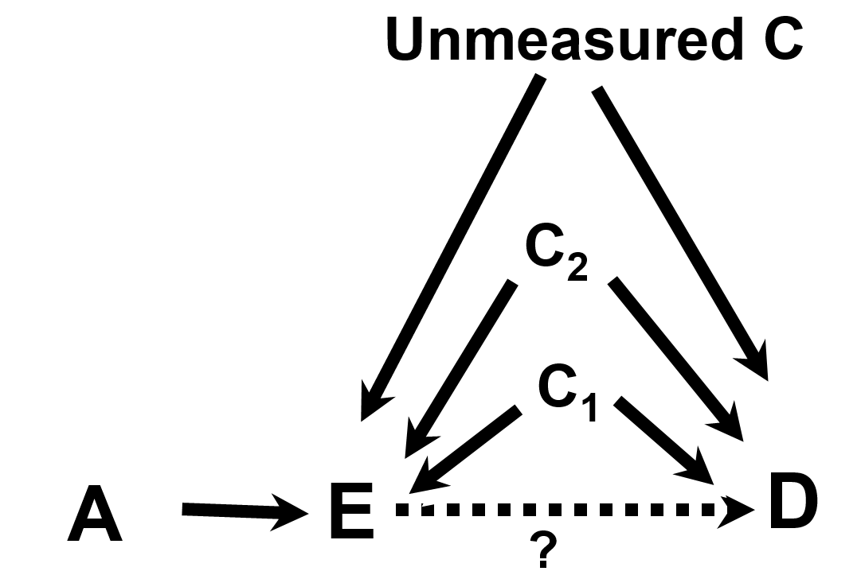
EPI203, Confounding & Interaction
Variable A is referred to as an instrumental variable (IV) or “instrument”.
Notes:
Variable A is referred to as an instrumental variable or “instrument”. An instrument is defined to as a factor related to exposure but to nothing else.

Slide 27
EPI203, Confounding & Interaction
Randomization
Variable A is referred to as an instrumental variable (IV) or “instrument”. Here, let A be randomization in a RCT.
Randomization is an Instrumental Variable, that is related to the Exposure and nothing else. In a RCT, we focus on the IV-D relationship (randomized assignment and disease outcomes) in Intent-to-Treat analyses
Notes:
Variable A is referred to as an instrumental variable or “instrument”. An instrument is defined to as a factor related to exposure but to nothing else.

Slide 28
Randomized Clinical Trial attributes:
  Randomization to Exposure (e.g., drug) or a Control (e.g., placebo) addresses known & unknown confounding factors
  Intention to Treat (ITT): “once randomized, always analyzed”, maintains randomization
  Blinding minimizes bias in assessments/self-report

Slide 29
RCT Rationale
Why do a randomized blinded trial?
  minimize confounding
  minimize co-interventions
  minimize biased outcome ascertainment
Why not do a randomized trial?
  major ethical issues
  narrow research question
  expensive
  long time from idea to publication
Generally reserved for mature questions
Notes:
Will talk more about why to do a trial…want to emphasize that there are some good reasons NOT to do a trial.
Randomized Clinical Trial attributes:
Randomization to Exposure (e.g., drug) or a Control (e.g., placebo) addresses known/unknown confounding factors
Intention to Treat (ITT): “once randomized, always analyzed”, maintains randomization
Blinding minimizes bias in assessments
Co-Intervention – additional diagnostic or therapeutic tests or procedures applied to either the intervention or control group in a RCT. Such additions that are not pre-specified by the protocol could introduce confounding and threaten validity of the trial.

Slide 30
Randomization
Participants are assigned to treatment groups by chance with a known probability
Random number sequence, generated by computer
Tamper-proof system
  ordered, sealed envelopes
  centralized system (phone, computer, web)

Slide 31
Value of Randomization
Balances baseline characteristics of the treatment groups
  eliminates confounding due to measured and unmeasured factors
  provides an unbiased comparison between groups
Does NOT maintain balance after randomization
  What does that mean?
  Consider an intervention that is not blinded….
Notes:
If your intervention is not blinded to the dr. or participant, self-awareness of the intervention after randomization can lead to the introduction of differences bt groups.

Slide 32
Choice of Intervention
Maximize
  effectiveness (highest tolerable dose)
  safety (lowest effective dose)
  generalizability
  trial design/conduct
    recruitment
    compliance
    blinding

Slide 33
Choice of Control
Inert placebo usually best
Active therapy or “standard of care”
  Active Comparator Trial - new therapy more effective than standard
    Ho: two treatments equally effective
    Ha: one treatment more effective
  Equivalence Trial - new therapy equivalent
    Ho: two treatments differ by at least X
    Ha: two treatments differ by less than X
Notes:
Best control is inactive placebo
easy to determine benefit or harm
Usually (not always) easy to blind
Some trials use an active treatment of “standard of care” as the comparator. Here, the goal might be to show that the new intervention is better than the standard. The design and statistical analysis here is exactly the same as if the standard of care were a placebo.
But often, the goal is to determine if the new treatment is AS GOOD as the standard of care. Sometimes, we do just want a second line therapy, but generally don’t really care if a new treatment is as good as the standard of care unless it has some advantages, for example better side effect profile, more convenient, or less expensive.
Decision about what is considered “good enough” for non-inferiority trial is based on lit. example: https://jamanetwork.com/journals/jama/fullarticle/2320315?utm_source=silverchair&utm_campaign=marketing&utm_content=article-decade&cmp=1&utm_medium=email
In this example, X was set at 24% for power calculations.
Consider, for example, the problem of conducting a clinical trial with a new drug for prevention of osteoporotic fractures. There are already proven effective drugs for this, namely estrogens, bisphosphonates and PTH. Is it ethical and/or clinically useful to study this new drug compared to placebo? There are many such examples - HTN, depression, lipid lowering, etc.

Slide 34
Adherence
Intervention cannot work if it is not used
Adherence measures
  intervention
    pill count, diaries, biologic measure, measuring device in dispenser
  visits
  study measurements

Slide 35
Maximizing Adherence and Follow-up
Choose subjects likely to adhere
  exclude if likely nonadherent
  complete several visits before randomization
  complete a run-in
Intervention easy and safe
Visits easy and enjoyable
  frequent enough to be engaging
  evening visits, travel and parking reimbursement
  personal relationships with participants
Measurements easy, safe and painless
Never discontinue participants

Slide 36
High Quality Randomized Trials
Tamper-proof randomization
Blinding of participants, study staff, lab staff, outcome ascertainment and adjudication
Adherence to study intervention
Complete follow-up
Adequate sample size

Slide 37
Clinical Trial Limitations
While RCT’s are often considered ”gold standard” & helpful for guiding other study designs, there are also limitations.
  Time
  Cost
  Generalizability
  Ethical Issues & need for Equipoise
  Issues related to Dose, Duration, & Timing of Intervention
Notes:
Equipoise – the group or tx allocations in the trial must be equally acceptable based on current state of knowledge
There are certain questions that will NEVER be addressed in a trial

Slide 38
RCT Examples
Challenges & Lessons Learned

Slide 39
Examples of RCT’s
Aspirin (ASA) & Myocardial Infarction (MI)
Beta-Carotene & Lung Cancer
PSA Screening & Prostate Cancer Death
Hormone Replacement Therapy (HRT) & heart disease

Slide 40
Physicians’ Health Study I
Randomized, double-blind, placebo-controlled trial of N~22,071 U.S. physicians
Examined if:
  Low-dose aspirin (325 mg every other day) decreased cardiovascular mortality
  Beta carotene reduced incidence of cancer
Aspirin component terminated earlier than scheduled
Average follow-up 60 months for aspirin component
Jan. 1988, 99.7% still providing information on morbidity
Notes:
https://www.uspreventiveservicestaskforce.org/Page/Document/UpdateSummaryFinal/aspirin-to-prevent-cardiovascular-disease-and-cancer
https://www.ncbi.nlm.nih.gov/pubmed/2664509
https://www.nejm.org/doi/full/10.1056/NEJM198907203210301?url_ver=Z39.88-2003&rfr_id=ori%3Arid%3Acrossref.org&rfr_dat=cr_pub%3Dpubmed

Slide 41
Physicians’ Health Study I
Adherent group
Randomized, double-blind, placebo-controlled trial of N~22,071 U.S. physicians
Examined if:
  Low-dose aspirin (325 mg every other day) decreased cardiovascular mortality
  Beta carotene reduced incidence of cancer
Aspirin component terminated earlier than scheduled
Average follow-up 60 months for aspirin component
Jan. 1988, 99.7% still providing information on morbidity
Notes:
https://www.uspreventiveservicestaskforce.org/Page/Document/UpdateSummaryFinal/aspirin-to-prevent-cardiovascular-disease-and-cancer
https://www.ncbi.nlm.nih.gov/pubmed/2664509
https://www.nejm.org/doi/full/10.1056/NEJM198907203210301?url_ver=Z39.88-2003&rfr_id=ori%3Arid%3Acrossref.org&rfr_dat=cr_pub%3Dpubmed
Balancing adherence with generalizability… Educated MD’s – more likely to take the mailed pill packs as prescribed and maintain follow up bc they valued the scientific endeavor

Slide 42
Physicians’ Health Study I
2x2 Factorial Design
Randomized, double-blind, placebo-controlled trial of N~22,071 U.S. physicians
Examined if:
  Low-dose aspirin (325 mg every other day) decreased cardiovascular mortality
  Beta carotene reduced incidence of cancer
Aspirin component terminated earlier than scheduled
Average follow-up 60 months for aspirin component
Jan. 1988, 99.7% still providing information on morbidity
Notes:
https://www.uspreventiveservicestaskforce.org/Page/Document/UpdateSummaryFinal/aspirin-to-prevent-cardiovascular-disease-and-cancer
https://www.ncbi.nlm.nih.gov/pubmed/2664509
https://www.nejm.org/doi/full/10.1056/NEJM198907203210301?url_ver=Z39.88-2003&rfr_id=ori%3Arid%3Acrossref.org&rfr_dat=cr_pub%3Dpubmed
2x2 factorial design: https://www.ncbi.nlm.nih.gov/pubmed/4023472
https://handbook-5-1.cochrane.org/chapter_16/16_5_6_factorial_trials.htm

Slide 43
Physicians’ Health Study I
Randomized, double-blind, placebo-controlled trial of N~22,071 U.S. physicians
Examined if:
  Low-dose aspirin (325 mg every other day) decreased cardiovascular mortality
  Beta carotene reduced incidence of cancer
Aspirin component terminated earlier than scheduled
Average follow-up 60 months for aspirin component
Jan. 1988, 99.7% still providing information on morbidity
Notes:
https://www.uspreventiveservicestaskforce.org/Page/Document/UpdateSummaryFinal/aspirin-to-prevent-cardiovascular-disease-and-cancer
https://www.ncbi.nlm.nih.gov/pubmed/2664509
https://www.nejm.org/doi/full/10.1056/NEJM198907203210301?url_ver=Z39.88-2003&rfr_id=ori%3Arid%3Acrossref.org&rfr_dat=cr_pub%3Dpubmed

Slide 44
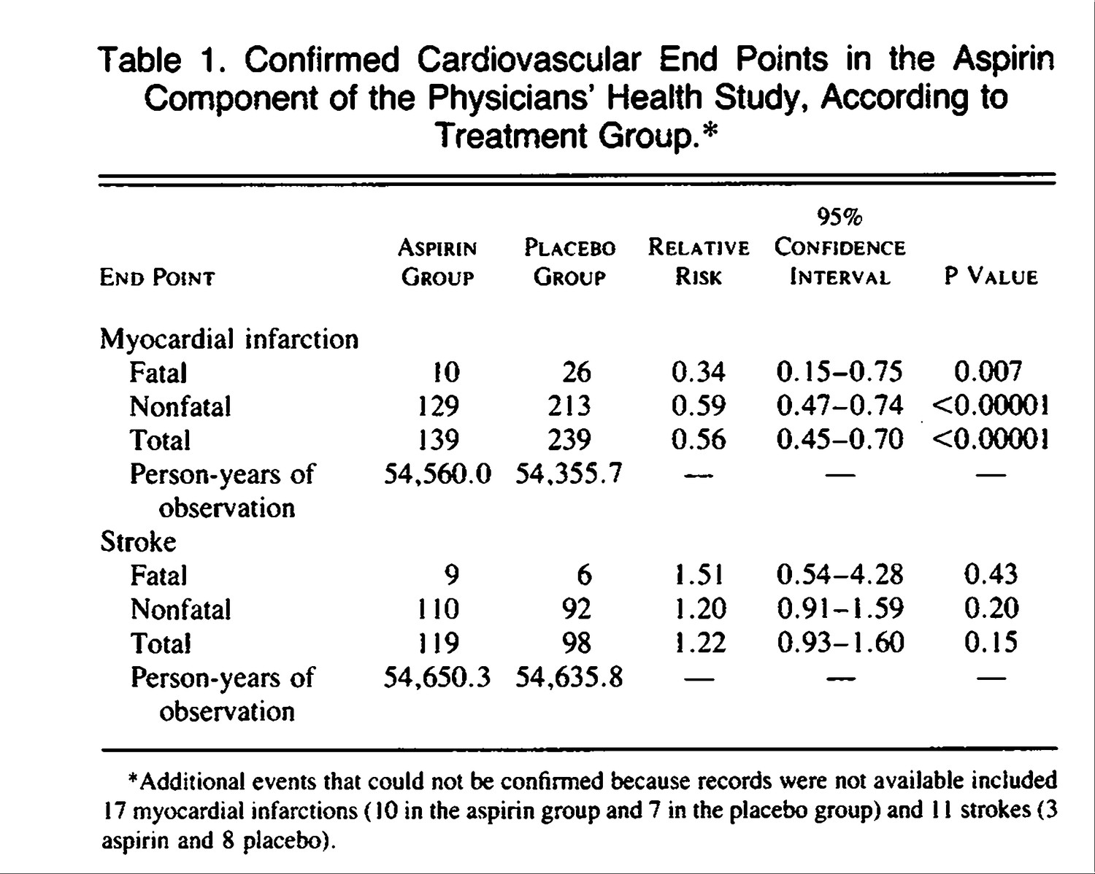

Steering Committee of the Physicians' Health Study Research Group* . N Engl J Med 1989;321:129-135.

Slide 45
PHS Aspirin Component terminated early – Why?
Highly statistically significant (P<0.00001) reduction in the risk of total MI among those in the aspirin vs. placebo group
Calculations indicated that to assess effects on overall cardiovascular mortality would take until the year 2000 or later (it was 1988)
Aspirin was subsequently being prescribed for 85% of participants who experienced nonfatal vascular events, making interpretation of mortality endpoints challenging.

Slide 46
Beta-Carotene & Lung Cancer

Slide 47
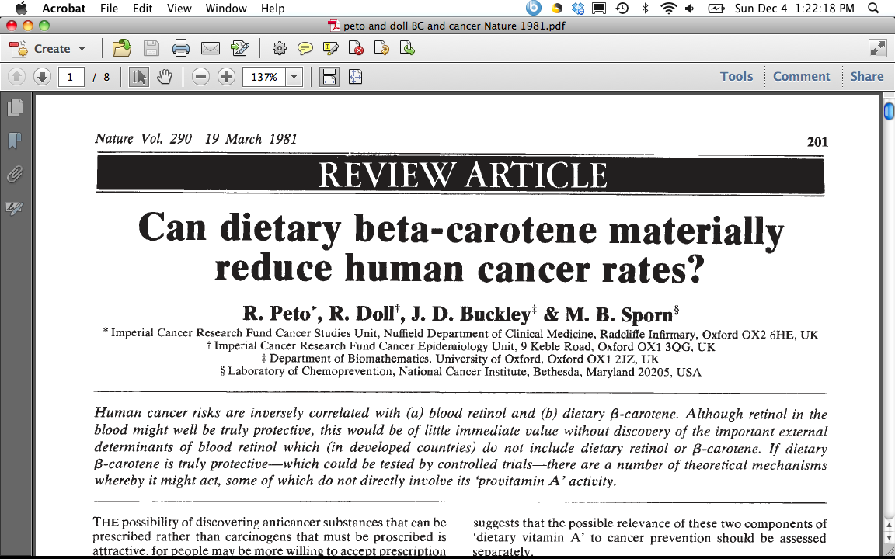
1980’s – Beta-Carotene & Lung Cancer
“This inverse association may, of course, be an artefact, due merely to association of B-carotene ingestion with some truly protective dietary habit(s) or component(s), or to association of B-carotene ingestion with avoidance of some truly harmful dietary habit(s) or component(s).”
“Equally, however, the inverse association between dietary B-carotene and cancer incidence may be due to genuine protective effect of B-carotene against the onset of cancer.”
“Although the evidence thus far available is not compelling that B-carotene is truly protective against cancer (or a fortiori against total mortality) this is not good reason to delay starting controlled trials because even if, as seems probable, a few truly protective agents do await discovery among the dozen or two dietary factors of current interest to the research community, compelling evidence may take decades to emerge without controlled trials.”
CONFOUNDING
TRUTH
Notes:
Ask Class - Who are Doll and Peto?
“Grandfathers of Epidemiology” who Richard Doll and Bradford Hill started the British doctors study in 1951, and published their preliminary and follow-up report in the mid-1950’s providing the earliest evidence that smoking was linked to many serious diseases, first and foremost lung cancer.
30 years later, they published this thoughtful piece on Beta-Carotene and cancer. At the time, the observation had been made that vegetables, in particular those rich in Vit A or carotene seemed to be protective in observational studies, AND some studies that measured retinol and carotene in blood also showed a protective effect, specifically for beta-carotene. At the time, there were only 3 prospective cohort studies that had been done, but these all seemed protective.
1981 Doll & Peto, Nature
ATBC recruited 1985 – 1988

Slide 48
Alpha-tocopherol & Beta-carotene Trial, ATBC
P: 29,133 male smokers in Finland, 50-69 yrs old in 1985-88
I: 50 milligrams (mg) alpha-tocopherol (a form of vitamin E)
OR 20 mg of beta-carotene (a precursor of vitamin A)
OR BOTH
C: Placebo
O: Lung cancer (and other cancers)
Vit E, Beta-Carotene Supplementation and Lung Cancer among Smokers (Albanes et al, JNCI, 1996)
Notes:
http://www.annalsofepidemiology.org/article/1047-2797(94)90036-1/pdf

Slide 49
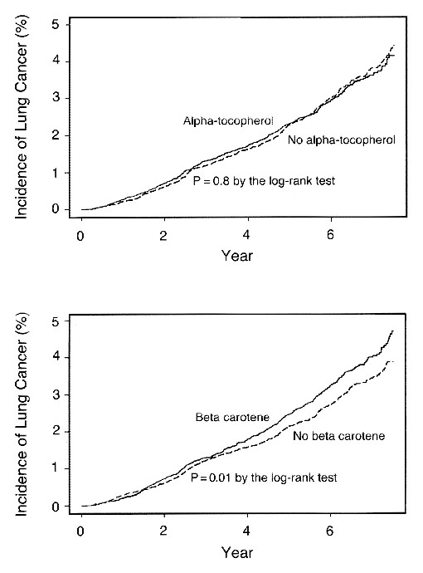
The Alpha-Tocopherol Beta Carotene Cancer Prevention Study Group. N Engl J Med 1994;330:1029-1035.
Kaplan-Meier Curves for the Cumulative Incidence of Lung Cancer among Participants Who Received Alpha-Tocopherol Supplements and Those Who Did Not (Upper Panel) and among Participants Who Received Beta Carotene Supplements and Those Who Did Not (Lower Panel).
More Lung Cancer occurred among men on supplements
Notes:
Figure 1. Kaplan-Meier Curves for the Cumulative Incidence of Lung Cancer among Participants Who Received Alpha-Tocopherol Supplements and Those Who Did Not (Upper Panel) and among Participants Who Received Beta Carotene Supplements and Those Who Did Not (Lower Panel). Data are shown only through 7 1/2 years of follow-up because of the small numbers of participants beyond that time.
Maybe TOO late to intervene with BC or Vit E in a population that has 30 pack years of smoking history
Or… the population was not deficient enough to observe a benefit
For Example…
JNCI 1993 Blot et al, Linxian China RCT combo vit E, BC, and SEL – associated with lower total mortality p=0.03, RR=0.91; esp for cancer RR =0.87 (0.75-1.00)… however baseline BC levels were 3 times LOWER than that in Finland (5.2 ug/dL vs 17 mg/dL)
https://atbcstudy.cancer.gov/

Slide 50
Interpretation Points to Appreciate
Incorrect inference from obs studies on beta-carotene being “causal” - Was beta-carotene THE nutrient in fruits/vegetables accounting for the inverse associations in the observational studies?
Confounding – the benefit in observational studies might have been due to confounding, which, when removed in the RCTS, revealed NO benefit of BC
“The lack of reduction in the incidence of lung cancer among men given the supplemental beta-carotene may be explained by bias, an inadequate duration of supplementations, the use of the wrong dose, or an inappropriate study population.”
Notes:
Maybe TOO late to intervene with BC or Vit E in a population that has 30 pack years of smoking history
Or… the population was not deficient enough to observe a benefit
For Example…
JNCI 1993 Blot et al, Linxian China RCT combo vit E, BC, and SEL – associated with lower total mortality p=0.03, RR=0.91; esp for cancer RR =0.87 (0.75-1.00)… however baseline BC levels were 3 times LOWER than that in Finland (5.2 ug/dL vs 17 mg/dL)
https://atbcstudy.cancer.gov/
http://www.nejm.org/doi/full/10.1056/NEJM199404143301501#t=article
“In the light of all the data available, an adverse effect of beta carotene seems unlikely; in spite of its formal statistical significance, therefore, this finding may well be due to chance.”
What happened next? Subsequent trials indicated that BC likely does increase risk of LC in smokers or those with other high risk (asbestos); not associated in general population of non-smokers (physicians health study)

Slide 51
PSA Screening & Prostate Cancer
Notes:
2012: D rating for PSA Screening
https://www.uspreventiveservicestaskforce.org/Page/Document/UpdateSummaryFinal/prostate-cancer-screening
2018: C rating for men 55-69; D rating for men 70+
https://www.uspreventiveservicestaskforce.org/Page/Document/RecommendationStatementFinal/prostate-cancer-screening1

Slide 52
PSA Screening Trials & Prostate Cancer Mortality
 | US Trial - PLCO | European trial | Göteborg trial
N men in trial | 76,000 | 182,160 | 20,000
Median follow-up, years | 13 | 13 | 14
Screening frequency | Annual | Every 4 years | Every 2 years
RR _{screen vs. no screen} | 1.09 (0.87-1.36) | 0.79 (0.69-0.91) | 0.44 (0.28-0.68)
NNS | *** | 781 invited to screen to prevent 1 death (NNI) | 234 to prevent 1 death
Slide acknowledgement:
MJ Stampfer, 2015
Andriole et al. JNCI, 2012; Schröder et al. NEJM, 2012; Hugosson Eur Urol, 2019; Schroder, et.al, Lancet 2014l Hugosson et al. Lancet Oncol, 2010
Notes:
PMID: 22228146 PMCID: PMC3260132 Andriole JNCI 2012
Pinsky, Cancer 2017 https://www.ncbi.nlm.nih.gov/pubmed/27911486
Schroder, NEJM 2012: main results ERSPC: https://www.ncbi.nlm.nih.gov/pubmed/22417251
Schroder, Lancer, 2014: https://www.ncbi.nlm.nih.gov/pubmed/25108889
Hugossn Eur Urol 2019: https://www.ncbi.nlm.nih.gov/pubmed/30824296
https://www.ncbi.nlm.nih.gov/pubmed/20598634. Hugosson Lan Onc 2010

Slide 53
PSA Screening and Stage Shift
Slide acknowledgement:
MJ Stampfer, 2015
 | PLCO | ERSPC | Göteborg
N men in trial | 76,000 | 182,160 | 20,000
Median follow-up, yrs | 13 | 13 | 14
RR _{screen vs. no screen} | 1.09 (0.87-1.36) | 0.79 (0.68-0.91) | 0.44 ( 0.28-0.68)
RR adjusted for contamination and nonattendance | Not reported | 0.68 (0.51-0.92) | Not reported
High stage ratio Ratio Control arm Intervention arm | 1.3 2.9% Stage IV 2.3% Stage IV | 2.9 3.8% T4 1.3% T4 | 3.1 3.4% T4 1.1% T4
Pre-trial screening | 45% | Not reported | None
Contamination (%) | ~50% (only 21% of controls had no PSA test) | Spain 7% Rotterdam 31% | Not reported
Screening frequency Control arm Intervention arm | 2.7 in 6 years 5 in 6 years | Not reported Every 4 years | Not reported Every 2 years

Slide 54
Contamination in PLCO
2,427 of 38,350 men in control arm surveyed ~ screening
  Only 1/3 of men with abnormal PSA/DRE underwent biopsy
Mean number of PSAs in the control arm = 2.7 in 6 years
  vs. 5.0 in the screening arm
Median screening interval in ERSPC was 4.02 years
Slide acknowledgement:
MJ Stampfer, 2015
Pinsky et al, Clinical Trials 2010

Slide 55
PLCO DAG - Ideal
C
Organized annual PSA Screening
Random assignment to PSA screening
Early Detection
More effective Txs
PC Death
Notes:
This is the Goal of the Randomization in PLCO.
Want to be able to study randomization to PSA screening and its effect on PC death, w/o concern about confounding factors associated with screening

Slide 56
PLCO DAG – In reality, there was non-adherence
C
Organized annual PSA Screening
Random assignment to PSA screening
Early Detection
More effective Txs
PC Death
Knowledge that you are in the Control Arm bc non-blinded study
Elevated PSA detected via opportunistic screening in Control group
Notes:
However, there was opportunistic screening in the control arm, bc screening was just so common at that time. This contamination of the control group can cause confounding bias

Slide 57
Cohort vs RCT

Slide 58
Hormone Replacement Therapy (HRT) & CHD
Observational cohort data through mid-1990’s suggested inverse association of HRT and CHD
Ex. Nurses’ Health Study Results:
  RR: 0.72 (95% CI, 0.55 to 0.95) for CVD mortality
    (Stampfer MJ et al, NEJM 1991)
  RR: 0.63 (95% CI 0.56 to 0.70) for total mortality for current users vs. never users, but benefit decreased over time
    (Grodstein F, NEJM 1997)
Notes:
NHS: https://www.nejm.org/doi/full/10.1056/nejm199109123251102 HRT and CVD, 1991
https://www.ncbi.nlm.nih.gov/pubmed/9187066 HRT and mortality, 1997
WHI:
37,000 women
Estrogen with (1) and without (2) progesterone
Ages 50-79, with or without CHD
Broad range of US women, 40 centers
Planned 8.5 years
CHD was one key endpoint
Results: https://www.nejm.org/doi/10.1056/NEJMoa030808?url_ver=Z39.88-2003&rfr_id=ori:rid:crossref.org&rfr_dat=cr_pub%3dwww.ncbi.nlm.nih.gov
Design: https://www.sciencedirect.com/science/article/pii/S0197245697000780
HERS centers recruited and randomized 2763 women. Participants ranged in age from 44 to 79 years, with a mean age of 66.7 (SD 6.7) years. postmenopausal women with a uterus and with CHD as evidenced by prior myocardial infarction, coronary artery bypass graft surgery, percutaneous transluminal coronary angioplasty, or other mechanical revascularization or at least 50% occlusion of a major coronary artery.
https://jamanetwork.com/journals/jama/fullarticle/187879 (results)
https://www.sciencedirect.com/science/article/pii/S0197245698000105 (design)

Slide 59
Hormone Replacement Therapy (HRT) & CHD
HERS and WHI trials examined HRT and outcome of CHD
  Heart and Estrogen/progestin Replacement Study (HERS)
  Women’s Health Initiative (WHI)
HERS, secondary prevention (started 1993, published 1998)
WHI, primary prevention (started 1992, published 2003)
Women with a uterus:
  0.625 mg conjugated estrogens + 2.5 mg medroxyprogesterone acetate daily vs. placebo
Notes:
NHS: https://www.nejm.org/doi/full/10.1056/nejm199109123251102 HRT and CVD, 1991
https://www.ncbi.nlm.nih.gov/pubmed/9187066 HRT and mortality, 1997
WHI:
37,000 women
Estrogen with (1) and without (2) progesterone
Ages 50-79, with or without CHD
Broad range of US women, 40 centers
Planned 8.5 years
CHD was one key endpoint
Results: https://www.nejm.org/doi/10.1056/NEJMoa030808?url_ver=Z39.88-2003&rfr_id=ori:rid:crossref.org&rfr_dat=cr_pub%3dwww.ncbi.nlm.nih.gov
Design: https://www.sciencedirect.com/science/article/pii/S0197245697000780
HERS centers recruited and randomized 2763 women. Participants ranged in age from 44 to 79 years, with a mean age of 66.7 (SD 6.7) years. postmenopausal women with a uterus and with CHD as evidenced by prior myocardial infarction, coronary artery bypass graft surgery, percutaneous transluminal coronary angioplasty, or other mechanical revascularization or at least 50% occlusion of a major coronary artery.
https://jamanetwork.com/journals/jama/fullarticle/187879 (results)
https://www.sciencedirect.com/science/article/pii/S0197245698000105 (design)

Slide 60
HERS trial results
CHD Nonfatal MI CHD Death
“postmenopausal women younger than 80 years with established coronary disease who received estrogen plus progestin did not experience a reduction in overall risk of nonfatal MI and CHD death or of other cardiovascular outcomes.
How can this finding be reconciled with the large body of evidence from observational and pathophysiologic studies suggesting that estrogen therapy reduces risk for CHD?”
Hulley S, JAMA 1998
Notes:
Figure 3.—Kaplan-Meier estimates of the cumulative incidence of primary coronary heart disease (CHD) events (left) and to its constituents: nonfatal myocardial infarction (MI) (center) and CHD death (right). The number of women observed at each year of follow-up and still free of an event are provided in parentheses, and the curves become fainter when this number drops below half of the cohort. Log rank P values are .91 for primary CHD events, .46 for nonfatal MI, and .23 for CHD death.

Slide 61
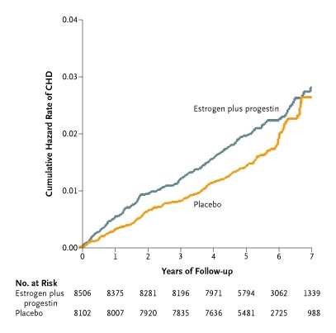
Manson JE et al. N Engl J Med 2003;349:523-534.
Kaplan–Meier Estimates of Cumulative Hazard Rates of CHD.
Notes:
Figure 2. Kaplan–Meier Estimates of Cumulative Hazard Rates of CHD. CHD included nonfatal myocardial infarction and death due to CHD. The overall hazard ratio for CHD was 1.24 (nominal 95 percent confidence interval, 1.00 to 1.54; 95 percent confidence interval with adjustment for sequential monitoring, 0.97 to 1.60).

Slide 62
NHS vs WHI – HRT & CVD Comparison
What accounts for the apparent discrepancies?
Confounding in Cohort?
Or differences in design features?
  Study Population
  Dose
  Duration
  Timing
Probably still some residual confounding
Considerations:
  WHI older
  Early cohort data primarily on estrogen only
  Estrogen may ↓ risk of CHD but higher doses ↑ risk of stroke
  Timing since menopause may be important due to different biological effects of estrogen on early vs. advanced atherosclerotic lesions
Notes:
Bhupathiraju SN et al, Am J Epidemiol. 2017;186(6):696–708
https://www.ncbi.nlm.nih.gov/pubmed/28938710
Suggestive inverse association from NHS data among women under 60, and within first 10 yrs of menopause (Hernan, Epid, 2008)
85% of NHS women initiated HRT bt 50-59, whereas in WHI, mean age at entry to RCT was 63, and 25% of women had previously used or were currently using HRT when they trial started
Earliest reports from NHS on benefit of CHD would be capturing that early phase of women just beginning menopause, and at the youngest ages. There may be a short term benefit of HRT in women under 59 or with few CHD risk factors; but as time goes on, HRT begins to have more of an adverse effect - which is what was captured in the RCT’s.

Slide 63
We present observational analyses from the NHS to simulate the inclusion and exclusion criteria and dose and formulation of HT used in the WHI trials. When analyses were conducted in the broader age range of 50– 79 years, results were discordant for total MI and for several other outcomes. However, much of the apparent discordance in the WHI versus NHS findings disappeared when we restricted our analyses to the ages of 50–59 years at HT initiation, the age range when more than 60% of women initiated HT use in the NHS.
Bhupathiraju, SN et al
Am J Epidemiol. 2017;186(6):696–708

Slide 64
HRT & Total MI, among women 50-79 yrs, and within 10 yrs menopause
◼︎ (squares): WHI
◆ (diamonds): NHS
Bhupathiraju SN, AJE 2017
Notes:
https://www.ncbi.nlm.nih.gov/pubmed/28938710
NHS models adjusted for: age, calendar time, smoking status (never, past, current 1–14 cigarettes/day, current 15–24 cigarettes/day, current
>24 cigarettes/day), alcohol intake (g/day: 0, 0.1–4.9, 5–9.9, 10–14.9, ≥15), physical activity (MET-hours/week: <3, 3–8.9, 9–17.9, 18–26.9, ≥27),
body mass index (weight (kg)/height (m)2; <21, 21–22.9, 23–24.9, 25–26.9, 27–29.9, 30–34.9, 35–39.9, ≥40), aspirin use for at least 1 day/month
(yes/no), history of high blood pressure (yes/no), history of hypercholesterolemia (yes/no), history of type 2 diabetes mellitus (yes/no; all models
except diabetes as an outcome), age at menopause (continuous), parental history of early myocardial infarction (yes/no), parental history of cancer
(yes/no), duration of CEE use (in months), and duration of CEE+MPA use (in months).

Slide 65
HRT and MI
C
Random assignment to HRT
HRT exposure
MI
What was planned
C
What was learned and not accounted for in RCT’s
Age
Random assignment to HRT
HRT exposure
MI
Time since Menopause
Notes:
In the WHI, the goal was to study random allocation to HRT and MI, assuming that this would only be associated with HRT exposure.
However, further studies suggested that age and time since menopause (which could be confounders) may each modify the effect of HRT on MI… (click to show interaction DAG)

Slide 66
HRT and MI
C
Random assignment to HRT
HRT exposure
MI
What was planned
C
What was learned and not accounted for in RCT’s
Age
Random assignment to HRT
HRT exposure
MI
Time since Menopause
Notes:
…which means that it may be more accurate to examine the effect of HRT allocation, conditional on age and time since menopause. In fact, when this was done in WHI, results were more similar to the original NHS results, for the sub group of younger women who had experienced menopause more recently, when they went on HRT.

Slide 67
Summary - RCT interpretation caveats / limitations
Changes in SOC or issues of adherence can cripple the ability to address a meaningful question
  Sample size estimates in planning phase need to anticipate some amount of lack of adherence, but can still under-estimate
Food can be complex, and a reductionist approach to nutrition may over-simplify the benefits
  RCT’s are better for addressing “mature” questions
Apparent discrepancies bt observational data & RCT’s may sometimes be explained by nuances in the actual question each addresses (pay attn to PICO)
  consider effect modification or differences in study population
Sometimes RCTs have surprising results that are true
Notes:
Changes in SOC or issues of adherence can cripple the ability to address a meaningful question (PLCO)
Sample size estimates in planning phase need to anticipate some amount of lack of adherence, but can still under-estimate
Food can be complex, and a reductionist approach to nutrition may over-simplify the benefits (ATBC)
RCT’s are better for addressing “mature” questions
Apparent discrepancies bt observational data & RCT’s may sometimes be explained by nuances in the actual question each addresses (pay attn to PICO)
consider effect modification or differences in study population (WHI vs NHS)
Sometimes RCTs have surprising results that are true (WHI, ATBC)

Slide 68
Target Trial Heuristic

Slide 69
Key Issues in Clinical Trials | Observational
Notes:
RCT typically have…

Slide 70
Key Issues in Clinical Trials | Observational
Clear Objective(s). Primary and secondary endpoints
Notes:
Clear objectives, with primary and secondary endpoints….we should be able to do that in Obs studies as well as RCT’s

Slide 71
Key Issues in Clinical Trials | Observational
Clear Objective(s). Primary and secondary endpoints
Study population. Inclusion/exclusion criteria
Notes:
Inclusion/exclusion criteria should be clear for both types of studies

Slide 72
Key Issues in Clinical Trials | Observational
Clear Objective(s). Primary and secondary endpoints
Study population. Inclusion/exclusion criteria
Longitudinal
longitudinal (versus cross-sectional) studies in which the temporal order of treatment and outcome is clear
Notes:
When the goal is estimating the causal effect of certain treatment on the outcome, longitudinal studies are preferred over non longitudinal (i.e., cross-sectional) ones in which the temporal order of treatment and outcome may be unclear

Slide 73
Key Issues in Clinical Trials | Observational
Clear Objective(s). Primary and secondary endpoints
Study population. Inclusion/exclusion criteria
Longitudinal
Randomized treatment assignment | No
How to achieve comparability (or exchangeability)?
Matching, stratification, restriction, modeling, etc.
Notes:
Longitudinal studies are usually classified as either experiments (the treatment is assigned by the investigators) or observational
studies (the investigators play no role in treatment assignment). Experiments are said to be randomized when the investigators assign the treatment at random.
They randomized the treatments… we cannot do that in obs studies.
This is one of the key differences and leads to CONFOUNDING BIAS
we have tried to achieve comparability (exchangeability) through addressing confounding in the design or analysis phase
Challenge – many methods can only address confounding factors one is aware of…

Slide 74
Key Issues in Clinical Trials | Observational
Clear Objective(s). Primary and secondary endpoints
Study population. Inclusion/exclusion criteria
Longitudinal
Randomized treatment assignment | No
Blinding | No
Not in the same way as RCT, but often assessments can be done by individuals who are “blinded” to exposure or disease status (e.g., lab measurements, or data abstracted from SOC tests, etc)
Notes:
Blinding is another key difference, although some assessments in OBS studies can be done blinded.
we could also perhaps do blinded analysis
Also, many types of clinical trials are NOT blinded (e.g., exercise, diet, etc)

Slide 75
Key Issues in Clinical Trials | Observational
Clear Objective(s). Primary and secondary endpoints
Study population. Inclusion/exclusion criteria
Longitudinal
Randomized treatment assignment | No
Blinding | No
Statistical Power. Sample size & follow up
Notes:
RCT very carefully estimate the adequate sample size… ethical ramifications if we do not properly design RCT

Slide 76
Key Issues in Clinical Trials | Observational
Clear Objective(s). Primary and secondary endpoints
Study population. Inclusion/exclusion criteria
Longitudinal
Randomized treatment assignment | No
Blinding | No
Statistical Power. Sample size & follow up
International, multicenter,…
Notes:
They are often international, multicenter… we can also do that, we can even collaborate… ☺
Cohorts also can be pooled for even larger studies/analyses

Slide 77
Key Issues in Clinical Trials | Observational
Clear Objective(s). Primary and secondary endpoints
Study population. Inclusion/exclusion criteria
Longitudinal
Randomized treatment assignment | No
Blinding | No
Statistical Power. Sample size & follow up
International, multicenter,…
Reference group. Active therapy or placebo
Notes:
Both types of studies have this. In Coh often also have flexibility over definition…

Slide 78
Key Issues in Clinical Trials | Observational
Clear Objective(s). Primary and secondary endpoints
Study population. Inclusion/exclusion criteria
Longitudinal
Randomized treatment assignment | No
Blinding | No
Statistical Power. Sample size & follow up
International, multicenter,…
Reference group. Active therapy or placebo
Loss to follow up & Compliance
Notes:
RCT also face the problem of incomplete compliance and deal with it in the analysis by doing intention to treat (ITT) rather than per protocol.
In obs studies, we sometimes evaluate exposure data from a single timepoint or from updated exposure data; keep in mind that data on time varying exposures and confounding factors can be collected in COHORTS… usage of such data sometimes needs particular attention in analysis phase (IPCW, msm)
Patients who discontinued early, die or are lost to follow up are typically censored at the date of the last contact in both RCT and COH studies

Slide 79
Key Issues in Clinical Trials | Observational
Clear Objective(s). Primary and secondary endpoints
Study population. Inclusion/exclusion criteria
Longitudinal
Randomized treatment assignment | No
Blinding | No
Statistical Power. Sample size & follow up
International, multicenter,…
Reference group. Active therapy or placebo
Loss to follow up & Compliance
Blind adjudication of events
Medical record review
Notes:
Blind adjudication of events (outcomes) can happen in both types of designs

Slide 80
Key Issues in Clinical Trials | Observational
Clear Objective(s). Primary and secondary endpoints
Study population. Inclusion/exclusion criteria
Longitudinal
Randomized treatment assignment | No
Blinding | No
Statistical Power. Sample size & follow up
International, multicenter,…
Reference group. Active therapy or placebo
Loss to follow up & Compliance
Blind adjudication of events
Inscription of Protocols
Notes:
Usage of standardized protocols for data collection and follow-up can be common to both Clinical Trials and obs studies

Slide 81
RCT vs. Cohort
RCT features COHORT equivalents
Randomization
Blinding
ITT
Methods to address confounding in design & analysis phase (restriction, matching, stratification, multivariate modeling, etc.)
Structured (& sometimes blinded) assessments (e.g., medical assessments may be part of SOC; labs can be agnostic)
Do not adjust for post-baseline covariates.
  Cohorts can collect data on time-varying exposures & confounders (may need special attention in analysis phase)
Notes:
As with randomized trials, we should not adjust for post-exposure covariates, only baseline covariates… except if we have time-varying exposures, then we do want data on time varying confounders…
Caution: we don’t want to adjust for something in the causal path or for covariates that are influenced by the exposure → Marginal Structural Models & Inverse Prob Censoring Weights (More in BIO 215)

Slide 82
Cohort & Target Trial – Summary
Concept of a target trial can help with cohort design
When cohorts don’t or can’t emulate a trial, may explain apparent discrepancies in the literature.
  NOTE: the observational study may address a different question than the trial and may still be valid.
Sometimes, RCTs will have limitations and rigorous observational evidence will give best available data
  How do we use this to guide clinical practice & public health recommendations?
    Weigh the risks and benefits, with best available data

Slide 83
In-Class Exercise (if time)

Slide 84
In-Class Exercise
Association of Leisure-Time Physical Activity With Risk of 26 Types of Cancer in 1.44 Million Adults. https://www.ncbi.nlm.nih.gov/pubmed/27183032
“time per week in moderate and vigorous leisure-time physical activities…. Assessed by asking about discrete activities such as walking, running, or swimming, or, alternately, by inquiring about overall weekly participation in moderate- to vigorous-intensity activities. The median activity level was 8 MET-h/wk …. equivalent to 150 minutes of moderate-intensity activity (eg, walking) per week, and comparable to the median activity level for the US population.”
“high vs low levels of leisure-time physical activity were associated with lower risks of 13 of 26 cancers.”
Notes:
In class
Divide into small groups or pairs
Read the abstract
Discuss in small groups – what would the “target trial” be to address the similar question? Is it feasible? What are aspects of the cohort design that cannot emulate the target trial? (or can’t’ emulate it well) What types of threats to validity are introduced, consequently, and what are other ways to address (if possible)?
Consistency - the values of treatment under comparison correspond to well-defined interventions that, in turn, correspond to the versions of treatment in the data
e.g., cohort with exercise assessed via self-reported survey will yield broad spectrum of activities. How do we group and study these into a well-defined “treatment”? If we boil it down to minutes per week, or number of sessions that are above a certain intensity – we begin to alter the specific research question and theorized “treatment” from a target trial.
Exchangeability - he conditional probability of receiving every value of treatment, though not decided by the investigators, depends only on measured covariates L
E.g., Also, whether someone voluntarily pursues exercise of a certain degree or type is influenced by a number of factors – background health, access to exercise, knowledge about exercise…are these all accounted for in the cohort study? What’s missing?
Positivity - the probability of receiving every value of treatment conditional on L greater than zero, i.e., positive
E.g., Once we start adjusting for a bunch of confounders, is there sufficient data in the study to observe each of the exposures of interest, within each stratum of the confounding factors? Data can become sparse, in which case, sometimes one is modeling an association based on whatever data are there, and it’s important to inspect the N for different strata. In the extreme case, imagine that you condition on body size, geography, age, gender, and comorbid conditions – imagine there is a stratum of obese, urban-dwelling, men, over the age of 80, with 5 or more co-morbidities… it’s possible that in your dataset for this group, there may not be someone doing more than 150 min of exercise per week, in which case, it is very hard to study the effect of this level of exercise in this sub-category.

Slide 85
Other options for Obs studies to RCT exercise…
Association of Leisure-Time Physical Activity With Risk of 26 Types of Cancer in 1.44 Million Adults. https://www.ncbi.nlm.nih.gov/pubmed/27183032
The Relationship Between Occupational Standing and Sitting and Incident Heart Disease Over a 12-Year Period in Ontario, Canada https://academic.oup.com/aje/article/187/1/27/4081581
Dietary Fat Intake and Fecundability in 2 Preconception Cohort Studies https://academic.oup.com/aje/article/187/1/60/3863377
Notes:
Pros/cons?
Strengths/challenges?

Slide 86
Acknowledgements:
Sonia Hernandez-Diaz, MD DrPH
Harvard TH Chan School of Public Health
Maria Glymour, PhD, UCSF
Deborah Grady, MD, MPH, UCSF
Rebecca Graff, ScD, UCSF
Shelley Devost
Dan Kelly Francois Rerolle

Slide 87
Notation or Shorthand I may commonly use…
Ca: cancer or case
Ca-co: Case control study
Coh: Cohort study
E: exposure or exposed or number exposed
E: unexposed or number unexposed
EM – effect modification
D: number with disease
D: those without disease
Dbx: Diabetes
Dx: diagnosis
N: total in a group or population count
Obs: Observational
PT: person-time
RCT: randomized controlled trial
SOC: Standard of Care
Tx: treatment

Slide 88
Appendix:
Life of a Research Study

Slide 89
Scientific Process
Figure out what you are really interested in or what you will at least enjoy working on for a while
Develop Research Question & Hypothesis
Identify & Select Team and Expertise Needed
Identify Funding Mechanisms
Design your Study & Make Analysis Plan
Write Proposal & Make a Budget
  Share proposal with colleagues & get feedback
  Review budget with mentors & justify budget
Submit… and revise & resubmit… until funded!
Study Implementation
  Review Team again… now its real, pick good people who are reliable, smart, ethical, and with whom you enjoy working!
Study Reporting – Conferences, Journals, Press, Social Media, Websites, etc

Slide 90
Scientific Process
Figure out what you are really interested in or what you will at least enjoy working on for a while
Develop Research Question & Hypothesis
Identify & Select Team and Expertise Needed
Identify Funding Mechanisms
Design your Study & Make Analysis Plan
Write Proposal & Make a Budget
  Share proposal with colleagues & get feedback
  Review budget with mentors & justify budget
Submit… and revise & resubmit… until funded!
Study Implementation
  Review Team again… now its real, pick good people who are reliable, smart, ethical, and with whom you enjoy working!
Study Reporting – Conferences, Journals, Press, Social Media, Websites, etc

Slide 91
Appendix:
Tips for Reading & Critiquing Scientific Papers

Slide 92
Reading & reviewing & writing a scientific manuscript
Title
Abstract
Introduction
Methods
Results
  Tables
  Figures
Discussion
References
Acknowledgements
Author overall recommendations:
  Ask meaningful, interesting and focused questions (i.e., for which both positive or negative result would be of interest)
  Plan a structure for the manuscript
  Writing order: Introduction, Methods, Tables/figures, text of Results, Conclusions, Abstract
  Good first sentence (hook reader), good last sentence (paunch line), and good figure
  One thought per sentence. Related thoughts in paragraphs
  No rambling, no unnecessary words. Active voice
  Logic: the methods should follow from the hypothesis, the results from the methods and the conclusions from the results
Notes:
You have been introduced to broad range of topics and methods in EPI 203.
With those initial tools, one of the best ways to learn epid is now to apply it – by reading/critiquing the peer-reviewed literature and writing your own proposals/ideas.
Would like to spend some time providing some structure for how to read/critique and write scientific reports, which we will be part of your regular HW assignments
This set of slides is intended to help guide you/give you some checklists/structure, as you will be presented with articles/problems sets in this class

Slide 93
Reading & reviewing & writing a scientific manuscript
Title
Abstract
Introduction
Methods
Results
  Tables
  Figures
Discussion
References
Acknowledgements
Editor (decision maker) and Reviewers look for:
Is the article novel, relevant, informative, valid and ethical ?
Would it affect practice or the way we understand a disease?
Is it the first paper, the best paper to date, or the last word on something ?
Is it well organized and well written?
Would the readers of this specific journal be interested?
Is it going to have a high impact and help my impact factor…

Slide 94
Reading & reviewing & writing a scientific manuscript
Title
Abstract
Introduction
  Background (justification)
    Problem
    Need to fill gap
    Solution
  Research question-hypothesis
  Objectives
Methods
Results
Discussion
References
Acknowledgements
READER
What was the justification for the study?
Which were the main objectives?
Does the significance of the problem justify the study? Can this study answer the question?
AUTHOR recommendations
Summarize key background information that makes the study significant
Make clear the hypothesis you are studying and why is it relevant
State your study aims
No need to provide extensive literature review (<40 references)

Slide 95
Reading & reviewing & writing a scientific manuscript
Title
Abstract
Introduction
Methods
  Design (cohort, case-control, etc)
  Population (study base, exclusion/inclusion)
  Disease (definition, selection, controls?)
  Exposure (definition, data collection)
  Analysis (measures, random error, bias reduction)
Results
Discussion
References
Acknowledgements
READER
What was the design?
What was the study population?
What was the outcome of interest? How did they select the cases?
How were the controls or comparison group selected?
What was the exposure of interest? How did they collect the information?
What measures of frequency or association were used in the study?
How did they account for the role of chance?
AUTHOR recommendations
ALL of the above
Clear description of primary versus secondary aims
IRB approval and informed consent

Slide 96
Reading & reviewing & writing a scientific manuscript
Title
Abstract
Introduction
Methods
Results
  Text
  Tables
  Figures, graphs, photos
Discussion
  Summary of main results
  Comparison with literature (consistent/refutes, why)
  Biologic explanation
  Limitations (internal and external validity)
  Implications and recommendations ?
  Conclusions, interpretation of results in context
References
Acknowledgements
READER or REVIEWER
What was the main result from the study?
Do you think confounding is a problem? If yes, what would be the magnitude and direction of the bias?
Do you think selection bias is a problem? If yes, what would be the magnitude and direction of the bias?
Do you think misclassification of exposure is a problem? If yes, what would be the magnitude and direction of the bias?
What would be the main conclusion from this study?

Slide 97
Reading & reviewing & writing a scientific manuscript
Title
Abstract
Introduction
Methods
Results
  Text
  Tables
  Figures, graphs, photos
Discussion
  Summary of main results
  Comparison with literature (consistent/refutes
  Biologic explanation
  Limitations (internal and external validity)
  Implications and recommendations ?
  Conclusions, interpretation of results in context
References
Acknowledgements
AUTHOR recommendations
Main findings clear in the text, with reference to the tables and figures. But don’t repeat all the numbers in the tables in the text
No claims of order (“We are the first to..”)
Don’t focus on criticizing other studies
  Recognize but don’t be overly defensive regarding limitations. Note available evidence to suggest these are not major flaws
Don’t speculate and don’t over-interpret your results
  Conclusions should follow logically from the results and provide clear take home message

Slide 98

Developing a Proposal
ARTICLE
Introduction
  Background (justification=problem+need+solution)
  Research question-hypothesis
  Objectives
Methods
  Design (cohort, case-control, etc)
  Population (study base)
  Disease (definition, selection, controls?)
  Exposure (definition, data collection)
  Analysis (measures, random error, bias)
Results
Discussion
  Comparison with literature
  Biologic explanation
  Limitations (internal and external validity)
References
PROPOSAL
Introduction
  Background (justification, significance)
  Research question-hypothesis
  Objectives
Methods
  Design (cohort, case-control, etc)
  Population (study base)
  Disease (definition, selection, controls?)
  Exposure (definition, data collection)
  Analysis (measures, random error, bias reduction [confounding control, validation studies] and quantification of impact [sensitivity analyses])
  Power
  Limitations and plans to minimize and quantify them
References

Slide 99
Terminology ⚐ - Retrospective vs. Prospective
⚐ This terminology is used differently by different authors
  Definition 1 (old one) – based on study design
    Prospective = cohort study
    Retrospective = case-control
  Definition 2 – based on exposure assessment
    Prospective = exposure history is assessed prior to the outcome
    Retrospective = exposure history is assessed at the same time as, or after, the outcome
Notes:
In the rothman chapter
challenge of epid – a lot of terms! And we take terms from the regular dictionary and give it different definitions!

Slide 100
Terminology ⚐ - Retrospective vs. Prospective
  Definition 3 – based on start of study/investigation
    Prospective = the outcomes occur after the implementation of the study protocol
    Retrospective = the outcome occurs before the implementation of the study protocol
  Definition 4 – based on person-time accumulation relative to study start
    Prospective = ‘person-time’ (time on the study) is accumulated after the study begins
    Retrospective = person-time is accumulated before the study begins
  Definition 5 (recommended) – based on potential for influence of Disease
    Prospective = exposure measurement cannot be influenced by disease
    Retrospective = exposure measurement can be influenced by disease
Notes:
Never liked definition 3.
Ques – how can you have collected data prospectively, but still have dis influence it? Can have data assessed prospectively, but then maybe its scored only when you are doing your analysis, and after disease has happened… its possible for disease to influence scoring if someone digs deeper
We don’t want the existence of Disease to influence the measurement of exposure → BIAS
NOTE: there can be a really well conducted retrospective cohort study… it doesn’t ALWAYS mean a retrospective study is more biased…
Temporarility of E before D is very helpful…when writing, often use “exposure assessment was done prospective relative to outcome”

Slide 102
HERS trial results
Hulley S, JAMA 1998
Notes:
Figure 2.—Participants taking protocol medications and with pill count of 80% or more, as a percentage of all women at risk for a primary coronary heart disease event.

Slide 103
Implications of PSA Screening for CaP research
Most CaP is harmful only if detected and (over)treated
    Main risk factor for indolent disease – getting screened and having a biopsy
Differing pattern of risk factors between incident and lethal disease
Larger fraction of cases diagnosed before PSA screening had lethal potential - studies pre-PSA are not always comparable to those conducted in the PSA-era
11yr lead time for PSA means studies and trials must be long enough to be meaningful
Slide acknowledgement:
MJ Stampfer, 2015

