Slide 1
Decision Analysis: What? Why? How?
Decision and Cost-Effectiveness Analysis (DCEA, Epi 213)
9 January 2020
Elliot Marseille DrPH, MPP
Health Strategies International
emarseille@comast.net
Skype: emarseille1

Slide 2
Objectives
    What is decision analysis?
    Why do we use decision analysis?
    How would we use decision analysis?

Slide 3
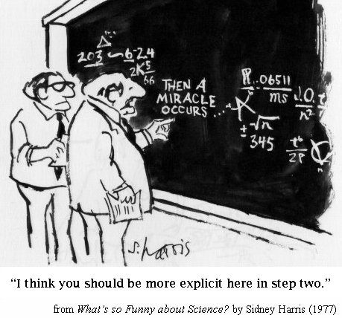
Clinical finding
Cure
Actually, discrete steps:
Diagnostic w/u
Diagnosis
Rx choice
Rx effects (main, side)
each with likelihoods not certainties

Slide 4
What is Decision Analysis?
An explicit, quantitative method
to make (or think about) decisions
in the face of uncertainty.

Slide 5
How does it work?
    Portrays options and their consequences (costs, longevity, QoL)
    Quantifies uncertainty using probabilities
    Quantifies the desirability of outcomes using utilities
    Calculates the expected utility of each option
    (alternative course of action)
    Helps choose the option that on average leads to
    most desirable outcomes

Slide 6
Why might we use decision analyses?
Because uncertainty is pervasive
Shape policy
Inform clinical choices
Determine research priorities
In life
As a teaching tool
Notes:
Lateral vs longitudinal extrapolation
As teaching tool to discourage dogmatism and to demonstrate rigorously the need to involve patients in decisions

Slide 7
Overview of Steps
Formulate an explicit question
Define outcomes of interest
Develop the decision tree: define various possible outcomes
Determine the probability of each event
Determine the relative importance/utility of each event
Calculate the “expected value”
Conduct sensitivity analyses

Slide 8
Case
  Ms. Brooks is a 50 year old high school teacher who presented to her primary care doctor with vertigo 3 weeks ago.
  She had an MRI of her brain that showed a cerebral aneurysm. Her vertigo has subsequently resolved and was attributed to labyrinthitis.

Slide 9
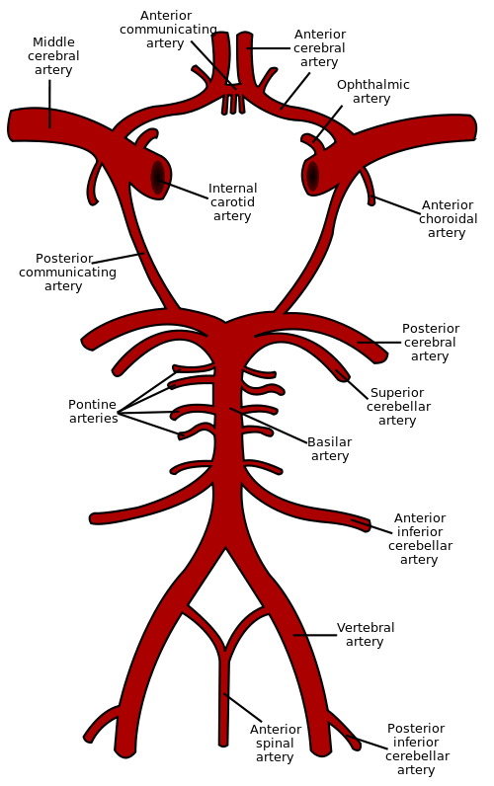
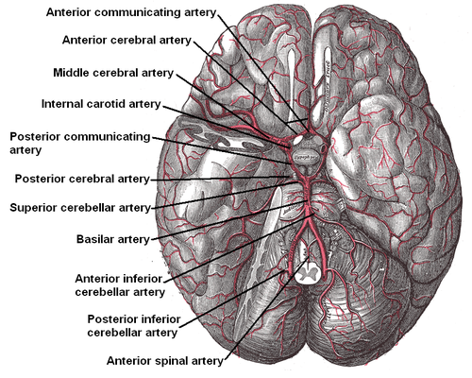

Slide 10
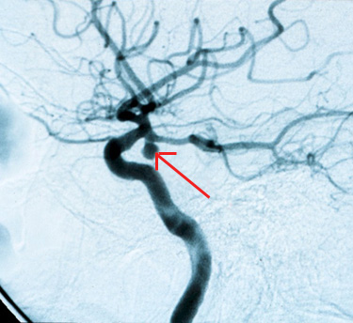
Case
  Her MRI showed a left posterior communicating artery aneurysm,
  and a subsequent
  cerebral angiogram confirmed a
  6 mm berry aneurysm.

Slide 11
Case
  Past medical history is remarkable only for 35 pack-years of cigarette smoking.
  Physical exam is unremarkable.
  Ms. Brooks: “I don’t want to die before my time.”
  Alternatives:
  Do nothing vs. Surgical Clipping of the Aneurysm

Slide 12
There are many ways of dealing with uncertainty
Dogmatism. All aneurysms should be surgically clipped.
Policy. At UCSF we clip all aneurysms.
Experience. I’ve referred a number of aneurysm patients for surgery and they have done well.
Whim. Let’s clip this one.
Nihilism. It really doesn't matter.
Defer to experts. Vascular neurosurgeons say clip.
Defer to patients. Would you rather have surgery or live with your aneurysm untreated?

Slide 13
Or
Perform a
Decision Analysis

Slide 14
1. Formulate An Explicit Question
Clear
Meaningful
Feasible
From Ms. Brooks’ perspective, which treatment strategy produces the greatest longevity: surgical clipping or observation?
Notes:
Formulate explicit, answerable question.
- May require modification as analysis progresses.
The simpler the question, without losing important detail, the easier and better the decision analysis.
In the aneurysm example, our interest is in determining what’s best for Ms. Brooks so we'll take her perspective. We will begin with the following question:

Slide 15
1. Formulate An Explicit Question
Embedded in the question are:
Perspective
Analytic horizon
From Ms. Brooks’ perspective, which treatment strategy produces the greatest longevity: surgical clipping or observation?
Notes:
Formulate explicit, answerable question.
- May require modification as analysis progresses.
The simpler the question, without losing important detail, the easier and better the decision analysis.
In the aneurysm example, our interest is in determining what’s best for Ms. Brooks so we'll take her perspective. We will begin with the following question:

Slide 16
Define the Perspective
What does the surgery mean to:
Ms. Brooks (the patient)
Her doctor
The hospital
The clinic
The radiology center
Her insurance company
Society
Notes:
Formulate explicit, answerable question.
- May require modification as analysis progresses.
The simpler the question, without losing important detail, the easier and better the decision analysis.
In the aneurysm example, our interest is in determining what’s best for Ms. Brooks so we'll take her perspective. We will begin with the following question:

Slide 17
What’s the Best Analytic Horizon?
30 days
1 year
5 years
10 years
lifetime
Notes:
Formulate explicit, answerable question.
- May require modification as analysis progresses.
The simpler the question, without losing important detail, the easier and better the decision analysis.
In the aneurysm example, our interest is in determining what’s best for Ms. Brooks so we'll take her perspective. We will begin with the following question:

Slide 18
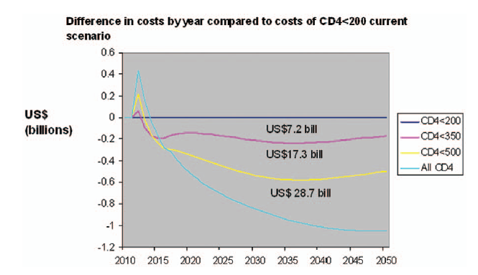
Analytic Time Line

Slide 19
2. Design A Decision Tree
(Structure the problem)
Complete
Simple
Decision vs. Chance nodes
Branches at a decision node – two or more diagnostic or therapeutic alternatives
Branches at a chance node – exhaustive and mutually exclusive
Notes:
Provide a reasonably complete depiction of the problem.
Best is one decision node (on the left, at the beginning of the tree).
Branches of each chance node -- exhaustive and mutually exclusive.
Proceed incrementally. Begin simple.

Slide 20
Start Simple

Slide 21
… to Less Simple…

Slide 22
…to Complex

Slide 23
Figure 1

Slide 24
3. Estimate Probabilities
Data sources: Valid, Relevant
Standard hierarchies of data quality
Definitive trials > Meta-analysis of trials > Systematic review > Smaller trials > Large cohort studies > Small cohort studies > Case-control studies > Case series > Expert opinion

Slide 25
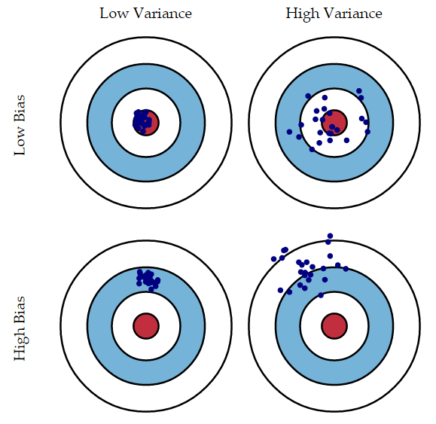
Estimating probabilities
Precision vs. Accuracy (Bias-Variance Trade-off)
Bias – different population or question (or method)
Harsha Pulletikurti, 2015

Slide 26
No treatment node
Lifetime rate of rupture = Expected life span * Rupture/year
  Expected life span (US life tables) = 35 years
Berry aneurysm rupture (cohort study) = 0.05 per 100
patients per year for <10 mm
  Lifetime rate of rupture = 0.05x 35 y = 1.75 per 100 patients
Case fatality of rupture = 45% (meta-analysis)

Slide 27
3. Estimate probabilities

Slide 28
Surgery node
Probability of rupture of a treated aneurysm:
  No data, but probably very small
  ~ 0 (expert opinion)
Surgical mortality:
Meta-analysis of case series: 2.6%
    Clinical databases: 2.3%
    UCSF experience: 2.3%

Slide 29
3. Estimate Probabilities

Slide 30
4. Estimate utilities
Valuation of an outcome
  Best = 1
  Worst = 0
In this case, she wants to avoid early death:
  Normal survival = 1
  Early death = 0
Notes:
(more restrictive use in the next lecture).

Slide 31
Fill in the utilities

Slide 32
5. Compute The Expected Utility
Of Each Branch
Called "folding back" the tree (in this tree format)
Expected utility of action = each possible outcome weighted by its probability.
Notes:
Simple arithmetic calculations

Slide 33
=0.55
=0
=0.55
=0

Slide 34
=0.9825
=0.9921
=0.55
=1.0
Diff = -0.0151
=0.55
=0.977
=0
.865 vs .977

Slide 35
6. Perform Sensitivity Analysis
How confident are we in our recommendation?
Vary the input parameters to see how they affect the final result
  What if her life expectancy were shorter?
  What if the rupture rate of untreated aneurysms were higher?
  How good a neurosurgeon is required for a toss up?

Slide 36
Thresholds are values at which the decision flips
Base Case
Notes:
How do you interpret this number?

Slide 37
At each iteration, step back…
Did we ask the right question?
Have we answered the question?
Are there other details that might be important?
Consider adding/removing complexity to improve accuracy.

Slide 38
Ms. Brooks: We recommend NO surgery.
“Thanks… But I meant I wanted to live the most years possible. Dying at age 80 isn’t as bad as dying tomorrow…”

Slide 39
Add layers of complexity
to produce a more realistic analysis.

Slide 40
Solution: Another Outcome
Three outcomes
Determine utility as a portion of expected life span
-Normal survival 1.0
-Early death 0.5
-Immediate death 0

Slide 43
Ms. Brooks
“Wait a minute… Nobody said anything about being disabled. If I lived with a disability because of surgery, that would stink. Did you factor that in?”

Slide 45
Decision trees: folding back vs. forward
This lecture – folding back
In “The ICER Man Cometh” & Excel template we fold forward
Which do you find more informative for learning? Or useful to see both?
Notes:
Folding back: Start from the right and work toward the left, i.e., to the decision node.
Folding forward: Start from the decision node and work toward the right, i.e., to the terminal nodes.

Slide 46
Summary
Explicit question: including perspective and time horizon
Decision tree
Probabilities of each outcome
Utilities for each outcome
Expected utility of each course of action
Sensitivity analyses

Slide 47
Final tips for Decision Analysis
(& CEA) Design
Ask a meaningful question, keep the analysis focused on it.
Start simple, then iteratively expand / elaborate.
  For this class, keep it simple.
Allocate roughly equal time to the decision tree, data collection, and sensitivity analyses
Delve into and enjoy modeling. Have fun with the nuances. Master the challenges.

Slide 48
The usefulness of these analytic techniques should not be overstated. None… is intended to be a magic bullet for removal of judgment, responsibility or risk from decision-making…, though each is capable of improving the quality and consistency of decision making.
At root, they are methods of critical thinking, of approaching choices, and often of placing difficult choices out in the open for discussion.
Drummond MF, Schulpher MJ, Torrance GW, et al.
Methods for the Economic Evaluation of Health Care Programmes
Oxford, 2005

