Slide 1
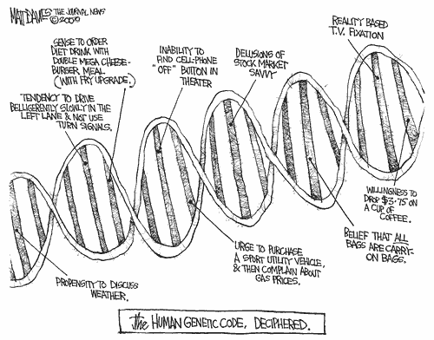
Epidemiology 217
Lecture #2
Notes:
1

Slide 2
Outline
Methods to assess whether a trait appears genetic:
  1. Familial Aggregation and recurrence risks
  2. Heritability
Some key genetic concepts:
  3. Allele and Genotype Frequencies
  4. Mendel’s laws & Hardy-Weinberg equilibrium
  5. Population Stratification

Slide 3
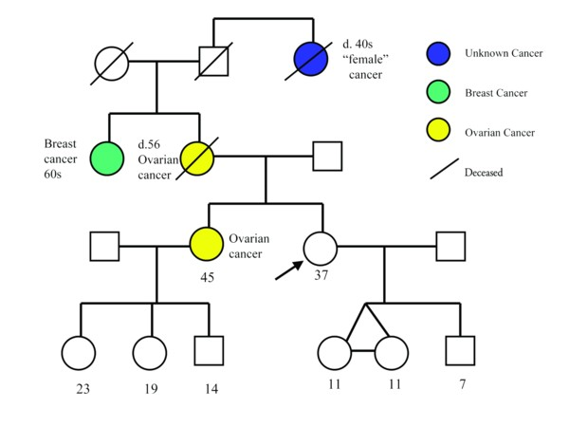
1. Familial Aggregation
Does the phenotype tend to run in families?
Ascertain family members by “probands”, i.e., affected individuals
Notes:
3
For a common disease or one that manifests as a continuous trait, one might simply enroll a random series of families and look at the pattern of correlations in the disease between different types of relatives (e.g., sibling-sibling, parent-offspring, etc.).
For a rare dichotomous disease, one would generally begin with the identification of probands, preferably in some population-based fashion, together with a comparable control series from the same population.
For each subject, one can then obtain a structured family history (i.e., to generate a pedigree), collecting disease and other (e.g., age, time at risk, etc.) information.
One could then consider two approaches to the analysis of such data.

Slide 4
Familial Aggregation
“Family case-control” approach
“Family cohort” approach
Relative has disease?
Yes No
# Relatives of a b
Cases
# Relatives of c d
Controls
Relative Risk = RR
= (a/(a+b))/(c/(c+d))
Family history of disease
Yes No
# Cases a b
# Controls c d
Odds Ratio = OR
= (a/b)/(c/d) = ad/bc
- Be careful with “family history”
- E.g., ovarian cancer, only females
- E.g., late onset diseases, relative may not generally have disease
-
Generally determined by interview (cost reasons), though medical records would be more accurate

Slide 5
Example of Familial Aggregation
 | Cases (%) | Controls (%) | Adjusted OR (95% CI)
FH of pancreatic cancer: 1st degree relatives
No | 1,107 (93.6) | 1,162 (94.4) | 1.00
Yes | 76 (6.4) | 43 (3.6) | 1.76 (1.19-2.51)
# affected 1st degree relatives with pancreatic cancer
One | 70 (92.1) | 42 (97.7) | 1.70 (1.14-2.51)
Two or more | 6 (7.9) | 1 (2.3) | 4.26 (0.48-37.8)
Jacobs et al., 2010

Slide 6
Recurrence (‘Familial’) Risk Ratios
Compares the probability a subject is affected given they have an affected family member to the population risk:
λ_{R} = K_{R}/K,
where K_{R} is the risk to relatives of type R
K is the population risk
λ_{S} = recurrence risk to siblings of probands versus the general population risk.

Slide 7
Estimating Recurrence Risk Ratios (RRR)
With case-control data, calculate RRR as:
  Proportion of affected relatives of the cases (observed) /
  Proportion of affected relatives of controls (expected) (assumed to estimate K, the population prevalence of disease)
Using λ_{R} = P(Y₂ = 1 |Y₁ = 1) / K
The higher the value of λ_{R} the stronger the genetic effect

Slide 8
Examples of λ_{s}
Alzheimer Disease 3-4
Rheumatoid Arthritis 12
Schizophrenia 13
Type I Diabetes 15
Multiple Sclerosis 20-30
Neural Tube Defects 25-50
Autism 75-150

Slide 9
Limitations of Recurrence Risks
Depend on mode of inheritance and disease frequency
Single gene diseases have high recurrence risks
More common complex diseases have lower values (e.g., CHD)
Hard to distinguish genetic versus environmental effects

Slide 10
2. Heritability
Evaluates the genetic contribution to a trait in terms of variance explained
Phenotype = Mean + Genetics + Environment
P = µ + G + E
Overall variation in Phenotype P
Var(P) = σ²_{P} = σ²_{G} + σ²_{E}
Notes:
10

Slide 11
Broad Sense Heritability
Proportion of the overall phenotypic variance attributable to genetic influences
H²=σ²_{G}/σ²_{P}
Ranges from 0 (little or no genetic influence) to 1 (strong genetic influence)

Slide 12
Narrow Sense Heritability
Proportion of variance explained only by additive genetic effects.
Most commonly calculated estimate since additive explains most variation.
(Recall: σ²_{P} = σ²_{G} + σ²_{E})
σ²_{G} = σ²_{A} + σ²_{D}
A: Additive effect
D: Dominance effect
Narrow sense heritability: h² = σ²_{A} /σ²_{P}

Slide 13
Estimate h² from Twin Studies
ACE Model: σ²_{P} = σ²_{A} + σ²_{C}+ σ²_{E}
A: Additive genetics
C: Common Environment
E: Unique Environment
Correlation in phenotype (P₁, P₂) among twins:
- Corr_{mz}(P₁, P₂) = r_{mz} = A + C [100% genes + Env]
- Corr_{dz}(P₁, P₂) = r_{dz} = ½A + C [50% genes + Env]
Heritability: h² = 2(r_{mz}- r_{dz} )

Slide 14
Example of Twin Study: Prostate Cancer
Twin registry (Sweden, Denmark, and Finland)
Twin | Concordant pairs (cp) | Discordant pairs (dp) | Concordance 2cp / (2cp+dp)
MZ | 197 | 807 | 0.33 (r_{mz})
DZ | 148 | 1719 | 0.15 (r_{dz})
heritability = 2(r_{mz}- r_{dz} ) = 2(0.33-0.15)
= 0.36
Mucci et al. JAMA 2016;315:68
(actual paper estimate uses Structural Equation Modeling, so differs)
Notes:
14

Slide 15
Heritability from GWAS
Extensive recent work using linear mixed models to estimate heritability from GWAS array data
Called ‘chip heritability’
TCGA and other software

Slide 16
Outline
Methods to assess whether a trait appears genetic:
  1. Familial Aggregation and recurrence risks
  2. Heritability
Some key genetic concepts:
  3. Allele and Genotype Frequencies
  4. Mendel’s laws & Hardy-Weinberg equilibrium
  5. Population Stratification

Slide 17
3. Allele and Genotype Frequencies
  Diploid, autosomal locus with 2 alleles: A and a
  Allele frequency is the fraction:
No. of particular allele
No. of all alleles in population
Notes:
17

Slide 18
Frequencies
Allele Frequency
Let p = Freq(A) frequency of the dominant allele
Let q = Freq(a) frequency of the recessive allele
Then, p + q =1
Genotype Frequency
p² = frequency of homozygous dominant genotype
q² = frequency of homozygous recessive genotype
2pq = frequency of heterozygous genotype
Then, p² +2pq + q² =1
Notes:
18

Slide 19
Estimating Allele Frequencies from Genotype Frequencies
  Genotypes: AA Aa aa
  Frequency: p² 2pq q²
  Frequency of A allele = p² + ½ (2pq)
  Frequency of a allele = q² + ½ (2pq)
Notes:
19

Slide 20
Ex. Calculation: Allele Frequencies
  Assume N=200 in each of two populations
  Pop 1: 90 AA 40 Aa 70 aa
  Pop 2: 45 AA 130Aa 25 aa
  In Pop 1:
  p = 90/200 + ½ (40/200) = 0.45 + 0.10 = 0.55
  q = 70/200 + ½ (40/200) = 0.35 + 0.10 = 0.45
  In Pop 2:
  p = 45/200 + ½ (130/200) = 0.225 + 0.325 = 0.55
  q = 25/200 + ½ (130/200) = 0.125 + 0.325 = 0.45
Notes:
20

Slide 21
Take home points
  p + q =1 (sum of the allele frequencies = 1)
  p² + 2pq + q² =1 (sum of the genotype frequencies = 1)
  Two populations with markedly different genotype frequencies can have the same allele frequencies
Notes:
21

Slide 22
4. Mendel’s Laws of Inheritance
Key principles of genetics:
    Equal Segregation: Two alleles at a genetic locus segregate from one another and are passed to offspring with equal probability
    Independent assortment: Genes on different chromosomes are inherited independently
Notes:
22

Slide 23
Hardy-Weinberg Equilibrium
  Hardy–Weinberg principle:
  Both allele and genotype frequencies in a population remain constant (i.e., in equilibrium) from generation to generation unless specific disturbing influences are introduced.
p² + 2pq + q² = 1
Notes:
23

Slide 24
Hardy-Weinberg Assumptions
Allele frequencies do not vary if:
    Large population
    Random mating
    No in or out migration
    No isolated groups within the population
    No mutation
    No selection (no allele is advantageous)
Notes:
24

Slide 25
Example: Test of Hardy-Weinberg Equilibrium (HWE)
Assume we have the following observed genotype frequencies: 100 GG, 30 AG, 20AA
Frequency of the G allele:
  p = 100/150 + 0.5(30/150) = 0.767
Frequency of the A allele
  q = 20/150 + 0.5(30/150) = 0.233 = 1-p
Notes:
25

Slide 26
Example
Calculate expected genotype frequencies based on HW: p² + 2pq + q² = 1
GG
p² = 0.767*0.767 = 0.588
n(p²) = 150(0.588) = 88.2
AG
2pq = 2*0.767*0.233 = 0.357
n(2pq) = 150(0.357) = 53.6
AA
q² = 0.233*0.233 = 0.054
n(q²) = 150(0.054) = 8.2
Notes:
26

Slide 27
Example
Compare observed genotype counts (O) to expected genotype counts (E)
 | O | E | (O-E)²/E
GG | 100 | 88.2 | 1.58
AG | 30 | 53.6 | 10.44
AA | 20 | 8.1 | 17.15
 |  |  | 29.17
Chi-square test
= Σ_{i} (O_{i} – E_{i})²/E_{i} = 29.17 (chi square distribution with 1 degree of freedom)
p = 4.63 x 10⁻⁷ -> out of HWE
Notes:
27

Slide 28
Application of HWE
For genetic association studies:
  Used as QC measure to assess the accuracy of the genotyping method
  Expect SNPs to be in HWE among control populations (ethnic-specific)
  Violations of HWE could indicate genotyping errors or bias in data
Notes:
28

Slide 29
5. Population Stratification
Confounding due to gene having marked variation in allele frequency across subgroups of a population
And these subgroups differ in their baseline risk of disease
Notes:
29

Slide 30
Population Stratification: Confounding
Exposure
Genotype of Interest
Disease
Confounder
Ethnicity
Notes:
30

Slide 31
HWE Game
Everyone receives ~5 pairs of cards
Two allele model: Red (R allele) & Black (B allele)
Random Mating: Exchange one card from each pair with another person (keep cards face down)
Determine genotype frequency: RR, RB, BB
Determine allele frequency: R, B
Notes:
31

