Slide 1
Housekeeping - units
For matriculated students:
Students can make changes to their study list until January 24, 2020. After January 24, students must submit a Study List Change petition via the student portal. Winter 2020 deadlines are as follows:
November 4 to January 24: you can add and drop courses or make changes in grade or unit options through the student portal with no fee.
January 25 to February 21: for any changes to your grade option or if you need to add or drop a course, you must submit a study list petition via the student portal (no fee).
After February 21: No changes can be made. Please note that this is a firm deadline.
Notes:
People can switch from 1 unit to 2 unit – by 3rd week of course
What are we struggling with in the field? Challenges that we don’t know a lot of things are causal
Job strain is controversial – mixed whether it’s causal or not – quasi experimental – plant changes and how they organize the plant
This is where the science is
These are the challenges and we take them seriously.
How do we move from associational studies to causal studies
We are at different places with research on these different factors. We are regularly challenged when we can’t do RCT’s with these.
MPO example

Slide 2
Multi-level Etiologies of Health Disparities:
Pt 1. social determinants
Salma Shariff-Marco, PhD, MPH
Associate Professor
Department of Epidemiology & Biostatistics

Slide 3
Overview/Objectives
Social determinants of health (SDOH)
  What are they?
  Why are they important?
Application of SDOH in research
  Socioeconomic status
  Racism
  Place

Slide 4
What?
Define social determinants of health

Slide 5
Social determinants of health (SDOH)
conditions in which people are born, grow, work, live, and age
Neighborhood and Built Environment
Health and Health Care
Social and Community Context
Education
Economic Stability
broader set of forces and systems that shape the conditions of daily life
SDOH
Notes:
political and economic policies and systems, social policies and norms, and societal institutions
housing, employment status, and working conditions

Slide 6
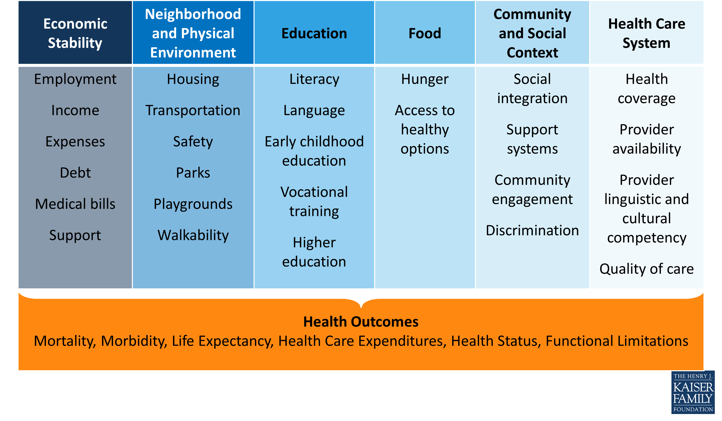
Social Determinants of Health
Beyond Health Care: The Role of Social Determinants in Promoting Health and Health Equity
http://www.kff.org/disparities-policy/issue-brief/beyond-health-care-the-role-of-social-determinants-in-promoting-health-and-health-equity/

Slide 7
Solar O, Irwin A. A conceptual framework for action on the social determinants of health. Social Determinants of Health Discussion Paper 2 (Policy and Practice). Geneva, World Health Organization, 2010.

Slide 8
Social contexts
Social stratification
Differential vulnerabilities:
Conditions, resources
Differential exposure:
health-damaging conditions
Differential consequences
of ill-health

Slide 9
Social status
“the relative rank that an individual holds, with attendant rights, duties, and lifestyle, in a social hierarchy based upon honor or prestige.”
www.brittannica.com
“relations of ownership or control over productive resources (i.e. physical, financial and organizational).”
WHO Social Determinants of Health

Slide 10
Dimensions of social status
Race/ethnicity
Socioeconomic status/position
Sex
Gender
Sexual orientation
Marital status
Religion
Immigration

Slide 11
So what?
Review contribution to health

Slide 12

Importance of social factors
in any research
Notes:
FRAME - Why should we care if we’re not doing health disparities research?
Having the big picture matters.
Make methodological pts – if you’re collecting your own data or working on data collected by someone else vs setting out to collect your own

Slide 13
Biology:
Reproductive factors 5%
Viruses 8%
Medication 5%
Social (behavioral)
Diet 5%
Tobacco 30%
Alcohol 4%
Physical Environment:
Sun/radiation 2%
Obesity 20%
Sedentary Lifestyle 5%
Environment 4%
From: Colditz and Wei, Annu Rev Public Health, 2012, 33:137-56 (p. 148—Figure 1)

Slide 14
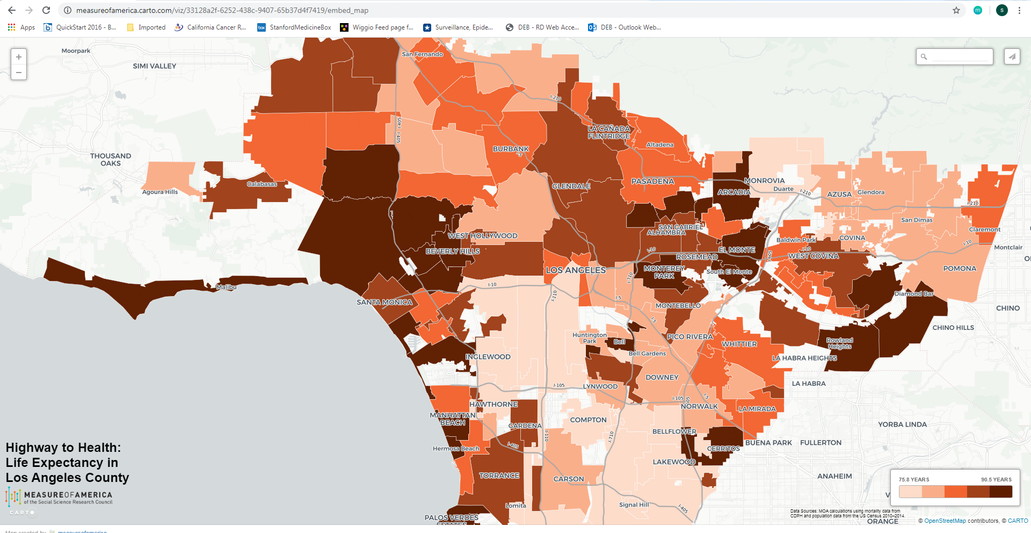
15-yr gap in life expectancy by zip codes
https://measureofamerica.carto.com/viz/33128a2f-6252-438c-9407-65b37d4f7419/embed_map

Slide 15
Improving health & reducing disparities by addressing the role of social factors
Economic & Social
Opportunities and Resources
Living & Working Conditions
in Homes and Communities
Behaviors
Medical Care
Interaction with genetic/other biological factors
HEALTH
Adapted from Braveman et al., for Robert Wood Johnson Foundation Commission to Build a Healthier America | www.commissiononhealth.org
Notes:
stress is cross cutting and is a mechanism, more than a social determinant itself. I think making that point would be great, and you could tie that into the RWJ model of SDH if you want by making a big picture point of how SDHs can impact health:
SDHs can directly lead to poor health outcomes through physical deprivation, toxic exposures, etc.
SDH can lead to lead to health outcomes through physical and emotional stress (allostatic load etc)
SDH can lead to health outcomes through modifications of behavior (i.e. smoking, exercise diet), that result in poor health outcomes (obviously say that Scarlett will touch on that in more detail)
And then also mention how this can be mediated by biological changes (which Maria will talk about) and be multigenerational as well.

Slide 16
Cells-to-Society model
A framework for multilevel research
Centers for Population Health and Health Disparities, NIH
Social conditions & policies
Poverty, norms, prejudice
Fundamental causes
Institutional context
The health care system, economic system, media, political system
Social context
Collective efficacy, social capital, racial/ethnic integration
Social relationships
Social networks, social support, religious participation, civic engagement
Social & physical context
Interactions
Physical context
Building quality, pollution, sidewalks, parks
Disparate health outcomes
Individual demographics
Age, race/ethnicity, SES, health insurance, education, acculturation
Individual factors
Individual risk behaviors
Smoking, alcohol, diet, sleep
Biological responses
Obesity, depression, stress, hypertension, chronic lung disease
Biologic/Genetic pathways
Allostatic load, biologic processes, genetic ancestry, genetic mechanisms
Biologic factors
Warnecke et al. AJPH 2008

Slide 17
Race/Ethnicity + SES as Fundamental Causes: Framework for social disparities in health
SDOH-Intermediate
Social Status
Diez Roux, Annual Review of Public Health 2012

Slide 18
unequal distribution of money, power, and resources at global, national, and local levels that results in health disparities
  human-made societal systems of power and privilege (not natural)
  awareness alone is not sufficient; skills/actions required to address them
  beyond the individual actions by health providers but will require systems-level or societal change

Slide 19
Now what?
Application of SDOH in research
(socioeconomic status, racism, neighborhood)

Slide 20
Typical/Prior applications
Surveillance (document social disparities)
Included in model as covariate
Ignore SDOH
Is this enough?
Let’s explore frameworks for how to think about the role of SDOH in health

Slide 21
SDOH: Examples
Race/Ethnicity ←→ Racism
SES ←→ Classism
Neighborhood ←→ differential exposure
Notes:
Race/Ethnicity ←→ Racism
SES ←→ Classism
Neighborhood ←→ differential exposure

Slide 22
Socioeconomic position/status
“… the social and economic factors that influence what positions individuals or groups hold within the structure of a society”
Galobardes et al 2006
SES and health
Multidimensional, multilevel construct
Life course perspective
Multiple causal pathways
  Independent and joint associations across levels
  Interacts with other social status measures (race/ethnicity)
Notes:
Pathways for education (not only economic)
--material resources
--general and health-related knowledge
--literacy
--problem-solving skills
--prestige
--influence over others and one’s own life
--social ties?
Wealth:
--buffer effects of temporarily low income (unemployment/illness)
--power/influence over others
Occupation
--psychosocial characteristics of one’s occupation (control over one’s work)

Slide 23
Measures of SES
Education
  years of formal education completed
  ordinal categories
Income
  annual household and factor number of dependents
Occupation
  laborer, technical, professional, business
  manual/non-manual
Neighborhood SES
  % poverty, composite indices

Slide 24
Additional SES Measures
Wealth
  Assets
  Debt
  Ownership (home, car)
Childhood SES
  Parental occupation and education
  Household income, wealth
Self-perceived ‘standing’ on a ladder ranging from 1 to 10

Slide 25
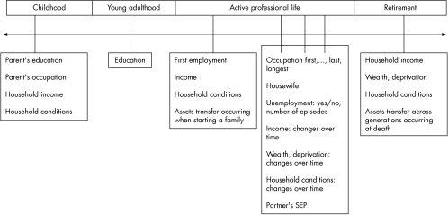
SES across the Life Course
Galobardes et al 2006
Notes:
Talk about research using cross-sectional measures, cumulative measures and then measures across the life course (more specific to research questions/outcomes)

Slide 26
SES across the Life Course
Latency/critical period model:
Exposure during sensitive window puts one at risk for development of disease later in life. Exposures encountered after the critical window closes do not influence risk. Focus on early life experiences that do not have a cumulative effect.
Galobardes et al 2006
Notes:
Example is cognitive and socioemotional development

Slide 27
SES across the Life Course
Social trajectory model:
Social disadvantage increases risk of future disadvantage later in life. The initial insult does not necessarily have a harmful effect on the outcome – but the first exposure leads to subsequent exposures that then directly cause the outcome.
Galobardes et al 2006
Notes:
Cumulative effects
Accumulation of risk model

Slide 28
Childhood SES is associated with adult health
Nurses Health Study:
Parental education is associated with the self-rated health of their adult children, after taking into consideration current SES (highest year of schooling, total household income, total net worth)
[Moody-Ayers, et al. 2007]
Health and Retirement Survey:
Parental occupation is associated with cardiovascular disease in middle age, after taking into consideration current SES (highest year of schooling)
[Gliksman et al. 1995]

Slide 29
SES-related Stressors
Job insecurity
Job strain (High demands / Low control)
Housing insecurity/homelessness
Food insecurity
Adequate health care coverage
Notes:
Can go even further and talk about food policy, corn syrup etc.
http://www.ncbi.nlm.nih.gov/pubmed/24392603
http://www.ncbi.nlm.nih.gov/pubmed/15622689
http://www.ncbi.nlm.nih.gov/pubmed/18366535/
Perceived discrimination/racism has been shown to play a role in unhealthy behaviors such cigarette smoking, alcohol/substance use, improper nutrition, and refusal to seek medical services (Lee, Ayers, & Kronenfeld, 2009; Peek et al, 2011).

Slide 30
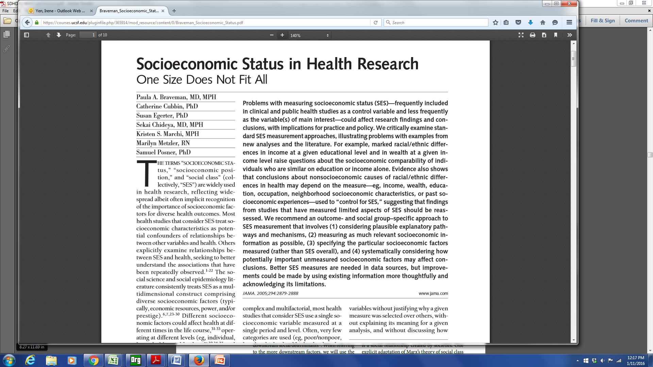

Slide 31
Braveman et al article –
a few of the take home points
Education and income are not interchangeable – earnings can vary at similar educ levels.
Income is not a proxy for wealth
Importance
  past socioeconomic experiences
  neighborhood socioeconomic conditions
Outcome and social-group specific approach

Slide 32
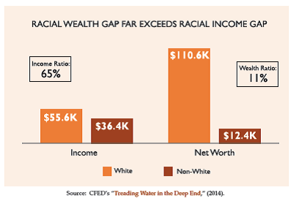
Notes:
African-Americans are twice as likely to be liquid asset poor as white households. This lack of savings corresponds with overall lower wealth and assets. Corporation for Enterprise Development (CFED) found that households of color have approximately one-tenth the median net worth (assets minus debt) of white households ($12,377 and $110,637, respectively).
The racial wealth gap is growing. According to research by the Urban Institute, the wealth gap has doubled in the past few decades. In 1983, the average wealth of white families was $230,000 higher than the average wealth of African-American and Hispanic families; in 2010, it has increased to over $500,000.

Slide 33
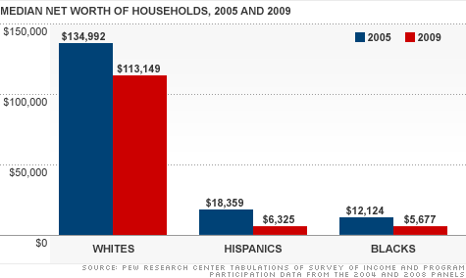
-16%
-66%
-53%

Slide 34
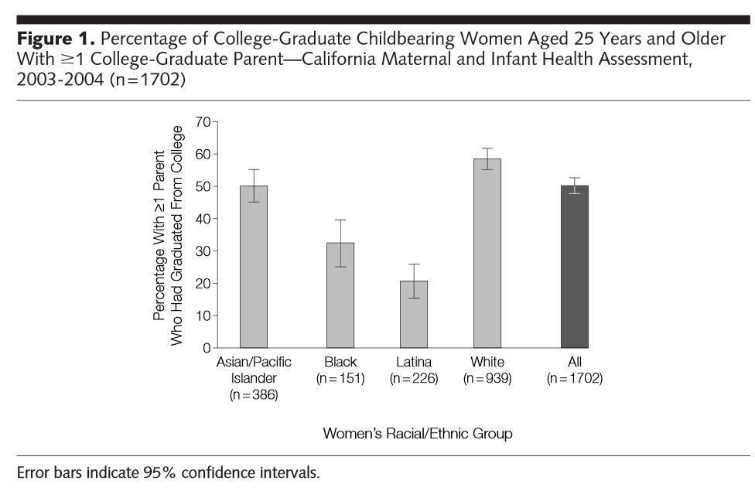

Slide 35
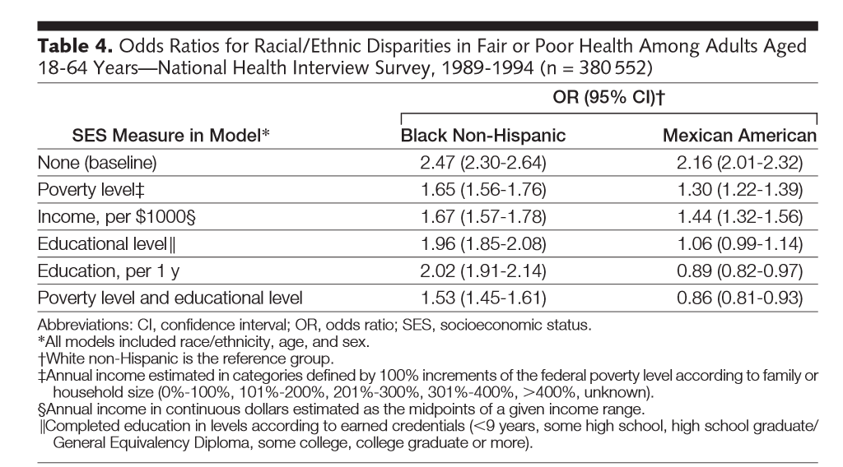
Notes:
Models differed by whether and how income and education were included.
When income was used to adjust for SES, Mexicans had increased risk for fair/poor health compared to Whites
If use education, risk appear similar

Slide 36
SDOH measures/tools: “STARS” study https://cancerregistry.ucsf.edu/stars-study
“Stars” = Standardizing survey questions for breast cancer research
Investigators: Scarlett Gomez, Nancy Krieger, scientific & community advisory boards
Overall objective: To develop recommendations for researchers in gathering SDOH information
  So that survey items are culturally and linguistically appropriate
  To optimize ability to pool data across studies
Supported by the California Breast Cancer Research Program (CBCRP)

Slide 37

SDOH measures/tools: “STARS” study
Multiple discipline literature review
Synthesis & preliminary recommendations
Scientific advisory feedback
Assemble initial set of survey items
Community
advisory feedback
Develop core set of survey items
Translations (5 languages)
Cognitive testing
Adjust questions
Pilot testing (N=20, for each of 6 r/e groups)
Telephone
(N=10 per r/e)
Mailed self-administered (N=10 per r/e)
Test-retest reliability
Telephone
(N=10 per r/e)
Mailed self-administered (N=10 per r/e)
Scientific & Community advisory feedback
Final survey tools & recommendations
Available in 5 languages at: https://cancerregistry.ucsf.edu/stars-study

Slide 38
“STARS” SDOH measures included
Race/ethnicity
Birthplace, migration history
Language
Literacy, numeracy
Community characteristics
Disability status
Socioeconomic status
Gender identification, sexual orientation

Slide 39
“STARS”: Core & expanded questions
Core items – to be used for all research
Expanded items – for more detailed and/or nuanced assessment
Race & ethnicity
  Detailed ancestry
SES – education, income, occupation, employment
  Wealth, financial hardship, health insurance, neighborhood, residential history, social & built environment
Immigration – nationality, immigrant status
  Reasons for immigration, time lived in US, citizenship, generational level
Language
  Interpreter needs, literacy, numeracy
Disability Status – health status, activity-limited days, physical health, emotional health
Sexuality and gender
  Biological sex at birth, marital status/co-habitation

Slide 40
SES: Education

Slide 41
SES: Wealth

Slide 42
Measurement of SES
Think about measures that have most relevance to your research question
  May need multiple measures
  Results may depend on what measures you use
Use validated measures
Consider life course perspective
Consider other social status dimensions (e.g., race/ethnicity) as jointly impacting health

Slide 43
Intersectional Framework & Approach
Social identities and categories should not be viewed as independent variables that capture individual characteristics; instead, they are markers of institutional processes
Intersecting inequalities & multiple vulnerabilities
  Multiple dimensions of social status impact health
Williams et al, Health Services Research 2012

Slide 44
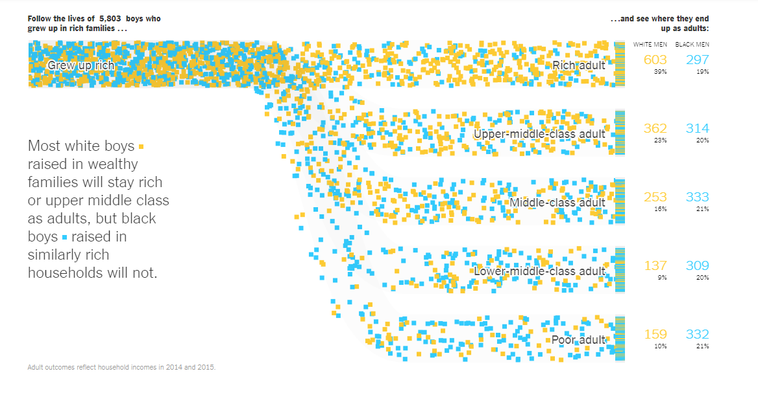
Adult SES | White Men | Black Men
Rich | 39% | 17%
Upper middle-class | 24% | 19%
Middle-class | 16% | 22%
Lower middle-class | 10% | 20%
Poor | 10% | 21%
https://www.nytimes.com/interactive/2018/03/19/upshot/race-class-white-and-black-men.html

Slide 45
Jan 2018 online

Slide 46
Education by Race/Ethnicity, CBCSC
Shariff-Marco et al, Journal of Community Health 2015

Slide 47
NSES by Race/Ethnicity, CBCSC
Shariff-Marco et al, Journal of Community Health 2015

Slide 48
Race/ethnicity/SES disparities in mortality after breast cancer in California
Shariff-Marco et al, Journal of Community Health 2015
Notes:
Compared with NL Whites with higher education and residence in higher SES neighborhoods, all other racial/ethnic groups with similar SES profiles were statistically not significantly at higher risk of death after breast cancer
Whites residing in lower SES neighborhoods had higher risk of death, as did AA, additionally, AA with low education in high SES neighborhoods had increased risk of death
Asians, regardless of SES, had no differences in risk of death
Latinas had lower risk of death, with lowest education and residence in lower SES neighborhoods

Slide 49
Racism, United Nations
“any distinction, exclusion, restriction or preference based on race, color, descent, or national or ethnic origin which has the purpose or effect of nullifying or impairing the recognition, enjoyment or exercise, on an equal footing, of human rights and fundamental freedoms in the political, economic, social, cultural or any other field of public life.”

Slide 50
Racism
Racism
  an organized system that categorizes population groups into ‘races’, and uses this ranking to preferentially allocate societal goods and resources to groups regarded as superior (Bonilla-Silva 1996)
  ideology of inferiority that ranks some racial groups as inherently or culturally superior to others and supports the social norms and institutions that implement this ideology (Jones 1997)
Williams and Mohammed, J Behav Med 2009
Notes:
Race/ethnicity as a social construct
social classification
impacts of racism

Slide 51
Multilevel, multiple dimensions of racism
Institutionalized racism (e.g., residential segregation)
  differential access to goods, services, opportunities and power
  structural, systemic (codified in customs, practices, laws)
Personally mediated racism (e.g., prejudice and discrimination)
  differential assumptions about abilities, motives, and intentions of others by race/ethnicity
  differential actions towards others by race/ethnicity
Jones, APJH 2000

Slide 52
Multilevel, multiple dimensions of racism
Internalized racism
  acceptance by members of stigmatized race/ethnicity of negative messages about their own abilities and intrinsic worth
Jones, APJH 2000

Slide 53
Lessons from the Gardener’s Tale
Interventions at 3-levels of racism
  internalized: Pink is beautiful
  personally mediated: Change gardener’s attitudes/behavior towards pink flowers
  institutionalized: improve the conditions in which the pink flowers born, grow and live
  Addressing the SDOH/fundamental causes will yield the biggest impact
Jones, APJH 2000

Slide 54
Racism and Health
Multiple pathways (direct)
  economic deprivation, including poor housing and educational opportunities, exposure to dangerous neighborhoods, lack of access to healthy food, riskier work, and a lack of health insurance
  excess exposure to toxins, hazards, pathogens
  social trauma
  targeted marketing of harmful commodities
Muennig & Murphy, Journal of Health, Politics, & Law, 2011
Krieger, AJPH 2012
Notes:
economic and social deprivation;
excess exposure to toxins, hazards,
and pathogens; social trauma;
health-harming responses to discrimination;
targeted marketing
of harmful commodities; inadequate
medical care; and, especially
(but not only) for indigenous peoples,
ecosystem degradation and
alienation from the land.

Slide 55
Racism and Health
Multiple pathways (indirect)
  effectively “stressing” the individual, leading to neuroendocrine disruptions that affect one’s physical and mental health (racism as a stressor)
  health-harming responses (coping via alcohol, smoking, poor diet)
Muennig & Murphy, Journal of Health, Politics, & Law, 2011
Krieger, AJPH 2012

Slide 56
Life course perspective & racism
Gee et al, AJPH 2012

Slide 57
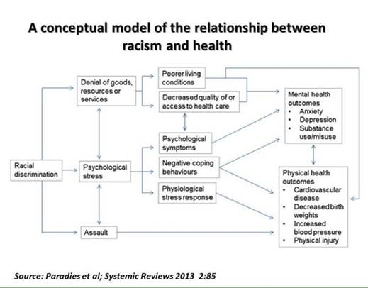

Slide 58
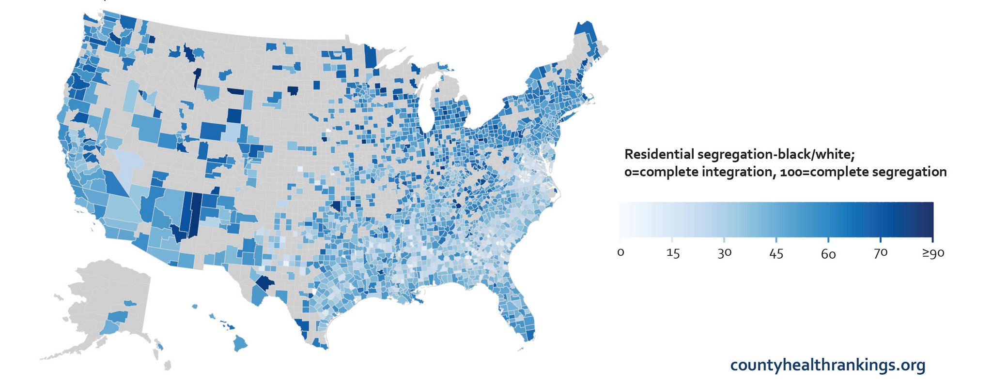
Residential segregation in the US
Notes:
Evenness
Exposure
Centralization
Concentration
Clustering

Slide 59
Notes:
For African-Americans and NH Whites, segregation has been on a slow decline
For Hispanic and Asian Americans, though their levels of segregation are not as high as African Americans, residence in segregated neighborhoods has increased for these populations (e.g., primarily due to influx of immigrants and residence in ethnic enclaves)

Slide 60
Homogenous neighborhoods vs. even distribution of minority members
Low vs. high exposure to majority members
Minority members are more vs. less densely packed
Notes:
UC Census report on Segregation 1980-2000, Iceland et al, 2002

Slide 61
Hypersegregation
Segregation highest for African Americans
Characterized by not only by racial segregation, but also socioeconomic segregation
Socioeconomic segregation does not account for racial/ethnic segregation
Related to discrimination in housing/ mortgage markets

Slide 62
Examples: segregation and health

Slide 63
Urban
Rural

Slide 65
Blacks vs. Whites
Hispanics vs. Whites

Slide 66
Notes:
Black cancer survivors had lower HRQOL
Poverty was not associated, but segregation was; and
B-W disparities attenuated after accounting for segregation, → residing in segregated neighborhoods impacted HRQOL among both whites and blacks

Slide 67
Residential Segregation & Cancer
17 studies of segregation and cancer outcome
70% of studies showed associations between segregation and adverse cancer outcomes (late stage diagnosis, higher mortality, lower survival, higher risks)
  while many used validated measures (isolation index, dissimilarity index), several did use less validated measures (% African American)
  did not test mediators
Landrine et al, J Racial and Ethnic Health Disparities, 2017

Slide 68
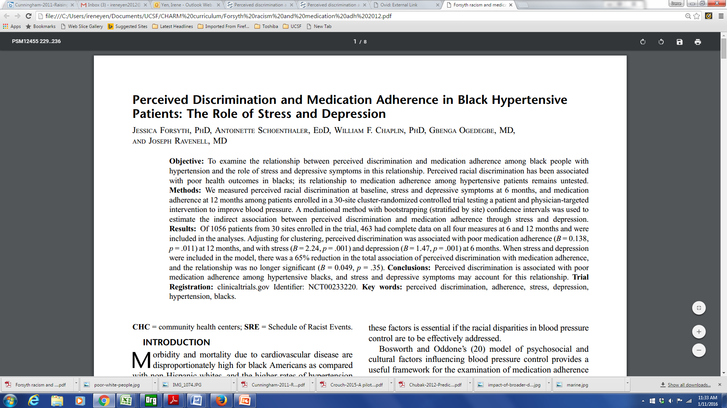
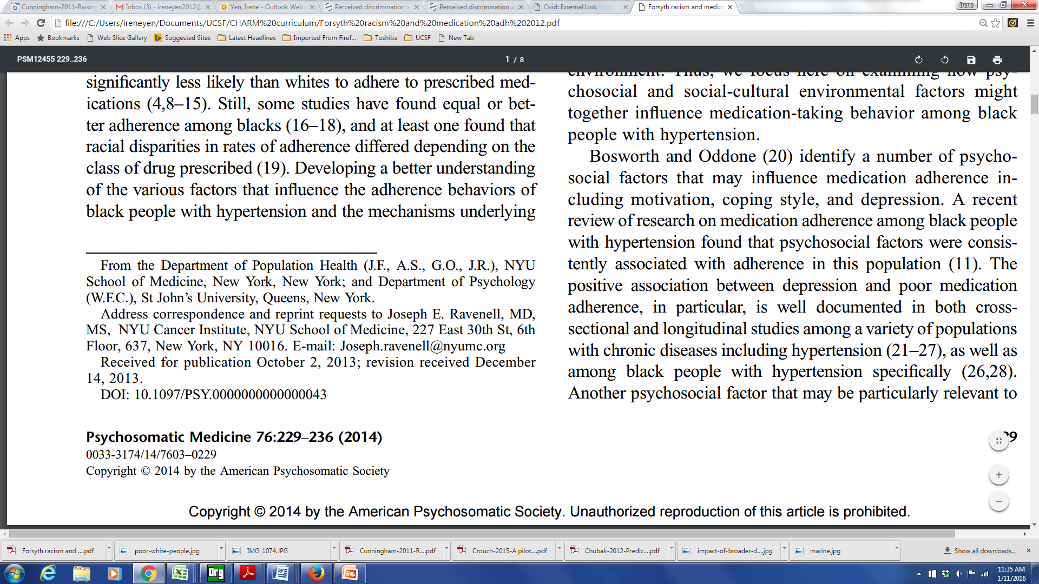

Slide 69
Discrimination and Medication Adherence
Perceived racial discrimination measured among patients enrolled in a 30-site cluster-randomized controlled trial
A mediational method was used to estimate the indirect association between perceived discrimination and medication adherence through stress and depression
Perceived discrimination was associated with poor medication adherence, and was mediated by stress and depression
Notes:
Racism
Pt’s experience racism
Medical mistrust
Research on the outcomes / prognosis of people with a condition – as contrasted with the incidence

Slide 70
Discrimination Measure
Schedule of Racist Events (SRE) -18 items
  domains including service settings, schools, the workplace, and public places
  frequency in the past year, over the lifetime
  appraisal of experiences as stressful
Experiences of Discrimination (Krieger et al)
Everyday Discrimination Scale; Major Experiences of Discrimination (Williams et al)

Slide 71
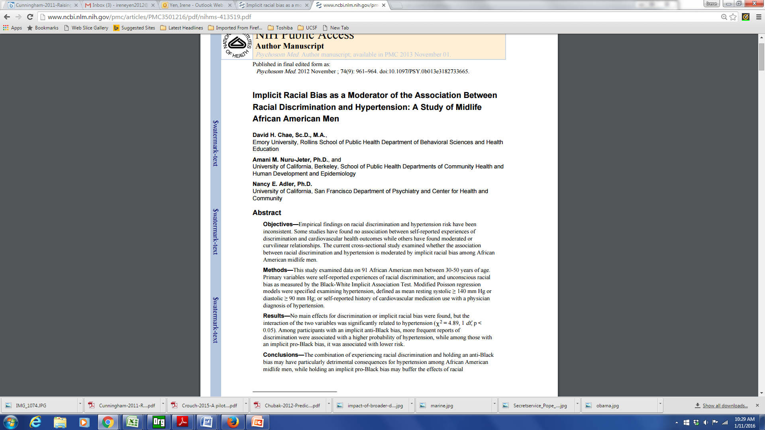
Internalized Racism

Slide 72
Internalized Racism
Implicit association test used to measure implicit (unconscious) racial bias
  https://implicit.harvard.edu/implicit/iatdetails.html
Among black men with anti-black bias, experiences of discrimination associated with hypertension
  Those with a pro-black bias had lower dx of hypertension

Slide 73
Additional dimensions of racism
Intergenerational impacts
  Historical trauma
  Wealth and inheritance
Discrimination in health care (medical discrimination)
  Institutional policies, practices
  Interpersonal interactions (providers/staff)

Slide 75
Other measures/domains of structural racism
Housing
  Redlining
  Bias in mortgage lending
Education
Employment
Judicial System
Beyers et al, Health &Place 40 (2016) 34–43
Notes:
Redlining: process of systematically denying mortgages based on location, where these locations are often defined by a predominant race or socioeconomic group
Bias in mortgage lending: previous work has conceptualized the odds of denial of mortgage applications for Black applicants, as compared to White applicants,

Slide 76
Considerations for research on racism
In the US, fundamental cause underlying racial/ethnic disparities in health
Relevant measures
  levels/dimensions
  exposure period
Validated instruments for study population
  measurement approach
  immigration

Slide 77
Racism, not race/ethnicity
Race/ethnicity
  social construct
  social status
    Relative ranking
    Ownership/control over resources
Proxy for racism as data not always available
  conceptual framework
  Interpretation of results

Slide 79
Neighborhood
Pubmed Articles “Neighborhood” in title: 1970 - 2012
79

Slide 80
Place and health
Where you live, work and play impacts your health
  Environmental exposures
  Material deprivation
  Psychosocial mechanisms (stress, social support)
  Lifestyle behaviors (physical activity, diet, smoking & alcohol use)

Slide 81
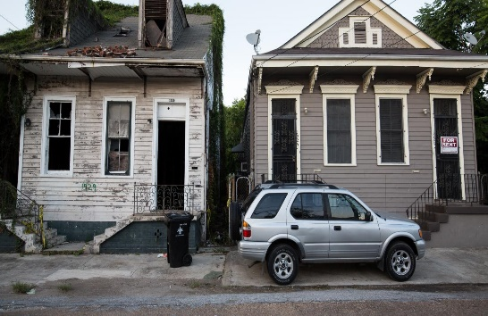
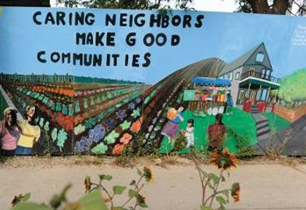

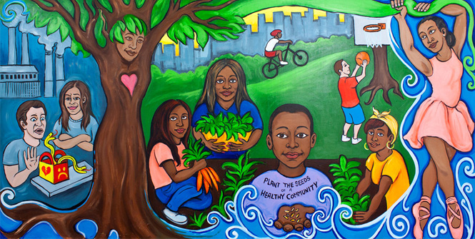

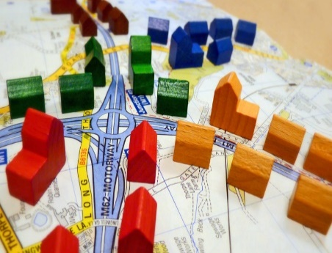

Social Environment Attributes
Social Environment
Socioeconomic status
Crime
Gentrification/ displacement
Ethnic enclave
Segregation
Racial/ ethnic composition
Social cohesion
Socioeconomic Status
Crime
Social Capital/
Social Cohesion
Racial/Ethnic Composition
Gentrification/
Displacement
Ethnic Enclave
Segregation

Slide 82
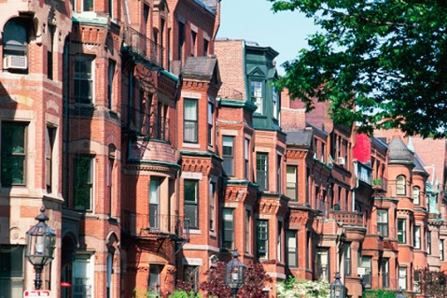
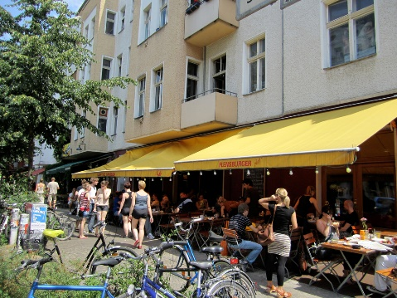
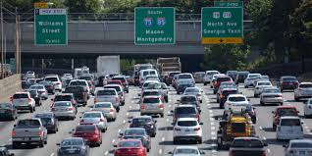
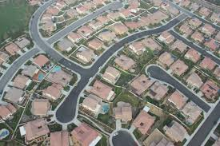
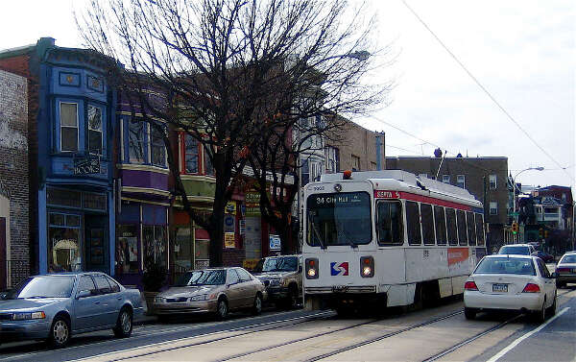

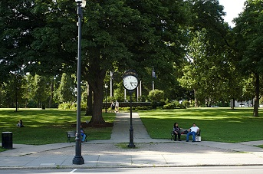

Built Environment Attributes
Population Density
Built Environment
Population density
Housing characteristics
Commuting patterns
Parks/green space
Recreational facilities
Food environment (retail food outlets, restaurants)
Street connectivity
Traffic density
Housing Characteristics
Traffic Density
Street Connectivity
Commuting Patterns
Food Environment
Parks/Green Space
Recreational Facilities

Slide 83
Additional neighborhood environments
Physical environment
  Air pollution
  Noise pollution
  Light pollution
  Toxic waste sites
Healthcare Context
  Resources: density of providers, facilities
  % insured/uninsured
  Distance to facilities

Slide 84
Gomez, Shariff-Marco, et al. Cancer 2015.

Slide 85
Diez Roux et al, Global Heart 2016

Slide 86
Arcaya et al, Social Science & Medicine 2016

Slide 87
Arcaya et al, Social Science & Medicine 2016

Slide 88
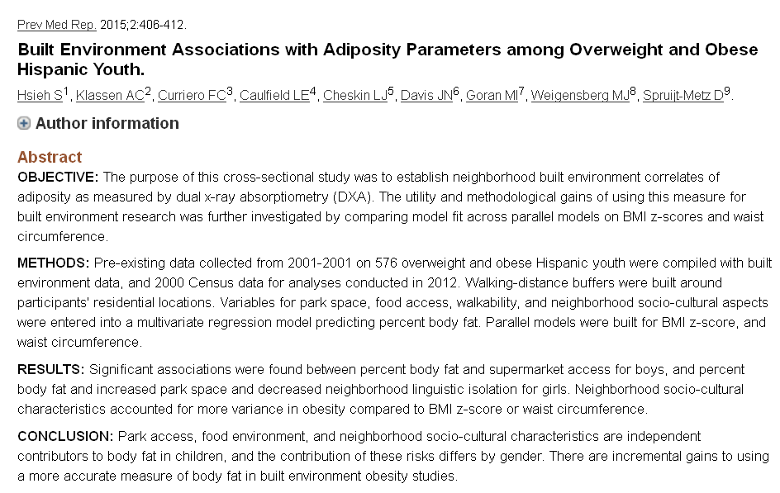

Slide 89
Moving to Opportunity
1994 – 4600 families with children living in public housing – RCT to move to lower poverty neighborhoods
  Vouchers (<10% poverty)
  Section 8
  control
2008-2010 – evaluation studies
http://www.nber.org/mtopublic/

Slide 90
Moving to Opportunity
adults offered housing vouchers
  a lower prevalence of severe obesity and diabetes compared to controls
  fewer physical limitations
  improved mental health in areas such as depression and psychological distress
self-reported health status and rates of hypertension and health-related risk behaviors are similar across groups
little or no effect on economic self-sufficiency

Slide 91
Moving to Opportunity: Update
With additional years of follow-up, most recent results suggest there are additional benefits for children (<13 years at time of move) of these families who have now grown up with increases in:
  Income
  College attendance rates and quality
  Marriage rates

Slide 92
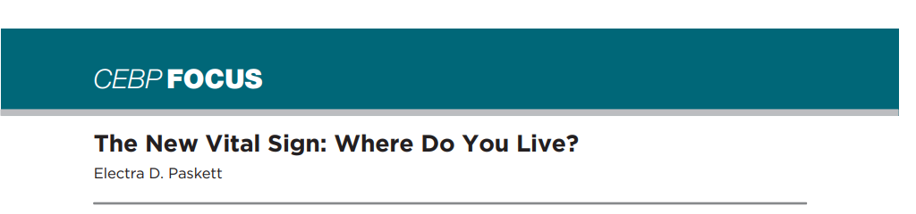
April 2016
Residential neighborhood = risk factor
What can providers do?
  Patient navigation
SDOH and electronic health records
  Natural language processing
  Appending/linking data across multiple sources

Slide 93
Recommendations for research on neighborhood + health
Consider the complex and dynamic relationships
A life-course perspective
  capture neighborhood environment factors during relevant time periods and account for changes in neighborhood characteristics
Consider neighborhood environments at work
Integration of secondary (objective) and self-report (perception) data
Engage communities in solutions/interventions
Develop analytical approaches and tools
Causal inference
  apply (develop) causal inference methods to allow for calculation of less biased estimates of associations between neighborhood environments and cancer outcomes

Slide 94
Resources for SDOH measures
Stars Study (English, Spanish, Chinese, Tagalog, Vietnamese) https://cancerregistry.ucsf.edu/stars-study
California Neighborhoods Data System
Health Equity Hub
PhenX Toolkit: https://www.phenxtoolkit.org/
California Health Interview Survey
  Adult, Adolescent, Child questionnaires (English, Spanish, Chinese, Korean, Vietnamese, Tagalog) https://healthpolicy.ucla.edu/chis/Pages/default.aspx
  Discrimination Module https://healthpolicy.ucla.edu/chis/data/Pages/DM.aspx

Slide 95
Map of First Four Weeks
Week 2
Week 5
Economic & Social
Opportunities and Resources
Week 3
Living & Working Conditions
in Homes and Communities
Week 4
Behaviors
Medical Care
Interaction with genetic/other biological factors
HEALTH
Adapted from Braveman et al., for RWJ Foundation
Commission to Build a Healthier America | www.commissiononhealth.org

Slide 96
Questions? Comments?
Salma Shariff-Marco, PhD, MPH
Associate Professor
Department of Epidemiology and Biostatistics
Helen Diller Family Comprehensive Cancer Center
Greater Bay Area Cancer Registry (GBACR), https://cancerregistry.ucsf.edu
DREAM Lab, https://dreamlab.ucsf.edu/
sshariff@psg.ucsf.edu

