Slide 1
Biostatistics 226, Winter 2020
Review: HW 1, Design of RCTs
HW1 Review
Adherence terminology
Adherence and compliance are often used interchangeably
  “the extent to which a patient acts in accordance with the prescribed interval and dose of a dosing regime”
Persistence is a related term that refers to remaining on a medical treatment for a specified period of time, regardless of the proportion of the doses taken
Attrition: Missing outcomes vs Lower intervention exposure
Participants who stop participating in a trial and have no further follow-up are referred to as withdrawals.
Ref: LM Friedman, CD Furberg, DL DeMets, DM Reboussin, CB Granger. Fundamental of Clinical Trials, 5th edition, 2015.
Notes:
In a drug trial, adherence typically refers to ingestion of predetermined amount of drug such as [at least] 80% of the protocol dose. This dose will depend on the nature and half-life of the drug being evaluated.

Slide 2
Biostatistics 226, Winter 2019
Review: HW 1, Design of RCTs
HW1 Review
Experimental vs observational unit
Experimental unit:
  the unit which can be assigned, at random, to an intervention
  participant, participant eye, provider, clinic, etc.
Observational unit:
  the unit on which the outcome is measured
  often same as experimental unit but can be different
Notes:
Experimental unit: what you apply the intervention to
Observational unit: units that you take measurements on

Slide 3
Biostatistics 226, Winter 2020
Review: HW 1, Design of RCTs
HW Readings
White Horton 2011 MissingOutcomes – Strategy for intention to treat analysis with incomplete observations; promotes sensitivity analyses.
Wittes 2009 MissingOutcomes – This article focuses on prevention of missing data via high quality trial execution.
  Train investigators and study participants about the importance of completing the trial.
  Use language in informed consent documents, protocols, and case report forms that distinguishes between stopping study medication and removal from the trial itself.
Vickers Altman 2013 Missing – Discusses strengths and weaknesses of multiple imputation, relative to complete case and LOCF analyses. Concludes: “Above all, analysis of missing data teaches us the importance of avoiding missing data in the first place.”

Slide 4
Biostatistics 226, Winter 2020
Course Overview
Jan 7 – Design of RCTs: How to avoid bias and achieve valid results
Jan 14 – Analyses: Baseline, Efficacy, and Safety
Jan 21 – Monitoring trials for efficacy, futility, and patient safety
Jan 28 – Cluster Randomized Trials
Feb 4 – Precision medicine I: SMART (Adaptive) Trials
Feb 11 – TBA
Textbook References
Friedman, Furburg, DeMets, Reboussin, Granger. Fundamental of Clinical Trials, 5th edition, 2015.
e-copy: https://link.springer.com/book/10.1007%2F978-3-319-18539-2
→ Many chapters support Lecture 2 including “What is the Question?” through “Blinding,” “Participant Adherence,” “Issues in Data Analysis,” “Reporting and Interpretation,” and “Multicenter Trials.”
Rosenbaum, Paul R. Observation and experiment : An introduction to causal inference, 2017.
→ Chapters 1-3 support Lecture 1.

Slide 5
Feb 19 – Analyses: Baseline, Efficacy, and Safety
More Resources
NEJM: RCT reports include study protocols. Can use as templates or examples.
  Study protocol documents all aspects of the trial. Avoids confusion and errors by ensuring that all parties involved in the trial have the same information.
  Today’s Example: Aspire Trial … http://www.nejm.org/doi/full/10.1056/NEJMoa1506110
http://www.consort-statement.org/
  Methodically defines key elements of an RCT protocol. Academic approach.
  The CONSORT Statement is an evidence-based, minimum set of recommendations for reporting randomized trials.
  It offers a standard way for authors to prepare reports of trial findings, facilitating their complete and transparent reporting, and aiding their critical appraisal and interpretation.
https://prsinfo.clinicaltrials.gov/results_definitions.html
Standards used by clinicaltrials.gov. FDA approach.
  Participant flow
  Baseline data
  Outcome measures
  Adverse event information
https://www.nist.gov/programs-projects/nist-randomness-beacon

Slide 6
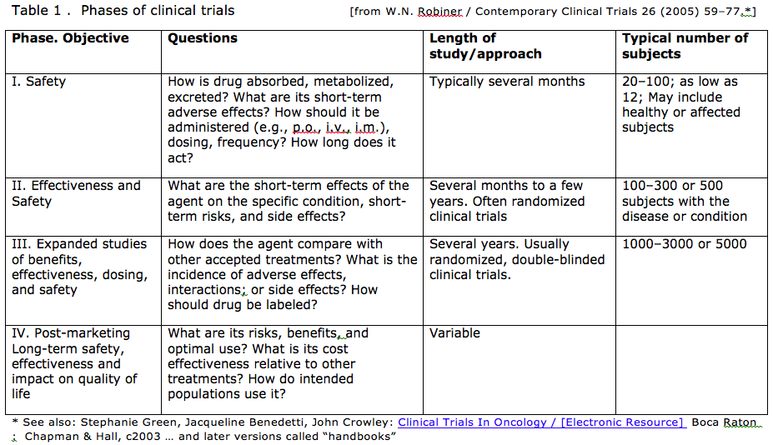
What is the objective of the research study?
A research question arises within the context of a research program. Each field makes progress in phases.
Notes:
These objectives are tackled in the order shown, sometimes overlapping.
Within phase III RCTs, TIME plays several roles:

Slide 7
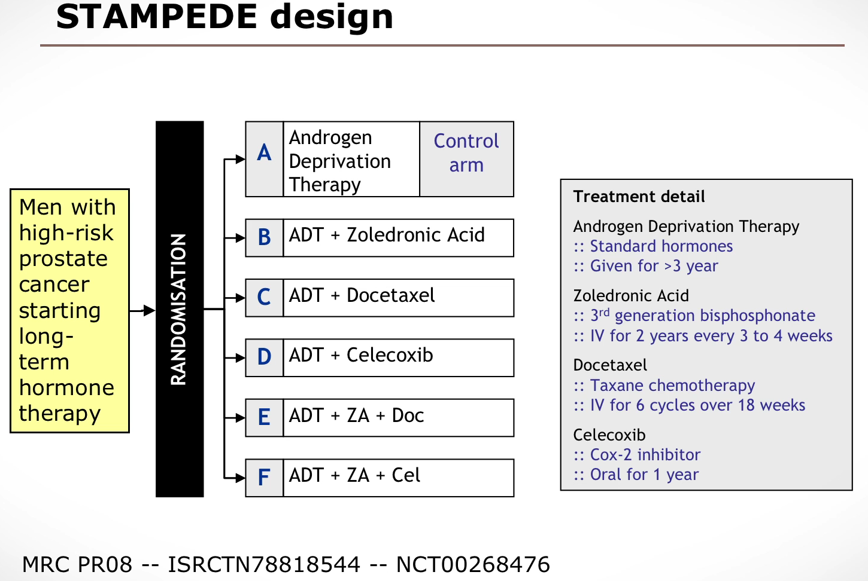
STAMPEDE: A Multi-arm Multi-stage (MAMS) “platform” trial

Slide 8
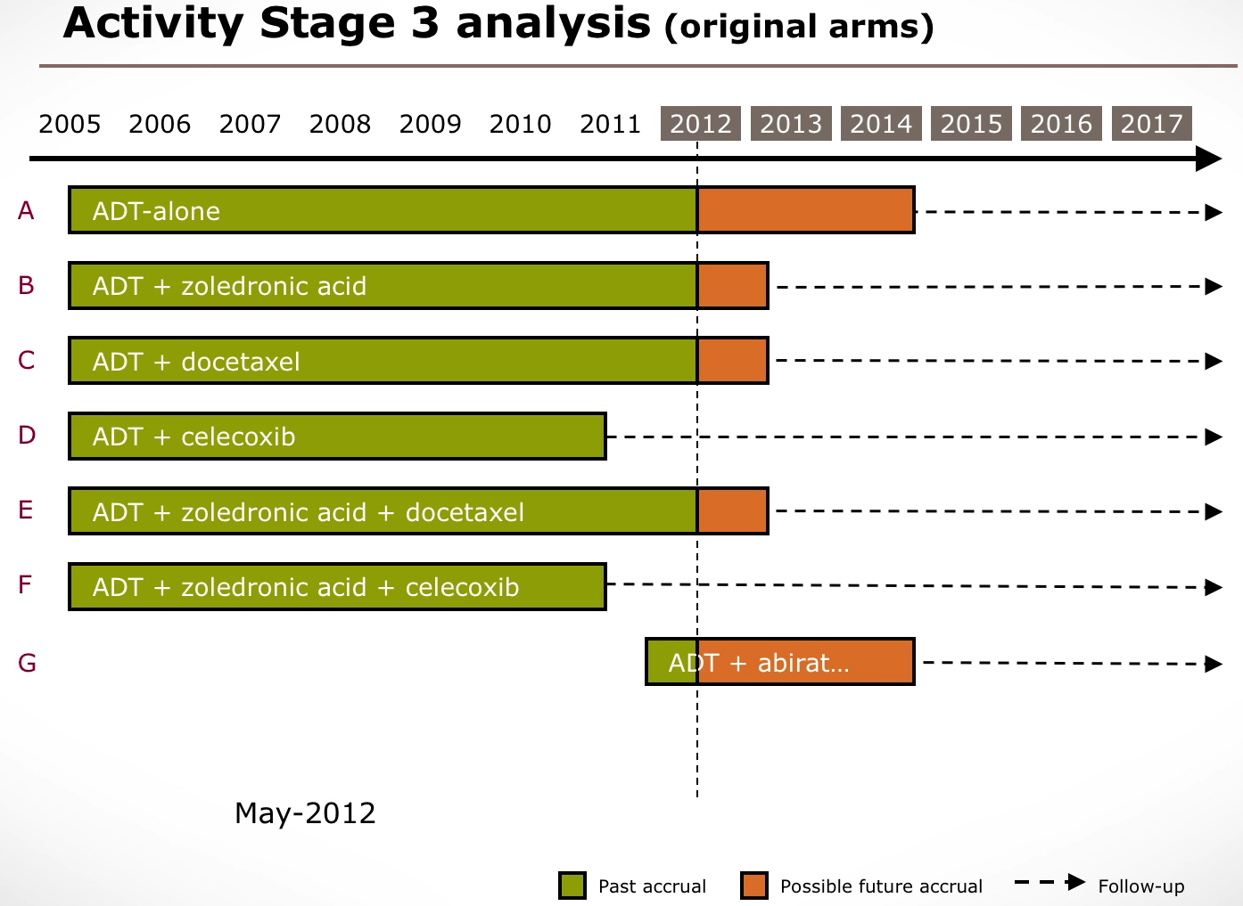
STAMPEDE: A Multi-arm Multi-stage (MAMS) “platform” trial

Slide 9
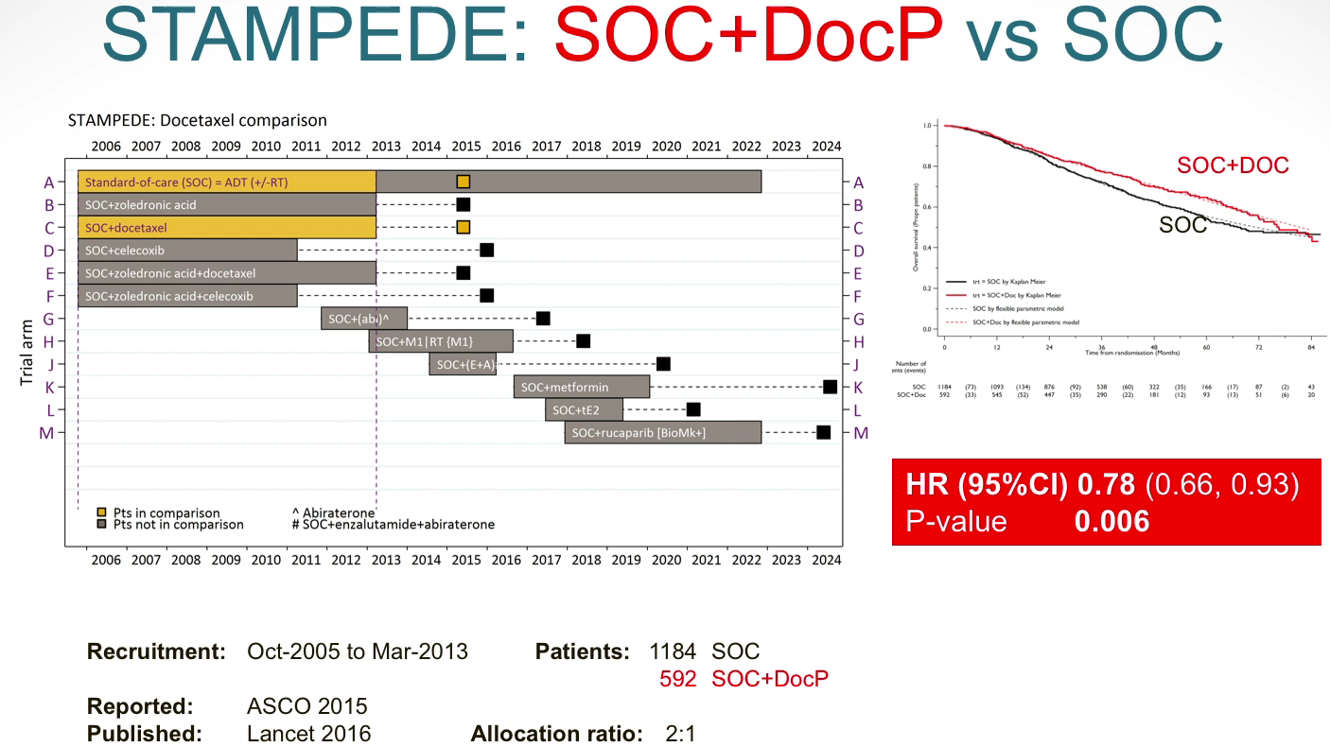
STAMPEDE: A Multi-arm Multi-stage (MAMS) “platform” trial

Slide 10
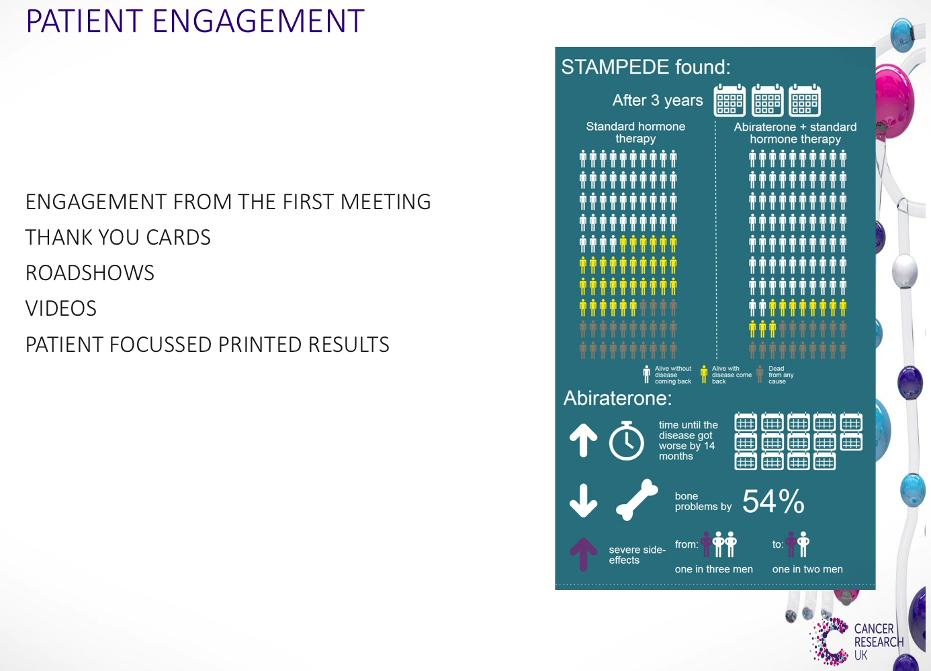
STAMPEDE: A Multi-arm Multi-stage (MAMS) “platform” trial

Slide 11
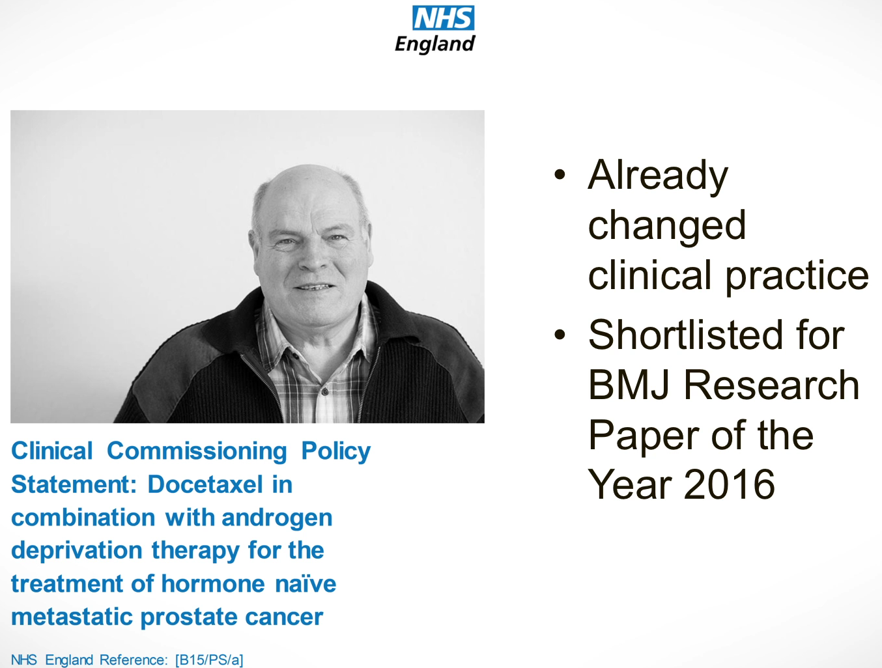
STAMPEDE: A Multi-arm Multi-stage (MAMS) “platform” trial

Slide 12
ASPIRE Trial: Protocol / Hypotheses
Heterosexual HIV transmission accounts for relatively high disease burden among African women
Scientific Hypotheses
“For HIV-1 prevention, an antiretroviral-containing vaginal ring could
provide long-acting HIV-1 protection
while reducing systemic exposure to the active pharmaceutical ingredient and delivering the anti–HIV-1 agent at the site of viral transmission.” → Note implied DAG: Efficacy or safety?
Statistical Hypotheses
“The trial was designed with power of 90% to detect a risk of HIV-1 infection that was [at least] 60% lower in the dapivirine group than in the placebo group, with a one-sided alpha level of 0.025.
Like other trials of new HIV-1 prevention interventions,^{6,7,18} this trial was powered so that the lower boundary of the 95% confidence interval would exclude [at least] a 25% reduction in risk, with the primary analysis comparison for the trial planned against a standard null of 0% [reduction] (Table S5, Suppl App’x).
… An annual HIV-1 infection incidence rate of [IR_{P}=] 3.9% in the placebo group was assumed … all participants followed for >12 months …”
  H₀: IR_{D} ≥ IR_{P} vs H_{A}: IR_{D} < (1-0.0)*IR_{P} → IRR < 1, where IRR = IR_{D}/IR_{P}
where IR = annual incidence rate and IRR = incidence rate ratio
  For power calculation: H_{A}: IR_{D} < (1-0.6)*IR_{P} → IRR < 0.4
Primary outcome variable
“The primary efficacy end point was HIV-1 infection, identified with the use of a standard seroconversion algorithm (Fig. S1 in the Supplemental Appendix).”
Notes:
Implied eligibility: African clinics, women, HIV-negative
Hypotheses link major structural parts of the RCT: Exposure arms and arm-specific outcomes. Hypotheses address effect size considered relevant for public health.
Individuals: outcome is binary (t-t-event); Groups: summary is annual incidence rate.
→ if IR_{P} = 3.9%, then IR_{D} = 1.6%
It is by the magic of randomization that we are able to make this leap.

Slide 13
ASPIRE Trial: Protocol / Allocation and Analysis procedures
Study Design
  Randomization: “At enrollment, women were assigned in a 1:1 ratio, with the use of fixed-size block randomization, stratified according to site, to receive either a silicone elastomer vaginal matrix ring containing 25 mg of dapivirine or a placebo vaginal ring.”
  Double blinding: “Both the dapivirine and placebo rings were manufactured by QPharma under contract with the International Partnership for Microbicides. The dapivirine and placebo rings were indistinguishable, and with the exception of staff members at the central statistical and data management center, investigators and participants were unaware of the randomization assignments until completion of the trial.”
  N.B. Blinding cannot be achieved without randomization. These procedures go hand in hand.
Analysis Plan – must account for study design
  “The primary analysis of HIV-1 protection was performed according to the intention-to-treat principle with the use of Cox regression, stratified according to site, to estimate the relative rates of time until HIV-1 acquisition.”
  Resource: Friedman, et al. Fundamental of Clinical Trials, 5th edition, 2015, Issues in Data Analysis.
Notes:
Participants were enrolled at 15 study sites: 9 in South Africa, 3 in Zimbabwe, 2 in Malawi, and 1 in Uganda. Of the 2629 women who enrolled, 1426 (54%) were from South Africa, 678 (26%) from Zimbabwe, 272 (10%) from Malawi, and 253 (10%) from Uganda.
Why stratify?

Slide 14
Protocol: TIME plays several roles in phase III RCTs
  Duration of the study from participants’ viewpoint :
  Initiation: Recruitment, Eligibility, Consent, Baseline data
  Exposure: Randomization, Intervention
    Treat at what dose and frequency, for how long?
  Assessment: Follow-up for outcomes
    Evaluate at what intervals for how long?
  Closeout
Duration of the study from investigators’ and funders’ viewpoint
Drivers of duration for trialists
  Accrual rate: Who’s eligible? Adequate pool? Techniques for shortening
  Consent rate: Techniques for increasing
  Retention rate: Techniques for increasing
  Adherence rate: Techniques for increasing
  Patient Safety: DMC can halt accrual to resolve problems (more common in phase I-II)
Notes:
What preliminary evidence supports these decisions?

Slide 15
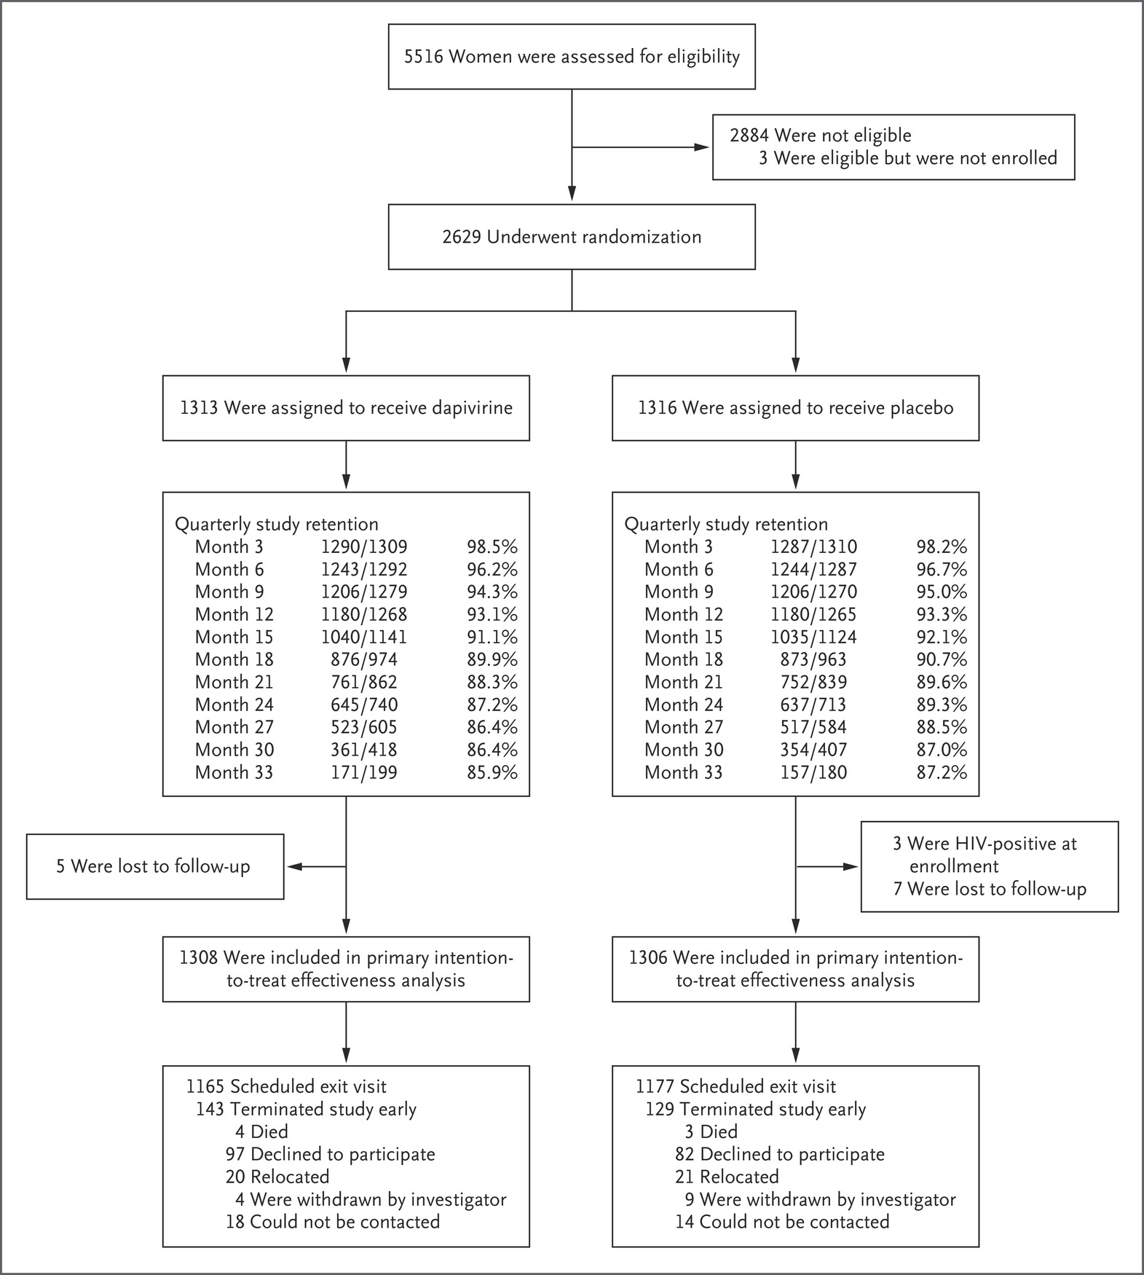
Consort Diagram for ASPIRE Trial: Participant Flow by Arm
Exposures
Quarterly
retention
Few ITT exclusions
Outcomes available
Notes:
Reports on completeness of steps.
This trial followed a previous trial of the same question that had failed due to poor adherence. Investigators were very alert to importance of complete outcome follow-up and maximal adherence to study arms. This may explain inclusion of adherence details in the Flow Diagram.
Definitions provided by authors:
OUTCOMES: Trial retention was defined as the provision of an HIV-1 test result, and women who withdrew early from the study were counted as having missed visits thereafter. Participants attended 91% of scheduled study visits (97% after accounting for early withdrawals from the study).
EXPOSURES: Interruptions in the use of the study rings owing to pregnancy and breast-feeding accounted for 2% of study follow-up time, and protocol-required, safety-related temporary interruptions of product use accounted for less than 1%.

Slide 16
Baseline Data = “Covariates”
An RCT report summarizes baseline characteristics by study arm using descriptive statistics suitable to the data type – e.g., mean +/- SD.
  To allow readers, especially practitioners, to judge how applicable the results of a trial might be to relevant individuals.
  Features related to eligibility, generalizability
Proper random assignment prevents selection bias but does not guarantee that the groups are equivalent at baseline.
  To compare study arms at baseline by important risk characteristics so that readers can sense how similar they were.
  Prognostic characteristics influence outcomes
At baseline, no PPT has been exposed to a study intervention so arms cannot influence covariate values. Thus study groups represent two independent samples from one pool and H₀ is true.
Historically, statistical tests compared study arms with respect to each characteristic listed. A finding that H₀ can be rejected is false positive (FP). Testing multiple covariates → 5% are FP.
Proper randomization ensures that any differences in baseline characteristics are the result of chance rather than bias.
HW2: See Austin (2010) for changing convention over time.
Baseline values of continuous outcomes are especially valuable.
If study outcomes: To adjust the analysis for pre-intervention level (or measure change scores).
HW2: See Vickers (2013) for analysis of baseline outcomes.
If mediators: To explain the mechanism of intervention (e.g., adherence).

Slide 17
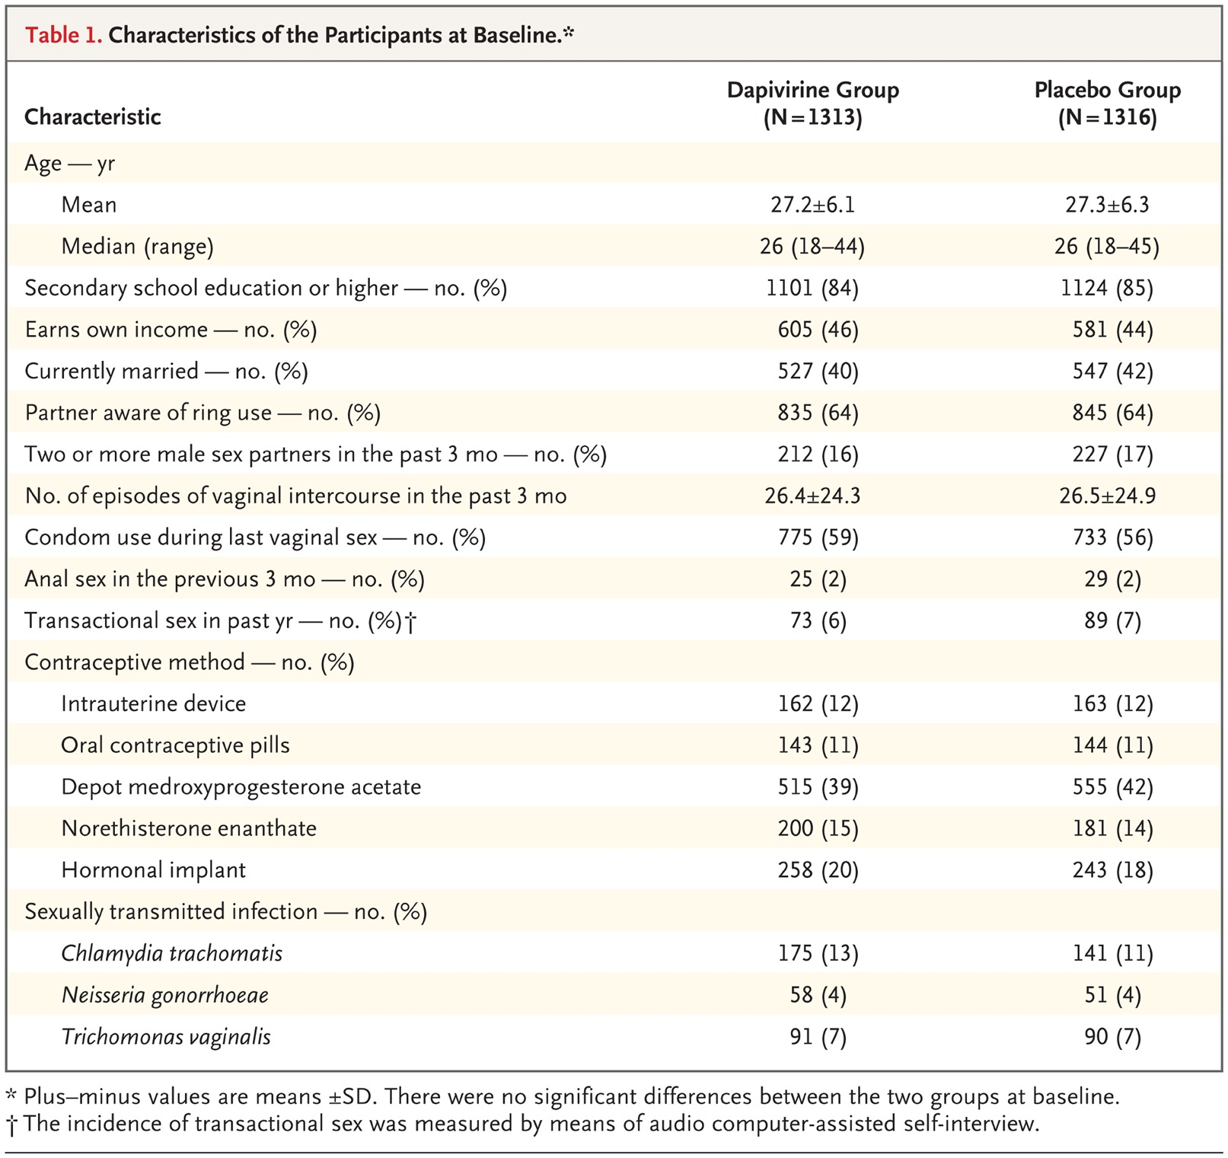
ASPIRE Trial: Reporting / Baseline Data
Notes:
For each variable, the summary measure(s) used must be indicated.
If a variable definition is not obvious, that info can be footnoted.
Table 1 reports condom use prior to the intervention was 59% at last encounter. Post-randomization, is it a background intervention that occurs in both groups? Required or voluntarily? Would it prevent HIV transmission, leading to equivalent groups?
Why is each variable on this table included?
Why is study site not included?

Slide 18
ASPIRE Trial: Reporting / Efficacy
Analysis plans must be consistent with variable types for endpoints
“The primary analysis of HIV-1 protection was performed according to the intention-to-treat principle with the use of Cox regression, stratified according to site, to estimate the relative rates of time until HIV-1 acquisition. Two analyses were defined:
first included data from all 15 sites
second excluded data from the 2 sites that discontinued enrollment early
  Protocol Change:
    The … plan to exclude data from the 2 sites [was] approved by the independent data and safety monitoring board and reviewed by regulatory agencies.”
Sub-group analyses
  Some plans were pre-specified.
  “A post hoc analysis was designed to characterize more fully that relationship by dividing the population [by] age -- categorized in thirds containing approximately equal numbers of participants with HIV-1 infection, thus balancing the statistical power for the exploratory subgroups.”

Slide 19
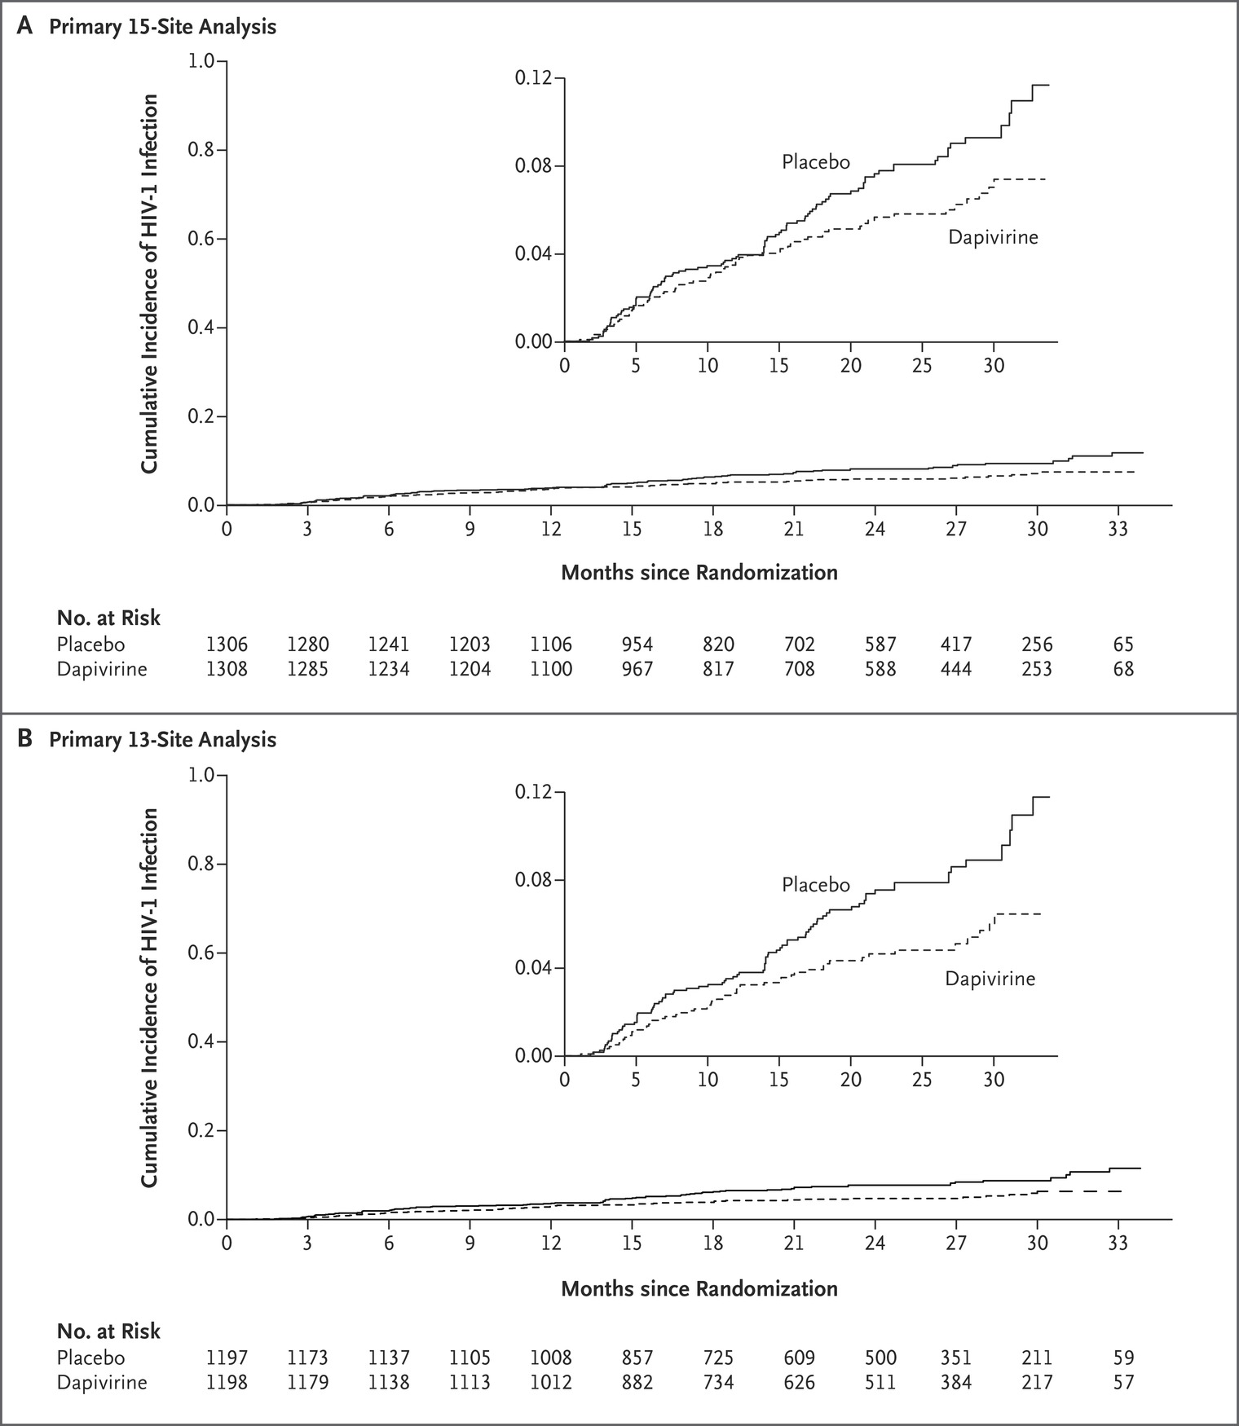
ASPIRE Trial: Efficacy – pre-specified methods
Data Completeness
Outcomes:
* Retention of participants for assessment of incident
HIV-1 infection was >85% (Fig. 1), with 2614
participants (99.4%) completing at least one post-
randomization HIV-1 test.
* The median follow-up was 1.6 years (interquartile
range, 1.1 to 2.3).
Exposures:
In the dapivirine group, the drug was detected in
82% of plasma samples at levels of >95 pg/mL. (etc)
Cox model findings – planned methods
  Unadjusted, based on 13 study sites:
  IR_{D} = 3.3 per 100 person-yrs,
  IR_{P} = 4.5 per 100 person-yrs;
  IRR_{D:P} = 3.3/4.5 = 0.73
  IRR_{P:D} = 4.5/3.3 = 1.37 → 37% reduction
  95% CI = (1.12 to 1.57) → excluded 0 but upper bound reduction did not exceed 60% and lower bound did not exceed 25%.
Notes:
Public health goal not achieved

Slide 20
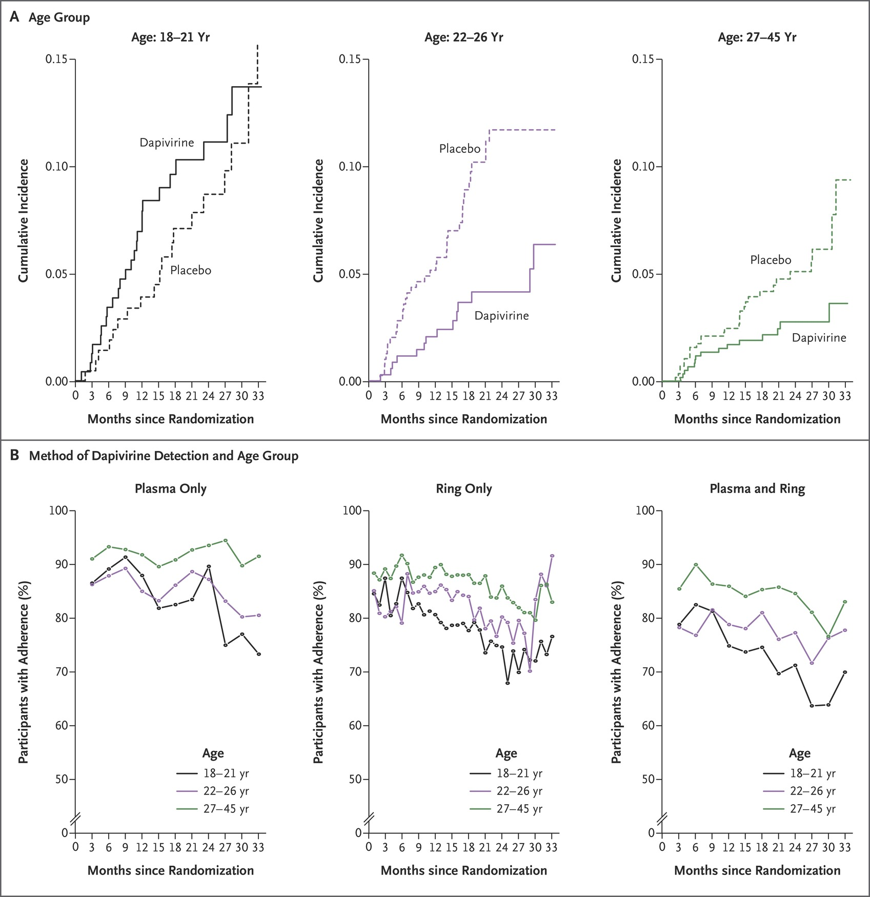
ASPIRE Trial: Efficacy – post-hoc methods
Cox model findings – mean (95% CIs)
  Stratify by median age:
  reduction_{<25} : 10% (-41% – 43%)
  reduction_{>25} : 61% (32% – 77%)
  Age*Arm interaction p=0.02
  Stratify by age tertile (see fig)
  Explanation:
  Lack of HIV-1 protection and lower
  adherence were seen in PPTs 18–21 y.o.
  (reduction: −27% (−133% to 31%)).
  For women who >21 y.o., adherence
  was >70% and reduction was
  56% (31% to 71%).
  Comments:
  Adherence levels can be analyzed as a
  distinct outcome, as was done here.
  Directly relating adherence levels to
  outcome levels, by person & follow-up time,
  would require mediation methods.
Notes:
Note

Slide 21
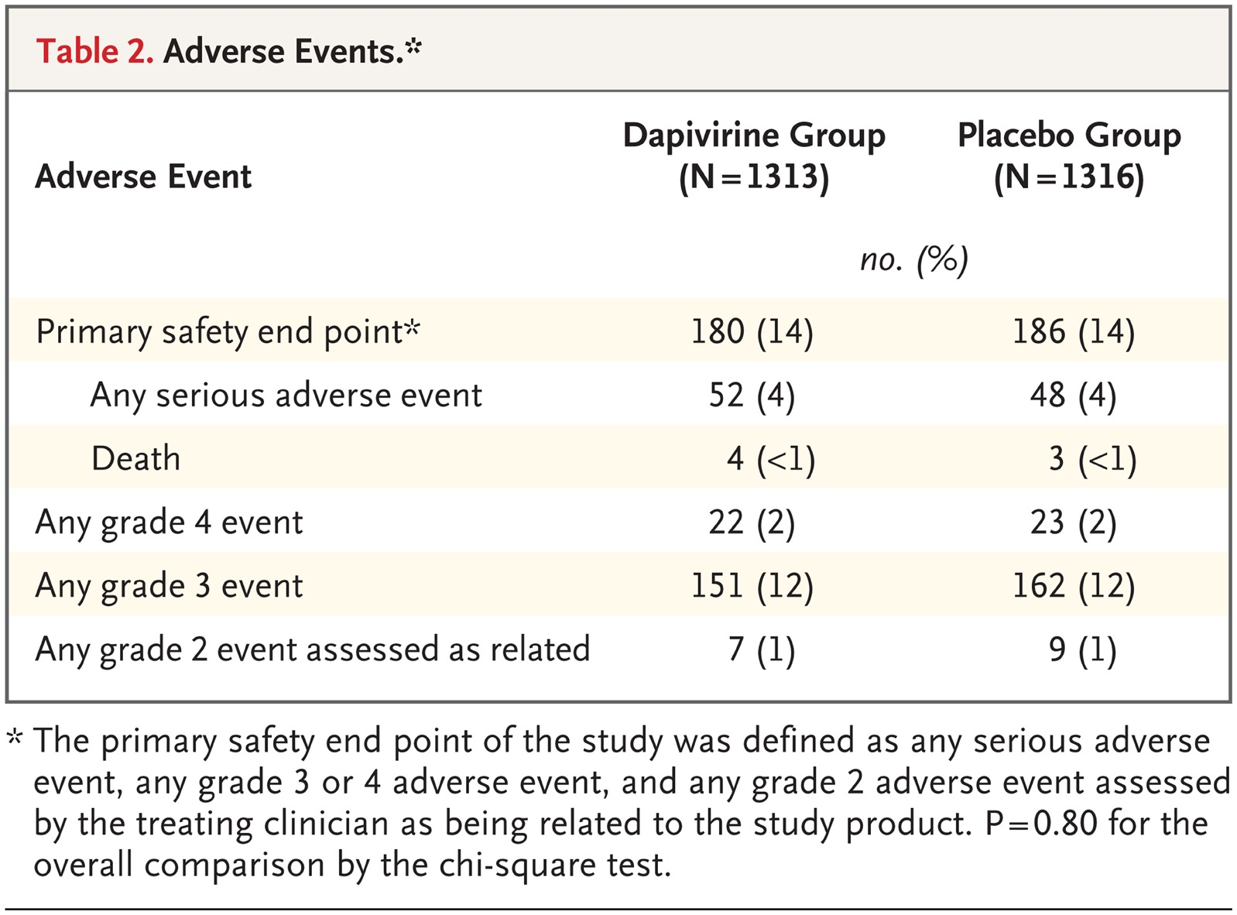
ASPIRE Trial: Safety
Safety endpoints are not identified in main body of the manuscript but are mentioned in the footnote of Table 2.
Methods of analysis for safety endpoints are not identified in main body of the manuscript. These were limited to descriptive statistics and chi-square tests (check protocol).
Findings
  There were no significant between-group differences in the frequency of the primary safety end points
  (Table 2, and Table S6 in the Supplementary
  Appendix) or in other adverse events
  commonly detected in the trial population.
Notes:
Note

Slide 22
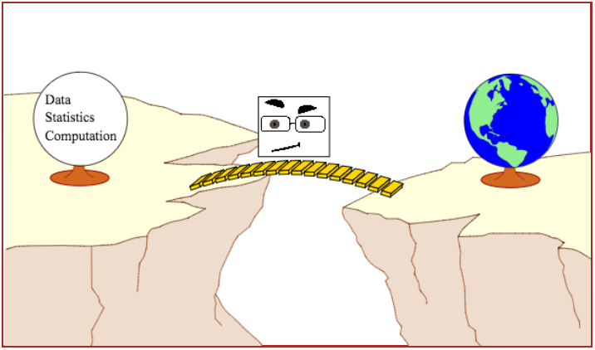
ASPIRE Trial: Discussion of Analyses and Results
The statistical methods for the efficacy analysis did not mention the Kaplan-Meier plots shown in Figures 2 and 3.
Why not? What is the role of these plots relative to the Cox model?
Were efficacy analyses based on complete cases, LOCF, multiple imputation, or sensitivity analyses?
The statistical methods for the efficacy analysis did not call for adjustment for baseline covariates but the Cox model would support such an analysis. [See ref 158 of Austin (2010).]
Would you have planned for any?
Which baseline covariate(s) might make good candidate(s)?
Safety analyses were pretty limited in this trial.
Were they based on appropriate samples?
Were they satisfactory?
Identify protocol changes made, including timing
and documentation procedures used.
Would this trial convince a skeptic that
dapivirine rings are safe and effective for HIV-1
prevention among child-bearing women?
Baeten JM et al. N Engl J Med 2016;375:2121-2132
Notes:
Table 2 Adverse Events.

Slide 23
ASPIRE Trial: Execution of the Trial
Clinicians and policymakers often distinguish between the efficacy and the effectiveness of an intervention. Efficacy trials (explanatory trials) determine whether an intervention produces the expected result under ideal circumstances. Effectiveness trials (pragmatic trials) measure the degree of beneficial effect under “real world” clinical settings. Hence, hypotheses and study designs of an effectiveness trial are formulated based on conditions of routine clinical practice and on outcomes essential for clinical decisions.
    https://www.ncbi.nlm.nih.gov/books/NBK44024/
VOICE Trial – Failed to show that the dapivirine ring was effective in the study settings: Lab specimens from VOICE participants showed that adherence was lower than self-reports.
Since dapivirine works well in other settings, the question of efficacy remained open.
Lecture 1 said :
The best basis for assessing the causal effect of treatment, and that which will satisfy skeptics, is inference based on randomization.
They conducted a randomized experiment.
If they have complete data, they can draw valid causal conclusions from a trial if they perform
  A simple direct comparison of responses
  for all randomized subjects (no missing data!)
  analyzed according to their assigned treatment groups
  regardless of their adherence to their assigned treatments.
Notes:
Table 2 Adverse Events.

Slide 24
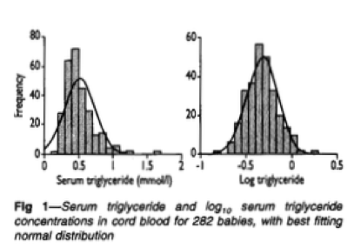
Other Thoughts: Continuous Outcomes
Generally, we use statistical tests to compare means.
A Normal distribution is characterized by two independent parameters, the mean μ and standard deviation σ.
When comparing samples, we want to assume σ is constant across groups so that we can focus on comparing means. Sometimes we can transform highly skewed data to achieve independence between μ and σ.
Notes:
Table 2 Adverse Events.

Slide 25
Continuous Outcomes – Within-group analyses
Example: Serum triglyceride levels have a positive-skew distribution on the natural scale and a Normal distribution on the log scale.
Compare mean (95% CI) by scale:
Natural: 0.51 (0.48 – 0.54) mmol/L → CI width = 0.06
Log₁₀: -0.33 (-0.35 – -0.31) … transform each value back to natural scale ... 0.47 (0.45 – 0.49) mmol/L → CI width = 0.04
Statistical methods must report
use of the transformation.
The means differ. We refer to the
mean calculated on the log scale as
the geometric mean.
→ Transform a skewed outcome before
analyzing it via a regression model.
Notes:
Table 2 Adverse Events.

Slide 26
Continuous Outcomes – Between-group analyses
When we want to compare groups with skewed distributions, we want to use the transformation that best achieves equal variances in each. Then the assumption of equal variances used by the statistical test holds, and the test is valid.
Example: Bicep skinfold thickness (mm)
If a log transformation is used*, we can calculate the mean difference (95% CI) on the log scale and transform each value back to natural scale ...
Log_{e}: 0.296 (-0.114 – 0.706) … transform each value back to natural scale ... 1.34 (0.89 – 2.03).
  Mathematically, log(a) – log(b) = log(a/b). On log scale, H₀: log(a) – log(b) = 0.
  Transformed back, yields the ratio of means. This relative measure is unitless. On natural scale, H₀: a/b = 1.
Another way to report the results is to multiply the log-scale findings by 100%: 29.6% (-11.4% -- 70.6%). An advantage of “log-based percentage difference” is its symmetric interpretation:
  The mean of group B is 30% larger than the mean of group A.
  Equivalently, the mean of group A is 30% as large as the mean of group B.
*Caution! In general, if other transformations are used, the conversion back to the natural scale does not work. Thus results have to be presented on the transformed scale – which can be hard to interpret.
Notes:
Table 2 Adverse Events.

