Slide 1
The Association Between Body Composition and Cystatin C in South Asians: Results from the MASALA Study
By: Arti Shah
Endocrine Fellow
May 29, 2014

Slide 2
Background
Obesity is a risk factor for kidney disease
Central (visceral) adiposity contributes to cardiometabolic risk
  Associated with insulin resistance, dyslipidemia, inflammation
Kim et al; Nephrol Dial Transplant, 2011.
de Boer et al; Am J Kidney Dis, 2009.
De Larochelliere et al; Atherosclerosis, 2014.
Rothney et al; Obesity, 2013.
Notes:
A study of adults 65 and older showed that BMI, waist circumference and fat mass were a/w an increased risk of loss of renal function

Slide 3
Background
Visceral adiposity is negatively associated with renal function in patients with type 2 diabetes
Central body fat associated with unfavorable pattern of renal hemodynamic measures (independent of BMI)
Kim et al; Nephrol Dial Transplant, 2011.
Kwakernaak et al; J Am Soc Nephrol, 2013.
Notes:
Hemodynamic measures – lower GFR, lower effective renal plasma flow, and higher filtration fraction

Slide 4
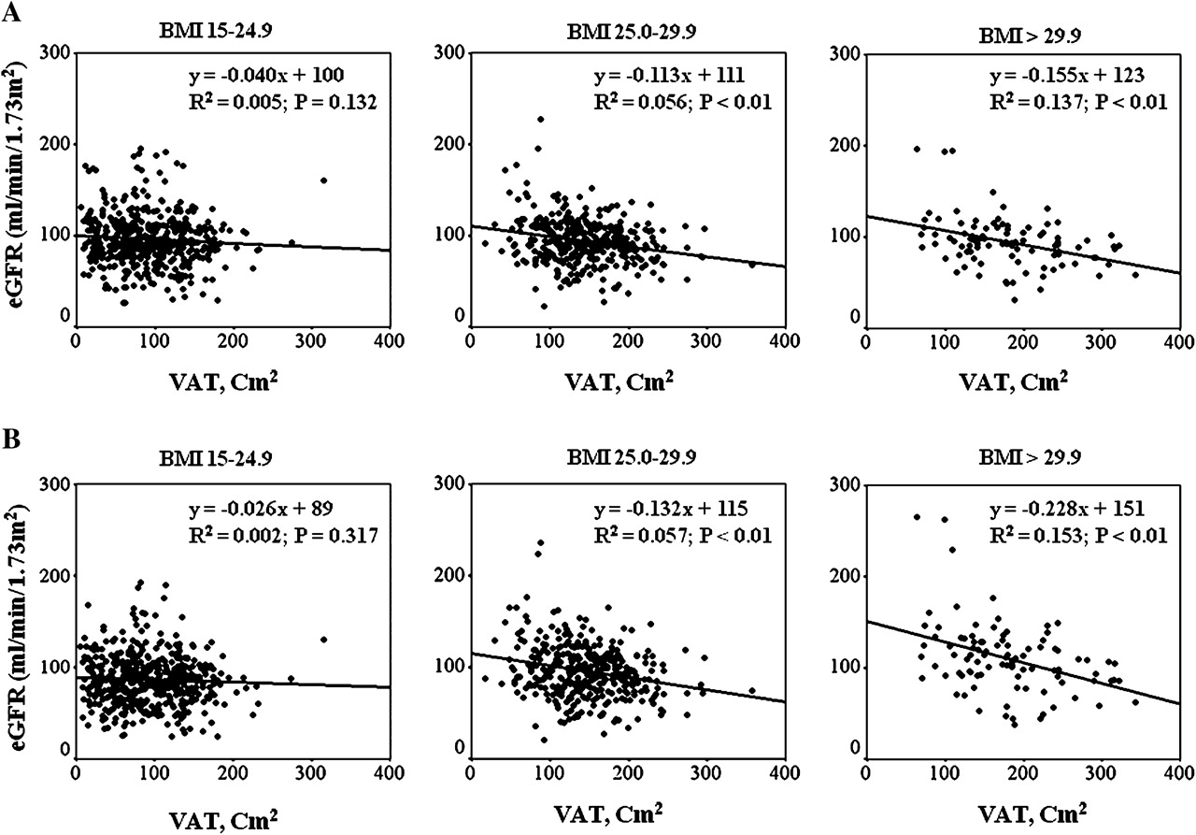

Association of visceral adiposity and eGFR calculated by the MDRD equation (A) and the Cockcroft-Gault formula (B) in the normal weight, overweight and obese subjects with type 2 diabetes.
Kim S R et al. Nephrol. Dial. Transplant. 2011;26:3550-3555
© The Author 2010. Published by Oxford University Press on behalf of ERA-EDTA. All rights reserved. For Permissions, please e-mail: journals.permissions@oup.com
Notes:
Association of visceral adiposity and eGFR calculated by the MDRD equation (A) and the Cockcroft-Gault formula (B) in the normal weight, overweight and obese subjects with type 2 diabetes.
Table 4 shows the multiple regression analysis for the association of abdominal adiposity with eGFR in the normal weight, overweight and obese subjects. For the overweight and obese subjects, VAT was negatively associated with eGFR by the MDRD equation and the Cockcroft–Gault formula after adjustment for age, gender, duration of diabetes, systolic and diastolic blood pressures, serum triglyceride, HOMA-IR score, uric acid level and urinary albumin excretion. In the normal weight subjects, there was no significant association between the VAT and the eGFR. The total fat area and SAT were not significantly associated with eGFR in the normal weight, overweight and obese subjects. Figure 1 demonstrated the relative strength of the association of VAT and eGFR by the BMI groups. The association between the VAT and the eGFR was stronger in the obese subjects.

Slide 5
Background
Kidney function is traditionally measured with serum creatinine which is used to calculate the estimated GFR
  Question is: Is this the best way to measure renal function?
Novel measure of renal function – cystatin C
Dharnidharka et al; Am J Kidney Dis, 2002.
Notes:
However – serum Cr measurements are affected by body composition – especially muscle mass
Cystatin C – renally cleared, superior to serum Cr for measuring renal function

Slide 6
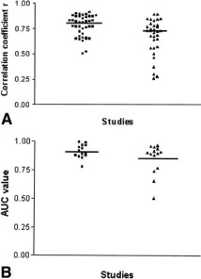
Background
Fig. 1 (A) Scatter plot of correlation coefficients ( r ) for (■) 1/Cys C and (▴) 1/Cr from studies analyzed. Horizontal line represents the cumulative mean r of all studies. (B) Scatter plot of ROC-plot AUC values for Cys C and Cr from 14 data sets. Horizontal line represents the cumulative mean. Note that meta-analysis was performed on 11 data sets that published mean ROC-plot AUC + SE values. Three studies shown in this graph did not publish SEs
Vikas R. Dharnidharka , Charles Kwon , Gary Stevens
Serum cystatin C is superior to serum creatinine as a marker of kidney function: A meta-analysis
American Journal of Kidney Diseases, Volume 40, Issue 2, 2002, 221 - 226
http://dx.doi.org/10.1053/ajkd.2002.34487
Notes:
Meta-analysis of studies to compare accuracy of cystatin C and serum Cr in relation to a reference standard of GFR
There were 54 data sets incorporating 4,492 subject samples included in this meta-analysis. Of these, we first compared 36 data sets for Cys C correlation coefficients with 29 data sets for serum Cr. The range of correlation coefficients for both 1/Cys C and 1/Cr is shown in Fig 1A.

Slide 7
Background
Now of interest – understanding the association between body composition and renal function measured using cystatin C

Slide 8
Background
Framingham Offspring Study
  Visceral and subcutaneous adipose tissue associated with CKD (measured by cystatin C)
Exposure | Model adjustment | OR per 1 SD VAT or SAT | 95% CI | P-value
CKD by eGFR_{cys}
VAT | Age + gender | 1.48 | 1.24-1.78 | < 0.0001
 | Multivariable | 1.35 | 1.10-1.65 | 0.006
SAT | Age + gender | 1.45 | 1.19-1.76 | < 0.001
 | Multivariable | 1.39 | 1.34-1.70 | 0.002
Young et al; Clin J Am Soc Nephrol, 2008.
Notes:
Design, setting, participants, & measurements: Participants from the Framingham Offspring Study who underwent abdominal computed tomography for VAT and SAT quantification were included (n = 1299; 53% women; mean age 60 yr). CKD was defined as estimated GFR <60 ml/min per 1.73 m², as estimated using creatinine (n = 89) in the Modification of Diet in Renal Disease (MDRD) formula or by cystatin C (n = 136). Regression models evaluated the cross-sectional relations between VAT and SAT with CKD and cystatin C, with age and gender adjustment and cardiovascular risk factor adjustment.
(primarily Caucasian)
Multivariable models adjusted for age, sex, systolic BP, hypertension treatment, HDL cholesterol, lipid treatment, diabetes, prevalent CVD, tobacco, menopausal status, hormone replacement therapy, and alcohol use.

Slide 9
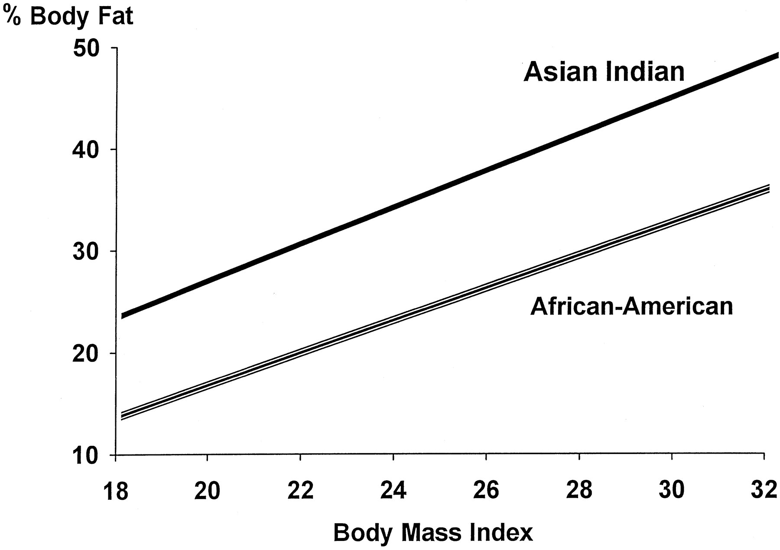
Background
Compared to Caucasians, South Asians have higher levels of total body fat, subcutaneous fat, and visceral fat for a given BMI
No studies have investigated the association between body composition and renal function in South Asians
Shah and Kanaya; Curr Cardiol Rep, 2014.
Banerji et al; J Clin Endocrinol Metab, 1999.
Notes:
Figure - Relationship between percent body fat and body mass index in Asian Indian and African-American men. There is a significant (P < 0.0001) difference in the intercepts, but no difference in slope.

Slide 10
Study Question and Hypothesis
Question: In a South Asian population recruited from the San Francisco Bay Area, are higher measures of adiposity associated with worse renal function (as measured by cystatin C)?
Hypothesis: Higher measures of adiposity (subcutaneous, visceral and hepatic fat) are associated with worse renal function as measured by cystatin C

Slide 11
Study Design
MASALA study – Metabolic Syndrome and Atherosclerosis in South Asians Living in America
Modeled on the Multi-Ethnic Study of Atherosclerosis (MESA)
Bild et al; Am J Epidemiol, 2002.

Slide 12
Study Design
Inclusion / Exclusion Criteria
  Ages 45-84, self-identify as South Asian, no clinical cardiovascular disease
Participants randomly sampled using surname lists
Cross-sectional study
  150 South Asians recruited from the SF Bay Area between 8/2006-10/2007
  Analyzed data on 149 (with measures of cystatin C)
Kanaya et al; Metab Syndr Relat Disord, 2010.

Slide 13
Study Measurements
Questionnaires to collect data on sociodemographics, lifestyle / behavioral factors, dietary intake, physical activity, medical history
Clinical Measurements: hypertension, diabetes, metabolic syndrome
Laboratory measurements: lipids, insulin, glucose, C-reactive protein, adiponectin, creatinine, urine albumin/Cr ratio

Slide 14
Study Measurements
Body Composition:
  BMI, waist circumference
  Total fat mass and lean mass – DEXA
  Subcutaneous, visceral and hepatic fat – CT
Cystatin C:
  Problem noted during calibration optimization
  Measurements after mid-2007 underestimated → adding 17% to those values to achieve harmonization

Slide 15
Statistical Methods
Univariate Analyses
  Characteristics of participants compared across tertiles of cystatin C
  Used chi-square test, ANOVA or Kruskall-Wallis as appropriate
  Evaluated for collinearity

Slide 16
Statistical Methods
Multivariate Analyses
  Bivariate results with p < 0.20 and biologic plausibility entered into the models
  Sequential multivariate models to assess the relationship between body composition parameters and cystatin C
  Modeled: BMI, waist circumference, subcutaneous fat area, visceral fat area, hepatic fat (measured by liver-minus-spleen attenuation)

Slide 17
Statistical Methods
Multivariate Analyses
  Linear regression
  Model checking
    Linearity
    Normality
    Constant variance
    Influential points
Notes:
Linearity – achieved, for hepatic fat – dropped an outlier observation, also tried adding quadratic terms – but did not improve model prediction
Normality – log transformed cystatin C
Constant variance – log transformed CRP
Influential data points – repeated all models excluding influential data points

Slide 18
Statistical Methods
Multivariate Analyses
  Stepwise models
    1: unadjusted
    2: + age, sex
    3: + history of ever smoking
    4: + HTN, diabetes
    5: + HDL, log triglycerides
    6: + log C-reactive protein
  Repeated analyses including only statistically significant covariates from step 6

Slide 19
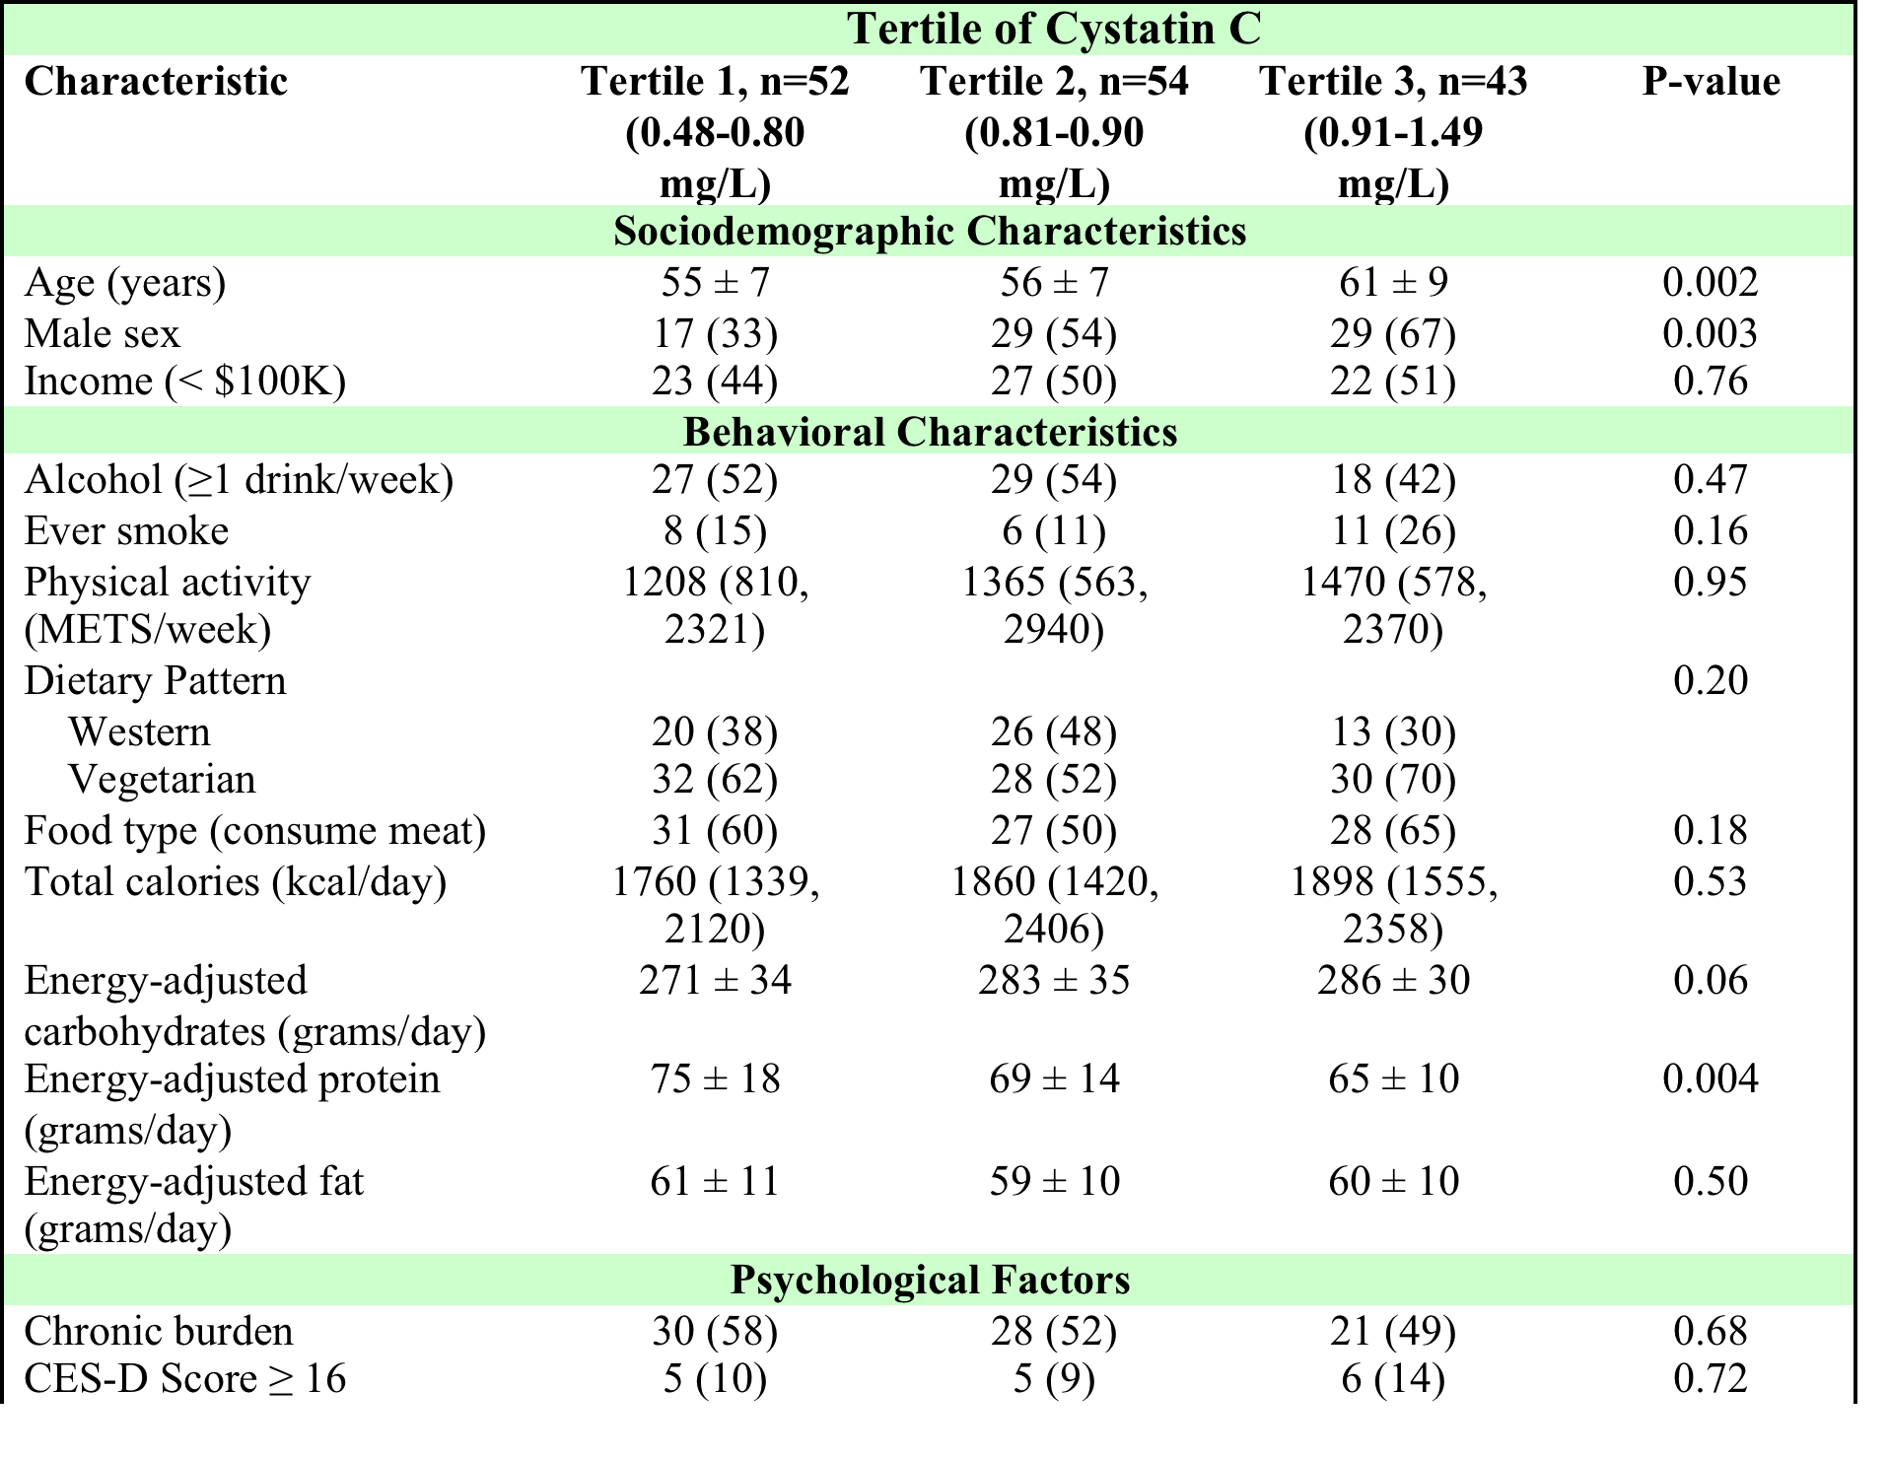
Results: Univariate Analyses

Slide 20
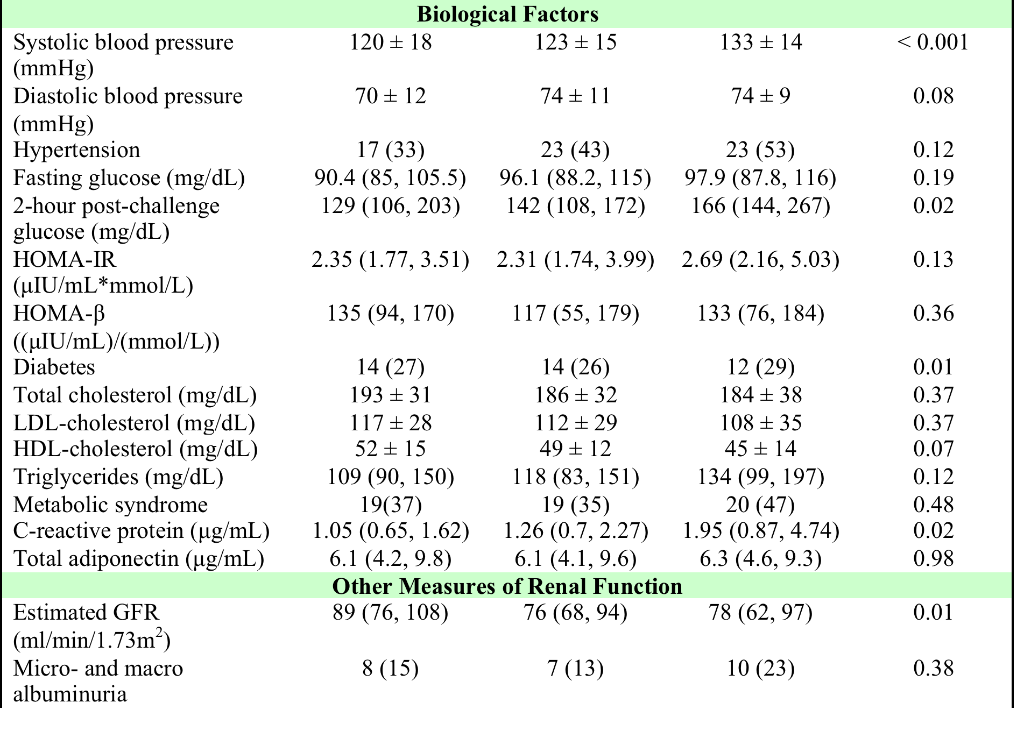
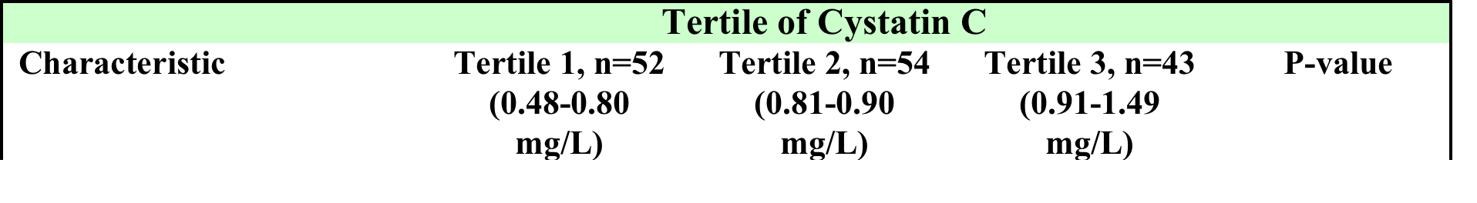
Results: Univariate Analyses

Slide 21
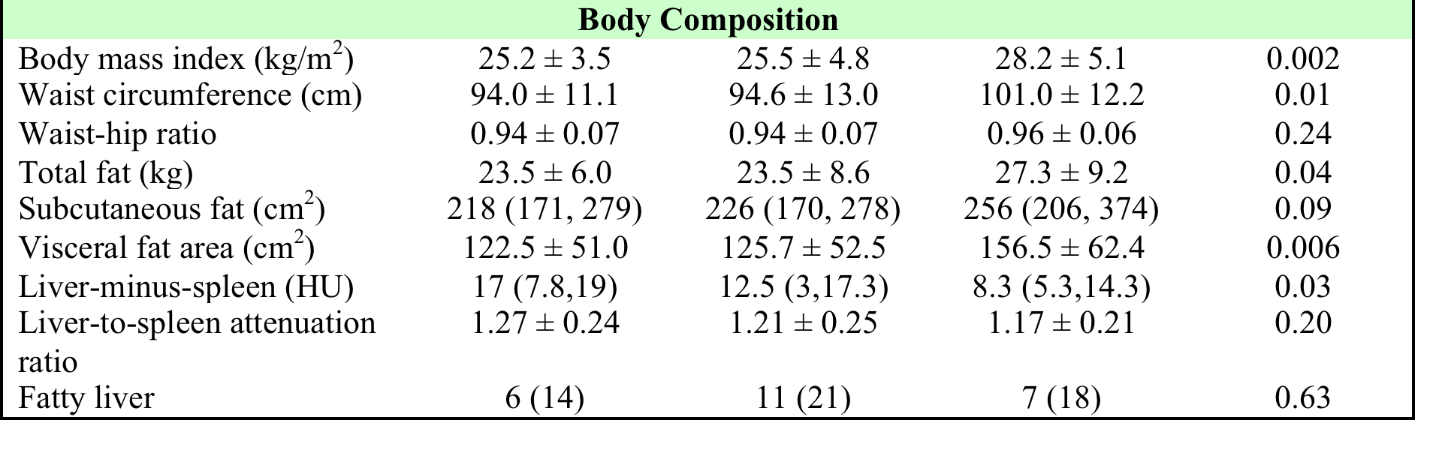
Results: Univariate Analyses

Slide 22
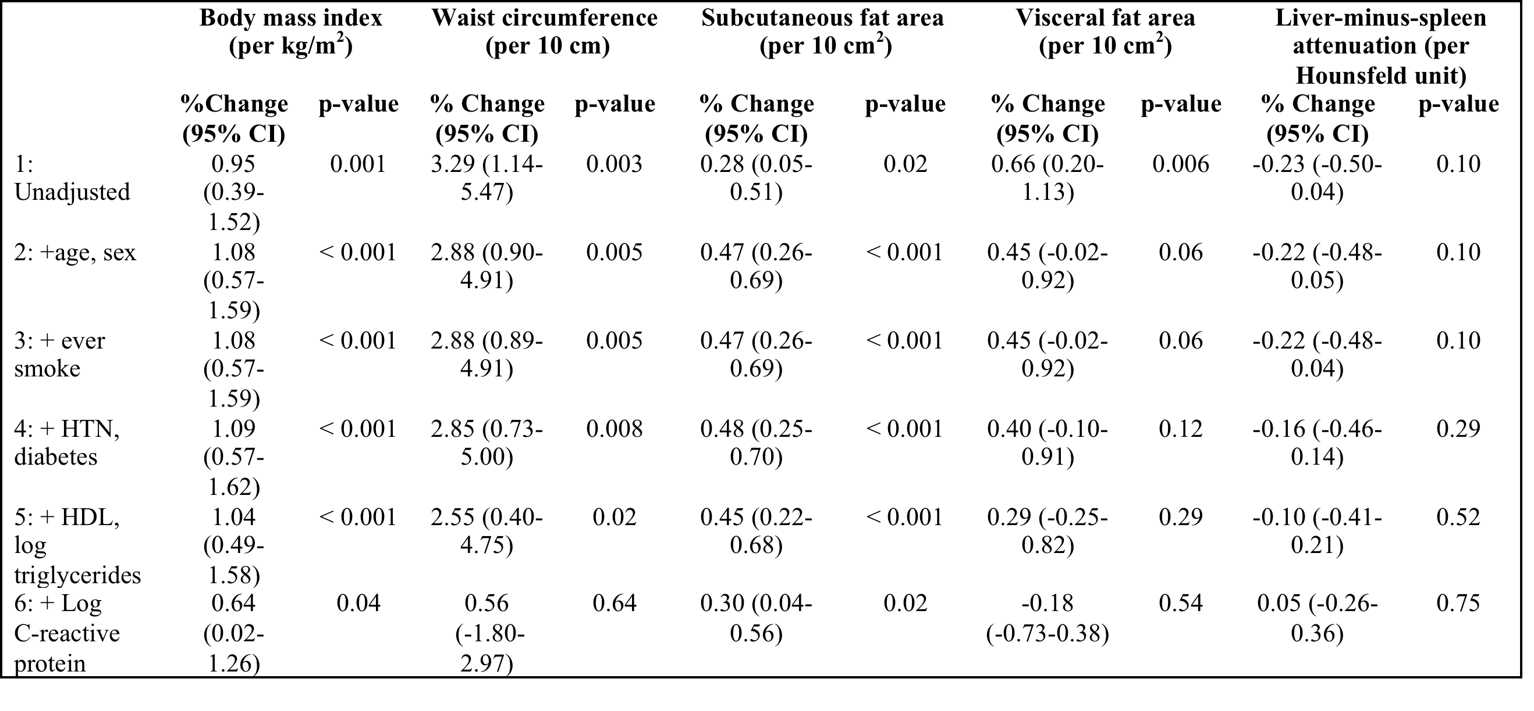
Results: Multivariate Analyses – Associations Between Log-Transformed Cystatin C and Body Fat Composition

Slide 23
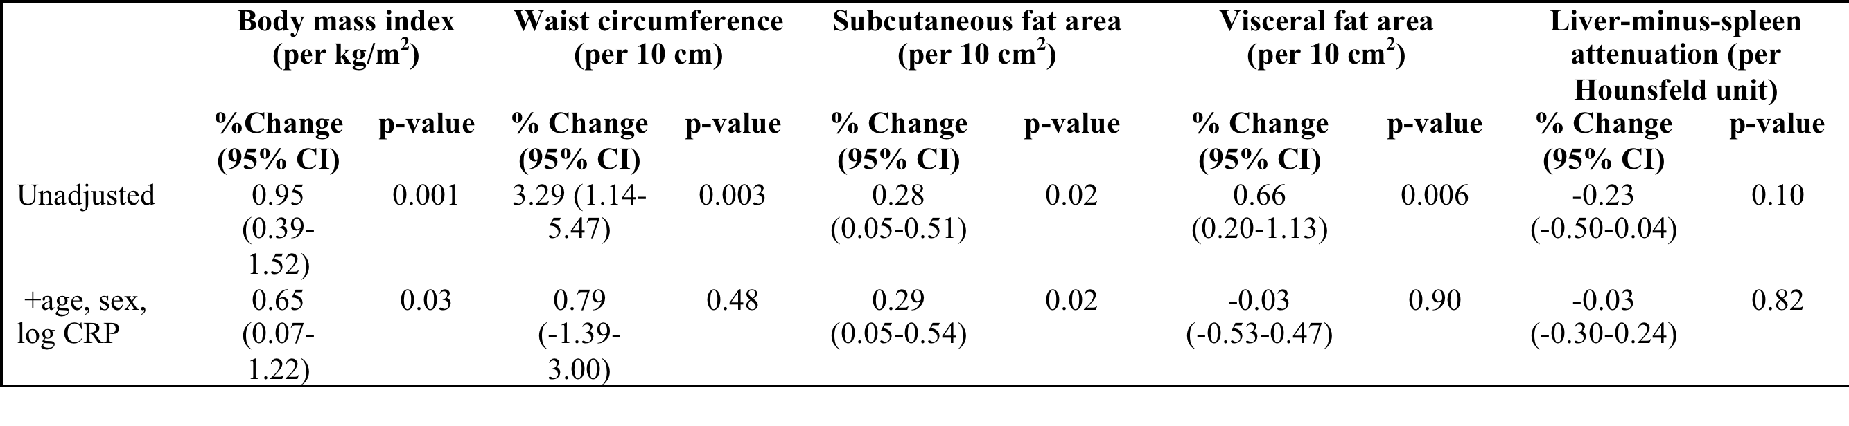
Results: Multivariate Analyses -
Associations Between Log-Transformed Cystatin C and Body Fat Composition, adjusted for significant covariates

Slide 24
Conclusions
Higher measures of body composition were associated with higher levels of cystatin C in unadjusted analyses
In adjusted analyses, BMI and subcutaneous fat remained strongly associated with cystatin C
In adjusted analyses, the association of waist circumference and visceral fat area was completely attenuated after adjustment for metabolic covariates and CRP
Hepatic fat (i. e. liver-minus-spleen attenuation) was not associated with cystatin C in adjusted analyses

Slide 25
Implications
Overall adiposity (measured by BMI and subcutaneous fat area) is independently associated with cystatin C
Association between metabolically active adipose tissue (waist circumference, visceral fat area, ? hepatic fat) and cystatin C is mediated by metabolic parameters and inflammation

Slide 26
Discussion
Association between body composition and cystatin C
  Conflicting data
  Caveat – adipose tissue reported to secrete cystatin C
Young et al; Clin J Am Soc Nephrol, 2008.
de Boer et al; Am J Kidney Dis, 2009.
Kwakernaak et al; J Am Soc Nephrol, 2013.
Notes:
Prior data on the association between body composition and cystatin C are conflicting. The Framingham Offspring Study found that both visceral and subcutaneous adipose are associated with chronic kidney disease as defined by cystatin C. ¹⁶ However, another study found no association between adiposity and loss of GFR measured by cystatin C. ¹⁷ In addition, adipose tissue has been reported to secrete cystatin C therefore making it difficult to determine the contribution of adiposity to renal disease using cystatin C. ¹⁸ Further studies are needed to understand the true contribution of adiposity to renal disease measured by cystatin C.

Slide 27
Discussion
Association between visceral fat / abdominal adipose and cystatin C
  Mediated by metabolic alterations and inflammation
  Prior studies showed that the association between visceral adipose and renal function is attenuated by adjustment for HTN, diabetes and CRP
  Data in South Asians is lacking
Axelsson et al; Am J Clin Nutr, 2004.
de Boer et al; Am J Kidney Dis, 2009.
Tang et al; Int J Nephrol, 2012.
Notes:
Visceral fat (abdominal adiposity) is biologically distinct from subcutaneous fat in that it secretes more inflammatory markers and is more metabolically active. ¹⁹ The visceral adipose inflammation and metabolic alterations are thought to cause renal injury. ^{20,21} Our results are consistent with this hypothesis. CRP and other inflammatory markers including interleukin-6 (IL-6) and tumor necrosis factor (TNF)-α have been shown to play a role in renal disease. ²¹ In fact, de Boer et al ¹⁷ found that the association between obesity (measured by BMI, waist circumference and fat mass) and renal function (measured by eGFR) is markedly attenuated by hypertension, diabetes, and CRP. And Axelsson et al ¹⁹ found that IL-6 is independently associated with total fat mass and truncal fat mass in patients with end-stage renal disease. While studies in South Asians are lacking, these studies suggest that the association between visceral (abdominal) adiposity and renal disease is mediated by metabolic dysregulation and inflammation.

Slide 28
Discussion
Association between subcutaneous fat and cystatin C
  Partially mediated by inflammation?
  Study in non-diabetic obese women
  Inflammatory markers in stage 2-5 CKD
Gilardini et al; Int J Obes (London), 2010.
Spoto et al; Nutr Metab Cardiovasc Dis, 2012.
Notes:
Furthermore, an Italian study in nondiabetic obese women found that greater expression of inflammatory markers (including TNF-α) in subcutaneous fat is associated with greater renal dysfunction as measured by albumin excretion rates suggesting that the association between subcutaneous adipose and renal function is also mediated by inflammation. ²² Our study found that inflammation may partially explain the association between subcutaneous fat and renal function as demonstrated by partial attenuation of the association with addition of CRP to the model.
→ Pts with stage 2-5 CKD – higher IL-6 and TNF-alpha in CKD subjects vs healthy subjects; however not overexpressed in the SAT - ? Contribution of visceral adiposity

Slide 29
Strengths / Limitations
First study to evaluate the association between body composition and renal function (as measured by cystatin C) in South Asians
Cross-sectional – unable to make causal inferences
Small sample size – may have lacked power to detect association between hepatic fat and cystatin C

Slide 30
Thank you!
Questions?

