Slide 1

Diminished non-cystic white matter injury in premature newborns
Biostatistics 209 Final Project

Slide 2
Introduction
Premature birth <37 weeks
12% all births in the US are premature
  454, 577 in 2012
Brain injury is common in premature newborns and associated with adverse outcomes

Slide 3
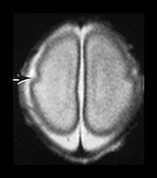
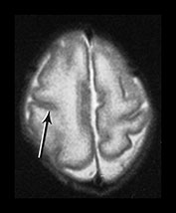
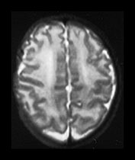
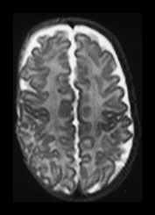
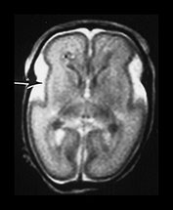
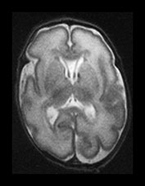
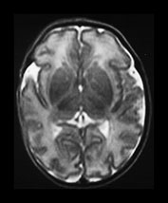
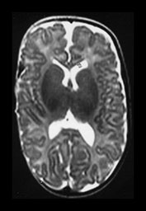
25 weeks
30 weeks
34 weeks
40 weeks

Slide 4
White matter injury (WMI)
Predominant pattern of brain injury in premature newborns
Vulnerability of pre-oligodendrocytes in the developing white matter to:
  Hypoxia
  Ischemia
  Inflammation

Slide 5
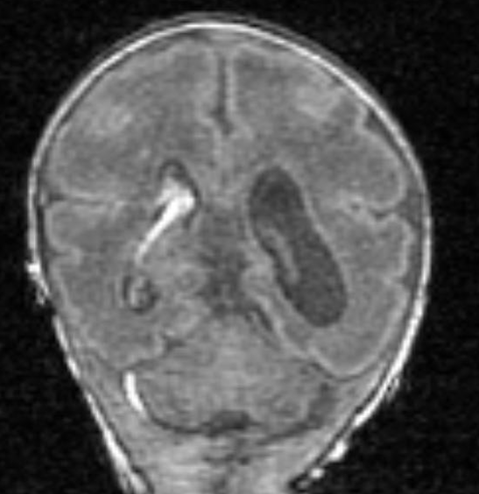
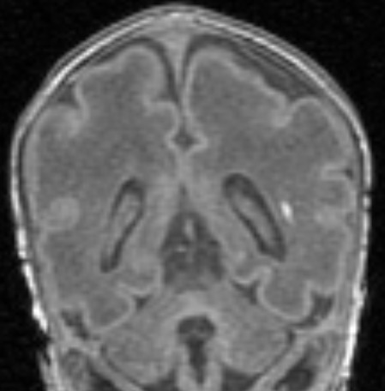
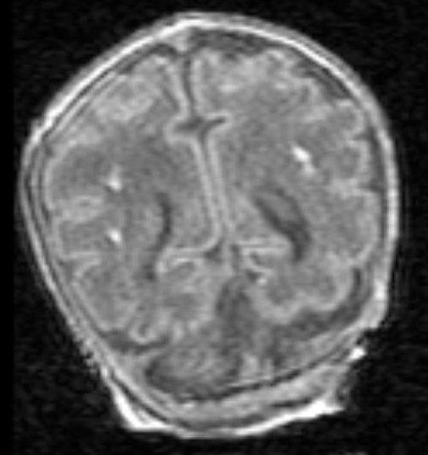
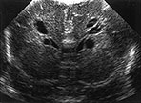
Spectrum of severity
Minimal
Moderate
Severe
Cystic
From Miller SP et al., J Pediatr 2005

Slide 6
WMI over time
Decreased prevalence of cystic-WMI 1992-2002 (Hamrick SE, J Peds 2004)
  Reduced duration of mechanical ventilation accounted for a proportion of the decline
Trend of non-cystic WMI over time unknown

Slide 7
Objectives
To determine the rate of MRI-detected non-cystic WMI over time in a prospective cohort of premature newborns imaged soon after birth.
To evaluate the associations between changes in clinical predictors of WMI and the rate of WMI over time.

Slide 8
Methods
MRI soon after birth
Premature birth (<33 weeks)
Outcome
Excluded:
Severe cystic WMI (9)
Periventricular hemorrhagic infarction (22)
Poor quality MRI (17)

Slide 9
Methods
MRI soon after birth
Premature birth (<33 weeks)
Outcome
Severity of WMI
Absent/Mild
Moderate/Severe

Slide 10
Methods
MRI soon after birth
276 premature newborns
(1998-2011)
Outcome
Clinical data collection

Slide 11
Analysis
Comparison of clinical characteristics between newborns with absent/mild or moderate/severe WMI
  Fisher’s exact test or chi-squared test for categorical variables
  Kruskal-Wallis test for continuous variables

Slide 12
Analysis
Trends over time
  Newborns divided into epochs of birth year
  Proportion with moderate/severe WMI evaluated using chi-squared test for trends
  Demographics and clinical predictors evaluated using chi-squared test for trends for categorical variables or variance-weighted least squares regression for continuous variables

Slide 13
Analysis
Clinical predictors associated with moderate/severe WMI evaluated using multivariate logistic regression
Final model included predictors with significant association (P<0.1)
Also evaluated model with additional biologically important predictors
Linearity between birth year and outcome verified; splines tried, but not appreciably better fit
Regression diagnostics performed, no influential points

Slide 14
Analysis
Relationship between indomethacin exposure and outcome of moderate/severe WMI evaluated in second logistic regression model
Final model included predictors chosen based on biological relevance, DAG and associations of significance level P<0.1
Explored effect modification of gestational age on the association between prolonged indomethacin and moderate/severe WMI

Slide 15
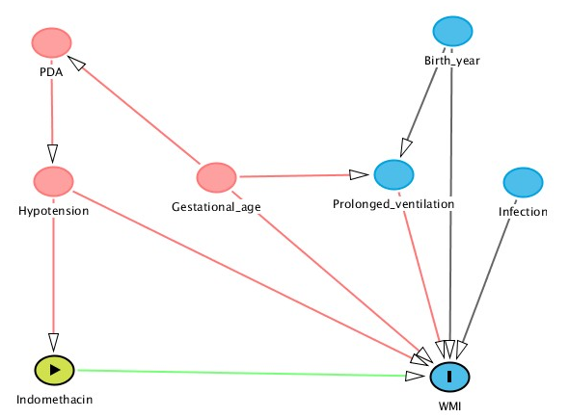
DAG

Slide 16
Characteristics of newborns with WMI
Characteristic | Absent/Mild WMI (N=222) | Moderate/ Severe WMI (N=45) | P-Value*
Gestational age (wks) | 28.1 ± 2.3 | 28.9 ± 2.5 | .06
Postmenstrual age at MRI (wk) | 31.7 ± 2 | 32.3 ± 2 | .03
Birth weight (g) | 1072 ± 342 | 1182 ± 412 | .1
Prenatal steroids | 189 (86) | 39 (89) | .7
Magnesium sulfate | 119 (56) | 24 (56) | 1
Hypotension | 116 (54) | 24 (56) | .5
Infection | 128 (57) | 30 (67) | .3
Ventilation ≥7 days | 91 (41) | 20 (44) | .7
Patent ductus arteriosus | 90 (40) | 15 (33) | .4
Indomethacin ≥4 doses | 62 (28) | 5 (11) | .03
*Kruskal-Wallis for continuous variables; X² or Fisher’s exact test for categorical variables
Notes:
RR .37 p=.02

Slide 17
Clinical predictors across birth year epochs
Characteristic | 1998-2002 (N=63) | 2002-2004 (N=74) | 2005-2008 (N=72) | 2009-2011 (N=58) | P-value*
Moderate/Severe WMI | 16 (25) | 15 (20) | 11 (15) | 3 (5) | .002
Postmenstrual age at MRI (wks) | 32.6 ± 2.3 | 31.7 ± 1.8 | 31.8 ± 1.8 | 31.2 ± 1.9 | .002
Prenatal steroids | 56 (89) | 58 (78) | 58 (84) | 56 (98) | .09
Magnesium sulfate | 33 (52) | 40 (54) | 28 (44) | 42 (75) | .06
Ventilation ≥7 days | 38 (60) | 30 (43) | 24 (33) | 19 (33) | .001
*variance-weighted least squares for continuous variables; x² test of trends for categorical variables
No association between birth year epoch and gestational age, birth weight, infection, hypotension, patent ductus arteriosus, prolonged indomethacin

Slide 18
Clinical predictors of moderate/severe WMI
Characteristic | Adjusted Odds Ratio* | 95% Confidence Interval | P-value
Gestational age (wks) | 1.17 | 0.94 – 1.45 | .2
Postmenstrual age at MRI (wks) | 1.07 | 0.89 – 1.3 | .5
Prenatal steroids | 1.01 | 0.34 – 2.96 | 1
Magnesium sulfate | 1.17 | 0.58 – 2.39 | .7
Ventilation ≥7 days | 2.06 | 0.75 – 5.65 | .2
Indomethacin ≥4 doses | 0.32 | 0.11 – 0.93 | .04
Birth year | 0.9 | 0.81 – 0.99 | .04
*Adjusted for all predictors listed in the table

Slide 19
Diminished WMI over time
Odds ratio 0.88, 95% CI 0.8-0.97, P=.007

Slide 20
Prolonged indomethacin exposure
*Adjusted Odds Ratio 0.2, 95% CI 0.06-0.78, P=.02
*Adjusted for gestational age, age at MRI, patent ductus arteriosus (PDA), PDA ligation, hypotension prolonged ventilation, infection, birth year

Slide 21
Discussion
Decreased odds of moderate/severe WMI per birth year after adjustment for multiple covariates
Prolonged exposure to indomethacin associated with absent/mild WMI
Limitations: unmeasured variables and possible confounders

Slide 22
Future directions
Relationship between reduced burden of WMI and birth year and neurodevelopmental outcomes over time
Association between indomethacin and metrics of microstructural brain development at term-equivalent age using diffusion tensor imaging
Randomized trial of indomethacin??

Slide 23




Acknowledgements
A. James Barkovich, MD
Donna M. Ferriero, MD MS
Sonia Bonifacio, MD
Hannah C. Glass, MD MAS
Rita Jeremy, PhD
Colin Partridge, MD MPH
Duan Xu, PhD
Olga Tymofiyeva, PhD
Laurel Haeusslein, BA
Jessica Kan-Vedder, MS
Veronica de Santiago, BSc
Trevor Flynn, BSc
Sarah Andersen, BSc
Neonatal Research Nursing Coordinators

