Slide 1




LATRINE CHARACTERISTICS AND FLY DENSITIES
South-Central Tanzania
Kristen Aiemjoy
Biostatistics 209

Slide 2

Diarrhea and Flies
1.7 BILLION cases
Second leading cause of death in children under 5
20-25% transmission → flies
Latrines traditionally considered a good control but provide breeding ground for flies

Slide 3
Research Question
What physical and chemical characteristics of latrines are associated with high fly densities?
Project Question
What is the best statistical model to use to fit the data and answer the research question?

Slide 4
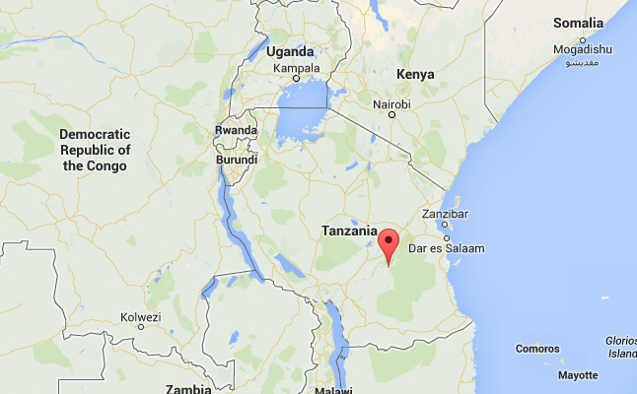

Slide 5
METHODS
Cross-sectional
50 latrines in 4 villages
  42 suitable for trapping
Data collection
  Household survey
  24-hour exit trap
  Sample from top layer of latrine

Slide 6
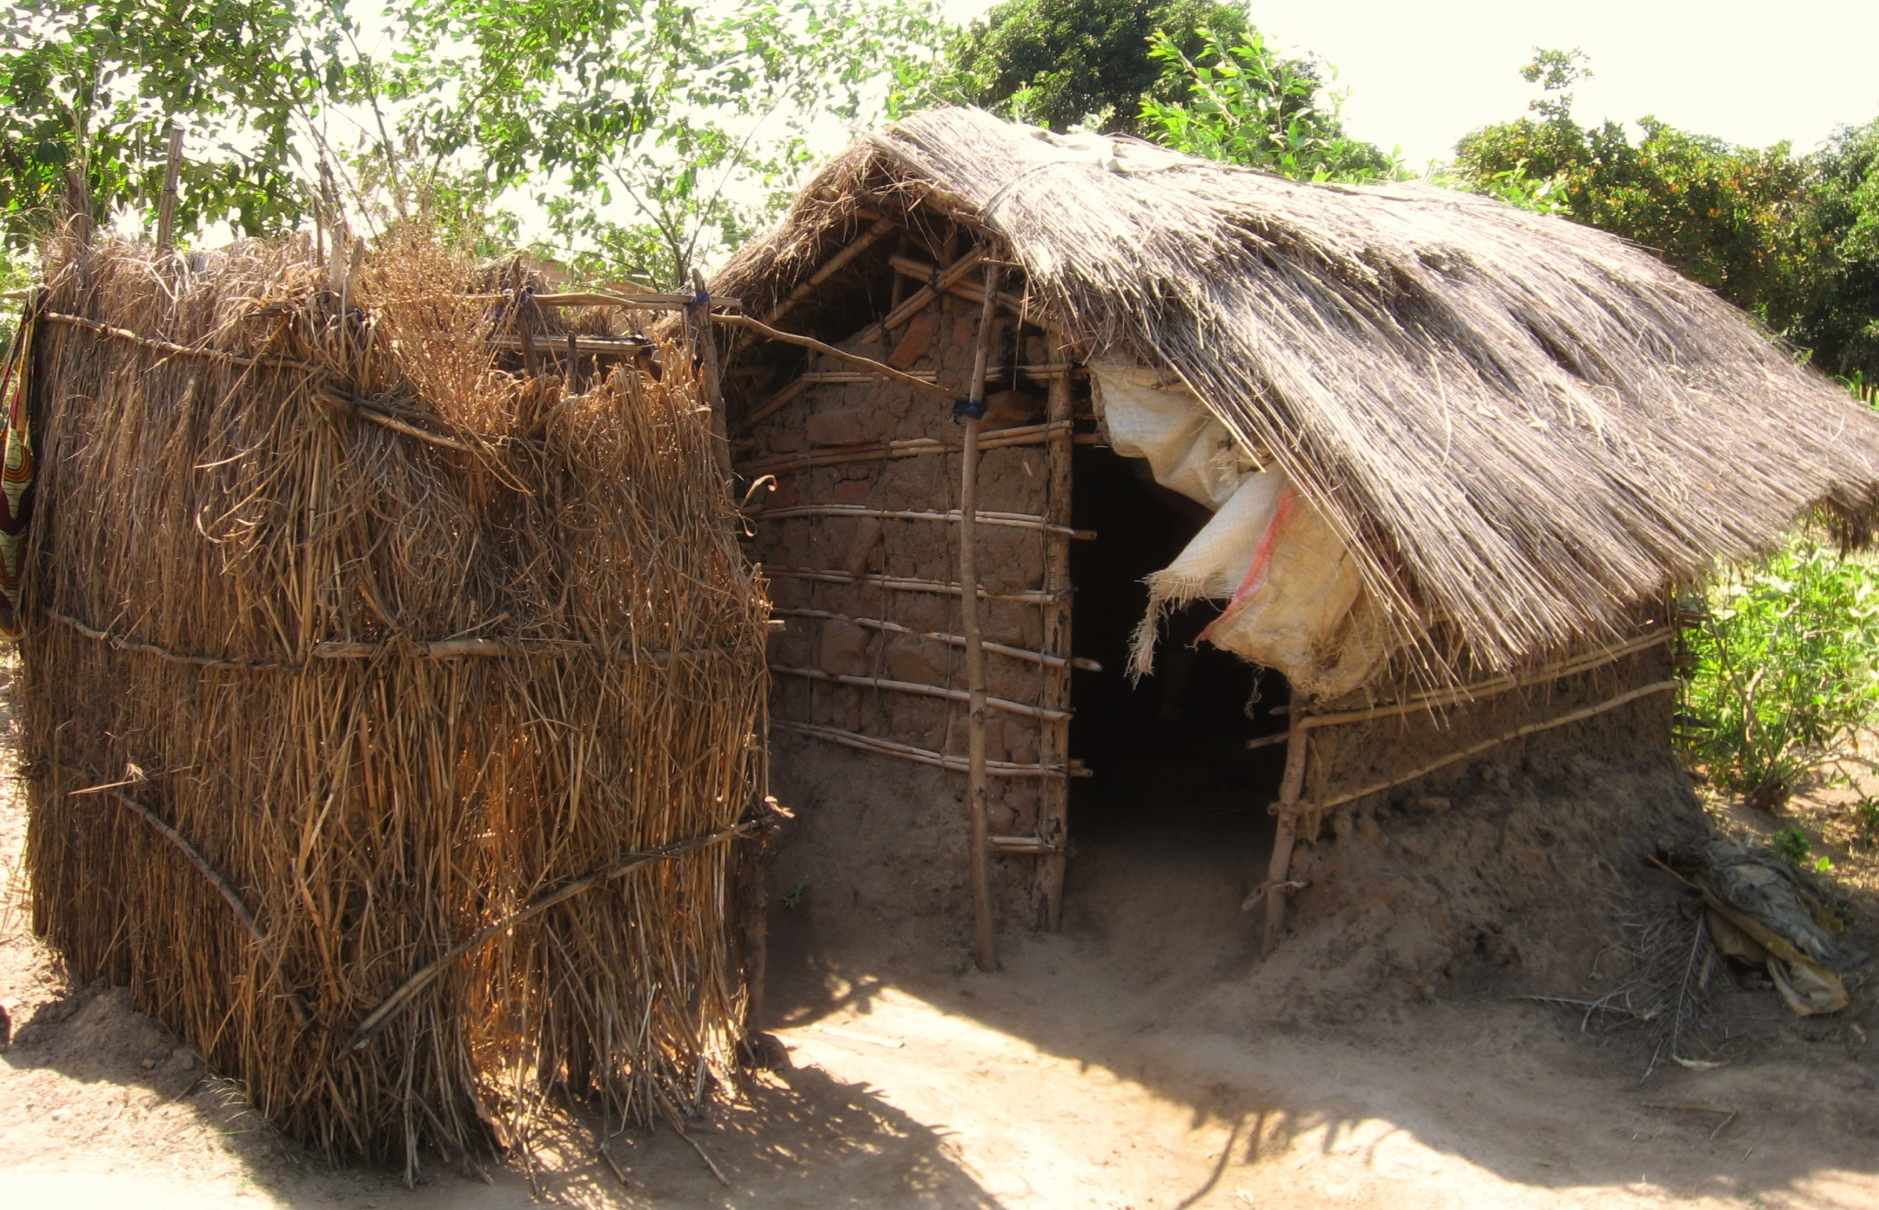

Slide 7


Slide 8
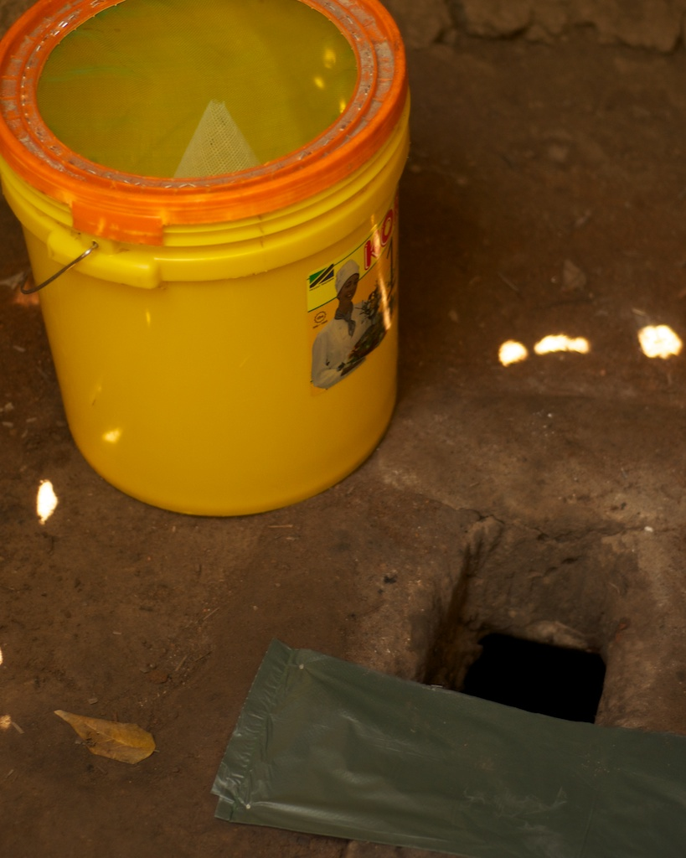
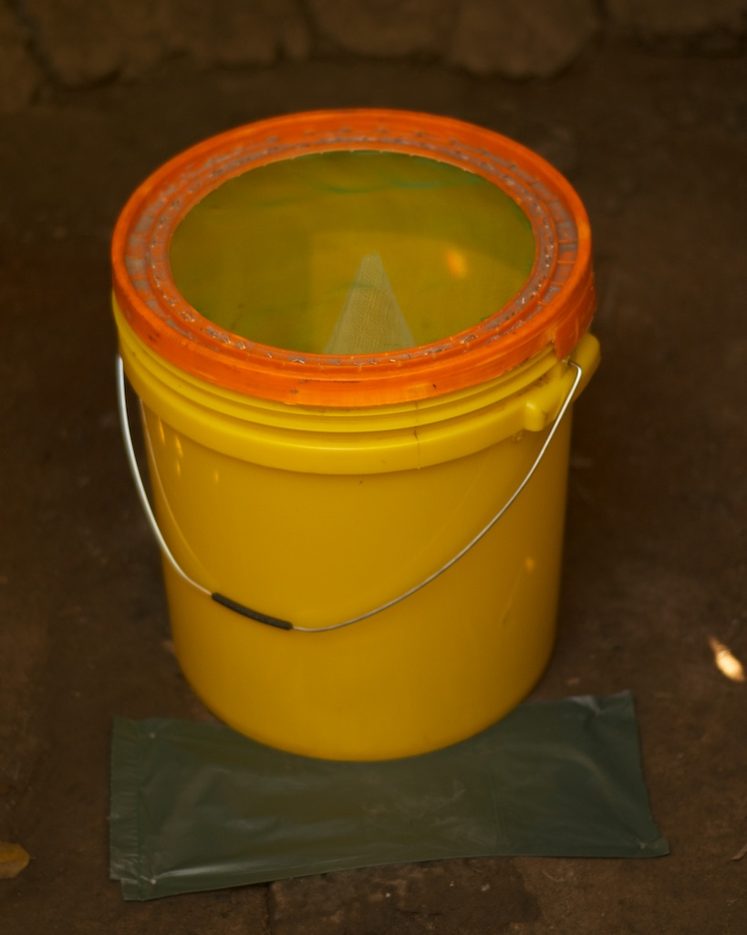

Slide 9



Slide 10
Predictor Variables
Latrine Characteristics
Roof
Roof material
Wall material
Floor type
Pit lining
Additives
Flooding
Water storage
Depth
Age
No. of users
Chemical Data
Total chemical O2 demand
Moisture content
Protein
Carbohydrates
Ammonium
Total phosphate
Volatile fatty acids
Volatile solids

Slide 11
Statistical Approach
4 different models:
  Fixed, Fixed+ village, GEE, Mixed
3 different distributions/transformations
  Untransformed (normal), Log+1, Gamma

Slide 12
PART 1: Compare models using standard set of predictors (roof, wall, total phosphate)
Check distributions of residuals
Compare test statistics, standard errors and p-values
PART 2: Build models
Select predictor variables
Retain in models if significant at 0.05 level
Compare results

Slide 13
Fixed model: Distributions of residuals
Part 1
Untransformed
Log +1
Notes:
Log also distorts the interpretation
With a standard set of predictors, I checked the distributions of the residuals

Slide 14
Part 1
Log+1 transformations: Distributions of residuals
Fixed
GEE
Fixed+ village
Mixed

Slide 15
Compare coefficients, test statistics, SEs and P-values
Part 1
In fixed, fixed +village and GEE models, test-statistics were the highest (for roof) under gamma distribution
In the untransformed total fly coefficients for roof are the same in the fixed, GEE and mixed models but the test statistic is the highest (and p-value is the lowest) in the mixed effects models

Slide 16
Selecting predictor variables
Part 2
Each predictor investigated individually in each model
If significant at p<0.1 level in at least one model – it was included in the set
  Roof (presence or absence)[1,2,3,4]
  Wall material type (grass/plastic, mud or bricks) [1, 4]
  Volatile solids [3,4]
  Total phosphate [1, 4]
  Protein [1,3,4]

Slide 17
Part 2

Slide 18
Step 4: build models
Include all 5 predictors in the model
Retain in model if significant at p<0.05

Slide 19
Notes:
Means of interest

Slide 20
Results
Mixed effects, Gamma distribution
Latrines with roofs produced on average 14.78% (95% CI: 4.33% - 50.41%) of the flies produced in latrines without roofs (p=0.002), accounting for any clustering by village.
No other physical characteristics of the latrine or chemical characteristics were significantly associated with total fly counts

