Slide 1
Causal Inference
Epidemiology 207 - Epidemiology Methods II
Rebecca E. Graff, ScD
Assistant Professor, Epidemiology & Biostatistics

Slide 2
Learning Objectives
Causal Models and Heuristics
  Bradford Hill Criteria
  Sufficient and Component Cause Model
  Counterfactual Model
Ideal Randomized Experiments
Conditional Randomization

Slide 3
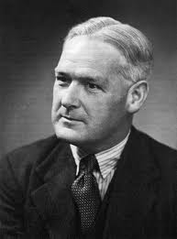
Bradford Hill Criteria
Strength
Consistency
Specificity
Temporality
Biological gradient
Plausibility
Coherence
Experiment
Analogy
Bradford Hill
(1897 – 1991)

Slide 4

Sufficient & Component Cause Model
Sufficient cause
Component cause
  Strong component cause
Necessary cause
U
T
A
B
X
B
Kenneth Rothman

Slide 5
Back to Counterfactuals

Slide 6
A Clarification on Notation
Capital letters denote random variables
  Variables that may have different values for different individuals
  A, Y, Y^{a=0}, Y^{a=1}
Lowercase letters denote possible values (realizations) of random variables
    a is a possible value (0 or 1) of the random variable A

Slide 7
Unconditional vs. Conditional Probabilities
Pr(Y^{a=1} = 1) is an unconditional (marginal) probability
  Proportion of subjects that would have developed the outcome Y had all subjects in the population of interest received exposure value a
  Calculated using the entire population
  Causal quantity
Pr(Y = 1 | A = 1) is a conditional probability
  Proportion of subjects that developed the outcome Y among subjects who received exposure value a in the population
  Calculated using a subset of the population
  Associational quantity

Slide 8
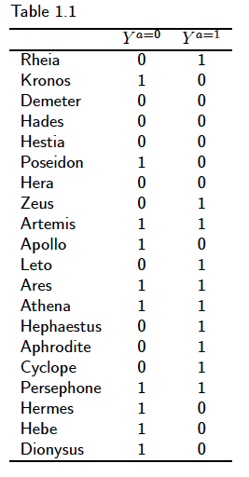
Sharp vs. Average Causal Null Hypothesis
Pr(Y^{a=1}=1) = Pr(Y^{a=0}=1) = 0.5
The average causal null hypothesis holds if:
Pr(Y^{a=1} = 1) = Pr(Y^{a=0} = 1)
The sharp causal null hypothesis holds if, for all subjects:
Y^{a=1} = Y^{a=0}
Does the sharp causal null hypothesis hold for these data?

Slide 9
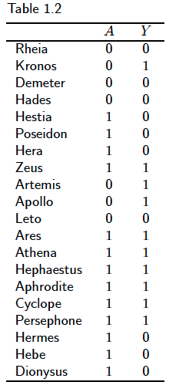

Independence
Pr(Y = 1 | A = 1) = 7/13 = 0.54
Pr(Y = 1 | A = 0) = 3/7 = 0.43
The exposure A and the outcome Y are associated if
Pr(Y = 1 | A = 1) ≠ Pr(Y = 1 | A = 0)
No association = independence
A Y
Are A and Y independent?

Slide 10
Effect vs. Association Measures
Effect Measures | Association Measures
Pr(Y^{a=1}=1) / Pr(Y^{a=0}=1) | Pr(Y = 1 | A = 1) / Pr(Y = 1 | A = 0)
Ratio of unobserved risks | Ratio of observed risks
Cannot be directly computed because Y^{a=1} and Y^{a=0} are unobserved in some subjects in the population | Can be directly computed in any study because Y is observed in all subjects In the population

