Slide 1
Causal Inference
Epidemiology 207 - Epidemiology Methods II
Rebecca E. Graff, ScD
Assistant Professor, Epidemiology & Biostatistics

Slide 2
Learning Objectives
Causal Models and Heuristics
  Bradford Hill Criteria
  Sufficient and Component Cause Model
  Counterfactual Model
Ideal Randomized Experiments
Conditional Randomization

Slide 3
Ideal Randomized Experiments

Slide 4
Key Features
Near infinite sample size
No loss to follow-up
Perfect adherence to the assigned treatment
One version of treatment
Double blind assignment

Slide 5
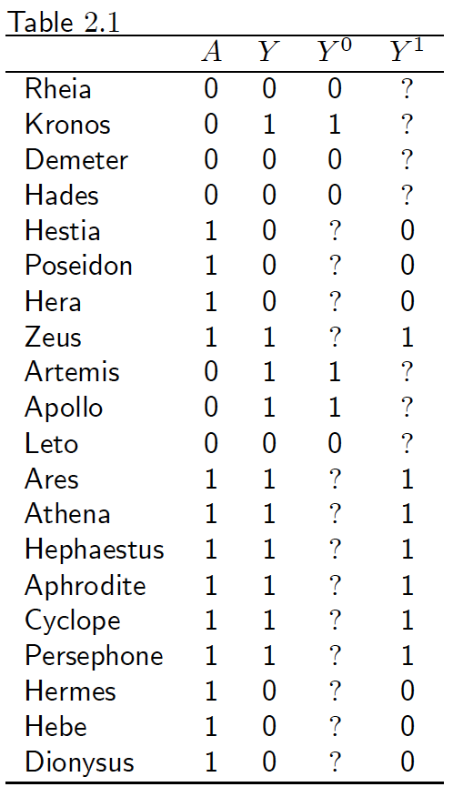
The Data
Only one counterfactual outcome is known for each individual
Randomization ensures that the missing values occur by chance
When group membership is randomly assigned, results are the same whether group 1 is treated and group 2 is untreated, or vice versa
The groups are exchangeable

Slide 6

Exchangeability
Pr(Yª = 1 | A = 1) = Pr(Yª = 1 | A = 0) = Pr(Yª = 1)
or, equivalently:
Yª A
How does this differ from Y A?

Slide 7
Consistency
If A_{i} = a then Y_{i}ª = Y_{i}^{A} = Y_{i}
For each subject, one of the potential outcomes (Y^{a=0} or Y^{a=1}) is the subject’s observed outcome Y
  i.e., the outcome under the treatment value that the subject actually experienced
The potential outcome Yª is factual for some subjects and counterfactual for others
  The term counterfactual is still used

Slide 8
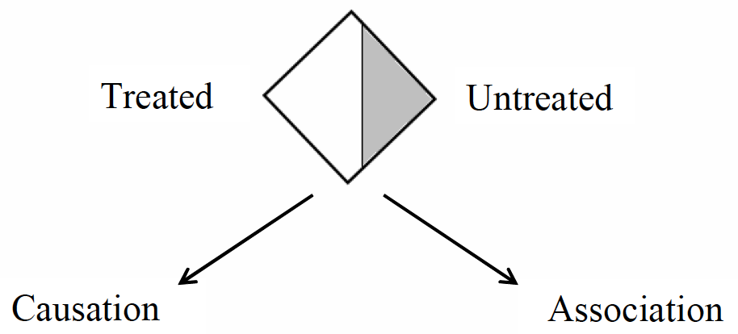


Outcome Had Everyone Been Untreated
Pr(Y^{a=0} = 1)
Pr(Y^{a=0} = 1 | A = 1)
Pr(Y^{a=0} = 1 | A = 0)
Pr(Y = 1 | A = 0)

Slide 9


Outcome Had Everyone Been Treated
Pr(Y^{a=1} = 1)
Pr(Y^{a=1} = 1 | A = 0)
Pr(Y^{a=1} = 1 | A = 1)
Pr(Y = 1 | A = 1)

Slide 10
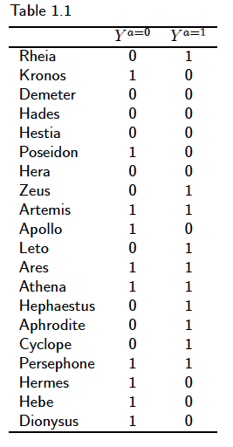
Does Exchangeability Hold?
Pr(Y^{a=0}=1 | A = 1) = 7/13
Pr(Y^{a=0}=1 | A = 0) = 3/7
Exchangeability doesn’t hold!

