Slide 1
Week 1 in review:
Study Design – RCT to Cohort –
Target trial emulation
Dan Kelly, MD, MPH
January 16, 2020

Slide 2
Research questions
A young couple moves into an apartment and decides to repaper the dining room. They ask the neighbor who has a dining room the same size,
“How many rolls of wallpaper did you buy when you papered the dining room?”
“Seven,” he says
So the couple buys seven rolls of expensive paper but finish papering the walls before they end the fourth roll.
Annoyed, they go back to the neighbor and say,
“We followed your advise but we ended up with three extra rolls!”

Slide 3
Research questions
”So,” he says, “that happened to you, too.”
(Plato and a Platypus walk into a bar)

Slide 4
Two stages of research
1. Ask the question
  Is it really a causal or comparative question?
2. Answer the question by conducting and analyzing
  Randomized trials
  Observational studies
Often methodological discussions (and courses) revolve exclusively around stage 2

Slide 5
Relationship bt Obs & Experimental Studies
Recap from Epid Methods I – Study Design
Experimental studies can be viewed as cohort studies where the investigator assigns the exposure
Observational studies should be viewed (and designed) as attempting to emulate a randomized controlled trial (RCT)
When designing an observational study, ask yourself: What is the RCT that I am trying to emulate?
  What is the “target trial”?
  To understand better a “target trial” – let’s discuss RCT’s
Notes:
EPI 203 notes fr J Martin:
A randomized controlled trial (RCT) is the gold standard design for comparing the effectiveness of different interventions to influence an outcome. We pointed out earlier that the RCT design can be thought of as a type of cohort study where the exposure is assigned to participants, rather than just measured as it occurs in nature. We also can turn this around. That is, a useful insight in the understanding of observational studies is that one should strive to have them emulate an RCT. Observational studies that aim to establish causality should be evaluated with respect to how well they emulate an experimental “target” trial (i.e., an RCT).

Slide 6
Basic Trial Design
Population
Intervention
Outcome
Sample
Randomization
+ Blinding
Placebo
Control
Outcome
Notes:
For example, select persons with memory loss, treat with daily mathematics and memory exercises and see if this improves score on MMSE and reduces risk of developing dementia.
Note can have an uncontrolled trial or time series design. These have no concurrent control group and can produce the wrong answer due to learning, regression to the mean, secular trends and the placebo effect. Note, for example, that it is common to have a 30-50% improvement in depression scores, pain scores, hot flash scores.
Can have a controlled trial without randomization. This addresses problems noted above, but may make the treatment look good simply because the groups are different to begin with. For example, if you put all the older people in the control group because it’s too hard to teach them mathematics, the rate of developing dementia may be higher in this group simply because they are older. This design is really no different from a double cohort study. Randomization fixes this - for both known (measured) and unknown (unmeasured) potential confounders - I.e., age will be balanced in both groups, as will education, etc. And potential confounders we don’t know about.
Can have a randomized controlled trial without placebo (blinding). This allows (as will be discussed later) for co-intervention and biases outcome ascertainment.
Also note that these three elements - treatment, randomization and blinding result in the major ethical concerns regarding randomized trials.

Slide 7
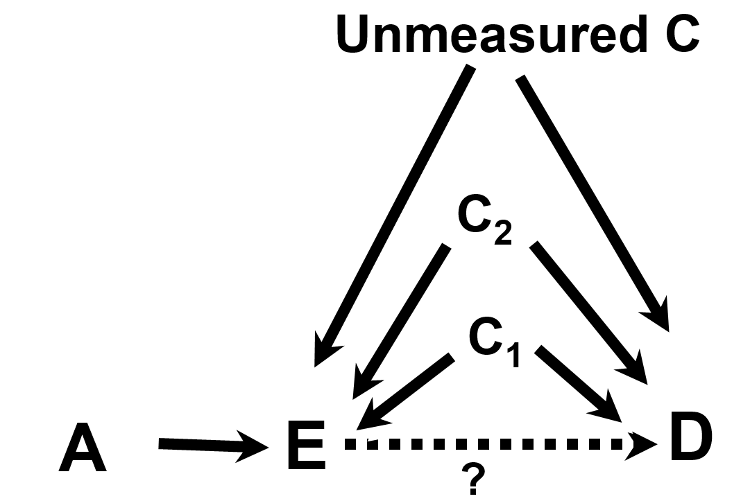
EPI203, Confounding & Interaction
Randomization
Variable A is referred to as an instrumental variable (IV) or “instrument”. Here, let A be randomization in a RCT.
Randomization is an Instrumental Variable, that is related to the Exposure and nothing else. In a RCT, we focus on the IV-D relationship (randomized assignment and disease outcomes) in Intent-to-Treat analyses
Notes:
Variable A is referred to as an instrumental variable or “instrument”. An instrument is defined to as a factor related to exposure but to nothing else.

Slide 8
HRT and MI
C
Random assignment to HRT
HRT exposure
MI
What was planned
C
What was learned and not accounted for in RCT’s
Age
Random assignment to HRT
HRT exposure
MI
Time since Menopause
Notes:
In the WHI, the goal was to study random allocation to HRT and MI, assuming that this would only be associated with HRT exposure.
However, further studies suggested that age and time since menopause (which could be confounders) may each modify the effect of HRT on MI… (click to show interaction DAG)

Slide 9
Randomized trial asked a comparative question
What is the CHD risk in women who initiate hormone therapy compared with women who do not?
Design and analysis
  Women randomly assigned to initiation of hormone therapy or placebo
  Analytic approach
    Compare risk between incident users and nonusers of hormone therapy (new users vs. never users)

Slide 10
Observational studies did not ask a comparative question
What is the CHD risk in women who are currently taking hormone therapy compared with women who are not?
Design and analysis:
  Women are asked about therapy use
    Consider a woman wondering whether to a start hormone therapy
    The current vs. never contrast does not provide the information she needs
  Analytic approach
    Compare risk between prevalent users and nonusers of hormone therapy (current users vs. never users)

Slide 11
When we ask the same question
RCT (WHI) Observational (NHS)
Overall 1.23 (0.99, 1.53)
Years of follow-up
  0-2 1.51 (1.06, 2.14)
  >2 1.07 (0.81, 1.41)
Years since menopause
  <10 0.89 (0.54, 1.44)
  10-20 1.24 (0.86, 1.80)
  >20 1.65 (1.14, 2.40)
1.05 (0.82, 1.34)
1.43 (0.92, 2.33)
0.91 (0.72, 1.16)
0.88 (0.63, 1.21)
1.13 (0.85, 1.49)
Distribution of time since menopause, age, and length of follow-up largely explained the differences

Slide 12
Consider key features of an RCT when emulating a target trial
RCT features COHORT equivalents
Randomization
Blinding
ITT
Methods to address confounding in design & analysis phase (restriction, matching, stratification, multivariate modeling, etc.)
Structured (& sometimes blinded) assessments (e.g., medical assessments may be part of SOC; labs can be agnostic)
Do not adjust for post-baseline covariates.
  Cohorts can collect data on time-varying exposures & confounders (may need special attention in analysis phase)
Notes:
As with randomized trials, we should not adjust for post-exposure covariates, only baseline covariates… except if we have time-varying exposures, then we do want data on time varying confounders…
Caution: we don’t want to adjust for something in the causal path or for covariates that are influenced by the exposure → Marginal Structural Models & Inverse Prob Censoring Weights (More in BIO 215)

Slide 13
Consider this target trial heuristic and how each issue is being approached on a spectrum of being similar or different than an RCT
Key Issues in Clinical Trials | Observational
Clear Objective(s). Primary and secondary endpoints
Study population. Inclusion/exclusion criteria
Longitudinal
Randomized treatment assignment | No
Blinding | No
Statistical Power. Sample size & follow up
International, multicenter,…
Reference group. Active therapy or placebo
Loss to follow up & Compliance
Blind adjudication of events
Inscription of Protocols
Notes:
Usage of standardized protocols for data collection and follow-up can be common to both Clinical Trials and obs studies

Slide 14
Cohort & Target Trial – Summary
Concept of a target trial can help with cohort design
When cohorts don’t or can’t emulate a trial, may explain apparent discrepancies in the literature.
  NOTE: the observational study may address a different question than the trial and may still be valid.
Sometimes, RCTs will have limitations and rigorous observational evidence will give best available data
  How do we use this to guide clinical practice & public health recommendations?
    Weigh the risks and benefits, with best available data
”So,” he says, “that happened to you, too.”

