Slide 1
Multi-level Etiologies of Health Disparities:
Pt 3. Behavioral
January 21, 2020
Scarlett Lin Gomez, PhD, MPH
Department of Epidemiology & Biostatistics
Helen Diller Family Comprehensive Cancer Center

Slide 2
Map of First Four Weeks
Week 2
Week 5
Economic & Social
Opportunities and Resources
Week 3
Living & Working Conditions
in Homes and Communities
Week 4
Behaviors
Medical Care
Interaction with genetic/other biological factors
HEALTH
Adapted from Braveman et al., for RWJ Foundation
Commission to Build a Healthier America | www.commissiononhealth.org

Slide 3
Outline
Health behaviors - patterned by social determinants, ex:
  Tobacco
  Diet
  Physical activity
  Alcohol / drugs
  Healthcare utilization
Conceptual models of health behaviors
Explanatory concepts/potential mechanisms connecting social determinants with health behaviors
  Putting it into practice

Slide 4

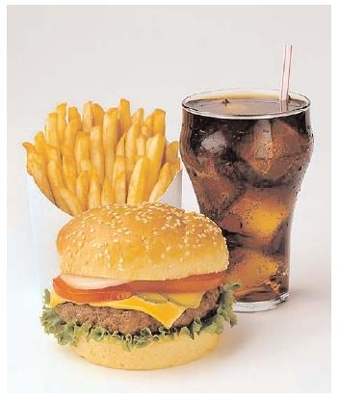
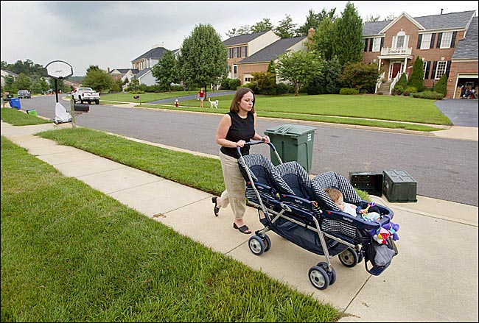
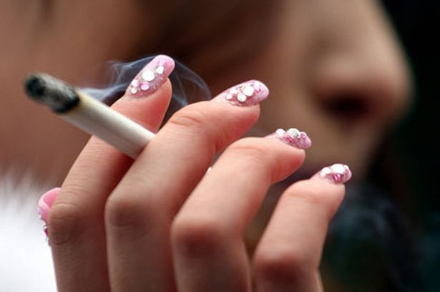
Health behaviors are patterned by social determinants

Slide 5
Health behaviors vary by SES
In representative US sample (Lantz, JAMA 1998)
Health Behavior | < High school education | College education
Smoking | 42% | 20%
Excessive alcohol intake | 4.4% | 3.7%
Physical inactivity | 37% | 14%
Obesity | 28% | 11%

Slide 6
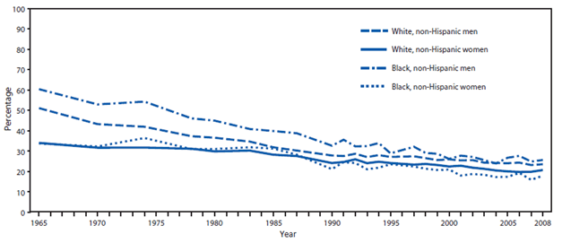
Tobacco trends by race/ethnicity and sex

Slide 7
Tobacco trends by education

Slide 8
Health behaviors by race/ethnicity,
California Health Interview Survey 2015-2016

Slide 9
Health behaviors by race/ethnicity,
California Health Interview Survey 2015-2016

Slide 10
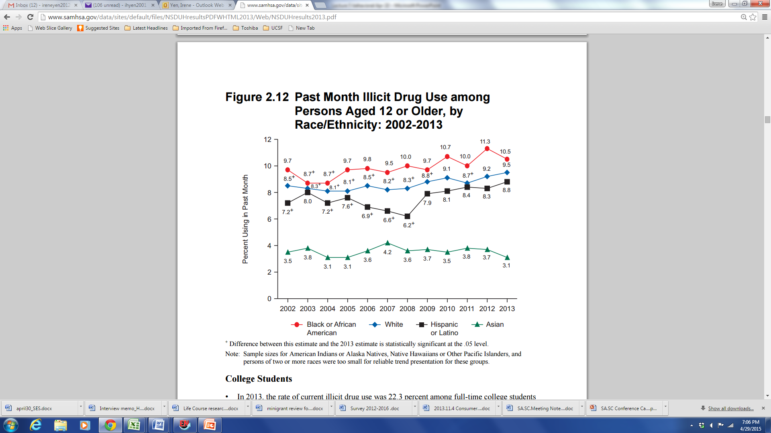
Drugs and Alcohol
2013 National Survey on Drug Use and Health

Slide 11
Illicit drug dependence or abuse by education
2013 National Survey on Drug Use and Health (aged 26+)
College graduates: 0.9%
Some college education: 2.1%
High school graduate: 1.9%
Did not graduate from high school: 2.5%

Slide 12
Binge drinking by race/ethnicity,
California Health Interview Survey 2015-2016

Slide 13
Conceptual models of health behaviors

Slide 14
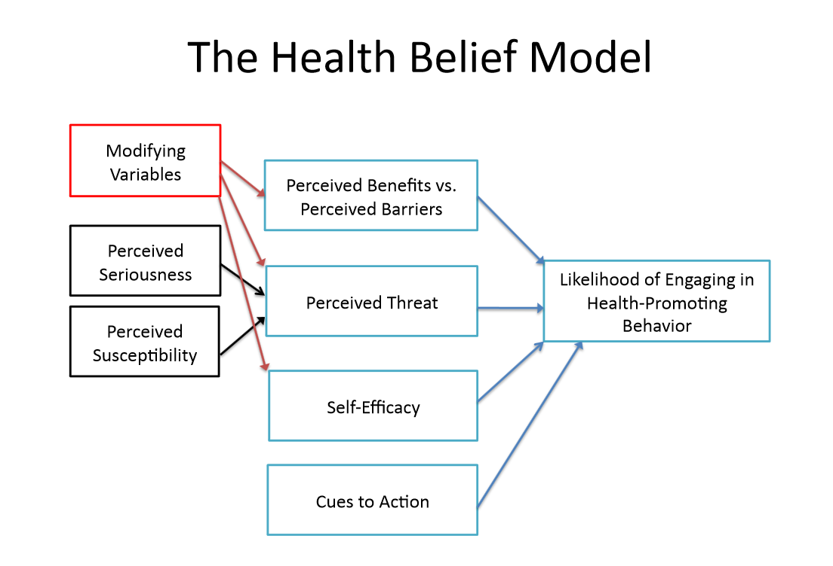
Psychological models of motivation and behavioral change

Slide 15
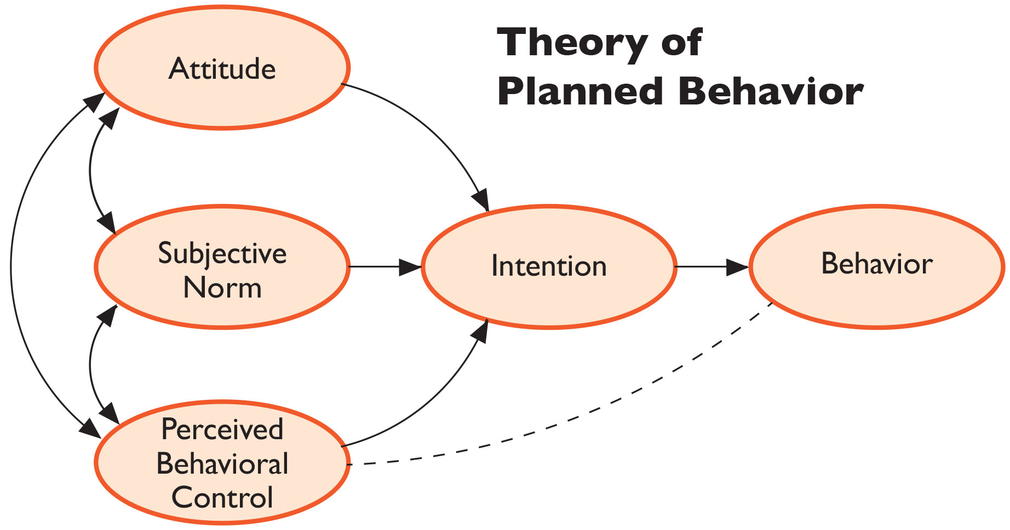
Psychological models of motivation and behavioral change

Slide 16
RWJ Foundation Framework
Economic & Social
Opportunities and Resources
Living & Working Conditions
in Homes and Communities
Behaviors
Medical Care
Interaction with genetic/other biological factors
HEALTH
Adapted from Braveman et al., for RWJ Foundation
Commission to Build a Healthier America | www.commissiononhealth.org

Slide 17

Putting it in Context: World Health Organization’s Commission on Social Determinants of Health Framework
Socioeconomic & political context
Governance
Policy (Macroeconomic, Social, Health)
Cultural and societal norms and values
Social Position
Material circumstances
Social cohesion
Psychosocial factors
Behaviors
Biological factors
Distribution of health and
well-being
Education
Occupation
Income
Gender
Ethnicity/Race
Health-Care System
SOCIAL DETERMINANTS OF HEALTH INEQUITIES
SOURCE: Amended from Solar & Irwin, 2007
http://www.who.int/social_determinants/thecommission/finalreport/graphs/en/

Slide 18
“Unnatural Causes. Place Matters” (PBS 2008)
Why is your street address…such a good predictor of your health?
“When we think about health, we usually think about health care and access to health care and the quality of care. But what research clearly shows is that health is embedded in the larger conditions in which we live and work.…
Sometimes, we naively think of improving health by simply changing behaviors. But the choices of individuals are often limited by the environments in which they live.”
(David Williams)

Slide 19
Health equity means social justice in health (i.e., no one is denied the possibility to be healthy for belonging to a group that has historically been economically/socially disadvantaged).”
Paula Braveman, Public Health Rep 2014

Slide 20
Cells-to-Society model
A framework for multilevel research
Centers for Population Health and Health Disparities, NIH
Social conditions & policies
Poverty, norms, prejudice
Fundamental causes
Institutional context
Health care system, economic system, media, political system
Social context
Collective efficacy, social capital, racial/ethnic integration
Social relationships
Social networks, social support, religious participation, civic engagement
Social & physical context
Interactions
Physical context
Building quality, pollution, sidewalks, parks
Disparate health outcomes
Individual demographics
Age, race/ethnicity, SES, health insurance, education, acculturation
Individual factors
Individual risk behaviors
Smoking, alcohol, diet, sleep
Biological responses
Obesity, depression, stress, hypertension
Biologic/Genetic pathways
Allostatic load, biologic processes, genetic ancestry, genetic mechanisms
Biologic factors
Warnecke et al. AJPH 2008

Slide 21
Cells-to-Society model
Fundamental causes
They are considered fundamental causes because their influence is solely reflected at the population level in the variation in rates of disease or poor health... Their roots are embedded in policy, shared social norms about health and social practices, socioeconomic disadvantage, and policies that affect public availability of health services, including who receives them and the level and quality of service. They are the determinants of inequities rather than differences.
Social conditions & policies
Poverty, norms, prejudice
Fundamental causes
Institutional context
Health care system, economic system, media, political system
Social context
Collective efficacy, social capital, racial/ethnic integration
Social relationships
Social networks, social support, religious participation, civic engagement
Social & physical context
Interactions
Physical context
Building quality, pollution, sidewalks, parks
Disparate health outcomes
Individual demographics
Age, race/ethnicity, SES, health insurance, education, acculturation
Individual factors
Individual risk behaviors
Smoking, alcohol, diet, sleep
Biological responses
Obesity, depression, stress, hypertension
Biologic/Genetic pathways
Allostatic load, biologic processes, genetic ancestry, genetic mechanisms
Biologic factors
Warnecke et al. AJPH 2008
Notes:
The Cells-to-Society model of cancer disparities research, published in 2008, nicely illustrates
The model provides examples of fundamental causes of disparity,
the contexts in which people live and work,
individual-level factors—like race/ethnicity and education and behavioral factors like smoking and diet—
and the biologic responses and pathways that ultimately decide an individuals’ health state.
The arrow on the left indicates that one can expect interactions between these levels and between factors within

Slide 22
Cells-to-Society model
Social conditions & policies
Poverty, norms, prejudice
Social Determinants
Social determinant of health are the conditions in which people are born, grow, work, live, and age, and the wider set of forces and systems shaping the conditions of daily life.
-World Health Organization
Fundamental causes
Institutional context
Health care system, economic system, media, political system
Social context
Collective efficacy, social capital, racial/ethnic integration
Social relationships
Social networks, social support, religious participation, civic engagement
Social & physical context
Interactions
Physical context
Building quality, pollution, sidewalks, parks
Disparate health outcomes
Individual demographics
Age, race/ethnicity, SES, health insurance, education, acculturation
Individual factors
Individual risk behaviors
Smoking, alcohol, diet, sleep
Biological responses
Obesity, depression, stress, hypertension
Biologic/Genetic pathways
Allostatic load, biologic processes, genetic ancestry, genetic mechanisms
Biologic factors
Warnecke et al. AJPH 2008
Notes:
The Cells-to-Society model of cancer disparities research, published in 2008, nicely illustrates
The model provides examples of fundamental causes of disparity,
the contexts in which people live and work,
individual-level factors—like race/ethnicity and education and behavioral factors like smoking and diet—
and the biologic responses and pathways that ultimately decide an individuals’ health state.
The arrow on the left indicates that one can expect interactions between these levels and between factors within

Slide 23
Cells-to-Society model
Social conditions & policies
Poverty, norms, prejudice
Fundamental Causes + Social Determinants
Meta-analysis of ~50 studies found that social factors accounted for 1/3 of total deaths in US
-S. Galea AJPH 2010
Fundamental causes
Institutional context
Health care system, economic system, media, political system
Social context
Collective efficacy, social capital, racial/ethnic integration
Social relationships
Social networks, social support, religious participation, civic engagement
Social & physical context
Interactions
Physical context
Building quality, pollution, sidewalks, parks
Disparate health outcomes
Individual demographics
Age, race/ethnicity, SES, health insurance, education, acculturation
Individual factors
Individual risk behaviors
Smoking, alcohol, diet, sleep
Biological responses
Obesity, depression, stress, hypertension
Biologic/Genetic pathways
Allostatic load, biologic processes, genetic ancestry, genetic mechanisms
Biologic factors
Warnecke et al. AJPH 2008
Notes:
The Cells-to-Society model of cancer disparities research, published in 2008, nicely illustrates
The model provides examples of fundamental causes of disparity,
the contexts in which people live and work,
individual-level factors—like race/ethnicity and education and behavioral factors like smoking and diet—
and the biologic responses and pathways that ultimately decide an individuals’ health state.
The arrow on the left indicates that one can expect interactions between these levels and between factors within

Slide 24

#RacismNotRace
Critical Race Theory
Selected tweets from academics
Race is NOT the risk factor, racism is.
M. McLemore
In fact, structural racism is THE risk factor…
J. Attilus
…we should be talking about the effects of structural, interpersonal, and cultural racism in not only the health care system but society in general
M. Agenor
#RacismNotRace is about pushing past the “control for race” mode of engaging structural racism & addressing the upstream factors that shape Black patients’ health.
A. Planey

Slide 25
Explanatory concepts/POTENTIAL PATHWAYS connecting social determinants with behaviors

Slide 26
Potential pathways
Sociological perspectives
Fewer benefits of health behaviors for longevity
Latent traits
Class distinctions
Knowledge and access to information
Efficacy and agency
(Pampel Annu Rev Sociol 2010)

Slide 27
Potential pathways
Contextual considerations
Access to resources: neighborhood/environmental context
Economic deprivation, financial constraints
Social and cultural norms, culturally-driven health beliefs
Stress & social support
Medical mistrust & healthcare utilization

Slide 28
Potential pathways
Sociological perspectives
Fewer benefits of health behaviors for longevity
Latent traits
Class distinctions
Knowledge and access to information
Efficacy and agency

Slide 29
Fewer benefits of health behaviors for longevity
Persons of low SES have less to gain from healthy behaviors
Less reason to invest in future longevity and more reason to focus on present when making decisions about health behaviors
Lower SES groups feel fatalistic about ability to act in ways that extend longevity, reduce disease risk
Pampel Annu Rev Sociol 2010

Slide 30
Potential pathways
Sociological perspectives
Fewer benefits of health behaviors for longevity
Latent traits
Class distinctions
Knowledge and access to information
Efficacy and agency

Slide 31
Latent traits
Personal characteristic with propensity to engage in risky and/or unhealthy behaviors
Crime literature – low self-control, attraction to risk, choose short-term gain in the face of long-term harm
Pampel Annu Rev Sociol 2010

Slide 32
Potential pathways
Sociological perspectives
Fewer benefits of health behaviors for longevity
Latent traits
Class distinctions
Knowledge and access to information
Efficacy and agency

Slide 33
Class distinctions
Engage in healthy behaviors and lifestyles to set themselves apart from lower SES groups
Classical theory: lifestyle as source of social differentiation, adoption of innovative fashion to reinforce differences
Pampel Annu Rev Sociol 2010

Slide 34
Potential pathways
Sociological perspectives
Fewer benefits of health behaviors for longevity
Latent traits
Class distinctions
Knowledge and access to information
Efficacy and agency

Slide 35
Knowledge and access to information
Lower SES groups have less access to and opportunities for learning about harms of unhealthy behaviors
Some groups may also be exposed to more advertising
Persons with college degree 3.6 x more likely to report that they pay attention to nutritional information from scientific experts, compared to those with less than high school degree
Pampel Annu Rev Sociol 2010

Slide 36
Potential pathways
Sociological perspectives
Fewer benefits of health behaviors for longevity
Latent traits
Class distinctions
Knowledge and access to information
Efficacy and agency

Slide 37
Efficacy and agency
Education provides human capital, effective agency, and sense of personal control
Education trains individuals to evaluate and use information
High SES groups are quickest to use new medical technologies
Education increases use of aids to quit smoking, and responsiveness to antismoking ads
Pampel Annu Rev Sociol 2010

Slide 38
Potential pathways
Contextual considerations
Access to resources: neighborhood/environmental context
Economic deprivation, financial constraints
Social and cultural norms, culturally-driven health beliefs
Stress & social support
Medical mistrust & healthcare utilization

Slide 39
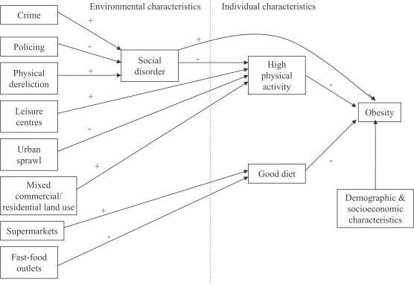
Model linking social and physical environmental characteristics to obesity
Pathways to obesity: Identifying local, modifiable determinants of physical activity and diet
Mai Stafford , Steven Cummins , Anne Ellaway , Amanda Sacker , Richard D. Wiggins , Sally Macintyre
Social Science & Medicine, Volume 65, Issue 9, 2007, 1882 - 1897

Slide 40
Model linking social and physical environmental characteristics to obesity
… choices of individuals are often limited by the environments in which they live.
D. Williams
Pathways to obesity: Identifying local, modifiable determinants of physical activity and diet
Mai Stafford , Steven Cummins , Anne Ellaway , Amanda Sacker , Richard D. Wiggins , Sally Macintyre
Social Science & Medicine, Volume 65, Issue 9, 2007, 1882 - 1897

Slide 41
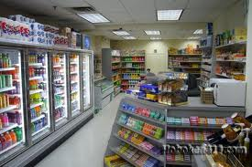
Food environment
Galvez et al 2009:
Children (ages 6-8) living on a block with 1 + convenience stores (range, 1–6) were more likely to have a BMI percentile in the top tertile (OR 1.90, 95% CI, 1.15–3.15) compared with children having no convenience stores
Oreskovic et al 2009:
Distance to nearest fast-food restaurant was inversely associated with BMI
Chen et al 2016:
Food environment incl. living in food desert associated with obesity after adjusting for home food environment factors

Slide 42
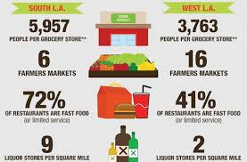
Diet / Food
“Food Desert” - low-income census tract where a large number of residents are more than a mile from a grocery store.

Slide 43
Potential pathways
Contextual considerations
Access to resources: neighborhood/environmental context
Economic deprivation, financial constraints
Social and cultural norms, culturally-driven health beliefs
Stress & social support
Medical mistrust & healthcare utilization

Slide 44
Economic deprivation/
Financial constraints
Meta-analysis of 27 studies - healthy eating costs $1.48 more per day per adult than eating a low-quality diet ($550 more annually per person).
Aids for healthy behavior (Pampel 2010)
  Costs required for resources to quit smoking/reduce alcohol dependency, physical activities

Slide 45
Potential pathways
Contextual considerations
Access to resources: neighborhood/environmental context
Economic deprivation, financial constraints
Social and cultural norms, culturally-driven health beliefs
Stress & social support
Medical mistrust & healthcare utilization

Slide 46
Social and cultural norms, culturally-driven health beliefs
Some negative health behaviors are more common among certain social groups
  Culturally acceptable? E.g., alternative forms of smoking among South Asians, esp. women
  Less stigmatized? E.g., overweight/obesity among immigrant/2nd gen Latinos and Asians
  Targeted advertising? E.g., menthol cigarettes among African-American communities
  Greater availability? E.g., betel-nut chewing in East Asia
  Perceived necessity of preventive health in absence of symptoms

Slide 47
Potential pathways
Contextual considerations
Access to resources: neighborhood/environmental context
Economic deprivation, financial constraints
Social and cultural norms, culturally-driven health beliefs
Stress & social support
Medical mistrust & healthcare utilization

Slide 48
Stress & social support
Socioeconomic disadvantage → increased adversity, drain on capacity to cope (Pampel 2010)
Affordances model:
  Poor health behaviors → regulate mood → ability to cope
Environmental affordances:
  Relationships between people and their environments that can have an effect on human activity whether or not they are visible, known, or desirable.

Slide 49
Affordances Model (Jackson)
Over the life course, Blacks (and other underserved populations) are more likely to engage in coping strategies (i.e., adverse health behaviors) that “preserve” mental health
However, over time, in concert with social, economic, and environmental stressors, these coping strategies lead to poor physical health in middle age and older life
Jackson et al. AJPH 2010

Slide 50
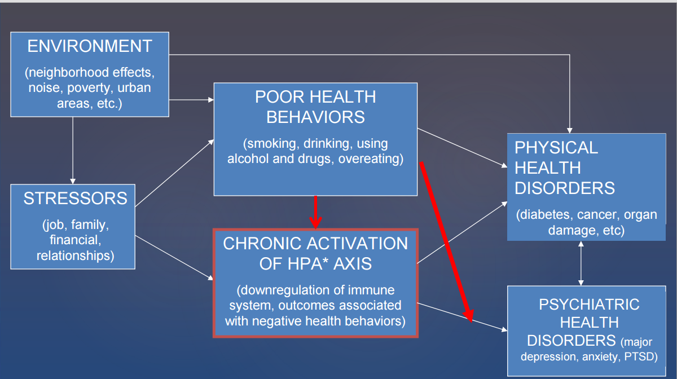
Affordances Framework: Inter-relationships among environment, stressors, negative health behaviors, and physical and mental health
Jackson & Knight, 2006; Jackson, Knight, & Rafferty, 2010, AJPH

Slide 51
Adverse Childhood Experiences (ACEs) - CDC
Before the age of 18:
Live with
  depressed or mentally ill person
  alcoholic
  drug user
  anyone sentenced to prison time
Parents separated or divorced
Exposed to domestic violence
Physical abuse
Sexual abuse

Slide 52
Adverse Childhood Experiences and adult health behaviors, UK
Bellis et al. AJPH 2013

Slide 53
Potential pathways
Contextual considerations
Access to resources: neighborhood/environmental context
Economic deprivation, financial constraints
Social and cultural norms, culturally-driven health beliefs
Stress & social support
Medical mistrust & healthcare utilization

Slide 54
Medical mistrust and healthcare utilization
Historical and personal experiences with adverse medical experiences may result in mistrust of the medical care system and providers, leading to avoidance of medical care
Medical mistrust index (of healthcare organizations) associated with measures of underutilization of health care (LaVeist et al. Health Serv Res 2009)
Review of 27 studies showed greater medical mistrust associated (in most studies) with lower use of colorectal cancer screening (Adams et al. J Comm Health 2017)

Slide 55
Putting it into practice: examples of research

Slide 56
Multilevel Research: built environment and physical activity
California Teachers Study: population cohort study of ~130,000 teachers and teaching administrators
Analysis included 117,367 women who resided in California at the time of the 1995 baseline survey and for whom residential address could be geocoded
Recursive partitioning was used to identify unique combinations of predictors of physical inactivity (< 25 hrs/wk)
Keegan et al. Am J Public Health, 2012

Slide 57
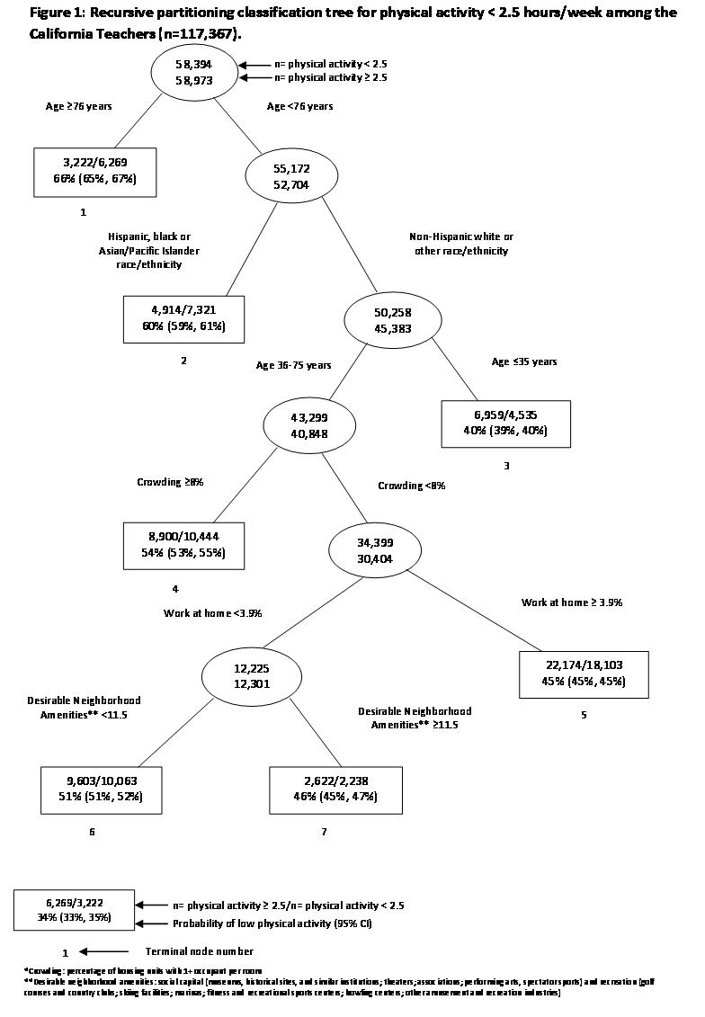

Slide 58
Multilevel Research: built environment and physical activity
Built environment variables associated with physical activity
  Household crowding
  % of population work at home
  N of desirable amenities
But built environment effects seen only among non-Hispanic Whites and “other” race/ethnicity, aged 36-75
Minority groups have low physical activity regardless of built environment in this educated population of educators

Slide 59
Colorectal cancer screening guideline adherence among Asian Americans & Pacific Islanders,
CHIS 2001-2005 (Lee, Ethnicity & Health 2011)

Slide 60
Studies addressing social and cultural norms, culturally-driven health beliefs
Factors associated with lower colorectal cancer screening in AAPIs (Lee, Ethnicity & Health 2011)
Female
Never married
Lower education
Poverty
No health insurance
No usual source of care
Fewer years in US
Speak English + another language at home
Fewer doctor visits
Fewer chronic diseases
Smoker

Slide 61
Social and cultural norms,
culturally-driven health beliefs
Ex: Colorectal cancer screening in South Asian Americans → preventive health beliefs
While immigration and language determinants were important, the factors most strongly associated with screening were being obese and having had a flu shot in the past year
Findings triangulate with qualitative data showing health beliefs, esp in preventive care, is important in this population (Ivey, J Health Care Poor Underserv 2018)

Slide 62
Applying conceptual models of health behaviors to intervention studies
Study #1: Colorectal cancer screening in Chinese Americans (Nguyen, AJPM 2017)
  In-language print materials
  Randomize to print materials vs. lay health worker
  Lay health worker outreach more effective than print materials alone

Slide 63
Applying conceptual models of health behaviors to intervention studies
Study #2: FLU-FIT program (Potter, AJPH 2013)
  Randomized flu clinics in an integrated healthcare system to offering FIT vs. no FIT
  Offering FIT increased FIT completion within 90 days of flu clinic, OR = 2.75

Slide 64
Applying Critical Race Theory & Intersectionality Theory to understanding impact of structural racism on engagement in HIV care
Qualitative research (Freeman, Int J Equity Health 2017)
  Semi-structured research
  African-American/Black & Hispanic persons w/HIV, not on retroantiviral therapy
  HIV care decisions & behavior influenced by:
    Healthcare settings overly institutionalized -> dehumanizing
    Knowledge of historical medical mistrust against persons of color -> distrust
    Perceptions that patients excluded from healthcare decision process
    Over-emphasis on antiretroviral therapy relative to other non-HIV concerns
  Intersectionality not as critical but race/ethnicity and social class important

Slide 65
Applying conceptual models of health behaviors to intervention studies
Study #3: A physician-initiated intervention to increase colorectal cancer screening (Sun Cancer 2018)
  Physicians from local independent practice association serving Chinese Americans
  Early intervention group: CME + patient intervention mailer w/FOBT kit
  Delayed intervention group: patient intervention mailer only
  No effect of CME → both arms saw equal increase in FOBT

Slide 66
Now our turn: design a research project

Slide 67
1. What’s the disparity? a. behavioral outcome b. disparity group
2. What is/are the multilevel social determinants being studied?
Mediator? Moderator?
3. Observational or intervention?
→ 5 min: work on your own
→ 15-20 min: take turns sharing & discussion

Slide 68
1. What’s the disparity?
Low physical activity levels among African American & Latino youth in low income neighborhood
2. What is/are the multilevel social determinants being studied?
Neighborhood-level factors: impact of built environment, safety, aesthetics
Social determinants: economic resources, peer pressure
3. Observational or intervention?
Observational: mixed methods study to identify barriers & facilitators to engaging in physical activity

