Slide 1
Biostatistics 226, Winter 2020
Course Overview
Jan 7 – Design of RCTs: How to avoid bias and achieve valid results
Jan 14 – Analyses: Baseline, Efficacy, and Safety
Jan 21 – Monitoring trials for efficacy, futility, and patient safety
Jan 28 – Cluster Randomized Trials
Feb 4 – Precision medicine I: SMART (Adaptive) Trials
Feb 11 – TBA
Textbook References
DeMets, Furberg, Friedman. Data Monitoring in Clinical Trials, A Case Studies Approach, 2006. https://doi-org.ucsf.idm.oclc.org/10.1007/0-387-30107-0

Slide 2
Review: Jan 14 – Analyses: Baseline, Efficacy, and Safety
HW Readings
Austin 2010
  Baseline Data –
    Altman: ‘‘performing a significance test to compare baseline variables is to assess the probability of something having occurred by chance when we know that it did occur by chance.”
    Although randomization will, on average, balance covariates between treated and untreated subjects, it need not do so in any particular randomization.
  Adjustment – Should adjusted regression model be used when estimating the effect of the treatment on the outcome?
    To adjust for chance imbalance in prognostically important baseline covariates (selected a priori).
    To increase precision when estimating the treatment effect.
Vickers Altman 2013 Change Scores –
  Continuous outcomes: Analyzing within-PPT changes over time does not control for baseline imbalance, but repeated measures (ANCOVA) model does.
Lineberry Berlin 2016 Safety Data --
  Graphical methods allow quick understanding of the findings
HW Exercise – Overview of a single RCT selected by each student
62% of interventions were therapeutic; 38% were behavioral

Slide 3
Jan 20 – Monitoring trials for efficacy, futility, & patient safety
Table: Outcomes of RCTs and corresponding analysis methods, with examples presented by students
* These binary events typically can only occur once per participant; are“absorbing” states. Timing of event is key, hence design is longitudinal. Other outcome types are “transient” levels/states that could be assessed once or repeatedly during study follow-up, thus definition of primary outcome should include a time/deadline for occurrence.
Outcome Type | Distribution | Within- & Between-arm parameters | Outcomes from students (Behavioral, Therapeutic, Other)
Continuous | Normal (or Normalizable) | δ = μ_{E} - μ_{C} | 6-mo changes in dietary intake # minutes of physical activity
Binary | Binomial | δ = π_{E} - π_{C} RR = π_{E}/π_{C} OR = [π_{E}/(1-π_{E})] / [π_{C}/(1-π_{C})] | 24-hr cessation of symptoms 48-dy mortality 60-dy mortality 16-wk ACR20 response 36-mo malaria parasitemia (clustered-R)
(Ordered) Categorical | (Ordinal) Multinomial | {π_{E1},π _{E2},π _{E3},π _{E4}}, {π_{C1},π _{C2},π _{C3},π _{C4}} Within arm: Categories are mutually exclusive and represent all outcomes, thus probabilities sum to 1. | Best clinical response levels = {progressed, stable, partial response, complete response}
Counts Can use offset to account for differing lengths of follow-up | Poisson (or Negative Binomial) | RR = λ _{E}/λ_{C} | # unprotected marital sex encounters, past 30 days # days with substance use, past 90 days (clustered-R) # symptom-free days, per 2-wk period (repeated measure)
Binary with censoring* | Exponential (or other) | HR = λ _{E}/λ_{C} | Time to first positive HIV test Incidence of cancer Time to recurrent VTE / bleeding
Notes:
Sometime Normal distribution can be used instead of Poisson and vice versa.

Slide 4
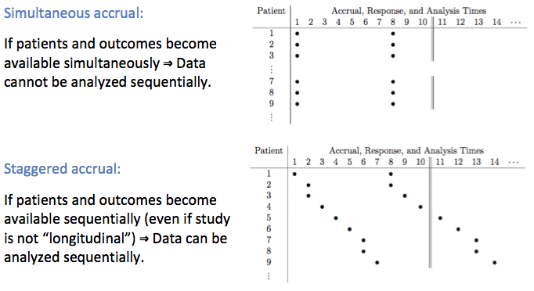
Monitoring efficacy
* We can take advantage of the possibility of early stopping if outcome times are spread out enough to allow interruption of accrual or intervention.
* The amount of information in the trial is a function of the number of patients, the amount of follow-up time, and the variability of the outcome variable.

Slide 5
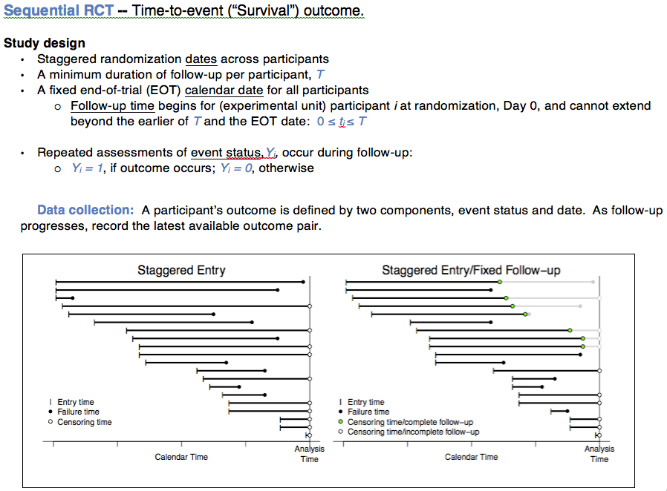
.

Slide 6
Time-frames of RCTs, with examples presented by students
Enrollment / Accrual | Outcome Assessment | Study Design & Outcomes (Behavioral, Therapeutic, Either) | Trial Duration
Non-sequential RCT Simultaneous for all PPTs | Y = Single value per PPT, collected simultaneously for all. → No or same f’up period for all. | Cross-sectional | All accrual and follow-up within short time period
Sequential RCT Staggered accrual over time | Y = Single value per PPT, collected after fixed follow-up period for all. → Fixed f’up duration for all. | Cross-sectional 9 examples provided by students, excluding 4 listed below | From accrual of initial PPT to assessment of final PPT.
Sequential RCT Staggered accrual over time | {Y,date} = Multiple values per PPT, collected over minimum intervals. → All PPTs should achieve minimum f’up; those accrued early could contribute longer f’up. | Longitudinal: Repeated measures # symptom-free days, per 2-wk period Time-to-event First positive HIV test Cancer Recurrent VTE or major bleeding | From accrual of initial PPT to final assessment of final PPT.

Slide 7
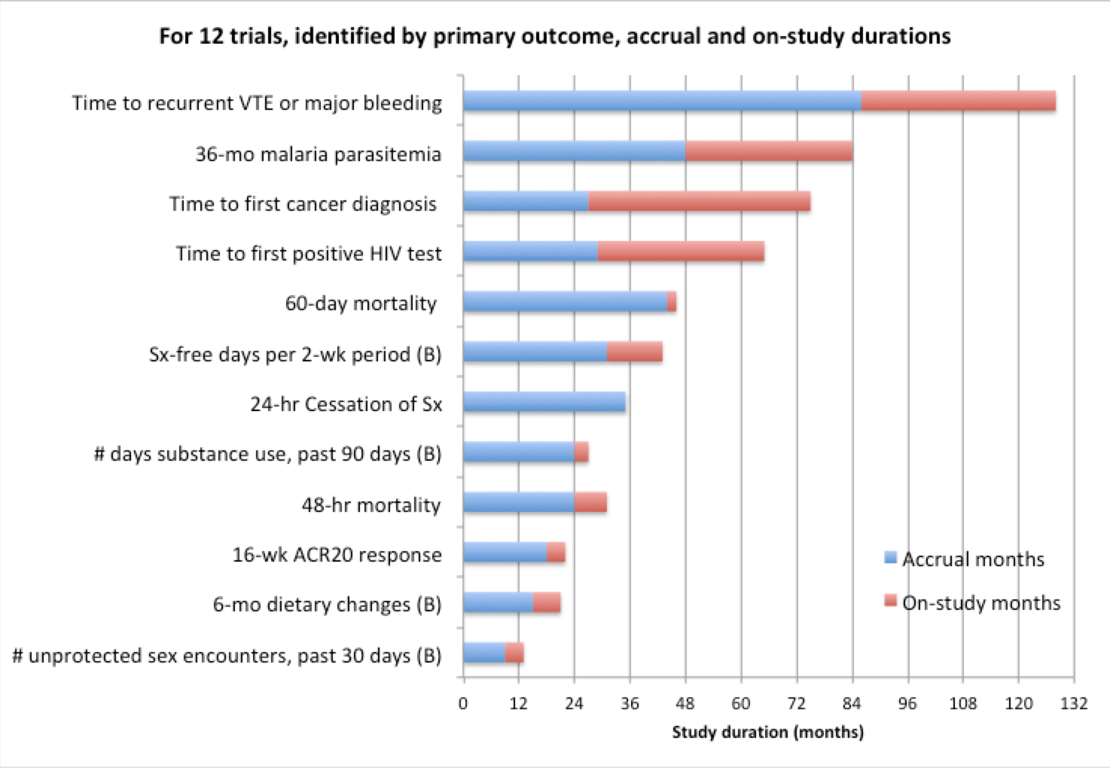
Time-frames of RCT examples presented by students; (B) denotes behavioral outcome
Accrual period accounts for a large proportion of overall study time. What are drivers of accrual duration?
“On-study” months: Exposure and Assessment periods can be distinct or overlap. How decided?
Of 4 longest trials, 3 use time-to-event outcomes (when events are rare, longer follow-up time can reduce # PPTs) and 1 targets a long-term public health intervention (with a small intervention effect).
Many RCTs fail to complete planned accrual. Then do not achieve planned power to detect hypothesized intervention effect.
Notes:
Drivers of accrual: Available PPT pool; consent rate

Slide 8
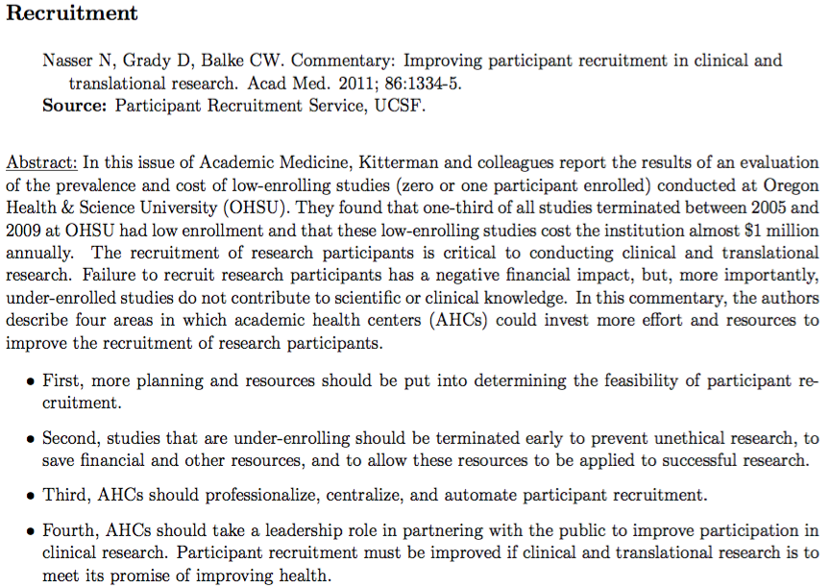

Slide 9
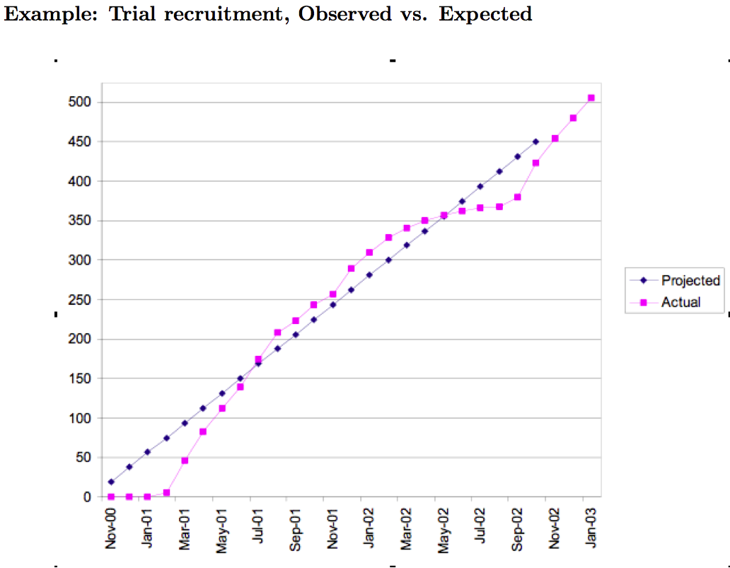

Slide 10
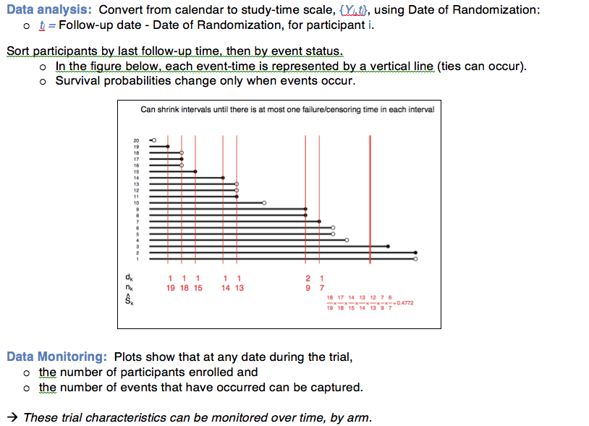
Notes:
This plot does not show change in estimate of SD

Slide 11
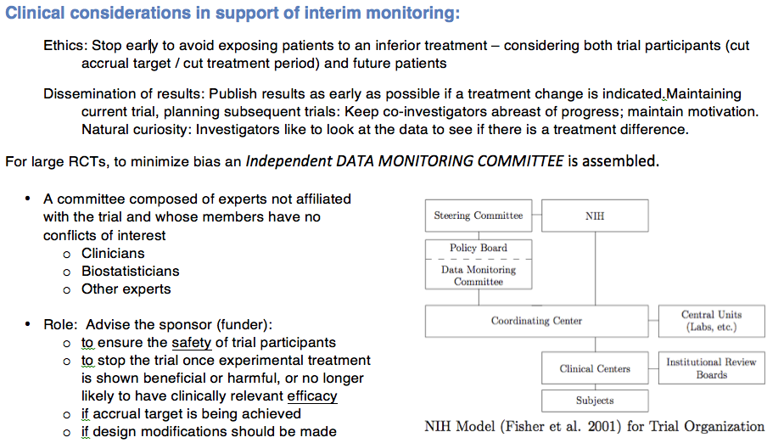
x

Slide 12
Time-frames of RCT examples presented by students; (B) denotes behavioral outcome
Investigators’ time frame (shown):
  Stopping during accrual period avoids exposing some participants to inferior treatment.
Participants’ time frame (not shown):
  Stopping during treatment period reduces exposure of some participants to inferior treatment.
Notes:
Drivers of accrual: Available PPT pool; consent rate

Slide 13
Resources
DeMets, Furberg, Friedman textbook, especially Chapter 2 – overview of 29 case studies (therapeutic trials; prevention and treatment)
Code of Federal Regulations (CFR) Title 45 Part 46
NIH : Overall policy and guidance by Institute/Center on data and safety monitoring.
https://humansubjects.nih.gov/data_safety
  NIDDK – addresses statistical issues related to efficacy monitoring
  NCI -- discusses site monitoring for protocol compliance; emphasizes safety over monitoring of efficacy outcomes (e.g., UCSF HDFCCC DSMB)
  NIAMS – sample Charter for DSMB
FDA
  Guidance for Clinical Trial Sponsors
  FDA Guidance for Industry E6 Good Clinical Practice: Consolidated Guidance
    5.5.2 The sponsor may consider establishing an independent data monitoring committee (IDMC) to assess the progress of a clinical trial, including the safety data and the critical efficacy endpoints at intervals, and to recommend to the sponsor whether to continue, modify, or stop a trial. The IDMC should have written operating procedures and maintain written records of all its meetings.

Slide 14
Last reviewed October 5, 2010
Relevant Extramural SOPs: Human Subject Resources
NIAID role: Clinical Trial Safety Monitoring and Reporting Requirements
After peer review
NIAID commits funds.
Before enrolling patients
As part of the completed protocol, PI details safety monitoring plans and procedures including assessing, documenting, and reporting adverse events.
PI sends to program officer or medical officer for approval.
Program officer or medical officer review
Does the PO or MO have concerns about patient safety?
Yes, concerned
PO or MO sends recommendations to the PI for collaborative revisions.
No concerns → Approval
PO or MO approves safety plan and adverse event reporting plan.
IRB, FDA, and NIAID address DSMB and SAE reports
PO must email or fax PI within 10 days and send official letter within 30 days of receipt.
NIAID can terminate award or take other action if PI does not comply with monitoring plan.
Patients may be enrolled once the trial meets all approval requirements.
Needs IRB approval of complete protocol as well as approval by other parties such as the DSMB, FDA, and division regulatory staff.
Serious adverse events
PI provides reports of serious adverse events following Guidance for Complying with the NIAID Clinical Terms of Award.
For multi-site trials, PI also sends DSMB summary reports to all IRBs and program officer.
During a clinical trial
PO monitors compliance with monitoring plan and adverse event reporting requirements.

Slide 15
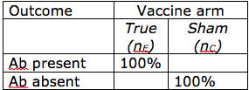
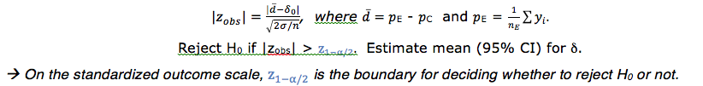
Statistical considerations regarding interim monitoring of a sequential RCT.
Review of statistical testing … Starting with a cross-sectional RCT.
Example: Efficacy of polio vaccination – confers lifelong immunity to the virus almost immediately.
Study design to determine efficacy:
Randomize susceptibles to True or Sham vaccine.
Test for presence of antibodies: Y_{i}=1 if present.
Parameterizations of intervention effect: risk difference,
RR, or odds ratio.
We usually test a two-sided alternative against the null hypothesis of no treatment effect:
H₀: δ₀ = 0 versus H_{A}: δ₀ ≠ 0, where δ₀ = π_{E} – π_{C}
Conduct a single analysis at the end of a trial: Estimate the treatment effect and its 95% confidence interval and Test H₀ – often using a test statistic with a standard normal distribution.
Let d represent the mean observed difference between active and control arms (data) and δ₀ represents the value of the mean parameter when H₀ is true.
Notes:
NB: A Normal approximation would work well if p=0.5 and n large. Generally, would use logistic regression for binary outcomes.

Slide 16
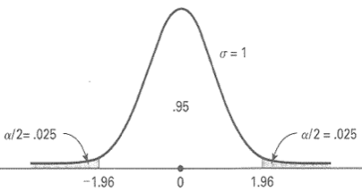
Review: Recall the standard Normal distribution and the one-to-one relationship between standardized outcome scale, z_{obs}, and probability scale.
Standard normal probability density function, Pr{Z = z_{obs}}: When H₀ true, mean = 0, SD = 1.
Horizontal axis: z = (d-δ₀)/SE. Vertical axis: Pr{Z = z}. Shaded areas: Pr{|Z|>z_{1-α/2} } = α .
Correspondence between common benchmarks: When α = 0.05, z_{1-α/2}= 1.96 and z_{1-α}= 1.645.
A statistical test can be conducted via comparison with either the x-axis or an area of the probability distribution. For 2-sided test:
On data scale: Reject H₀ if |z_{obs}|=|d-δ₀|/ (2σ/n) > z_{1-α/2}.
On probability scale: Reject H₀ if p-value < α = Pr{|z_{obs}|>z_{1-α/2} } < α.
Note that the test assumes H₀ is true; the results (data) reject or do not reject H₀.
Notes:
Note also

Slide 17
At the end of the RCT, we want to be able to draw a firm conclusion: “reject H₀” or “do not reject H₀.”
→ However, our conclusion will be based on data, and errors can occur. ←
    When H₀ is true: Specificity = 1-α = Pr{Do no reject H₀, when H₀ is true}
    When H_{A} is true: Sensitivity = 1-β = power = Pr{Reject H₀, when H₀ is false}
Risk of false-positive finding is α.
Its consequence: Claim that an intervention is effective when it isn’t.
Changes standard of care from Control to Experimental in a broad population.
We work hard to minimize this important error.
What is consequence of type-2 error?
Statistical test | Two possible true states
 | H_{A}: δ ≠ 0 | H₀: δ = 0
|z_{obs}|≠ 0: Reject H₀ … “positive trial” | TP = 1-β | FP = α
|z_{obs}|= 0: Do not reject H₀ … “negative trial” | FN = β | TN = 1-α
Notes:
What is consequence of type-2 error?

Slide 18
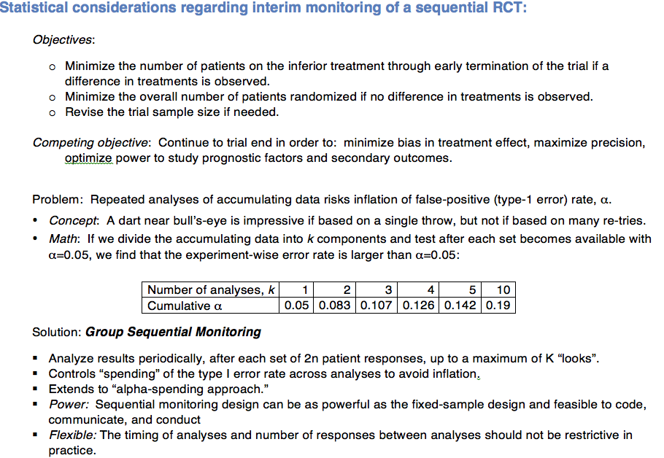
Notes:
multiple comparisons: The more often one analyses the accumulating data, the greater the chance of eventually and wrongly detecting a difference, and thus drawing incorrect conclusions from the trial.

Slide 19
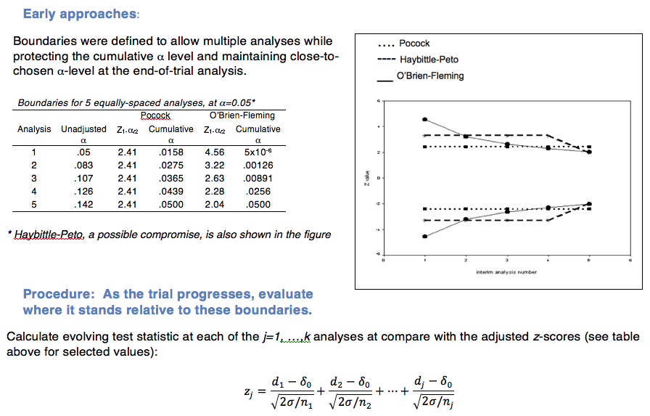
Notes:
Still makes use of the 1:1 relationship between the information captured by the data and how common / rare that outcome is when H₀ is true.
Here, extending the cross-sectional trial example, the Z-statistic is Normally distributed.

Slide 20
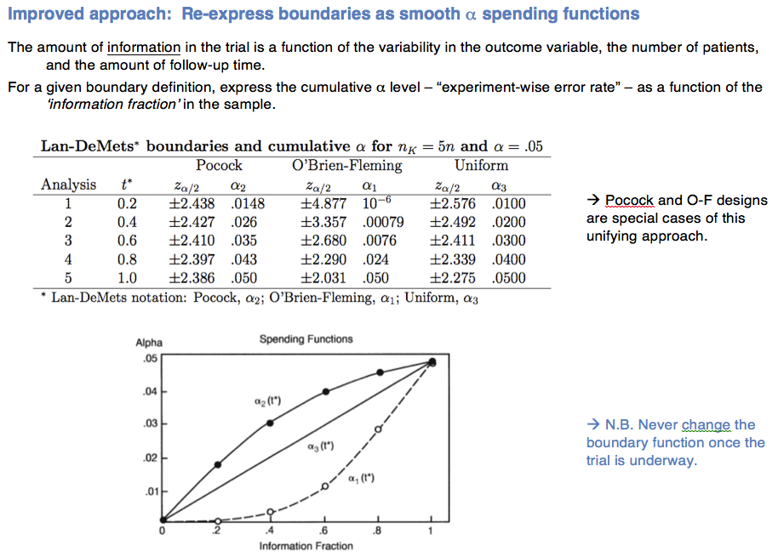

Slide 21
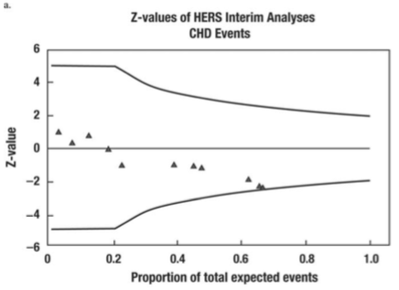
Example, from DFF textbook, Case 17 – Heart and Estrogen/Progestin Replacement Study (HERS) Trial:
Figure 1. Lan and DeMets plots of Z-values over the first two-thirds of the study for interim looks at the relative hazard comparing hormone replacement therapy (HRT) to placebo for CHD deaths. Positive values represent lower event rates in the hormone treatment group.

Slide 22
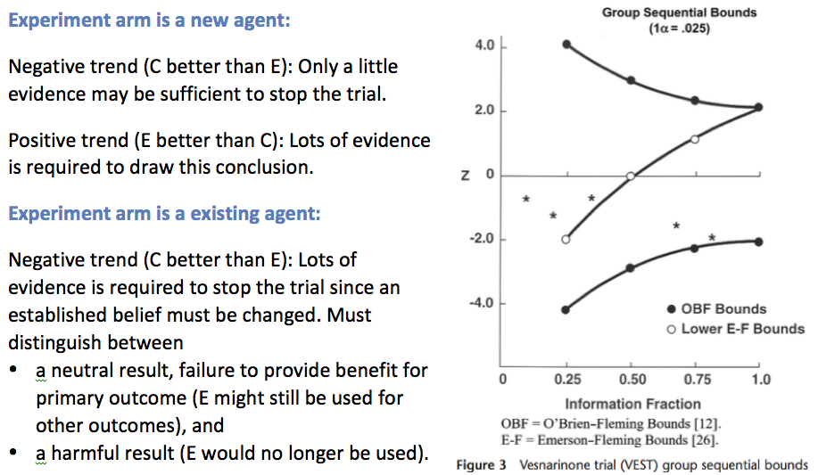
Trials can also be monitored for futility (Ref: Demets, 2006)

Slide 23
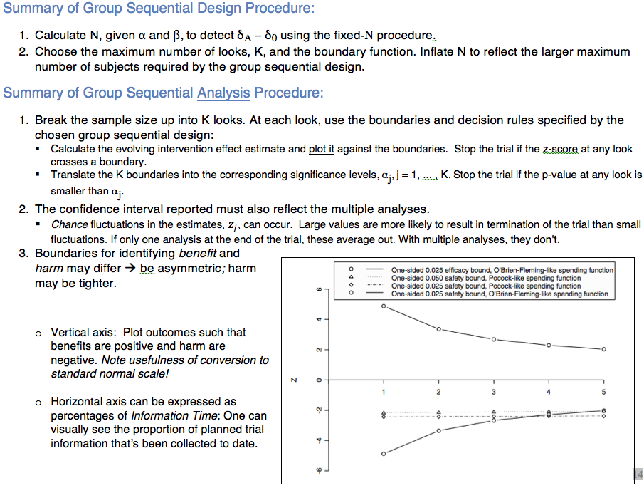

Slide 24
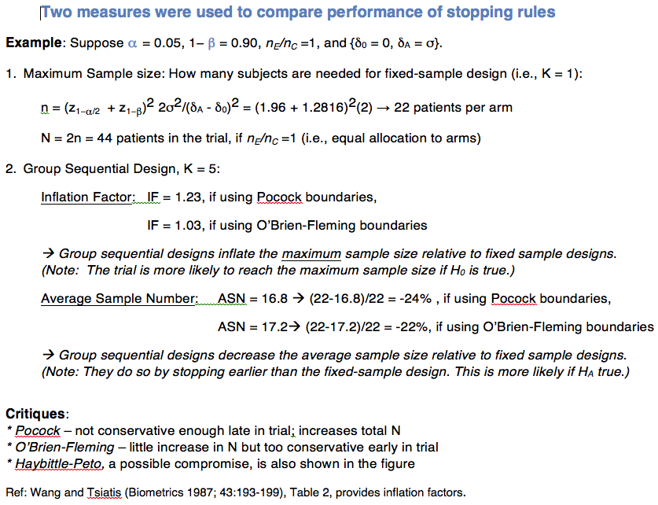

Slide 25
More comments on efficacy monitoring:
A formal significance test is only one factor in the decision to continue or stop a trial. DSMB may recommend stopping an arm or the whole trial or may choose to watch and wait.
Estimated efficacy is just that – an estimate, that is subject to variation. At a particular interim analysis, it may be on a high or low “bounce.”
Stopping for evidence in favor of H_{A} (efficacy or harm): controls spending of α. Stopping for evidence in favor of H₀ (futility): controls spending of β.
Evidence in support of benefit and harm needn’t be symmetrical.
  The trial seeks to “prove” benefit: direction of interest is one-sided, using one primary endpoint.
  The trial seek to “detect” harm: direction of concern is one-sided, based on multiple measures of harm (eg, organ/system classes of adverse events).

Slide 26
Monitoring Safety is Statistically Challenging
Adverse event (AE) definitions must be consistent
  MedDRA = Medical Dictionary for Regulatory Activities is an adverse event classification dictionary used in the USA, European Union, and Japan, endorsed by the International Conference on Harmonisation (ICH)
AEs may be disease-related or treatment-related
  Adverse events that are rare and unexpected may signal harm → relies heavily on medical judgment.
  AEs vary in frequency and in severity (mild to life-threatening). The threshold for harm depends on the context.
    The threshold in a prevention study is lower than in a treatment trial.
    Healthy people may be less willing to tolerate drowsiness than patients with metastatic cancer.
  AEs may arise earlier or later than efficacy outcomes → thus f’up periods for efficacy and safety outcomes can differ.
    CHD versus breast cancer (WHI Trial).
    Diabetes versus death (ACCORD Trial).
… Thus A Structured Approach Helps Identify Harm (see Lineberry et al HW2 reading)
A pre-specified safety boundary helps a DSMB make judgments about the endpoint of interest when the data are showing harm.
  It allows earlier termination of the study with a statistically based conclusion of harm.
Estimates of mean differences (95% CIs) are more useful than tests of differences between arms. Within-arm reference is expected prevalence in study population.

Slide 27
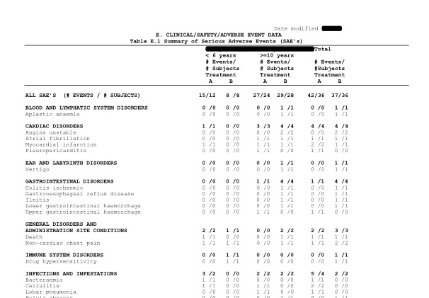

Slide 28
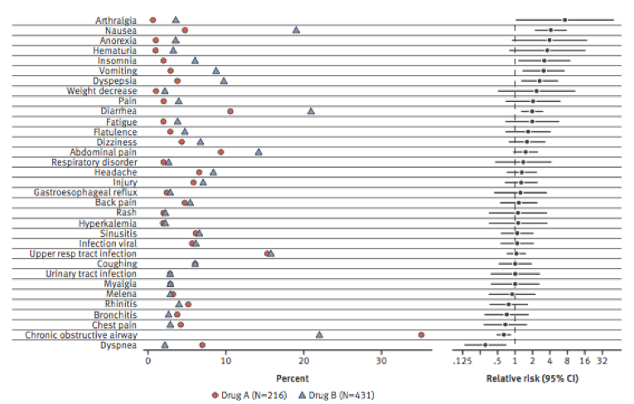
Notes:
Lineberry

Slide 29
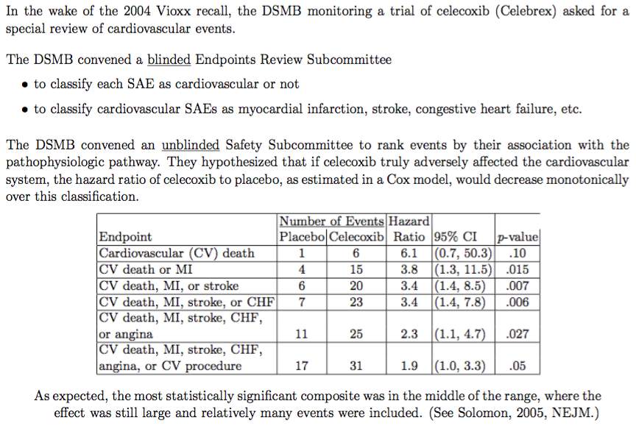
Effect of external information on monitoring: Use of a composite safety outcome

