Slide 1
Causal Inference
Epidemiology 207 - Epidemiology Methods II
Rebecca E. Graff, ScD
Assistant Professor, Epidemiology & Biostatistics

Slide 2
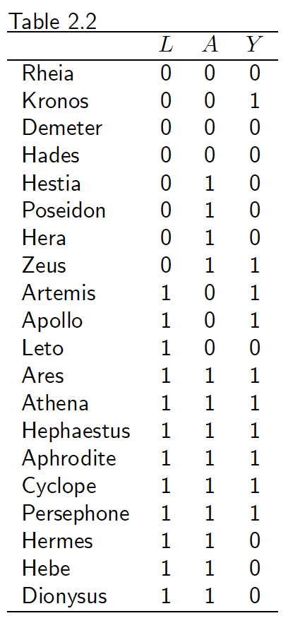
Standardized Risk in the Unexposed
Pr(L = 0) = 8/20
Pr(L = 1) = 12/20
Assuming consistency and conditional exchangeability hold:
Pr(Y^{a=0} = 1 | L = 0) = Pr(Y = 1 | A = 0, L = 0) = 1/4
Pr(Y^{a=0} = 1 | L = 1) = Pr(Y = 1 | A = 0, L = 1) = 2/3
Pr(Y^{a=0} = 1) = Pr(Y = 1 | A = 0, L = 0) * Pr(L = 0) +
Pr(Y = 1 | A = 0, L = 1) * Pr(L = 1)
= (1/4) * (8/20) + (2/3) * (12/20)
= 0.5

Slide 3
Questions about Our Conditionally Randomized Experiment
Does exchangeability hold?
  No, Pr(Y^{a=0}=1 | A = 1) ≠ Pr(Y^{a=0}=1 | A = 0) and, furthermore Pr(Y^{a=1}=1 | A = 1) ≠ Pr(Y^{a=1}=1 | A = 0)
Does conditional exchangeability given L hold?
  Yes, Pr(Yª = 1 | A = 1, L = l) = Pr(Yª = 1 | A = 0, L = l) for all a and l
Is there a null average causal effect of A on Y?
  Yes, Pr(Y^{a=1} = 1) = Pr(Y^{a=0} = 1)
Is there a null association between A and Y?
  No, Pr(Y = 1 | A = 1) ≠ Pr(Y = 1 | A = 0)

Slide 4
Inverse Probability Weights
Original Data:
Pr(A = 1 | L = 1) = (6+3)/(6+3+2+1) = 0.75
Pr(A = 0 | L = 1) = (2+1)/(6+3+2+1) = 0.25
Pr(A = 1 | L = 0) = (1+3)/(1+3+1+3) = 0.5
Pr(A = 1 | L = 0) = (1+3)/(1+3+1+3) = 0.5
Inverse Probability Weights:
 | L = 1 |  | L = 0
 | Y = 1 | Y = 0 | Y = 1 | Y = 0
A = 1 | 6 | 3 | 1 | 3
A = 0 | 2 | 1 | 1 | 3
 | L = 1 |  | L = 0
 | Y = 1 | Y = 0 | Y = 1 | Y = 0
A = 1 | 1 / 0.75 = 1.33 | 1 / 0.75 = 1.33 | 1 / 0.5 = 2 | 1 / 0.5 = 2
A = 0 | 1 / 0.25 = 4 | 1 / 0.25 = 4 | 1 / 0.5 = 2 | 1 / 0.5 = 2

Slide 5
Creating the Pseudopopulation
Application of Inverse Probability Weights:
Pseudopopulation (having removed the effect of L):
 | L = 1 |  | L = 0
 | Y = 1 | Y = 0 | Y = 1 | Y = 0
A = 1 | 6*1.33 = 8 | 3*1.33 = 4 | 1*2 = 2 | 3*2 = 6
A = 0 | 2*4 = 8 | 1*4 = 4 | 1*2 = 2 | 3*2 = 6
 | Y = 1 | Y = 0
A = 1 | 10 | 10
A = 0 | 10 | 10

