Slide 1

Perspectives on Causal Inference
Epidemiology 207 - Epidemiology Methods II
June M. Chan, ScD
Professor, Epidemiology & Biostatistics and Urology
Steven & Christine Burd Safeway Distinguished Professor

Slide 2
Brief Overview of Causal Models and Heuristics
Causal guidelines (B. Hill)
Sufficient cause & Causal Pies (Rothman, Ch. 2)
Counterfactual model and causation vs. association (Hernan & Robins, Causal Inference, Ch. 1)
Notes:
Causal Inference, online book, Hernan & Robins, Ch. 1

Slide 3

Counterfactual Heuristic
What is a counterfactual?
Individual causal effect and average causal effect
What do we calculate using counterfactuals and idea of average causal effect?
How does what we calculate using counterfactuals compare to what we calculate when using observed data?
Causation ≠ Association
Notes:
Recommended reading: Ch. 1, Hernan & Robins Online Book. Causal Inference, updated 10/4/2017
https://www.hsph.harvard.edu/miguel-hernan/causal-inference-book/

Slide 4
What is a counterfactual?

Slide 5

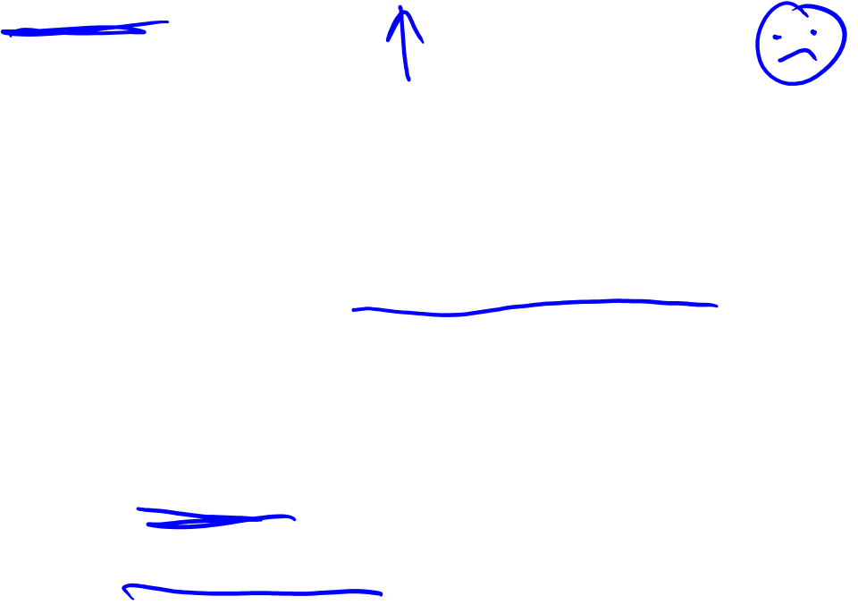
"Zeus is a patient waiting for a heart transplant. On January 1, he receives a new heart. Five days later, he dies. Imagine that we can somehow know, perhaps by divine revelation, that had Zeus not received a heart transplant on January 1, he would have been alive five days later. Equipped with this information most would agree that the transplant caused Zeus’s death. The heart transplant intervention had a causal effect on Zeus’s five-day survival.”
Hernan & Robins
Causal Inference, 2017

Slide 6
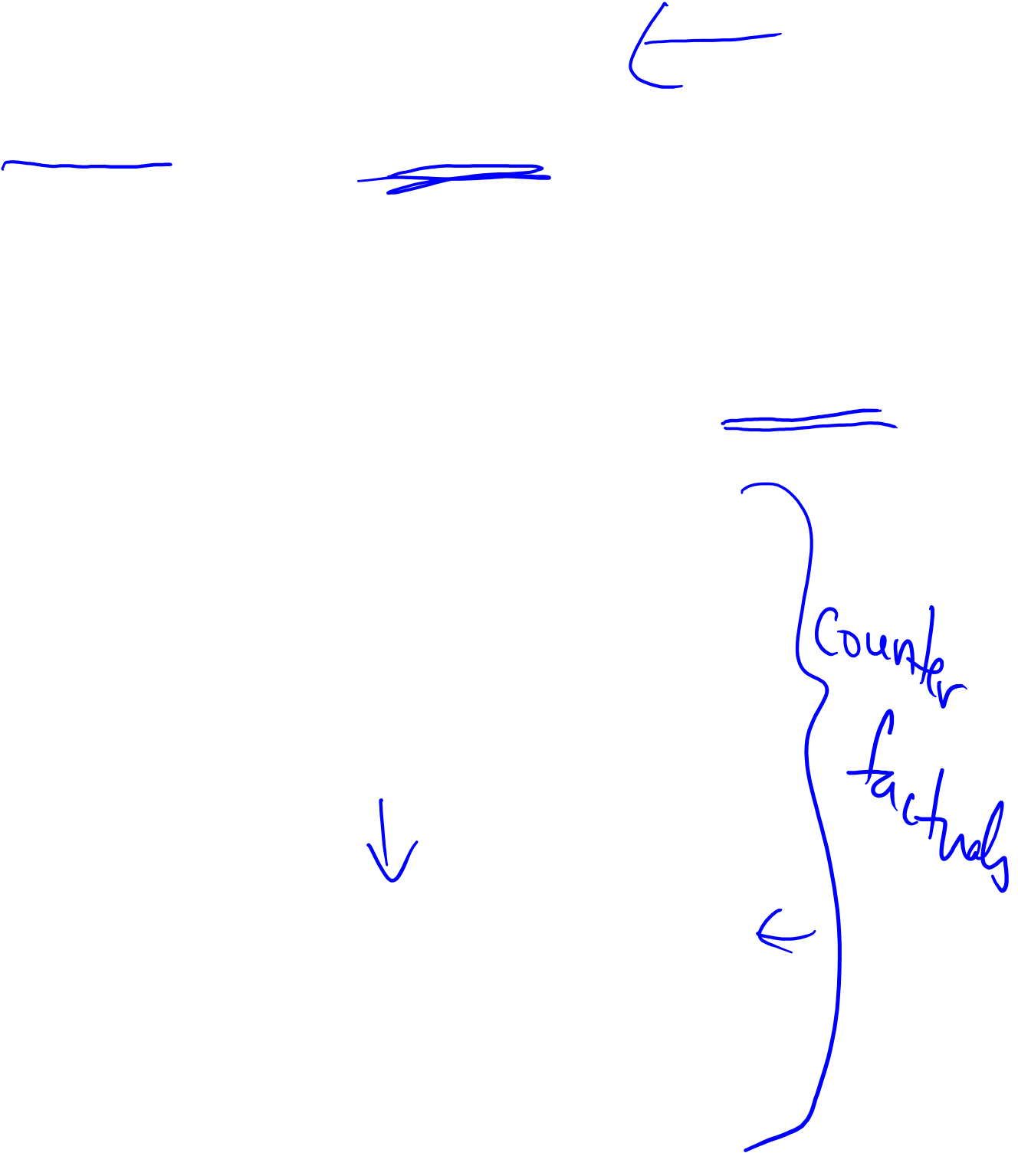
Motivating the idea of a “counterfactual”
Zeus had a heart transplant and dies after 5 days.
In an ideal experiment, you could rewind time, NOT give Zeus the heart transplant and observe what happens.
Then you could compare the outcome when Zeus had the transplant vs. did not have the transplant, and draw an inference about whether the transplant caused his death
Scenario 1: Zeus has transplant and dies in 5 days
Scenario 2: Zeus does NOT have transplant and is still alive 5 days later
Acknowledgement: Matteo Allen, graphical assistance

Slide 7

Motivating the idea of a “counterfactual” continued…
Notation:
  Let A reflect an action taken, like having a heart transplant
  A=1 means treated; A=0 means not treated
  Let Y reflect an outcome, Y=1 dead, Y= 0 alive
Revise this statement: Then you could compare outcome (Y) when Zeus had the transplant (Y^{a=1}) vs. did not have the transplant (Y^{a=0}), and draw an inference about whether the transplant caused his death.
These two potential outcomes (Y^{a=1} and Y^{a=0}) are “counterfactuals”
If the counterfactual outcome under the condition a=1 is dead, and the counterfactual outcome under the condition of a=0 is alive, then we infer that the transplant (A) caused Zeus’s death.
  If Y^{a=1} = 1 ≠ 0 = Y^{a=0} then we infer that A has causal effect on the individual
General definition of a causal effect for individual “i”: Y_{i}^{a=1} ≠ Y_{i}^{a=0}

Slide 8
How is this concept of a counterfactual used in epidemiology?

Slide 9

Striving for the Counterfactual
Recap of Epid Methods I – Confounding I
In the real (observable) world all of our strategies in analytic studies to eliminate confounding are striving to simulate the counterfactual
We strive for our TWO distinct populations (exposed & unexposed) to be “exchangeable”
  i.e., identical in the “other influences” upon them
Whenever the TWO distinct populations are “non-exchangeable”, confounding will occur
Our strategies to manage confounding are attempts to make populations exchangeable
  Exchangeable populations are, in theory, achievable
  In practice, however, we cannot prove that we have achieved exchangeability
  For our work to move forward, we nonetheless have to assume that we have achieved exchangeability
Notes:
Fr Epid Methods 1, J martin 2017
So, you may not have known it, but we are always striving for the counterfactual in our analytic work. We cannot ever get to the counterfactual per se so the next best thing is to have our two distinct populations to be “exchangeable”, in other words, identical in their “other influences” except for the exposure under study. After all, this is what we would have if we had the counterfactual situation.
Whenever our TWO distinct populations are not exchangeable, confounding will be present. It therefore follows that all of our strategies to manage confounding are attempts to make our populations under study (exposed and unexposed) exchangeable. It is important to note that exchangeable populations are, in theory, achievable, but we cannot prove, in practice, that any two populations are exchangeable. Yet, in practice, in order for us to be able to move on and conduct science and make causal inferences that have implications for public health and clinical practice, we have to work under the belief or assumption that we have achieved exchangeability.
Some students upon initially learning about counterfactuals express some skepticism and wonder about the relevance because it sounds like make believe. Counterfactual theory, however, is now the dominant paradigm in epidemiology and the dominant theory in the field of causal inference. The reason is because it clarifies the meaning of some heretofore vague concepts, and it also provides a framework for expressing important metrics in research and resolving some complex analytic issues. It is gaining traction in all aspects of human subjects-based health-related research. Everyone should all be familiar with this concept. I encourage everyone to think it over in a quiet room.
(Jewell Chapt 8 explains exchangeability in terms of the “randomization assumption”.)

Slide 10

Usage of counterfactuals for causal inference
In real life, for each individual, only one of the outcomes is actually observed
However, in an ideal setting, to evaluate causation, we would want to observe and compare the counterfactual outcomes under the different possible treatment actions.
While we cannot do this in real life, this counterfactual concept helps us think about confounding and has led to methods that attempt to simulate this kind of “experiment”

Slide 11




















Hades
Zeus… & his extended family!
N = 20
Leto
Cyclope
Persephone
Acknowledgement: Matteo Allen, graphical assistance

Slide 12

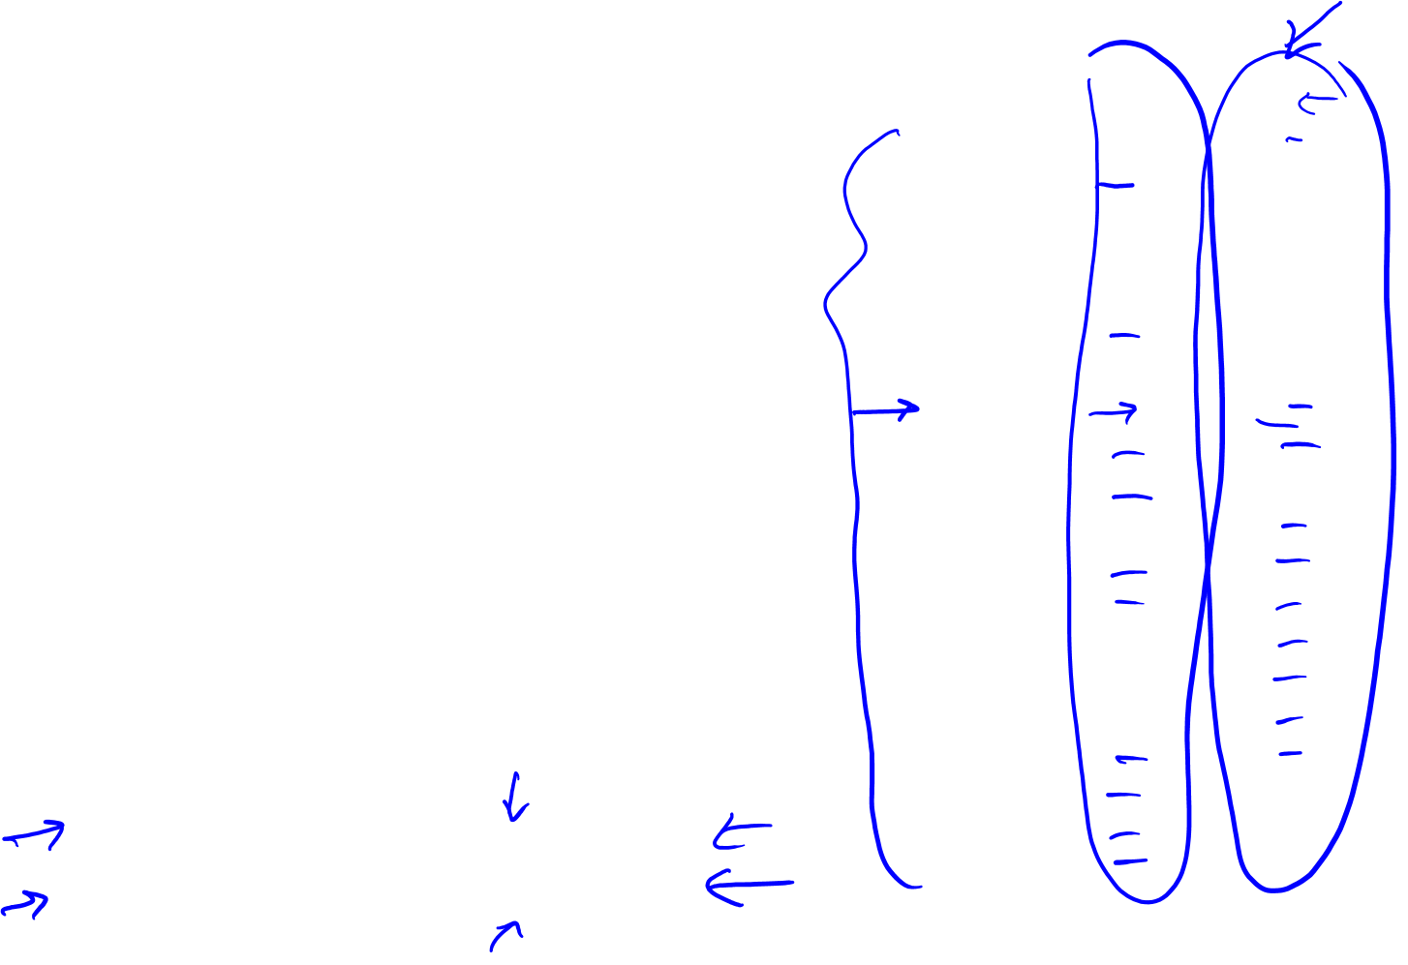
Average Causal Effects
Counterfactuals
Hades
Leto
Cyclope
Persephone
Probability of death when a=1 is 10/20
Probability of death when a=0 is 10/20
Acknowledgement: Matteo Allen, graphical assistance
Notes:
Table 1.1 from Hernan & Robins, Causal Inference book

Slide 13
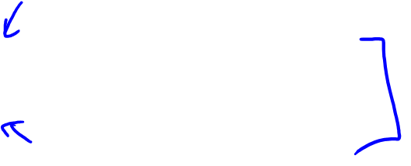
Average Causal Effects
Counterfactuals
Hades
Leto
Cyclope
Persephone
Probability of death when a=1 is 10/20: Pr(Y^{a=1}=1) = .5
Probability of death when a=0 is 10/20: Pr(Y^{a=0}=1) = .5
We infer that on average, in this population, heart transplant does not cause death
Acknowledgement: Matteo Allen, graphical assistance
Notes:
Table 1.1 from Hernan & Robins, Causal Inference book
Pr(Y^{a=1}=1) is the “counterfactual risk under treatment”
Pr(Y^{a=0}=1) is the “counterfactual risk under no treatment”

Slide 14

Average Causal Effects
Counterfactuals
Hades
Leto
Cyclope
Persephone
We infer that there is an average causal effect if:
Pr(Y^{a=1}=1) ≠ Pr(Y^{a=0}=1)
There is an average causal effect if the probabilities of the counterfactual outcomes is different.
Acknowledgement: Matteo Allen, graphical assistance
Notes:
Table 1.1 from Hernan & Robins, Causal Inference book
Pr(Y^{a=1}=1) is the “counterfactual risk under treatment”
Pr(Y^{a=0}=1) is the “counterfactual risk under no treatment”
Because Risk is the Average for a population, we also can also write the following relationship, where E denotes expectation or average for the population:
E[Y^{a=1}] ≠ E[Y^{a=0}] to denote a causal effect for dichotomous and non-dichotomous outcomes

Slide 15

Average Causal Effects vs Individual Effects
From Table 1.1, there was no average causal effect in this population: (Pr(Y^{a=1}=1) = .5 = Pr(Y^{a=0}=1)
However, in Table 1.1, we can observe an individual causal effect in 12 members.
For 6 members, the action caused harm; in 6 members it was beneficial
For the other 8 members, the outcome was the same regardless of the action taken.
Counterfactuals
Hades
Leto
Cyclope
Persephone
Acknowledgement: Matteo Allen, graphical assistance
Notes:
Table 1.1 from Hernan & Robins, Causal Inference book
The harm in 6 and benefit in 6 is not an accident. This exact opposite effect in an equivalent number of people is what makes the average causal effect 0 or null.

Slide 16

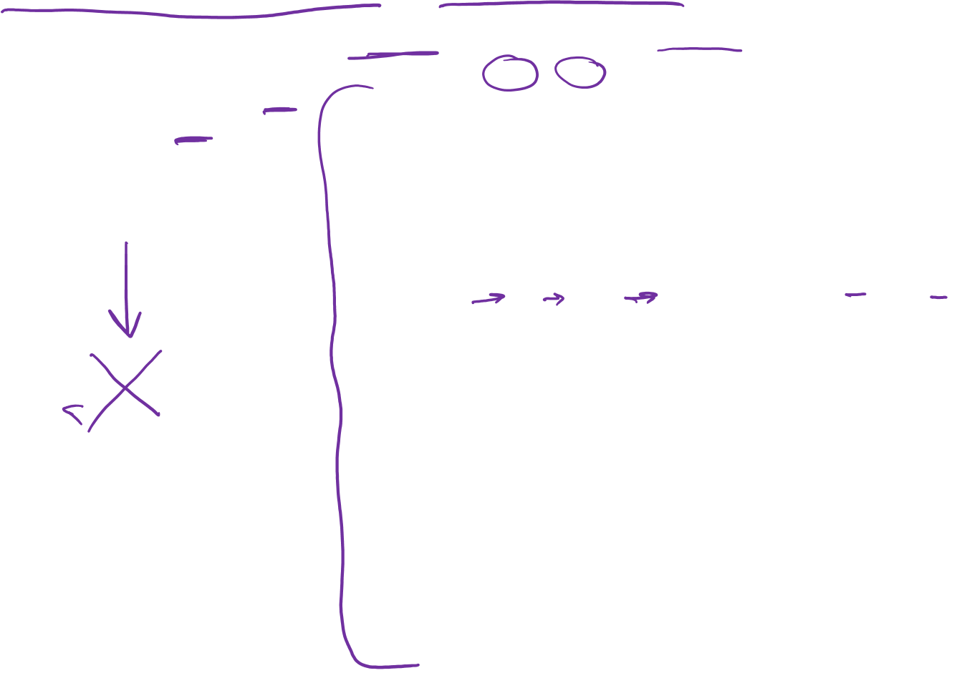
Observed Actions and Txs vs Counterfactuals
Recall that in real life, we only observe one action taken (A) and one outcome (Y).
For Zeus’s family, this is shown in Table 1.2.
Observed Counterfactuals
Hades
♥️
♥️
♥️
Leto
♥️
♥️
♥️
♥️
♥️
♥️
♥️
♥️
Cyclope
Persephone
♥️
♥️
♥️
♥️
♥️
♥️
♥️
♥️
♥️
Acknowledgement: Matteo Allen, graphical assistance
Notes:
Table 1.1 from Hernan & Robins, Causal Inference book

Slide 17
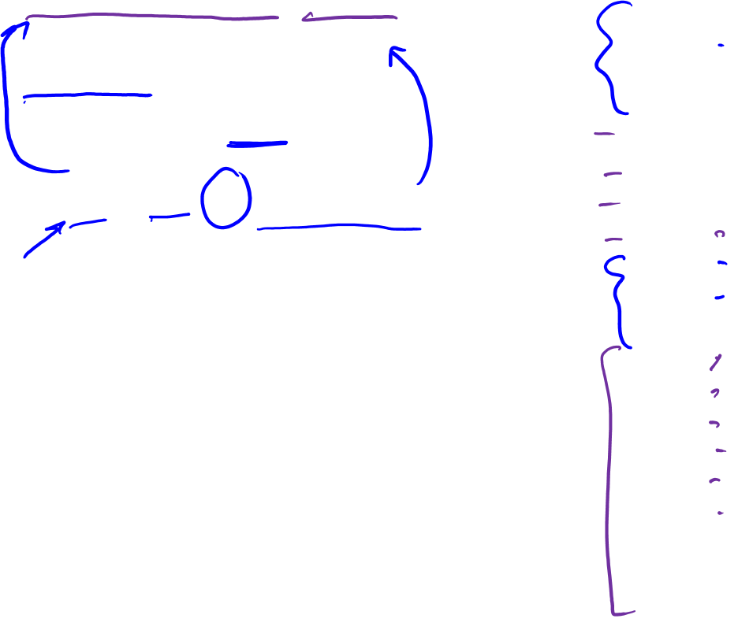
Observed Actions and Txs vs Counterfactuals
From Table 1.2:
13 members Treated, 7 deaths
7 were Not Treated, 3 deaths
RR of Tx: (7/13) / (3/7)
= 49/39 = 1.26
Pr[Y=1|A=1] ≠ Pr[Y=1|A=0]
Observed Counterfactuals
Hades
♥️
♥️
♥️
Leto
♥️
♥️
♥️
♥️
♥️
♥️
♥️
♥️
Cyclope
Persephone
♥️
♥️
♥️
♥️
♥️
♥️
♥️
♥️
♥️
Acknowledgement: Matteo Allen, graphical assistance
Notes:
Table 1.1 from Hernan & Robins, Causal Inference book

Slide 18

Observed Actions and Txs vs Counterfactuals
So, based on observed data from Table 1.2,
RR of Tx = 1.26 AND
Pr[Y=1|A=1] ≠ Pr[Y=1|A=0]
Indicating an association
But, recall from Table 1.1.
Pr(Y^{a=1}=1) = .5 = Pr(Y^{a=0}=1)
Indicating NO average causal effect
Observed Counterfactuals
Hades
♥️
♥️
♥️
Leto
♥️
♥️
♥️
♥️
♥️
♥️
♥️
♥️
Cyclope
Persephone
♥️
♥️
♥️
♥️
♥️
♥️
♥️
♥️
♥️
Acknowledgement: Matteo Allen, graphical assistance
Notes:
Table 1.1 from Hernan & Robins, Causal Inference book

Slide 19
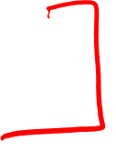
Observed Actions and Txs vs Counterfactuals
RR of Tx = 1.26 AND
Pr[Y=1|A=1] ≠ Pr[Y=1|A=0]
Indicating an association
BUT: Pr(Y^{a=1}=1) = .5 = Pr(Y^{a=0}=1)
Indicating NO average causal effect
This is an example of how association does NOT equal causation!
Observed Counterfactuals
Hades
♥️
♥️
♥️
Leto
♥️
♥️
♥️
♥️
♥️
♥️
♥️
♥️
Cyclope
Persephone
♥️
♥️
♥️
♥️
♥️
♥️
♥️
♥️
♥️
Acknowledgement: Matteo Allen, graphical assistance
Notes:
Table 1.1 from Hernan & Robins, Causal Inference book

Slide 20

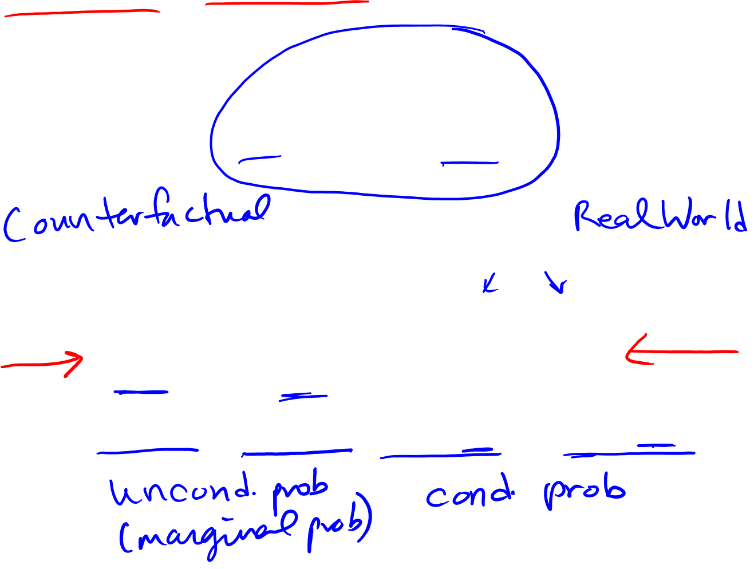
Causation vs. Association
Pr(Y^{a=1}=1) vs. Pr(Y^{a=0}=1)
Pr[Y=1|A=1] vs. Pr[Y=1|A=0]

Slide 21




vs.
Hades
Assessing Association via Observed Data
Leto
Cyclope
Persephone
Assessing Causation via Counterfactuals
Hades
vs.
Leto
Cyclope
Persephone
Acknowledgement: Matteo Allen, graphical assistance

Slide 22

Summary - Counterfactual Heuristic
Individual counterfactual outcomes (sometimes just called counterfactuals) refer to the theoretical outcomes (Y_{i}ª) we would observe if the individual experienced treatment (Y_{i}^{a=1}) or if s/he did not experience treatment (Y_{i}^{a=0})
Individual causal effect: Y_{i}^{a=0} ≠ Y_{i}^{a=1}
Average causal effects are assessed in a population by comparing the probability of the outcome if everyone was treated Pr(Y^{a=1}=1) vs. probability of the outcome if everyone was not treated Pr(Y^{a=0}=1)
Assessing a causal effect (using the concept of counterfactuals) is a comparison of two unconditional (or marginal) probabilities
  Causal effect: Pr(Y^{a=1}=1) ≠ Pr(Y^{a=0}=1)
Assessing association (using observed data) is a comparison of two conditional probabilities.
  Association: Pr[Y=1|A=1] ≠ Pr[Y=1|A=0]
Causation ≠ Association
Notes:
Recommended reading: Ch. 1, Hernan & Robins Online Book. Causal Inference, updated 10/4/2017
https://www.hsph.harvard.edu/miguel-hernan/causal-inference-book/

Slide 23
Causal Inference
Epidemiology 207 - Epidemiology Methods II
Rebecca E. Graff, ScD
Assistant Professor, Epidemiology & Biostatistics

Slide 24
Learning Objectives
Causal Models and Heuristics
  Bradford Hill Criteria
  Sufficient and Component Cause Model
  Counterfactual Model
Ideal Randomized Experiments
Conditional Randomization

Slide 25
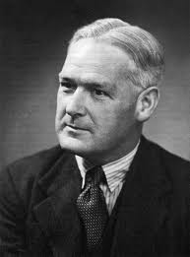
Bradford Hill Criteria
Strength
Consistency
Specificity
Temporality
Biological gradient
Plausibility
Coherence
Experiment
Analogy
Bradford Hill
(1897 – 1991)

Slide 26

Sufficient & Component Cause Model
Sufficient cause
Component cause
  Strong component cause
Necessary cause
U
T
A
B
X
B
Kenneth Rothman

Slide 27
Back to Counterfactuals

Slide 28
A Clarification on Notation
Capital letters denote random variables
  Variables that may have different values for different individuals
  A, Y, Y^{a=0}, Y^{a=1}
Lowercase letters denote possible values (realizations) of random variables
    a is a possible value (0 or 1) of the random variable A

Slide 29
Unconditional vs. Conditional Probabilities
Pr(Y^{a=1} = 1) is an unconditional (marginal) probability
  Proportion of subjects that would have developed the outcome Y had all subjects in the population of interest received exposure value a
  Calculated using the entire population
  Causal quantity
Pr(Y = 1 | A = 1) is a conditional probability
  Proportion of subjects that developed the outcome Y among subjects who received exposure value a in the population
  Calculated using a subset of the population
  Associational quantity

Slide 30
Sharp vs. Average Causal Null Hypothesis
Pr(Y^{a=1}=1) = Pr(Y^{a=0}=1) = 0.5
The average causal null hypothesis holds if:
Pr(Y^{a=1} = 1) = Pr(Y^{a=0} = 1)
The sharp causal null hypothesis holds if, for all subjects:
Y^{a=1} = Y^{a=0}
Does the sharp causal null hypothesis hold for these data?

Slide 31

Independence
Pr(Y = 1 | A = 1) = 7/13 = 0.54
Pr(Y = 1 | A = 0) = 3/7 = 0.43
The exposure A and the outcome Y are associated if
Pr(Y = 1 | A = 1) ≠ Pr(Y = 1 | A = 0)
No association = independence
A Y
Are A and Y independent?

Slide 32
Effect vs. Association Measures
Effect Measures | Association Measures
Pr(Y^{a=1}=1) / Pr(Y^{a=0}=1) | Pr(Y = 1 | A = 1) / Pr(Y = 1 | A = 0)
Ratio of unobserved risks | Ratio of observed risks
Cannot be directly computed because Y^{a=1} and Y^{a=0} are unobserved in some subjects in the population | Can be directly computed in any study because Y is observed in all subjects In the population

Slide 33
Causal Inference
Epidemiology 207 - Epidemiology Methods II
Rebecca E. Graff, ScD
Assistant Professor, Epidemiology & Biostatistics

Slide 34
Learning Objectives
Causal Models and Heuristics
  Bradford Hill Criteria
  Sufficient and Component Cause Model
  Counterfactual Model
Ideal Randomized Experiments
Conditional Randomization

Slide 35
Ideal Randomized Experiments

Slide 36
Key Features
Near infinite sample size
No loss to follow-up
Perfect adherence to the assigned treatment
One version of treatment
Double blind assignment

Slide 37

The Data
Only one counterfactual outcome is known for each individual
Randomization ensures that the missing values occur by chance
When group membership is randomly assigned, results are the same whether group 1 is treated and group 2 is untreated, or vice versa
The groups are exchangeable

Slide 38
Exchangeability
Pr(Yª = 1 | A = 1) = Pr(Yª = 1 | A = 0) = Pr(Yª = 1)
or, equivalently:
Yª A
How does this differ from Y A?

Slide 39
Consistency
If A_{i} = a then Y_{i}ª = Y_{i}^{A} = Y_{i}
For each subject, one of the potential outcomes (Y^{a=0} or Y^{a=1}) is the subject’s observed outcome Y
  i.e., the outcome under the treatment value that the subject actually experienced
The potential outcome Yª is factual for some subjects and counterfactual for others
  The term counterfactual is still used

Slide 40



Outcome Had Everyone Been Untreated
Pr(Y^{a=0} = 1)
Pr(Y^{a=0} = 1 | A = 1)
Pr(Y^{a=0} = 1 | A = 0)
Pr(Y = 1 | A = 0)

Slide 41


Outcome Had Everyone Been Treated
Pr(Y^{a=1} = 1)
Pr(Y^{a=1} = 1 | A = 0)
Pr(Y^{a=1} = 1 | A = 1)
Pr(Y = 1 | A = 1)

Slide 42
Does Exchangeability Hold?
Pr(Y^{a=0}=1 | A = 1) = 7/13
Pr(Y^{a=0}=1 | A = 0) = 3/7
Exchangeability doesn’t hold!

