Slide 1

Cohort Studies
Person Time & Bias
June M. Chan, ScD
Professor, Epidemiology & Biostatistics and Urology
Steven & Christine Burd-Safeway Distinguished Professor

Slide 2
Overview
Open vs. Fixed Cohorts
What do we calculate in Cohorts?
Assignment of Person Time
Survivor Cohorts
Bias
  Measurement Error
  Reverse Causation
  Confounding by Indication
  Residual Confounding
  Selection bias
  Immortal person time bias

Slide 3
Overview
Open vs. Fixed Cohorts
What do we calculate in Cohorts?
Assignment of Person Time
Survivor Cohorts
Bias
  Measurement Error
  Reverse Causation
  Confounding by Indication
  Residual Confounding
  Selection bias
  Immortal person time bias

Slide 4

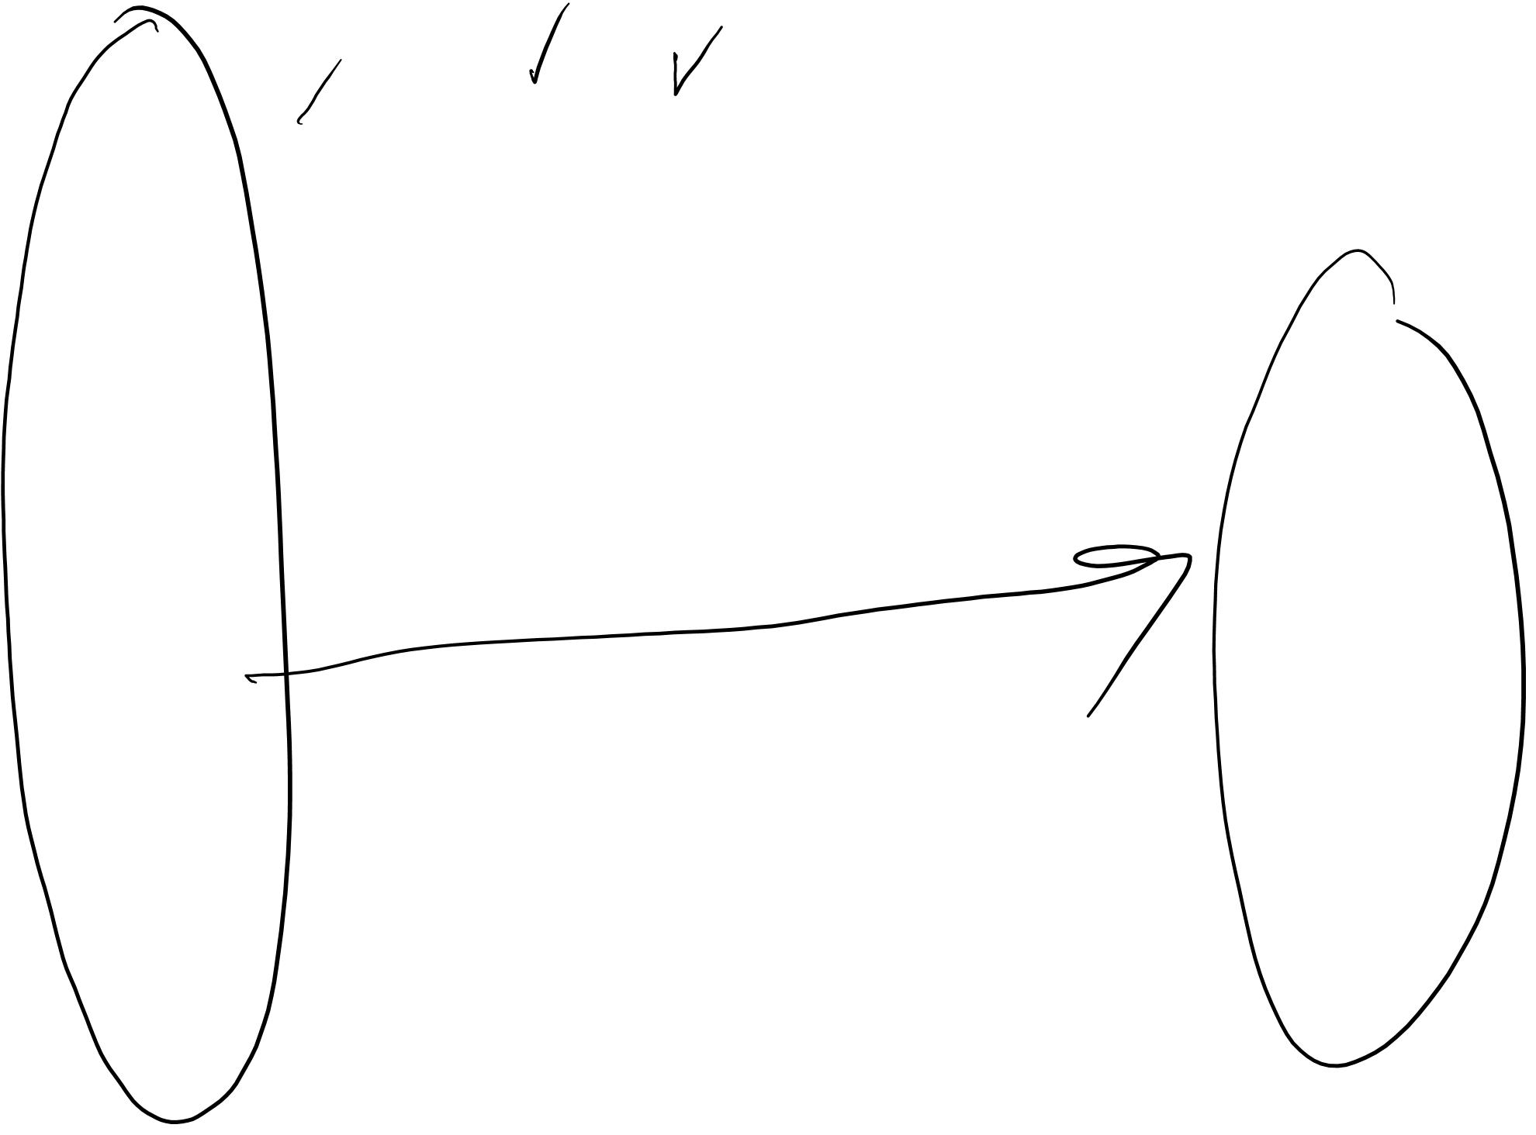
Recap of Epid Methods I – Study Design, week 1
Fixed (or “Closed”) Cohort
= event = loss to follow-up CE = competing event
CE
CE
Initial Cohort
Cohort at the end
of Follow-Up
Time since enrollment
Notes:
From Epid Methods 1, J Martin 2017
This is a modified schematic from your text for a cohort. This particular schematic illustrates a fixed cohort, also called a closed cohort A fixed cohort begins with a group of individuals, depicted with the stick figures, whom at time zero have some defined set of characteristics. Examples of a fixed cohort: UCSF graduating class of 2009; survivors of the atomic bombings of Japan; all those undergoing knee replacement surgery at Northern California Kaiser Permanente in 2015.
A fixed cohort can also be assembled explicitly for research purposes. Probably the most famous example is the Framingham cohort (more on this later). UCSF is the coordinating center for several research-dedicated fixed cohorts: Study of Osteoporotic Fractures; and the Health, Aging and Body Composition Study.
If the goal is to study the etiology of a particular event or outcome, we would typically include in the defined set of characteristics that none of the individuals have the event or outcome of interest. These individuals then experience their lives until the event of interest occurs, if it occurs at all. The event could be anything, a disease, death, cessation of smoking, attending a primary care visit for the first time, etc.
The timeline for a fixed cohort starts from the point of entry into the cohort or from the time of assembly. So, the x-axis here shows “time since enrollment” or “time since entry,” not calendar time. Time zero for each individual occurs when they enter the cohort.
Some persons develop the outcome of interest, here depicted with a solid circle. Others become lost to follow-up, while others stay in the cohort but have not yet developed the outcome of interest by the last date of observation.
Many descriptions of cohorts (including the S + N textbook) list three possible outcomes for a participant in a fixed cohort: Loss to follow-up, having the event of interest, or being followed without an event to the end. We want to emphasize a fourth possibility. A participant can experience an event that is a “competing event,” also called a “competing risk”. A competing event is one that precludes the occurrence of the event of interest. An example of a competing event in a study of the occurrence of cancer would be death by heart attack. We will discuss this more later.
Stick figures are modified from Keyes and Galea. Epidemiology Matters. Oxford.

Slide 5

Fixed Cohort
Fixed population
  Followed from defined starting point to defined ending point
  After enrollment is complete/start of follow-up, no one added
Membership-defining event
  Cohort of persons born in 2012 (calendar time)
  Cohort formed at entry into UCSF medical school (an event)
  Randomization to drug vs placebo in a clinical trial (an event)
Notes:
NOTE on terminology: per RGL p. 101, sometimes a Fixed cohort is used to describe a cohort where members are defined as exposed or unexposed at the start, and don’t change. That is a Fixed cohort, but not the only type; it is more of a rigid or constrictive definition than we will use.
For our purposes, we will define Fixed Cohort as a group of people whose membership does not change over time.
For example, Nurses Health Study: “Married [female] registered nurses, aged 30 to 55 in 1976, who lived in the 11 most populous states, and whose nursing boards agreed to supply NHS with their members' names and addresses, were eligible to be enrolled in the cohort if they responded to the NHS baseline questionnaire. The original states were California, Connecticut, Florida, Maryland, Massachusetts, Michigan, New Jersey, New York, Ohio, Pennsylvania, and Texas.”
http://www.nurseshealthstudy.org/about-nhs/history
Delivered surveys to 172,413 nurses and 71% response rate; membership has been 121,700 since 1976-1977 and has not changed since.

Slide 6
Fixed Cohort
Fixed population
  Followed from defined starting point to defined ending point
  After enrollment is complete/start of follow-up, no one added
Membership-defining event
  Cohort of persons born in 2012 (calendar time)
  Cohort formed at entry into UCSF medical school (an event)
  Randomization to drug vs placebo in a clinical trial (an event)
Closed cohort ⚐
  RGL, p101 – A closed cohort = a subtype of fixed cohort, where there are no losses to follow-up or dropout, and members only leave cohort due to death
  NOTE: more restrictive definition than Epid Methods I and how we will use it here.
Notes:
NOTE on terminology: per RGL p. 101, sometimes a Fixed cohort is used to describe a cohort where members are defined as exposed or unexposed at the start, and don’t change. That is a Fixed cohort, but not the only type; it is more of a rigid or constrictive definition than we will use.
For our purposes, we will define Fixed Cohort as a group of people whose membership does not change over time.
For example, Nurses Health Study: “Married [female] registered nurses, aged 30 to 55 in 1976, who lived in the 11 most populous states, and whose nursing boards agreed to supply NHS with their members' names and addresses, were eligible to be enrolled in the cohort if they responded to the NHS baseline questionnaire. The original states were California, Connecticut, Florida, Maryland, Massachusetts, Michigan, New Jersey, New York, Ohio, Pennsylvania, and Texas.”
http://www.nurseshealthstudy.org/about-nhs/history
Delivered surveys to 172,413 nurses and 71% response rate; membership has been 121,700 since 1976-1977 and has not changed since.

Slide 7
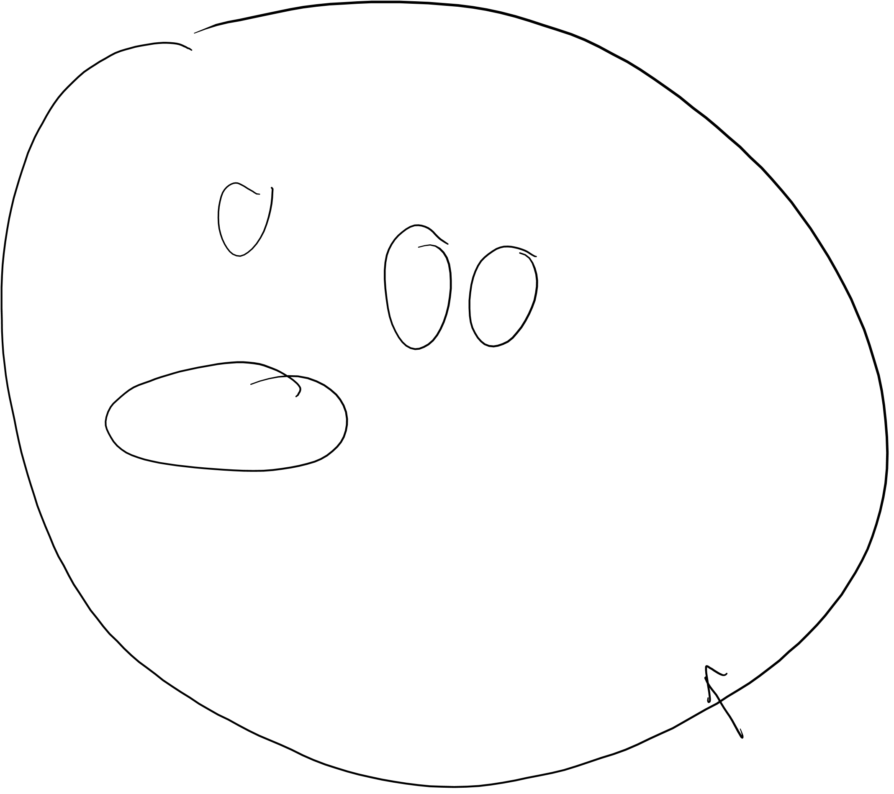
Recap of Epid Methods I – Study Design, Week 1
3 Ways to Sample An Underlying Fixed Cohort
= event = loss to follow-up CE = competing event
CE
CE
Cohort
Cross-sectional
= Case-control
Time
Notes:
From Epid Methods 1, J Martin 2017
How would a researcher study the people in a fixed cohort? There are at least 3 ways to sample an underlying fixed cohort for the purposes of studying the population:
Cohort sampling -- follow everyone at time zone (or a sample of everyone) as they move forward in time
Cross-sectional sampling -- sample everyone at one point in time
Case-control sampling -- a strategic sampling scheme limited to just those who developed your outcome of interest and a reference group.
These 3 methods of sampling correspond to our 3 most common study designs: cohort study, cross-sectional study, and case-control study.

Slide 8
Fixed Cohort – How to build
Define your population of interest to whom you wish to generalize the results
Choose all or a sample
Define the “event” that triggers start of follow-up time
Specify Eligibility

Slide 9

Fixed Cohort Ex – Nurses Health Study I
Eligibility:
  Married [female] registered nurses
  Aged 30 to 55 in 1976
  Lived in the 11 most populous states and nursing boards supplied names and addresses (California, Connecticut, Florida, Maryland, Massachusetts, Michigan, New Jersey, New York, Ohio, Pennsylvania, and Texas)
  Responded to the baseline questionnaire
Surveys mailed to 172,413 nurses & 71% response rate
N = 121,700 enrolled in 1976-1977
As a “fixed” cohort, this N ↓ over time due to death, loss to follow-up, or withdrawal and new participants NOT added after enrollment phase
Notes:
For example, Nurses Health Study: “Married [female] registered nurses, aged 30 to 55 in 1976, who lived in the 11 most populous states, and whose nursing boards agreed to supply NHS with their members' names and addresses, were eligible to be enrolled in the cohort if they responded to the NHS baseline questionnaire. The original states were California, Connecticut, Florida, Maryland, Massachusetts, Michigan, New Jersey, New York, Ohio, Pennsylvania, and Texas.” http://www.nurseshealthstudy.org/about-nhs/history
Delivered surveys to 172,413 nurses and 71% response rate; membership has been 121,700 since 1976-1977
NHS I PI’s: Grodstein F, Stampfer M, Hankinson, Colditz, Speizer
NHS II: Eliassen & Willett
NHS III: Chavarro J
Parallel study of men started by similar team of investigators (Willett, Stampfer, et al) – Health Professionals Follow-up Study. https://content.sph.harvard.edu/hpfs/
51,529 male health professionals (non-MD) completed qx in1986 - “composed of 29,683 dentists, 4,185 pharmacists, 3,745 optometrists, 2,220 osteopath physicians, 1,600 podiatrists, and 10,098 veterinarians. Among the study participants are 531 African-Americans and 877 Asian-Americans”

Slide 10
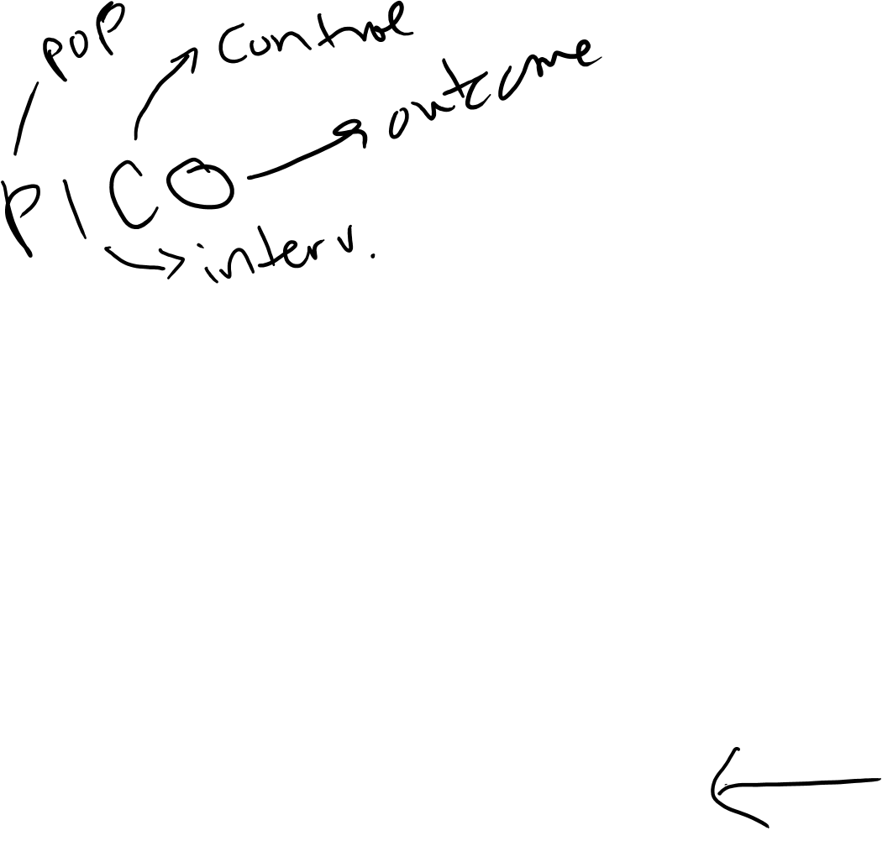
Fixed Cohort – How to build
Define Exposure status
  Person-time Exposed vs. Unexposed
  Sometimes straight-forward, sometimes not… more on this soon!
Define Outcome
  incident disease (count or event data)
  change in a continuous metric, like blood pressure or weight (outcome may be continuous “difference” or “change”)
Develop “baseline” & “follow-up” assessments
Consider duration of follow-up
  Long enough to observe events of interest
  Short enough that you can maintain participants, minimize loss
Notes:
PICO
P: Population
I: Intervention (or E, Exposed, if not RCT)
C: Comparison Group for Exposure (or Control group for the intervention)
O: Outcome

Slide 11
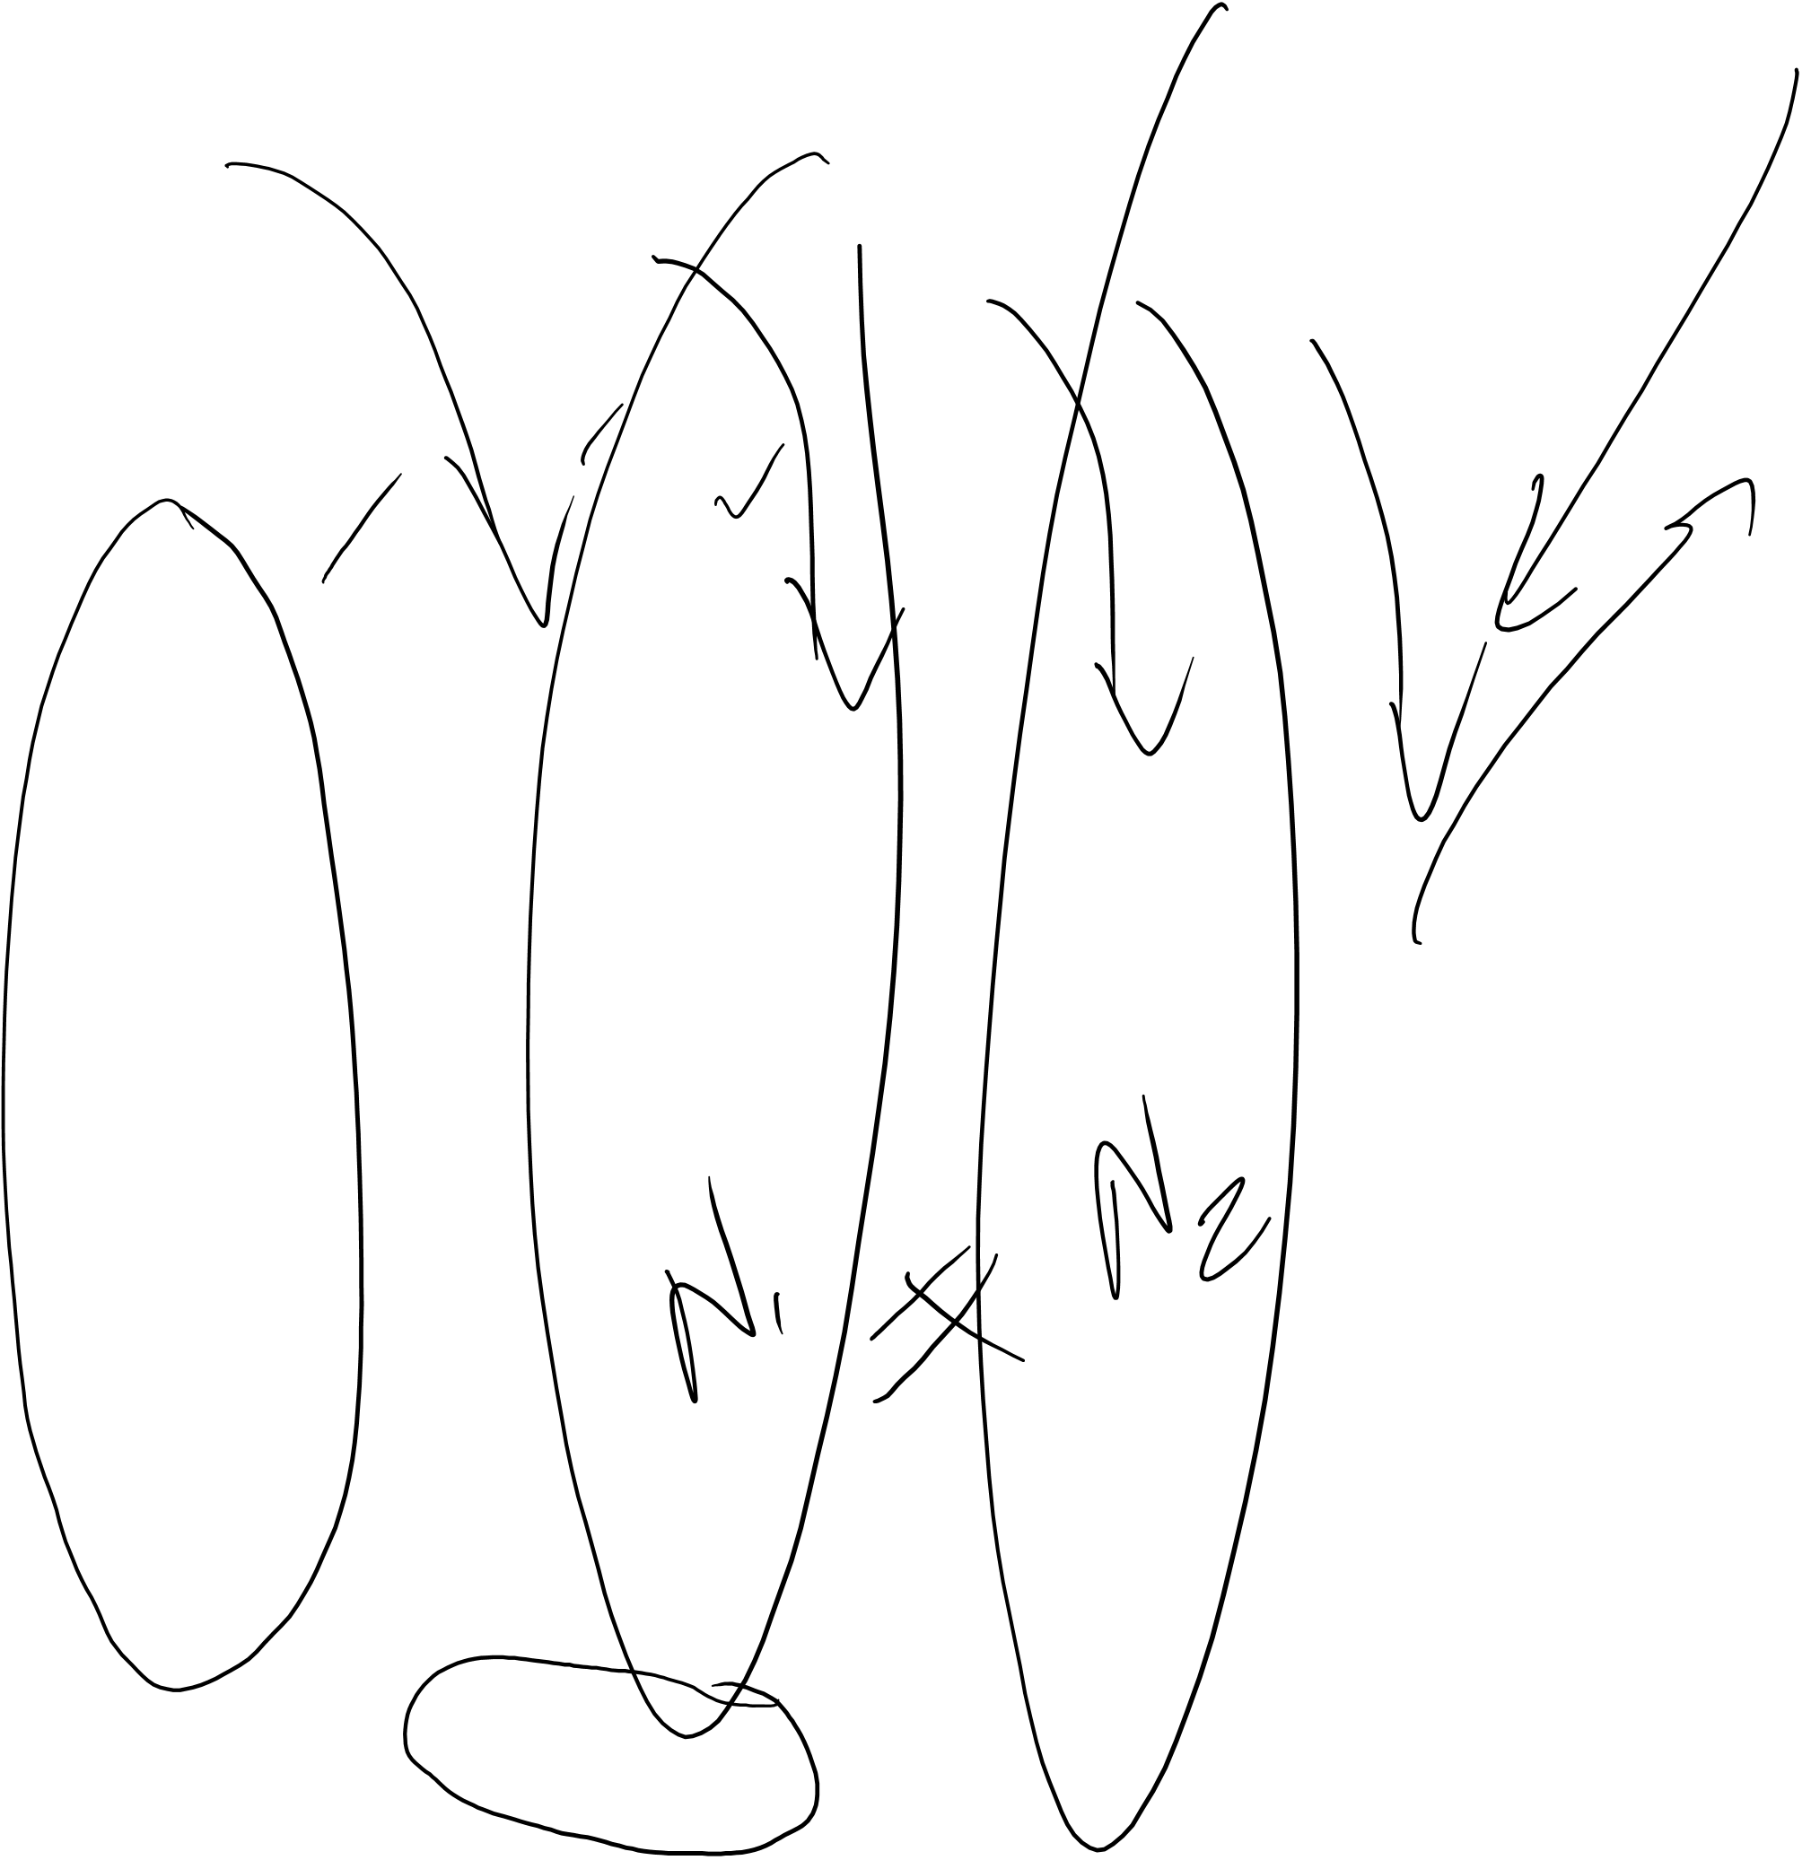
Recall Epid Methods I – Study Design
Dynamic (or “Open”) Cohort
New Members
CE
CE
Observation begins
Time (calendar)
Observation ends
Notes:
From Epid Methods 1, J Martin 2017
The other kind of cohort is a dynamic or “open” cohort, also referred to as a “dynamic population” in the Vanderbroucke reading. A dynamic cohort is generally a free living population defined by geography, membership, etc and whose time zero typically extends over some duration of calendar time. There is no sense of any short fixed period of enrollment. There is the expectation that new members of the cohort will be constantly joining. Dynamic cohorts typically have the expectation that its participants will often leave the cohort.
For example, San Francisco (SF) County residents, who are defined by geographic county lines, in a given calendar period, are a dynamic cohort. We know that new members will continually be moving into the county and established members will continually be moving out. Another example is the members of Kaiser Permanente (a Health Care Maintenance Organization (HMO), which provides health insurance to a given set of people) during some specified calender time period. It is a dynamic cohort that is administratively defined by membership. It is an open cohort since we expect that new members will continually enter and established members will leave. In this slide, we show a dynamic cohort that has about the same total members throughout the period of observation; as members leave the cohort, a similar number of new members join. Dynamic cohorts may also be increasing or declining in overall numbers.
Dynamic cohorts differ conceptually from fixed cohorts. In a dynamic cohort, time is generally calendar time and not observation time; this is because there was no single time of enrollment. Persons leave the cohort because of developing an event of interest, a competing event, no longer fulfilling the criteria of the cohort (e.g., no longer living in San Francisco or no longer being a member of the Kaiser HMO, or just simply the end of follow-up for the entire population (e.g., persons were followed up until last month). In a fixed cohort, in contrast, follow-up time starts with the construct that defines cohort membership and time is typically described in observation time since time zero. Just like a dynamic cohort, in fixed cohorts observation is ceased when the outcome of interest occurs, leaving the cohort (which is called “loss to follow-up” in the context of a fixed cohort, competing event, or administrative end of observation.
Many textbooks do not provide much discussion of dynamic cohorts, and this is unfortunate. Historically, for example, dynamic cohorts have been used for clinical research of cancer outcomes, facilitated in the US by the establishment of cancer registries in defined geographic areas. Currently, in the era of so-called “Big Data”, the use of dynamic cohorts from clinical practice settings is growing and encompasses a wider range of health outcomes.

Slide 12
Open Cohorts (Dynamic Cohorts)
No fixed roster – person-time accrued from a potentially changing roster of individuals
  Residents of California
  Members of Kaiser Permanente
  Cancer of the Prostate Strategic Urologic Research Endeavor (CaPSURE): men with prostate cancer, 1996-current
Individuals can leave and re-enter the cohort
  Connecticut Tumor Registry
  UCSF primary care

Slide 13
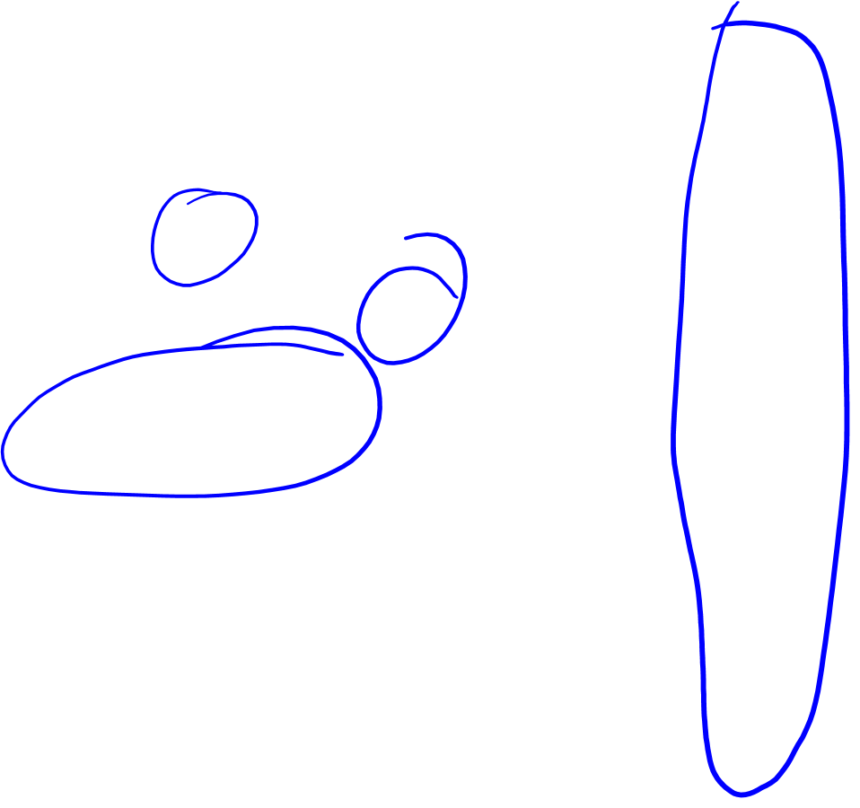
Recall Epid Methods I – Study Design
= Case-control
Sampling a Dynamic Cohort
New Members
CE
CE
Cross-sectional
Cohort
Observation begins
Observation ends
Time (calendar)
Notes:
From Epid Methods 1, J Martin 2017
Just like there are at least 3 main different ways to sample a fixed cohort, there are also 3 main different ways to sample a dynamic cohort. It is important to be conscious of which type of underlying cohort you are sampling.

Slide 14

Open Cohort – How to build?
Similar to Fixed, with additional considerations regarding “time”
  Define your population of interest – inherently changes over time
  Define your “sample” – this may be continuously growing/changing
  Define the “event” that triggers start of follow-up time
  Specify Eligibility
  Define Exposure & Outcome
    Be mindful of secular trends
    Data contributed may vary over time, e.g., EHR
  Develop “baseline” & “follow-up” assessments – to what extent will you follow someone after they have technically left your population of interest?
  Consider duration of follow-up
Notes:
Secular trends; societal norms or standards may change – “subjective” question asked in 1996 and 2006 may need to be interpreted differently: e.g., “Do would you rate your comfort level with using the Internet or mobile technology?”
The data available from the Electronic Health Record could vary over time. E.g., what if the standards changed for classifyng a tumor as “intermediate” grade… and the data from the cancer registry only provides “low” “intermediate” and “high” grade as options…

Slide 15

Summary of Measures of Association
Recap of Epid Methods I – Disease Association II
Design | Ratio (often easiest to assess for strength of association) | Difference (for public health impact, especially of interventions)
Cross- | prevalence ratio | prevalence difference*
sectional | prevalence odds ratio | prevalence odds difference*
Cohort | risk ratio | risk difference
 | rate ratio hazard ratio | rate difference hazard difference*
 | incidence odds ratio* | incidence odds difference*
Case-control | odds ratio (can estimate risk ratio, hazard ratio & rate ratio) | Risk & rate difference in case-cohort if observations weighted properly
* Rarely used
Notes:
From Epid Methods 1, J Martin 2017
This is the schematic from the previous lecture, showing all the possible ratio and difference measures that can be calculated from cross-sectional and from cohort studies, and now with case-control studies added. Case-control studies have traditionally been known as only deriving ratio measures of association, but as sophistication grows, it is now the case that investigators are also beginning to estimate difference-based measures, particularly in case-cohort study designs. This can be done if the fraction of the underlying cohort that is sampled is known. For ratio measures of association, we can measure the odds of exposure in cases and a reference group, calculate the OR of exposure, which we know is equal to the OR of disease. However, to obtain a difference measure we need the exposure-specific estimates. We will not be performing these difference measures in this course, but we want to make you aware that they can be derived.
This completes our lectures on disease association. We have covered the basic approach to reporting exposure-disease associations (ratio measures in all and difference measures where possible) for the 3 basic designs: cross-sectional, cohort and case-control.

Slide 16
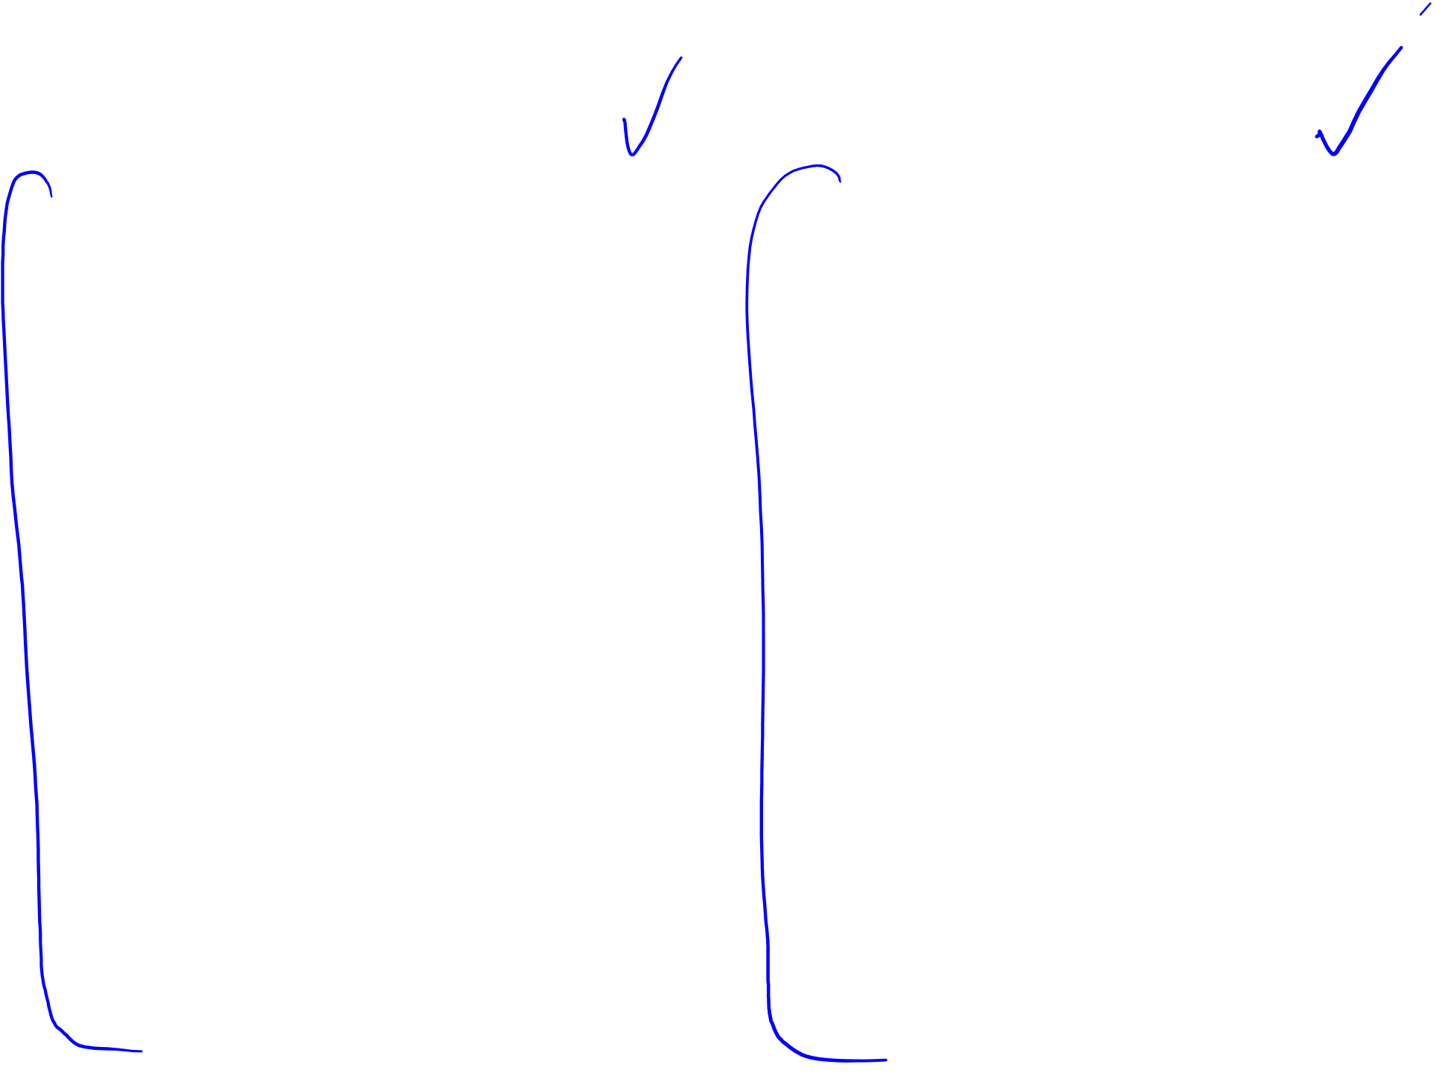
What do we calculate?
Fixed Cohort:
  N = Total # at beginning
  Cumulative Incidence
    Cumulative Incidence ratio
    Cumulative Incidence difference
  Incidence rate (IR)
    Incidence ratio
    Incidence difference
  Hazard
    Hazard Ratio
    (Hazard Difference*)
Open Cohort:
  N may vary over time
  Cumulative Incidence
    Cumulative Incidence ratio
    Cumulative Incidence difference
  Incidence rate (IR)
    Incidence ratio
    Incidence difference
  Hazard
    Hazard Ratio
    (Hazard Difference*)
* Rarely used

Slide 17
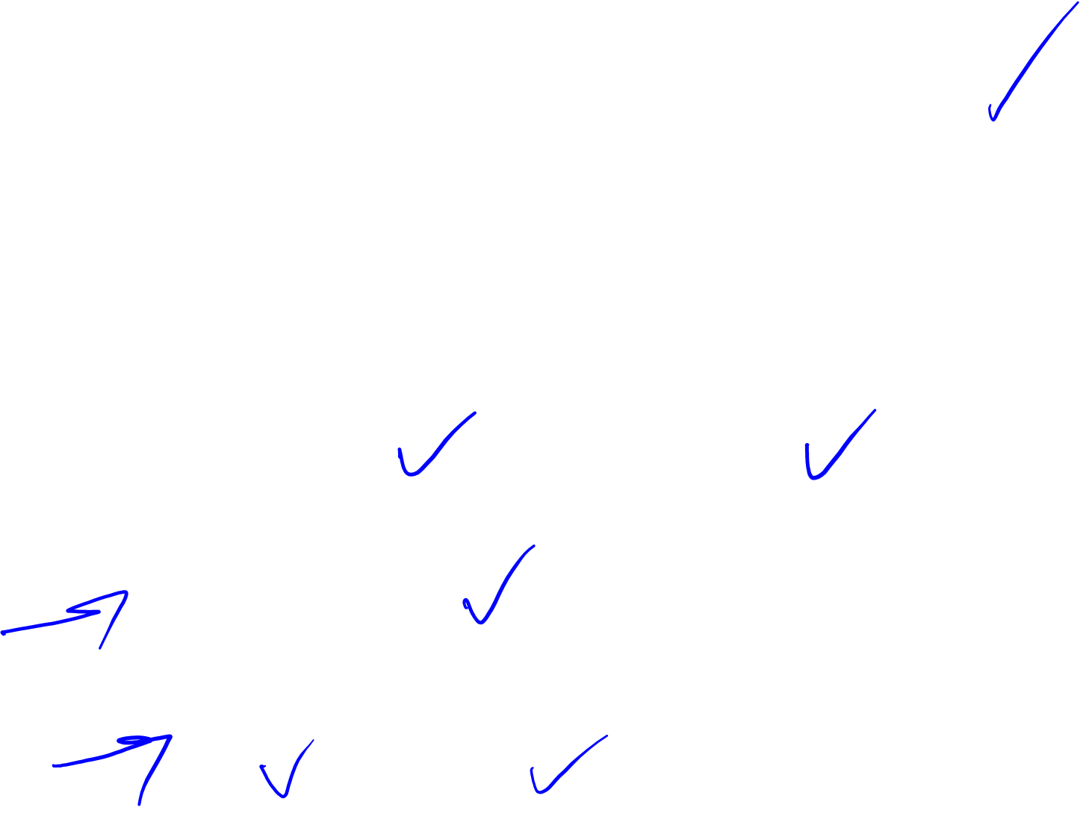
Cumulative Incidence in Cohorts
Basic Formula for Cumulative Incidence at time t₁:
  (cases observed during t₀ to t₁) / (total at risk at t₀)
  Where t₁ is some point during follow-up, and t₀ is baseline (start of follow-up)
In this basic formula, how do we deal with
  Loss to follow-up?
  Changing N over time? (e.g., Open Cohort)
Recall: Cumulative Incidence can be estimated by
  “shifting everyone left” and allowing censoring (addresses the variable follow-up times and changing N)
  Apply KM estimators
  Or estimate using hazard:
Assuming constant hazard and no competing risks
Notes:
Recall: Aaeln Johnson method introduced in Disease Occurrence II from Epid Methods I, to deal with competing risks

Slide 18
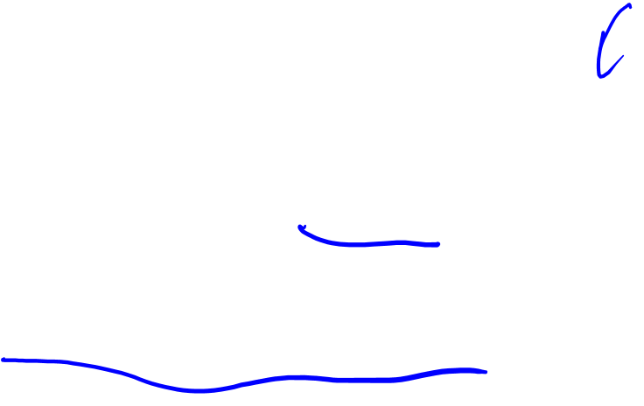
Relationship between Constant Hazard and Cumulative Incidence
Recap of Epid Methods I – Disease Occurrence II
A constant hazard (rate) produces an “exponential” cumulative incidence (or survival) function
If know the constant incidence rate, can derive the cumulative incidence/survival function or vice-versa from the “exponential formula”
where S(t) = cumulative survival and
F(t) = cumulative incidence
e= 2.71828; λ = rate; t = time units
Assumes no competing events
Notes:
From Epid Methods 1, J Martin 2017
There is a formal mathematical relationship between rate and cumulative incidence. For the special situation of a constant rate, it is represented by this formula. If the rate is constant, applying that rate to a given number of persons for a given time period produces a cumulative incidence that follows an exponential distribution given by the formula above, where F(t) = the cumulative incidence, e = 2.71828, λ = the rate per the person-time units, and t = the number of time units. Remember that F(t) and S(t) are bounded by 0 and 1. This formula is called the “exponential formula.” The proof for this can be found in advanced textbooks. Please note that this assumes no competing events.

Slide 19
Summarize
Fixed Cohort – Well-defined group of individuals, followed from a stated starting point to a stated end point, and whose membership does not change from beginning to end.
Open or Dynamic Cohort – Cohort whose membership composition may change over time.
Similar metrics can be calculated, with special consideration for the dynamic “N” of open cohorts
How one builds or implements an open cohort is similar to starting a fixed cohort, but may require more thoughtfulness regarding secular trends
Notes:
Closed Cohort: Often used synonymously with ‘fixed cohort’ but RGL (2008; p. 101) specifies that a ‘closed cohort’ is a ‘fixed cohort’ when there is no drop out or losses to follow-up.

Slide 20

Cohort Studies
Person Time & Bias
June M. Chan, ScD
Professor, Epidemiology & Biostatistics and Urology
Steven & Christine Burd-Safeway Distinguished Professor

Slide 21
Overview
Open vs. Fixed Cohorts
What do we calculate in Cohorts?
Assignment of Person Time
Survivor Cohorts
Bias
  Measurement Error
  Reverse Causation
  Confounding by Indication
  Residual Confounding
  Selection bias
  Immortal person time bias

Slide 22
Cohort Studies & Classifying Person Time

Slide 23
Overview: Cohort Studies & Classifying Person Time
Individuals contribute varying amounts of person-time
Individuals can contribute person-time to multiple exposure categories over time
Exposed Groups: Prevalent vs. Incident use of ”exposure”
How we count this time is crucial
  Induction time
  Latent period
  Time of exposure accrual
  Time at risk of exposure effects
  Categorizing chronic exposures

Slide 24
Overview: Cohort Studies & Classifying Person Time
Individuals contribute varying amounts of person-time
Individuals can contribute person-time to multiple exposure categories over time
Exposed Groups: Prevalent vs. Incident use of ”exposure”
How we count this time is crucial
  Induction time
  Latent period
  Time of exposure accrual
  Time at risk of exposure effects
  Categorizing chronic exposures

Slide 25
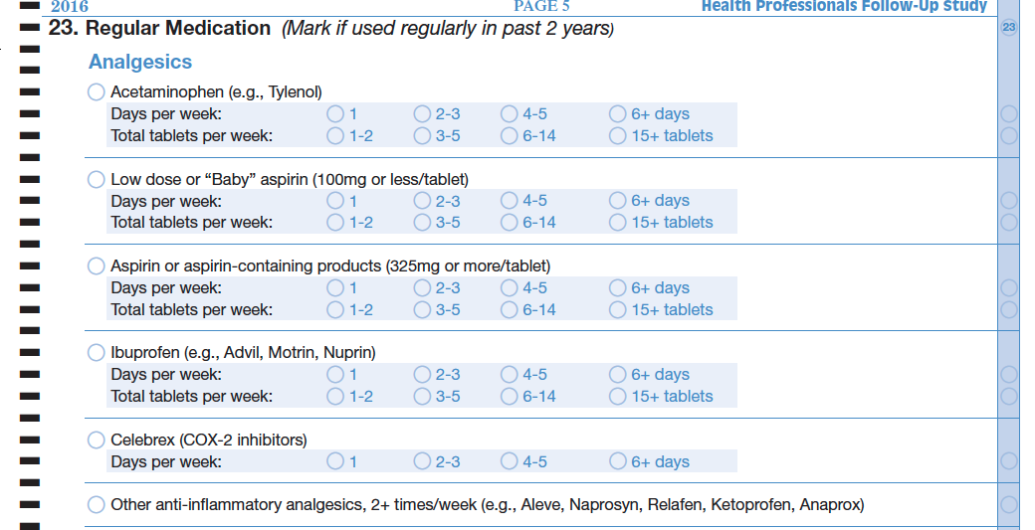

Example Qx that generates time-varying exposure data
Some version of this question asked at baseline in 1986 and every 2 yrs since for ~30 yrs (!)
Notes:
Sample qx from Health Professionals Follow-Up Study
https://content.sph.harvard.edu/hpfs/
51,529 male health professionals (non-MDs)

Slide 26
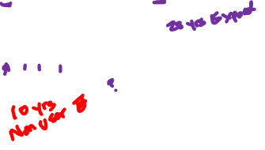
Individuals Contribute Variable Person Time
Using Not using
Entry to study
A
86 88 90 92 94 96 98 00 02 04 06 08 10 12 14
B
86 88 90 92 94 96 98 00 02 04 06 08 10 12 14
Drops out, moves to S. America and doesn’t want to be in the study anymore
26
Notes:
At baseline in 1986, question was: ”Current Medications (mark if used regularly)….Aspirin 2 or more times per week (Anacin, Buffrin, Alka Seltzer)”
Fixed cohort of the Health Professionals Follow-up Study, 51,529 male heath professionals enrolled in 1986, upon return of a baseline survey. Surveys and disease follow-up occur every 2 yrs thereafter; diet surveys administered every 4 years thereafter.
Person A contributes person time from 1986 through 2014, according to diagram above.
Person B contributes person time from 1986 to 1996 only.

Slide 27
Individuals May Contribute to Multiple Exposure Categories Over Time
Using Not using
Entry to study
A
86 88 90 92 94 96 98 00 02 04 06 08 10 12 14
B
86 88 90 92 94 96 98 00 02 04 06 08 10 12 14
C
86 88 90 92 94 96 98 00 02 04 06 08 10 12 14
27
Notes:
At baseline in 1986, question was: ”Current Medications (mark if used regularly)….Aspirin 2 or more times per week (Anacin, Buffrin, Alka Seltzer)”

Slide 28
Prevalent vs. Incident User
Using Not using
Entry to study
A
86 88 90 92 94 96 98 00 02 04 06 08 10 12 14
C
86 88 90 92 94 96 98 00 02 04 06 08 10 12 14
28
Notes:
At baseline in 1986, question was: ”Current Medications (mark if used regularly)….Aspirin 2 or more times per week (Anacin, Buffrin, Alka Seltzer)”

Slide 29
Overview: Cohort Studies & Classifying Person Time
Individuals contribute varying amounts of person-time
Individuals can contribute person-time to multiple exposure categories over time
Exposed Groups: Prevalent vs. Incident use of ”exposure”
How we count this time is crucial
  Induction time
  Latent period
  Time of exposure accrual
  Time at risk of exposure effects
  Categorizing chronic exposures

Slide 30
Induction Time
RGL (2008, Ch. 2):
  “Period of time from causal action until disease initiation”
  Characteristic of each component cause, not disease
  Each component cause of a disease may have a different “induction time”
  Last component cause to act has an induction time of 0
General literature uses “induction time” differently and may refer to a disease with a long or short induction time.
  This causes confusion and ignores the multi-factorial nature of many diseases, and the fact that certain exposures may act very early, while others take action very close in time to disease

Slide 31
Latent Period
Time from disease occurrence until disease detection
Latent period may be shortened if we improve methods for disease detection, e.g., screening
Latent period is a characteristic of the disease and the methods available to detect the disease
RGL (2008, Ch. 2)

Slide 32
Induction Period vs. Latent Period
Soda Drinking in childhood
Impaired Insulin Sensitivity
Fasting Glucose ≥126mg/dL
Diagnosis Diabetes
32

Slide 33
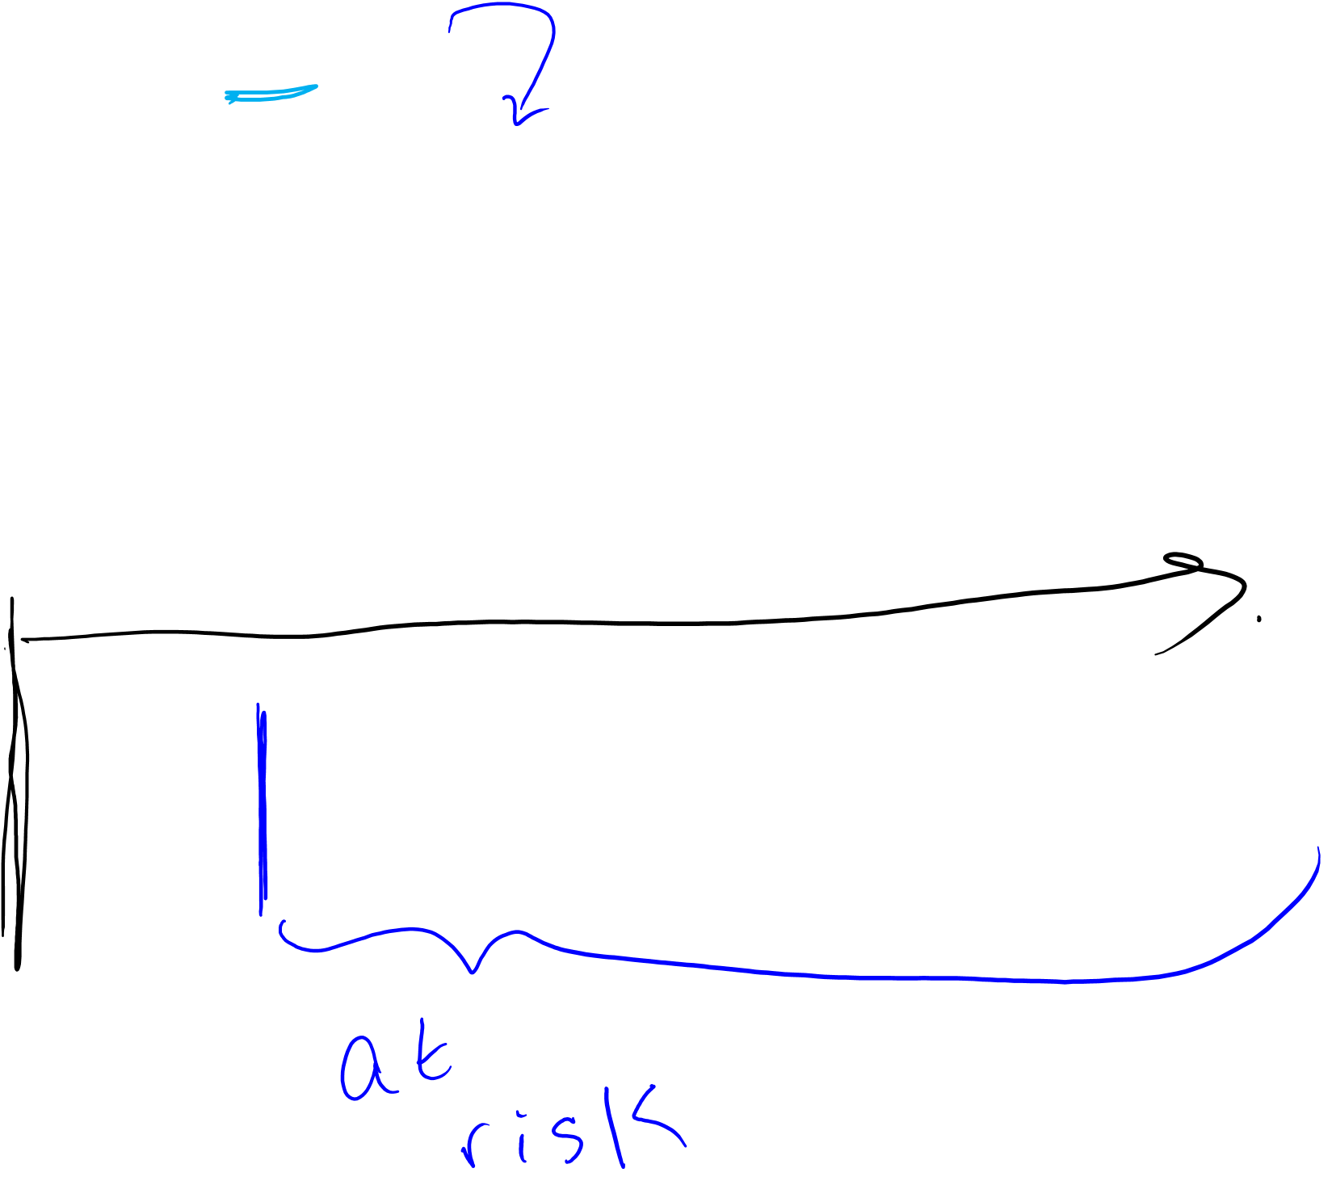
Time of exposure accrual & Time at risk of exposure effects
E: Soda drinking as adult
D: Incident type 2 diabetes in adulthood
Time of Exposure Accrual ~ years during which person drank soda as an adult
Time at risk for exposure effects – depends on hypothesis regarding association between soda and diabetes
Soda Drinking
Incident Diabetes (type 2)

Slide 34
In practice…
Follow fixed cohort of adults who consent and complete a survey, starting in 1986
At baseline and every 4 yrs, you ask participants to report usual diet of 132 foods and beverages, including soda
Classify ”regular soda drinking” as consuming soda 3+/week
To conduct your analysis
  Exclude anyone with diabetes before start of follow-up
  Classify your participants as regular soda drinkers, Yes/No during follow-up intervals (every 4 yrs)
  Follow existing cohort for incident diabetes (every 2 yrs)

Slide 35
Time of Exposure Accrual & Time at Risk for Exposure Effects
Regular soda drinking in adulthood & incident diabetes
One model….
Using Not using
Time at risk of exposure effects
86 88 90 92 94 96 98 00 02 04 06 08 10 12 14
Diabetes
Time of exposure accrual
Notes:
At the time of Dbx dx, was this person classified as exposed or unexposed to “soda drinking”?
Unexposed.
Do you think the soda drinking he did between 86-2002 is relevant for the risk of diabetes in 2010? Did this person ever have his blood checked prior to 2010? (thinking about latent period)
This is where ideas about Induction Period and Latent period come in, and considerations regarding “lagging” exposure, or looking at “ever” vs “never” come into play

Slide 36
Classifying Chronic Exposures
Cumulative Exposure
  Function of intensity & time
  E.g., pack-years of smoking =
  (#packs per day) x (years smoking at that level)
  20 pack-years → 2 packs a day for 10 years
  or ½ pack a day for 40 years

Slide 37
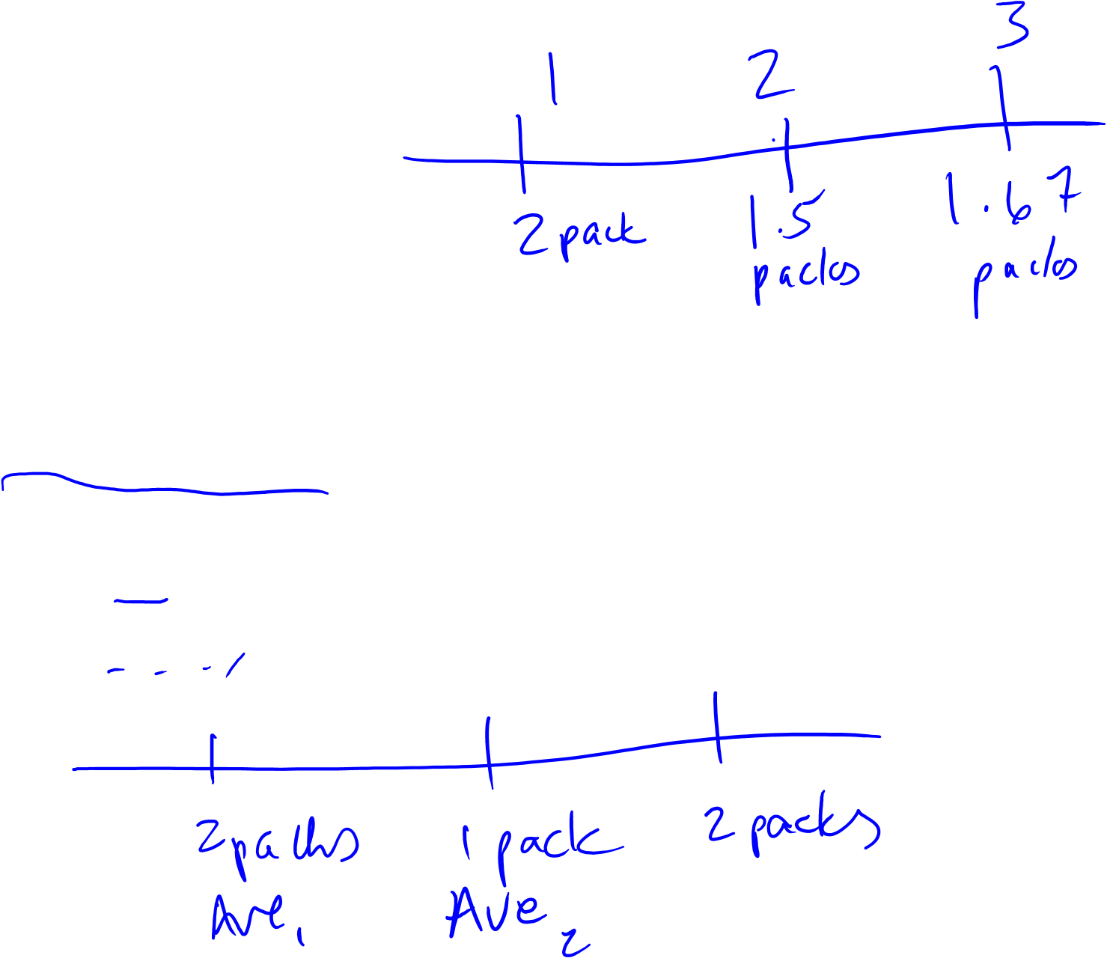
Classifying Chronic Exposures
Average & Cumulative Average Intensity
  Average:
    2 packs/day in yr 1, 1 pack/day in yr 2, 2 packs/day in yr 3
  Cumulative Average
    Yr1: 2 packs/day
    Yr2: (2+1)/2 = 1.5 packs/day
    Yr3: (2+1+2)/3 = 1.67 packs/day

Slide 38
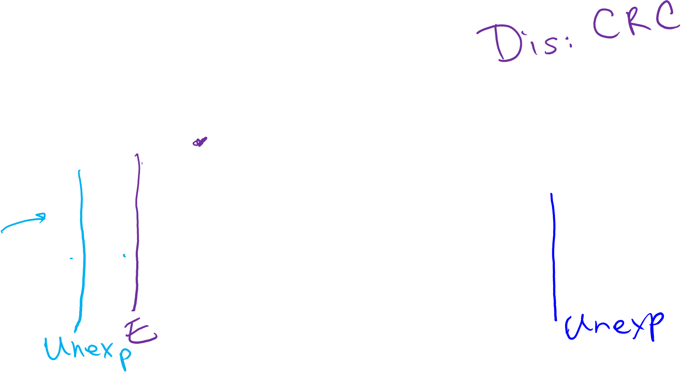
Alignment of Person-time and Event with Exposure Status
“the event and the person-time that is being accumulated at the moment of the event should both be assigned to the same category of exposure” (RGL 2008, p. 106)
Example: yes, using no, not using
86 88 90 92 94 96 98 00 02 04 06 08 10 12 14
Notes:
If diagnosed with outcome in 1992, dose the “event” count as occurring among exposed or unexposed group? (exposure = “current user of ASA”)? (A. exposed in 1992)
If dx’d in 2006, where dose the event get counted? exposed or unexposed? (unexposed)
Diagnosed in 1991? Unexposed (note, this is the case, even though, technically, in 1992, he reports that he’s been a regular user for the past 2 yrs, based on the wording of the qx. However, we do not know exactly when that change occurred, and if you are following along in time, when the even happens, as far as we know, he’s still unexposed. The survey data in 1990 is used to classify exposure during the interval 1990-1992; the survey in 1992 is used to classify exposure going forward in time, between 1992-1994; the survey in 1994 is used to classify exposure bt 1994 and 1996, and so forth.
What if we apply a 2 yr lag? This might be done as a sensitivity analysis to take into consideration an induction period of 2 yrs, associated with “current” aspirin use…More on this later…

Slide 39

Summary: Person Time in Cohorts
Participants may contribute varying amounts of person-time to different categories of exposure, over time.
Induction time = feature of component cause; describes time between the action and the occurrence of disease
Latent time = feature of the disease and the methods used to detect the disease; describes time between when the disease has occurred and when it is diagnosed
Exposure accrual time vs. time at risk of exposure effects
Chronic exposures: cumulative & average intensities
A clear and specific hypothesis, ideally, reflects some specifications, knowledge (or assumptions) for each of these “time” concepts

Slide 40

Cohort
Person Time & Bias
June M. Chan, ScD
Professor, Epidemiology & Biostatistics and Urology
Steven & Christine Burd-Safeway Distinguished Professor

Slide 41
Overview
Open vs. Fixed Cohorts
What do we calculate in Cohorts?
Assignment of Person Time
Survivor Cohorts
Bias
  Measurement Error
  Reverse Causation
  Confounding by Indication
  Residual Confounding
  Selection bias
  Immortal person time bias

Slide 42
Overview
Open vs. Fixed Cohorts
What do we calculate in Cohorts?
Assignment of Person Time
Survivor Cohorts
Bias
  Measurement Error
  Reverse Causation
  Confounding by Indication
  Residual Confounding
  Selection bias
  Immortal person time bias

Slide 43
Patient or Survivor Cohorts

Slide 44

Survivor or Patient Cohorts
Cohorts defined by a disease or condition
These can be Fixed or Open
Fixed Example
  Cases from a case-control study
Open Example
  Registry based studies, CaPSURE
Considerations
  Population (denominator) is different → questions are different
  What do you do about exposure prior to disease?
  Shifting concept of ”prevention”
  Becoming easier to ‘define’ with electronic health records
  Strong clinical predictors become potential strong confounders
Notes:
Clinical Epid
Studies that may be more common here at UCSF, given our dept’s place in a school of medicine

Slide 45
Examples of Patient Cohorts & Questions
Adults who have had one MI
  How does usage of medicine X affect risk of 2nd MI?
  Does a Mediterranean diet prevent all cause mortality?
Patients who have been diagnosed with colorectal cancer
  Does usage of aspirin after diagnosis affect risk of progression?
Women with breast cancer
  Does exercise or weight loss after diagnosis prevent death?
Men with prostate cancer
  Is time to recurrence different among those who received surgery vs. radiation?

Slide 46
Contrast Questions used in Healthy vs. Patient cohorts
Question | Population | Exposure | Outcome
Is usage of aspirin associated with risk of colorectal cancer (CRC)? | General healthy adults from fixed cohort (e.g., NHS) | Aspirin use during adulthood, prior to diagnosis of CRC | Incidence of CRC, or time to CRC diagnosis
Does aspirin prevent cancer progression or death, in patients with CRC who had Surgery? | Cases diagnosed with CRC, 2000 -2010, using hospital cancer registry | Aspirin use after diagnosis and surgery | Time to progression or death
Dx
Progression
Death due to CRC
Surgery
Notes:
Draw:
Time of exposure accrual
Time at risk for the event
Consideration for Induction time?
SIDE NOTE
Aspirin use for 10-20 yrs is considered to reduce primary occurrence of CRC https://www.cancer.gov/types/colorectal/hp/colorectal-prevention-pdq#link/_964_toc “Magnitude of Effect: ASA use reduces the long-term risk for developing CRC by 40% about 10 to 19 years after initiation (hazard ratio [HR], 0.60; 95% CI, 0.47–0.76).[18] Daily doses of 75 to 1,200 mg of ASA reduce the 20-year risk of CRC death by about 33% (HR, 0.67; 95% CI, 0.52–0.86).[16,17]”
It has been given a “B” rating by the USPSTF in adults aged 50-59, with a >=10% 10-year CVD risk: https://www.uspreventiveservicestaskforce.org/Page/Document/RecommendationStatementFinal/aspirin-to-prevent-cardiovascular-disease-and-cancer
Aspirin for secondary prevention in patients with CRC is still under study, although several studies suggest a potential protective association (e.g., http://ascopubs.org/doi/full/10.1200/jco.2015.65.3519)

Slide 47
Measurement Error & Reverse Causation

Slide 48
Exposure Definition & Implications for Measurement Error
Exposure Options
  Current use
  Prior use
  Dose
  Frequency
How might you collect data on ASA use?
  Medical chart abstraction
  Pharmacy database
  Survey of your population after diagnosis
Pros/Cons of these?

Slide 49
Possible Measurement Error in Exposure Assessment
Medical chart abstraction or Pharmacy Database
  May have details on dosage, dates prescribed, indication, etc
  ASA is not always a Rx med, so may not be in chart or database
  Prescribed or recommended is not the same as actual ingestion
Survey of your population after diagnosis
  Probably good way to assess “current use” or “current frequency”
  Patients may not report accurate details on dose
  If trying to assess long-term use in adulthood, relies on recall

Slide 50
Measurement Bias is the Result of Measurement Error:
Refined Terminology for Measurement Error
Recap of Epid Methods I – Measurement Bias
 |  | Is error related to whether other variables in the analysis are measured in error? (“Dependence”)
 |  | Independent | Dependent
Is error related to true values of other variables in the analysis? (“Differentiality”) | Non-differential | Independent Non-differential Misclassification | Dependent Non-differential Misclassification
 | Differential | Independent Differential Misclassification | Dependent Differential Misclassification
Predictable: Bias almost always towards the null (if at all)
Predictable, but context-specific; bias can go in either direction
Complicated and harder to predict: bias can go in either direction
Notes:
Fr Epid Methods 1, J Martin 2017
This is a summary of the more refined terminology for measurement error. We have talked about two axes. The first axis is whether error is related to the true values of other variables in the analysis. This axis is informally called the “differentiality” axis. If no, we said this is called non-differential misclassification. If yes, then it is called differential misclassification. The other axis concerns whether error is related to the occurrence of other errors in other variables in the same participants. Are the errors correlated? This is called the axis of “dependence”. If errors on one variable are not related to errors on other variables, this is called “independent” misclassification. If errors on one variable are related to errors on other variables, we call the errors dependent misclassification. Putting these two axes together, we have this table.
Errors in the green box have a predictable direction, which is (almost always) towards the null, if they occur at all (remembering that independent non-differential misclassification of outcome in the face of 100% specificity will not bias a risk or prevalence ratio). Errors in the blue box will also go in the predictable direction that is context-specific. Importantly, the bias can go in either direction, either toward or away from the null. These two orange boxes are the most complicated. They are not simple to predict because there are two processes going on. Of note, dependent non-differential misclassification can result in bias away from the null.

Slide 51
Measurement Error Bias?
To consider if there is bias, need to consider outcome too
P: Cases of early stage CRC diagnosed 2010-2015, registry
I, C: ASA use – current use (Y/N) within first 3m of Dx (Binary)
O: CRC progression as assessed via med chart review
Measurement Error Bias?
  Medical chart or Pharmacy Database
    It can either over- (don’t take the drug) or under- (over the counter) estimate ASA use
    Assume chart and registry operate well → errors are not dependent on error in outcome assessment
    Probably non-differential with regards to outcome; bias to the null
  Self-report
    What gets reported may more accurately reflect use
    Probably also independent and non-differential; bias to the null
    But may be more “missing” datapoints (selection bias)
Notes:
Self-report - The “missing” –ness of data when using self-report could lead to selection bias, depending on how you define the cohort and what you do with folks who do not respond at all to the survey.
NOTE: This is an example of a binary exposure (current use, y/n) with non-differential measurement error. As it is binary, we can suggest that it’s likely to bias to the null.
However, if the exposure had been with more than 2 categories, and in particular if the effect estimates for any given category were not reflective of a linear relationship, then it becomes harder to estimate the direction of the non-differential bias.

Slide 52

Non-Binary Exposure with Non-Diff Msrmt Error
-Direction of Bias is harder to Anticipate
Aspirin Use | Colorectal cancer | No Colorectal cancer
Never use
1-3x per week
4-7 per week
>7x per week
Notes:
In the example shown here, let’s imagine that your exposure variable has 4 categories instead of 2. In this case, the possible direction of measurement error between categories is multiple and harder to anticipate. In particular, for the middle categories, the misclassification that can happen in varying directions, such that the net effect is harder to anticipate. If we layer upon this scenario the possibility that the association between the exposure and the outcome is not linear, it becomes even harder to anticipate the overall effect on the direction of bias.

Slide 53
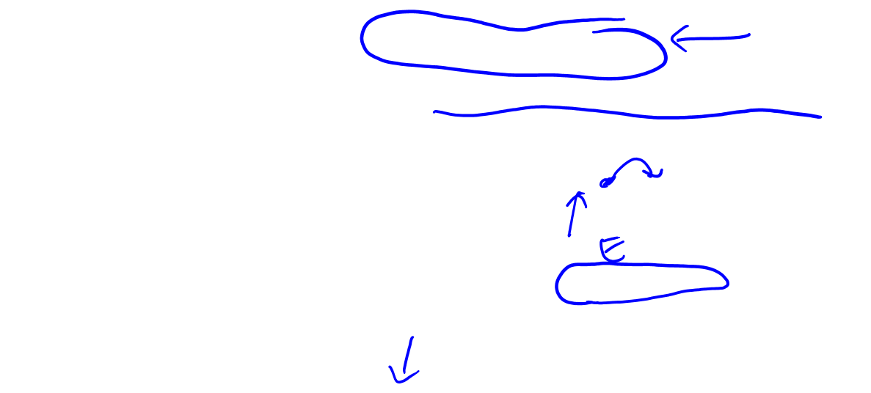
What about if you update exposure beyond the first 3m?
If people start taking ASA due to pain prior to diagnosis of progression, then one may see a positive association between ASA and risk progression, due to Reverse Causation
Using Not using
Pain due to worsening of disease
92 94 96 98 00 02 04 06 08 10 12 14
Dx
Progression
Death due to CRC
How do we deal with this?
Sometimes you will see a “lagged” analysis, where assign exposure during one interval to the follow-up interval 1 or more cycles ahead.
E.g., exposure collected in 1992 is applied to the follow-up interval of 1994-1996, etc.

Slide 54
Ex: Lagging Exposure to avoid Reverse Causation
Using Not using
Pain due to worsening of disease
92 94 96 98 00 02 04 06 08 10 12 14
Dx
Progression
Death due to CRC
Lagging Exposure:
Sometimes you will see a “lagged” analysis, where assign exposure during one interval to the follow-up interval 1 or more cycles ahead.
E.g., exposure collected in 1992 is applied to the follow-up interval of 1994-1996, etc.
Notes:
With a lagged analysis, note that one is essentially making an assumption about a certain “induction time” for that exposure relative to the outcome.

Slide 55
Ex: Exercise and Prostate Cancer Death
“We updated activity every 2 years, maintaining a 4- to 6-year lag…We applied their 1994 first postdiagnosis physical activity to deaths occurring between 1998 and 2000, their 1996 postdiagnosis physical activity to deaths occurring between 2000 and 2002, and so on. This approach allowed us to capture recent activity in relation to survival while minimizing reverse causation as a result of the effect of illness preceding death on physical activity.”
- Kenfield SA J Clin Onc, 2011
Notes:
By applying a 4-6 yr lag in the sensitivity analysis described here, this is akin to assuming that there is a 4-6 yr induction time for physical activity and the outcome of prostate cancer death.
Reverse causation is a type of confounding.
Structurally can be similar to conf by indication, discussed next

Slide 56
Confounding by Indication
“The effect of drug A on the risk of outcome (Y) will be confounded if the drug is more likely to be prescribed to individuals with certain condition (L) that is both an indication for treatment and a risk factor for the disease.”
- Hernan & Robins, 7.1, p. 84
A: Aspirin
Y: Death
L: Heart Disease
U: Atherosclerosis
A
Y
L
A
Y
L
U
56

Slide 57
Ex: Residual Confounding
Fruit & Veg Intake & Risk of Lung Cancer in Nurses Health Study

Slide 58
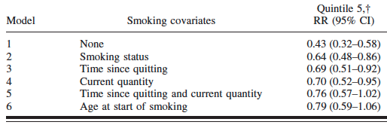
Ex: Residual Confounding
Fruit & Veg Intake & Risk of Lung Cancer in Nurses Health Study
*Model 1 is adjusted for age, follow-up cycle, total energy intake, and availability of diet data after baseline. Model 2 is adjusted for the covariates in model 1
plus smoking status (never, past, or current). Model 3 is adjusted for the covariates in model 2 plus time since quitting among past smokers. Model 4 is adjusted
for the covariates in model 2 plus quantity among current smokers. Model 5 is adjusted for the covariates in models 3 and 4. Model 6 is adjusted for the covariates
in model 5 plus age at start of smoking.
†Quintile 1 is the reference category.

Slide 59
Summary
Patient or Survivor cohorts are defined by individuals having a shared condition or disease
Questions addressed in patient cohorts are different given the study population (denominator) is different
Reviewed examples of Bias
  Measurement error bias
  Reverse causation
  Confounding by indication
  Residual confounding

