Slide 1
Causal Inference
Epidemiology 207 - Epidemiology Methods II
Rebecca E. Graff, ScD
Assistant Professor, Epidemiology & Biostatistics

Slide 2
Questions from the Recorded Lectures?

Slide 3
Learning Objectives
Causal Models and Heuristics
  Bradford Hill Criteria
  Sufficient and Component Cause Model
  Counterfactual Model
Ideal Randomized Experiments
Conditional Randomization

Slide 4
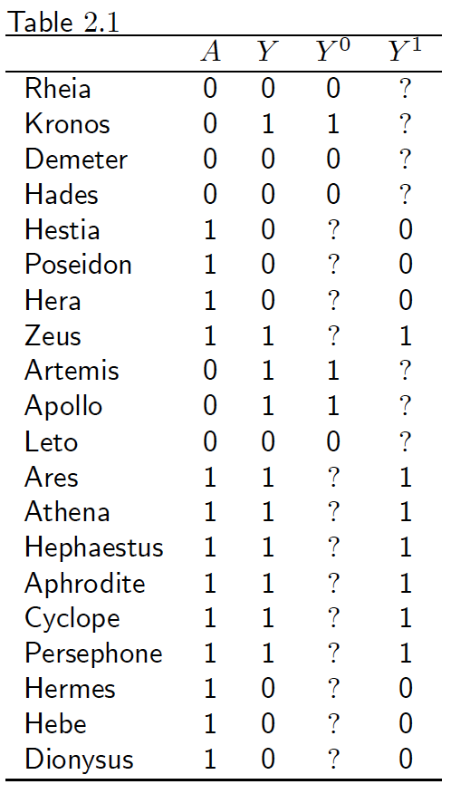
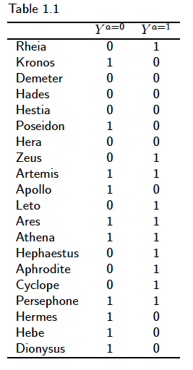
Recall that…
Pr(Y^{a=0}=1 | A = 1) = 7/13
Pr(Y^{a=0}=1 | A = 0) = 3/7
Exchangeability doesn’t hold!

Slide 5
Conditional Randomization

Slide 6
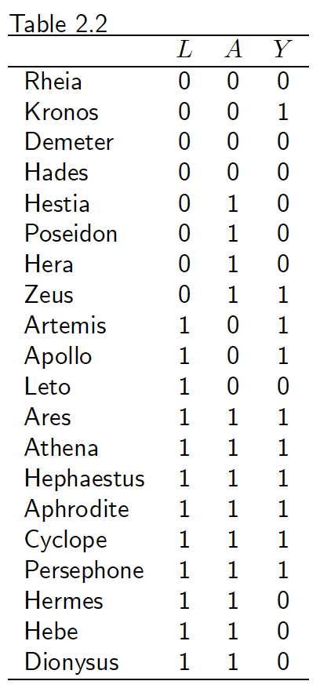
The Data
L = 1 ➔ critical condition
Goal: Estimate the effect of A on Y
Two Options:
  Marginally randomized experiment exposing 65% of participants
  Conditionally randomized experiment exposing 50% of non-critical participants and 75% of critical participants
    Randomization probabilities are conditional on the value of L

Slide 7

Conditional Exchangeability
Within levels of L, exposed subjects would have had the same risk as unexposed subjects had they been unexposed, and vice versa
Counterfactual risk is the same in the exposed and the unexposed with the same value of L
Pr(Yª = 1 | A = 1, L = l) = Pr(Yª = 1 | A = 0, L = l)
or, equivalently:
A Yª | L = l

Slide 8
Computing the Average Causal Effect
E.g., Pr(Y^{a=1} = 1)
  Compute the conditional risk in each stratum
    Pr(Y^{a=1} = 1 | L = 0) = Pr(Y = 1 | A = 1, L = 0)
    Pr(Y^{a=1} = 1 | L = 1) = Pr(Y = 1 | A = 1, L = 1)
  Compute the weighted average of the conditional risks
    Pr(Y^{a=1} = 1) = Pr(Y = 1 | A = 1, L = 0)*Pr(L = 0) +
    Pr(Y = 1 | A = 1, L = 1)*Pr(L = 1)
Standardization!

Slide 9
In Our Data
Risk in each level of L:
  Pr(Y = 1 | A = 1, L = 1) = 6/9
  Pr(Y = 1 | A = 1, L = 0) = 1/4
Proportion of subjects in each level of L:
  Pr(L = 1) = 12/20
  Pr(L = 0) = 8/20
Standardized risk in the exposed using the study population as the standard:
  Pr(Y = 1 | A = 1, L = 1)*Pr(L = 1)
  Pr(Y = 1 | A = 1, L = 0)*Pr(L = 0) +
  (6/9)*(12/20) + (1/4)*(8/20) = 0.5

Slide 10
Exercise
Calculate the standardized risk in the unexposed
In this conditionally randomized experiment:
  Does exchangeability hold?
  Does conditional exchangeability given L hold?
  Is there a null average causal effect of A on Y?
  Is there a null association between A and Y?

Slide 11
Alternative View of the Data
Y=1 (0.25)
1
Y=0 (0.75)
3
A=1 (0.5) 4
Y=1 (0.25)
1
A=0 (0.5) 4
Y=0 (0.75)
L=0 (0.4) 8
3
n=20
L=1 (0.6) 12
6
A=1 (0.75) 9
Y=1 (0.67)
Y=0 (0.33)
A=0 (0.25) 3
3
Y=1 (0..67)
2
Y=0 (0.33)
1

Slide 12
The Pseudo-population
Y=1 (0.25)
2
Y=0 (0.75)
6
A=1 8
Y=1 (0.25)
2
A=0 8
Y=0 (0.75)
L=0 (0.4) 8
6
n=20
L=1 (0.6) 12
8
A=1 12
Y=1 (0.67)
Y=0 (0.33)
A=0 12
4
Y=1 (0..67)
8
Y=0 (0.33)
4

Slide 13
Data Analysis in the Pseudo-population
 | Y = 1 | Y = 0
A = 1 | 10 | 10
A = 0 | 10 | 10
Pr(Y^{a=1} = 1) = 10/20
Pr(Y^{a=0} = 1) = 10/20
Inverse Probability Weighting!

Slide 14
Inverse Probability Weights
W^{A} = 1/f(A | L)
Y=1 (0.25)
1 1/0.5 = 2
Y=0 (0.75)
3 1/0.5 = 2
A=1 (0.5) 4
Y=1 (0.25)
1 1/0.5 = 2
A=0 (0.5) 4
Y=0 (0.75)
L=0 (0.4) 8
3 1/0.5 = 2
n=20
L=1 (0.6) 12
6 1/0.75 = 1.33
A=1 (0.75) 9
Y=1 (0.67)
Y=0 (0.33)
A=0 (0.25) 3
3 1/0.75 = 1.33
Y=1 (0..67)
2 1/0.25 = 4
Y=0 (0.33)
1 1/0.25 = 4

Slide 15
One More Identifiability Condition
Exchangeability
Consistency
Positivity:
  The probability of receiving every value of treatment conditional on L is greater than zero (i.e., positive)

Slide 16
Identifiability Conditions in Practice
Association of Leisure-Time Physical Activity With Risk of 26 Types of Cancer in 1.44 Million Adults. https://www.ncbi.nlm.nih.gov/pubmed/27183032
“time per week in moderate and vigorous leisure-time physical activities…. Assessed by asking about discrete activities such as walking, running, or swimming, or, alternately, by inquiring about overall weekly participation in moderate- to vigorous-intensity activities. The median activity level was 8 MET-h/wk …. equivalent to 150 minutes of moderate-intensity activity (eg, walking) per week, and comparable to the median activity level for the US population.”
“high vs low levels of leisure-time physical activity were associated with lower risks of 13 of 26 cancers.”

Slide 17




Acknowledgements
June Chan
Miguel Hernán
Dan Kelly
Francois Rerolle

Slide 18
Questions?

