Slide 1
Biostatistics 226, Winter 2020
Course Overview
Jan 7 – Design of RCTs: How to avoid bias and achieve valid results
Jan 14 – Analyses: Baseline, Efficacy, and Safety
Jan 21 – Monitoring trials for efficacy, futility, and patient safety
Jan 28 – Cluster Randomized Trials
Feb 4 – Precision medicine I: SMART (Adaptive) Trials
Feb 11 – TBA
Textbook References
Lawrence Friedman, Curt Furburg, David DeMets. Fundamental of Clinical Trials, 5th edition, 2015.
e-copy is available online to UCSF community
Murray DM: The Design and Analysis of Group-Randomized Trials. London: Oxford, University Press; 1998.
Donner A, Klar N: Design and Analysis of Cluster Randomised Trials in Health Research. London: Arnold 2000.

Slide 2
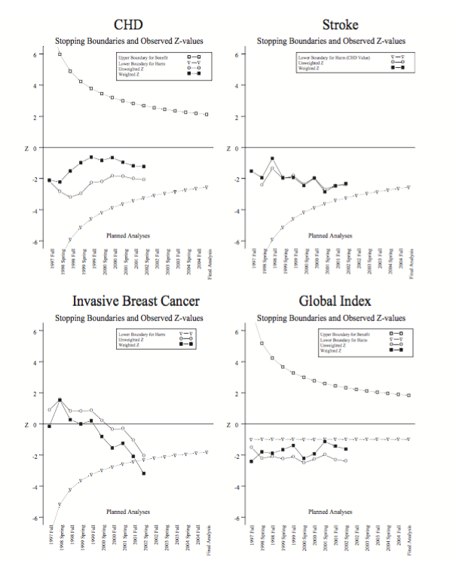
Review: Jan 21 – Monitoring trials for efficacy, futility, and patient safety
HW Reading: Anderson 2007
A huge amount of effort went into planning the
trial, with great emphasis on ensuring good
communication among stakeholders.
Statistical methods were carefully planned.
Nonetheless they were complicated, which
reduced confidence in the unexpected results.
Follow-up research continues to re-examine this
dataset to explain surprising findings.

Slide 3
Jan 28 – Cluster Randomized Trials (CRT)
Lecture reference:
  Gao F, Earnest A, Matchar DB, Campbell MJ, Machin D. Sample size calculations for the design of cluster randomized trials: A summary of methodology. Contem Clin Trials. 2015 May;42:41-50. https://doi: 10.1016/j.cct.2015.02.011.
Features of CRTs:
Experimental unit = Unit of randomization & intervention exposure
Observational unit = Unit of outcome measurement
Unit of randomization differs from unit of analysis: Obs units are nested within Exp units; Multiple respondents per cluster
Outcomes within clusters are more alike than outcomes from different clusters: Must account for this positive correlation at the design stage & the analysis stage.
All Exp units per cluster are exposed to the same intervention arm
  → Single arm per cluster avoids contamination between exposures
  → Generally cannot blind investigators or PPTs to study arm.
  Motivated by practicalities:
  to avoid contamination
  To enhance participation and adherence
  for logistic and economic reasons
Notes:
are randomized to study arms → gives rise to nested (hierarchical) outcomes. Unit of randomization differs from unit of analysis.
Exposure: All PPTs per cluster receive the same intervention.
Outcomes from PPTs within a cluster are more alike than from PPTs between clusters. Why?
How to handle at the design stage?
How to handle at the analysis stage?
Typically, all clusters are randomized simultaneously in time.
Motivations include:
to avoid contamination
To enhance participation and adherence
for logistic and economic reasons

Slide 4
Example 1:
  Minian N, et al. Tailored Versus Generic Knowledge Brokering to Integrate Mood Management Into Smoking Cessation Interventions in Primary Care Settings: Protocol for a Cluster Randomized Controlled Trial. JMIR Res Protoc. 2018 Apr 27;7(4):e111. doi: 10.2196/resprot.9715.
  Objectives: To investigate: 1) the effectiveness of generalized, exclusively email-based prompts versus a personalized knowledge broker in implementing mood management interventions; …
  Methods: … a cluster randomized controlled trial of Family Health Teams [sites; clinics] participating in the Smoking Treatment for Ontario Patients program. FHTs [k=128] will be randomly allocated 1:1 to
  (group A) receive generalized messages (related to depression and smoking) exclusively via email, or
  (group B) be assigned a Knowledge Broker (KB) who provides personalized support through phone- and email-based check-ins.
  The primary outcome, measured at the site level, is the proportion of eligible baseline visits that result in the provision of the mood management intervention to patients.
  The actual number of eligible trial participants that each clinic will enroll is not directly observable a priori. Proposed enrollment, N=1224 PTs; m=10 per FHT.
Notes:
In this example, outcomes are measured at the PT level but summarized at the cluster level: mean proportion of PTs eligible at BL to whom PCPs provide the study intervention.
are randomized to study arms → gives rise to nested (hierarchical) outcomes. Unit of randomization differs from unit of analysis.
Exposure: All PPTs per cluster receive the same intervention.
Outcomes from PPTs within a cluster are more alike than from PPTs between clusters. Why?
How to handle at the design stage?
How to handle at the analysis stage?
Typically, all clusters are randomized simultaneously in time.
Motivations include:
to avoid contamination
To enhance participation and adherence
for logistic and economic reasons

Slide 5
Example 1:
  Minian N, et al. Tailored Versus Generic Knowledge Brokering to Integrate Mood Management Into Smoking Cessation Interventions in Primary Care Settings: Protocol for a Cluster Randomized Controlled Trial. JMIR Res Protoc. 2018 Apr 27;7(4):e111. doi: 10.2196/resprot.9715.
  Exposure Details:
Practitioners from group A will receive one email per month for one year.
Practitioners from group B will receive individualized support from a KB communicating through interactive technology (ie, Skype) on an as-needed basis.
This pragmatic, cluster trial is designed to evaluate an intervention to change practitioners’ behavior. Blinding of the clinic through its practitioners will therefore not be possible as the practitioner will be aware of the presence or absence of the KB. Participating clinics will not be informed of their treatment allocation until the trial begins. → Preliminary accrual of sites? Simultaneous allocation to arms?
→ Multiple PCPs per site?
  Outcome Details:
The primary outcome will be provision of the mood management intervention to eligible patients upon completion of the STOP smoking cessation program enrollment.
Data analysis will be blinded to treatment allocation.
Notes:
are randomized to study arms → gives rise to nested (hierarchical) outcomes. Unit of randomization differs from unit of analysis.
Exposure: All PPTs per cluster receive the same intervention.
Outcomes from PPTs within a cluster are more alike than from PPTs between clusters. Why?
How to handle at the design stage?
How to handle at the analysis stage?
Typically, all clusters are randomized simultaneously in time.
Motivations include:
to avoid contamination
To enhance participation and adherence
for logistic and economic reasons

Slide 6
Example 2: Compare SOC vs algorithm-driven management of SBP
Clusters: Cardiologists at UCSF → Units randomized to study arms: K clusters
Eligible patients have SBP > 150. Each cardiologist cares for ~20 such patients and believes ~16 would consent to participate in an RCT with 12 months’ follow-up. PPTs will measure and record SBP daily; measurements will be uploaded to EMR. → Units of observation (m=16 per cluster)
Experimental intervention: Based on prediction models, an algorithm will evaluate evolving PPT data and guide the MD on how to treat the individual.
Control intervention: MD will treat the individual per best judgment.
Randomizing by cluster:
Facilitates capture, intervention, adherence, evaluation of eligible patients. MDs participate in the RCT as agents of intervention. Setting is real world.
Outcomes are positively correlated, 0 < ρ ≤ 1: Effects of interventions are more alike within MDs than between MDs.
Avoids contamination: MDs who care for PPTs on both study arms could learn the algorithm guidance over time, consciously/unconsciously → Over time, less distinct study arms.

Slide 7
Methods for CRT Sample-size Calculations
Key result : We can calculate the sample size for an individually-randomized trial, N_{I}, and scale it up to find the sample size for an CRT, N_{C}:
DE = 1+(m-1)ρ
DE = “Design effect” (or VIF = Variance Inflation Factor),
where m = cluster size (# PPTs per cluster),
and ρ = ICC = intra-cluster correlation.
N_{C} = N_{I} * DE
K = N_{C} / m
where K = # clusters per arm
The research setting dictates the values of m and ρ.
The value of ρ is based on past studies, whereas m is based on available units.
Notes:
A slightly different formula for VIF is given by Hemming et al (2011) to allow variation in m across clusters. This version assumes average m.

Slide 8
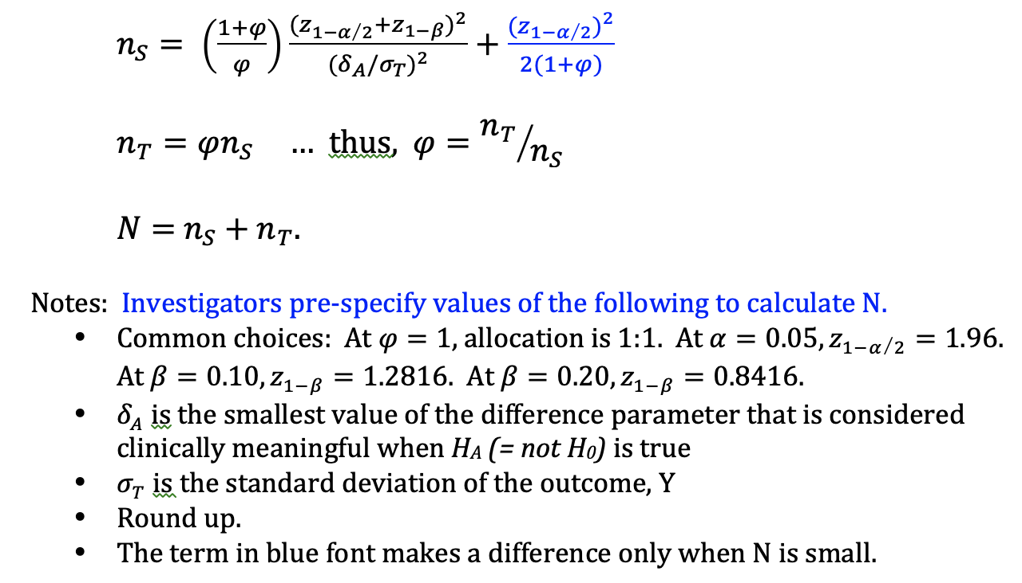
Sample size for Individually randomized design, Continuous outcome, Y
Notes:
Last term is a small sample continuity correction → t-dist rather than normal distn

Slide 9
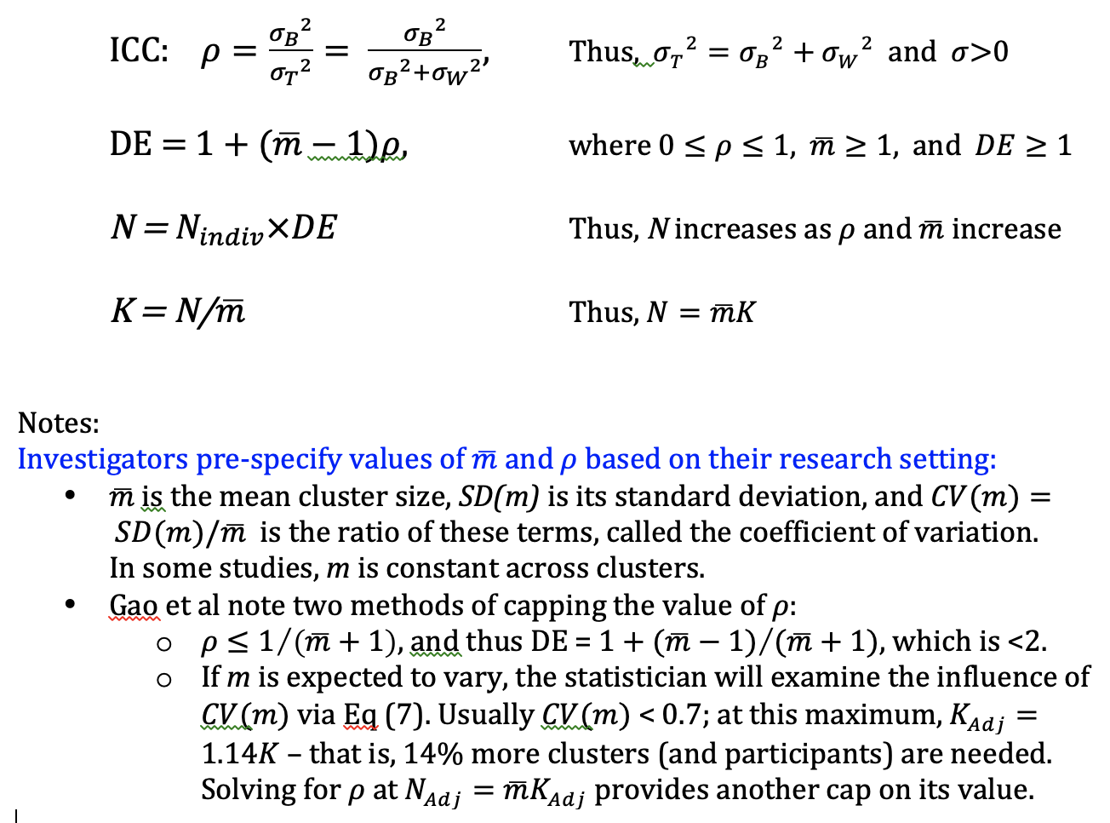
Sample size for Cluster randomized design, Continuous outcome, Y
Notes:
Allocation to {Ks,Kt} parallels allocation to {Ns,Nt}.

Slide 10
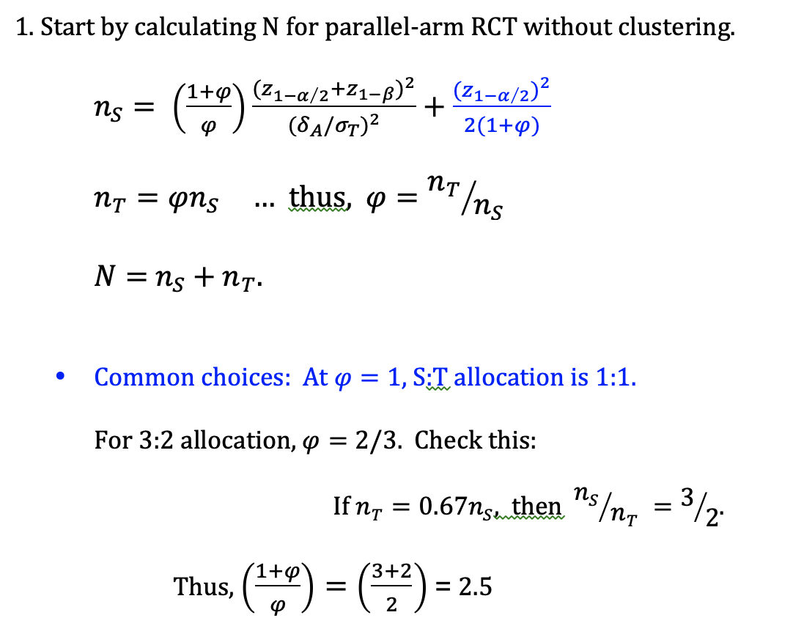
Example of Ref 21, Gao et al: How many observational units are needed?
Notes:
Allocation to {Ks,Kt} parallels allocation to {Ns,Nt}.

Slide 11
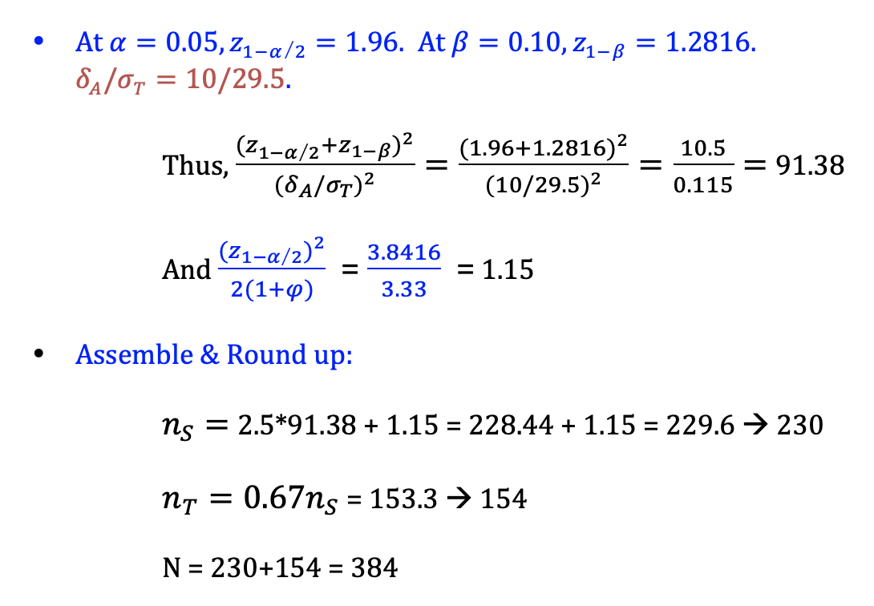
Example of Ref 21, Gao et al:
Notes:
Allocation to {Ks,Kt} parallels allocation to {Ns,Nt}.

Slide 12
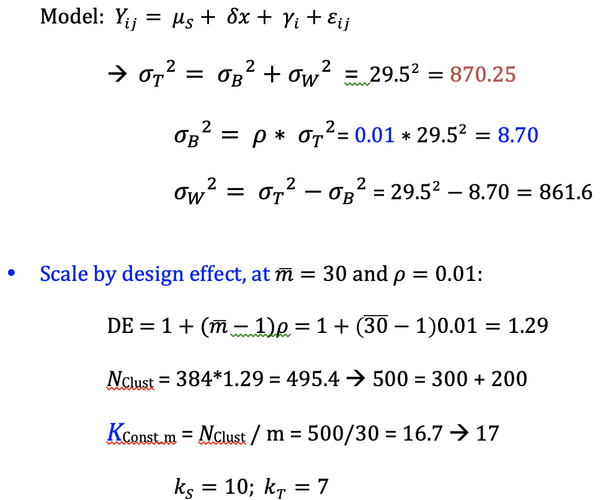
Example cont’d: How many experimental units are needed?
Case 1: Assume observation-level outcomes will be analyzed
Notes:
Allocation to {Ks,Kt} parallels allocation to {Ns,Nt}.

Slide 13
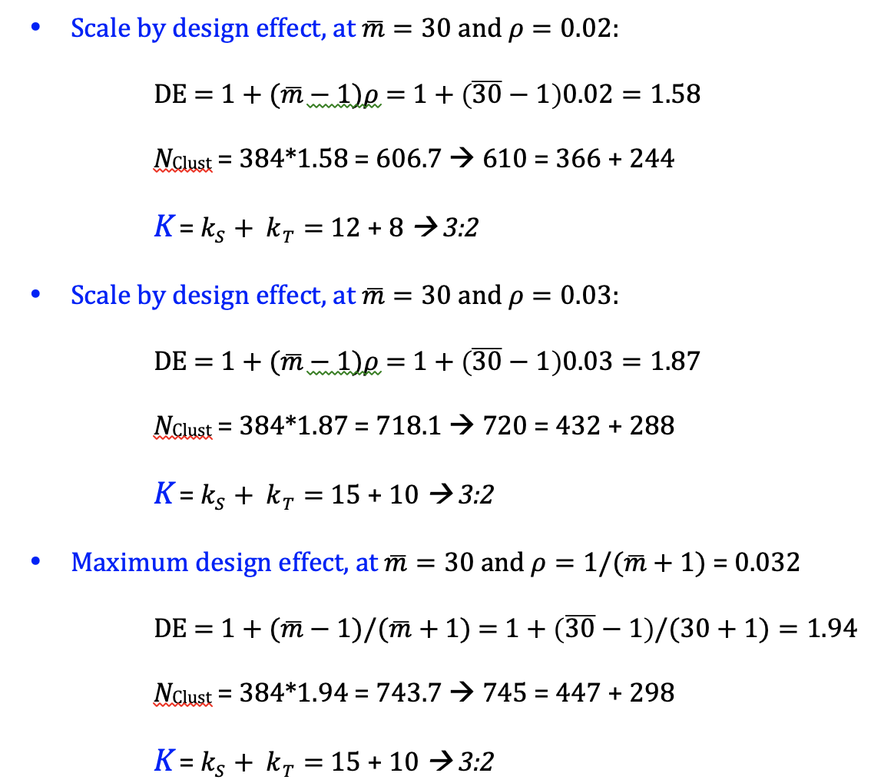
Example cont’d: Consider alternative values of ICC
Notes:
Allocation to {Ks,Kt} parallels allocation to {Ns,Nt}.

Slide 14
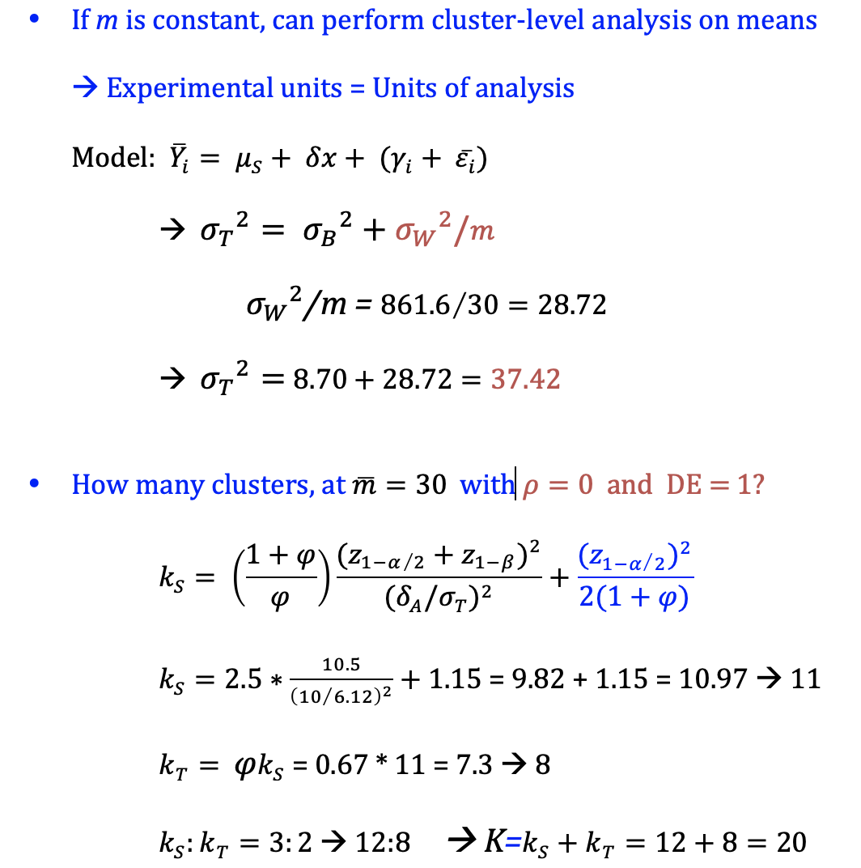
Example cont’d: How many experimental units are needed?
Case 2: Assume cluster-level outcomes will be analyzed
Notes:
Allocation to {Ks,Kt} parallels allocation to {Ns,Nt}.

Slide 15
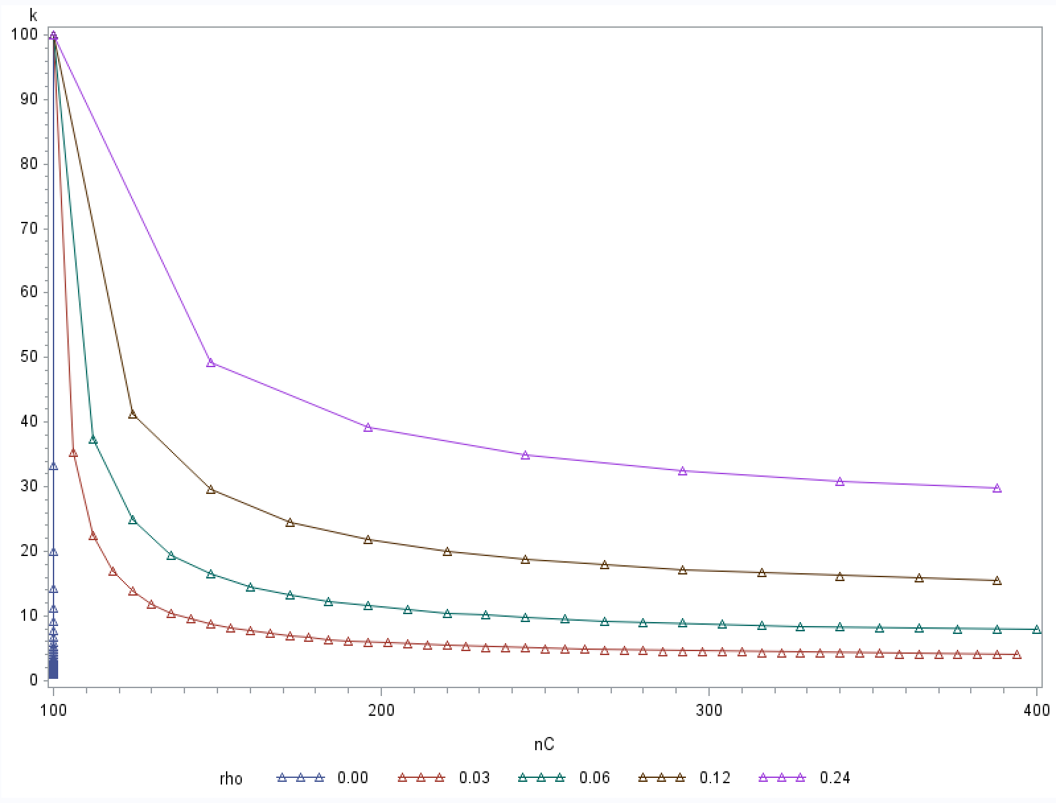
Methods for CRT Sample-size Calculations
Plot of # clusters, K, by # participants, N, in CRT, indexed by the ICC, ρ
Not all combinations of {ρ,m,K}
work well.
ρ=0: Every PPT contributes
equal information to the sample.
As ρ increases, unique PPT
contributions diminish. Designs
with high m are inefficient.
→ PPT resources are wasted
Instead, as ρ increases, add more
clusters, K.

Slide 16
Example 3: Compare prospective reimbursement (E) with after-sales service (C) for effect on health insurance usage in rural India
Clusters: k=4 districts per study arm
Eligible patients receive national health insurance; m=1000 per cluster. Claim rates were measured after the intervention period.
Results: Claim rates per district and arm (no missing values):
So, 150+120+90+110=470 of 4,000 experimental arm PPTs filed claims and 340 of 4,000 control arm PPTs filed claims.
Consider 3 analysis approaches:
Chi-squared test, 2-sample t-test, generalized linear model
 | A | B | C | D | Mean
Experimental | 15% | 12% | 9% | 11% | 11.75%
Control | 9% | 10% | 8% | 7% | 8.50%

Slide 17
a) Chi-squared test:
. csi 470 340 3530 3660
  | Exposed Unexposed | Total
  ------------+------------------------+------------
  Cases | 470 340 | 810
  Noncases | 3530 3660 | 7190
  ------------+------------------------+------------
  Total | 4000 4000 | 8000
  | |
  Risk | .1175 .085 | .10125
  chi2(1) = 23.21 Pr>chi2 = 0.0000
Notes:
This analyzes units of observation without accounting for nesting within districts.

Slide 18
b) 2-sample t-test:
. ttest Intervention=Control, unpaired unequal
  Two-sample t test with unequal variances
  ----------------------------------------------------
  Variable | Obs Mean Std.Err. Std.Dev. [95% CInt]
  ---------+------------------------------------------
  Interv~n | 4 .118 .013 .025 .077 .157
  Control | 4 .085 .006 .013 .064 .106
  ---------+------------------------------------------
  diff | .035 .014 -.005 .070
  ----------------------------------------------------
  diff = mean(Interv) - mean(Control) t = 2.3102
  Ho: diff = 0 Satterthwaite's d.f. = 4.49378
  Ha: diff < 0 Ha: diff != 0 Ha: diff > 0
  Pr(T<t)=0.96 Pr(|T|>|t|)=0.075 Pr(T>t)=0.037
Per Gao et al, df = K – 2. What’s different here?

Slide 19
c) Generalized linear model:
. xtgee tot_claims Intervention, i(siteid) family(binomial Nsampled) link(identity) corr(indep) robust nmp
  Estimated mean difference = 0.035,
  SE=0.013,
  z=2.50,
  p=0.013

Slide 20
Thoughts on analysis approaches:
Chi-squared test:
This analyzes units of observation without accounting for nesting within districts. → Do we want to make inferences at the PPT or at the cluster level?
b) 2-sample t-test:
Thanks to balanced study design and complete data, the simple t-test – with allowance for cluster-level data and unequal SD between arms, via modified d.f. – is a straightforward, valid ITT analysis.
c) Generalized linear model:
The GEE model directly accounts for the study design via a nested model.
A drawback is use of a large-sample method when there are only K=4 units of randomization per arm.
This approach would be needed if m varies or to adjust for covariates.
Notes:
Comments?
Thanks to balanced study design and complete data, the simple t-test – with allowance for unequal SD across groups, via modified d.f. – is a straightforward, valid unadjusted analysis.
The GEE model directly accounts for the study design. A drawback is use of a large-sample method when there are only k=4 units of randomization per arm.

Slide 21
Implications for CRT Sample-size Calculations
Chi-squared test:
Assuming random samples of n=4,000 PPTs per arm led to a more precise comparison (smaller variance; smaller p-value → type-1 error!) than other two methods.
→ Needing to account for both within- and between-cluster variance means that CRTs have larger sample size than individually-randomized trials (RCTs).
b) 2-sample t-test:
Balanced m and k, and complete data allow simple analyses of cluster-level summary data.
→ If inferences at the cluster level are desired, the “usual” sample-size calculation can be performed, substituting clusters for individuals.

Slide 22
Summary of Methods for CRT Sample-size Calculations
Steps used above:
  Calculate n_{I} via usual approach.
  Find ρ. Choose m.
  Calculate DE then N_{C} = N_{I} * DE . Solve for K = N_{C} / m.
  Solve for k_{S} and k_{T}, given allocation ratio.
When the number of units of randomization, K, is limited,
Arms could differ by chance imbalances; little opportunity to adjust via analysis.
External generalizability and credibility diminish.

