Slide 1
A brief history of human disease genetics
Presented by: Yusuph Mavura
01/28/2020

Slide 2
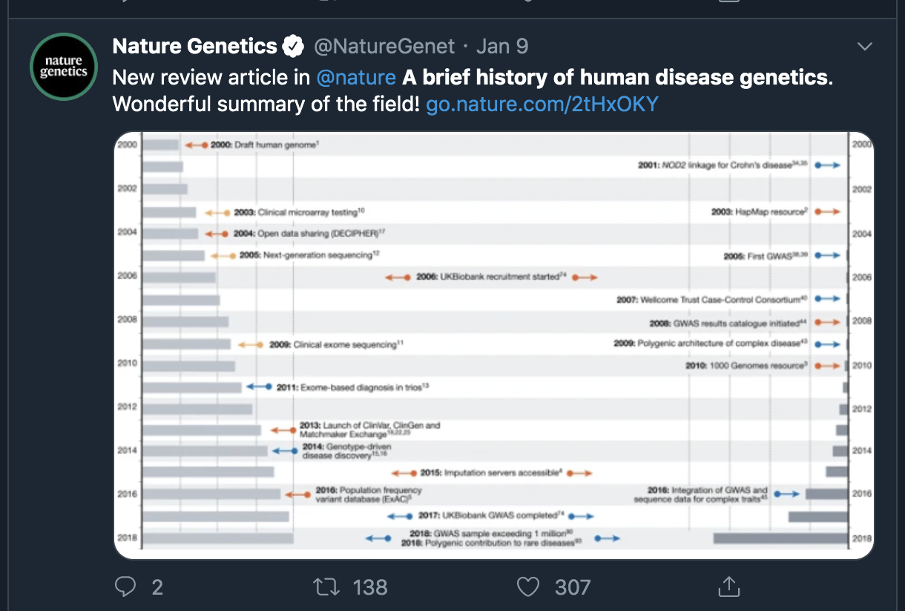
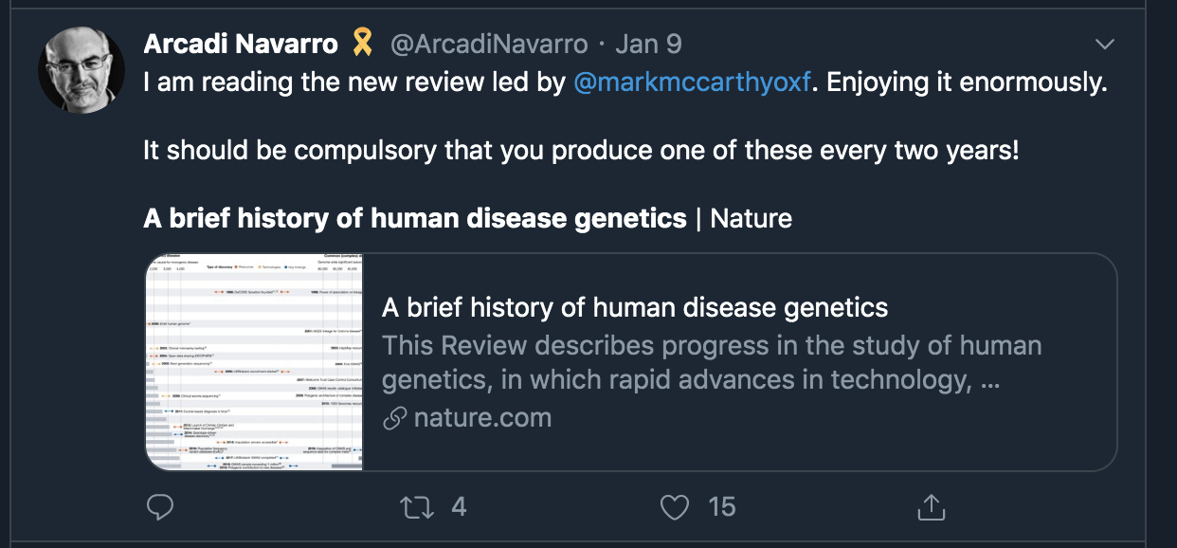
Twitter reactions to the paper
Generally, the paper was well received in the genetics twittersphere

Slide 3
Introduction
Individual susceptibility is to some extent influenced by genetic variation.
Major advances in the past 25 years in the identification of genes and variants causal for rare diseases and genetic basis of common multifactorial traits.
Split in efforts in discovery of rare variants with large effects vs discovery of alleles that are predispositional to common diseases.
Reality is that there is a continuous spectrum of disease risk alleles across the range of frequencies and effect sizes.

Slide 4
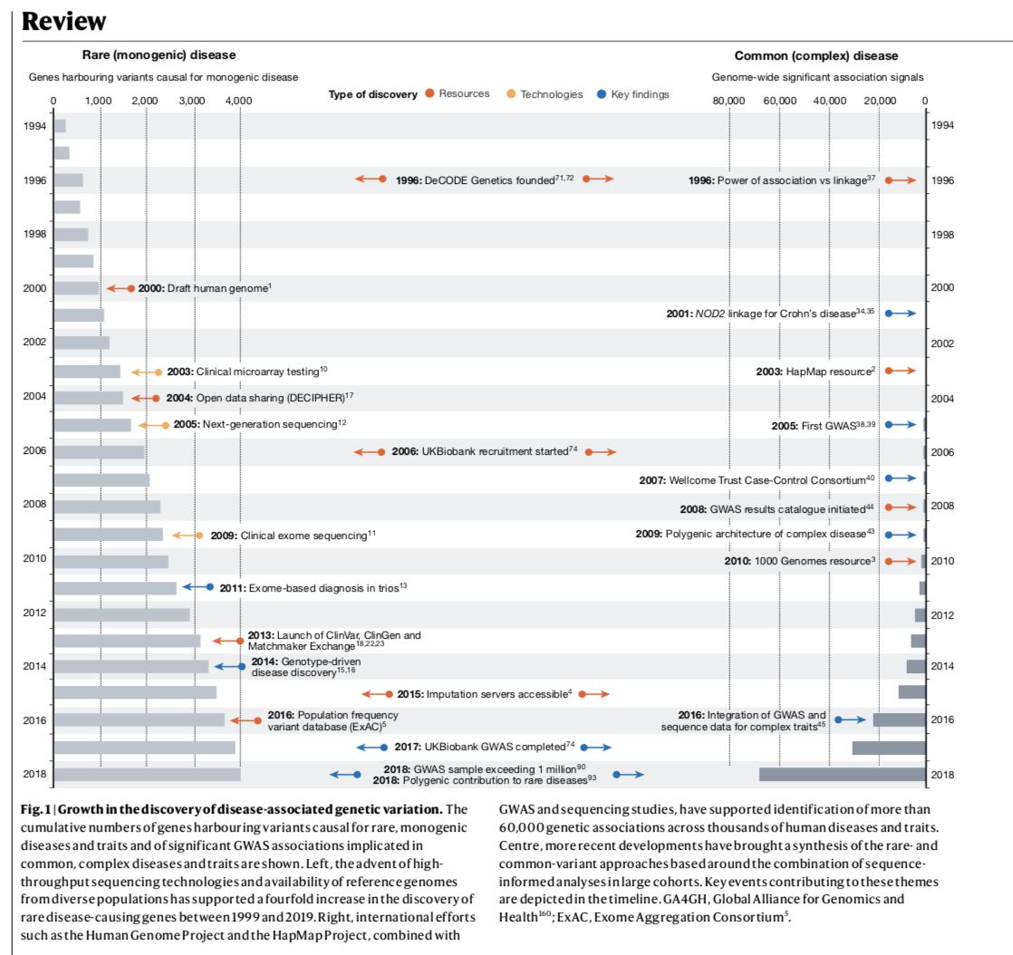

Slide 5
Introduction: Structure of the paper
Rare disease, rare variants
Common disease, common variants
Comprehensive genotype-phenotype maps
Adding Function
Clinical implementation
Looking forward

Slide 6
Rare disease, rare variants
In the 80s and 90s, efforts to map disease genes were focused on rare, monogenic diseases and driven by linkage analysis and fine mapping within large multiplex pedigrees.
Single gene inherited diseases such as Huntington's disease and cystic fibrosis were characterized.
Draft human genome sequence, microarray based technologies and high throughput sequencing tech have enabled faster diagnosis for genetic disorders.
Rare disease gene discovery has transitioned from small number of individuals to genome wide sequencing of large number of phenotypically diverse patients.

Slide 7
Rare disease, rare variants
Systematic approaches to data sharing has been crucial for characterization of new disorders and diagnostic interpretation.
Open databases of genes associated with rare disorders eg. OMIM, ORPHANET, as well as databases for clinically interpreted variants eg. ClinVar, ClinGen.
There has been huge steps in associating genes with particular disorders.
Establishment of causal role of individual variants within those genes remains problematic.
Many patients with suspected rare genetic diseases remain undiagnosed definitively.

Slide 8
Common diseases, common variants
Linkage analysis in multiplex pedigree methods were largely unsuccessful in common multifactorial diseases like diabetes and depression.
Characterization of genome wide patterns of genomic variation through HapMap consortium paved the way for GWA studies. (eg. acute macular degeneration)
Most variants of early GWAS were common and had subtle effects.
Tens of thousands of robust associations have been identified.
In most complex traits, genetic predisposition is shared across thousands of mostly common variants with individually modest effects on population risk.

Slide 9
Common diseases, common variants
Most large scale GWAS have been powered by information from individuals of European descent.
Even though common risk alleles discovered in one population are detectable in others, allele frequencies can vary substantially. There is need to do studies in more diverse populations.
High correlation between adjacent variants due to linkage disequilibrium frustrates mapping of causal variants responsible for these associations.
Most common disease variants map to non-coding sequences and are thought to be transcriptional regulators.
Risk variants identified by GWAS are important for mapping causal relationships between traits, identification of novel therapeutic targets and development of polygenic risk scores.

Slide 10
Comprehensive genotype-phenotype maps
There has been a division in disease-gene discovery into monogenic (family based linkage methods) and polygenic (case-control methods).
Disease risk alleles are distributed across a continuous spectrum of frequencies and effect sizes.
Developments in genotype phenotype relationships include:
Increase in the availability of large prospective population based cohorts.
  Popularly known as Biobanks.
  Most famous is UK Biobank where rich phenotypic information has been combined with genetic data.
Access to whole genome sequence data
  This has bolstered array-based access to lower frequency alleles eg. through imputation

Slide 11
Comprehensive genotype-phenotype maps
Developments in genotype-phenotype mapping are leading to a comprehensive matrix of effect of all observable genetic variants across the range of cross-sectional and longitudinal biomedical phenotypes.
Data sharing is key to this.

Slide 12
Adding Function
There have been huge developments in the mapping of genetic factors that underlie traits.
However, there is very slow progress in determining how these variants influence disease.
Molecular, cellular and physiological functional effects of these variants are largely unknown.
It is important to understand the mechanism which these disruptive variants leads to disease.
Some challenges include: GWAS associations map to non-coding genome, and many of the variants have a pleiotropic effect across multiple cell types.

Slide 13
Adding Function
There have been successes, regulatory variants of SORT1 expression influence LDL cholesterol.
There is a challenge in creating a systematic multidimensional approach.
Efforts to achieve this include:
  ENCODE project
  Genotype-Tissue Expression Consortium (GTEx)
  DNA proximity analysis such as Hi-C
  Single cell data
  HubMap and Human Cell Atlas projects

Slide 14
Adding function
QTLs are used to implicate a haplotype to molecular or cellular phenotype but cannot be used to define specific causal variants responsible.
Technologies such as massively parallel reporter assays, CRISPR genome editing have enabled functional characterization at various scales through knockout screening.
Other technologies include high content imaging and single cell transcriptomics and genomics.

Slide 15
Clinical implementation
Targeted genetic tests have been developed for mostly all clinical presentations attributed to a large impact allele.
Genetic testing for at risk individuals as well as somatic cancer testing has increased.
For monogenic disease diagnosis, targeted panels are used whereas for complex diseases, exome and genome sequencing is used.
Deep sequencing of affected tissues and the use of RNA seq to detect non-coding variants that drive disease have been developed.
Non-invasive prenatal testing and newborn screening done regularly although there are many ethical issues surrounding this.

Slide 16
Clinical implementation
In common diseases, attention has shifted to clinical potential of polygenic risk scores. This has been facilitated by GWAS.
There is a shift from array based genotyping to sequence based analysis in risk prediction.
Direct-to-consumer genetic and genomic testing raises concerns about release of data that may be dubious or inflated clinical relevance.
Gene therapy is making a comeback after advances in gene editing.

Slide 17
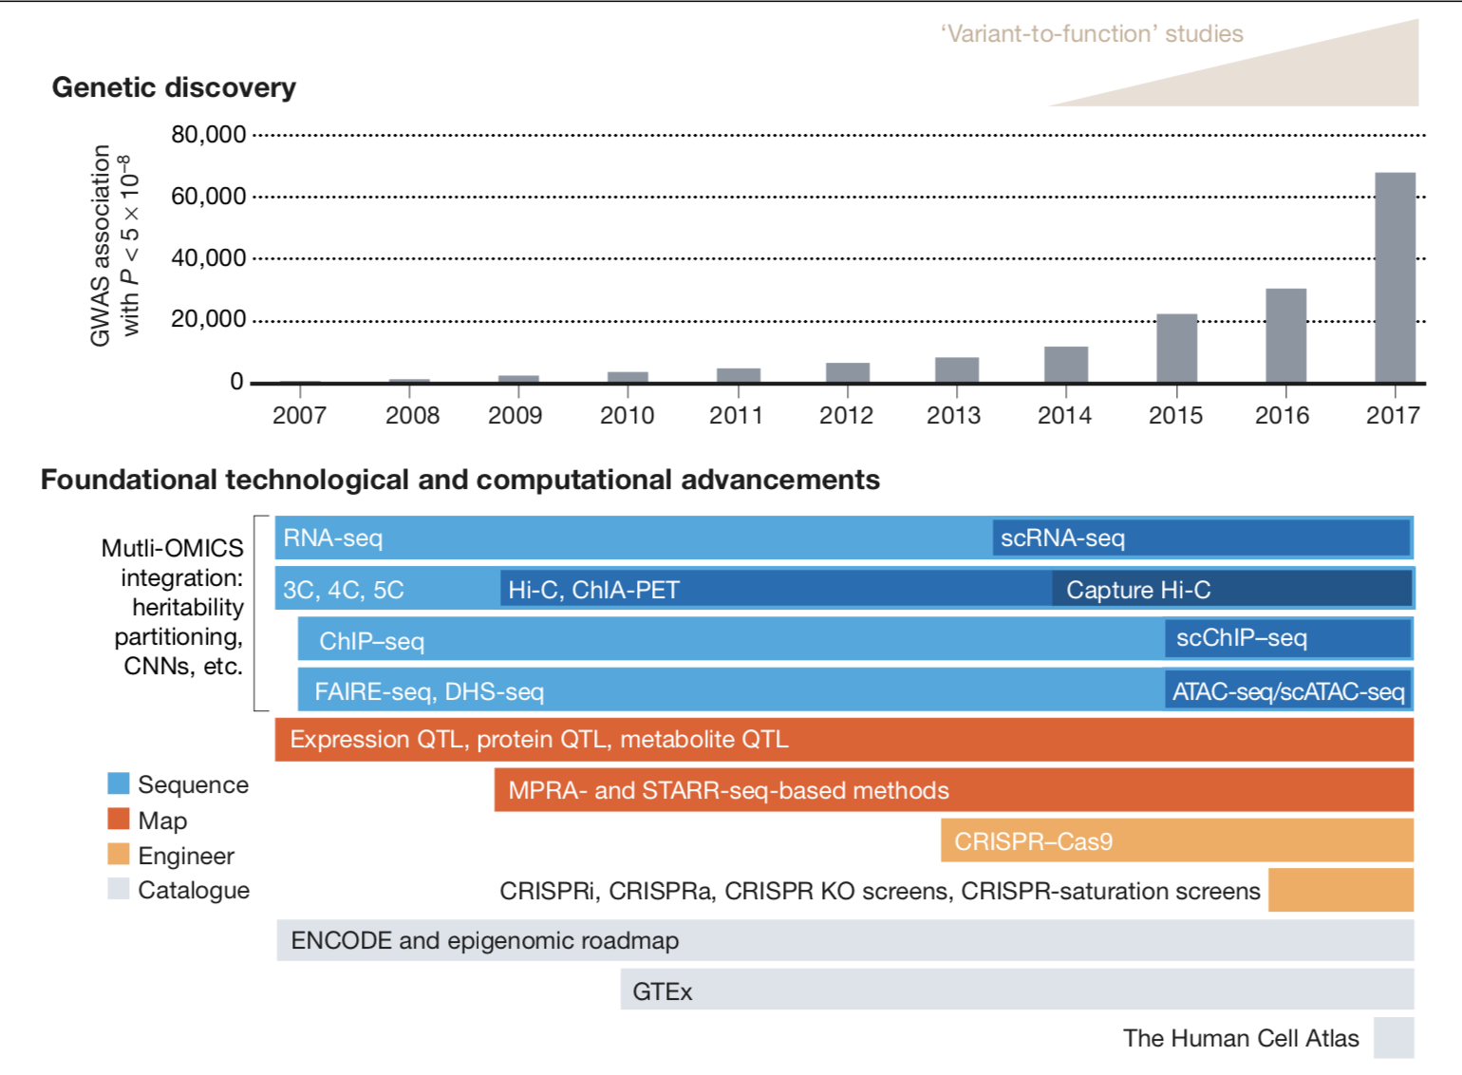

Slide 18
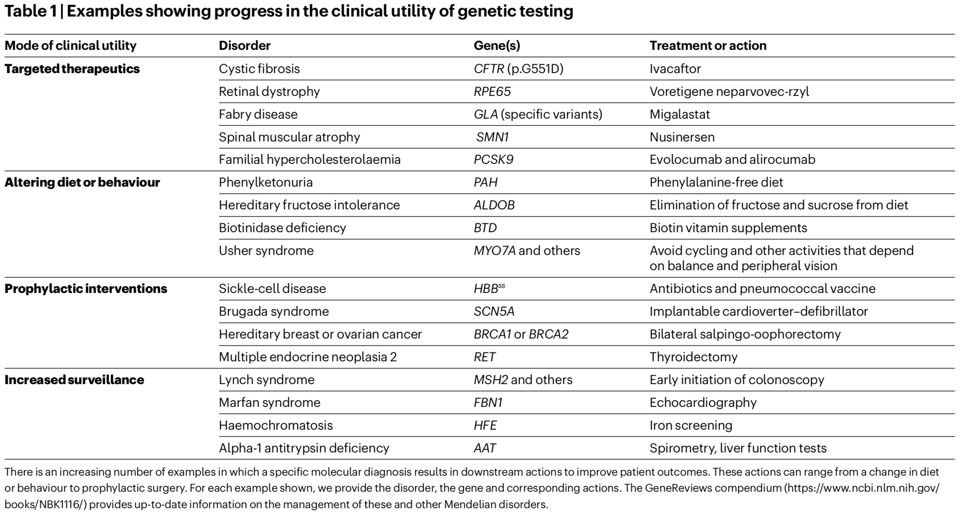

Slide 19
Looking forward
Main challenge in the upcoming decade is to optimize and implement at scale the strategies that use human genetics to understand health and disease.
Efforts in documenting the full spectrum of natural genetic variation across human populations including somatic and structural variants. (Is it possible?)
Important to include populations underrepresented eg. H3Africa consortium.
Systematic annotation of sequence variants for mechanistic interpretation of genetic associations.
Research access to data should remove barriers

Slide 20
Looking forward
Class discussion.
Where do you think the human disease genetics field is headed to?
What important questions do you think could be answered by advancements in human disease genetics?
What aspects in the field of human disease genetics should be given more attention/ more funding eg. research in underrepresented populations.

Slide 21
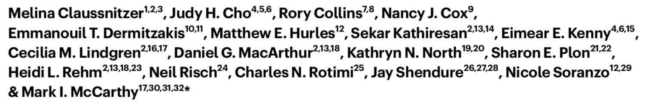
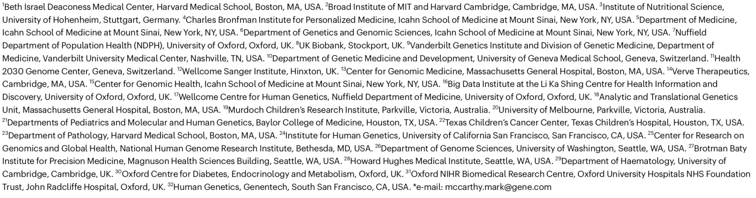
Authors

Slide 22
Questions ?

Slide 23
Thank you!

