Slide 1
Statistical Aspects of RCTs (+ factorial designs)

Slide 2
Data Analysis/Statistical Issues in Clinical Trials
(More alternative designs)
Simple analysis for parallel group RCTs
Analysis for non-standard study designs
  Factorial designs
  Cross-over
  Cluster randomization
Multiple comparisons in clinical trials
Special topics in data analysis in RCT’s (today and later lectures)
  Subgroups (Wang, et al, assigned reading)
  Adjustment for baseline covariables
  Multiple endpoints and adverse events (later lectures)
  ITT analysis (later lectures)

Slide 3
Alternative designs for RCT’s:
Cross-over designs
Matched pair designs
Cluster randomization
Large, simple trials
Factorial designs

Slide 4
Alternative RCT designs:
Factorial design
Test of more than one treatment (vs. control)
Each treatment alone and in combination
Allows multiple hypotheses in single trial, efficient
Examples
  Physician’s Health Study (classic)
    Aspirin ==> MI vs
    Beta carotene ==> cancer
  Vitamin E and Selenium for prostate CA
  Vitamin D/Omega 3 Fatty acids for Cancer and CHD (Homework) (2019)

Slide 5
Factorial design Classic Example:
Physician’s Health Study
( 2 treatments, 2 outcomes)
Placebo
Beta-carotene
Aspirin vs. no aspirin (MI)
Aspirin
Aspirin plus
Beta-carotene
Beta carotene vs. no beta carotene (cancer)
NEJM 321; 1989

Slide 6
Physician’s Health II study
(Gaziano) (JAMA, 1/7/09)
Placebo
Vitamin E
Vitamin C vs. no Vitamin C (Prostate CA)
Vit. C
Vitamin E +
Vitamin C
Vitamin E vs. No Vitamin E (Prostate CA)

Slide 7
3-way Factorial Design of WHI
(3 treatments, 3 outcomes)
HRT vs. no HRT (CHD)
Calcium/Vit D vs. no calcium/D (Fracture)
Low fat vs. regular diet (Breast Cancer)

Slide 8
Factorial design issues:
Getting’ something for nothin’?
Do treatments interact? (prostate ca example)
  Key Assumption: Treatments don’t interact
  Vitamin C effect on prostate Ca is the same in those taking vs. not taking vitamin E?
    Vit E 40% reduction
    Vit C 30% reduction
    V E + V C= 70% reduction (additive)
Must test for interaction of treatments
  Power to test for interactions is low
  Large sample required
May require more complicated stopping rules

Slide 9
Physician’s Heath Study—
Placebo
Beta-carotene
Aspirin plus
Beta-carotene
Aspirin vs. no aspirin (MI)
Aspirin
Beta carotene vs. no beta carotene (cancer)
“Interaction unlikely”

Slide 10
3-way Factorial Design of WHI
(3 treatments, 3 outcomes)
HRT vs. no HRT (CHD)
Key results:
HRT not protective for CHD or increased Breast Ca
Calcium D no effect on fractures,
Diet no effect on BC
Calcium/Vit D vs. no calcium/D (Fracture)
Normal vs. Low Fat Diet (Breast Ca)

Slide 11
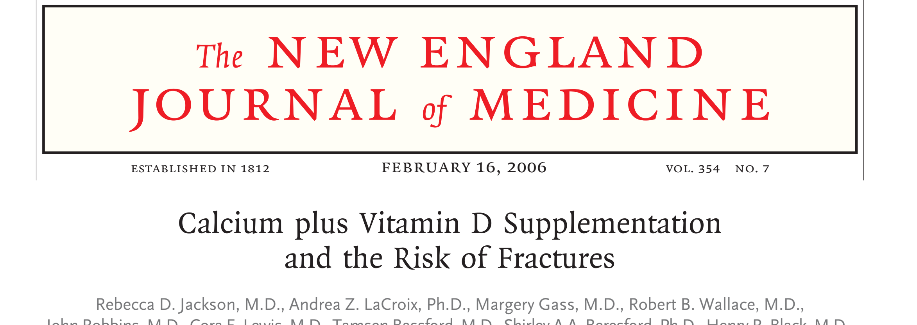
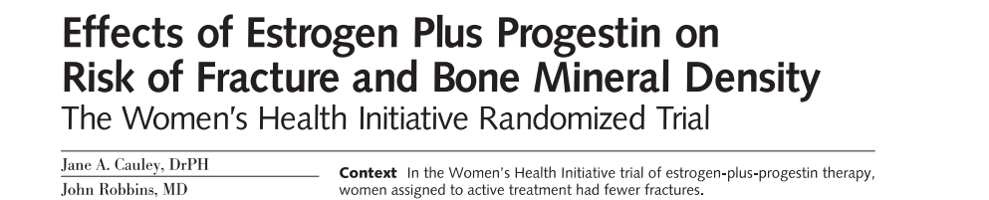
2 WHI Key Fracture Publications
Conclusions: Calcium/D do not reduce hip fx (2006) (kinda, sorta)
HRT reduces hip fractures (2006)

Slide 12
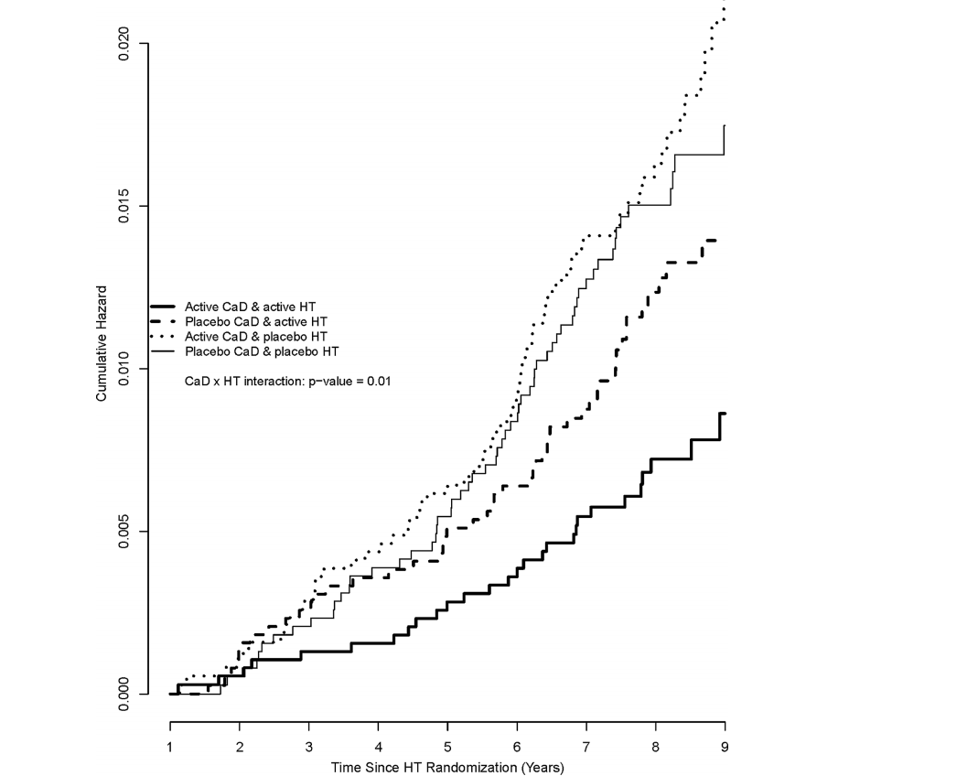
Estrogen and Calcium on Hip Fractures:
More Complex Story
Hip Fractures
CA, HRT
No CA, HRT
CA, No HRT
No CA, No HRT
Robbins 2013

Slide 13
3-way Factorial Design of WHI
(3 treatments, 3 outcomes)
Why Factorial? Use $260 million (2012$) to answer several key PH questions
“Efficient”
Worth it?
HRT vs. no HRT (CHD)
WHI: 2014 Cost-benefit Analysis (Roth, Ann Int Med,2014)
WHI resulted in 4.3M fewer cHT users, 126k fewer breast cancer cases, 76k fewer cardiovascular disease cases, 263k more fractures, 145k more quality-adjusted life-years➔savings of $35.2 billion. The corresponding net economic return was $37.1 billion ($140 per dollar invested in the trial)….
Calcium/Vit D vs. no calcium/D (Fracture)
Normal vs. Low Fat Diet (Breast Ca)

Slide 14
Factorial design conclusions
Factorial designs are seductive but complicated
  Key assumption: no interaction
Must weigh benefits in efficiency against compounded uncertainty and complexity

Slide 15
Use Lippman and Gaziano RCTs of Prostate cancer
Lippman, et al. Effect of selenium and vitamin E on risk of prostate cancer and other cancers. JAMA. 2009;301(1)
Gaziano J, et al. Vitamins E and C in the prevention of prostate and total cancer in men: The Physicians’ Health Study II randomized controlled trial. JAMA 2009;301(1):(doi:10.1001/jama.2008.862)

Slide 16
Data analysis for parallel group clinical trials
Example: 2 treatment groups (active/placebo)
Goal: Compare intervention in active vs. placebo
Appropriate analysis depends on type of outcome variable

Slide 17
Type of statistical tests
Depends on the types of variables
RCTs

Slide 18
Comparison of 2 treatment groups in RCT
Depends on type of outcome variable
  Continuous (t-test or non-parametric)
  Binary (y/n) (chi-squared)
  Binary, time to event (log rank)

Slide 19
Continuous Outcomes: Analysis
Compare mean in placebo with mean in active
  e.g., effect of statins on lipids, b-blocker on BP
Other examples:
  Change in menopausal symptoms score
  Change in weight (RCT’s of diets)

Slide 20
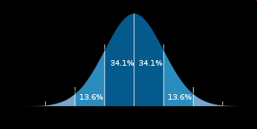
PTH and Alendronate (PaTH)* for Bone:
P-M women, 55-85 years
Randomize to:
  PTH alone (119)
  PTH + Alendronate combination (59)
  (Others)
Tale of 2 endpoints (both continuous)-
  Require differing analyses
  Change in bone density (%) (Normal distribution)
  Change in biochemical markers of bone remodeling
40
**
** Compare means,
p<.01 by “Student’s” t-test
30
Mean Change (%)
20
10
0
Spine BMD
PTH
PTH/ALN
* Black, et. al. NEJM (9/23/03)

Slide 21
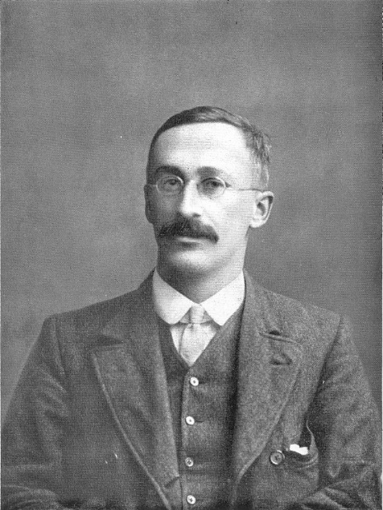
The “sordid history” of Stat. Tests: Who is “Student”?
Student’s t-test
Developed by W.S. Gossett ("Student”) [1876-1937]
Developed as statistical method to solve problems stemming from his employment in...??
A brewery
Quiz 1: Which brewery did “Student” work for?

Slide 22


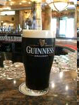
Quiz 1: Which brewery did “Student” work for?
Final Jeopardy: Why did Gossett use the pseudonym “Student”?
  Ans. Guinness, worried about publishing trade secrets, forbade employees from publishing anything! Gossett begged compromise was use pseudonym “Student”

Slide 23
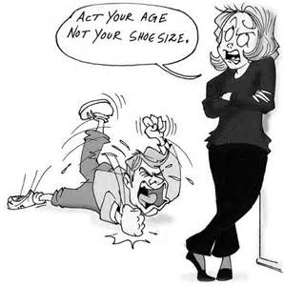
What to do about bad behavior?
t-test requires that sample means (not individuals) are well-behaved and normally distributed.
Practical implication: t-test almost always valid for continuous data as long as n is large enough or variable not too weird.
What about dramatic departures from normality?

Slide 24
Non-normal data: Badly behaved continuous outcomes (eg. days of back pain)
Can’t use T-tests and compare means
Use Non-parametric methods
  Descriptive: medians, %-tiles
  Test for 2 groups:
    Wilcoxin (aka Rank-sum) test
Other example:
  Cigarettes per day

Slide 25
% Change in Biochemical Bone Turnover Markers with PTH therapy in PaTH*
For strong departures from normality, use non-parametric techniques
80
60
Frequency (%)
40
20
0
-90
0
90
180
270
360
450
540
630
1 Year Change (%)
Black, et. al. NEJM 2002

Slide 26
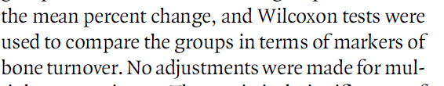
% Changes in Markers of Bone Turnover
(Use medians and interquartile range, Wilcoxin test)
400
Formation (P1NP)
75th percentile: +400%
300
200
Median Change (%)
Median (150%)
100
25th percentile (25%)
0
-100
0
3
6
9
12
Month
P<.001
PTH
PTH/ALN
*(Increases as high as 800%)
Black, et. al. NEJM 2002

Slide 27
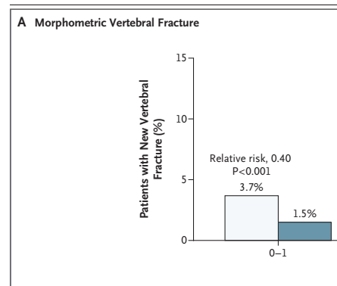

Comparison of 2 treatment groups in RCT
Depends on type of outcome variable
  Continuous (t-test)
  Binary (y/n) (chi-squared)
  Binary, time to event (log rank)
Compare proportions across treatments
  e.g.,
    vertebral fracture on baseline vs. follow-up x-ray (yes/no, don’t know date)
Relative risk, test with Chi-square

Slide 28
Analysis of trials with binary outcomes
Compare proportions across treatments
  e.g.,
    vertebral fracture on baseline vs. follow-up x-ray (yes/no, don’t know date)
Relative risk, test with Chi-square

Slide 29

Dichotomous Outcome:
Morphometric Vertebral Fracture
Compare 2 Radiographs: Follow-up vs Baseline
(Don’t know time of event)
Essentially a chi-square test
Black et al NEJM 2007

Slide 30
Comparison of 2 treatment groups in RCT
Depends on type of outcome variable
  Continuous (t-test)
  Binary (y/n) (chi-squared)
  Binary, time to event (log rank)
Compare survival curves in active vs. placebo groups
Measure of association is the Relative Hazard (RH) or Hazard Ratio (HR)
  RH usually similar to RR
Describe with Kaplan-Meier survival curve
Use log rank test
  Equivalent to PH model with single binary predictor

Slide 31

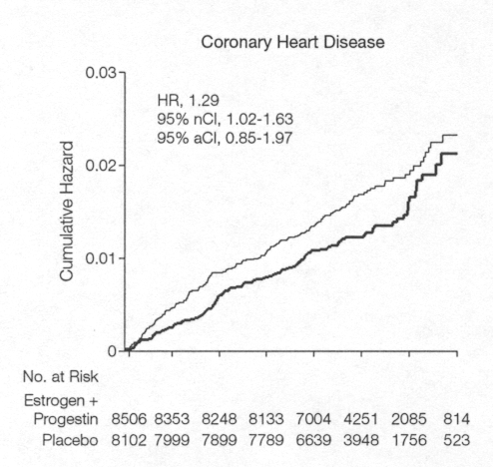
Survival Curve
Women’s Health Initiative (HRT vs PBO) for CHD
years 1 2 3 4 5 6 7

Slide 32
Raloxifene and Risk of
Breast Cancer (MORE trial)
1.25
Placebo
3.8 per 1,000
1.00
0.75
p < 0.001
(log rank test)
% of participants
0.50
Raloxifene
1.7 per 1,000
0.25
0.00
0
1
2
3
4
0 1 2 3
Years

Slide 33
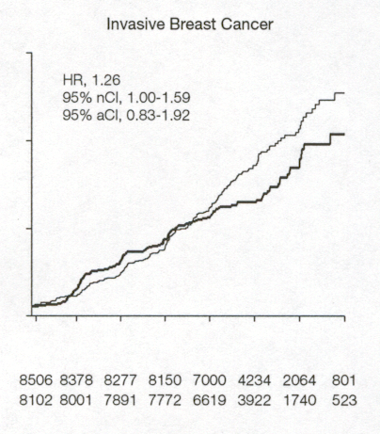
Survival Curves Can Be Informative: WHI CHD and Invasive Breast Cancer
3%
2%
1%
years 1 2 3 4 5 6 7
years 1 2 3 4 5 6 7
years 1 2 3 4 5 6 7

Slide 34
Intro to Data Analysis for
More Exotic RCT Designs
Cluster randomization designs
Factorial designs
Repeated measures design
Cross-over designs

Slide 35
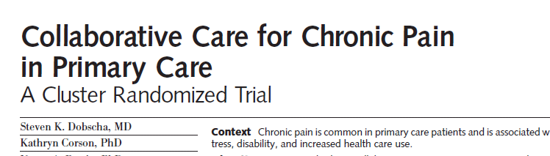
Cluster randomization: Data analysis
Cluster randomization designs
  Randomize/analyze clusters
Example
  Collaborative Care for Pain Randomize Medical Practices (clusters)
Interesting and underutilized design
  Popular (epi 205)

Slide 36
Cluster randomization: JAMA study
46 clinicians
401 patients

Slide 37




Cluster randomization of Clinicians
~10 patients
~10 patients
~10 patients
~10 patients
100 kids
~10 patients
~10 patients
~10 patients
~10 patients
46 clinicians, 401 patients

Slide 38
Cluster randomization of Clinicians
~10 patients
~10 patients
~10 patients
~10 patients
100 kids
~10 patients
~10 patients
~10 patients
~10 patients
46 clinicians, 401 patients

Slide 39
Cluster randomization: Analysis
Analysis must account for randomization of clusters, not individuals
Most commonly used technique: Generalized Estimating Equations (GEE)
  Type of multiple regression (Stata and SAS)
Effective sample size is between total n and number of clusters
  Methods (see following 3 slides, not presented in class)

Slide 40
Cluster randomization:
Steps in sample size calculation
1. Calculate sample size as if total n
2. Inflation factor:
= (1 + (CS-1)*RHO)
Where : CS=cluster size
RHO=Intraclass corr. coef.
CS RHO Inflation
30 .05 x 1.5
100 .05 x 6
1000 .05 x 51
eg. if n=100 with no clusters
150
600
51,000

Slide 41
Cluster randomization: Sample size
How big is intraclass correlation (rho)?
- Degree of similarity within cluster. Corr. Coefficient within cluster (0=no relationship to 1)
-In Collaborative Pain Study in section, assumed rho=.05 for sample size
-Some empiric studies suggest: in range of .01 to .2 for clusters like medical practice or community
- Need pilot data--Challenge in planning a cluster randomization study

Slide 42
Some References for Cluster Randomization Designs
  Eldridge, S. M., D. Ashby, et al. (2004). "Lessons for cluster randomized trials in the twenty-first century: a systematic review of trials in primary care." Clin Trials 1(1): 80-90.
  Gulliford, M. C., O. C. Ukoumunne, et al. (1999). "Components of variance and intraclass correlations for the design of community-based surveys and intervention studies: data from the Health Survey for England 1994." Am J Epidemiol 149(9): 876-83.
  Smeeth, L. and E. S. Ng (2002). "Intraclass correlation coefficients for cluster randomized trials in primary care: data from the MRC Trial of the Assessment and Management of Older People in the Community." Control Clin Trials 23(4): 409-21.

Slide 43
Factorial design: Analysis Implications
Factorial designs
  Seductive but tricky
  Need to believe and show that no interaction between treatments (statistical test)
Examples:
  Vitamin C and E on prostate cancer (Gaziano)
    About 15,000 men
    4 treatment groups (all combos)
  Selenium and Vitamin E (SELECT, Lippman)

Slide 44
Factorial design: Vitamin C and E and Prostate Ca.(Gaziano, JAMA, 1/7/09)
Vitamin C
No
Yes
No
Placebo
N=3653
Vitamin C alone
N=3673
N=7326
Vitamin E
Vitamin E alone
N=3659
Vitamin C +
Vitamin E
n=3656
N=7315
Yes
N=7312
N=7329

Slide 45
Factorial design: Physicians Health Study II Vitamin C and E and Prostate Ca. (JAMA, 1/7/09)
From Figure 1 from Gaziano et al
Vitamin E + C
Vitamin E alone
Vitamin C alone
Placebos only

Slide 46
Factorial design: Physicians Health Study II Vitamin C and E and Prostate Ca. (JAMA, 1/7/09)
Vitamin C
No
Yes
No
Placebo
N=3653
Vitamin C alone
N=3673
N=7326
Vitamin E
Vs.
Vitamin E alone
N=3659
Vitamin C +
Vitamin E
n=3656
N=7315
Yes
N=7312
N=7329
Vs.

Slide 47
Physicians Health Study II:
Prostate CA Results for Vit E
Vitamin C
No
Yes
No
Placebo
N=3653
Vitamin C alone
N=3673
N=7326
9.3/1000
Vitamin E
Vs.
Vitamin E alone
N=3659
Vitamin C +
Vitamin E
n=3656
N=7315
9.5/1000
Yes
HR=.97 (.85, 1.09)
N=7312
N=7329
Vs.

Slide 48
Factorial design: Physicians Health Study II Vitamin C and E and Prostate Ca. (JAMA, 1/7/09)
HR=.97 (.85, 1.09)

Slide 49
Factorial design assumption:
No interaction between treatments
Vitamin C
No
Yes
No
10%
6%
40% reduction for Vitamin C
Vitamin E
Yes
8%
4.8%
40% reduction for Vitamin C
20% reduction for Vitamin E
20% reduction for Vitamin E
40% reduction for Vitamin C

Slide 50
Factorial design: Interaction between treatments
Vitamin C
No
Yes
No
10%
6%
40% reduction for Vitamin C
Vitamin E
Yes
8%
4.8%
1%
90% reduction for Vitamin C
20% reduction for Vitamin E
~80% reduction for Vitamin E

Slide 51
Factorial design: Interaction between treatments
Vitamin C
No
Yes
No
10%
6%
40% reduction for Vitamin C
Vitamin E
Yes
8%
4.8%
10%
20% increase for vitamin C
20% reduction for Vitamin E
40% increase for Vitamin E

Slide 52
Factorial design: Analysis Implications
No interaction: the effect of treatment 1 is the same regardless of treatment 2
If you test for interactions and see none, simple comparison of groups
In prostate cancer paper end of results:
  “we examined 2 way interactions between vitamin C and E and found no interaction”
Effect of vitamin C was the same regardless of whether or not they received vitamin E
Effect of vitamin E was the same regardless of whether or not they received vitamin C
Caution: test of interaction may have very low power

Slide 53
Physicians Health Study II: Results
Vitamin C
No
Yes
No
Placebo
N=3653
Vitamin C alone
N=3673
N=7326
9.3/1000
Vitamin E
Vs.
Vitamin E alone
N=3659
Vitamin C +
Vitamin E
n=3656
N=7315
9.5/1000
Yes
HR=.97 (.85, 1.09)
N=7312
N=7329
Vs.

Slide 54
Factorial design: SELECT study (Selenium and Vitamin E Trial) and Prostate cancer (Lippman) (JAMA, 1/7/09)
Vitamin E
alone
Selenium
alone
Vitamin E + Selenium
placebos

Slide 55
Factorial design:
Alternative methods of data analysis
Assume that there are interactions
Don’t collapse treatment groups
Used in SELECT study (Lippman)

Slide 56
Factorial design: SELECT study (Lippman) (JAMA, 1/7/09)
Selenium
5 hypotheses each tested at 0.005 (one sided). Why not .05?
No
Yes
No
Placebo
Selenium alone
Vitamin
E
To adjust for multiple comparisons
Vitamin E alone
Selenium +
Vitamin E
Yes

Slide 57
Factorial design: SELECT study (Lippman) (JAMA, 1/7/09)
Selenium
No
Yes
Advantages/disadvantages of this analysis approach?
No
Placebo
Selenium alone
Vitamin
E
Vitamin E alone
Selenium +
Vitamin E
Yes
“There were statistically nonsignificant increased risks of prostate cancer in the vitamin E group (P = .06)”

Slide 58
Factorial Designs: Data Analysis Summary
Factorial design must be taken into account in analysis
Many different approaches but should be thought out in advance
Tests for interactions have low power and may negate some advantages of factorial design

Slide 59
Cross Over Designs: Analysis Implications
Cross-over designs
  Subject is own control
    Example: paroxetine and menopausal symptoms
  Good design when within-person variation is small
  Interpretation requires (mild) assumptions
    1. No effect of order to treatments: a then b is same as b then a
    2. No carryover effect (need long enough wash out period)
  Can test for effect of order via model with interaction but large sample size required
  Multivariable model with the following independent vars:
    treatment
    order of treatments
    treatment by order interaction

Slide 60
Paroxetine for Hot Flashes
(Sterns et al from lecture 1 and HW 1)

Slide 61
More Advanced Topics in Data Analysis for Clinical Trials

Slide 62
More Advanced Topics in Data Analysis for Clinical Trials
Subgroups
Adjustment for baseline covariables (later)
Multiple endpoints (later)
Analysis of adverse events (later)
Interim analysis (later)
Multiple Comparisons
A digression….

Slide 63
Multiple comparisons: Central Issue in RCTs
The general problem
  Each statistical test has a 5% chance of Type I error
  We are wrong 1 time out of 20
Take a worthless drug (placebo 2) compare to placebo 1
  1 study: P(type I error)= 5%
  2 studies: P(1 or 2 type I errors)= almost 10%
  20 studies: P(at least one significant)=64%
Publication bias
  Rationale for registration of all clinical trials (www.clinicaltrials.gov) and Cochrane collaboration
(Huge problem in genetics and -omics studies) p<.0000001

Slide 64
Multiple Comparisons in RCTs: solutions?
Bonferroni
  Divide overall p-value by number of tests
  Often unacceptable losses of power
Use common sense/Bayesian
  Does result make sense?
  Biologic plausibility
  Is result supported by previous data?
  Was analysis defined apriori?
Special solutions for special situations
  Multiple comparison procedures for 3 treatment groups
  Interim analysis (later lecture)

Slide 65
Subgroups
A problem caused by multiple comparisons
After primary analysis, look at subgroups
  If drug effective, more effective in some subgroups?
  If ineffective, does drug work in subgroup of participants?
Are adverse effects concentrated in some subgroups?

Slide 66
Efficacy of Alendronate On Reducing Clinical Fractures
Fracture Intervention Trial (FIT) II: Women with BMD T-score < -1.6
  Osteoporosis defined as <-2.5
  Only 1/3 have osteoporosis
  Primary endpoint: clinical fractures (non-spine plus clinical spine)
Overall results:
  14% reduction in clinical fractures (RH=0.86, p=.07)
  Wimpy
Cummings, Black et. al, JAMA, 1997

Slide 67
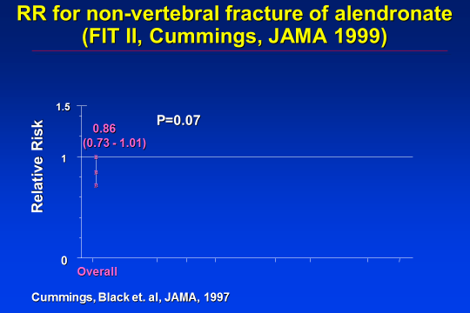
1.5
P=0.07
0.86
(0.73 - 1.01)
1
B
Relative Risk
B
B
0
Overall
Cummings, Black et. al, JAMA, 1997

Slide 68
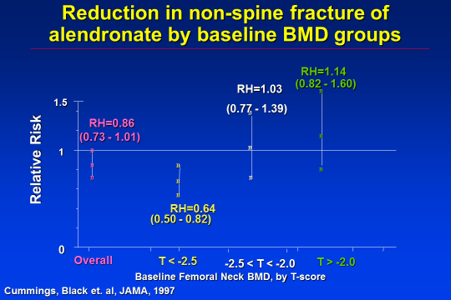
Reduction in non-spine fracture of alendronate by baseline BMD groups
RH=1.14
RH=1.03
(0.82 - 1.60)
B
1.5
(0.77 - 1.39)
B
RH=0.86
(0.73 - 1.01)
B
1
B
B
Relative Risk
B
B
B
B
B
B
B
RH=0.64
(0.50 - 0.82)
0
Overall
T < -2.5
-2.5 < T < -2.0
T > -2.0
Baseline Femoral Neck BMD, by T-score
Cummings, Black et. al, JAMA, 1997

Slide 69
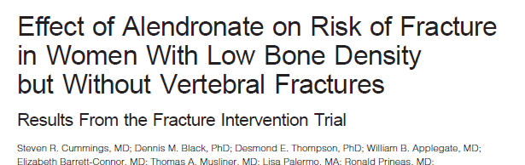
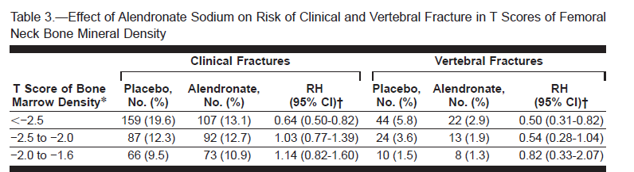

Slide 70
Data Analysis of Subgroup Results
2 important components:
- 1. Test for interaction
  Is RH equal at all levels of covariate (BMD)
- 2. Also look at significance within subgroup

Slide 71
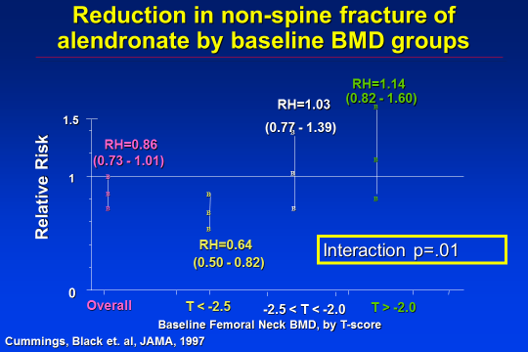
Reduction in non-spine fracture of alendronate by baseline BMD groups
RH=1.14
RH=1.03
(0.82 - 1.60)
B
1.5
(0.77 - 1.39)
B
RH=0.86
(0.73 - 1.01)
B
1
B
B
Relative Risk
B
B
B
B
B
B
B
RH=0.64
Interaction p=.01
(0.50 - 0.82)
0
Overall
T < -2.5
-2.5 < T < -2.0
T > -2.0
Baseline Femoral Neck BMD, by T-score
Cummings, Black et. al, JAMA, 1997

Slide 72
What to Do With an
Unexpected Subgroup Finding
Is this a real finding???
Was it specified in protocol (with small number of other analyses specified)?
Has this been previously observed?
  Increase prior probability
Ways to verify
  Most important: replication. Other trials, if possible and available
  Look at other similar subgrouping variables (BMD at hip, spine, radius)
  Examine for other similar endpoints (hip fractures, etc.)
  Consider biologic plausibility

Slide 73
Another alendronate trial: Fosamax International Trial (FOSIT)
1908 women, 34 countries
Alendronate vs. placebo
47% reduction in all clinical fractures (p<.05)
Pols, Osteo Int, 1999

Slide 74
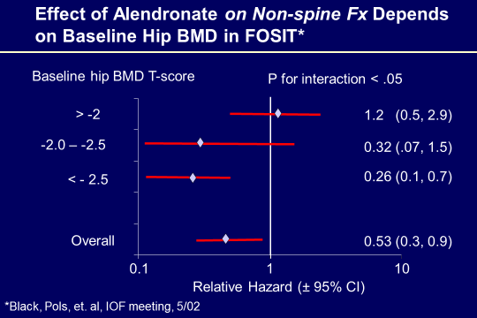


Slide 75
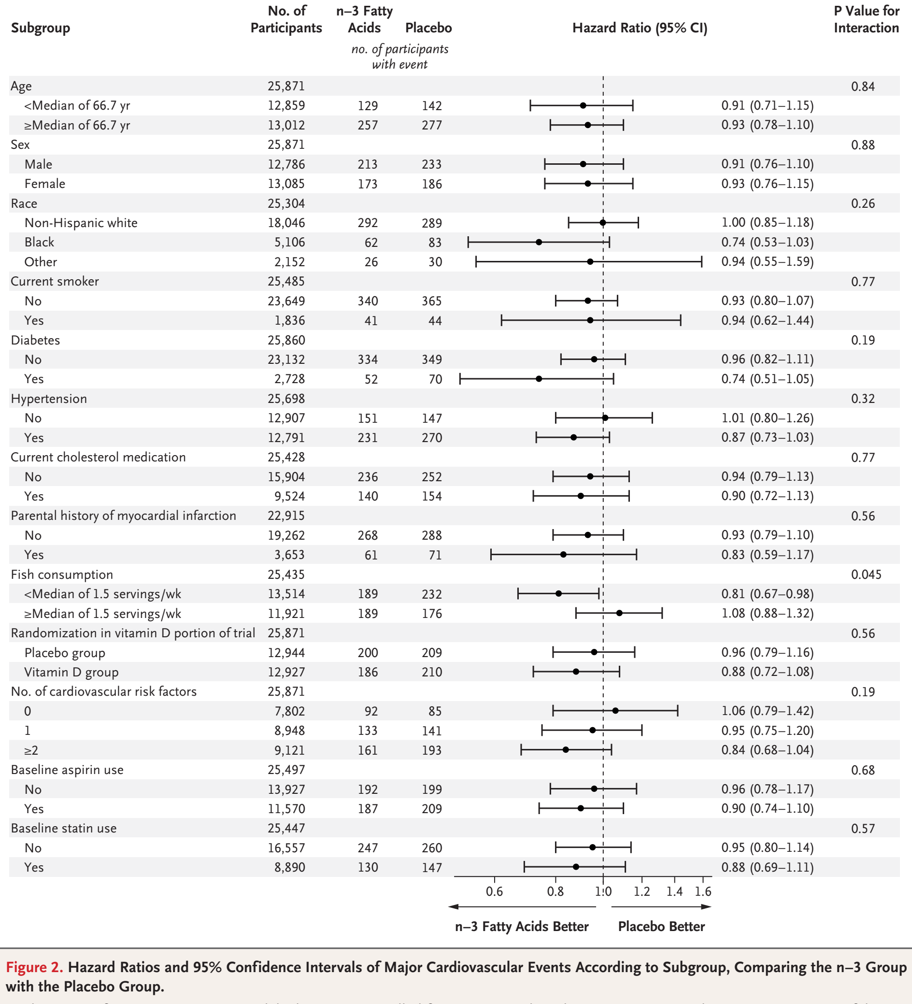
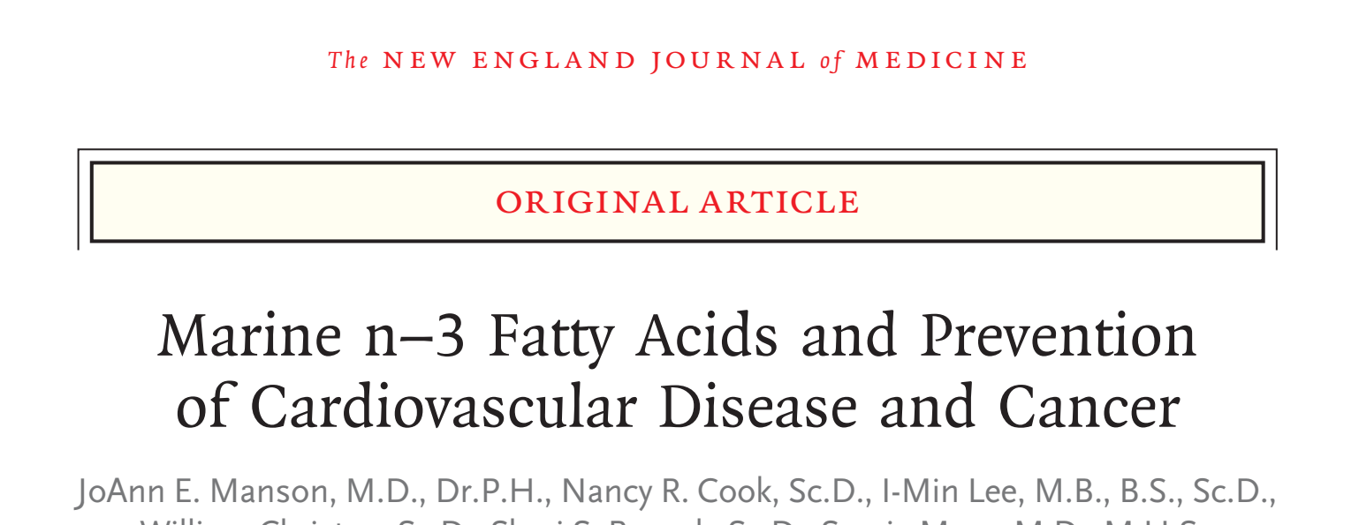
VITAL Trial (Omega-3 FAs and Vit D on Ca and CHD)
NEJM 2019

Slide 76
BMD Interaction of alendronate non-spine fracture
Ways to verify
  Most important: replication. Other trials, if possible and available
  Look at other similar subgrouping variables (BMD at hip, spine, radius)
  Examine for other similar endpoints (hip fractures, etc.)
  Consider biologic plausibility
Also seen in FIT study for other endpoint (hip fractures) and for other BMD sites
Seen in some (but not all) other osteoporosis studies
- Ibandronate (bisphosphonate): 2001
- Risedronate (bisphosphonate): 1999 and 2002
- PTH(1-84) (anabolic agent): 2007
- Denosumab (anti-rank): 2010
Conclusion: More credibility

Slide 77



Subgroup Analysis During
HERS for DSMB
Look at impact of HRT on new CHD in women with existing CHD (expected large reduction based on observational study)
Early results showed that HRT increased CHD risk (YIKES!!!)
Is there subgroup with significant harm? Might want to discontinue that subgroup.
Look at relative hazard (RH) within subgroups defined by baseline variable. For DSMB during study…

Slide 78


Subgroup analysis for DSMB during HERS:
Alter trial due to HARM for CHD????
Relative hazard (E vs. placebo)
Subgroup Within Among
Subgroup N (%) Subgroup Others p (intrac)*
history of smoking 1712 (62) 1.01 3.39 .01
current smoker 360 (13) 0.55 1.92 .03
digitalis use 275 (10) 4.98 1.26 .04
>= 3 live births 1616 (58) 1.09 2.72 .04
lives alone 775 (28) 2.97 1.14 .05
prior mi by chart review 1409 (51) 2.14 0.93 .05
beta-blocker use 899 (33) 2.89 1.15 .06
age >= 70 at randomization 1019 (37) 2.65 1.14 .06
*Statistical significance of interaction
Dave Demets

Slide 79
Lots of subgroups were analyzed in HERS
history of smoking (at rv) 1712 (62) 1.01 3.39 0.30 .01
current smoker (at rv) 360 (13) 0.55 1.92 0.29 .03
digitalis use (at rv) 275 (10) 4.98 1.26 3.96 .04
>= 3 live births 1616 (58) 1.09 2.72 0.40 .04
lives alone (at rv) 775 (28) 2.97 1.14 2.60 .05
prior mi by chart review (cr) 1409 (51) 2.14 0.93 2.30 .05
beta-blocker use (at rv) 899 (33) 2.89 1.15 2.51 .06
age >= 70 at randomization 1019 (37) 2.65 1.14 2.32 .06
prior mi in most distant tertile 447 (16) 2.64 0.93 2.82 .07
walk 10m or in exercise program (at rv) 1770 (64) 2.35 1.11 2.12 .08
prior ptca by chart review (cr) 1189 (43) 0.92 1.98 0.46 .08
prior mi within 2 years 420 (15) 3.20 1.28 2.50 .11
tg > median (at rv) 1377 (50) 2.02 1.05 1.93 .12
rales in the lungs (at rv) 80 ( 3) 0.43 1.65 0.26 .13
digitalis or ace-inhibitor use (at rv) 653 (24) 2.33 1.24 1.88 .16
previous ert for >= 12 months 302 (11) 4.19 1.41 2.98 .18
serious medical conditions 1028 (37) 1.05 1.81 0.58 .21
age >= 53 at lmp 578 (21) 3.19 1.38 2.31 .23
hdl > median (at rv) 1315 (48) 1.18 1.95 0.61 .24
lp(a) > median (at rv) 1378 (50) 1.26 2.08 0.60 .25
use of non-statin llm (at rv) 420 (15) 0.89 1.69 0.52 .25
married (at rv) 1588 (57) 1.26 1.98 0.64 .29
lvef <= 40% 178 ( 6) 2.16 1.01 2.13 .31
prior mi within 4 years 765 (28) 2.07 1.32 1.57 .32
previous ert use for >= 1 year 327 (12) 2.86 1.41 2.03 .32
prior mi within 1 year 194 ( 7) 2.88 1.43 2.02 .33
chest pain (at rv) 982 (36) 1.25 1.88 0.67 .33
dbp >= 90 mmhg (at rv) 149 ( 5) 0.91 1.62 0.56 .35
prior ptca within 1 year 206 ( 7) 3.94 1.46 2.71 .38
prior mi within 3 years 612 (22) 2.05 1.37 1.50 .40
prior ptca within 4 years 838 (30) 1.15 1.70 0.68 .40
use of any llm (at rv) 1296 (47) 1.23 1.76 0.70 .40
diuretic use (at rv) 775 (28) 1.89 1.33 1.42 .41
signs and symptoms of chf (at rv) 118 ( 4) 0.94 1.60 0.58 .42
ace inhibitor use (at rv) 483 (17) 2.05 1.40 1.46 .44
total cholesterol > median (at rv) 1377 (50) 1.32 1.80 0.74 .47
l-thyroxine use (at rv) 414 (15) 2.29 1.43 1.60 .47
poor/fair self-rated health (at rv) 665 (24) 1.30 1.72 0.76 .51
heart murmur (at rv) 540 (20) 1.89 1.42 1.34 .53
sbp >= 140 mmhg (at rv) 1051 (38) 1.37 1.72 0.80 .59
prior ptca within 3 years 695 (25) 1.27 1.61 0.78 .62
s3 heart sounds (at rv) 19 ( 1) 2.74 1.50 1.82 .63
htn by physical exam (at rv) 557 (20) 1.32 1.62 0.81 .64
>= 2 severely obstructed main vessels 1312 (47) 1.53 1.26 1.22 .69
statin use (at rv) 1004 (36) 1.34 1.59 0.84 .71
have you ever been pregnant 2564 (93) 1.55 1.15 1.35 .72
calcium-channel blocker (at rv) 1511 (55) 1.61 1.38 1.17 .73
previous hrt for >= least 12 months 132 ( 5) 1.24 1.60 0.78 .77
ldl > median (at rv) 1373 (50) 1.44 1.63 0.89 .77
prior ptca within 2 years 475 (17) 1.35 1.56 0.87 .81
baseline left bundle branch block 212 ( 8) 1.31 1.55 0.85 .82
white 2451 (89) 1.48 1.62 0.92 .88
ever told you had diabetes 634 (23) 1.48 1.53 0.97 .94
aspirin use (at rv) 2183 (79) 1.51 1.56 0.97 .95
any alcohol consumption (at rv) 1081 (39) 1.54 1.57 0.98 .97
gallstones or gallbladder dis. 633 (23) 1.55 1.52 1.02 .97
baseline atrial fibrillation/flutter 33 ( 1) - 1.50 - -
Total subgroups examined: 102
Total subgroups with p< .05: 6

Slide 80
Subgroups: many problems
Subgroups are full of statistical problems
  Multiple comparisons may lead to erroneous conclusions
Limited power within subgroup
Subgroups based on baseline variables are less bad
Subgroups based on post-randomization variables are more problematic

Slide 81
Subgroups Recommendations in NEJM
(Wang et al)

Slide 82
Summary Subgroup Recommendations in NEJM (Wang, et. al)
Methods. Indicate..
  Number of pre-specified subgroups analyzed and reported
  Number of post-hoc..
  Potential effect on Type I error. Formal adjustment? Or ?
Results
  Base analyses on tests for interaction and present along with within-group effects and CIs
Discussion
  Avoid overinterpretation
  Review supporting/conflicting data

Slide 83
Statistical issues: Summary
Main analysis generally straightforward
  Based on two-group comparison tests or multi-group generalizations
Special designs require special analysis
Multiple comparisons are ubiquitous in RCTs
  Subgroup analyses
  Monitoring, Safety analyses, etc.
  Where possible, minimize subjectivity and adhoc-ness
  Try to replicate or find replicated results

Slide 84
RCT: Do an Adjusted Analysis?
Could view RCT as a prospective trial with binary predictor (treatment)
Use ANOVA or ANCOVA to adjust if a continuous outcome
Could use logistic regression or Cox PH models to adjust if binary outcome
General rule: Variable could be a confounder if it is related to both outcome and predictor (treatment)
Ok?

Slide 85
Adjusted analysis in a randomized trial
- What if important prognostic variables (confounders) are maldistributed by chance alone?
eg. Trial of MI: placebos older than treated
Adjust for age?
- Controversial issue
If you adjust for enough variables, you can eventually change the results. High potential for hanky-panky.

Slide 86
Adjusted analysis in a randomized trial
Potential solutions:
If a specific variable is highly prognostic, then use stratified blocking to guarantee balance
  - eg. psa for prostate Ca
Perform analysis unadjusted and then adjusted
Pre-specify condition under which adjustment will be done for a small set of prognostic variables:
  - eg. If age, BP or ldl are maldistributed (p<.05), then adjust for that/those variable(s) only.

Slide 87
Other topics in Data Analysis of Clinical Trials for later lectures
(Adjusted analysis)
Multiple endpoints
Analysis of adverse events
Interim analysis
Intention to treat (ITT)

Slide 88
When is a T-test Valid?
If the outcome variable is normally distributed, use a t-test. If the outcome is not normal, use a nonparametric test such as a Wilcoxin test.
True or False?
Ans: False
T-test is valid even when variables are somewhat non-normal

Slide 89
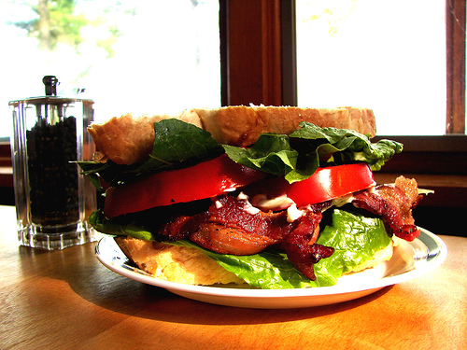
When is t-test Valid
t-test requires that sample means (not individuals) are normally distributed.
What does CLT stand for?
Central Limit Theorem
  (The mean from any variable becomes normally distributed as n becomes larger (goes to infinity) )
Practical implication: t-test almost always valid for continuous data as long as n is large enough or variable not too weird.

Slide 90
Advanced Topics in Data Analysis for Clinical Trials
Subgroups
Adjustment for baseline covariables (later)
Multiple endpoints
Analysis of adverse events
Interim analysis

Slide 91
Levels of subgroups (from FFD)
1. Those specified in study protocol have highest validity
  Especially if number is small
2. Those implied by study protocol
  eg. If randomization stratified by age, sex or disease stage
3. Subgroups suggested by other trials
4. (Weakest) Subgroups suggested by the data themselves (“fishing” or “data dredging”)
5. (Diastrous) Subgroups based on post-randomization variables

