Slide 1
Accessing Cancer Registry Data and Surveillance Tools
Meg McKinley, MPH

Slide 2
Overview
Cancer surveillance overview
Overview of cancer registry systems
Sources of publicly available registry data
SEER*Stat as an analytic tool
  SEER*Stat demonstration: obtaining case count frequencies, calculating rates, survival

Slide 3
Cancer Surveillance Overview

Slide 4

Cancer Surveillance
Systematic collection and analysis of data
  Patients and population
Allows understanding of patterns of cancer occurrence, treatment and survival
Used to identify differences in cancer occurrence, treatment, deaths and survival across groups according to clinical, demographic, social or geographic characteristics
Notes:
Do you think I need to touch on this? Seems like this may have already been covered by Scarlett’s section

Slide 5
New Cases and Deaths in the Greater Bay Area, 2016
Notes:
Examples of data retrieved for surveillance purposes

Slide 6
Rates and Trends, Greater Bay Area
Notes:
Examples of data retrieved for surveillance purposes

Slide 7
Incidence Rates by Age
Invasive Melanoma in Non-Hispanic Whites
Notes:
Examples of data retrieved for surveillance purposes

Slide 8
Various Cancer Registry Systems

Slide 9
Cancer Registry Systems
Federal programs
  National Cancer Institute: Surveillance, Epidemiology, and End Results Program (SEER)
  Center for Disease Control and Prevention: National Program for Cancer Registries (NPCR)
  North American Association for Central Cancer Registries (NAACCR)
State programs
  e.g., California Cancer Registry (CCR)
Regional programs
  e.g., Greater Bay Area Cancer Registry (GBACR)

Slide 10
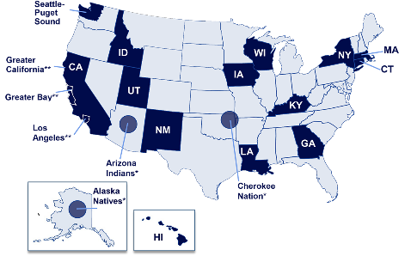
SEER
Surveillance, Epidemiology, End Results Program
Established by the 1971 National Cancer Act
Data collection began in 1973 with a limited number of registries and continues to expand
Notes:
The SEER Program is the main program that the NCI uses to support cancer surveillance activities.
Act designed to strengthen the NCI in order to more effectively carry out the national effort against cancer
9 regions with coverage from 1973+
18 regions with coverage 1992+
21 regions with coverage 2000+
Now ~35% of the total U.S. population

Slide 11
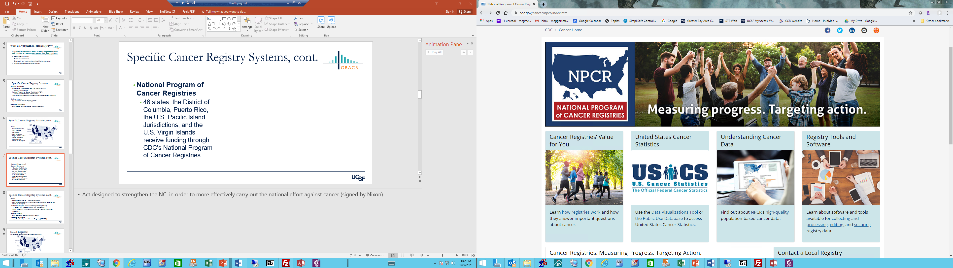
NPCR
National Program of Cancer Registries
Established through the Cancer Registries Amendment Act in 1992
46 states receive funding through NPCR
United States Cancer Statistics
https://www.cdc.gov/cancer/npcr/index.htm

Slide 12
NAACCR
North American Association for Central Cancer Registries
Established in 1987, NAACCR is an umbrella organization for cancer registries
  All central cancer registries in the United States and Canada are members
  Nearly all registries in North America have adopted the NAACCR consensus standards

Slide 13
What Data Items are Collected?
Patient demographic information
  Name, social security number, address at diagnosis, date of birth, race, ethnicity, gender, marital status, birthplace
Tumor information
  Anatomic site, histology, detailed extent of disease (stage: tumor size, tumor extension, lymph nodes, metastasis at diagnosis, etc.), site-specific factors (biomarkers – ER, PR, Her2Neu)
Treatment information (first course only)
  Surgery, chemotherapy, radiation therapy, hormone therapy, immunotherapy
Survival information
  All patients followed for vital status for life
  Recurrence, metastastic disease NOT reported

Slide 14
Sources of Publicly Available Registry Data

Slide 15
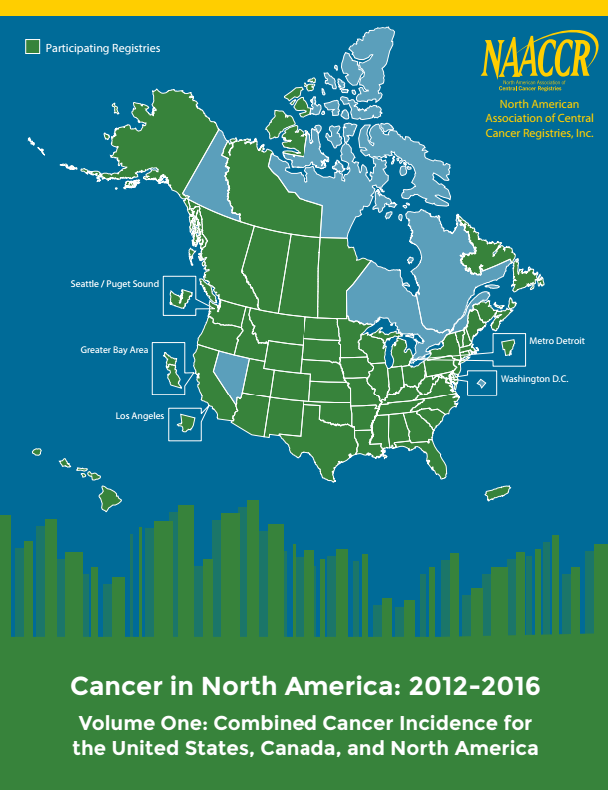
CiNA (Cancer in North America)
Statistics and Data from NAACCR
Mapping, Fast Stats available
Annually produces CiNA report (Cancer in North America), providing current incidence and mortality stats for U.S. and Canada
https://www.naaccr.org/cancer-in-north-america-cina-volumes/

Slide 16
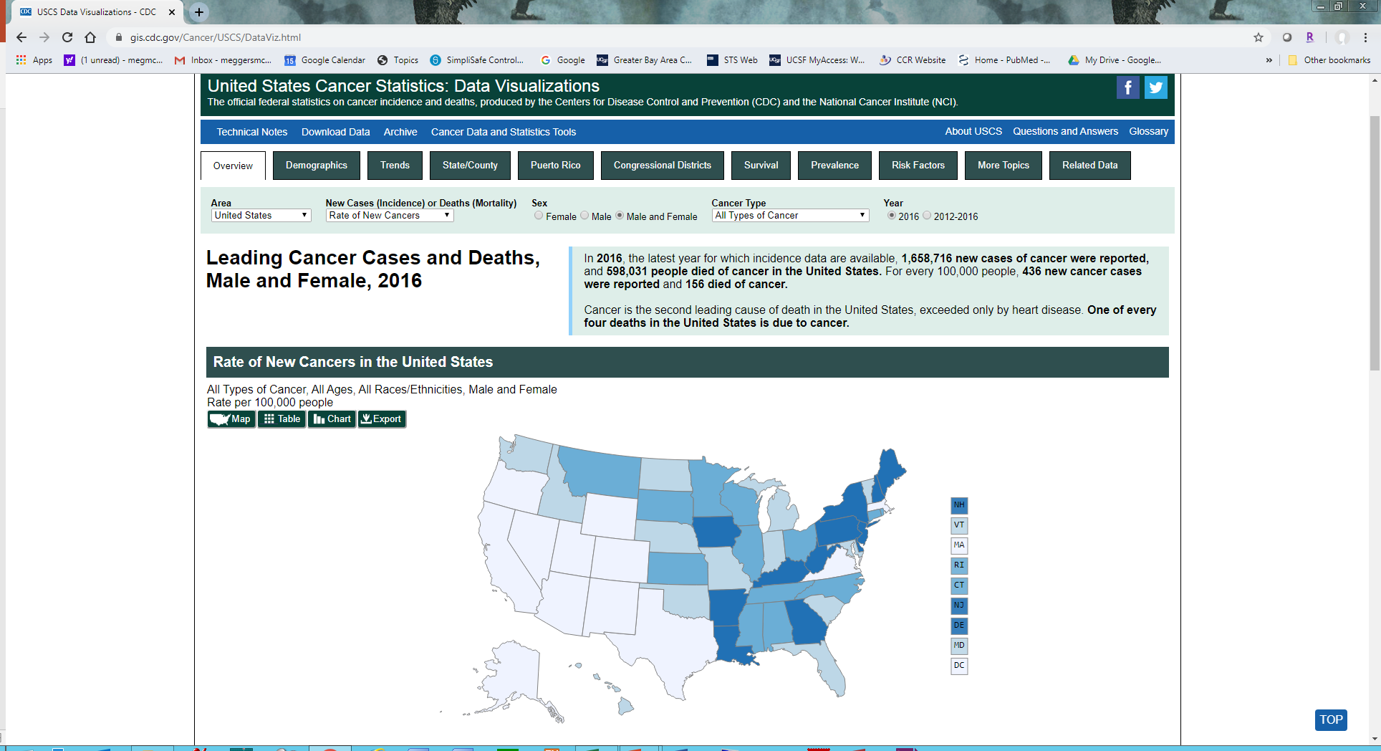
NPCR: United States Cancer Statistics
Notes:
Provides a Data Visualization Tool
Query system
Reports
Downloadable data (tables)

Slide 17
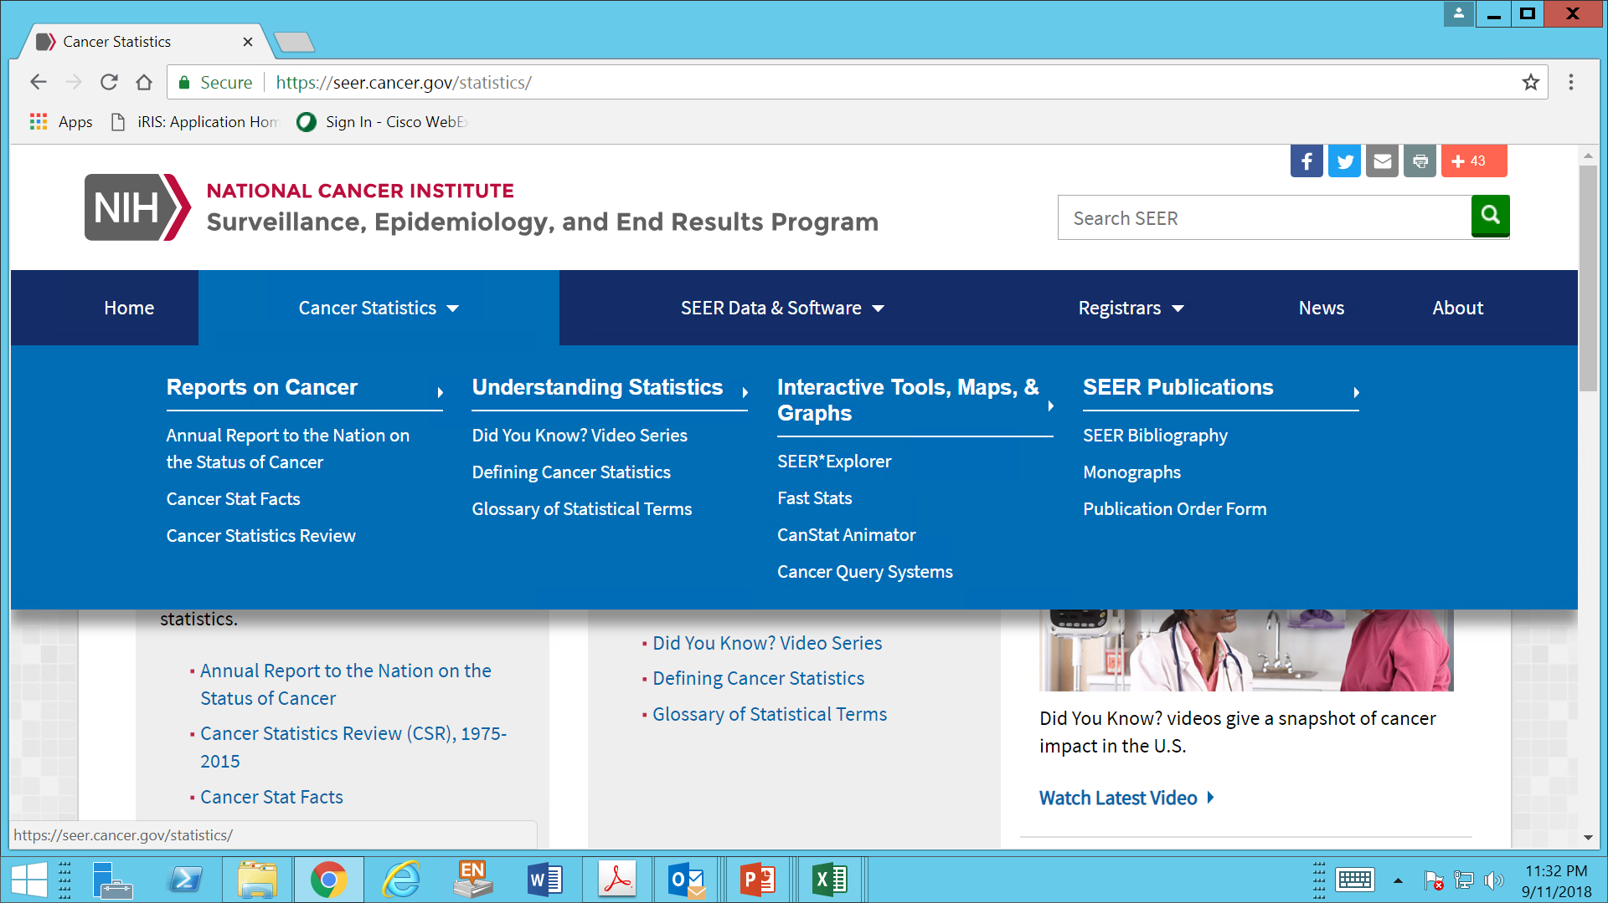
SEER Tools @ seer.cancer.gov
Notes:
Numerous reports available: Annual Report to the Nation, Cancer Statistics Review
Query systems, infographics with data

Slide 18
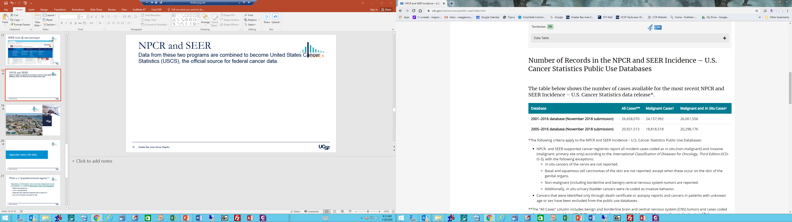
NPCR and SEER
Data from these two programs are combined to become United States Cancer Statistics (USCS), the official source for federal cancer data
https://www.cdc.gov/cancer/uscs/public-use/index.htm
Notes:
Together, CDC’s NPCR and the National Cancer Institute’s (NCI’s) Surveillance, Epidemiology, and End Results (SEER) Program collect data for the entire U.S. population.

Slide 19
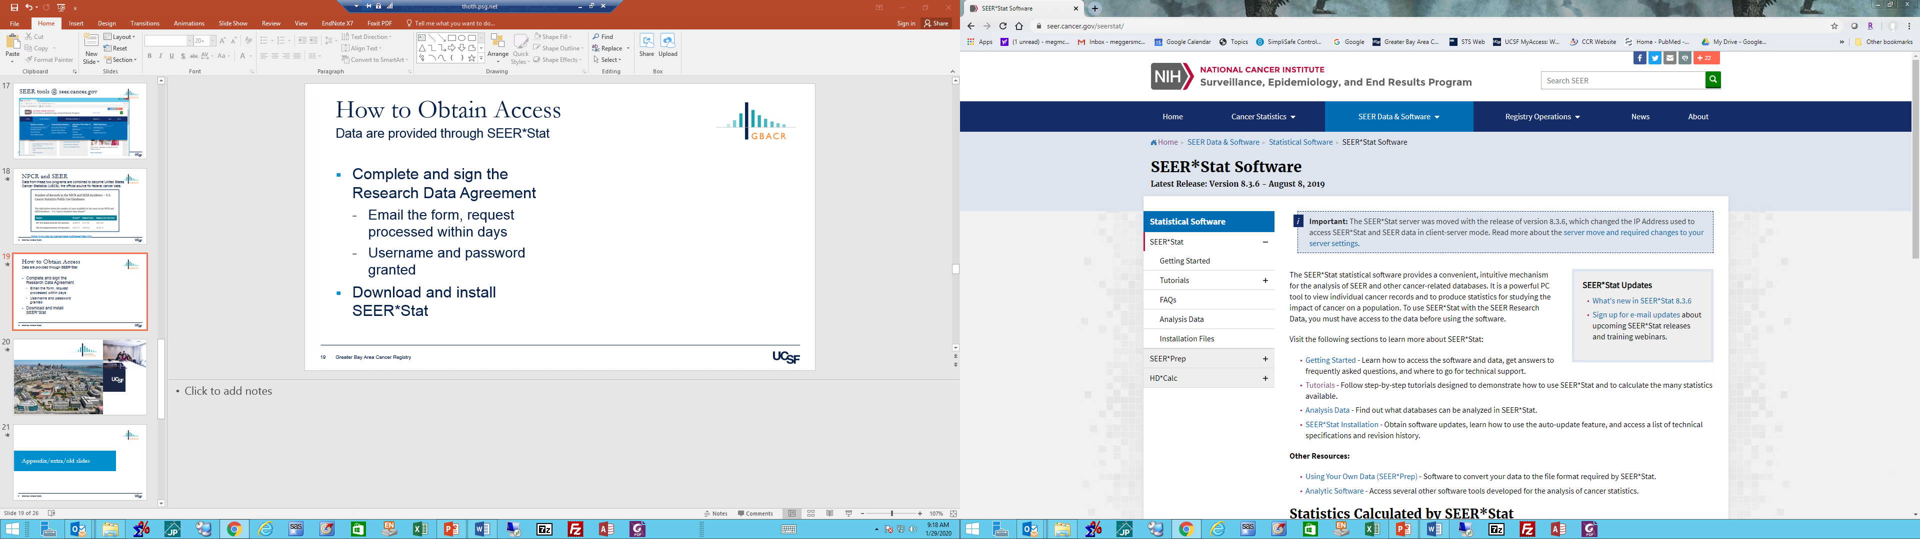
How to Obtain Access
Data are provided through SEER*Stat
Complete and sign the Research Data Agreement
  Email the form, request processed within days
Download and install SEER*Stat
Complete tutorials
https://seer.cancer.gov/seerstat/

