Slide 1
Biostatistics 226, Winter 2020
Course Overview
Jan 7 – Design of RCTs: How to avoid bias and achieve valid results
Jan 14 – Analyses: Baseline, Efficacy, and Safety
Jan 21 – Monitoring trials for efficacy, futility, and patient safety
Jan 28 – Cluster Randomized Trials
Feb 4 – Precision medicine I: SMART (Adaptive) Trials
Feb 11 – Precision medicine II: N-of-1 Trials
Textbook References
Friedman, Furburg, DeMets, Reboussin, Granger. Fundamental of Clinical Trials, 5th edition, 2015. https://doi.org/10.1007/978-3-319-18539-2
W. Tang and X. Tu (eds.), Modern Clinical Trial Analysis, Applied Bioinformatics and Biostatistics in Cancer Research, Springer Science+Business Media New York 2013.
Chapter 5: Qian M, Nahum-Shani I, Murphy SA. Dynamic treatment regimes; pp. 127–148.
  https://doi.org/10.1007/978-1-4614-4322-3
Notes:
https://www4.stat.ncsu.edu/~laber/smarts.html

Slide 2
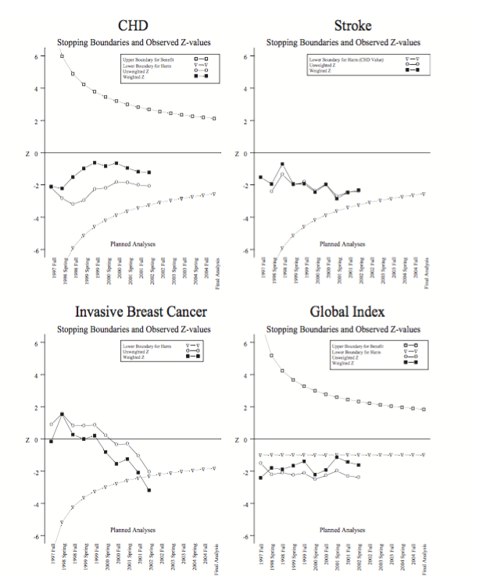
Review: Jan 21 – Monitoring trials for efficacy, futility, and safety
HW Readings: Anderson et al, 2007
A huge amount of effort went into planning the
trial, with great emphasis on ensuring good
communication among stakeholders.
Statistical methods were carefully planned.
Nonetheless they were complicated, which
reduced confidence in the unexpected results.
Follow-up research continues to re-examine this
dataset to explain surprising findings.

Slide 3
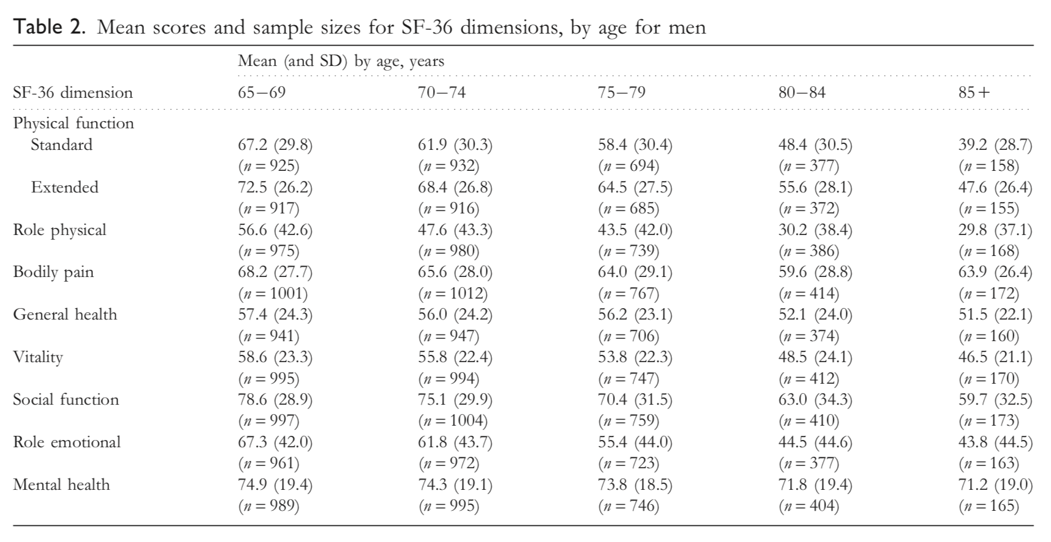
Review: Jan 28 – Cluster Randomized Trials (CRT)
HW4: Gao et al (2015) generated a design example based on their Ref 22 (Walters et al, 2001). Discuss the values μ = 66.4, δ = 10, and σ = 29.5 used in the study design.
* How might δ = 10 be viewed as the “smallest clinically relevant improvement” in the outcome? * Is σ the standard deviation of the estimate of δ?
Notes:
Mean (sd) come from Gao (2015)

Slide 4
Review: Jan 28 – Cluster Randomized Trials (CRT)
How do the roles of “strata” and “clusters” differ at the study design stage? Could the selected variables be used interchangeably?
Strata are used to balance important covariates (e.g., risk factors for the outcome) between the study arms. Randomization occurs within each stratum, where the numbers of observational units on arms E and C, for example, reflect the E:C allocation ratio.
Clusters define the experimental units – that is, the units randomized. Thus all observational units within a cluster are assigned to the same arm.
Can both “strata” and “clusters” be analyzed as covariates?
Strata can be analyzed as covariates but clusters inform the model of a hierarchical data structure, to specify variance of correlated observational units in a CRT, σ_{C}² = σ_{B}² + σ_{W}² , rather than variance of independent observational units in a RCT where experimental and observational units are the same, σ_{I}². Subscripts denote: Clustered outcomes, Between clusters, Within clusters, and Independent outcomes.
Can both “strata” and “clusters” be analyzed as experimental or observational units?
Clusters are experimental units and can sometimes be analyzed as observational units also.
Strata cannot be analyzed as experimental or observational units.

Slide 5
Feb 4 – Precision medicine I: SMART Trials
Traditional RCTs:
Randomly assign 2 single-exposure regimens 1:1 to experimental units
(possibly stratify participant by expected prognostic baseline covariates)
Observe evolving outcomes over time for planned duration
  Efficacy outcomes
  Safety outcomes
Analysis plans:
  ITT analysis: Analyze observational units within randomly assigned arms
  Interim monitoring
    to ensure participant safety
    to determine if H₀ can be rejected or not earlier than expected
  Final analysis: Conduct after all participants have had equal opportunity to respond
    Focus on separate analyses per outcome variable
    No analysis approach available to account for post-randomization data
      Example: Subgrouping by adherence level could introduce selection bias

Slide 6
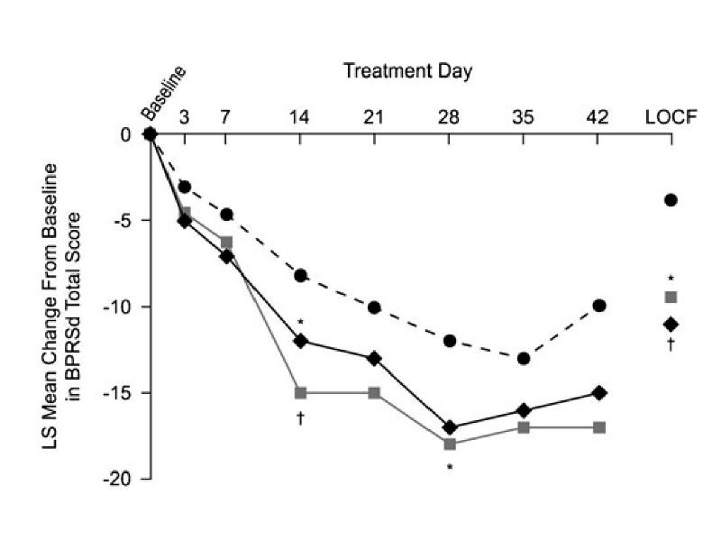
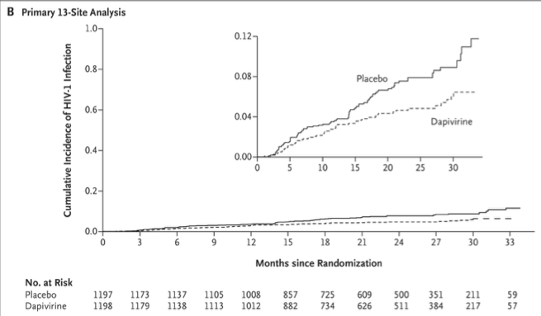
As discussed, the typical primary goal of phase 3 RCTs is to estimate the efficacy of an intervention by comparing effects of study arm exposures on an outcome variable.
→ Analysis methods reflect the outcome type & frequency (continuous; time to event; …)
Lecture 1 example, Change from baseline in BPRSd Score at 6 weeks.
Ogasa et al. (Psychopharmacology, 2012) … (BPRS = Brief Psychiatric Rating Scale )
Lecture 2 example, Aspire Trial: Incidence of HIV infection
Notes:
Note: Arm is considered fixed; outcome is a random variable.

Slide 7
Adaptive RCTs: Which intervention is best, for whom?
RCTs are conducted to guide clinical management of diseases.
An RCT is more valuable if it reflects sequence of decisions encountered in practice.
Some interventions generate highly heterogeneous responses.
  Humans are not clones.
  For some individuals, treatment A is better than B; for others, the reverse is true .
Some interventions are burdensome: cause AEs or nonadherence
  Adapt intervention to increase/decrease intensity in reflection of intervention burden
Some chronic disorders wane and wax over time.
  Intervention should be modified (eg, increase/decrease intensity) in reflection of disease state
  A sequence of treatments is needed to obtain sufficient treatment response
Behavioral interventions can be excessively demanding or can become boring
  To enhance engagement and adherence,
    Adapt intervention to user’s attention capacity.
    Change intervention modalities over time.
Intervention options vary in cost or scalability
  Start with least expensive, most widely acceptable
  Roll out costly options to subgroups as needed
These observations call for Adaptive Interventions applied sequentially over time in order to guide clinical practice or public health policy.
Notes:
Heterogeneity might be driven by individuals’ biology or their behavior. A DAG would be useful in this arena!

Slide 8
Compare Adaptive with Traditional RCTs:
Randomly assign 2 single-exposure regimens 1:1 to experimental units (possibly stratify participant by expected prognostic baseline covariates)
  Retain randomization: Relying on human judgment would lead to bias
  Retain Stratification: Recognizes heterogeneity of patients’ responses
Observe evolving outcomes over time, for planned duration
→ Allow re-randomization to new arms as time passes, at pre-specified time or
when it’s clear an arm is ineffective
  → Re-stratify: Heterogeneity quantified by evolving covariates & responses
Analysis plans: Adjust intervention effect for prognostic baseline covariates
    → Design avoids post-randomization data by re-randomizing
Uses “potential outcomes models" to provide a framework for developing optimal dynamic treatment regimes and analyzing them in experimental trials.

Slide 9
Some History
“Potential outcomes” framework (Lecture 1)
-- Introduced by Neyman (1923) to analyze causal effects of
time-independent treatments in randomized studies
-- Extended by Rubin (1978) to observational studies
Formal theory of causal inference (DAGs)
-- Proposed by Robins (1986, 1987) -- to assess the direct and indirect effects
of time-varying treatments from experimental and observational data
Biased coin adaptive within-subject (BCAWS) design
-- Lavori and Dawson (2000): each PPT progresses through stages of treatments,
being randomly assigned to arms at each stage
Sequential Multiple Assignment Randomized Trial (SMART) design
-- Murphy (2005a) proposed a general framework
-- Analysis methods are still evolving
Notes:
Heterogeneity might be driven by individuals’ biology or their behavior. A DAG would be useful in this arena!
More valuable if reflect complexities encountered in practice.

Slide 10
SMART -- Sequential Multiple Assignment Randomized Trial
A multi-stage randomized trial
Each stage corresponds with a critical decision point
Randomization to treatment options takes place at each critical decision point
PPTs can be randomized more than once (singular/sequential), often based on earlier covariates (static/dynamic)
Goal: To inform the construction of effective adaptive interventions
[Lecture 4, Example 1: How was this intervention constructed?
Relative to generic reminders (Arm C), does PCP-individualized support from Knowledge Brokers increase PCP referrals of eligible patients (Arm E)?]
Contrast:
The overarching aim of an RCT is to evaluate an already-developed intervention versus a suitable control.
The overarching aim of a SMART is to construct a high-quality AI based on data.
→ Following development of an optimized AI, research would proceed with evaluation of the AI using a subsequent RCT.

Slide 11
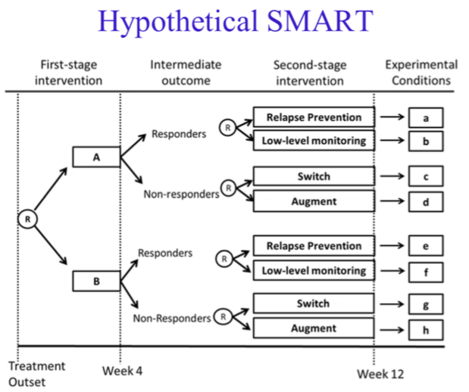
Adaptive Intervention: A set of {decision points, tailoring variables, treatment options, decision rules}.
PPT perspective: Here, each randomization is 1:1. There are 2³ = 8 sequences. Which is best for whom?
Clinical perspective: Decision rules recommend when & how an intervention should be modified over time.
Notes:
Ultimate outcome, not shown, measured at end of follow-up.
AI names in other fields:
Statistics: dynamic treatment regimes
Psychology: adaptive treatment strategies

Slide 12
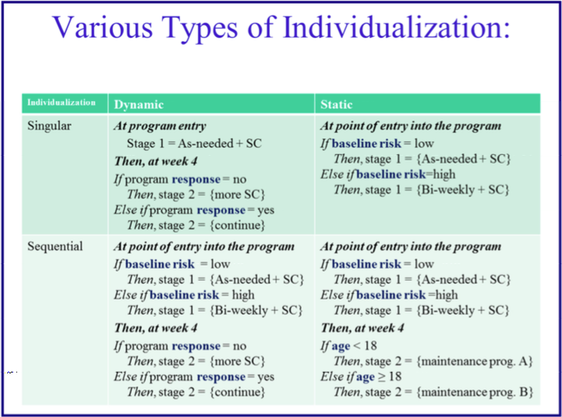
Decision Rules: Tailor Interventions to Groups of Individuals
Change intervention options at nodes:
Singular: Define once; Sequential: Redefine at intervals
Select intervention options based on data up to or at a node:
  Static: Define via BL covariates; Dynamic: Redefine via evolving outcomes
Example: Adaptive Drug Court Program
Notes:
Are all adaptive?

Slide 13
Example: ExTENd Trial
Background: Treatments for alcohol dependence include
Oral naltrexone (NTX) – blocks the pleasurable effects of alcohol consumption
  Heterogeneous response associated with differences in
    Biologic response to both alcohol and medication
    Adherence associated with coping skills and social support → intervention target
Behavioral interventions – to increase adherence behaviors:
  More intensive: Cognitive Behavioral Therapy (CBI)
  Less intensive: Telephone Disease Management (TDM)
ExTENd Trial (PI: David Oslin, U Penn)
Stage 1: Randomize by outcome stringency. Treat all with NTX (≤ 8 weeks).
  Strata: Number of heavy drinking days: Lenient, >5; Stringent, >2 defines nonresponder.
  Outcomes: Responder, If succeed for 8 wks. Nonresponder, If fail < 8 wks.
Stage 2: Stratify by stage-1 response, randomize to pairs of arms (≤ 24 weeks)
  Strata: Responders: Maintain or Augment with less intensive behavioral intervention.
  Nonresponders: Switch or Augment with more intensive behavioral intervention.
  Outcome: Abstinent between a pair of visits at end of follow-up.
Notes:
Stage 1 outcome is intermediate: NTX is easy to deliver, CBT intervention is harder. Need to know who really needs it.
Is it important to anticipate quick efficacy or NTX and ramp up intervention quickly (stringent) or allow slower efficacy of NTX before behavioral intvn?

Slide 14
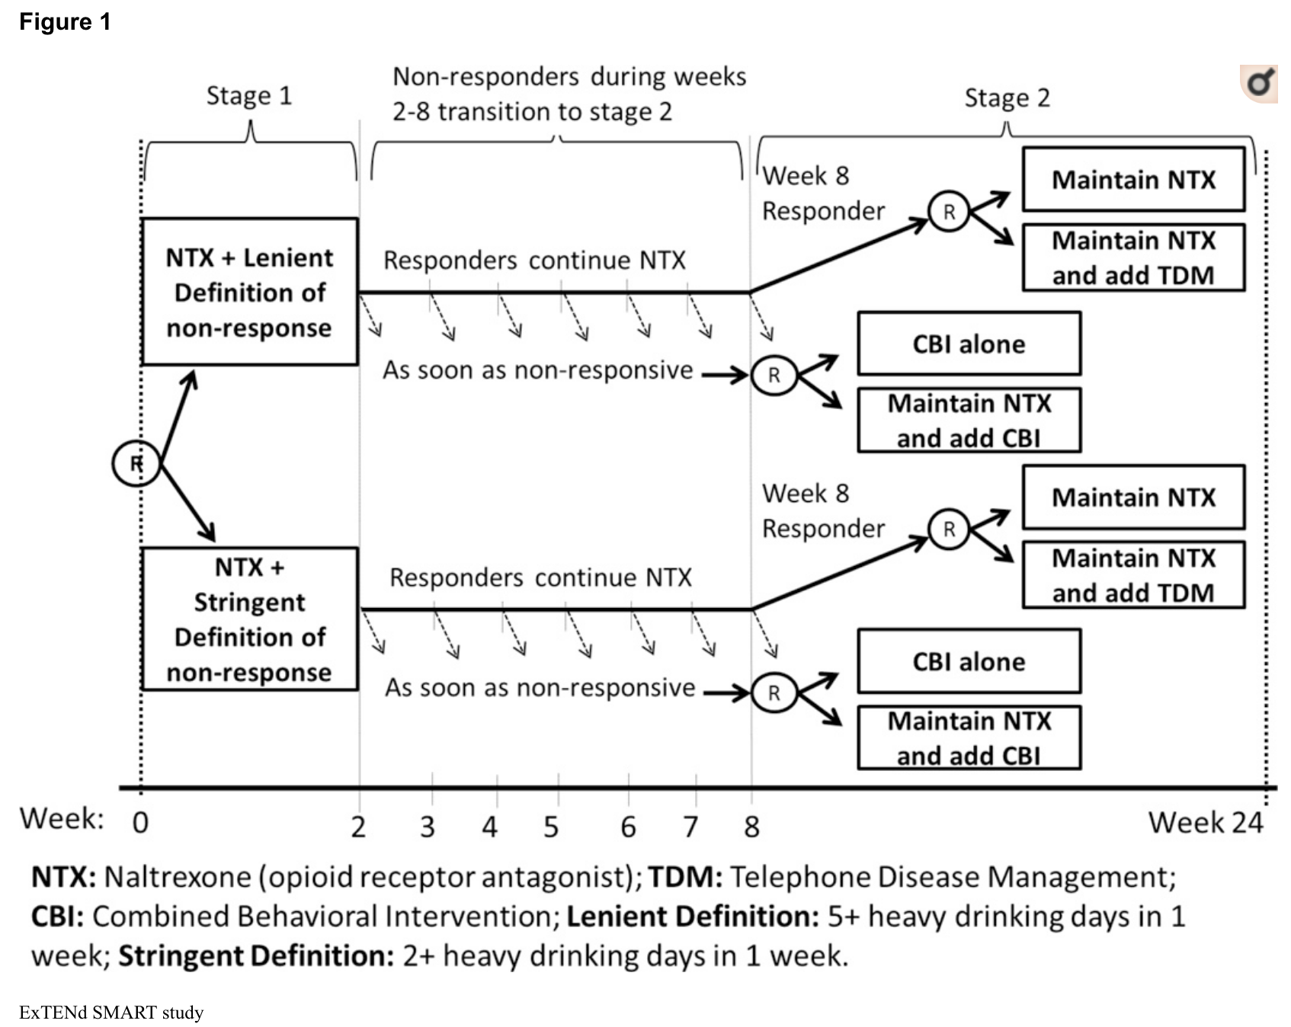
Example 1: ExTENd trial includes 8 Adaptive Treatment Strategies (ATS)
Notes:
An adaptation: Person-specific timing of decision node when nonresponse occurs
Notation: ATS = AI

Slide 15
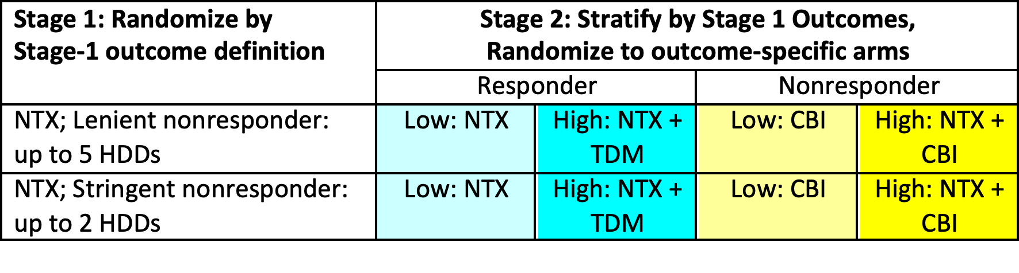
SMARTs use factorial designs
ExTENd example: includes 8 Adaptive Treatment Strategies (ATS)
Stage 1 outcome (up to 8 weeks): #HDD / week (HDD = heavy drinking day)
Stage 2 outcome (end stage 1; 24 weeks): Abstinent between specific visits at end of follow-up
The factorial design allows key hypotheses to be addressed .
NTX = Naltrexone
TDM = Telephone Disease Management
CBI = Combined Behavioral Intervention
Notes:
Heterogeneity might be driven by individuals’ biology or their behavior. A DAG would be useful in this arena!
More valuable if reflect complexities encountered in practice.

Slide 16
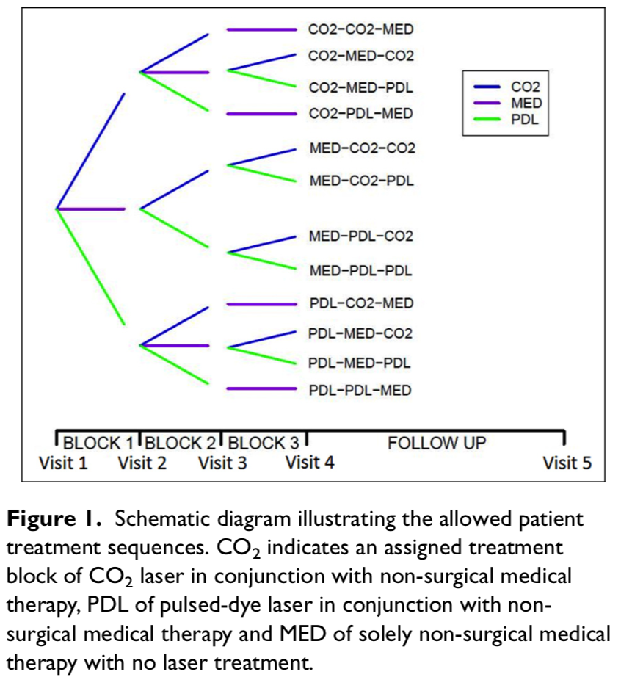
Example 2: LIBERTI:
A SMART study in
plastic surgery
(Hibbard, 2018).
Outcome:
Vancouver Scar Score,
a single numerical score
from an evaluation of many
separate scar attributes
Measurements occur at
0, 4, 8, 12 and 24 months
Exposures: In this example
the factorial design doesn’t
balance intervention arms.
Notes:
Heterogeneity might be driven by individuals’ biology or their behavior. A DAG would be useful in this arena!
More valuable if reflect complexities encountered in practice.

Slide 17
Example 2: Hypotheses & analysis
Short-term null hypotheses
No significant difference on average in short-term scar score change between pulsed-dye laser and non-surgical medical therapy.
No significant difference on average in short-term scar score change between CO₂ laser and non-surgical medical therapy.
No significant difference on average in short-term scar score change between pulsed-dye laser and CO₂ laser.
We can use 3 standard t-tests to compare pairwise mean differences at month 4 between arms, estimate mean differences (95% CI) -- or slopes, and examine whether we have good evidence to reject each of the null hypotheses.
Using t-tests with overall type I error rate of 5%, we estimate we will have 80% power to detect a minimal clinically important difference of 𝜹_{A} = 0.9 Vancouver Scar Score units in treatment effect after 4 months between pulsed-dye laser and non-surgical medical treatment alone, between CO₂ laser treatment and non-surgical treatment alone or between pulsed-dye laser treatment and CO₂ laser treatment.
Such pooling of treatment groups between different treatment paths in a SMART and testing simple hypotheses is a standard and very simple way of approximating power and appropriate sample size for a SMART.
Notes:
Heterogeneity might be driven by individuals’ biology or their behavior. A DAG would be useful in this arena!
More valuable if reflect complexities encountered in practice.

Slide 18
Analyses
(a) aimed at discovering when the effect of one intervention is enhanced by subsequent or prior interventions
  Investigators can prospectively manipulate and record the type and intensity of the intervention during the initial stage
(b) aimed at discovering useful tailoring variables
  Investigators can capture adherence to the stage-1 intervention, and propose stage-2 interventions that improve it
(c) aimed at reducing the impact of cohort effects
  PPTs who complete a SMART may
    Be more representative of the target population: The range of SMART options could boost accrual relative to RCT
    Differ from those who complete an RCT (less complex; shorter): Lack of options for nonresponders can increase poor adherence or drop-out in an RCT
Notes:
Heterogeneity might be driven by individuals’ biology or their behavior. A DAG would be useful in this arena!
More valuable if reflect complexities encountered in practice.

Slide 19
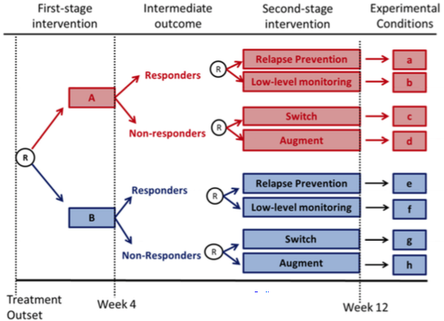
Stage 1: H_{A1}: Option A will result in fewer symptoms than Option B.
By 1:1 stage-1 randomization, this analysis controls for (averages over) all later intervention options.

Slide 20
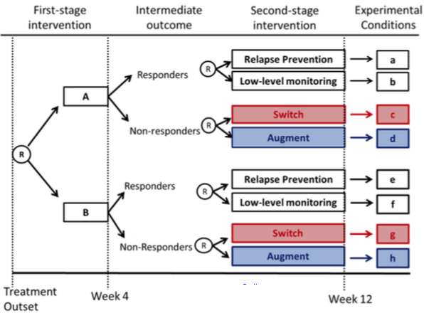
Stage 2: H_{A2NR}: Among non-responders, switching treatments will result in fewer symptoms than augmenting earlier treatment.
V1: By 1:1 Stage-2 randomization, this analysis controls for Stage-1 interventions via stratification.
V2: At Stage 2, can adjust for effect of Stage-1 adherence (as a covariate) on Stage-2 efficacy.

Slide 21
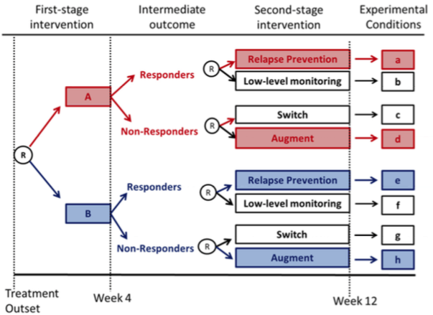
Longitudinal AI: H_{A3}: Compare 2 AI’s .
V1: Controlling for initial option, which AI is better: Option+Augment vs Option+Relapse-prev?
V2: Assuming Resp→Relapse-prev & NonResp→Augment, better to start on Option A or B?

Slide 22
Example 1: ExTENd trial includes 8 Adaptive Treatment Strategies (ATS)
Notation:
Subscripts: stages 1,2
Pretreatment info:
(s₁, s₂) = covariates
“treatment decisions”:
(a₁, a₂) = study arms
Y = long-term
Primary outcome
Decision rules:
(d₁, d₂)
Mean outcome if
every PPT undergoes
(d₁, d₂) → Goal is
to identify optimal
sequence
Notes:
Identify (a1,a2), (s1,s2), Y, (d1,d2)

Slide 23
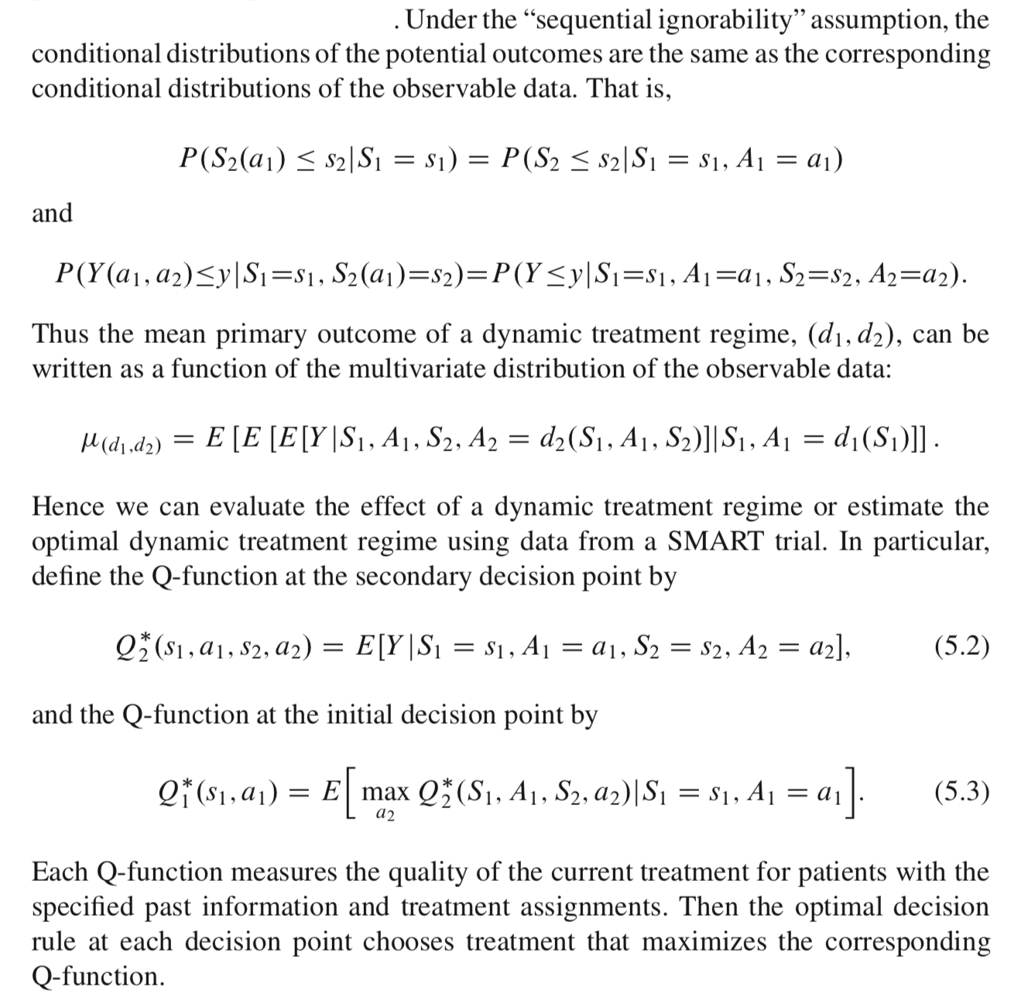
Analysis via
Q-learning
(Qian et al,
2013;
NahumShani
et al, 2017)

Slide 24
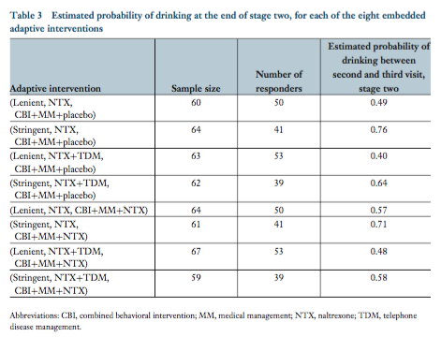
ExTENd Results

Slide 25
SMART Design Principles
Focus on just a few research questions concerning AI’s.
Use tailoring variable(s) to restrict Stage-2 randomization:
  It should be prognostic of distal outcome (eg, adherent; early responder).
  Randomization should be ethical (not harmful), scientific (evidence-based promise), and practical (stepped care rather than abrupt change)
Choose a primary hypothesis
  Initial randomization should be scientifically important. Sample size calculation should address this.
  This choice will aid in development of AI.
Choose secondary hypotheses
  These will aid in further development of AI. Associated with randomizations, used to eliminate confounding (effects other than arm explain outcomes).
  Sample size calculation need not address these.

Slide 26
Adaptive Intervention Trials – How to design them?
Desirable characteristics
Strength of effectiveness
  Effects detectable via both proximal and distal outcomes
  Credible: Based on theory, clinical experience, expert opinion, published literature
Replicability
  Clear decision rules allow replication – different samples, investigators, research staff, locations
  Driven by real-world applications beyond standard RCTs
These goals are achieved through
Careful planning to accommodate unusual scenarios
  (eg, how to proceed if proximal outcome is missing?)
Clear articulation of the AI (via protocol) → I think a DAG would be extremely useful.
Fidelity of implementation
Using a Sequential Multiple Assignment Randomized Trial (SMART) to design an AI
Complements other sources of evidence on best fit between interventions and disease,
  Expert opinion; clinical consensus
  Published literature
  Theoretical models
Notes:
Burden = exceeds personal resources
Recent gamechanger: Extensive contributions of Susan Murphy and colleagues at U Michigan.

Slide 27
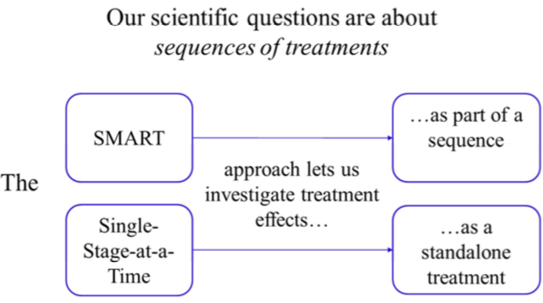
Summary
SMARTs are part of the Multiphase Optimization Strategy (MOST) – a framework for constructing effective multicomponent behavioral interventions.
  https://methodology.psu.edu/ra/most

