Slide 1
Lecture 5:
Health CARE Disparities
Christine Dehlendorf, MD MAS

Slide 2
Objectives
Differentiate disparities in health care from inequities in health
Recognize common explanations of disparities
Discuss approaches to decreasing health care disparities

Slide 3
Toxic exposures, developmental, stress, etc.
Epigenetic modification/
neurocognitive, etc.
Economic & Social
Opportunities and Resources
Living & Working Conditions
in Homes and Communities
Behaviors
Medical Care
Interaction with genetic/other biological factors
HEALTH
Adapted from Braveman et al., for Robert Wood Johnson Foundation Commission to Build a Healthier America | www.commissiononhealth.org

Slide 4
What are Health Disparities?
“A particular type of health difference that is closely linked with economic, social, or environmental disadvantage. Health disparities adversely affect groups of people who have systematically experienced greater social or economic obstacles to health based on their racial or ethnic group, religion, socioeconomic status, gender, age, or mental health; cognitive, sensory, or physical disability; sexual orientation or gender identity; geographic location; or other characteristics historically linked to discrimination or exclusion.”
Healthy People 2020 (HealthyPeople.gov)

Slide 5
Health CARE Disparities
Differences in quality of health care that are not due to access-related factors or clinical needs, preferences and appropriateness of intervention.
Financial access, a known problem in US health care, is often not included in disparities studies
IOM, Unequal Treatment, 2003

Slide 6
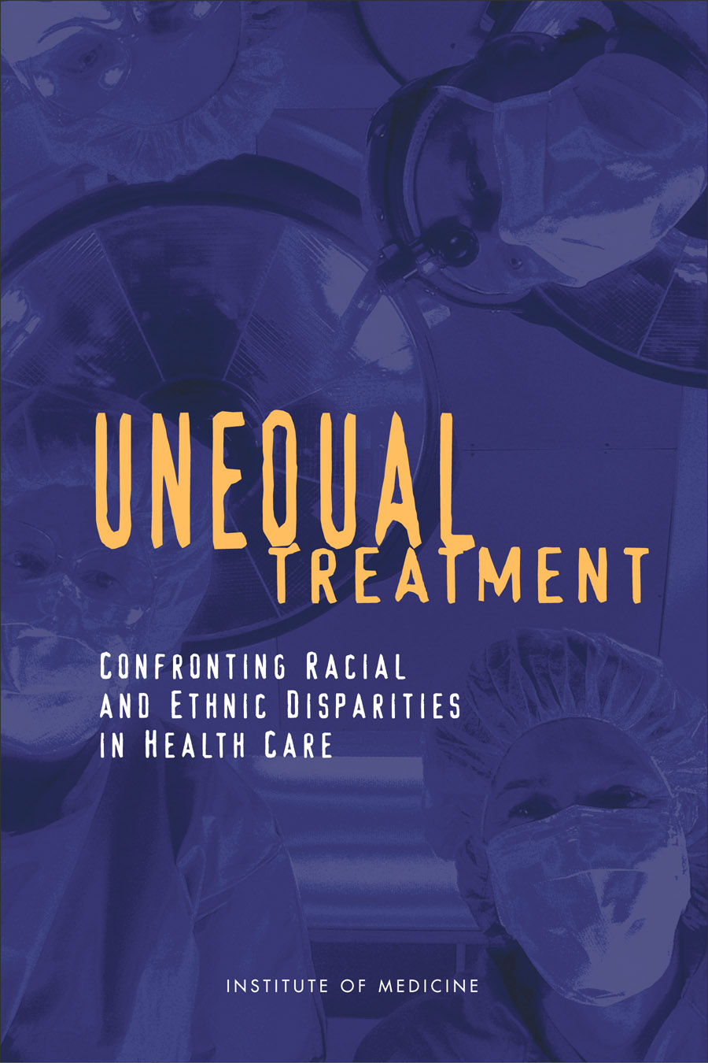

Slide 7
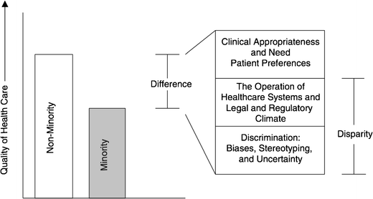
Differences, Disparities, and Discrimination: Populations with Equal Access to Health Care

Slide 8
Evidence Shows Disparities Exist
  The evidence is “remarkably consistent across a range of illnesses and healthcare services”
    Best studied in cardiology
    Also well documented in oncology, HIV care, etc.
  Lead to worse outcomes among disadvantaged populations
  Source: Unequal Treatment: Confronting Racial and Ethnic Disparities in Healthcare, March 2003.
Notes:
In 2002, the Institute of Medicine conducted a review of the published literature that assessed the quality of healthcare for various racial and ethnic minority groups.
Racial and ethnic minorities tend to receive lower-quality health care than whites do, even when insurance status, income, age, and severity of conditions are comparable.
The vast majority of studies found that minorities received fewer clinically necessary procedures.
In contract to whites, minorities are more likely to receive certain less-desirable procedures, such as lower limb amputations for diabetes and other conditions.

Slide 9
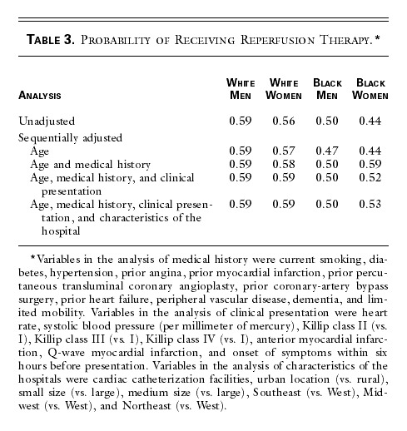
Disparities in Cardiac Treatment
Canto, NEJM, 2000
Notes:
https://www.ncbi.nlm.nih.gov/pubmed/15778634

Slide 10
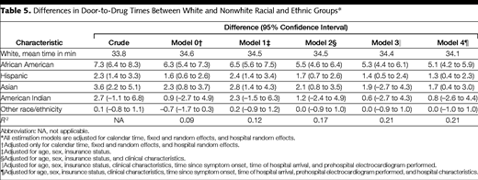
Door to Drug Time in AMI
Bradley, JAMA, 2004

Slide 11
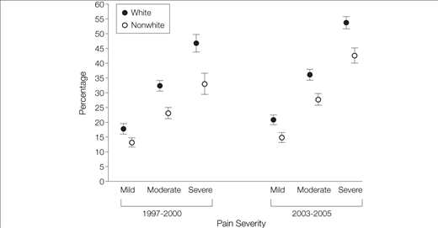
Percentage of Emergency Department Visits at Which an Opioid Was Prescribed, by Pain Severity and Period, NHAMCS 1997-2000 and 2003-2005
Pletcher, JAMA, 2008
Notes:
Differential prescribing by race/ethnicity was evident for all types of pain visits, was more pronounced with increasing pain severity, and was detectable for long-bone fracture and nephrolithiasis as well as among children

Slide 12
What about Latinos? Or Asians? Or Native Americans? Others?
Fewer studies
Latinos in UCLA ER were less likely to be prescribed pain meds than whites with long bone fractures. (Todd, JAMA, 1993)
Language and ethnicity appear to be independent risk factors
Notes:
Am J Emerg Med. 2008 May;26(4):462-4. doi: 10.1016/j.ajem.2007.05.007.
Are racial disparities in ED analgesia improving? Evidence from a national database.
Quazi S¹, Eberhart M, Jacoby J, Heller M.
Author information
Abstract
OBJECTIVE:
Ethnic disparities in emergency department (ED) analgesic use have been noted previously; the purpose of this study was to determine if current ED practice has been altered subsequent to the widespread recognition of these inequalities.
METHODS:
Using data from the National Hospital Ambulatory Care Survey, we analyzed ED analgesic treatment with respect to race for the complaints of headache (HA) and long bone fractures (LBF) for 1995 to 1999 (period A) and compared that with data for 2000 to 2003 (period B). We compared the use of "any analgesics" and "opioids" among blacks, whites, and Hispanics.
RESULTS:
For both HA and LBF, improvements over time were noted in all 3 ethnic subgroups. A statistically significant increase was documented in the treatment of HA among Hispanics using any analgesia (71.3% vs 80.8%, P = .011). Although individual differences between the 2 periods in the LBF cohort were not statistically significant for any of the 3 ethnic groups, there was an overall improvement noted when combining all ethnicities: among all patients treated for LBF, 66% received some analgesic and 42.8% received opioid analgesia during period A vs 75% and 51%, respectively, during period B (all P < .001). Furthermore, in the latest study period, there were no differences in the frequency of analgesic administration for LBF with respect to race (blacks, 43%; whites, 48%; Hispanics, 43.8%; P > .1).
CONCLUSION:
There is evidence that previously described racial inequalities in analgesic use have decreased over time.

Slide 13
What about SES?
Less research/focus in the US
Does appear to be independently predictive of treatment
  Guideline concordant treatment after AMI
  Valve replacement in aortic stenosis
  Cardiac procedures
Both race/ethnicity and SES matter
Hanley, JGIM, 2011
Sleder, JERHD, 2017
Notes:
Mostly in Canada

Slide 14
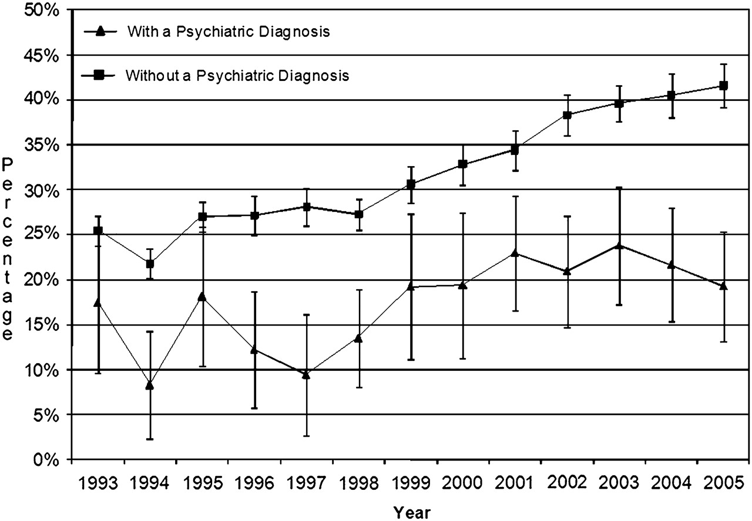
Weighted percentage of pain-related visits for psychiatric and non-psychiatric patients at which an opiate was prescribed, for visits with and without a psychiatric diagnosis
Lorna J Simon et al. Emerg Med J 2012;29:201-204
Notes:
Weighted percentage of pain-related visits for psychiatric and non-psychiatric patients at which an opiate was prescribed, for visits with and without a psychiatric diagnosis.

Slide 15

How big an effect do health care disparities have?

Slide 16
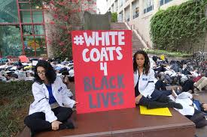
How big an effect do health care disparities have?
Focusing on relative impact misses an important ethical component
Health care should be a tool for social justice/equity, not the opposite

Slide 17
Do Differences in Insurance Explain Racial/Ethnic Differences?
Access mediated by insurance explained differences seen in national datasets
But many studies have examined procedure rate within an insurance/care system, such as Medicare, VA studies or Kaiser studies

Slide 18
Racial Differences Not Completely Explained by Insurance
Cardiac Procedure Use in Chronic Renal Disease Patients, by Race and Gender, 1986-1992
Equally likely as white men
*Difference is statistically significant after adjustment.
NOTE: Odds ratios are adjusted for age, health insurance, sociodemographic characteristics, and clinical factors.
DATA: Daumit and Powe, 2001.
SOURCE: Kaiser Family Foundation, Key Facts: Race, Ethnicity and Medical Care, June 2003.
Notes:
Though insurance coverage diminishes disparities in cardiac care, it does not eliminate them. For example, a nationwide study examined patients with chronic renal failure who, when they progress to end-stage renal disease (ESRD), acquire Medicare coverage.
Before qualifying for Medicare, male and female African American patients with chronic renal failure were 32% and 30% as likely to receive catheterization, angioplasty and bypass surgery as white men (the study reference group).
After enrolling in Medicare and entering into a comprehensive system of care, there was no difference in the cardiac procedure use between African American women and white men.
However for African American men, the disparity persisted even after enrolling in Medicare.

Slide 19
Do Patient Factors Explain Differences?
“The studies that the IOM reviewed suggest that racial differences in patients’ attitudes, such as their preferences for treatment, do not vary greatly and cannot fully explain racial and ethnic disparities in healthcare.”
          IOM, Unequal Treatment, 2003

Slide 20
What Else Explains Differences?
- System Related Issues?
  Non-financial access
  Hospital and provider characteristics
  Literacy, numeracy and language issues
Doctor/Clinician Issues?
  Bias
  Statistical discrimination
Patient Issues?

Slide 21
Other Possible Explanations…
Overuse in whites? or Underuse in blacks?
Some overuse in whites, particularly in cases when procedure indication has larger subjective component
Substantive underuse in blacks

Slide 22
What Causes Health Care Disparities?

Slide 23
48% of Physicians Treat 82% of All Minority Patients
Source HSC Community Tracking Study Physician Survey, 2004-05.

Slide 24
Primary Care Provided to Medicare Patients
% of MDs
Bach, NEJM; 2004
Notes:
https://www.ncbi.nlm.nih.gov/pmc/articles/PMC6912985/

Slide 25
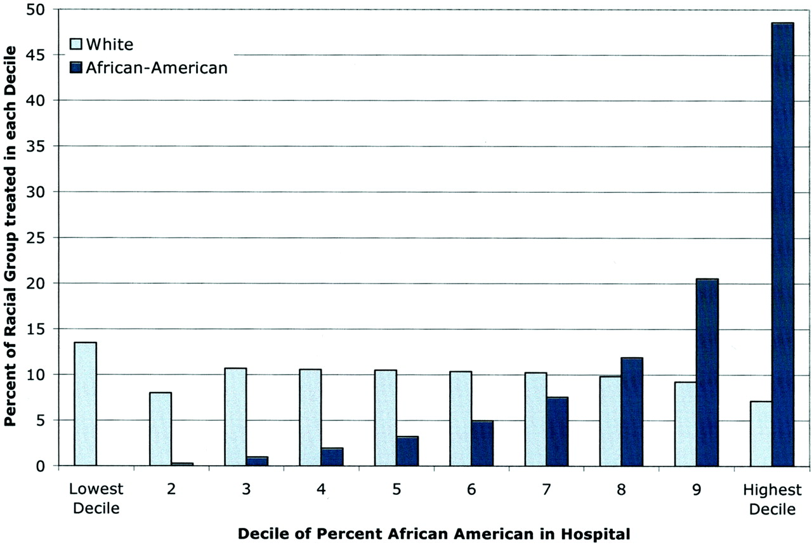

Blacks with MI Disproportionately Treated in a Subset of Hospitals Nationally
Skinner, J. et al. Circulation 2005;112:2634-2641
Copyright ©2005 American Heart Association

Slide 26
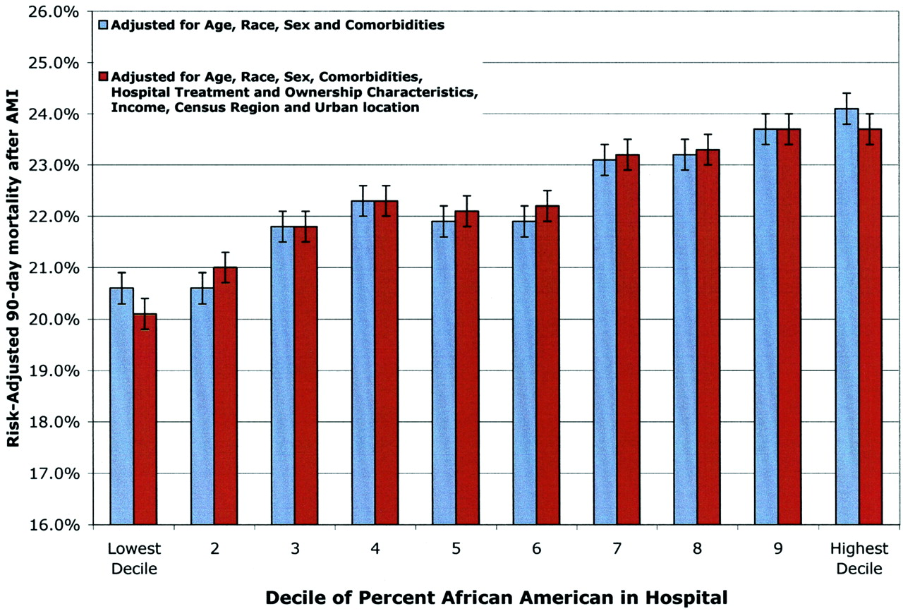
Hospitals that Disproportionately Treat Blacks with AMI Have Higher Mortality Rates
Skinner, J. et al. Circulation 2005;112:2634-2641
Copyright ©2005 American Heart Association

Slide 27
How do Fragmented Systems of Care Contribute to Disparities?
System deficits affect all segments of society, but especially those with least flexible resources
Disadvantaged patients “fall through the cracks” in complex system of care
Small disparities in multi-step processes create moderate to large disparities overall
Disparities arise even when providers well intentioned
Ayanian, 2009

Slide 28
What About Health Literacy and Numeracy?
Low health literacy and numeracy associated with worse health outcomes
Have been found to be a mediating factor for health disparities
Is this a social determinant or a indication of health care disparities? Or both?
Berkman, Ann Int Med, 2011
Mantwill, PLOS One, 2015

Slide 29
Health Literacy and Numeracy
Clearly impacts ability to access and understand health care
But is this ONLY a social issue, or does it also reflect failures of the health care system?
Health care system should be responsive to patient’s needs for information and access

Slide 30
Language Concordance
Even among insured, language barriers associated with:
  Decreased patient satisfaction with care
  Increased problems with medication comprehension
  Decreased receipt of health services

Slide 31
Language Concordance
LEP among Latinas associated with worse glycemic control
  Mediated by patient-provider language concordance
Disparities in colon cancer screening between whites and Asians
  Explained by LEP and LHL in Asians
Disparities related to language services are a systems-issue that leads to racial/ethnic disparities in health
Fernandez, JGIM, 2010
Sentell, J Health Comm, 2013

Slide 32
Differences, Disparities, and Discrimination: Populations with Equal Access to Health Care

Slide 33
Do Physician Factors Explain Procedural Differences?
Differences persist even when controlling for the following factors:
  Hospital: teaching vs community
  Provider specialty
  Region

Slide 34
Door to Drug Time in AMI
Bradley, JAMA, 2004

Slide 35
Schulman Summary
Videotaped vignettes with 8 actors representing men/women, AA/whites, 55y/70y
Convenience sample of physicians at ACP and ACC meetings
All “patients” had identical script describing chest pain – outcome was decision to refer for angiography
Schulman, et al. NEJM 1999

Slide 36
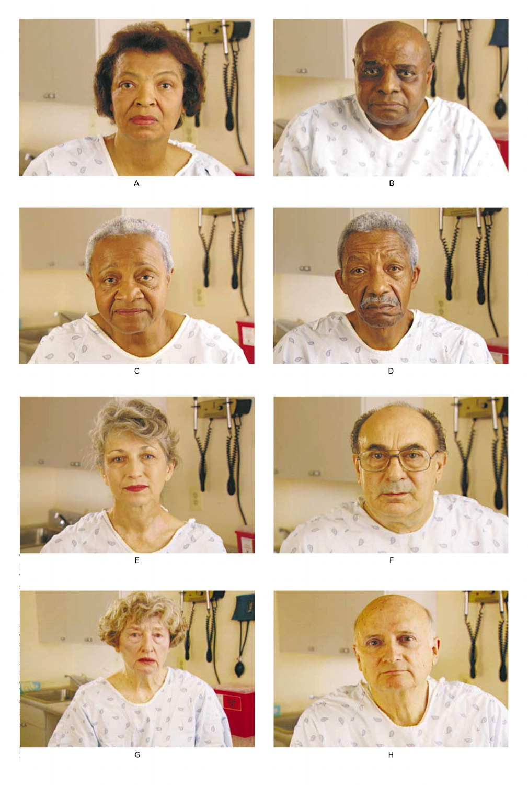

Slide 37
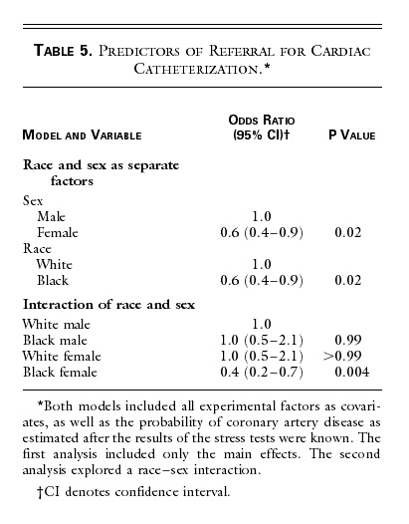

Slide 38

Provider-Level Disparities in Reproductive Health
History of reproductive abuses by family planning providers towards women of color and poor women
Are there disparities in counseling about the IUD?
  RCT using videos of standardized patients presenting for contraceptive advice
  Shown to participants at national meetings of ACOG and AAFP
Dehlendorf: Am J Obstet Gynecol, 2010
Notes:
Check about income in Harrison study.

Slide 39



The “Patients”
Notes:
Just to give a sense of the videos, here are snapshots of the standardized patients. This slide is of the high SES patients…
As you can imagine, planning an directing these videos, including the hiring of models was a challenge for someone with no background in this area.

Slide 40

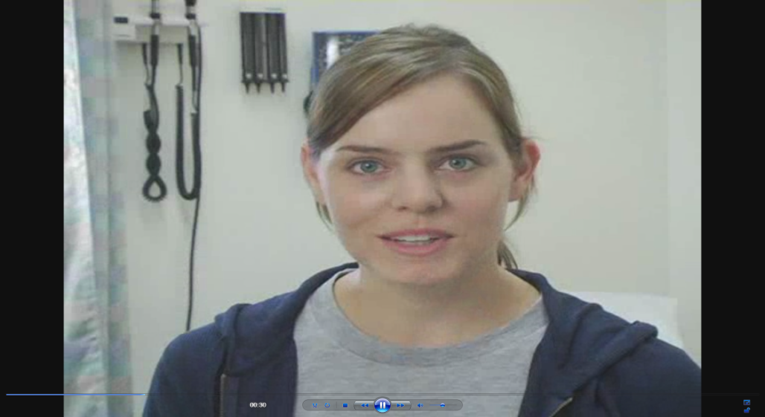

The “Patients”
Notes:
And these are the low SES patients
As you can imagine, planning and directing these videos, including the hiring of actresses as a challenge for someone with no background in this area, so it was definitely a learning experience.

Slide 41
Dehlendorf, et al. AJOG, 2010
Notes:
We interpreted this to indicate concern about pid in this group

Slide 42
Differences in Health Communication
Patient experience is a critical part of the Triple Aim, and is associated with outcomes
  Providers have less positive affect and are more dominant with minority patients
  African Americans report less participation in clinical decision making
  Hispanics experience less patient-centered communication
  In general, racially discordant care results in less information and less patient participation
Beach, AIDS Behav, 2011 Gordon, Cancer, 2016
Beach, JGIM, 2010

Slide 43
Audiotaped Conversations After Angiography
Less information given to AA patients
Fewer questions asked by AA patients
Less social or bonding type statements
→Cycle: less information, fewer questions, less social comfort
Less Information
Fewer Questions
Less Social Comfort
Gordon, Soc Sci Med, 2005

Slide 44
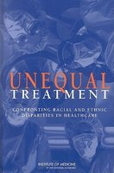
Can well-intentioned providers be biased?
“…biases may exist…often unconsciously, among people who strongly endorse egalitarian principles and truly believe that they are not prejudiced. There is considerable empirical evidence that even well-intentioned whites…who do not believe that they are prejudiced demonstrate unconscious implicit negative racial attitudes and stereotypes [which] significantly shape interpersonal interactions….Evidence suggests that bias, prejudice, and stereotyping on the part of healthcare providers may contribute to differences in care.”

Slide 45
Can well-intentioned providers be biased?
“…biases may exist…often unconsciously, among people who strongly endorse egalitarian principles and truly believe that they are not prejudiced. There is considerable empirical evidence that even well-intentioned whites…who do not believe that they are prejudiced demonstrate unconscious implicit negative racial attitudes and stereotypes [which] significantly shape interpersonal interactions….Evidence suggests that bias, prejudice, and stereotyping on the part of healthcare providers may contribute to differences in care.”

Slide 46
Health Care Disparities
Systematic review of 15 studies found that all but one found that providers have pro-white bias
  Similar to general population
Physicians judge Black patients to be:
    Less intelligent
    Less likely to comply
    More likely to abuse drugs
Hall, AJPH, 2015
Notes:
Both about how we interact with patients and the bias we bring in

Slide 47

The Effect of Patient Race/Ethnicity on Physicians' Ratings of Patients
63
All p ≤ 0.01
%
Adjusted for SES, age and sex (both physician and patient) and health risk status
Van Ryn and Burke. Soc. Sci. Med. 2000
Notes:
Soc Sci Med. 2000 Mar;50(6):813-28.
The effect of patient race and socio-economic status on physicians' perceptions of patients.
van Ryn M¹, Burke J.
Author information
Abstract
Despite its potential influence on quality of care, there has been little research on the way physicians perceptions of and beliefs about patients are affected by patient race or socio-economic status. The lack of research in this area creates a critical gap in our understanding of how patients' demographic characteristics influence encounter characteristics, diagnoses, treatment recommendations, and outcomes. This study uses survey data to examine the degree to which patient race and socio-economic status affected physicians' perceptions of patients during a post-angiogram encounter. A total of 842 patient encounters were sampled, out of which 193 physicians provided data on 618 (73%) of the encounters sampled. The results of analyses of the effect of patient race and SES on physician perceptions of and attitude towards patients, controlling for patient age, sex, race, frailty/sickness, depression, mastery, social assertiveness and physician characteristics, are presented. These results supported the hypothesis that physicians' perceptions of patients were influenced by patients' socio-demographic characteristics. Physicians tended to perceive African-Americans and members of low and middle SES groups more negatively on a number of dimensions than they did Whites and upper SES patients. Patient race was associated with physicians' assessment of patient intelligence, feelings of affiliation toward the patient, and beliefs about patient's likelihood of risk behavior and adherence with medical advice; patient SES was associated with physicians' perceptions of patients' personality, abilities, behavioral tendencies and role demands. Implications are discussed in terms of further studies and potential interventions.

Slide 48
Trust in Family Planning Patients
Table 3. Multivariate analysis for Providers’ Trust in Patient Scale (PTPS) Scores *
 | Difference in Provider trust in patient score | ^{ǂ}p-value
Patient race/ethnicity
White | ref | ref
African-American | -2.3 | 0.05
Latina | -1.2 | 0.3
Asian Pacific Islander | 1.1 | 0.5
Native American | -14.9 | 0.016
Multi-racial/Other | -.6 | 0.8
Provider age | -0.06 | 0.6
Provider type
Nurse Practitioner | -2.1 | 0.5
Physician | ref | ref
*Includes all patient and provider demographics with p-value <0.05 in bivariate analysis
Jackson, unpublished data

Slide 49
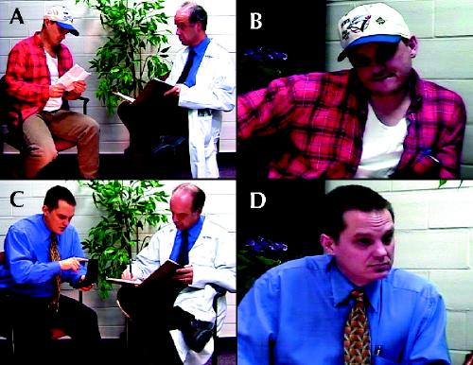
Unconscious Bias by SES
Woo, CMAJ, 2004
Notes:
Of medical students specifically

Slide 50
Unconscious Bias by SES
Low SES patients perceived as less likely to:
  Adhere to medications
  Follow up as recommended
  Second year students were less likely to report wanting the low SES patients in their practice
    But less true among low SES medical students
Woo, CMAJ, 2004
Notes:
Also in van ryn study with post angiogram encounter - patient SES was associated with physicians' perceptions of patients' personality, abilities, behavioral tendencies and role demands

Slide 51
Stereotyping is necessary and unavoidable
Stereotyping
  Fixed and oversimplified image or idea of a particular type of person or thing
  Not necessarily negative
  Cognitive psychology demonstrate it is used to organize our complex world
  United States has a long history of racism that creates negative racial and ethnic stereotyping

Slide 52
How is stereotyping used in medicine?
Two learning and memory systems
Slow learning
  Information is extracted and applied rapidly, automatically and unconsciously→ implicit beliefs
Fast binding
  Information is extracted and applied consciously and deliberate
  When there is ample time to determine the answer for a complex question →explicit beliefs
Which type of memory system do you think clinicians most often use? And why?

Slide 53
How we naturally process information -> unequal care
When we are tired, distracted, stressed or under time pressure → automatic, slow-learning process are used to make decisions
These conditions are typical of many clinical settings
Regardless of intention or motivation we all fall prey to using automatic cognitions (stereotypes)
Burgess, D. J Gen Intern Med 2004

Slide 54
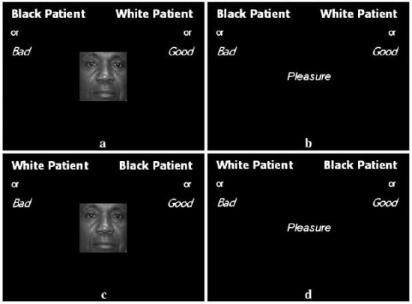
Implicit associations can be measured
    Implicit association test (IAT): https://implicit.harvard.edu/
  Assesses speed and accuracy of responses to linking concepts together, varying values across two dimensions
  Done rapidly so that your slow-
  learning (unconscious) decision
  making is in play
  Various areas
    Race, substance abuse,
    sexual orientation
Notes:
Describe the test(s)
My results
How I felt
Quote from Christine

Slide 55
Implicit bias results in unequal care
Implicit attitudes affect verbal communication and non-verbal behavior (eye contact, friendliness)
Physicians who implicitly favored whites have:
    Less patient-centered communication
    More negative tone during the visit
    Poorer ratings of care by black patients
    Black patients with worse treatment adherence and worse health outcomes
Difference in perception of black patients mediate differences in recommendations in heart disease
Burgess, D. J Gen Intern Med 2004 Hall, AJPH, 2015
Van Ryn, M. JAMA 2011 Van Ryn, AJPH, 2006

Slide 56
Statistical Discrimination
Making assumptions about individuals based on the probabilistic application of data about their demographic group
For example:
  Differences in recommendations for IUD could be related to considering population rates of unintended pregnancy
  Differences in diagnosis of PID vs. appendicitis related to STI demographics
Fails to consider individual differentiating information
Balsa, HSR, 2005

Slide 57
How important are differences in systems of care?
151 Medicare managed care plans
4 HEDIS quality measures
  DM control; Lipids in DM, Lipids in CVD, BP control
Performance measures 7-14% lower among blacks than whites
70% of the differences due to differentiation within plans rather than concentration of Blacks in lower quality plans
Trivedi, JAMA 2006

Slide 58
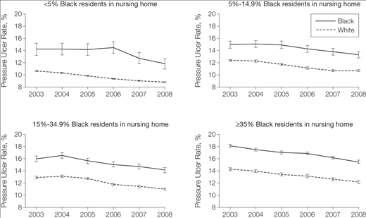
Intra- and inter-site contributions to disparities in pressure ulcers
Li, JAMA, 2005

Slide 59
How important are differences in physicians?
Study of claims for Medicare fee-for-service, assessed disparities in cancer care quality
Overall, between-physician differences explained 15-21% of the variation in treatments for breast cancer, and 14-17% of variance for treatment for colorectal cancer.
  Most of the effect was within-physician
Popescu, Med Care, 2016

Slide 60
Patient Factors
Black patients known to have less trust in the medical system
  But shouldn’t the medical system be addressing this?
May have different preferences for care that are not reflected in guidelines
Real question is how can the system adapt to accommodate/address these factors

Slide 61
Summary of Causes of HCD
Health Care system:
  Segregated and inferior
  Fragmented and challenging for all
  Language barriers
  “Literacy” and “Numeracy”
Provider:
  Unconscious bias
  Statistical discrimination
Patients?
So what can we do about it?

Slide 62
Interventions to Eliminate Disparities in Healthcare
Systems:
  Better systems
  Tailored support
Providers:
  Address unconscious bias
  Change the provider workforce
Bring together clinical care and public health

Slide 63
Quality Improvement and Health Disparities

Slide 64
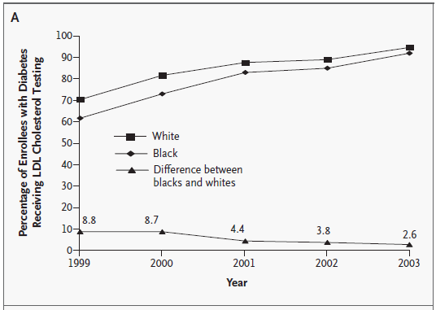
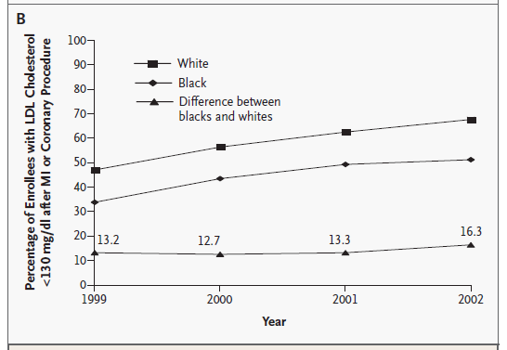
Trends in Receipt of Two HEDIS Measures for Enrollees in Medicare Managed-Care Plans, by Race
LDL TESTING
LDL CONTROL
Trivedi, A. N.; NEJM, 2005
Notes:
Figure 1. Trends in Receipt of Two HEDIS Measures for Enrollees in Medicare Managed-Care Plans, by Race. Panel A shows large overall improvements in the quality of care by year and a significant narrowing of the disparity between blacks and whites in testing for levels of low-density lipoprotein (LDL) cholesterol among patients with diabetes (P

Slide 65
Quality Improvement and Disparities
QI works
Variable effect on disparities
Generic programs probably less useful for addressing disparities
Weak correlation between overall quality of care and size of disparities for a given system of care
Pay for performance may worsen disparities
Shakir, JGIM, 2018

Slide 66
Patient Portals
May increase care coordination and access to information
  Safety net patients indicate interest in electronic communication
However, internet access and computer literacy can lead to exacerbation of disparities
Schickendaz, JGIM, 2013
Lyles, PLoS Med, 2015

Slide 67
Other Interventions
Address barriers to care related to numeracy/literacy
  Decision support tools
Promote ease of access to services and information
  Reducing co-payments (Lewey et al.,2015)
Adequate interpreter services used by trained providers

Slide 68
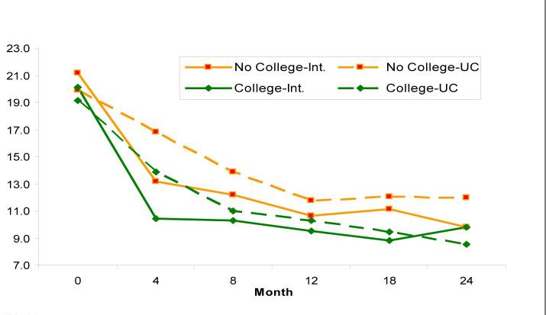
Addressing Disparities Through Collaborative Care Management - Depression
Bao, Arch Gen Psychiatry, 2011
Angstman, Medical Care, 2015
2
Notes:
Maybe both about social determinants and health care did not have an effect on race

Slide 69
Provider Interventions
Make provider population more representative of patients served
  Race and language concordant interactions associated with more patient-centered care
Change the philosophy of care
  Patient-centered attitudes associated with fewer disparities in communication among medical students
What about implicit bias itself?
Beach: Acad Med, 2007
Shen, J Racial Ethn Health Disparities, 2017

Slide 70
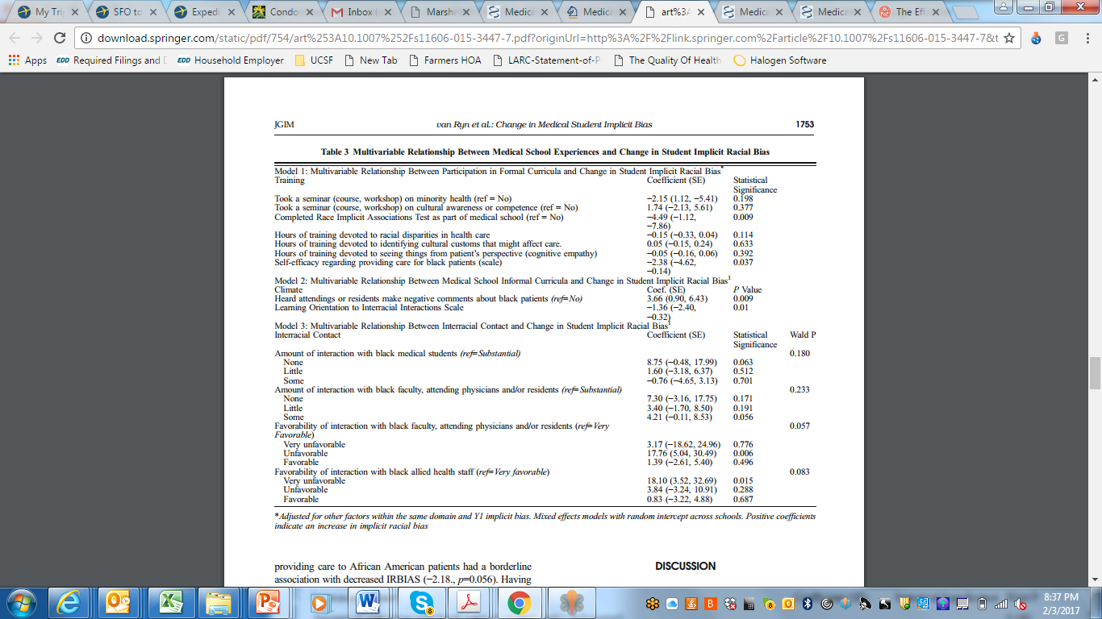
Implicit Association Test?
Van Ryn, JGIM, 2015

Slide 71
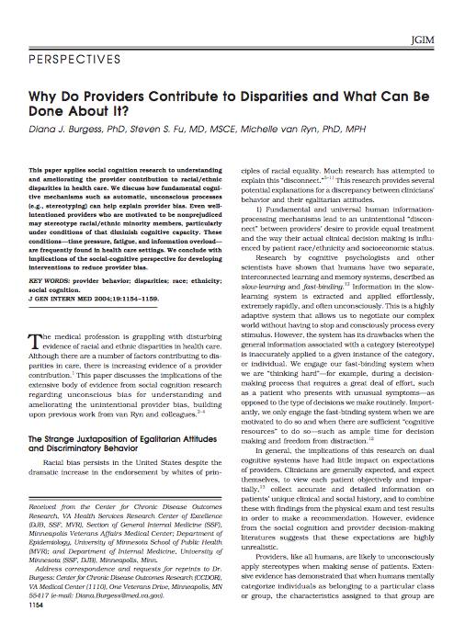
Addressing Implicit Racial Bias
Focus on individual qualities
  Individuation v. categorization
Enhance individual motivation
  IAT/ what would/should I do?
Open discussion of stereotypes
Improve confidence in interacting with dissimilar group
Empathy – perspective-taking
Partnership building with patients
Burgess, JGIM, 2004
Notes:
Perspectives from Psych Literature

Slide 72
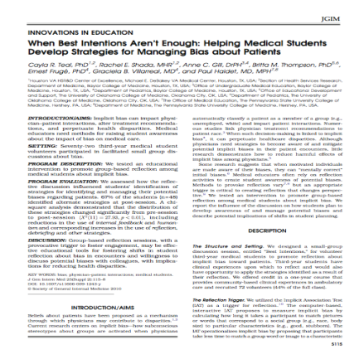
Effects of Implicit Bias Workshop
    Workshop using Implicit Attitude Test
    Facilitated small group discussion
      Discussion
        Reactions, clinical experiences, and strategies
      Noted differences after sessions in strategies
        Focus on recognition of bias
        Shift from self-reliance to talking with others
        Consider possible bias before seeing patient
Teal, JGIM, 2010

Slide 73
Facing Outward
Social screening is gaining prominence – e.g. collecting social variables in EHR
Benefit for linkages to social resources
Can also help inform treatment and care by addressing barriers to treatment
HOWEVER, important to prevent stereotyping
  Some health care disparities arise from assumptions about preferences or abilities based on social variables

Slide 74
Map of First Five Weeks
Week 2
Week 5
Economic & Social
Opportunities and Resources
Week 3
Living & Working Conditions
in Homes and Communities
Week 4
Behaviors
Medical Care
Interaction with genetic/other biological factors
HEALTH
Adapted from Braveman et al., for RWJ Foundation
Commission to Build a Healthier America | www.commissiononhealth.org

Slide 75
Why Ecology Matters
Ensure research is grounded in contextual understanding
  Collect necessary data
  Use appropriate analytic techniques
  Provide nuanced interpretation of results
Notes:
Even if you are not attacking it all
Example of – race being a proxy for SES – missing the point
Regardless of wehther primary question is disparities or not

Slide 76
Collect appropriate race/ethnicity and SES data
Assess representativeness/generalizability
Control for confounding
Investigate disparities
Notes:
Should include to think about what measures to collect and also collecting mechanisms rather than just these constructs

Slide 77
Confounding
Cancer
Exposure
Race
SES
Notes:
When are doing it to identify confounding can be important, but still need to recognize are identifying social risks – if actually care about what causes the cancer are probably missing something big

Slide 78
Investigate Disparities
“When income was used to “adjust for SES,” Mexican Americans appeared to be at significantly increased risk of fair or poor health compared with non-Hispanic whites; however, risks appeared significantly lower when both poverty and educational levels were included.” Braveman, JAMA, 2005
Notes:
True for all research – not just health disparities research
For example – you may be just interested in controlling for confounding – but if you don’t do it well
Will take about this later – how you can
Need example where this was a problem
Need to say that also need to consider ecological measures – will mention in a second
http://www.ncbi.nlm.nih.gov/pubmed/24618999 - winkleby shows that effect of SES on breast cancer outcomes varies by race/ethnicity

Slide 79
Incorporating Ecology into Analysis
Consider race/ethnicity and SES separately and in combination in analytic models
  “Both neighborhood and individual SES are associated with survival after breast cancer diagnosis, but these relationships vary by race/ethnicity.” - Shariff-Marco S, 2014
Be thoughtful about what variables to include in models as confounders vs. mediators
  Depends on the research question
Notes:
Consider neighborhood too!

Slide 80
Maternal Mortality
Race
SES? Incarceration?
Experience of racism?
Hospital type?
Notes:
Think about parental education….etc. what are you controlling for?
Think about whether to flesh this out

Slide 81
Maternal Mortality
Prenatal care
SES?
Race?
Notes:
Think about parental education….etc. what are you controlling for?
Think about whether to flesh this out

Slide 82
Caution with interpretation
Risk of misinterpreting data from multivariate models
  Individualistic fallacy
  Biologic fallacy
Implications of results may depend on context

Slide 83
Biologic Fallacy
The presumption that differences that cannot be explained by identified non-biologic factors must be due to biologic differences.
  “High rates of ESRD among blacks is not fully explained by racial differences in age, socioeconomic status, or access to health care…. suggest[ing] an inheritable genetic predisposition.“ – Controlled for percent of individuals with college education in zip code
Notes:
You have all learned about ecologic fallacy – but the other side is an issue as well.
Only controlled for education, was looking at individual level factors – intepreted this as “independent of SES”. Studies that have controlled for multiple factors have found a much bigger effect of controlling.
So did not collect right data, and provided overly broad interpretation – even if was not SES controlled, then needs to say why lifestyle factors might be diferrent.
http://www.ncbi.nlm.nih.gov/books/NBK25517/#a2000af96rrr00690
Kaufman, cooper and mcgee
May even be a factor in genetic studies
1996
Such a conclusion is unwarranted
because of our limited knowledge of non-biologic factors,
combined with our inability to measure and
adjust for known non-biologic factors.

Slide 84
Individualistic Fallacy
The fallacy of assuming that individual-level outcomes can be explained exclusively in terms of individual-level characteristics
  “Living in a low SES neighborhood confers additional mortality risk beyond individual SES.”
  “The odds of violence for African Americans was 2.7 times greater than the odds of violence for Whites… when neighborhood disadvantage was added to the logistic regression equation, the significant effect of race was eliminated.”
Winkleby, J Epi Comm Health, 2003
Silver, Law Hum Behav, 2000
Notes:
Good example of this is with respect to infectious disease – vaccines and stis
http://www.ncbi.nlm.nih.gov/pubmed/10974802
With respect to discharged psychiatric patients
http://aje.oxfordjournals.org/content/151/4/409.full.pdf+html
Examples – air pollution etc
Some variables are not measurable on the individual level
http://www.ncbi.nlm.nih.gov/pmc/articles/PMC1615039/pdf/amjph00456-0117.pdf
Individualistic fallacy is the erroneous presumption
that differences in population outcomes can be entirely
explained by differences in individual-level characteristics.
In the present study, the census-based variables
are intended to capture neighborhood or "contextual"
effects of SES, and not to stand as proxies for personlevel
SES variables.
The use of the ecological fallacy in
epidemiology also fosters a dismissal of
social variables as causal factors in disease.
First, as seen above, it leads to a
consignment of sociological and anthropological
studies to examining impacts on
whole societies,2 and it denies that ecological
variables can affect individual processes.
28 Second, it reinforces an assumption
that aggregated variables are
substitutes for individual-level variables.
Under such an assumption, the potential
etiological influence of aggregate-level
variables, distinct from the effects of the
same measures on an individual level,
would not be considered.
http://www.ete-online.com/content/11/1/18
ecological study design may also be utilised when the underlying question regards individuals, such as when one is interested in the effects of air quality on health. In this context, ecological studies are potentially susceptible to the “ecological fallacy”; biases that may occur when an observed relationship between aggregated variables differs from the true, i.e. causal, association at an individual level [2]. Indeed, since Robinson in 1950 showed that correlations on an individual level can differ markedly from those on an aggregate, ecological level, epidemiological textbooks, papers and courses have warned us about the dangers of this ecological fallacy [3,4].

Slide 85
Interpretation of Results:
PrEP Studies in Women
Seidman, Ob Gyn, 2016
Notes:
However, product
diversity alone is not enough: preexposure prophylaxis
implementation requires careful attention to
both women’s preferences and powerful social forces
at play. Without developing implementation strategies
that incorporate an individual’s sexual health goals
and the context of her community and greater structural
environment (Fig. 1), the full potential of preexposure
prophylaxis’ effect is unlikely to be realized.
The implications of negative preexposure prophylaxis

Slide 86
And Another Reason Ecology Matters
Provide broader and more accurate insight into possible approaches to improve health and address health disparities
Relevant even when targeting proximal risk factors
Notes:
This leads into the fact that you have to understand the nuance of your results in order to be able to understand how to act on them to make a difference
Only controlled for education, was looking at individual level factors – intepreted this as “independent of SES”. Studies that have controlled for multiple factors have found a much bigger effect oif controlling.
So did not collect right data, and provided overly broad interpretation
Didn’t take into account true importance of SES, and did not think about different ecological approaches

Slide 87
Examples
Health coaches that help with diet and medication adherence in the context of social situation (including food insecurity)
PrEP promotion efforts that acknowledge issues of gender-based power and relationship dynamics (e.g. not just stopping at offering PrEP)
Barbershop/church interventions to address risk for chronic diseases
Policies with impacts on determinants of health, such as soda taxes and improved housing
Notes:
Examples of incorporating a multilevel socioecological perspective even while investigating/intervening on more proximal mechanisms include

Slide 88
So how do you do apply this in your own work?

Slide 89
Incorporating the SEM Model
Interconnections and variables of interest depend on research question
Specifying relationships:
  Ensures that ecologic thinking is incorporated into research question and design
  Provides clarity into pathways being investigated and how they relate to other influences

Slide 90
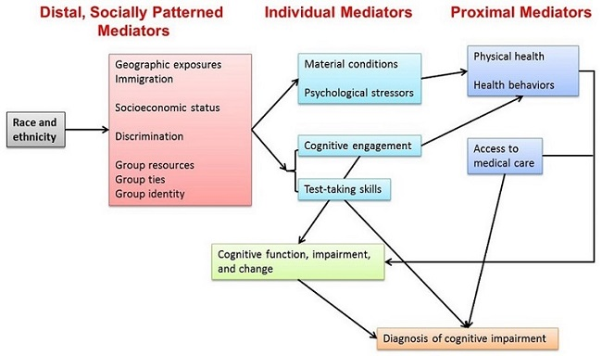

Slide 91

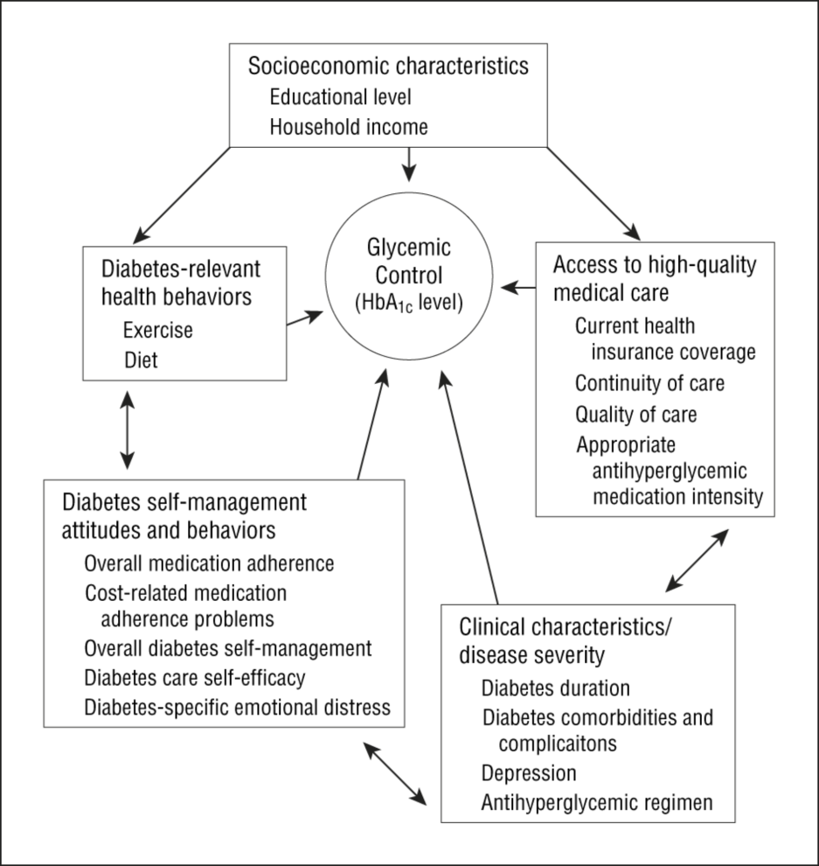
From: Mechanisms for Racial and Ethnic Disparities in Glycemic Control in Middle-aged and Older Americans in the Health and Retirement Study
Arch Intern Med. 2007;167(17):1853-1860. doi:10.1001/archinte.167.17.1853
Figure Legend:
Hypothesized mechanisms for racial/ethnic disparities in glycemic control. HbA_{1c} indicates hemoglobin A_{1c}.
Date of download: 2/9/2015
Copyright © 2015 American Medical Association. All rights reserved.
Notes:
The next few weeks will help you do this

Slide 92
Group Activity
Talk in groups of three about study design(s) you could use to investigate structural or interpersonal causes of health care disparities for your area of interest

