Slide 1
Assessing Outcomes and Safety in RCTs
Dennis Black

Slide 2
Outline: Outcomes and Safety Assessment in RCTs
Outcomes and Efficacy Endpoints
Safety Assessment in RCTs
Phases of RCTS (if time)

Slide 3
Outcomes and Endpoints

Slide 4
(Efficacy) Endpoints
Primary: The main answer of your research question
Secondary:
  Important clinical endpoints, pre-specified
  Minimum number preferred.
  Hard to draw inference
Exploratory:
  Vague, mention in protocol.
  Limited strength of inference.
Ad hoc
  “hypothesis generating”

Slide 5
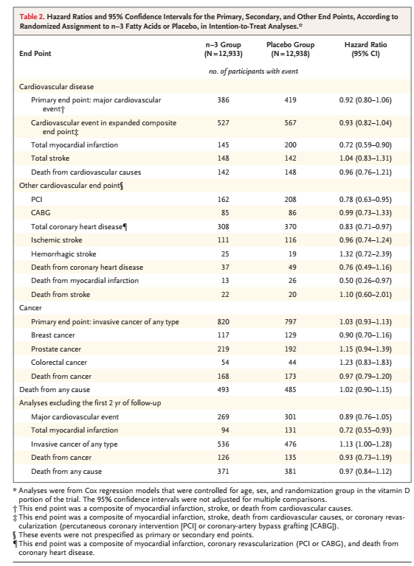
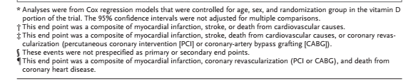
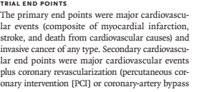

VITAL Study n-3 Fatty Acids (Manson, NEJM 2018)
Exploratory or Ad Hoc
(‘not prespecified as primary or secondary’)
?

Slide 6
Primary Endpoints: Morbone
A new (fictitious) treatment for osteoporosis
Morbone improves bone mass and bone strength in animal models
Early phase trials in postmenopausal women showed that it may improve bone density (BMD)
The company is planning a trial to obtain FDA and EMA approval to market Morbone
The company wants your advice

Slide 7
The most important decision
What will be the primary endpoint?
Possibilities
Improved bone density (BMD)
Vertebral fractures (by spine x-rays)
Nonvertebral fractures
Hip fractures

Slide 8
Why one primary outcome?
To calculate sample size
To test statistical significance of the result without a penalty
  (think multiple comparisons)
The FDA requires that an outcome be specified as “primary” to approve a drug for that indication
  Beneficial effects on secondary outcomes cannot be indications for prescribing the drug
NIH and other funders are a bit more liberal (eg. VITAL)

Slide 9
Which primary endpoint for the Morbone trial?
Bone density (BMD)
Vertebral fractures (by x-ray)
Nonvertebral fractures
Hip fractures

Slide 10
Considerations in choosing the primary outcome
Clinical importance
Feasibility
  Sample size and cost
Commercial considerations
Regulatory requirements

Slide 11
Clinical importance
Hip fracture: causes death, disability, and most of the costs of fractures
Nonvertebral fractures: common, cause disability – less then hip fracture
Vertebral fracture by x-ray: about 1/3 cause cause pain and disability
Bone mineral density (BMD): no symptoms but low BMD increases risk of fracture

Slide 12
Considerations in choosing the primary outcome
Clinical importance
Feasibility
  Sample size and cost
Regulatory requirements

Slide 13
Sample size depends on incidence of the endpoint and the efficacy of the treatment

Slide 14
Sample size for the trial
Alternatives
Improvement in BMD
Vertebral fractures
Nonvertebral fracture
Hip fractures
Sample size
200 / 2 yrs
2,500 / 3 yrs
5,000 / 3 yrs
8,000 / 4 yrs

Slide 15
Sample size and cost
Alternatives
Improvement in BMD
Vertebral fractures
Nonvertebral fracture
Hip fractures
Sample size Cost
200 / 2 yrs $5M
2,500 / 3 yrs $50M
5,000 / 3 yrs $200M
8,000 / 4 yrs $400M

Slide 16
Why not make BMD the primary outcome?
The best choice to minimize cost
Less clinically relevant
Might it substitute for clinical endpoints?
  Is it a valid “surrogate marker” for the clinical outcome, reduction in risk of fracture?
  For drug approvals, FDA requires vertebral fracture (or other fracture types)
  (Note: Current application with FDA to validate BMD formally as a surrogate endpoint (2018 process))

Slide 17
Considerations in choosing the primary outcome
Clinical importance
Feasibility
  Sample size and cost
Commercial considerations
Regulatory requirements

Slide 18
Commercial considerations
Indicators for competitive products
  I’ve developed a new drug that is able to reduce SBP by an average of 5 mm Hg.
    Small, cheap, quick trial with relatively small sample size
  My competitors drug reduces CHD by 30%
  Will you survive in the market place?
  Argues for choice of most impactful clinical endpoint (eg. CHD, hip fx)

Slide 19
Considerations in choosing the primary outcome
Clinical importance
Feasibility
  Sample size and cost
Commercial considerations
Regulatory requirements

Slide 20
The trump highest card
EMA (and FDA)

Slide 21
FDA and EMEA Requirements
Alternatives
Improvement in BMD
Vertebral fractures
Nonvertebral fracture
Hip fractures
Sample size Cost
200 / 2 yrs $5M
2,500 / 3 yrs $50M
5,000 / 3 yrs $200M
8,000 / 4 yrs $400M

Slide 22
Composite endpoints

Slide 23
Sample size also depends on the effect size
Expected % reduction
Nonvertebral fractures 20%
Vertebral‘fractures’ 50%
Composite endpoint ~25%

Slide 24
Pros and Cons of Composite Endpoints
Pro
More events (smaller sample size?)
Data about several outcomes
Con
May have heterogeneous biology
Treatment may have different effects on each of the outcomes
  Might lose statistical power
Example: In VITAL study, any CHD event.

Slide 25
Combine the endpoints?
Decrease the size and cost by increasing the number of endpoints
Rate per 3 yrs
Nonvertebral fractures 12%
Vertebral ‘fractures’ 4%
Composite 16%

Slide 26
Which Primary Outcome?
Sample size
Alternatives
Improvement in BMD
Vertebral fractures
Nonvertebral fracture
Either vert or non-vert fracture*
Sample size/duration
200 / 1 year
2,500 / 3 yrs
5,000 / 3 yrs
2,000 / 3 yrs
* Combined: A positive result for vertebral fracture may be hidden
by less effect for nonvertebral fracture

Slide 27
Multiple Endpoints in RCTs
Might want to have more than one endpoint for a trial
FDA and EMEA
  “MUST maintain overall alpha at .05”
How to reconcile???
Consider 2 examples:
  Different diseases for 2 endpoints
    Fractures and breast cancer
  Two types of fractures
    Vertebral and hip fractures

Slide 28
Vertebral fracture and Breast Cancer as Ourcomes: Raloxifene
In a large trial (MORE) of Raloxifene for osteoporosis, significant reduction in vertebral fracture (primary endpoint)
Ettinger JAMA 1999

Slide 29
Raloxifene and Risk of Breast Cancer (MORE Trial)
1.25
Placebo
3.8 per 1,000
1.00
P <0.001
(log rank test)
0.75
% of Participants
0.50
Raloxifene
1.7 per 1,000
0.25
0.00
0
1
2
3
4
Years
Ettinger JAMA 1999

Slide 30
Vertebral fracture and Breast Cancer as Ourcomes: Raloxifene
In a large trial (MORE) of Raloxifene for osteoporosis, significant reduction in vertebral fracture (primary endpoint)
Raloxifene partially blocks the estrogen receptor and a 70% reduction in a secondary endpoint of risk of ER+ breast cancer (p<.001)
FDA did not allow breast cancer as an indication for treatment
A second trial was needed
Ettinger JAMA 1999

Slide 31
Co-primary endpoints
How to allow testing more than one potential benefit of a treatment while maintaining overall alpha=0.05?
Two main approaches
  Splitting alpha
  Gated, or stepwise, testing of statistical significance

Slide 32
“Splitting alpha”
The overall level of statistical significance for “benefit” is maintained at P<0.05
The 0.05 can be divided, in an additive way, between endpoints ala Bonferonni
  Usually 0.025 for each endpoint
Coulda done in Raloxifene trial:
Vertebral fracture: significant if P<0.04
  More lenient it requires less power to achieve that level
Breast cancer: significant if P<0.01
  More stringent because it requires less power

Slide 33
“Gated”/Hierarchical Approach to Multiple Endpoints
Approach must be part of initial study design
Set up a sequence of tests, each with another endpoint
Each test at alpha=.05
Continue in sequence until you reach a non-significant test, then stop.
Overall significance level is controlled at .05
Becoming quite popular of late
Mauer et. Al 1995

Slide 34
“Gated”/Hierarchical Approach to Multiple Endpoints
Test Outcome 1 p<.05
No
Yes
Test Outcome 2 p<.05
STOP
No
Yes
Test Outcome 3 p<.05
STOP
No
Yes
Test Outcome 4 p<.05
STOP
No
Yes
Mauer et. Al 1995
STOP
More outcomes

Slide 35
A Simple Example with 2 Gates
RCT of Zoledronic Acid vs. PBO
~ 7700 women with osteoporosis
Vertebral fracture and hip fracture are “co primary endpoints”
  Simple gated approach
  Test for vertebral fractures in ZOL vs. PBO, if significant, then test for hip fracture significance for ZOL vs. PBO
Black et al NEJM 2007

Slide 36
Simple “Gated”/Hierarchical Approach in Zol vs. PBO trial
Test Outcome 1 p<.05
Vertebral fracture? P<.05
No
Yes
Test Outcome 2 p<.05
Hip fracture? P<.05
STOP
No
Yes
Conclusions:
ZOL reduces both vertebral and hip fractures.
FDA label includes both.
STOP
Black NEJM 2007

Slide 37
Recent Example of Gated Approach
RCT of Abaloparatide vs. placebo for fracture
Abaloparatide also compared to a 3rd treatment: Teriparatide (active control)
  Why? Hope that new treatment superior to existing treatment
2463 women with low BMD
Vertebral fracture (primary endpoint, Abalo. vs. Pbo)
Multiple secondary endpoints and multiple treatments
  Use a gated/hierarchical approach ..
Miller, JAMA 2016

Slide 38
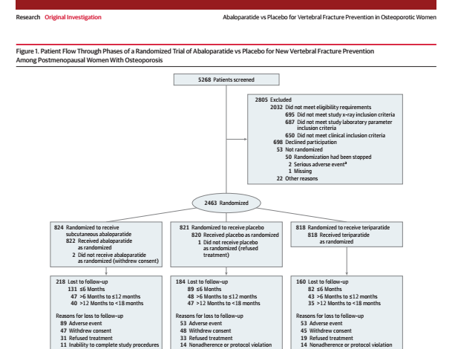

Slide 39

Gated Approach to Secondary Endpoints (9 tests)
Gate | Outcome | Treatments compared | P<.05?
1 | Vertebral fracture | Abalo. vs. PBO | Yes
2 & 3 & 4 | BMD: Thip & Fnhip & spine | Abalo. vs. PBO | Yes & Yes & Yes
5 | Non-vert fx | Abalo vs. PBO | Yes
6 & 7 | Thip and FNhip BMD | Abalo. vs. Teripar. (6 mos) | Yes & Yes
8 | Non-vert fx | Abalo. vs. Teripar. | No
9 | Spine BMD | Abalo. vs. Teripar. | Not done

Slide 40
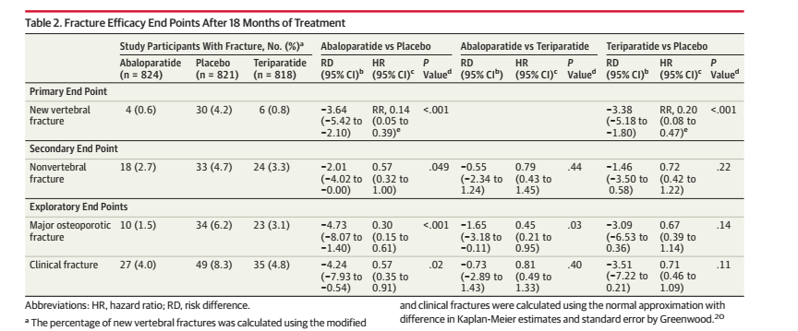



Gate 1
Gate 5
Gate 8
Miller, JAMA 2016

Slide 41
Outcomes: Summary
Selecting a primary outcome is key decision in designing trials
Selection of outcome impacts sample size, cost, clinical inferences, etc.
Can use multiple primary endpoints but need to control for overall significance level
Secondary endpoints interpret very cautiously
Exploratory endpoints for generating hypotheses only

Slide 42
Assessing Safety

Slide 43

Adverse
events

Slide 44
Safety: Outline
A word about DSMBs
Overview of Adverse Events
Methods for collecting info
Serious vs other adverse events (AEs)
How to elicit AEs
Coding AEs
Adjudicating AEs and outcomes

Slide 45
Data Safety Monitoring Boards
Will be discussed in 3/7 lecture (Dr. Huang)
Required for all clinical trials
Comprised of experts in biostatistics, the condition being studied, the intervention, and medical ethics
Establishes a plan to monitor unblinded results of the trial
  Always safety, sometimes efficacy
Makes recommendations to the sponsor, NIH or PI

Slide 46
What is an Adverse Event in a Trial?
Regulatory definition (98% of RCTs) but similar in non-regulatory RCTs
An adverse event (AE) is any untoward medical occurrence in a patient or clinical investigation subject administered a pharmaceutical product and which does not necessarily have a causal relationship with this treatment. An adverse event (AE) can therefore be any unfavourable and unintended sign (including an abnormal laboratory finding), symptom, or disease temporally associated with the use of a medicinal (investigational) product, whether or not related to the medicinal (investigational) product.

Slide 47
Serious Adverse Events (SAEs)
AEs are classified as Serious Adverse Events when any of
the following occur:
1. Results in death
2. Is life-threatening
3. Results in permanent or substantial disability
4. Results in or prolongs an existing in-patient hospitalization
5. Is a congenital anomaly/birth defect
6. Requires (medical or surgical) intervention to prevent
permanent impairment or damage
Regulatory definition (FDA, EMEA, others)

Slide 48
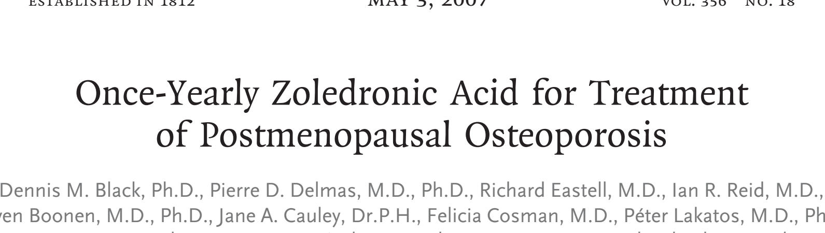
Starting at the End..How are AE’s Reported
7736 women with osteoporosis (mean age 73)
Zoledronic acid vs PBO for osteoporosis
IV bisphosphonate given once/year
International (23 countries)
Primary endpoints: Hip & Vertebral Fracture
Black, et al. NEJM 2007

Slide 49
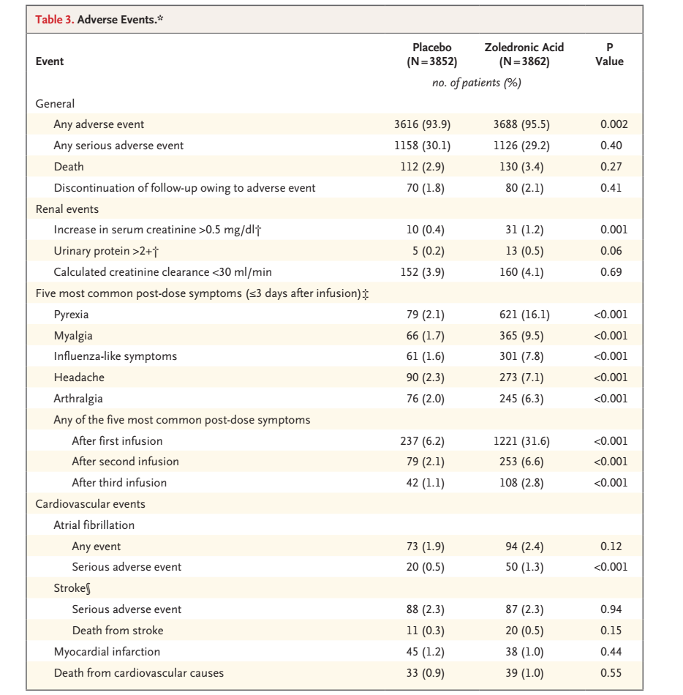
Black, et al. NEJM 2007

Slide 51
AE Data Collection Methods
1. Open-ended questions
“Have you had any health problems since your last visit?”
Data collected as text
Very commonly used (almost all trials)
2. Direct measurement
e.g., Labs always, plus also testing, imaging, etc.
3. Targeted AE’s based on previous concerns..
e.g., statins: “have you had any body pain…” or
  Biphosphonates: Any stomach pain or difficulty in swallowing
Notes:
Bent et al study
n=214, BL characteristics similar in all groups
Rand assignment # reported events
Open ended question 11
Open ended, defined question 14
Checklist of 53 common side effects 238; 77% of

Slide 52
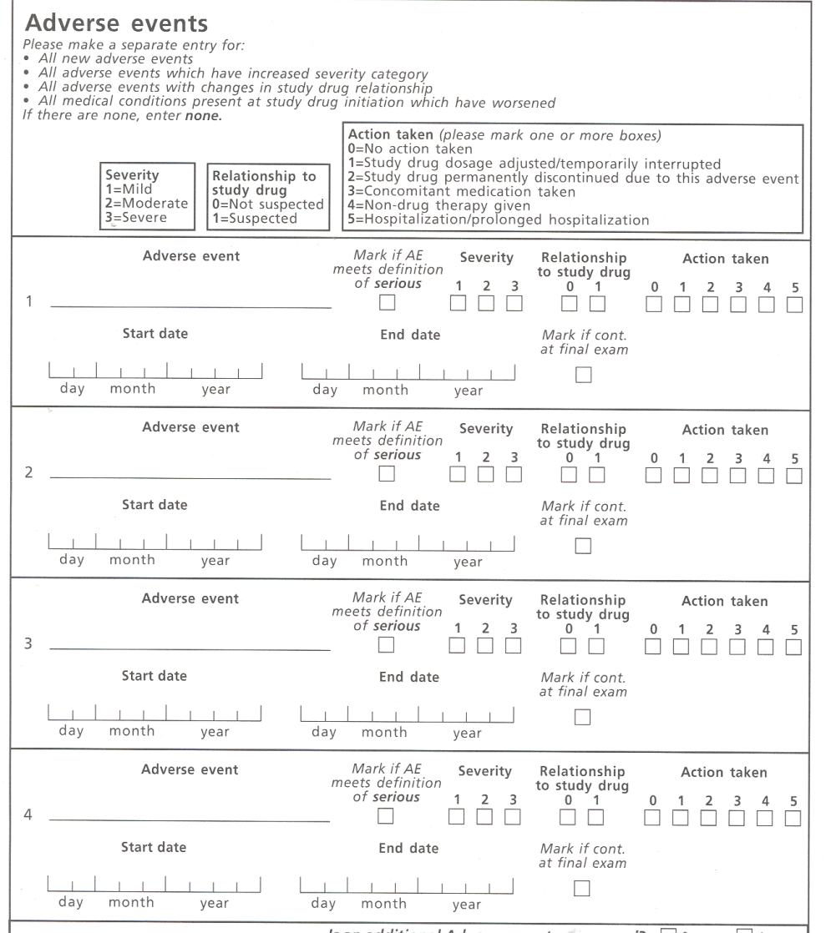
Open Ended AE Reporting:
Typical AE Report Form
How is form used?
Use for EVERYTHING
  - Hang nail to stroke
Multiple events
Multiple times for each patient
  At each visit (eg. annually)
  Patient reports by phone
Some events continuing..
Notes:
Example:
Severity Grading Guidelines
Mild
asymptomatic or mild symptoms;
clinical or diagnostic observations only;
intervention not indicated
Moderate
minimal, local or noninvasive intervention indicated;
may limit age-appropriate instrumental activities of daily living
Severe
medically significant (may or may not be immediately life-threatening);
intervention indicated;
hospitalization or prolongation of hospitalization may be indicated;
may be disabling;
may limit self-care activities of daily living

Slide 53
AE Report Form
Sample AE Variables:
- Description
- Date started
- Severity (e.g. serious, moderate, or
mild; NCI grading 1-5)
Serious AE (SAE)
Action taken
- Related to study intervention
(usu. subjective assessment by investigator)
- Signature of investigator at clinical site
Free text
Notes:
Example:
Severity Grading Guidelines
Mild
asymptomatic or mild symptoms;
clinical or diagnostic observations only;
intervention not indicated
Moderate
minimal, local or noninvasive intervention indicated;
may limit age-appropriate instrumental activities of daily living
Severe
medically significant (may or may not be immediately life-threatening);
intervention indicated;
hospitalization or prolongation of hospitalization may be indicated;
may be disabling;
may limit self-care activities of daily living

Slide 55
AE Report Form
What happens next?
Free text
Notes:
Example:
Severity Grading Guidelines
Mild
asymptomatic or mild symptoms;
clinical or diagnostic observations only;
intervention not indicated
Moderate
minimal, local or noninvasive intervention indicated;
may limit age-appropriate instrumental activities of daily living
Severe
medically significant (may or may not be immediately life-threatening);
intervention indicated;
hospitalization or prolongation of hospitalization may be indicated;
may be disabling;
may limit self-care activities of daily living

Slide 56
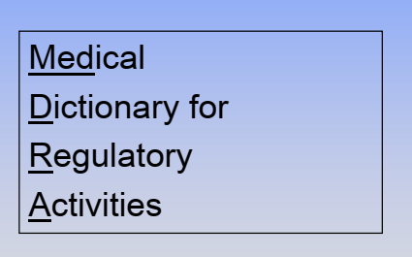
How to Classify AE Free Text?
MeDRA System
Translate free text into standard set of terms
  Concise and clear text by clinicians
  Use some kind of standard terms
Code using a coding dictionary
  MeDRA most commonly used (others)
    Internationally accepted coding dictionary
  Take free text and try to match

Slide 57
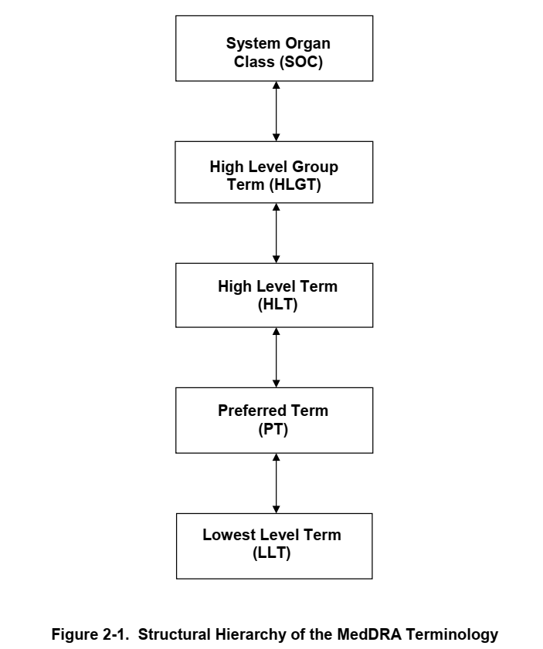
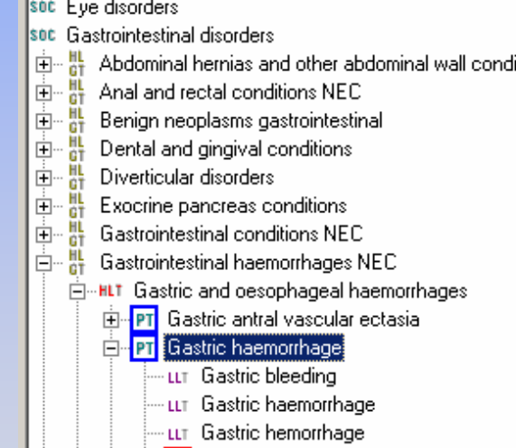
MeDRA: Multiple Level Categorization Hierarchy
More Specific

Slide 58
MeDRA: Multiple level categorization
System Organ Class – 27
Higher Level Group Terms – 337
High Level Terms – 1737
Preferred Terms – 23088
Lower Level Terms – 78808
How to use to monitor safety (during study) and report safety (after trial)???

Slide 59
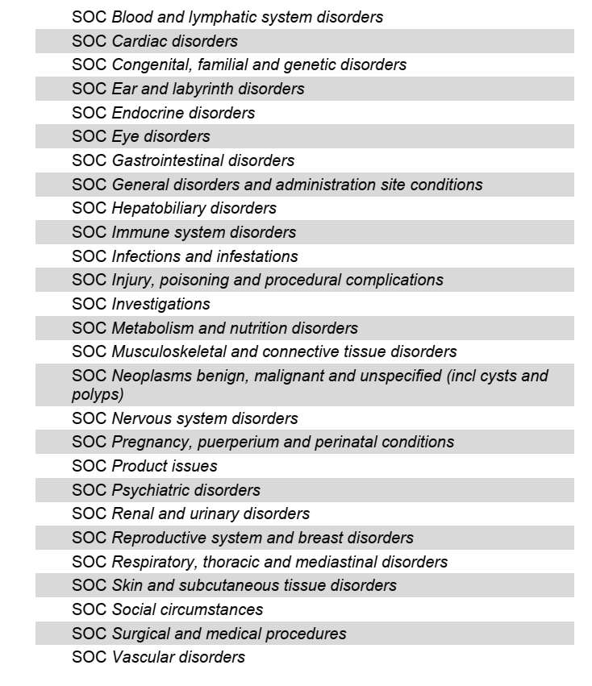
The 27 System Organ
Classifications:
Not mutually exclusive eg.
Stroke

Slide 60
AE Coding: classification into groups
EXAMPLE AE REPORT:
headache and runny nose and hot flashes
MedDRA classification:
Primary system organ class nervous system disorders
Preferred term headache
Primary system organ class Respiratory, thoracic, and
mediastinal disorders
Preferred term post-nasal drip
Primary system organ class vascular disorders
Preferred term hot flush

Slide 61
MeDRA: Multiple Level Categorization Hierarchy
Example 1 |  | N
Nervous System Disorders | Vascular Disorders | 27
 |  | 337
 |  | 1737
Headache, CVA | Hot Flush | 23088
 |  | 78,800

Slide 62
MeDRA for DSMB Reports
KEEPS trial.
  2 types estrogen vs. placebo
  728 early post menopausal women
  Primary endpoint: CIMT
  Funding by a foundation

Slide 63
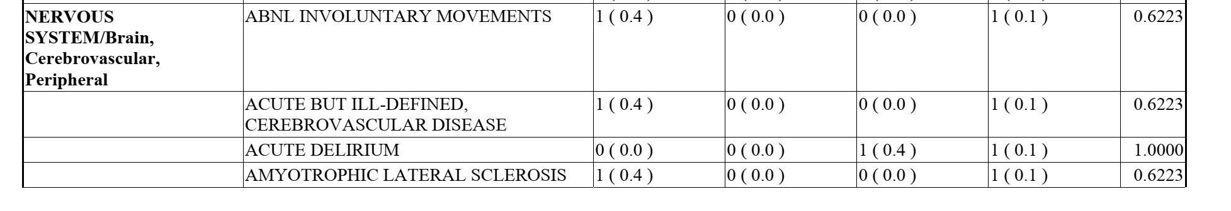
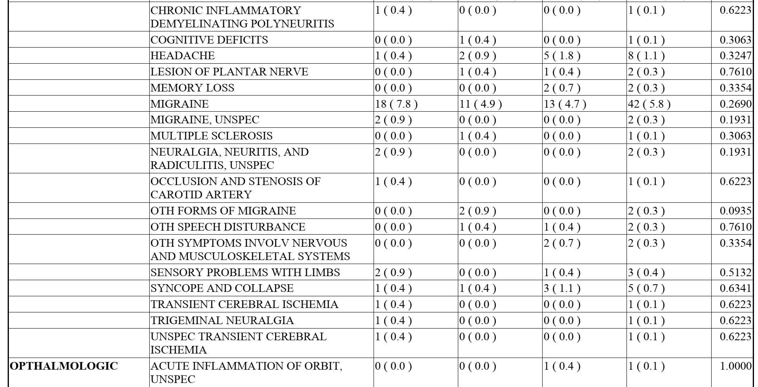
DSMB Report: Using MeDRA
SOC
Preferred Term

Slide 64
MeDRA for Scientific Reports
HORIZON Study
Zol vs. placebo

Slide 65

Post-Dose Symptoms (aka acute phase reaction)
- Known effect of IV bisphosphonates
- Pre-defined safety category
- 5 “symptoms” (eg. Pyrexia)
Defined as any within a predefined group of Medra Preferred Terms Terms (eg. ‘high temperature”, “fever”, “feeling hot”, etc) starting within 3 days of first infusion.

Slide 66
Cardiovascular effects
- Not predefined but arose during trial and noted by DSMB
- Atrial fibrillation (group of MeDRA Preferred Terms)
Any Afib (non-serious + serious) not different by treatment
Serious Afib 2.5 times more common in ZOL than pbo
????
- Excess stroke deaths seen by DSMB during trial but not different by end

Slide 67
MeDRA System
Usually accurate, but categorization can be challenging
  How to group preferred terms?
  Best to pre-specify groupings if possible.
  Needs medical judgment to group terms
  Often quite subjective
Other dictionaries but grass may not be greener!

Slide 68
Clinical Collection of Adverse events
2 general approaches
  1. Open-ended questions to assess any health condition
  2. Targeted questions to assess suspected adverse events

Slide 69
Check list approach
“Since your last visit, has a doctor told you you had (check all that apply)”
__A blood clot in the leg or lung (venous thrombosis)
__ An ulcer
…for all possible diseases
What’s wrong with this approach?

Slide 70
Elicited for Specific AEs vs Systematic for all AEs
Elicited/check list
Pro
More sensitive?
Easier to code
Con:
More Aes
Works only for expected events
Systematic all AES
Pro
Catch unexpected AEs
Con:
Hard to code; costly
Less sensitive for true adverse effects: multiple comparisons

Slide 71
Expert Adjudication
(for Safety or Study Endpoints)
Expert or panel of experts
  Neurologists for stroke
Collect medical records for the event
  Neurologic exam?
  Brain MRI or CT
One or more expert reviews the records and makes a diagnosis

Slide 72
Expert Adjudication
Expensive and time consuming
  Consider for important AEs and efficacy outcomes (especially primary)
Does it improve the accuracy?
  Depends on the event
    Hip fracture: accurate, no need for adjudication?
    Rib fracture: often wrong – needs adjudication
    Heart attack / MI: may need expert adjudication
    Stroke: definitely need adjudication

Slide 73
Summary Adverse Experiences: AEs
Important component of all RCTs
Very expensive & time-consuming
  Collecting and monitoring AEs can account for 20-25% of the cost of trials
  Try to balance safety assessment needs vs. budget
Interpretations: often challenging due to multiple comparisons
Little research about the best approaches to separate wheat from chafe

Slide 74

Phases

Slide 75
Phase 1
Phase 1: “First in humans”
First administration of the drug to human volunteers. Generally in special units.
Healthy people
Dose may be escalated to the highest potential level
Endpoints:
  Symptoms (tolerability)
  Many markers of potential efficacy and adverse effects

Slide 76
Phase 2
Phase 2: (usually) randomized trials of effect of the drug on biomarkers of efficacy and safety.
Usually tests several doses and includes PK/PD studies to identify the best dose
For example, placebo vs. 3 potential doses of Abaloparatide

Slide 77
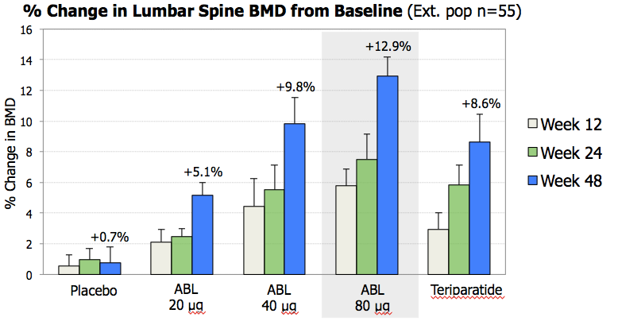
Effect of doses of Abaloparatide vs. with placebo and Teriparatide
;

Slide 78
Phase 3
Phase 3: randomized trials powered to detect the effect on a clinical endpoint required by FDA for approval to prescribe
Morbone trial with vertebral fracture endpoint
Adverse event data collected to determine the ‘safety’ of treatment
Results reviewed in detail by FDA and an advisory panel to decide on approval

Slide 79
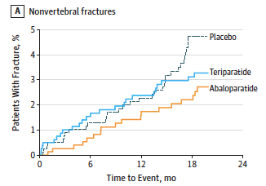
Effect of Abaloparatide on fracture risk
;
43% reduction in
nonvertebral fracture

Slide 80
Phase 4
Phase 4: studies with the FDA-approved drug for new indications or safety
May be ‘open label’ or without controls
For example, drug approved in women and then tested in patients taking corticosteroids or in men
Or an extension, without placebo, for 5 years after the main placebo–controlled trial ends

Slide 81
Safety Assessment Summary
Trials must have multidisciplinary DSMBs
Capture AEs by open ended questions
  Consider a check-list if you don’t want to miss and likely to be related to the drug
  Use dictionary to translate into standard terms
  Classification and reporting can be subjective
If the potential AE is very important and sometimes misclassified, then adjudicate by experts

