Slide 1
Epi 207: Introduction to Directed Acyclic Graphs
Rebecca Graff
Assistant Professor, Department of Epidemiology & Biostatistics
Based on Slides from Maria Glymour and Miguel Hernán

Slide 2
Organization
Overview of DAGs
DAGs for Common Problems in Epidemiology
  Confounding
  Selection Bias
  Measurement Bias
  Bias in RCTs
Limitations of DAGs
2

Slide 3
Overview of DAGs

Slide 4
Why Causal Diagrams?
Conceptualize problems
Show your assumptions about relationships among variables
Classify sources of bias
Identify issues of in study design and analysis
4

Slide 5
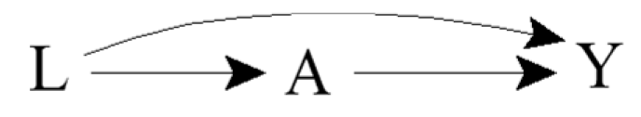
Terminology
Directed: Edges imply a direction
Acyclic: No cycles; a variable cannot cause itself
Edge: Arrow
Node: Random variable
Causal DAG: Common causes of any pair of variables in the graph are also in the graph
5

Slide 6

Ideal Randomized Experiments
What does the DAG look like for a marginally randomized experiment?
What does the DAG look like for a conditionally randomized experiment?
6

Slide 7
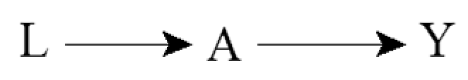
Incorporating Expert Knowledge
Complete DAGs do not exclude any possible causal effect
Incomplete DAGs encode expert knowledge in the form of missing arrows
7

Slide 8
Causal Effects and Association
For example:
  A: Cigarette smoking
  Y: Lung cancer
  Pr(Y^{a=1} = 1) ≠ Pr(Y^{a=0} = 1)
  Pr(Y = 1 | A = 1) ≠ Pr(Y = 1 | A = 0)
8

Slide 9
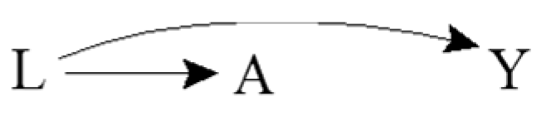
Common Causes and Association
For example:
  A: Yellow fingers
  Y: Lung cancer
  L: Cigarette smoking
  Pr(Y^{a=1} = 1) = Pr(Y^{a=0} = 1)
  Pr(Y = 1 | A = 1) ≠ Pr(Y = 1 | A = 0)
Confounding!
Results in lack of unconditional exchangeability
9

Slide 10
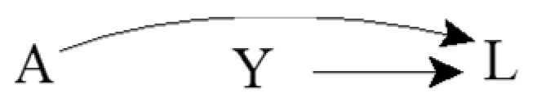
Common Effects
For example:
  A: Rain
  Y: Sprinkler system is on
  L: Grass is wet
  Pr(Y^{a=1} = 1) = Pr(Y^{a=0} = 1)
  Pr(Y = 1 | A = 1) = Pr(Y = 1 | A = 0)
Collider
10

Slide 11
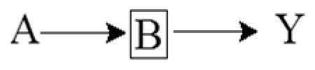
Conditioning on Mediators
For example:
  A: Cigarette smoking
  Y: Lung cancer
  B: DNA damage to lung cells
  Pr(Y^{a=1} = 1) ≠ Pr(Y^{a=0} = 1)
  Pr(Y = 1 | A = 1) ≠ Pr(Y = 1 | A = 0)
  Pr(Y = 1 | A = 1, B = b) = Pr(Y = 1 | A = 0, B = b)
11

Slide 12
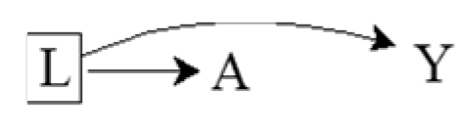
Conditioning on Common Causes
For example:
  A: Yellow fingers
  Y: Lung cancer
  L: Cigarette smoking
  Pr(Y^{a=1} = 1) = Pr(Y^{a=0} = 1)
  Pr(Y = 1 | A = 1) ≠ Pr(Y = 1 | A = 0)
  Pr(Y = 1 | A = 1, L = l) = Pr(Y = 1 | A = 0, L = l)
12

Slide 13
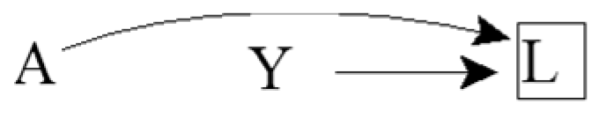
Conditioning on Common Effects
For example:
  A: Rain
  Y: Sprinkler system is on
  L: Grass is wet
  Pr(Y^{a=1} = 1) = Pr(Y^{a=0} = 1)
  Pr(Y = 1 | A = 1) = Pr(Y = 1 | A = 0)
  Pr(Y = 1 | A = 1, L = l) ≠ Pr(Y = 1 | A = 0, L = l)
Selection Bias!
Results in lack of conditional exchangeability
13

Slide 14
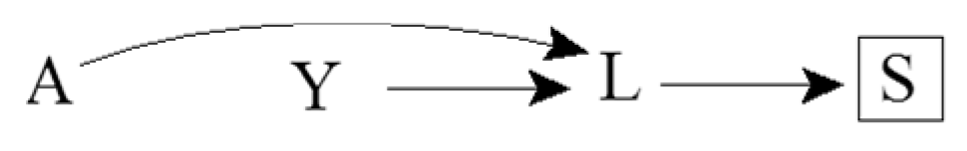
Consequences of Colliders
For example:
  A: Rain
  Y: Sprinkler system is on
  L: Grass is wet
  S: Soil is saturated
  Pr(Y = 1 | A = 1, S = s) ≠ Pr(Y = 1 | A = 0, S = s)
14

Slide 15
Sources of Association
Statistical association between two variables A and Y may be due to:
Random fluctuation
A causing Y
Y causing A
A and Y sharing a common cause
Conditioning on a common effect of A and Y
15

Slide 16
How we can use this
Eliminating four of these explanations is usually the goal of an analysis
Knowing these five sources of statistical association helps identify the (set of) causal structure(s) that could have generated the observed statistical associations
16

Slide 17
D-separation
Set of graphical rules to decide whether two variables are
  D-separated: independent
  D-connected: associated (in general)
If two variables are d-separated
  Without conditioning on any other variables in the DAG, then they are marginally independent
  After conditioning on a set of other variables, then they are conditionally independent
17

Slide 18
More Terminology
Ancestors / Descendants
  Parents / Children
Path: a route that connects two variables by following a sequence of edges such that the route visits no variable more than once
  A causal path consists entirely of edges with their arrows pointing in the same direction
Paths can be either blocked or open according to the following graphical rules
18

Slide 19
Rule 1
If there are no variables being conditioned on, a path is blocked if and only if two arrowheads on the path collide at some variable on the path
E.g., L → A → Y is open, but L → A ← Y is blocked
19

Slide 20
Rule 2
Any path that contains a noncollider that has been conditioned on is blocked
E.g., L → A → Y is blocked after conditioning on A
We use a box around a variable to indicate that we are conditioning on it
20

Slide 21
Rule 3
A collider that has been conditioned on does not block a path
E.g., L → A ← Y is open after conditioning on A
21

Slide 22
Rule 4
A collider that has a descendant that has been conditioned on does not block a path
E.g., but L → A ← Y is open after conditioning on S, a descendent of the collider A
22

Slide 23
Demonstrating Causation
Block all back door paths
  I.e., condition on all common prior causes
Measure all front door paths
Use an instrumental variable
23

Slide 24
Research Design
You are interested in estimating the effect of A on Y
Imagine the most plausible the ways the world might work
If the world worked like this or like that, would your analysis plan successfully identify the effect of A on Y?
What assumptions do you have to make to interpret your statistical association as a causal effect?
24

Slide 25
Quizlet: Can you test which DAG is correct if you have data on these variables?
X₁
X₁
X₂
X₃
X₂
X₃
X₄
X₄
X₅
X₅
If you know that one of these two causal structures generated the data, and you have perfect measures of all 5 variables, can you tell which one is correct?
25

Slide 26
Quizlet
X₁
X₁
X₂
X₃
X₂
X₃
X₄
X₄
X₅
X₅
X₁, X₂, and X₃ are independent of X₅, unless you condition on X_{4,} when they become associated with X₅
X₁, X₂, and X₃ predict X₅, but are independent of X₅ conditional on X₄.
26

Slide 27
Quizlet: Can you test which DAG is correct if you have data on these variables?
X₁
X₁
X₁
X₁
X₂
X₃
X₂
X₃
X₂
X₃
X₄
X₄
U
X₄
X₅
X₅
X₅
If you know that one of these three causal structures generated the data, and you have perfect measures of all 5 variables, can you tell which one is correct?
27

Slide 28
Quizlet
X₁
X₁
X₁
X₂
X₃
X₂
X₃
X₂
X₃
X₄
X₄
U
X₄
X₅
X₅
X₅
X₁, X₂, and X₃ are independent of X₅, unless you condition on X_{4,} when they become associated with X₅
X₁ and X₃ are independent of X₅, unless you condition on X₂ or X_{4,} when they become associated with X₅
X₁, X₂, and X₃ predict X₅, but are independent of X₅ conditional on X₄.
28

Slide 29
DAGs for Common Problems in Epidemiology
Confounding

Slide 30
Confounding is When…
Exposure and outcome have common causes
The exposed are not exchangeable with the unexposed
Association is not causation
All equivalent characterizations!
30

Slide 31
Identifiability of Causal Effects
Two components of an unconditional association between exposure and outcome:
  Effect of exposure on outcome
  Result of common causes
Can we identify the former component?
31

Slide 32
The Backdoor Criterion
A set of variables L satisfies the backdoor criterion relative to A and Y in a DAG if:
  No variable in L is a descendant of A
  All backdoor paths between A and Y are blocked by conditioning on L
If a set of variables L satisfies the backdoor criterion, then the causal effect of A on Y is identifiable
32

Slide 33
Healthy Worker Bias
For example:
  A: Working as a firefighter
  Y: Death
  L: Physical fitness
33

Slide 34
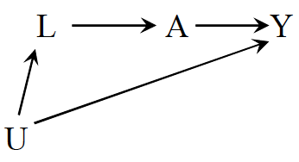
Confounding by Indication
For example:
  A: Aspirin
  Y: Stroke
  L: Heart disease
Or:
  U: Atherosclerosis
34

Slide 35
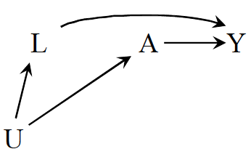
Confounding by Lifestyle
For example:
  A: Exercise
  Y: Death
  L: Cigarette smoking
  U: Personality or social factors
35

Slide 36
Confounding by Early Life Factors
L₂
1
For example:
  A: Depression
  Y: Death
  L₁: Education
  L₂: Income
36

Slide 37
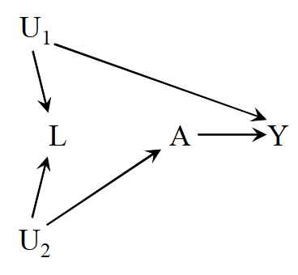
Be Careful with Adjustment!
For example:
  A: Physical activity
  Y: Cervical cancer
  L: Pap smear
  U₁: Pre-cancer lesion
  U₂: Health-conscious personality
37

Slide 38
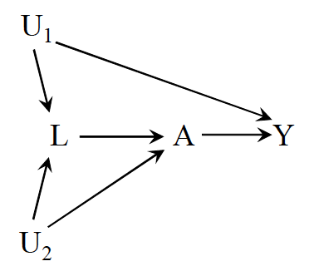
Intractable Confounding
Open backdoor path A ← L ← U₁ → Y
But what happens if we adjust for L?
  Open the path A ← U₂ → L ← U₁ → Y
38

Slide 39
DAGs for Common Problems in Epidemiology
Selection Bias

Slide 40
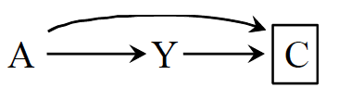
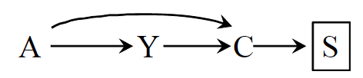
What is Selection Bias?
Bias due to the process used to select subjects into the study or into the analysis
Consequence of conditioning on a common effect of exposure and outcome
  Or on a common effect of a cause of the exposure and a cause of the outcome
40

Slide 41
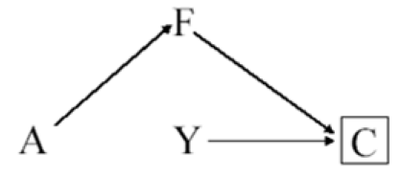
Inappropriate Selection of Controls
For example:
  A: Postmenopausal hormones
  Y: Coronary heart disease
  F: Hip fracture
  C: Selection into study
41

Slide 42
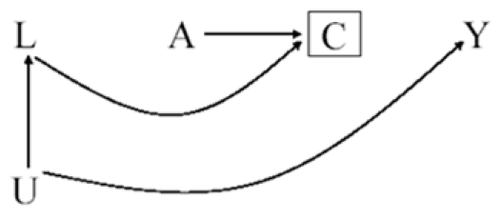
Differential Loss to Follow-up
For example:
  A: Antiretroviral therapy
  Y: AIDS
  C: Censoring
  L: Symptoms, CD4, viral load
  U: Immunologic status
42

Slide 43
Non-response / Missing Data Bias
For example:
  A: Antiretroviral therapy
  Y: AIDS
  C: Reluctance to answer questions
  L: Symptoms, CD4, viral load
  U: Immunologic status
43

Slide 44
Volunteer (Self-Selection) Bias
For example:
  A: Smoking
  Y: Coronary heart disease
  C: Volunteered to participate
  L: Heart disease awareness
  U: Family history of heart disease
44

Slide 45
Another Healthy Worker Bias
For example:
  A: Chemical exposure
  Y: Death
  C: Being a work
  L: Physical exam
  U: Health status
45

Slide 46
Prevalent Users Bias
A
Y₋₁
C
Y₁
L
For example:
  A: Aspirin use
  Y₋₁: Death before time 0
  Y₁: Death after time 0
  C: Selection into study
  L: Exercise
46

Slide 47
Immortal Person-time Bias
It’s complicated!
Experts disagree on how to represent
DAGs are dependent on your assumptions (and that’s what you need to know!)
47

Slide 48
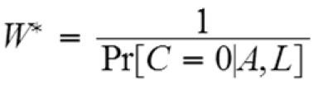
Adjusting for Selection Bias
Design
  E.g., sampling controls that represent the exposure distribution in the population
Analysis
  Stratification
  Inverse Probability Censoring Weighting
    Same concept as IPW
    But treat censoring as the “exposure”
    Everyone in the pseudopopulation is uncensored
48

Slide 49
DAGs for Common Problems in Epidemiology
Measurement Bias

Slide 50
What is Measurement Bias?
Bias due measurement of study variables with error, such that the observed associational measure does not equal the causal measure
No single structure describing measurement bias
50

Slide 51
Relevant Variables
For example:
  A: Exposure
  A*: Exposure measurement
  U_{A}: Factors other than A that determine the value of A* (i.e., measurement error)
  Y: Outcome
  Y*: Outcome measurement
  U_{Y}: Factors other than Y that determine the value of Y* (i.e., measurement error)
51

Slide 52
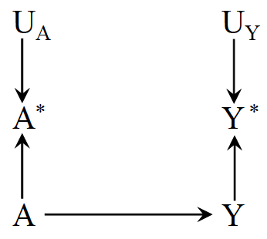
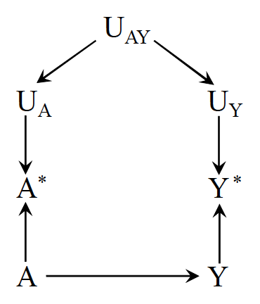
Nondifferential Measurement Error
Independent nondifferential measurement error
Dependent nondifferential measurement error
52

Slide 53
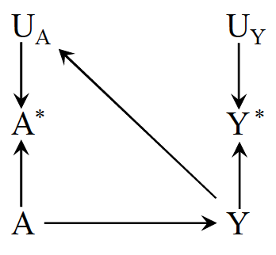
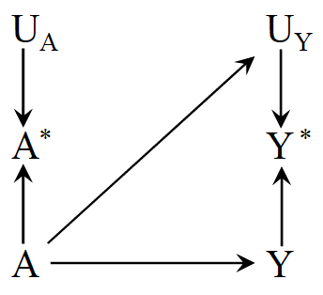
Independent Differential Measurement Error
Independent differential measurement error of exposure
Independent differential measurement error of outcome
53

Slide 54
Recall Bias
For example:
  A: Alcohol use
  A*: Recalled alcohol use
  Y: Birth defects
54

Slide 55
Reverse Causation Bias
For example:
  A: Drug A
  A*: Blood levels of drug A
  Y: Liver toxicity
55

Slide 56
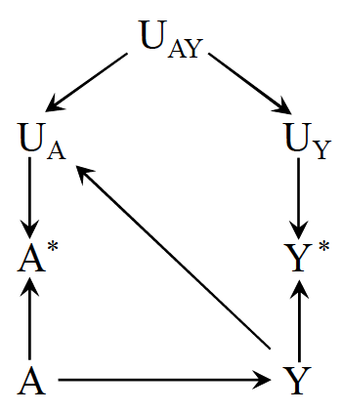
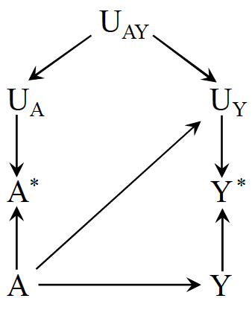
Dependent Differential Measurement Error
Dependent differential measurement error of exposure
Dependent differential measurement error of outcome
56

Slide 57
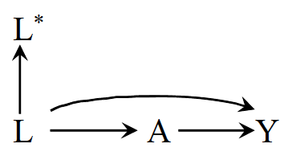
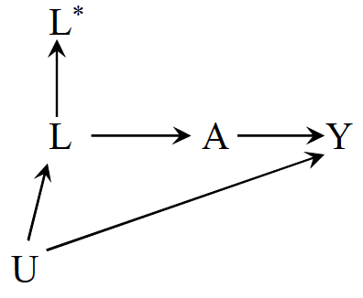
Mismeasured Confounders
Conditioning on L* does not block the backdoor back between A and Y in either scenario
57

Slide 58
DAGs for Common Problems in Epidemiology
Bias in RCTs

Slide 59
Confounding & Selection Bias
Can confounding occur in a marginally randomized RCT?
Can selection bias occur in a marginally randomized RCT?
59

Slide 60
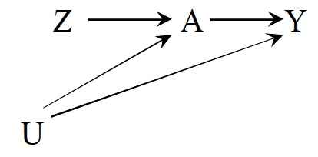
Noncompliance
For example:
  Z: Exposure assignment
  A: Exposure
  Y: Outcome
  U: Factors affecting adherence and the outcome
What kind of analysis is looking at the effect of A on Y?
What kind of analysis is looking at the effect of Z on Y?
60

Slide 61
Unblinding
What happens to the DAG when unblinding occurs?
61

Slide 62
Limitations of DAGs

Slide 63
Some Objections to DAGs
DAGs do not display effect modification
  If Z modifies the effect of X on Y, then Z must itself affect Y.
  Effect modification is scale dependent, so showing an effect modifier implies a scale and DAGs do not represent any scale
  Some progress on this: e.g., VanderWeele’s sufficient cause framework
  If Z and X both affect Y, then there is some scale on which Z modifies the effect of X and vice versa
63

Slide 64
Some Objections to DAGs
DAGs do not represent the magnitude of bias
  Major limitation
  Lots of work now on (a) signing the bias and (b) estimating the magnitude
  Simulations and bias bounding formulas
64

Slide 65
Some Objections to DAGs
DAGs do not match the complex, dynamic feedback loops in the real world
  DAGs can represent feedback between two variables
  DAGs can represent complex interventions (e.g., deliver this set of 4 treatments vs only 2 of these)
  DAGs match (one of the) things you want to know: will intervening in a specific way elicit a change in health?
  To say “it’s all very complicated and impossible to specify which variables come first” is to abdicate any hope of guiding clinical or policy decisions
  DAGs do not tell you everything, and complex systems simulations are often useful as a next step to predict spillovers and interactions with variables you do not have in your DAG; the simulation will presumably rely on causal parameter inputs.
65

Slide 66
Some Objections to DAGs
I’m not sure about which causal structure is right
  Do you know enough to rule some DAGs out?
  What are the commonalities across all plausible DAGs?
  Useful to state: under these assumptions, we can draw these inferences; need evidence on the assumptions from other sources
I don’t know anything about the causal structure
  This is not an objection to DAGs, this is an objection to ever drawing causal inferences
66

Slide 67
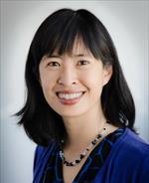




Acknowledgements
June Chan
Shelley DeVost
Maria Glymour
Miguel Hernán
Francois Rerolle
67

Slide 68
Questions?

