Slide 1

Introduction to Cost-Effectiveness
Elliot Marseille - Health Strategies International
DCEA – Epi 213 - 30 January 2020

Slide 2
Goals
Understand the essential components of CEA.
Learn the basic steps in conducting CEA.
Able to design own CEA analyses on diabetes prevention or treatment interventions.

Slide 3
Underlying Theory
Opportunity Costs and Resource Allocation

Slide 4
Opportunity Costs
KEY theoretical concept underlying CEA.
Profound and trivial at the same time.
Notes:
A central concern of economics is how best to use available resources in a world where desires, if not needs, always exceed the capacity to fulfill them. The key concept informing consideration of this issue is “opportunity cost”. Opportunity cost refers to the simple truth that use of resources one place precludes their use elsewhere. It is concerned with real resources consumption, rather than with mere financial effects. Thus, the real cost of a particular expenditure is the best alternative use of those funds, now foreclosed. These statements may seem trivial because they devolve to the truism that money spent here can’t be spent there. But, like the prospect of being hanged in the morning ‘opportunity cost’ focuses the mind wonderfully, and therein lies its utility. It can counteract the bureaucratic tendency to unthinkingly continue this year what worked last year. Thinking about opportunity cost can thus stimulates creativity about the best use of resources given current needs and alternatives.
The opportunity cost concept suggests that it is not enough to do something useful with the resources available. Action with a net positive effect is still wasteful if the foregone alternative would have had higher value. It prompts the question, “Because money is limited (budgets are constrained), what is its best use at the margin (the next available dollars)”? But budgets are always constrained and the margin is our permanent residence, so opportunity cost and the challenge to allocate resources rationally are always present. Opportunity costs and rigorous thinking about resource allocation inoculate decision makers against the kind of thinking that prompts statements such as, “We are concerned with saving children’s lives. Money cannot be a determining factor.” What such statements overlook is that “money” is not “mere money” to be subordinated to the saving of lives. Cost is another name for an unrealized benefit somewhere else. That benefit might result in the saving of more children’s lives than the use being defended.
The problem of resource allocation then becomes, “Where can the greatest benefit be obtained for a given expenditure?” Cost-effectiveness analysis provides a conceptual framework and practical tools to assist with that determination. It is purely instrumental. As with economics generally, cost- effectiveness analysis is value-neutral regarding goal selection. One must look elsewhere to decide what is worth having. Once a goal is determined (e.g., reduced HIV incidence), the role of cost- effectiveness analysis is to help reach it with as small an expenditure (opportunity cost) as possible. It is concerned, in other words, with efficiency.

Slide 5
Opportunity Costs: Definitions
Use of resources for one purpose precludes their use for another purpose.
Concerned with real resource consumption.
Resources are usually reflected in dollars (but not always).
Notes:
Opportunity cost refers to the simple truth that use of resources one place precludes their use elsewhere. It is concerned with real resources consumption, rather than with mere financial effects. Thus, the real cost of a particular expenditure is the best alternative use of those funds, now foreclosed.

Slide 6
The Utility of Considering Opportunity Costs
Counteracts the tendency to unthinkingly continue this year what worked last year.
Stimulates creativity about the best use of resources given current needs and alternatives.
Notes:
These statements may seem trivial because they devolve to the truism that money spent here can’t be spent there. But, like the prospect of being hanged in the morning ‘opportunity cost’ focuses the mind wonderfully, and therein lies its utility. It can counteract the bureaucratic tendency to unthinkingly continue this year what worked last year. Thinking about opportunity cost can thus stimulates creativity about the best use of resources given current needs and alternatives.

Slide 7
The Reality of Resource Allocation
The problem: Resources are always limited.
The challenge: To allocate resources to achieve a maximum benefit.
The focus: The best use of the next dollar.
Notes:
The opportunity cost concept suggests that it is not enough to do something useful with the resources available. Action with a net positive effect is still wasteful if the foregone alternative would have had higher value. It prompts the question, “Because money is limited (budgets are constrained), what is its best use at the margin (the next available dollars)”? But budgets are always constrained and the margin is our permanent residence, so opportunity cost and the challenge to allocate resources rationally are always present.

Slide 8
Methods of Resource Allocation
Where can the greatest benefit be obtained for a given expenditure?
  Cost-Effectiveness Analysis (CEA) can help answer this question.
Notes:
The problem of resource allocation then becomes, “Where can the greatest benefit be obtained for a given expenditure?” Cost-effectiveness analysis provides a conceptual framework and practical tools to assist with that determination. It is purely instrumental.

Slide 9
“Speaking Truth to Power”
CEA can Support Clear Decision-Making
Our priority is saving children’s lives. Money is a subordinate issue.
-vs.-
Cost is another name for an unrealized benefit somewhere else.
Notes:
Opportunity costs and rigorous thinking about resource allocation inoculate decision makers against the kind of thinking that prompts statements such as, “We are concerned with saving children’s lives. Money cannot be a determining factor.” What such statements overlook is that “money” is not “mere money” to be subordinated to the saving of lives. Cost is another name for an unrealized benefit somewhere else. That benefit might result in the saving of more children’s lives than the use being defended.

Slide 10
The role of CEA
It doesn’t decide the goals (value neutral)
CEA helps to reach goal with smallest expenditure possible (most efficient)
Notes:
As with economics generally, cost- effectiveness analysis is value-neutral regarding goal selection. One must look elsewhere to decide what is worth having. Once a goal is determined (e.g., reduced HIV incidence), the role of cost- effectiveness analysis is to help reach it with as small an expenditure (opportunity cost) as possible. It is concerned, in other words, with efficiency.
Question to the audience: with limited funds and many different programs, how do you think about resource allocation for HIV programs? Give examples of trade-offs.

Slide 11
Why is this question important?
(What is the existential problem?)
Good definition: “People are dying of AIDS, a preventable disease”
Bad definition: “People are engaging in unprotected sex”
Significant public health question.
Something is at stake - A trade-off is implied. Otherwise, why bother?
Alternatives are feasible

Slide 12
Cost-Effectiveness Analysis: When to use it?
When selecting among 2+ courses of action with different effects and costs.
  HIV Prevention:
    Intervention vs. no intervention?
    One intervention vs. another?
    Universal vs. targeted interventions?
    Group counseling vs. individual counseling?
Notes:
Use CEA making comparing two or more interventions for HIV and a single outcome, HIV infection.
For example, one can compare an intervention vs no intervention or two interventions such as nevirapine vs other antiretroviral regimens
In addition, one can compare the ce of nevirapine regimen for all pregnant women to giving it only to those who are HIV+

Slide 13
Trading off cost and effectiveness
Costs
Effectiveness

Slide 14
Trading off cost and effectiveness
Costs
CE ratio relevant
CE ratio irrelevant and not interesting
Effectiveness
CE ratio irrelevant and interesting

Slide 15
Anatomy of a CEA
Inputs
Outcomes
Analytic Approach
Potential Users

Slide 16
Two Broad Types of Inputs into CEA
Costs of intervention and of outcomes
Health effects

Slide 17
Outcome measures
Health: intermediate effects (eg physiological), morbidities, mortality
DALYs -- determined mainly by which health outcomes?
Net costs, i.e., intervention costs & offsetting savings
Incremental CE ratio

Slide 18
Analysis Approach
Time Frame – Over how many years are you measuring costs and outcomes?
Economic perspective
  Society’s?
  Medical system’s?
  Patient’s

Slide 19
Analytic Perspective, Cost-Effectiveness and Policy Implication
 |  | S O C I E T A L
 |  | Cost-effective | Not cost-effective
P A Y E R | Cost-effective | “No brainer” (Yes) | Problematic (Should be “No”)
 | Not cost-effective | Subsidy (Should be “Yes”) | “Non-starter” (No)
Notes:
Results heavily dependent on perspective. Define boundaries and make perspective explicit. Ideally would want to do analysis from societal perspective, but the decision maker often doesn’t have the luxury of taking the societal perspective into account. Has to work for her or his budget. This is OK if societal and payer perspective is the same. If CE from societal but not from payer, this s a very useful finding because argues for subsidies.
Solution is to make the boundaries explicit. Who’s perspective are you taking into account?
Some governments may be reluctant because they believe they are in “problematic”. Fairly rare, but there is a fear that orphans may be an example.

Slide 20
Potential uses
Policy – More $$ on screening for diabetes prevention?
Programs – Does screening for gestational diabetes make sense?
Clinical – Which screening test is best?

Slide 21
Consider Possible Implications
Who will read the analysis?
How might the CEA change policy?
Notes:
Who will read the analysis? How relevant will they deem it. How might it change policy, e.g., influencing resource allocation

Slide 22
The CE Ratio
  Increment in costs between two courses of action
  divided by
  Increment in health outcomes

Slide 23
Example: The CE Ratio for Diabetes Prevention
Prevention intervention cost – 0 cost
________________________________
Cases without program - with program
Notes:
The ce ratio is the difference in costs between two coursed of action divided by the difference in health outcomes. The smaller the cost-effectiveness ratio is, the more economically efficient the program.

Slide 24
The cost per QALY gained is defined as:
  Cost with intervention - cost with no intervention
  QALYs with intervention - QALYs with no intervention
Δ Cost
Δ QALYs
Formulation must be incremental: from no intervention to intervention, or from lower cost to higher cost intervention.

Slide 25
Cost
Numerator of the CE Ratio
Computed as an inventory of all resources and unit costs necessary to run the intervention.
Costs = Net costs: Adjusted for diabetes medical costs averted because of the prevention intervention.

Slide 26
Effectiveness
Denominator of the CE Ratio
Cases of diabetes delayed or averted
Standardized metrics—Quality Adjusted Life Years (QALYs) & Disability Adjusted Life Years (DALYs).
Based on empirical data
Based on models of risk reduction

Slide 27
Outcomes
Finally, the incremental cost-effectiveness ratio (ICER): Cost per Unit of Health Benefit
Example 1: Adult Male Circumcision in S. Africa
(Kahn, Marseille, Auvert PLoS Medicine 2006)
$181 per HIV infection averted (unadjusted)
$2.4 million saved for 1,000 MCs (adjusted)
Example 2: pMTCT –HIVNET-012 in Uganda
(Marseille et al Lancet, 1999
  $5.25 per DALY averted
Notes:
Lancet study on nevirapine results at 30% prevalence: $138/case averted and $5.25 per DALY

Slide 28
Potential Uses of CEAs
Improve resource allocation
Improve resource allocation
Improve resource allocation
Mobilize resources

Slide 29
Overview of Specific Steps

Slide 30
Steps in Conducting a CEA
1. Define the analysis.
2. Determine input values.
3. Conduct the analysis.
4. Publish the results.
Notes:
There are multiple descriptions on how to do a CEA. These four steps are an introduction to CEA.

Slide 31
Step 1: Define the Analysis
What is the intervention?
  Activity
  Target population
What is the comparator?
  Status quo (no intervention)
  Same intervention but different target group?
  Same intervention but more (less) intensive?
  From targeted to universal
Formulation must be incremental:
Isolate the additional activity, its costs and consequences
Notes:
the importance of problem definition. Beware of definitions that have a solution already implied. The limit the range of options that can be considered.
Good definition: “People are dying of AIDS, a preventable disease”
Bad definition: “People are engaging in unprotected sex”
It is important to frame the analysis before undertaking an economic evaluation such as a CEA. The first step in defining the analysis is o specify the policy situation. In Indonesia, we are addressing a situation where the government and civil society are addressing HIV.
We can start out by asking the question we want to analyze: what are the most cost-effective prevention interventions for mitigating HIV in Indonesia?
Specifying the study question also helps to define other parts of the analysis such as the options, perspective and outcome measures.

Slide 32
Define the Analytic Comparisons
Possible CEA Comparisons:
  SW peer education vs. no intervention.
  Annual screening versus biannual screening
  STD treatment vs. VCT.
  Itinerant market women vs. college students
Notes:
Once the study question has been determined, it is important that the comparisons for the analysis be defined. In many cases, an HIV intervention will be compared to no intervention. Alternatives include comparisons between two interventions or between two or more target populations.

Slide 33
What is an “Incremental CEA”?
In one sense all CEAs are “incremental”
  Incremental = Additional costs vs additional benefits
  True even if comparison is a program or activity versus status quo
  However “Incremental CEA” usually means:
  Comparison of one feasible, non-status quo option with another feasible option

Slide 34
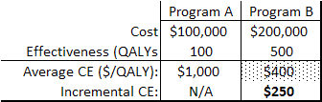
Calculating Incremental CEA
Incremental CE ratio = Additional cost / additional QALYs

Slide 35
Why does the distinction between incremental and average CE matter?
$400 is not merely another way to express CE – it’s wrong (because it ignores existence of Program A)
Big difference between $400 and $250
If CE threshold were $300, using average CE would lead to incorrect choice

Slide 36
Define the Analysis—Perspective
Possible CEA Perspectives:
  Society
  Public sector health care payer
  Provider
  Individual
In general broader analysis is better, but sometimes useful to look at effect on narrower groups too
Notes:
The perspective of the analysis relates to the question “who is responsible for the costs and consequences of the programs being evaluated”. For example, analysts may be interested in examining the perspective of the donor(such as USAID or the national government) who pays for the intervention. Other perspectives that might be examined include the entire society and the individual
The choice of perspective helps determine the types of costs that are captured. For example, a donor may incur the costs of the intervention, but not the costs of treating opportunistic infections resulting from HIV.
Source: HIV/AIDS Prevention and Care in Resource Constrained Settings. Family Health International.

Slide 37
Define the Analysis: Outcome Measures
Possible CEA Outcome Measures:
  Cost per QALY gained
  Cost per DALY averted.
  Cost per infection averted.
Notes:
Defining the analysis includes defining the appropriate outcome measures. This also helps determine which data are needed for each outcome.

Slide 38
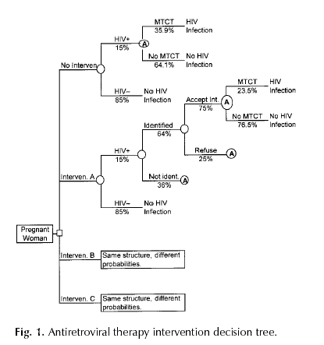
Notes:
A decision tree involves translating the defined analysis into operational tools. The major task is creating the decision tree that portrays the consequences of each action option. The essential cost task is specifying the formulas to calculate the cost effectiveness outcome measures. This step is equivalent to the analytic plan for a research project

Slide 39
Step 2: Determine Input Values
Health values:
  Chance node probabilities
  Utilities
Costs:
  For programs
  For medical care
Notes:
Sophisticated input data make CEA meaningful. There are two kinds of inputs: health values (chance node probabilities, utilities), and costs (for programs and medical care). Obtaining them requires broad searches, systematic review and synthesis, and sometimes new data collection.

Slide 40
Step 3: Conduct the Analysis
How are calculations done?
  By hand
  Spreadsheets
  Decision analysis packages
Notes:
This is using decision tree software and inputs to determine the health outcomes for each option, and also the cost outcomes: cost and cost effectiveness measures. Doing the base case analysis is the first step. Extensive sensitivity analyses help debug the software and show how uncertainty in inputs affects results.
The more practical approach involves relying on one of two types of computer programs such as spreadsheets like Excel or which is very flexible or decision analysis packages such as SMLTREE or DATA which are designed to perform most common decision analytic tasks, but they are less flexible.

Slide 41
Step 4: Publish the Results
Problem:
  People can use CEAs to argue anything.
Solution:
  Make methods and underlying inputs and parameters explicit.
Notes:
TURN INTO SLIDES:
Reading and Using Cost-Effectiveness Analyses
The results of CEAs are driven mainly by the assumptions that underlie them, such as intervention effectiveness or baseline HIV incidence. A jaundiced extension of this truism is that one can therefore use CEAs to argue anything. The best protection against the manipulation of CEAs is complete and clear presentation.

Slide 42
Critiquing Published CEAs
Four “tires to kick” before buying:
  The black box.
  The perspective.
  Uncertainties.
  Comparisons.
Notes:
Although this section cannot inventory all of the elements of a good cost-effectiveness analysis, nor all of the pitfalls that may snare the unwary reader, there are a few general principles that consumers of economic appraisals should bear in mind:
no black box
Note the perspective
Confront the uncertainties
Compared to what? What is your CE ratio comparing.

Slide 43
The Crystal-Clear Black Box
Are key inputs and parameters clearly identified and justified?
  The data.
  The model.
Are the inputs and parameters appropriate for the setting?
  Sources.
  Sensitivity analyses.
Notes:
Bullet 1: The first and most important is “No Black Boxes”. The analyst should clearly identify and justify all of the key assumptions that drive the analysis or, anticipating the reader, that might be expected to do so. These include both modeling assumptions that determine how inputs are related mathematically to produce the final cost-effectiveness ratio, and data assumptions concerning the estimated value of those inputs. A convincing rationale should be presented for each.
Bullet 2: Readers should ask, “Are they appropriate for the setting? Are they thoroughly examined in the sensitivity analyses where the effect of changed assumptions on results is studied? Are the estimates derived from reliable sources?”

Slide 44
The Perspective
Is the level at which costs and benefits are counted explicit?
Is the perspective appropriate to the policy question being addressed?
How might a different perspective change the results?
Notes:
Bullet 1: A second rule is “Note the Perspective”. This means being aware of the level (e.g., individual clinic, agency, national government, society as a whole) at which costs and benefits are being accounted. This should be made explicit, but often is not.
Bullet 2: The reader should ask, “Is the analytic perspective appropriate to the policy question being addressed? How might a different perspective change the results?” Cost-effective interventions, except those that are also cost-saving, still require a net increase in funds. An analysis that assesses only the financial effects on a health care agency or clinic may conclude that a given intervention is unaffordable. This could happen, for example, if averted future medical care costs do not accrue to the implementing agency. However, from the perspective of a higher level of government that does receive the savings in medical cost, the intervention could be cost-effective or even cost-saving.

Slide 45
Uncertainties
Is there a “base case” analysis that incorporates best estimates?
Are there sensitivity analyses that explore a range of circumstances?
Notes:
Bullet 1: A third rule is “Confront the Uncertainties.” A good cost-effectiveness analysis presents the results of a “base case” analysis that incorporates the best estimates for each input.
Bullet 2: These findings are then supplemented by extensive use of sensitivity analyses, which explore how variations in the value of key inputs affect the results.
The sensitivity analyses are very helpful in determining the range of circumstances in which a given intervention is likely to be cost-effective. These explorations can be instructive in their own right: Figure 1 shows how the number of HIV cases averted by a program of female condom distribution to sex workers (SWs) in South Africa varies according to the HIV prevalence in the client population.(Marseille, Kahn et al. 2001) Cases averted increase as prevalence rises to 60 percent. Thereafter, it falls as higher prevalence means fewer HIV-negatives susceptibles who can be protected through female condoms. This includes both fewer HIV-negative SWs susceptible from their clients, and fewer HIV-negative clients susceptible from HIV-positive SWs.

Slide 46
Compared to What?
Everything (including CEA) is relative . .
  What is cost-effective to a particular community?
  Is there an explanation of the cost-effectiveness threshold?
Notes:
Bullet 1: A final rule could be called “Compared to What?” A cost-effectiveness ratio is strictly a relative measure. The finding that an intervention is cost-effective simply means that one can expect as much or more health benefit from spending a given amount of money on that intervention as on alternative uses of the same money in that setting. For example, $3,000 per case of HIV averted may be cost-effective in one setting but not in another of equal wealth where the portfolio of cheaper programs has not yet been exhausted.
Bullet 2: The problem is that there is usually little relevant information on the cost-effectiveness of the other options. The analyst is then thrown back on a more general standard of what is viewed to be cost-effective in sub-Saharan Africa or in developing countries generally. As more cost-effectiveness information becomes available, it will become possible to tune these comparisons more closely to the specific setting under consideration.
Bullet 3: In the meantime, the analyst should explain the rationale for using a particular cost-effectiveness threshold.

Slide 47
Summary of Specific Steps
Determine input values.
    Costs
    Health outcomes
    Probabilities
Conduct the analysis.
    Decision tree/analytic structure.
    Economic outcome measures.
    Health outcomes.
    Cost/savings.
Publish results.
Notes:
Bullet 1:
Bullet 2: Determine the health values and costs
Bullet 3: Next it is necessary to perform the analysis using spreadsheets or a decision analysis package.
Bullet 4: Lastly, you will publish the results in a journal and distribute the results to decision makers in country.

Slide 48
Outline
Overview
Components of cost-effectiveness analysis
Steps in cost-effectiveness analysis
Implications of CEA

Slide 49



Why do cost-effectiveness analysis?

Slide 50
Why do cost-effectiveness analysis?
Choice of Subaru Impreza vs Ferrari vs Infinity XM
Points:
  Why not get a Ferrari? Maybe its not right for us: need to transport children, friends, etc.
  Then maybe a brand new Infinity SUV? It costs a lot. Could probably get extra money – loans from parents, friends, banks – but that money would then be taken out of other priorities in our budget.
  So the question is about the value of the new car.

Slide 51
Why do cost-effectiveness analysis?
  Resource allocation is a reality:
  among social goods, within health care
  $ for one intervention decreases $ for another – via budgets
  We don’t like to spend huge $ on health care that hardly works
  Use health care $ to do most good: CEA is a measure of efficiency
  efficient allocation saves lives, improves health

Slide 52
How can CEAs make a positive difference?
  Huge concerns with rising health care costs in U.S.
  Renewed attention to international health, e.g., AIDS
  Funding decisions: which programs should get funded?
  Cost-effectiveness = one consideration

Slide 53
How can CEAs make a positive difference?
~ $3.5 Trillion
2017 data: Petersen KFF https://www.healthsystemtracker.org/dashboard/#spending

Slide 54
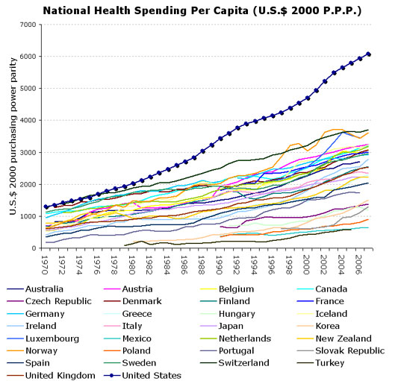

Slide 55
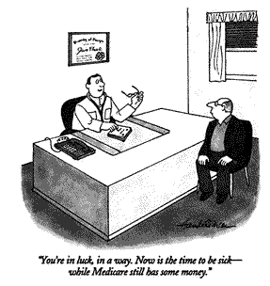

Slide 56
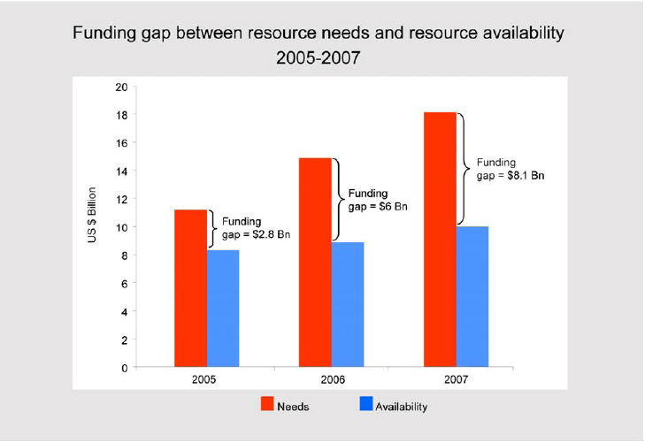

Financing HIV care in developing countries

Slide 57
Medical interventions need to be judged by the value they provide

Slide 58



Slide 59
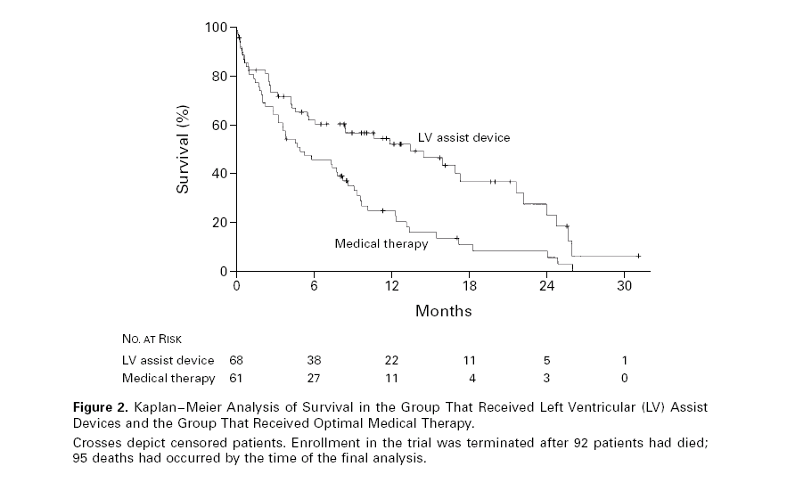

Slide 61
The Basic Question
What health benefits do we get
for money we spend on health care?

Slide 62
Choices and CEA
  Assessing a choice:
  comparing 2 or more courses of action with different effects and/or costs.
Clinical management: medication vs. surgery, medication A vs. B (e.g., streptokinase vs. t-PA).
Prevention: program vs. no program, or universal vs. targeted to high risk individuals, or vs. treatment
Health service delivery: incentive payments vs none, innovative programs such as home care vs none.

Slide 63
COX-2 Inhibitors vs NSAIDS
$12k
Comparator: Naproxen
$100k per QALY
$6k
$50k per QALY
Change in costs
$10k per QALY
$0
0
0.05
0.10
Gain in health benefit (QALYs)
Source: Spiegel et al., The Cost-Effectiveness of Cyclooxygenase-2 Selective Inhibitors in the Management of Chronic Arthritis, Ann Intern Med. 2003;138:795-806.
Notes:
Explain that the slope of the dashed line reflects a CER of $100k. How to pick the threshold is a value judgement.

Slide 64
COX-2 Inhibitors vs NSAIDS
$12k
Comparator: Naproxen
Base case
$100k per QALY
Assumption: Excludes effects on heart
$6k
$50k per QALY
Change in costs
Change in cost: $11,600
Change in benefit: 0.04 QALYs
Incremental CER: $290,000/QALY
$10k per QALY
$0
0
0.05
0.10
Gain in health benefit (QALYs)
Source: Spiegel et al., The Cost-Effectiveness of Cyclooxygenase-2 Selective Inhibitors in the Management of Chronic Arthritis, Ann Intern Med. 2003;138:795-806.
Notes:
Explain that the slope of the dashed line reflects a CER of $100k. How to pick the threshold is a value judgement.

Slide 65
COX-2 Inhibitors vs NSAIDS
$12k
Comparator: Naproxen
Base case
$100k per QALY
Assumption: High-risk patients
$6k
$50k per QALY
Change in costs
High risk
Change in cost: $4,720
Change in benefit: 0.08 QALYs
Incremental CER: $56,000/QALY
$10k per QALY
$0
0
0.05
0.10
Gain in health benefit (QALYs)
Source: Spiegel et al., The Cost-Effectiveness of Cyclooxygenase-2 Selective Inhibitors in the Management of Chronic Arthritis, Ann Intern Med. 2003;138:795-806.
Notes:
Explain that the slope of the dashed line reflects a CER of $100k. How to pick the threshold is a value judgement.

Slide 66
Selected CEA results from the literature
Intervention Cost per year of life saved
Lovastatin for high cholesterol,
men with CHD 50 y.o. (savings)*
Varicella vaccination (societal perspective) (savings)
Needle exchange, IDUs $ 300
HIV counseling and testing, IDUs,
U.S. northeast $ 1,000
Brief quit smoking counseling $ 2,000
Varicella vaccination (payer perspective) $ 2,500
Beta blockers for MI $ 2,700
F/u visit for quit smoking $ 5,000

Slide 67
Selected CEA results from the literature (cont’d)
Intervention Cost per year of life saved
Neonatal intensive care (1,000 – 1,499 gm) $ 5,500
Nicotine gum $ 4,100
Drug treatment of HTN (moderate disease) $ 6,250
Drug treatment of HTN (mild disease) $ 13,500
Neonatal intensive care (500 – 999 gm) $ 38,800
t-PA (versus Streptokinase) for AMI, overall $ 32,700
Cholestyramine for cholesterol >265, men 48 y.o. $160,000
t-PA (versus Streptokinase) for inferior
wall AMI, ≤40 y.o. $ 203,100
Lovastatin for high cholesterol,
low-risk men 30 y.o. $ 1 million

Slide 68
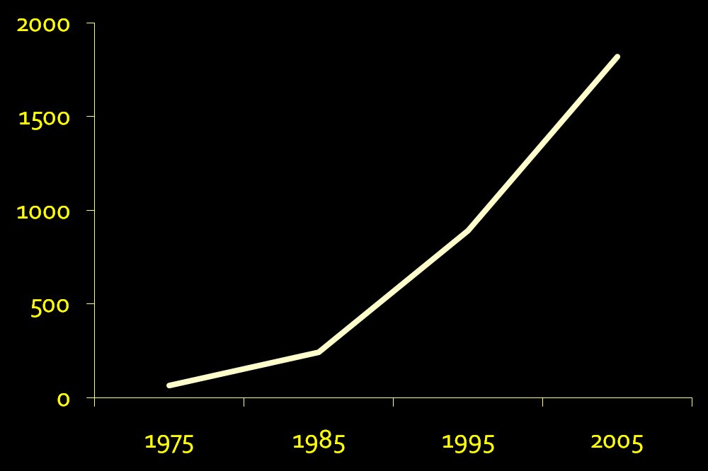
Cost-effectiveness literature: pubmed articles

Slide 69
Outline
Overview
Components of cost-effectiveness analysis
Steps in cost-effectiveness analysis
Implications of CEA

Slide 70
    Two major components of CEA:
    Outcome measures
    Input data

Slide 71
1. Outcomes
  Cost-effectiveness analysis in health care assesses the incremental gain in health status achievable with incremental increase in health care resources

Slide 72
Gain in Health Status
  Measured in "health outcomes”
  Mortality
  Morbidity: e.g., episodes of illness, infections, duration of disability (e.g., years of sight)
  Life years: expected duration of life
  Quality-adjusted life years (QALYs): life years
  x utility scores
  Disability-adjusted life years (DALYs): life years * weight

Slide 73
Increase in health care resources
  Difference in resources between less and more expensive course of action.
  Unit = dollars, to allow resources of all types to be summed and compared

Slide 74
The Incremental CE Ratio (ICER):
  increment in costs between two courses of action
  divided by
  the increment in health outcomes
E.g., cost of universal HIV prevention minus cost of targeted HIV prevention, divided by the difference in HIV infections prevented. Thus, dollars per HIV infection prevented.

Slide 75
Other CE outcomes
Cost-utility analysis (CUA): dollars per QALY gained. Often used interchangeably with “CEA”.
Cost per DALY averted – adopted in global health. Approx. the negative version of cost per QALY gained.
Cost-benefit analysis (CBA): Health outcomes translated into financial values (e.g., willingness to pay). Difference (rather than ratio) used: dollars spent on the intervention minus dollars saved in benefits.

Slide 76
2. Input data
  Broad set of input data on health outcomes and costs.
  Data collected using various techniques.
  How does it all fit together?

Slide 77
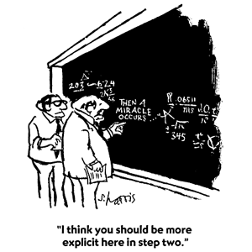

Slide 79
Outline
Overview
Components of cost-effectiveness analysis
Steps in cost-effectiveness analysis
Implications of CEA

Slide 80
Steps in conducting a cost-effectiveness analysis
  (1) Define analysis.
  DA: Clinical or policy situation, alternative strategies.
  CEA: Economic perspective, CE outcome measures.
  (2) Specify technical approach.
  DA: decision tree, with chance nodes and utilities.
  CEA: Cost outcomes, formulas for outcome measures.

Slide 81
Steps in conducting a cost-effectiveness analysis (cont’d)
  (3) Determine input values.
  DA: health values (chance node probabilities, utilities)
  CEA: costs (for programs and medical care).
  (4) Conduct analyses.
  (5) Prepare manuscripts

Slide 82
CEA is iterative
  Steps usually in order, more or less.
  Often desirable to refine or redefine the analysis as it progresses
  Good news: Until published, can revise. Feedback and reflection makes better analysis.
  Bad news: Until published, can revise.
  When will this end?
  Perfection vs. good enough: experience → balance

Slide 83
(1) Define the analysis
  Aneurysm: clinical situation = woman, aged 50, with unruptured cerebral aneurysm found incidentally.
  Options = no treatment or surgery (clipping).
  Perspective = societal. i.e., economic effects on patients, providers, insurers, etc not separated.
  Costs counted regardless of who pays.
  Outcome measure is cost per QALY gained.
    “This CEA compares surgical clipping to no treatment
    for the management of an asymptomatic small cerebral
    aneurysm, for a 50 year old woman, estimating the societal
    cost per QALY gained.”

Slide 84
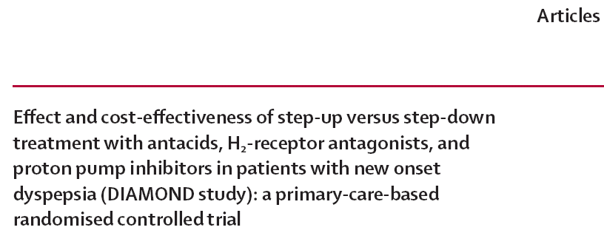
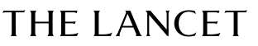
    Our analysis compares the cost-effectiveness of a step-up approach with a step-down approach in a population of patients with new onset dyspepsia from a societal perspective.

Slide 85
Specify the technical approach
Spreadsheet / decision tree analysis
Markov model
Simulation
Dynamic models

Slide 86
Specify the technical approach

Slide 87
The cost per QALY gained is defined as:
  Cost with surgery - cost with no surgery
  QALYs with surgery - QALYs with no surgery
I.e.,
Δ Cost
Δ QALYs
Formulation must be incremental: from no intervention to intervention, or from lower cost to higher cost intervention.

Slide 88
(3) Determine input values
Here are key cost inputs:
Cost input Value (range) Source
Clipping $25,150 (18,000-35,000) Cohort study – cost accounting system
Moderate/severe
disability $20,000/yr (13,000-30,000) Published estimate
SAH hospitalization $47,000 ($33,000-$67,000) Cohort study – cost accounting system
Discount rate 3% (0-5) CEA guidelines

Slide 89
(3) Determine input values (cont’d)
Both effectiveness and cost must be discounted
e.g., $47,000 for SAH hospitalization, average 17 years into the future, NPV = $35,912.

Slide 91
(4) Conduct analyses
How are calculations done?
By hand
Instructive once, inefficient and error-prone with multiple calculations. Does anyone know how to do long division anymore?
Spreadsheets
Flexible –any structure, input, calculation, outcome,
or format E.g., infectious disease epidemic modeling,
or interacting Markov models
Must program some standard CEA tasks.
For Monte Carlo and other sensitivity analyses, Crystal Ball.

Slide 92
(4) Conduct analyses (cont’d)
Decision analysis packages
SMLTREE, DATA, TreeAge, etc
Designed to do CEA tasks, eg trees, inputs, outputs, simple Markov, SA.

Slide 93
“Base case” for aneurysm analysis

Slide 94
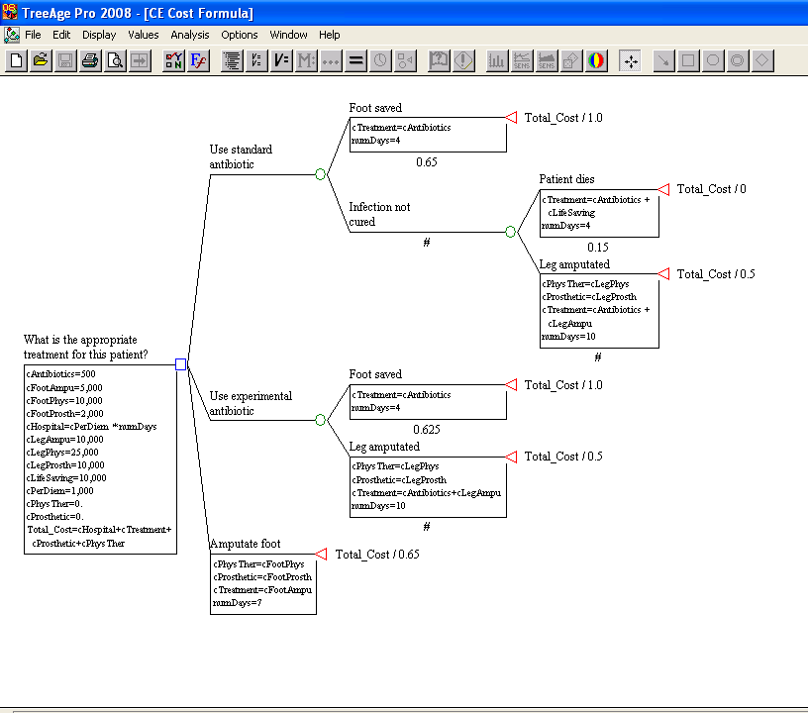

Slide 95
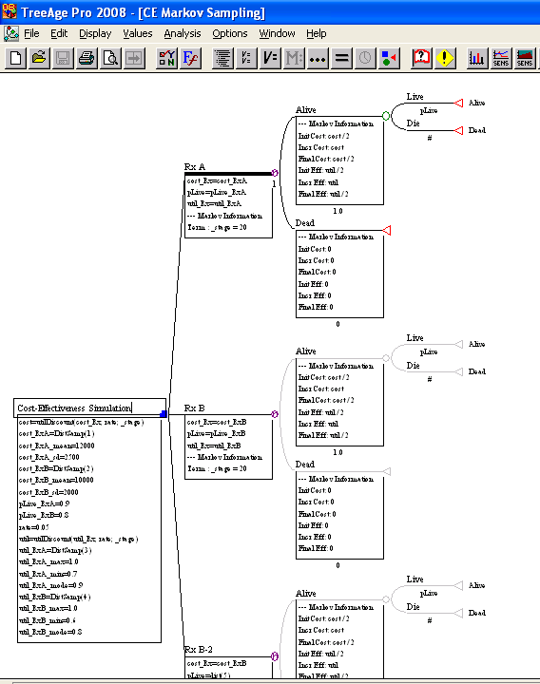

Slide 96
Base case graphically, referent case at origin
$
$39,666
$534
QALYs
19.74
21.37

Slide 97
Base case graphically,
zero cost/QALYs at origin
$39,666
$
$534
QALYs
0
19.74
21.37

Slide 98
In manuscript, the results might be presented as follows.
QALYs Costs
Scenario Total Incremental Total Incremental $ / QALY
No symptoms, <10 mm, no past SAH
No treatment 21.37 -- $534 -- --
Clipping 19.74 -1.63 $39,666 $39,132 Dominated

Slide 99
Dominance
$10k
ICERs:
Comparator vs A: Dominated (strictly)
Strategy C
B vs A: ($2,800-$1,000) / (5-2)
=$600/QALY
Strategy D
$5k
C vs B: ($9,000-$2,800) / (7-5)
=$3,100/QALY
Costs
Strategy B
D vs B: ($6,200-$2,800) / (5.5-5)
=$4,800/QALY
Dominated by extended dominance, if a mix of B & C is possible
Comparator
Strategy A
$0
0
5
10
Gain in health benefit (QALYs)

Slide 100
Incremental analysis: Targeting
HIV Prevention, group of 1000 individuals
QALYs Program Costs
Scenario Total Added Total Added $ / QALY
No prevention 20,000 -- $0 -- --
Targeted (100) 20,025 25 $20,000 $20,000 $800
Universal 20,027 2 $200,000 $180,000 $90,000

Slide 104
Sensitivity analysis: How high does rupture risk need to be to recommend clipping?

Slide 105
Outline
Overview
Components of cost-effectiveness analysis
Steps in cost-effectiveness analysis
Implications of CEA

Slide 106
Cost-effective medicine vs evidence-based medicine
EBM only tells you whether something works, not whether we should pay for it.
  LVAD example
  Many other similar examples
Evidence of effectiveness ≠ Evidence of value

Slide 107
What does CEA say about value of life?
A cost-effectiveness threshold is one way to use CEA to determine which interventions represent good value.
In the US and OECD countries, that threshold is probably around $150,000 per QALY gained.
What is the threshold in other countries?
  Related to per-capita GDP as a proxy for income
  Less that 1 x pcGDP: very good value
  1-3 x pcGDP: acceptable (WHO threshold – 3x)
NO! Instead, as first approximation, compare with the ICER of other interventions in use in relevant country. (See Marseille, WHO Bulletin, 2015)

Slide 108
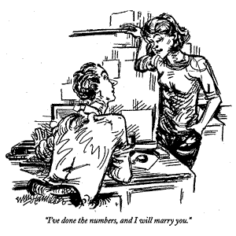
CEA can seem an odd input …

Slide 109
CEA abuse …
  Defend policies deemed unacceptable for other reasons (depriving of rights, unfair, cruel, etc)
  Methods correct but interpretation skewed
  Methods incorrect or strategies not considered

Slide 110
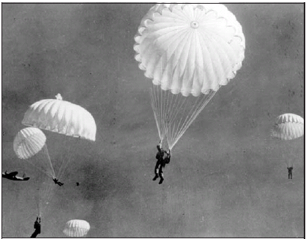
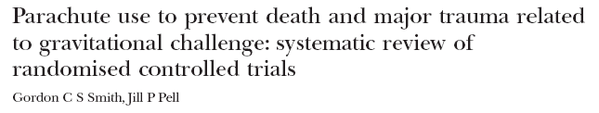

Cost-effective medicine vs evidence-based medicine
Evidence barrier in EBM can be unrealistically high.
Objectives To determine whether parachutes are effective in preventing major trauma related to gravitational challenge.
Design Systematic review of randomised controlled trials.
Data sources: Medline,Web of Science, Embase, and the Cochrane Library databases; appropriate internet sites and citation lists.
Study selection: Studies showing the effects of using a parachute during free fall.
Main outcome measure Death or major trauma, defined as an injury severity score > 15.
Results We were unable to identify any randomised controlled trials of parachute intervention.
Conclusions As with many interventions intended to prevent ill health, the effectiveness of parachutes has not been subjected to rigorous evaluation by using randomised controlled trials. Advocates of evidence based medicine have criticised the adoption of interventions evaluated by using only observational data. We think that everyone might benefit if the most radical protagonists of evidence based medicine organised and participated in a double blind, randomised, placebo controlled, crossover trial of the parachute.

Slide 111
What’s next?
Data inputs
Sensitivity analyses
Markov simulations

